Slide 1
GridKa 2018 - Aug 30, 2018 Six Key Challenge Areas Driving Innovation in Distributed High Throughput Computing
Todd Tannenbaum
Center for High Throughput Computing
Department of Computer Sciences
University of Wisconsin-Madison

Slide 2
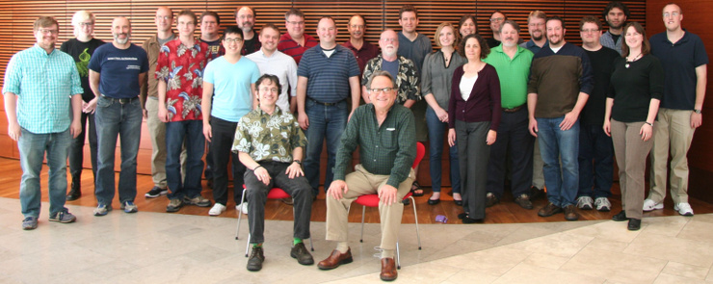
University of Wisconsin Center for High Throughput Computing

Slide 3
HTCondor
Open source software to enable distributed High Throughput Computing (HTC)
Full featured, mature production system (1M+ LOC)
Widely deployed
Used in production at hundreds of universities, government labs, commercial companies to manage compute clusters in science, engineering, finance, …
Components used to federate compute clusters into campus grids and wide-area computing grids, e.g. Open Science Grid, WLCG, …

Slide 4
Six Challenge Areas
We have identified six challenge areas directing innovation in HTC technologies.
We use these to guide our efforts on HTCondor.
Survey questions concluding this talk!

Slide 5
Challenge Area #1 Hardware complexity

Slide 6
It all starts with a server
A server: The building block of a HTC environment
Fundamental task of a DHTC environment: manage the workload (jobs), and manage the resources (servers):
Schedule server resources to jobs
Manage server resources (utilization, isolation, monitoring, fault detection, …)

Slide 7
A simpler time…
Commodity Intel CPU server resources back in the day before 2006
CPU w/ one core
Memory
One core → one job per server
Existing workloads gained substantial speed-ups just from processor upgrades
higher clock speeds
supposedly "smarter" processors (e.g. from simple in-order processors to complex superscalar out-of-order processors)

Slide 8
Things start to get complicated
CPU clock speeds stagnated (due to heat)
Industry moved to CPUs with multiple cores in Yr 2006, and servers with multiple CPUs
Multiple cores → multiple jobs per server
More scheduling complexity
More monitoring/isolation complexity
Linux Control Groups (cgroups) : memory, cpu, io, network
Still a work in progress…

Slide 9
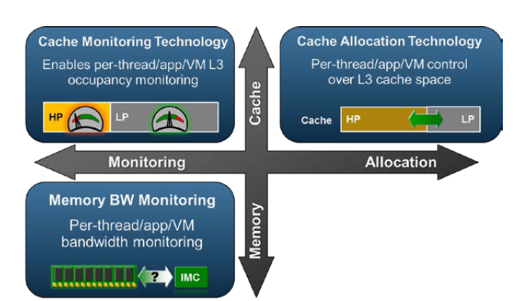
Intel Resource Director Technology (RDT)

Slide 10
Death of Moore's Law making even more complexity
Yr 2016 or so Moore's Law died, killed by
Economics (Rock's Law)
Physics (5nm ~ 150 atoms between features?)
"Smart" processors? (Foreshadow, Spectre, Meltdown, …)
Result? GPUs, Knight Landing, FPGAs, coming soon quantum computing …
Now we have multi-axis co-scheduling complexity (and recursion with nVidia Volta)
…not just complexity, heterogeneity! And the speed of change!

Slide 11
Challenge Area #2 Evolving resource acquisition MODELS

Slide 12
Public Cloud Services
Cloud services enable fast acquisition of compute infrastructure for short or long periods of time.
Enables homogenous, single user, single purpose clusters. How do we best leverage that capability?
Enables elasticity: augment existing on-site cluster with resources offered by competing commercial clouds. Best on-the-fly capacity planning mechanisms? Budget-based scheduling? To cloud or not to cloud?

Slide 13
Not just public clouds…
HPC Supercomputers
Often have special considerations, like no network connectivity!
Grids (federations of compute clusters across institutions), e.g. WLCG, Open Science Grid
Private Clouds
To consolidate IT servers, IT data centers at home institutions increasingly using 'private cloud' services
OpenStack, Apache Mesos, Docker Swarm, Kubernetes!
Technologies are changing rapidly!

Slide 14
HTCondor has long allowed dynamic augmentation of a cluster…
HTCondor can be used to submit and track "pilot" or "glidein" jobs (aka the HTCondor daemons themselves) to remote cluster/cloud services to add execute nodes
Amazon EC2, Google Cloud, Microsoft Azure, SLURM, PBS/Torque, SGE, HTCondor, ...
Cluster augmentation frameworks evolving
glideinWMS, pyglidein, HEPCloud, COBalD, …

Slide 15
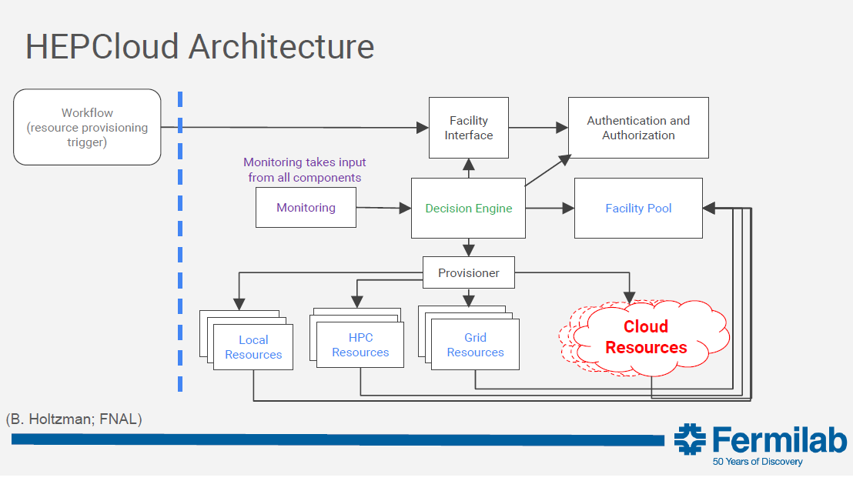
HEPCloud

Slide 16
Some Examples

Slide 17
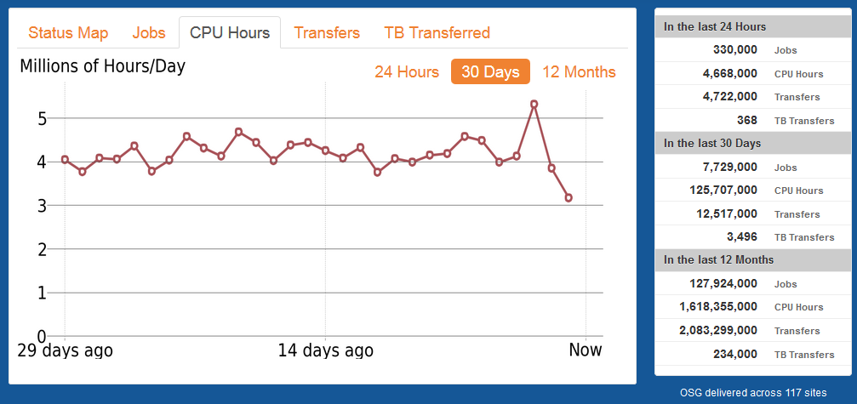
Open Science Grid
http://display.opensciencegrid.org

Slide 18
CMS Global Pool
Dynamic cluster, ~200k - 250k cores pulled in from sites worldwide (including KIT!)

Slide 19
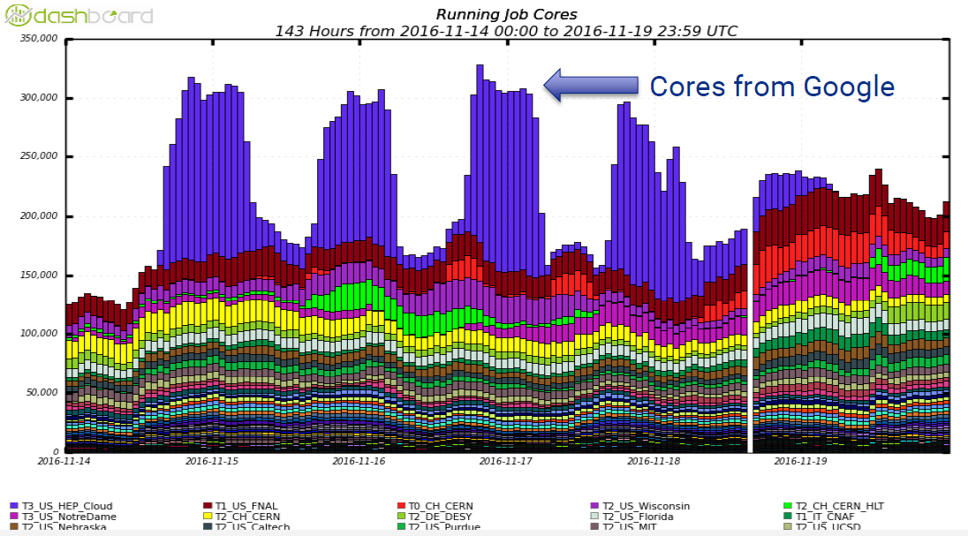
Bursting into Google Cloud @ SC16

Slide 20
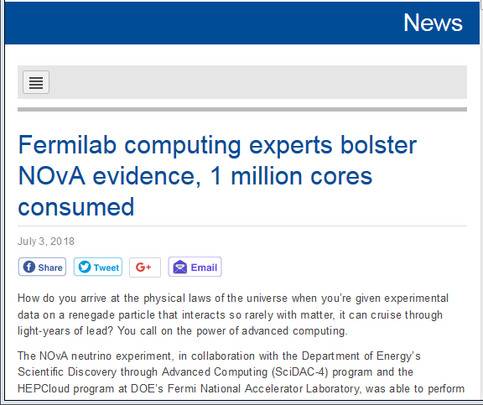
Bursting into HPC
Fermilab augments their HTCondor pool with nodes from NERSC supercomputer to to perform the largest antineutrino data analysis ever in record time.
http://news.fnal.gov/2018/07/fermilab-computing-experts-bolster-nova-evidence-1-million-cores-consumed/

Slide 21
Challenge Area #3 Scalability

Slide 22
No shortage of work to do here
Growth everywhere you look
manufacturers give us more cores
researchers bring us more jobs
universities and science communities bring us more users
cloud providers offer us more machines
Operational scaling
Grouping for both operations and user/admin interactions
Who can effectively reason about millions of individual jobs or machines?
Reliability, damage from "black holes" nodes

Slide 23
Challenge Area #4 WIDELY DISPARATE USE CASES

Slide 24
A growing spectrum of scenarios
Increased demand for higher throughput, HTC technologies are being called upon to serve in a growing spectrum of scenarios:
Large multi-purpose institutional clusters managed by IT experts
Ephemeral overlay clusters atop other batch systems (grid computing)
Purpose built clusters from a cloud provider
Cycle scavenging server farms (K8), desktops
Manage a workflow on a single server (laptop)
Non-batch interactive computing environments such as Jupyter Lab / Notebook
And a growing spectrum of user backgrounds

Slide 25
Challenge Area #5 BLACK BOX APPLICATIONS

Slide 26
HTC Users aren't just Unix Wizards anymore
Contemporary HTC users, many with no experience with large scale computing, are much less knowledgeable about the codes they run than their predecessors.

Slide 27
Our Goal: You do not need to be a computing expert in order to benefit from HTC!
Meeting this goal requires HTC frameworks that can effectively manage work when the user cannot state the
Software dependencies
Resource requirements
Compute time
of their application.

Slide 28
Challenge Area #6 DATA INTENSIVE COMPUTING

Slide 29
Manage data movement and manage data storage.
We all know the story: more data pouring in from everywhere.
Everyone fixated about managing and scheduling data transfers… but what about the storage?
All the software we write assumes that disk space is infinite. Once you remove that assumption, what happens?

Slide 30
Thank you! And now time for your feedback!

Slide 31
Results from survey at GridKa School 2018

