Slide 1
Welcome to GridKa School 2018
Achim Streit
Notes:
Good afternoon and welcome to Karlsruhe and the KIT.
My name is Achim Streit and I‘m director of the Steinbuch Centre for Computing (SCC), which is operating GridKa, the German Tier-1 data and computing centre for the LHC data and which gave name to the 17th edition of this years GridKa School.
In the following I would like to give you a very brief overview about KIT and the activities of the Steinbuch Centre for Computing.

Slide 2
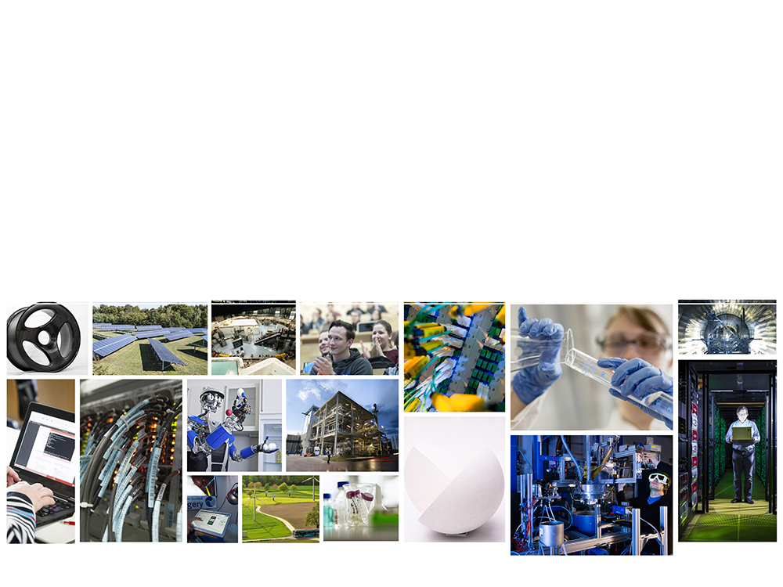
KIT – The Research University in the Helmholtz Association
Prof. Dr.-Ing. Holger Hanselka | President

Slide 3
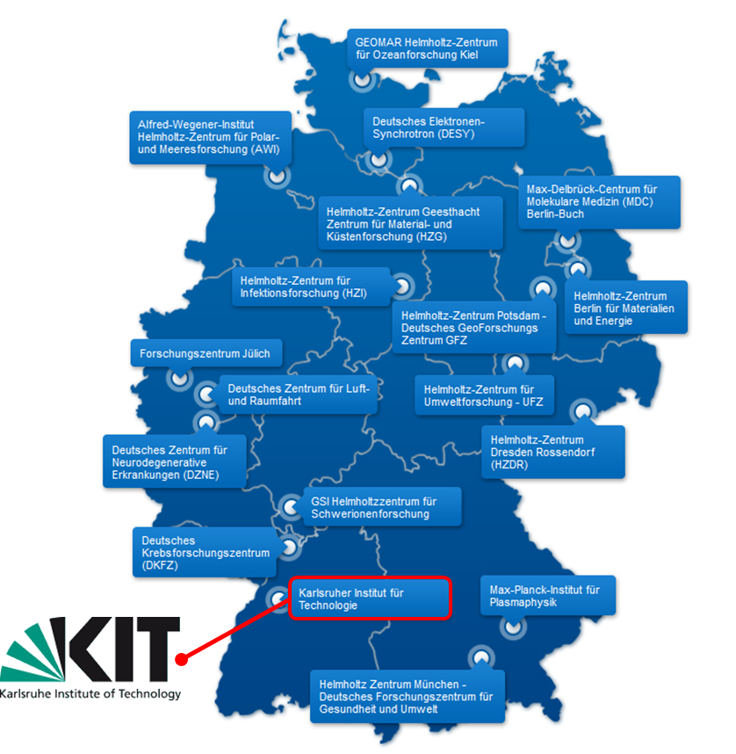
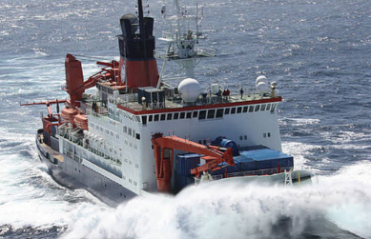
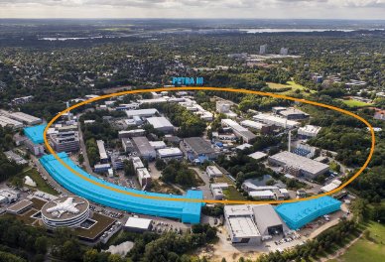
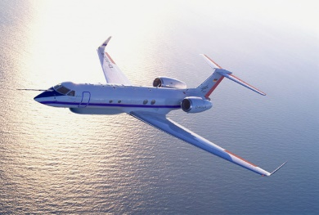
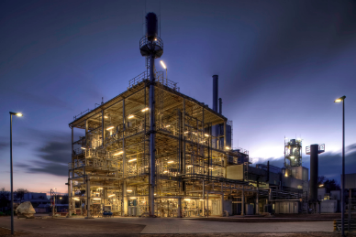
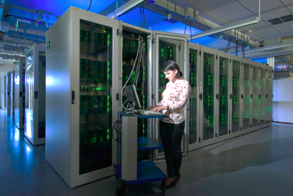
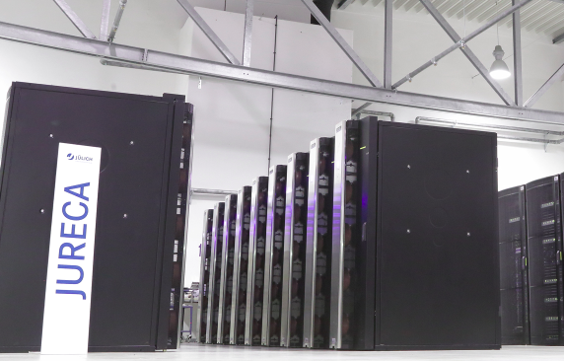
Helmholtz Association
Mission: Systems solutions for grand challenges based on scientific excellence, critical mass and long term research programmes
  6 research fields: Energy, Earth & Environment, Health, Aeronautics & Space & Transport, Key Technologies, Matter
Developing and operating complex infrastructure and large-scale facilities for the national and international scientific community

Slide 4
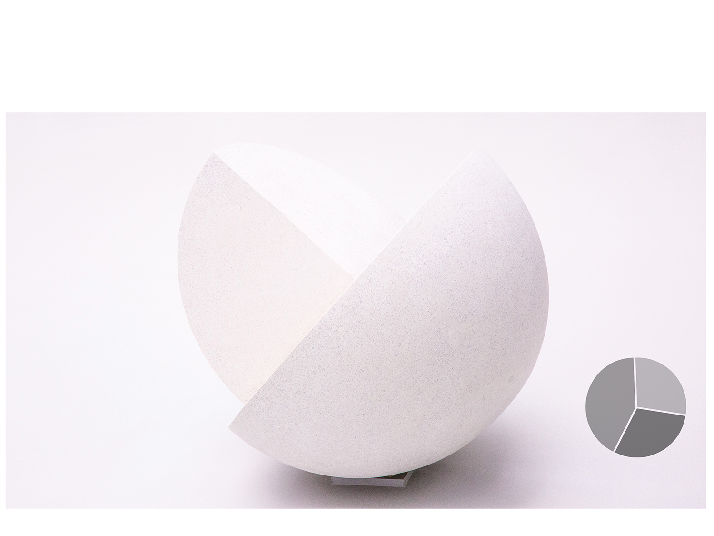
KIT Figures and Facts
5 Campuses – 200 ha area
29 Spinoffs and startups
367 Professors and executive
scientists
430 Trainees
300 Buildings with a usable
area of 430,000 m²
55 Patent applications
25,500 Students
KIT budget
EUR 860 million
3,200 Doctoral students
9,300 Employees
40%
Third- party funds
28%
State
funds
32%
1,000 International scientists
Federal funds
Status: 2017

Slide 5

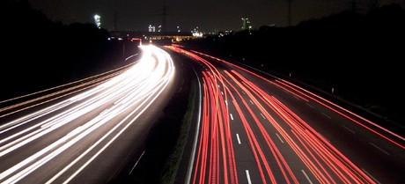
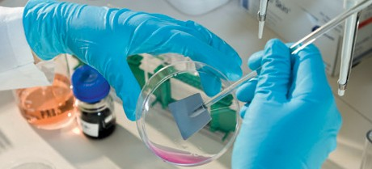


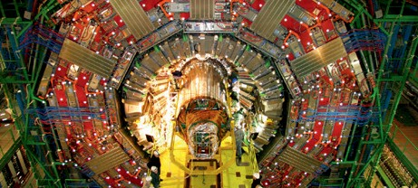
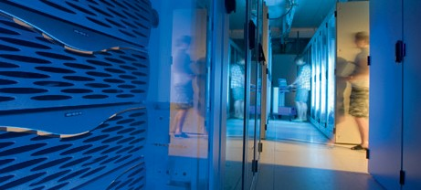
KIT Research Profiles
Five Discipline-focused Divisions
Division I Biology, Chemistry, and Process Engineering
Division II Informatics, Economics, and Society
Division III Mechanical and Electrical Engineering
Division IV Natural and
Built Environment
Division V Physics and Mathematics
Seven Interdisciplinary KIT Centers
Energy
Mobility Systems
M
Materials
Humans and Technology
Climate and Environment
Elementary Particle and Astro- particle Physics
Information Systems Technologies

Slide 6

Topics Sharpening the Profile of KIT
Renewable Energies
Robotics, Automation,
Cognition, Anthropomatics
Energy Conversion
Optics, Photonics, and
Quantum Technology
Energy Storage and Energy Distribution
Supercomputing
and Big Data
ENERGY
Nuclear Energy
and Safety
INFORMATION
Security and Dependability
Energy Systems
Analysis
Algorithm
Engineering
Energy Sources and
Storage Systems
Driver and Vehicle Guidance
Combustion Engines
Infrastructure, Traffic,
Mobility Behaviour
Chassis and Body
MOBILITY
Drive Systems

Slide 7
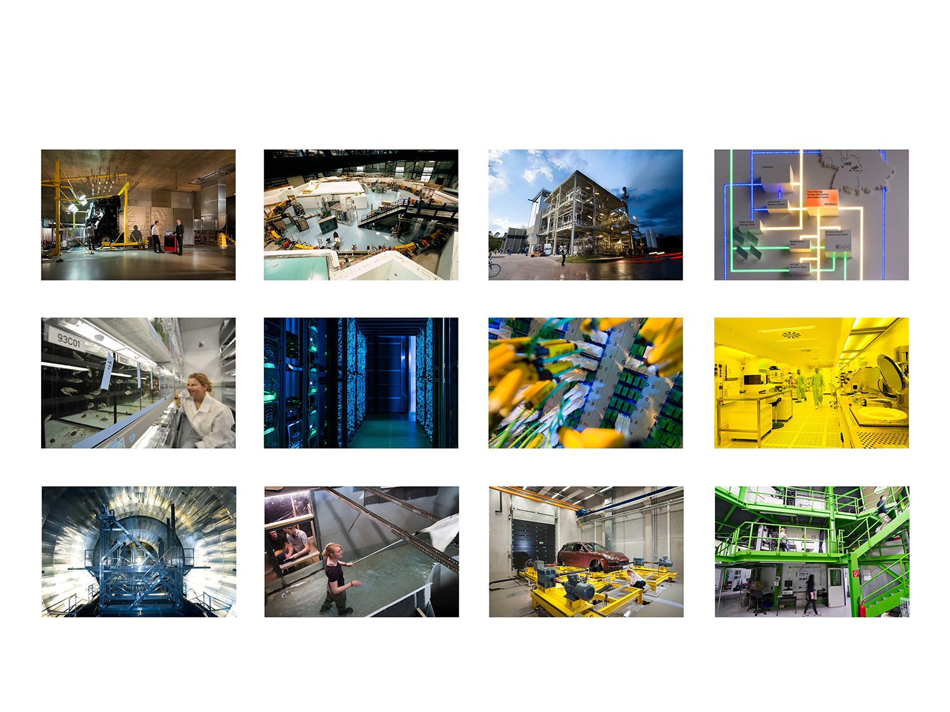
Big Research Infrastructures at KIT
Acoustic Four-wheel Roller Dynamometer
KARA Synchrotron Radiation Facility
Biomass to Liquid (bioliq®)
EnergyLab 2.0
European Zebrafish
Resource Center
High-perfomance Computer for Research
Grid Computing Centre Karlsruhe (GridKa)
Karlsruhe Nano Micro Facility (KNMF)
Karlsruhe Tritium Neutrino Experiment
Theodor Rehbock River Engineering Laboratory
Vehicle Efficiency
Laboratory
AIDA Cloud Chamber

Slide 8
Steinbuch Centre for Computing (SCC)

Slide 9

Steinbuch Centre for Computing
Which demands do we satisfy?
Computational Science and Engineering (CSE)
Data-Intensive Science
For users in KIT, Baden-Württemberg, Germany and worldwide
Who are we?
Central scientific
unit in KIT
What do we do?
R&D in scientific computing and data analytics, management of large-scale scientific data, data-intensive computing and secure IT-federations
Provision of basic IT services
Development and provision of IT application systems, management of application software
Operation of large scale research facilities for data-intensive computing

Slide 10
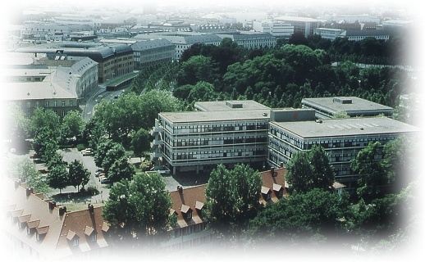
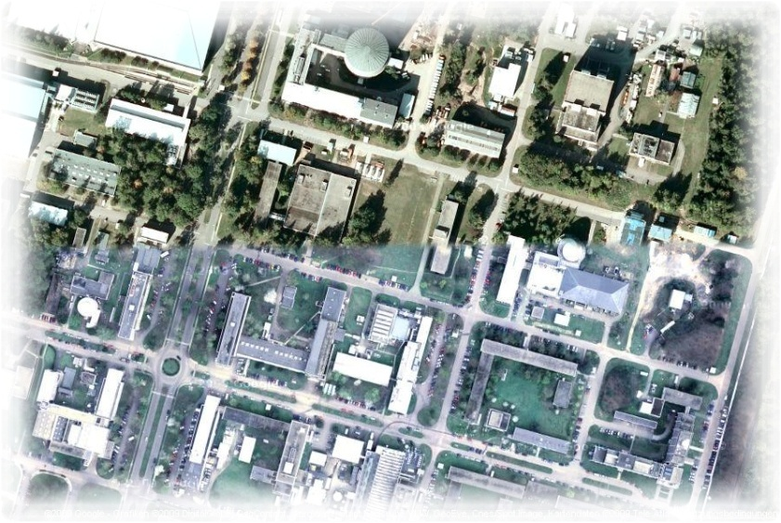

SCC IT-Services
Campus-wide IT-services for > 25.000 students and > 10.000 employees
Networks: 1700 switches/router,
1900 WLAN APs
Server virtualisation: 1000 virtual servers
HW server: ca. 400 servers in 80 racks
Backup/archive: 3000 Clients, 6 Libraries, 30.000 Slots
E-Mail: 45.000 mail boxes, 450.000 incoming mails/d, 200.000 outgoing mails/d
Databases: ca. 1250 MS-SQL/Oracle DB
Web: 600.000 web pages, 800 virt. web servers
Computer rooms: 400 PCs, 250 courses
Portal for students/e-learning: 8.000 users/d, 26.000 users/a, 8.300 active courses

Slide 11

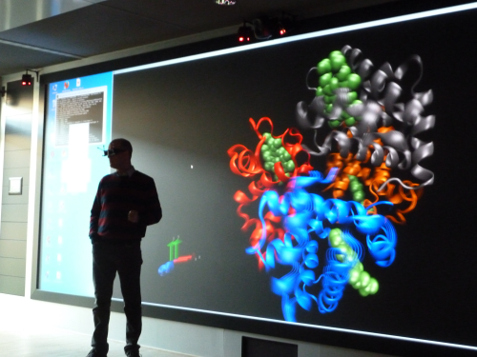
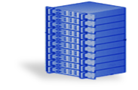
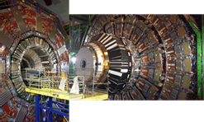
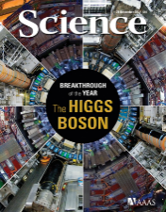

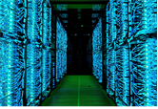
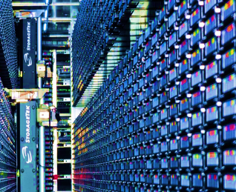
Enabling Data-Intensive Computing
Data Analysis
Visualization
Data analysis systems,
Visualization
Experiment
Publications
Large Scale Data Facilitiy
Repository
HPC systems
Archive
Data Creation
Archive
Simulation

Slide 12
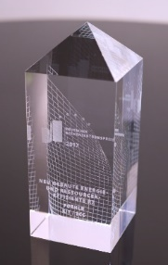
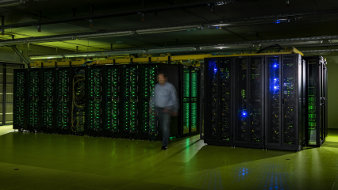
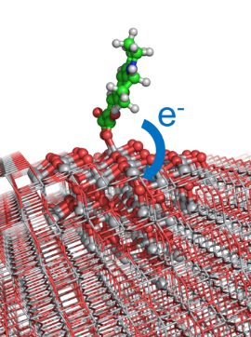


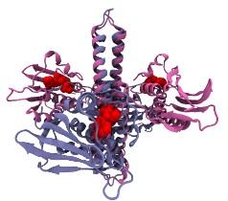




Supercomputing
Operation of HPC systems
  ForHLR: Tier-2 system in Germany,
  34.000 cores with > 1,4 PetaFlop/s peak,
  peer-review access for users in Germany
  bwUniCluster: Tier-3 system in the state BaWü,
  HPC capacity system with 18.300 cores,
  shareholder ownership with all 9 state universities
Joint R&D with scientific communities & KIT institutes
  Application optimisation, scaling, model enhancements
  Simulation Labs in HGF Programme SBD
HYIGs MBS + FiNE
Innovation drivers for SMEs
Architect for HPC environment in BaWü

Slide 13
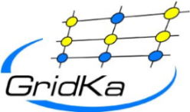


























Big Data
Operation of GridKa
  German Tier-1 in WLCG
  for an international community
Operation of the Large-Scale Data Facility
  Multi-disciplinary data centre for climate research,
  systems biology, energy research, etc. in BaWü
Joint R&D with scientific communities
  Generic data management research
  Data Life Cycle Labs in Helmholtz Programme SBD
Innovation driver for SMEs
Active role in large projects & initiatives

Slide 14
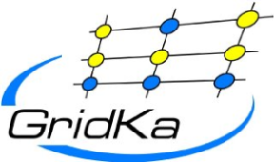

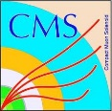


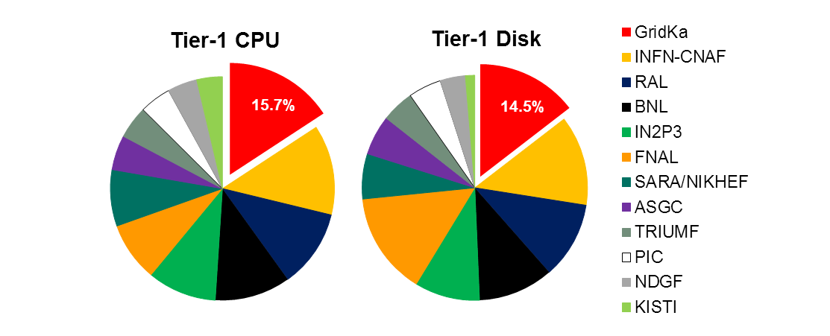
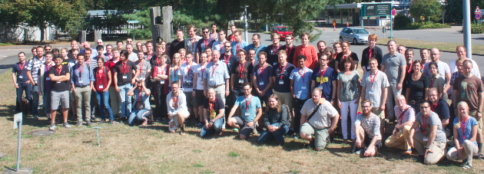

GridKa
German Tier-1 High Energy Physics and
Astroparticle Data & Analysis Centre
  Supports all four LHC experiments
  Belle II, Pierre-Auger, several small communities
Close interaction with user communities
through experiment representatives
Joint R&D with computer science towards HL-LHC
Resources
  Computing: ~ 29k physical cores
  Disk: 25 PB (netto), Tape: 35 PB (used)
  100 Gbit/s connectivity to LHCOPN, LHCONE
Among the largest and best performing T1s
Annual international GridKa School
  > 1700 participants in 16 years!

Slide 15
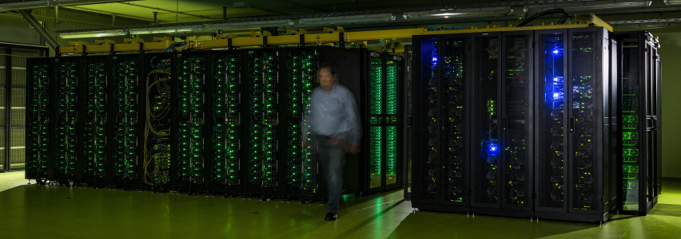
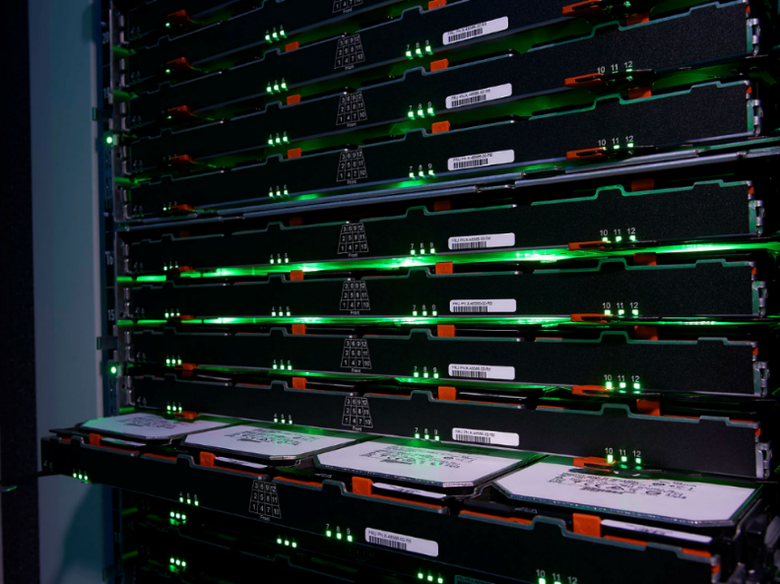
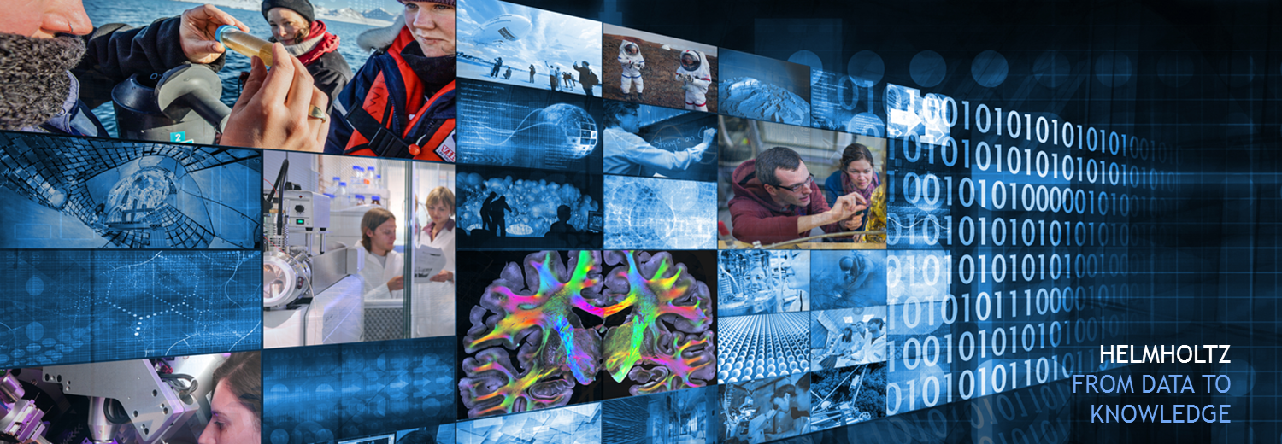
Thank you – Questions ?

