Slide 2
Behind the scenes perspective:
Into the abyss of profiling for performance
Part I
Servesh Muralidharan & David Smith
IT-DI WLCG-UP
CERN
29 Aug’18

Slide 3
Format of Workshop
Essentials (45 minutes)
  Program and Computer Architecture
  Parallelism
  Compilers
  Profiling and benchmarking
Exercises: Matrix multiplication
Hands on (90 minutes)
Break (30 minutes)
Exploiting parallelism (45 minutes)
  SIMD
  OpenMP
Hands on (90 minutes)

Slide 4
Concept of an Ideal Program
Readability Vs Performance
Compute Algorithm
  20% – 30% of code but has >90% of run time
  Most optimizations are applied here
  Big O notation
    Describes the worst case performance in terms of input size
    Can represent time or space
    Example: O(n) – Linear (Finding an item in an unsorted array)
  Extremely readable code for compilers
    Elegance and Obscurity
    Compilers will love it and we only care about performance!!!
    Be nice and use explicit comments for fellow human beings to understand
Glue code
  70% – 80% of code but has <10% of run time
  Contains code used for structuring and connecting different blocks
  Extremely readable code for humans
    Compilers will hate you but that’s okay, we don’t care about performance here

Slide 5

Essentials: Computer Architecture
Stored-Program computer
  Von Neumann model
  Program and data are stored in memory and then processed
CPU
Control Unit
ALU
Input
Output
Memory Unit

Slide 6
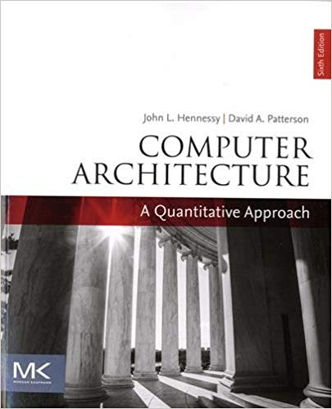
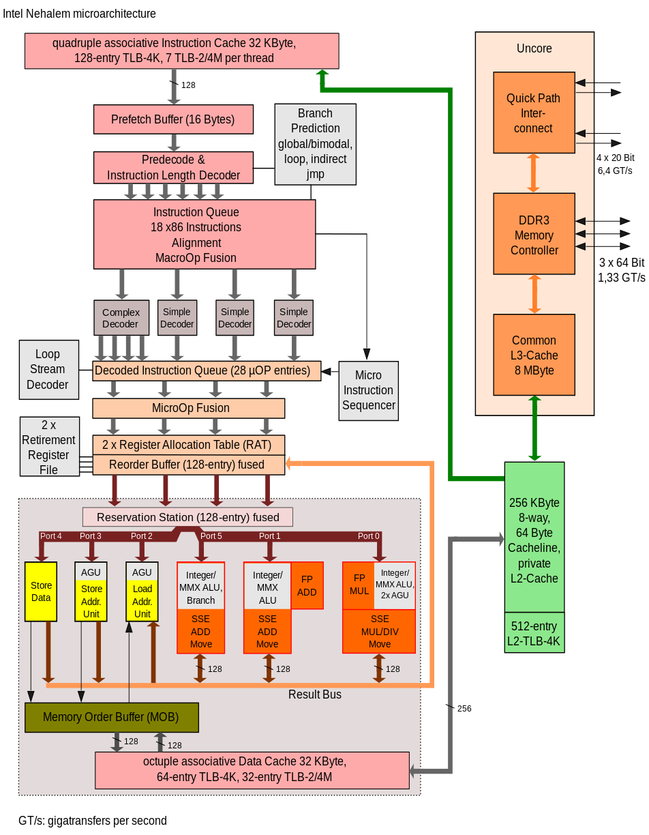
Instruction processing
Fetch
 | Step | What happens
1 | Fetch | Get the instruction (from memory or cache)
2 | Decode | Translate the x86 machine codes op codes into (possibly multiple) internal operations
3 | Execute | Do the instruction (may require memory access)
4 | Writeback | Write the result to storage or make visible in the architectural registers (Retirement)
Decode
Execute
Writeback
https://commons.wikimedia.org/wiki/File:Intel_Nehalem_arch.svg

Slide 7

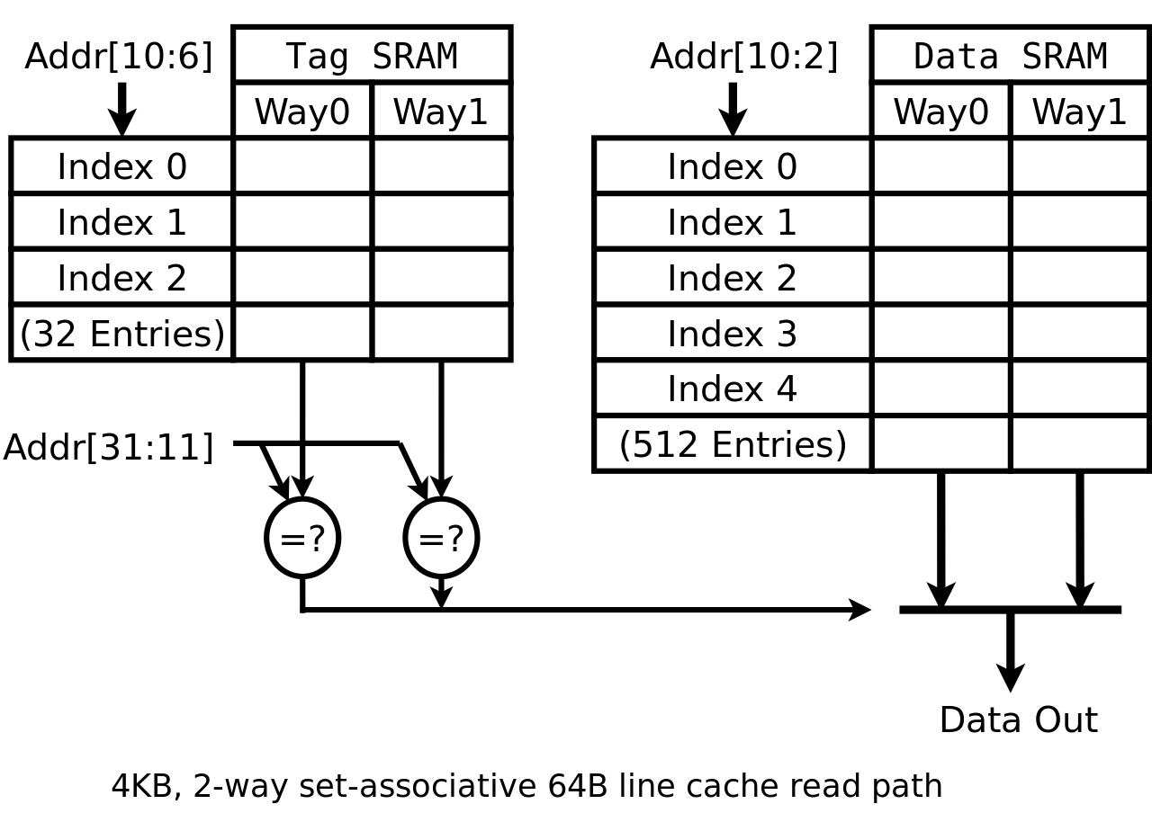
Cache lines
Data is always fetched in units of a cache line
  On x86 cache line size is 64 bytes
  Usually data read from main memory still be stored in the cache, so even if you need less than the size of a cache line 64 bytes will be fetched
  Caches have to be kept consistent if the same cache line is present in multiple caches: e.g. those associated to different cores or different processor sockets within a machine
https://commons.wikimedia.org/wiki/File:Cache,associative-read.svg

Slide 8





Memory Hierarchy
Processor Core
(Registers)
Few sec
L1I
(32 KB)
L1D
(32 KB)
4 cycles
<1 Min
Memory size increases
L2
(256 KB)
Few mins
12 cycles
Memory access latency decreases
Shared L3
(8192 KB)
~36 cycles
Few hours
Local memory
(relatively large)
200-450 cycles
Few days
Approximate memory latencies on Intel Haswell CPUs
Adapted from S. Jarp, A. Nowak

Slide 9


Memory and Disk
Today we are concerned mostly with main memory (RAM) when talking storage outside the processor
  Typically 1 to 100s of Gigabytes in size
However often data will be on a storage device like:
  Object storage, Disks, SSDs, NVMe devices
  These will have latencies from 50 to +100,000 times longer than main memory
  But often much larger capacity, multiple terabytes or petabytes

Slide 10
Essentials (45 minutes)
  Program and Computer Architecture
  Parallelism
  Compilers
  Profiling and benchmarking
Exercises: Matrix multiplication
Hands on (90 minutes)
Break (30 minutes)
Exploiting parallelism (45 minutes)
  SIMD
  OpenMP
Hands on (90 minutes)

Slide 11
1st form of HW Parallelism: Instruction level parallelism
(Absolutely Free*)
Multiple instructions can be decoded per cycle
Multiple instructions can be dispatched
  Because there are multiple execution units (ports) they may execute simultaneously
  The execution units take different types of instructions when the port is available
Called superscalar architecture
Execution
Units
https://commons.wikimedia.org/wiki/File:Intel_Nehalem_arch.svg

Slide 12
2nd form of HW Parallelism: Pipelining
(Absolutely Free*)
Only possible if the execution flow of the code is understood by the processor
Ex: Compiler hints, Strided memory access, Loop bounds
Without pipelining approach
With pipelining approach
Instruction | 1 |  |  |  | 2
Fetch | X |  |  |  | X
Decode |  | X |  |  |  | X
Execute |  |  | X |  |  |  | X
Write |  |  |  | X |  |  |  | X
Clock | 1 | 2 | 3 | 4 | 5 | 6 | 7 | 8
Instruction | 1 | 2
Fetch | X | X
Decode |  | X | X
Execute |  |  | X | X
Write |  |  |  | X | X
Clock | 1 | 2 | 3 | 4 | 5

Slide 13
3rd form of HW Parallelism: Vector Instructions
There are vector registers
  e.g. in processors with Intel AVX there are registers YMM0 – YMM15 which are 256 bits in length
Example of one instruction that operates on multiple data
Data may be placed into these in various ways
  Scalar (just some of the width for one value)
  Packed (a number of values one after the other)
128b Vector Instruction
4B | 4B | 4B | 4B
Packed
single | single | single | single
Scalar
 |  |  | single
Packed
Double | Double
Scalar
 | Double
A1 | A2 | A3 | A4
⊙
B1 | B2 | B3 | B4
=
A1 op B1 | A2 op B2 | A3 op B3 | A4 op B4

Slide 14
4th form of HW Parallelism: Hardware threads
A.K.A Resource Multiplexing
DCACHE
Register
Hardware thread
  The register files and instruction pointer to provide the architectural execution environment. e.g. rax, rbx, the instruction pointer and other registers
  One ore more hardware threads share the resources of a core
  Instruction executed by a core is tagged as belonging to the associated hardware thread
  Intel called this hyperthreading (HT) or generally Simultaneous Multithreading (SMT)
Control
Memory
LLC
ICACHE
Execution Port
DCACHE
Register
HW Thread 2
Control
Memory
LLC
ICACHE
Execution Port
HW Thread 1

Slide 15
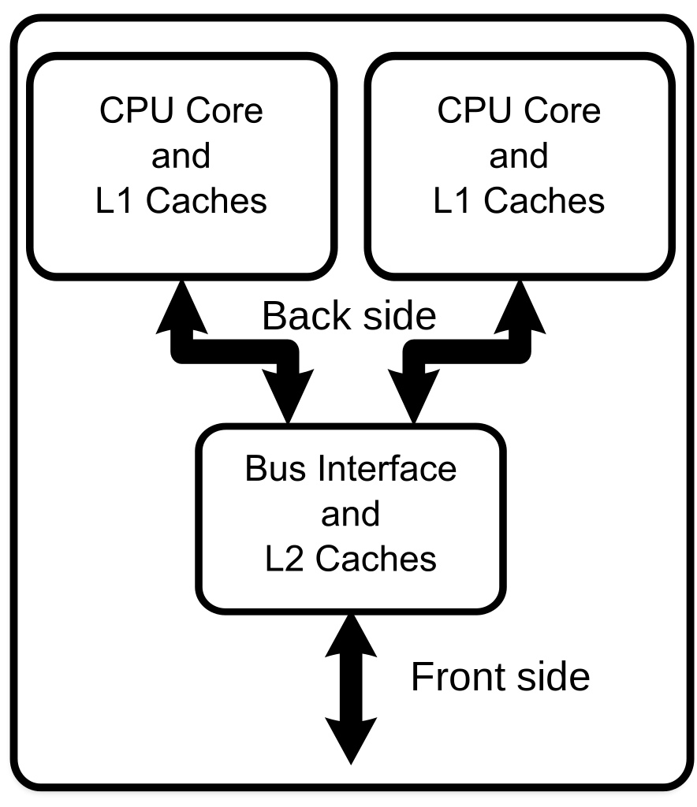
5th form of HW Parallelism: Multicore
Core
  The execution logic, cache, and facilities for storing execution state. e.g. register files
https://commons.wikimedia.org/wiki/File:Dual_Core_Generic.svg

Slide 16
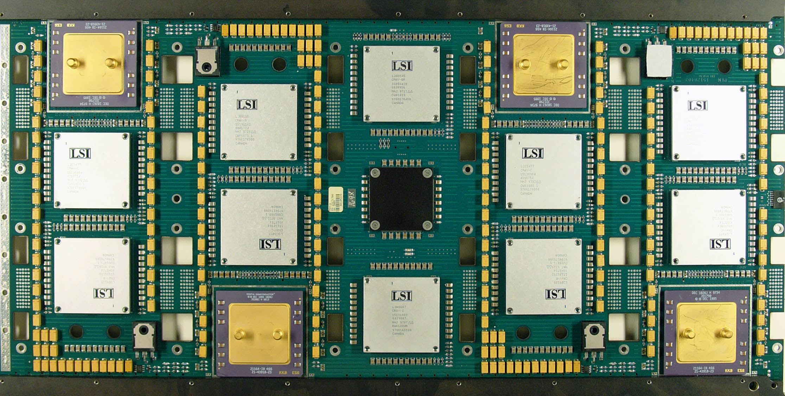
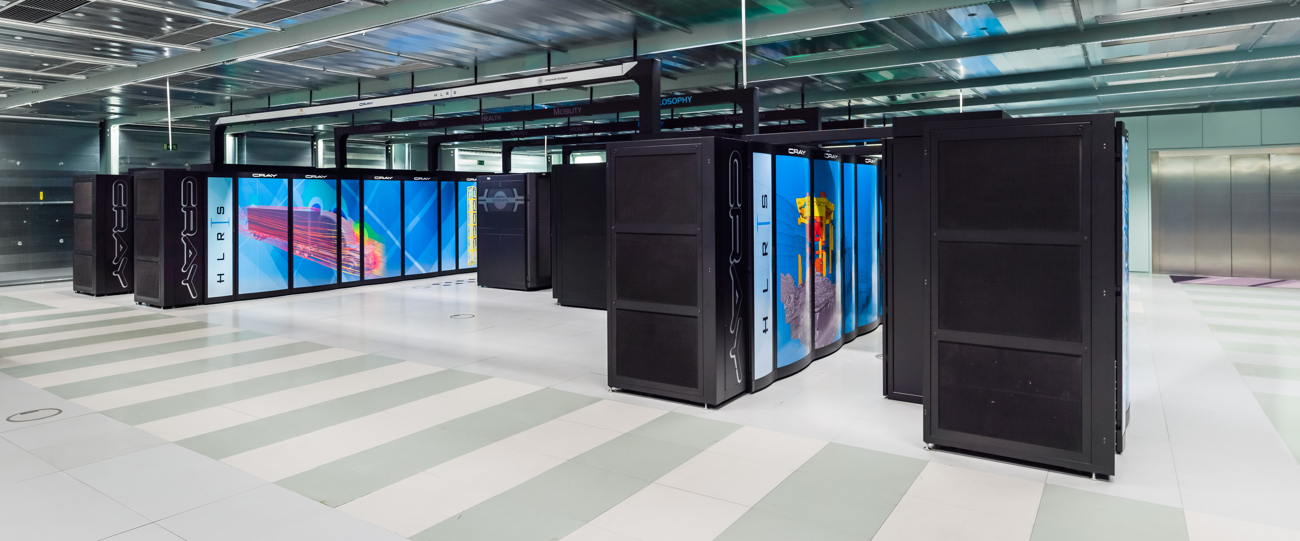
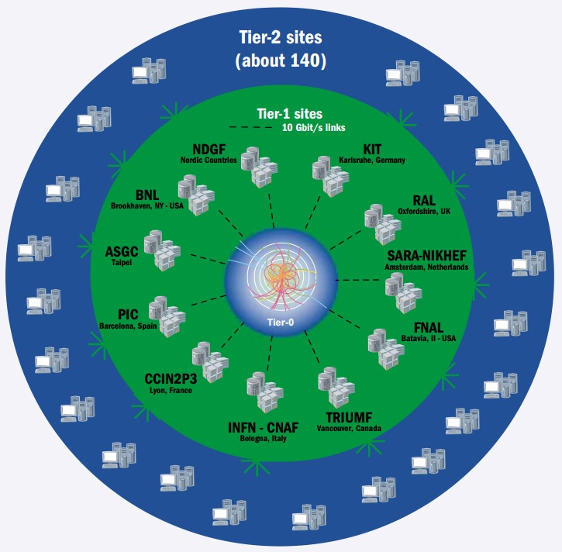
6th form of HW Parallelism and on...
Multisocket, Cluster, Grid…
https://commons.wikimedia.org/wiki/File:Processor_board_cray-2_hg.jpg
https://commons.wikimedia.org/wiki/File:High_Performance_Computing_Center_Stuttgart_HLRS_2015_10_Cray_XC40_Hazel_Hen.jpg
https://sciencenode.org/feature/large-hadron-colliders-worldwide-computer.php

Slide 17
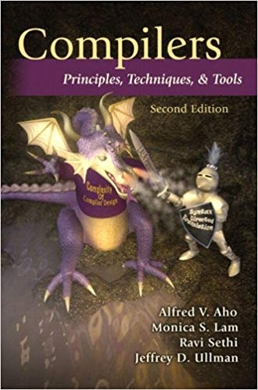
The Compiler
Compiler is the bridge between your code and the hardware
Consist of a front-end and back-end
Front-end:
  Language focused
Back-end:
  Machine focus: architecture specific analysis
  Optimization
  Code generation in native machine code
Source File
Compiler
Object file
Executable

Slide 18
Compiler
Compiler is one of the layers which can help in having well performing code
Compiler features can give you performance with no change of your code (‘for free’)
  Each compiler is different
  Different releases of a compiler can behave differently, to give different performance or even different results

Slide 19
Compiler
Provide your compiler as much information as possible
  Typically make loops explicit
    Let the compiler generate code which can reason on the number of iterations
      Don’t break out of the loop early
      Try to keep memory access contiguous
      Keep arithmetic operations together
  Some flags may change results
  Tune for your target architecture if you can

Slide 20
Floating Point essentials
Floating point numbers are a way to represent real numbers, stored as a significand (mantissa), exponent and sign
N = (-1)^{s} x 1.ccc… x b^{qqq…}
  Finite number of floating point numbers of a given width (e.g. doubles) whereas an uncountable number of real numbers
Therefore while the FP operations are precisely defined by IEEE-754 the result will usually need to be rounded.
  Usually b = 2 and ccc.. and qqq… are stored as binary representation. b=10 (decimal) is also specified by the standard
  Some rational numbers which can be represented as terminating decimals are recurring when using base 2
    numbers like 0.1 can only be represented as a truncated number (i.e. are rounded) in floating point

Slide 21
Floating Point
Some basic properties of operations on real numbers do not hold on floating point numbers
  E.g. associativity. Generally:
Where
denotes floating point addition,
denotes floating point multiplication

Slide 22
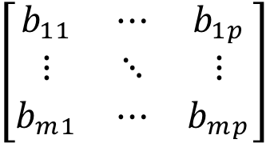
Matrix Multiplication
A=
B=
C=AB=

Slide 23
Why Matrix Multiplication???
Matrix multiplication is fundamental to large numerical computations
  Large math problems can be decomposed into linear equations and then solved using MM
  Motivation behind the development of high performance math libraries such as BLAS, MKL, etc./
  LINPACK benchmark used to rank Supercomputers is based on matrix operations
Computer scientists are obsessed with matrix multiplication optimizations
  For very good reasons!!!
  The naive version has O(n³) complexity
    However, several algorithms that do it faster already exists
  Arithmetic Intensity
    Naïve algorithm has a very low Floating point operations per byte
      Fundamental computation involves 2 operations for every 3 numbers
  Several hundred papers
For the hands on we will use matrix multiplication as an illustration
  However, if you want to do matrix multiplication in your application use a common library
    If you want to know why we can give you more than hundred different reasons (with proof!!!)

Slide 24
First Attempt
for(size_t i=0;i<n;++i) {
for(size_t j=0;j<p;++j) {
sum = 0;
for(size_t k=0;k<m;++k) {
sum += a[i*m+k] * b[k*p+j];
}
c[i*p+j] = sum;
}
}
C_{ij}
A_{ik}
B_{kj}
=
*

Slide 25
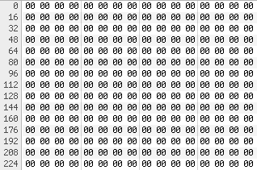
Possible memory layout
e.g. A, B and C are 3 x 3 matrix of doubles
Row Major
A
Possible cache line boundary
B
Padding or used by allocator
C

Slide 26
Memory access pattern
i=0, j=0, k=0
i=0, j=0, k=1
A₀₀
A₀₁
B₀₀
B₁₀
C₀₀
C₀₀
i=0, j=0, k=2
i=0, j=1, k=0
A₀₂
A₀₀
B₂₀
B₀₁
C₀₀
C₀₁

Slide 27
Improvement: Order memory access
By ordering the access differently can improve cache locality
Try to access memory in a previously access cache line (e.g. improve spatial locality)

Slide 28
Change order
i=0, j=0, k=0
i=0, j=1, k=0
A₀₀
A₀₀
B₀₀
B₀₁
C₀₀
C₀₁
i=0, j=2, k=0
i=0, j=0, k=1
A₀₀
A₀₁
B₀₂
B₁₀
C₀₂
C₀₀

Slide 29
Cache Blocking (also called tiling)
Divide a problem into pieces where work can be done on a subset of the data, and where the subset fits into the CPU caches, e.g. where the value of block is chosen so the three inner loops can run over data that fits inside the cache
  /* This gives C = A*B + C */
  for(size_t i=0;i<n;i+=block) {
  for(size_t j=0;j<p;j+=block) {
  for(size_t k=0;k<m;k+=block) {
  for(size_t ii=i; ii<min(i+block,n);++ii) {
  for(size_t jj=j; jj<min(j+block,p);++jj) {
  sum = c[ii*p+jj];
  for(size_t kk=k; kk<min(k+block,m);++kk) {
  sum += a[ii*m+kk] * b[kk*p+jj];
  }
  c[ii*p+jj] = sum;
  }
  }
  }
  }
  }

Slide 30
Profiling
Utilization of resources
  What? Why? How?
  Help understand performance i.e. Better bang for buck
Profiling with a view to understand performance
  Resource specific
    Examine utilization, saturation or errors specific to a resource
  Code specific
    Investigate resources used by the program and its functions
  Dependable results
    Strict methodology that is free from bias
    Reputability of the measurements

Slide 31
Things that impact profiling
What affects the timings?
  Other workloads
  Concurrent access to disk, network, memory etc.
  Frequency scaling (Intel Turbo Boost)
  Non-uniform memory access (NUMA)
  CPU scheduler
There can still be large time variations
Always do multiple runs, make sure each run has similar conditions, e.g. if you program accesses data from files
  Remove staging in files
  Empty filesystem caches
    echo 3 > /proc/sys/vm/drop_caches

Slide 32
How to profile
Profiling at the level of an application
  Add timings into source code
  Measure call counts etc
Disadvantages
  Creates overhead
  It is not always possible to recompile the code
    Production software is large and complex
    Source code is not readily available

Slide 33
How to profile
Kernel, OS and hardware offer a variety of tools and interfaces to measure high and low-level events with little performance impact. This can be done in an intrusive and non-intrusive way. Some examples for non-intrusive techniques:
  Performance Monitoring Unit
  /proc - is a virtual filesystem that represents the current state of the Linux kernel
  Linux Control Groups (cgroups) limits and monitors resource usage of processes
Some examples of intrusive techniques:
  Dynamic linker allows one to replace symbols at runtime
    Instrumented function, e.g. malloc

Slide 34
How to profile
Performance Monitoring Unit
  Number of registers, counters and features supported are CPU specific. The following can be measured:
    CPU cycles
    Branch predictions
    Instructions
    Cache accesses
    Memory accesses
    Any many other things…
  Will use this today (via the tool perf)

Slide 35
How to profile – non-intrusive tools
Performance Monitoring Unit – Problems:
  Vast amount of counters – correlation between them can be difficult to understand
  Encoding can change for different CPU models
Tools to read counters from PMU:
  perf https://perf.wiki.kernel.org/index.php/Tutorial
  pmu-tools is a wrapper around perf
    https://github.com/andikleen/pmu-tools

Slide 36
Exercises
Connect to machines at CERN to run the exercises: user name is gss2018
Thanks to the teams at CERN for providing machines and access, including:
Luca Atzori Olof Barring Ian Bird
Maria Girone Stefan Lueders Alberto Di Meglio
Guillermo Izquierdo Moreno Wayne Salter
Markus Schulz Hannah Short Bernd Panzer-Steindel

Slide 37
Exercise 1 – Naïve matrix multiplication
Investigate the basic (naïve) matrix multiplication
  The source and ‘makefiles’ are setup to build binaries with gcc and icc
  The example is setup to multiply two square matrices of a size (order) given on the command line, using double precision floating point
Time how long the multiplication takes, e.g. with order 2300
Use perf to measure the number of cycles and number of retired instructions
  Calculate the IPC count for the application
Amount of work performed per clock tick (Instructions Per Cycle):
perf stat –e cpu-cycles,instructions ./program

Slide 38
Exercise 2 – Change data access order
Adapt the naïve multiplication and try every ordering of the 3 for loops
  Measure the execution time of all the combinations
Consider the order of data access
For the i, k, j ordering
  Measure IPC again
  Measure the LLC cache misses
    Remeasure the naïve case and compare
Last level cache: relevant perf event names LLC-load-misses, LLC-prefetch-misses and for totals LLC-loads, LLC-prefetches
perf stat –e LLC-load-misses,LLC-prefetch-misses ./program

Slide 39
Exercise 3 – Rewrite with blocking
Taking the i,k,j loop order for the previous example and adapt the multiplication routine to use cache blocking
  Leave the block size as a parameter that you can adjust
  Measure the runtime, IPC and LLC misses with varying blocksize:
    try sizes 64, 128, 256, 512, 1024, 2048, 4096 matrix rows/columns (but you must use vectors of sufficiently large order)
  Estimate the working size of the data being access for the optimum blocksize. How does it compare to the CPU cache size?
    You can use the following to get information:
    getconf -a | grep CACHE

Slide 41
olsnbb03
olsnbb05
olsnbb08
olsnbb09
olsnbb10
olsnbb11
olsnbb16
olsnbb17
olsnbc03
olsnbc04
olsnbc06

