Slide 2
Behind the scenes perspective: Into the abyss of profiling for performance Part II
Servesh Muralidharan & David Smith
IT-DI WLCG-UP
CERN
29 Aug’18

Slide 3
Sources of Parallelism in Modern Architectures
Instruction level parallelism (ILP)
Pipelining
Vector Operations
Hardware Threads
Multicore
Multi Socket
Cluster
Grid
Architecture handles this with good coding practice
Can be implicitly generated by compiler understandable code or explicitly with intrinsic
Explicitly programmed using shared-memory parallel programming model
Explicitly programmed using distributed-memory parallel programming model

Slide 4
Flynn’s taxonomy: Can be a programmer’s guideline
MISD
SISD
Proposed in 1966
Instruction streams
single (SI) or multiple (MI)
Data streams
single (SD) or multiple (MD)
Types
SISD
SIMD
MISD
MIMD
Instruction Pool
Instruction Pool
Processing Unit
Processing Unit
Processing Unit
Data Pool
Data Pool
MIMD
SIMD
Instruction Pool
Instruction Pool
Processing Unit
Processing Unit
Processing Unit
Processing Unit
Processing Unit
Processing Unit
Data Pool
Data Pool
Processing Unit
Processing Unit
Processing Unit
Processing Unit
Processing Unit
Processing Unit

Slide 5
Using SIMD
Choose between code manageability and portability and speed:
Use different levels of abstraction
Assembly
Intrinsic
Wrapper functions or classes in C or C++ (using intrinsics)
Custom languages like Cilk/Cilk++
Autovectorization

Slide 6
SIMD: SSE, AVX & FMA
The use of SIMD instructions in vectorized code can give good performance gains
(S)SSE 1,2,3
SSE 4.1, 4.2
AVX
AVX2 + FMA
AVX-512
From 1999
Width 128b
From 2007
Width 128b
From 2011
Width 256b
From 2013
Width 256b
From 2016
Width 512b
256b -> 8 floats or 4 doubles (possibility of 4 or 8 speedup)

Slide 7
Fused Multiply Add
These are instructions which can do calculations of the form:
A <- A*C + B or
A <- B*C + A
Can bring gain because one instructions replaces a multiply and add instruction (reduces throughput cycles and latency)
Is also a SIMD instruction

Slide 8
FMA and floating point
FMA is specified to round only once
Therefore FMA is a change which can affect the result of a calculation compared to using separate multiply and add operations
Enable with:
GCC:
Will use FMA if it is compiling for an architecture that has it
May be explicitly set with –mfma or –mno-fma

Slide 9
Autovectorization
Depends on compiler and version
Advantages
Can get great speedups (x2 or more) with little change of the source code
Compiler can generate a report to help
Source code remains architecture independent
Disadvantages
Can be delicate. A small change of the source can stop the compiler autovectorizing, causing a large change in performance
Lots of compiler options that affect the autovectorization
Usually you could have bigger gains using intrinsics or assembly
Some compiler options which help autovectorization can change the way FP operations are done: you have to be aware when that may be important

Slide 10
Autovectorization
Two main places where automatic vectorization can be done
In loops
compiler tries to do several iterations of the loop at once using SIMD
May unroll a number of the loops so to fill pipeline and improve ILP
May peel loops to allow aligned access to data
Combining similar independent instructions into vector instructions
Known as SLP vectorizer

Slide 11
Autovectorization difficulties
for(i=0;i<*p;++i) {
A[i] = B[i] * C[i];
sum += A[i];
}
(example from slide by Georg Zitzlsberger, Intel)
Possible to vectorize? Concerns may be:
Is the loop range invariant during the loop
Is A[] aliased with the other arrays or with sum, is sum aliased with B[] or C[]
Is the + operator associative?
Is the vectorized version expected to be faster?

Slide 12
Using autovectorization
GCC:
Switch on using –ftree-vectorize
Off by default
Information on autovecotization analysis
using –ftree-vectorizer-verbose=X (X=0-7, 7 is most information)
Or examine generated code with gdb
May be necessary to use –ffast-math
Often with reductions (e.g. summations)
This will cause the compiler to relax certain some constrains, for example allow it to assume associative properties
ICC:
On by default, modify with –x and -ax
Would switch off by using –no-vec
ICC defaults to ignoring parentheses to specify floating point associativity and generally can make more aggressive optimizations on floating point calculations
Controlled by -fprotect-parens and –fp-model
Information on autovectorization analysis
-qopt-report=2 –qopt-report-phase=vec
-opt-report-help and –opt-report-phase={hpo,ipo}
Or examine with gdb…

Slide 13
FP caution
E.g. summing a number of values: One technique to reduce rounding error over long sums is Kahan summation
double sum = 0.0, C = 0.0, Y, T;
size_t i;
/* Kahan summation of values in A[i] */
for (i=0; i<length; i++) {
Y = a[i] - C;
T = sum + Y;
C = (T-sum) - Y;
sum = T;
}
If the compiler reasons C=0 the correction is lost. Perhaps pairwise summation could be used instead.

Slide 14
SoA vs AoS
It is better to load the contents of a vector register from a contiguous piece of memory rather than gather the values
Can arrange that the data layout fits this access pattern. e.g. use of Structure of Arrays instead of Array of Structures. e.g.
struct points {
double x[1000];
double y[1000];
double z[1000];
} locations;
struct point {
double x,y,z;
} location[1000];

Slide 15
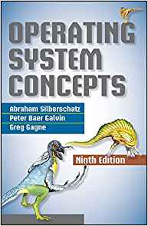
Software processes & threads
Process (OS process):
Encapsulated entity of a program running in its own private address space
It consists of a private copy of program code and data along with file descriptors and permissions
It has a dedicated heap and stack space from which data is accessed and modified.
Thread
Lightweight execution context that runs under a process
They share address space, program code and operating system resource of their parent process
Can be created and destroyed with low overhead in comparison to that of a process
Consists of a small amount of thread local storage space

Slide 16
Processes & threads
Process
Thread 1
Registers
Registers
Registers
Thread 2
Time
Program Counter
Program Counter
Program Counter
Thread 3
Stack
Stack
Stack
Data
File Descr
Registers
Program Counter
Stack
Code
Data
File Descr
Code

Slide 17
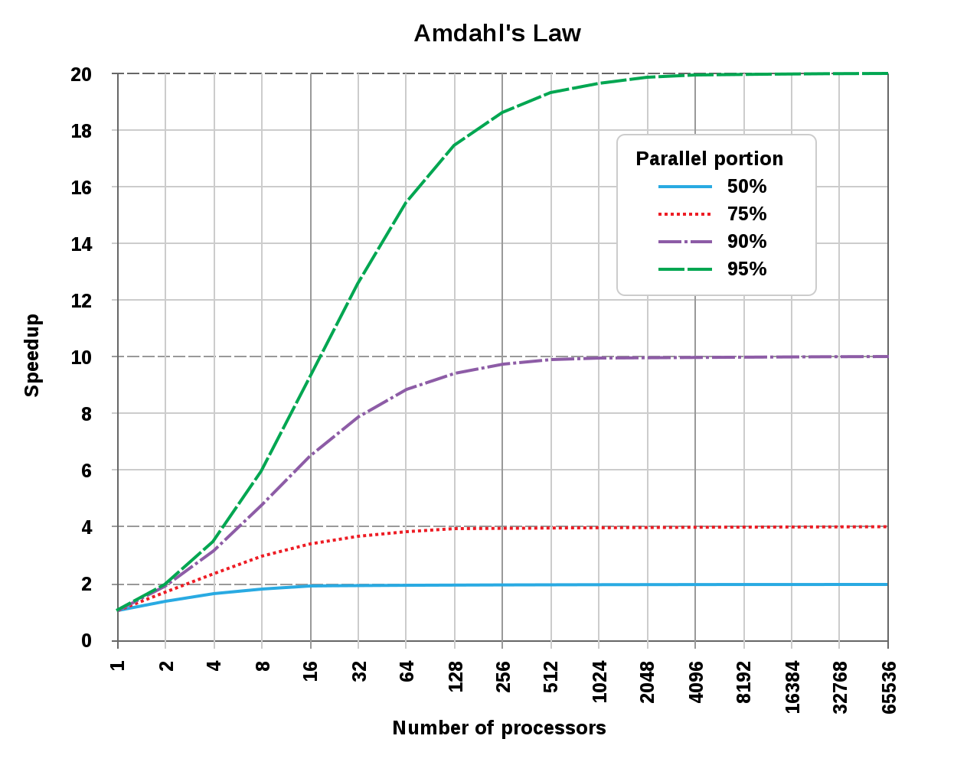
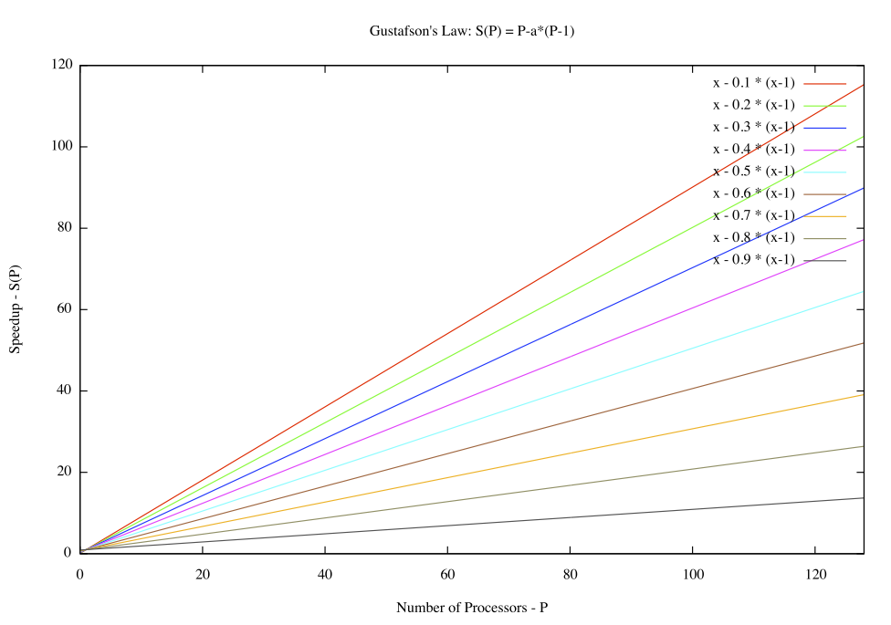
Parallel computing
Performing certain computations simultaneously using multiple resources
Amdahl's law & Gustafson's law
Speedup only comes from the parallelizable part of the code
i.e. Serial part of the code will impact or limit the achievable performance
Amdahl's law
Gustafson's law
Where,
S_{latency} is the theoretical overall speedup
s is the speedup in the parallel part
p is the percentage of the execution time of serial part

Slide 18
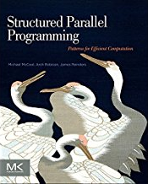
Parallel Programming
Is a large topic. Many tools and techniques, a few:
pthreads is a standard API for managing threads
Fundamental API for threading in Linux
Cilk Plus
Language support by compiler extensions: appears as C/C++ with extensions
TBB (threading building blocks from Intel)
C++ large use of templates
commercial binary distribution with support or open source
C++11 threads
CUDA and OpenCL
GPU or CPU/GPU unified programming models
OpenMP
http://concurrency.web.cern.ch/GaudiHive
A framework from the HEP community

Slide 19
OpenMP
A specification:
See https://www.openmp.org
Are compiler directives, routines and variables that can be used to specify high-level parallelism in C, C++ and Fortran
GCC
4.4 – OpenMP 3.0
4.9 – OpenMP 4.0
6.1 – OpenMP 4.5
Clang
3.7 – OpenMP 3.1
Intel
12 – OpenMP 3.1
16 – OpenMP 4.0
17 – OpenMP 4.5

Slide 20
OpenMP
Code looks similar to a serial version
#pragma are used to indicate handling of parallel parts
Usually uses a fork-join model
Sequential
Parallel Region
Parallel Region
Sequential
master thread

Slide 21
OpenMP
May need to compile with –fopenmp (check your compiler)
Most OpenMP features are used through pragmas
#pragma omp construct [clause [clause] … ]
You can change the number of threads via environment or an API or specify it in the pragma
export OMP_NUM_THREADS=16

Slide 22
Parallel regions
Threads (up to the number configured) are created, if needed, when the pragma is crossed
Threads execute the parallel region, the sequential part continues once all the threads have come to the end of the region
Data is shared, but stack variables declared in the parallel region are private
#pragma omp parallel
{
function_called_in_parallel();
}
function_sequential();

Slide 23
Parallel for-loops
Loop iterations become threads
Data is shared between threads (i.e. iterations), except loop index
Threads wait at the end of the for loop
The pragma is specified directly before the loop
#pragma omp parallel
{
#pragma omp for
for (i=0;i < N; i++) {
function(i);
}
}
The two pragmas above are equivalent to
#pragma omp parallel for

Slide 24
Sharing control
Consider
double x, y;
#pragma omp parallel for
for(i=0;i<N;i++) {
x = a[i]*4;
y = b[i] * b[i];
b[i] = x/y;
}
This will probably not give the intended result: x and y are shared between the threads of the parallel for loop

Slide 25
The private clause
Used to give each thread a private copy of a variable which was already declared outside
The variable is uninitialized
double x, y;
#pragma omp parallel for private(x,y)
for(i=0;i<N;i++) {
x = a[i]*4;
y = b[i] * b[i];
b[i] = x/y;
}

Slide 26
Variations on sharing control
As well as private:
firstprivate: initializes each private copy to the value from the master thread
lastprivate: copies the value from the thread, which executed the last iteration of the loop, to the master thread
shared: is the default, but for documentation or if the default is changed you can uses this clause
Plus others, e.g. those which concern threadprivate variables

Slide 27
Reductions
Reductions will implicitly produce a local copy of the reduction variable in each thread
Each thread updates its copy
At the end of the construction the reduction operation merges sub-results into a single value and puts it in the reduction variable
Operations: + * - ^ & | && || min max
#pragma omp for reduction(op:var)

Slide 28
Reduction example
double dotprod=0;
#pragma omp parallel for reduction(+:dotprod)
for(i=0;i<N;i++) {
dotprod += a[i] * b[i];
}

Slide 29
Exercise 4 – Use SIMD in the matrix multiplication
Starting with the blocked version of the matrix multiplication see if autovectorization has an effect
The Makefile already has the matrixmul-simd target.
Autovectorization may work or might need a small change
Compare the execution time to a similar multiplication not using autovectorization
See if you have SIMD instructions (you may use Intel SDE, see next slide)
Check the compiler report if it didn’t work

Slide 30
Intel SDE
Is the software development emulator
In this case we can use it to count and classify different types of instructions
export PATH=/home/gss2018/exercises/sde-external-8.16.0-2018-01-30-lin:$PATH
sde -iform 1 -omix test.out -top_blocks 5000 -- ./my_executable
Look in test.out for lines ending in _1, _2 or _4 representing scalar or packed operations, e.g.
cat test.out | egrep '^\*.*_[124]'

Slide 31
Exercise 5 - OpenMP
Use OpenMP to make the matrix multiplication from the previous exercise use multiple threads
Set OMP_NUM_THREADS=6, 12, 24, 36 and then 48
Run a multiplication and use top to look at the running process. Note that %CPU should be >100%.
Compare the runtime each time and
Use perf to measure the instructions and cycles; vary the number of threads and note how each changes

