Slide 1


GÉANT Network Overview
Mian Usman
Network Architect
GridKa School 2018
www.geant.org

Slide 2



To support collaboration and development amongst researchers, the dissemination of information & knowledge, and provide access to a portfolio of services and infrastructure resources:
Runs a membership association for Europe's National Research & Education Networks (NRENs)
GÉANT Association
Coordinates and participates in EC-funded projects
Under Horizon 2020 the financial instrument for implementing the Innovation Union, a Europe 2020 flagship initiative aimed at securing Europe's global competitiveness
Operates a pan-European e-infrastructure
GÉANT network
Manages a portfolio of services for research & education
EduX
Organises and runs community events & working groups
TNC, task forces & special interest groups

Slide 3





































Membership Association
GÉANT Association supports and represents over 40 NRENs across Europe.
Together they support over 10,000 institutions and 50 million academic users.

Slide 4
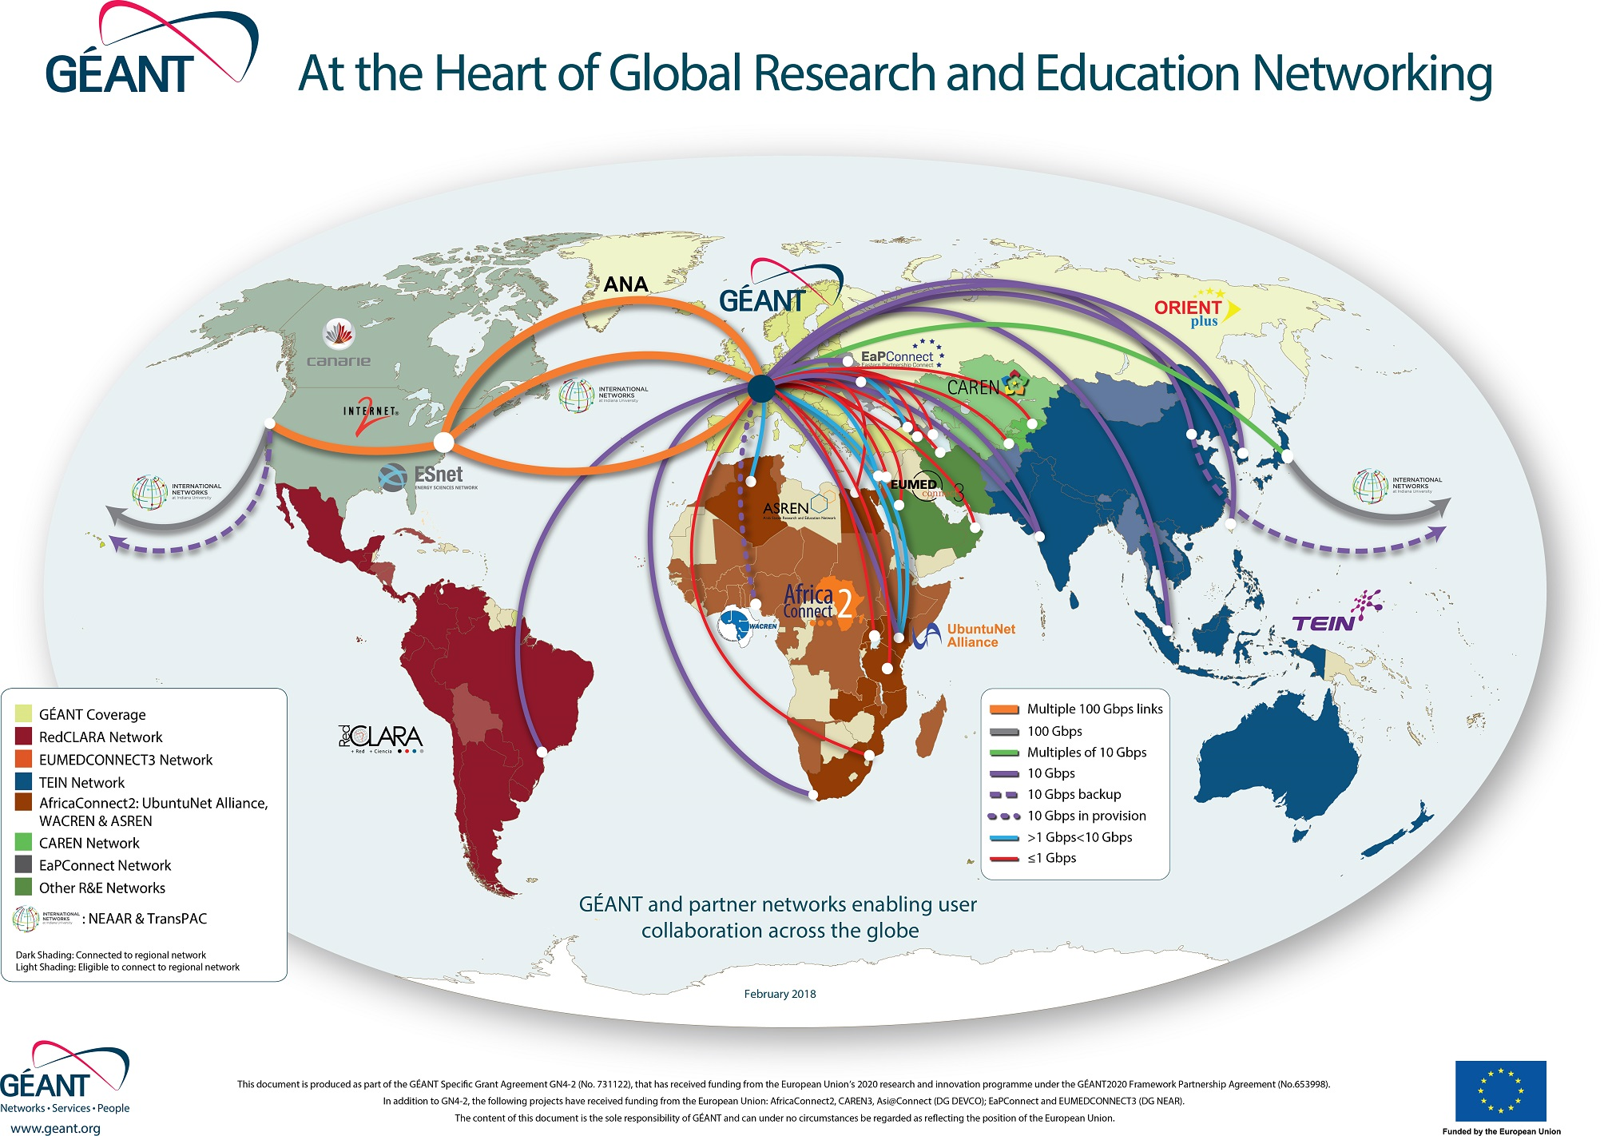
GÉANT Network
The GÉANT network interconnects research, education and innovation communities worldwide, with secure, high-capacity networks.
We design, plan, build and operate the large-scale, high-performance GÉANT network that connects European NRENs to each other and the rest of the world for sharing, accessing and processing the high data volumes generated by research and education communities and for testing innovative technologies and concepts.
Interconnecting Europe’s NRENs over a 500Gb highly-resilient pan-European backbone.
NRENs serve 50 million users at 10,000 institutions across Europe.
Network services: IP, Point-to-Point Services, VPN, Testbeds, performance monitoring
Data transfer tests in 2017 between 10G servers in GÉANT and AARNET achieved 9.73Gbps over 48h through R&E networks, whereas over commercial links this was only 1.77Gbps.

Slide 5

Network
A separate ultra-high-speed internet, only for research & education
Ro​bustness
Over 3,000 terabytes o​​f data are transferred every day via the GÉANT IP backbone. ​
​Total ​​reliabil​​ity
100% average monthly access availability​.
​​Flexibility
Services and infrastructure can be tailored to individual user requirements.​
​Capacity and rapid upscale
100Gbps (gigabits per second) services​ are now available across the core network, with a network design that will support up to 8Tbps (terabits per second), ensuring the network remains ahead of user demand and the data deluge.
​Efficient operations
The dedicated GÉANT Operations Centre ensures 99% of cases are reported within 15 minutes of any outage being detected, leading to rapid resolution.​
Services
A wide range of services including IP and dedicated circuits, testbeds and virtualised resources, authentication and roaming, monitoring and troubleshooting, advisory and support services.​
“Today it would not be possible to work without the network that GÉANT and the NRENs have provided.”
CMS experiment, Large Hadr​on Collider (LHC)

Slide 6
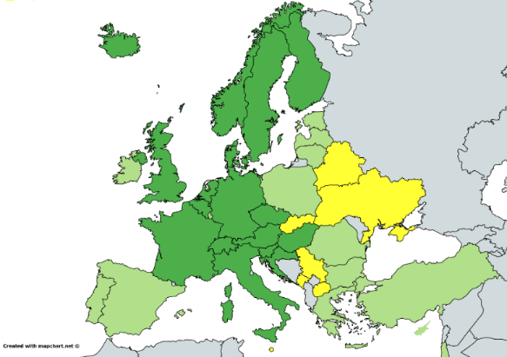
Network Services
GÉANT operates an advanced, high-performance network supporting Europe’s NRENs with cost-effective, highly available, high-capacity services customised for and dedicated to research and education
GÉANT network services
GÉANT IP – Ultra-high performance uncontended IP connectivity at up to 100Gbit/s
GÉANT VPN – Layer 3 VPN services for NRENs and institutions supporting private networking needs
GÉANT Point-to-Point – High performance dedicated connectivity up to 100Gbit/s for the most demanding applications
GÉANT Open – Allows NRENs and approved commercial organisations to exchange connectivity in a highly efficient and flexible manner
eduroam – Seamless WiFi access around the world
Availability Targets
99.999% - 27 seconds downtime/month
99.99% - 4.5 minutes/month
99.4%* - 4 hours/month

Slide 7
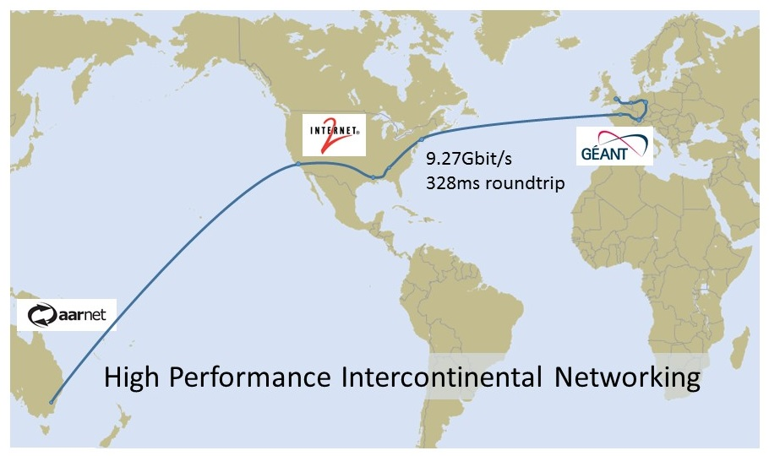
R&E Networks Optimised for research data transfer
Throughput: Average including slow start 9.09 Gbit/s
NO TCP re-transmitted segments

Slide 8
10 Gigabit TCP performance on R&E Networks
Route using ANA300 & AARNet 100Gig:
London-Washington-LosAngeles-Sydney-Canberra
TCP offload on, TCP cubic stack
RTT 304 ms.
Delay Bandwidth Product 280 MB.
One TCP flow rises smoothly to the
plateau at 350 MBytes.
Throughput:
  Average including slow start 9.09 Gbit/s
  Plateau from 5s onwards 9.73 Gbit/s.
NO TCP re-transmitted segments

Slide 9
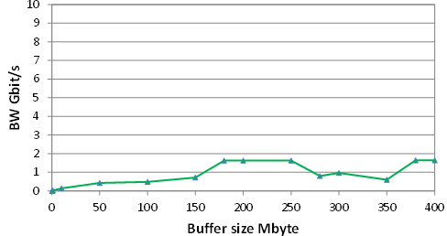
10 Gigabit TCP performance on R&E Networks
Public Internet
GÉANT and R&E partners
London to Canberra using public internet
London to Canberra using GEANT + R&E networks via US to Australia
Proof that R&E networks are providing real value to the research community

Slide 10
100 Gigabit TCP performance on R&E Networks
Route: London-Paris
TCP offload on, TCP cubic stack
RTT 7.5 ms.
Delay Bandwidth Product 34.7 MB for a 37 Gbit/s flow.
One TCP flow rises smoothly to the 37 Gbit/s plateau at 35 MBytes.
NO TCP re-transmitted segments

Slide 11
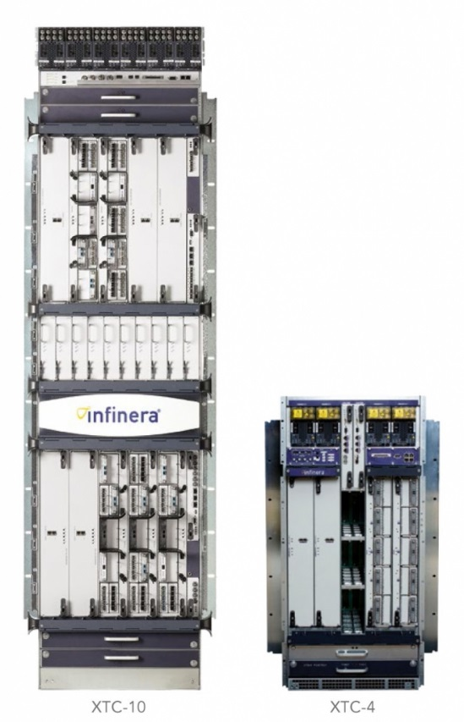
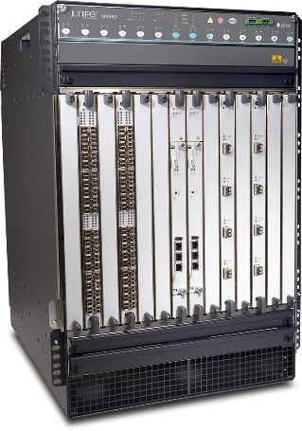
GÉANT Network Equipment
GÉANT network
Two main network
Infinera based DWDM Network
Juniper based IP/MPLS network
Overlay networks
Global R&E IP
LHCONE
Internet Access Service
Cloud VPN
MDVPN
P2P VPNs
Project specific VPNs

Slide 12
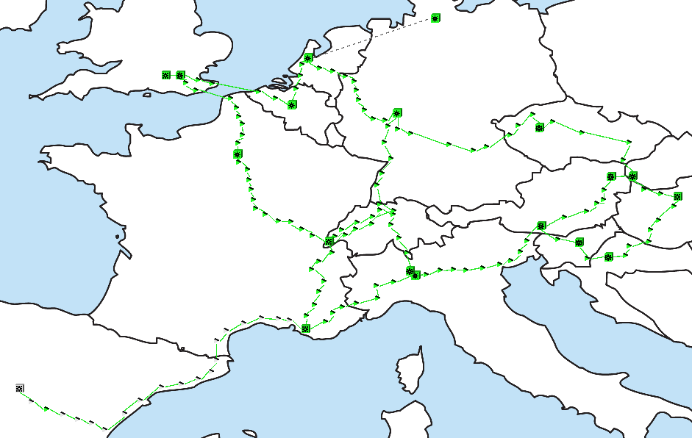
GÉANT Network
GÉANT DWDM network
Based on Infinera DTNx system – Network elements provide large capacity point to point circuits across defined routes
GÉANT Point-to-Point – 10G and 100G lambda services are provided on this infrastructure

Slide 13
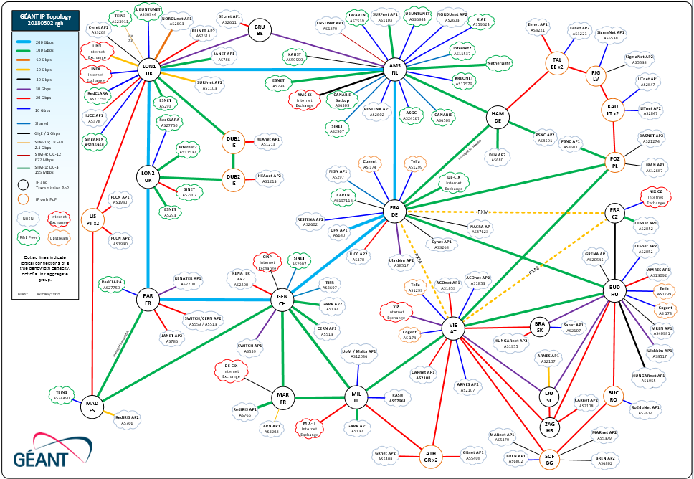
GÉANT IP Network
GÉANT IP network
Based on Juniper MX Platform – All layer 2 and layer 3 services are provided on IP layer
Makes use of GÉANT DWDM Network for its core links and uses leased capacity where dark fibre isn’t available.

Slide 14
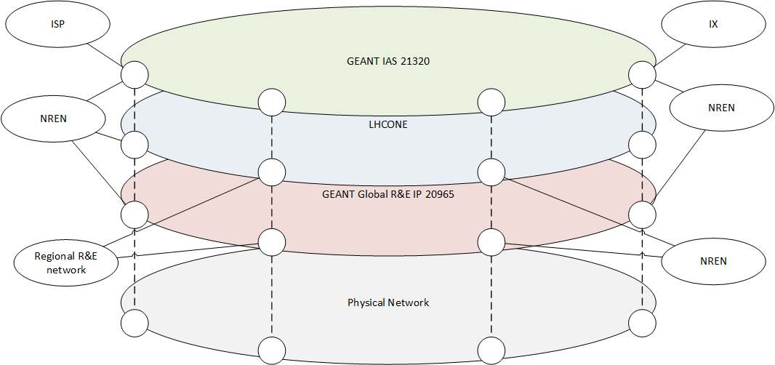
GÉANT Network Overlays
GÉANT Overlays
Global R&E IP–connects the NRENs and other regional R&E networks
LHCONE – connects the NRENs and other regional networks for LHC related data service
Internet Access Service–connects the NRENs to ISPs and CDN networks

Slide 15
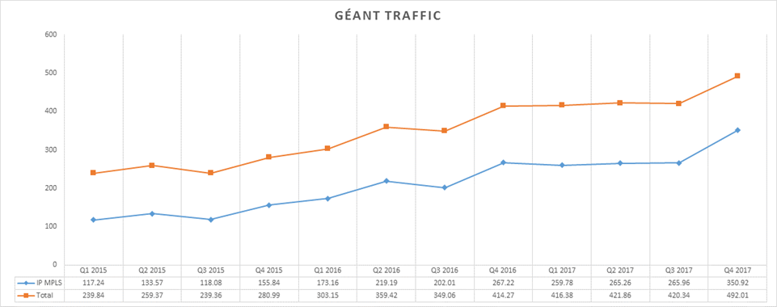
GÉANT Network Traffic
Network Traffic
Average volumes during 2017 were 3.13PB per day for the IP/MPLS network, average daily rate of 289Gbps
Average volumes including Lambdas are 4.79PB day or an average data rate of 444Gbps
Science traffic growth: 43%
Internet traffic growth : 26%

Slide 16
GÉANT Network Challenges
Exponential growth in network traffic
  Nearly 50% year on year growth
  Traffic expected to double every 18 months
  Find cost effective ways to support the traffic growth
Increase space and power efficiencies
Dependence on a single vendor solution
To address these challenges we need to optimise the network architecture and take maximum advantage of the current disruptive trends
With a growth rate of over 50% projected traffic in 10 years will be over 50 times that of current traffic.

Slide 17
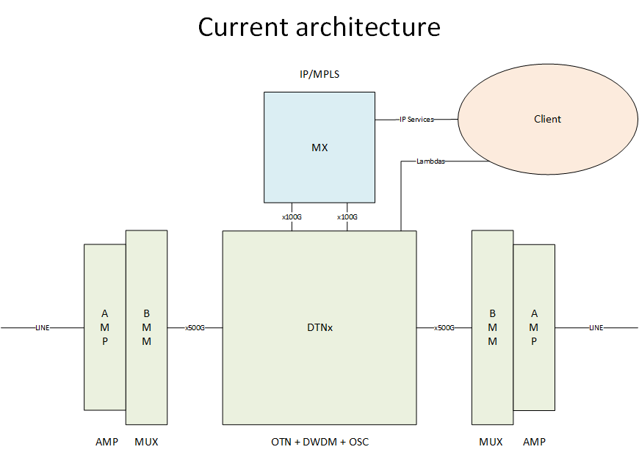
GÉANT Network Challenges
Problems with current architecture:
OTN layer expensive
OTN chassis running out of slots in central PoPs
OTN useful for protection switching and multihop but traffic is 70% unprotected and next hop
OTN chassis are DC powered full rack cost is very high in some PoPs
Proliferation of IP/MPLS interconnection with OTN layer

Slide 18

Industry Trends
Content providers (FAANGs) are experiencing huge growth in traffic volume. They are driving innovation to ensure that their business models scale.
Moving towards disaggregation
  From a monolithic block to a modular, flexible and best in class
  Clean separation between hardware and software – each innovate independently of other
Transport Layer
  Open Line System
  Merchant Optics - Data Centre Interconnects (DCI) or External Transponders
Packet Layer: Core of networking devices has always been ASICs
  Merchant Silicon: until Broadcom came along there weren’t many options available
  Third Party NOS

Slide 19
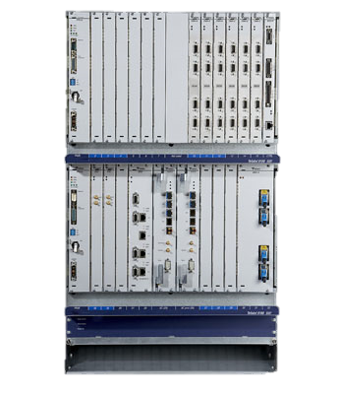
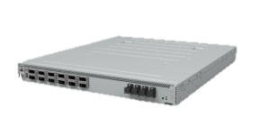
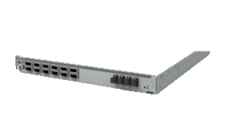
Data Center Interconnects
Data centre style 1 RU stackable form factor.
Around 6 times reduction in cost over traditional telecoms equipment architectures
Significant increase in density and reduction in power consumption
Next gen of commodity pluggable optics has excellent performance
Modular – easy to scale up
Easy upgrade path to new technology
Loss of equipment integrity – not designed to be highly available as per ETSI etc.
  No internal hardware redundancy
  No in-service upgrades
  Restricted temperature operation

Slide 20
Data Center Interconnects Cost Comparison
Blue line is carrier-grade DWDM with OTN. Grey/Orange are DCI boxes
HW cost of delivering capacity between adjacent PoPs over a fibre link (€/Bps)
Analysis by Sebastiano Buscaglione and Matthew Gordon, August 2017

Slide 21
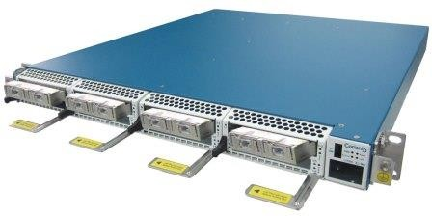
DCI Procurement
GÉANT has chosen the Coriant Groove G30 product.
I RU stackable
4 sleds, each up to 4 x 100G
Optics are based on Acacia CFP2 ACO
  200G up to 1000km with 16 QAM modulation
  150G up to 2000km with 8 QAM modulation
  100G up to 5000km with DP-QPSK
Client side is QSFP28
Next generation to support AC1200 with 600Gbps using 64QAM

Slide 22
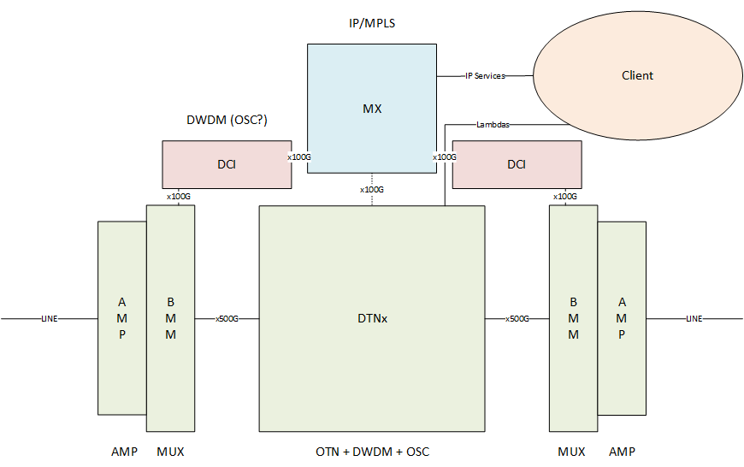
GÉANT Transmission Short Term Solution
Use DCI to provision bandwidth for high capacity IP/MPLS trunks
DCIs are up to 6x cheaper than carrier grade transmission
Keep OTN layer for link management and lambda provisioning greatly simplifying DCI role and minimising risk
Integration of DCI allows for growth offset and generate enough spares

Slide 23
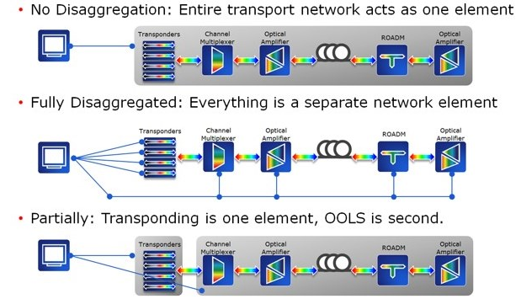
Medium Term solution – Open Line System
Current closed interop model
Long-term vision. But open standards and management under development
Medium term solution. Open access, single management plane for OLS

Slide 24
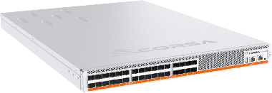
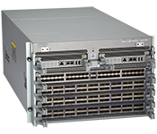
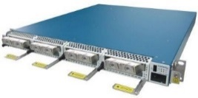


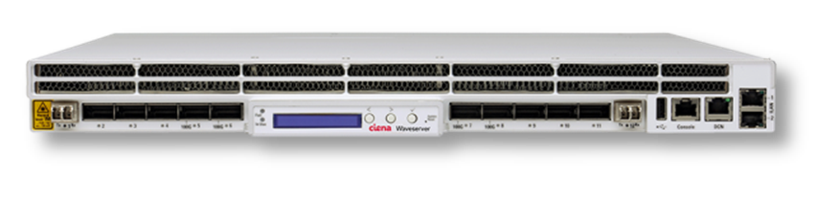
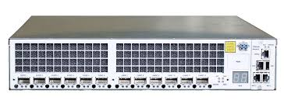
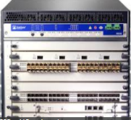
Open Line System
Technology is moving faster in the packet and transponders than the amplifiers and WSS.
Alien waves allow transponders from multiple vendors to operate on a single line system.
Still benefit from a single vendor providing end-to-end optical management: Channel & span equalization, DCN connectivity (OSC), ALS, Alarm reporting etc.
ROADM
ILA
ILA
ROADM
Open Line System

Slide 25
GÉANT Packet Layer Evolution
Current cost per bit paid on IP/MPLS is based on the requirements of the most complex service/s but flow requirement are very diverse
GÉANT investigating three options for replacement of current GÉANT packet platform
  Deploy high-density line cards in existing platform to support the traffic growth
  Find an alternative and cost-effective solution to replace existing platform with another vendor equipment or smaller platform e.g. MX204s
  Disaggregated solution - White box and third party NOS

Slide 26
Disaggregation Increases Options

Slide 27
Disaggregation Increases Options
Increase the options for connectivity between clients and network allows for new services and better mapping of services requirements to technology and cost

Slide 28
Managing a disaggregated network?
Disaggregation and modularisation of infrastructure will results in the use of specialised equipment from different vendors each having is own management system.
Aggregation of information and orchestration will have to be provided by upper software layer.

Slide 29


Thank you
Any questions?
www.geant.org
© GEANT Limited on behalf of the GN4 Phase 2 project (GN4-2).
The research leading to these results has received funding from
the European Union’s Horizon 2020 research and innovation programme under Grant Agreement No. 731122 (GN4-2).

Slide 30
IRU – SGA – The Opportunity
  Go beyond the state-of-the-art by restructuring the backbone network through exploration and procurement of long-term IRUs and associated equipment to increase the footprint, stimulating the market in cross-border communications infrastructure whilst decreasing the digital divide and reducing costs
From EC objectives for IRU SGA

Slide 31
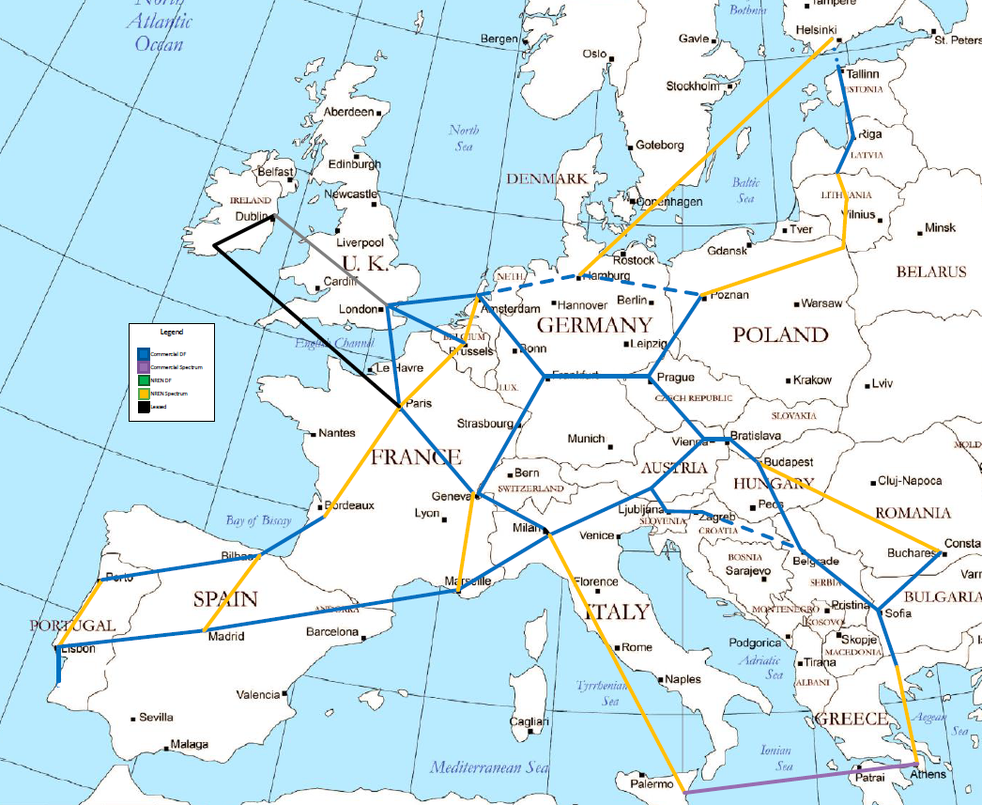
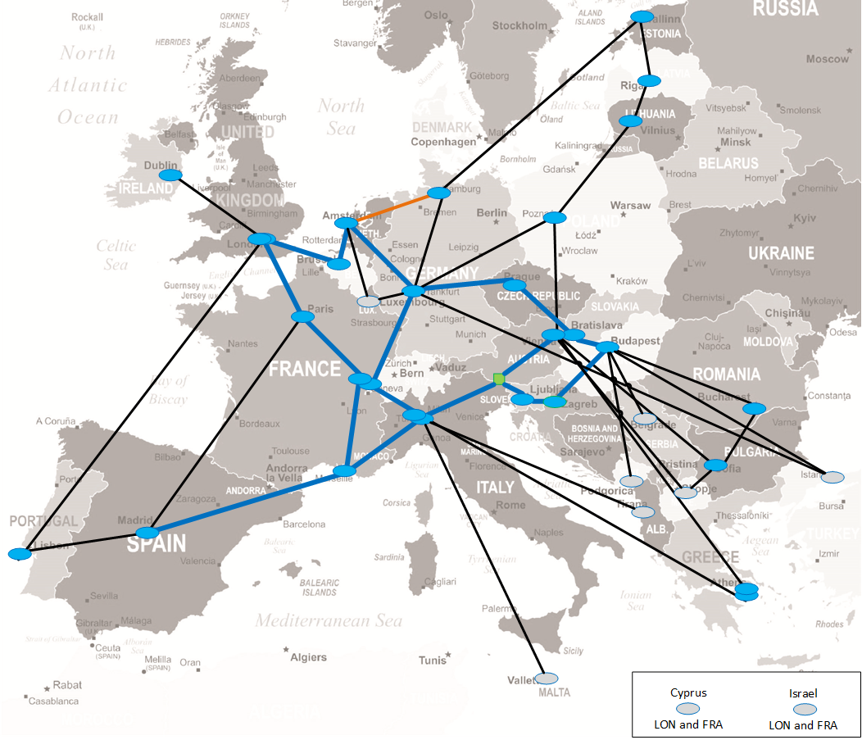
GÉANT Network
Reduction of ~35% on OPEX of directly involved items vs 2018
Dark fibre core
Leased capacity regions
Hub and Spoke
Short procurement cycles
Short term requirements
Cost impact
Black – Leased Capacity
Blue – Dark Fibre
Orange - Spectrum
Yellow = NRENs
Blue = Commercial DF
Other colors = lease

