Slide 1



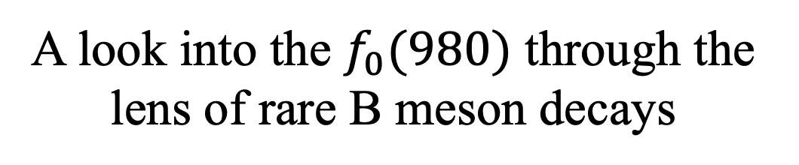
A look into the $f_{0}(980)$ through the lens of rare B meson decays
Written by Jaime del Palacio Lirola
Prof. Dr. Robert Fleischer, Dr. Keri Vos and MSc. Anders Result

Slide 2
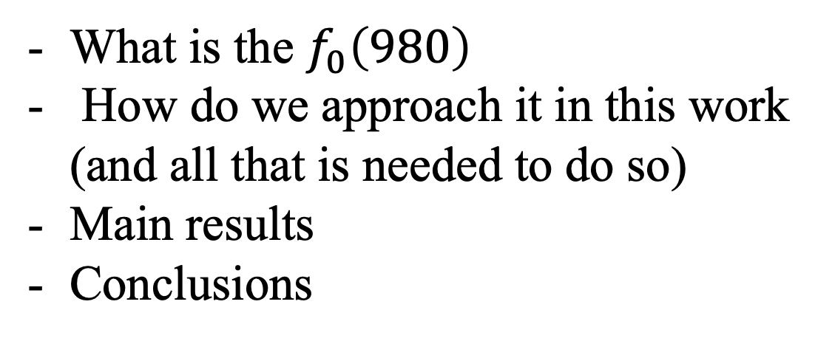
Overview
What is the $f_{0}\left(980\right)$
How do we approach it in this work (and all that is needed to do so)
Main results
Conclusions

Slide 3
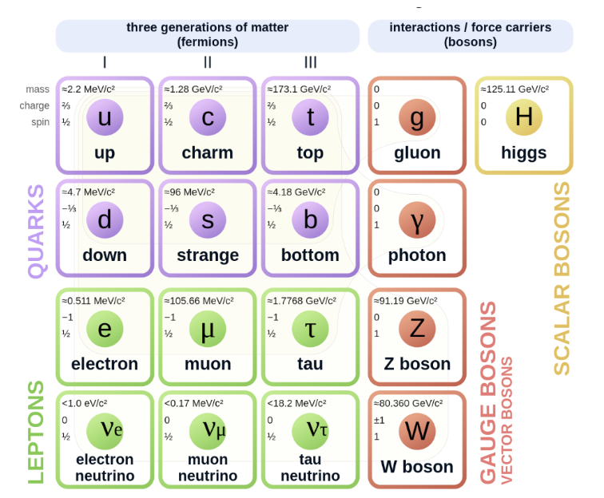
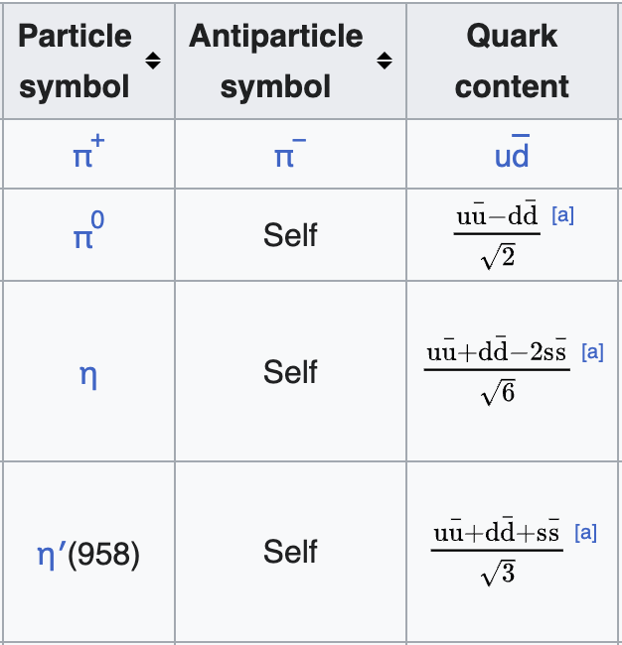
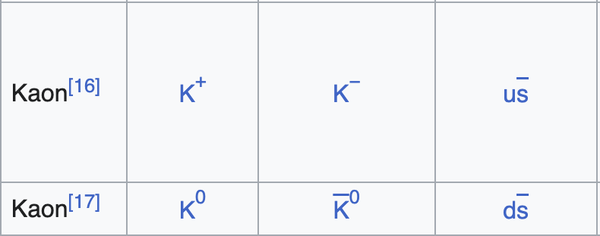
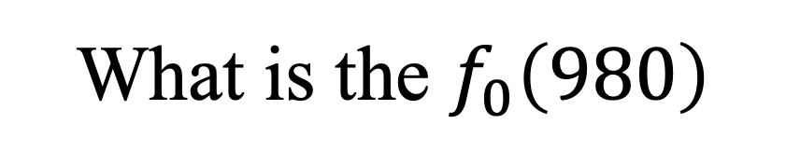
What is the $f_{0}\left(980\right)$
Quark model
Light ground-state pseudoscalars

Slide 4
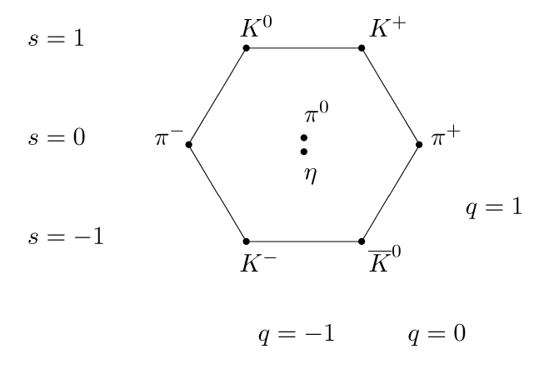

What is the $f_{0}\left(980\right)$
$SU{\left(3\right)}_{f}$ multiplet
Particle zoo in the 60’s
We solved it! The 8-fold way and the quark model
Except…
Notes:
I am going to tell you a bit of a story…

Slide 5
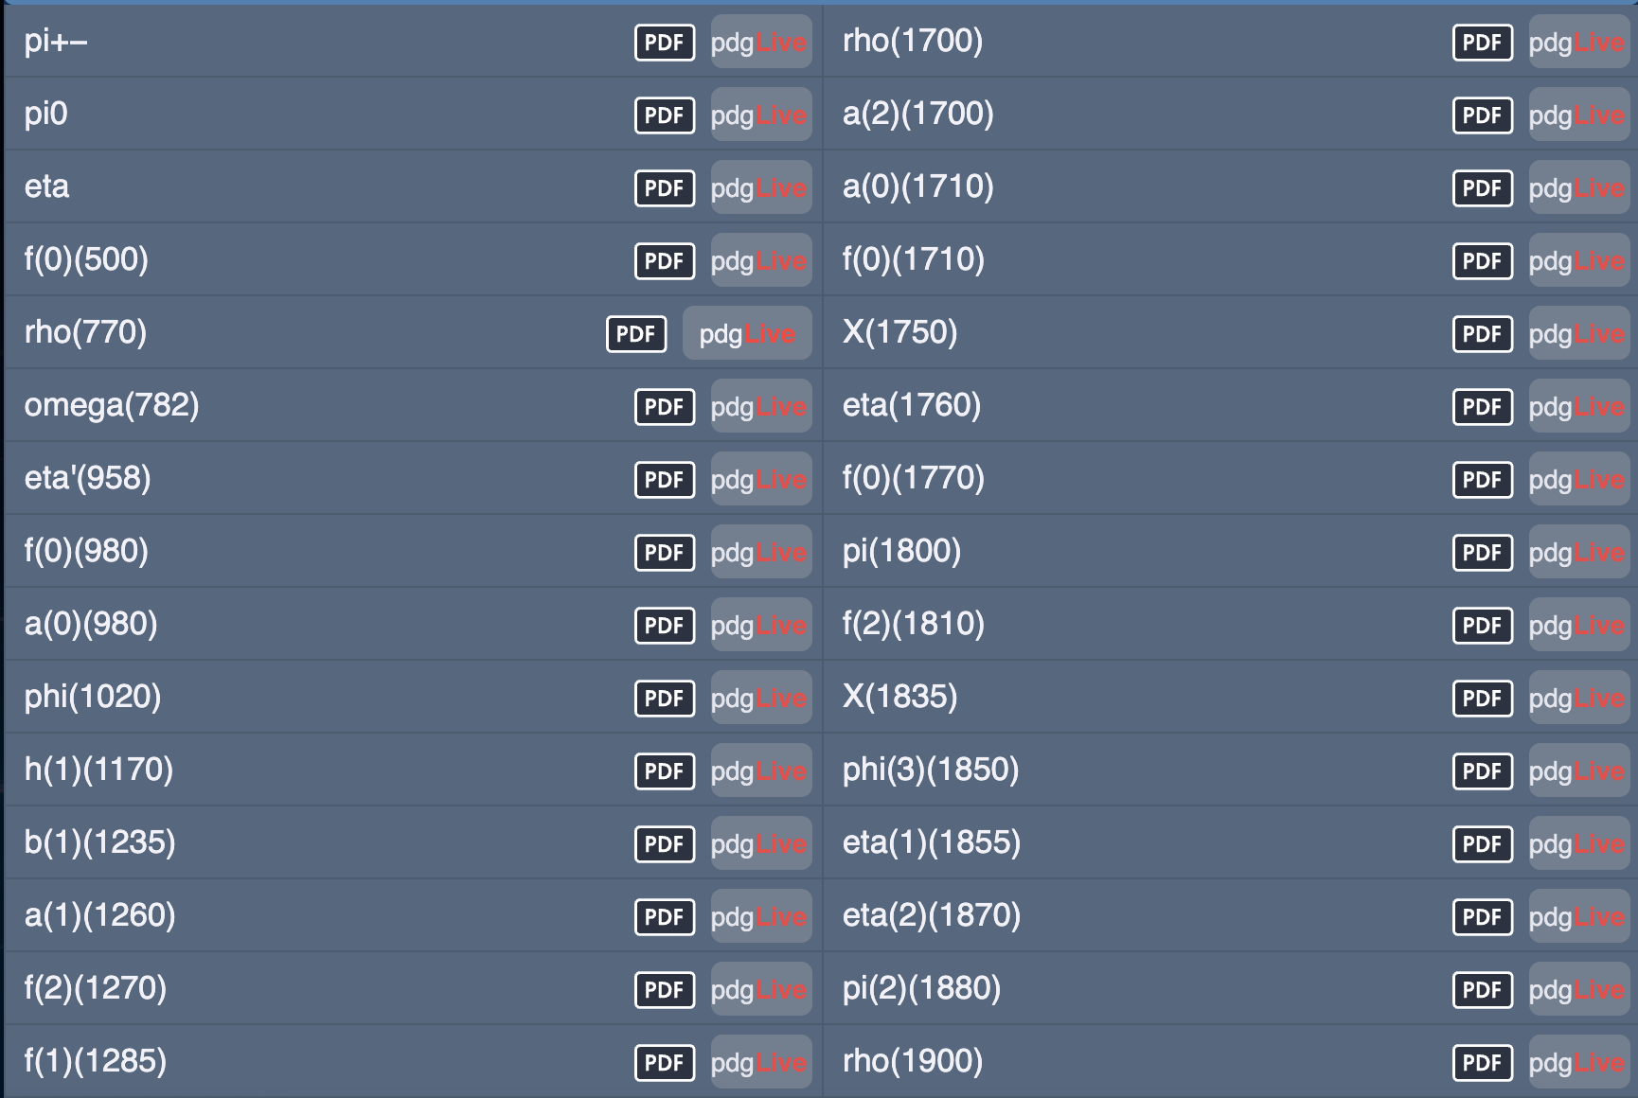

Slide 6
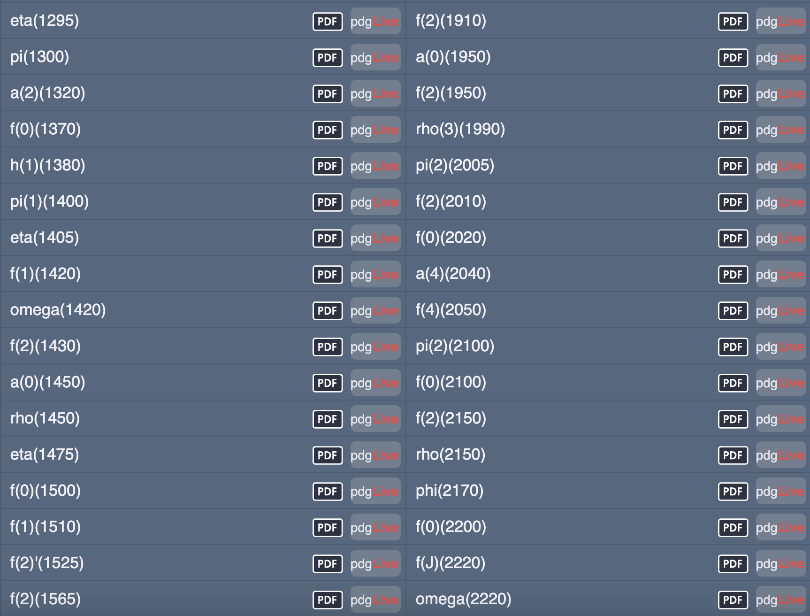
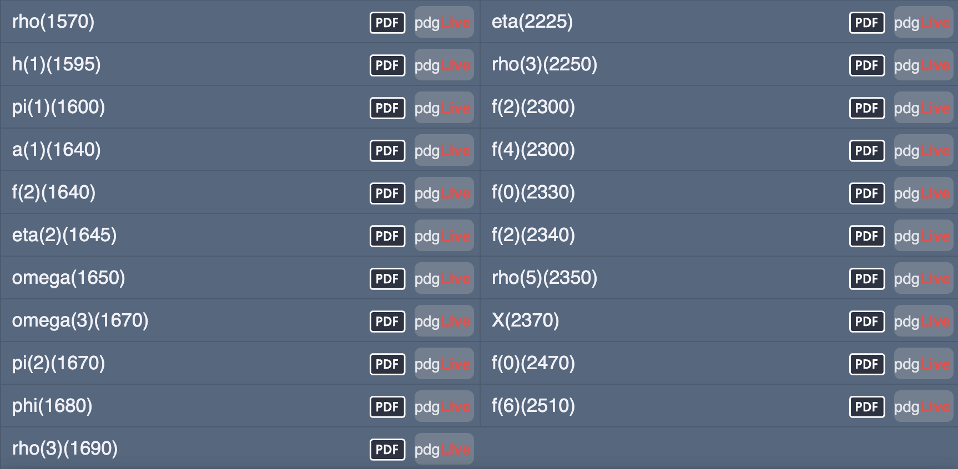

Slide 7
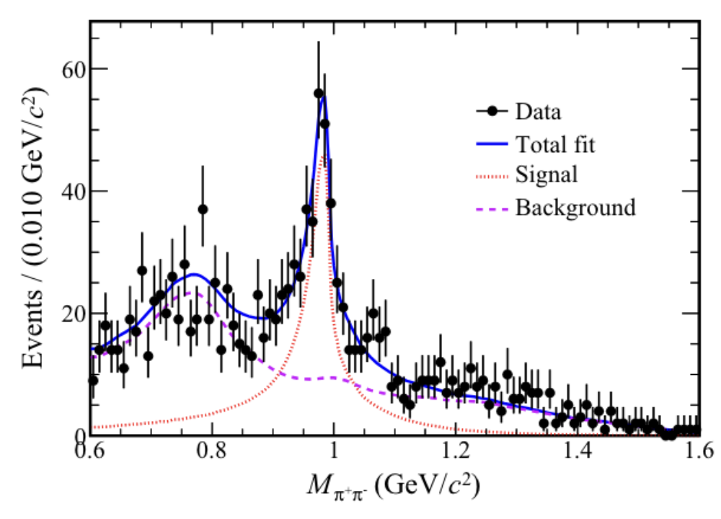
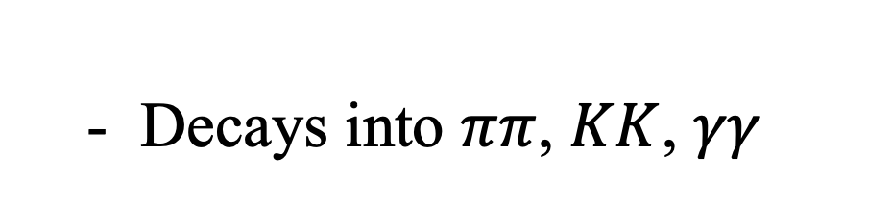

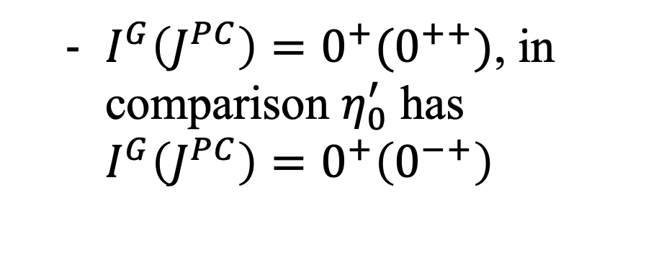
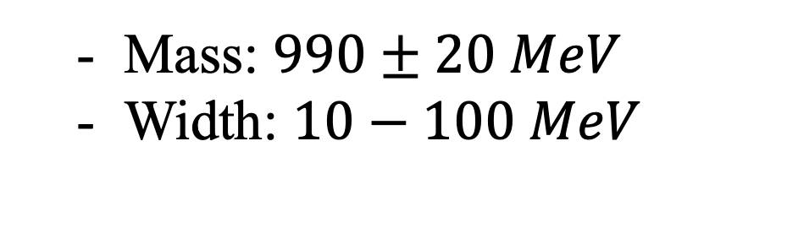
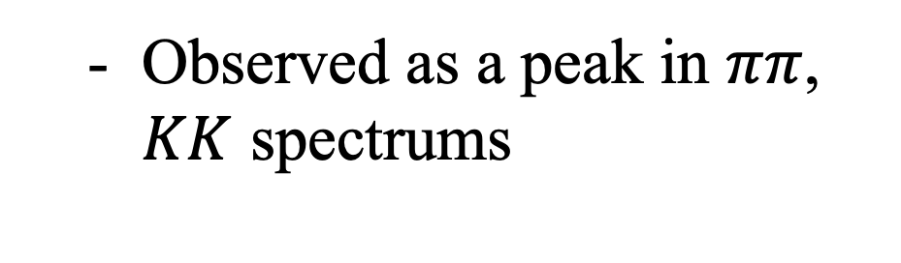

What is the $f_{0}\left(980\right)$
What do we know:
  Observed as a peak in $ππ$, $KK$ spectrums
  Mass: $990±20 MeV$
  Width: $10−100 MeV$
  Decays into $ππ$, $KK$, $γγ$
  $I^{G}\left(J^{PC}\right)=0^{+}(0^{++})$, in comparison $η_{0}^{′}$ has $I^{G}\left(J^{PC}\right)=0^{+}\left(0^{−+}\right)$
  Has a strong $s\overline{s}$ component (but there is something else)
arXiv:2303.12927v1

Slide 8
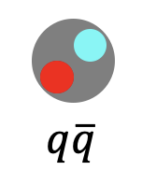
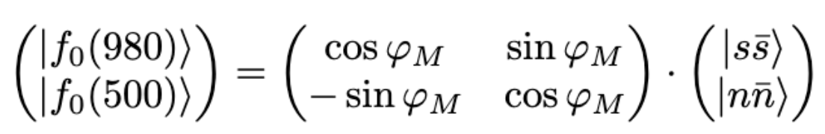



What is the $f_{0}\left(980\right)$
  What if it’s a $q\overline{q}$state?
    Put it in a scalar octet with other measured states
    L=1, S=1, J=0
    Pure state? Does not seem so
$$(1)$$
    but it is not very promising (experimentally)…

Slide 9

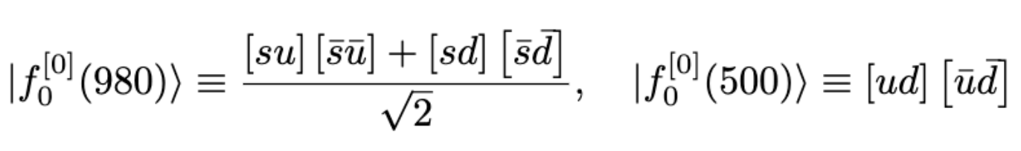
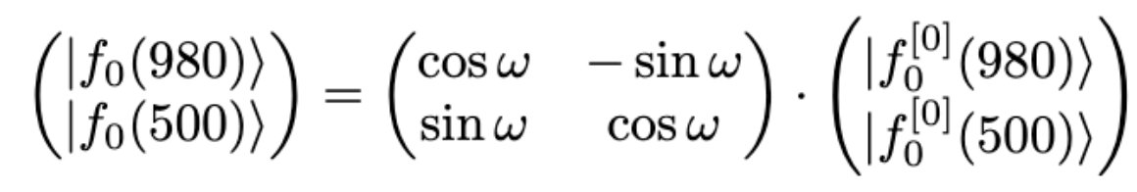


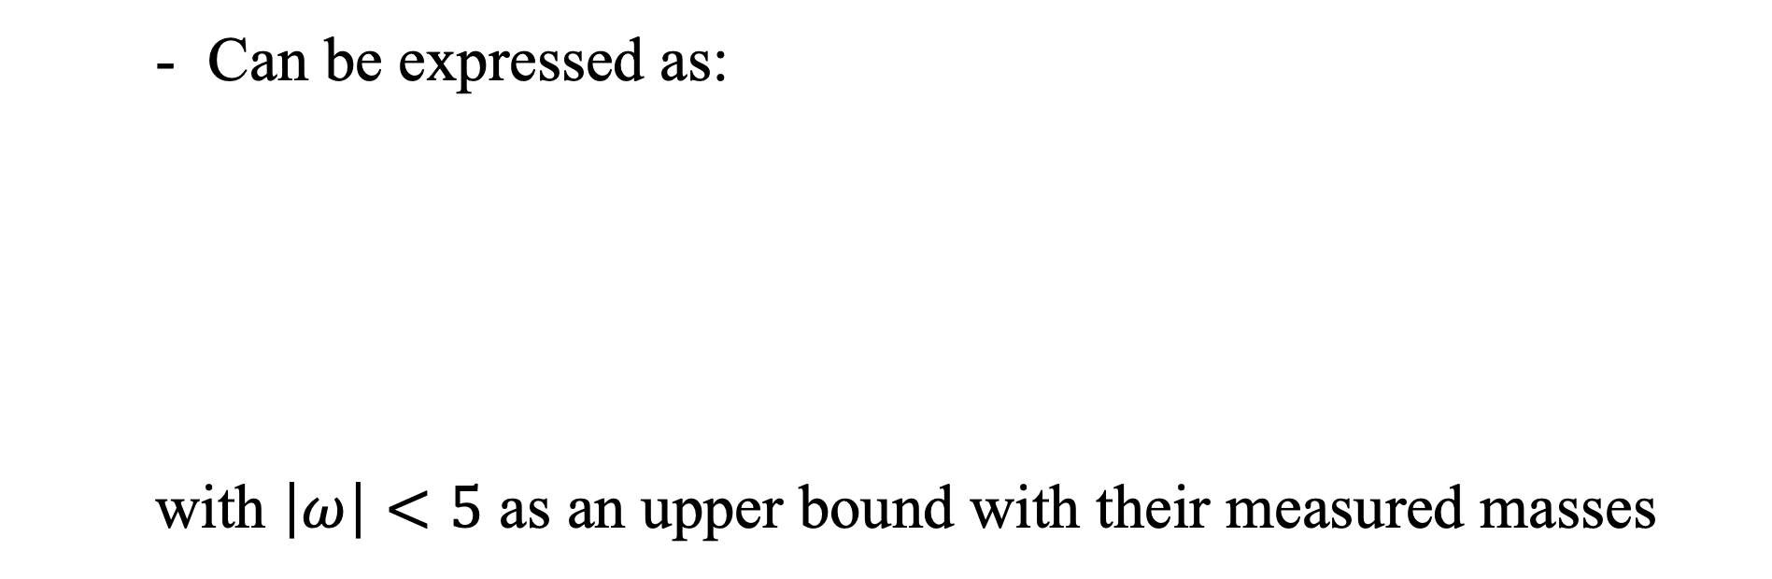
What is the $f_{0}\left(980\right)$
  What if it’s a $q\overline{q}q\overline{q}$ state?
    Put in a scalar tetraquark octet
    Does not require non-vanishing angular momentum
    Describes the mass spectrum hierarchy
    Can be expressed as:
    with $\left|ω\right|<5$ as an upper bound with their measured masses
$$(2)$$

Slide 10

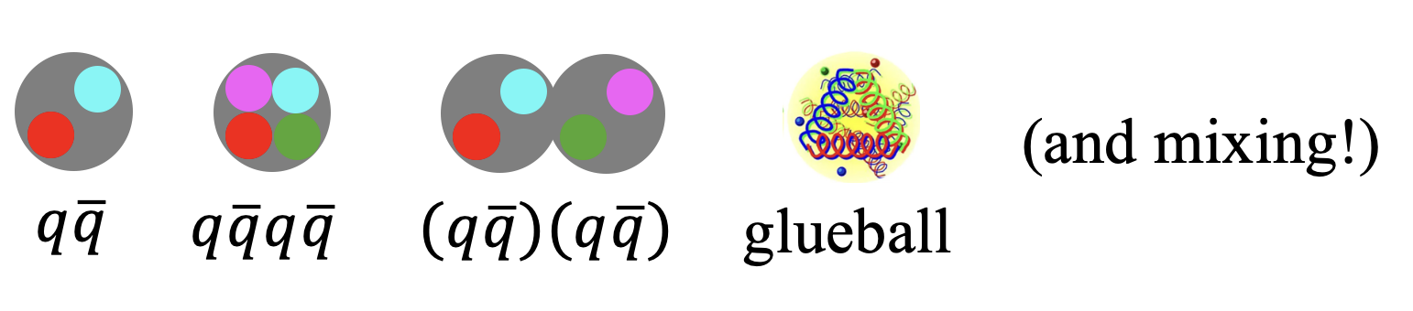
What is the $f_{0}\left(980\right)$
  What if it’s a combinations of both?
    It is dominated by the tetraquark component
    Describes the mass spectrum satisfactorily (has more degrees of freedom)
  KK molecule has also been proposed
  Could also add a scalar glueball component…

Slide 11
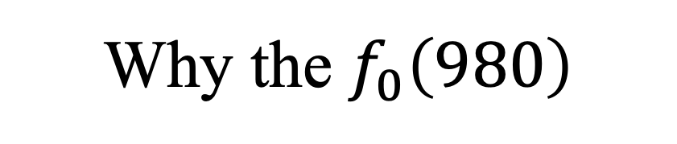
Why the $f_{0}\left(980\right)$
  It is one of the lighter scalar particles
  It is common
  It is a strong candidate for an exotic quark state
  Exploring the nature of these exotic bound states could enhance our understanding of QCD

Slide 12
Overview
What is the $f_{0}\left(980\right)$
How do we approach it in this work (and all that is needed to do so)
Main results
Conclusions
We are here!

Slide 13
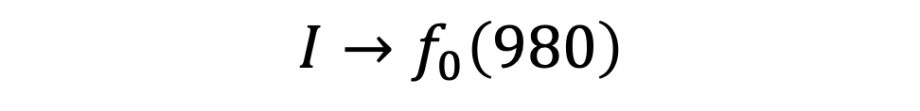
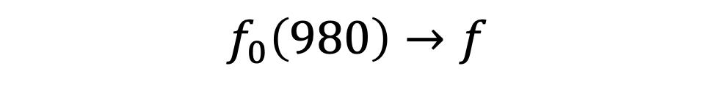
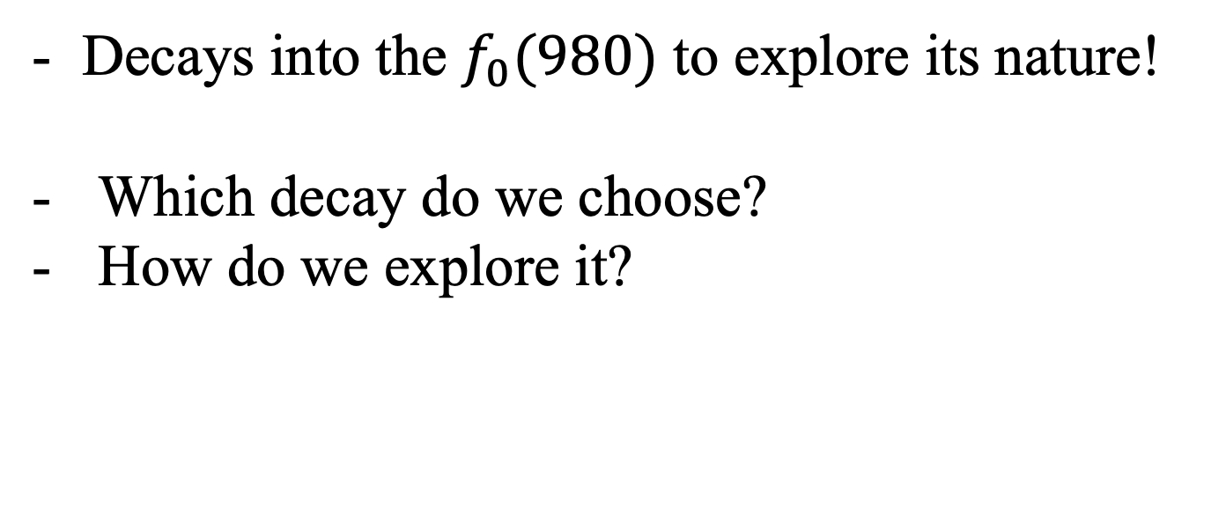
How do we approach it in this work?
$$f_{0}\left(980\right)→f$$
$$I→f_{0}\left(980\right)$$
or
Decays into the $f_{0}(980)$ to explore its nature!
Which decay do we choose?
How do we explore it?

Slide 14
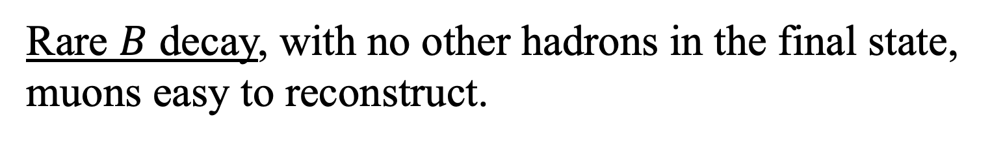
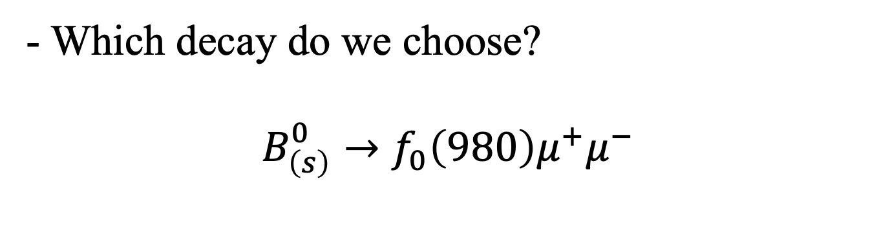
How do we approach it in this work?
- Which decay do we choose?
$$B_{\left(s\right)}^{0}→f_{0}\left(980\right)μ^{+}μ^{−}$$
Rare $B$ decay, with no other hadrons in the final state, muons easy to reconstruct.

Slide 15
How do we approach it in this work?
- How do we explore it?
See how observables are influenced by the form factors.
Show how feasible it is to extract the form factors from data.

Slide 16
Overview
What is the $f_{0}\left(980\right)$
How do we approach it in this work (and all that is needed to do so)
Main results
Conclusions
We are here!

Slide 17
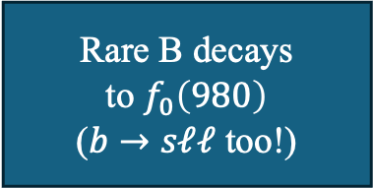
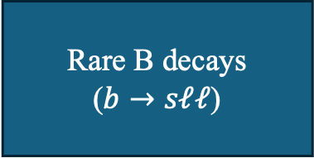
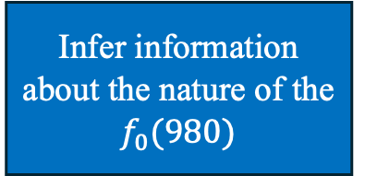
Flowchart of our approach
Rare B decays
($b→sℓℓ$)
Using WET
Extract WCs
from data
(can include NP!)
Usual approach:
Rare B decays
to $f_{0}\left(980\right)$
($b→sℓℓ$ too!)
Using WET + WCs from other B decays
Extract form factors from data
Our approach:
Infer information about the nature of the $f_{0}(980)$

Slide 18
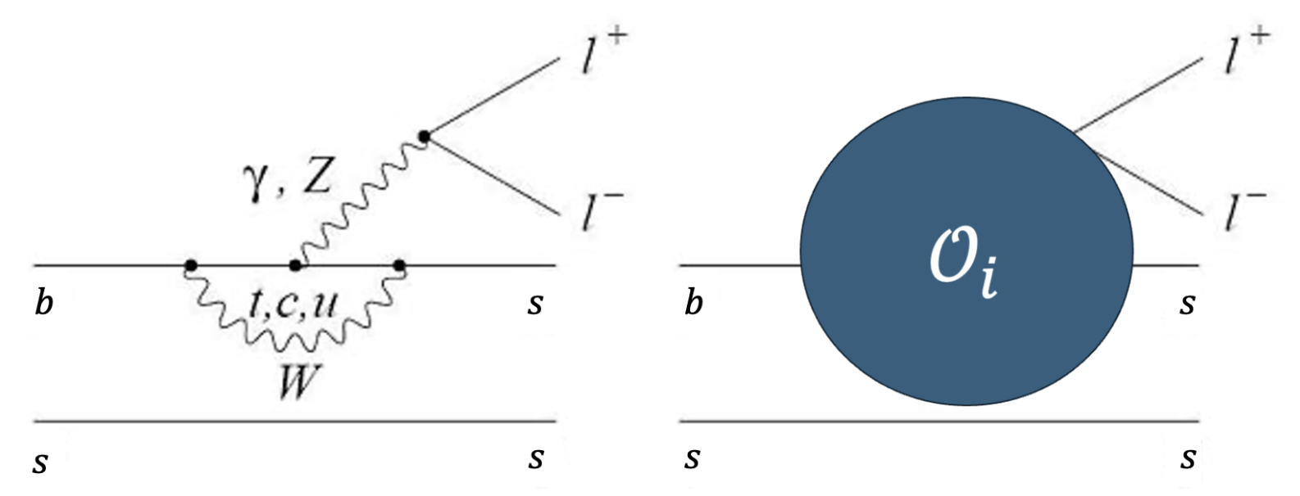
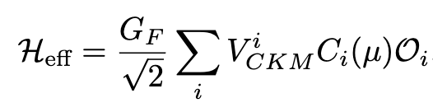

All we need to explore the selected decay
Weak Effective Field Theory
$$(4)$$
We will use the Wilson coefficients determined from the SM and from data on other decays with the same quark level transition.

Slide 19
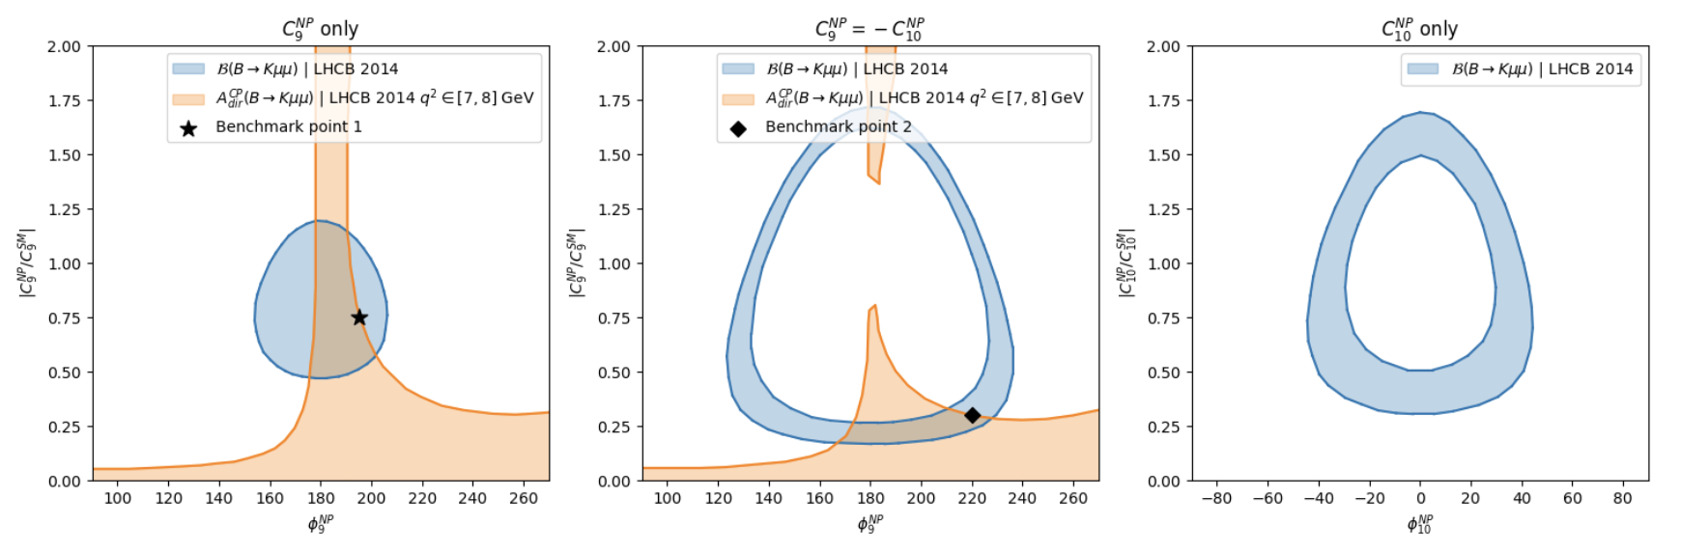


All we need to explore the selected decay
Current state of Wilson Coefficients
  Come from data on other decays
$$(5)$$
Have possible weak phases!

Slide 20

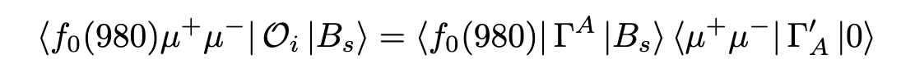
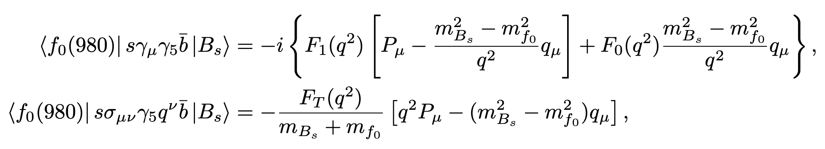

All we need to explore the selected decay
Form factors calculations
$$(3)$$
these are the form factors!

Slide 21
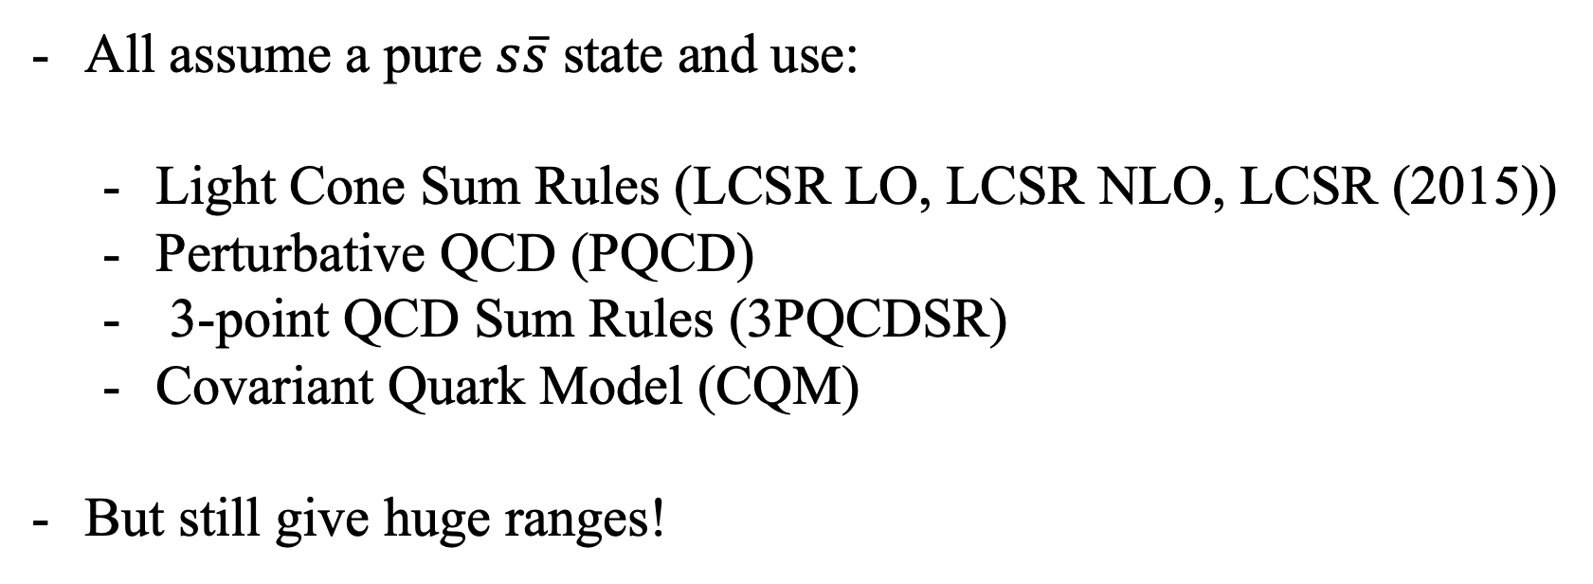
All we need to explore the selected decay
Form factors calculations
All assume a pure $s\overline{s}$ state and use:
  Light Cone Sum Rules (LCSR LO, LCSR NLO, LCSR (2015))
  Perturbative QCD (PQCD)
  3-point QCD Sum Rules (3PQCDSR)
  Covariant Quark Model (CQM)
But still give huge ranges!
Notes:
But no lattice QCD!

Slide 22
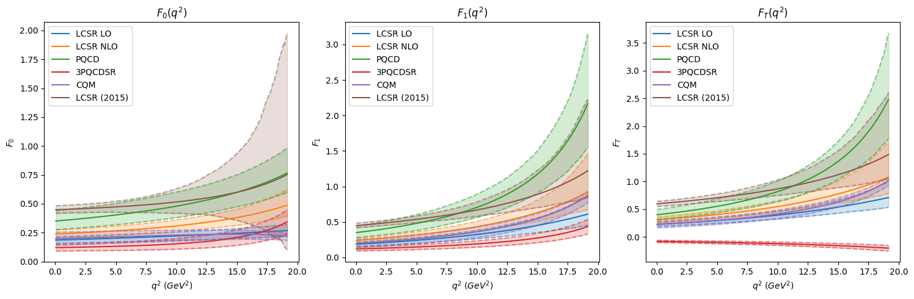
All we need to explore the selected decay
Form factors calculations

Slide 23
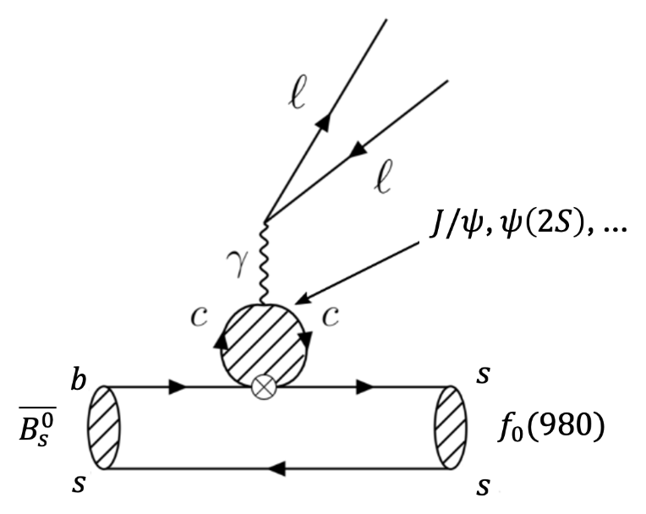


All we need to explore the selected decay
Long-distance effects
$$(6)$$

Slide 24
Overview
What is the $f_{0}\left(980\right)$
How do we approach it in this work (and all that is needed to do so)
Main results
Conclusions
We are finally here!

Slide 25
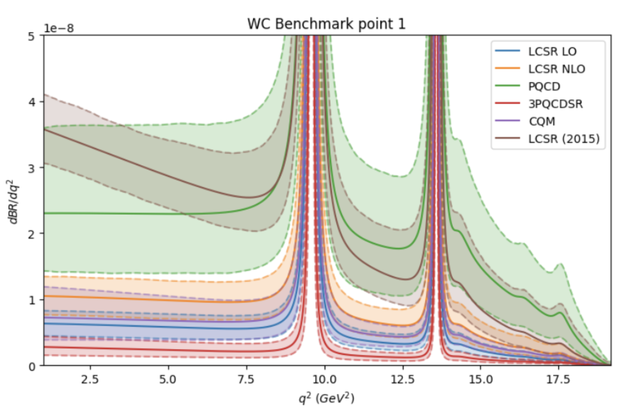

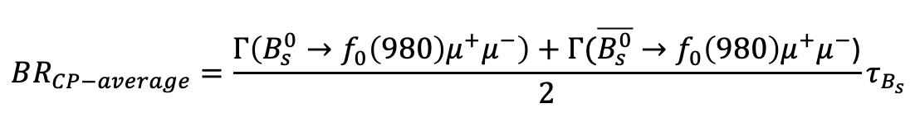
Main Results
$$BR_{CP−average}=\frac{Γ\left(B_{s}^{0}→f_{0}\left(980\right)μ^{+}μ^{−}\right)+Γ(\overline{B_{s}^{0}}→f_{0}\left(980\right)μ^{+}μ^{−}\text{)}}{2}τ_{B_{s}}$$
$$(7)$$
Notes:
Comment on the resonances

Slide 26
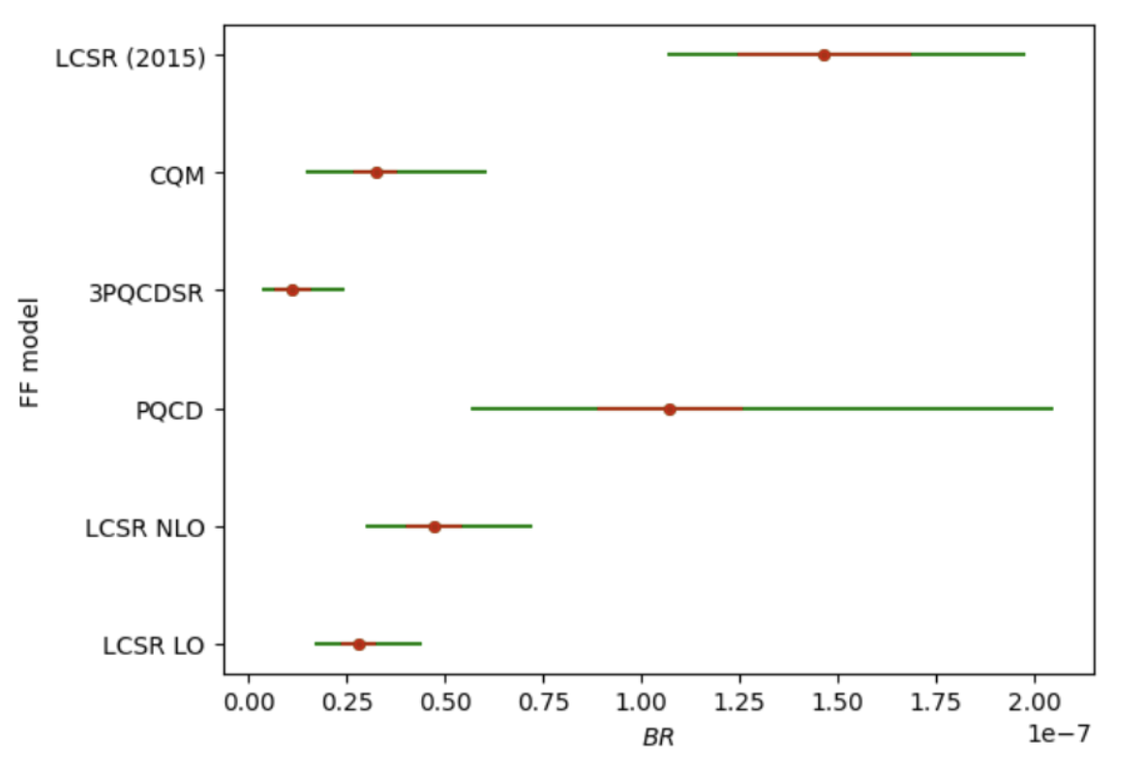

Main Results
$$BR_{CP−average}=\frac{Γ\left(B_{s}^{0}→f_{0}\left(980\right)μ^{+}μ^{−}\right)+Γ(\overline{B_{s}^{0}}→f_{0}\left(980\right)μ^{+}μ^{−}\text{)}}{2}τ_{B_{s}}$$
$$(7)$$
$$q^{2}∈[1,6]$$

Slide 27
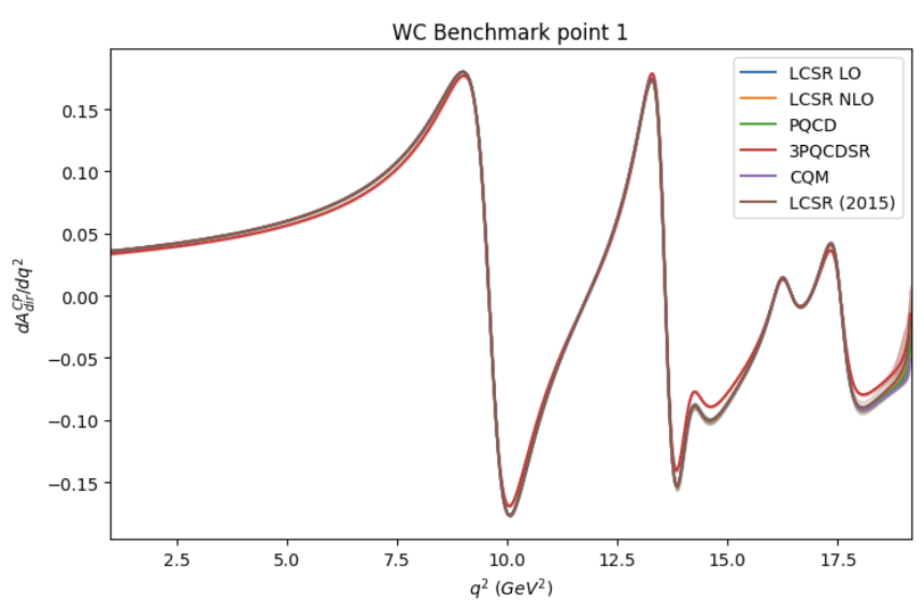
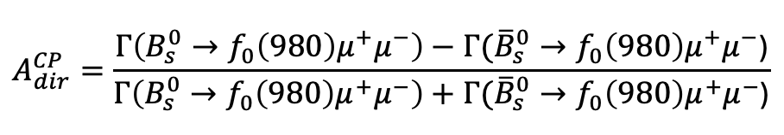
Main Results
$$A_{dir}^{CP}=\frac{Γ\left(B_{s}^{0}→f_{0}\left(980\right)μ^{+}μ^{−}\right)−Γ({\overline{B}}_{s}^{0}→f_{0}\left(980\right)μ^{+}μ^{−}\text{)}}{Γ\left(B_{s}^{0}→f_{0}\left(980\right)μ^{+}μ^{−}\right)+Γ({\overline{B}}_{s}^{0}→f_{0}\left(980\right)μ^{+}μ^{−}\text{)}}$$
Direct CP-violation
Sturdy!

Slide 28
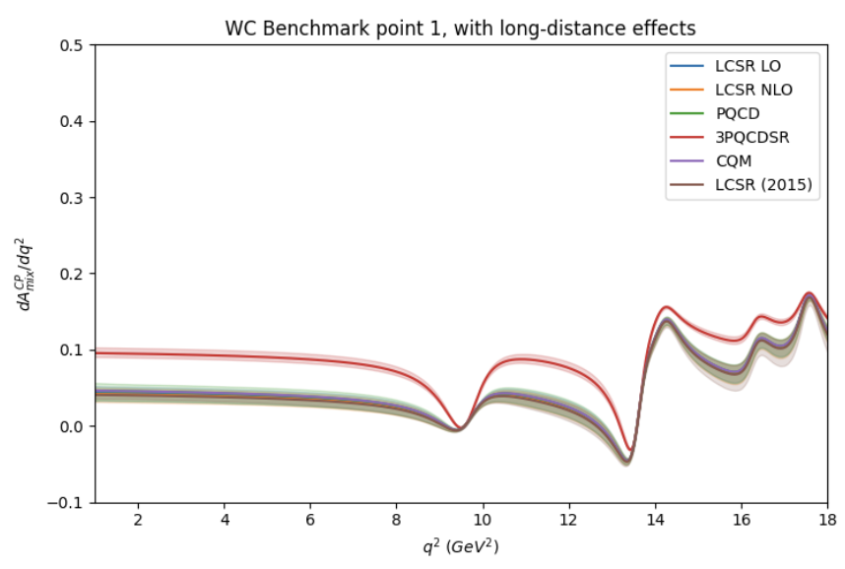
Main Results
Mixing induced CP-violation
Almost sturdy!

Slide 29
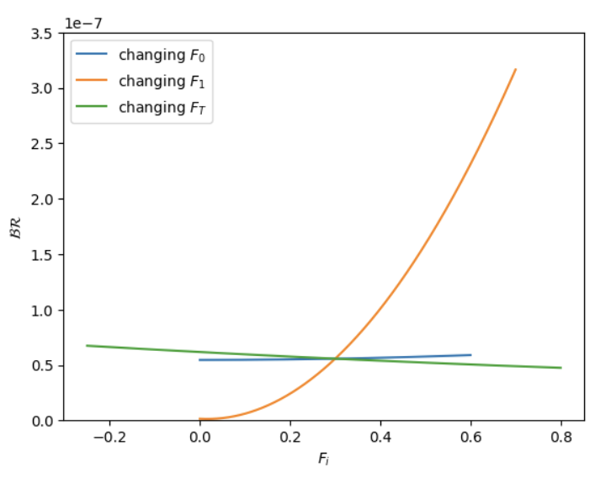
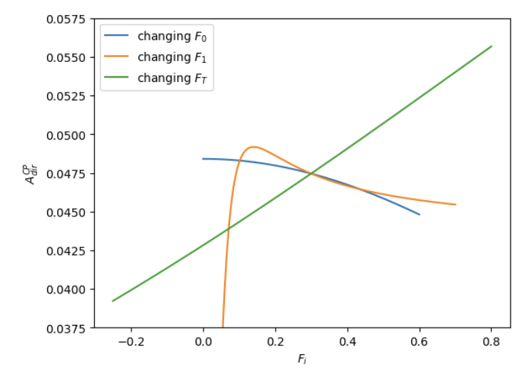
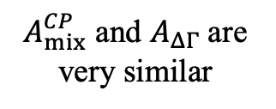
Main Results
Observables vs form factors
Observables integrated in $q^{2}∈\left[1,6\right]GeV^{2}$, and considering $F_{i}\left(q^{2}\right)=F_{i}$ in said range
$A_{mix}^{CP}$ and $A_{ΔΓ}$are very similar
Experimentally viable!
Not able to discern experimentally… (for now)

Slide 30
All needed to explored the selected decay
Form factors calculations

Slide 31
Main Results
Observables vs form factors
$A_{mix}^{CP}$ and $A_{ΔΓ}$are very similar
Experimentally viable!
Not able to discern experimentally… (for now)

Slide 32
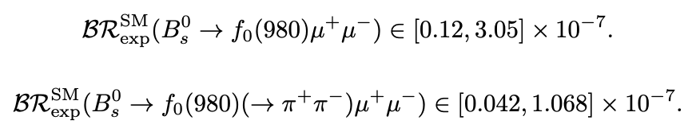
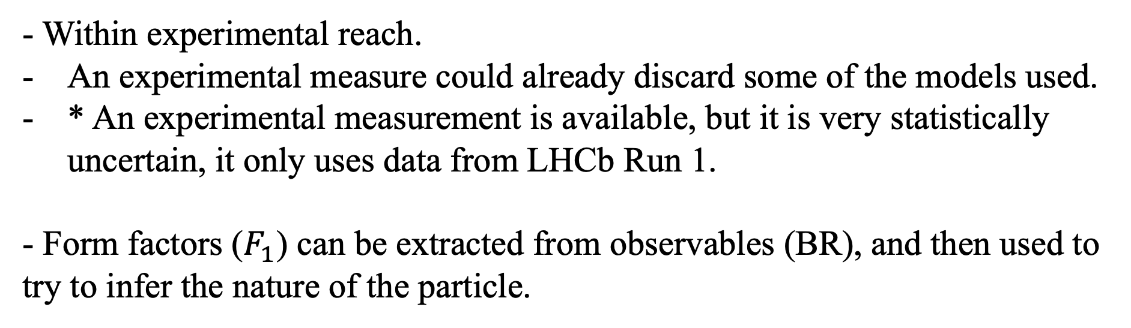
Conclusions
- Within experimental reach.
An experimental measure could already discard some of the models used.
* An experimental measurement is available, but it is very statistically uncertain, it only uses data from LHCb Run 1.
- Form factors ($F_{1}$) can be extracted from observables (BR), and then used to try to infer the nature of the particle.

Slide 33
Thank you!

Slide 34
Extra slides

Slide 35


Slide 36



Slide 37



Slide 38

Main Results

Slide 39
Main Results

Slide 40

Main Results

Slide 41



All we need to explore the selected decay
CKM matrix and flavour changing currents
$$(3)$$
Needed for the observables we explore,
give CP-violating phases in the SM

Slide 42




All we need to explore the selected decay
Direct CP-violation
$$(4)$$

Slide 43


All we need to explore the selected decay
Mixing induced CP-violation
Two different amplitudes that can produce CP-violation!

Slide 44


Main Results

Slide 45


PQDC approach

