Slide 1

EGI Federation
USN KoM
Sept. 10, 2024
giuseppe.larocca@egi.eu

Slide 2

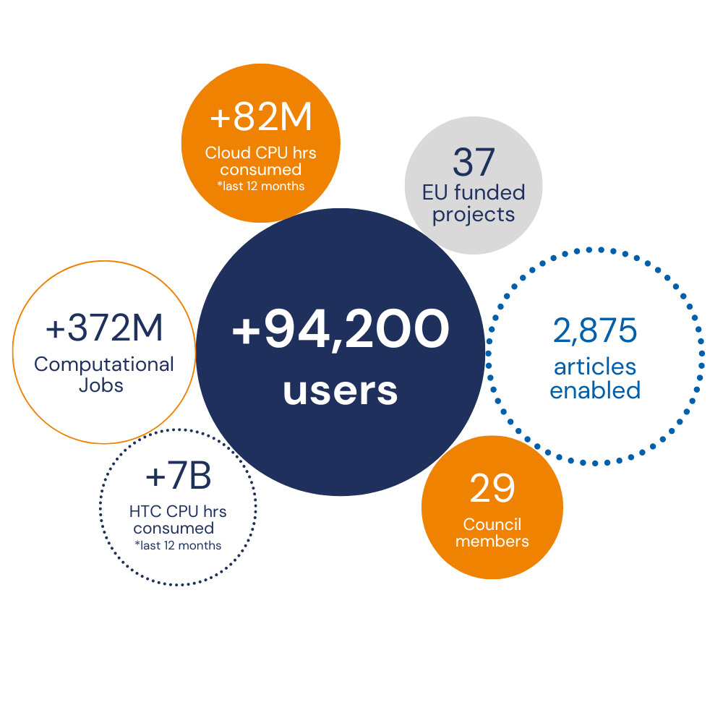
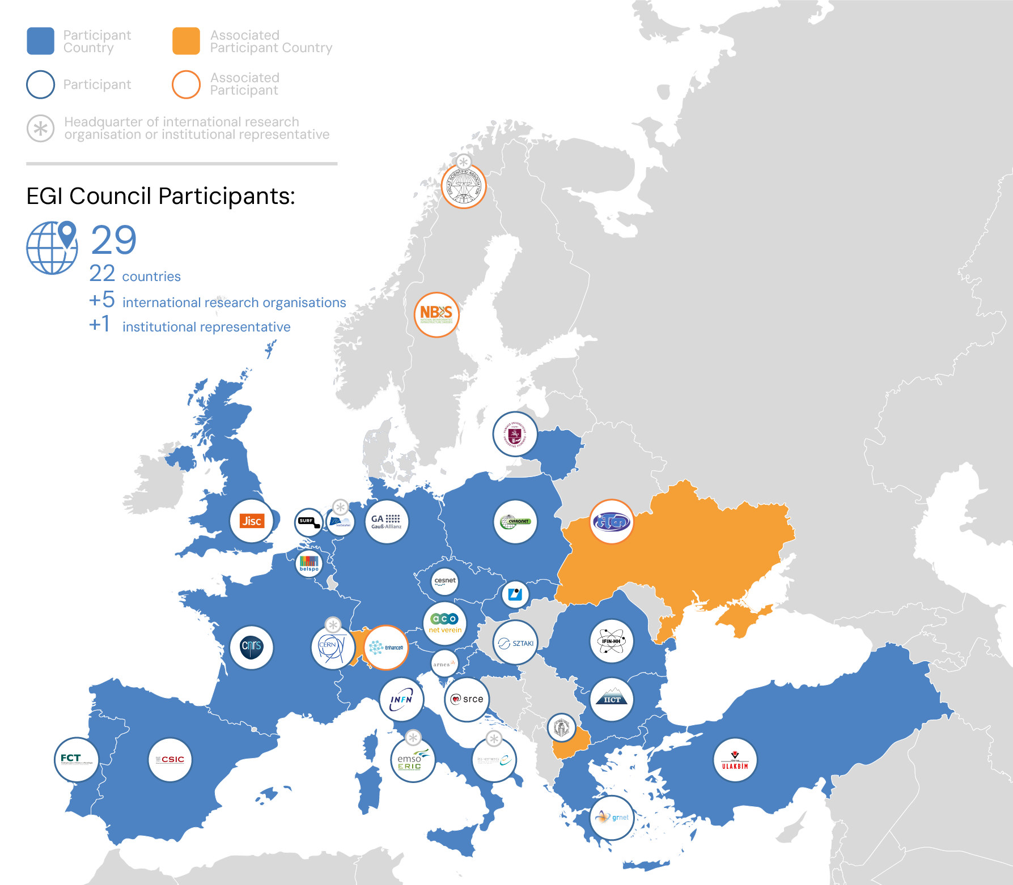
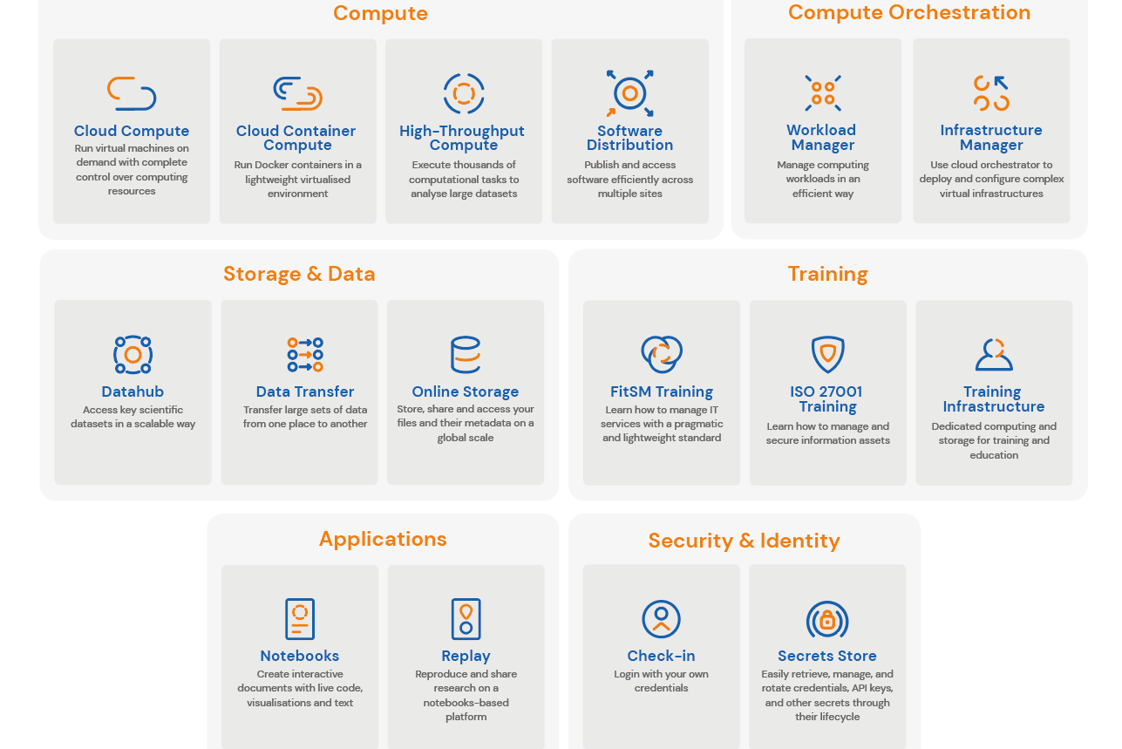
EGI Federation
www.egi.eu
EGI in numbers ⁽¹⁾
EGI Services
EGI delivers advanced computing services to support scientists, international projects, research infrastructures and businesses.
EGI Federation
A European flagship digital infrastructure for data-intensive scientific computing
EGI services for research
Why a federation?
Support science at international scale
Build an hyperscale facility for research
Invest nationally, access globally
Bring computing to the data
(1) 1 the key numbers are correct as of April 2024.

Slide 3
What is your field and your activity as user support team
General Support:
  Distributed computing,
  Scalable analysis of scientific data,
  Identity and Access Management in distributed environments,
  Help organisations to acquire the expertise and skills to improve IT Service Management and enhance the service delivery.
Open Science:
  Data federation - Making distributed data FAIR
  Digital scientific reproducibility

Slide 4
Expectations, offer and members
Expectations:
  Contribute to the User Support Network by sharing know-how, best practices and solutions to support reproducibility and Open Science in EGI and EOSC.
Offer:
  EGI compute, storage and data federation services
  EGI Notebooks/Replay services for reproducible workflows
Network members:
  Giuseppe La Rocca (giuseppe.larocca@egi.eu) acting as a proxy towards the EGI User Support Network

