Slide 1
INFN team: open science and data stewards
USN KoM
Online – September 10^{th,} 2024
francesca.marchegiani@lngs.infn.it

Slide 2
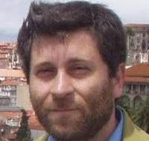
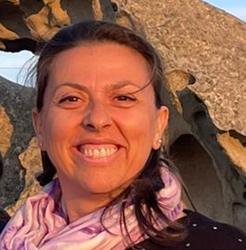
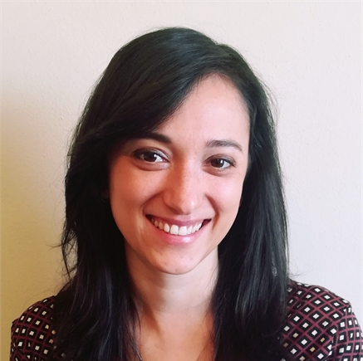
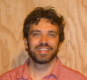
INFN team: open science and data stewards …meet the team…
Stefano Dal Pra
Senior technologist @ INFN-CNAF
Master degree in Electronic Engineering
Francesca Marchegiani
Technologist @ INFN-LNGS
Master degree in Chemistry
Irene Piergentili
Fellowship for technological research @INFN-LNF
Master degree in Archive and Library theory and management
Lorenzo Rinaldi
Associate Professor @ UNIBO Department of Physics and Astronomy and “Incarico di Ricerca Scientifica” @ INFN
PhD in Physics

Slide 3
INFN team: open science and data stewards …field and activities as user support team …
Stefano Dal Pra
More than two decades of experience in Grid computing centers, storage, and batch systems
Computing infrastructure for Machine Learning / Deep Learning
Computing models design for the VIRGO experiment and IGWN community
Long Term Data Storage
Lorenzo Rinaldi
Research activities on the Software and Computing for the ATLAS physics experiment
Director of First Cycle Degree in Physics and Open Science coordinator @ UNIBO Dept of Physics and Astronomy
Francesca Marchegiani
Over a decade of experience in analytical chemistry: method development and validation specialist, technical expert for both chemistry laboratory and quality assurance implementation
From 2023 @INFN-LNGS Computing and Networking service in the framework of LNGS-FUTURE NPRR project – “Data and digital infrastructure”:
Development of a pilot platform for research data management according to FAIR principles based on InvenioRDM open-source software
DMP or technical documents drafting
Research data stewardship and support to researchers in the framework of Open Science and FAIR data management practices implementation
Irene Piergentili
Nearly 10 years of experience in the library field, mainly in cataloging and user services
Management and editing of open access digital archives for research contents in the framework of IBISCO infrastructure (metadata definition and validation)
INFN institutional Open Access Repository management @INFN-LNF as well as development of communication and training strategies for users

Slide 4
INFN team: open science and data stewards What are your expectations to the network, what you can offer to the network and network members
Foster a collaborative environment
Holistic perspective
Research outputs management strategies sharing
IT knowledge sharing
Feedback and input
A collaborative environment for sharing know-how, ideas, experiences both positive and negatives, implemented strategies in managing research outputs, database, setting up of a repository based on InvenioRDM according to FAIR principles and Open Science guidelines
Expect and give feedback and input enabling all stakeholders to enhance the workflows finding the solution fitting the purpose
A network consisting of different teams with multi-disciplinary expertise in which to share the consolidated strategies to face new challenges as improving and/or developing processes and workflows, drafting technical documents (e.g. DMPs, quality assurance protocol, risk analysis protocol)

