Slide 1
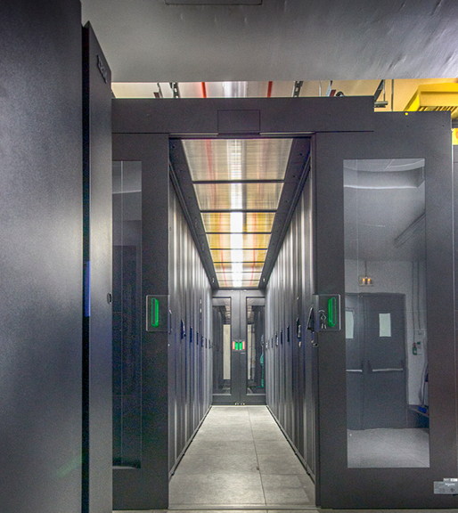
HPC support team in GRNET
Dimitris Dellis, Evangelia Athanasaki

Slide 2
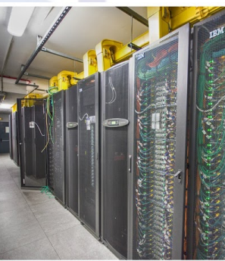
GRNET current HPC infrastructure (ARIS)
Compute Nodes – 533 computational nodes - 535 TFLOPS.
2 PB raw storage – 1.3 PB usable capacity
Available Software modules on:
Life Sciences, Computational Chemistry/Material Science, Weather Forcast, Engineering, Numerical Libraries, Visualisation Software, Machine Learning, Containers, Big Data, etc.
Request for higher number of resources than available.
Expansion of current DC (end 2024) covers only short-term needs.
New HPC system Daedalus (>60PF) expected end 2025.

Slide 3
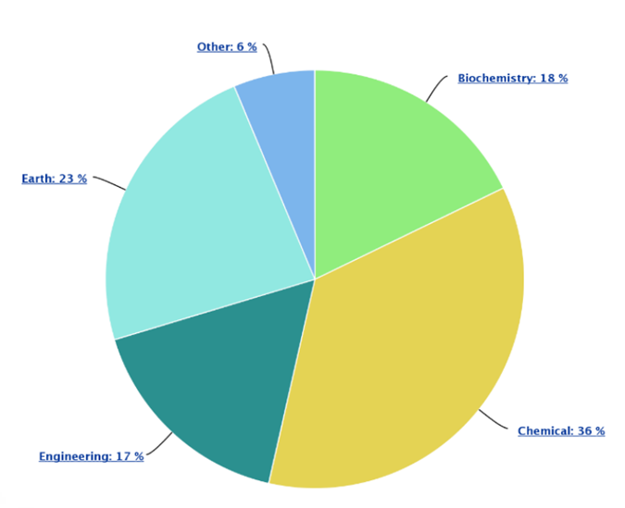
Usage of ARIS
Access to Greek researchers is provided by submitting proposals for research projects:
periodic invitations announced by GRNET (large production projects)
continuous open call for development or preparation projects.
European researchers can gain access to ARIS through various EOSC projects
GRNET user support is usually the motivation for researchers to apply for ARIS thanks to GRNET HPC support team:
~1000 users supported
GRNET operates as EuroCC Training Center.
ARIS documentation: https://doc.aris.grnet.gr/
644 publications acknowledged ARIS usage (since 2015): https://www.hpc.grnet.gr/en/publications/

Slide 4
GRNET HPC support team
Expectations:
Best practices knowledge exchange.
Community building.
Collaboration on projects.
Offer:
Training (HPC/AI).
Technical expertise.

