Slide 2
LHC Computing
Clouds and Agility
GridKa School 2014
KIT
01/09/2014
Tim Bell
@noggin143
tim.bell@cern.ch

Slide 3
About Tim
Runs IT Infrastructure group at CERN
Previously worked at
  Deutsche Bank running European Private Banking Infrastructure
  IBM as a consultant and kernel developer
Member of OpenStack management board

Slide 4

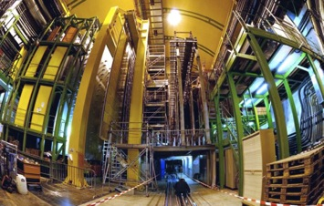
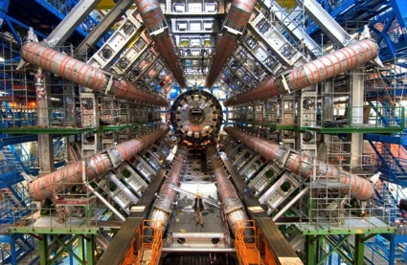
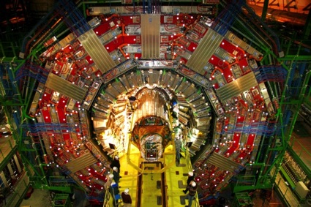
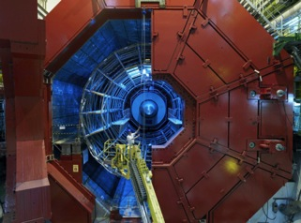
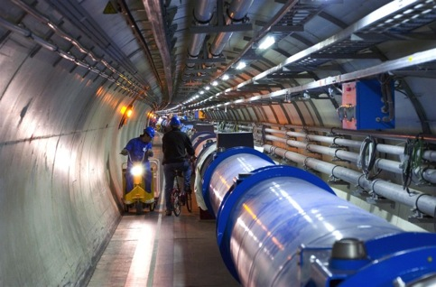

LHCb
CMS
ATLAS
ALICE
LHC ring:
27 km circumference
Notes:
4

Slide 5
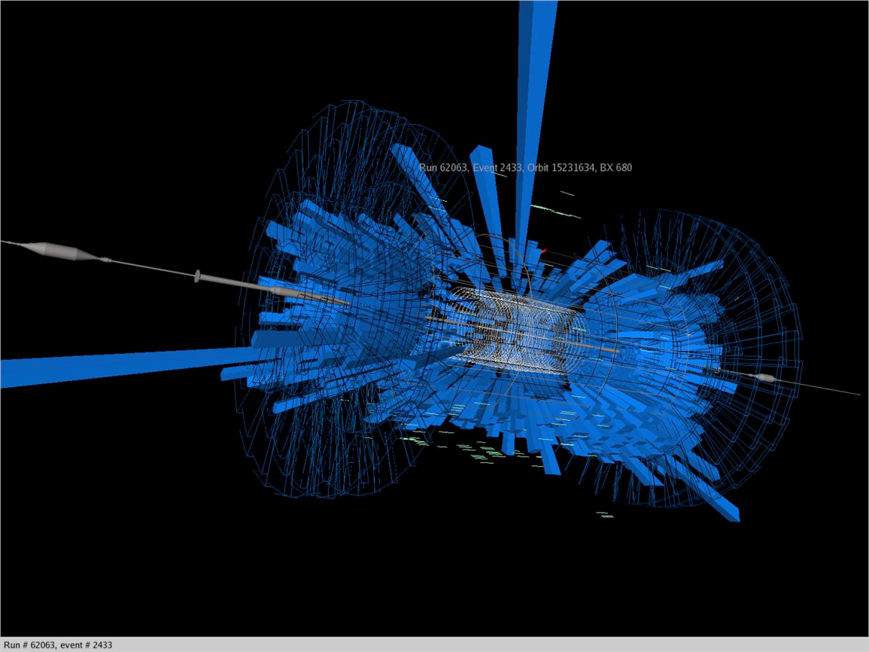
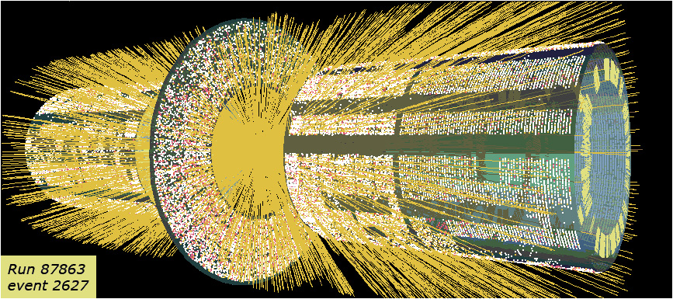
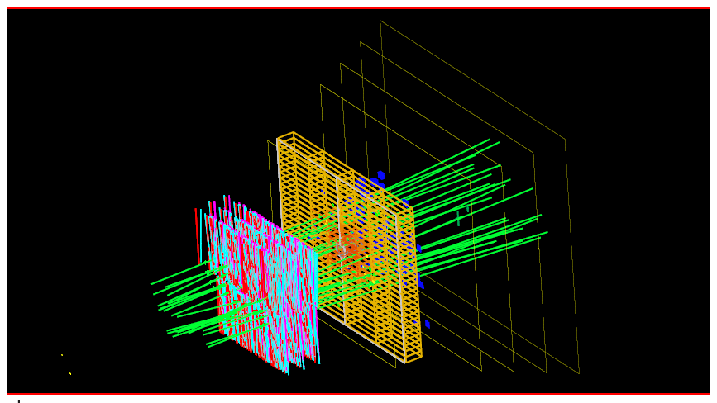
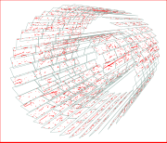
Complex events

Slide 6
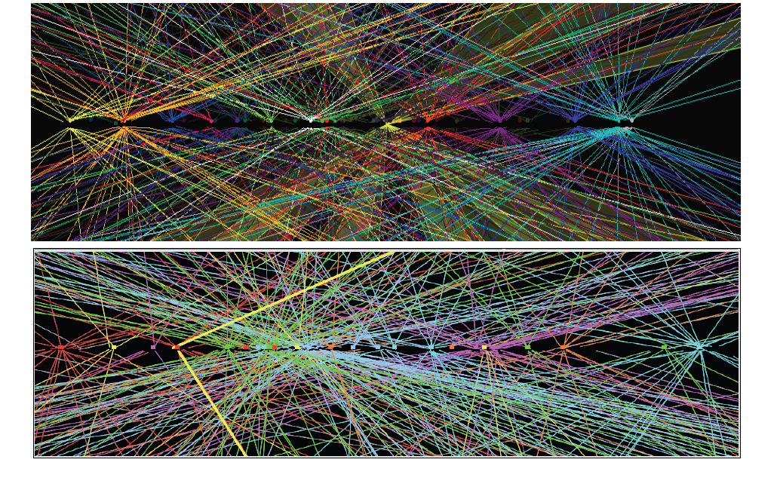
Complexity …

Slide 7
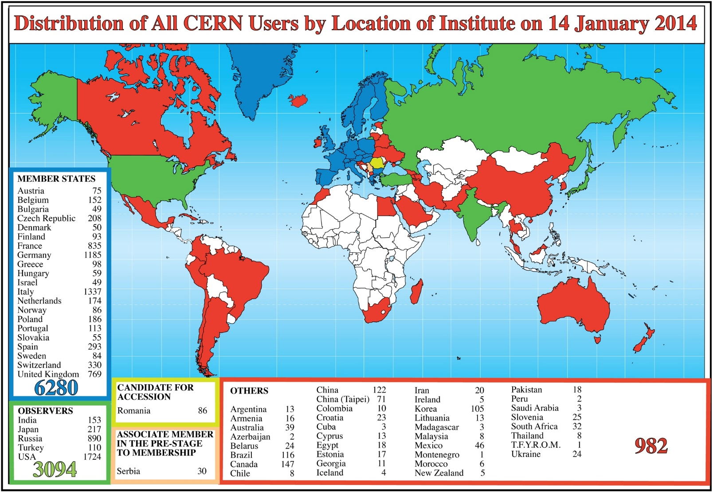

Slide 8
Some history of scale…
Date | Collaboration sizes | Data volume, archive technology
Late 1950’s | 2-3 | Kilobits, notebooks
1960’s | 10-15 | kB, punchcards
1970’s | ~35 | MB, tape
1980’s | ~100 | GB, tape, disk
1990’s | 700-800 | TB, tape, disk
2010’s | ~3000 | PB, tape, disk
For comparison:
1990’s: Total LEP data set ~few TB
Would fit on 1 tape today
Today: 1 year of LHC data ~25 PB

Slide 9











Timeline of projects
MONARC project
CERN
LHC Approval
Hoffmann Review
Computing TDRs
LHC Run 1
Run 2
1994 | 1995 | 1996 | 1997 | 1998 | 1999 | 2000 | 2001 | 2002 | 2003 | 2004 | 2005 | 2006 | 2007 | 2008 | 2009 | 2010 | 2011 | 2012 | 2013 | 2014 | 2015
“Trillium” = PPDG+GriPhyN+iVDGL

Slide 10

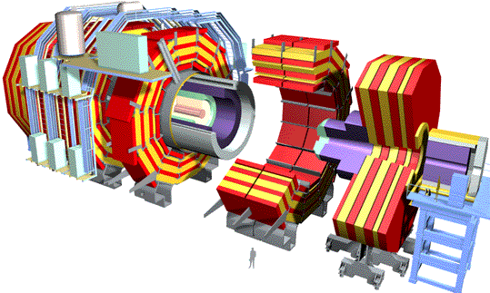

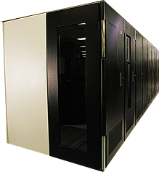
Original LHC computing model ~1999
1 TIPS = 25,000 SpecInt95
PC (today) = 10-15 SpecInt95
~PBytes/sec
Online System
~100 MBytes/sec
Offline Farm
~20 TIPS
Bunch crossing per 25 nsecs.
100 triggers per second
Event is ~1 MByte in size
~100 MBytes/sec
~622 Mbits/sec or Air Freight
Tier 0
CERN Computer Center
HPSS
Tier 1
France Regional Center
Germany Regional Center
Italy Regional Center
Fermilab
~4 TIPS
HPSS
HPSS
HPSS
HPSS
~2.4 Gbits/sec
Tier 2
Tier2 Center ~1 TIPS
Tier2 Center ~1 TIPS
Tier2 Center ~1 TIPS
Tier2 Center ~1 TIPS
Tier2 Center ~1 TIPS
Tier 3
~622 Mbits/sec
Institute ~0.25TIPS
Physicists work on analysis “channels”.
Each institute has ~10 physicists working on one or more channels
Data for these channels should be cached by the institute server
Institute
Institute
Institute
Physics data cache
100 - 1000 Mbits/sec
Tier 4
Workstations

Slide 11
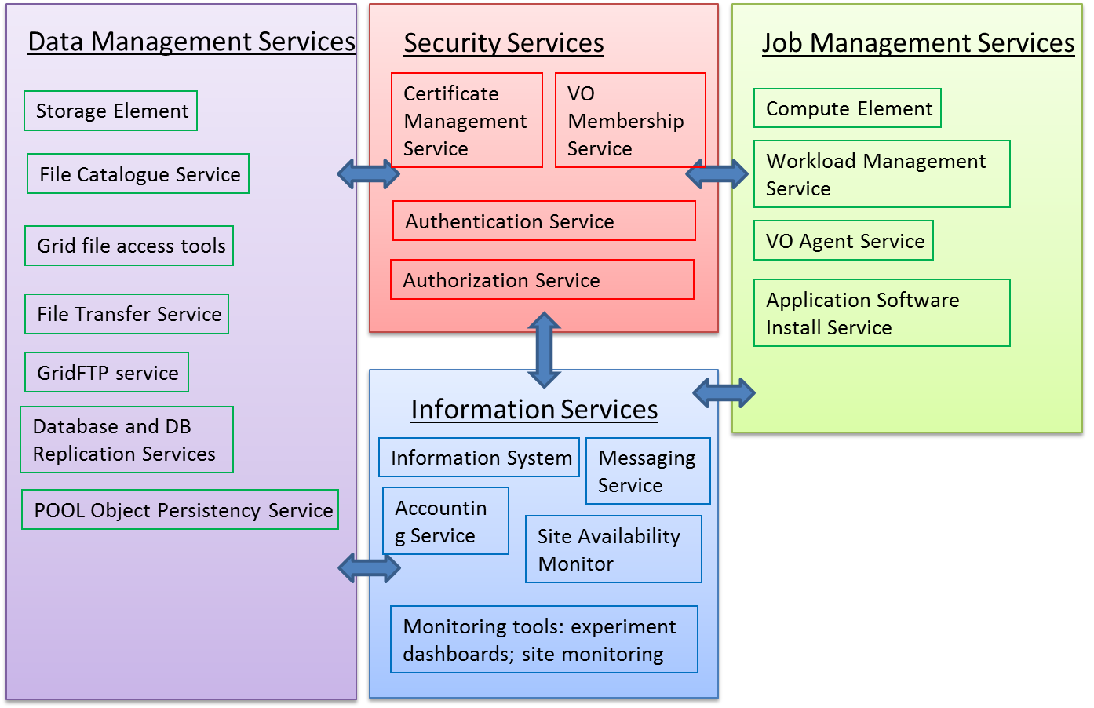
Original Baseline Services were integrated into experiment workflow with much effort to hide underlying complexity

Slide 12
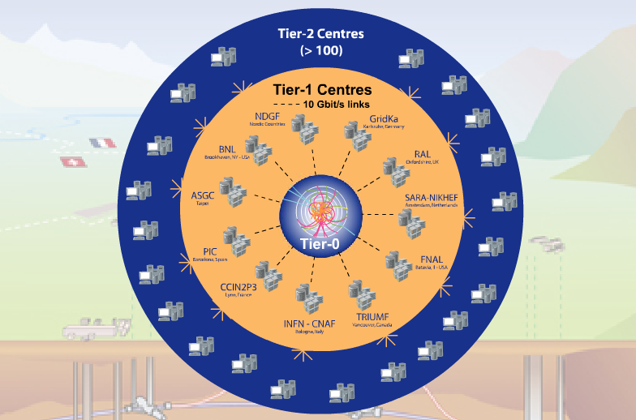
Tier-0 (CERN): (15%)
  Data recording
  Initial data reconstruction
  Data distribution
Tier-1 (13 centres): (40%)
Permanent storage
Re-processing
Analysis
Connected 10 Gb fibres
Tier-2 (156 centres): (45%)
Simulation
End-user analysis
15%
40%
45%
Notes:
The Tier 0 centre at CERN stores the primary copy of all the data. A second copy is distributed between the 11 so-called Tier 1 centres. These are large computer centres in different geographical regions of the world, that also have a responsibility for long term guardianship of the data. The data is sent from CERN to the Tier 1s in real time over dedicated network connections.
In order to keep up with the data coming from the experiments this transfer must be capable of running at around 1.3 GB/s continuously. This is equivalent to a full DVD every 3 seconds.
The Tier 1 sites also provide the second level of data processing and produce data sets which can be used to perform the physics analysis. These data sets are sent from the Tier 1 sites to the around 130 Tier 2 sites.
A Tier 2 is typically a university department or physics laboratories and are located all over the world in most of the countries that participate in the LHC experiments. Often, Tier 2s are associated to a Tier 1 site in their region. It is at the Tier 2s that the real physics analysis is performed.
12

Slide 13
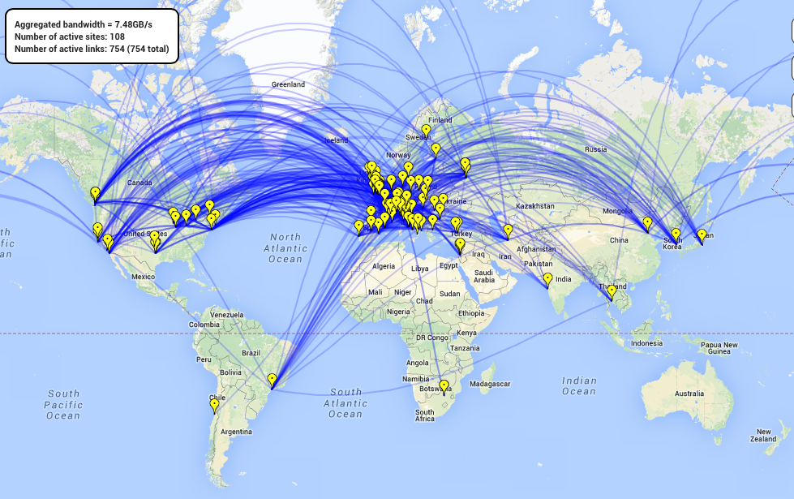
Global data
movement: 15 GB/s
1.5 PB/week recorded
2-3 GB/s from CERN
170 sites, ~8000 users
nearly 40 countries
CERN
Tier 2s
Tier 1s
Resource distribution
2 M jobs / day
250 000 CPU days/day
200PB Storage
13
Notes:
Linking 3 distributed infrastructures
OSG Open Science Grid in the US
EGI European Grid Infrastructure
NDGF Nordic Data Grid Facility

Slide 14
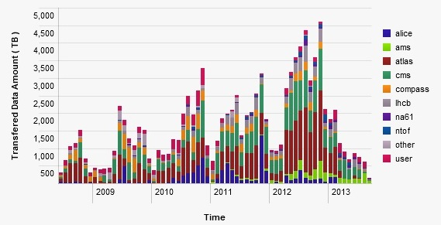
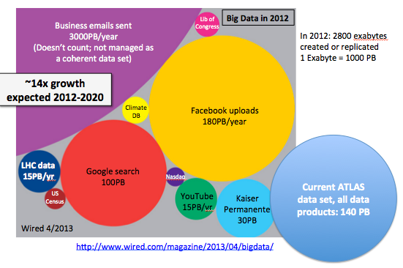
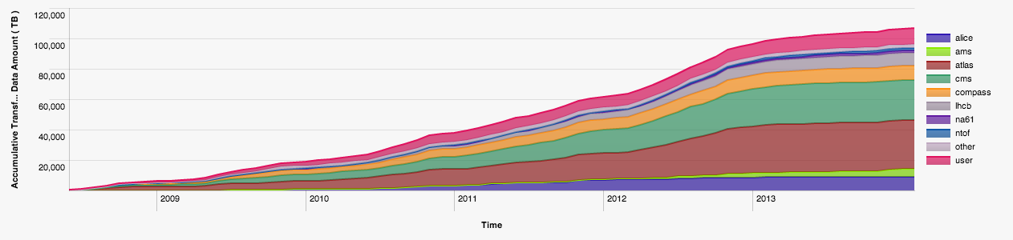
CERN New data
27 PB
23 PB
15 PB
CERN Archive
>100 PB

Slide 15
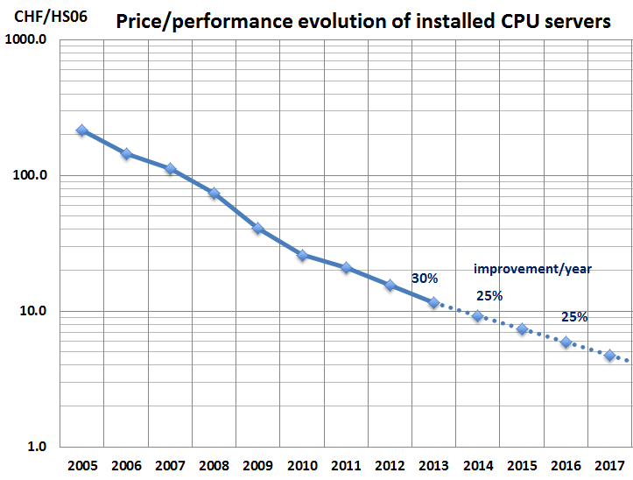
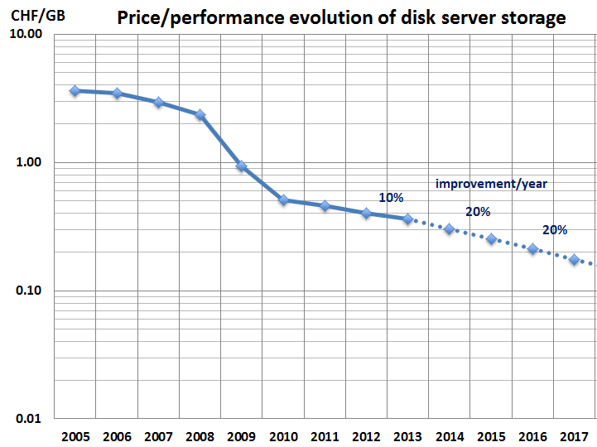
Technology outlook
Effective yearly growth: CPU 20%, Disk 15%, Tape 15%
Assumes:
  75% budget additional capacity, 25% replacement
  Other factors: infrastructure, network & increasing power costs

Slide 16
Data: Outlook for HL-LHC
PB
Very rough estimate of a new RAW data per year of running using a simple extrapolation of current data volume scaled by the output rates.
  To be added: derived data (ESD, AOD), simulation, user data…

Slide 17


CPU: Online + Offline
MHS06
GRID
ONLINE
Very rough estimate of new CPU requirements for online and offline processing per year
Little headroom left, we must work on improving the performance.

Slide 18
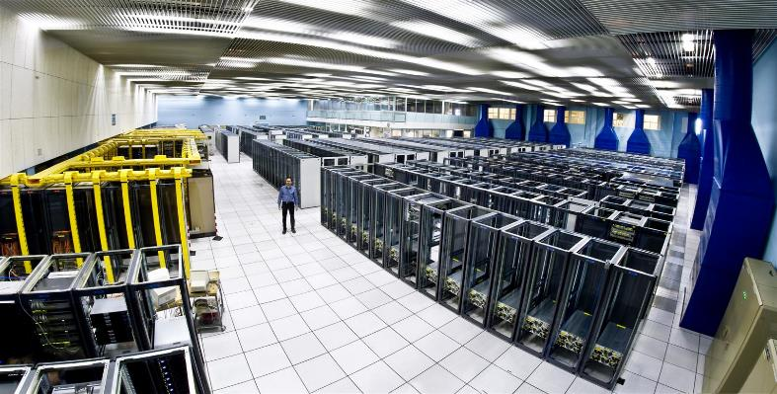
The CERN Meyrin Data Centre
Notes:
Recording and analysing the data takes a lot of computing power.
The CERN computer centre was built in the 1970s for mainframes and crays. Now running at 3.5MW of power, it houses 11,000 servers but is at the limit of cooling and electrical power. It is also a tourist attraction with over 80,000 visitors last year!
As you can see, racks are only partially empty in view of the limits on cooling.

Slide 19

CERN Tier-0 Role
In 2014,
~ 100PB archive with additional 35PB/year
~ 11,000 servers
~ 75,000 disk drives
~ 45,000 tapes
Data should be kept for at least 20 years
In 2015, we start the accelerator again
Upgrade to double the energy of the beams
Expect a significant increase in data rate
Notes:
These collisions produce data, lots of it. Over 100PB currently 45,000 tapes… data rates of up to 35 PB/year currently and expected to significantly increase in the next run in 2015. The data must be kept at least 20 years so we’re expecting exabytes….

Slide 20
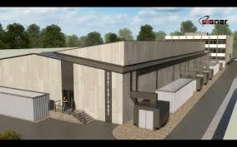
New Data Centre in Budapest
Notes:
We asked our 20 member states to make us an offer for server hosting using public procurement. 27 proposals and Wigner centre in Budapest, Hungary was chosen. This allows us to envisage sufficient computing and online storage for the run from 2015.

Slide 21
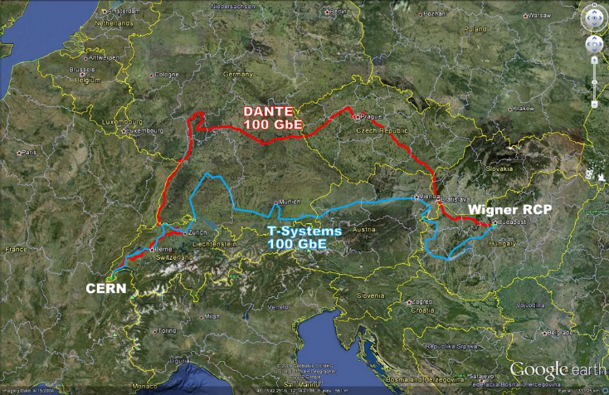
Networking @ 200Gb/s
Two 100Gb/s links via different routes from Geneva to Budapest
Aim is to provide sufficient bandwidth to reduce the need for complex scheduling
Latency sensitive applications can be affected

Slide 22
Good News, Bad News
Additional data centre in Budapest now online
Increasing use of facilities as data rates increase
But…
Staff numbers are fixed, no more people
Materials budget decreasing, no more money
Legacy tools are high maintenance and brittle
User expectations are for fast self-service
Notes:
With the new data centre in Budapast, we could now look at address the upcoming data increases but there were a number of constraints.
In the current economic climate, CERN cannot be asking for additional staff to run the computer systems.
At the same time, the budget for hardware is also under restrictions. The prices are coming down gradually so we can get more for the same but we need to find ways to maximise the efficicency of the hardware.
Our tools for management were written in 2000s, consist of 100,000 of lines of perl over 10 years, often by students, and in need of maintenance. Changes such as IPv6 or new operating systems would require major effort just to keep up.
Finally, the users are expected a more responsive central IT service… their expectations are set by the services they use at home, you don’t have to fill out a ticket to get a dropbox account so why should you need to at work ?

Slide 23
Public Procurement Cycle
Step | Time (Days) | Elapsed (Days)
User expresses requirement |  | 0
Market Survey prepared | 15 | 15
Market Survey for possible vendors | 30 | 45
Specifications prepared | 15 | 60
Vendor responses | 30 | 90
Test systems evaluated | 30 | 120
Offers adjudicated | 10 | 130
Finance committee | 30 | 160
Hardware delivered | 90 | 250
Burn in and acceptance | 30 days typical with 380 worst case | 280
Total |  | 280+ Days
Notes:
However, CERN is a publically funded body with strict purchasing rules to make sure that the contributions from our contributing countries are also provided back to the member states, our hardware purchases should be distributed to each of the countries in ratio of their contributions.,
So, we have a public procurement cycle that takes 280 days in the best case… we define the specifications 6 months before we actually have the h/w available and that is in the best case. Worst case, we find issues when the servers are delivered. We’ve had cases such as swapping out 7,000 disk drives where you stop tracking by the drive but measure it by the pallet of disks.
With these constraints, we needed to find an approach that allows us to be flexible for the physicists while still being compliant with the rules.

Slide 24
Approach
There is no Moore’s Law for people
  Automation needs APIs, not documented procedures
Focus on high people effort activities
  Are those requirements really justified ?
  Accumulating technical debt stifles agility
Find open source communities and contribute
  Understand ethos and architecture
  Stay mainstream
Notes:
We came up with a number of guiding principles…
We took an approach that CERN was not special. Culturally, for a research organisation this is a big challenge. Many continue to feel that our requirements would be best met by starting again from scratch but with the modern requirements.
In the past, we had extensive written procedures for sysadmins to execute with lots of small tools to run, These were error prone and often the guys did not read the latest ones before they performed the operation. We needed to find ways to scale the productivity the team to match the additional servers.
One of the highest people cost items was the tooling. We had previously been constructing requirements lists, with detailed must-have needs for acceptance. Instead, we asked ourselves how come the other big centres could run using these open source tools yet we had special requirements. Often, the root cause was that we did not understand the best approach to use the tools rather than that we were special.
The maintenance of our tools was high. The skills and experienced staff were taking up more and more of their time with the custom code so we took an approach of deploy rather than develop.
This meant finding the open source tools that made sense for us, trying them out. Where we found something that was missing, we challenged it again and again. Finally, we would develop in collaboration with the community generalised solutikons for the problems that can eb maintained by the community afterwards. Long term forking is not sustainable.

Slide 25


O’Reilly Consideration
Notes:
So how did we choose our tools ? There were the technical requirements are a significant factor but there is also the need to look at the community ecosystem.
Open source on its own is not enough.. Our fragile legacy tools were open source but were lacking a community. Typical example of this is the O’Reilly books.. Once the O’Reilly book is out, the tool is worth a good look.
Furthermore, it greatly helps to train new staff… you can buy them a copy and let them work it through to learn rather than needing to be guru mentored.

Slide 26
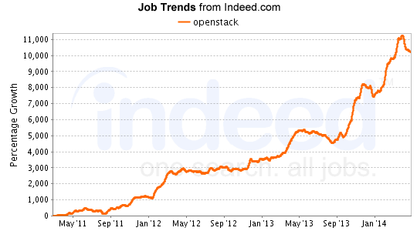
Indeed.Com Consideration
Notes:
CERN staff are generally on short term contracts, 2-5 years and come from all over the member states.
They come to CERN, often out of university or their 1st jobs. We look for potential rather than specific skills in the current tools.
After a time at CERN, they leave with expert skills and experience in our tools which is a great help for finding future job opportunities and ensuring motivation to the end of their contracts.

Slide 27
Evaluating Communities
Open Source code is not enough
  Community must have diversity
  Open to external contributions
  Transparent evolution blueprint process
Understand viability and sustainability
  Open core & Enterprise edition
  Support revenue oriented
  Time limited research funding

Slide 28
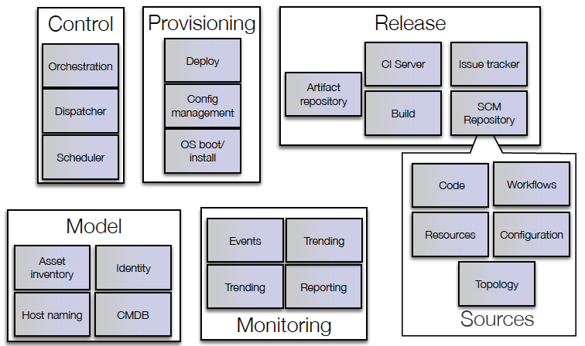
mcollective, yum
Bamboo
Puppet
AIMS/PXE
Foreman
JIRA
OpenStack
Nova
git
Koji, Mock
Yum repo
Pulp
Active Directory /
LDAP
Hardware database
Lemon /
Hadoop /
LogStash /
Kibana
Puppet-DB
Notes:
We adopted a Google toolchain approach. The majority of home written software was replaced by open source projects. Commercial tools which were already working well such as JIRA and Active Directory were maintained. The approach was to select a tool, prototype, fail early and then refine requirements (following the we are not special approach)
Key technologies were Puppet for configuration management and OpenStack for the private cloud.

Slide 29
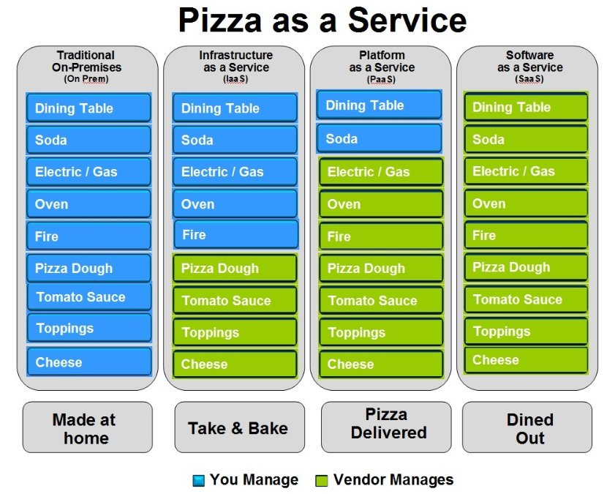
Is there a better way that doing it all yourself ?
Source: IBM

Slide 30
Duplication and Divergence
Storage
Compute
Windows
Storage
Compute
Web
Platform as a Service
Windows
Database
Custom
Infrastructure as a Service
Hardware Facilities
Hardware Facilities
Network
Network
Service Silos
Functional Layers

Slide 31


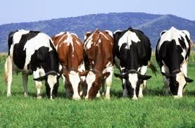
Service Models
Pets are given names like pussinboots.cern.ch
They are unique, lovingly hand raised and cared for
When they get ill, you nurse them back to health
Cattle are given numbers like vm0042.cern.ch
They are almost identical to other cattle
When they get ill, you get another one

Slide 32
Configuration Management
Puppet
  Describe your server configuration with software and configuration files
  Repeat as needed for N hosts
  Used widely elsewhere e.g. ATLAS online, HEP sites, Google, Facebook, …
  Puppetforge provides many standard modules
Foreman
  GUI to browse Puppet state
  Provides parameters for different host groups
PuppetDB
  Datawarehouse for configuration

Slide 33
Infrastructure is code
Each module and hostgroup is a git repository, but it drives configuration
It’s code, treat it like code, run it like a software project
A running service is configured by many modules, with different groups developing them
Need to manage risk and throughput
Throughput and stability isn’t a 0-sum game

Slide 34
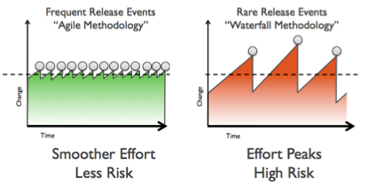
Rate of change
By default changes flow individually into QA
Changes flow individually into Prod after successful QA
Production is always moving

Slide 35
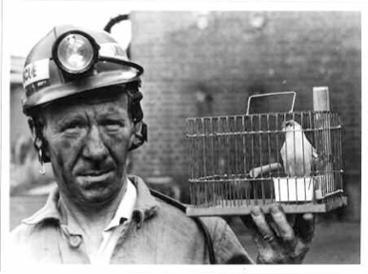
Canaries
To manage rate of change, essential to detect failures
“Canary” machines are exposed to changes sooner than other machines in service
Can use “QA” or delayed production

Slide 36
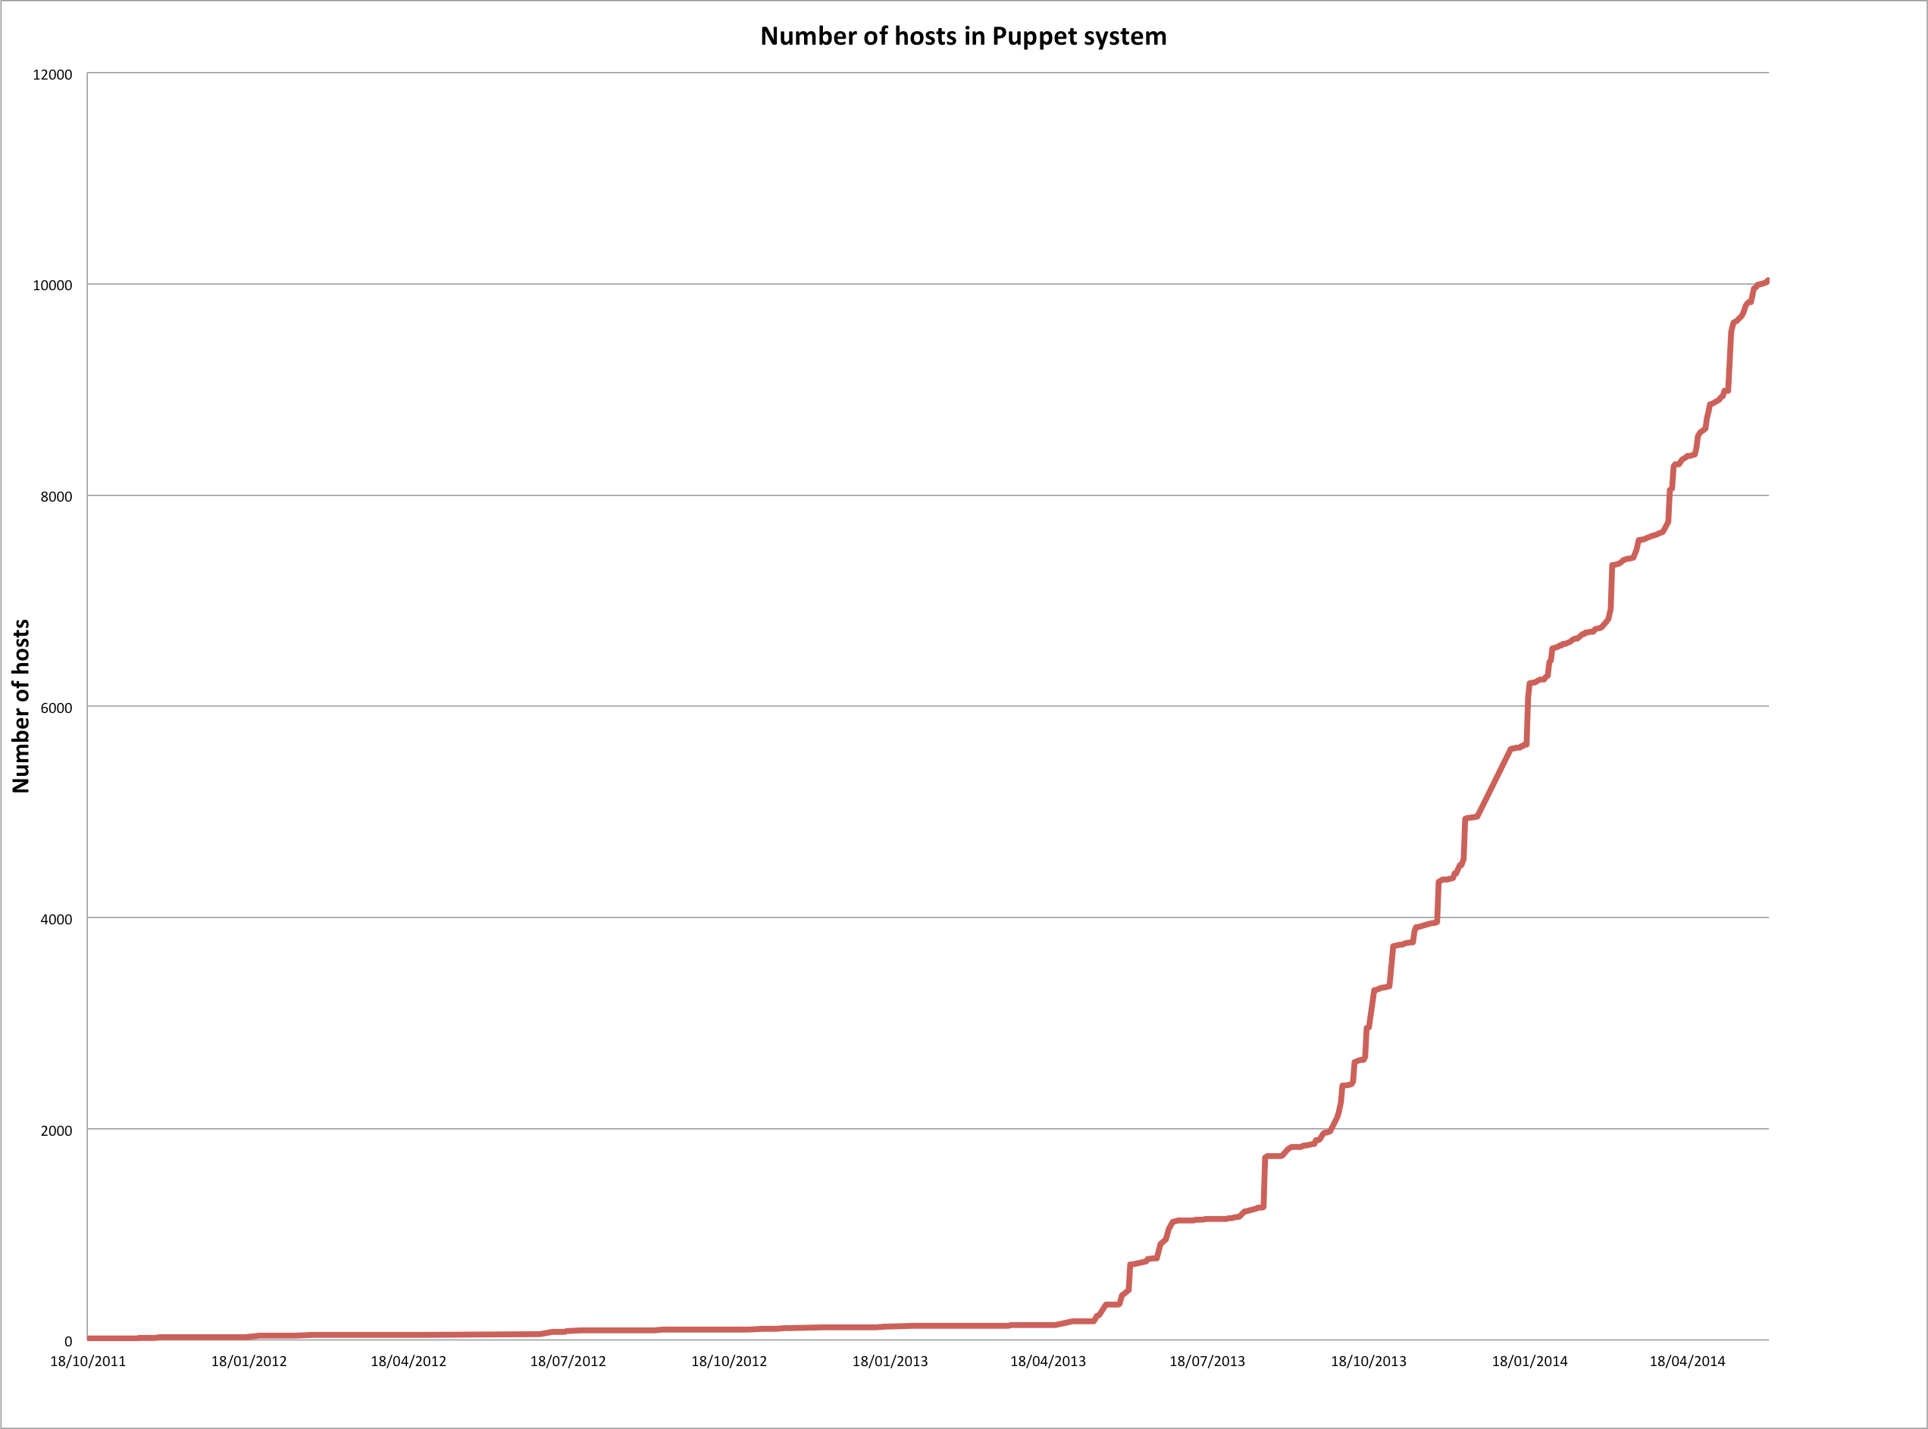
Puppet Configuration
Over 10,000 hosts in Puppet
200+ different hostgroups
Scaling issues resolved with the communities

Slide 37
Monitoring
Dashboards are very popular projects
No standards on transport, storage or displays
Cross service analytics was very difficult
Integration into standard problem and incident management solutions was varied

Slide 38
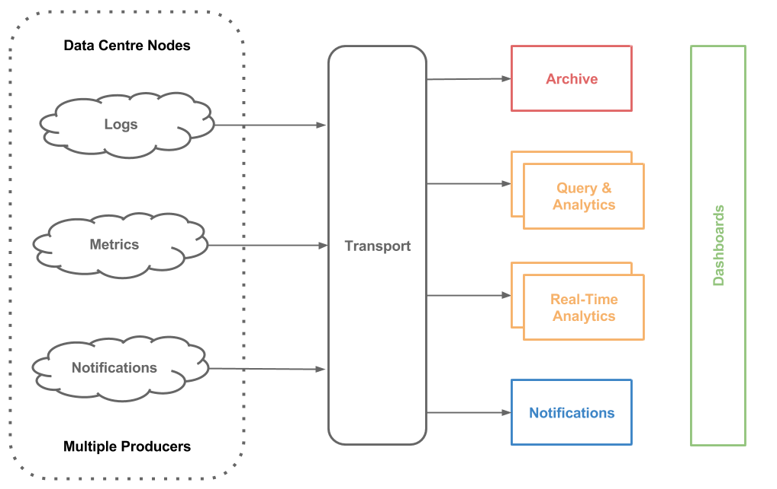
Architecture

Slide 39
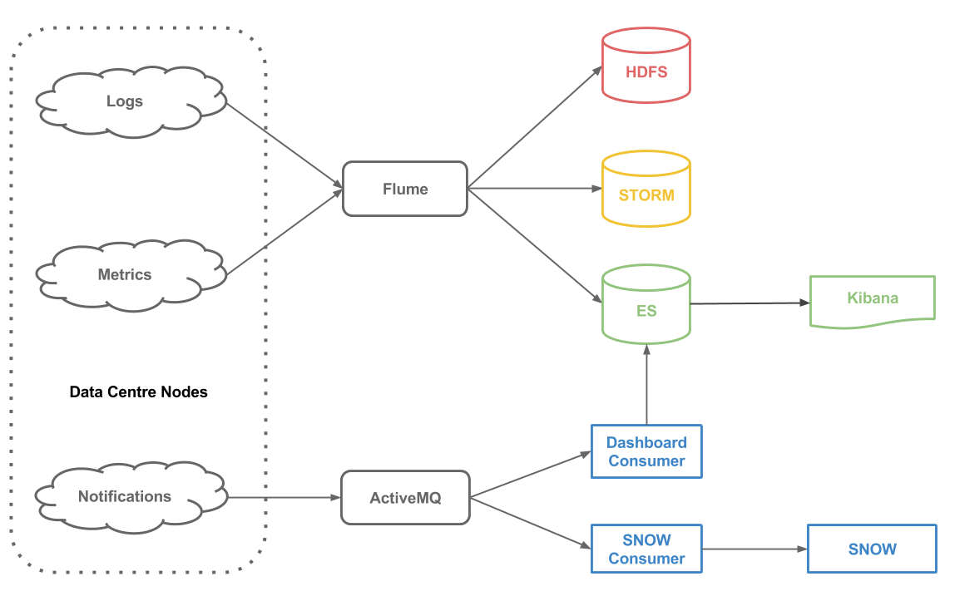
Technologies

Slide 40
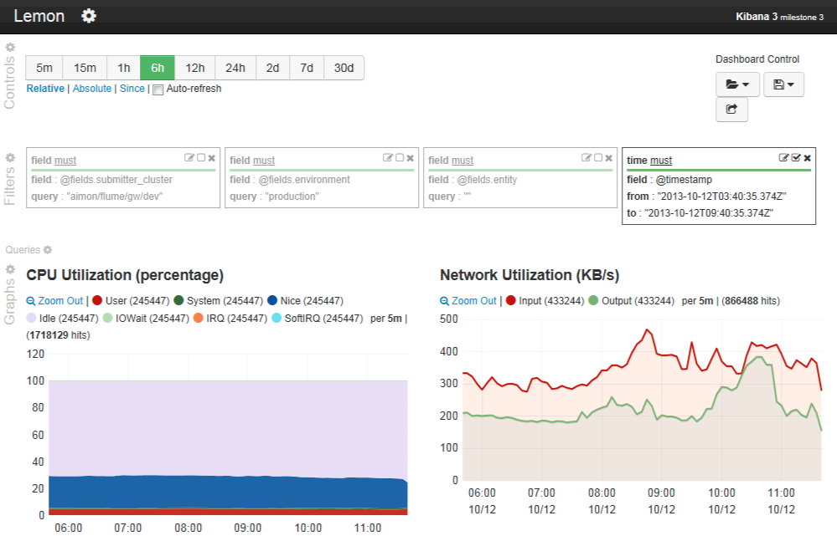
Dashboards Without Code

Slide 41
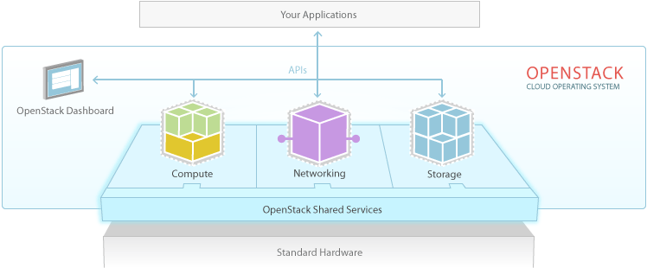
OpenStack Cloud Platform
Notes:
Add Heat (Cloud Formation templates)

Slide 42
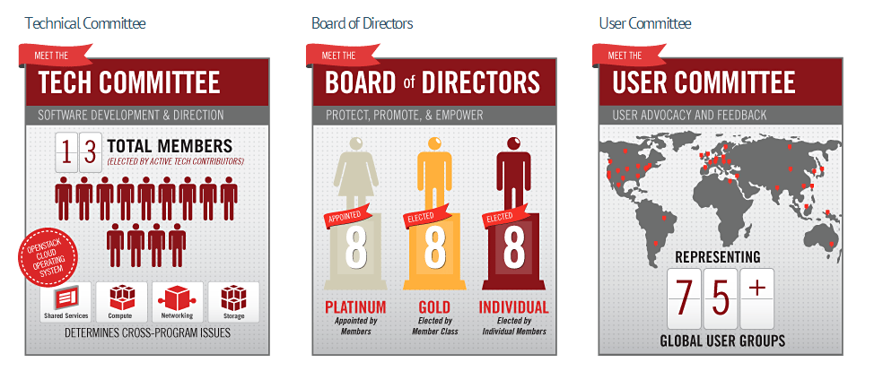
Open Governance

Slide 43
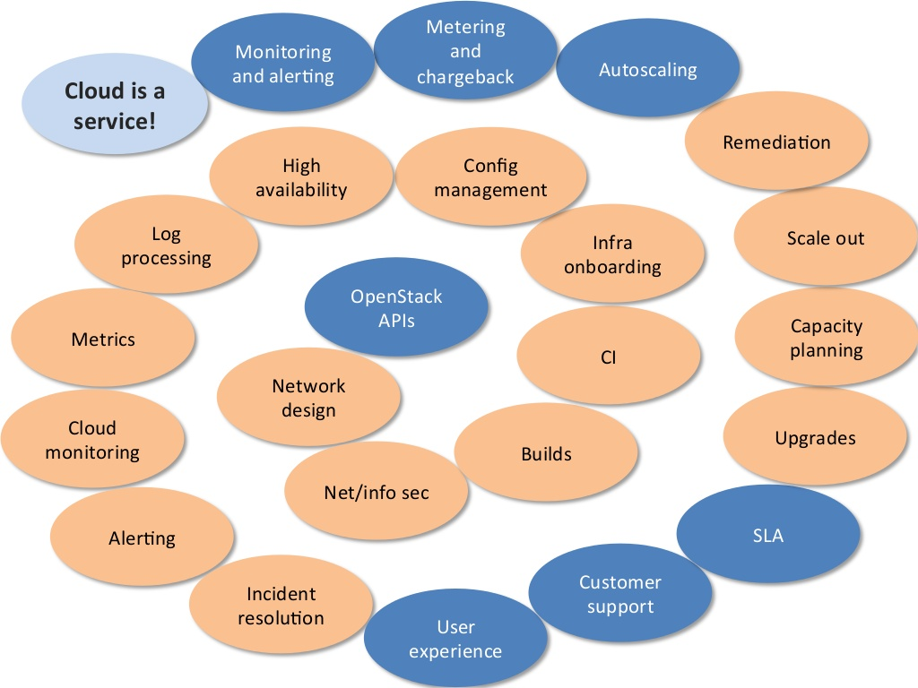
Cloud software does not give you a service
Integration with site services needed before production
Source: eBay

Slide 44


Block Storage
Ceph & NetApp
CERN Accounting
CERN Network Database
Ceilometer
Cinder
Account mgmt system
Network
Compute
Keystone
Scheduler
Microsoft Active Directory
Nova
Horizon
Glance
CERN DB on Demand
Notes:
Account Management Automation
CERN legacy network database
No Neutron yet

Slide 45



Scaling Architecture Overview
Child Cell
Geneva, Switzerland
controllers
compute-nodes
Load Balancer
Geneva, Switzerland
Top Cell - controllers
Geneva, Switzerland
Child Cell
Budapest, Hungary
controllers
compute-nodes
Notes:
HA Proxy load balancers to ensure high availability
Redundant controllers for compute nodes
Cells used by the largest sites such as Rackspace and NeCTAR – more than 1000 hypervisors is the recommended configuration

Slide 46
Status
Multi-data centre cloud in production since July 2013 (Geneva and Budapest) with nearly 800 users
Currently OpenStack Havana with some Icehouse
  KVM and Hyper-V deployed
  All configured automatically with Puppet
  ~70,000 cores on ~3,000 servers
  3PB Ceph pool available for volumes, images and other physics storage
Notes:
Already 3 independent clouds – federation is now being studied
Rackspace inside CERN openlab
Helix Nebula as discussed later

Slide 47
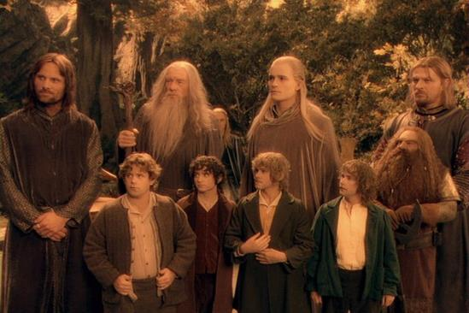
The Agile Experience
Notes:
So, we assembled a team made up of experienced service managers and new students. By freezing developments on legacy projects, we were able to make resources available but only as long as we could rapidly implement new functions. Many of the staff had to do their ‘day’ jobs as well as work on the new implementations. Several effects
- Newcomers often had experience of the tools from university
People learnt very rapidly by following mailing lists, going to conferences and interacting with the community. Contributions such as contributing to the governance, use cases and testing in addition to standard development contributions.
Short term staff saw major improvements in their post-CERN job prospects as they left with very relevant skills

Slide 48




Cultural Barriers
Notes:
The agile approach is a major cultural change which is an ongoing process. To illustrate this, there are some characteristics which I show extreme examples of to watch out from Tolkein…. Luckily, we never had characters like this at CERN:
Don’t be hasty, let’s go slowly… transformations such as this cannot be done in a reasonable time by incremental change
Move away from silos… top to bottom from application to hardware managed by a single team to a layered model with shared budget and resources.
Knowledge management responsibilities change. The guru who wrote the tool and trains others on how to use it is replaced by the outside community in which people participate. Everything can appear to be research if you start with a blank piece of paper.
The server or application manager of ‘precious’ applications that need special handling and care has to be understood… some cases are inevitable but many reflect non-technical aspects of the application or server management and may justify changes of process

Slide 49
Next Steps: Scale with Physics
Scaling to >100,000 cores by 2015
  Around 100 hypervisors per week with fixed staff
Deploying and configuring latest releases
  Need to stay close … but not too close
Legacy systems retirement
  Server consolidation
  Home grown configuration and monitoring
Analytics of processor, disk and network
  Focus on efficiency

Slide 50
Grids to Clouds ?
Grid infrastructure can run on top of a cloud
  Batch system with job queue as before
  Batch workers are virtual machines
  Grid service nodes are virtual machines
Can we simplify the model ?
  Reduce potential software failure points
  Limit software costs and improve sustainability
  Provide similar environment to Amazon/Google

Slide 51
Scheduling Challenges
Clouds have no queue
  No credit card to control demand
  No fair share to adjust quota
How to use opportunistic capacity
  Spot market approach ?
Virtualisation overhead
  I/O is particularly costly – containers may help

Slide 52
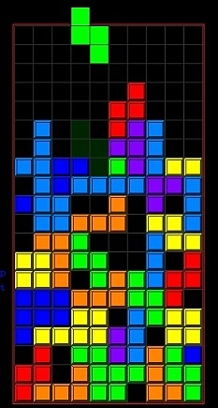
Scheduling at Scale
CERN users want more sophisticated scheduling:
  Processor architecture
  Private network subnets
  Varying memory/core/disk ratios
  Hardware with more redundancy
Servers should be used fully
  Tetris-like problem to find the matches
  Packing is more difficult the nearer to 100% used
Cells scheduler is rather simple currently
  Try Cell X, if not match, try Cell Y…

Slide 53




Next Steps: Federated Clouds
Many Others on Their Way
Public Cloud such as Rackspace
NecTAR
Australia
Brookhaven National Labs
IN2P3
Lyon
CERN Private Cloud
70K cores
ATLAS Trigger
28K cores
CMS Trigger
12K cores
Notes:
The trigger farms are those servers nearest the accelerator which are not needed while the accelerator is shut down till 2015
Public clouds are interesting for burst load (such as coming up to a conference) or when price drops such as spot market
Private clouds allow universities and other research labs to collaborate in processing the LHC data

Slide 54

Academic
Other market sectors
Big Science
Small and Medium Scale Science
Government
Manufacturing
Oil & gas, etc.
Helix Nebula
Broker(s)
Network Commercial/GEANT
EGI Fed Cloud
Atos
Cloud
Sigma
T-
Systems
Interoute
Front-end
Front-end
Front-end
Front-end
Front-end
Front-end
Publicly funded
Commercial

Slide 55
Summary
LHC Computing requirements continue to grow
Man power and materials budget pressure remains
Clouds have potential to simplify computing models
Sharing development with vibrant open source communities helps build sustainable software
Cultural change to an Agile approach has required time and patience but is paying off

Slide 56
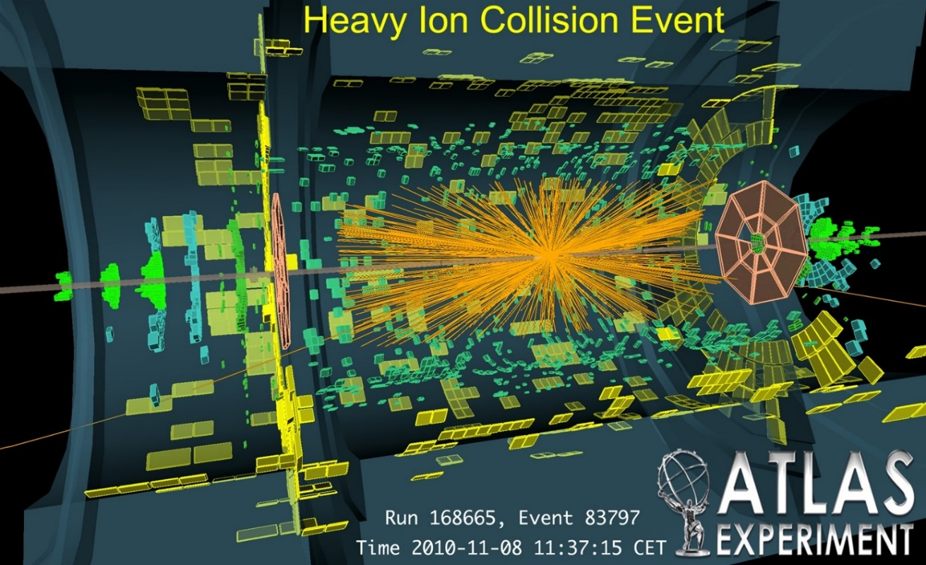
Questions ?
LHC Computing Overview GridKa 2012 LHC Computing
CERN code is at http://github.com/cernops

Slide 57
Backup Slides

Slide 58
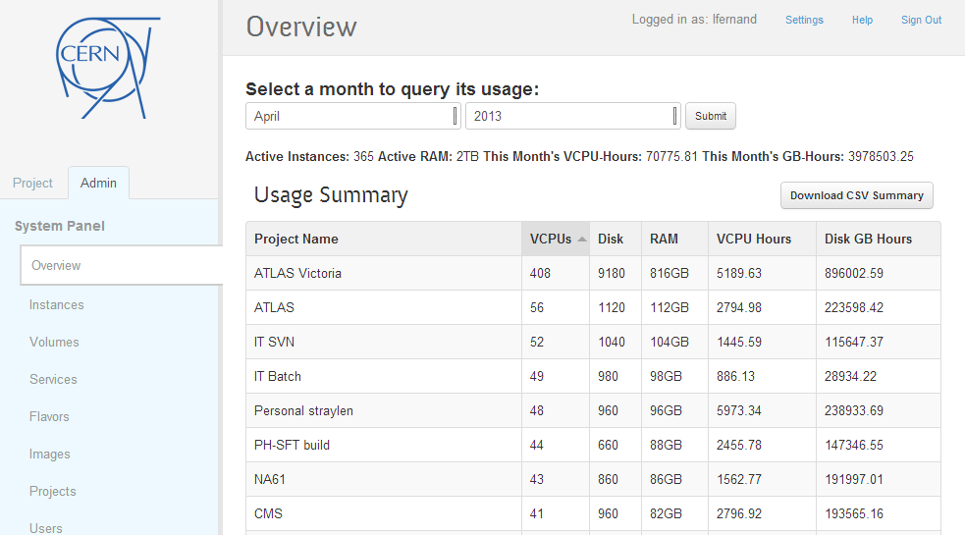

Slide 59
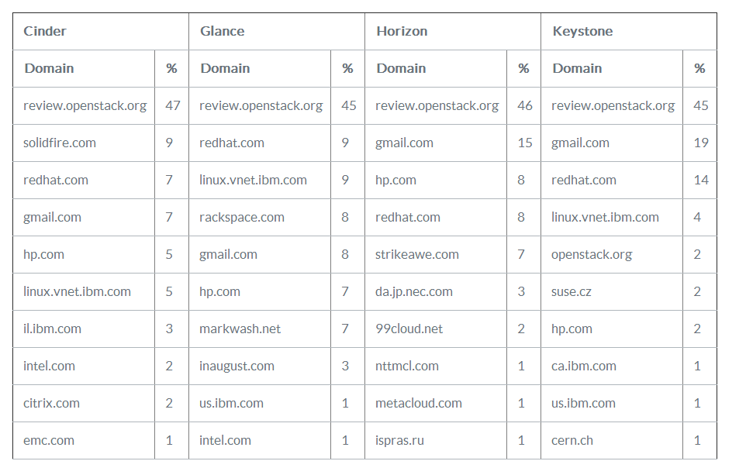
http://www.eucalyptus.com/blog/2013/04/02/cy13-q1-community-analysis-%E2%80%94-openstack-vs-opennebula-vs-eucalyptus-vs-cloudstack

Slide 60
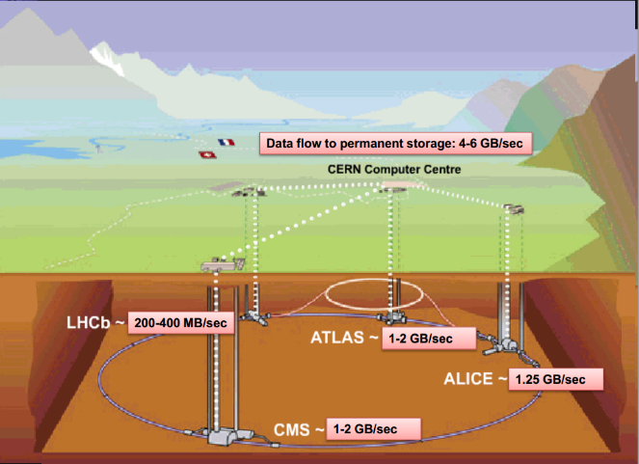

Slide 61
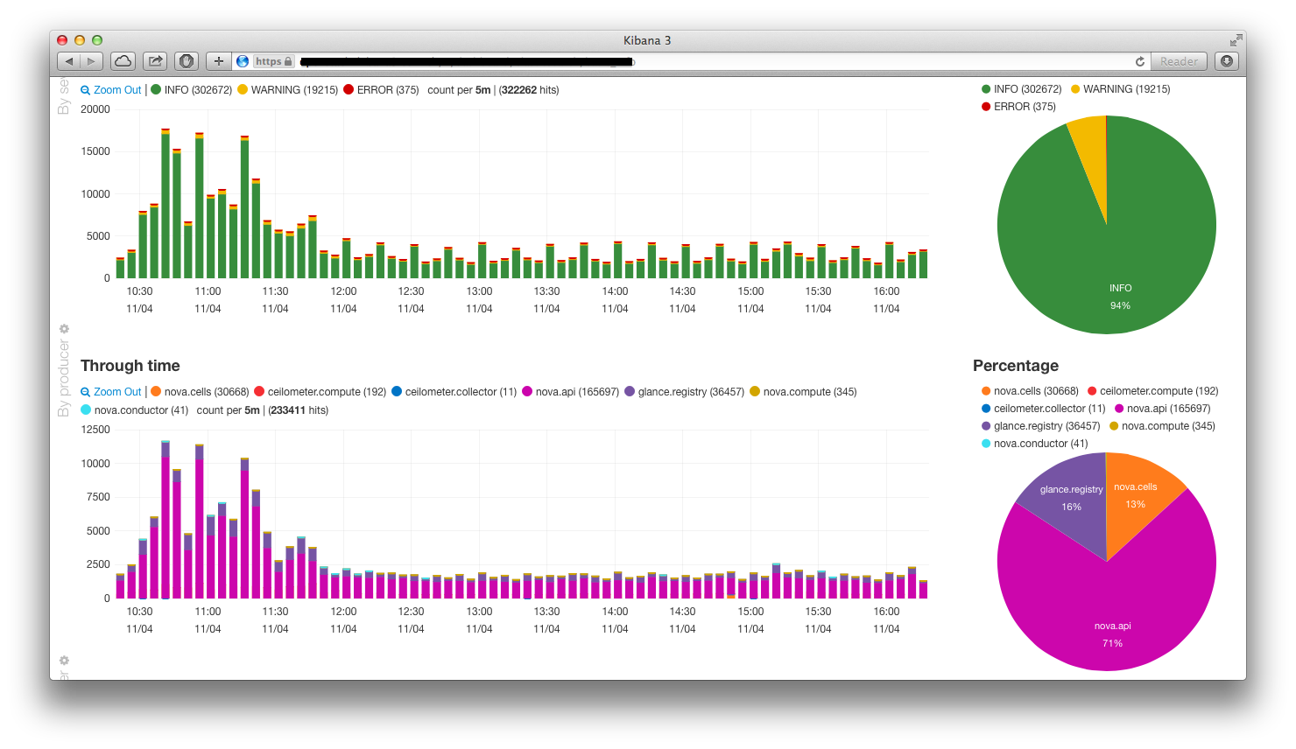
Monitoring - Kibana

Slide 62
Agility and Elasticity Limits
Communities help to set good behaviour
Internal demonstrations build momentum
Finding the right speed is key
Keeping up with releases takes focus
Coping with legacy requires compromise
Travel budget needs significant increase!
Notes:
As we implemented the tool chain, we started to notice some interesting characteristics.
Staff got heavily involved in mailing lists and IRCs, helping others and learning themselves. The open source collaboration culture then starts to affect how they work with their colleagues. Ownerships between more shared, pull requests came in for enhancements rather than bug reports.
Many people had good ideas and these were often competing. Spinning up a VM with a new tool, demonstrating it to a public town hall meeting and debating the potential benefits was a good way to give an initial yes/no decision (or put on hold to look at later)
Speed of adoption is varied… some of the team immediately understood the concepts and approach. They became highly productive, using CI for testing, Puppet even for single servers and cloud architectures. Others were more cautious… even though they used these new tools, the approach used remained the same… release once a quarter, test manually carefully, hand-configure.. This causes tension in the teams and dis-satisfaction with the tools since trying to use these tool without changing the approach is sub-optimal.
We organised boot camp training…. Initially, people suggested to send all newcomers to the department for the training but we often found these people already had the knowledge from their training.. The key team to train was actually the people who had been at CERN for a longer time and had significant professional experience with other approaches.
Many of those used to conventional software enterprise had difficulties with the rate of change. New releases each week with additional features, potentially changing behaviour can be mis-interpreted as unstable by an enterprise sysadmin. Adoption of CI helped but some apps are difficult to handle in these circumstances. Classic case was backup software where the vendor did not test with all releases, this needed configuration freezing and snapshots.
Discussions like hostname conventions became very intense and town hall meetings to gather the different perspectives for community decisions helped. Sometimes, these discussions would drag on for weeks to converge.
Part of the collaboration with communities involved face-to-face time. The travel budget was rapidly used up as we sent people to the OpenStack summits, Puppetconf and FOSDEM to keep in touch. We found cases where our ‘free’ software travel costs exceeded costs of the commercial products….
Overall, trying to keep the team so that the gap between the front runners and the main body of administrators is kept to the minimum. We’ve not completed 100% but the bulk of the cultural transition is over.

Slide 63
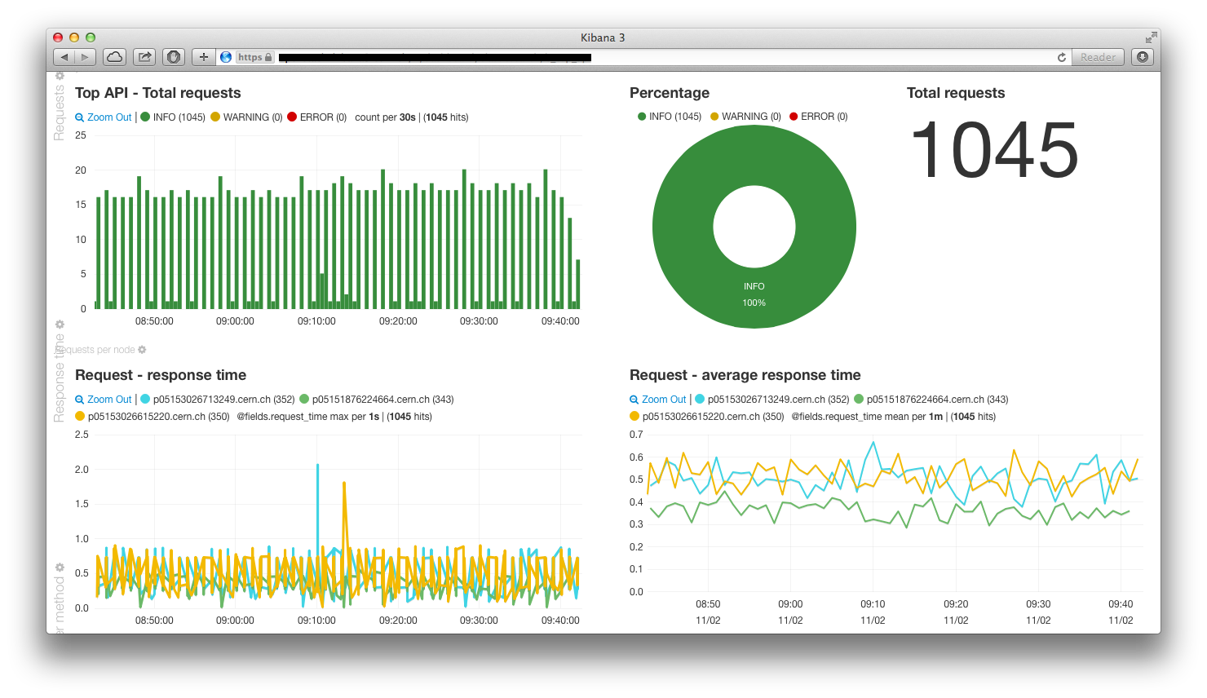
Monitoring - Kibana

Slide 64
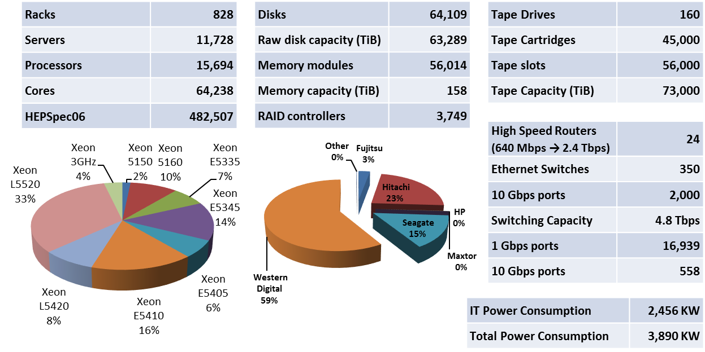

Slide 65
Architecture Components
Top Cell
Children Cells
Controller
Controller
Compute node
rabbitmq
- Nova api
- Nova consoleauth
- Nova novncproxy
- Nova cells
rabbitmq
- Nova api
- Nova conductor
- Nova scheduler
- Nova network
- Nova cells
- Nova compute
- HDFS
- Ceilometer agent-compute
- Elastic Search
- Flume
- Kibana
- Glance api
- Glance registry
- Glance api
- Ceilometer api
- Stacktach
- Ceilometer agent-central
- Ceilometer collector
- Cinder api
- Cinder volume
- Cinder scheduler
- Ceph
- Keystone
- Keystone
- Flume
- MySQL
- Horizon
- MongoDB
- Flume
Notes:
Child cells have their own keystone in view of load from ceilometer
Requires care to set up and test

Slide 66
Upgrade Experience
No significant outage of the cloud
  During upgrade window, creation not possible
  Small incidents (see blog for details)
  Puppet can be enthusiastic! - we told it to be ☺
Community response has been great
  Bugs fixed and points are in Juno design summit
  Rolling upgrades in Icehouse will make it easier

Slide 67
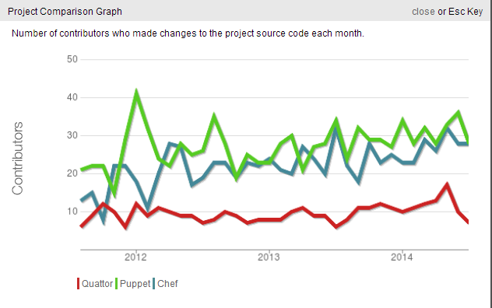
Ohloh.net for Community
Diverse community of contributors
Stable of increasing membership

Slide 69
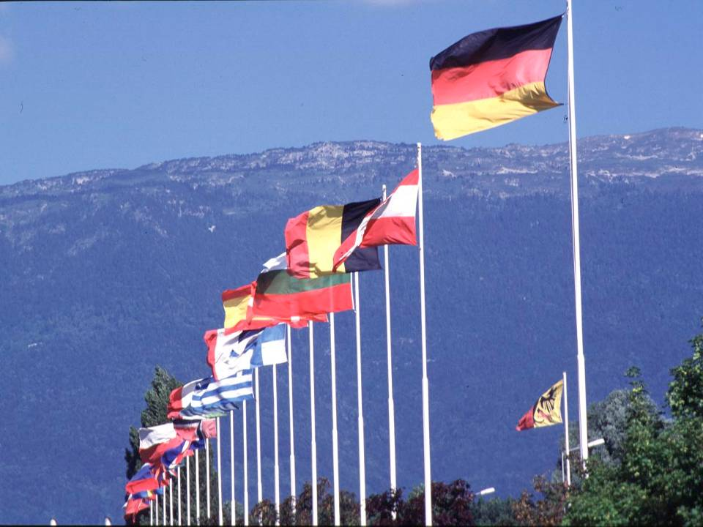
CERN was founded 1954: 12 European States
“Science for Peace”
Today: 21 Member States
~ 2,300 staff
~ 1,000 other paid personnel
> 11,000 users
Budget (2013) ~1,000 MCHF
Member States: Austria, Belgium, Bulgaria, the Czech Republic, Denmark, Finland, France, Germany, Greece, Hungary, Israel, Italy, the Netherlands, Norway, Poland, Portugal, Slovakia, Spain, Sweden, Switzerland and
the United Kingdom
Candidate for Accession: Romania
Associate Members in Pre-Stage to Membership: Serbia
Applicant States for Membership or Associate Membership:
Brazil, Cyprus (awaiting ratification), Pakistan, Russia, Slovenia, Turkey, Ukraine
Observers to Council: India, Japan, Russia, Turkey, United States of America; European Commission and UNESCO

Slide 70
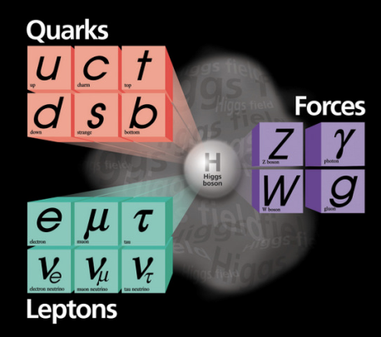
What are the Origins of Mass ?

Slide 71


Matter/Anti Matter Symmetric?

Slide 72
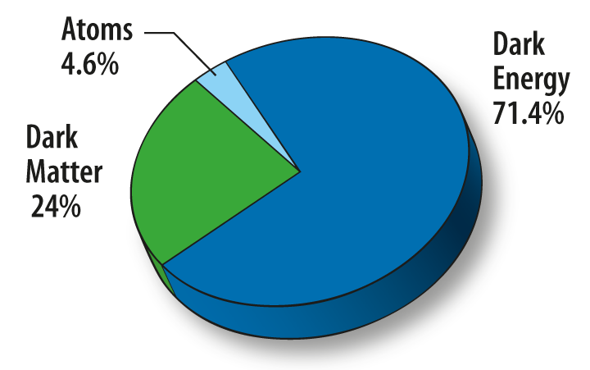

Where is 95% of the Universe?

Slide 74

Notes:
Over 1,600 magnets lowered down shafts and cooled to -271 C to become superconducting. Two beam pipes, vacuum 10 times less than the moon

Slide 75


Slide 76


Collisions

Slide 77
Futures
Containers

