Slide 1
Can (HPC)Clouds supersede traditional High Performance Computing?
Michael Gienger
High Performance Computing Center Stuttgart

Slide 2
Agenda
Welcome
What is HPC?
What is Cloud Computing?
How could Cloud Computing enrich traditional HPC
  Hybrid Model
  Virtual Clusters
Virtual Clusters: Hands on !
Conclusions & Results

Slide 3
What IS HPC?
High Performance Computing
  Computing systems configured for maximum performance
    CPU – Memory – I/O
  “Hundreds of thousands of cores & threads“
Only special applications and / or algorithms are able to cope with the HPC prerequisites
  Big problems
    Scalability
    Long term computing
  Climate, Physics, Chemistry, Computational Fluid Dynamics, ...
Notes:
Special hardware
Networks
Storages
High memory
Gpu / cpu
Post processing / pre processing

Slide 4


















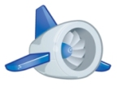



What is a Cloud?
There is NO common answer to that !
The term became popular
  Amazon’s “Elastic Clouds”
No clear concept behind it
  Related areas have jumped on the wagon
  Rebranded offerings to “clouds”
Diverging usage
Confusion about the term by now
So we should take the likes and ignore the non-likes
(if possible)
Notes:
Market is saturated with clouds, but what is a cloud
Service oriented
Different user models (iaas, paas, saas)
Pay per use
Scale
Get what you request, share resources for effectiveness

Slide 5

Service models
User friendly
Scalable services
Service portfolio
High Performance ?
Performance
Economic
Portable
Flexible
Service oriented
Efficient
Encapsulation

Slide 6

Comparison between Clouds and HPC
CLOUDS
HIGH PERFORMANCE COMPUTING
Want to scale over the amount of (service) instances => improved availability
Latency tolerant
“Nodes” are instances that can host the service functionality
Replication is easy and comparatively small
  Full service & state can be replicated
Access is comparatively easy
A wide range of platforms is supported
Scales over parallel processes/threads => improves performance, but not availability
Requires a potentially unlimited number of compute units
“Nodes” are compute units
Low latency applications
Replication involves complicated post-processing
  Typically only data is replicated
Access is typically difficult (not only due to security)
Range of platforms is limited
Notes:
Combined?
Depends on the workflow
Depends on the availability
Application vs scalability
Service vs availability

Slide 7
HPC and Clouds obviously don‘t compete
  Different markets and general goals
  Different operation and business models
  Different ways of using & providing the offered service
      Ease of use for HPC
      Increased service portfolio for Clouds
        HPC as a Service
      Different service provisioning models
      “Real“ pay per use
Why should we combine both models ?

Slide 8
Why should we combine Clouds and HPC?
Three different models conceivable
  (Cloud like access to HPC resources)
  Hybrid operation model
  Virtual Clusters
All models don’t compete
  Increase usability
  Increase service portfolio
HPC
Virtual Clusters
Clouds
Cloud like access
Hybrid Model
Notes:
Full control on virtual instances

Slide 9
The Hybrid Model
Operate HPC Clusters and Clouds in parallel

Slide 10
The Hybrid Model - Purpose
Enrich HPC capabilities with modern Cloud functionality
  Ease of use
  Different service models (Cloud services – HPC access)
  Towards HPC as a Service
Schedule workflow / tasks to the most suitable hosts
  High level scheduling to submit jobs from VMs
  Available capacity for providing „real time“ results
Needs a dedicated and intelligent federation & scheduling
management for HPC and Clouds !
Notes:
Take a workflow and put parts which use latency-tolerant scalability on the Cloud
Put those parts needing performance on a HPC resource
Pre / postprocessing

Slide 11
Schematic example for Hybrid Cloud / HPC combination
Data
Data
Map/
Reduce
Map/
Reduce
Map/
Reduce
Map/
Reduce
Cloud
Domain
Hadoop
Hadoop
  Data-level
  integration
  Optimal
  performance/
  costs ratio
TCP/IP
HDFS
HDFS
Federation Service
MPI process
Data
Data
Data
Subset
Data Subset
Data
Subset
Data Subset
HPC
Domain
Open MPI
Open MPI
Infiniband
LUSTRE
LUSTRE

Slide 12
Status Quo
Couple HPC cluster with Clouds
  Technically done
Intelligent scheduling mechanisms for reliable information retrieval
  Partially done for light-weighted workflows
  Real-time capabilities sometimes problematic
  Complex fault tolerance & management structures necessary
Check systems for usability on all available domains
  Partially done

Slide 13
Virtual Clusters
Full Virtualization for Clusters

Slide 14
Virtual Clusters
Fully virtualized environments
  Xen, KVM, Containers, ESX(i), ...
  OpenStack, OpenNebula, CloudStack, ...
Fully enabled HPC as a Service
  Virtual Cluster built up on request
  Various OS supported & physical node control
  Intelligent scheduling in combination with energy efficient operation
Enable HPC in Clouds to benefit from service oriented computing !

Slide 15
High Performance Clouds
Architectural design very close to typical HPC systems
  Infiniband interconnects
  Fast system storages
Middleware control
  Pay per use models
Different layers of services and control
  IaaS
  PaaS
  SaaS
Notes:
Hpc as a service
Control in contrast to real hpc where there is de facto no control
Batch node reservation
Iaas – full control for the behaviour of all instances
Paas – provisioning of a platform to run all mandatory application runs, including software etc.
Saas – mpi installation to run applications directly
Dont forget java

Slide 16
Status Quo
Currently tests running as a base line for improvements
Virtualization overhead (according to studies)
  25 – 30 % for parallel I/O
  5 – 15 % for computation
Full virtualization of a (big) cluster
  Not done
Investigation on possible algorithms
  Partially done
  Performance analysis partially done
Notes:
OpenStack, XEN
Xeon E5-2630, 128GB RAM
10GE, 40GE, Infiniband

Slide 17
Status Quo – Problems
Hardware
Enable full hardware virtualization
  Enable controlled networking
Provision strong storages
  Disk-less operation models
  Enable local SSD storages
Software
Address shortcomings of current Cloud-Stacks
  E.g. hypervisors, middleware, efficient scheduling, node reservation, VM alignment, ...

Slide 18

Virtual clusters:
Hands on !
A SPECIFIC CASE STUDY

Slide 19
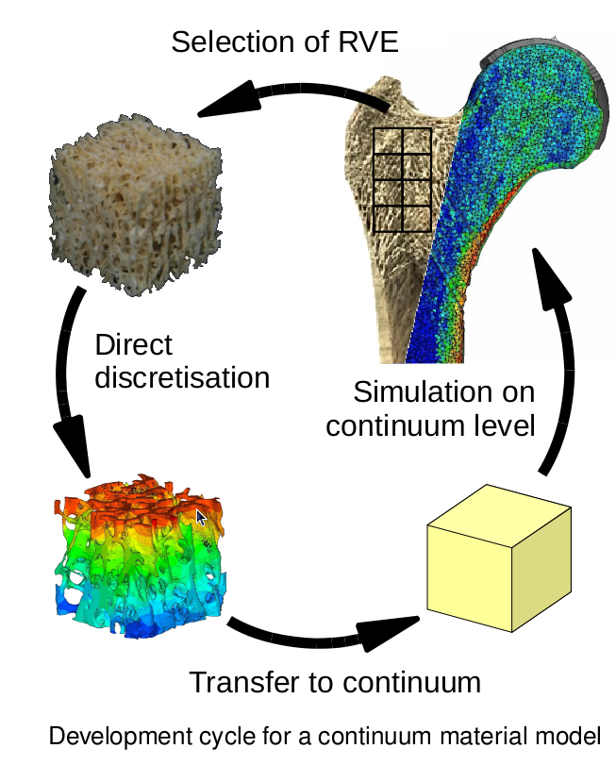
Bones FEM simulation
Aims
  Determine the local material behaviour of cancerous bones via direct mechanical simulation
  Find a transfer function from clinical CT-density data to an inhomogeneous distribution of anisotropic elastic material data throughout a complete bone
  Generate an anisotropic material model applicable to biomechanical simulations of bone-implant-systems

Slide 20
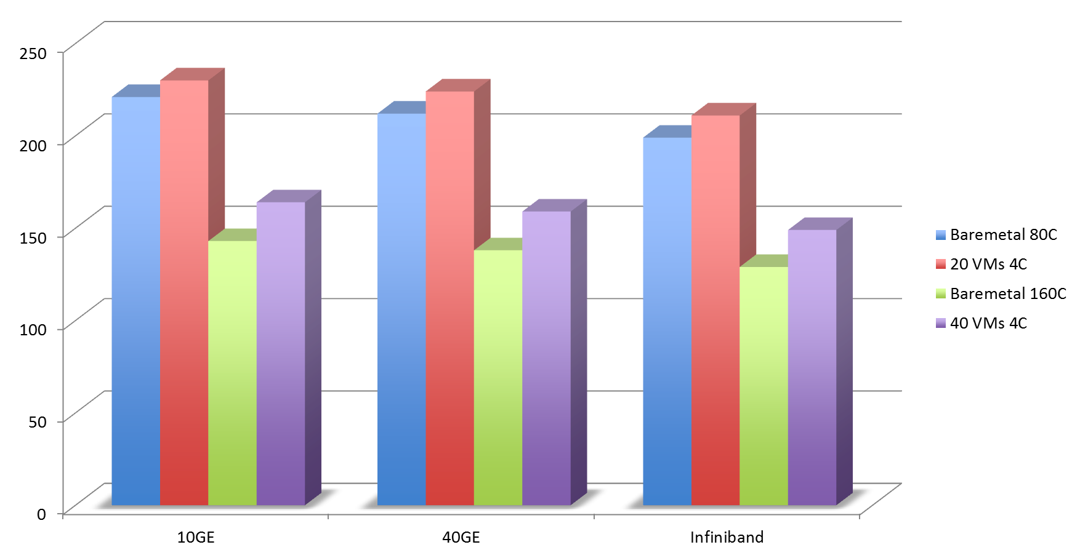
Initial Performance
Application
40 GB of raw data
  14 GB of results
FORTRAN / C
Communication – I/O
6 %
14 %
Hardware
4 nodes Intel Xeon
System storage node
  5 GB/s
Management node
10 GE / 40 GE / Infiniband

Slide 21
Performance VS ease of use
Performance
Ease of use
6 % to 14 % of performance drop
  Runtime
  Costs
Cluster architecture very close to standard HPC
  Full virtualization
VM placement crucial
  Complexity
Not all applications built for Clouds
Control ability
  Operating systems & software versions
  Different service models
Less adaptations
  Costs
Private Clouds can be built up
  Special purpose nodes
Easy access
  Service oriented provisioning
  Customized access models
Notes:
Combined?
Depends on the workflow
Depends on the availability
Application vs scalability
Service vs availability
Tradeoff

Slide 22
Conclusions
& Results

Slide 23
Conclusions & Results
HPC and Clouds do not necessarily compete !
Cloud technologies might be the basis for extending the HPC services portfolio
  Using Cloud concepts can broaden the user communities for HPC
  Enabling HPC in Clouds enriches the service portfolio
    2 different operation models possible
Using Clouds as „the one and only replacement“ for HPC cannot address all modern needs of HPC
  HPC hardware highly specialized
  Performance drop VS maximum control

Slide 24
Conclusions & Results (II)
Next Generation Clouds need to address important issues such as the performance of virtualization technologies
  Standard Cloud hardware is NOT capable for HPC applications
  Standard Cloud software technology is NOT capable for HPC computing
HPCClouds could be present in the near future due to the manifold operation models, but it won‘t be a standardized and exchangeable cloud service !

Slide 25
“Prediction is very difficult, especially about the future”
(Niels Bohr)

Slide 26

Thank you!
Questions?
Michael Gienger
Höchstleistungsrechenzentrum Stuttgart
Nobelstrasse 19
70569 Stuttgart
Telefon: : +49-711-685-63824
E-mail: gienger@hlrs.de

