Slide 1
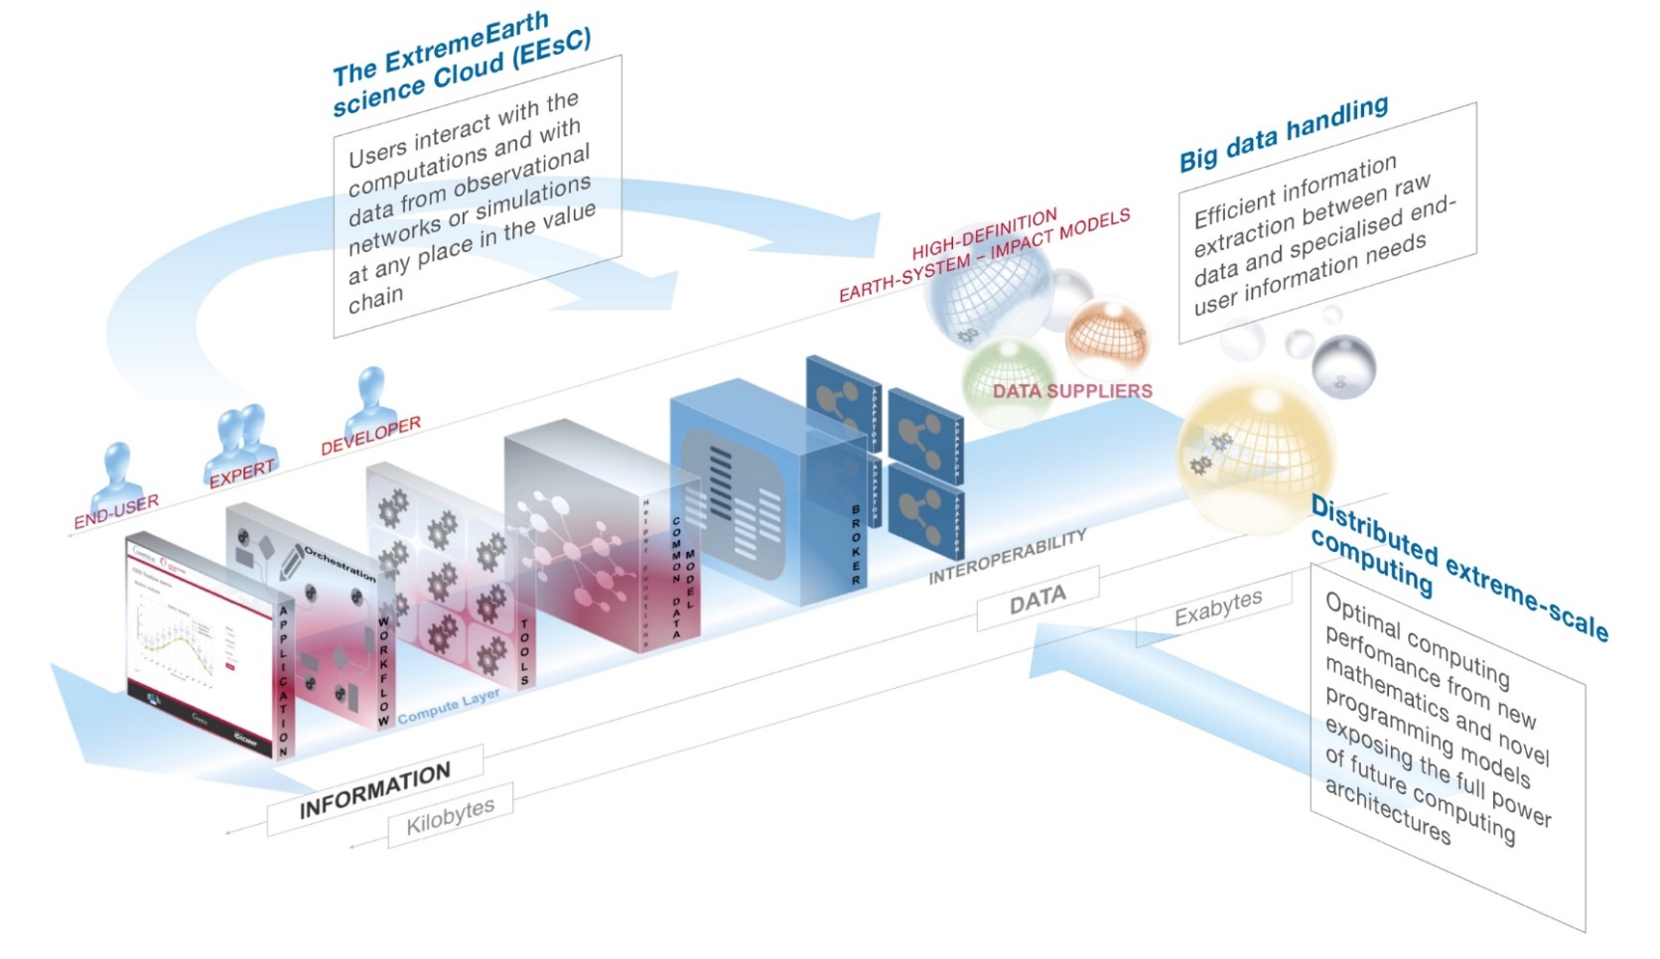

Why the future of weather and climate prediction
will depend on
supercomputing, big data handling and artificial intelligence
Peter Bauer

Slide 2
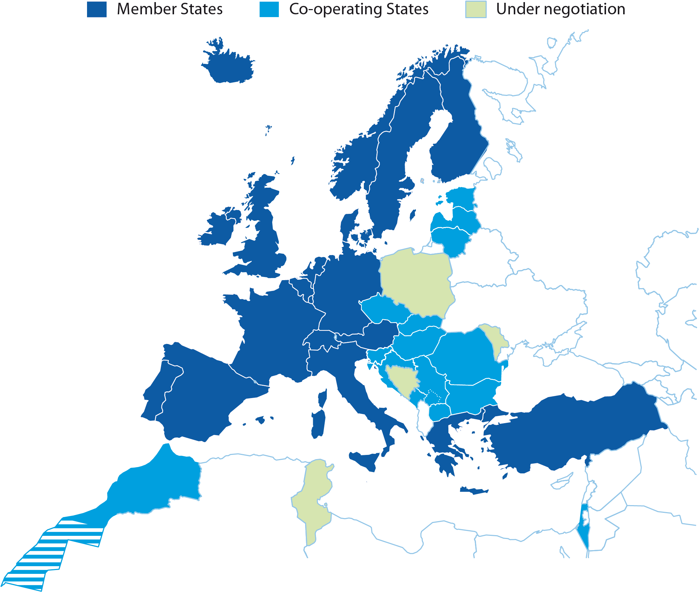
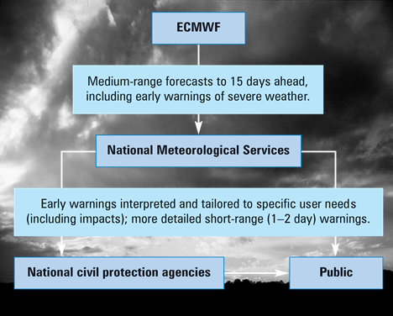
European Centre for Medium-Range Weather Forecasts
Independent
intergovernmental organisation
established in 1975
with
22 Member States
12 Co-operating States

Slide 3
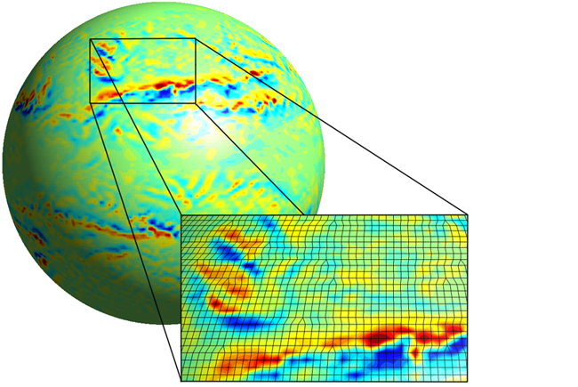
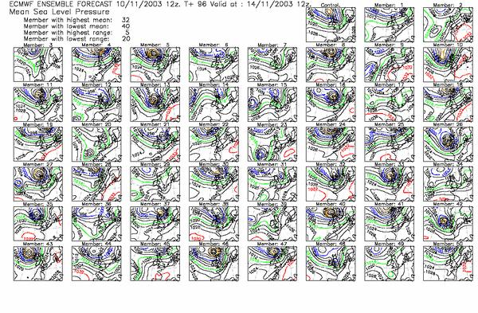
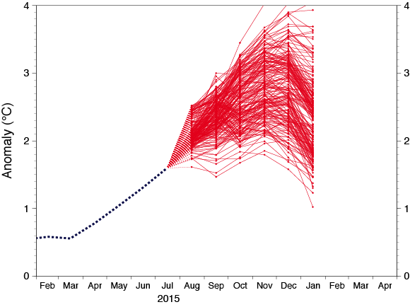
Operational Predictions
← 2x 9-km global high-resolution 10-day forecasts per day
51x 18-km global lower-resolution 15-day forecasts per day… →
… extended to 46 days twice per week at 36 km
← 51x 64-km global low resolution 7-month forecast per month

Slide 4
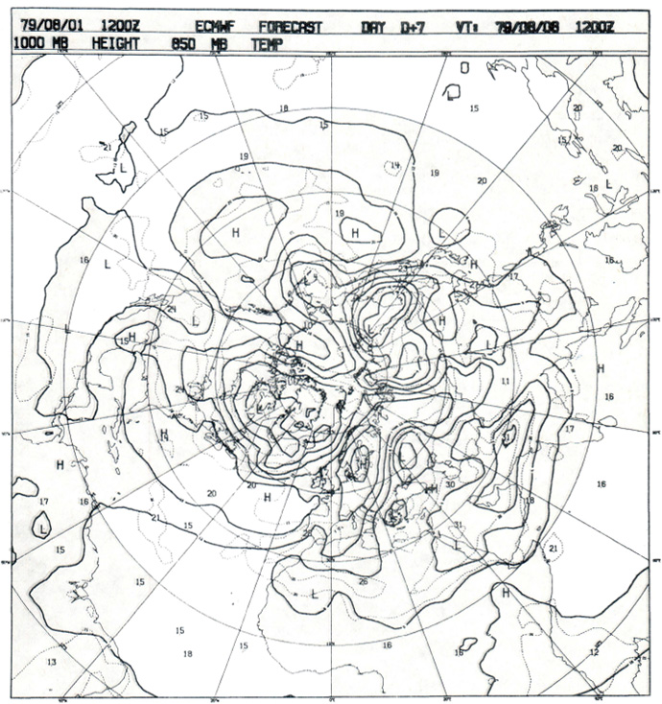
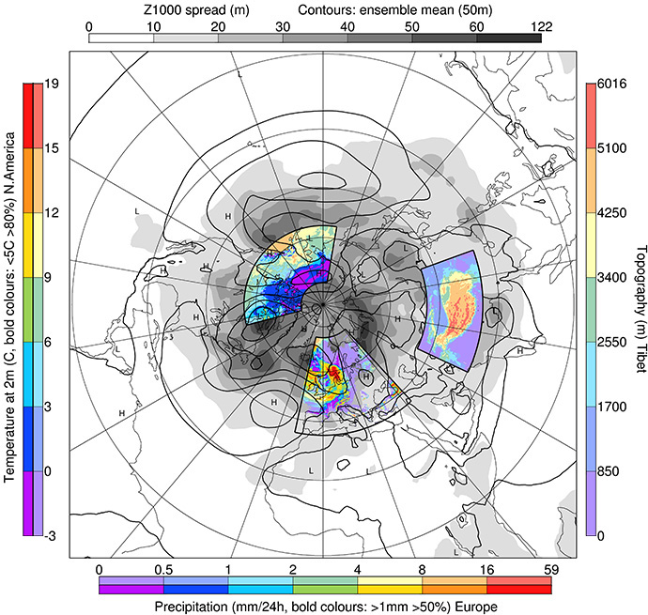
1st medium-range forecast 1 August 1979
Then: 01/08/1979 12z, z1000, t850
Now: ERA-5+50M ENS, 01/08/1979 12z, z1000, t2m, tp

Slide 5
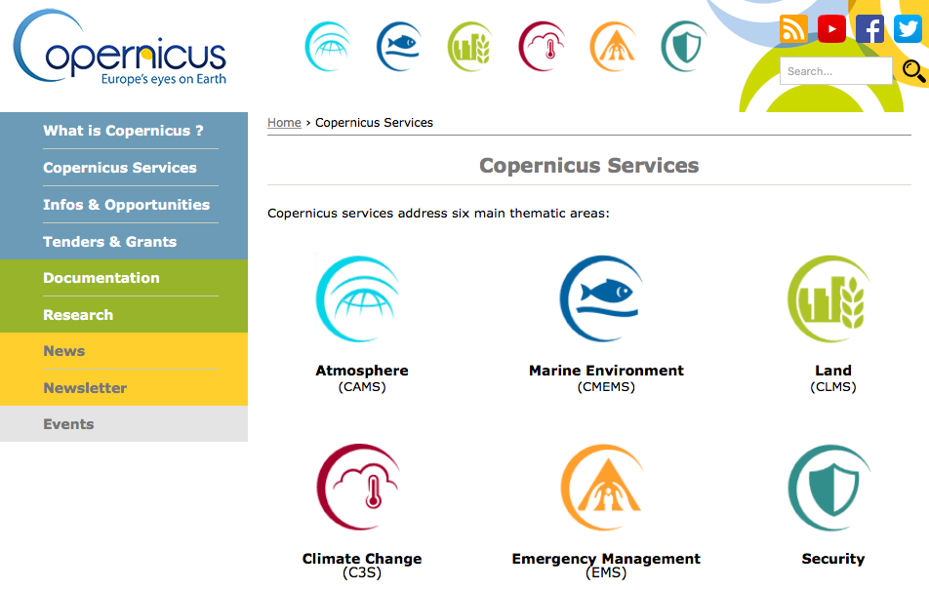
European Commission Copernicus Services
Hosted by
ECMWF
Supported by
ECMWF

Slide 6
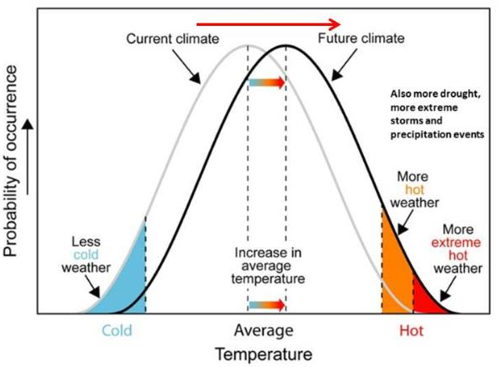
Weather & Climate
“weather decides what clothes you wear, climate decides what clothes you buy”

Slide 7
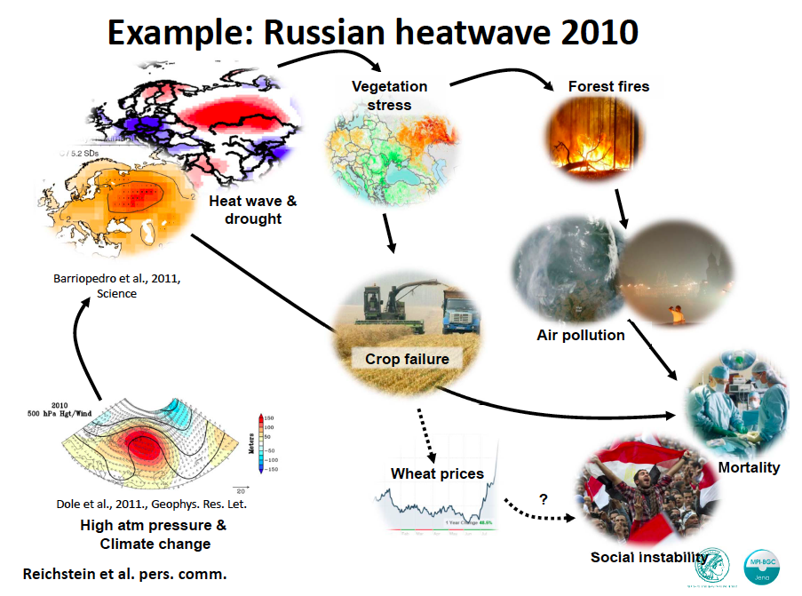
Impacts are an integral part of prediction
Example Russian heat wave 2010:
[Courtesy M. Reichstein]

Slide 8
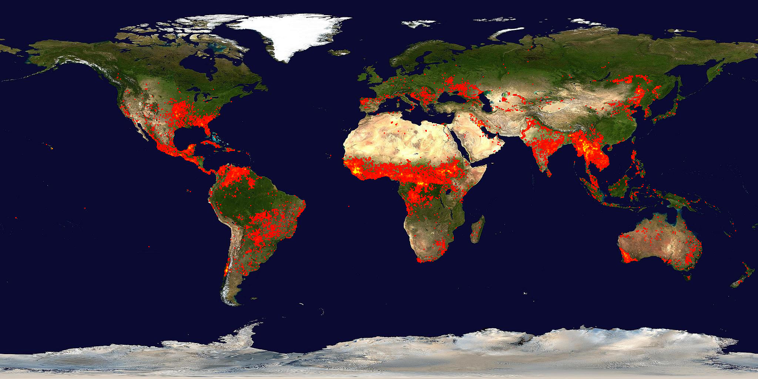
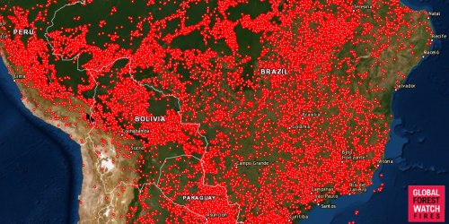
Fire extremes
The grand forecasting challenge:
Predict loss of carbon uptake, CO₂+ release and impact on climate
A few years ago…
Now…

Slide 9
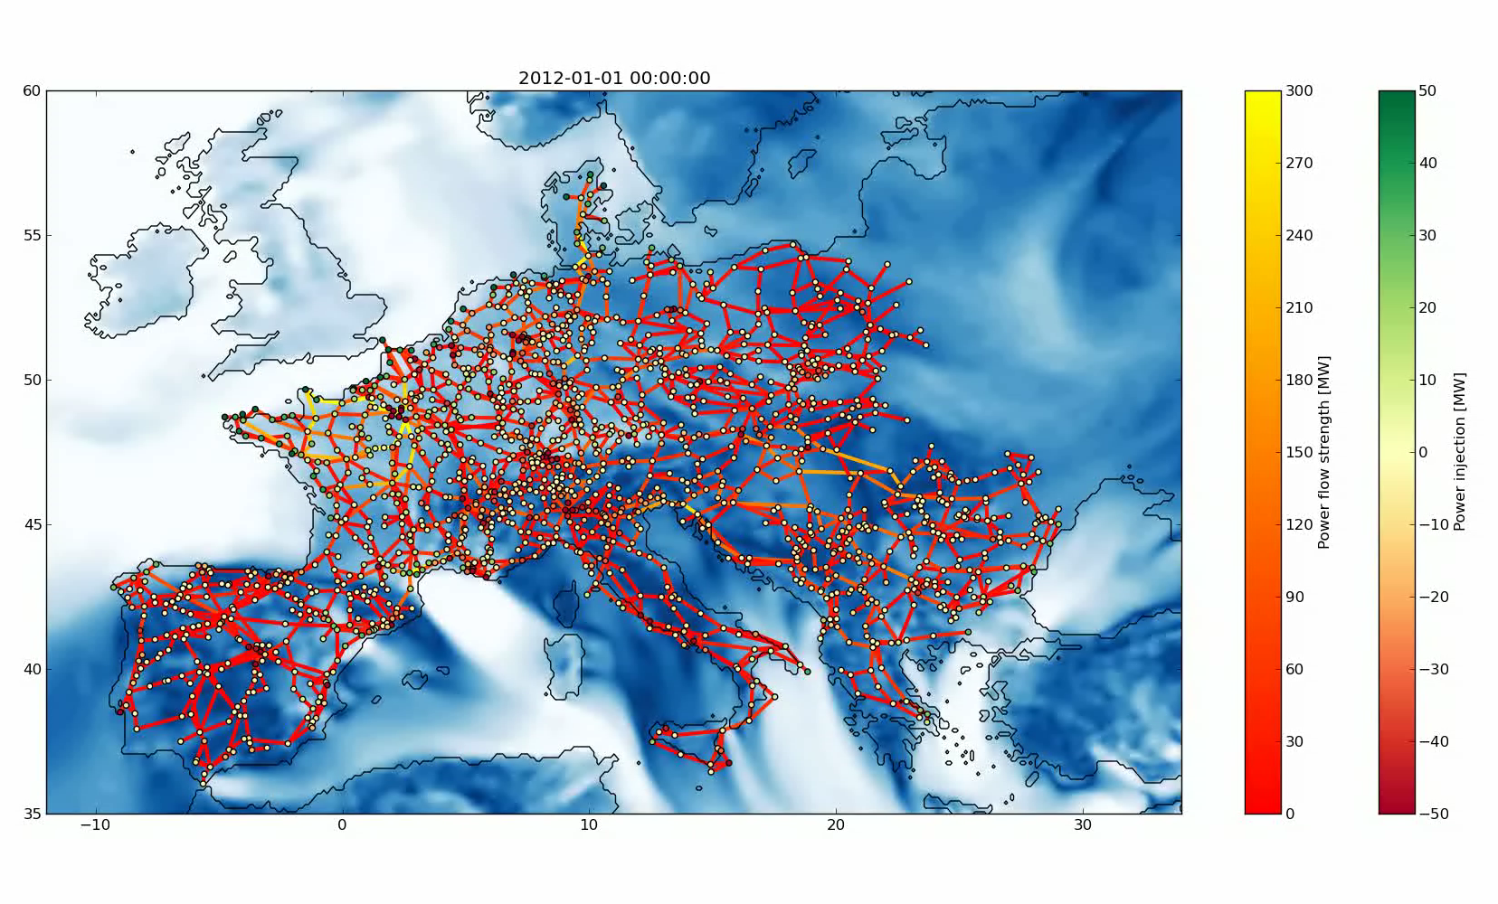
Energy extremes
The grand forecasting challenge:
Predict renewable power generation, dynamic uncertainties, and space-time dependencies at once for Europe
(…with a changing climate?)
[Courtesy Pierre Pinson DTU]

Slide 10

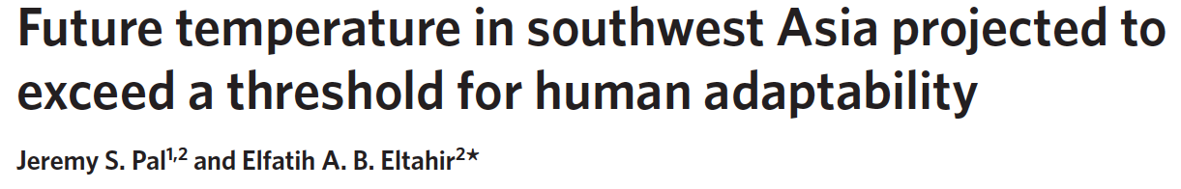
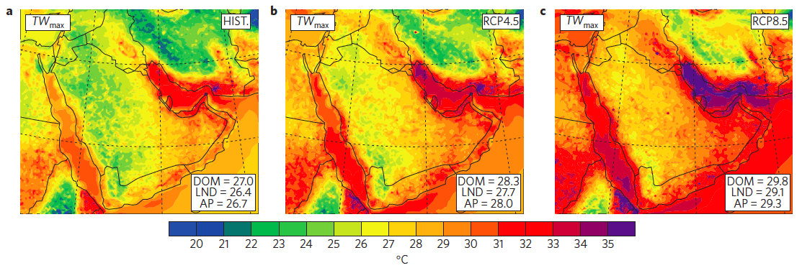
Health extremes
RCP8.5 ensemble predictions cause life threatening wet bulb temperature regimes
The grand forecasting challenge:
Predict location of future uninhabitable regions (…with a changing climate)

Slide 11
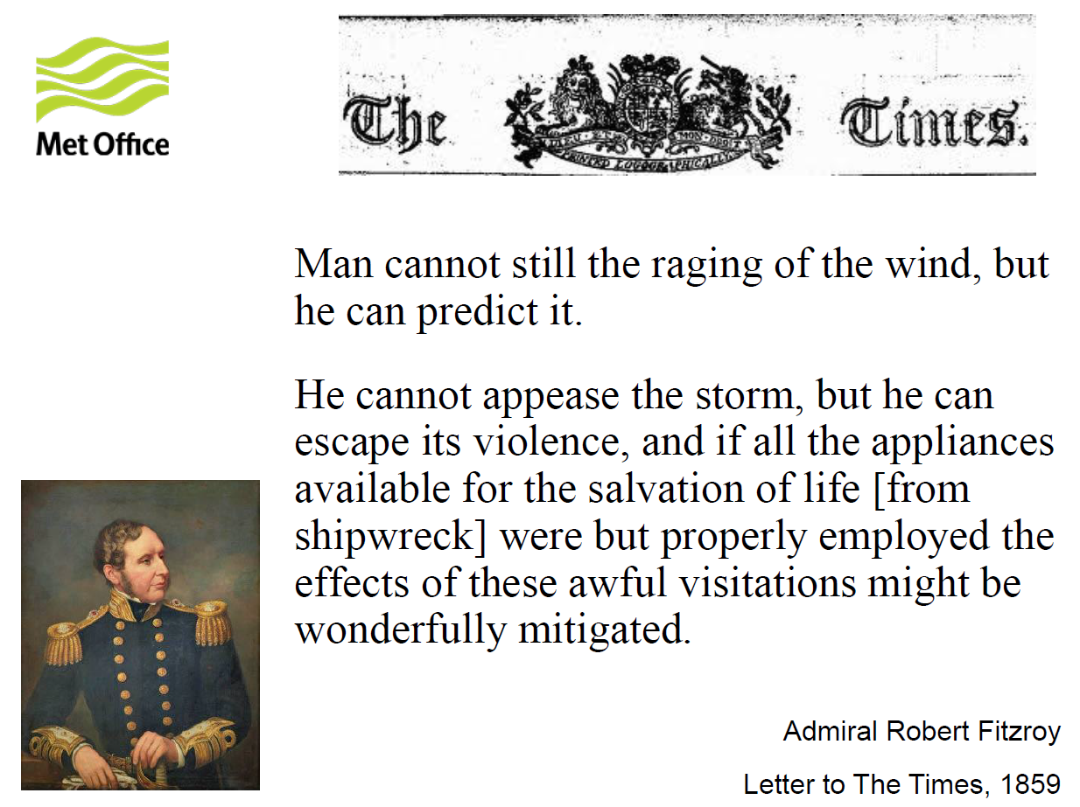
A bit of history: First attempts
Vice-Admiral Robert Fitzroy (1805-1865)
Among other appointments, captain of HMS Beagle, hosting Charles Darwin on his South American voyages
“Man cannot still the raging of the wind, but he can predict it. […]
He cannot appease the storm, but he can escape its violence, and […] the effects of these awful visitations might be wonderfully mitigated”
(Letter to the Times, 1859)
“I need not repeat, Sir, what has been so often explained, that the ‘forecasts’ are expressions of probabilities – and not dogmatic predictions”
(Letter to the Times, addressed to “those whose hats have been spoiled by umbrellas having been omitted”)

Slide 12
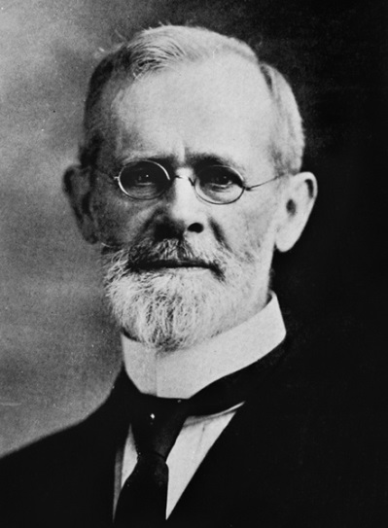
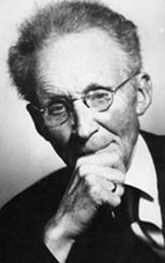
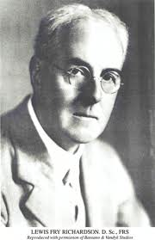
A bit of history: Numerical
Cleveland Abbe (1838-1916), Meteorologist:
Weather observation and basics of prediction
1901: “The physical basis of long-range weather forecasting ”. Monthly Weather review.
Vilhelm Bjerknes (1862-1951), Physicist und Meteorologist:
Interaction between dynamics und thermodynamics
Weather diagnostics, followed by prognoses
1904: “Das Problem der Wettervorhersage, betrachtet vom Standpunkte der Mechanik und der Physik”. Meteorologische Zeitschrift.
Lewis Fry Richardson (1881-1953), Physicist, Meteorologist, Psychologist, Pacifist:
Basics of numerical weather prediction
First explicit calculation of weather on 20 May 1910
1922: “Weather prediction by numerical process”. Cambridge University Press.

Slide 13
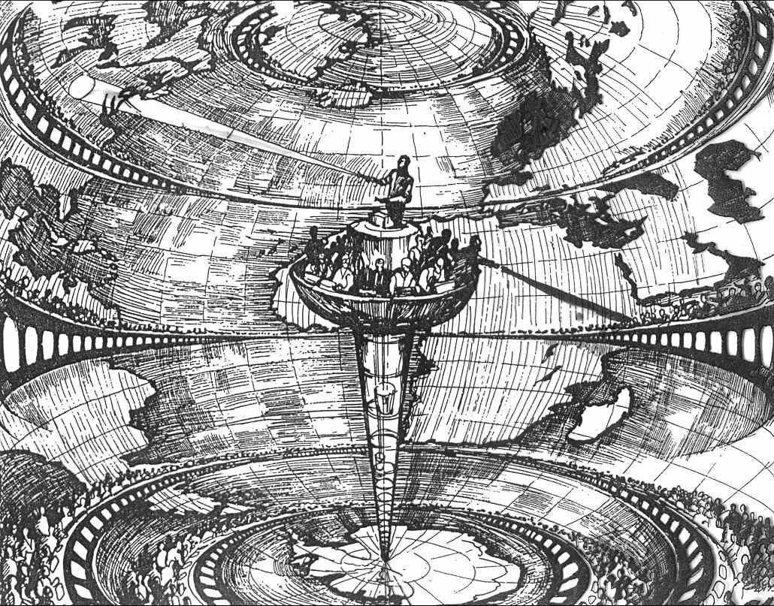
A bit of history: Richardson’s weather factory

Slide 14
A bit of history: Helmholtz lecture

Slide 15
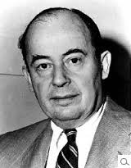
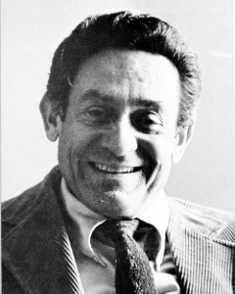
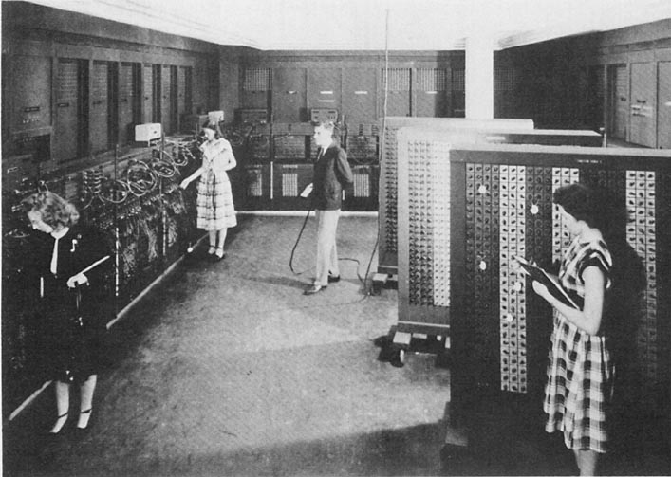
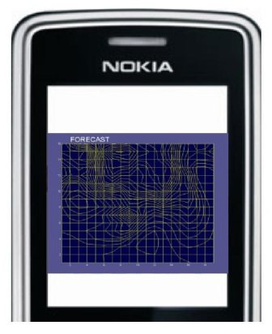
A bit of history: Computing
John von Neumann (1903-1957), Mathematician:
Function theory, abstract algebra, quantum physics
Leader of Electronic Computer Project (1946-52)
Jule Charney (1917-1981), Meteorologist:
Set of equations for numerical prediction of planetary waves
Founder of theory of baroclinic instability
ENIAC 1950
Electronic Numerical Integrator and Computer (ENIAC)
140 kW, 30 tons, 18000 thermo-ionic valves
1-layer model, resolution 400-700 km, over North America
Single 24-hour forecast needed 24 hours compute time
The same prediction needed 1 second on a Nokia 6300 mobile phone (2006)!

Slide 16
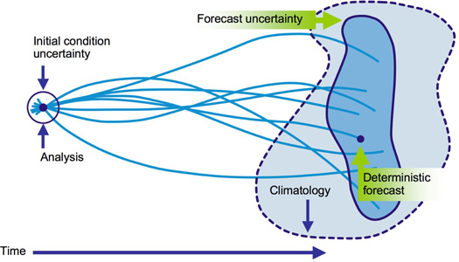
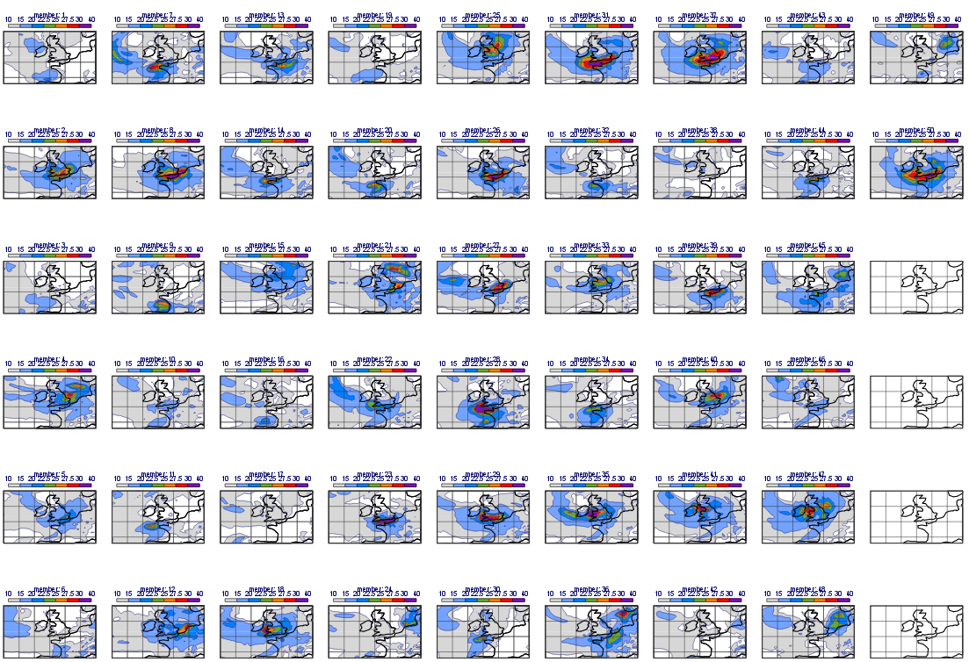
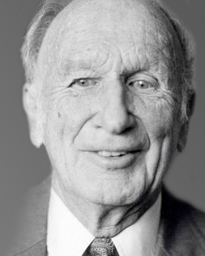

A bit of history: Foundation of Chaos Theory
Analysis error
Forecast error
Analysis
climatology
Single forecast
Time
Ed Lorenz (1917-2008), Mathematician, Meteorologist:
Impact of initial conditions on forecasts in non-linear systems
Founder of chaos-theory
Shakespeare:
“for want a nail, the shoe was lost.
for want a shoe, the horse was lost.
for want a horse, the rider was lost.
for want a rider, the battle was lost.
for want a battle, the kingdom was lost.”

Slide 17
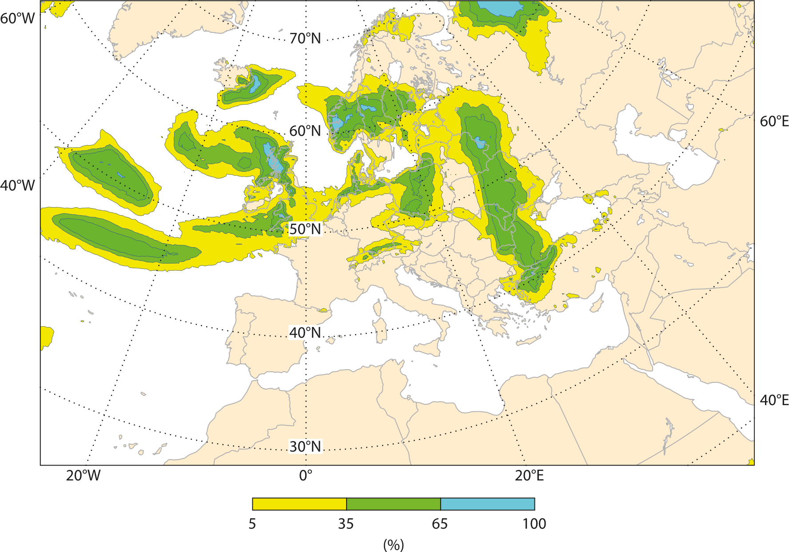
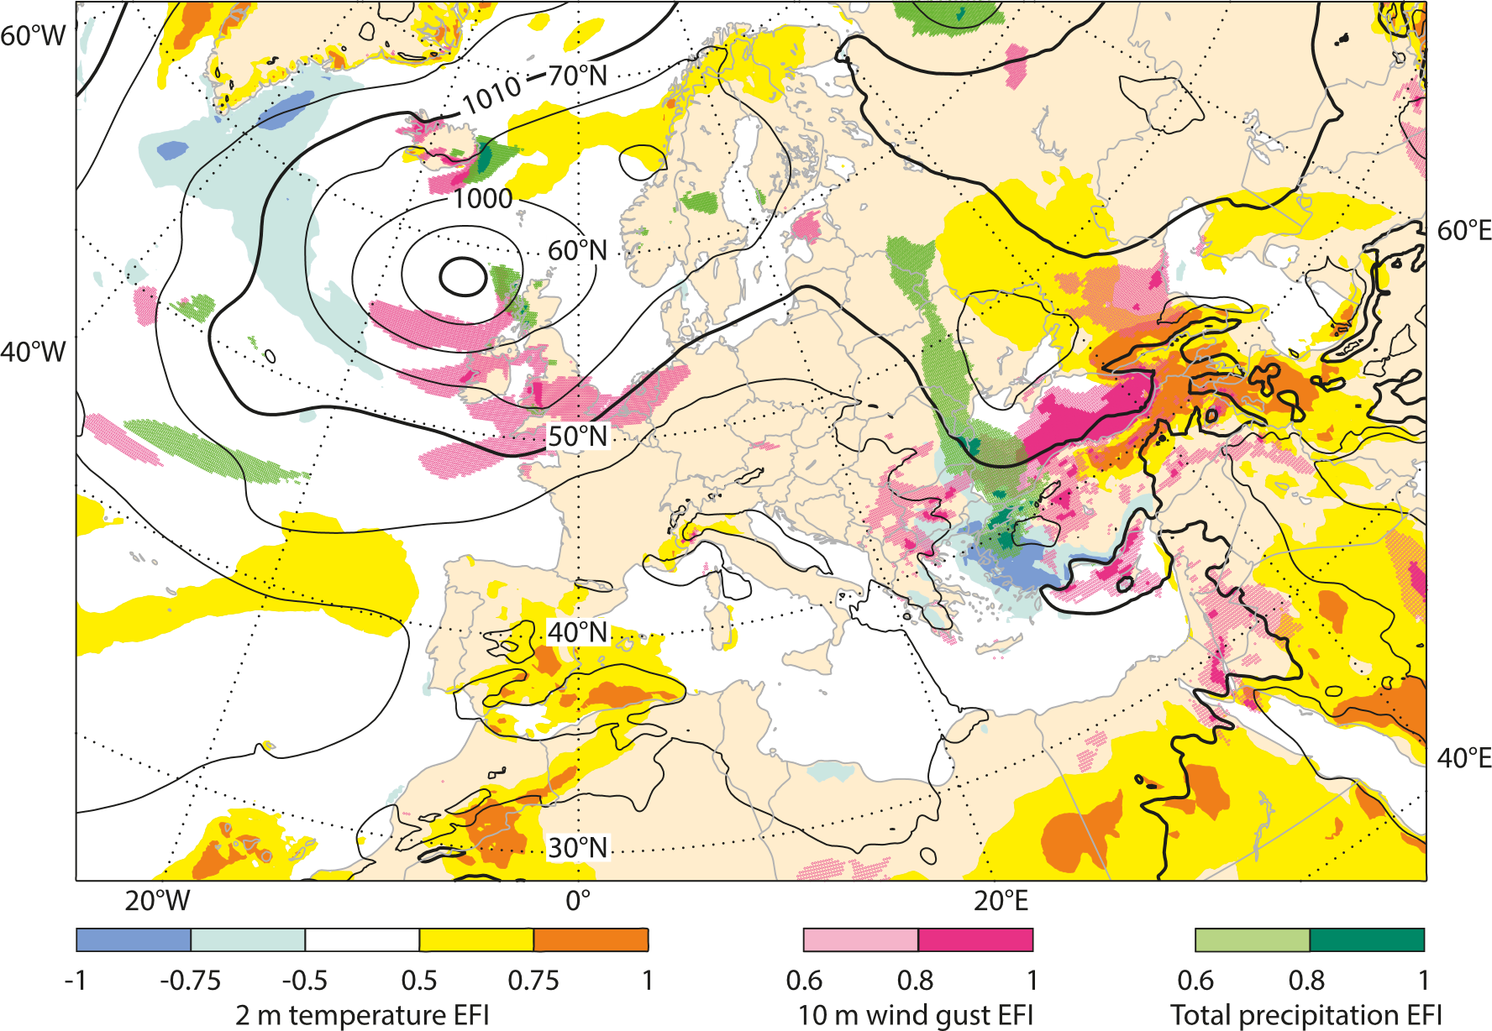
Reliable prediction of extremes 2 weeks ahead
Ensemble-based Extreme Forecast Index (EFI) forecast where the ensemble forecast distribution differs substantially from the model climatological distribution for 2-metre temperature, 10-metre wind gusts and precipitation
Ensemble-based probability of 24-hour precipitation in excess of 5 mm

Slide 18
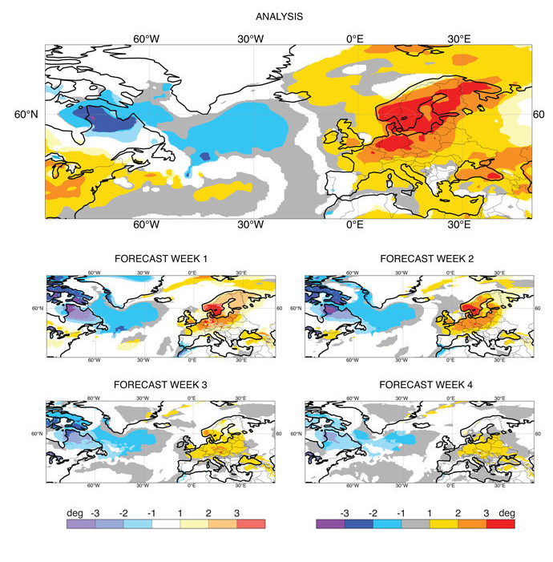
Reliable prediction of extremes 4 weeks ahead
Summer heatwave over Europe:
2m Temperature,
7 May – 12 August 2018

Slide 19
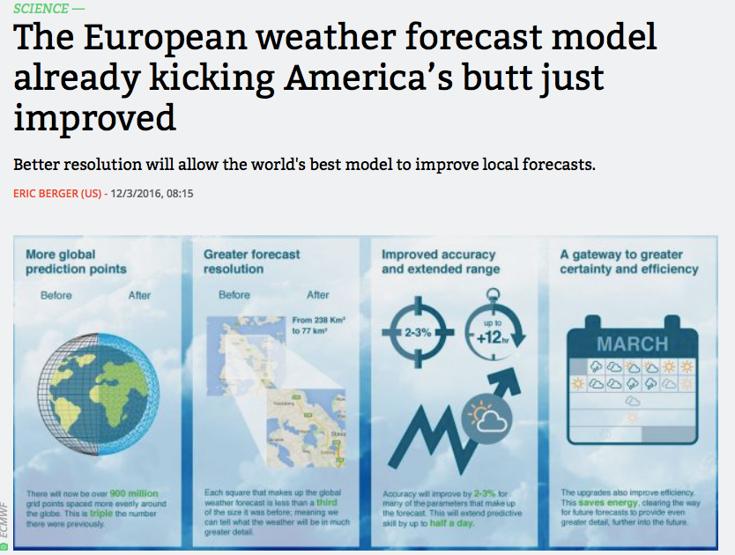
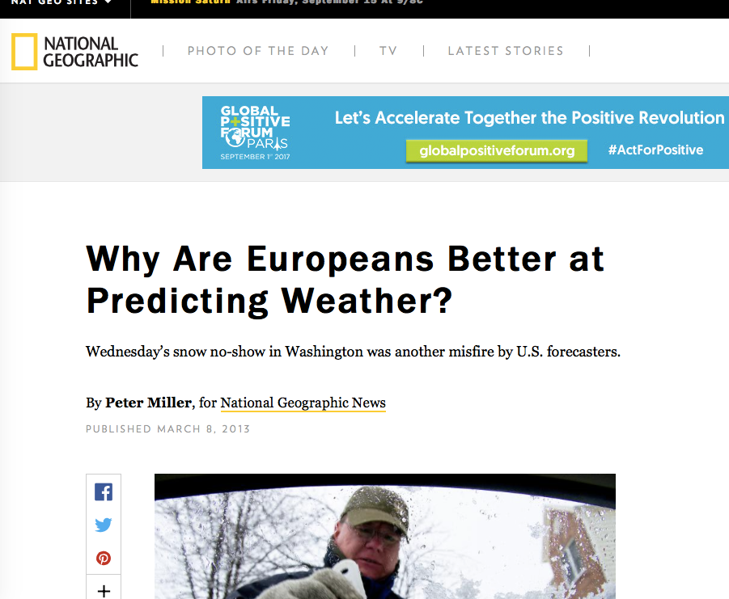
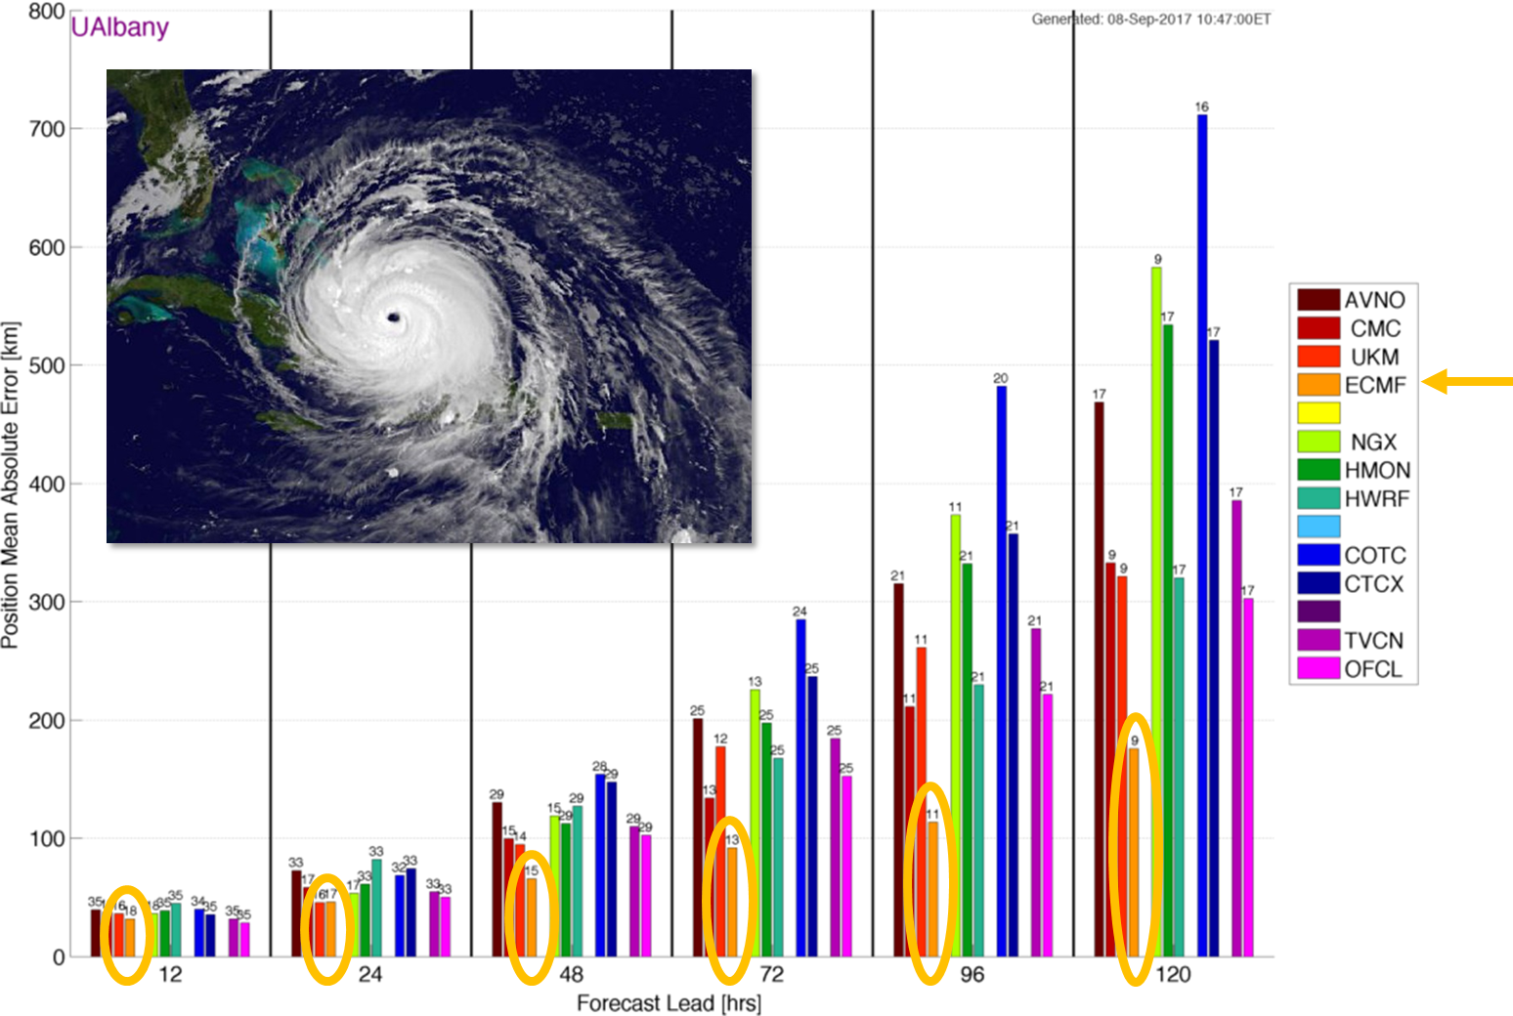
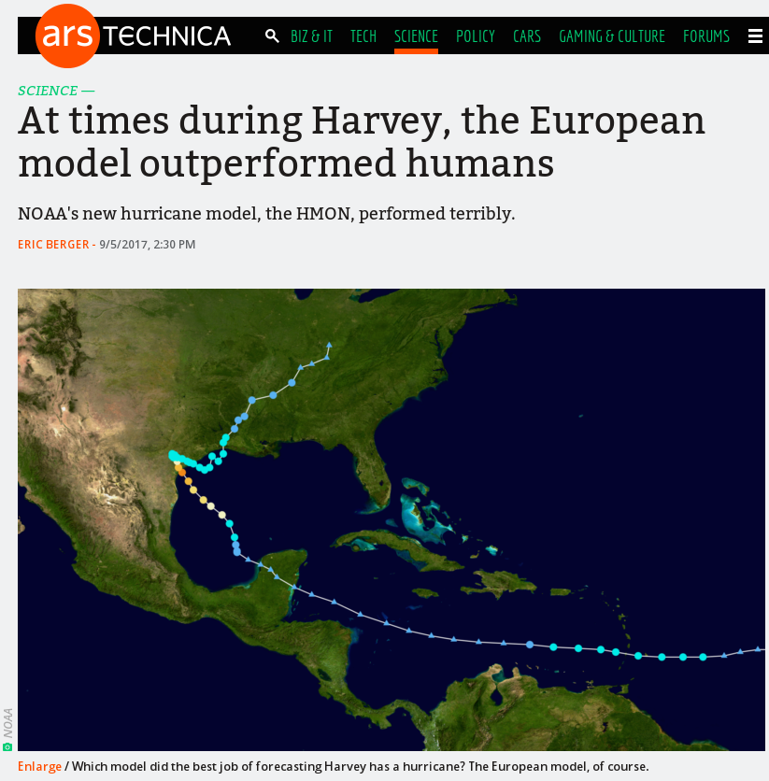
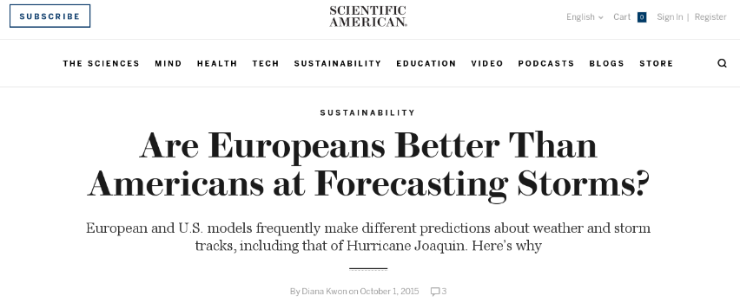
European leadership
World leadership in Europe – but still far away from sufficient accuracy and reliability!

Slide 20
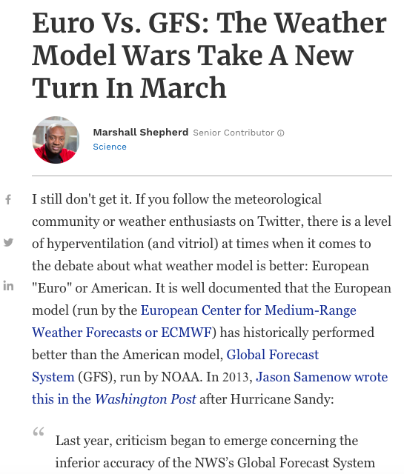
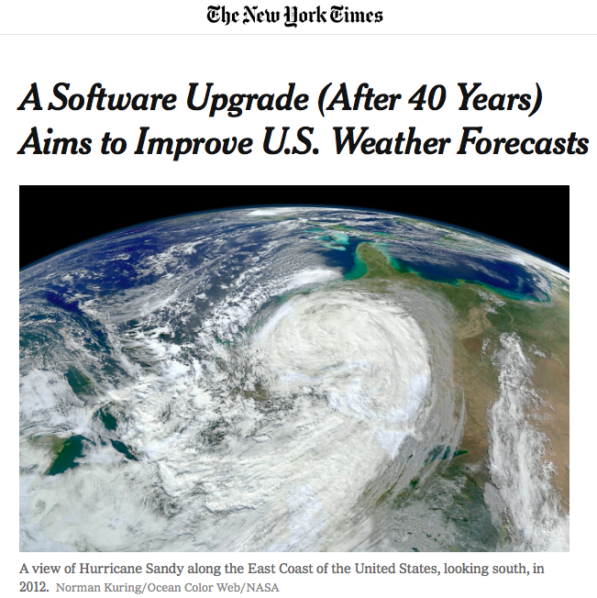
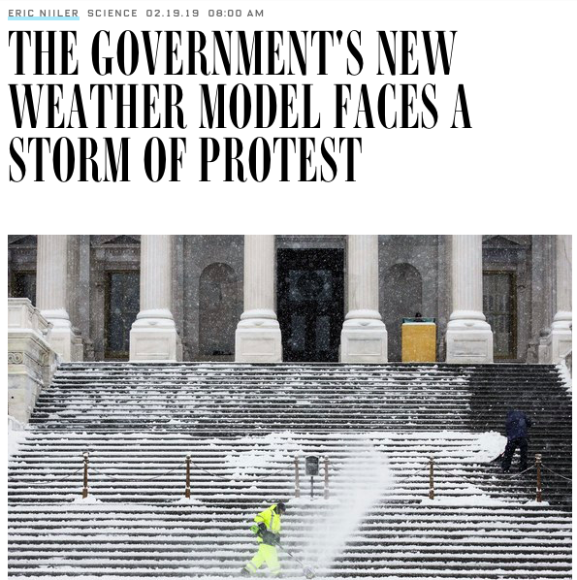
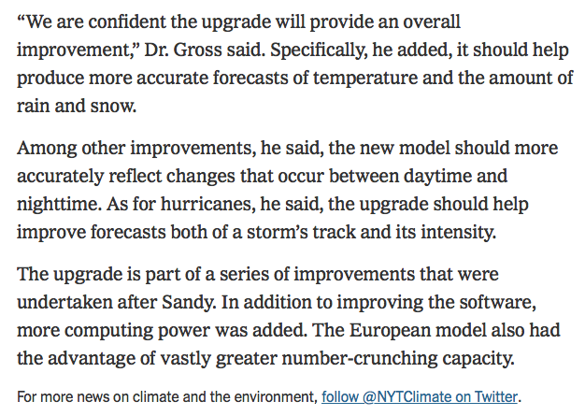

Slide 21
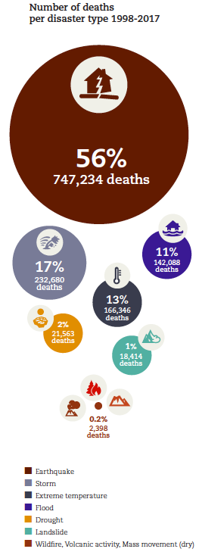
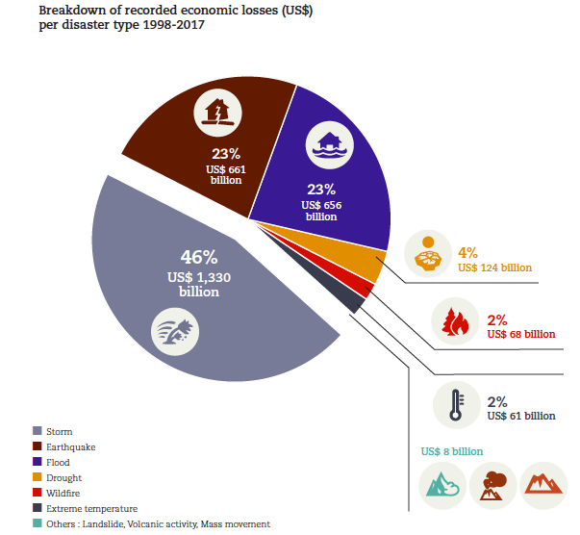

“Economic losses, poverty and disasters 1998-2017”
> 1.3 million fatalities
> 2.9 trillion US$ losses
UN Report published on 10 October 2018 by:

Slide 22

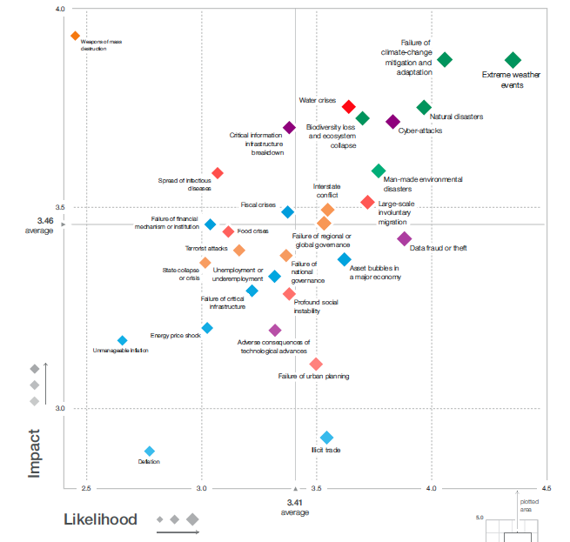
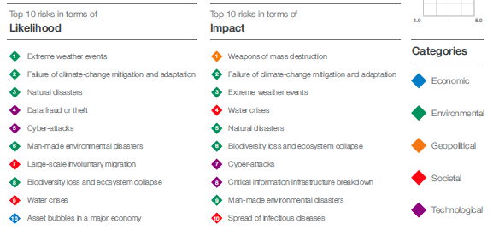
“The 2019 Global Risks Report”

Slide 23
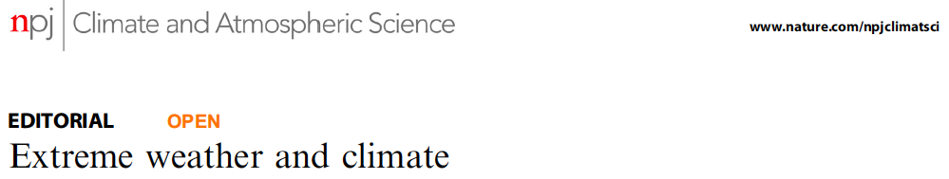
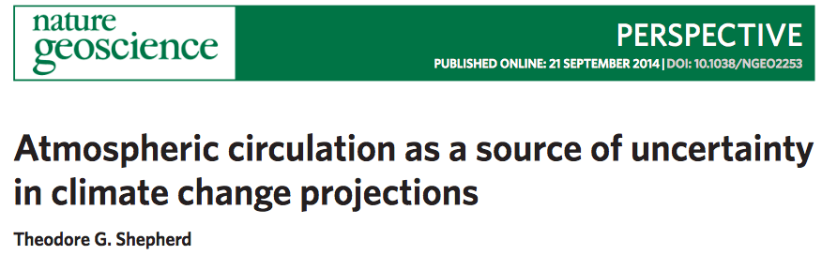
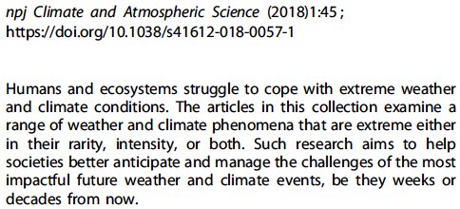
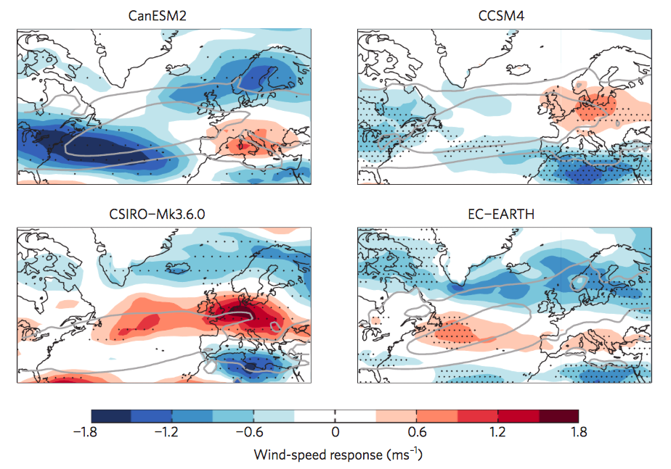
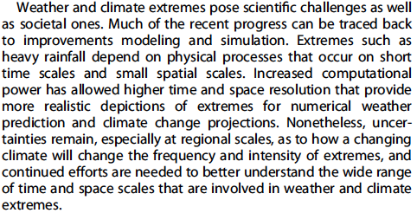
Reliable prediction of extremes decades ahead?
…
850 hPa wind speed response to RCP8.5 forcing by 2100

Slide 24
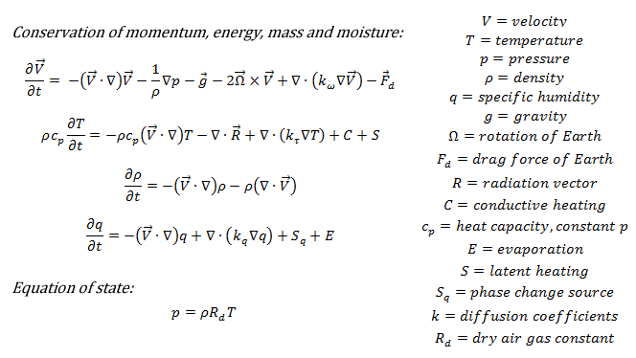

Resolved or not resolved?
Resolved Not resolved
… from parameterizations for radiation, cloud, convection, turbulence, waves…

Slide 25



Present schools of thought
Resolution: Add spatial resolution to eliminate parametrisations
→ Computing?
Traditional: Add model complexity, rely on parametrisations
→ Realism?
Technology: Use ML
to replace parametrisations
→ Training?

Slide 26



ECMWF model @ 1.45km
Better orography, better boundary layers
Wind gusts at 1.45 km
Wind gust at 9 km

Slide 27
Global storm resolving models
resolved
parameterised
Global Storm Resolving Models ≠ High-resolution General Circulation Models:
[Courtesy Bjorn Stevens]

Slide 28



The biggest challenges
Parameterizations: are in the way of overcoming key sources of model error
Coupling: drives how Earth-system components interact: fluxes, budgets
Observation/assimilation: key to model improvement, initialisation
Computing: key to running realistic models in the future

Slide 29



https://www.ecmwf.int/en/about/media-centre/science-blog

Slide 30




Present capability @ 1 km
→ O(100-250) too slow (still no I/O)
→ O(1000) incl. everything (ensembles, Earth system, etc.)
→ O(3-10) too slow (atmosphere only, no I/O)
[Schulthess et al. 2019, Computing in Science & Engineering]
Notes:
(e.g. 56 species, 200 reactions)

Slide 31


1-slide tutorial on computing performance
Basic performance metrics (serial):
Execution time = number of instructions x cycles per instruction x clock-cycle
Floating point operations per second FLOPS = floating point operations / execution time
Transistor size and clock-cycle (serial, Moore, Dennard):
The smaller the transistor the faster its state can be changed by clock cycles
Power P = capacitance x voltage² x 1/clock-cycle (capacitance $∝$ area)
Caveats:
  transistors cannot become smaller anymore → spontaneous electron leakage
  transistor voltage does not scale with size anymore → overall power increases
Basic performance metrics (parallel, Amdahl):
Performance gain for n parallel streams = $\frac{1}{α+ \frac{1−α}{n}}$
with α = fraction of serial code
Moving data is more expensive than performing calculations:
[Kogge and Shalf 2015]

Slide 32


The end of Moore’s law and Dennard scaling
Transistor size and clock-cycle (serial, Moore, Dennard):
The smaller the transistor the faster its state can be changed by clock cycles
Power P = capacitance x voltage² x 1/clock-cycle (capacitance area)
Caveats:
  transistors cannot become smaller anymore → spontaneous electron leakage
  transistor voltage does not scale with size anymore → overall power increases

Slide 33





The future – ultimately, touch everything
Neural networks
Mathematics&algorithms
Back-end: GridTools
Processors
Data structures: Atlas
Notes:
Touch everything

Slide 34

What’s wrong with weather and climate codes?
No 1: sequential with time steps (10d x 24h x 3600s / 450s = 1920 @ 9km
Transforms: communication bandwidth, memory
Advection: halo-communication, scalability
Physics: expensive calculations, scalable
Ocean waves: expensive calculations
3D-solver: iterations, memory, communication bandwidth
Transforms: communication bandwidth, memory
Notes:
Dwarfs:
Spectral transforms (FT/LT and bi-FT) ………….. very memory and communication bandwidth intensive, possibly limited scalability
2 & 3-dimensional elliptic solver ……………….... compute and communication latency intensive, possibly limited scalability
Semi-Lagrangian advection …………………….... communication intensive, possibly limited scalability
Flux-form finite-volume advection ……………….. local communication, latency intensive, limited scalability
Cloud physics parameterization …………………. expensive computations, independent vertical columns, scalable
Radiation parameterization ………………………. expensive computations, spatial, temporal and wavenumber space, scalable

Slide 35



Daily data access at ECMWF
40 billion fields
20 PB data retrieved
25 thousand users
Public
Total activity (Member States and commercial customers) per day:
450 TBytes retrieved
200 TBytes archived
1.5 million requests
Total volume in MARS: 220 PiB
2014 2015 2016 2017 2018

Slide 36
Deep learning and Earth-system sciences

Slide 37



Application areas in workflow
Observational data processing (edge & cloud &HPC):
Quality control and bias correction
Data selection
Inversion (=retrieval)
Data fusion (combining observations)
…
Prediction models (cloud & HPC):
Data assimilation (combining models w/ observations)
Surrogate model components
Prediction itself
Model error statistics
…
Service output data processing (cloud &HPC):
Product generation and dissemination
Product feature extraction (data mining)
Product error statistics
Interactive visualisation and selection
Data handling (access prediction)
…
Data acquisition
Forecast run
Dissemination
RMDCN
Internet
Web services
Product generation
Internet
Archive
Data Handling System

Slide 38


But can we predict the weather?
An attempt to test if Neural Networks could replace weather forecast models that are based on physics principles:
Use Ed Lorenz’s 1996 simplified model that captures chaotic and non-linear interaction between scales, just like in the real atmosphere
Use real ECMWF model forecasts at (much) reduced resolution, local stencil
Local NN only slightly worse than
T21 forecast model
This is the real target: T1279 (9km) forecast mode

Slide 39


https://www.extremeearth.eu

Slide 40

https://sites.google.com/view/climatemodelingcentre
There are new career opportunities for computational scientists in weather and climate prediction – an opportunity to create impact for society!

