Slide 1
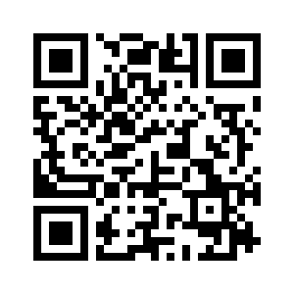
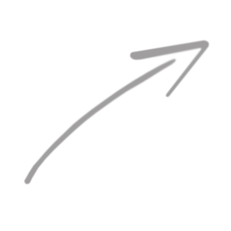
Advancing
Openness and Transparency
in Scientific Contributions
Scan to read a summary!
https://osf.io/preprints/metaarxiv/3hb6g
Rima-Maria Rahal^{1,2} & Susann Fiedler^{2,3}
¹ Tilburg University
² Max Planck Institute for Research on Collective Goods
³ Open Science Framework
26.08.2019 | GridKa School
Notes:
Common incentive structures and evidence of irreproducibility in various areas of research discourage individual researchers in their quest for knowledge to some extent and leave many with a sense of uncertainty about how to go about their scientific work. Discussing the problems highlighted through the research presented within this symposium, I will make concrete suggestions for increasing reproducibility within one’s own research and address the potential for an increase in reproducibility across all stages of a full research project. Thereby, highlighted are the opportunities that come along with small changes in everyday procedures. The talk will give an overview on how one can become part of a movement promoting a cultural shift toward open-mindedness for complex relationships and a strong interest in innovation, going hand in hand with a redefined understanding of responsibility of a social science researcher in 2016, supporting transparency and reproducibility.

Slide 2
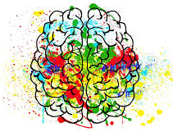
Pretty different...
Notes:
advanced computing, machine learning, big data analytics vs. empirical behavioral science, psychology, behavioral economics
if I google image search our fields … it already looks very different

Slide 3
Do we have anything in common?
Notes:
looking for the truth, for where our insights lead, for clearing the fog -- although we go about it in potentially very different ways
what matters to us is seeing clearly at the end of the path

Slide 4
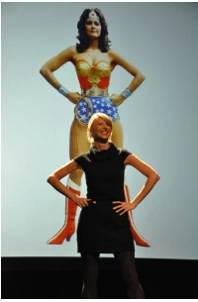
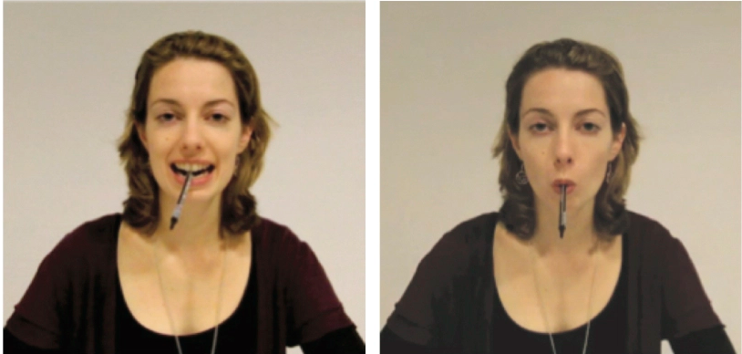
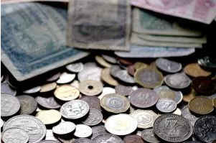
Tension between Mission and Practice.
Notes:
Ten Famous Psychology Findings That It’s Been Difficult To Replicate
via giphyBy Christian Jarrett
Every now and again a psychology finding is published that immediately grabs the world’s attention and refuses to let go – often it’s a result with immediate implications for how we can live more happily and peacefully, or it says something profound about human nature. Said finding then enters the public consciousness, endlessly recycled in pop psychology books and magazine articles.
Unfortunately, sometimes when other researchers have attempted to obtain these same influential findings, they’ve struggled. This replication problem doesn’t just apply to famous findings, nor does it only affect psychological science. And there can be relatively mundane reasons behind failed replications, such as methodological differences from the original or cultural changes since the original was conducted.
But given the public fascination with psychology, and the powerful influence of certain results, it is arguably in the public interest to summarise in one place a collection of some of the most famous findings that have proven tricky to repeat. This is not a list of disproven or dodgy results. It’s a snapshot of the difficult, messy process of behavioural science.
Power posing will make you bolder
Put your hands on your hips, widen your stance. Do you feel bolder now? Harvard psychologist Amy Cuddy and others have published numerous studies that appear to show that our body position can affect our emotional state. One of the reasons this line of research has been so influential is because of Cuddy’s TED talk “Your Body Language Shapes Who You Are” which has been viewed many millions of times (image to left shows Amy Cuddy power posing at PopTech 2011, via Erik Hersman/Flickr).
In 2010, in a paper that’s already been cited over 450 times, Cuddy and her colleagues Andy Yap and lead author Dana Carney showed that after adopting one of two power poses for just one minute (either legs on desk/hands behind head or feet apart leaning on a desk) participants made riskier bets and had higher testosterone and lower cortisol, compared with participants who spent one minute in a low power pose (sitting with hands in lap or standing embracing oneself).
However, last year researchers led by Eva Ranehill at the University of Zurich attempted to replicatethese findings with 200 participants (compared with the sample of 42 participants in Cuddy’s research) and while participants who adopted power poses said they felt more powerful, they showed no differences in their testosterone or cortisol levels compared with the low-power pose participants, nor were they more willing to make risky bets. “Using a much larger sample size but similar procedures as Carney et al. did, we failed to confirm an effect of power posing,” the replication team said.
Cuddy and her colleagues responded with an overview of 33 published studies that have shown psychological and physiological effects of power posing. But in a paper that’s forthcoming in Psychological Science Joseph Simmons and Uri Simonsohn at the University of Pennsylvania have conducted a statistical analysis on these 33 published studies that they say shows “the existing evidence is too weak to justify a search for moderators or to advocate for people to engage in power posing to better their lives”.
Smiling will make you feel happier
We know that feeling happy makes us smile, but can smiling make us happy? In 1988, researchersreported that participants found cartoons funnier when they held a pen between their teeth, forcing them to smile, as compared with when they held a pen between their lips, forcing them to pout. The finding appeared to be consistent with the facial-feedback hypothesis – the idea that our facial expression doesn’t just reflect our feelings but also affects them – and according to Google Scholar it has been cited nearly 1500 times.
However, a replication attempt published this Summer by 17 independent labs and involving nearly two thousand participants found overall no effect of mouth position on people’s rating of the funniness of cartoons. The replication team said their replication failure was “statistically compelling”. The lead author of the 1988 study, Fritz Strack, said he was surprised by the null result and he highlighted a number of problems with the replication attempt, including the fact the participants were filmed during the study, which may have made them self-conscious and affected their emotions.
Self-control is a limited resource
One of the most influential psychological theories of modern times is that willpower is akin to a fuel – the more of it you use in one situation, the less you have left over to deal with other demands. Of the many dozens of studies that have demonstrated this principle, known as “ego depletion”, one that was recently targeted for replication was published inPsychological Science in 2014 by Chandra Sripada and colleagues – it showed that performance on a task requiring self-control was impaired if it was preceded by an earlier task that also required self-control, but not if it was preceded by a non-demanding task (the study also demonstrated that this apparent effect of depleted self-control was ameliorated by earlier intake of the drug Ritalin, presumably through its neurochemical effects, but this aspect of the study was not part of this year’s replication attempt).
The replication effort, by 23 labs and involving nearly two thousand participants, repeated the sequential task procedure used by Sripada, to check whether the basic principle holds true that being drained by one self-control task impairs people’s performance on a further test of self-control. In fact, overall, the combined results were not consistent with this idea. “… [I]f there is any [ego depletion] effect, it is close to zero,” the replication researchers said. Their finding added to the outcome of a recent meta-analysis of 68 relevant published and 48 unpublished studies that found little support for the idea of willpower as a limited resource.
Responding to the failed replication, Roy Baumeister, who co-discovered and proposed the concept of ego-depletion, said that it was “misguided” and had been a mistake to focus on trying to replicate a study that had used new procedures, rather than more established means, for provoking depleted self-control.
Revising after your exams can improve your earlier performance
If I told you that I was planning to revise for my upcoming examafter the exam, you’d quite understandably probably think I was rather daft. And yet a series of studies published in the prestigious APA publication the Journal of Personality and Social Psychology (currently cited nearly 500 times) appeared to show that such a plan could work – among the bizarre findings that appeared to show established psychological effects working backwards in time, Darly Bem and his colleagues found that spending time learning words after a memory test actually boosted performance on that earlier memory test.
However, when Stuart Ritchie, Richard Wiseman and Chris French each independently attempted toreplicate this finding, in each case using Bem’s original computer programme and materials, they were unsuccessful. “Our participants were no better at remembering the words they were about to see again than the words they would not, and thus none of our three studies yielded evidence for psychic powers,” Ritchie and his colleagues said in a commentary for The Psychologist.
But the controversy hasn’t gone away. This year Bem and his colleagues gathered together all the data from 90 experiments from 33 laboratories in 14 countries that have attempted to replicate his surprising findings (including the retrospective effects of learning, but also the other backwards effectshe documented). Overall, Bem says the totality of this evidence is overwhelmingly in favour of “pre-cognition” or “psi” being a real phenomenon. “The incompatibility of psi with our current conceptual model of physical reality may say less about psi than about the conceptual model of physical reality that most non-physicists, including psychologists, still take for granted—but which physicists no longer do,” Bem and his team concluded.
Exposure to words pertaining to ageing will make you walk more slowly
The idea that our thoughts and behaviour can be influenced by the meaning and connotations of the words, symbols and objects around us, even when we’re not paying attention to them, is known as “social priming”. The findings in this field are fascinating but they are proving to be the most difficult effects to replicate in psychology.
A modern classic of the social priming literature – cited over 3700 times to date – was published in 1996 and involved participants unscrambling jumbled lists of words to form coherent sentences. When these word lists contained words pertaining to ageing and the elderly, participants on leaving the lab walked out more slowly than when the lists did not contain such words. Presumably the ageing-related words triggered related ideas in the participants’ minds that led them to behave in a stereotypically more elderly way.
This makes for a neat story, but unfortunately this specific finding and others in the field has been tricky to repeat. In 2012, researchers at the Université Libre de Bruxelles and the University of Cambridge attempted to obtain the same effect on walking speed but failed. They only achieved the same outcome as the original research when they deliberately manipulated the expectations of the researchers who were interacting with the participants, to make them consistent with the earlier results.
John Bargh the lead author of the 1996 classic criticised the replication attempt and outlined a number of reasons why it might have failed, including that the replication researchers may have included too many ageing-related words thereby making the priming effect too obvious.
Cleaning your hands will wash away your guilt
“Out, damned spot!” cries a guilt-ridden Lady Macbeth, obsessively washing her hands in the hope it will clear her conscience. Many research findings have demonstrated the that the link between moral purity and physical cleanliness is more than metaphorical, and that when we’re feeling guilty we’re motivated to clean ourselves physically.
In one of the earliest examples of the “Macbeth Effect“, Chen-Bo Zhong and Katie Liljenquist asked participants to hand-copy an account of either an ethical or an unethical deed (helping or sabotaging a work colleague, respectively), and then asked them to rate the desirability of various products. Those who’d written about an unethical deed rated hygiene-related products more highly, such as soap and toothpaste.
But in 2013, when researchers at the University of Oxford tried three times to replicate this effect with participants from the UK, USA and India, they failed on each occasion. Brian Earp and his colleagues did not claim that there is no link between physical and moral purity, nor did they dismiss the existence of a Macbeth Effect. But they said their replication failures call for a “careful reassessment of the evidence for a real-life ‘Macbeth Effect’ within the realm of moral psychology.” The Oxford University research complemented another study from 2011 that failed to replicate more of Zhong and Liljenquist’s findings on the Macbeth Effect, including the idea that physical cleaning reduces guilt and as a result makes people less likely to be altruistic.
Babies are born with the power to imitate
Pick up almost any introductory psychology book and inside you’ll read about research conducted in the 1970s that appeared to show that humans are born with the power to imitate, complemented by black and white images of a man sticking his tongue out at a baby, and the tiny baby duly sticking out her tongue in response.
Earlier this year, however, a methodologically rigorous investigation found no evidence to support the idea that newborn babies can imitate. Janine Oostenbroek and her colleagues tested 106 infants four times between the ages of one week and nine weeks. The researcher performed a range of facial movements, actions or sounds for 60 seconds each including tongue protrusions, mouth opening, happy face, sad face, index finger pointing and mmm and eee sounds. Each baby’s behaviour during these 60-second periods was filmed and later coded according to which faces, actions or sounds, if any, he or she performed during the different researcher displays.
Whereas many previous studies have compared babies’ responses to only two or a few different adult displays, this study was more robust because the researchers checked to see if, for example, the babies were more likely to stick out their tongues when that’s what the researcher was doing, as compared with when the researcher was doing any of the 10 other displays or sounds. There was no evidence that newborn babies can reliably imitate faces, actions or sounds. Across all the different displays, actions and sounds, there was no situation in which the babies consistently performed a given facial display, gesture or sound more when the researcher specifically did that same thing, than when the researcher was doing anything else.
Writing on The Conversation website, psychologist Richard Cook and PhD candidate Daniel Yon said the new results appeared to show that “Rather than being born with an innate ability to imitate, it therefore appears that human infants actually learn to imitate.” They added that this shouldn’t cause concern: “Instead, the new findings … suggest that cultural forces can profoundly shape our psychology. Many of the abilities that define us may not reside in our DNA, but may instead have their roots in the societies around us.”
Big brother eyes make us behave more honestly
Imagine there was an honesty box in your coffee room at work, do you think it would make any difference to your behaviour if there was poster of staring eyes on the wall? A hugely influential study published in 2006 suggested that it does – that feeling watched, even by a picture of eyes rather than an actual person, increases people’s honesty. In fact, in the study, donations to the box were an average three-fold larger in the presence of an eye poster rather than a picture of flowers. The finding even inspired the West Midlands Police in the UK to launch a poster campaign featuring staring eyes and the strapline “We’ve got our eyes on criminals”.
Unfortunately, the finding has proven difficult to replicate. For example, in 2011 researchers at University of Bamberg, Germany tested the effects of the same poster materials on a larger sample of participants (138 people compared with 48 in the original), in this case in terms of how the participants said they would behave in various social situations, such as lending study materials to a fellow student who has been off sick. They found no evidence that the Big Brother eyes increased prosocial behaviour.
Furthermore, this year, two meta-analyses combined the data from over 50 studies involving collectively tens of thousands of participants and found no evidence overall that watching eyes boost people’s generosity.
Sniffing the “cuddle hormone” will make you more trusting
via jess/flickrOxytocin is neurohormone produced by the hypothalamus in the brain and it’s released when we hug or have sex, and there’s some evidence that when we sniff it we become more trusting and empathic, hence its various nicknames including the “moral molecule” and “cuddle hormone”. For example, in a studypublished in the prestigious journal Nature, and that’s been cited over 2500 times, researchers reported that after ingesting oxytocin nasally, participants were more willing to give money to a stranger in a financial game.
Findings like these have led to a lot of hype – the io9 websitewent so far as to brand oxytocin “the most amazing molecule in the world”. However, the effects of the hormone have proved to be a lot more complex than originally realised. For example, in some contexts it can elicit envy and if someone has an aggressive nature it can even increase their intentions to be violent toward their partner.
Some of the positive effects of oxytocin have also turned out to be difficult to replicate. In 2015 researchers at the Université catholique de Louvain attempted to replicate their own finding that inhaling oxytocin increases participants’ trust in a researcher not to open an envelope in which the participants have inserted confidential information. Twice the researchers failed to reproduce this effect leading them to conclude that “nothing can be taken for granted about oxytocin”. One possibility they considered is that all previous demonstrations of the effects of intra-nasally administered oxytocin on behaviour have been false positive results. “Even though this is a chilling hypothesis, it is still plausible,” they said.
Being reminded of money makes us selfish
Money symbolises materialism and market competition. So powerful are these connotations that when exposed to reminders of money, it changes our mindset to be more selfish and less interested in equality. That’s according to severalstudies, including a 2013 paper, led by Eugene Caruso and co-authored by Kathleen Vohs, that asked participants to complete one of two versions of a questionnaire about their personal details, one featuring a faint background image of a $100 bill. Participants exposed to the money imagery subsequently showed stronger endorsement of the current political system and less sympathy for victims or socially disadvantaged groups.
However, as part of the “Many Labs” Replication Project, 36 international psych labs attempted to replicate the effect of money reminders on endorsement of the existing political system and only one reported a significant effect. Separately a team led by Doug Rohrer attempted to replicate all of the findings obtained Caruso and colleagues, but with larger sample sizes, and failed in each case. “Although replication failures should be interpreted with caution,” Rohrer’s team said, “the sheer number of so many high-powered replication failures cast doubt on the money priming effects found by Caruso et al.”
In her response Kathleen Vohs highlighted that over ten years, 165 studies from 18 countries have documented psychological effects of money reminders, and that perhaps one factor influencing the results is how important money is to the participants in question – she and her colleagues had tested students at the University of Chicago, an institution renowned for its economics scholars, whereas Rohrer had mostly tested people online via Amazon’s Mechanical Turk and The University of California.
“Recently I read a quotation that is not about science but could well be,” Vohs concluded. “It said that democracy is valuable because it ‘doesn’t think of itself as finished or perfect’ – and neither does science. It takes many scholars and many attempts to figure out the way the world works.”

Slide 5
Seizing up the problem.
Estimating the replicability of scientific research.
0%
100%

Slide 6
Predictions of Replication.
5%
(all true effect sizes 0)
0%
100%

Slide 7
Predictions of Replication.
≈ 92%
(all original effect sizes valid)
5%
(all true effect sizes 0)
0%
100%

Slide 8
Predictions of Replication.
54%
mean expectation of psychologists
(Fuchs, Fiedler & Jenny, 2012)
≈ 76 %
mean expectation of economists
≈ 92%
(all original effect sizes valid)
5%
(all true effect sizes 0)
0%
100%

Slide 9
Predictions of Replication.
36%
significant replications
(Open Science Framework)
54%
mean expectation of psychologists
(Fuchs, Fiedler & Jenny, 2012)
≈ 76 %
mean expectation of economists
≈ 92%
(all original effect sizes valid)
5%
(all true effect sizes 0)
0%
100%

Slide 10
Predictions of Replication.
36%
significant replications
(Open Science Framework)
66.7 %
significant replications (Camerer et al.)
54%
mean expectation of psychologists
(Fuchs, Fiedler & Jenny, 2012)
≈ 76 %
mean expectation of economists
≈ 92%
(all original effect sizes valid)
5%
(all true effect sizes 0)
0%
100%
Notes:
After recalculating the power calculations of 3 studies we became aware that 3 teams felt short in their planning, with 56%, 69%, and 76% power

Slide 11
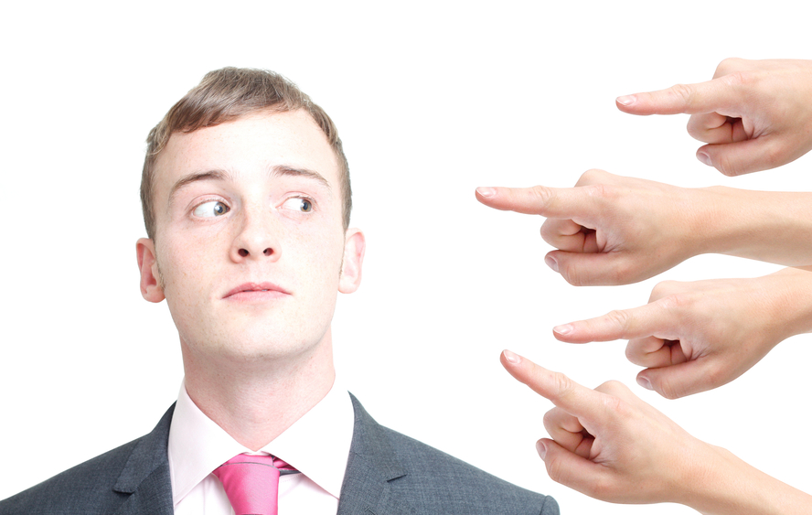
Is reproducibility a concern only for psych & behavioral econ?

Slide 12
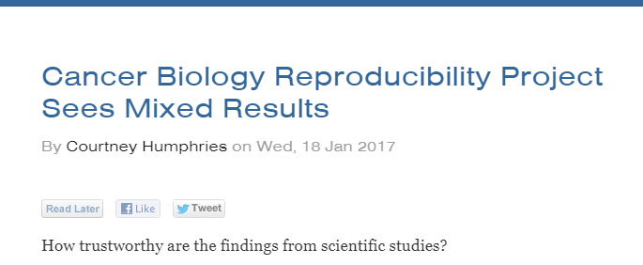

Slide 13
Predictions of Replication.
36%
significant replications
(Open Science Framework)
66.7 %
significant replications (Camerer et al.)
11-25%
cancer biology
(RPP: Cancer Biology)
≈ 76 %
mean expectation of economists
54%
mean expectation of psychologists
(Fuchs, Fiedler & Jenny, 2012)
≈ 92%
(all original effect sizes valid)
5%
(all true effect sizes 0)
0%
100%
Notes:
After recalculating the power calculations of 3 studies we became aware that 3 teams felt short in their planning, with 56%, 69%, and 76% power

Slide 14
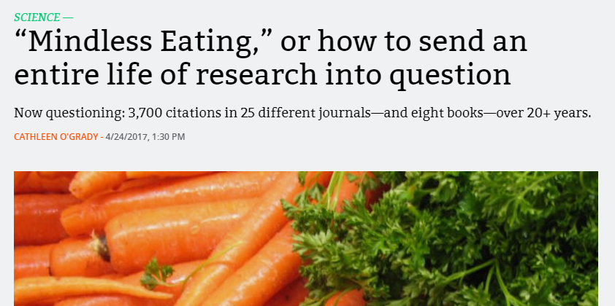
52 publications from Brian Wansink which (are alleged to) contain minor to very serious issues (which are summarized in this post),
which have been cited over 4000 times,
are published in over 25 different journals, and in 8 books,
spanning over 20 years of research,
7 articles have been retracted, and
15 articles have been corrected.
Notes:
Brian Wansink didn’t mean to spark an investigative fury that revisited his entire life’s work. He meant to write a well-intentioned blog post encouraging PhD students to jump at research opportunities. But his blog post accidentally highlighted some questionable research practices that caused a group of data detectives to jump on the case.
52 publications from Brian Wansink which (are alleged to) contain minor to very serious issues (which are summarized in this post),
which have been cited over 4000 times,
are published in over 25 different journals, and in 8 books,
spanning over 20 years of research,
7 articles have been retracted, and
15 articles have been corrected.

Slide 15
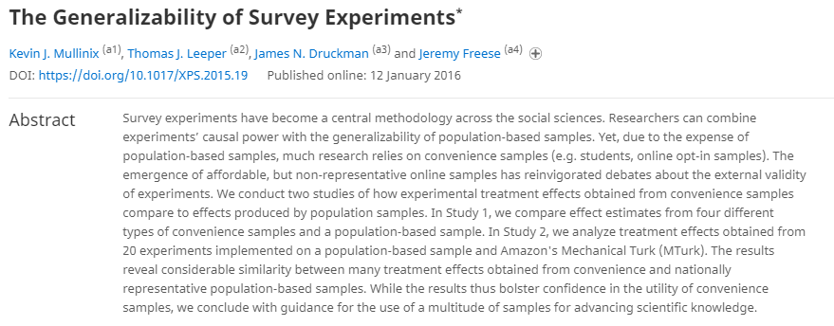

Slide 18
Causes and Effects

Slide 19
The incentive system
Culture of „Publish or Perish!“
Publishing as much as possible (count of IF)
Multiple underpowered studies („efficient resource alloctaion“)
Preferential publishing of statistically significant studies
Preferential publishing of surprising (counter-intuitive) and catchy results
Data are rather rhetorical devices

Slide 20
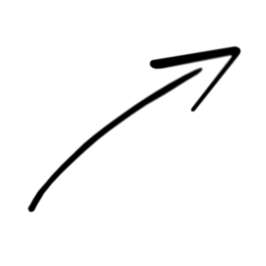
Research Cycle
Publication or new Experiment
Generating Hypothesis
Interpretation
Study design
Analysis & Hypothesis test
Data collection
Open Science Ambassadors

Slide 21
Research Cycle: Goes Wrong
Publication or new Experiment
Generating Hypothesis
Interpretation
Study design
Low Power
~ –50% Chance to show medium sized effect
(Cohen, 1962; Sedlmeier & Gigerenzer, 1989; Bezeau & Graves, 2003)
Analysis & Hypothesis test
Data collection
Open Science Ambassadors
Notes:
POWER: „Cohen, in a now classic paper on statistical power, reviewed articles in the 1960 issue of one psychology journal and determined that the majority of studies had less than a 50-50 chance of detecting an effect that truly exists in the population, and thus of obtaining statistically significant results. Such low statistical power, Cohen concluded, was largely due to inadequate sample sizes. “ (Bezeau & Graves, 2003)
PHACKING: trying a bunch of analyses to find something that gives you significant results
HARKING: hypothesizing after the results are known

Slide 22
Research Cycle: Goes Wrong
Publication or new Experiment
Generating Hypothesis
Interpretation
Study design
Low Power
p-hacking
~ –2 - 11% prevalence
(Fiedler & Schwarz, 2015)
~ –50% Chance to show medium sized effect
(Cohen, 1962; Sedlmeier & Gigerenzer, 1989; Bezeau & Graves, 2003)
p-hacking / flexible stopping
Analysis & Hypothesis test
Data collection
Open Science Ambassadors
Notes:
POWER: „Cohen, in a now classic paper on statistical power, reviewed articles in the 1960 issue of one psychology journal and determined that the majority of studies had less than a 50-50 chance of detecting an effect that truly exists in the population, and thus of obtaining statistically significant results. Such low statistical power, Cohen concluded, was largely due to inadequate sample sizes. “ (Bezeau & Graves, 2003)
PHACKING: trying a bunch of analyses to find something that gives you significant results
HARKING: hypothesizing after the results are known

Slide 23
Research Cycle: Goes Wrong
Publication or new Experiment
Generating Hypothesis
HARKing
~ –5 -10% prevalence
(Fiedler & Schwarz, 2015)
Interpretation
Study design
Low Power
p-hacking
~ –2 - 11% prevalence
(Fiedler & Schwarz, 2015)
~ –50% Chance to show medium sized effect
(Cohen, 1962; Sedlmeier & Gigerenzer, 1989; Bezeau & Graves, 2003)
p-hacking / flexible stopping
Analysis & Hypothesis test
Data collection
Open Science Ambassadors
Notes:
POWER: „Cohen, in a now classic paper on statistical power, reviewed articles in the 1960 issue of one psychology journal and determined that the majority of studies had less than a 50-50 chance of detecting an effect that truly exists in the population, and thus of obtaining statistically significant results. Such low statistical power, Cohen concluded, was largely due to inadequate sample sizes. “ (Bezeau & Graves, 2003)
PHACKING: trying a bunch of analyses to find something that gives you significant results
HARKING: hypothesizing after the results are known

Slide 24
Research Cycle: Goes Wrong
Publication bias & lack in transparency
~ –70% no data (Psychology, Wichters et al. 2006)
~ –66% no data (AER, Dewald, Thursby, & Anderson, 1986)
Publication or new Experiment
Generating Hypothesis
HARKing
~ –5 -10% prevalence
(Fiedler & Schwarz, 2015)
Interpretation
Study design
Low Power
p-hacking
~ –2 - 11% prevalence
(Fiedler & Schwarz, 2015)
~ –50% Chance to show medium sized effect
(Cohen, 1962; Sedlmeier & Gigerenzer, 1989; Bezeau & Graves, 2003)
p-hacking / flexible stopping
Analysis & Hypothesis test
Data collection
Open Science Ambassadors
Notes:
POWER: „Cohen, in a now classic paper on statistical power, reviewed articles in the 1960 issue of one psychology journal and determined that the majority of studies had less than a 50-50 chance of detecting an effect that truly exists in the population, and thus of obtaining statistically significant results. Such low statistical power, Cohen concluded, was largely due to inadequate sample sizes. “ (Bezeau & Graves, 2003)
PHACKING: trying a bunch of analyses to find something that gives you significant results
HARKING: hypothesizing after the results are known

Slide 25
Research Cycle: Goes Wrong
Publication bias & lack in transparency
~ –70% no data (Psychology, Wichters et al. 2006)
~ –66% no data (AER, Dewald, Thursby, & Anderson, 1986)
Lack of replications
Publication or new Experiment
1 in 1000 papers
(Makel et al. 2012)
Generating Hypothesis
27% should be replications
(Fuchs et al. 2011)
HARKing
~ –5 -10% prevalence
(Fiedler & Schwarz, 2015)
Interpretation
Study design
Low Power
p-hacking
~ –2 - 11% prevalence
(Fiedler & Schwarz, 2015)
~ –50% Chance to show medium sized effect
(Cohen, 1962; Sedlmeier & Gigerenzer, 1989; Bezeau & Graves, 2003)
p-hacking / flexible stopping
Analysis & Hypothesis test
Data collection
Open Science Ambassadors
Notes:
POWER: „Cohen, in a now classic paper on statistical power, reviewed articles in the 1960 issue of one psychology journal and determined that the majority of studies had less than a 50-50 chance of detecting an effect that truly exists in the population, and thus of obtaining statistically significant results. Such low statistical power, Cohen concluded, was largely due to inadequate sample sizes. “ (Bezeau & Graves, 2003)
PHACKING: trying a bunch of analyses to find something that gives you significant results
HARKING: hypothesizing after the results are known

Slide 26
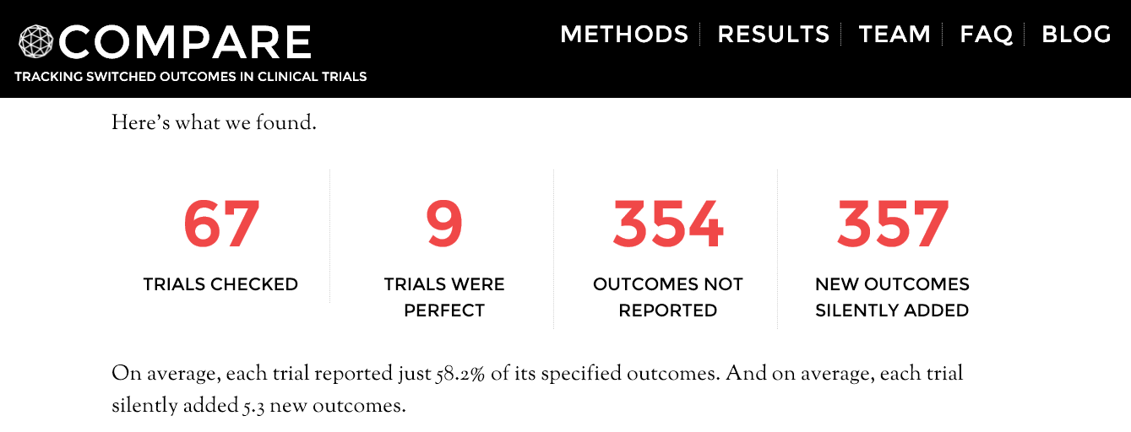
Research Cycle: Goes Wrong
October 2015 - January 2016: top 5 medical journals (NEJM, JAMA, The Lancet, Annals of Internal Medicine, BMJ )
http://compare-trials.org
Notes:
Outcome switching in clinical trials is a serious problem. Between October 2015 and January 2016, the COMPare team systematically checked every trial published in the top five medical journals, to see if they misreported their findings. We are now submitting the first set of findings from the project as an academic paper, summarising the quantitative results, and the themes of responses from journal editors and trialists in collaboration with a qualitative researcher. Prior to publication, cite our data and methods as per the reference at the bottom of this page. This is our workflow:
We compared each clinical trial report with its protocol or registry entry. Some trials reported their outcomes perfectly. For the others, we counted how many of the outcomes pre-specified in the protocol or registry were never reported. We also counted how many new outcomes were silently added.
When we detected unreported or added outcomes, we wrote a letter to the journal pointing them out. We tracked which journals published our letters – and which did not.
Here’s what we found.
http://compare-trials.org/

Slide 27
False Discovery Rate
The smaller the studies conducted in a scientific field...
The smaller the effect sizes in a scientific field...
The greater the number and the lesser the selection of tested relationships in a scientific field..
... the less likely the research findings are to be true.
(Ioannidis, 2005)

Slide 28
Norms
Problematic
Secrecy
Closed
Self-interestedness
Treat science as a competition
Organized dogmatism
Invest career promoting one’s own theories, findings
Quantity

Slide 29
Norms
Problematic
Lack of Open Data and Materials
Secrecy
Closed
Self-interestedness
Treat science as a competition
Organized dogmatism
Invest career promoting one’s own theories, findings
Quantity
P-hacking, HARKing, publication bias
Lack of replications, publication bias
Low statistical power

Slide 30
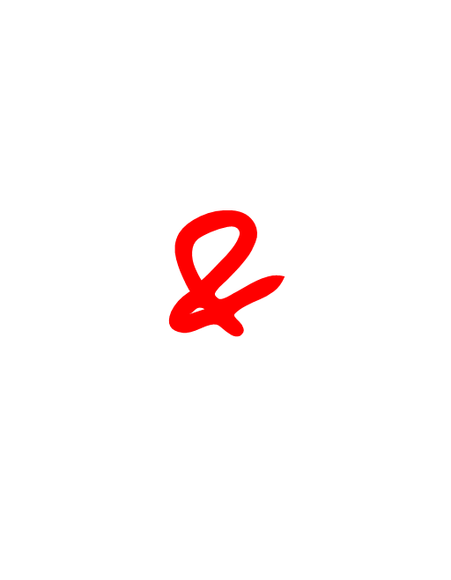
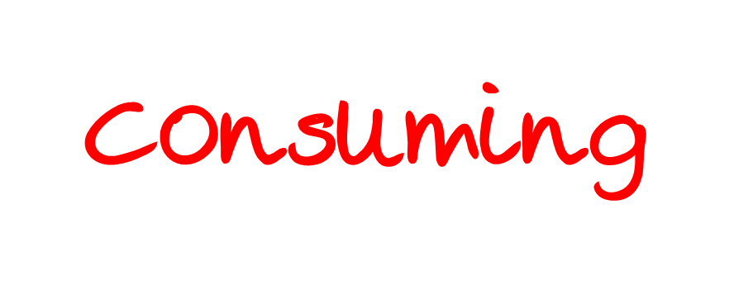
Notes:
now, doing research is very time-and resource consuming, doing something that doesn’t pay and help the individual researchers career who is systematically investigating it and it the best case you do not find out something new, but learn that what you have thought before receives a little bit more evidence.

Slide 31
Notes:
This is a hard task to shoulder

Slide 32
Notes:
And we did it and still do it – fundamentally change the way how we do, report and think about research and the empirical results that we find in the literature – with the reproducibility project we want to contribute to this debate and process of change. To give psychology as a science the chance to do the best it can and to give society what it expects. Reproducible findings that build a solid basis for the accumulation of knowledge and thereby fosters progress in our understanding of human nature. Many of us thought we couldn´t, but looking at Nature (just to take one example) that introduced in may checklists for its authors concerned with many of the points that psychologists are discussing the last 3 years. Because all experimental science needed a change. We see projects like the open science framework grow each day, see changes in the daily work flow of my colleagues creating more transparent and better documented research and an increase in replications.

Slide 38
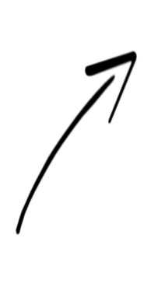
Open Science

Slide 39
Who makes the rules?
Editors
Reviewers
Funders
Committee members
Scientists
...
„There is no single solution for such a complex problem“ (Pashler & Wagenmarkers, 2012)
Notes:
Every single one change the.

Slide 40
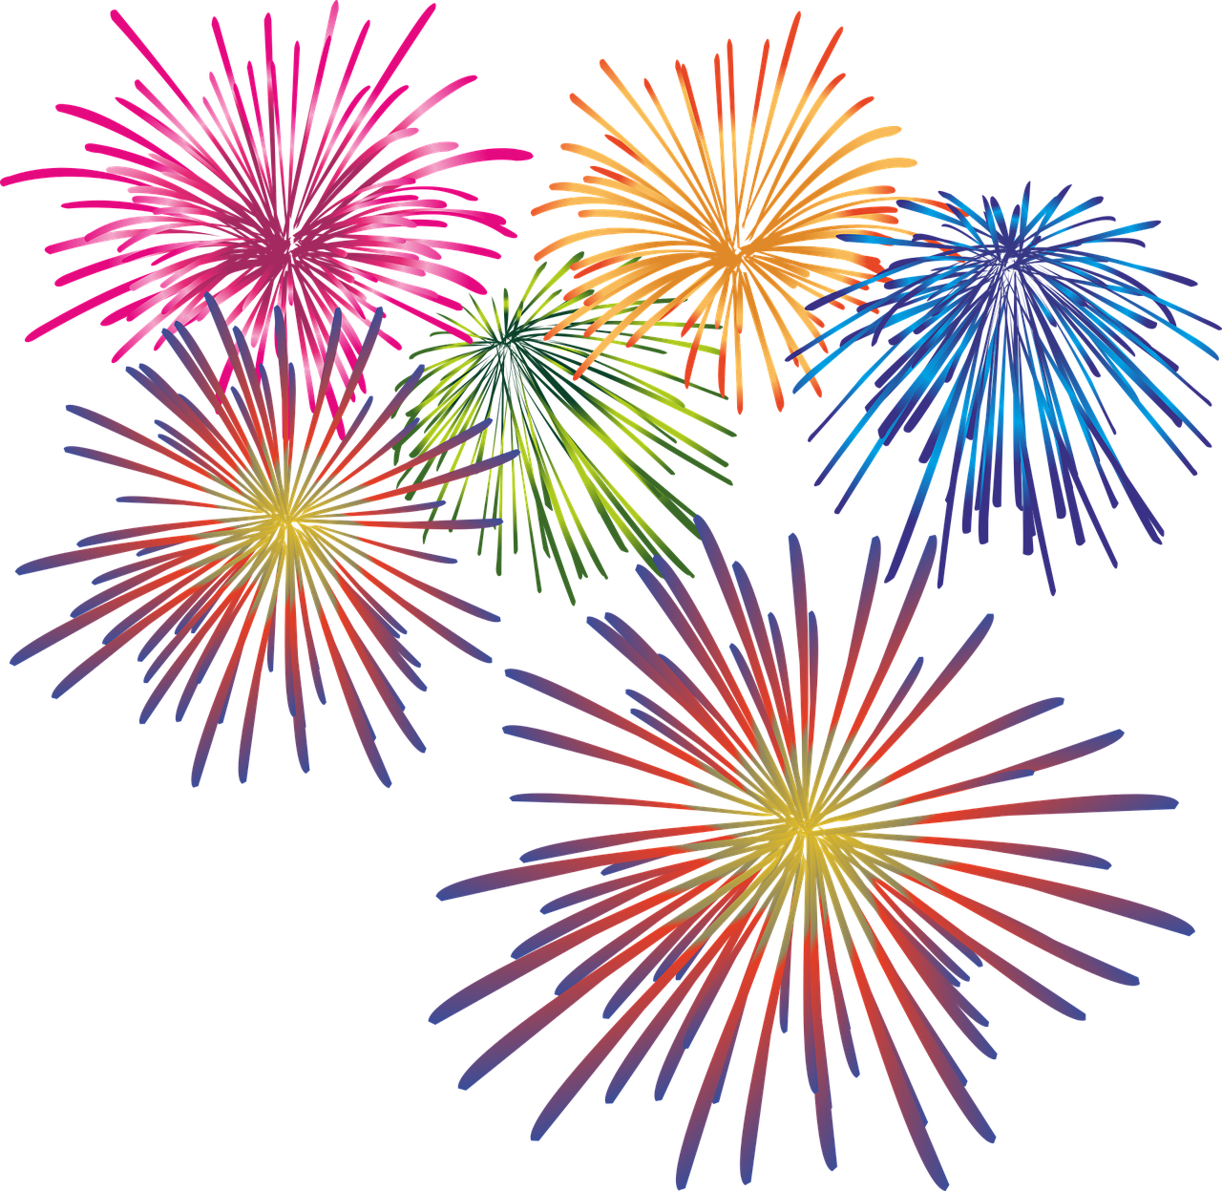
The rules ARE changing.
Open Science principles demanded by
German Research Foundation (DFG)
European Research Council
40% of scientific funding institutions now have Open Data guidelines.
More and more institutions demand Open Science commitment as a hiring criterion

Slide 41
2019 Researcher
Notes:
So how is it to do open science
We receive a lot of training on research methods and statistical procedures (but likely not enough—another talk!)
But, not much (if any) on how to do open science (Feynman, 1974, and Lykken, 1991 made similar arguments)
Technology today allows for open science practices

Slide 42
2019 Researcher
Reporting
Doing
Planning

Slide 43
2019 Researcher
Reporting
Doing
Planning
actually make a plan ...

Slide 44
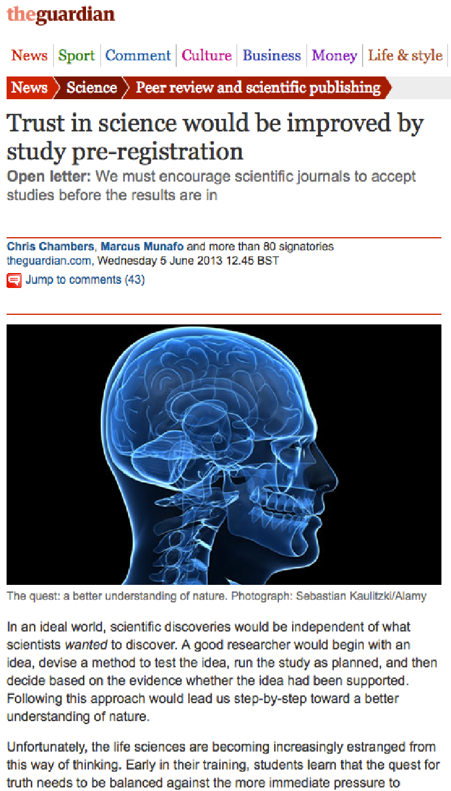
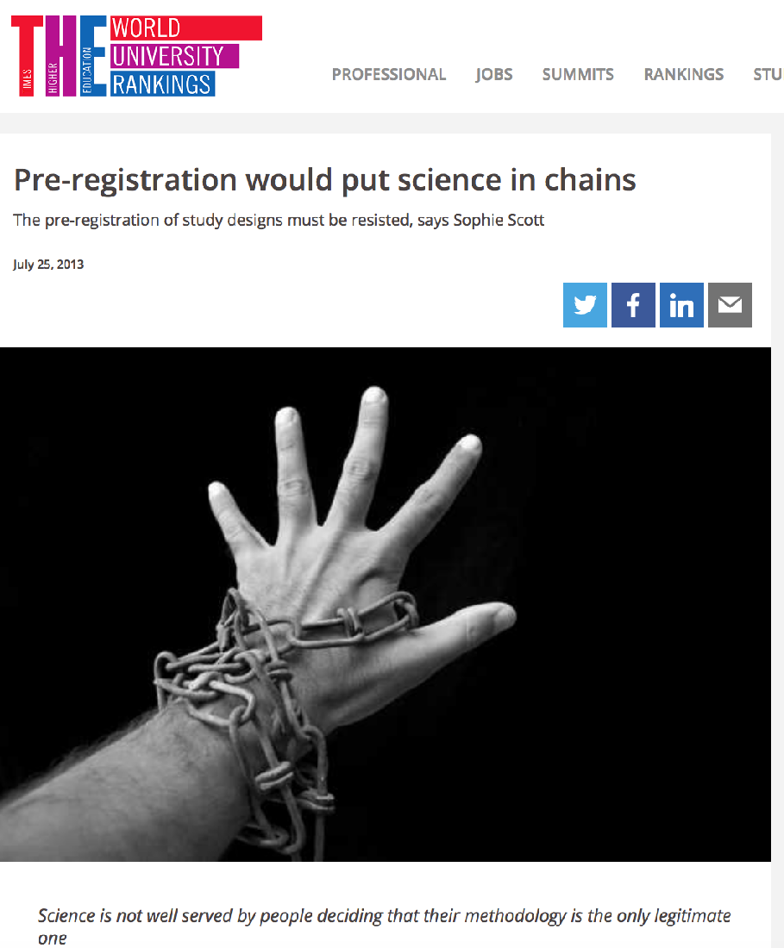
Pre-registration

Slide 45
What Problems Does Pre-registation fix?
Pre-registration makes the distinction between confirmatory and exploratory research more clear.
As a field we want to produce both new discoveries AND reliable evidence (or even well tested theories)
Context of confirmation | Context of discovery
Traditional hypothesis testing Results held to the highest standards of rigor Goal is to minimize false positives – don‘t rely on anything false! | Pushes knowledge into new areas/ data-led discovery Finds unexpected relationships Goal is to minimize false negatives – don‘t miss anything new!
p-values interpretable | p-values meaningless
Notes:
Divide cognitive labor in a way that produces both new discoveries and well tested theories (Romero, 2017)

Slide 46
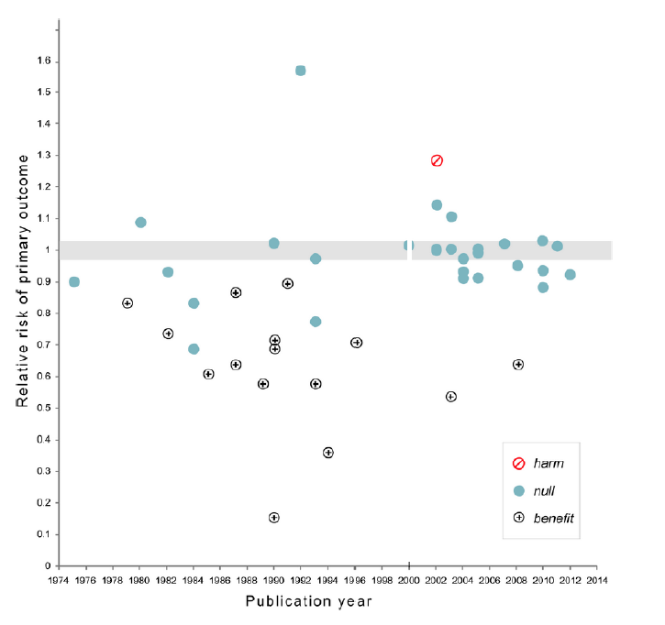
How will this probably look like?
harmful
null
benefit
Relative risk of primary outcome
Publication year
Notes:
Clinical trials outcomes over the years: many show positive outcomes, no harmful outcomes, only few null effects

Slide 47
How will this probably look like?
harmful
null
benefit
Relative risk of primary outcome
Publication year
Notes:
suddenly, many more null effects, even a harmful outcome
.. what’s the difference?

Slide 48
How will this probably look like?
2000
Registration of all primary outcomes on ClinicalTrials.gov
harmful
null
benefit
Relative risk of primary outcome
Publication year
Notes:
Which medication would you like to take?

Slide 49
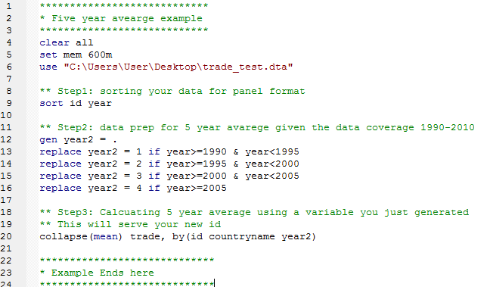
Create an Analysis Plan
Extensive degrees of freedom in the analysis
241 fMRI studies reported 223 unique combinations of data cleaning and analysis (Carp, 2012)
When using all these combinations 90% of all voxels show a significant difference in at least one analysis (Carp, 2012)
Decide before the experiment: What are the critical conditions, measures, exclusion criteria, potential moderators and covariates
This is the essence of confirmatory testing

Slide 50
It´s becoming the norm
2016
Sunday
292,926 new registrations

Slide 51
Changing Incentives

Slide 52
2019 Researcher
Reporting
Doing
Planning
you need the power ….

Slide 53
Power in Observations

Slide 54
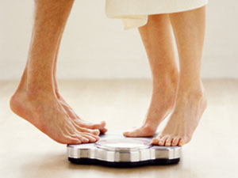
Notes:
Literally speaking you need the power. To give experiments a good chance to find effects that exist. Power comes from the number of observations you have.
Do you think that men weigh more than women, on average?
What do you think: how many subjects do you need to show this effect with a good chance if it exists in reality?

Slide 55
Gender effect on weight (d = .59) → around 40 per cell

Slide 56
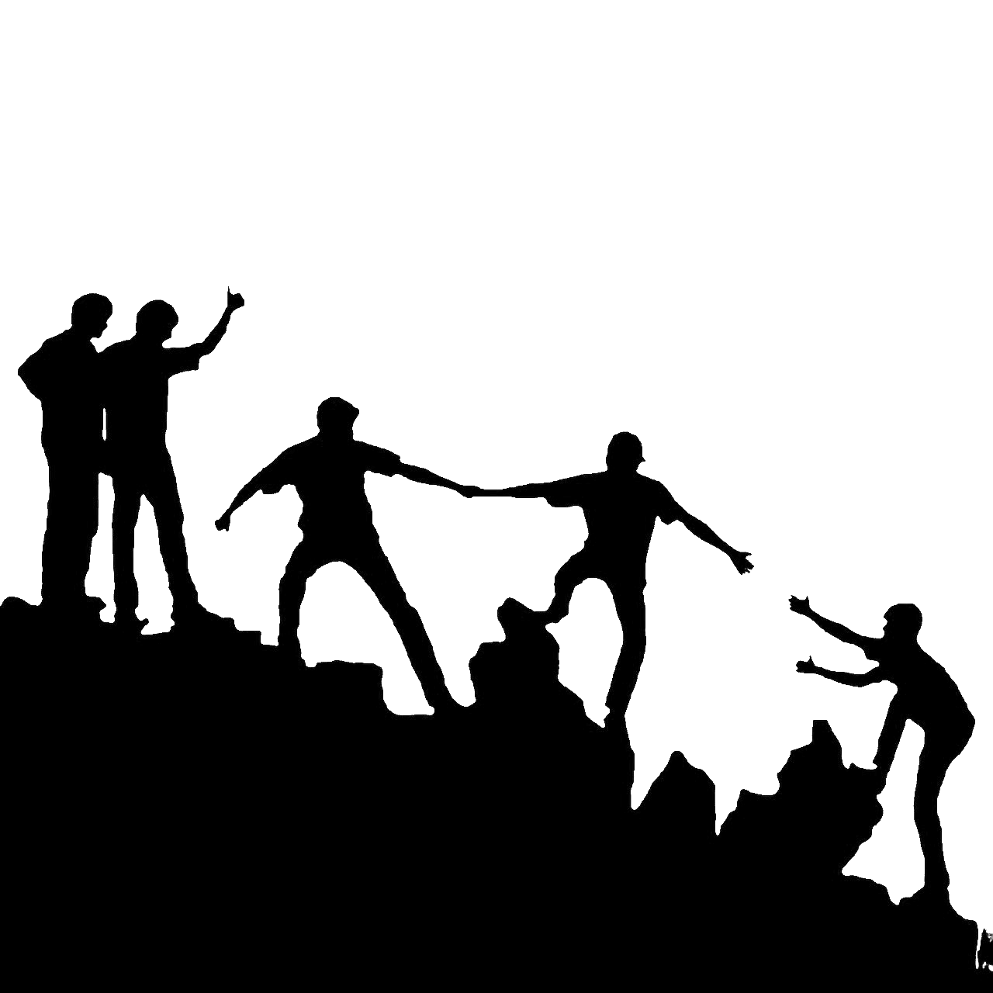
Adequate power -- joint data collection

Slide 57
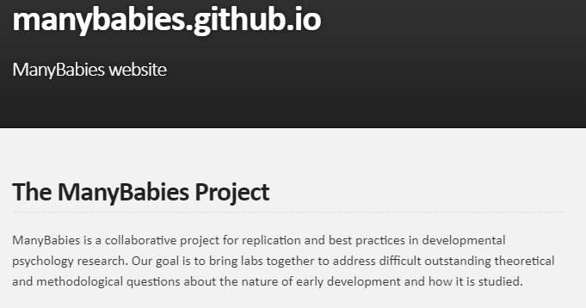
Many Babies Project

Slide 58
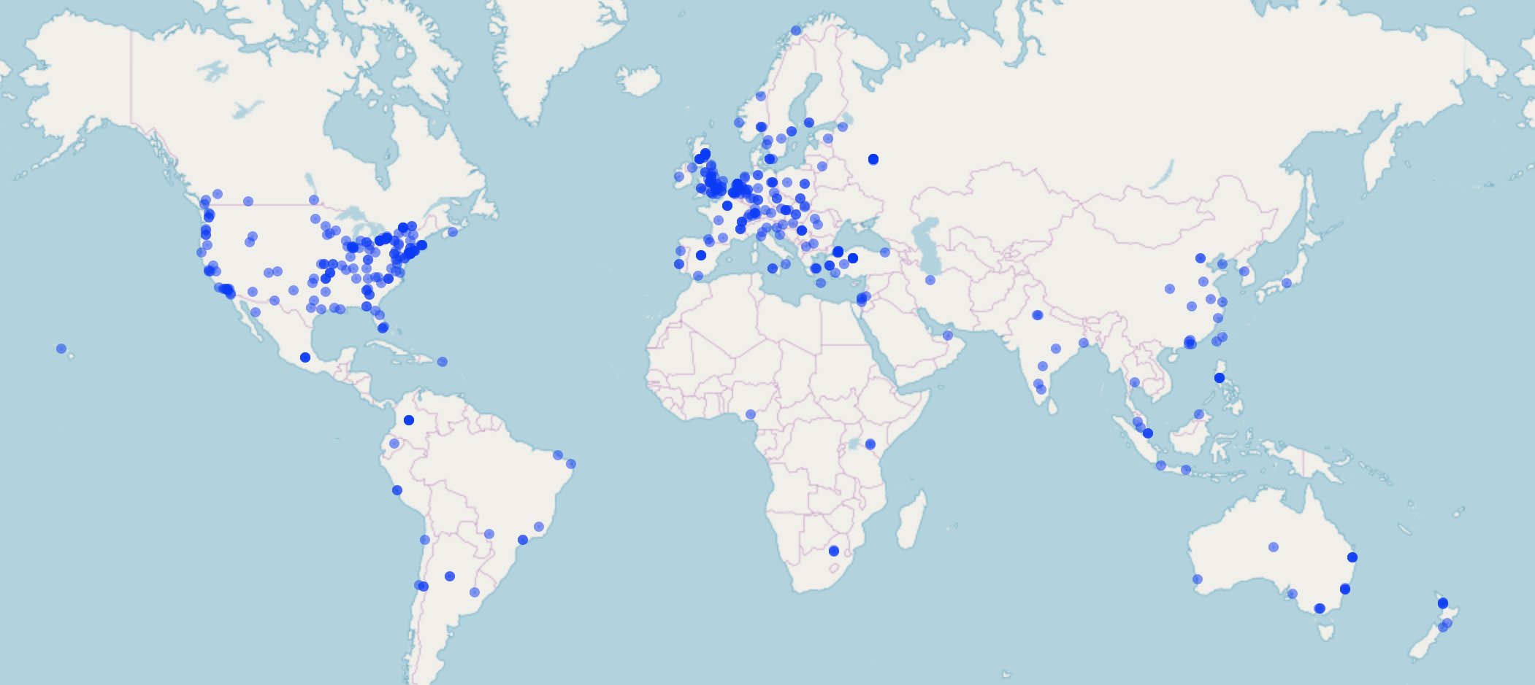
Psychological Science Accelerator
548 Labs in 72 countries

Slide 59
Power in Solving Problems

Slide 60
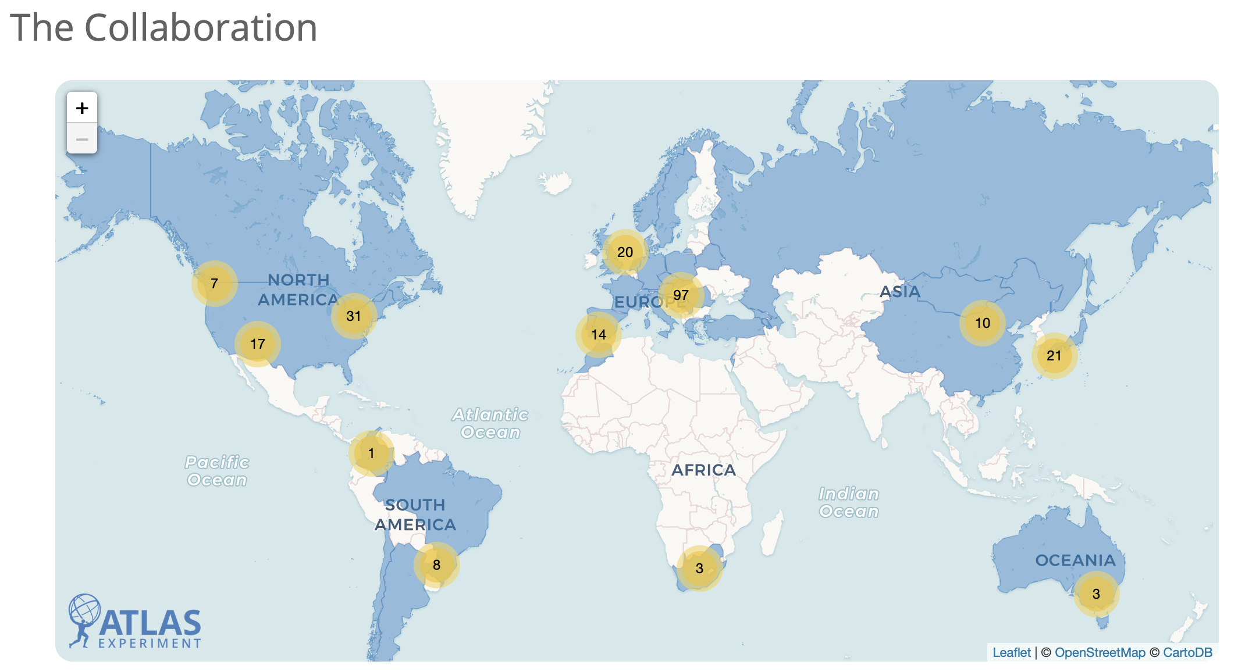
ATLAS collaboration
Testing the Standard Model
3000 authors from 183 institutions
Notes:
CERN: ATLAS comprises about 3000 scientific authors from 183 institutions
detector development, data collection and analysis. The collaboration depends on the efforts of countless engineers, technicians and administrative staff.

Slide 61
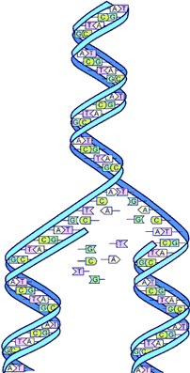
Human Genome Project
13-year joint effort to sequence the human genome
data now publicly available

Slide 62
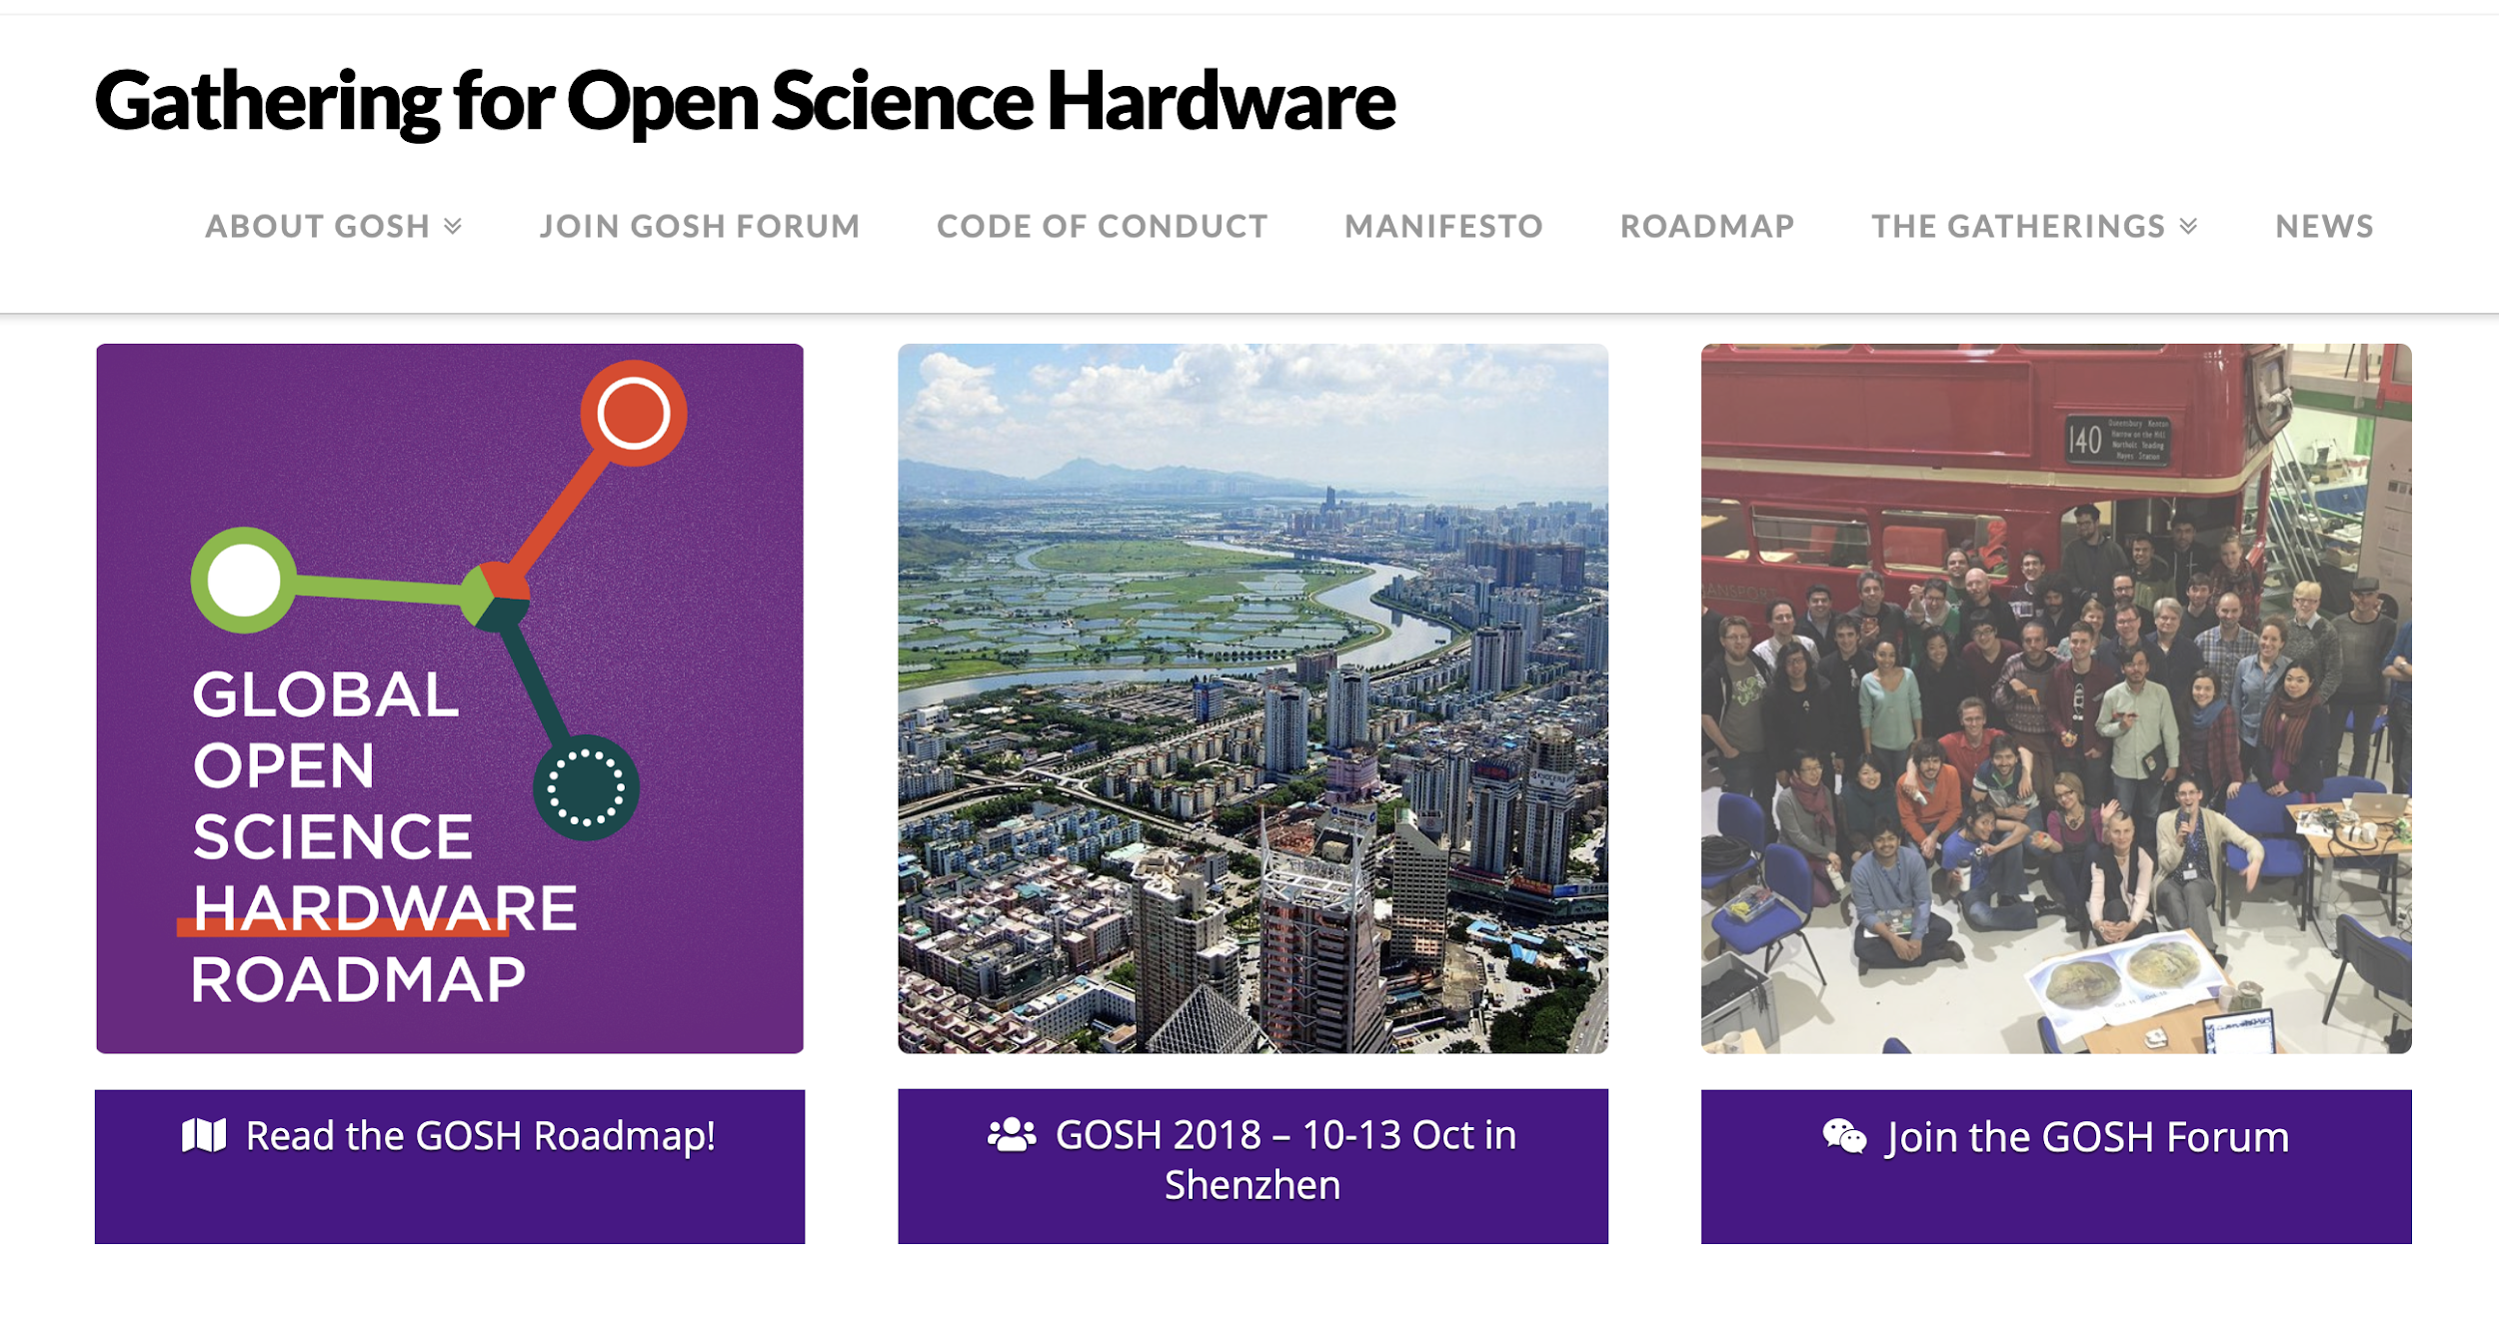
Open Hardware

Slide 63
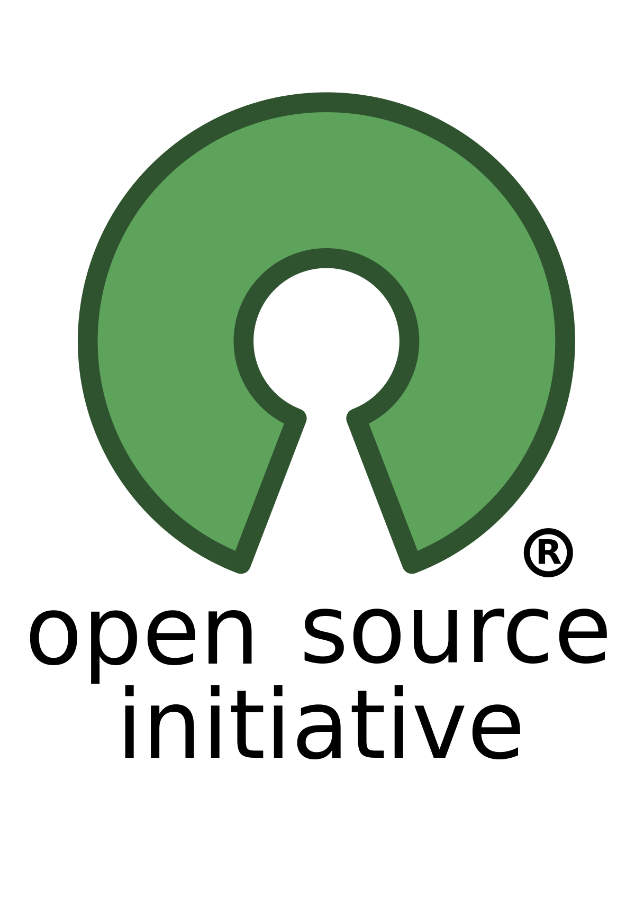
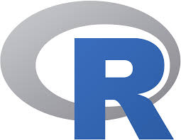
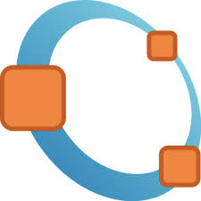
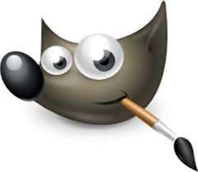
Open Software

Slide 64
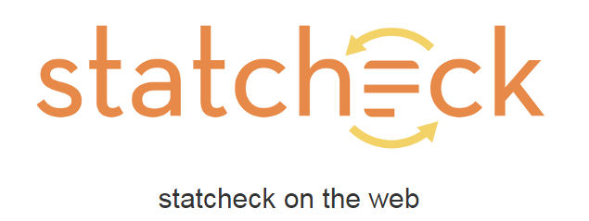
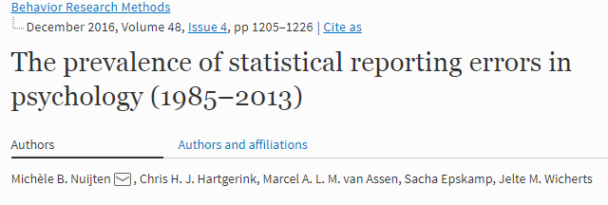
Open Software
Notes:
“…we found that half of all published psychology papers that use NHST contained at least
one p-value that was inconsistent with its test statistic and degrees of freedom. One in
eight papers contained a grossly inconsistent p-value that may have affected the
statistical conclusion.”

Slide 65
2019 Researcher
Reporting
Doing
Planning
get it out there ...

Slide 66
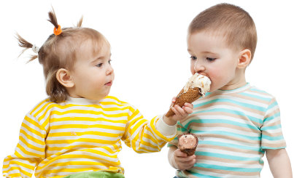
Share your work!
Share your Materials, Data & Code
release your work under a license and indicate explicitly in the paper or in the metadata how you want others to give you credit
Notes:
Chances are that you want to get credit for what you share. The attribution system used for scholarly articles, accomplished via citations, often breaks in the case of data and software. When other authors reuse or cite your data or code, you may get an acknowledgment or an incoming link. If you and your colleagues have gone to the trouble to write a “data paper,” whose main purpose is to describe your data and/or code, you may also get a citation [9]. But, “data paper” writing is not always desirable, or relevant. So, how do you go about getting the full credit you deserve for your data and code? The best way is to simply describe your expectations on how you would like to be acknowledged. If you want, you can also release your data under a license and indicate explicitly in the paper or in the metadata how you want others to give you credit. But, while legal mechanisms have advantages, they can also inadvertently lead to limitations on the reuse of the data you are sharing. In any case, make information about you (e.g., your name, institution), about the data and/or code (e.g., origin, version, associated files, and metadata), and about exactly how you would like to get credit, as clear as possible. Easy-to-implement licenses, many of which offer the advantage of being machine-readable, are offered by the Creative Commons organization (http://creativecommons.org/choose/), as are other similar options, such as those offered by Open Data Commons (http://opendatacommons.org/licenses/pddl/).
(Goodman et. al, 2014; Ten Simple Rules for the Care and Feeding of Scientific Data)

Slide 67
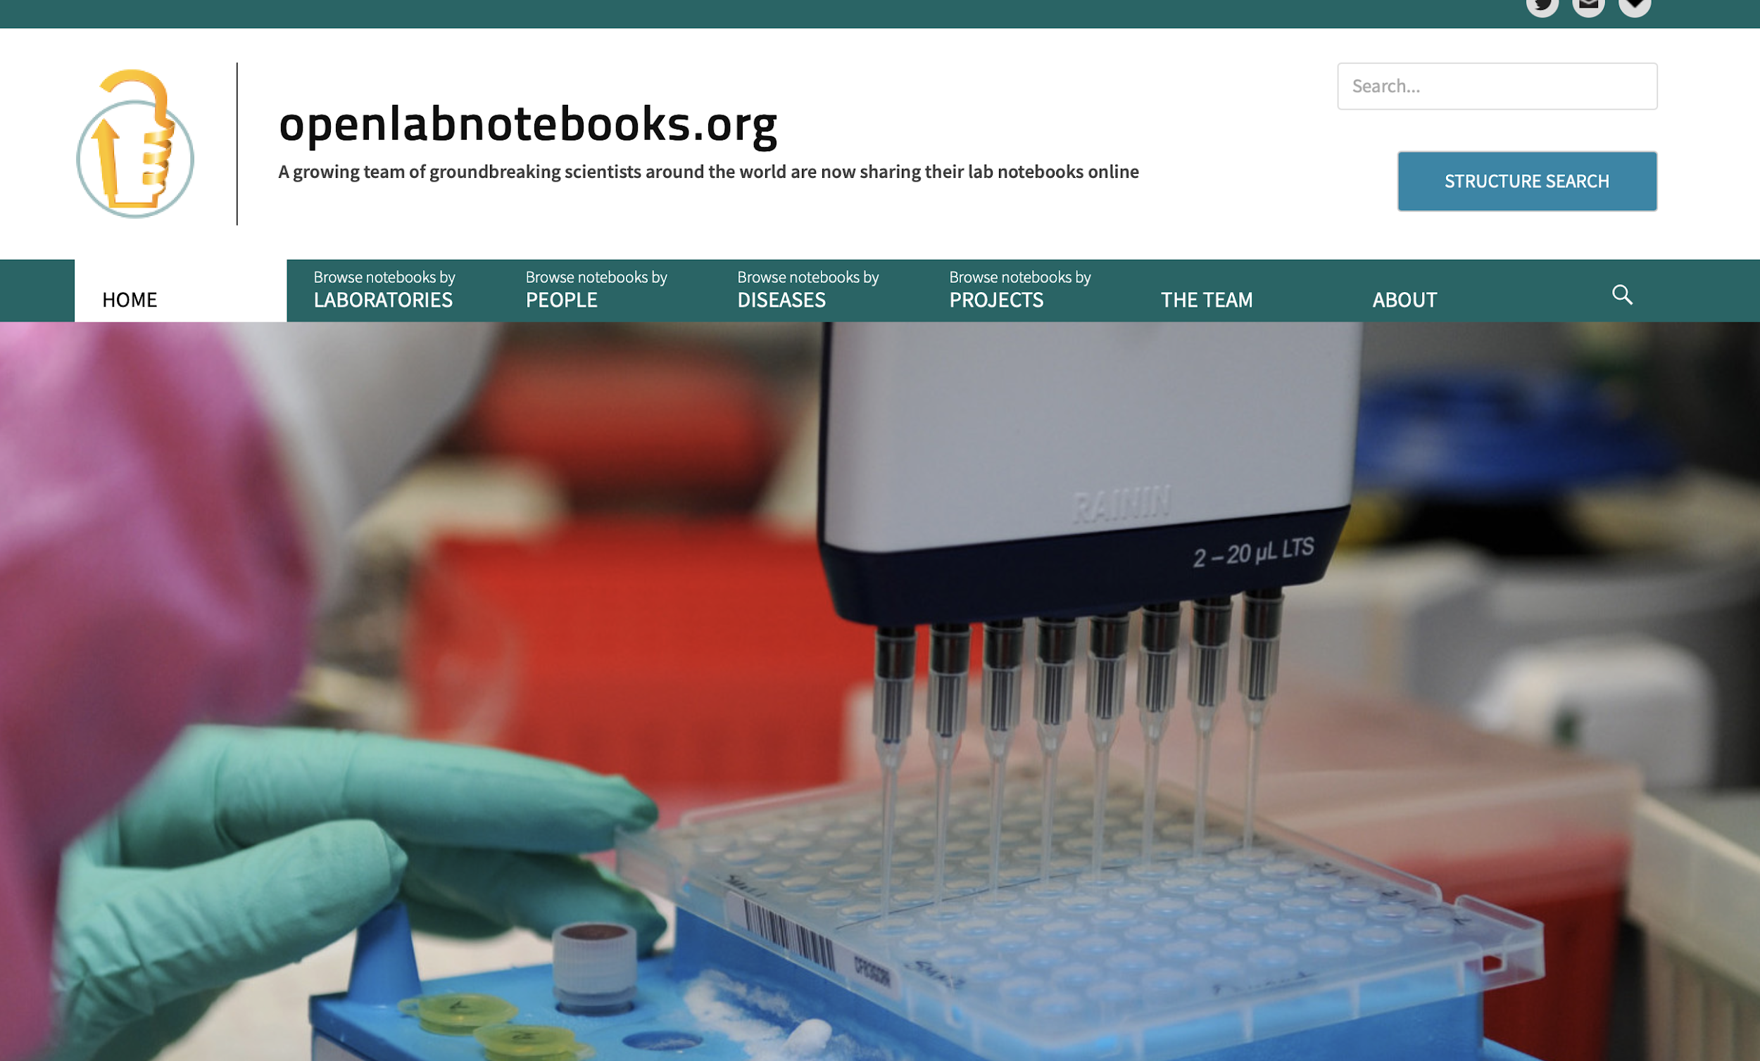
Document & Share your Procedure

Slide 68
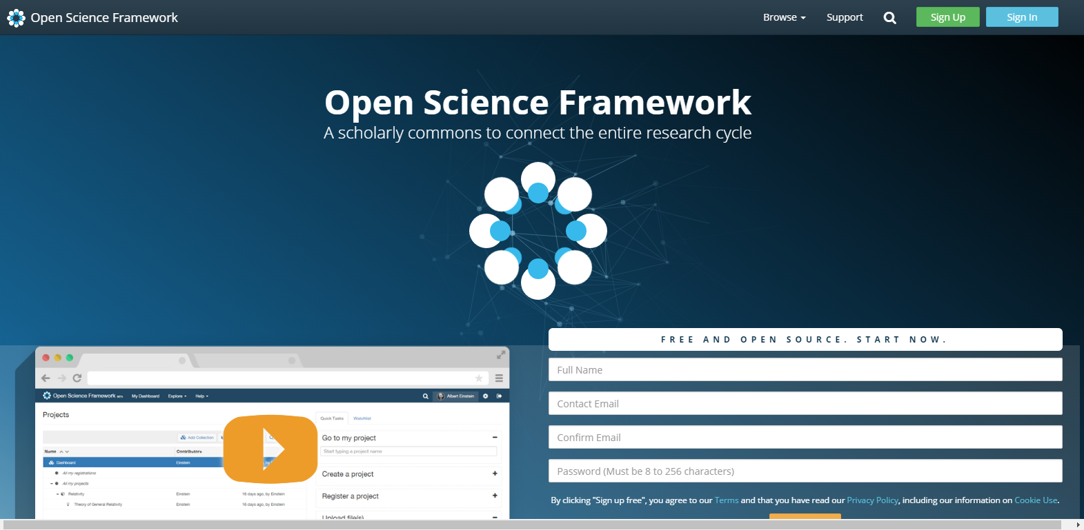

Slide 69
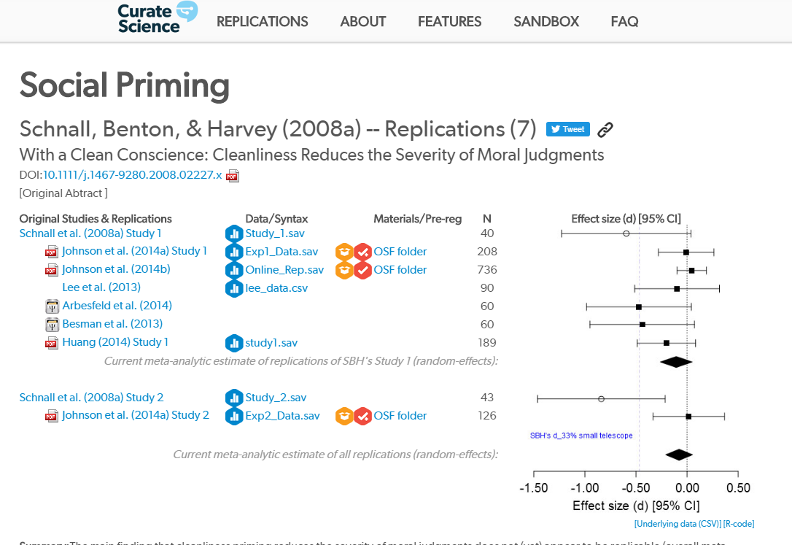
Facilitate Meta-Analysis

Slide 70
Share your work!
Share your Paper!
http://www.sherpa.ac.uk/romeo/index.php
Check which version of your paper you are allowed to share
Share your Data & Code!
https://osf.io/
What coud be reasons not to do that?
Share your Materials
https://osf.io/
What coud be reasons not to do that?

Slide 71
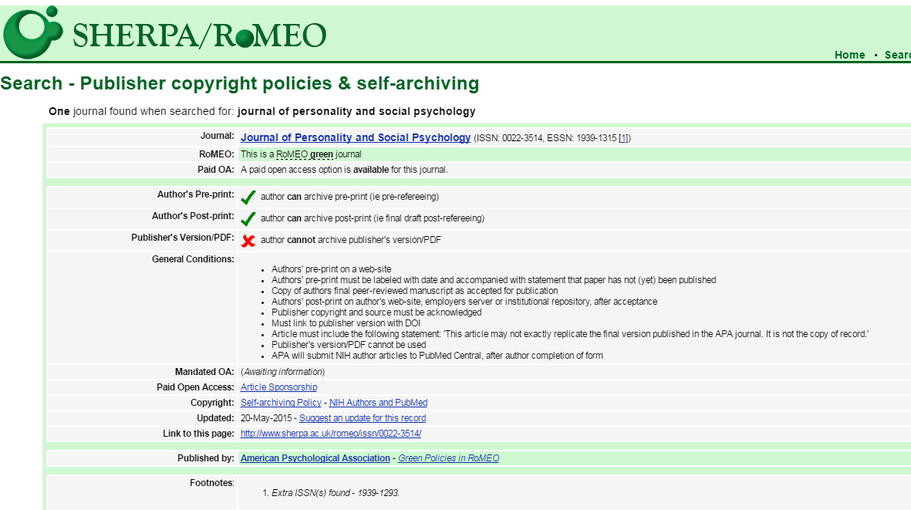
Share your paper!

Slide 72
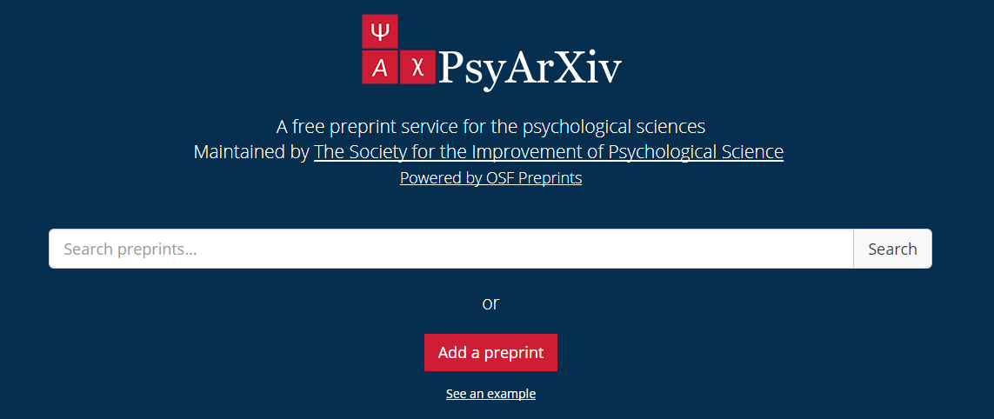
Pre-prints

Slide 73
Pre-print servers and general repositories accepting pre-prints.
Preprint server or repository* | Subject areas | Repository open source? | Public API? | Can leave feedback?† | Third party persistent ID?
arXiv arxiv.org | physics, mathematics, computer science, quantitative biology, quantitative finance, statistics | No | Yes | No | No‡
bioRxiv biorxiv.org | biology, life sciences | No | No | Yes | Yes (DOI)
CERN document server cds.cern.ch | high-energy physics | Yes (GPL) | Yes | No | No
Cogprints cogprints.org | psychology, neuroscience, linguistics, computer science, philosophy, biology | No | Yes | No | No
EconStor econstor.eu | economics | No | Yes | No | Yes (Handle)
e-LiS eprints.rclis.org | library and information sciences | No§ | Yes | No | Yes (Handle)
figshare figshare.com | general repository for all disciplines | No | Yes | Yes | Yes (DOI)
Munich Personal RePEc Archive mpra.ub.uni-muenchen.de | economics | No¶ | Yes | No | No
Open Science Framework osf.io | general repository for all disciplines | Yes (Apache 2) | Yes | Yes | Yes (DOI/ARK)
PeerJ Preprints peerj.com/archives-preprints | biological, life, medical, and computer sciences | No | Yes | Yes | Yes (DOI)
PhilSci Archive philsci-archive.pitt.edu | philosophy of science | No** | Yes | No | No
Self-Journal of Science www.sjscience.org | general repository for all disciplines | No | No | Yes | No
Social Science Research Network ssrn.com | social sciences and humanities | No | No | Yes | Yes (DOI)
The Winnower thewinnower.com | general repository for all disciplines | No | No | Yes | Yes (DOI)††
Zenodo zenodo.org | general repository for all disciplines | Yes (GPLv2) | Yes | No | Yes (DOI)
Notes:
Table 1
Preprint servers and general repositories accepting preprints.
HTTPS://DOI.ORG/10.7554/ELIFE.16800.003
* All these servers and repositories are indexed by Google Scholar.
† Most, if not all, of those marked ’Yes’ require some type of login or registration to leave comments.
‡ arXiv provides internally managed persistent identifiers.
§ e-LiS is built on open source software (EPrints), but the repository itself, including modifications to the code, plugins, etc. is not open source.
¶ MPRA is built on open source software (EPrints), but the repository itself, including modifications to the code, plugins, etc. is not open source.
** PhilSci Archive is built on open source software (EPrints), but the repository itself, including modifications to the code, plugins, etc. is not open source.
†† The Winnower charges a $25 fee to assign a DOI.

Slide 74
2019 Researcher
Reporting
Doing
Planning
change the game ...

Slide 75
2019 Researcher
Planning
Doing
Reporting
change the game ...

Slide 76
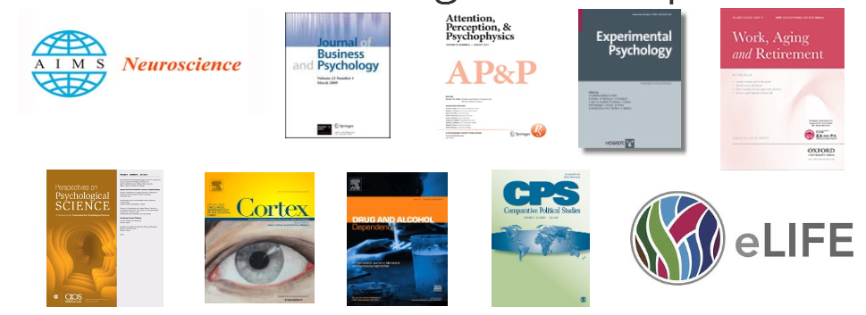
Who Publishes Registered Reports?
204 journals currently accept registered reports
See the full list: http://cos.io/rr

Slide 77
Research Cycle: Goes Wrong
Publication bias & lack in transparency
~ –70% no data (Psychology, Wichters et al. 2006)
~ –66% no data (AER, Dewald, Thursby, & Anderson, 1986)
Lack of replications
Publication or new Experiment
1 in 1000 papers
(Makel et al. 2012)
Generating Hypothesis
27% should be replications
(Fuchs et al. 2011)
HARKing
~ –5 -10% prevalence
(Fiedler & Schwarz, 2015)
Interpretation
Study design
p-hacking
~ –2 - 11% prevalence
(Fiedler & Schwarz, 2015)
Low Power
~ –50% Chance to show medium sized effect
(Cohen, 1962; Sedlmeier & Gigerenzer, 1989; Bezeau & Graves, 2003)
p-hacking / flexible stopping
Analysis & Hypothesis test
Data collection
Open Science Ambassadors
Notes:
Und sollte es doch dort angekommen sein, so stand es in der Literatur – Replikationen finden in einer Vielzahl von Fällen auf Konstruktebene statt, d.h. man untersucht die beschriebenen Effekte in abgewandelter Form um Erweiterungen und Grenzen des Effektes zu untersuchen. Ein wichtigen Bestandteil der Wissenschaft ohne Frage, aber all diese konzeptuellen Replikationen ersetzen dochnicht die direkte Replikation. Der Test der selben Forschungsfrage mit ´Hilfe des selben Designs. Makel schreibt, dass ca. jedes 1000ste Papier eine Replikation ist und ich denke der unterschätzt die Zahl hier ein wenig, aber die Grundrichtung ist die richtige – es sind eine sehr geringe Anzahl von . Wir haben 2011 über 1200 wissenschaftlich arbeitende Psychologen befragt was sie glauben wie groß der Anteil von Replikationen in unserer Fachliteratur sein sollte und sie antworteten im Schnitt mit 27% .
Bei diesem Bild wird einem schnell klar, dass nicht ganz klar ist wie belastbar unserer Ergebnisse eigentlich sind und wie schon zu Begin angesprochen, ist dies in der Vergangenheit auch schon häufig in der Debatte kritisch aufgekommen. Man munkelte auf Konferenzen und sprach mit Kollegen darüber, insbesondere dann wenn man viel Zeit damit zugebracht hatte gemeinsam mit Studenten bekannte Effekte zu replikzieren und dabei wiederholt scheiterte.

Slide 78
Research Cylce: Goes GRRRREAT!
Pre-print Server
PsyArXiv
Share
(Data, code, meta-data)
Pre-registration
(OSF, as Predicted)
Publication or new Experiment
Generating Hypothesis
Registered Reports
(Not Utopia)
Interpretation
Study design
Register study design, procedure, materials, & data analytic plan
Analysis & Hypothesis test
Open Notebook
(No insider information)
Data collection
Confirmatory and Exploratory analyses
Data Management Plan
Notes:
Open notebook science is the practice of making the entire primary record of a research project publicly available online as it is recorded. This involves placing the personal, or laboratory, notebook of the researcher online along with all raw and processed data, and any associated material, as this material is generated. The approach may be summed up by the slogan 'no insider information'. It is the logical extreme of transparent approaches to research and explicitly includes the making available of failed, less significant, and otherwise unpublished experiments; so called 'dark data'.^{[1]} The practice of open notebook science, although not the norm in the academic community, has gained significant recent attention in the research^{[2][3]} and general^{[1][4]} media as part of a general trend towards more open approaches in research practice and publishing. Open notebook science can therefore be described as part of a wider open science movement that includes the advocacy and adoption of open access publication, open data, crowdsourcing data, and citizen science. It is inspired in part by the success of open-source software^{[5]} and draws on many of its ideas.

Slide 79
Norms
Open
Problematic
Communality
Open sharing
Disinterestedness
Motivated by knowledge and discovery
Organized skepticism
Consider all new evidence, even against one’s prior work
Quality
Secrecy
Closed
Self-interestedness
Treat science as a competition
Organized dogmatism
Invest career promoting one’s own theories, findings
Quantity

Slide 80
Norms
Open
Communality
Open sharing
Disinterestedness
Motivated by knowledge and discovery
Organized skepticism
Consider all new evidence, even against one’s prior work
Quality
Open data & Material
Pre-registration, Transparency
Large scal replication efforts, Registered Reports, Curate Science
Increased statistical power

Slide 81
“The first principle is that you must not fool yourself -and you are the easiest person to fool”
Feynman, 1974

Slide 82
Put reality back into the published literature!

Slide 83
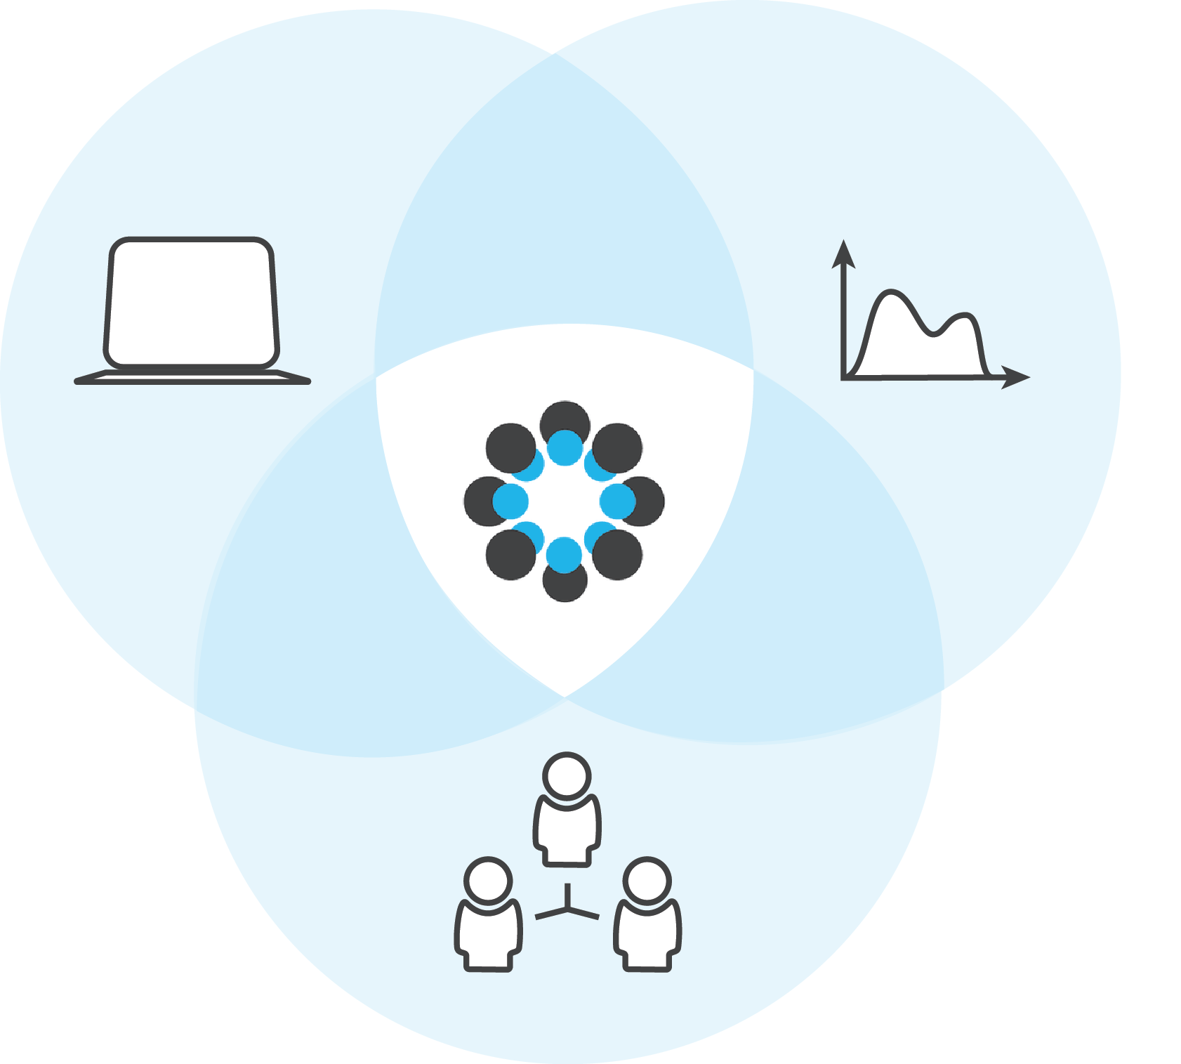
Join Your Research Community!
Notes:
Another reason is that we are too busy just getting on in this system to pause to fix its flaws. Urgent grant submissions and experimental time points — tasks that reward the individual and have strict deadlines — will always win against some important but nebulous effort for the common good. It can feel as if those who spend their time on anything but their own projects and papers will find themselves scooped of the recognition required to win funding and resources.
Worst of all is the sad reality that those who most feel the need for change have the least power to effect it. The best time to fix the system, we tell ourselves, is after we have gained influence. If a PhD student shouts in frustration, are things going to change, or will she or he just be marginalized as a rabble-rouser?
This pernicious inertia persists at every rung of the career ladder — the higher scientists rise, the smaller seem the problems of those at the level below. Gaining a tenured post puts researchers in a position to make change, yet insulates them from much of what needs changing. The principal investigator tells the postdoc that finding a permanent position is easy compared to the angst of getting a grant. The postdoc tells the PhD student that defending a thesis is easy compared to the angst of finding a permanent position.

Slide 84
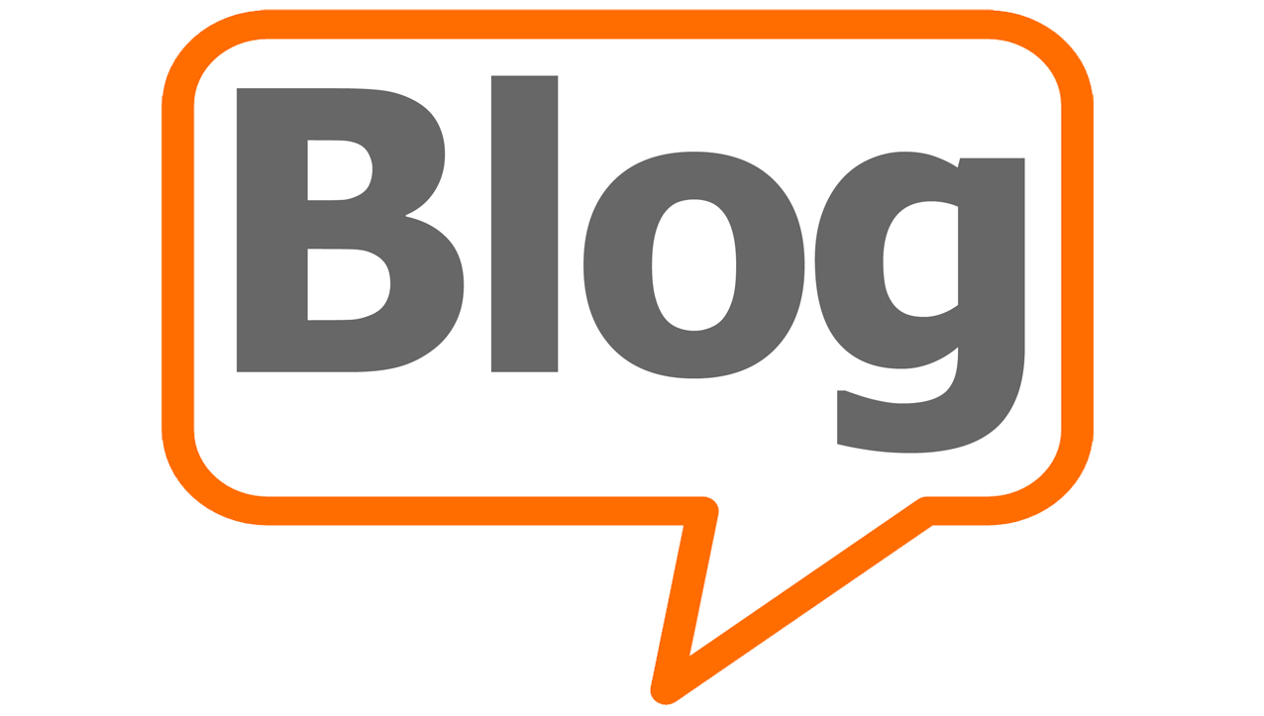
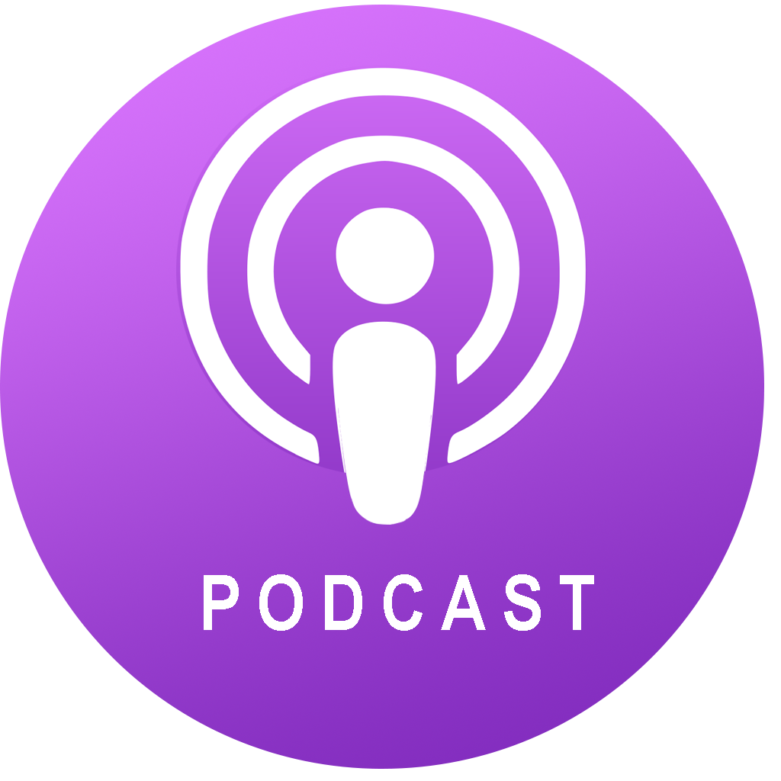
Expand your Research Community
datacolada.org
the100.ci
andrewgelman.com
thehardestscience.com
@openscience
#openscience
https://ask-open-science.org/
PsychMAP
Psychological Methods Discussion Group
Open Science Radio
The Black Goat

Slide 85
https://rimamrahal.wordpress.com
Learn new and refresh old stuff!

Slide 86
https://www.coursera.org/learn/statistical-inferences
Learn new and refresh old stuff!

Slide 87
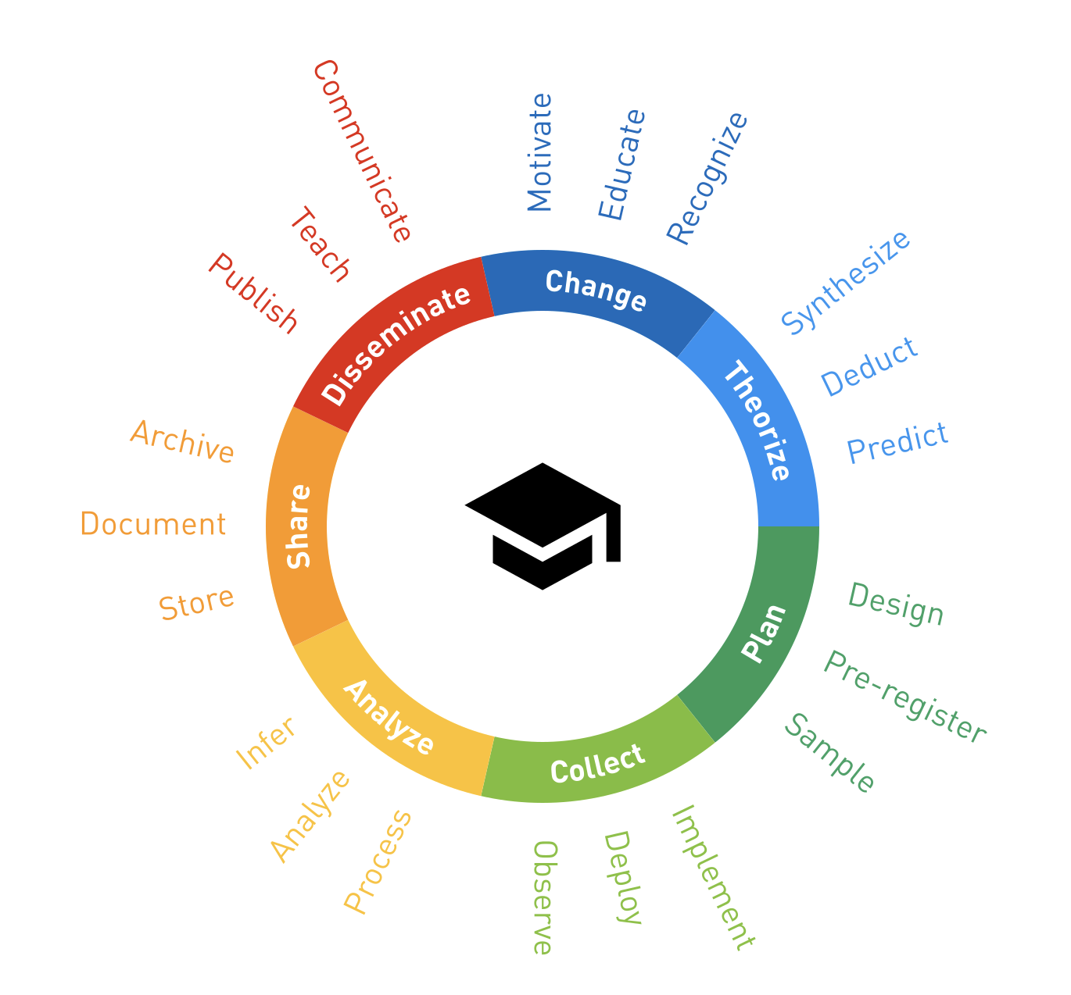
Keep asking questions!
https://how-to-open.science

Slide 88
Jump right in!
Planning
Doing
Reporting
Scan to read a summary!
https://osf.io/preprints/metaarxiv/3hb6g
change the game ...

