Slide 2
On the Agenda
Technology and society
Technology Assessment
Challenges of Assessing
Methods of Technology Assessment
Responsible Research and Innovation
Assessing Big Data – Insights from a project

Slide 3
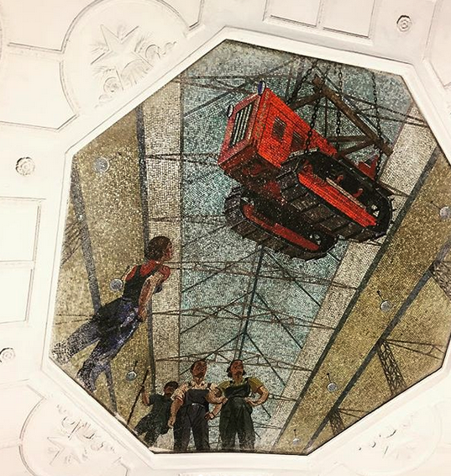
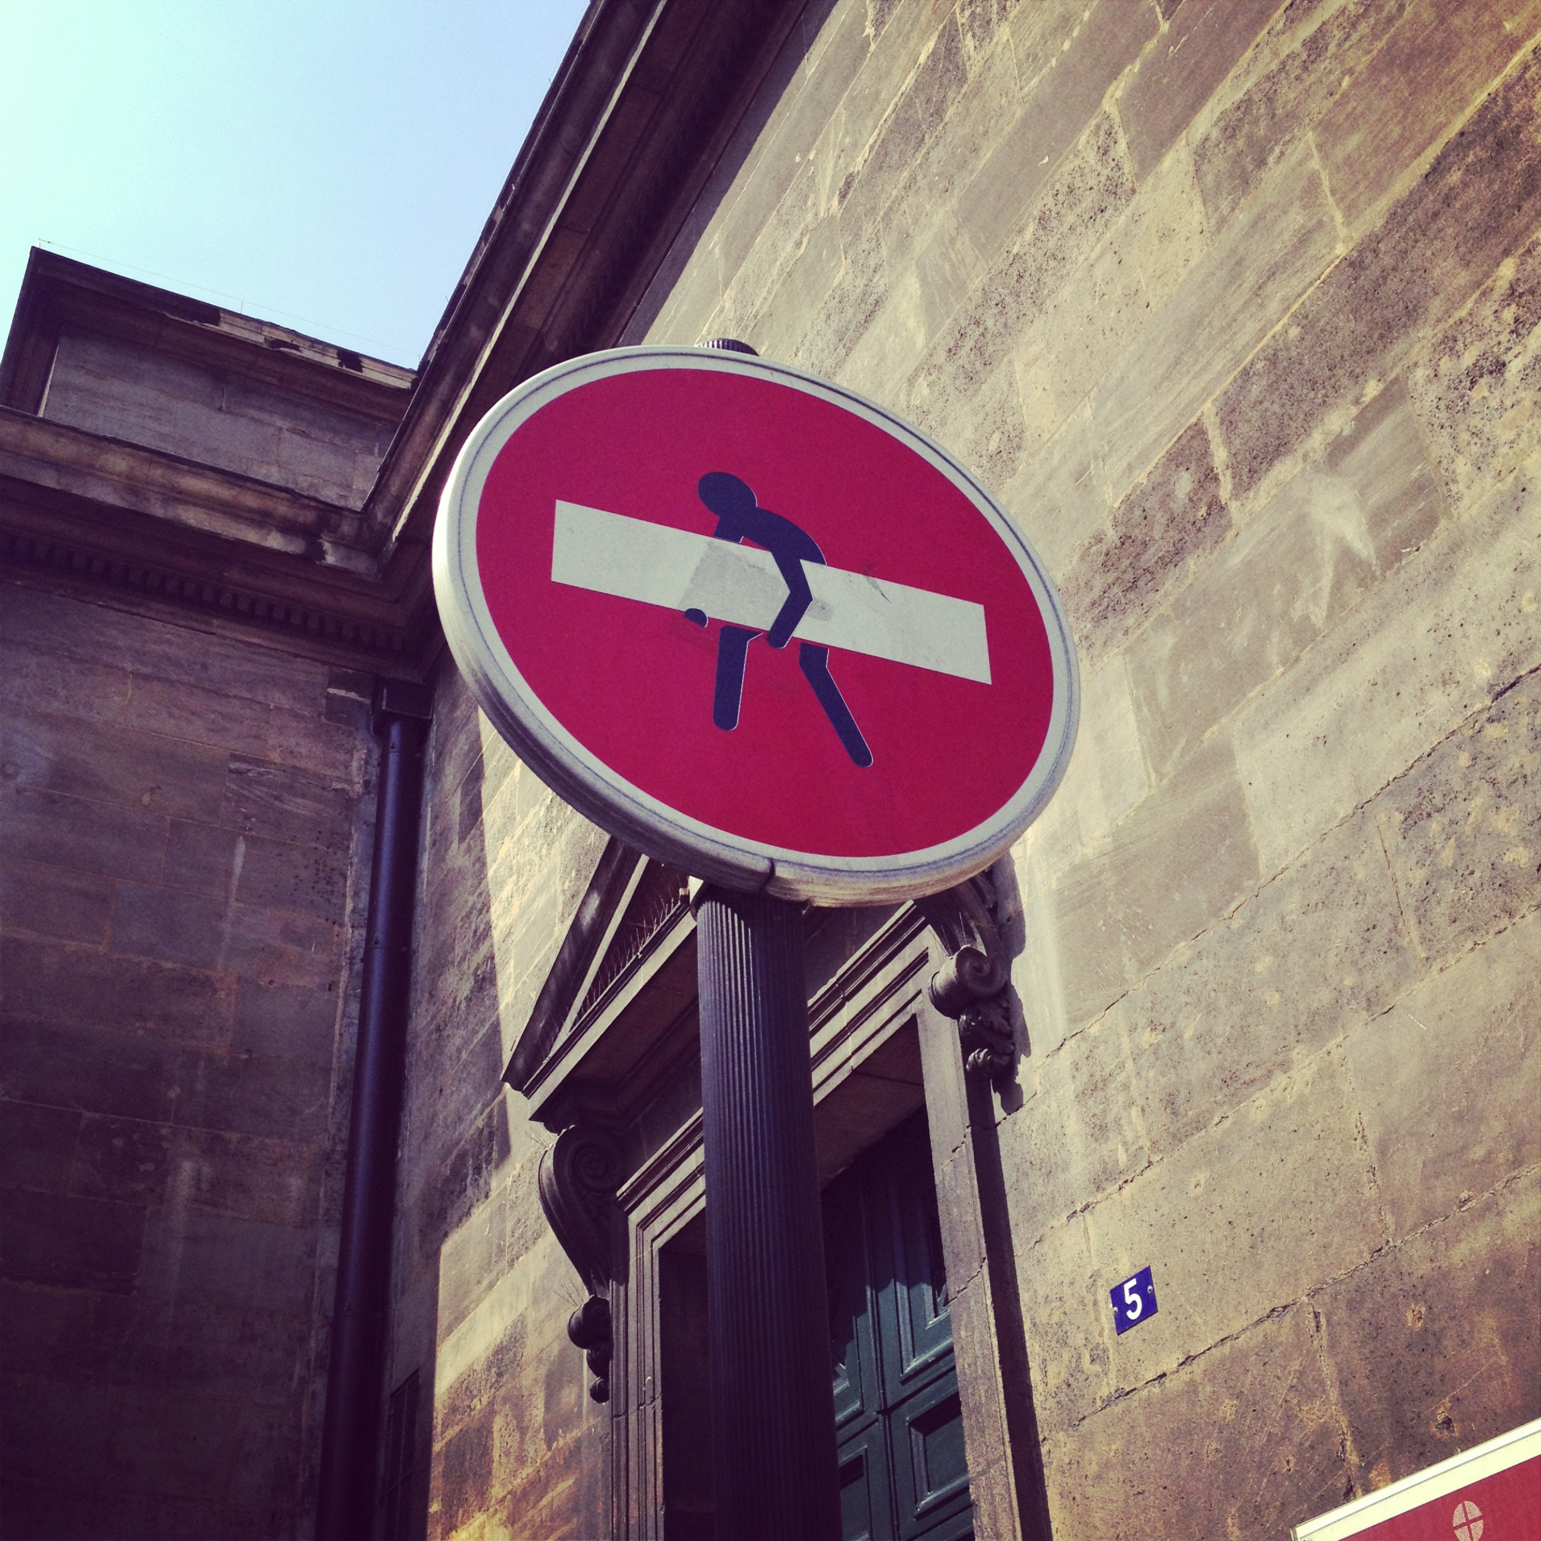
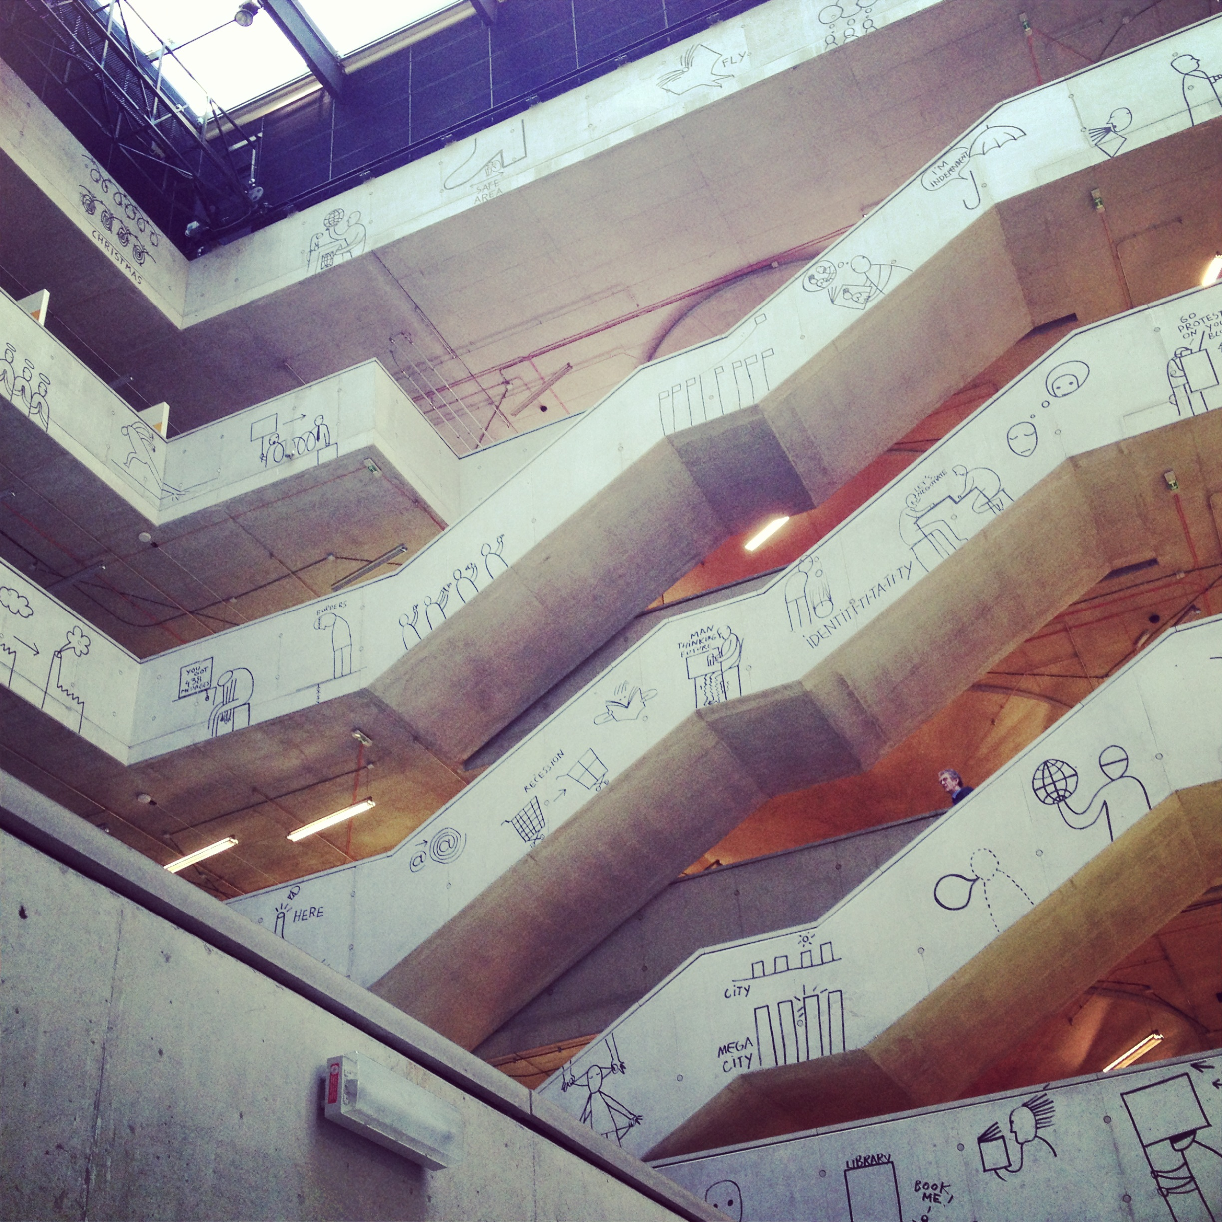
Technology AND Society
Effects of technologies are the outcome of human decisions and activities in a specific context (“intended or unintended consequences”)
Assumption: Technology systems are results of social processes
Basis question: How can societal challenges be solved by technologies without necessarily increasing unintended consequences?
Research AND Advice
Natural AND Social Sciences
Technology AND Society
Notes:
Grundlegende Frage: Wir brauchen Technologieentwicklungen um die grand challenges (Klimawandel, alternde Gesellschaft, Nahrungssicherheit, etc.) zu ‚lösen‘. Hierbei muss möglichst früh über die nicht intendierten Folgen nachgedacht werden. Z.B. durch Einbindung betroffener Gruppen (Stakeholder)
Das geht nur inter- und transdiziplinär: Eine Disziplin kann dem komplexen Verhältnis von Gesellschaft und Technologie nicht gerecht werden

Slide 4
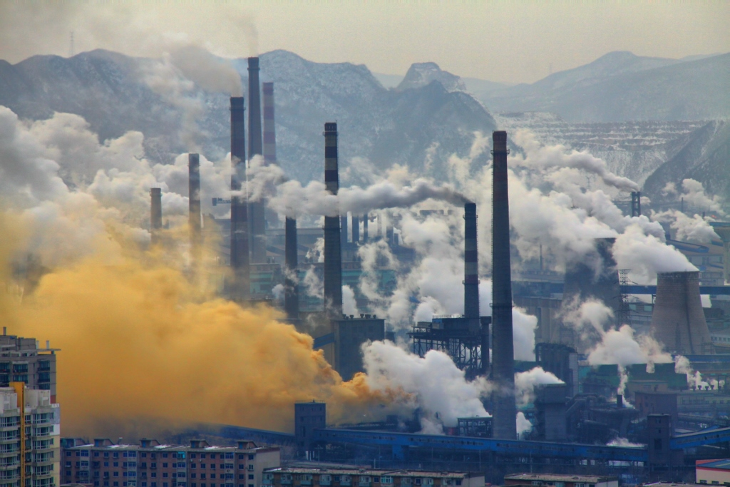
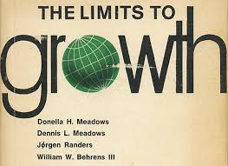
A Bit of Historical Context...
Technological progress increasingly criticized, e.g. sustainability
Investments in research and development increase
Risks often underestimated or ignored
Need for an early warning system to identify potential hazards and minimize effects
“it is essential that, to the fullest extent possible, the consequences of technological applications be anticipated, understood, and considered in determination of public policy on existing and emerging problems” (US Senate 1972)

Slide 5
Technology Assessment on the Rise
1960s: TA as a ‘technocratic’ response to technocratic problems: TA as experts, assessments as reaction to progress and complex effects
“TA is class of policy studies which systematically examine the effects on society that may occur when a technology is introduced, extended or modified…” J.F. Coates, 1980
Science and technology are social processes, embedded in society: TA is problem-oriented
“TA is a scientific, interactive and communicative process which aims to contribute to the formation of public and political opinion on societal aspects of science and technology.” TAMI, 2003
Central for TA:
Knowledge of possible consequences for various stakeholders
Knowledge for decision making processes
‘Better’ developments and innovation for society

Slide 6
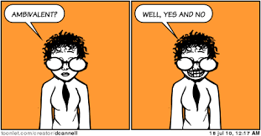
Challenge: Ambivalenz
TA is not about providing recommendations to morally justify or a certain technology or not
Instead it is about balancing options, needed for this: knowledge and assessment
Assessment of effects and weighing of options

Slide 7
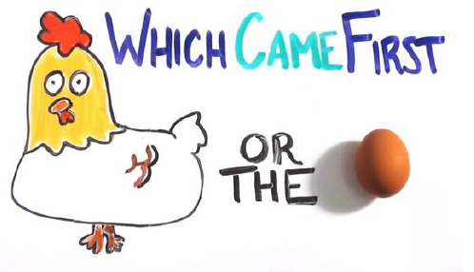
Challenge: Complexity
The positive and negative effects of technology are determined by societal frames and contexts
Often unclear, which cause is responsible for which effect
Effects are different for different groups, individuals, societies

Slide 8
Challenge: Uncertainty
Technology effects can lead to very different reactions by different individuals, stakeholders, etc.
Next to classic measurement errors uncertainty also comes from non-knowledge
Non-knowledge due to assessment of only certain systems or unknown external factors
When do we start assessing?

Slide 9
Dealing with Challenges....
Inclusion of public and stakeholders in assessments
Ethical considerations often based on culture, values, identity, emotions, etc.
Facts don’t speak for themselves: framing of issues and narratives important for providing evidence-informed policy advice
Technologies are often connected to “controversies about risk and benefits and ethical disputes about human dignity, the common good and questions of responsible research” (Zhao et. al 2015: 40)
Engagement as method to include ethical considerations and current discussions based on values, etc. in assessment
Notes:
JRC Report: understanding our political nature

Slide 10
Methods of TA
Classical TA
Expert orientated / focus on risks
Attempt to ‘rationalise’ debate (threat diffusion)
One-way relationship between TA and public
Examples: TAB, ITAS
Participatory TA
Non-expert / public inclusion
Focus also on ‘value’
Attempt to create ‘coherent’ debate
Variety of experimental models
Examples: DBT, RATHENAU

Slide 11
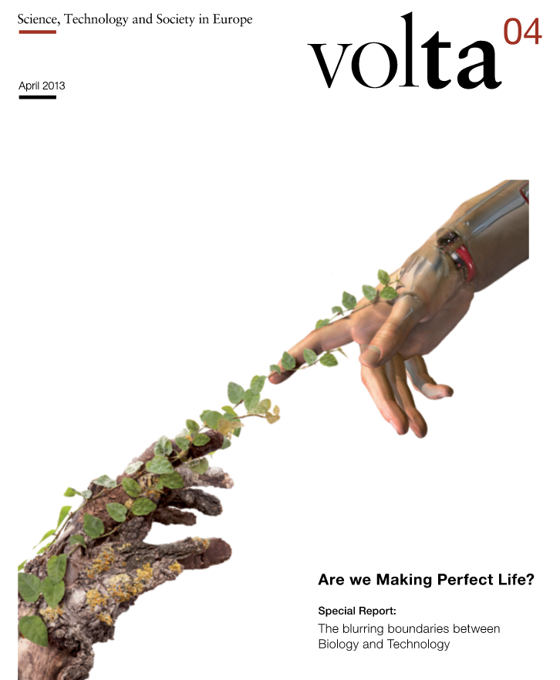
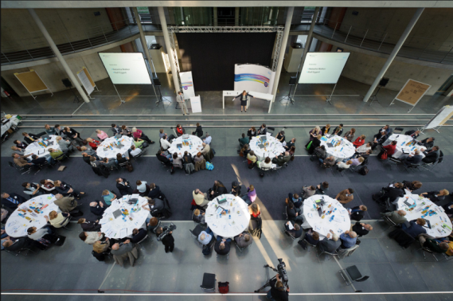
TA Tool Box
Interactive methods:
Consensus conference
Citizens’ jury
Scenario workshop
Communication:
Newsletter
Articles in press
Video presentation
Scientific methods:
Expert discussion
Delphi method
Modelling / simulation

Slide 12
Responsible Research and Innovation
“RRI implies that societal actors (researchers, citizens, policy makers, business, third sector organisations, etc.) work together during the whole research and innovation process in order to better align both the process and its outcomes with the values, needs and expectations of society” (EU Commission)
Ideally: through engagement problems of acceptance are solved by including all relevant actors during the entire development process
Stakeholders should “obtain relevant knowledge […] to effectively evaluate both outcomes and options in terms of societal needs and moral values […] to use these considerations […] as functional requirements for design and development [this] should be established as a collective, inclusive and system-wide approach” (EU Commission 2013).
Notes:
What does responsibility mean???

Slide 13
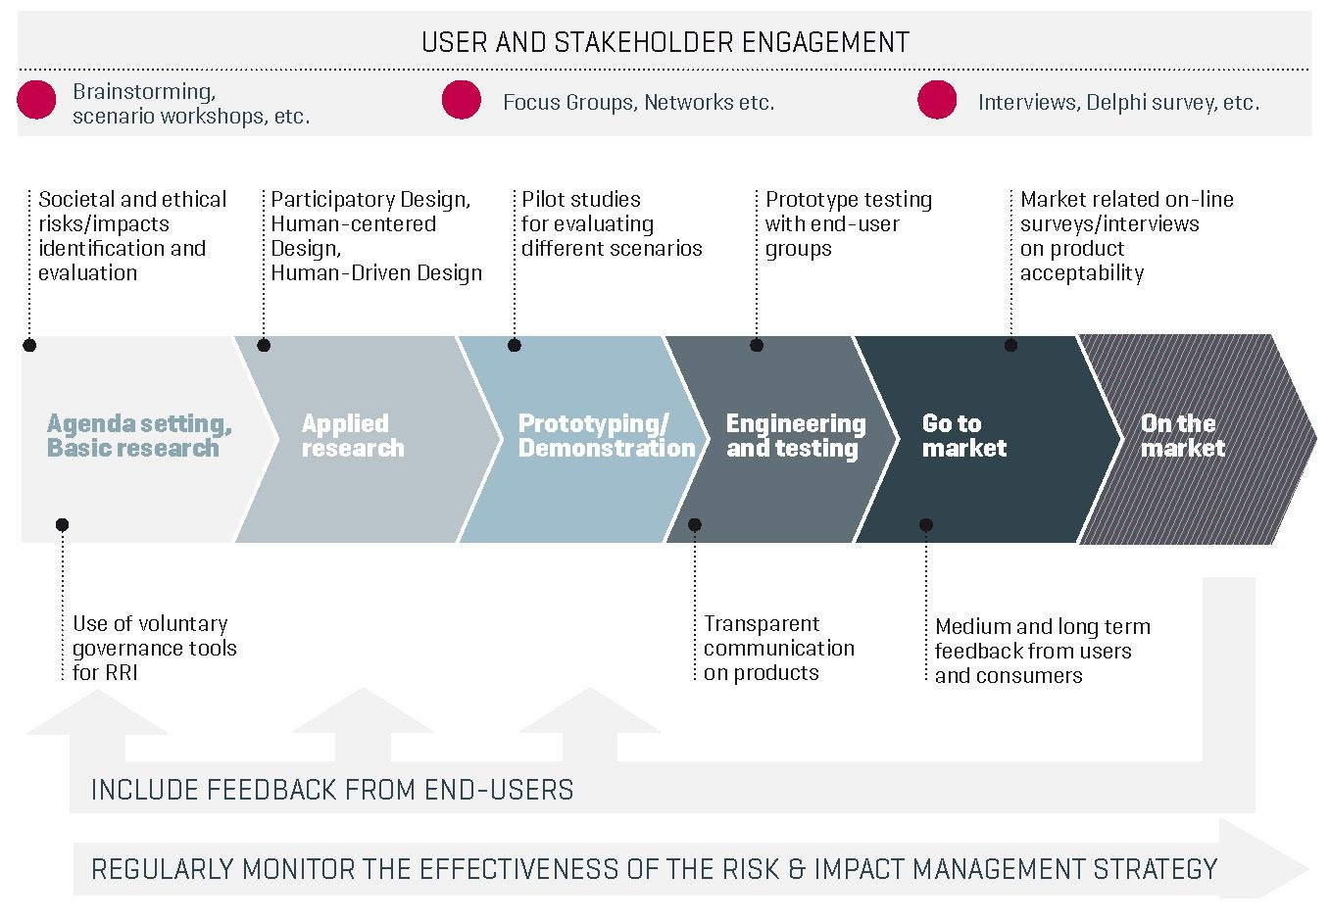

Slide 14
Assessing Big Data – ABIDA
What are the developments in Big Data technologies and applications and what trends can be expected in the near future? What changes will be brought about in the economy, in services, in government action, or private life?
What do citizens know about Big Data and what is their assessment of the developments?
What are the relevant issues of social change triggered by Big Data? What do individual disciplines know about it, and how are Big Data developments judged by them?
What conclusions can be drawn for options for political and social action?
Notes:
generation, linking and analysis of huge amounts of data →term itself different according to disciplines: in the project understood as umbrella term under which different crucial questions of digitalization and how different actors discuss and reflect
e.g. assessment of societal effects of scoring or profiling or machine learning
data sources have multiplied due to an extensive use of networked computer technologies. These range from smartphones, social networks and surfing habits up to the networking of everyday live – the latter made possible through advances in the Internet of Things (e.g., smart wearables, watches, buildings, and electric supply networks). At the same time, the possibility to link these data sources and advances in the development of hard- and software technologies have brought about new possibilities of data evaluation affecting almost all areas of human life and the economic sectors.
Project components feed into each other: e.g. monitoring and scenarios go into citizens consultations and survey →this then goes into the determination of in-depth studies

Slide 15
Some Insights…
Expert workshop: “Discrimination through algorithms in AI and eRecruiting”
More transparency required regarding comprehensiveness of factors, not entire algorithm but instead decisions made and the parameters used
Algorithms can help show interdependencies and uncover structural discrimination
Often unclear what companies regard as a “good employee” (soft factors) and correlation between prejudices and confidential factors (gender, religion, etc.)
Expert workshop: “Digital Demos - Big Data in political campaigns”
Journalistic coverage ambivalent: big data either as new power encompassing all or as exaggeration
Often unclear whether fascination is with content or function of big data, e.g. presidential campaign in USA: often reported how heterogenic the data sets and the resulting prognosis were → shift from actual content of prognosis to a judgement of outcome (big data use for Clinton positive, for Trump negative)
Need for a dialogue-form of education with inclusion of public for open dialogue
Big data itself a form of politics encompassing and behind each algorithm or digital claim there is a interest or intension
Need for minimal consensus and discourse on democracy in the context of social media
Notes:
Factors (competence as team player, social behavior)

Slide 16
What Now?
Insight: ethical, social, cultural aspects should be part of technology assessments and reflection
Challenges such as complexity, ambivalence, uncertainty require different forms of gaining knowledge
TA and RRI are approaches that aim to find answers → mix of methods and problem-oriented focus
All-encompassing developments such as big data require the inclusion of an array of disciplines (interdisciplinarity) and actors (transdisciplinarity)

Slide 17
https://publikationen.bibliothek.kit.edu/1000085280/23225323

