Slide 1




Do citizen science data improve the reconstruction of heavy rainfall events?
H. Müller-Thomy, F. Meyer, K. Schröter
Leichtweiß-Institute for Hydraulic Engineering and Water Resources
Div. Hydrology and River Basin Management
Opportunistic Sensing of Precipitation
Offenbach, 26.06.2025

Slide 2
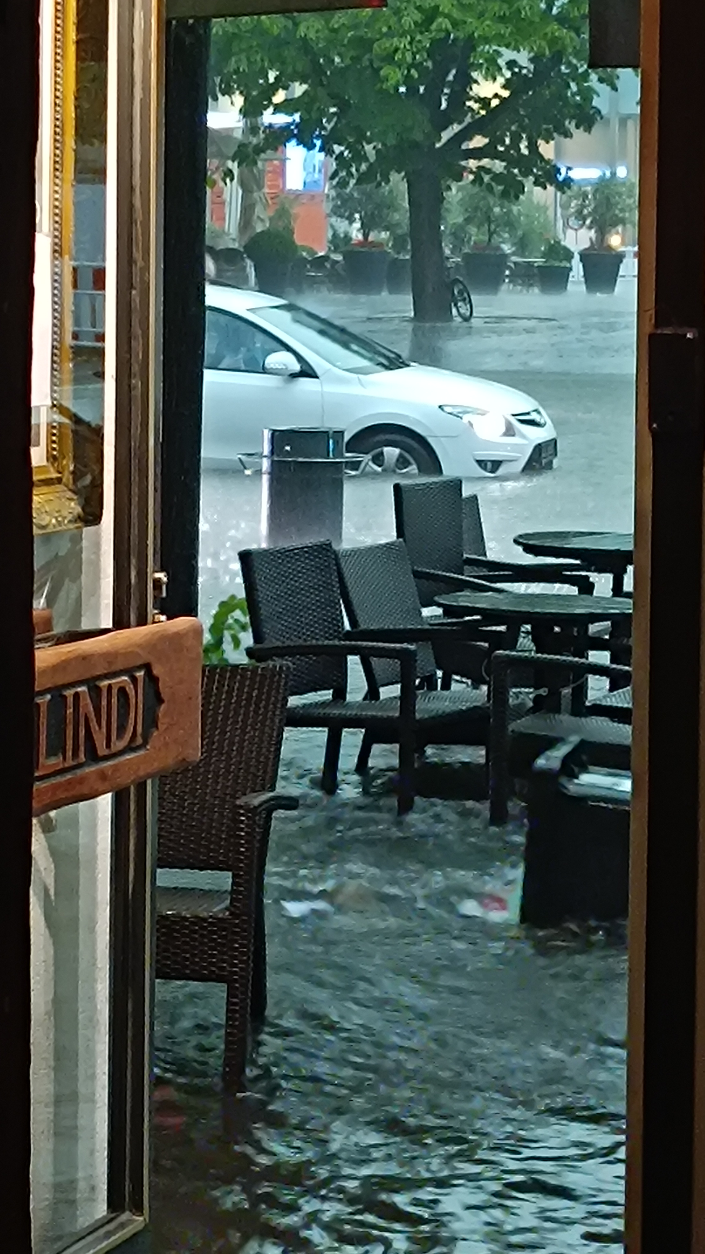
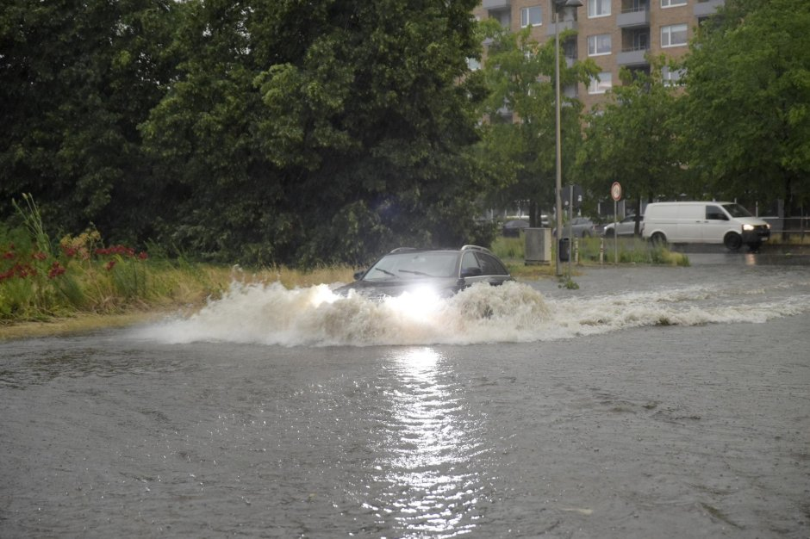
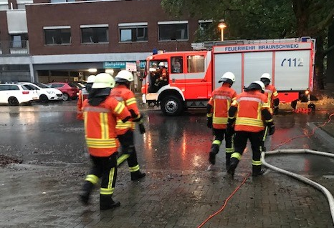
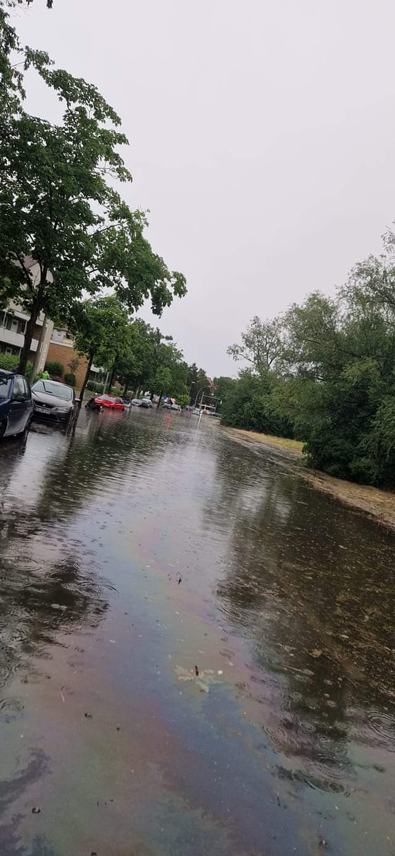
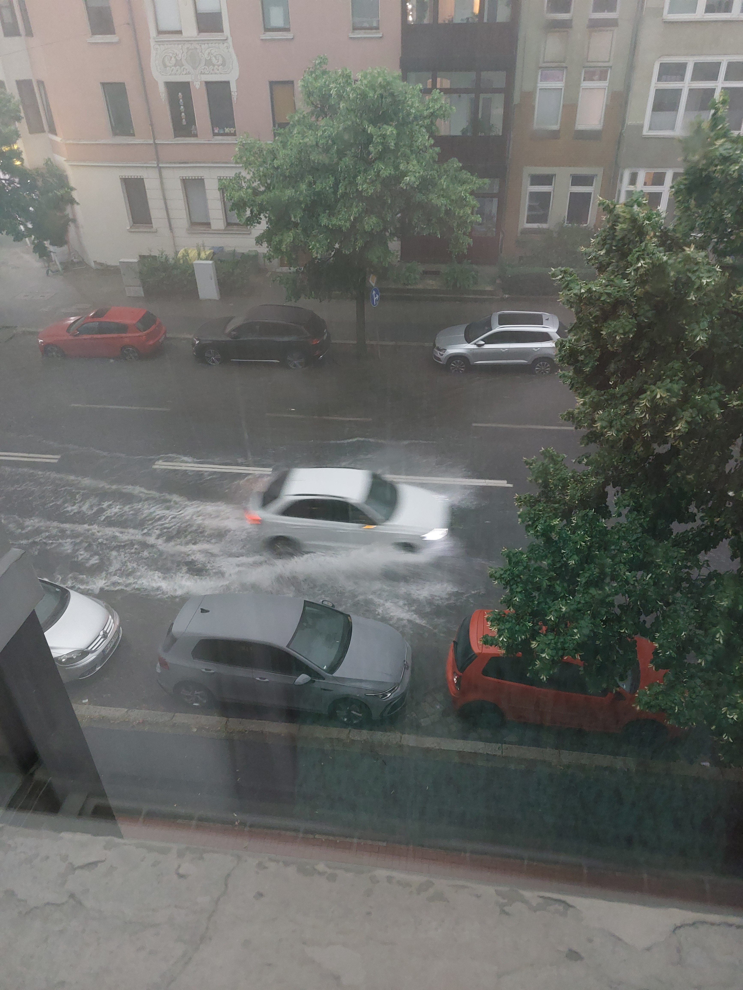
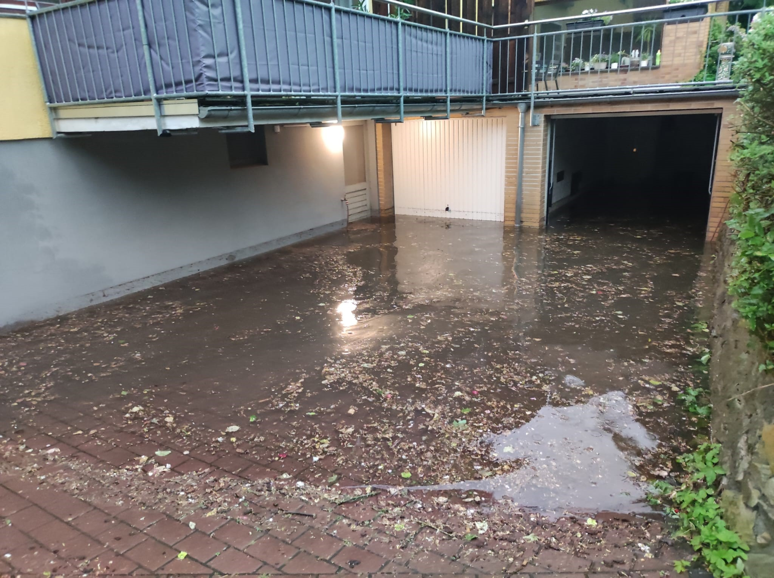
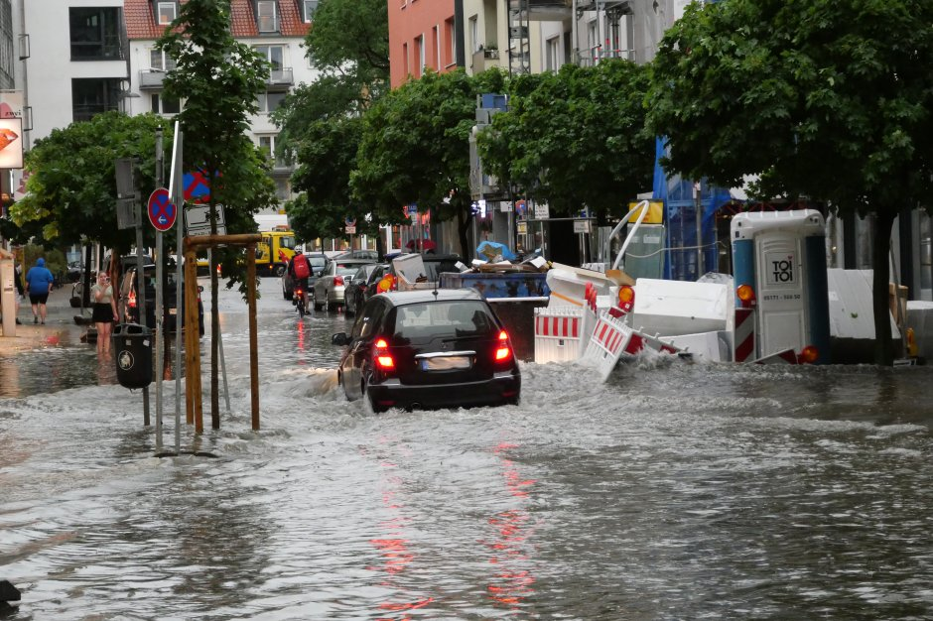
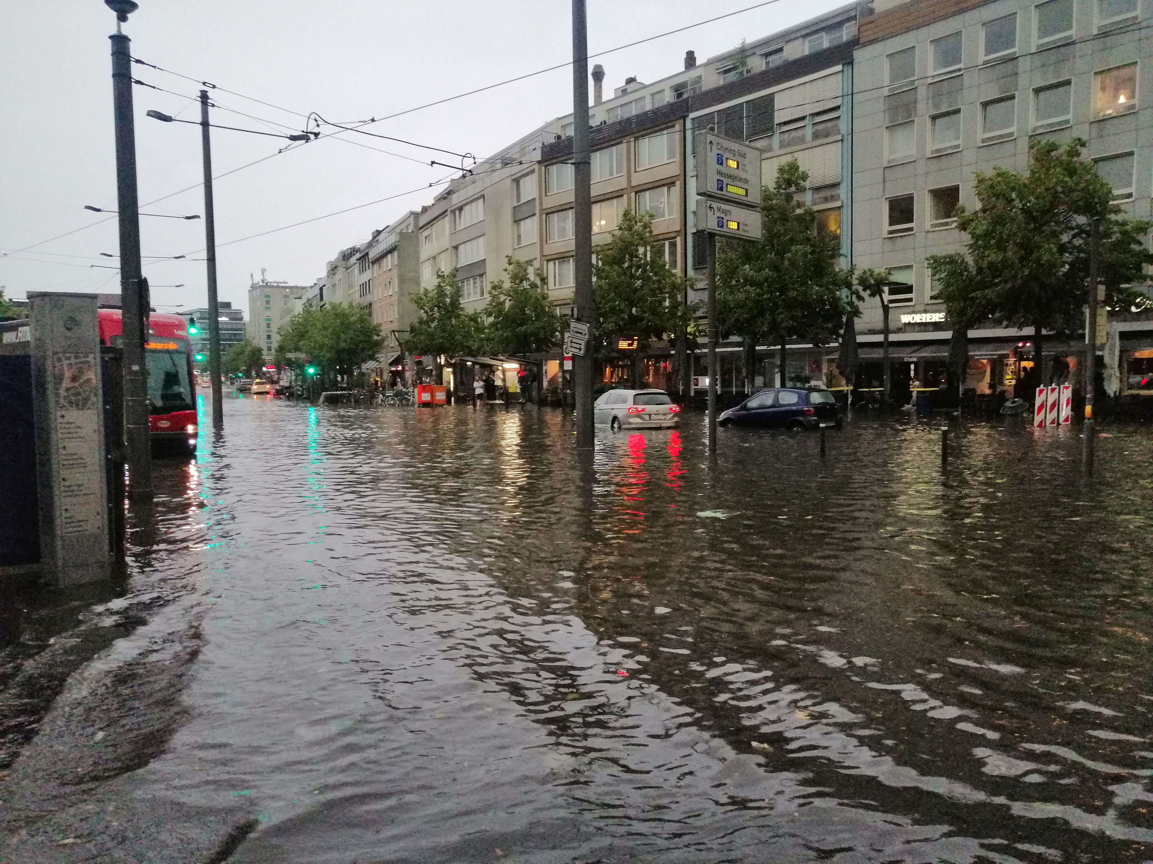
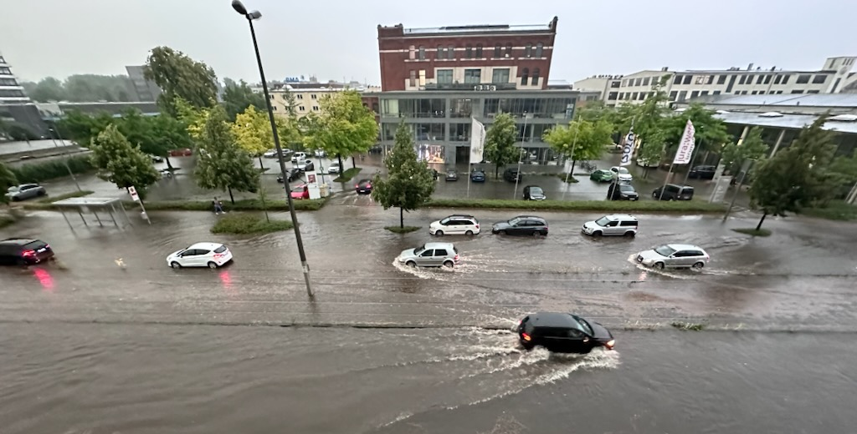
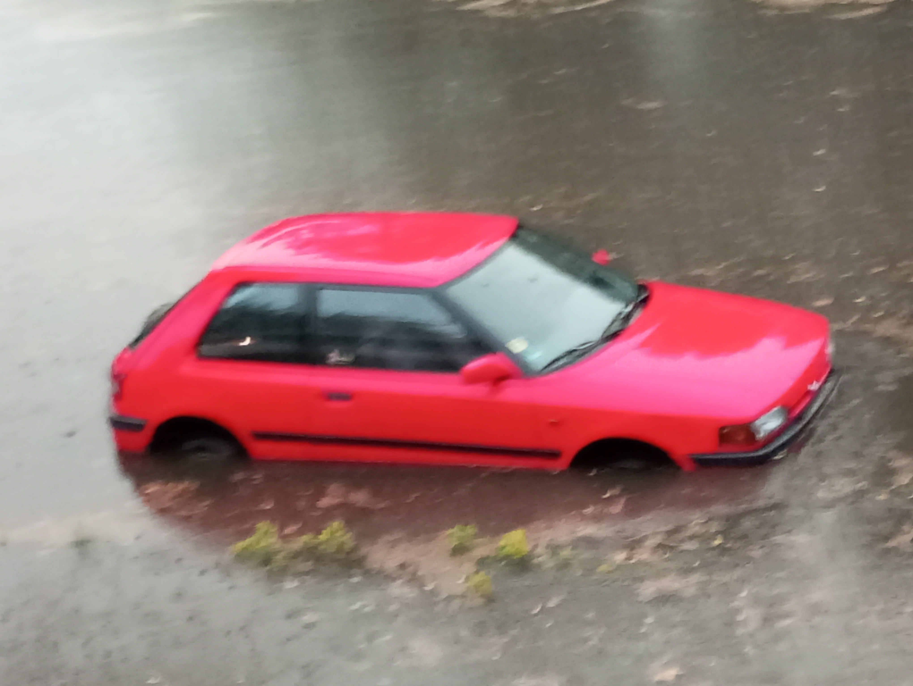
Data
Studied rainfall event
Storm Lambert (single rainfall event)
Braunschweig, Germany (205 km²)
Start: 22.06.2023, 18:00 CET
End: 23.06.2023, 18:00 CET
Notes:
DWD German Weather Service
BS Municipal Wastewater management
Quality checks: Double sum analysis, number of missing values

Slide 3
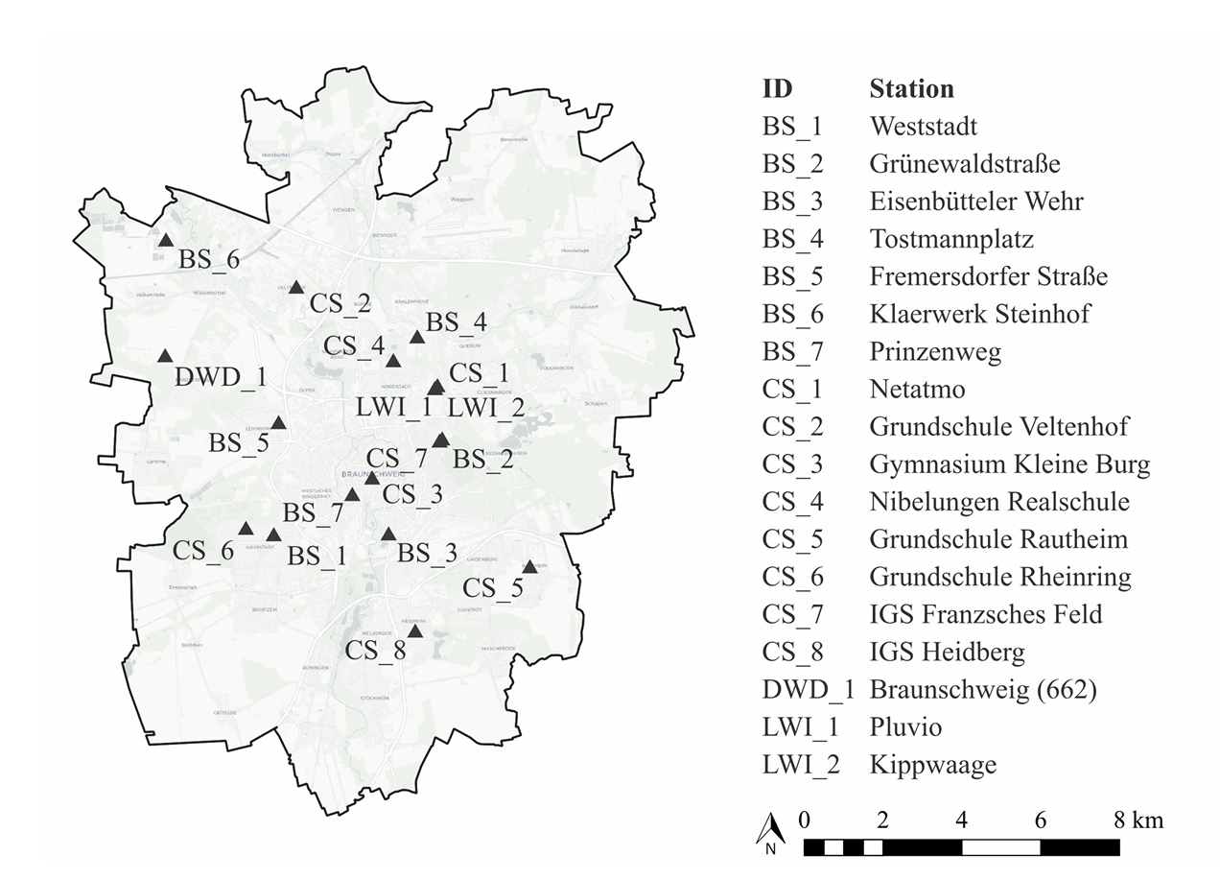
Data
Studied rainfall event
Storm Lambert (single rainfall event)
Braunschweig, Germany (205 km²)
Start: 22.06.2023, 18:00 CET
End: 23.06.2023, 18:00 CET
Station data
DWD: 1 station
Citizen Science: 8 stations
BS (incl. LWI): 9 stations
Radar data:
  YW data set (downscaled RADOLAN)
4 stations
8 stations
Simple quality checks
Notes:
DWD German Weather Service
BS Municipal Wastewater management / NOT accessible
CS / accessible
Quality checks: Double sum analysis, number of missing values

Slide 4

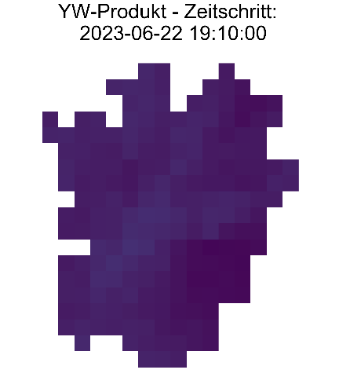
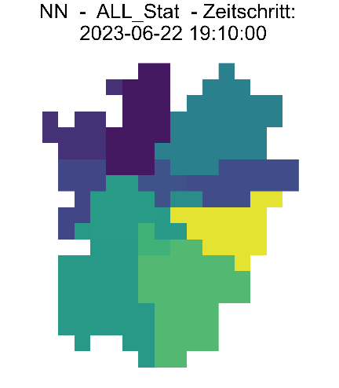
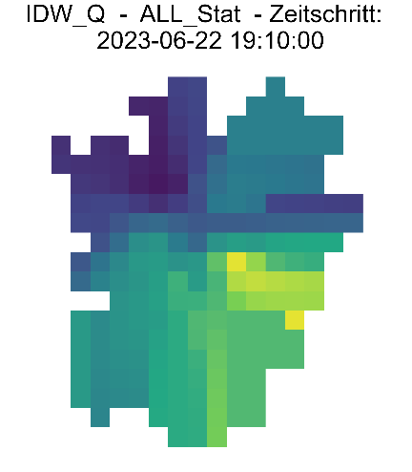
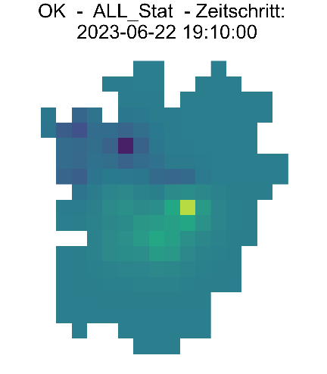
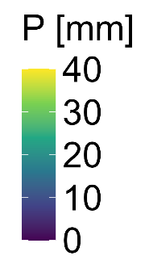
Methods
Regionalization Rainfall amount 22.06., 19:00-19:10
DWD
Radar
All Stat - NN
All Stat – IDW-Q
All Stat – OK
Regionalization | Event rainfall amount [mm/24h]
 | DWD | Radar | BS | BS+DWD | CS | ALL_Stat
NN | 72 | 69 | 133 | 132 | 98 | 125
IDW |  |  | 130 | 126 | 90 | 115
IDW_Q |  |  | 133 | 131 | 98 | 127
OK |  |  | 128 | 121 | 91 | 113
OK_Q |  |  | 130 | 129 | 98 | 124
Data set choice is more important than regionalization technic!
Notes:
Cross-validation: The data set validated is assumed as truth and by leave-one-out evaluated

Slide 5
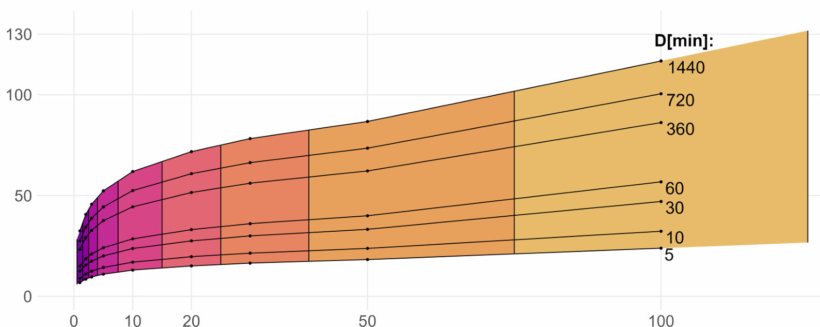
Methods
Return period
Extreme value analysis based on KOSTRA2020
Raster-based extreme value analysis for Germany
Durations: D={5, 10, 15, 20, 30, 45, 60, 90 [min], 2, 3, 4, 6, 9, 12, 18, 24 [h]}
Return periods: T={1, 2, 3, 5, 10, 20, 30, 50, 100 [a]}
(Junghähnel et al., 2022; Shehu et al., 2023)
Rainfall amount [mm]
Return period [yrs]
→ For all durations D the maximum value for each raster field was classified.
→ 12 KOSTRA raster cells for Braunschweig enable spatial return period estimation
Notes:
national extreme value catalogue
Example OK-BS

Slide 6
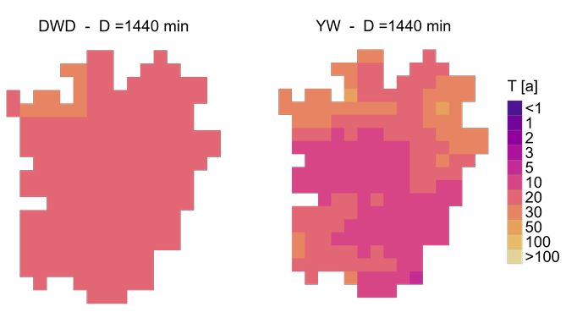
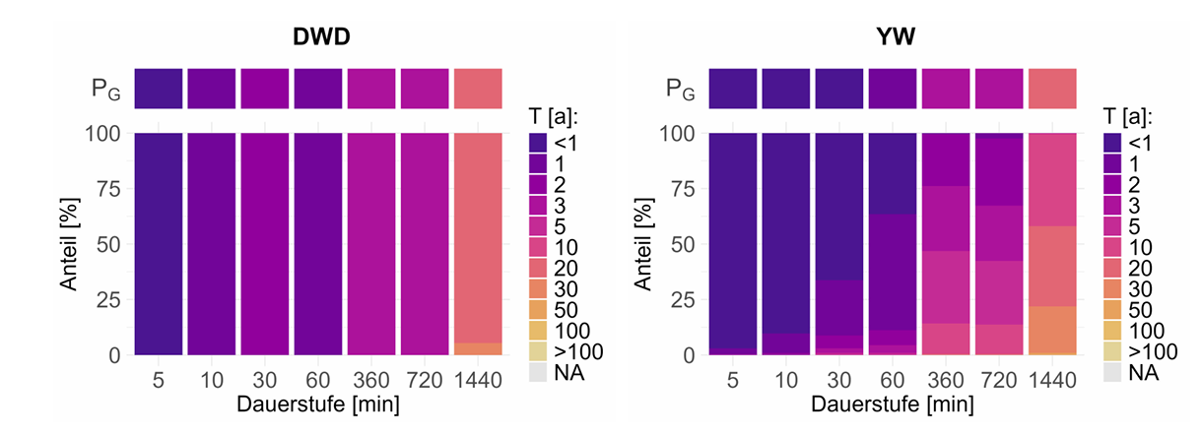
Results
Return period
Raster-based extreme value within the event
Spatial return period estimation
Fraction [%]
Fraction [%]
Notes:
national extreme value catalogue

Slide 7
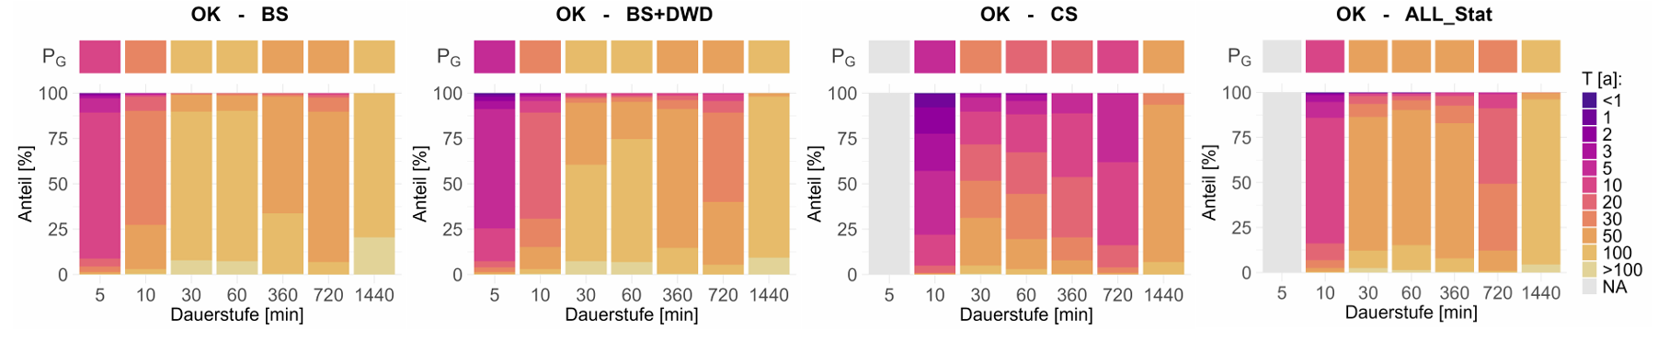
Results
Return period
DWD & YW:
T_{G}(10min) = 1 yr & <1 yr
T_{G}(1440 min) = 20 yrs
Fraction [%]
BS & BS+DWD (‘conventional measurements’):
T_{G}(10min) = 30 yrs
T_{G}(1440 min) = 100 yrs
Fraction [%]
CS :
T_{G}(10min) = 5 yrs
T_{G}(1440 min) = 50 yrs
Fraction [%]
Duration [min]
Duration [min]
Notes:
national extreme value catalogue

Slide 8




Conclusions
Citizen science data:
Enrich rainfall information and are easily accessible
Add spatial detail which outweighs limited measuring accuracy
With simple quality checks only slightly less accurate than conventional measurements
Thank you for your attention!
  @HydroHannes
@hydriv-lwi
@hydriv@mas.to

Slide 9


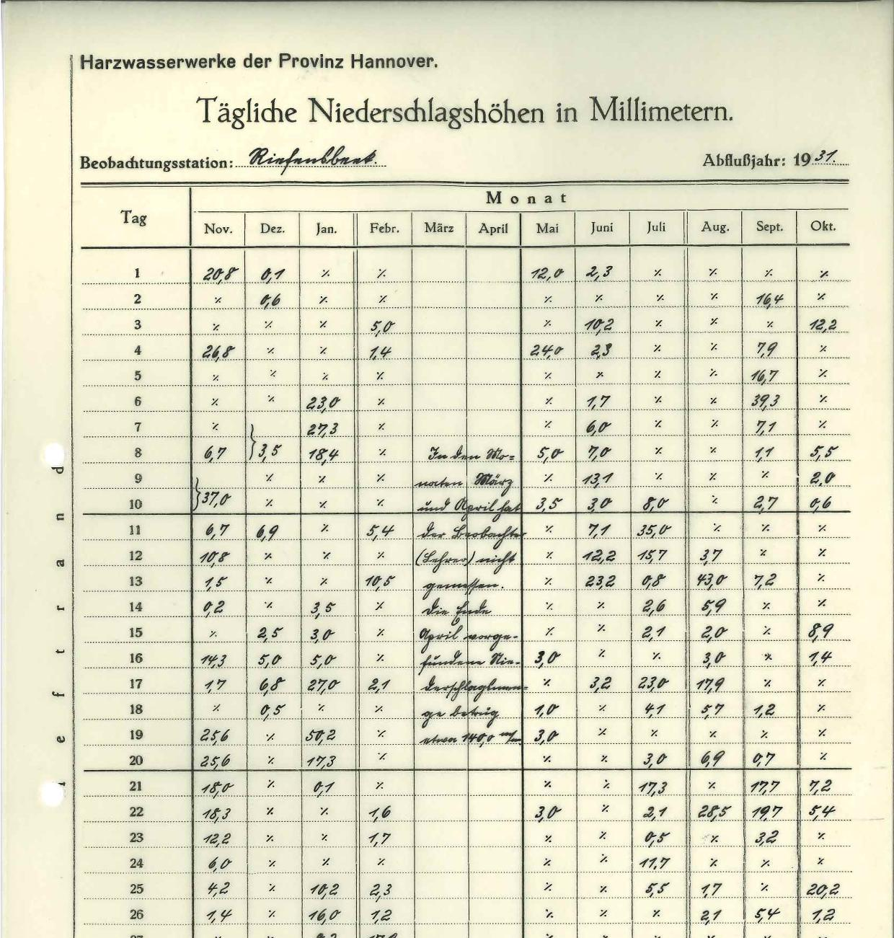

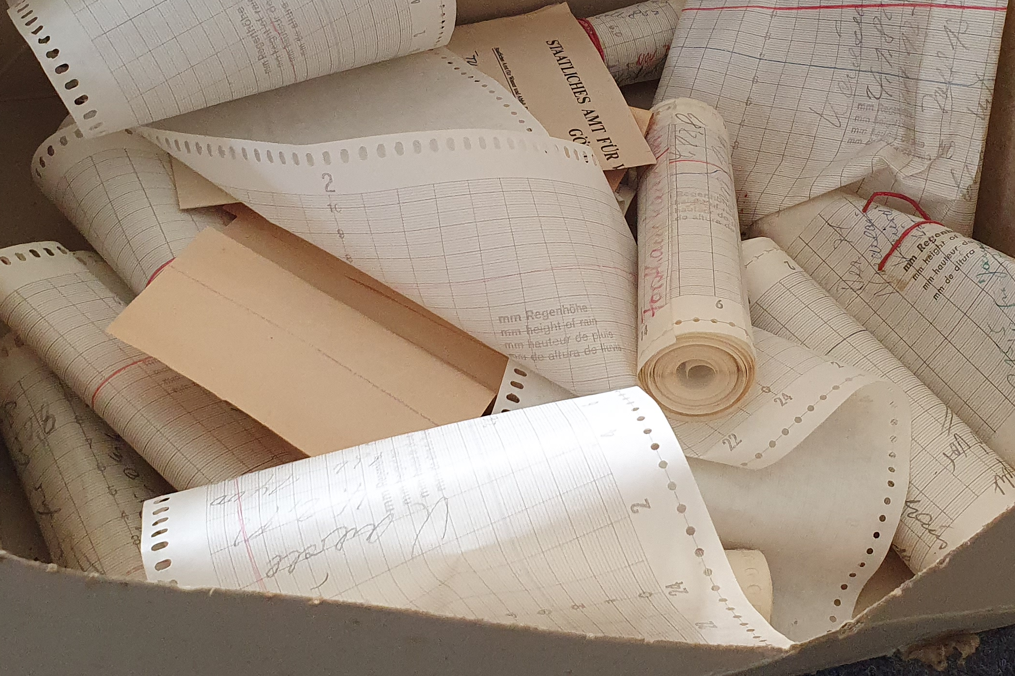



DO IT!
Digitization of analogue records in time
Opportunistic sensors will improve
the precipitation data situation…
…in the meanwhile in the archives:
Help us to digitize historical records - only a few minutes by everyone will add centuries of records to our precipitation data!
doit-lwi.tu-bs.de
Questions & feedback?
h.mueller-thomy@tu-bs.de

Slide 10
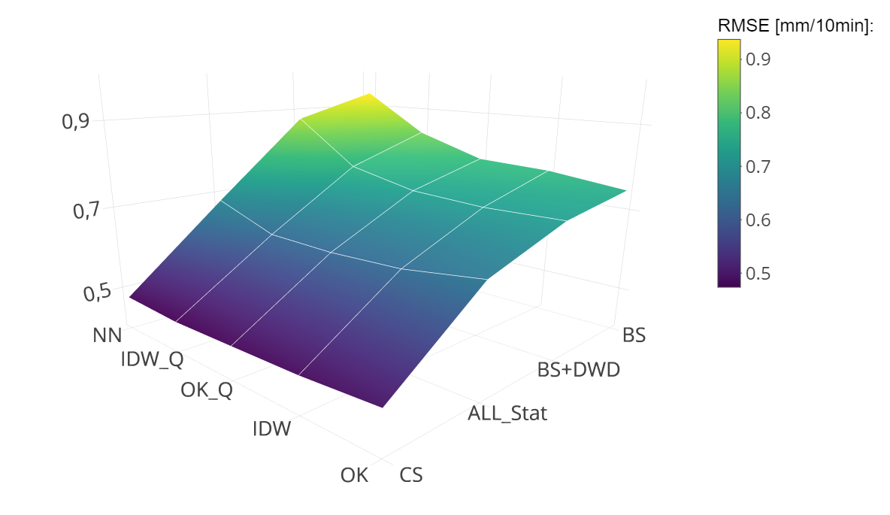
Methods
Regionalization Rainfall amount 22.06., 19:00-19:10
DWD
Radar
All Stat - NN
All Stat – IDW-Q
All Stat – OK
Cross-validation via RMSE:
(truth := data set studied)
CS less peaky than ALL_Stat
Method
Data set
Notes:
Cross-validation: The data set All_Stat is assumed as truth and by leave-one-out evaluated
Bias is smallest for all data sets using OK

Slide 11
References
Shehu, B., Willems, W., Stockel, H., Thiele, L.-B., Haberlandt, U. (2023): Regionalisation of rainfall-dept-duration-frequency curves with different data types in Germany, Hydrol. Earth Syt. Sci. 27, 1109-1132, doi.org/10.5194/hess-27-1109-2023.
Junghänel, T., Bär, F. , Deutschländer, T., Haberlandt, U., Otte, I., Shehu, B., Stockel, H., Stricker, K., Thiele, L.-B., Willems, W. (2022): Methodische Untersuchungen zur Novellierung der Starkregenstatistik für Deutschland (MUNSTAR), Synthesebericht. 95 pp.
Notes:
Transition probabilities extended by position and volume dependencies

