Slide 1


Comparison between terrestrial and satellite microwave links as opportunistic rainfall sensors
1st International Conference on Opportunistic Sensing of Precipitation
Jun 25 – 26, 2025 – DWD,Offenbach,Germany
R. Nebuloni¹, F. Giannetti², F. Sapienza², V. Lottici², G. Scognamiglio³, A. Vaccaro³, E. Covi⁴, C. De Michele⁵, C. Gianoglio⁶, M. Colli⁷, E. Adirosi⁸, G. Roversi⁸
¹CNR-IEIIT (Italy), ²University of Pisa (Italy),³MBI Srl (Italy), ⁴ARPAE (Italy), ⁵Politecnico di Milano (Italy),
⁶Univ. of Genova (Italy), ⁷Artys, Darts Engineering Srl (Italy), ⁸CNR-ISAC

Slide 2
Outline
General view of CS and OS: Table I paper (characteristics of CS and OS)
Implementation of Opportunistic sensing by CML/SML based on experience of 4 groups in Italy on CML/SML. Map of active groups. (RN)
Fig. 1 modified. Data transfer + data processing (FG)
Data processing: CML vs SML (fig 2+3)
Propagations/Environment effects/technical limitations (2 slides) (FG+FS)
Mitigation of disturbances
Are SML/CML reliable as precipitations sensors? Recommended KPI & results
Operational ? Standardization (data format & quality, link features, quality of measurements, other aspects, increasing TRL especially for SML)
Future of terrestrial and satellite, TN + NTN 6G
New project: upcoming COST ACTIONS (deadline 21.10.2025)

Slide 3
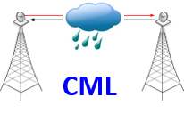
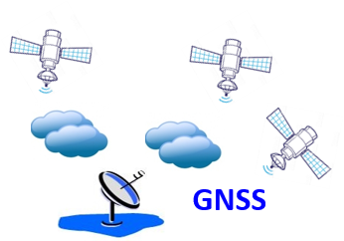
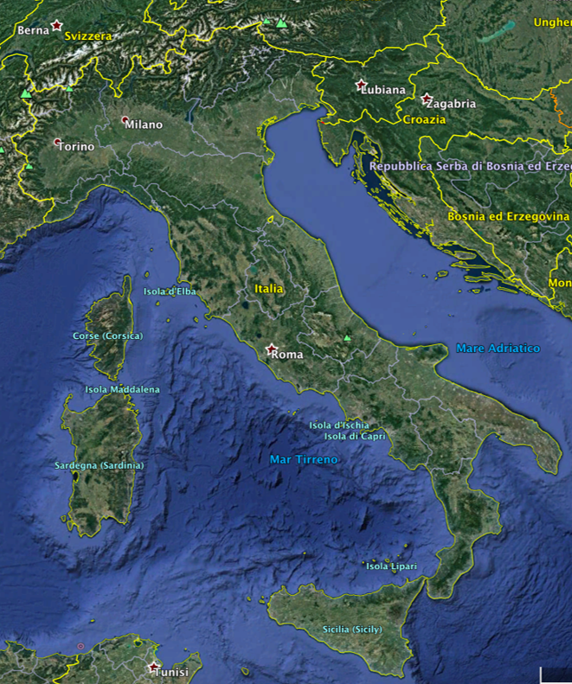
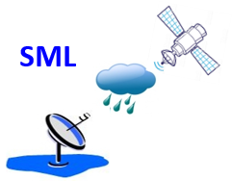
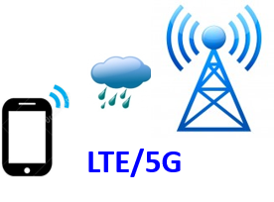


Research on Opportunistic Sensing of Precipitation in Italy
CNR &
ARPA ER / DPC
Bologna
CNR &
Politecnico MIlano
Milan
Bologna
Genoa
Pisa
Florence
Univ. Genova & Artys
Rome
Univ. Pisa, MBI, CNR, LaMMA & Univ. Firenze
Most of us are in the OpenSense community!
Univ. Catania
Catania

Slide 4
Characteristics of Opportunistic Sensors: CMLs vs SMLs
 | CML | SML
Frequency Range | 6-42 GHz (C-band to Q-band), 71-76 & 81-86 GHz (E-band) | 10.7-12.75 GHz & 17.7-21.2 GHz (Ku-band)
Measured | Path attenuation | Path attenuation
Primary geophysical variable | Precipitation Intensity | Precipitation Intensity
Spatial sampling | Over an almost horizontal straight line (terrestrial path) | Over a slanted straight line (satellite-to-Earth)
Spatial resolution (single sensor) | Considered as a point sensor | Considered as a point sensor
Spatial resolution (network of sensors) | Average distance between sensors | Average distance between sensors
Temporal resolution | 10 s - 15 min | 30 s - 15 min
Ownership & Cost | MNOs are the data owners Data can come at a cost | Who installs the sensors Cost per sensor: € 100 - 1000
Scalability Issues | Potential of global infrastructure But many private networks | SMLs are already-installed satcom terminals: scalability has no cost, but it depends on their distribution over sat footprint. SMLs are purposely deployed satcom receivers: scalability comes at a cost proportional to their number.
Notes:
Please note that all SML work in the same band, which is at a lower frequency than most of CMLs, that is, less sensitive to rainfall

Slide 5
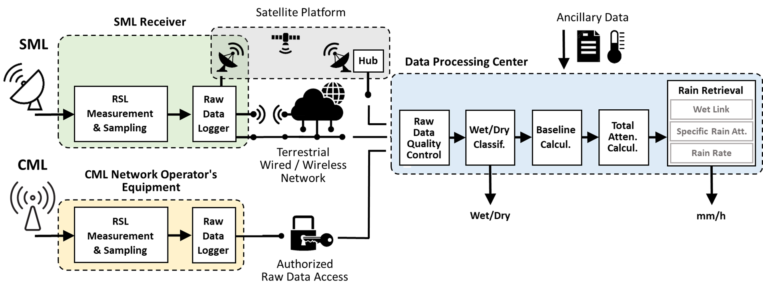
Processing Chain
TSL: Transmitted Signal Level
RSL: Received Signal Level

Slide 6
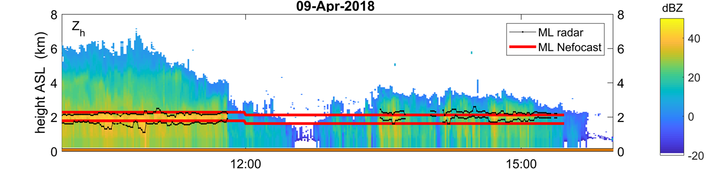
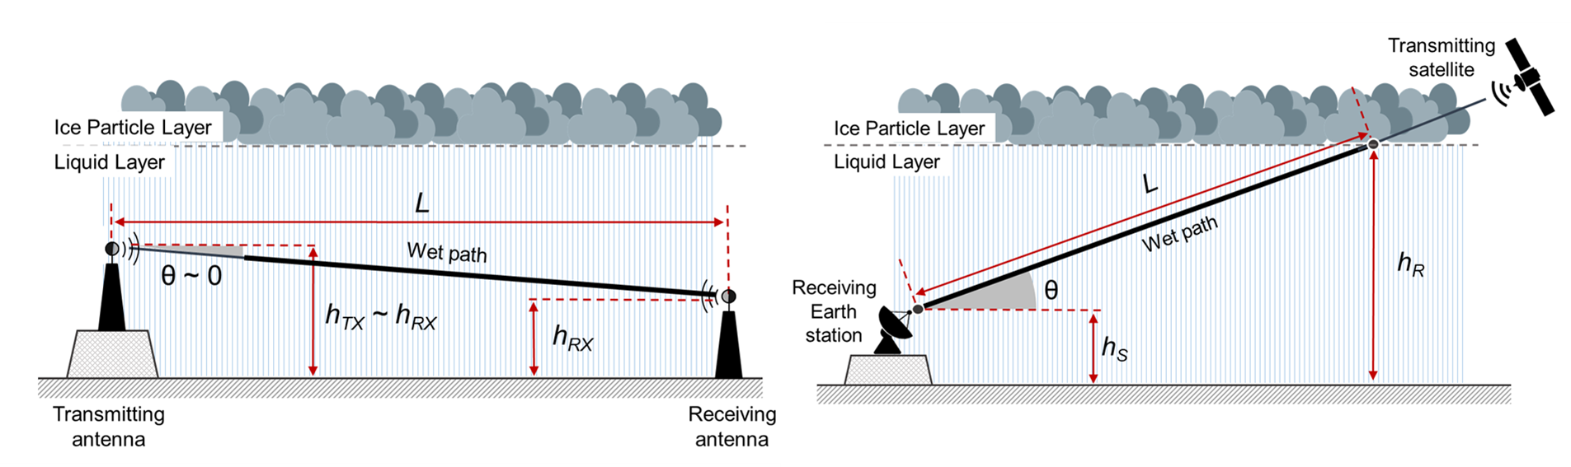
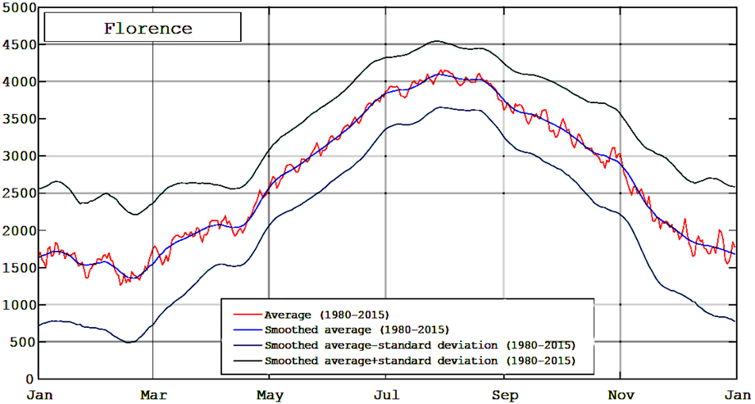

Data processing: major differences between CML and SML
Rain height can be derived from 0°C isotherm height, whose
(location-dependent) values can be obtained in several ways:
  daily mean based on historical data archive, e.g., NASA’s MERRA-2
  yearly mean by ITU-R P.839-4
  short-term forecast by models, e.g., WRF (Weather Research and
  Forecasting) or reanalysis (ERA-5)
  altitude gradient applied to a single ground temperature measurement
  high-altitude extrapolation of a couple of low-altitude temperature
  measurements
  real time bright band detection by radar vertical reflectivity profiles
Example of time series of Zh collected by Polar 55C radar on April 9, 2018. Black lines: ML bottom and top from radar data. Red lines: ML bottom and top from WRF model.
0°C isotherm height in Florence
Daily mean from 35-year MERRA data average
Yearly mean from ITU-R P.839
CML
SML

Slide 7


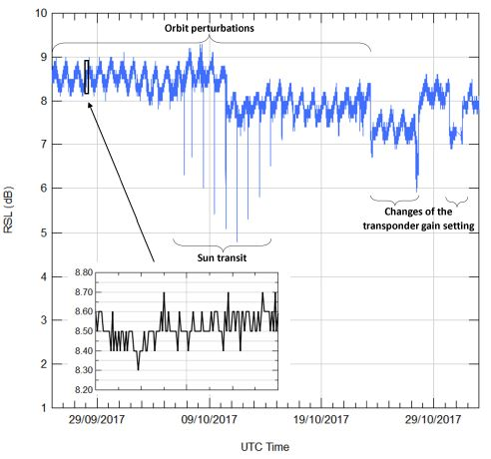
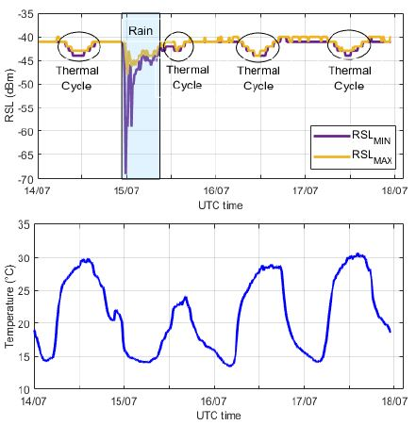
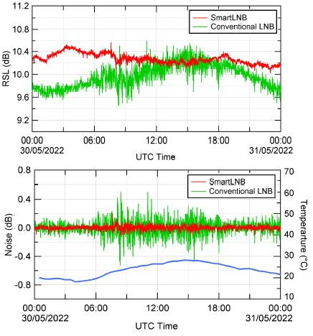
Disturbances in Opportunistic Rainfall Estimation (1/2)
Environmental Effects on the Sensor
CMLs and SMLs
SML Specific
Wet antenna attenuation: extra attenuation
due to water on the antenna surface.
Thermal effects: slow and regular RSL variations
due to temperature changes.
Wind effects: temporary misalignment of antennas.
Link malfunctioning: glitches, signal/data loss due to power issues.
Orbit perturbations
Sun transit
Transponder power adjustments

Slide 8
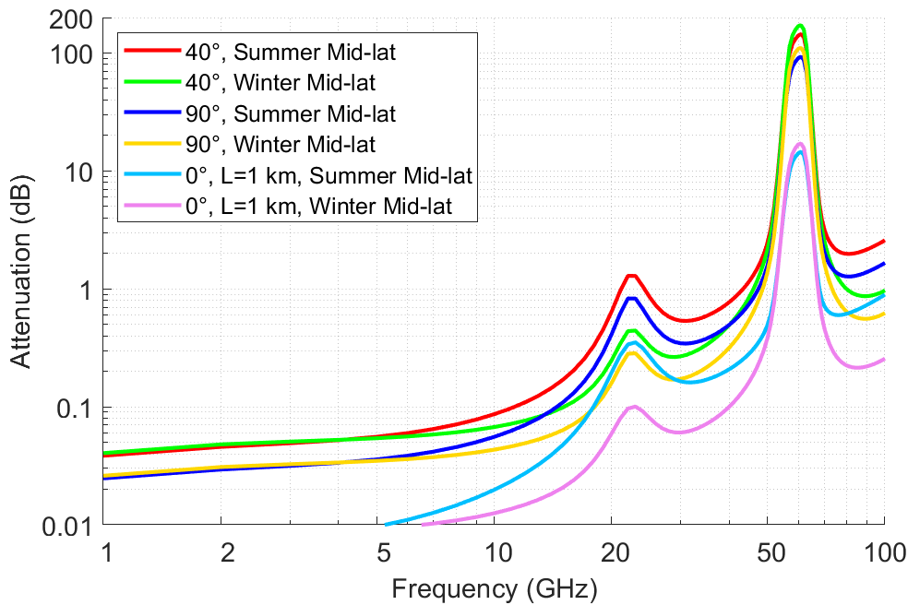
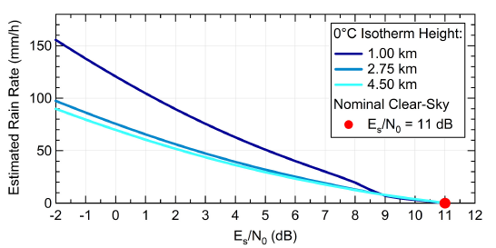
Disturbances in Opportunistic Rainfall Estimation (2/2)
Propagation Effects
Attenuation due to atmospheric components: gases, fog, clouds, snow, hail, and dust.
Interference: vegetation, multipath, obstacles in first Fresnel zone.
Intrinsic Technical Limitations
Temporal sampling: CMLs up to 15-min; SMLs depend on the receiver (e.g., SmartLNB: 30–60 s)
Rain field reconstruction: for CMLs is bounded by network density and topology.
Signal format: CML data is not optimized for obtaining
quantitative precipitation estimates, as TSL and RSL are
mainly stored for link quality purposes.
Dynamic range: maximum measurable rain rate is limited
by the receiver's sensitivity; SMLs may saturate during
heavy rain, while CMLs typically offer a wider dynamic range.
Data transfer: transmitting RSL data from thousands of
links to a central server can be bandwidth-intensive.

Slide 9
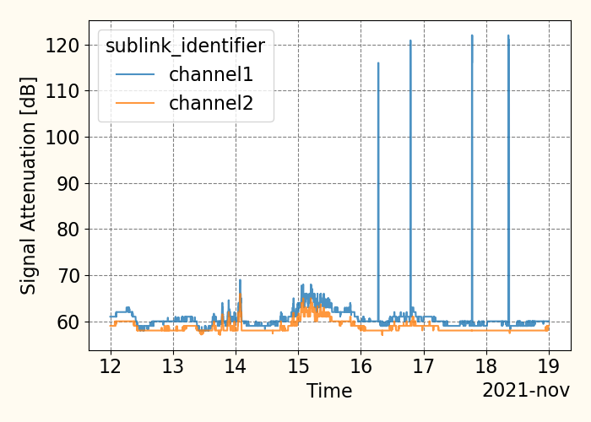
Mitigation of disturbances
Data quality control, 3 levels
  raw data
  rainfall intensity/accumulation
  statistics (i.e. CDF)
Use concurrent weather data or ground data
Thermal effects (pattern recognition)
CML: exploit data redundancy
SML
  orbit perturbations by baseline averaging
  satellite diversity reception by a multi-LNB set-up
Single Channel (Sublink) Analysis
CML
quality
control
Channel (Sublink) Comparison
Near CML Comparison
Comparison with Conventional Sensors
Notes:
Concurrent weather data help in a number of ways: gas attenuation can be predicted by ground data

Slide 10
Are SML/CML reliable as precipitations sensors?
Wet/Dry Classification
Rain Intensity Retrieval
Binary Problem
Rain events are labeled as positive events
High imbalance between wet and dry observations (5 - 10% rain events)
Need for proper KPIs:
  Harmonic Mean (HM):
  harmonic mean between specificity and recall.
  worst = 0, best = 1.
  Matthews Correlation Coeff. (MCC):
  summarizes the values of the confusion matrix. worst = -1, best = 1.
Regression Problem
2 KPI types: dimensional and dimensionless
Dimensional KPIs: root mean square error (RMSE) and mean absolute error (MAE)
Dimensionless KPIs are more useful for comparisons:
  Normalized MAE (NMAE):
  MAE divided by observed values mean.
  The lower the better.
  Pearson Correlation Coefficient (PCC):
  measures the linear relationship between observed and calculated values.
  +1 indicates a perfect correlation.
Notes:
HM combines specificity and recall (sensitivity)

Slide 11
KPIs: Research Results
Comparing researches is not trivial:
  different ways of ground truth retrieval
  different techniques of data processing and sampling
  SML sensors are way lower than CMLs
  for CMLs there are available datasets to validate the elaboration techniques
In general, AI methodologies present better results than statistical approaches both in wet/dry classification and rain intensity retrieval.
A recent campaign involving 3904 CMLs showed that AI reached an MCC higher than statistical methods for 95% of CMLs at least in wet/dry classification (Polz et al.,2020).
A different study highlighted that AI improves the performance (HM≈80%) over statistical methods (HM≈60%) even in the case of SMLs (Gianoglio et al., 2024).
When direct rainfall estimation is carried from SMLs through AI from SNR data better results were obtained over conventional methods, passing from NMAE = .50 to NMAE=.11 (G. Scognamiglio et al., 2024; S. Angeloni et al, 2024).

Slide 12
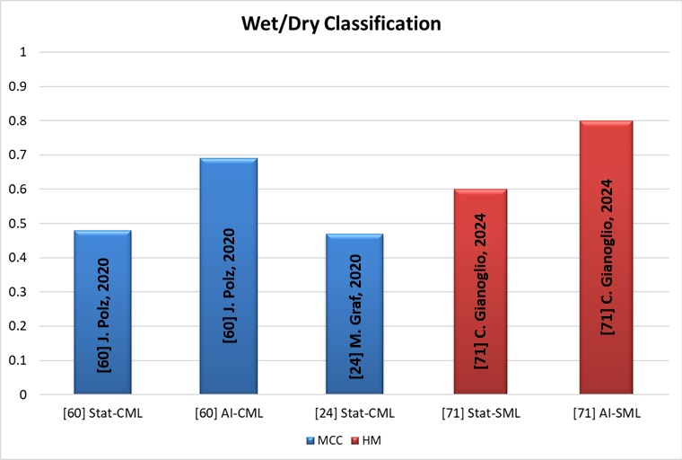
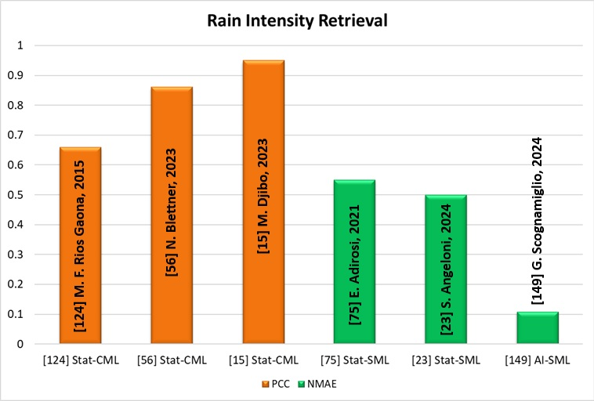
KPIs: Research Results
Different networks, data, climatology, data processing, integration time, ground truth data, validation strategy,… and different KPIs
The number of SML sensors is way lower than CMLs

Slide 13
Increasing the TRL of Opportunistic Sensors
Need for standardization at several levels
  Data format and data quality
  Data generation and transfer
  Processing chain including an effective data quality control
  Performance assessment
Identify standardizations bodies (WMO, ITU, ETSI, GSMA)
SMLs: sensors are ground terminals.
  Antenna (currently Ku-band dish): lab test on antenna
  LNB test
  Algorithms: assess reliability of rain height estimate by different methods
Notes:
ETSI (European Telecommunications Standards Institute) https://www.etsi.org/about
We got aware that standardization in the case of SML might apply also to HW in particular antennas and receivers

Slide 14
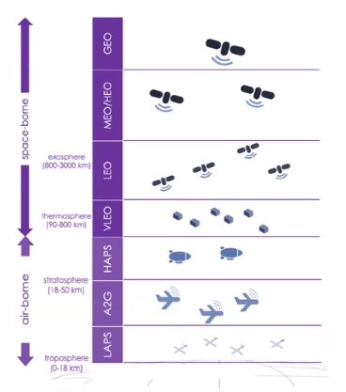
Future of CMLs and SMLs
Exploitation of higher frequency bands
Integrated communication and sensing (ISAC)
Future of terrestrial and satellite in 6G+
  NTN (non-terrestrial network) instead of SATCOM
  Integration between TN and NTN
Not only precipitation sensors?
  water vapor, humidity, sand and dust storms,
  volcanic ash
  fire alerts, smart agriculture,
  public protection and disaster relief

Slide 15

This work is a piece of a broader survey: Nebuloni et al. “A Review of Technical Aspects and Challenges in Opportunistic Rainfall Estimation Using Satellite and Terrestrial Microwave Links”, to be published on IEEE GRSM
Thank you!
1st International Conference on Opportunistic Sensing of Precipitation
Jun 25 – 26, 2025 – DWD,Offenbach,Germany

Slide 16
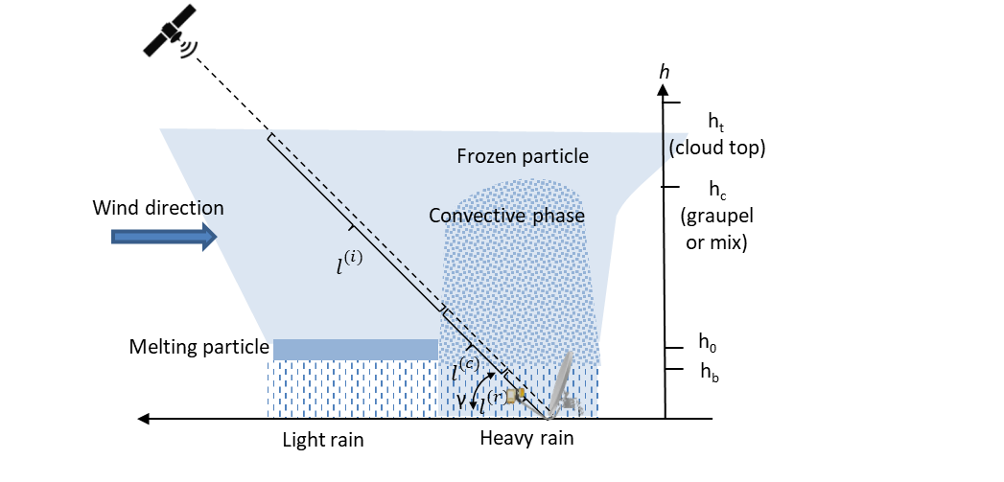
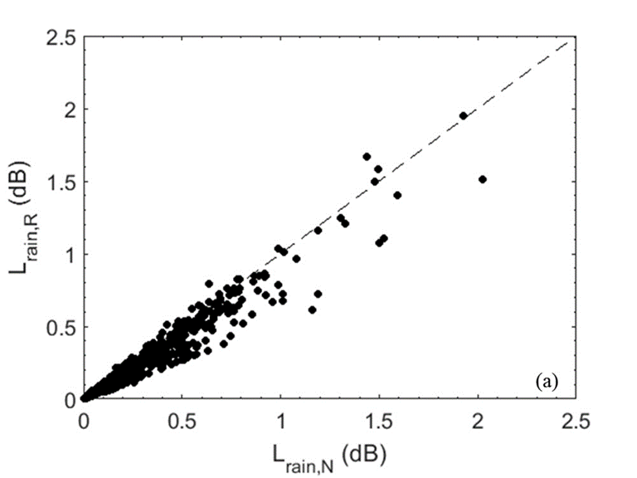
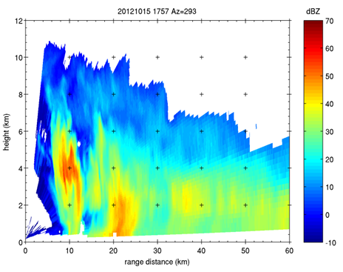
EXTRA: SML and convective rain
Effects of the ML height and thickness on the rain-induced attenuation estimation (L)
Scheme of SML view geometry during a convective precipitation event.
RMSE = 0.06 dB
NMAE = 21.3%
From Giannetti et al. 2017 (Sensors; doi:10.3390/s17081864)
Example of Polar 55C reflectivity on 15 October 2015.
RHI mode.
From Adirosi et al. 2020 (IEEE TRANSACTIONS ON GEOSCIENCE AND REMOTE SENSINGs; doi:https://doi.org/10.1109/TGRS.2020.3041448)
y-axis → rain induced attenuation computed from effective values ML height and thickness obtained from weather radar measurements
x-axis → rain induced attenuation computed from NPW model estimation of ML height and constant ML thickness

Slide 17
Increasing the TRL of Opportunistic Sensors
Need for standardization at several levels
  Data format and data quality
  Data generation and transfer
  Processing chain including an effective data quality check
  Performance assessment
Towards Standardization of sensors characteristics, data quality, reliability
  Identify standardizations bodies (WMO, ITU, ETSI)
  Procedures/SML
    Antenna (currently Ku-band dish): lab test on antenna
    LNB: test on LNB
    Uncontrollable Tx signal (satellite): ML approach
  Procedures/CML
    CML optimize data format for rainfall intensity measurement
Notes:
We got aware that standardization in the case of SML might apply also to HW in particular antennas and receivers

