Slide 1
Exploring Rain Scintillation Spectra from Microwave Links for Raindrop Size Distribution Retrieval
Peiyuan Wang, Arjan Droste, Marc Schleiss, Remko Uijlenhoet
Faculty of Civil Engineering and Geoscience, Delft University of Technology

Slide 2
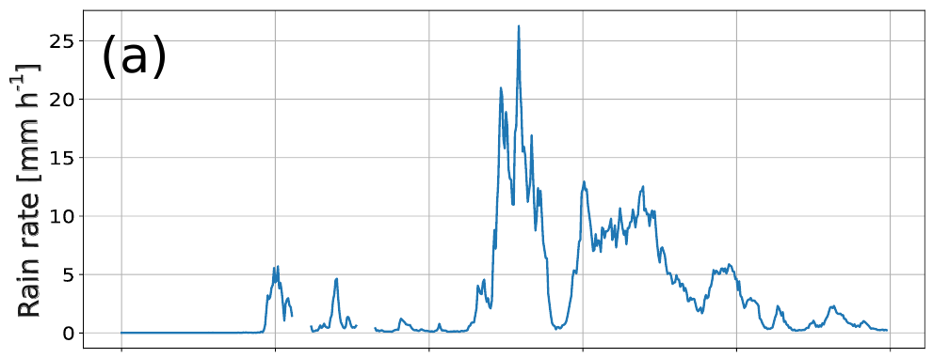
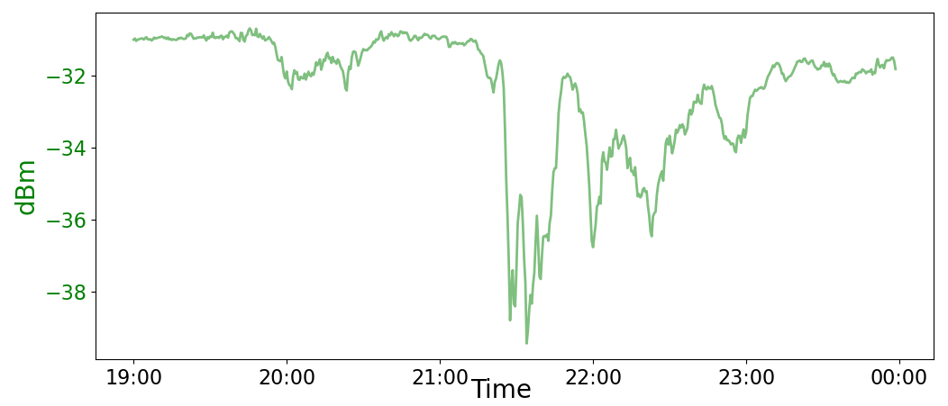
Received power: $P_{r}∝A^{2}$
Amplitude
Received voltage
Phase

Slide 3
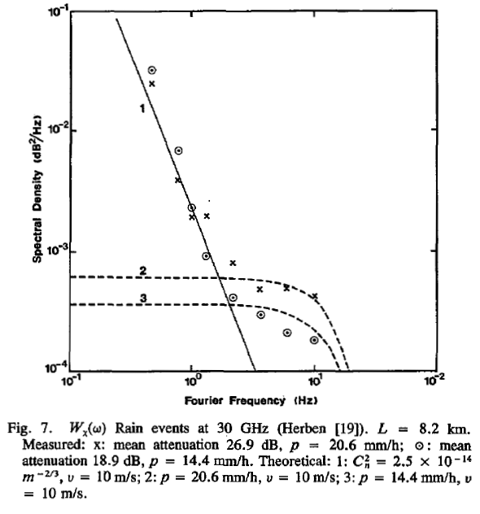
Doppler shift
$$E_{i}$$
$$E_{s}$$
ν
Haddon, 1986

Slide 4
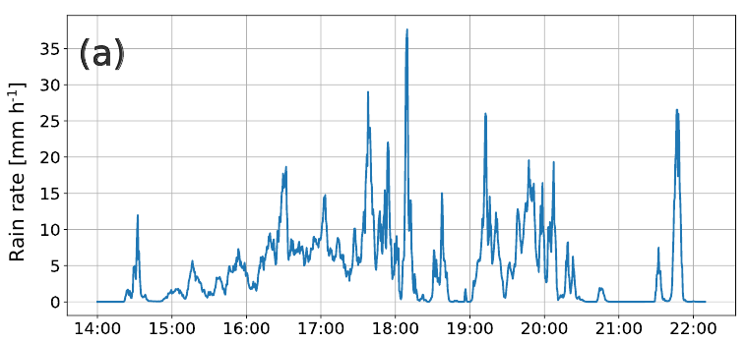
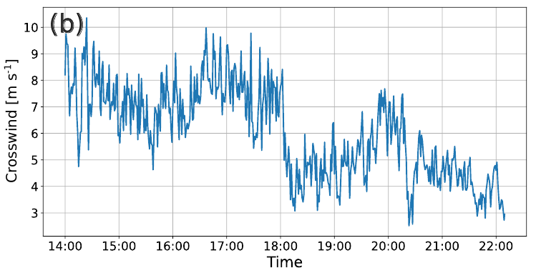
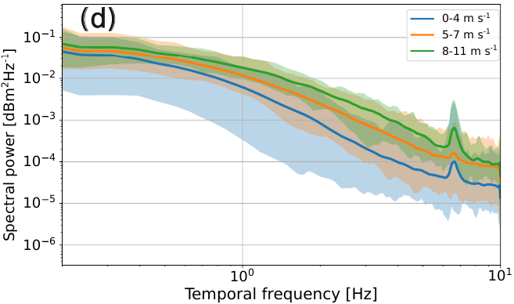
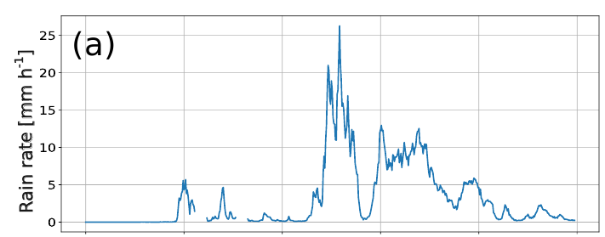
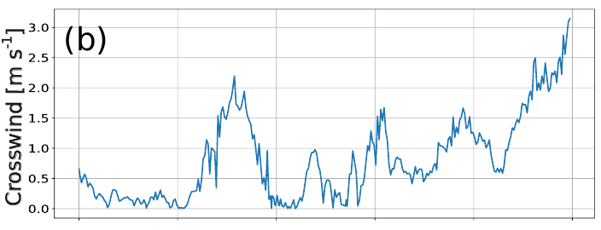
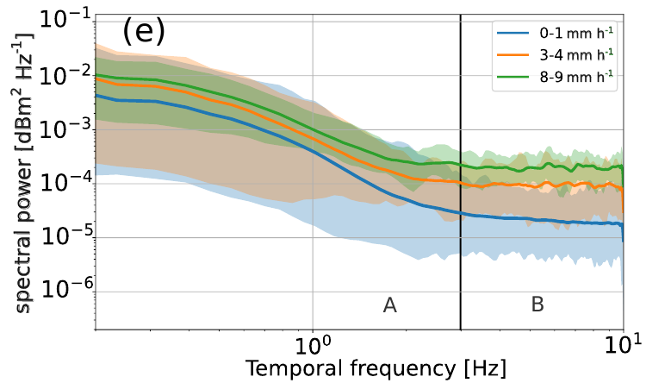
Previous measurements: RAL 26, received power, Wageningen, the Netherlands
Wide-range crosswind:
r = 0.178
Slow crosswind:

Slide 5
Input Raindrop Size Distribution
T-matrix
$S_{V}$ in rain
Forward modelling
Specifications of the Microwave link
Ishimaru,1978
(RAL 26)
$S_{V}$: incoherent received voltage

Slide 6
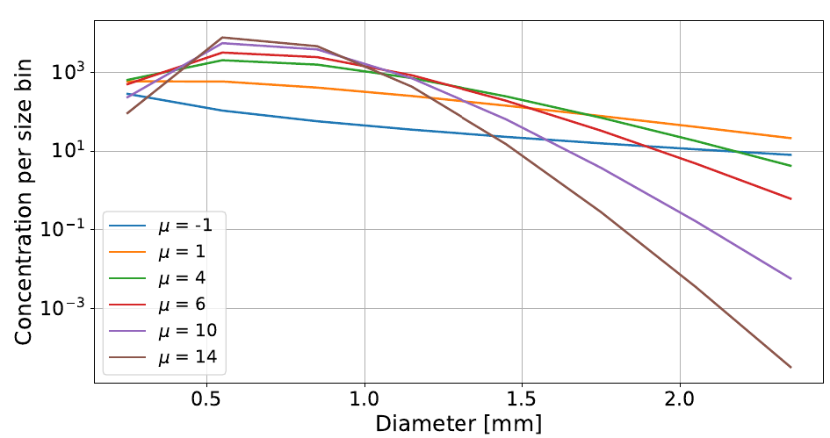
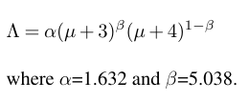
DSD parameterization
(Gatidis et. al. 2024)
Link setting
Antenna gain functions
Path length
Wavelength
(Elevation angle=0, transmitted power=1 W, crosswind=0)

Slide 7
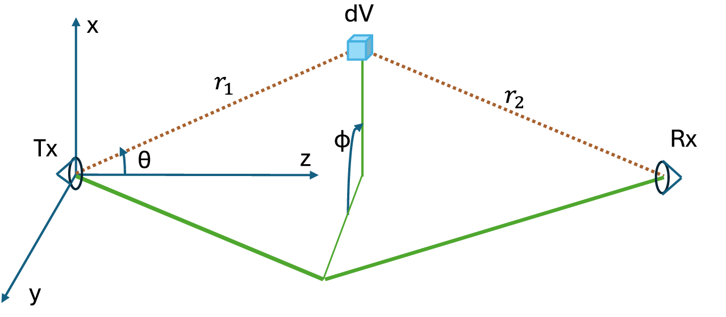
Calculation of $S_{V}$
Ishimaru,1978
Post Calculation
Characteristic frequencies (i.e., $f_{max}$, $f_{half}$): The frequency at which the peak spectral power locates; the frequency at which the spectral power drops to half of max spectral power.
Spectral width: the difference between $f_{max}$ and $f_{half}$
Variance: the integral of $S_{V}$

Slide 8
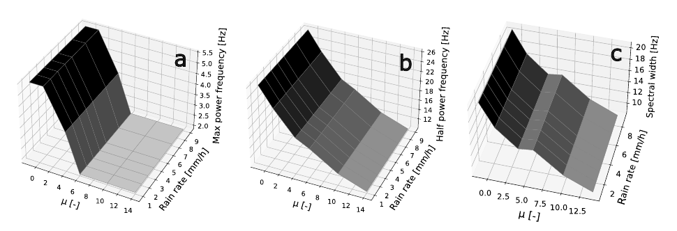
Spectral Width
$$f_{max}$$
$$f_{half}$$
(1Hz-40Hz with resolution of 0.3 Hz)

Slide 9
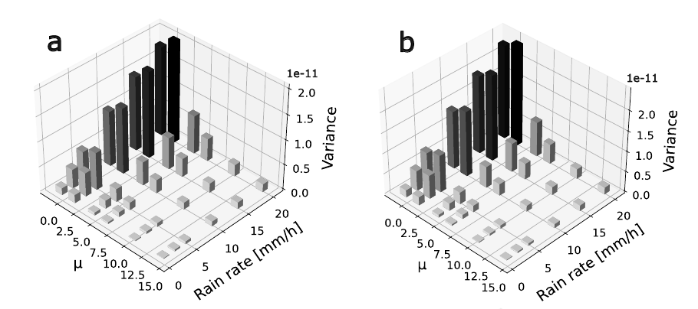
Variance
1 Hz - 30 Hz
1 Hz - 100 Hz

Slide 10
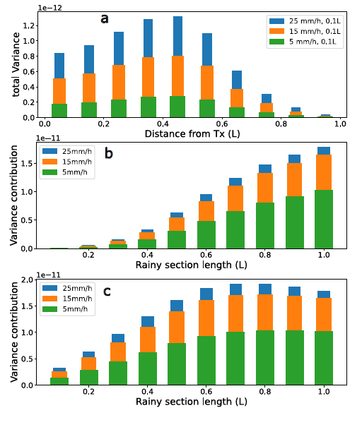
(a) A rain cell with length of 0.1L over the path moves from the Tx to Rx.
(b) Rainfall covers a fixed fraction between 0 and 100 of the link, starting from the receiving antenna
(c) starting from transmitting antenna.
Variance

Slide 11
Take home messages:
Rainfall has a measurable impact on the spectra of received power, while other factors (e.g., crosswind & $C_{nn}$) also play a role.
Based on our simulations:
The $f_{max}$, $f_{half}$ and spectral width are more sensitive to μ than rain rate.
The μ and rain rate can both affect the variance of $V$.
The contributions to the variance of $S_{V}$ (1-30 Hz) is affected by the distance to Tx. The regions close to Rx have least contributions to the variance.
In general, it is challenging to extract DSD information from the rain scintillation spectra.

Slide 13
Appendix

Slide 14
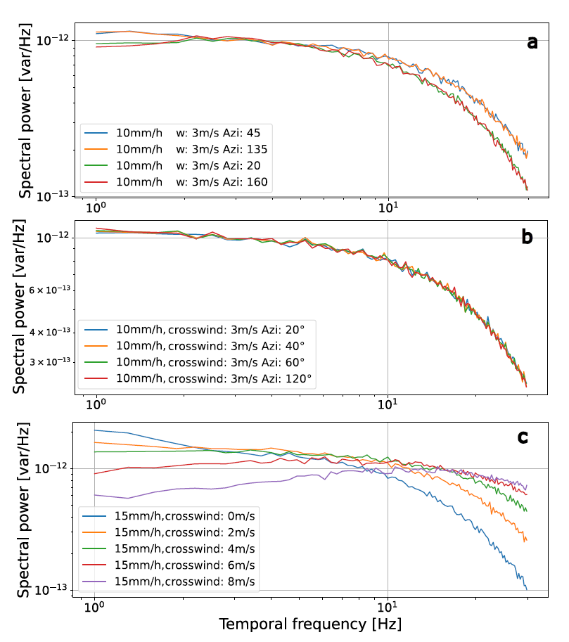
Crosswind

Slide 15
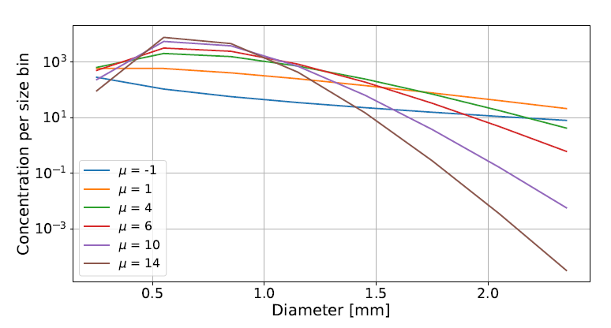
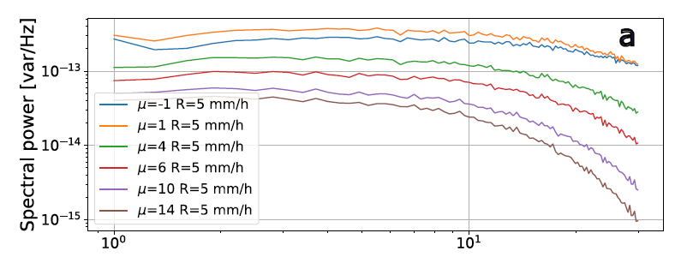
5mm/h
Example of $S_{V}$

