Slide 1
The EURADCLIM gauge-adjusted radar precipitation dataset
26 June 2025
1st International Conference on Opportunistic Sensing of Precipitation, Offenbach, Germany
Aart Overeem, Else van den Besselaar, Gerard van der Schrier, Jan Fokke Meirink, Emiel van der Plas, Hidde Leijnse, Irene Garcia-Marti, Lotte de Vos

Slide 2
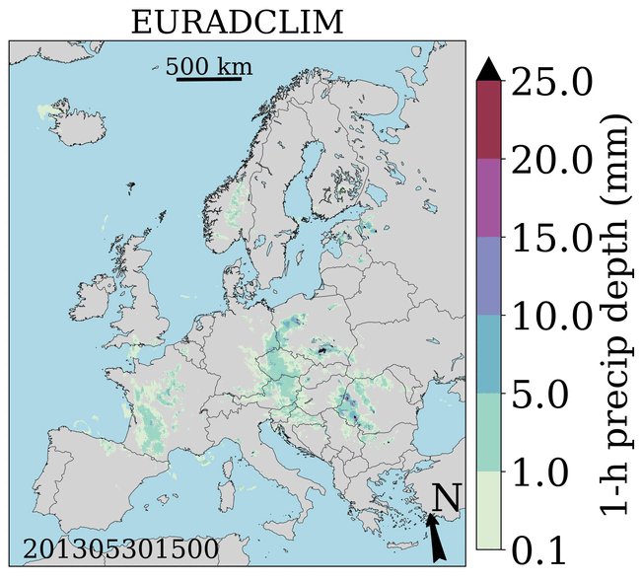
What is EURADCLIM?
A former project (Apr 2019 – Dec 2022) of KNMI's Multiannual Strategic Research Program (MSO).
Climatological gauge-adjusted radar precipitation dataset of 1-h & 24-h accumulations (every clock-hour), covering Europe at a 2 km grid from 2013-2020 2022 (v1 v2)
EURADCLIM website
https://doi.org/10.5194/essd-15-1441-2023 (v1; scientific article)

Slide 3
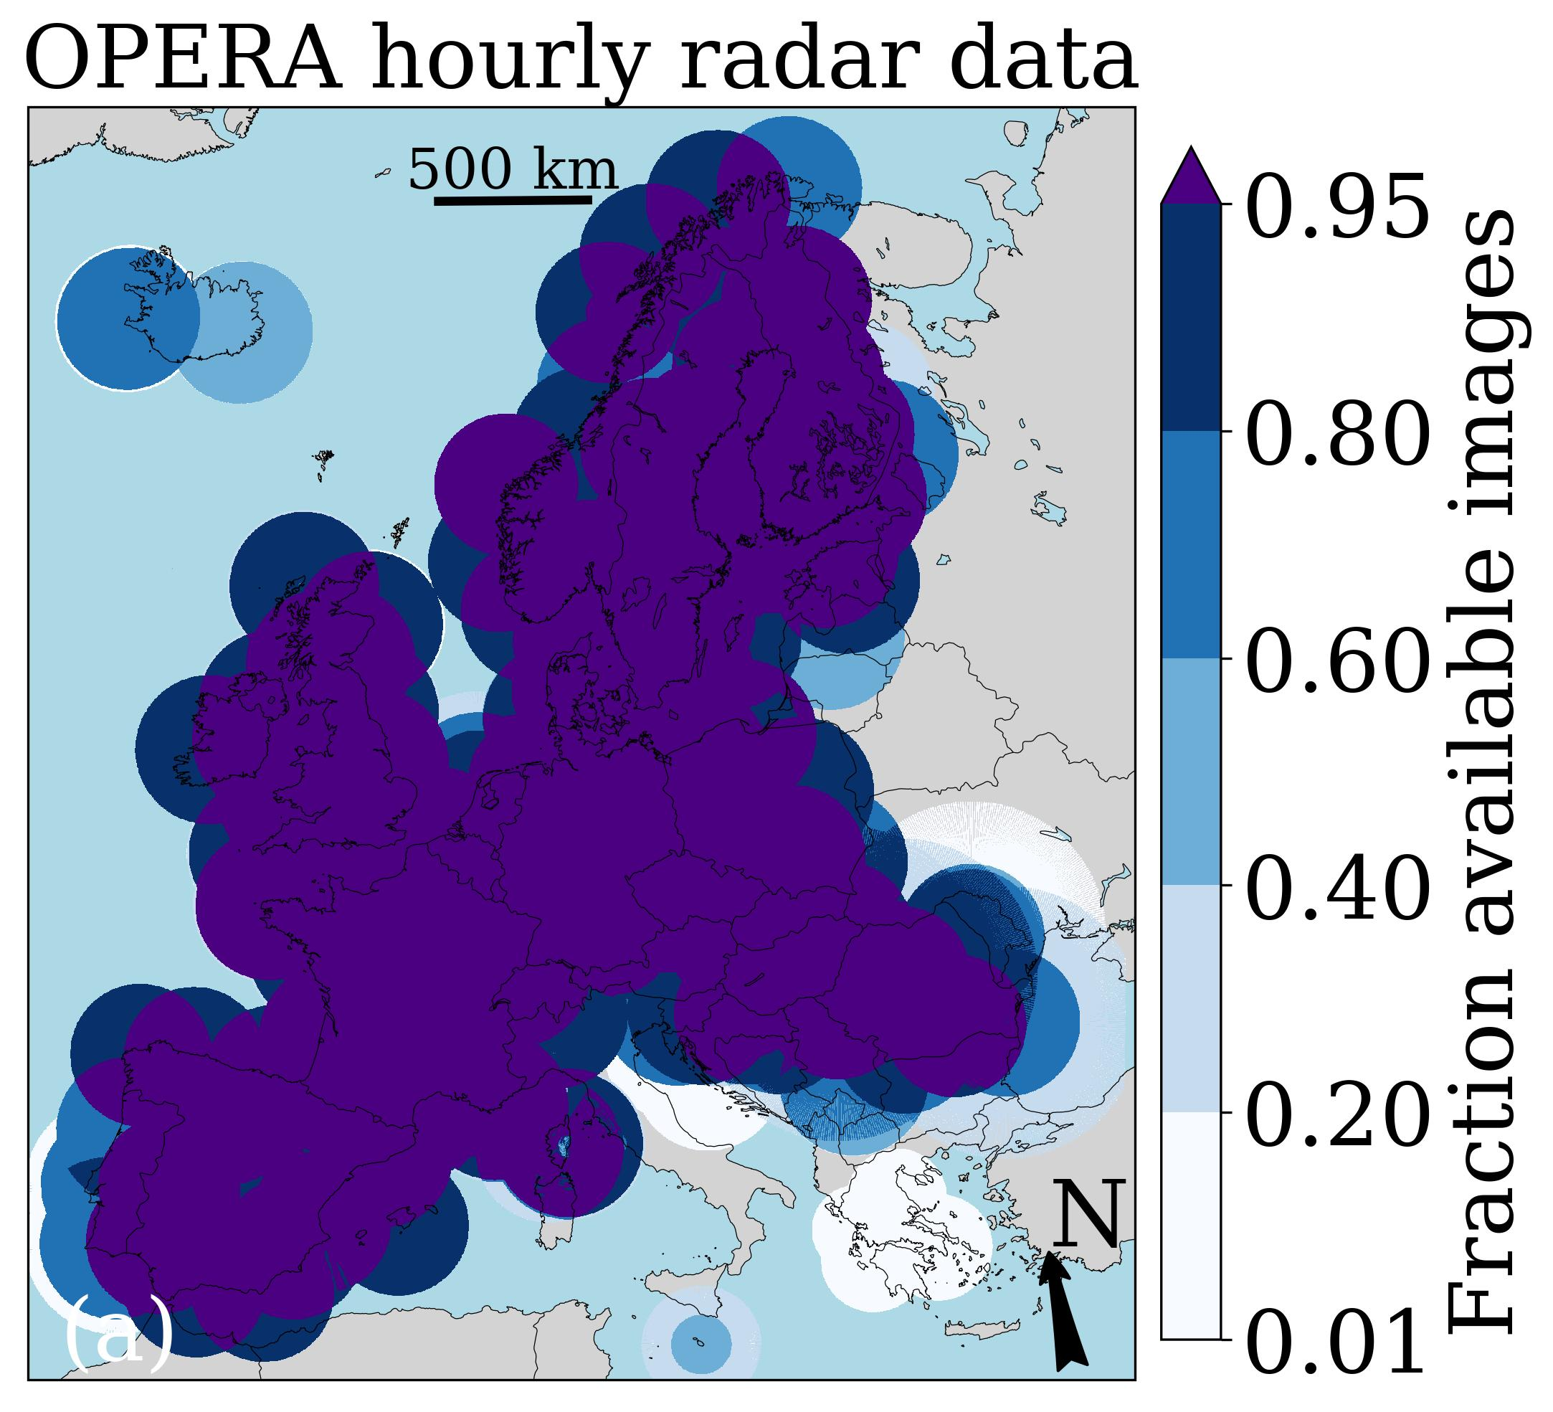
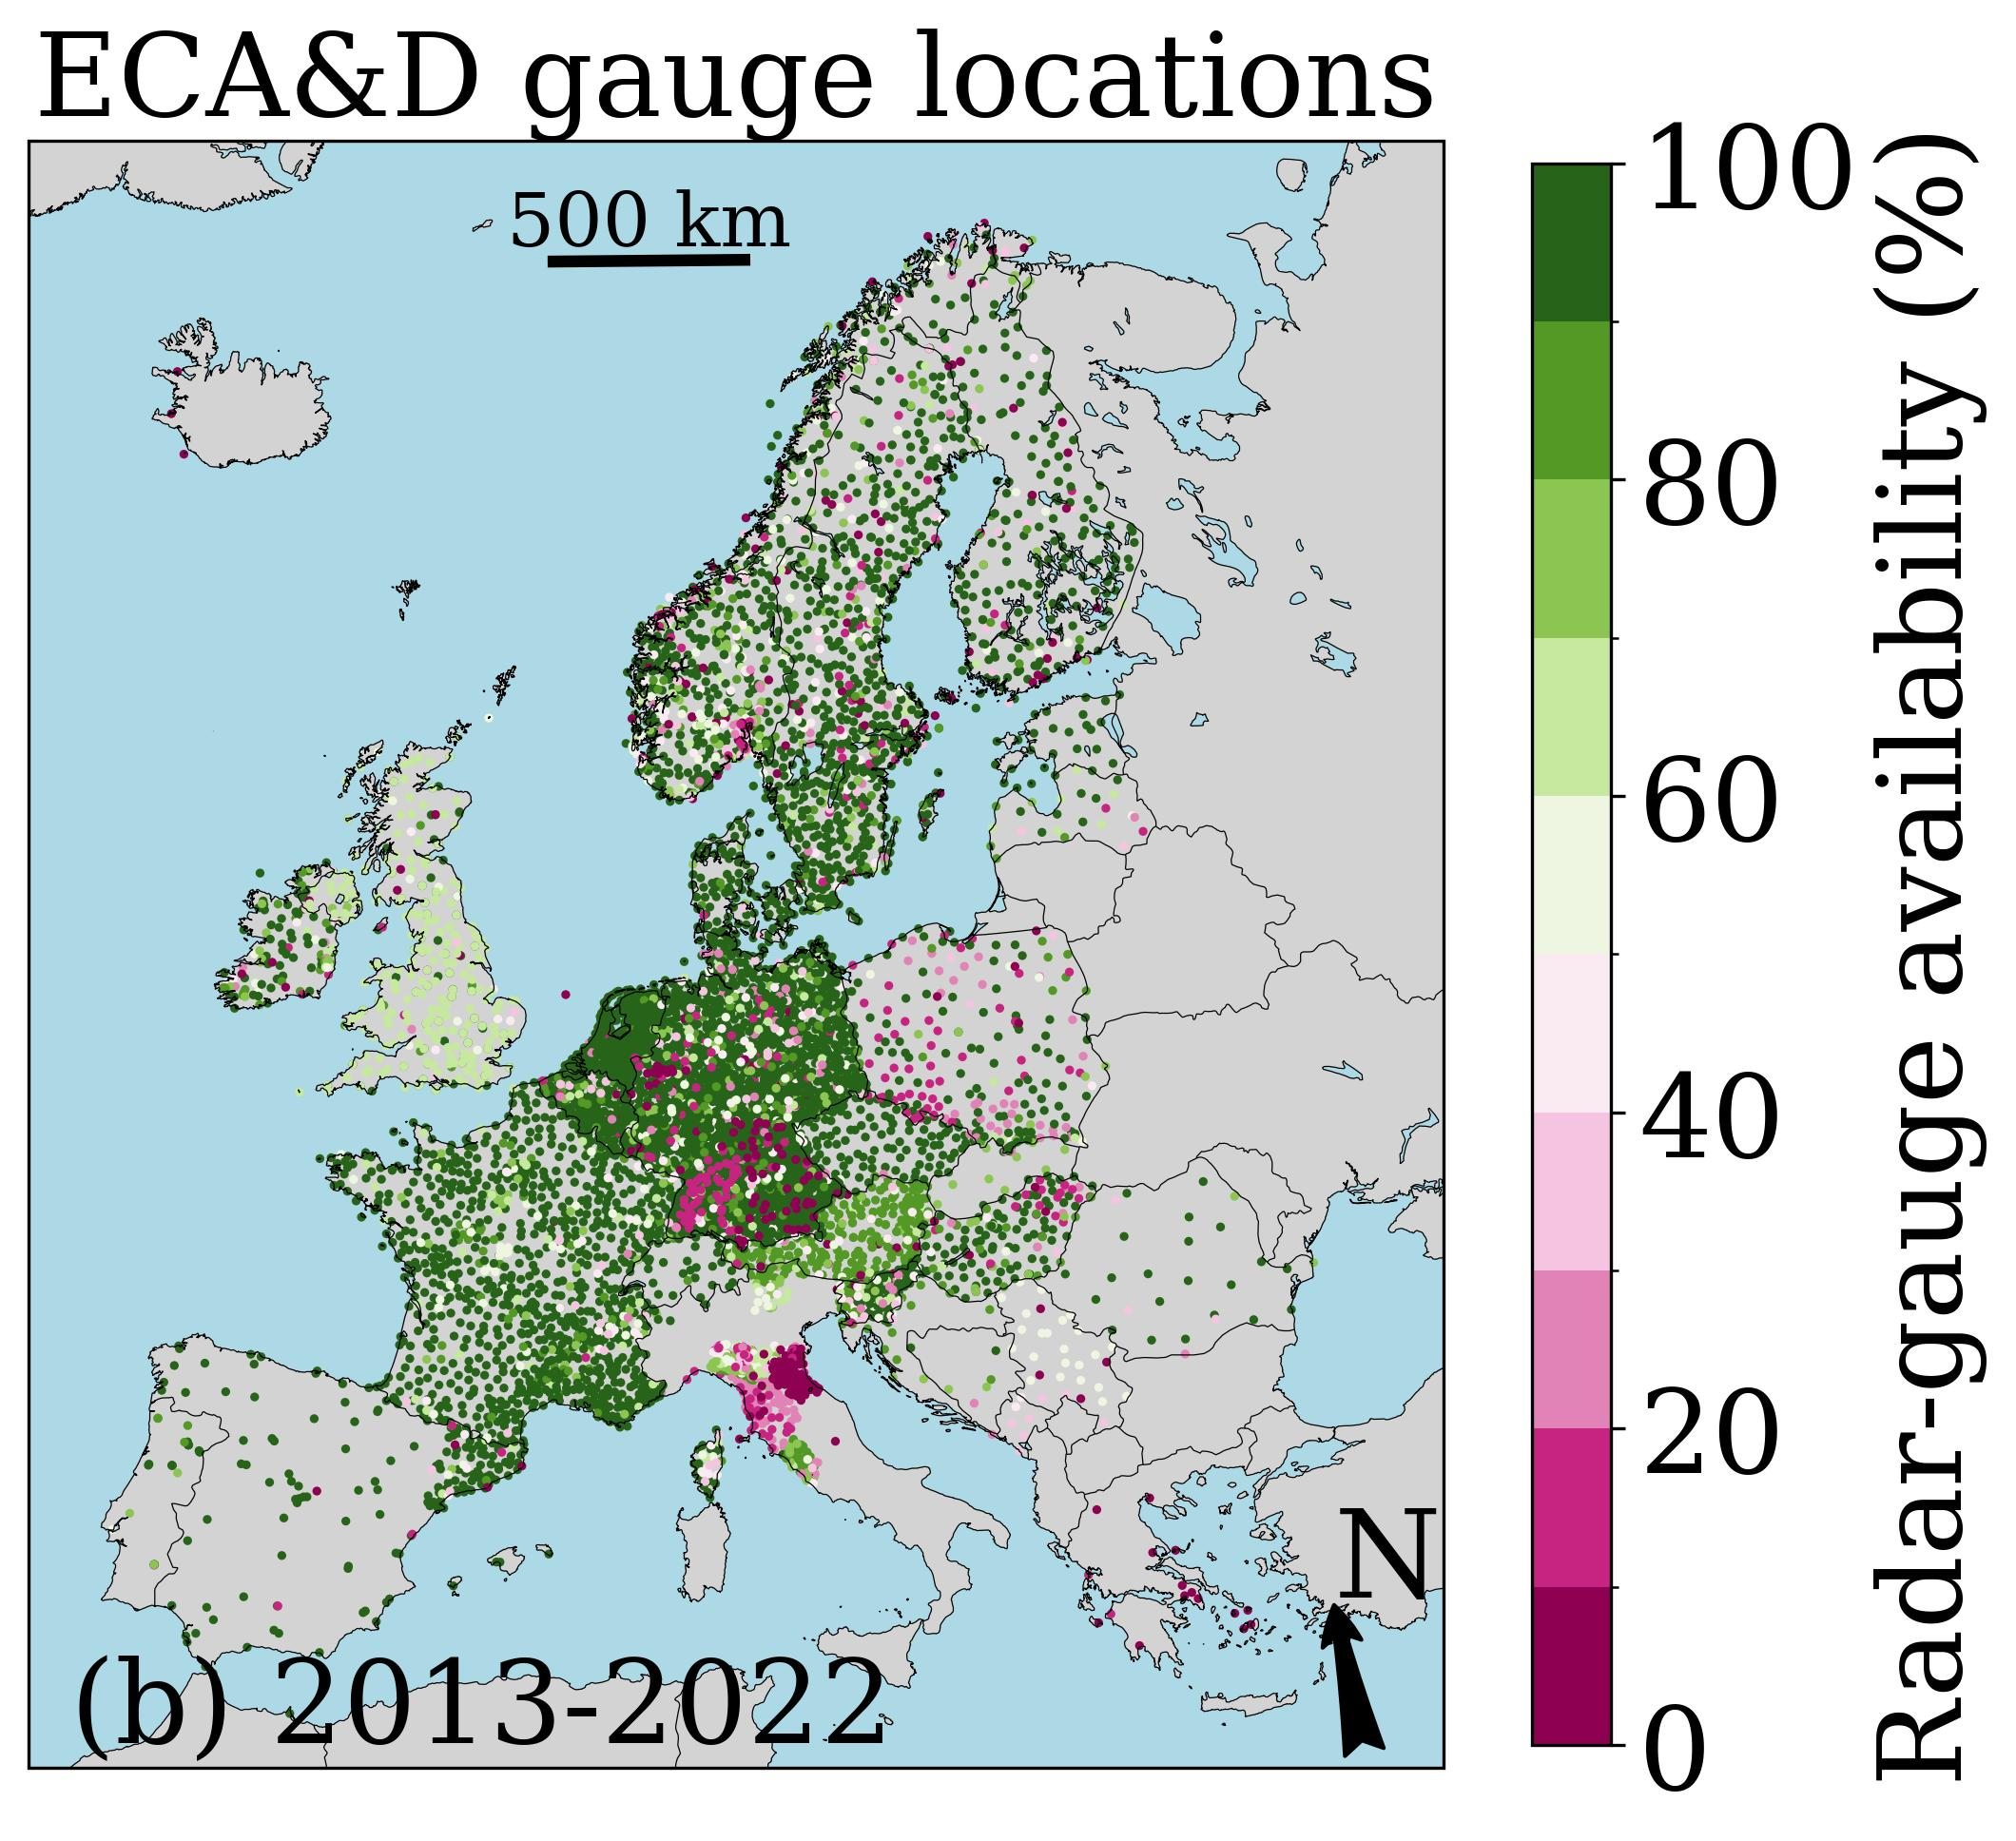
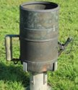
Radar and rain gauge datasets
EUMETNET OPERA radar archive of 15-min instantaneous surface rain rates @4 km².
European Climate Assessment & Dataset (ECA&D) daily rain gauge accumulations from potentially 8300 stations (https://www.ecad.eu).

Slide 4
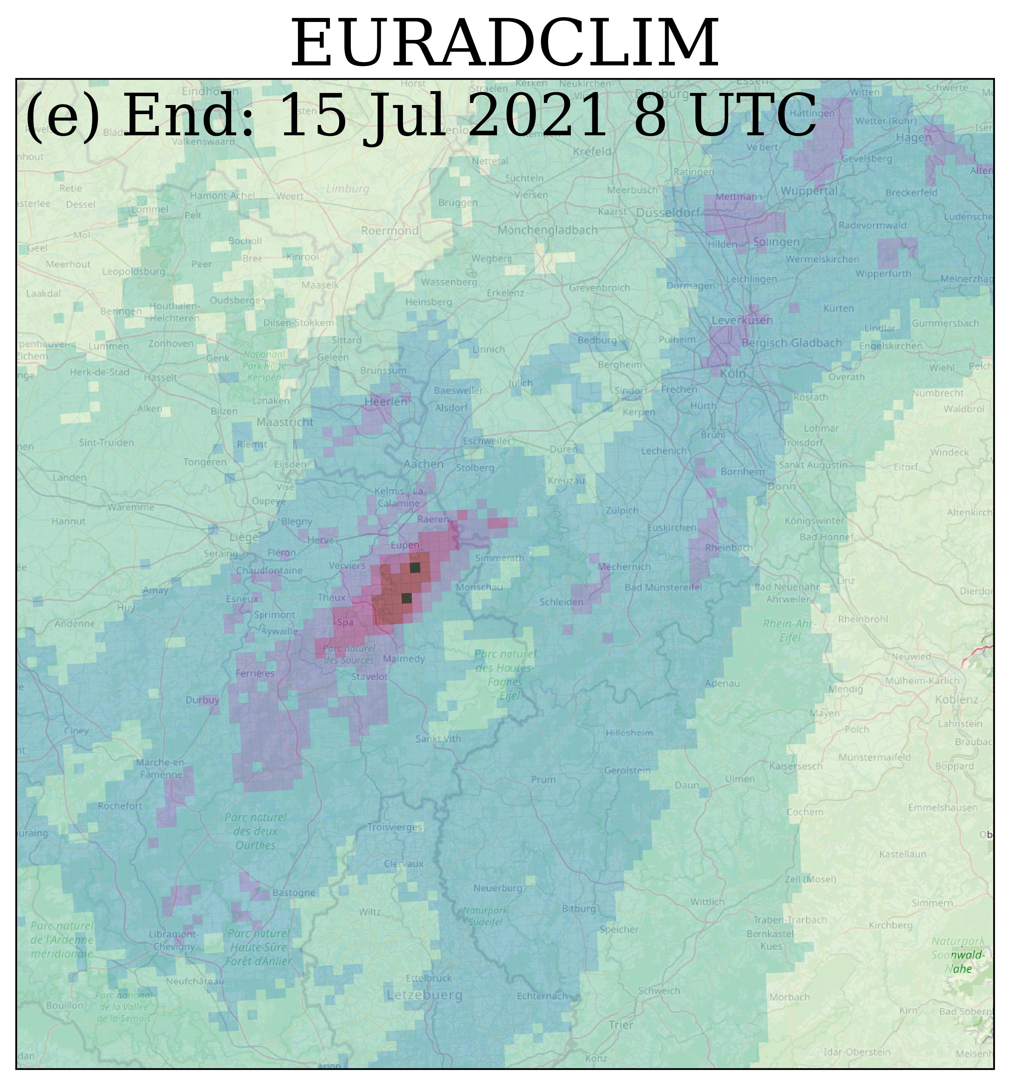
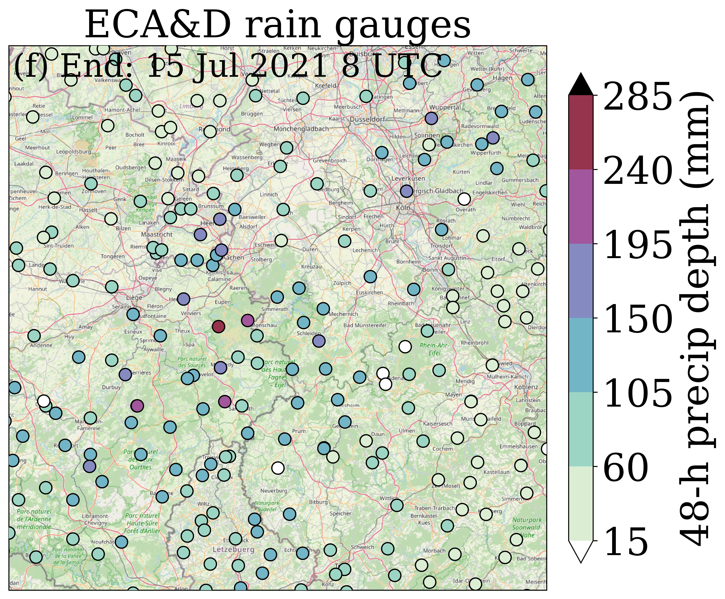
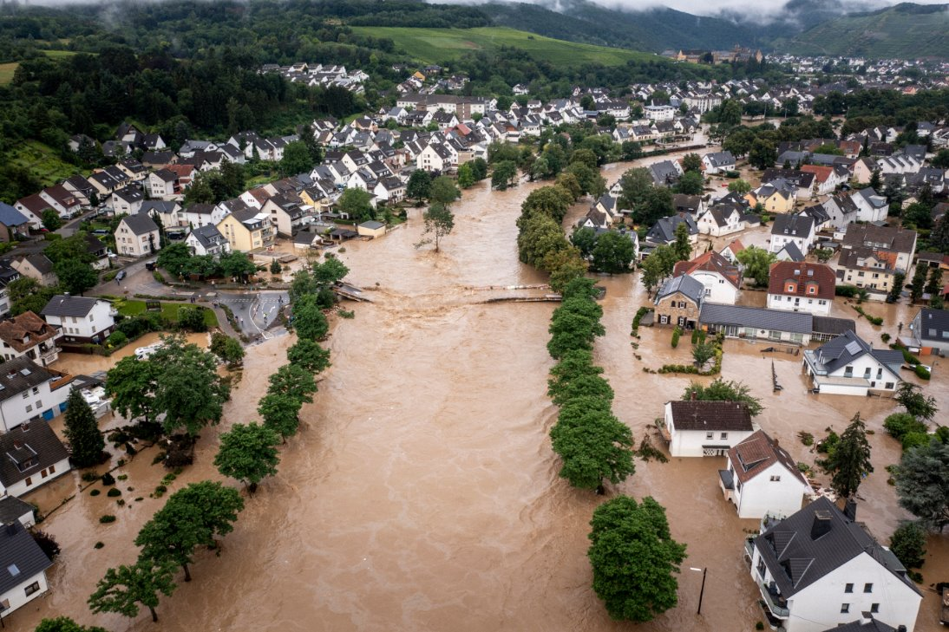
EURADCLIM version 2
Merges OPERA + ECA&D rain gauge data
Slightly improved removal of non-meteorological echoes (1-h accumulations > 200 mm before adjustment are set to 0 mm)
Somewhat better rain gauge coverage for 2013-2020
Years 2021 & 2022

Slide 5
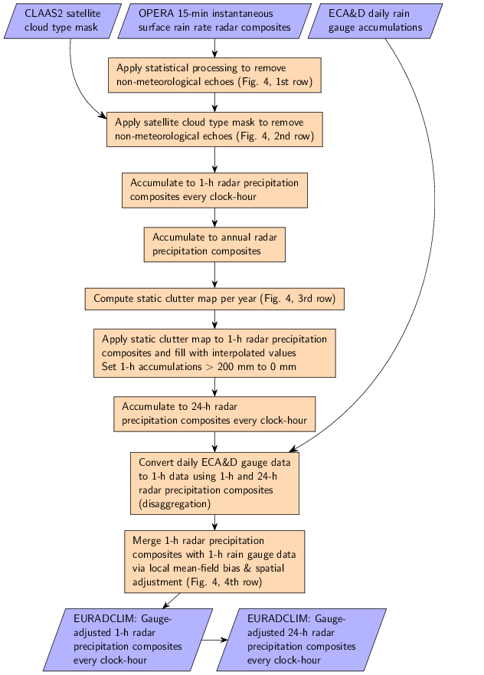
EURADCLIM processing
Additional removal of non-meteorological echoes (2 statistical methods from open-source library wradlib & satellite cloud type mask).
Combine the best of 2 worlds:
OPERA radar data: high spatiotemporal resolution, less accurate.
ECA&D rain gauge data from potentially 8300 stations: accurate, but limited coverage and highly varying network density.
On average 491 radar-gauge pairs for merging.

Slide 6
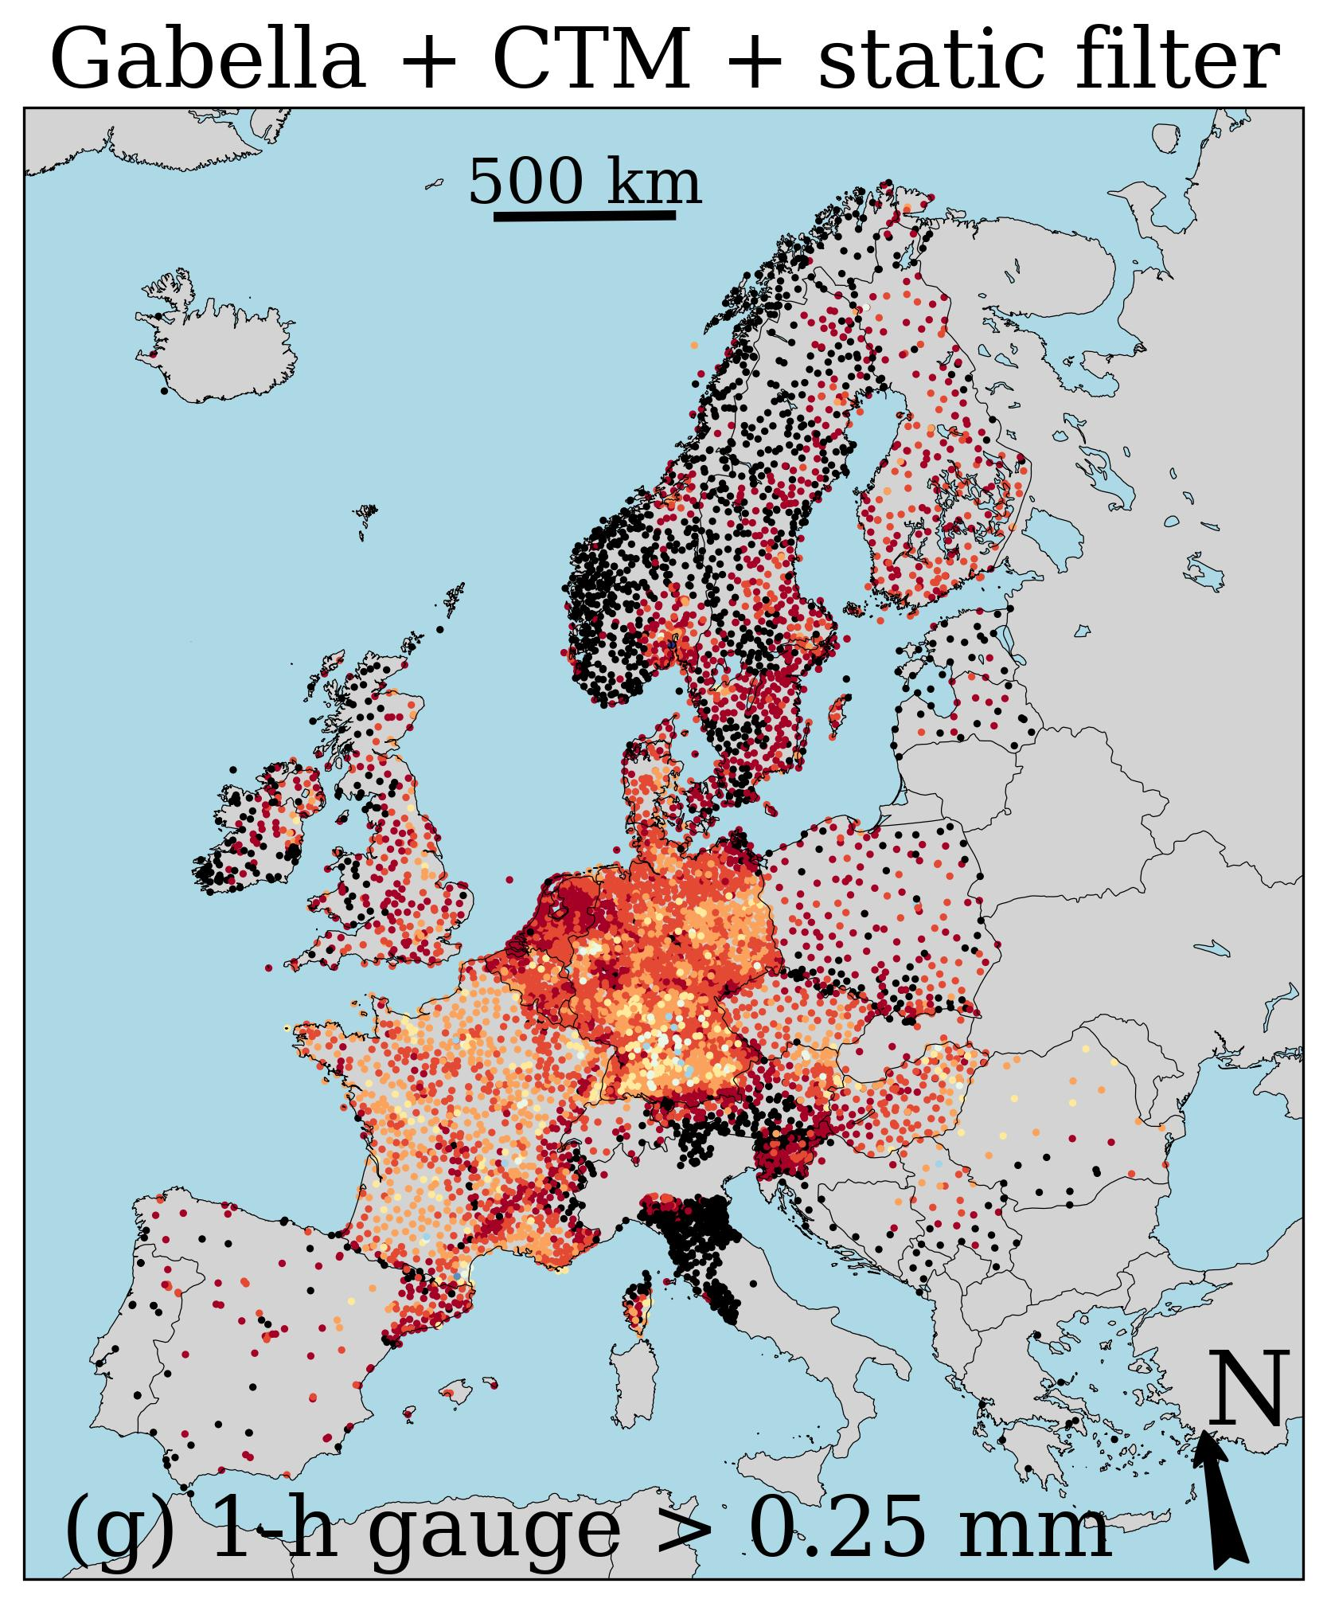
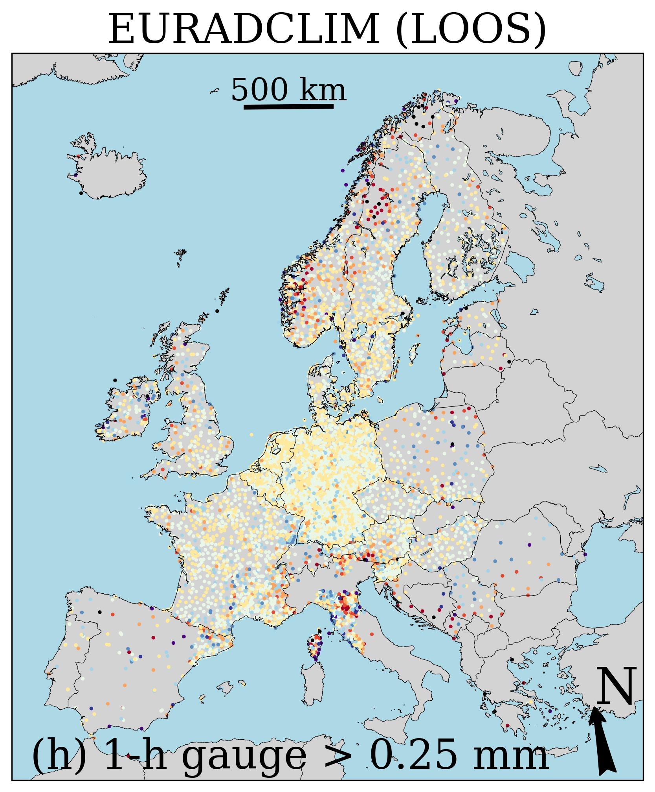
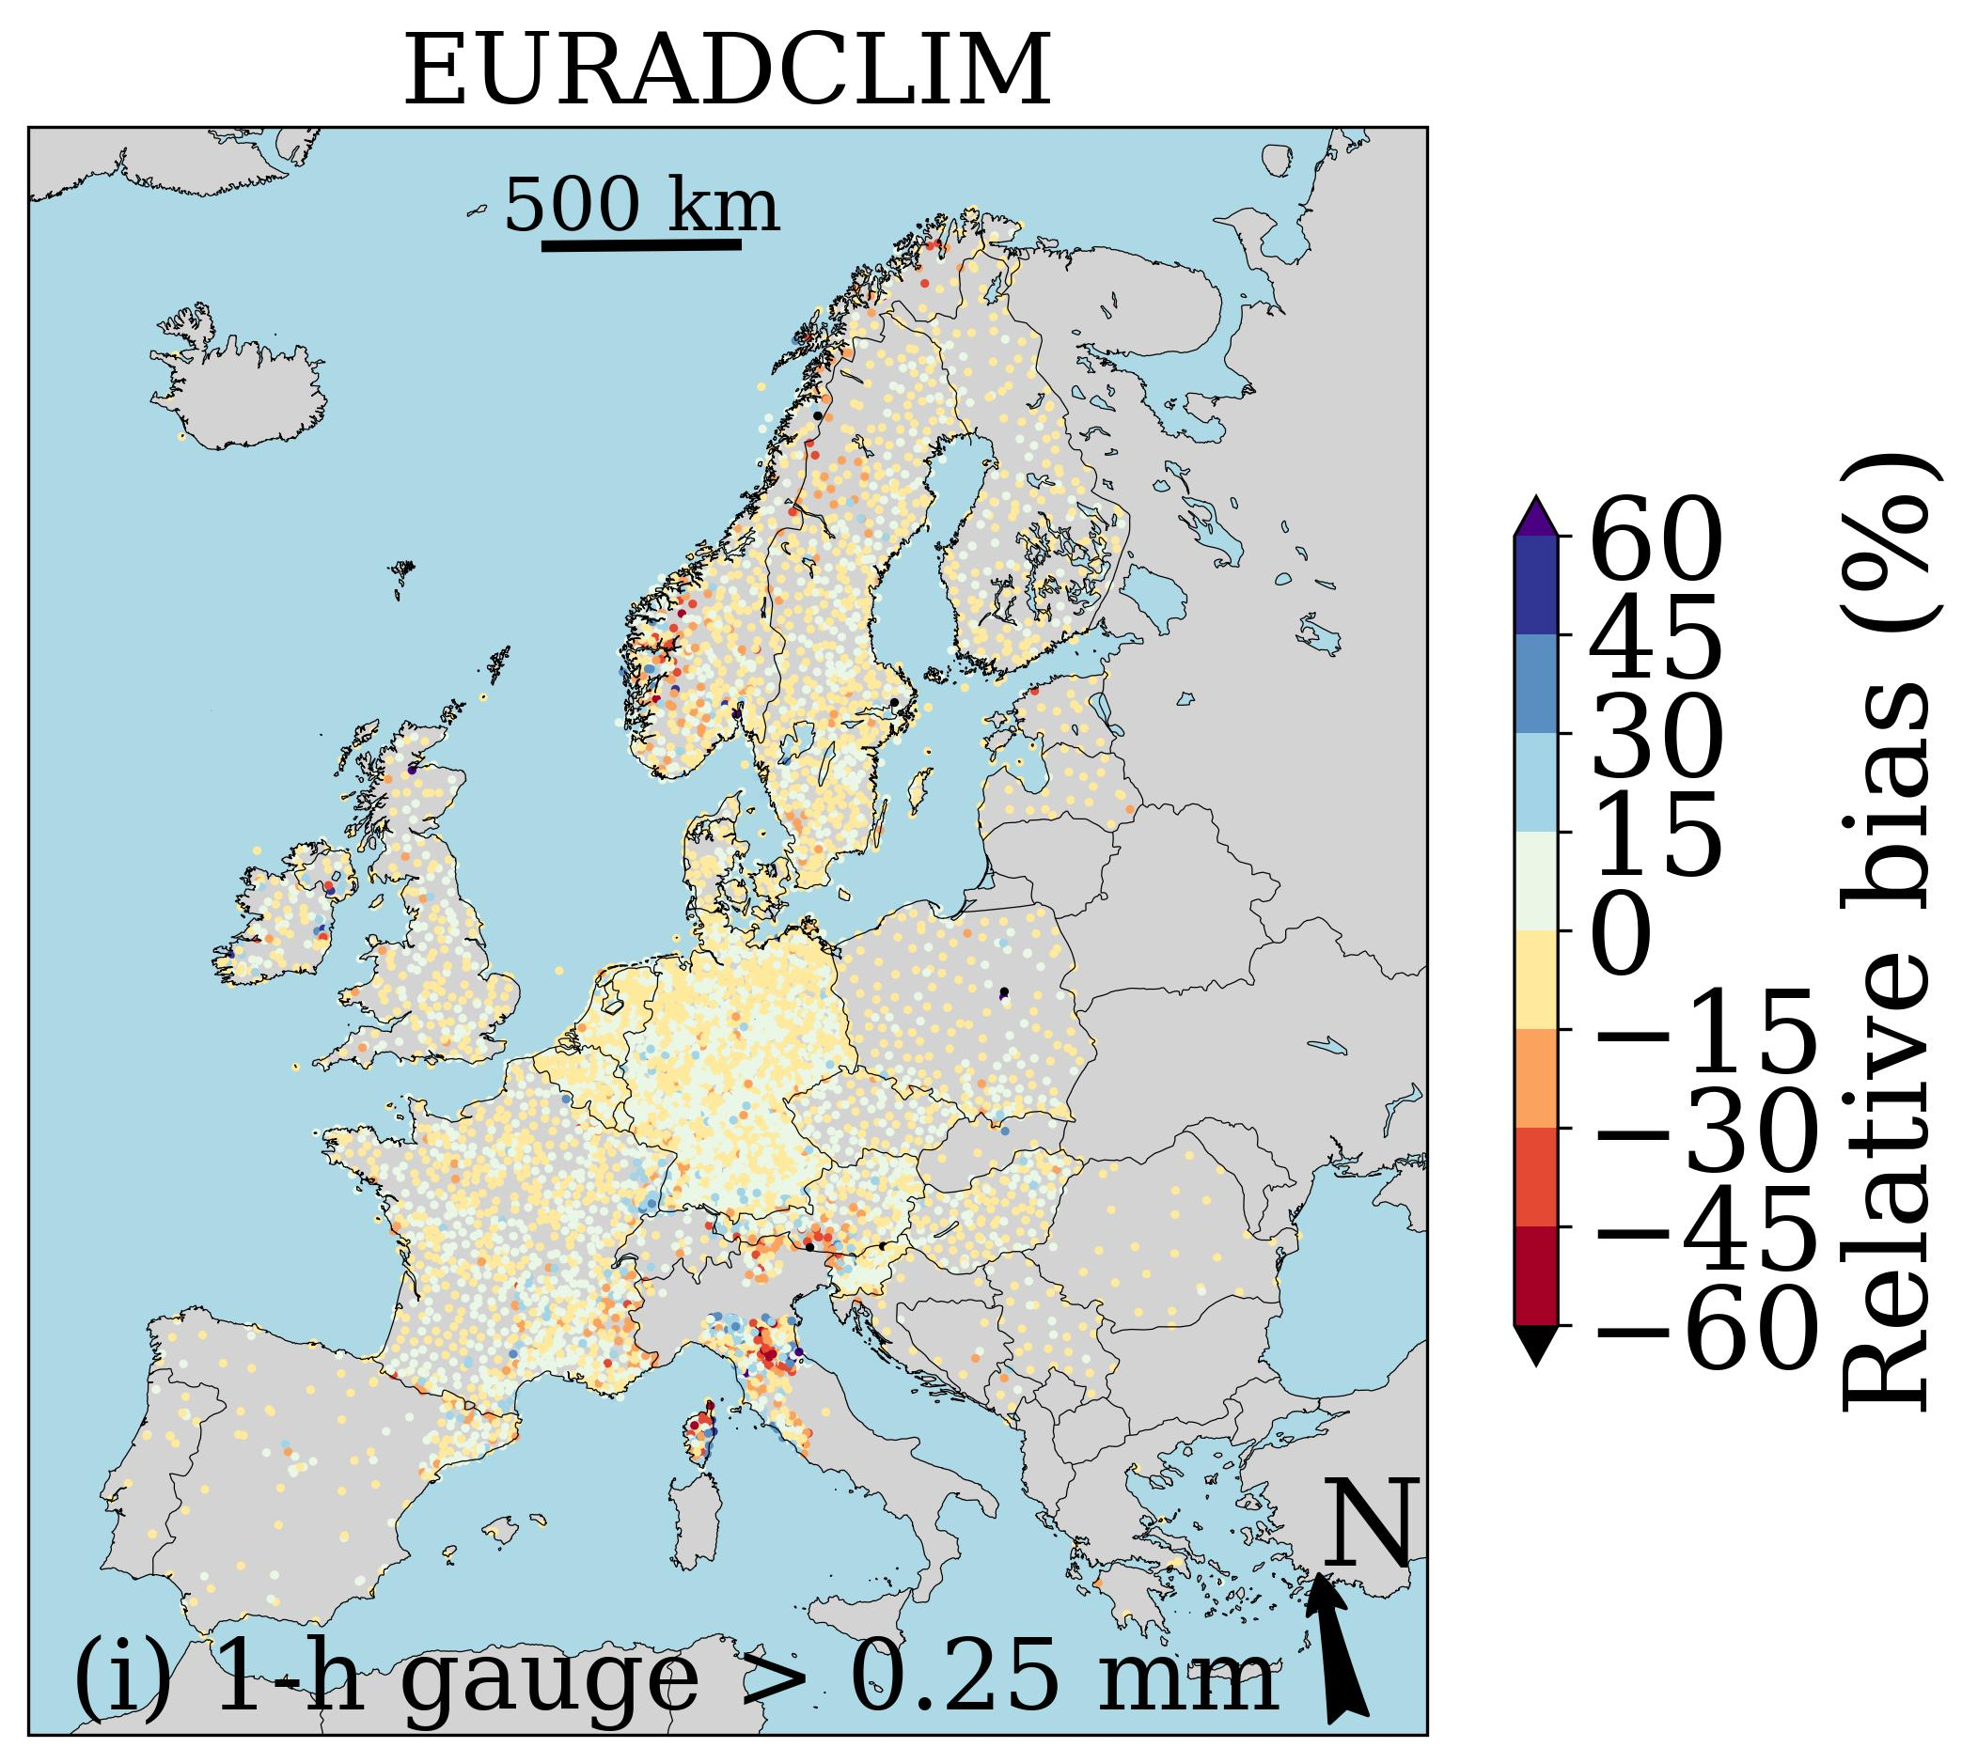
Verification against disaggregated ECA&D 1-h rain gauge accumulations
No gauge adjustment
Gauge adjustment
Gauge adjustment
Underestimation is much reduced by merging with rain gauge accumulations.
LOOS = leave-one-out-statistics

Slide 7
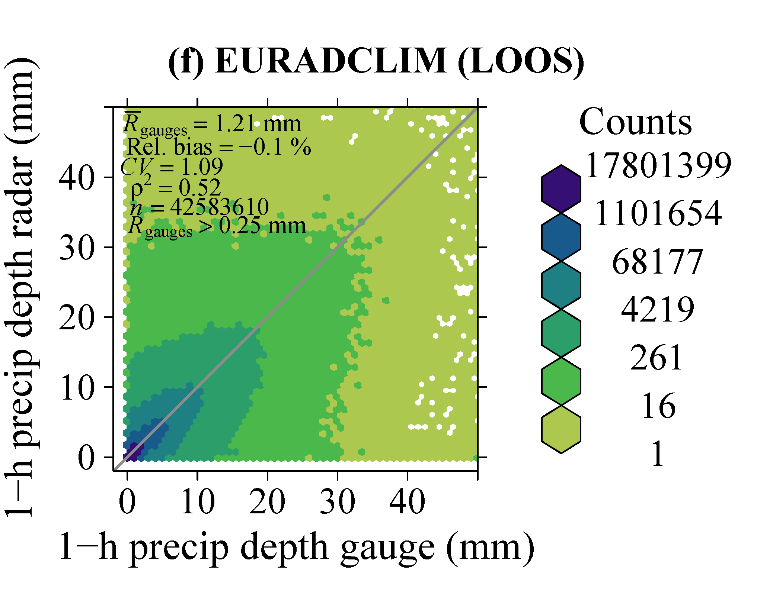
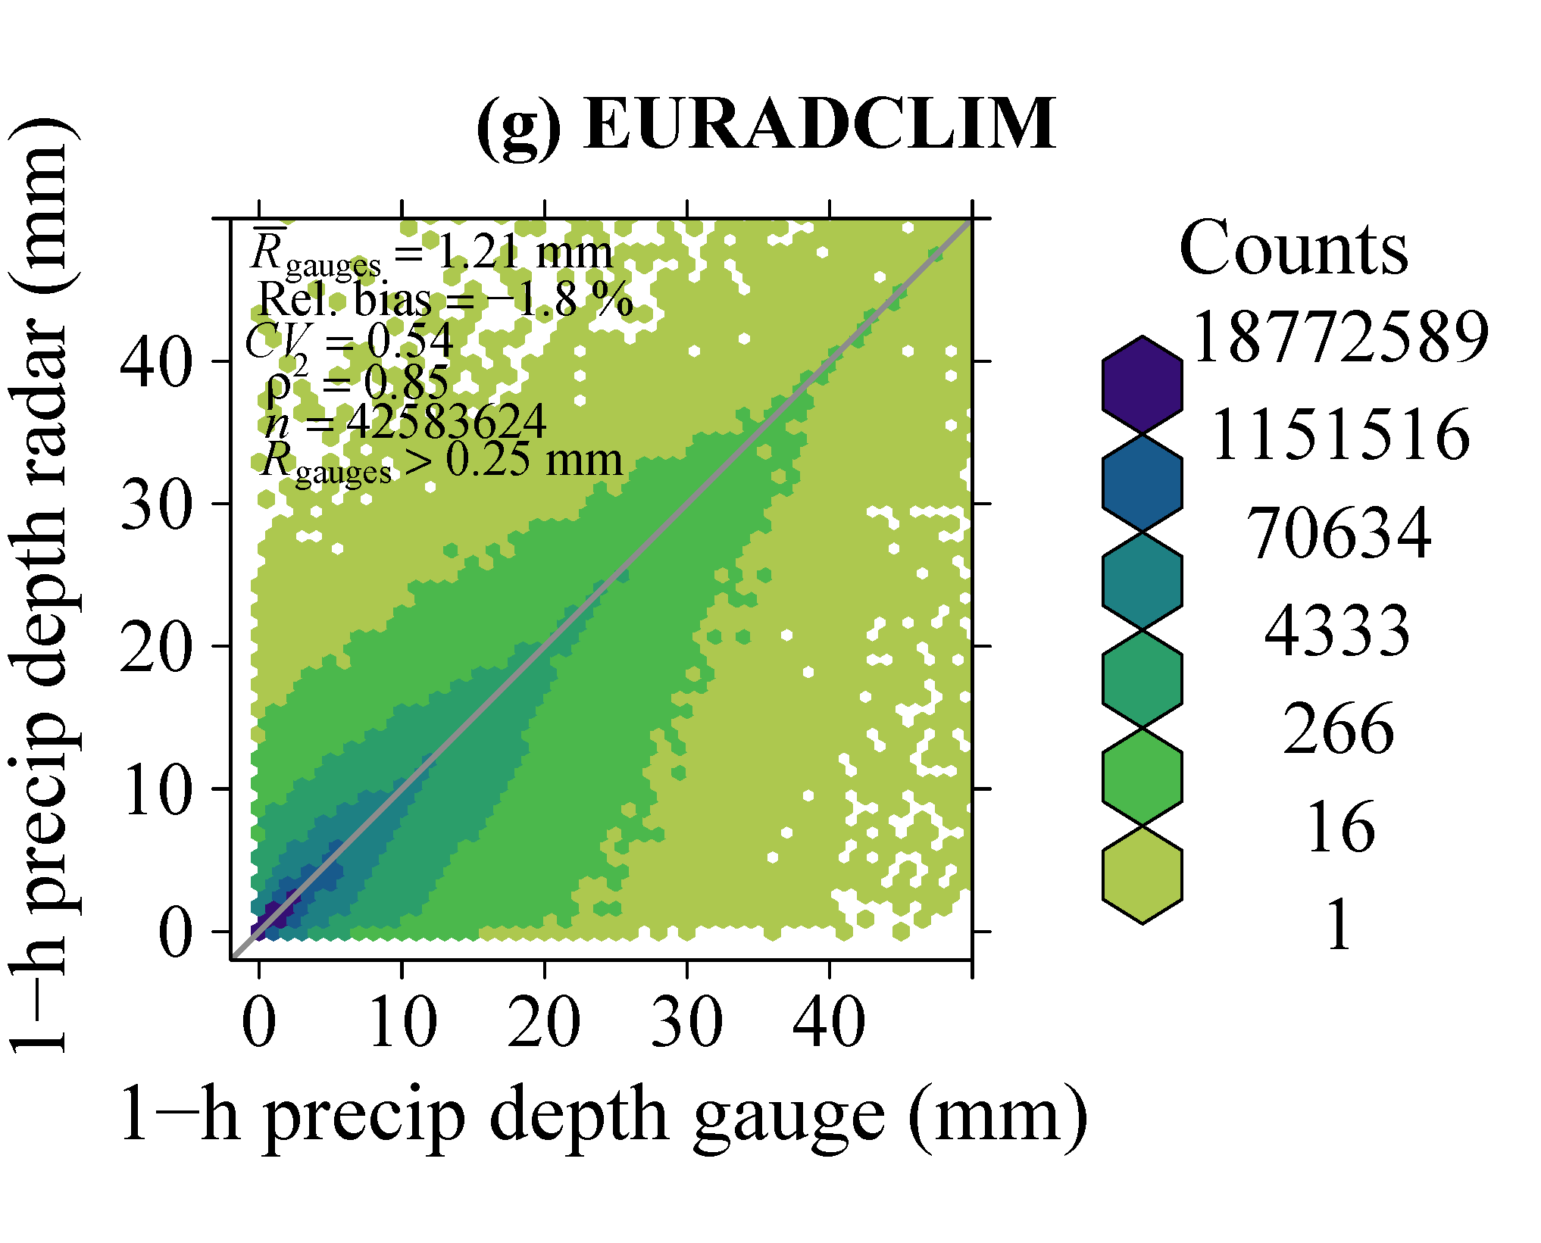
Verification against disaggregated ECA&D 1-h rain gauge accumulations
Independent verification
Dependent verification
+
+

Slide 8
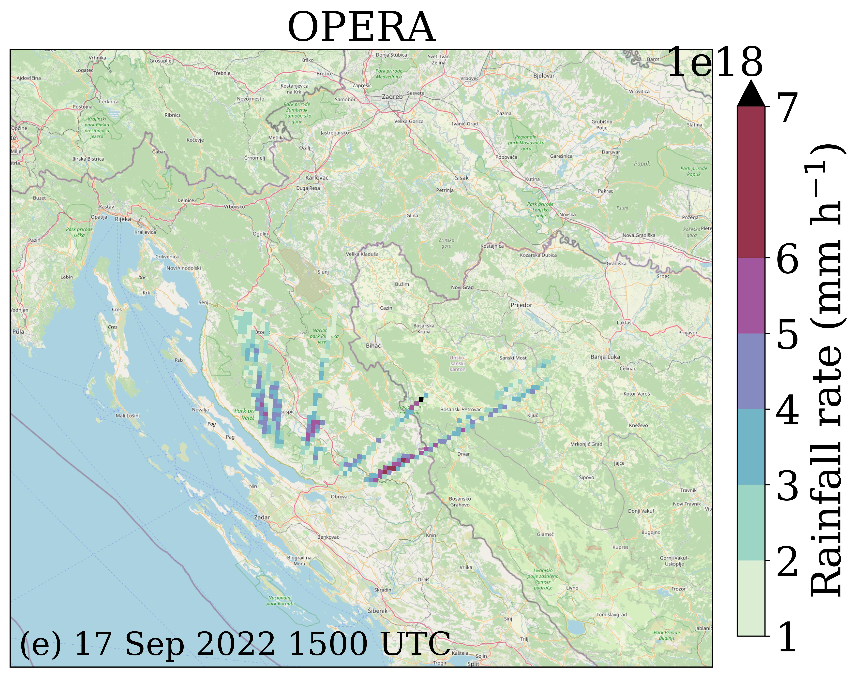
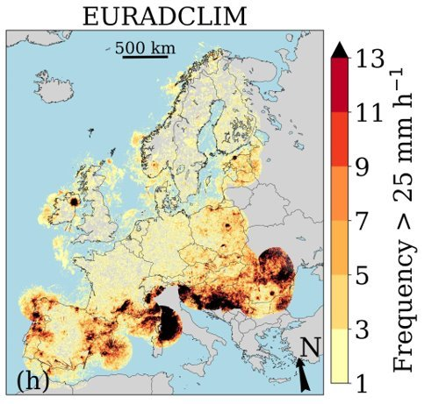
Outliers
We found extremely high "rain rates" above Croatia, Bosnia and Herzegovina or Slovenia in the 2022 OPERA data for 49 time intervals.
These outliers are largely removed for EURADCLIM (daily rain > 10^5 mm does never occur).
Non-meteorological echoes over 2013-2022 remain an issue, though.
Adjustment factor field can also be unrealistically large.

Slide 9
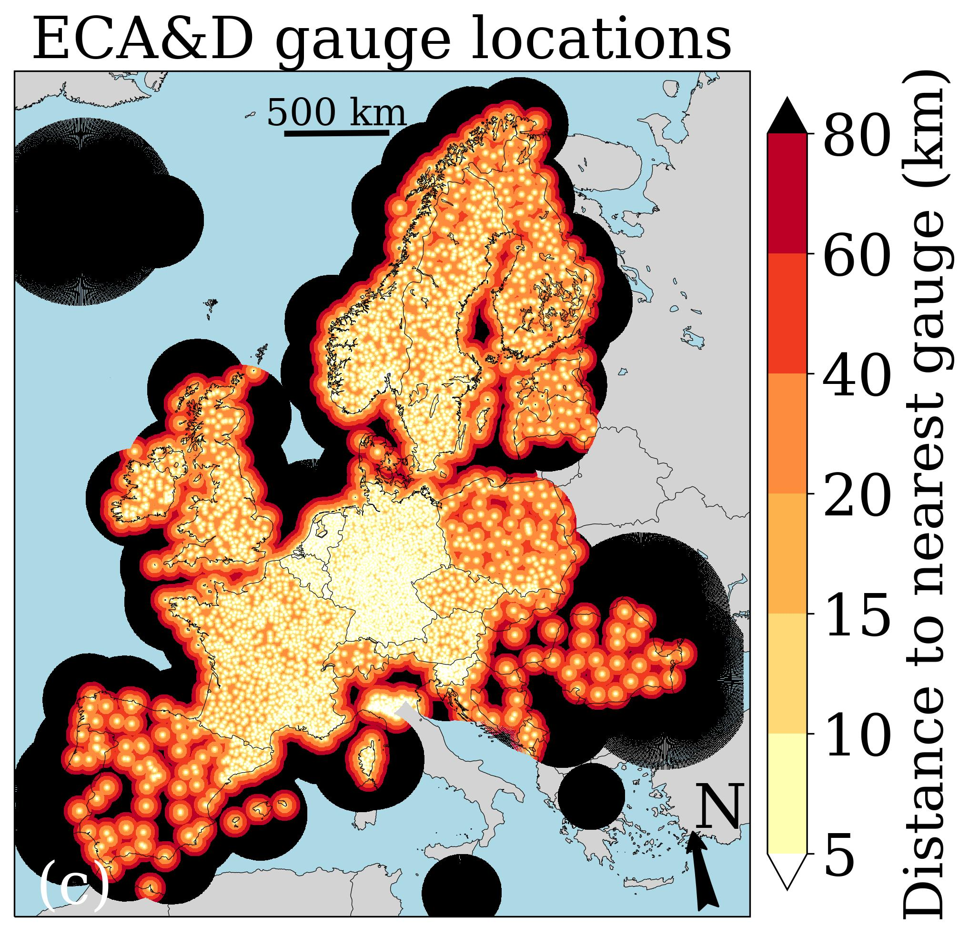
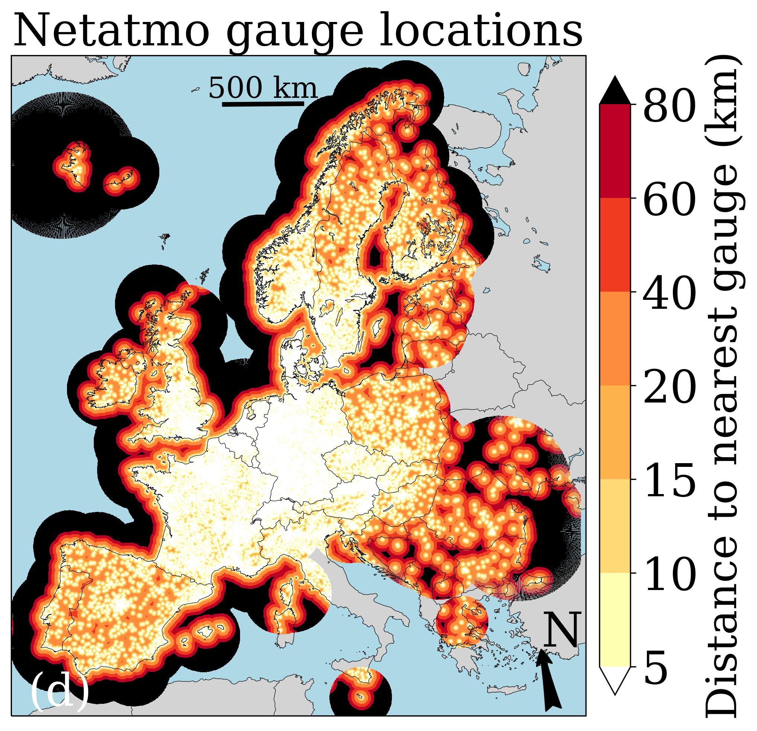
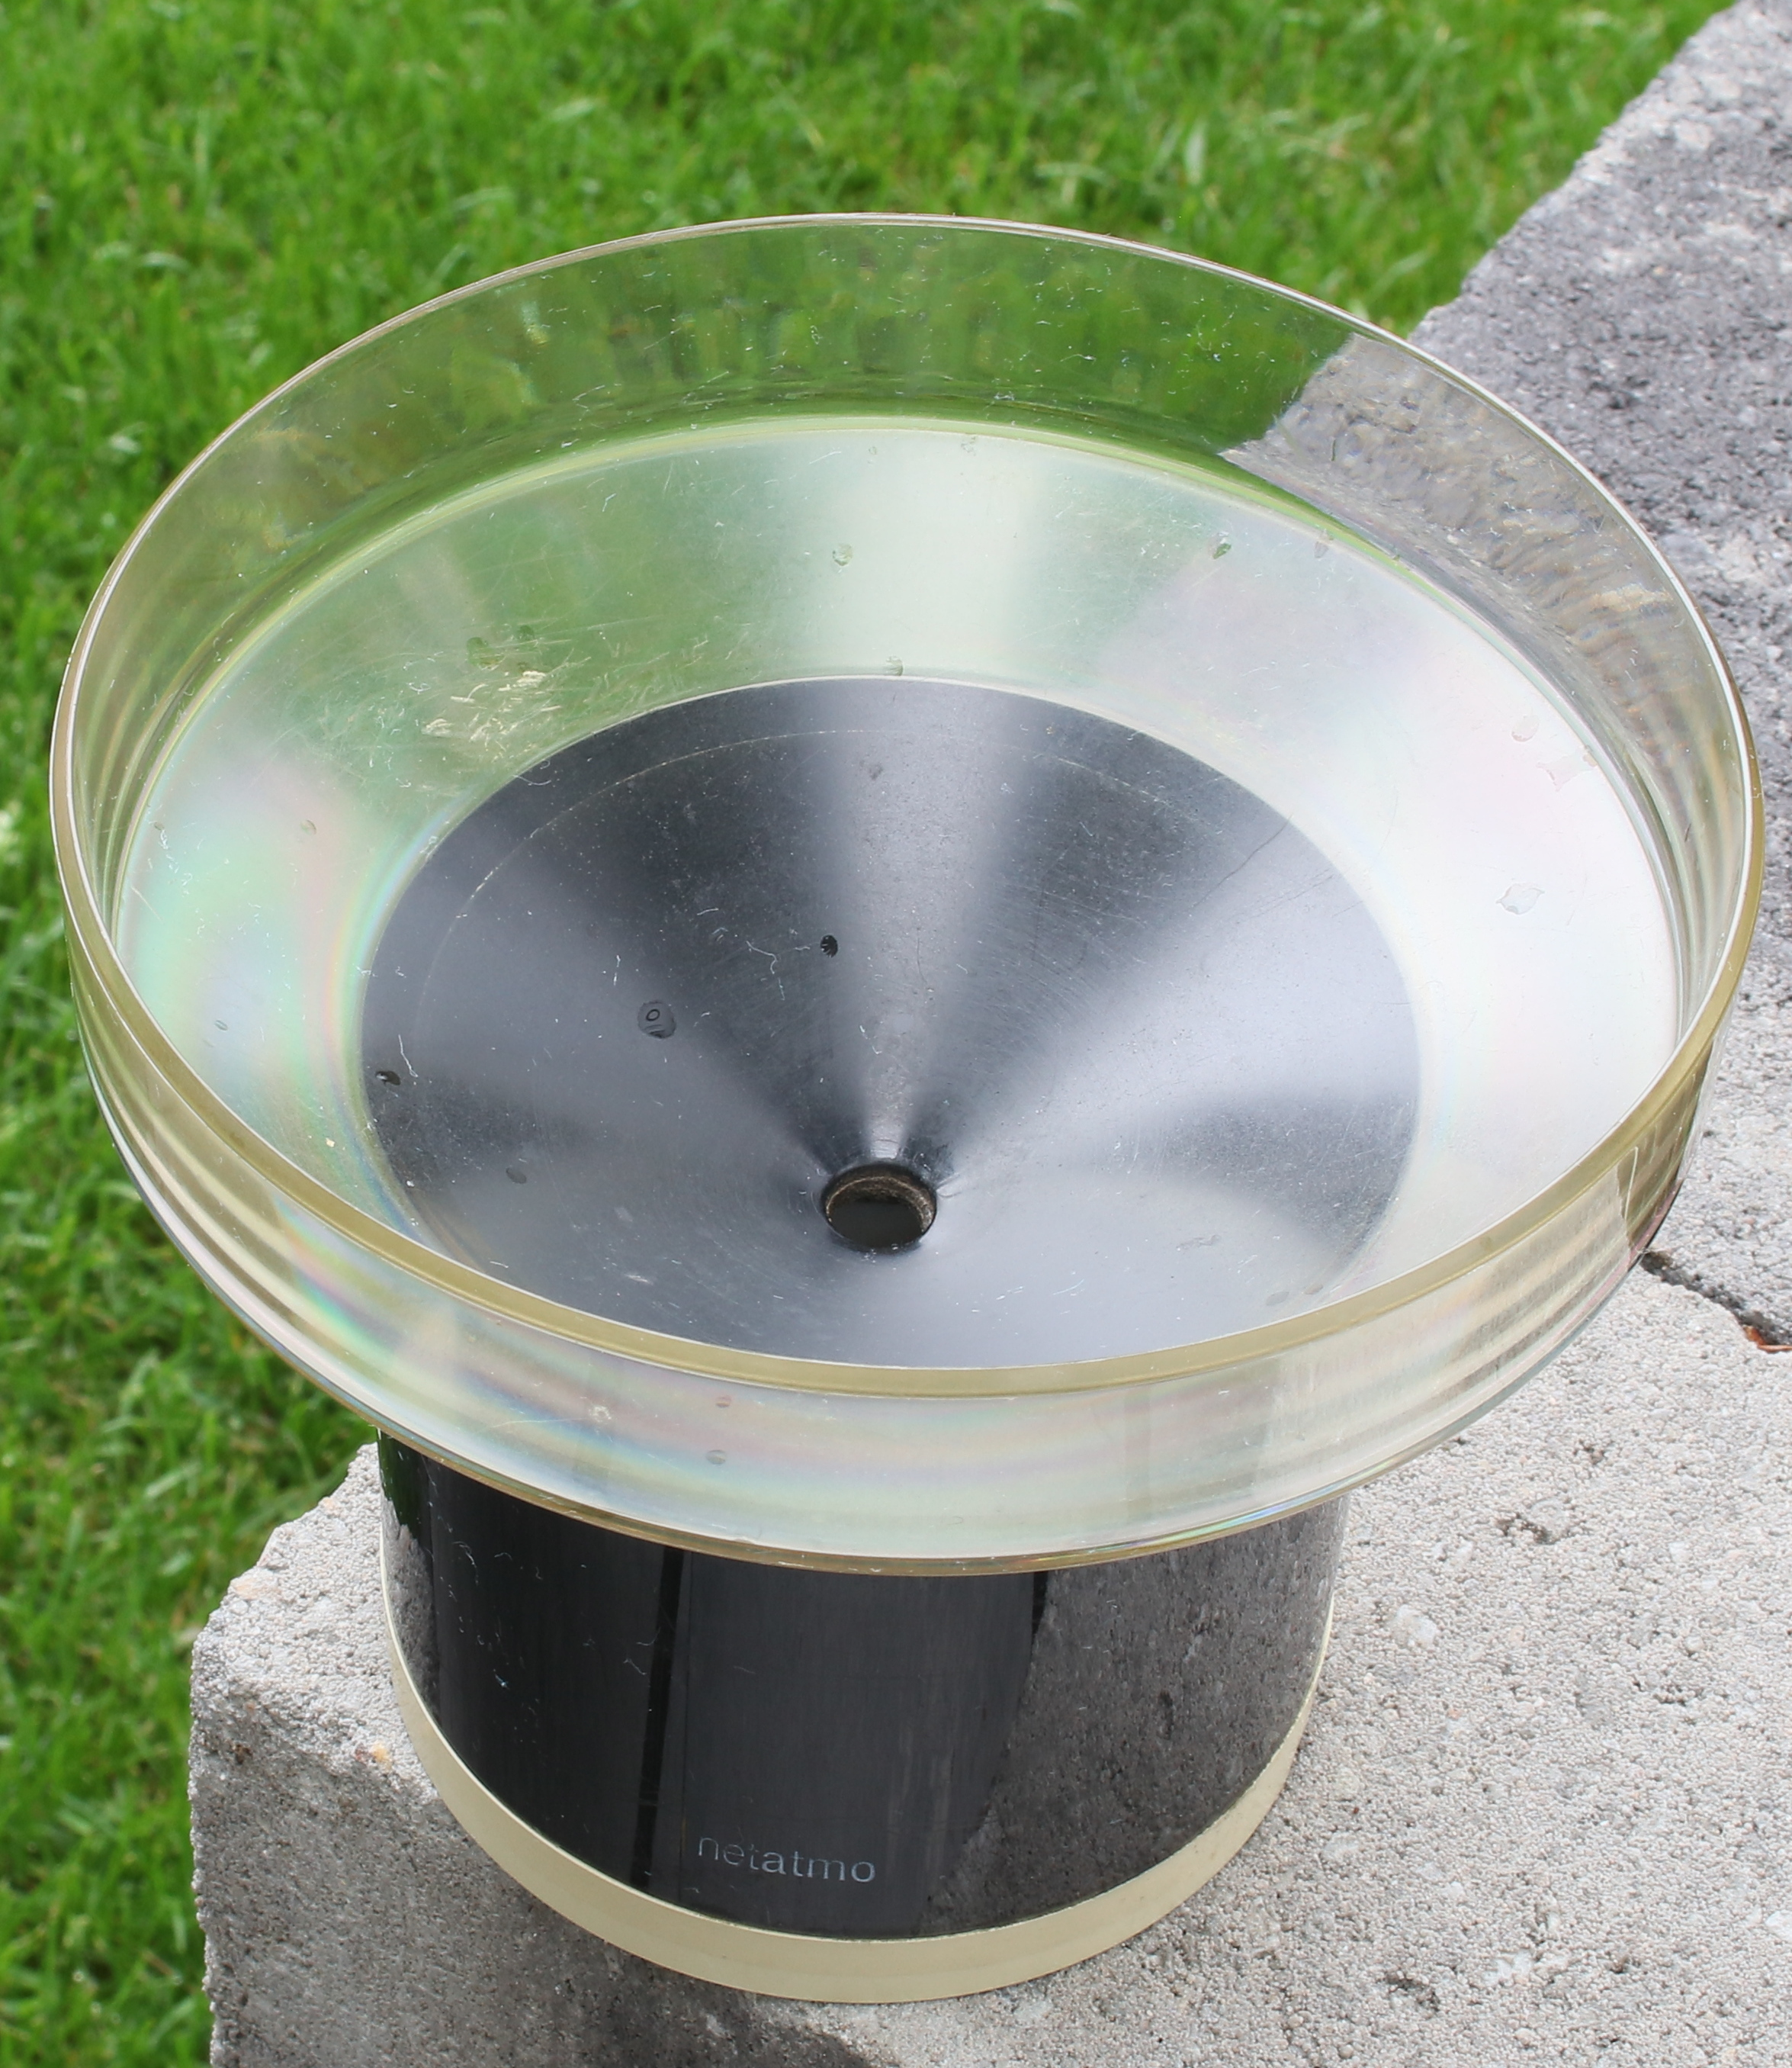
What about crowdsourcing?
Personal weather station (PWS)
https://www.netatmo.com/en-eu/smart-weather-station
Density of network from 1 brand of IoT rain gauges is ~10 × ECA&D gauge density
Merging with crowdsourced rain gauge data improves pan-European radar precipitation estimates, Hydrol. Earth Syst. Sci., https://doi.org/10.5194/hess-28-649-2024, 2024.
Government rain gauges
PWS gauges

Slide 10
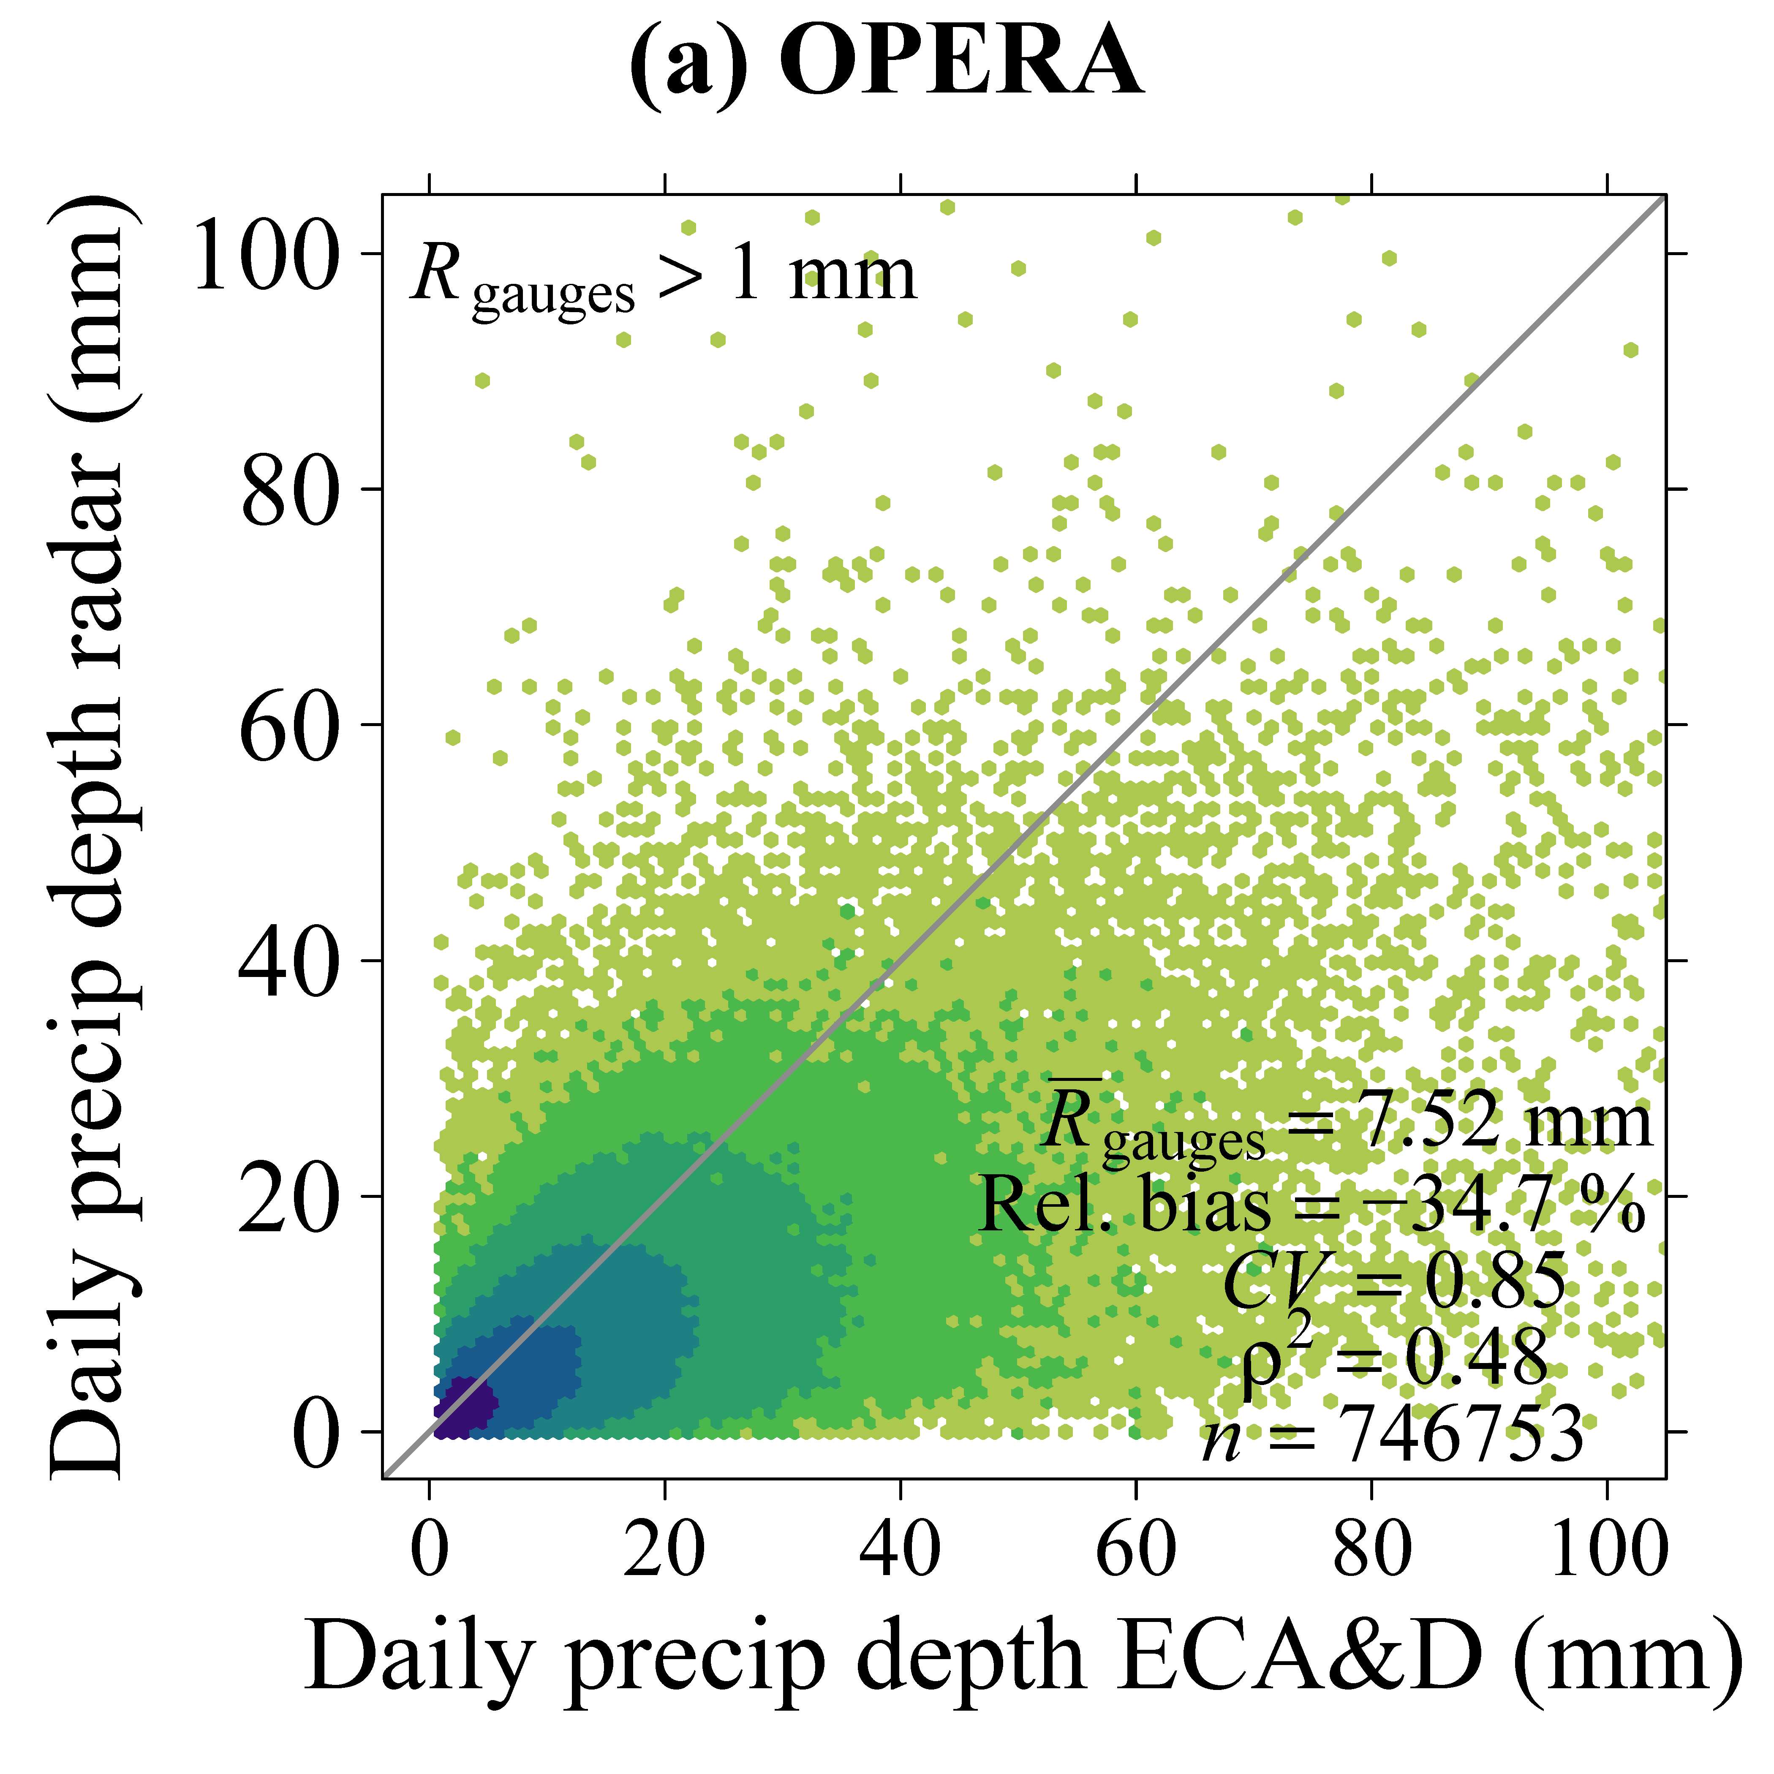
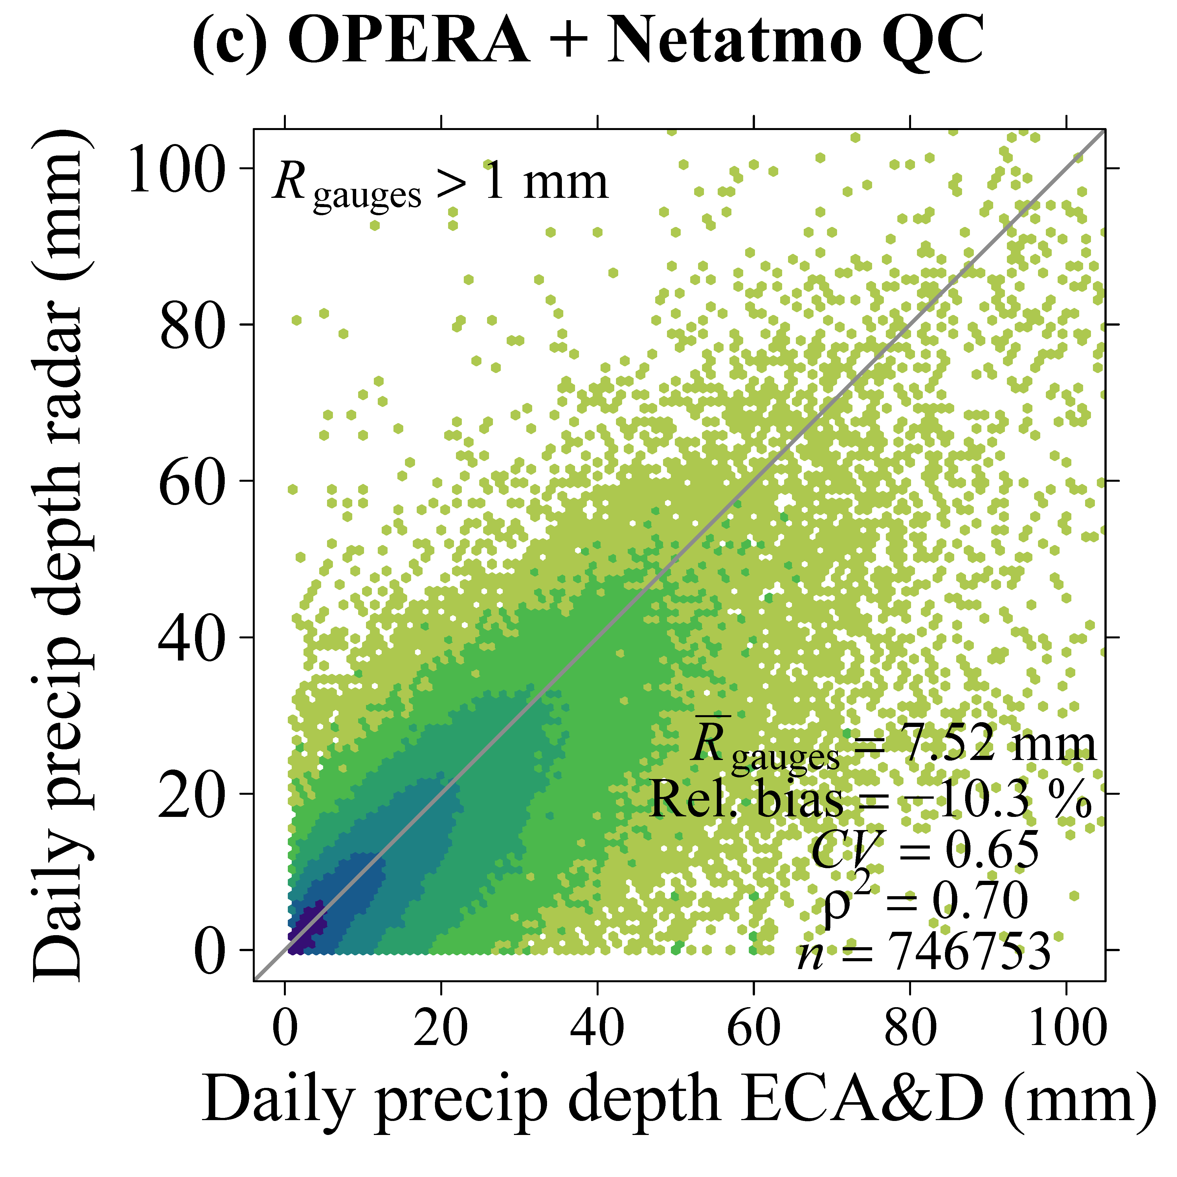
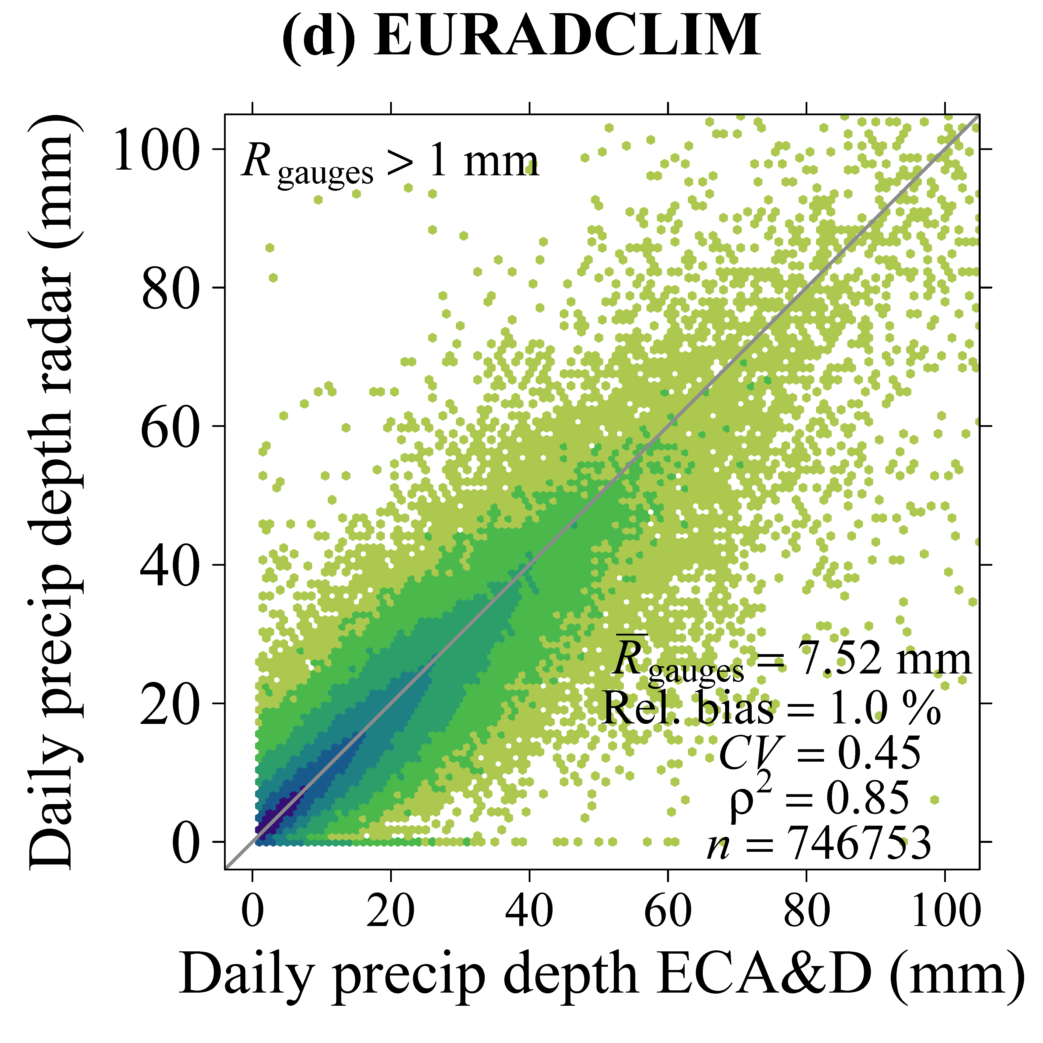
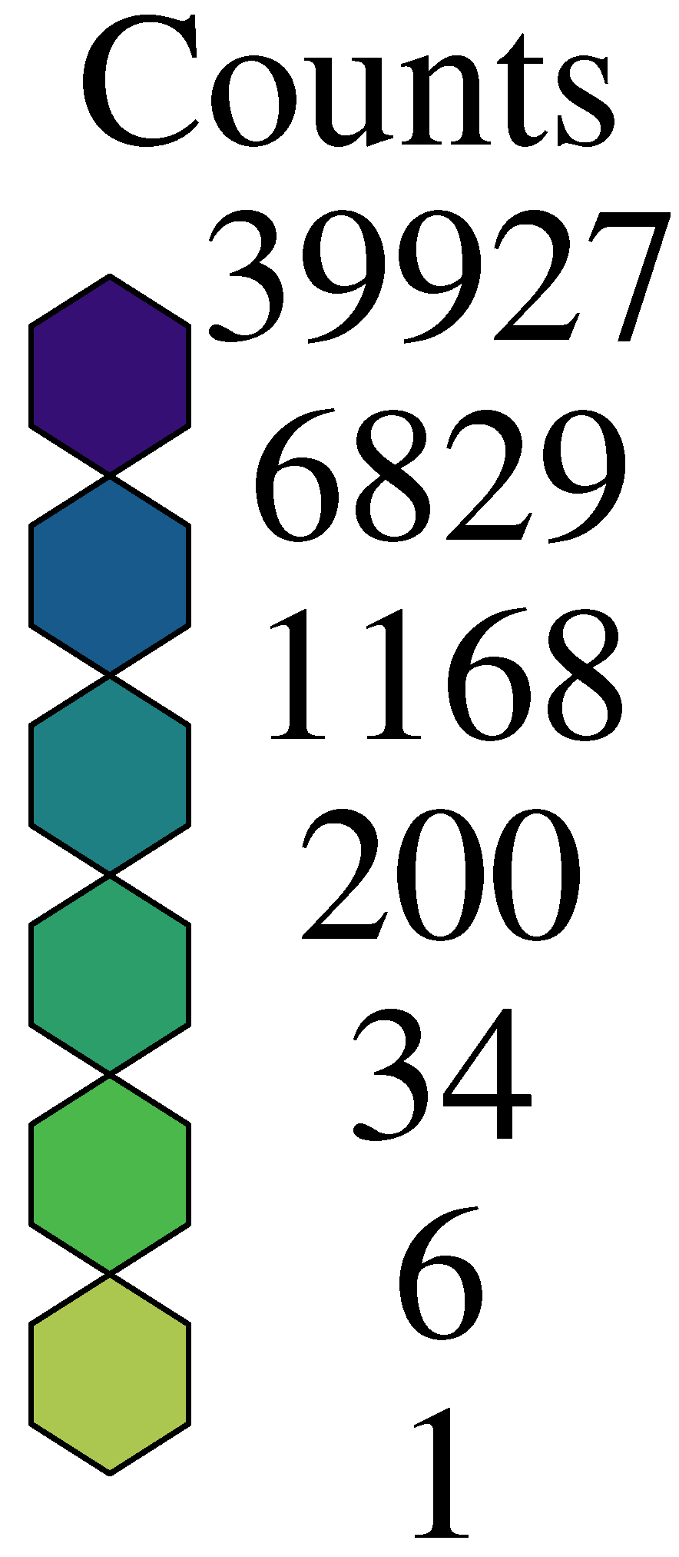
Verification against ECA&D gauges: daily rainfall
Independent verification
Independent verification
Dependent verification
+
+
Quality of real-time merged OPERA-Netatmo dataset would lie somewhere between that of OPERA and EURADCLIM.
Thanks to Netatmo and citizens buying and operating these stations.
https://doi.org/10.4121/675f3f64-04a8-48db-ae3e-4a6c004a0776.v2 (merged dataset publicly available)

Slide 11
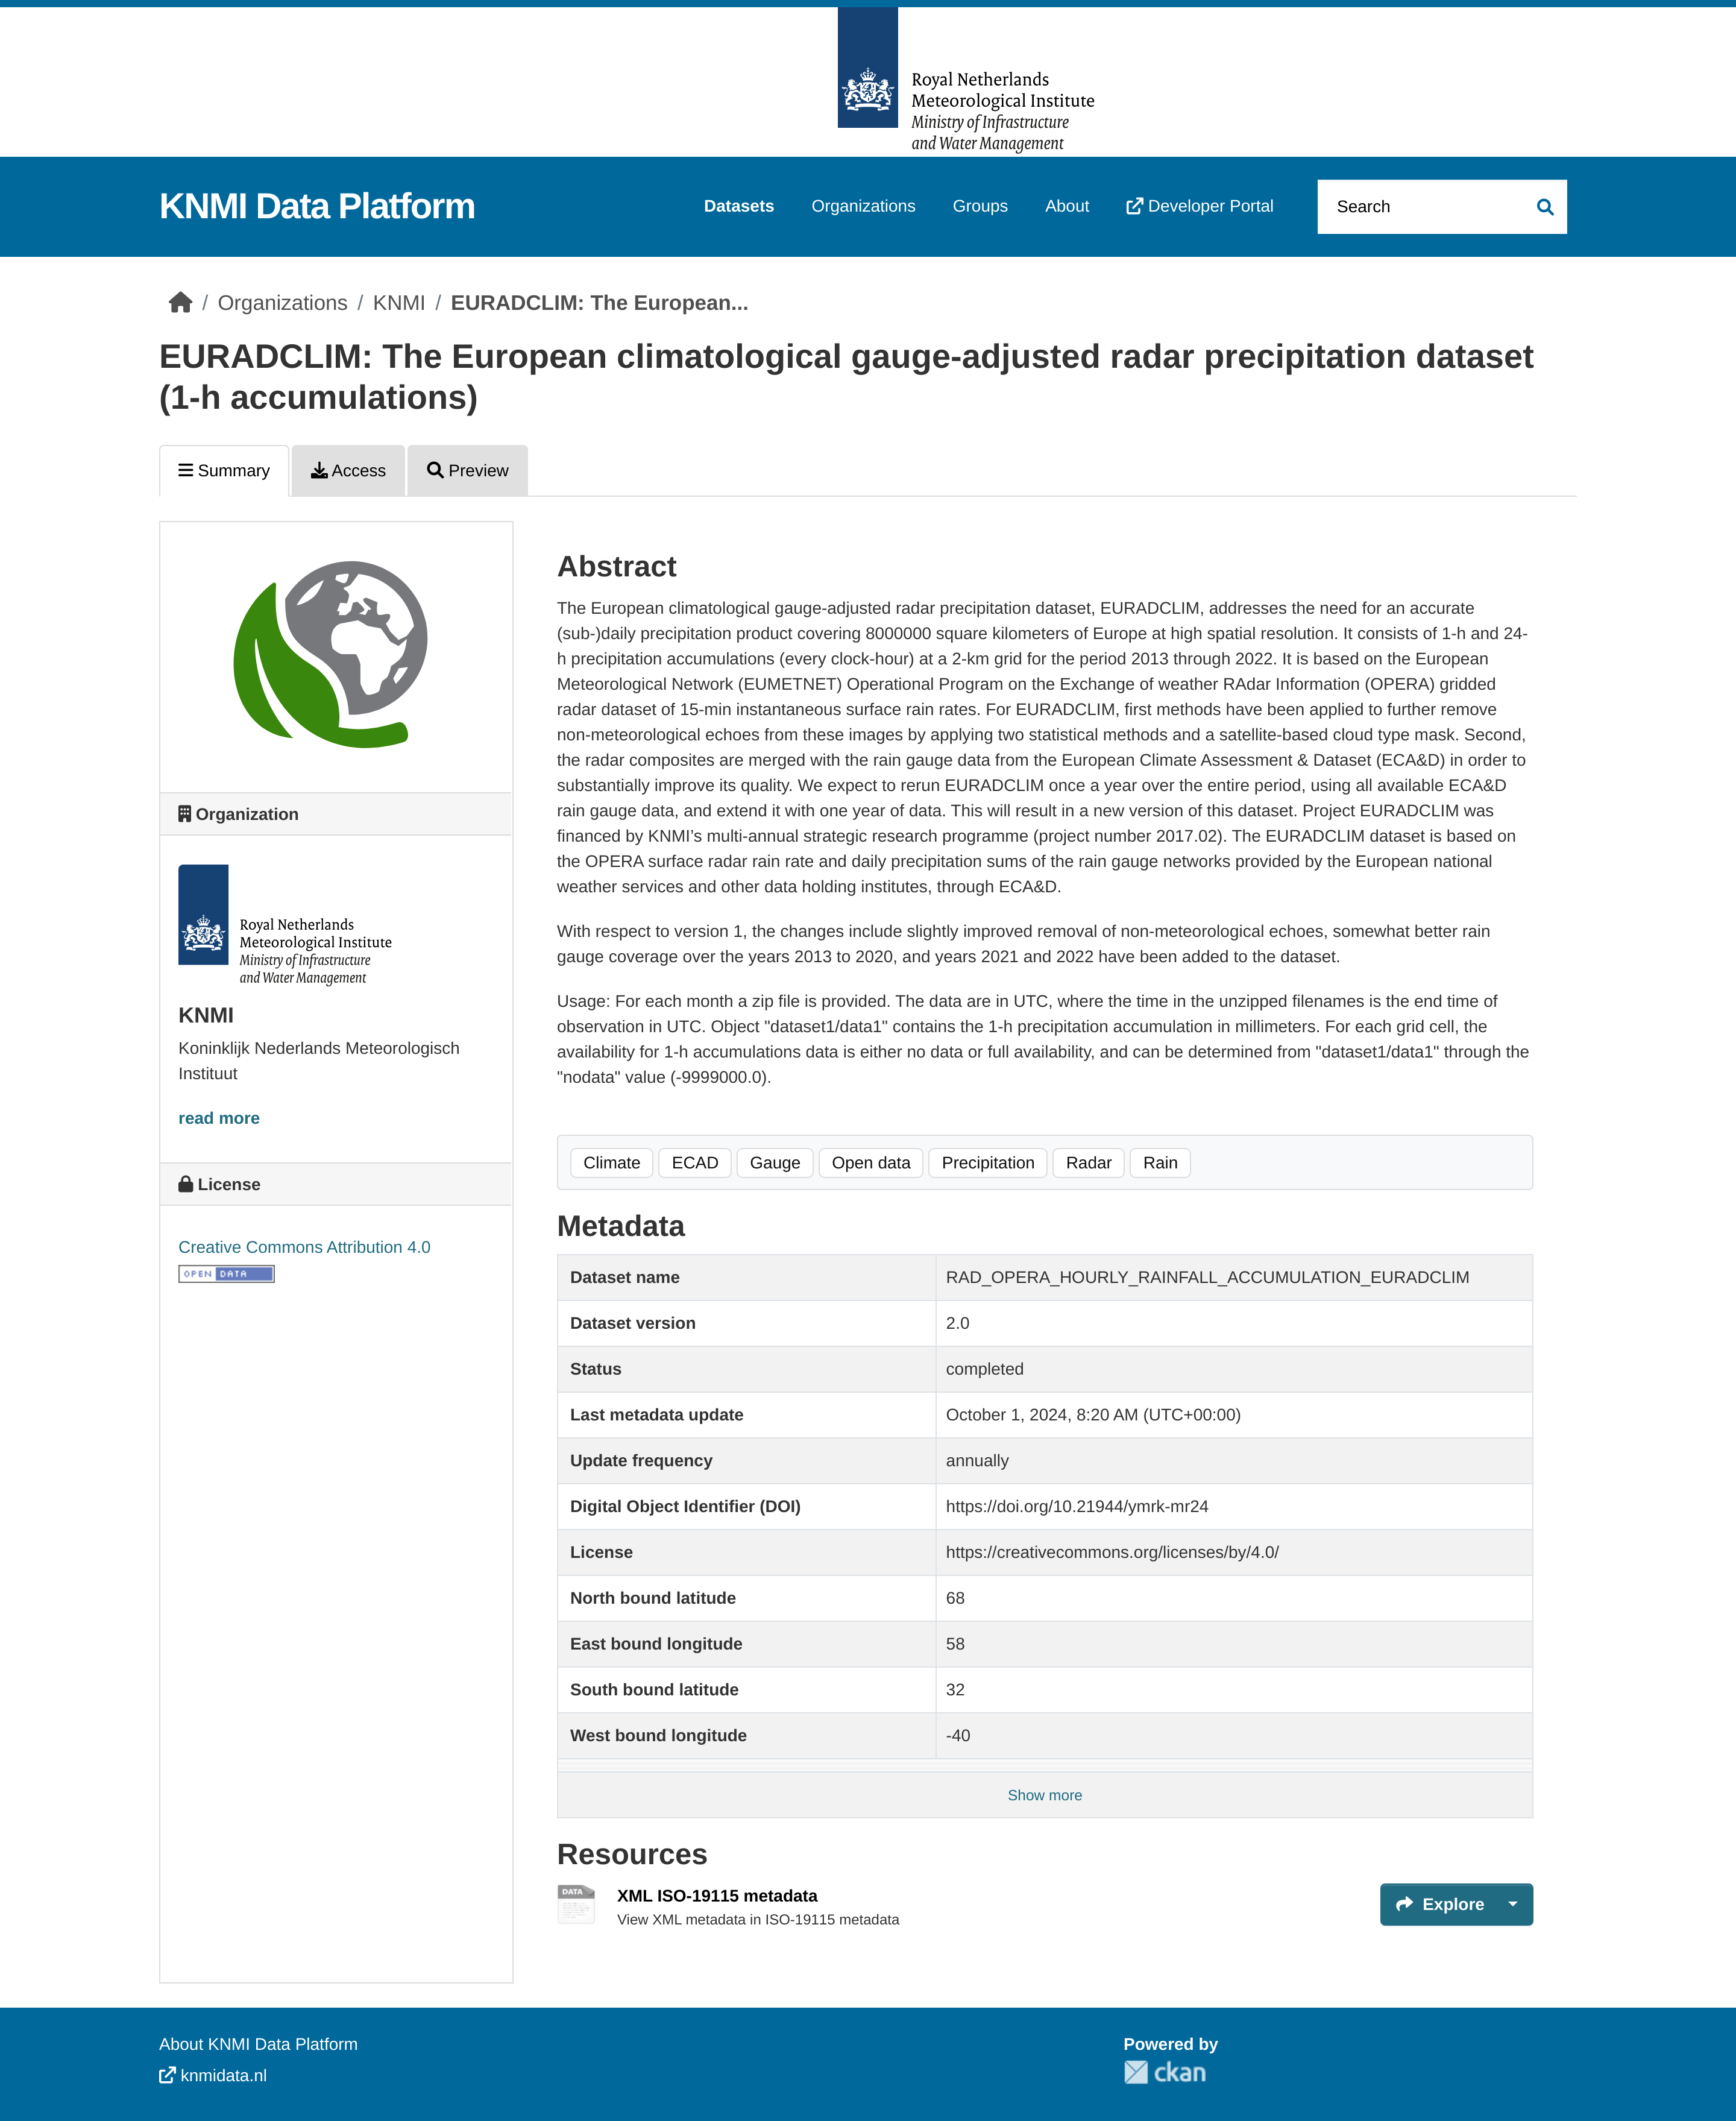
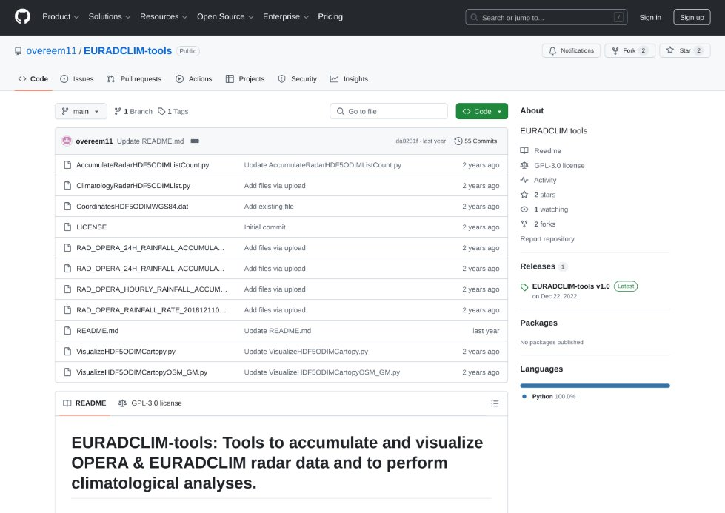
Summary
EURADCLIM fills a gap in pan-European climatological precipitation datasets due to its high spatiotemporal resolution.
Is not expected to outperform national climatological radar datasets, but these are often not available or do not exist.
Publicly available.
https://doi.org/10.21944/ymrk-mr24 & https://doi.org/10.21944/kcd7-3y59
One update per year with more rain gauge data included in EURADCLIM over whole period + extension of EURADCLIM with 1 year.
Reference for evaluating OS precipitation estimates, but preferably the reference should be improved by OS.
Open-source tools to work with EURADCLIM
(Saltikoff et al., 2019)

Slide 12
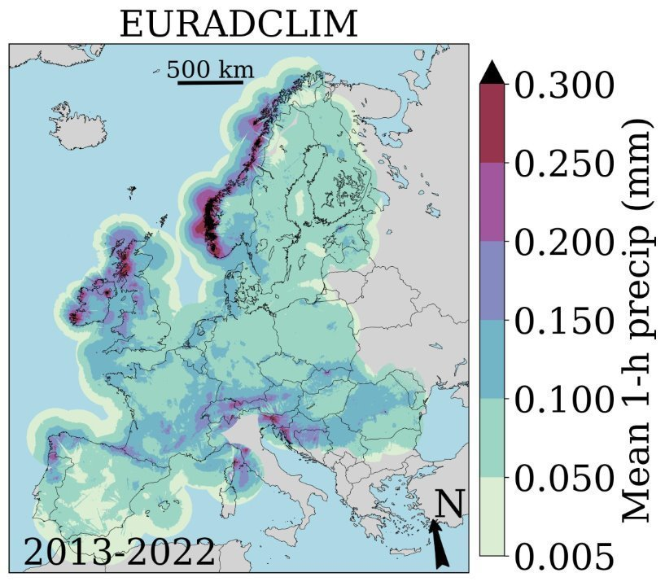
EURADCLIM v3
Some research on improved clutter removal: setting high rain intensities (e.g., 100 mm/h or 200 mm/h) to 0 mm/h (helps a bit), or counting number of exceedances of 3 threshold values in previous and next 24 h for each radar pixel and use high counts to set to 0 mm/h, or perhaps interference pattern recognition.
Improved, more local, merging of radar and gauge accumulations.
Rerun merging 2013 – 2022.
Add year 2023.
Dataset published (probably September 2025).
(Saltikoff et al., 2019)

Slide 13
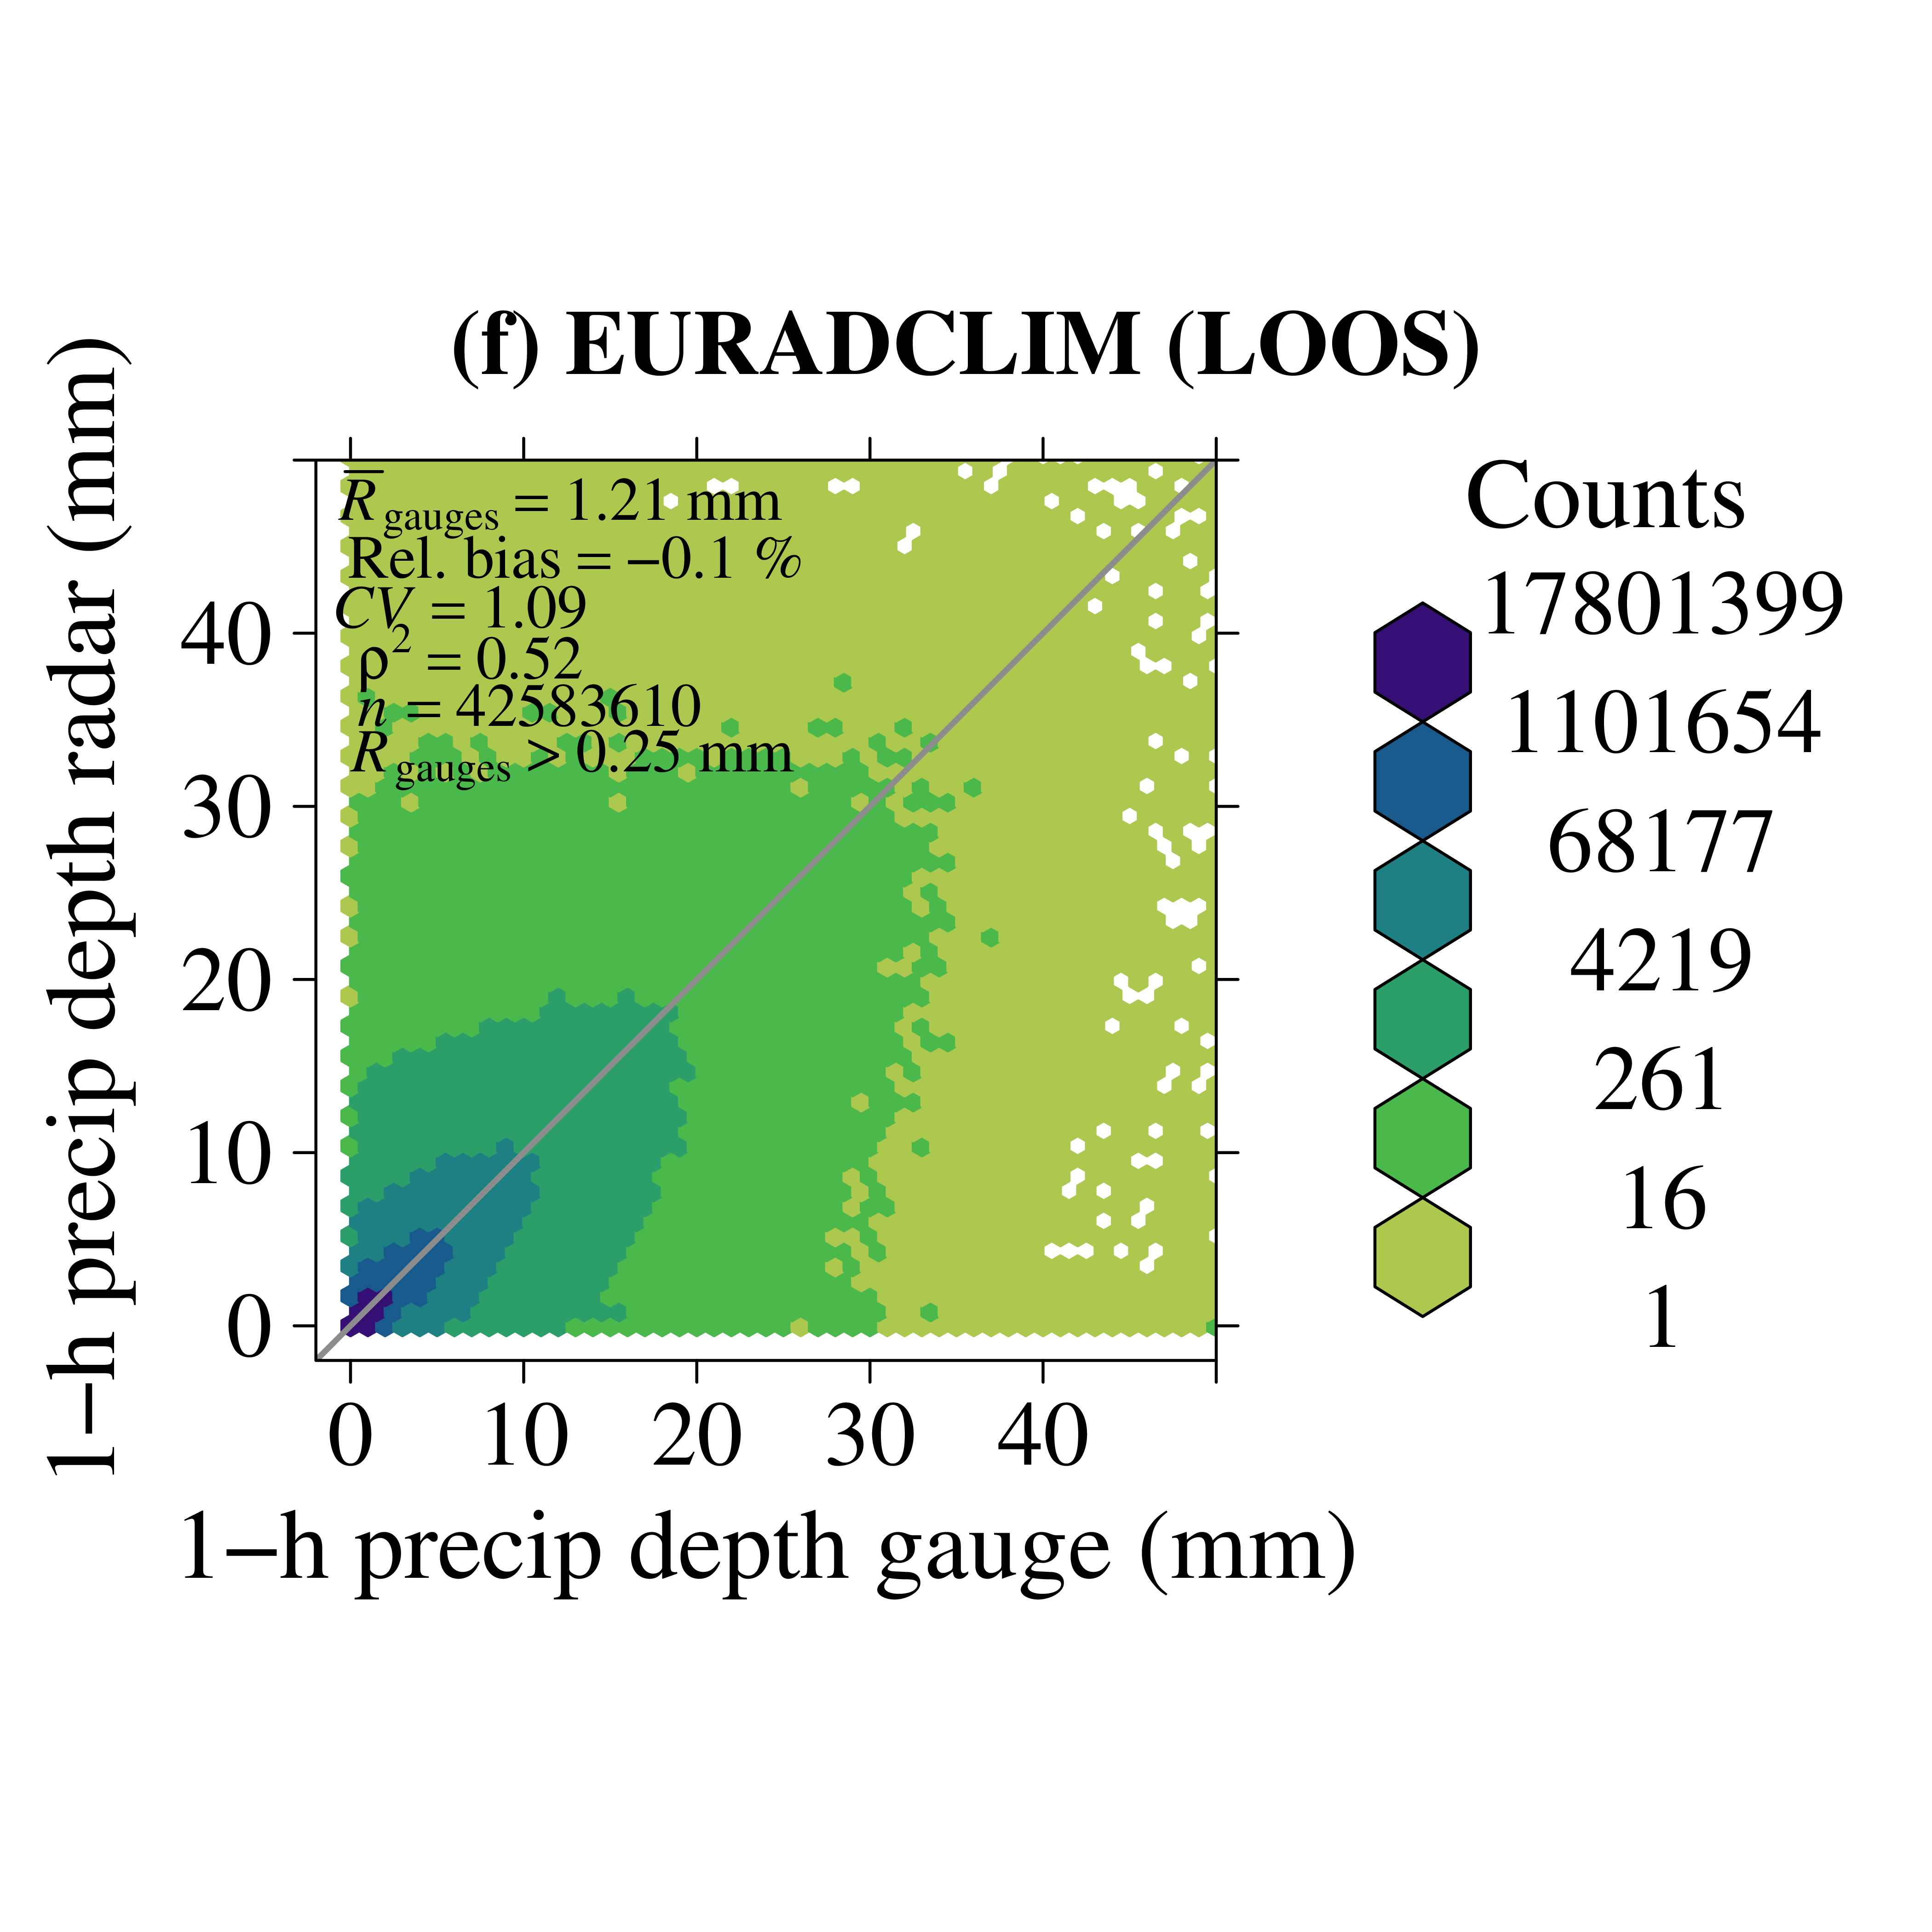
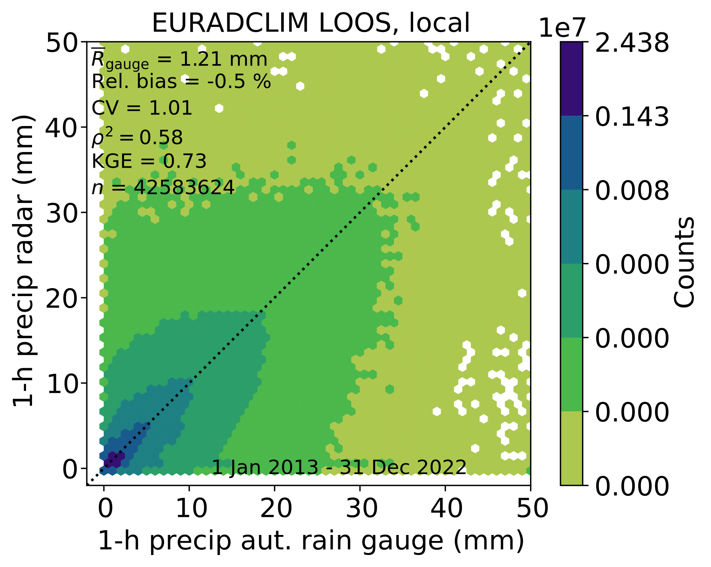
More local merging leave-one-out-statistics
Generally, an improvement when merging is more local, i.e., closest rain gauge data get a higher weight.

Slide 14
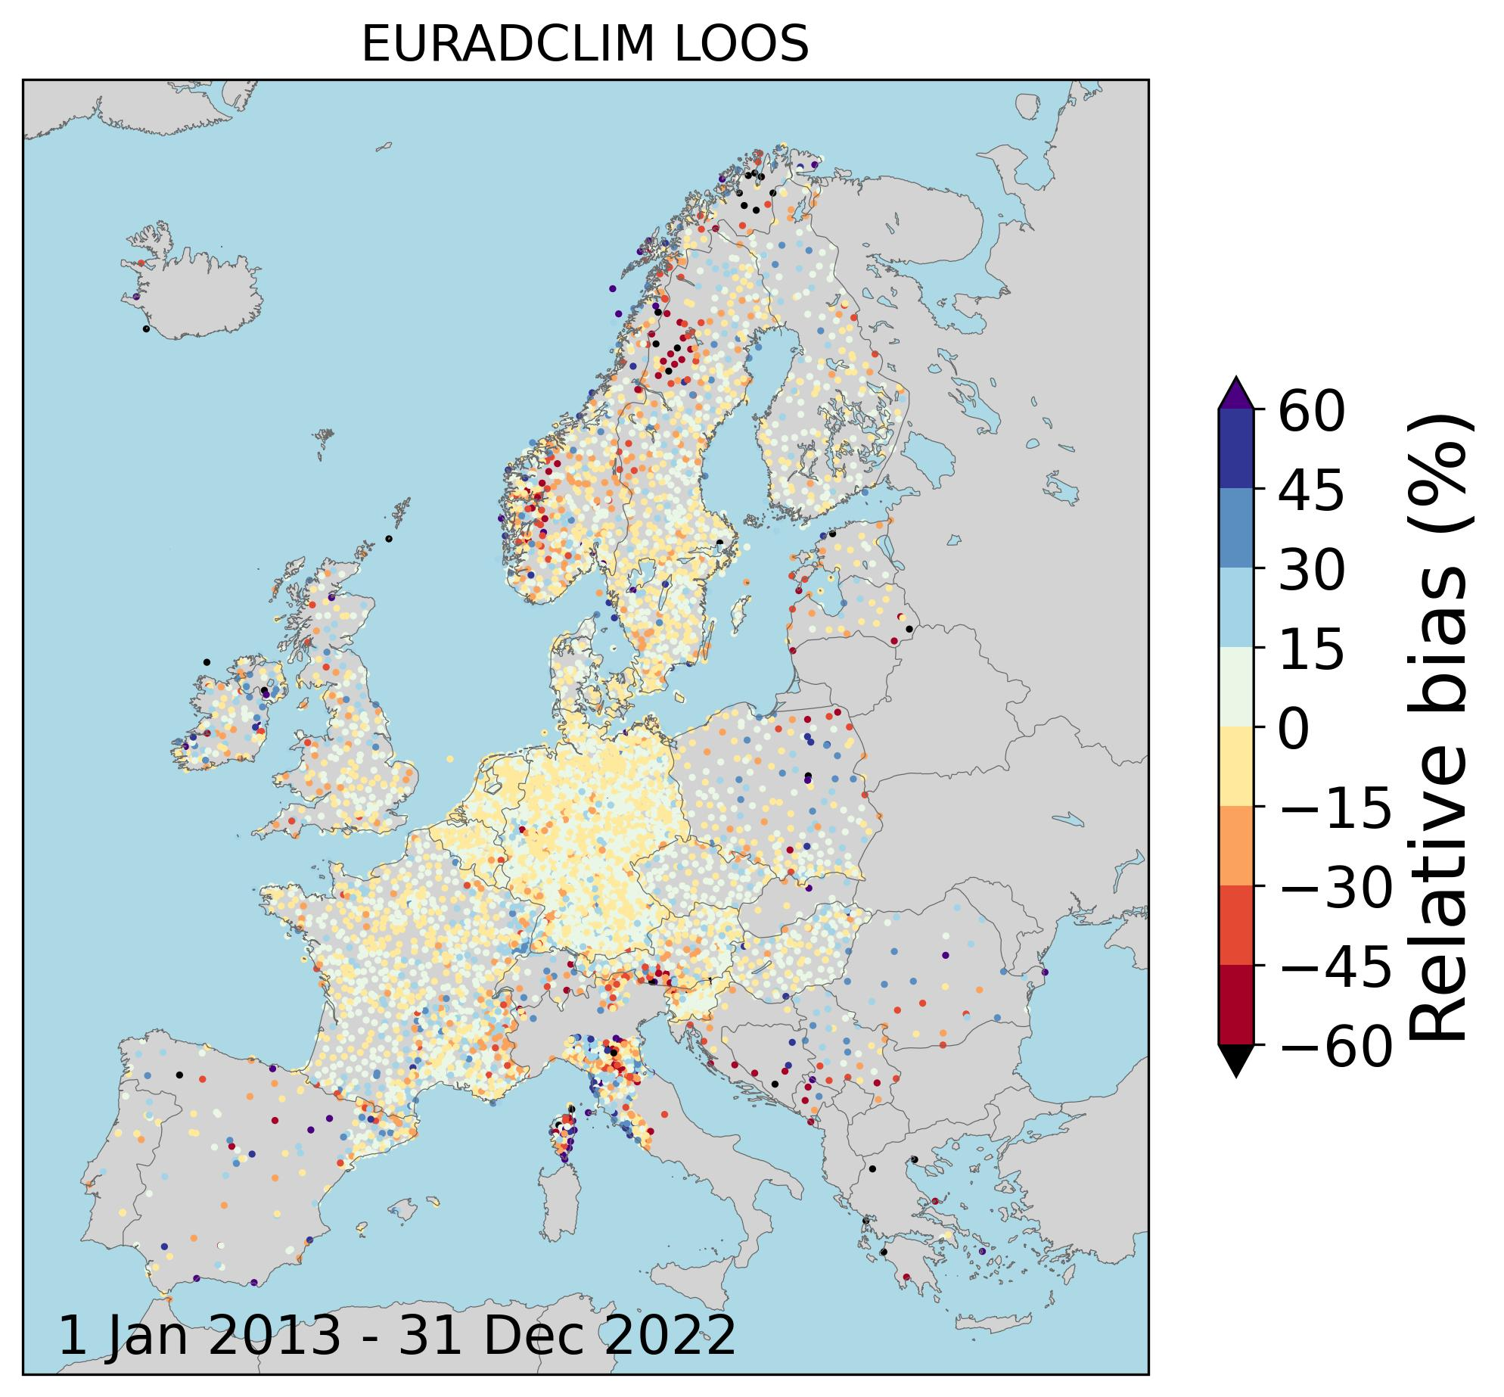
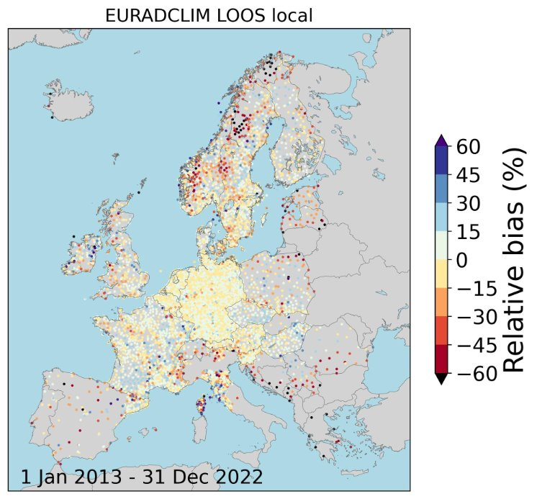
More local merging leave-one-out-statistics
For some regions more local merging provides worse results (but LOOS, so in real dataset this effect is expected to be smaller).

Slide 15
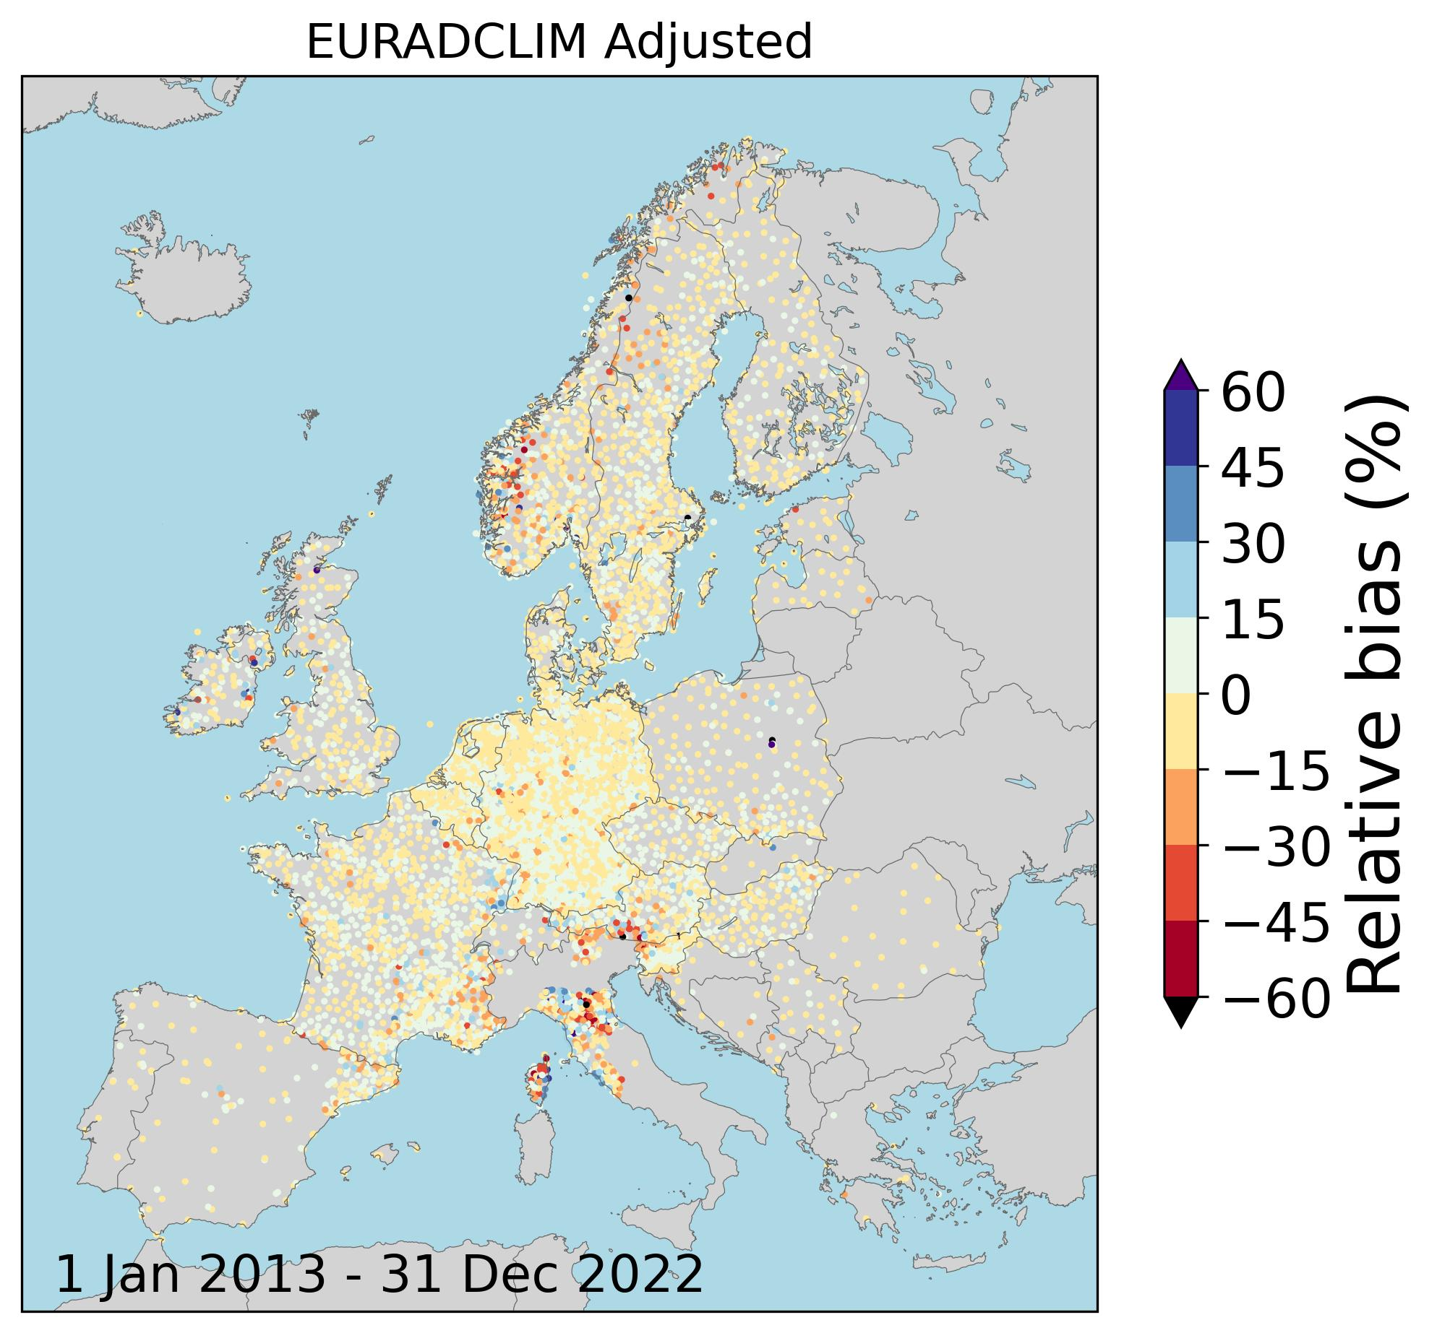
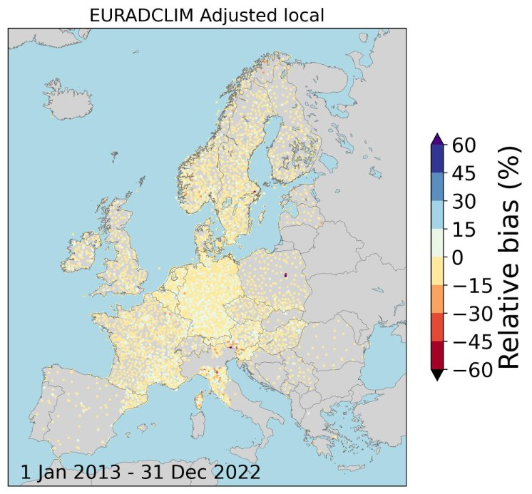
More local merging dependent verification
Strong improvement when merging is more local, i.e., closest rain gauge data get a higher weight.

Slide 16
Additional slides

Slide 17
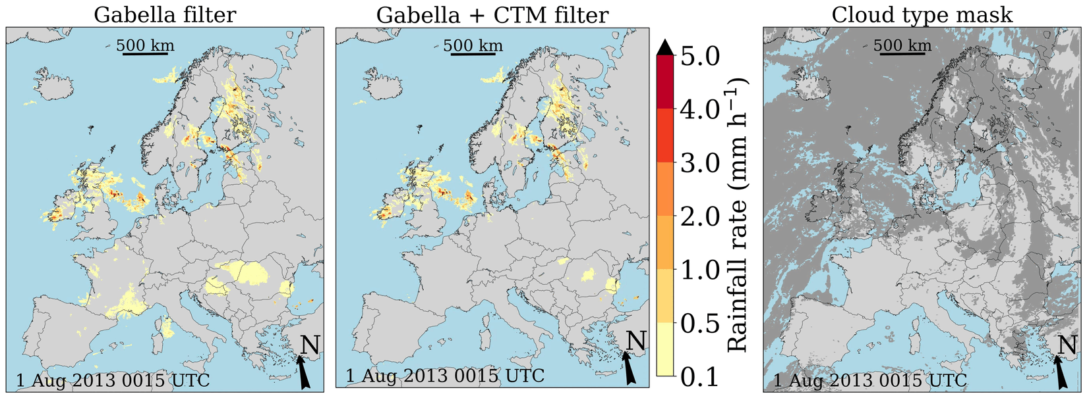
Satellite cloud type mask
Satellite cloud type mask from the CLAAS-2 product based on data from the geostationary MSG satellites operated by EUMETSAT. Thanks to Martin Stengel (DWD) for providing the product for 2013-2021 (as of 2022 product from NWC SAF is used).

Slide 18
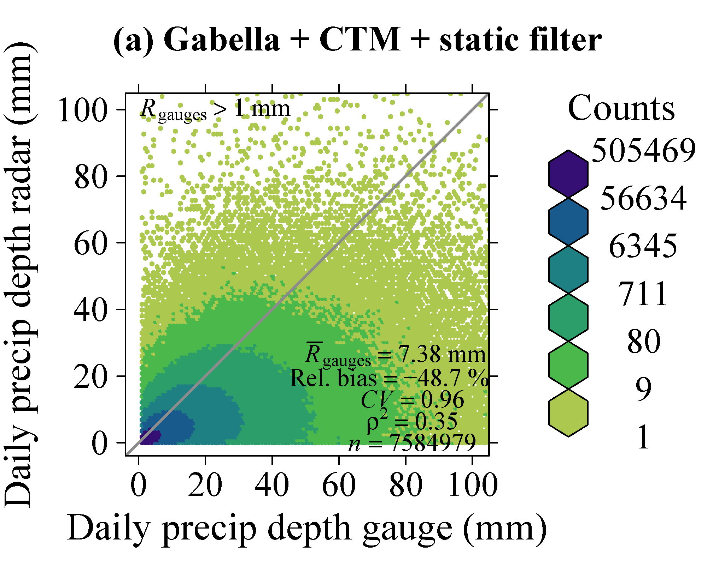
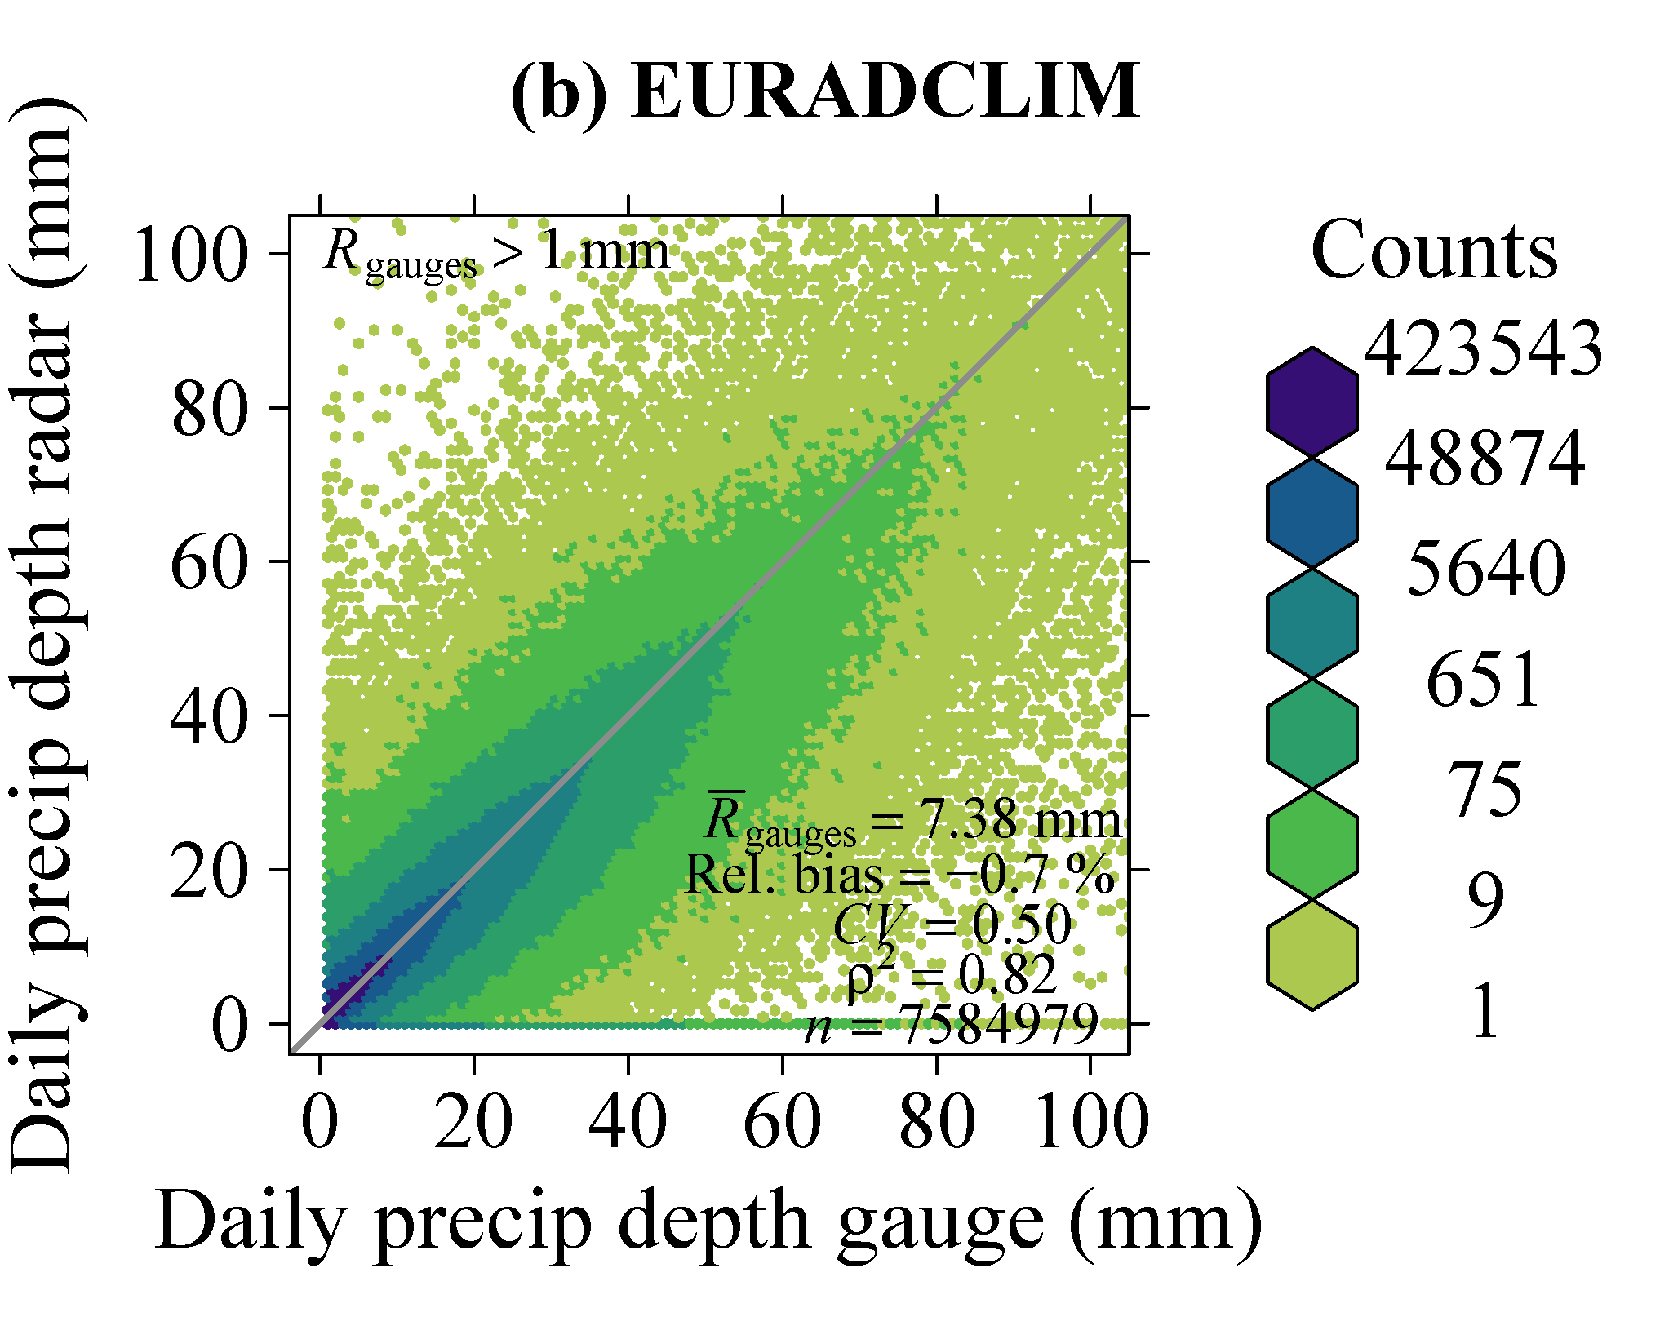
Verification against ECA&D gauges: daily rainfall
version 2
Independent verification
Dependent verification
+

Slide 19
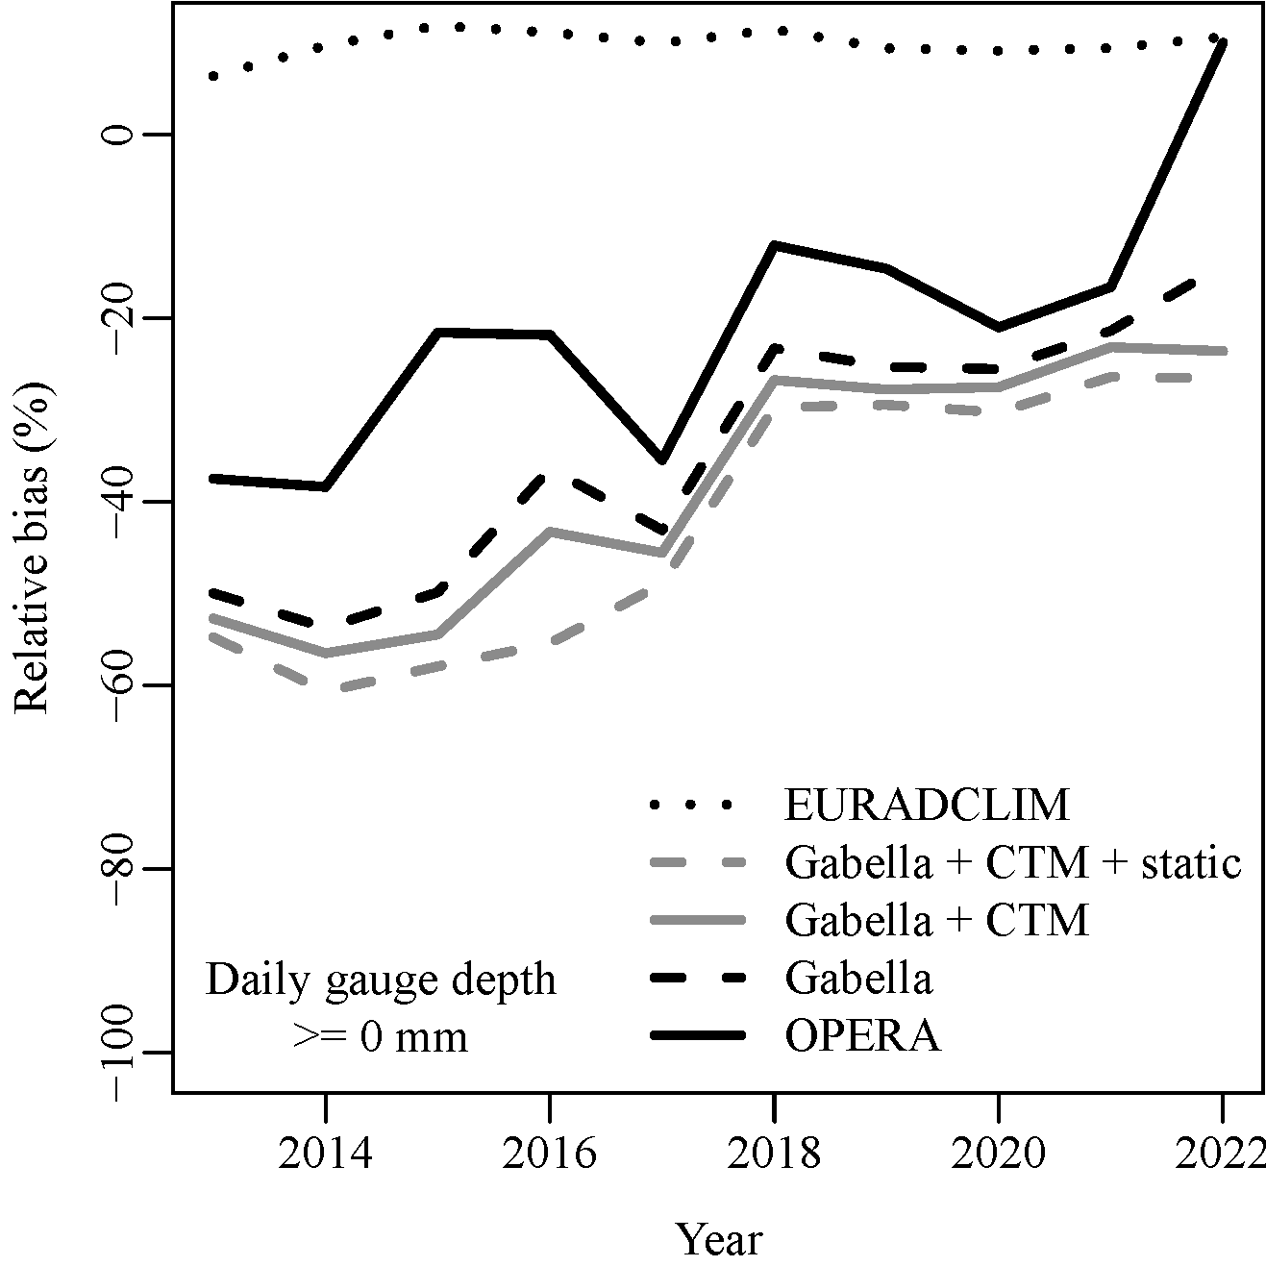
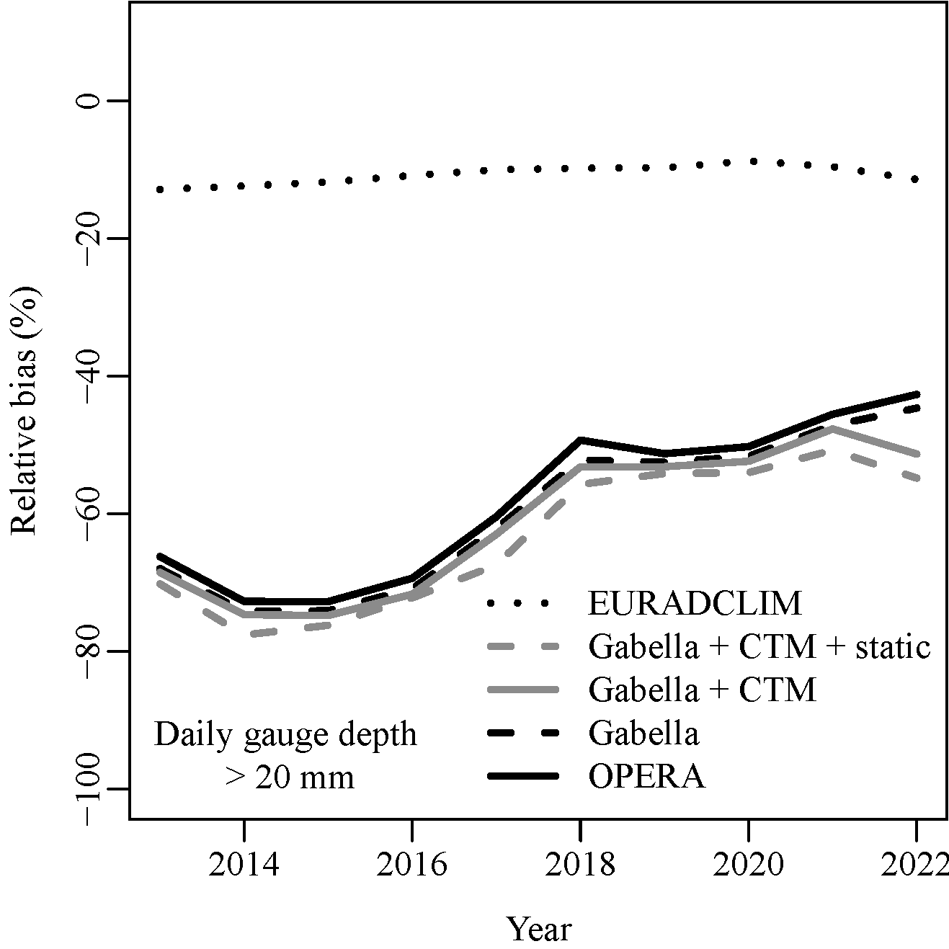
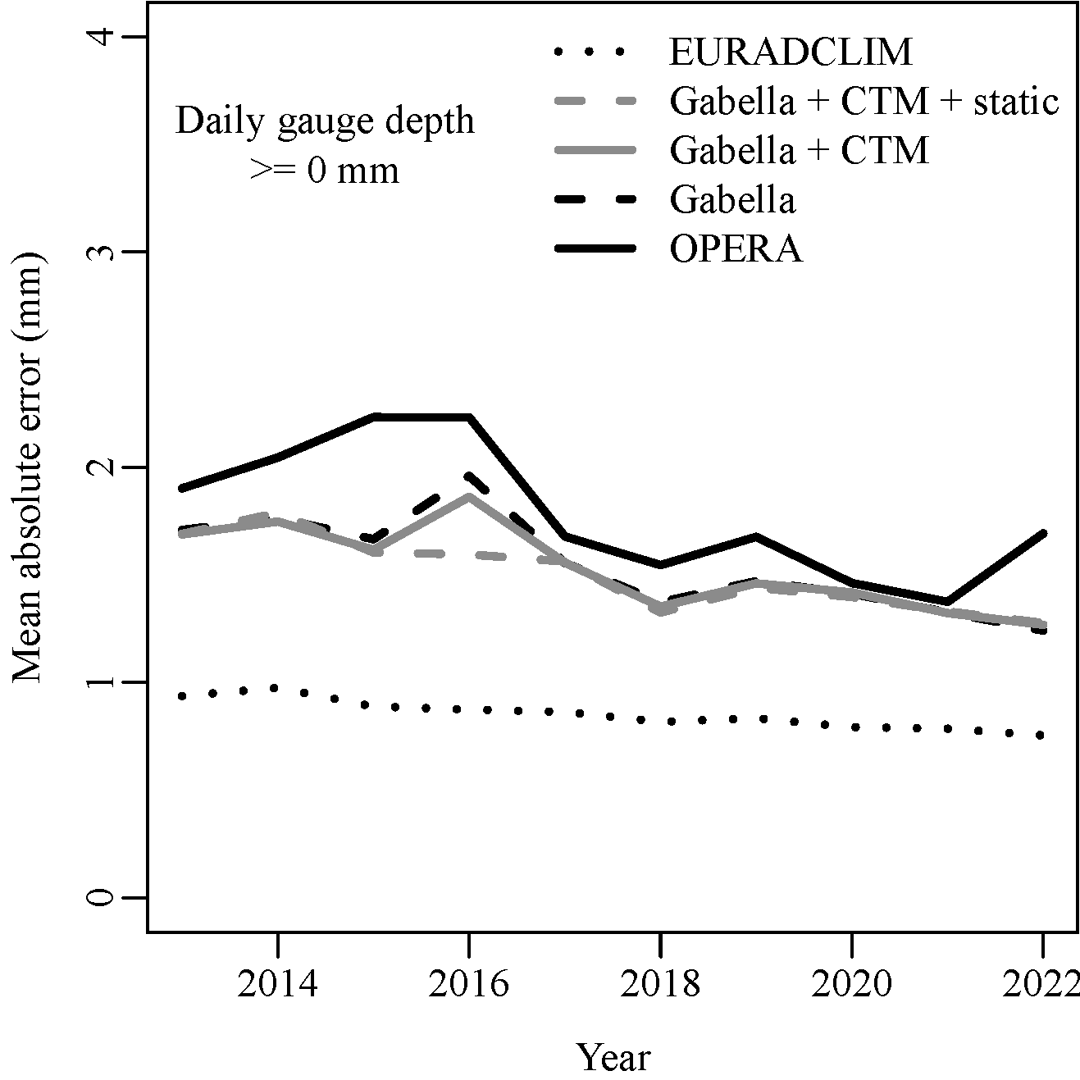
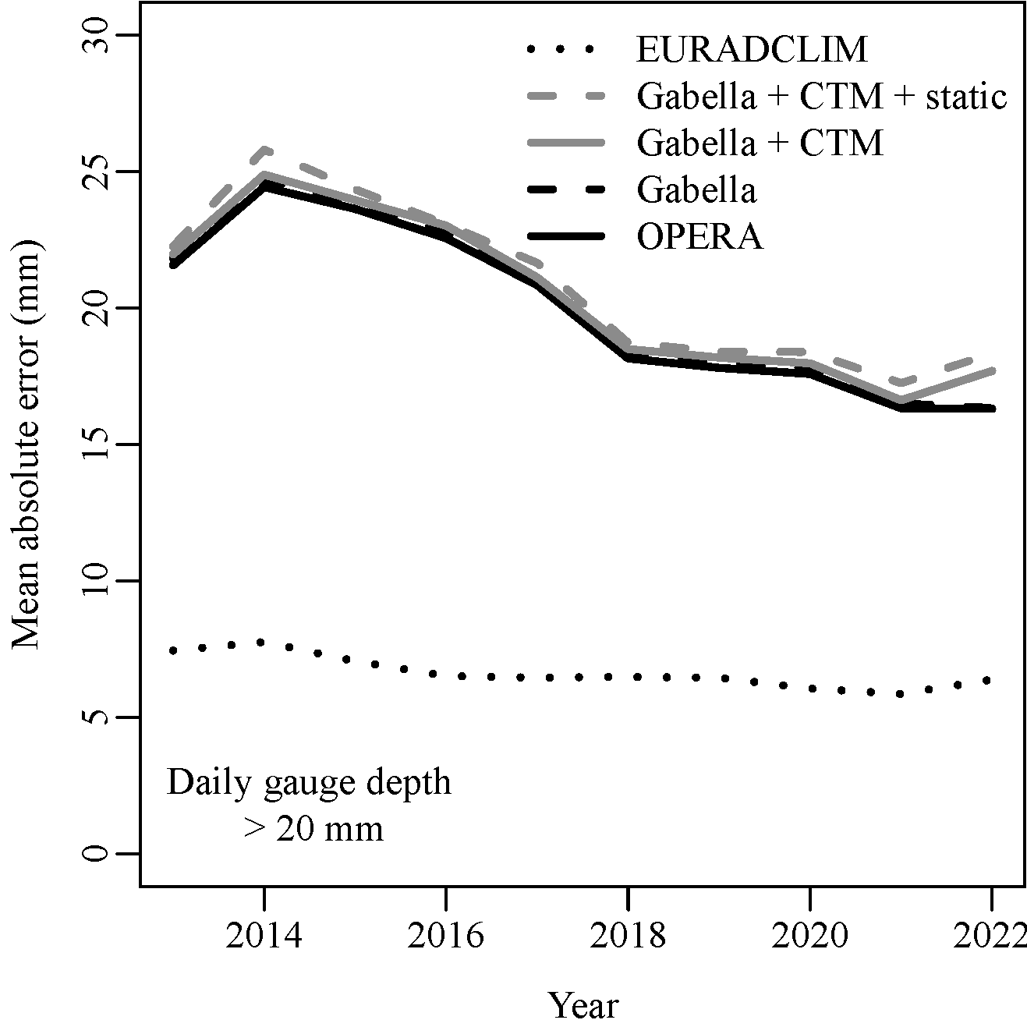
Performance OPERA 2013-2022
OPERA clearly improves in time w.r.t. 7000+ ECA&D gauges (ind. verification).
Performance of EURADCLIM v2 relatively stable over the years (but dep. verification)

Slide 20
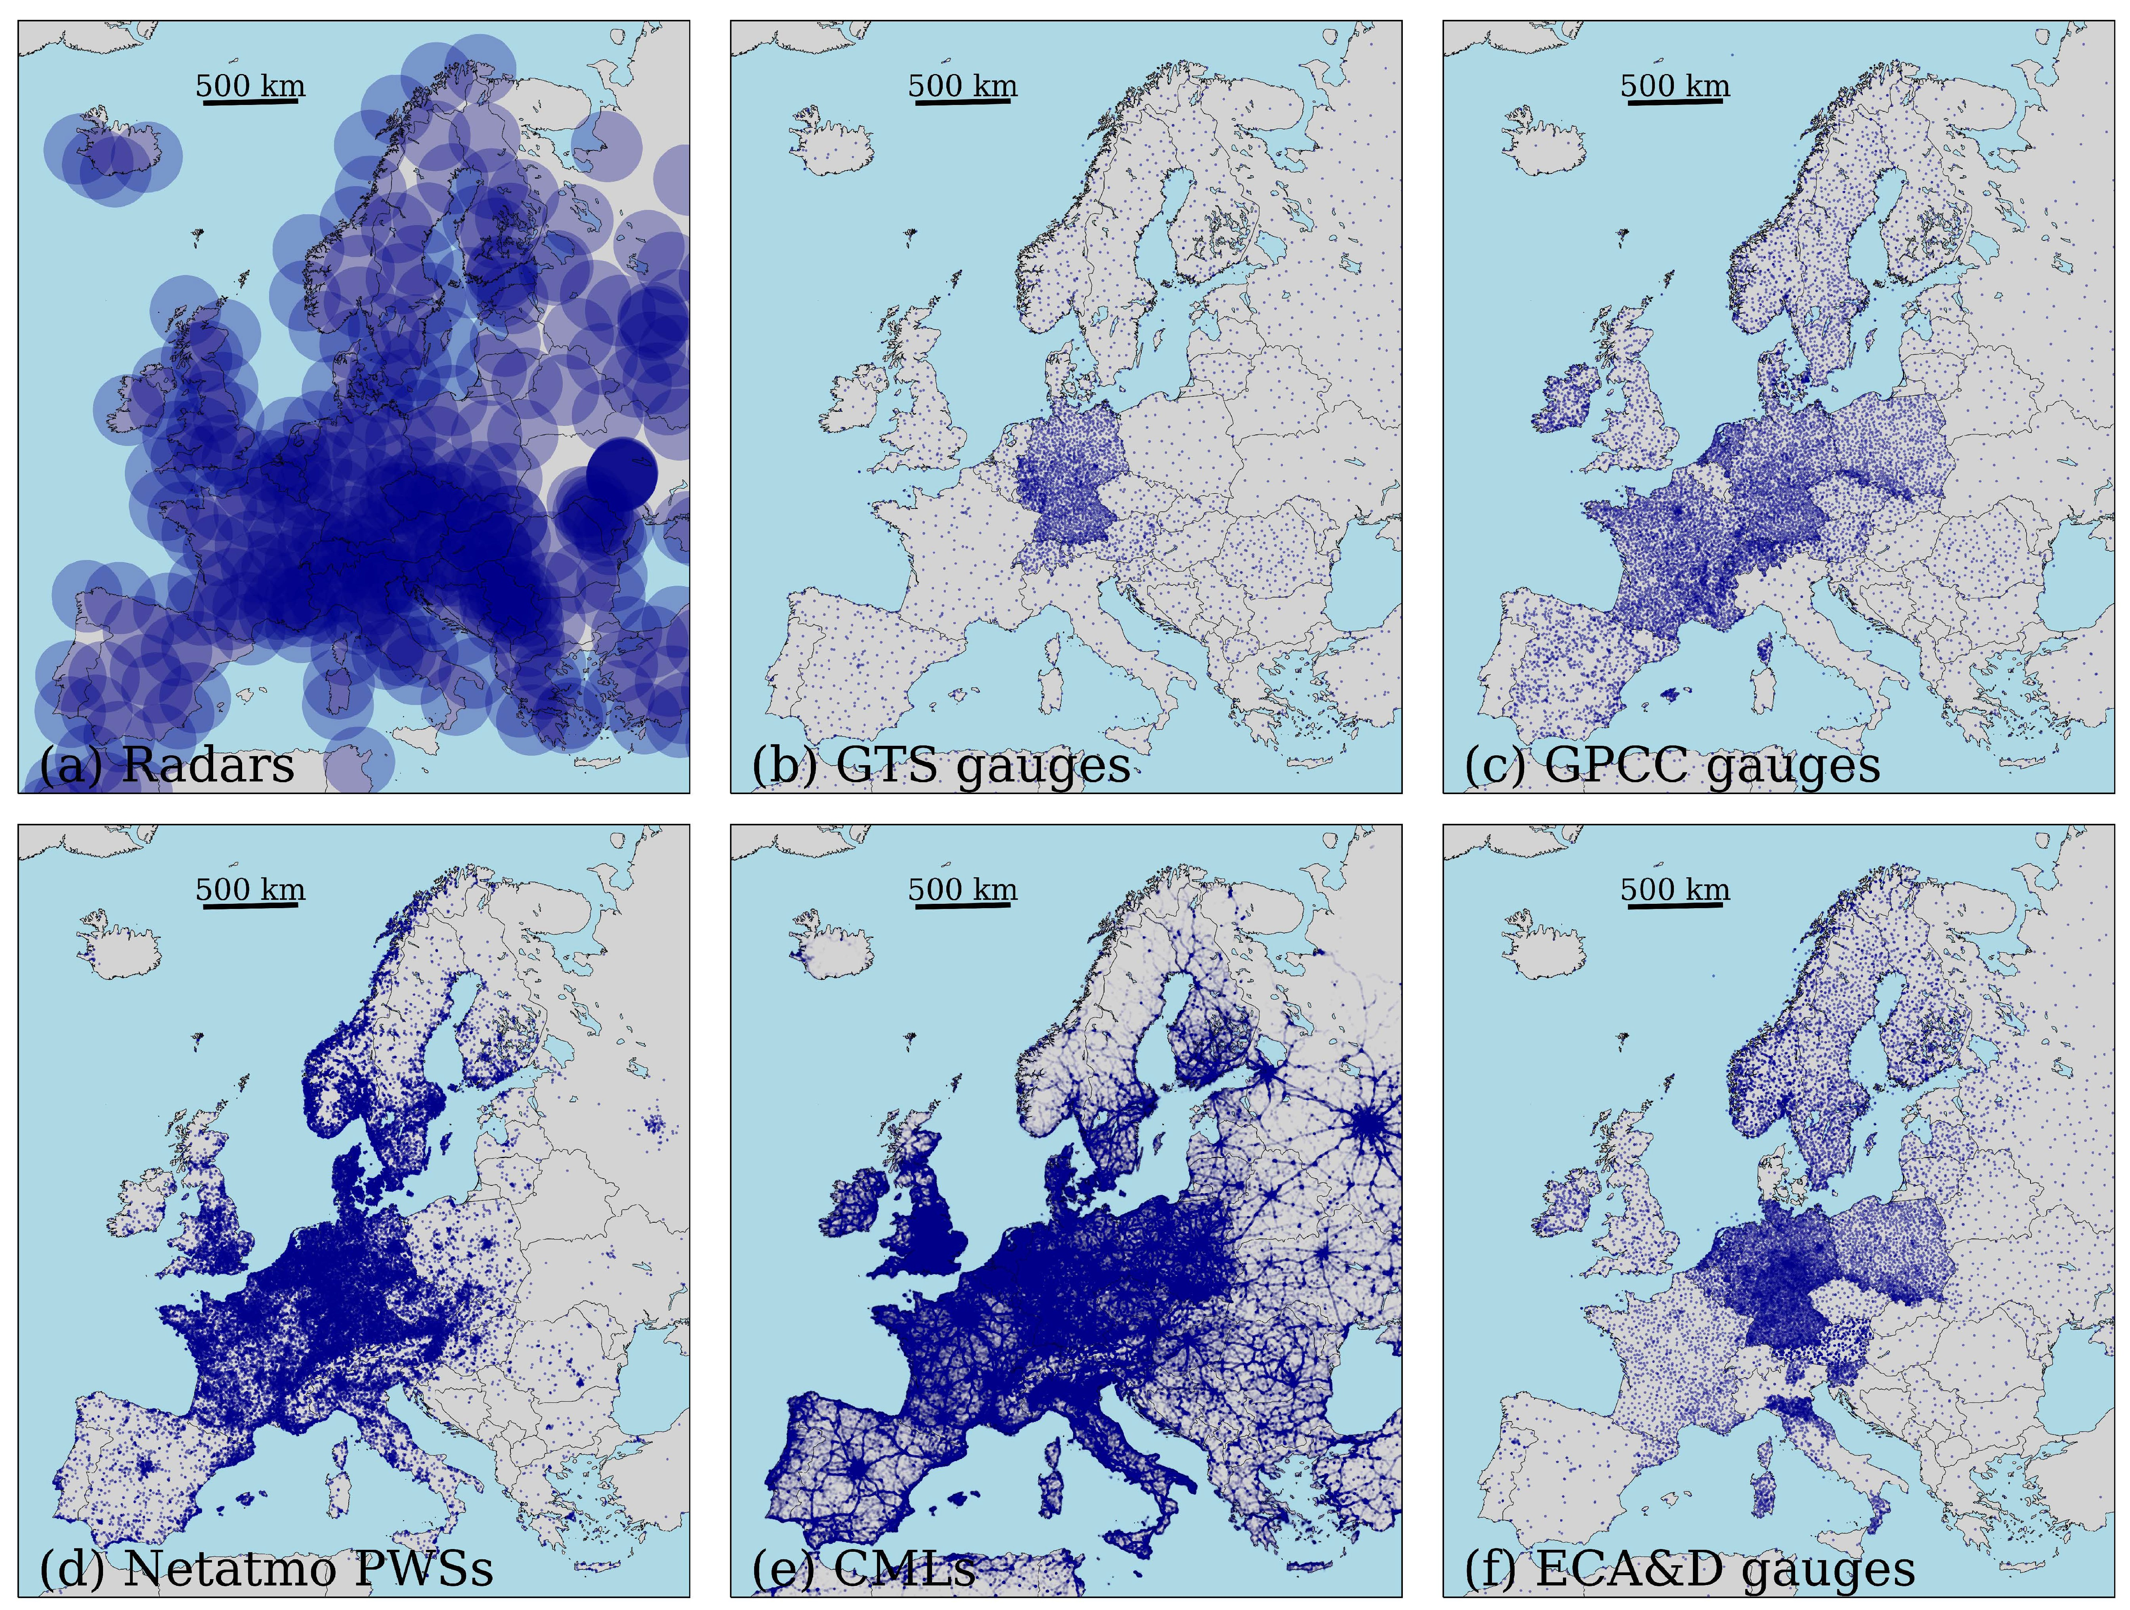
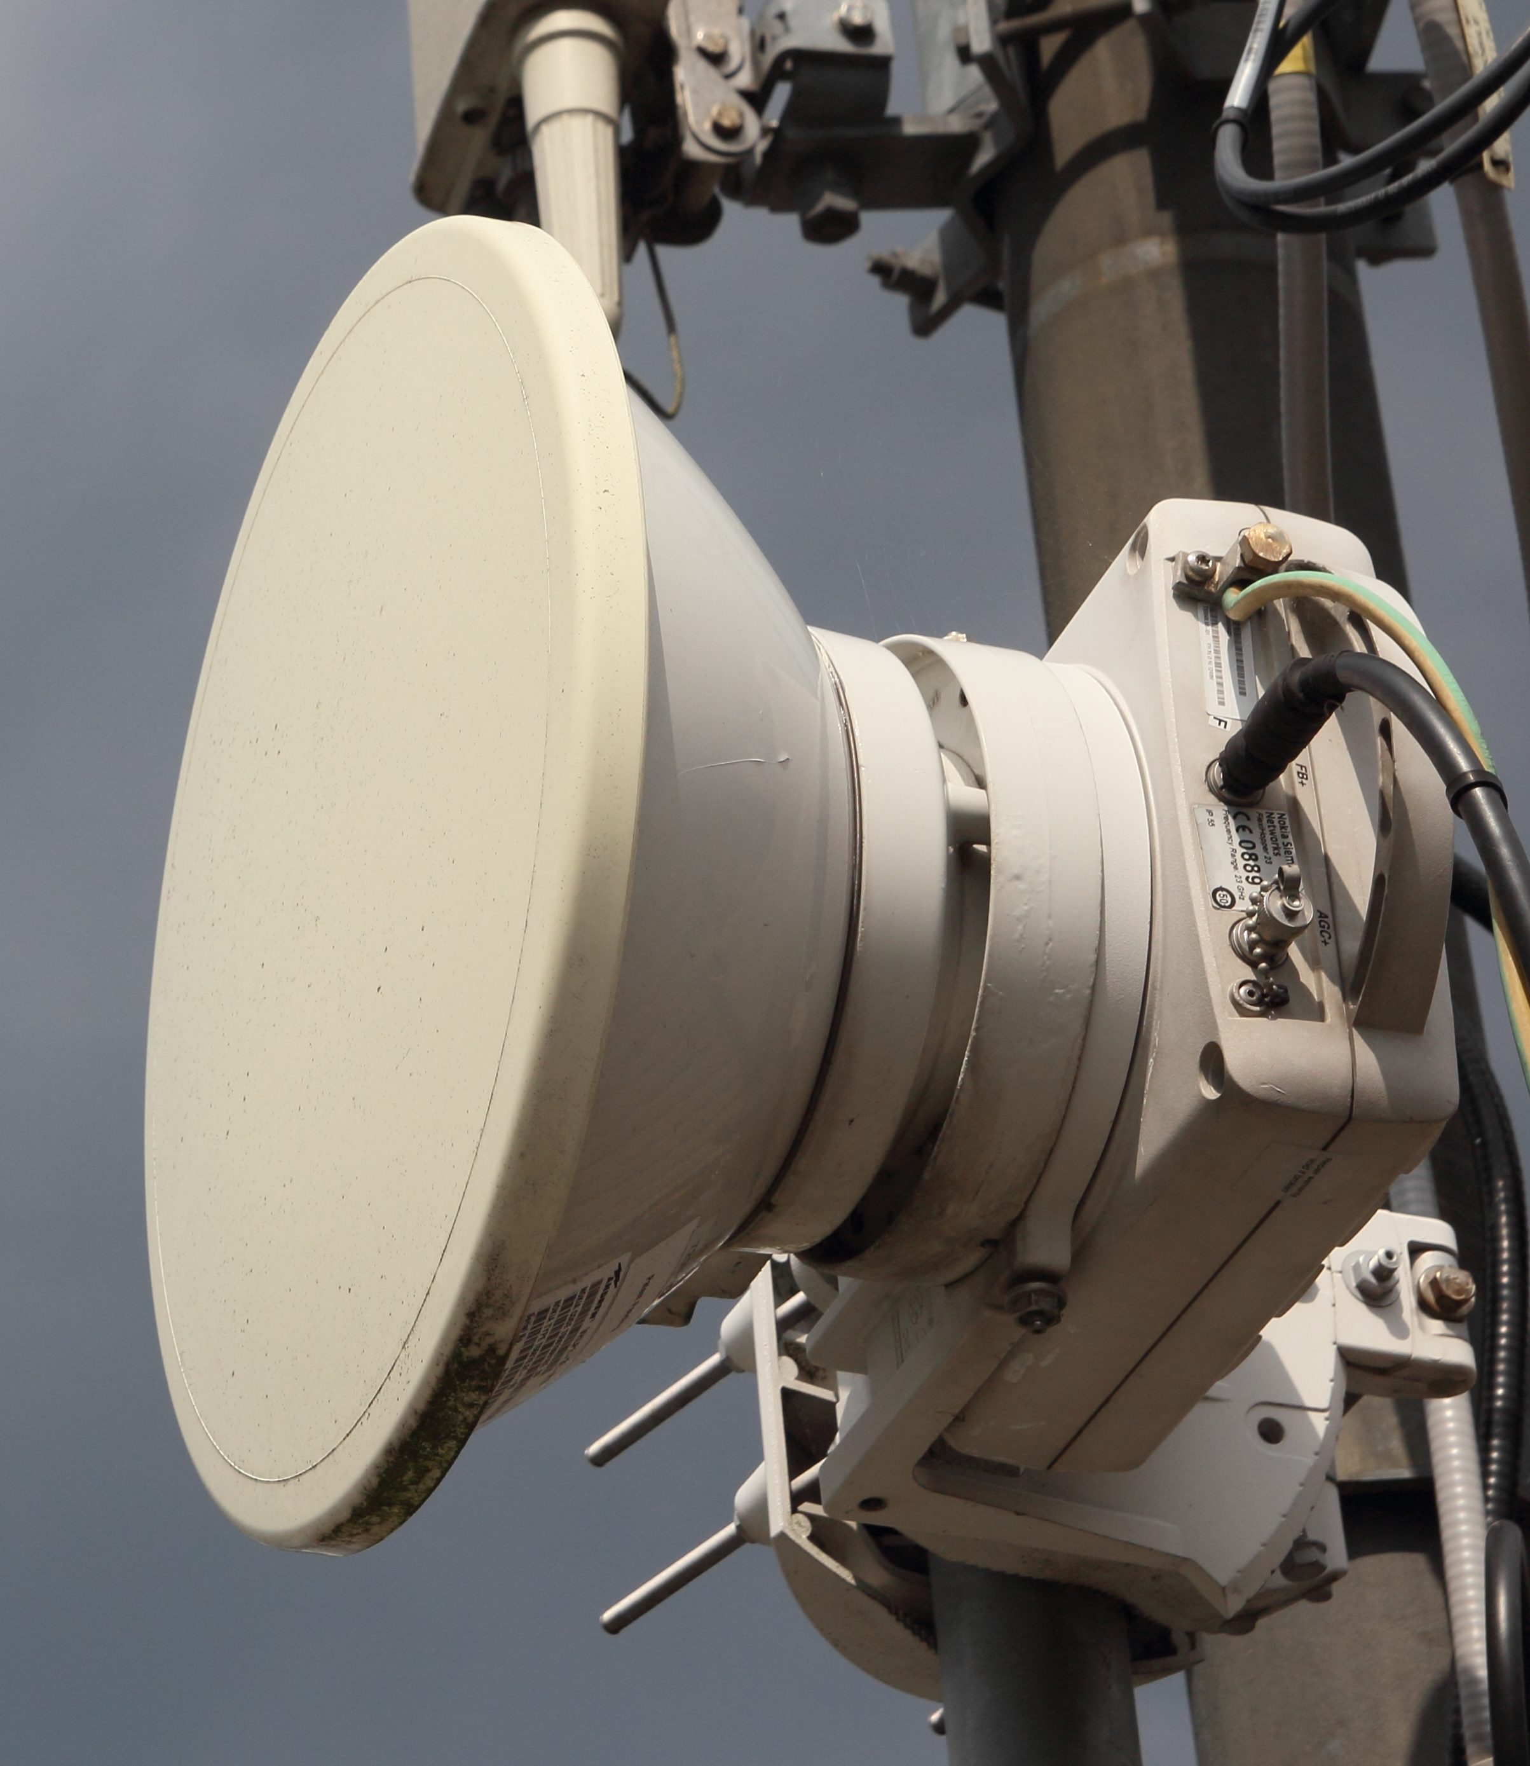
Coverage (opportunistic) precipitation sensors
Taken from: https://doi.org/10.1049/SBRA557H_ch2
identim/Shutterstock
(Saltikoff et al., 2019)
Commercial microwave links (CMLs)
https://opensenseaction.eu/
Personal weather stations (PWSs)
GTS/GPCC locations: Thanks to Peter Finger, Udo Schneider and Andreas Becker (DWD).
https://opencellid.org

