Slide 1
Applications of opportunistic rainfall observations: a review
JONAS OLSSON
Swedish Meteorological and Hydrological Institute

Slide 2

Contributors
Laura Horváth-Varga, Budapest University of Technology and Economics, Hungary
Remco van de Beek, Swedish Meteorological and Hydrological Institute, Sweden
Maximilian Graf, German Weather Service, Germany
Aart Overeem, Royal Netherlands Meteorological Institute, The Netherlands
Magdalena Szaton, Institute of Meteorology and Water Management, Poland
Vojtěch Bareš, Czech Technical University, Czech Republic
Nejc Bezak, University of Ljubljana, Slovenia
Christian Chwala, Karlsruhe Institute of Technology, Germany
Carlo De Michele, Politecnico di Milano, Italy
Martin Fencl, Czech Technical University, Czech Republic
Jochen Seidel, University of Stuttgart, Germany
Andrijana Todorović, University of Belgrade, Serbia

Slide 3
Background and motivation
Rainfall observations – high-resolution – are crucial for a multitude of reasons and purposes within e.g. hydro-meteorology and climatology.
National/official observation networks are resource-demanding and generally have an insufficient resolution.
Observations by Opportunistic Sensors (OS) may be complementary:
  Commercial Microwave Links (CML)
  Personal Weather Stations (PWS)
  Satellite Microwave Links (SML)
Many proof-of-concept type of studies have been published, demonstrating potential.
But, how close are OS rainfall to practical application and societal benefit?

Slide 4
Main questions
What is the scientific support for practical applications of OS rainfall data, e.g. in an operational setting?
How technically ready are different countries with respect to operational implementation of OS rainfall data?
What challenges remain and how can these be solved?

Slide 5
Question 1: method
What is the scientific support for
practical applications of OS rainfall data?
Literature review of scientific papers:
distinctly application-oriented
peer-reviewed
using real rainfall observations
Types of applications:
Rainfall mapping
  Single type of opportunistic sensor
  Merged opportunistic and conventional sensors
Subsequent application
  Rainfall nowcasting
  Hydrological prediction

Slide 6
Question 1: results
What is the scientific support for
practical applications of OS rainfall data?
CML:
  Rainfall mapping: 25-30
  Subsequent applications: ~15
PWS:
  Rainfall mapping: 10-15
  Subsequent applications: 3-5
SML:
  Rainfall mapping: ~3
  Subsequent applications: few (any?)

Slide 7
Question 2: method
How technically ready are countries
with respect to operational implementation?
Questionnaire distributed within the OpenSense community.
Examples of contents:
What types of OS data as well as merged products are available?
Are they used (pre-)operationally for e.g. nowcasting or hydrological prediction?
What is the self-assessed Technology Readiness Level (TRL)? (TRL1-9 was transformed in Readiness for Routine Operation (RRO) 1-3)

Slide 8
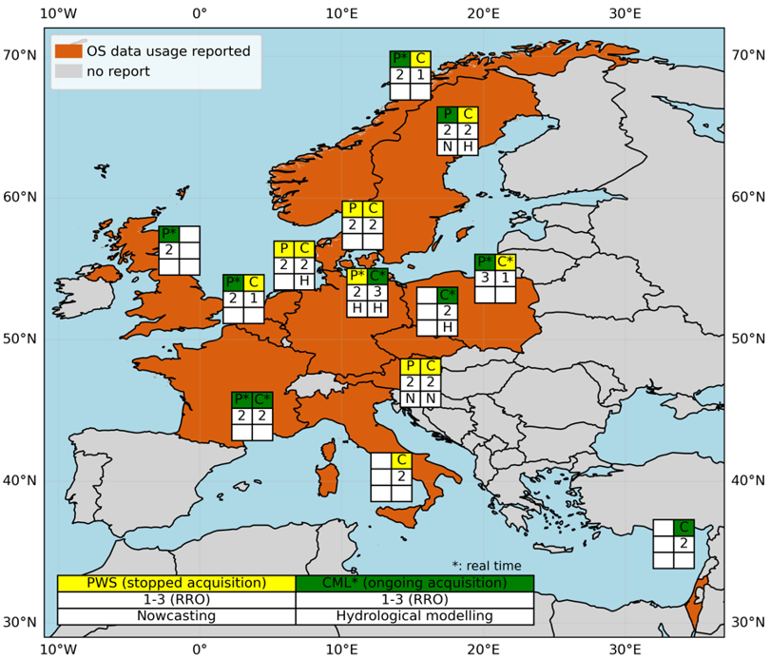
Question 2: results
How technically ready are countries
with respect to operational implementation?
CML, PWS: see map
SML: explored in e.g. Italy and France

Slide 9
Question 3
What challenges remain and
how can these be solved?
Some key challenges and potential solutions:
CML acquisition is complicated by e.g. the dependency upon commercial and non-meteorological actors. Development of tailored business models, the Global Microwave Link Data Collection Initiative (GMDI).
Application of OS rainfall data requires Quality Control/Quality Assurance on another level, as compared with conventional observations. Further development of (accurate and fast) QC/QA protocols, use the useful signals in observations from different sensors, apply Machine Learning.
OS rainfall data sets are often relatively short and from dynamically evolving networks, which complicates e.g. hydrological model calibration. Utilize the generally high temporal resolution, develop clever methods to reach spatial consistency, let time pass…

Slide 10
Short summary
Support for applications of OS rainfall:
  rainfall mapping: quite strong (many studies)
  subsequent applications: quite limited (fewer studies)
Operational status of OS rainfall:
  RRO=2 in many countries
  RRO=3 for CML in DE and PWS in PL
Challenges include CML acquisition, QC/QA and short/dynamic data sets
Paper under revision in J. Hydrometeorology
THANK YOU FOR LISTENING!

