Slide 1
AI in hydrometeorological applications
From rainfall nowcasting to climate modelling
Li-Pen Wang (lpwang@ntu.edu.tw)
Department of Civil Engineering, National Taiwan University
International Conference on Opportunistic Sensing of Precipitation
2025/06/25-26

Slide 2






Li-Pen Wang
PhD in Civil & Env. Engineering, Imperial College London (2008-2012)
MSc in Computer Aided Engineering, National Taiwan University (2003-2005)
BSc in Civil Engineering, National Taiwan University (1999-2003)
Education
Assistant Professor, National Taiwan University (2020/02-now)
Expert Consultant, IMF (2024-now), UK Met Office (2022-now)
Postdoctoral Researcher, Imperial College London, KU Leuven
Head of CAT unit, Microinsurance Catastrophe Risk Organisation
Founder/Director/Hydrometeorologist, Rain++ Ltd.
Professional
Experience
Research Areas
Hydrometeorology
Remote Sensing
Computational Statistics

Slide 3
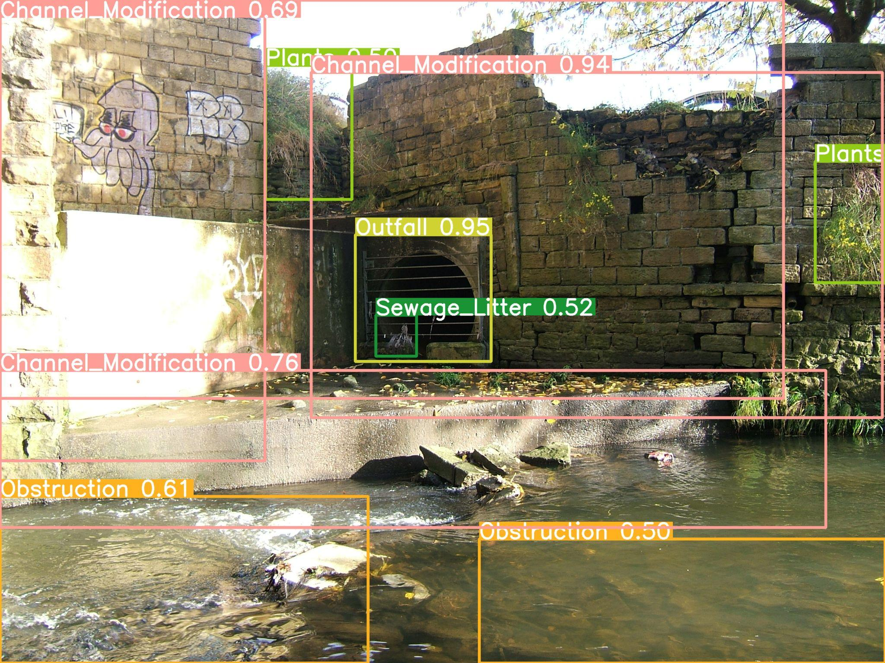
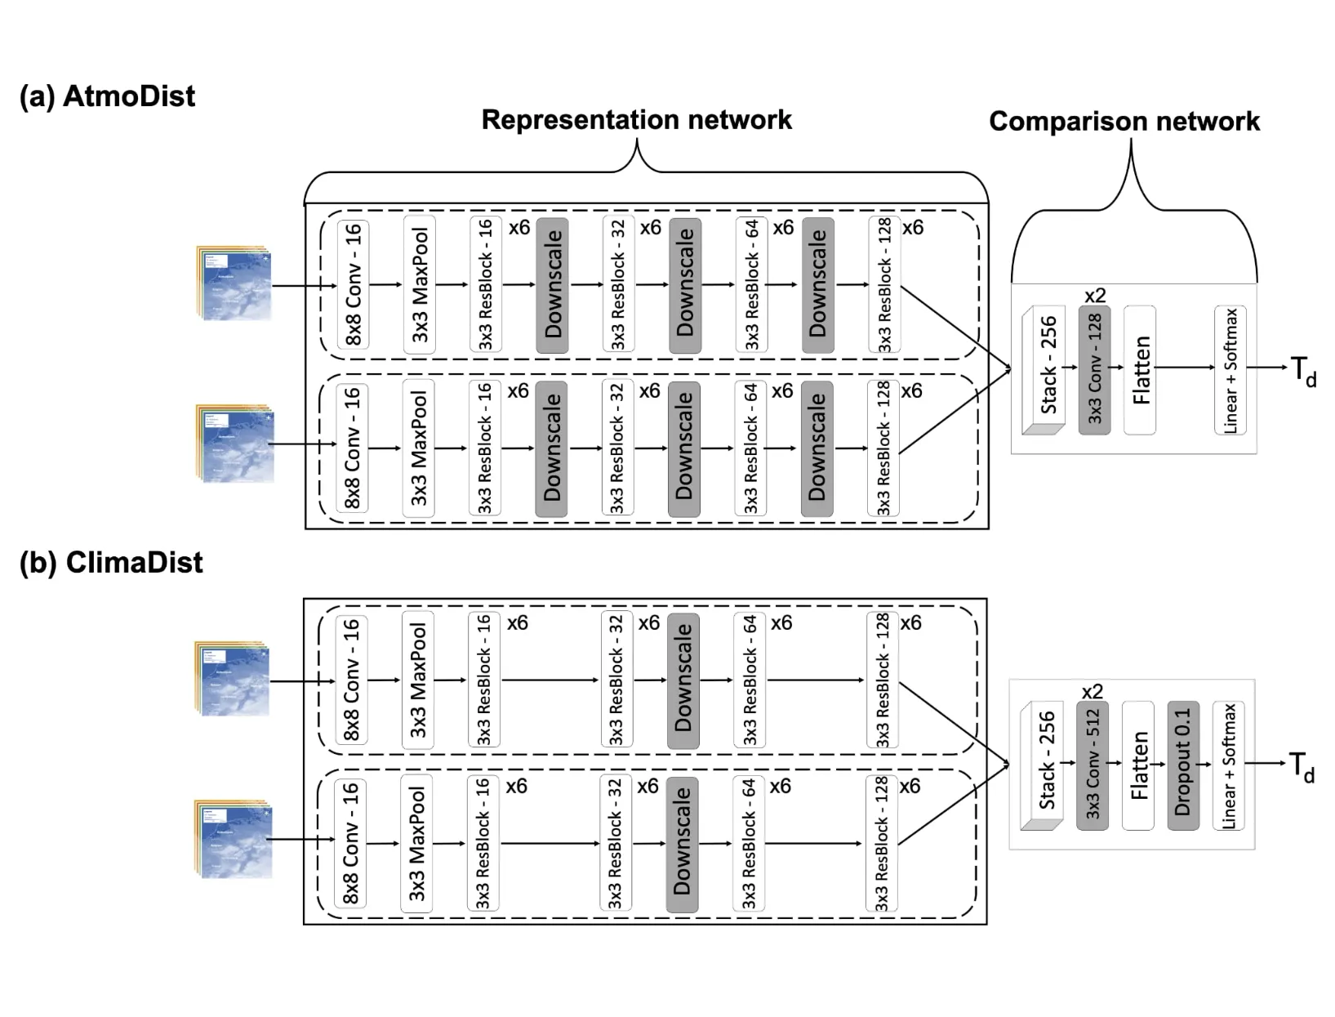
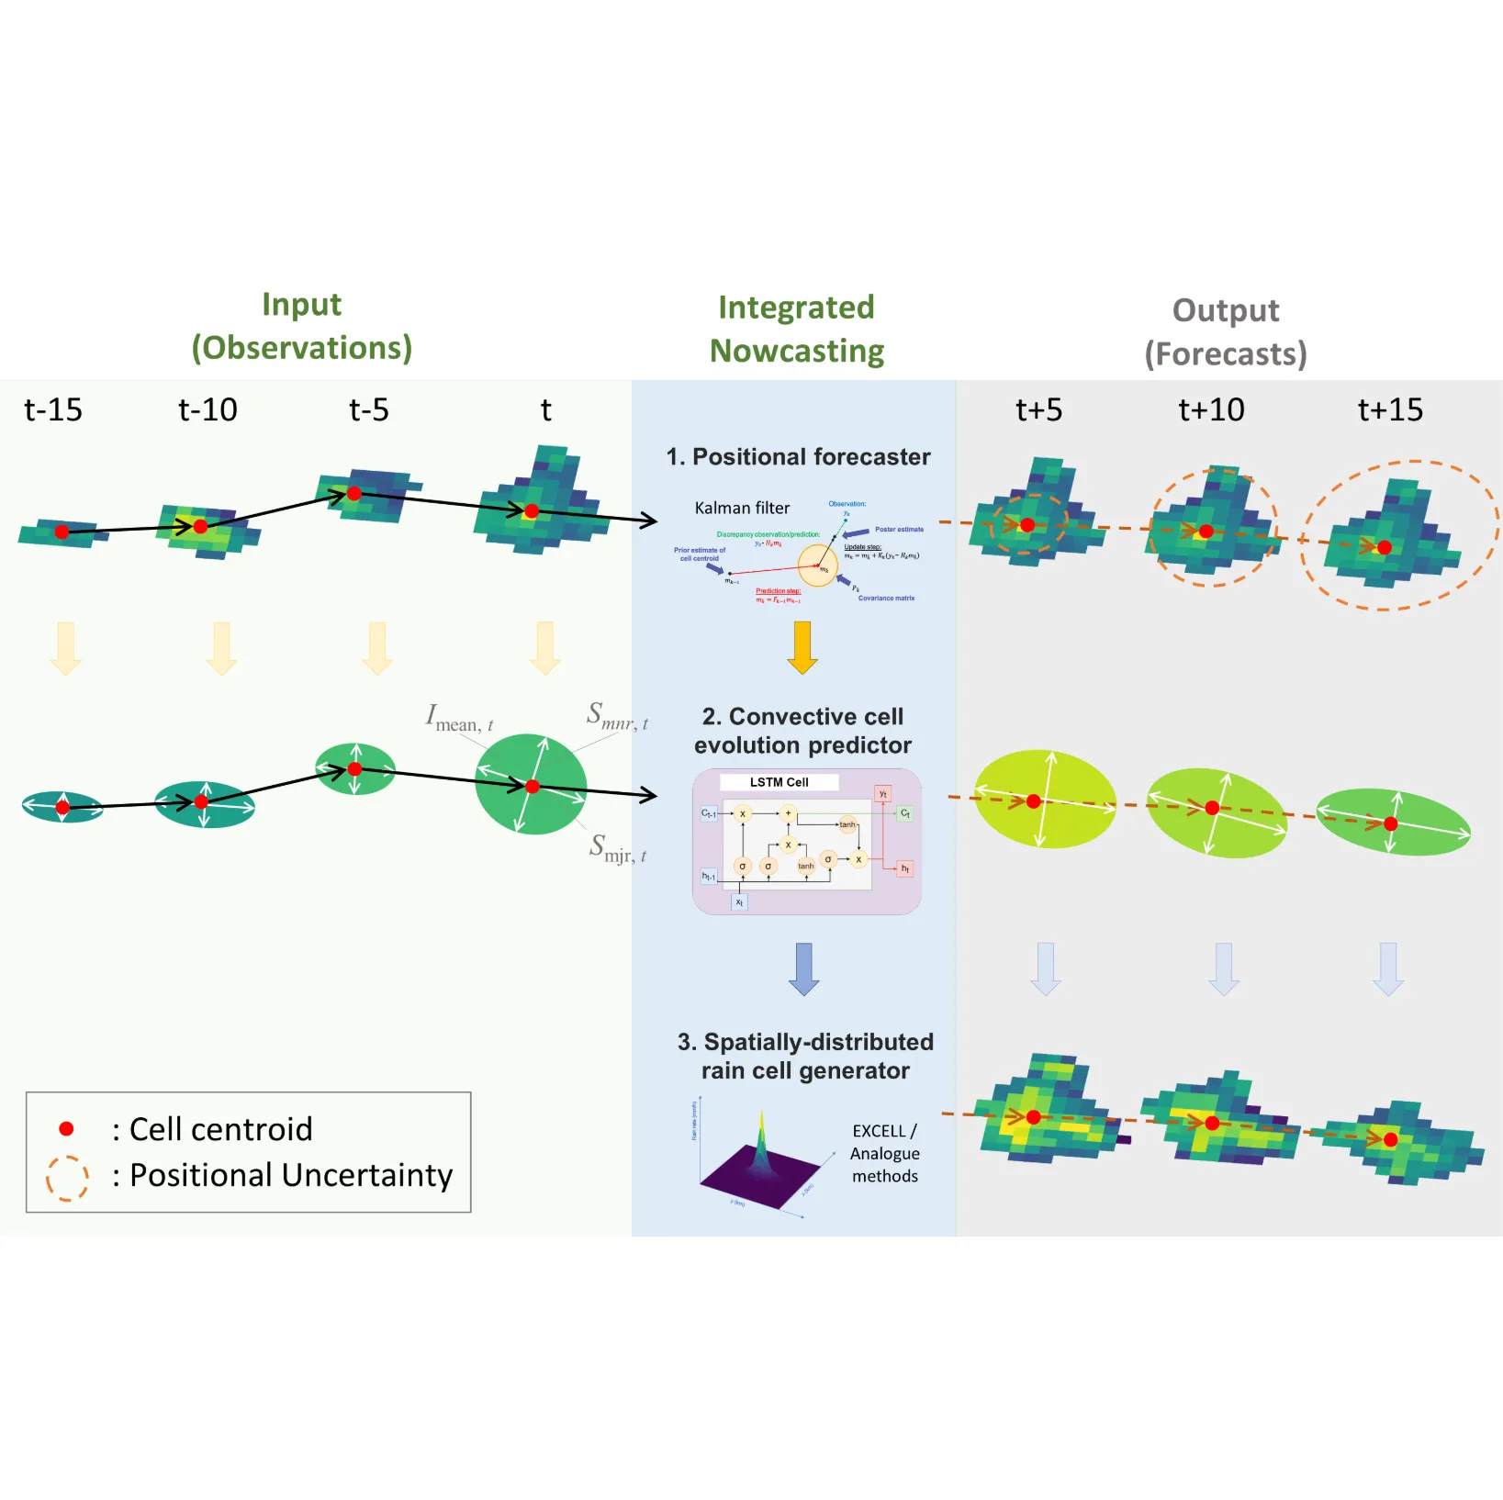
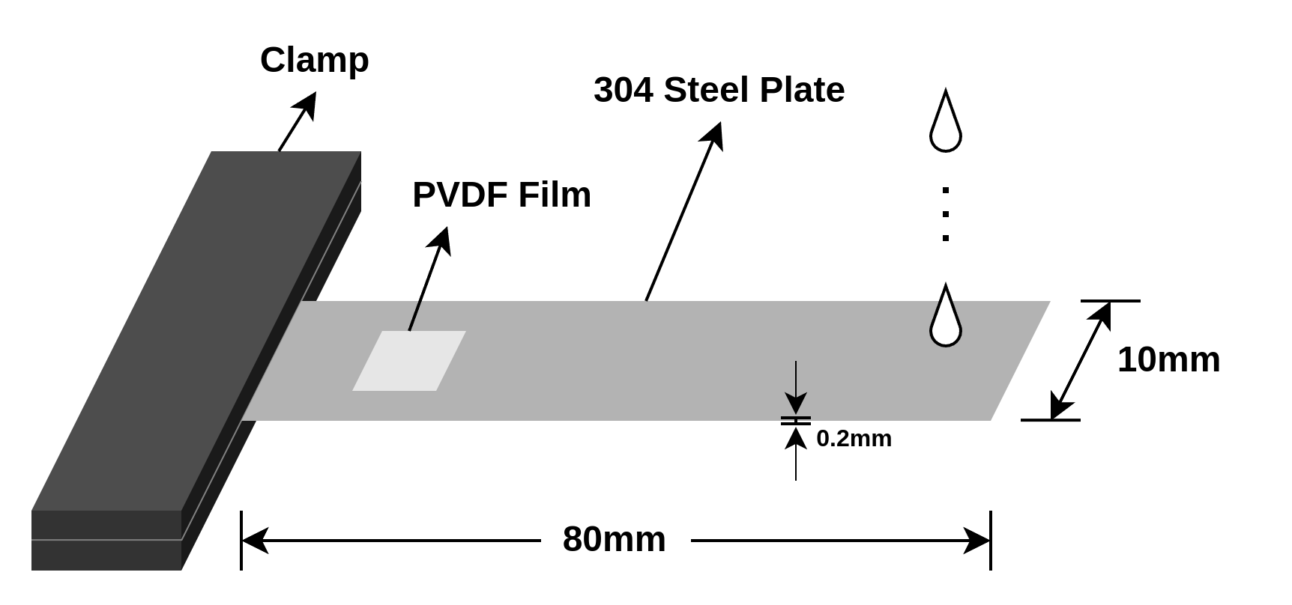
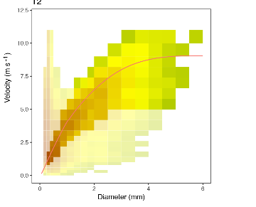
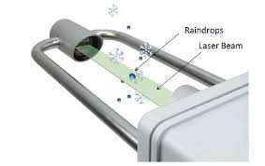


Computational Hydrometeorology Lab
Unconventional environmental modelling
Modelling climate change impacts to rainfall at local scales
Modelling and nowcasting of convective storms
Learn more about
CompHydroMetLab!
Visit our
Github
Current lab members: 4 PhD students, 7 MSc students, 6 BSc students, and 1 research assistant.
Unconventional
environmental
monitoring solutions
Convective storm
nowcasting & modelling
Incorporating impact of
climate changes to
local rainfall modelling

Slide 4
Contents
It is NOT new to apply AI to nowcasting, but what is AI actually good at?
Can we teach AI to say ‘I don’t know’?
AI’s power of learning spatial and temporal features

Slide 5
Nowcasting
It is NOT new to apply AI to nowcasting, but what is AI actually good at?

Slide 6



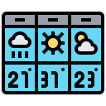



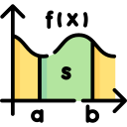


Radar-based nowcasting is effective and affordable
Numerical weather prediction (NWP)
Radar-based nowcasting
Forecast quality
Extrapolation
Mesoscale NWP
Synoptic NWP
physical variables
mathematical models
based on physical constaints
long-term
forecasts
6hr
12hr
18hr
Forecast
lead time
Target lead time of nowcasting
2~3 hours
For short forecast lead time, radar-based nowcasting methods are still more ‘cost’ effective than NWP.
radar rainfall images
extrapolation
from previous images
short-term
forecasts

Slide 7
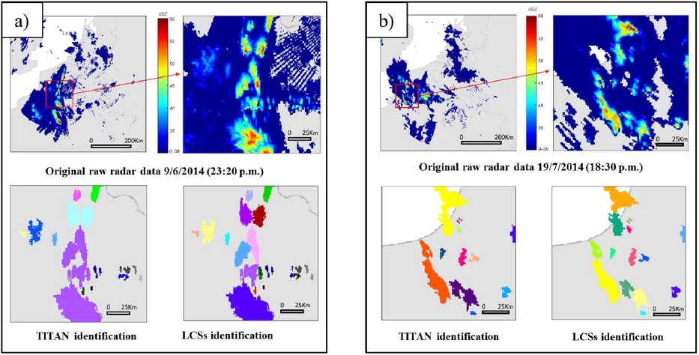
Object-based nowcasting
Object-based nowcasting
  Extrapolates the movement of identified rainfall cells
TITAN
  Most widely-used basis model
  Storm identification
  Temporal association of rainfall objects between successive time steps
  Widely used for thunderstorm nowcasting

Slide 8
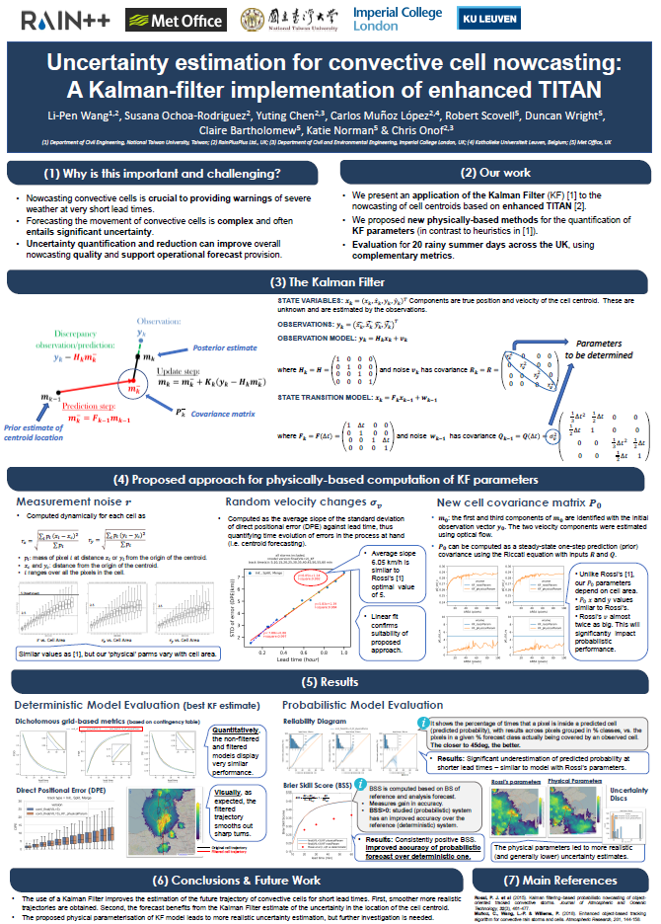
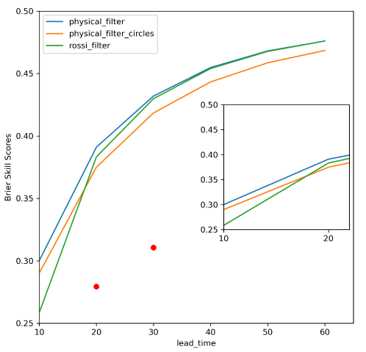
A joint effort to develop an object-based probabilistic convective storm nowcasting system
A positional forecasting system based on Enhanced TITAN + Kalman filter, based on Rossi et al (2016)
Physical-based computation of Kalman filter parameters
More informative ensemble forecasts can be obtained at short lead time

Slide 9
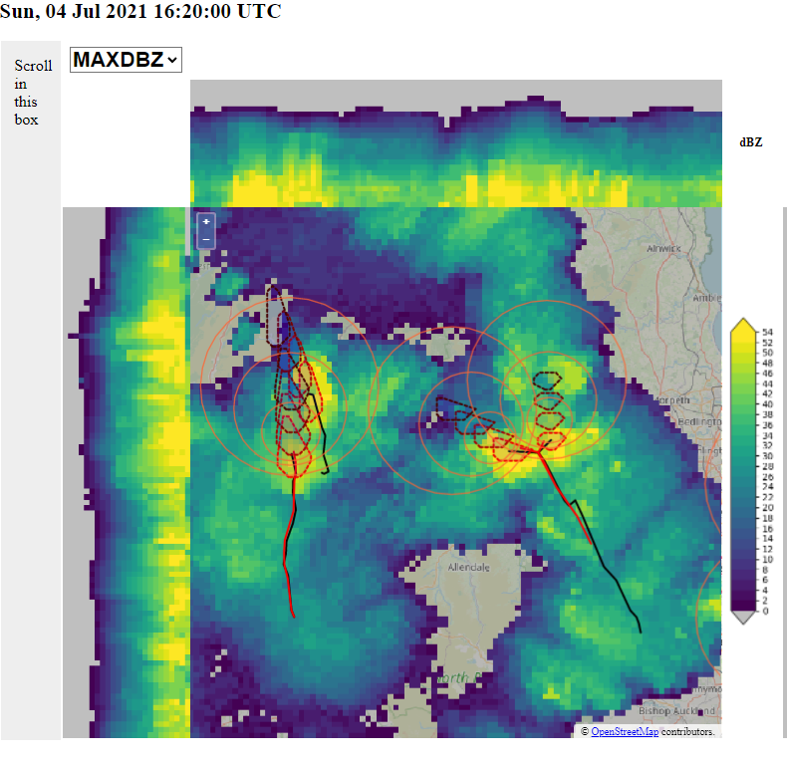
Advection is taken care of, but what about rain cell evolution?

Slide 10
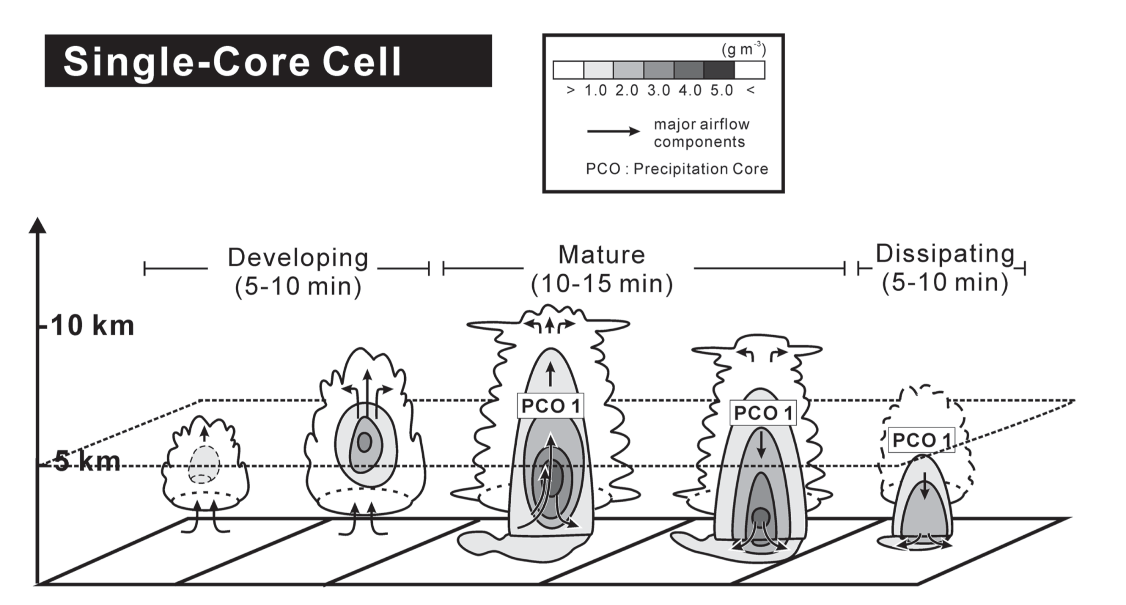
The mechanism of single-core cell evolution has been studied, but has not been incorporated into object-based nowcasting

Slide 11
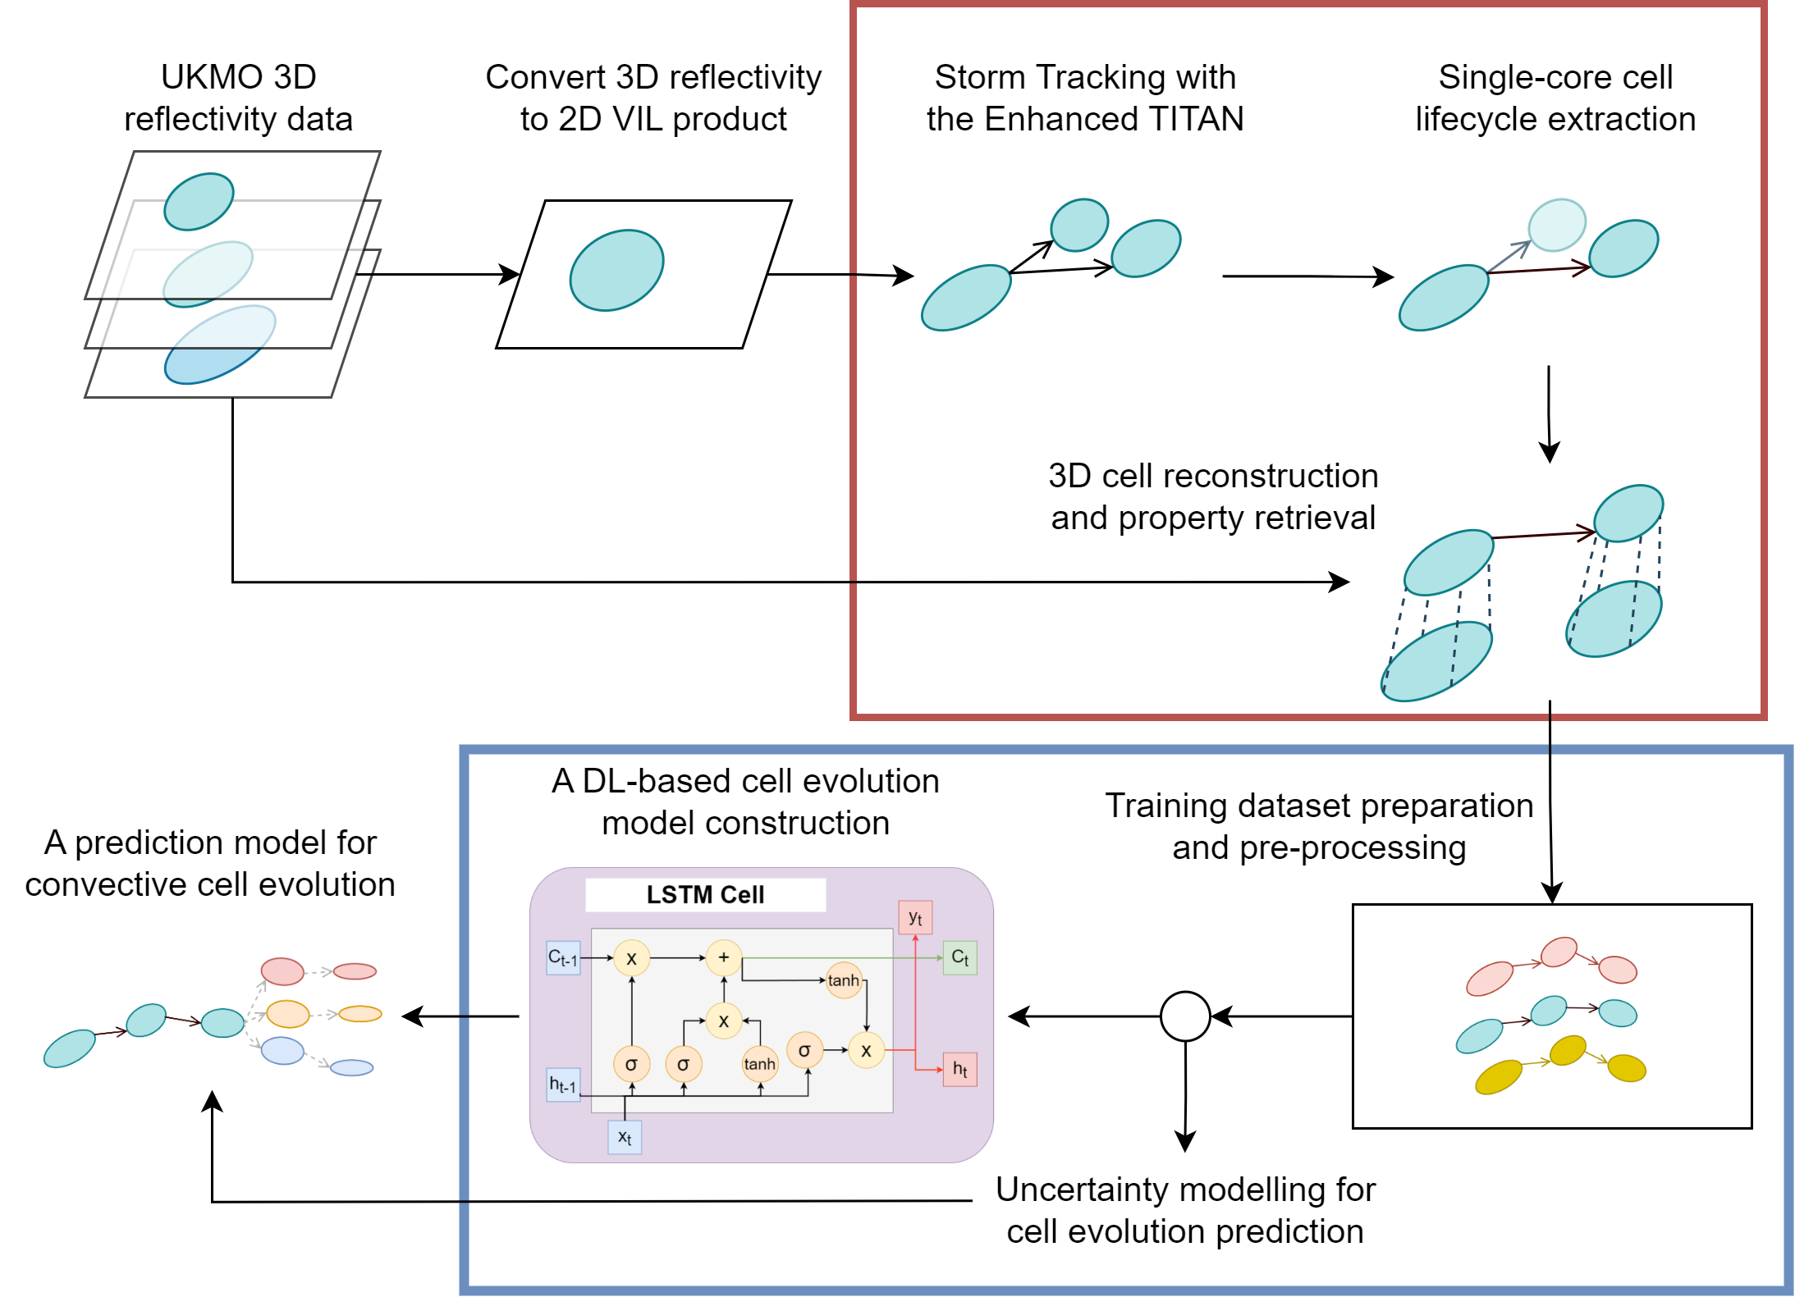
Our method
Reconstruct single-core rain cell lifespans (in 3D)
Train, test and validate DL-based cell evolution prediction model
Model prediction errors

Slide 12
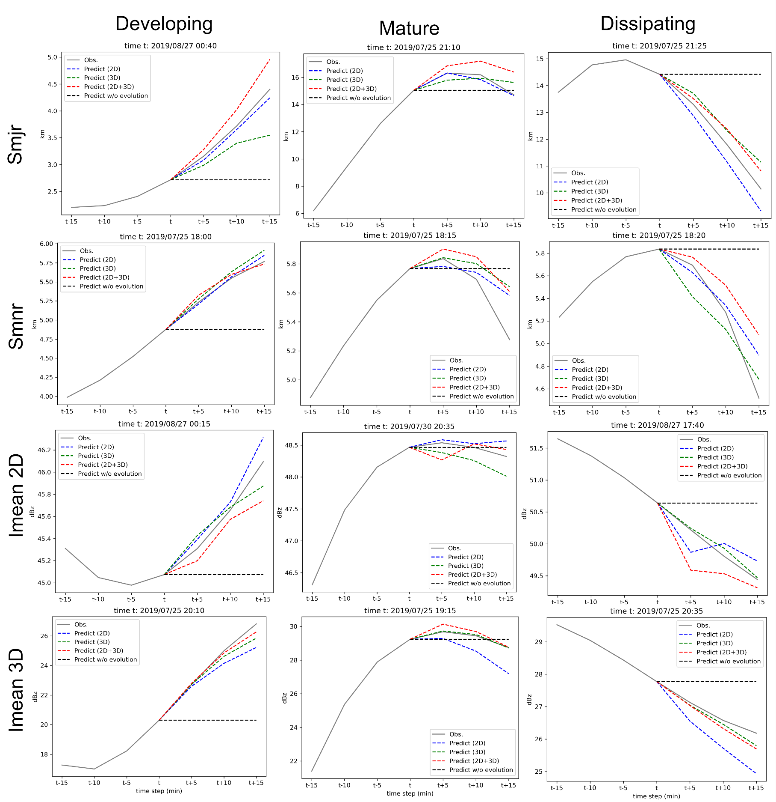
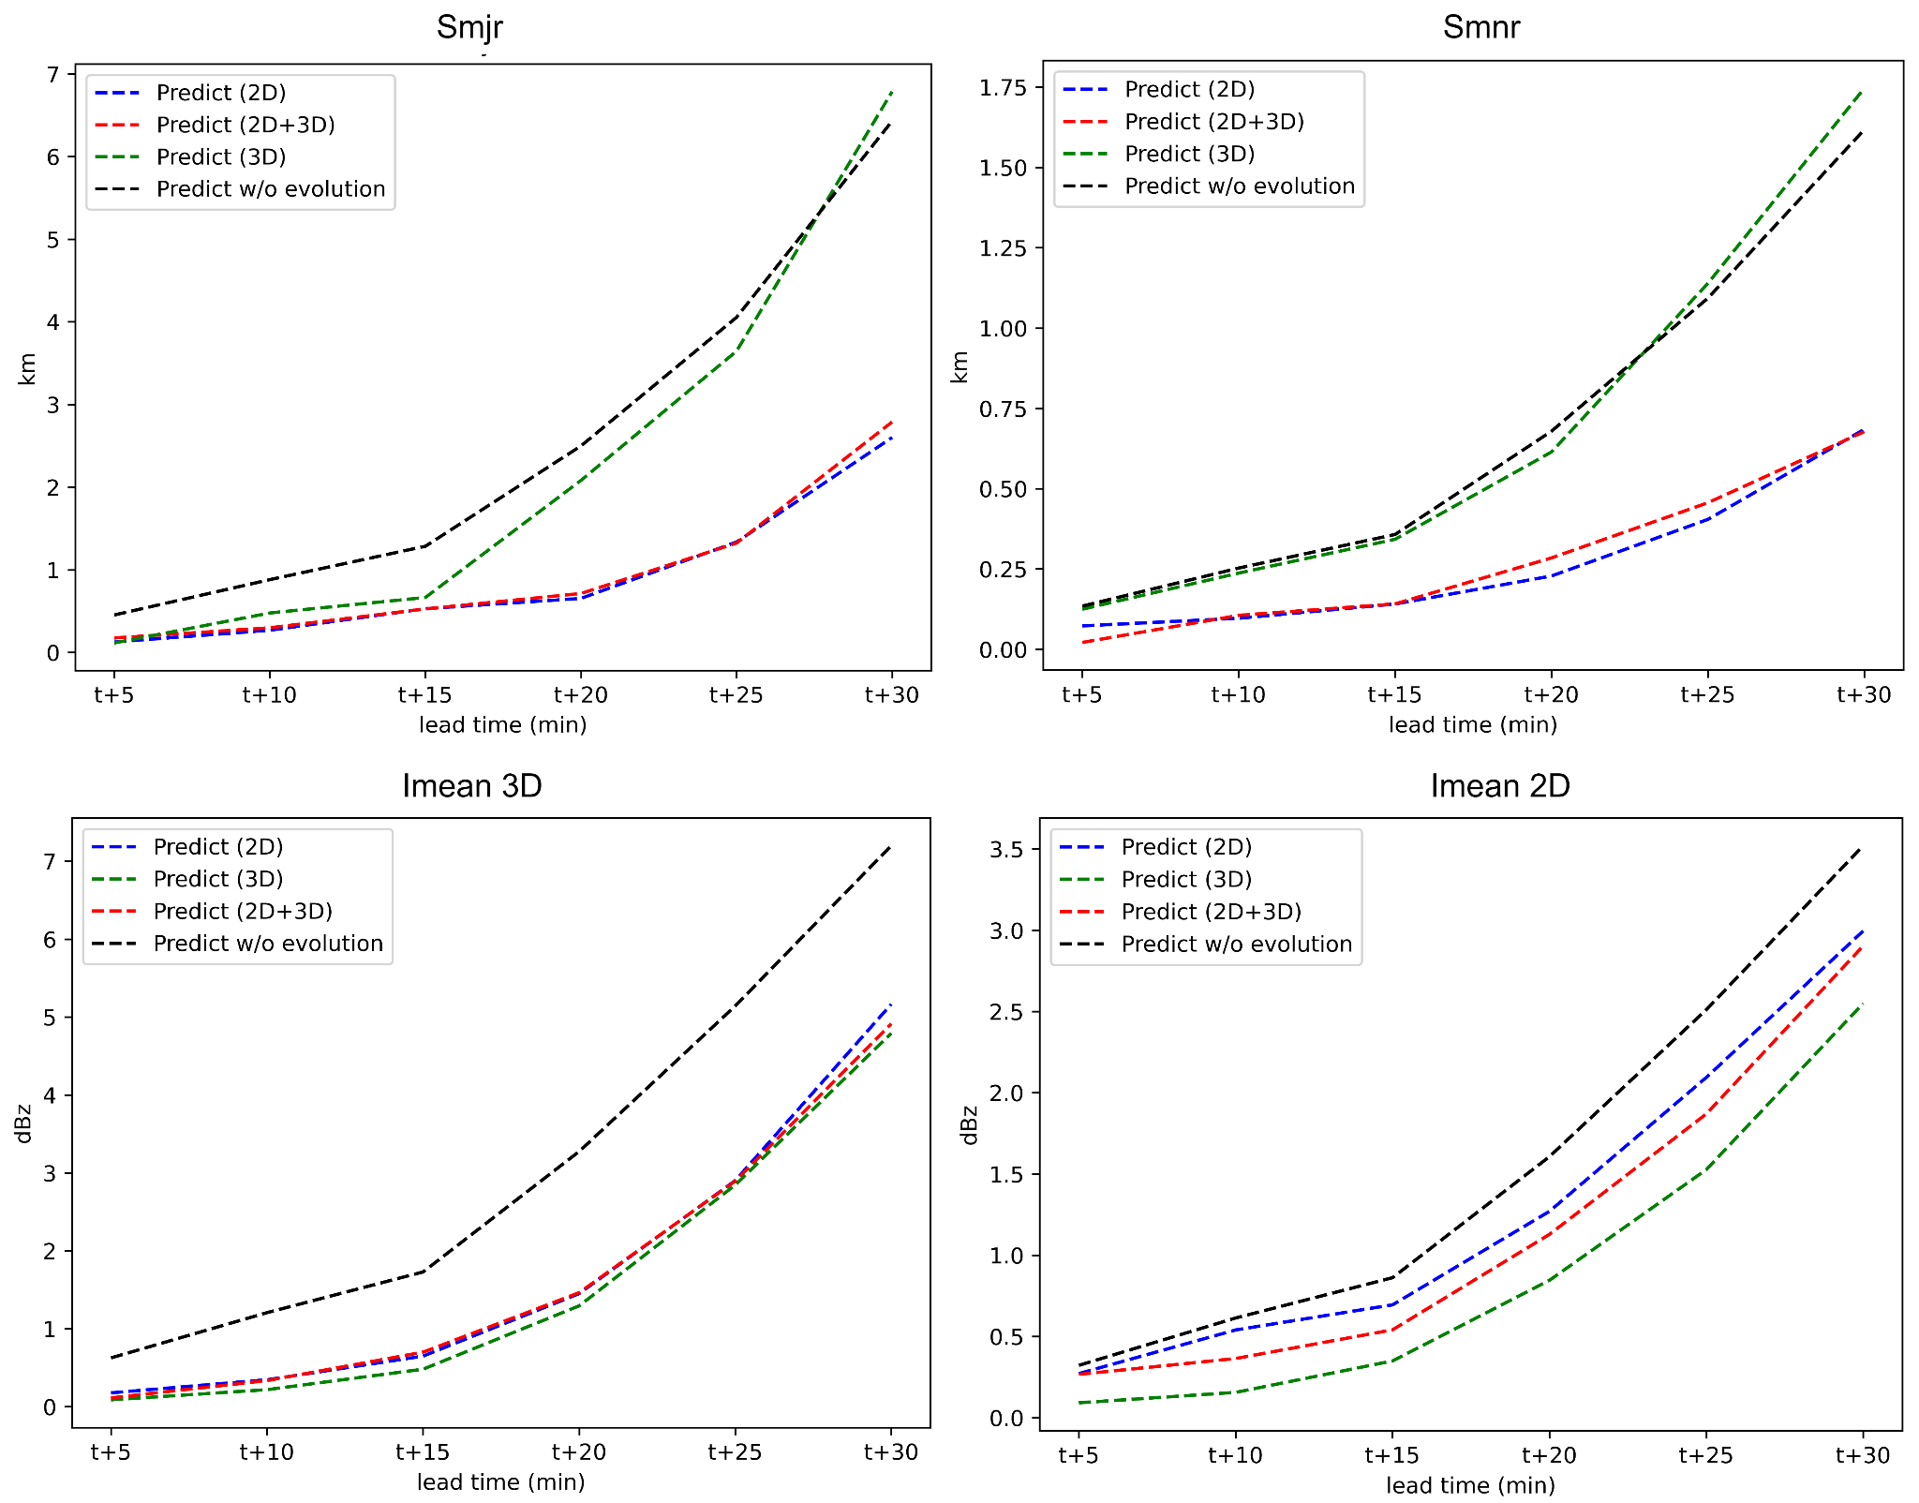
A single LSTM model can well predict the evolution of rain cell properties at different life stages.
Nowcasting intensity error (MAE) can be reduced by 50% at 15-min lead time.

Slide 13
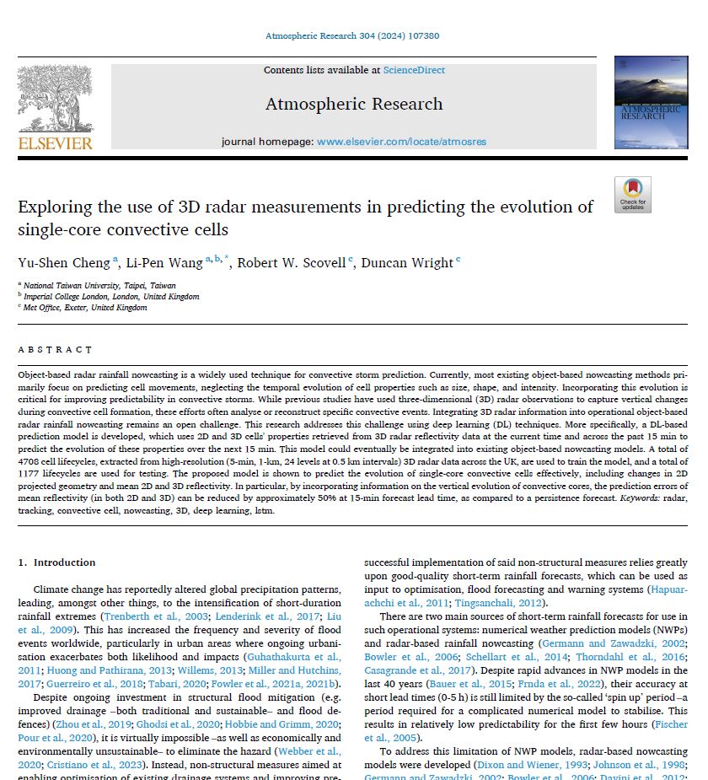
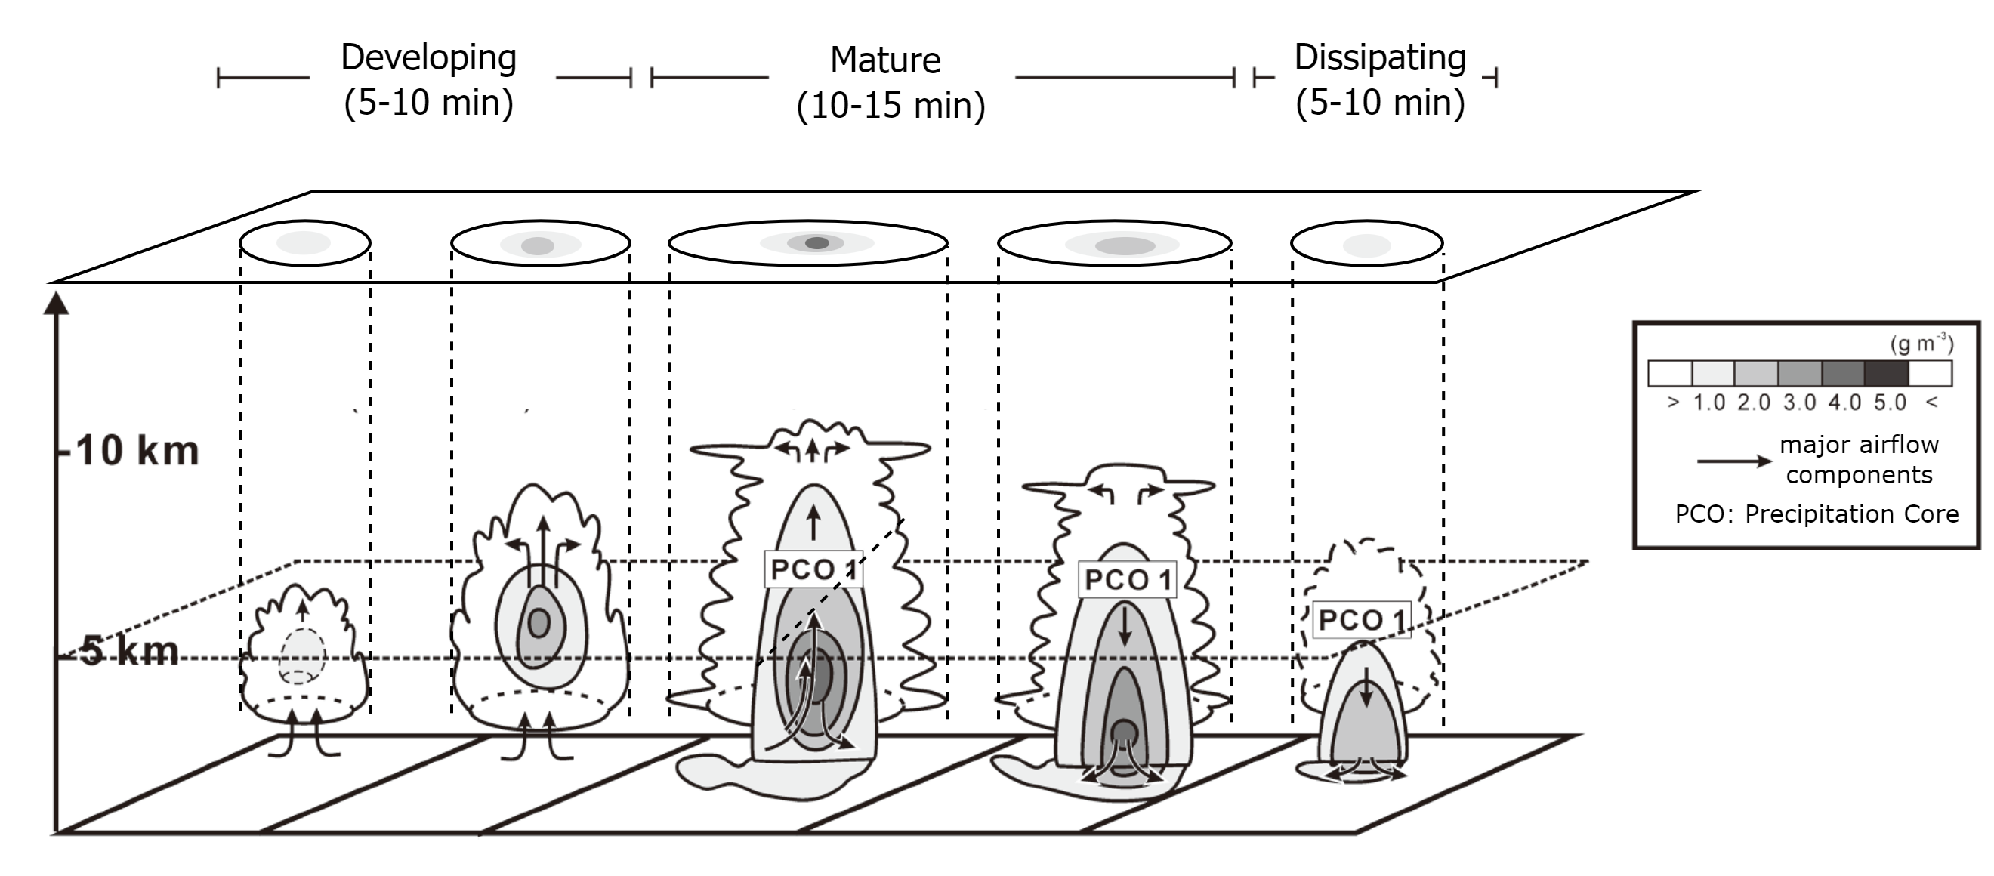

A deep-learning based model to predict convective cell lifecycles
The altitude of convective cores found to be a good indicator of the underlying cell life stages
Adopted from Kim et al., 2012
doi:10.1016/j.atmosres.2024.107380

Slide 14
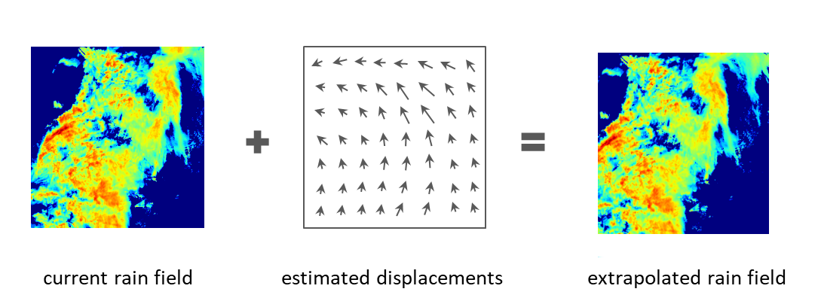
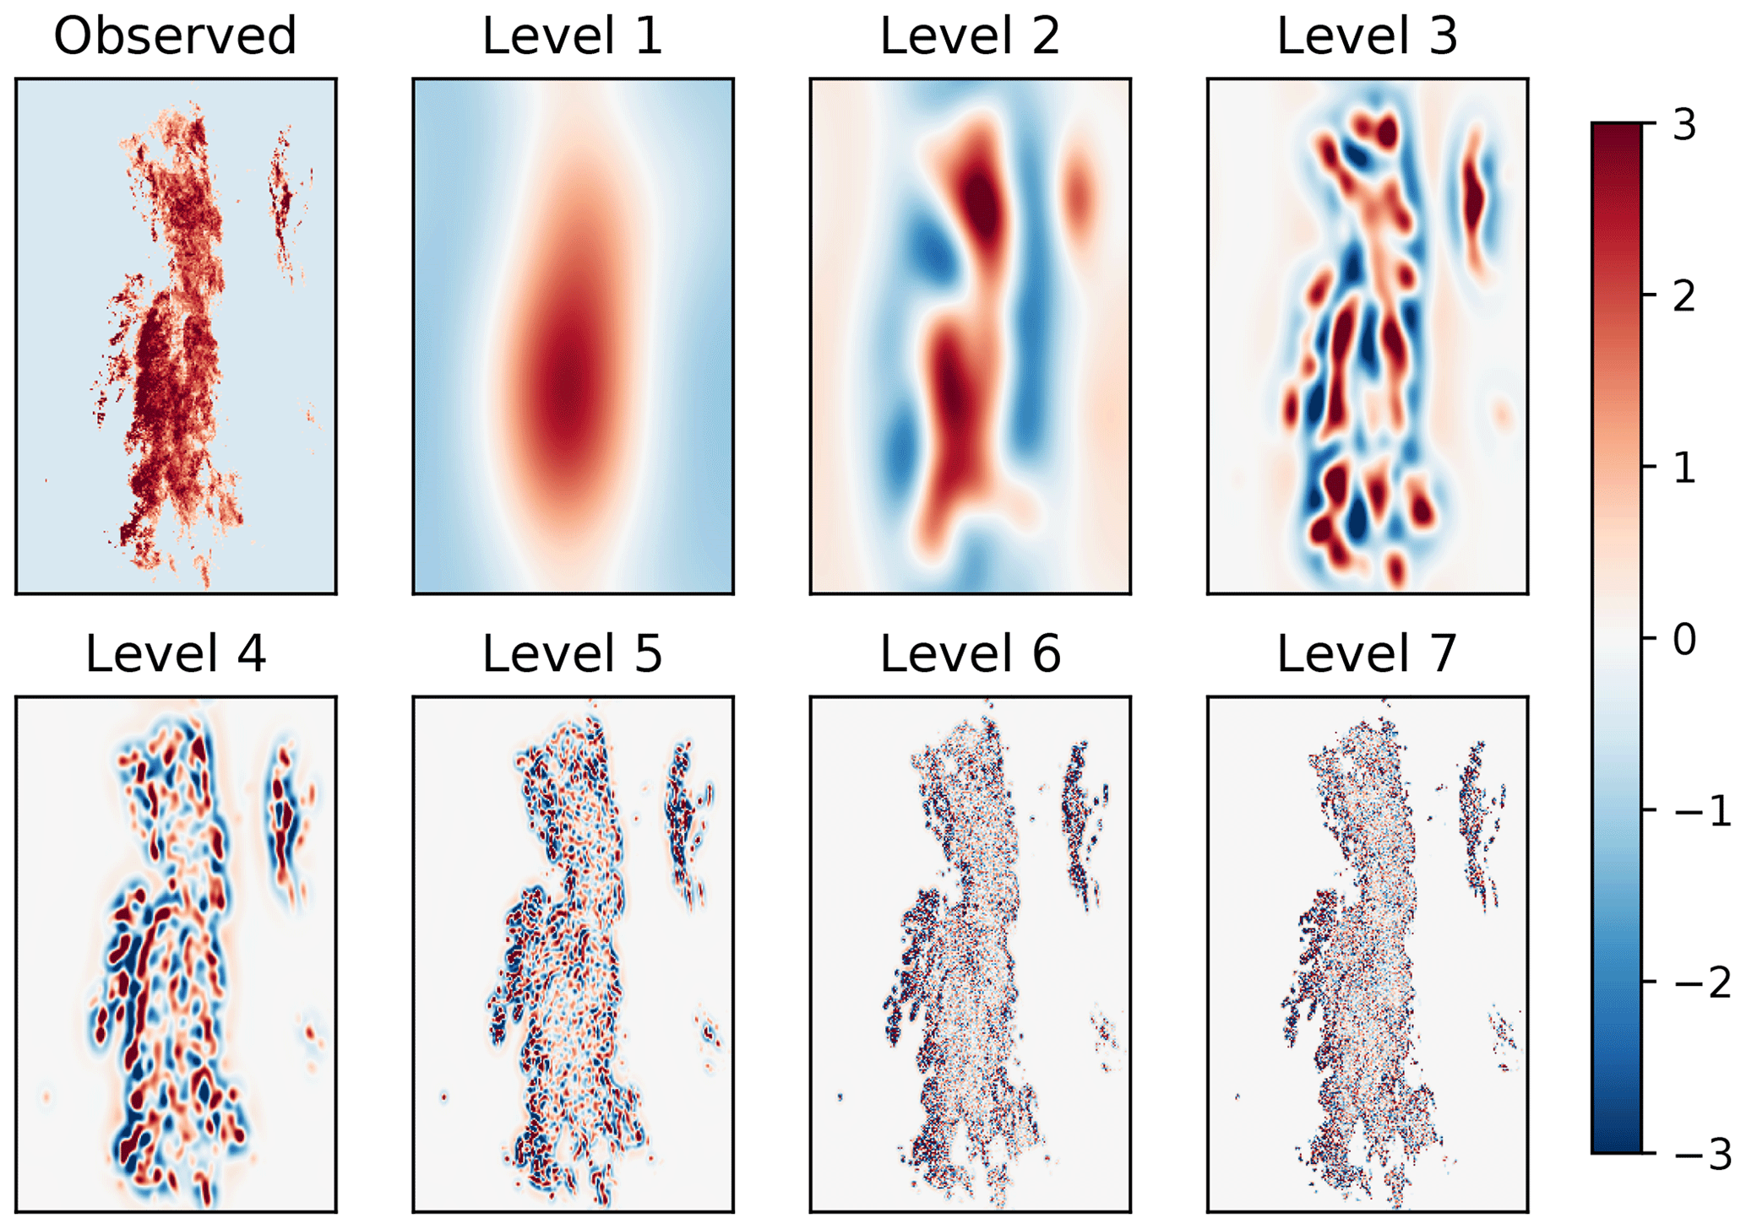
Field-based nowcasting
Advection nowcasting
  Extrapolates current radar rainfall fields into future frames using estimated displacements
STEPS
  State-of-the-art nowcasting model
  Optical flow is employed for displacement estimation
  Probabilistic nowcasting model
  The spatial-temporal scaling relationship is explicitly modelled.
https://pysteps.github.io/

Slide 15
Challenges in modelling spatial-temporal rainfall process
Variations in rainfall = Advection + Evolution (in time)
The variations in spatial and temporal features of rainfall are NOT independent from each other
Preserving consistency across scales

Slide 16
Category of recent AI-based nowcasting methods
Explicit separation of advection and evolution prediction (TrajGRU, NowcastNet)
Focusing on spatial-temporal feature extraction (DGMR, MetNet)

Slide 17
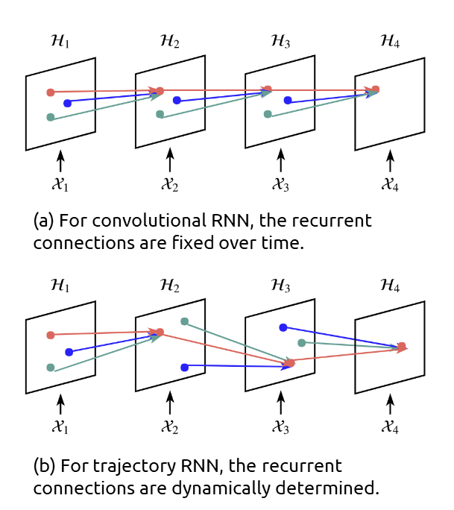
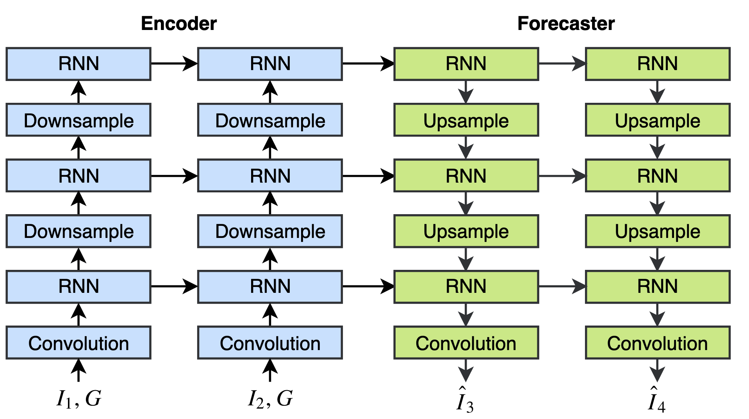
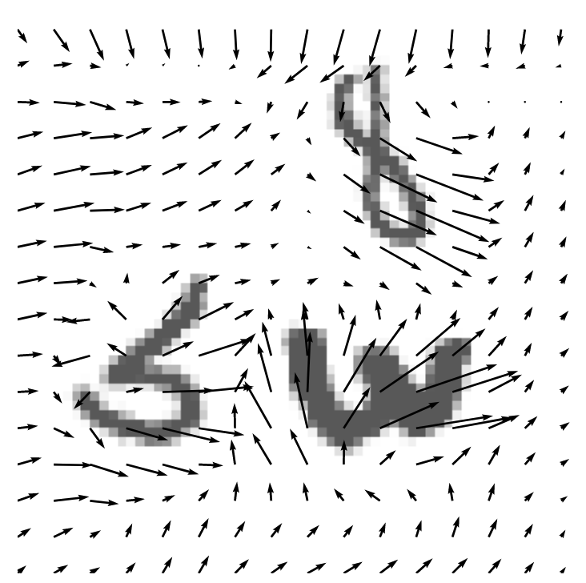
TrajGRU for precipitation nowcasting
A classic encoding-forecasting framework
Motion ‘flow’ is incorporated
TrajGRU is flexible and better at capturing complex spatiotemporal patterns, such as rotation and scaling
https://doi.org/10.48550/arXiv.1706.03458

Slide 18
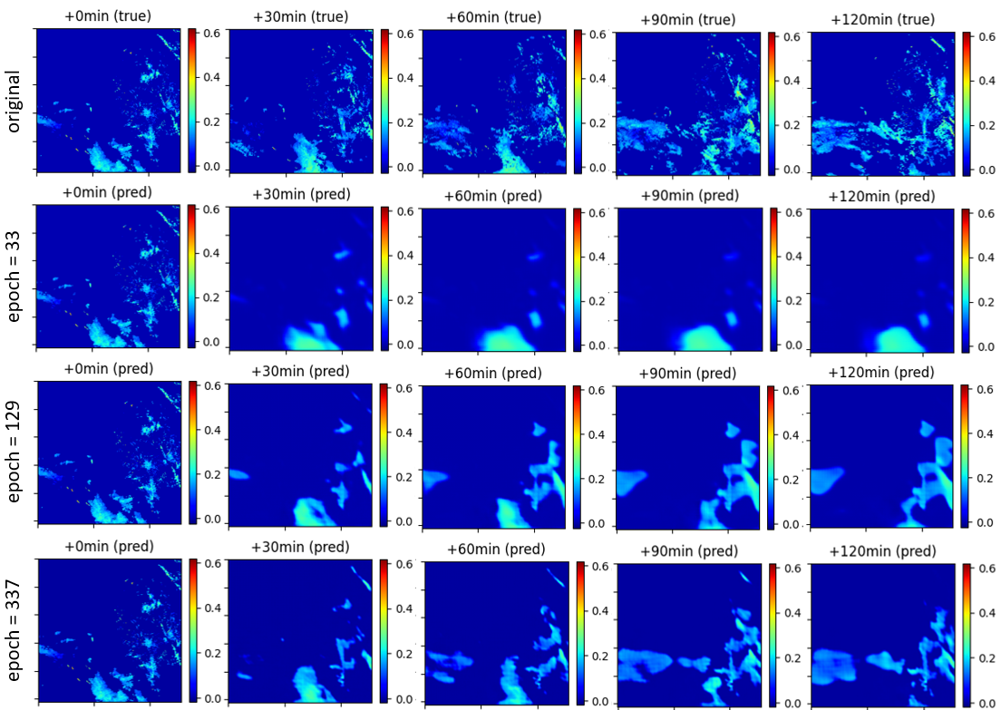
A case of training TrajGRU with CWA 10-min radar data
In early training iterations, the rainfall field only ‘evolves’ – it doesn’t move
Advection starts to be learnt at later iterations
AI appears to learn evolution first, then advection.
More detailed field reproduction

Slide 19
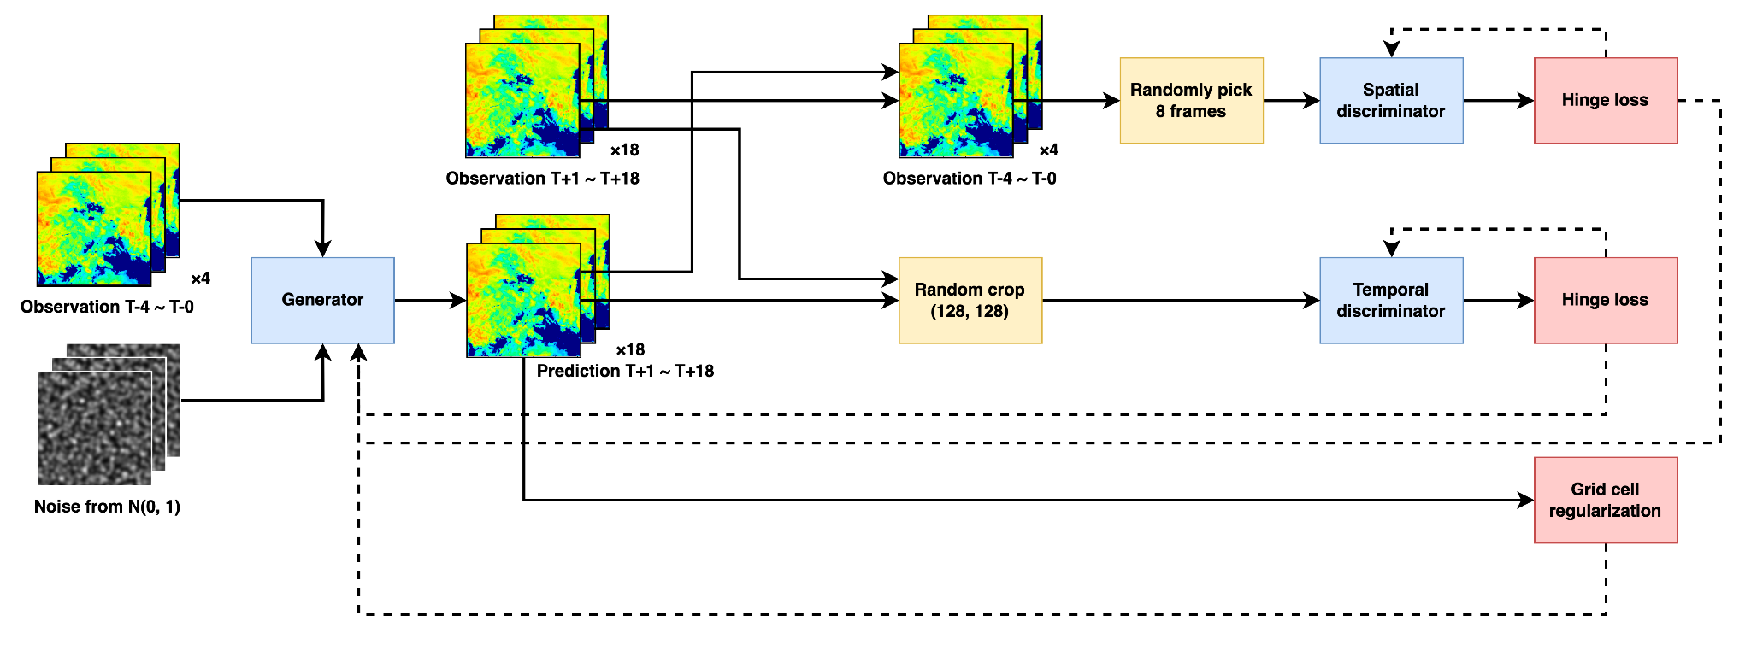

DGMR: A rainfall nowcasting model trained with the GAN technique
DGMR includes three main models, which are trained simultaneously via an adversarial process.
These models are:
A Generator that produces rainfall nowcasts.
Two Discriminators that discriminate if the generated nowcasts are ‘similar enough’ to the ground truth in terms of their spatial and temporal features, respectively.
Our DGMR replica on Github!
https://doi.org/10.1038/s41586-021-03854-z

Slide 20
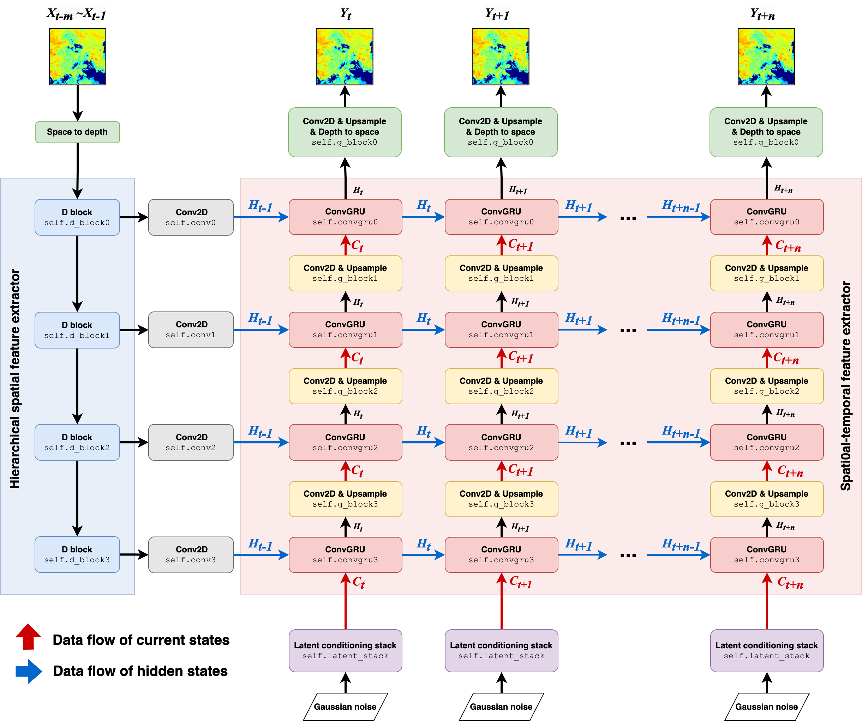
DGMR generator
=
Spatial feature extractor
+
Temporal feature extractor

Slide 21
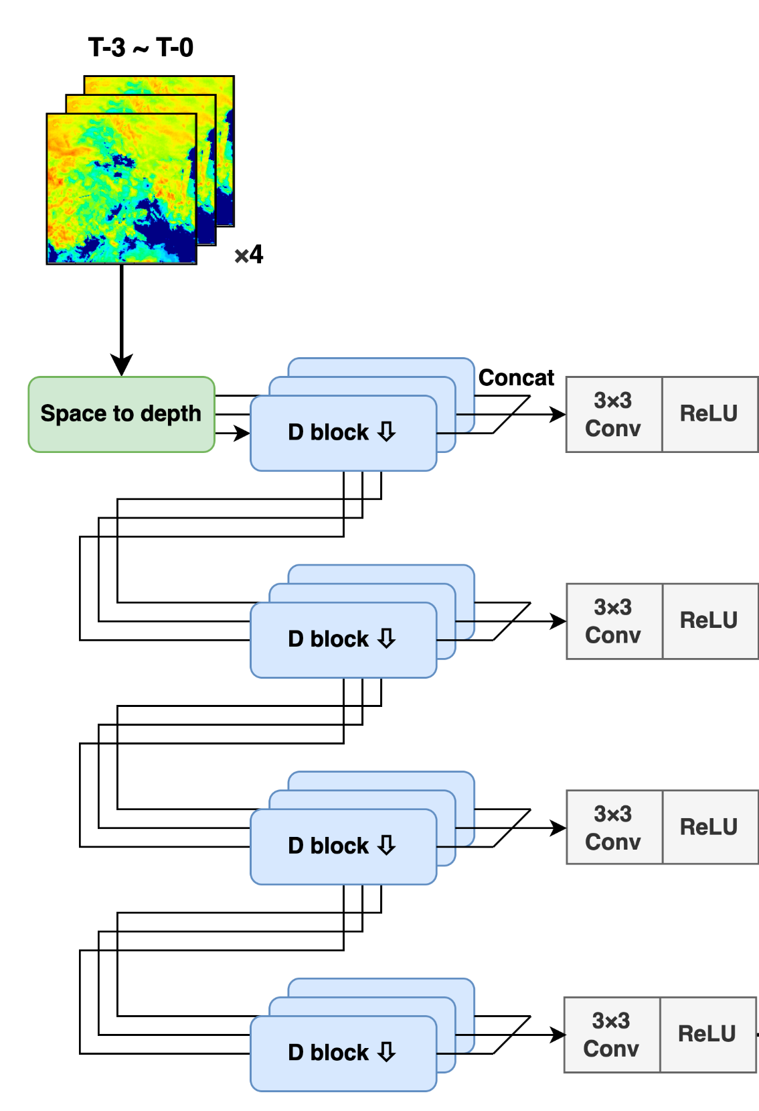
Hierachical feature extractor: Extract features in different levels of spatial extent
Extracted features’ spatial extent
original image size = 256km × 256km, resolution = 1km × 1km
≦ 14km × 14km
≦ 36km × 36km
≦ 80km × 80km
≦ 168km × 168km

Slide 22
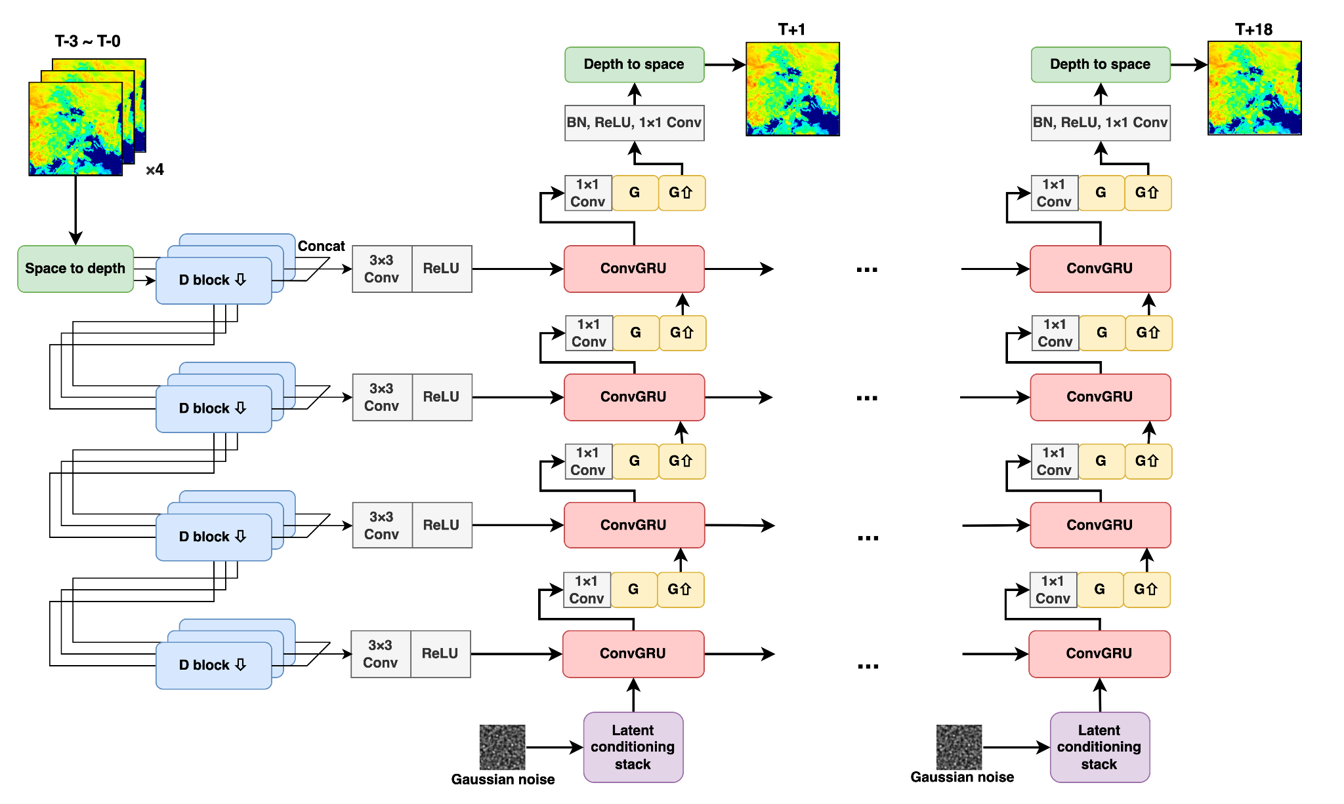
ConvGRU: Temporal feature extractor
T-3 ~ T-0
T+1
T+18
Hidden states
Time

Slide 23
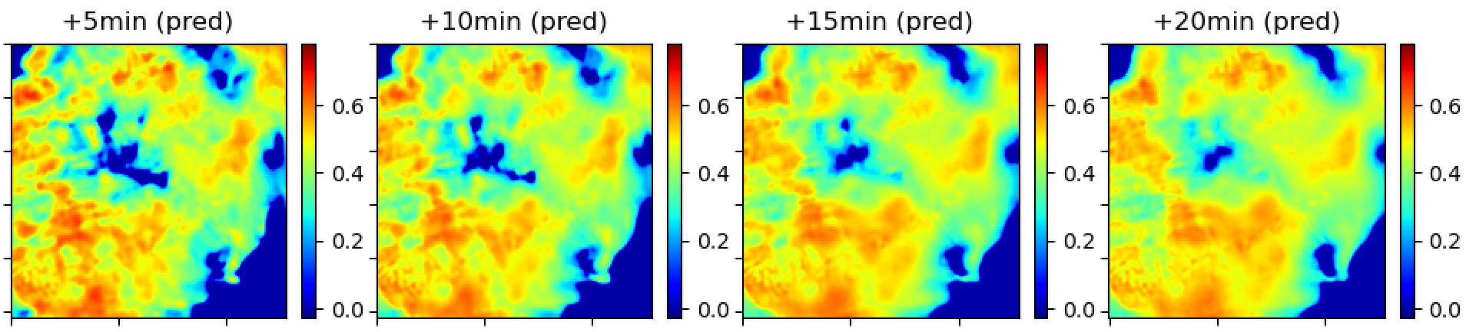
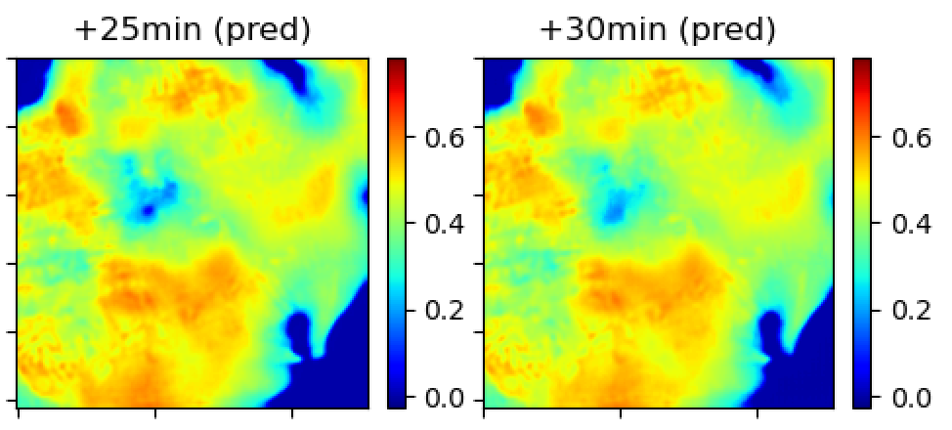
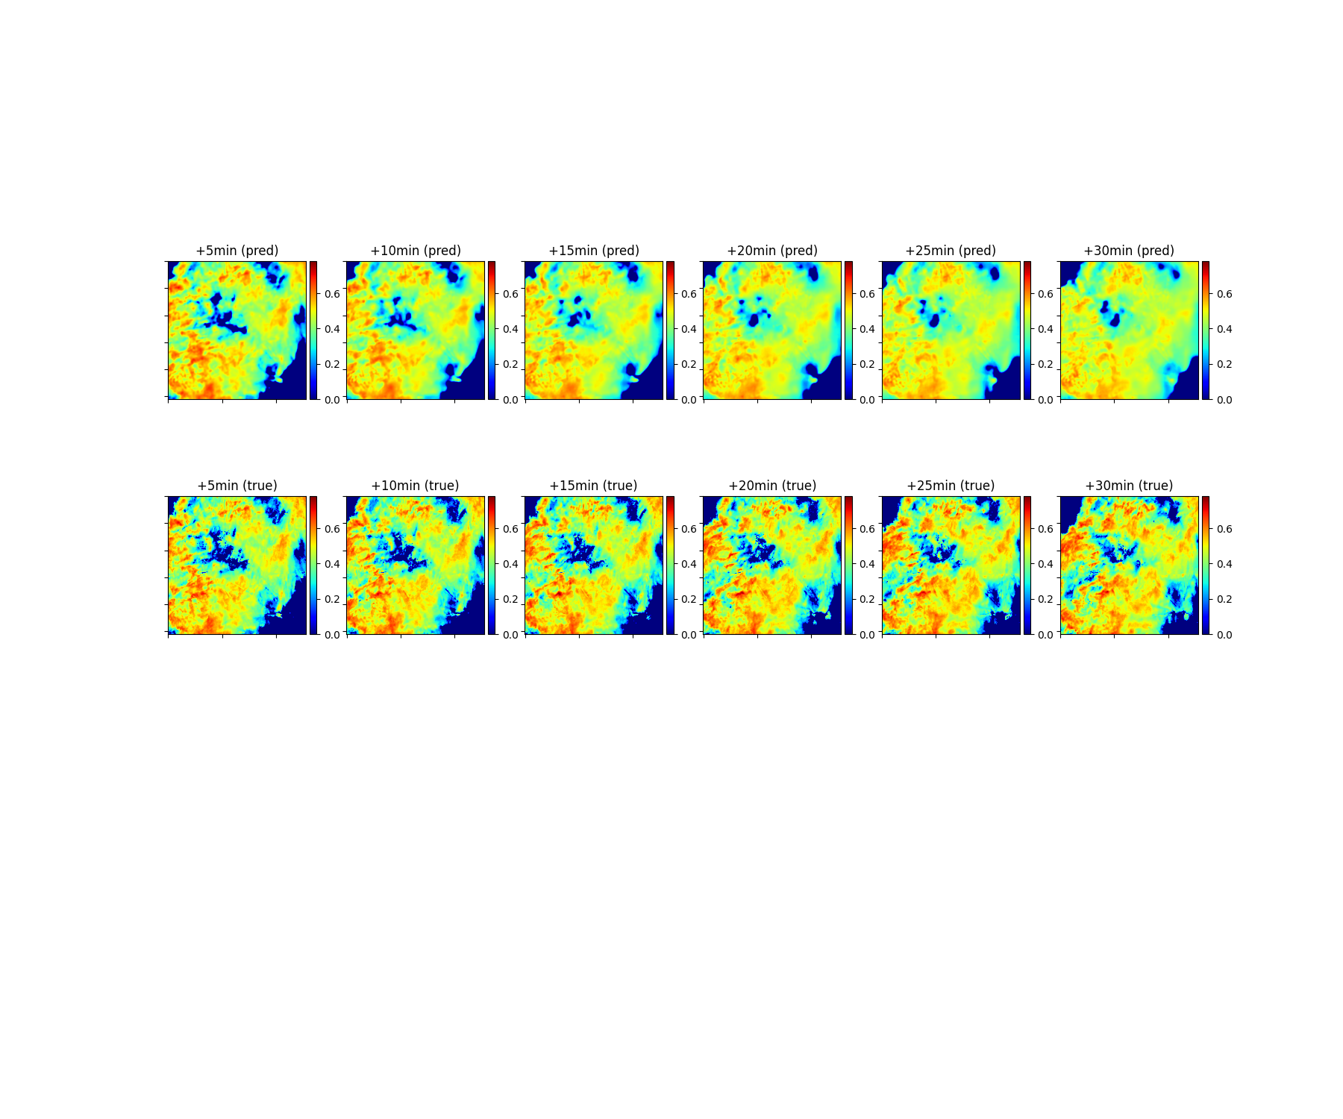
More details can be preserved in the predicted fields while GAN is used.
+5min
+10min
+15min
+20min
+25min
+30min
DGMR
training without discriminators
DGMR
training with discriminators
Ground truth

Slide 24
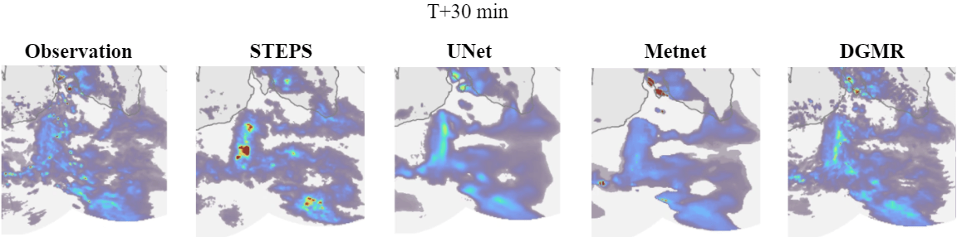
DeepMind’s introduction of GANs to rainfall nowcasting was a catalyst.
Since then, GANs have been widely adopted for AI-based nowcasting, valued for their ability to produce sharp, realistic forecasts.
Ground truth
STEPS
UNet
MetNet
DGMR

Slide 25
Climate modelling
Can we teach AI to say ‘I don’t know’?

Slide 26



Beyond Accuracy:
Teaching Models to Say "I Don't Know"
The Overconfidence Trap
This is a dog
Confidently Incorrect
I think this is a dog,
but I'm not sure
Solution: Introducing uncertainty assessment
https://www.ettoday.net/dalemon/post/6299

Slide 27
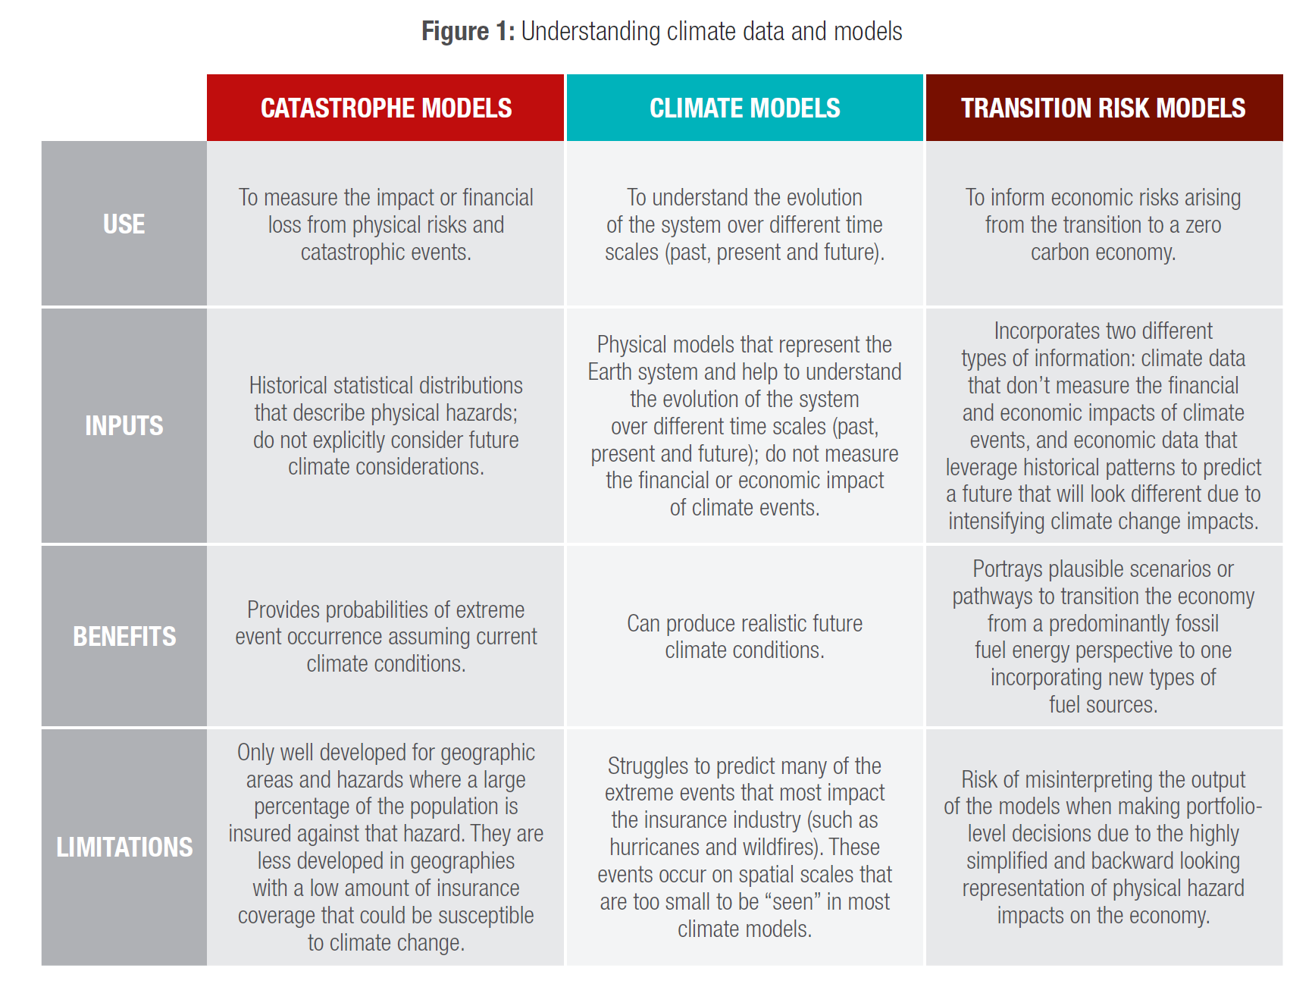
Climate risk modelling:
Understanding the key challenges and opportunities in creating climate transition pathways
Gap to be filled

Slide 28
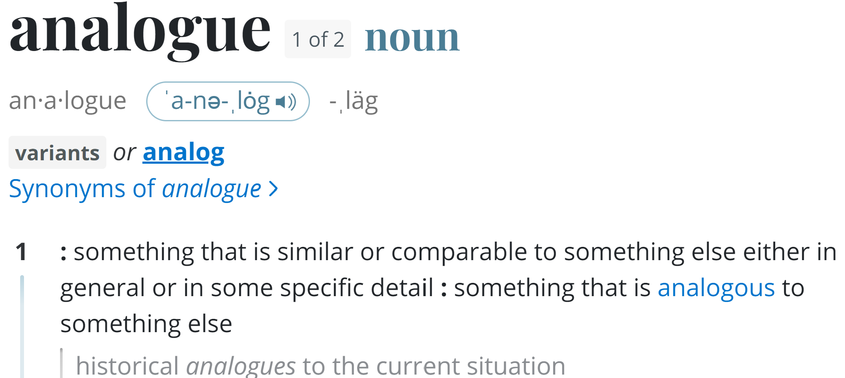

Slide 29
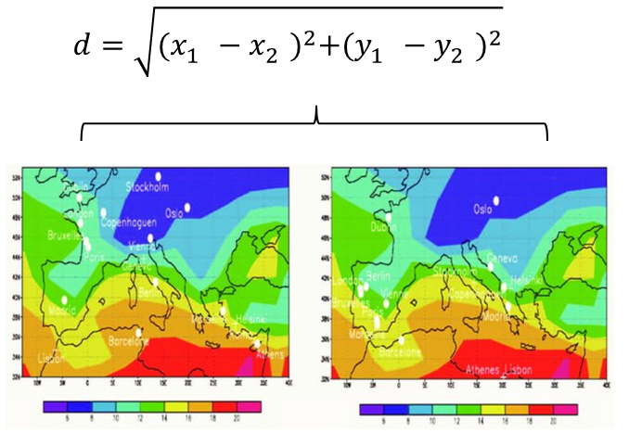
What is Climate/weather analogue method?
A method of examining today's forecast scenario and finding a day in the past when the weather condition looks very similar.
Traditionally, the level of similarity was quantified by computing the Euclidean Distance between key weather variables determined by the experts.

Slide 30

ClimaDist:
Re-discovering the Climate Analogue Method with Applications to Rainfall Modelling
https://www.researchsquare.com/article/rs-5382842/latest

Slide 31
ClimaDist
A deep-learning model (CNN) is used to capture weather dynamics, without the need for labelling.
Model outputs can be used to create a ‘feature’ to chracterise weather across a 30-day period, at 6-hour resolution, accounting for spatial-temporal variability and inter-dependence.
                The resulting features are used for analogue identification.
                Ultimately, the analogue model can be applied e.g. for dynamic rainfall modelling -> finding 30-day rainfall patterns from a given set of climate variables.
Dataset
ERA5 1940 – 2009
Climate variates: Temperature, U and V-component of wind, geopotential height

Slide 32
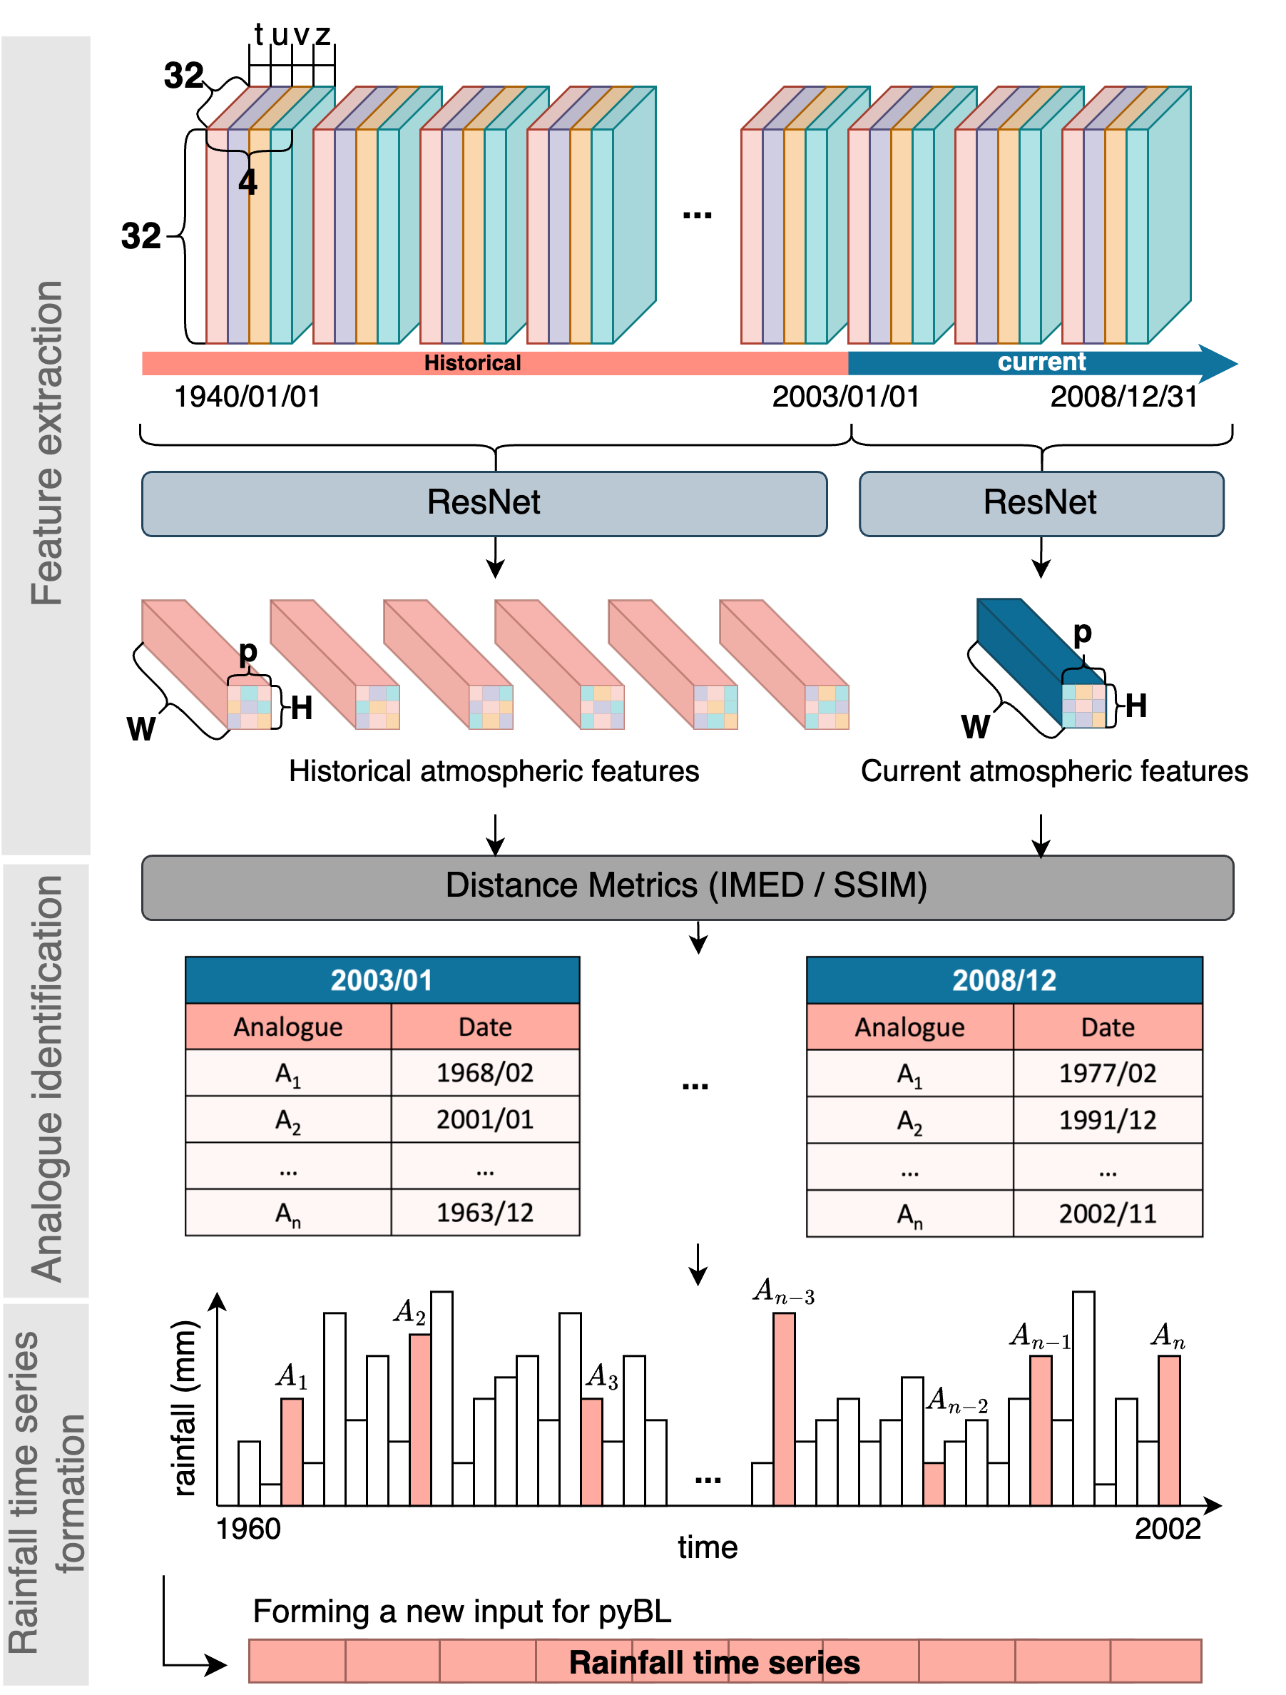
A climate-dependent rainfall time series modelling

Slide 33
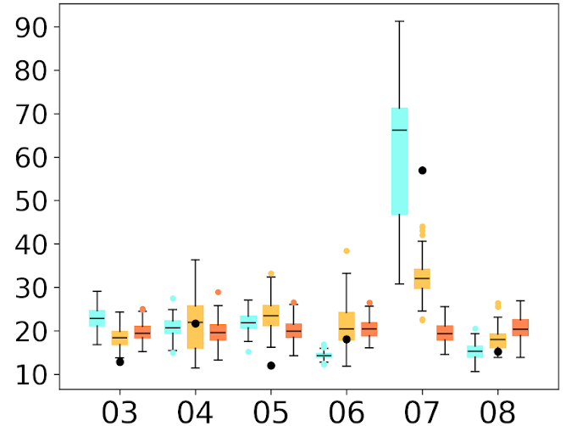
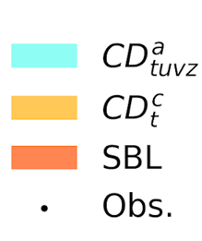
Example Application – incorporating climate dynamics into rainfall modelling
Apr’2007 was an abnormally hot and dry month
All Aprils (2003-2008)
Incorporating climate dynamics successfully captures extreme climate and rainfall behaviour!
Stationary methods, without considering climate dynamics, cannot predict this type of extreme events – they are treated as outliers
Skewness (5-min rainfall)
Year

Slide 34
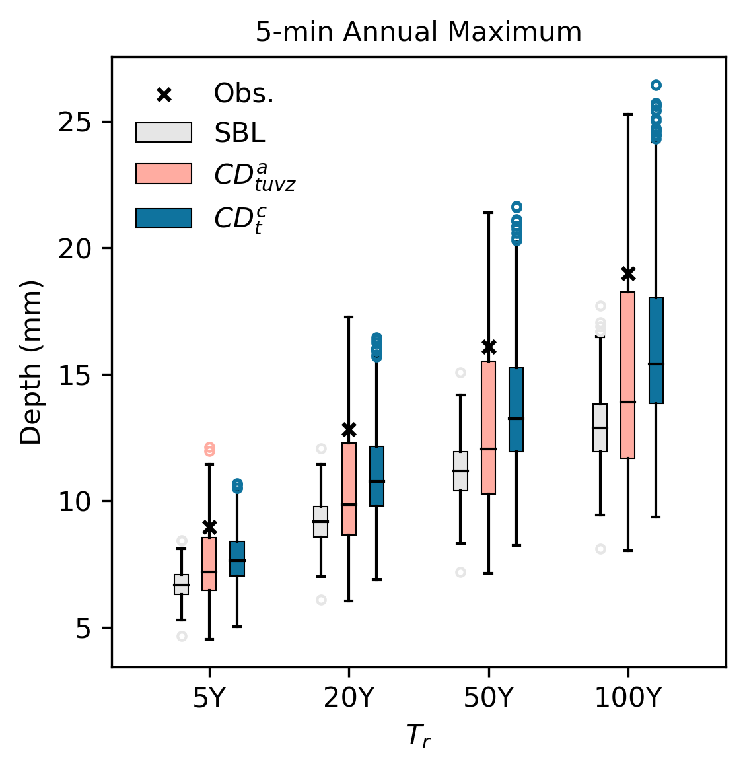
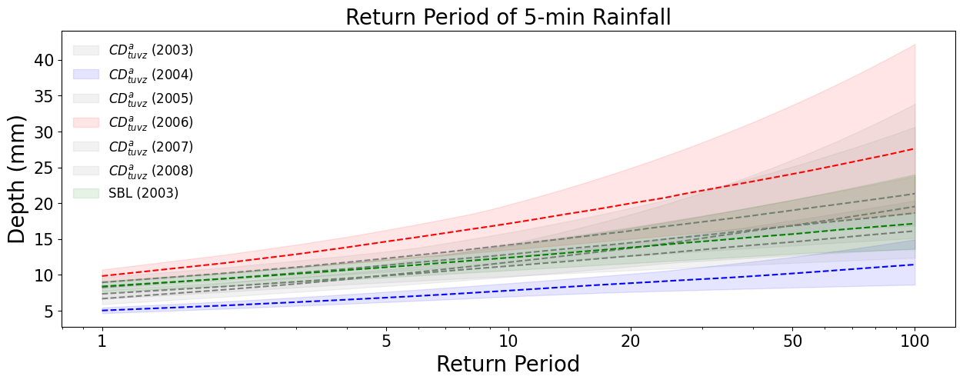
Application – the impact of climate dynamics propagates to rainfall extremes
The original ‘stationary’ rainfall model (SBL) fails to account for the variation in rainfall properties between years, which causes an underestimation of rainfall extremes and their estimation uncertainty.

Slide 35
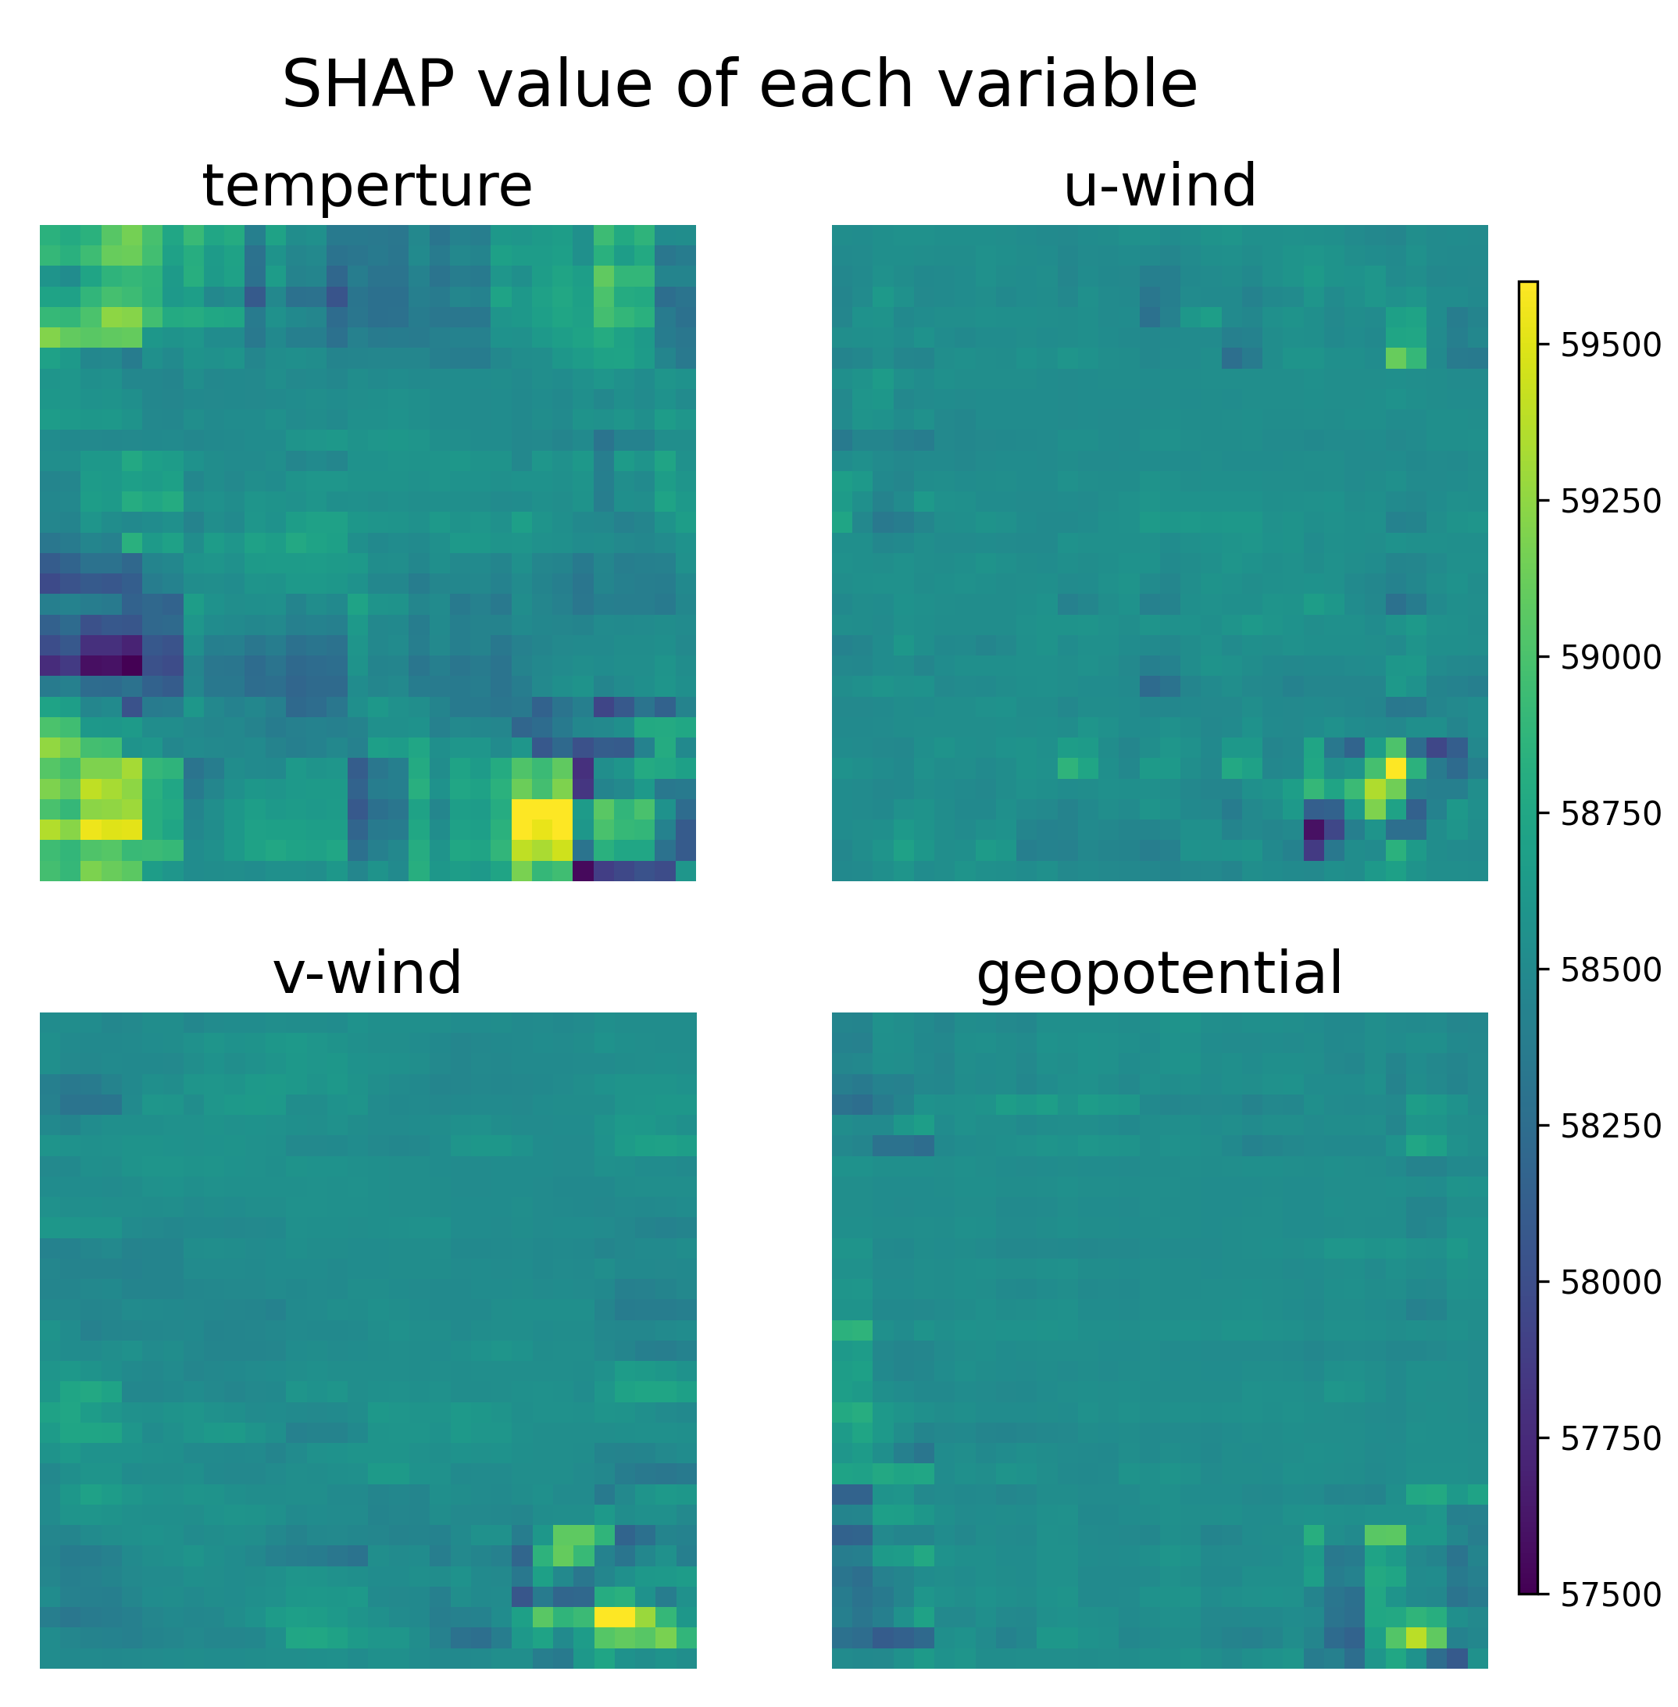
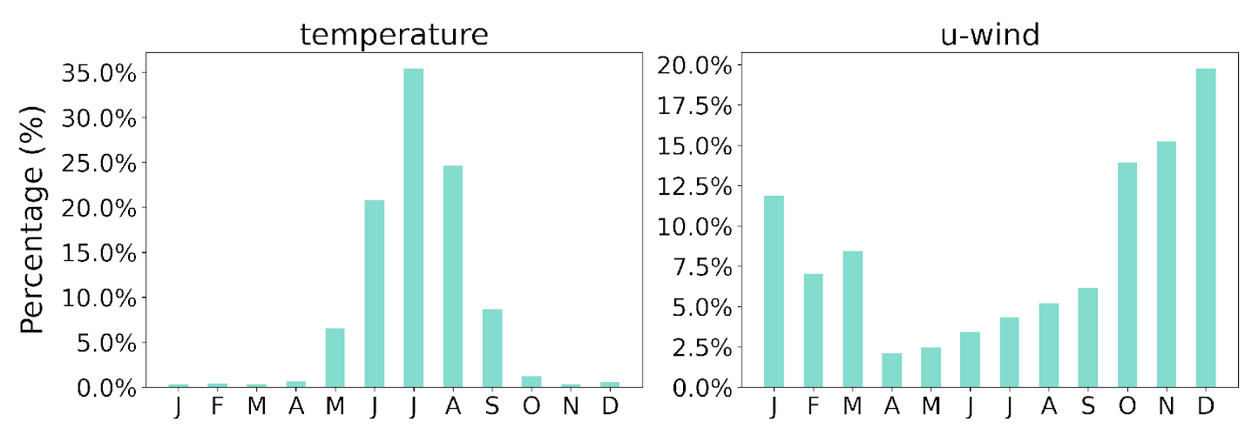
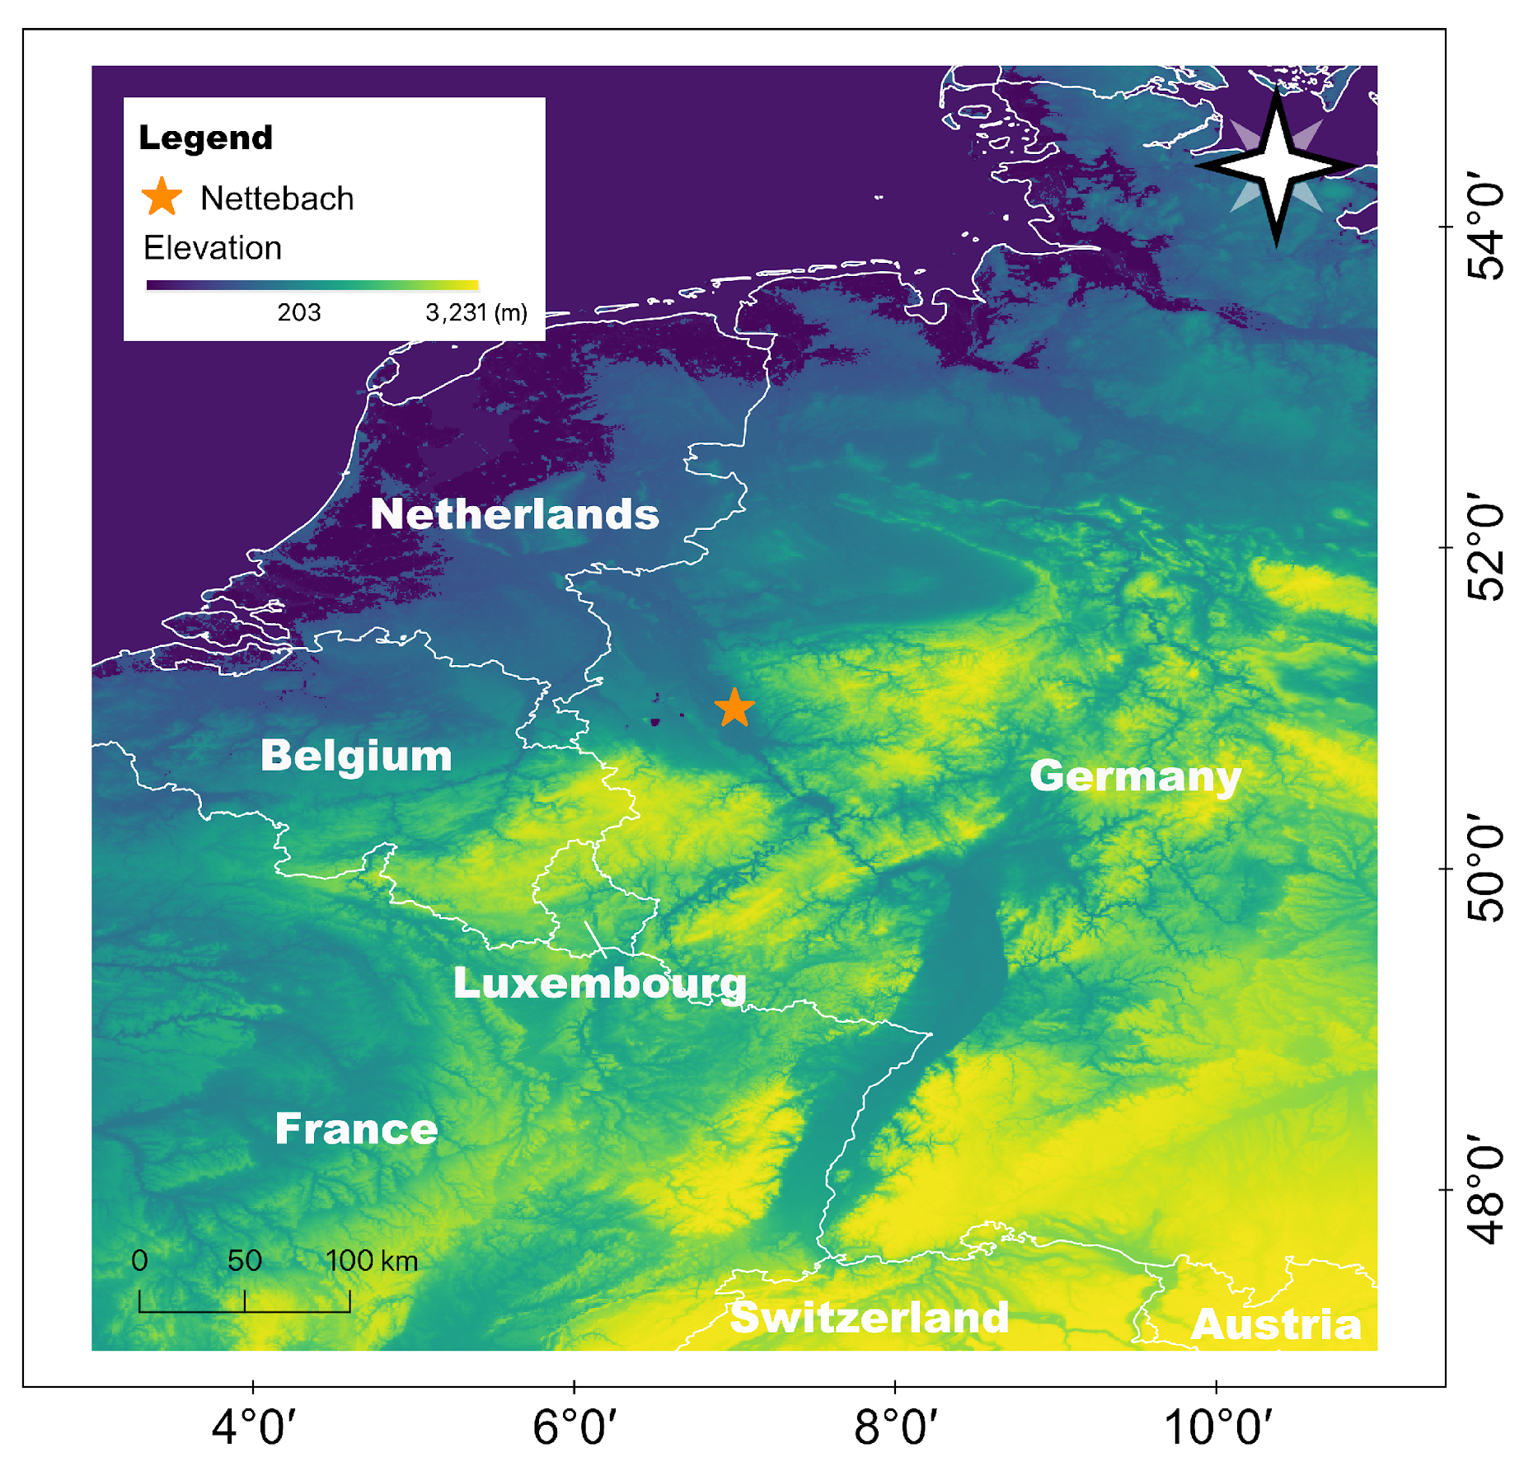
Explainable AI (XAI) to understand ClimaDist
Temporal view (LRP)
Spatial view (SHAP)
Tells us the decision flow of NN, accounting for seasonality
SHAP value tells us the importance of each variable at different locations
Temperature
dominates in summer and is prioritised by the model
U–wind
dominates in winter

Slide 36
Evidential Deep Learning: Uncertainty Estimation
A Bayesian-inspired ML approach that does not directly predict class probabilities but instead predicts a distribution over these probabilities.
By modelling the output as a Dirichlet distribution, we can separately quantify two types of uncertainty
  Dempster−Shafer Theory of Evidence: DST 𝑢
  Law of Total Variance and Entropy (LoTV):
    Aleatoric (data) uncertainty
    Epistemic (model) uncertainty

Slide 37
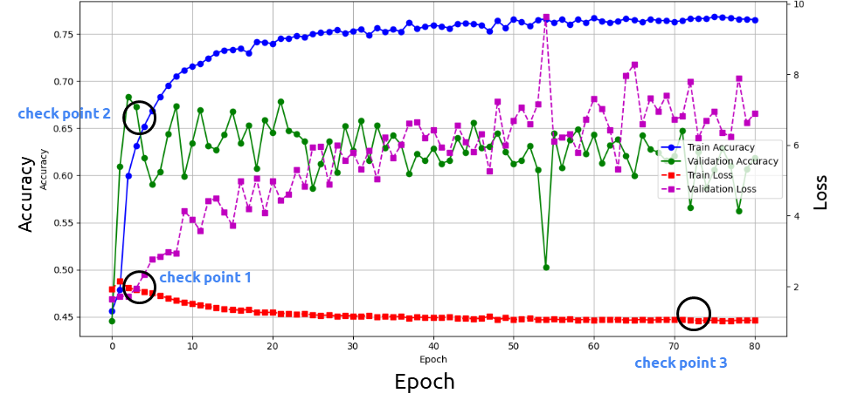
Exercise: Training ClimaDist model with EDL
Three checkpoints (training targets) are saved from the same model architecture during training to serve as the basis for subsequent experiments
check point 1:
best validation loss
check point 2:
best validation accuracy
check point 3:
best training performance
(overfitting)
Training: Seen data (1960 - 2003)
validation: Unseen data (2004 - 2008)

Slide 38

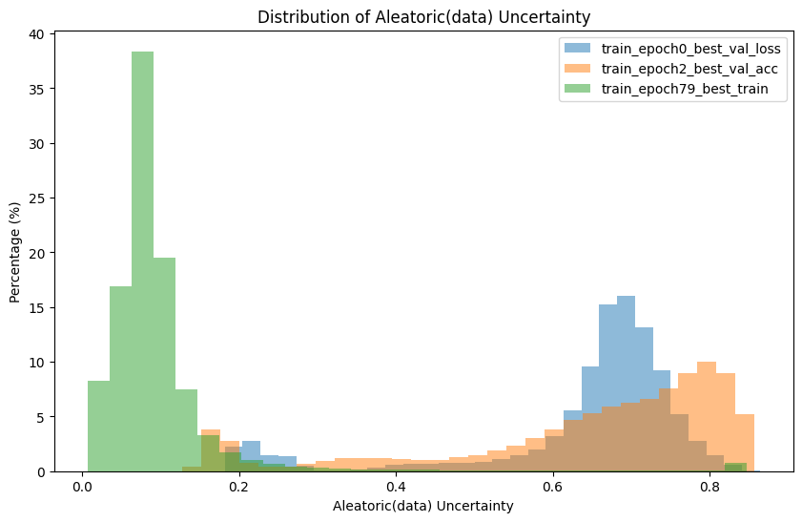
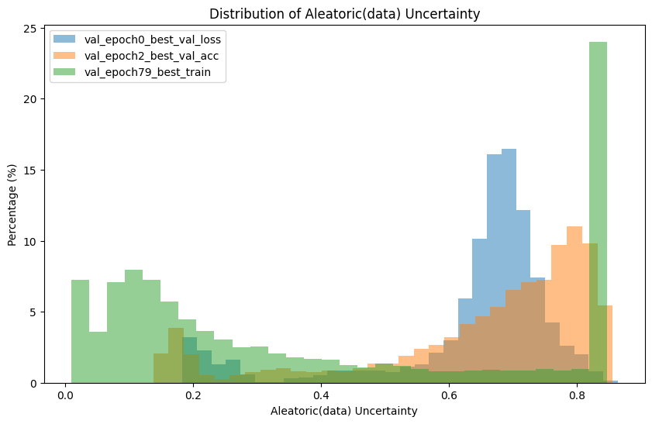
Distribution of Aleatoric (data) Uncertainty
Overfitted models exhibit high data uncertainty on unseen data
Our EDL model is telling us ‘I haven’t seen this data’!
training (seen) data
validation (unseen) data
check point 3
overfitting
check point 3
Percentage(%)
check point 1
best val loss
check point 1
check point 3
check point 2
check point 2 best val acc
Aleatoric (data) Uncertainty
Aleatoric (data) Uncertainty

Slide 39
Spatial-temporal reconstruction of rainfall
AI’s power of learning spatial and temporal features

Slide 40
Kriging is a powerful tool to generate fields from point data, but…
It is sensitive to the density and location of known data points
The generated fields are of relatively low temporal consistency
The generated fields are generally smooth, lacking detail
Can AI help us overcome these limitations?

Slide 41
Problem formulation in an AI style

Slide 42




Proposed model architecture
All Conv2d is 3*3 is Conv2d = FD
is DN or UP = IE
F
I
$$R^{b,c,t,h,w}$$
U-Net backbone: multi-scale feature extraction
Fourier decoder: enhances fine details and temporal coherence
$$R^{b,c∗t,h,w}$$
I
F
$$R^{b,c∗t,h,w}$$
*a
*i
h , c*t
F
h/2 , c*t*4
$$R^{b∗t,c,h,w}$$
h/2 , c*t*4
*h
Skip connection only at layer stage
F
h/4 , c*t*8
h/4 , c*t*8
*g
U-GAN
Input block = a
Fourier block = [e, f, g, h, i]
h/8 , c*t*16
F
h/8 , c*t*16
Discriminator
*f
h/16, c*t*32
F
h/16, c*t*32
GAN Discriminator: guides output toward realism
*e
Notes:
直接在圖上顯示出來

Slide 43
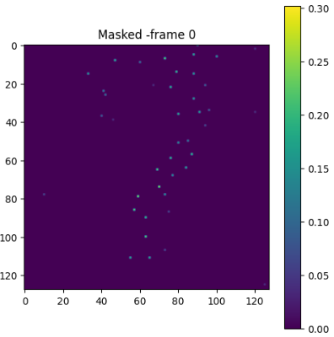
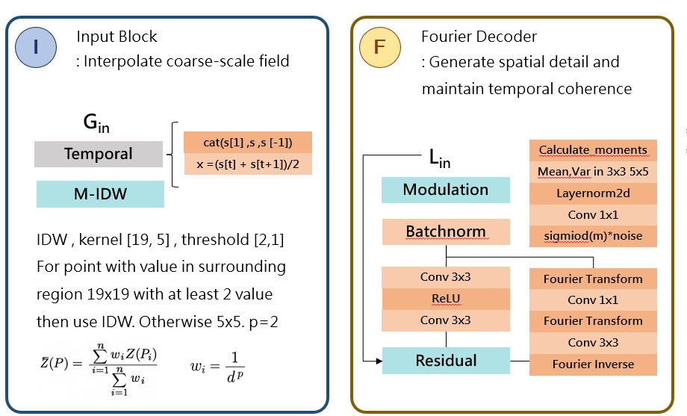
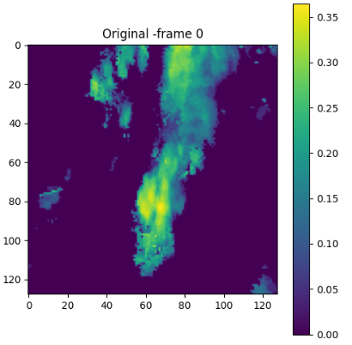
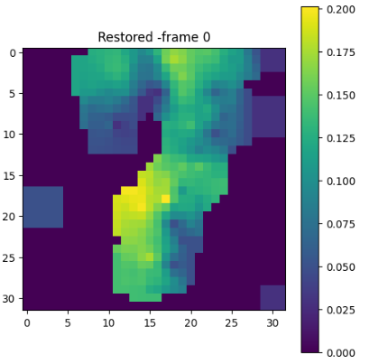

Key model components
1
Masked Frame
True Value
2
3
4
After Input Block
Model Output
G_{out}
L_{out}

Slide 44

Yes, with <1% known data, AI can well reconstruct the rainfall fields, where:
More details are preserved
Observed temporal consistency is maintained
Less sensitive to gauge density -> see performance in low density areas
255
0
Original Radar
Known radar data
Our model
Kriging

Slide 45

Extension: How if we replace the known radar data to real gauge data?
255
Original Radar
Known gauge data
Our model
Kriging
0
With real gauge data, kriging becomes even less realistic and displays lower temporal coherence
Notes:
ouput5

Slide 46
Concluding remarks
Understanding physical processes is key to best use AI.
We should take advantage of what (current) AI models are good at – in our applications:
  Capturing spatial and temporal features
  Faster in learning rainfall evolution than advection
While pursuing high model accuracy, it is critical to assess model’s behaviour and uncertainty
  Explainable AI can help confirm if the model behaviour makes sense.
  EDL helps quantify uncertainty and teaches AI models to indicate ‘I don’t know’.
Li-Pen Wang (lpwang@ntu.edu.tw)
https://wangup.caece.net/

Slide 47
Back-up slides

Slide 48



ClimaDist
Dataset
ERA5 1940 – 2009
Climate variates: Temperature, U and V-component of wind, Geopotential
ClimaDist is trained to predict the time difference between weather variables from any two time points.
(AtmoDist - Hoffmann and Lessig,2022)​
A deep-learning model (CNN) proposed to capture weather dynamics, without the labelling needs.

