Slide 1

I.FAST Workshop 2025
Experimental Application of Neural Network Fast Feedback Modeling at the Canadian Light Source
Shervin Saadat
Online talk
Mar 18, 2025, 3:35 PM
25 Min
KARA large seminar room in building 348 (KIT North Campus)

Slide 2

I.FAST Workshop 2025
Introduction of Neural Network (NN):
What are Neural Networks?
Neural Networks (NN) are a set of algorithms inspired by the structure and functioning of the human brain.
They consist of neurons (nodes) arranged in layers:
  Input layer – Receives data
  Hidden layers – Processes data through activation functions
  Output layer – Produces final result
Neural networks are capable of learning complex patterns and making predictions.

Slide 3
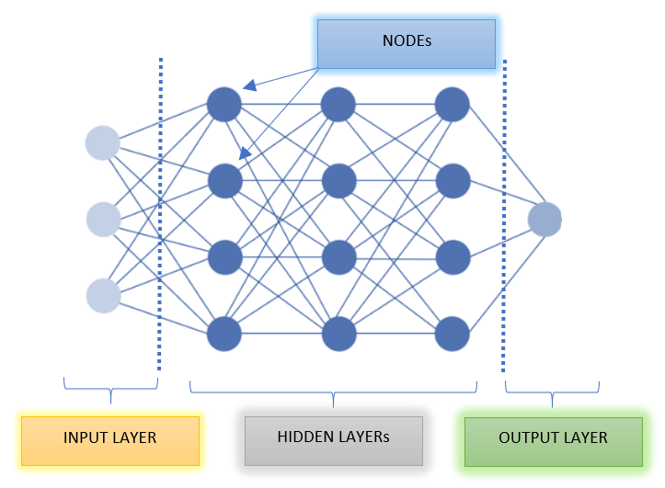
I.FAST Workshop 2025
How Neural Networks Work?
  Structure:
    1- Input Layer : Raw data is input into the network.
    2- Hidden Layers :
    Each neuron applies an activation function (e.g., ReLU, Sigmoid)
    Weights and biases are adjusted using backpropagation
    3- Output Layer : Produces prediction based on learned patterns
  Training Process:
    Forward Pass : Data propagates through the network
    Loss Calculation : Compares output to expected value
    Backpropagation : Adjusts weights using gradient descent
  Famous Architectures:
  Convolutional Neural Networks (CNN)
  Recurrent Neural Networks (RNN)
Let X be the input vector : x = [ x₁ , x₂ , … , x_{n}]
Let W be the weight matrix b the bias vector :
z = W . X + b
Apply an activation function f: a = f(z)
The output of the network is : y = f(W . X + b)

Slide 4
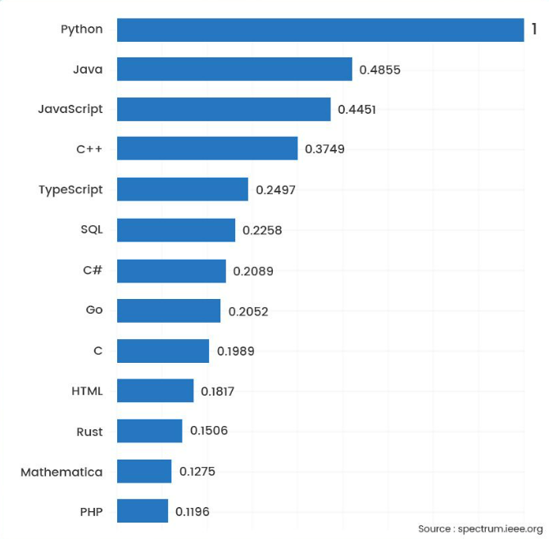
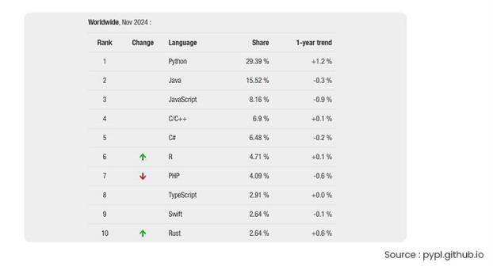
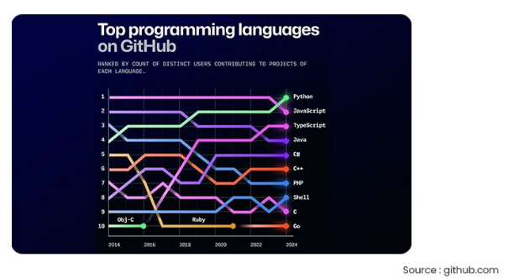

I.FAST Workshop 2025
Implementing Neural Networks in Code:
Programming Languages for Neural Networks?
Python – Most widely used due to its simplicity and powerful libraries.
R – Useful for statistical modeling and data analysis.
Julia – Known for high-performance computing and mathematical modeling.
MATLAB – Commonly used in academia and engineering for prototyping.

Slide 5
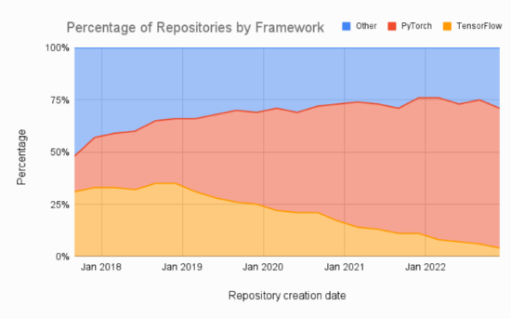
I.FAST Workshop 2025
Why Python for Neural Networks?
Python is the most widely used language for machine learning and neural networks.
It offers a large number of libraries (TensorFlow, PyTorch, Keras) that simplify the implementation of complex models.
Strong community support and extensive documentation make problem-solving
easier.
Self-Programming vs. Libraries
Self-Programming:
Suitable for experts who want full control over model architecture and optimization.
Requires deep understanding of neural network theory and implementation.
Using Libraries:
Recommended for most users, including beginners and intermediate developers.
Libraries like TensorFlow and PyTorch handle complex optimizations and backpropagation.
Allows faster development and better performance with fewer errors.
  Python + Libraries = Fast, reliable, and efficient neural network development.
  Self-programming is useful for research and deep customization but libraries are better for production and general use.
Source : www.assemblyai.com

Slide 6
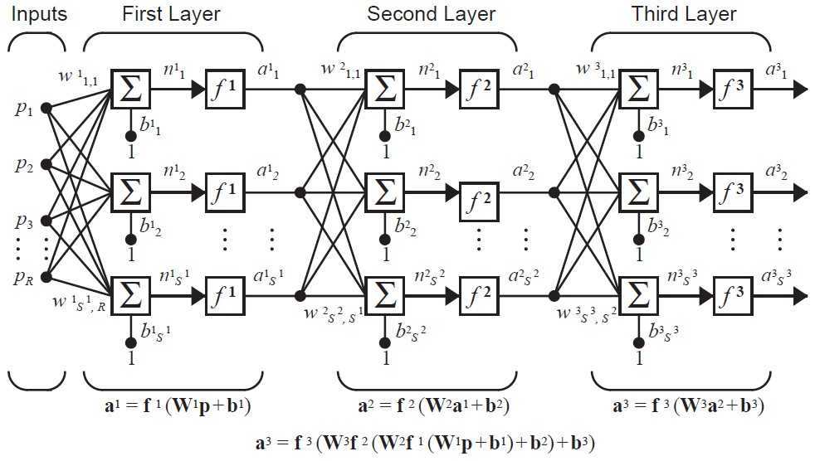
I.FAST Workshop 2025
Key Considerations in Designing a Neural Network
  Selecting a Language:
    Python is the most versatile and well-supported language for neural networks.
  Number of Layers and Nodes:
    Start with 2–3 hidden layers.
    Increase nodes for complex data but avoid overfitting.
  Data Normalization:
    Normalize input data to improve convergence and training speed.
  Choosing an Activation Function:
    ReLU for hidden layers.
    Sigmoid or Softmax for classification.
  Epochs:
    Start with 10–20 epochs.
    Increase if the model underfits; reduce if overfitting.
Source: M. T. Hagan, H. B. Demuth, and M. Beale, Neural network design

Slide 7
I.FAST Workshop 2025
Introduction to Key Concepts
  Activation Functions
  Activation functions introduce non-linearity to the model, enabling it to learn complex patterns. Common types include:
    ReLU (Rectified Linear Unit): Outputs zero for negative values and linear for positive values. Efficient and commonly used for hidden layers.
    Sigmoid: Maps values between 0 and 1; useful for binary classification.
    Tanh (Hyperbolic Tangent): Maps values between -1 and 1; useful when the data is centered around zero.
    Softmax: Converts outputs into probabilities; ideal for multi-class classification.
Epochs
An epoch is one complete pass through the entire training dataset.
    Too few epochs → Model may underfit (fails to learn patterns).
    Too many epochs → Model may overfit (memorizes data instead of generalizing).
  Overfitting
  Overfitting occurs when the model learns noise or irrelevant details from the training data, reducing its performance on unseen data.

Slide 8
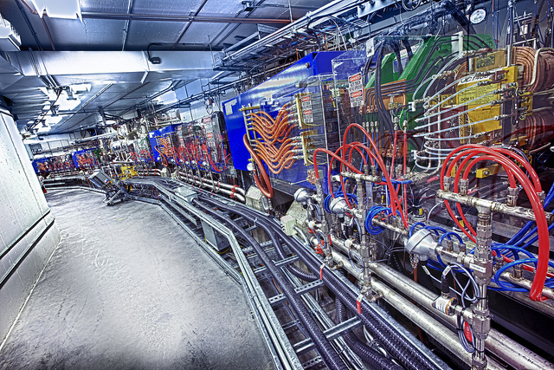
I.FAST Workshop 2025
Canadian Light Source (CLS)
CLS (Canadian Light Source) is a synchrotron light source. There are 12 sections in the storage ring, which runs at 2.9 GeV. A perturbation of the electron position in the closed orbit leads to a decrease in beam lifetime and fluctuations in light at the beamlines.
The Orbit Correction System (OCS) consists:
48 sets of (X/Y) BPMs BERGOZ (96 data sheets with 1000 Hz recording) that measure the beam position and use the response matrix to calculate the strength of the orbit correctors
48 sets of (X/Y)OCs (functional 96 signal with 18Hz)
    OCS
    96 Inputs (1000 Hz) → RM → 96 Outputs (18 Hz)
    NN Model
    96 Inputs (1000 Hz) → NN → 96 Outputs (18 Hz)

Slide 9
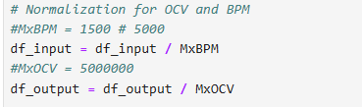
Normalization Techniques:
  Static Normalization:
    Use a fixed value (e.g., maximum possible value) to scale the data.
    Ensures consistent scaling across different datasets.
    Example: Divide BPM data by 10³ and OCV data by 10⁶.
  Dynamic Normalization:
    Calculate maximum and mean values for each sample.
    Scale data based on sample-specific characteristics.
  Chosen Approach:
  ✅ Static Normalization (for consistency and simplicity).
  Why Static Normalization?
  Ensures consistent scaling across all samples.
  Reduces computational complexity and simplifies the model.
I.FAST Workshop 2025
Data Normalization
  Input (BPM):
    96 columns (representing BPMs)
    Time resolution: 1000 Hz → 0.001 [S]
    Values range between approximately ±10³
  Output (OCV):
    96 columns (representing OCs)
    Time resolution: 18 Hz → 0.0556 [S]
    Values range between approximately ±10⁶

Slide 10
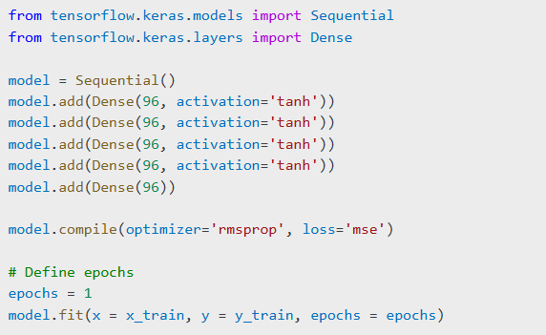

I.FAST Workshop 2025
Finding the Best Model Configuration
Tuning Approach:
Try different numbers of layers and nodes.
Experiment with different activation functions (e.g., ReLU, Tanh).
Adjust the number of epochs based on model performance.
Fine-tuning through trial and error leads to the best configuration.
Testing and adjusting different parameters is key to finding the best model.

Slide 11
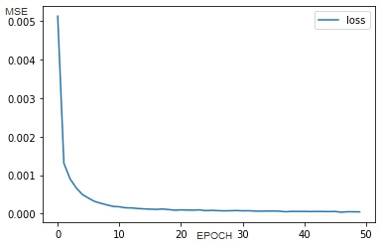
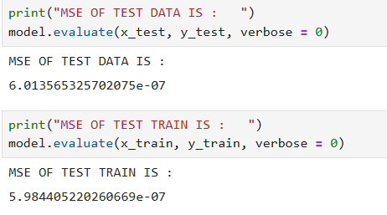
I.FAST Workshop 2025
Finding the Best Model
Metrics Used:
  Run Time: Measures how fast the model completes training.
  MSE (Mean Squared Error): Measures the model's accuracy by calculating the average squared difference between predicted and actual values.
Testing and adjusting different parameters is key to finding the best model.
Process:
Tested different hidden layers (from 1 to 6 layers).
Tested different activation functions (ReLU, Sigmoid, Tanh, Softmax, etc.).
Evaluated different epoch values to balance training time and accuracy.

Slide 12
I.FAST Workshop 2025
Model Optimization Summary
Overfitting Prevention
Monitored training and validation loss to detect overfitting.
Used early stopping and balanced complexity to prevent overfitting.
Hidden Layers and Nodes
Tested 1 to 6 hidden layers and different node counts.
Best configuration: 3 hidden layers with 96 nodes.
Training Time vs. Performance
1 hidden layer → 30–40% faster but higher MSE.
3 hidden layers → Best trade-off between accuracy and training time.
4–6 layers → <2% accuracy gain but >50% increase in training time.
At the end of this part, your model is ready.
Why This Model?
✔ Balanced between fast run time and low MSE.
✔ Tanh provided better performance for this data set.
✔ 3 hidden layers and 96 nodes achieved the best balance of accuracy and training efficiency.
Your architecture is ready.

Slide 13
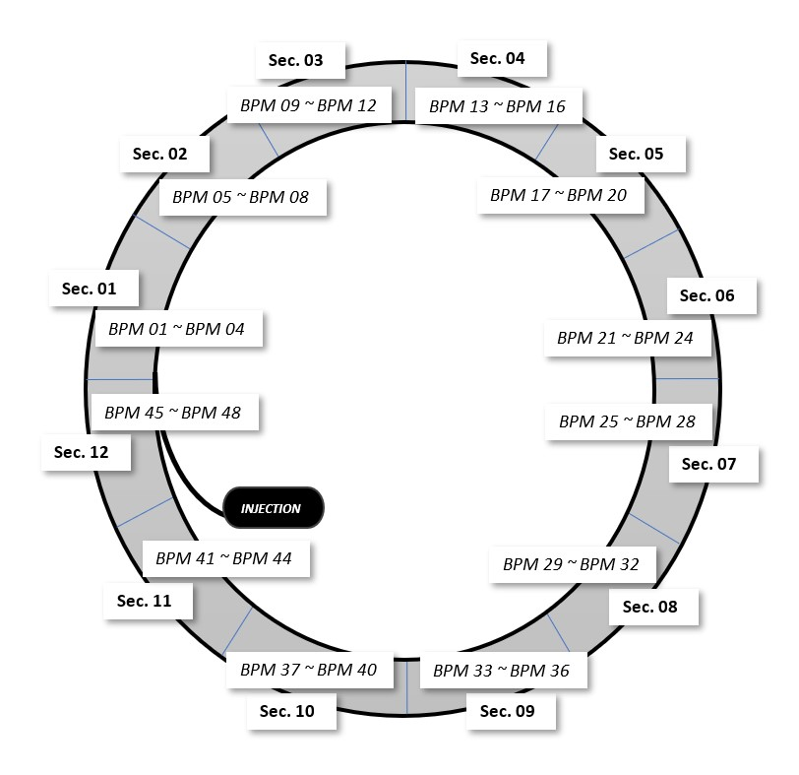

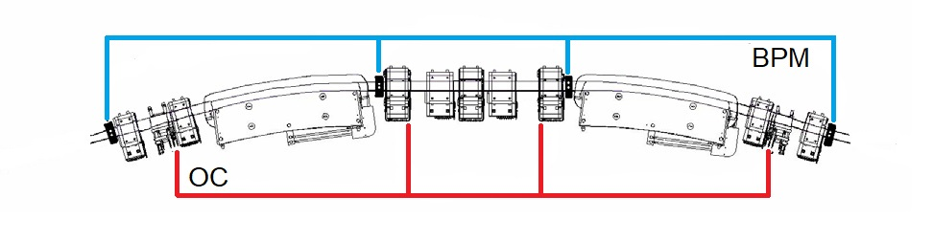
I.FAST Workshop 2025
NN Fast Feedback Modeling for CLS
Problem Setup:
  96 inputs from Beam Position Monitors (BPMs)
  96 outputs for Orbit Correctors (OCs)
Model Design:
Language: Python
Library: TensorFlow – Keras
Input Layer: 96 nodes
Output Layer: 96 nodes
Hidden Layer: 96 nodes (to balance complexity and training time)
Logical Reasoning:
Keeping the hidden layer size equal to input and output size balances complexity and reduces calculation time.
Increasing hidden layer nodes would increase complexity and calculation time without significant performance improvement.
The balanced structure improves generalization and reduces computation time.

Slide 14
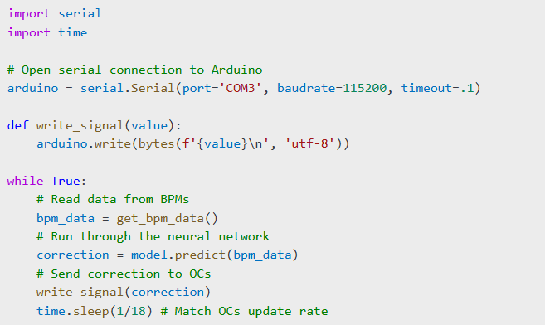
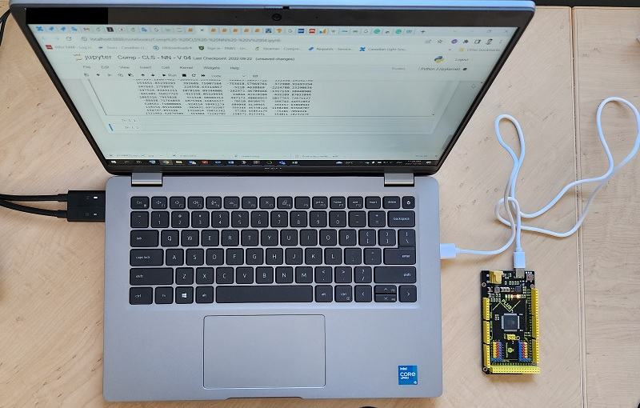
I.FAST Workshop 2025
Real-Time Processing with Arduino
Hardware Setup:
After preparing the neural network architecture, we integrated it with an Arduino board for real-time data processing.
The Arduino handles:
  Reading BPM data at 1000 Hz.
  Sending correction signals to the OCs at 18 Hz.
Why Arduino?
  Low latency and fast communication with BPMs and OCs.
  Ensures real-time correction with minimal delay.
  Provides stability for long-term operation.

Slide 15
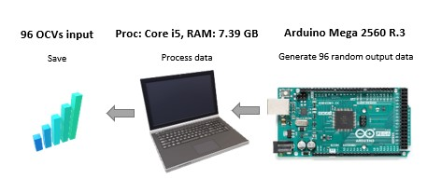
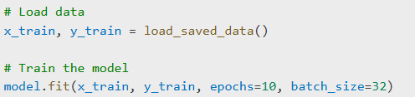
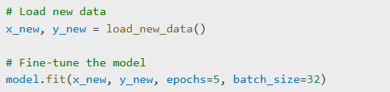
I.FAST Workshop 2025
Training and Upgrading the Model
Data Collection:
Saved data from the machine during operation.
Dataset includes:
  BPM signals (input)
  OCV correction signals (output)
Model Training:
Load saved data.
Normalize the data using static normalization.
Train the model using the collected data.
(15 % TEST, 15% VER. 70% TRN).
Model Updating:
Collect new data during operation.
Fine-tune the model with the updated dataset.
Why Update the Model?
  Ensures the model adapts to changing machine conditions. Improves accuracy and performance over time.

Slide 16
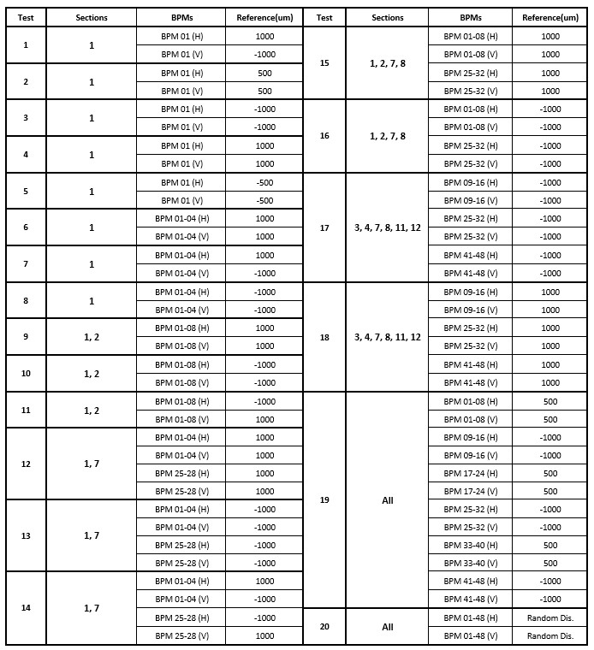
Data Sets for Model Upgrade
Experiment Setup
  BPM values were modified in different sections of the SR by adjusting the reference (offset) to create specific beam position scenarios:
    +1 mm and -1 mm adjustments.
  System tested at a beam current of 8.0 mA.
Purpose:
  To assess the OCS’s response under controlled offset variations.
  Performance of the OCS was recorded for both BPM and OC values.
Data Usage:
  The recorded data was used to:
  ✅ Learn patterns in beam behavior.
  ✅ Train and test the model.
  ✅ Improve and develop DOCS (Dynamic Orbit Correction System).
I.FAST Workshop 2025

Slide 17
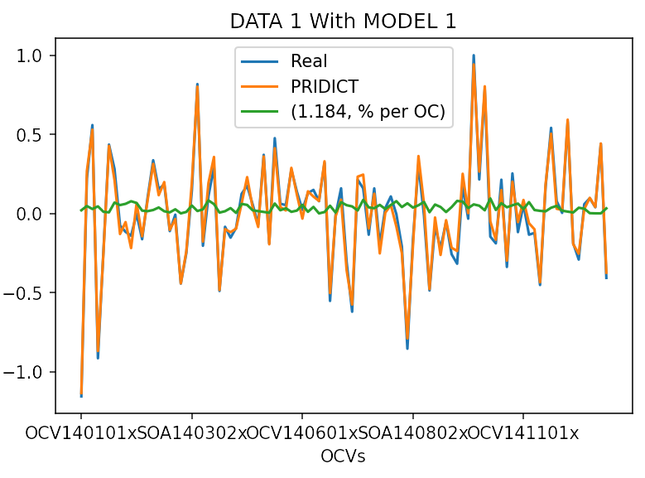
I.FAST Workshop 2025
Results After Model Upgrades
Model Improvement:
After each model upgrade with new data:
  The model becomes more accurate.
  Prediction error between real data and predicted data decreases.
Error Trend:
Over multiple upgrades:
  The difference between real and predicted values consistently decreases.
  Model generalization improves with more diverse datasets.
Continuous upgrades lead to a more accurate and reliable model.
Performance improvement is seen through reduced error and better generalization.
X: OCs (1-96)
Y: Normalized Signal Value

Slide 18
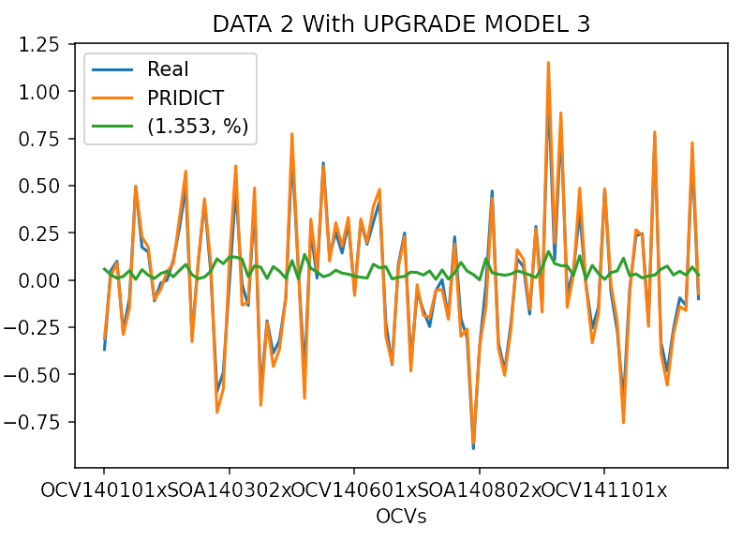
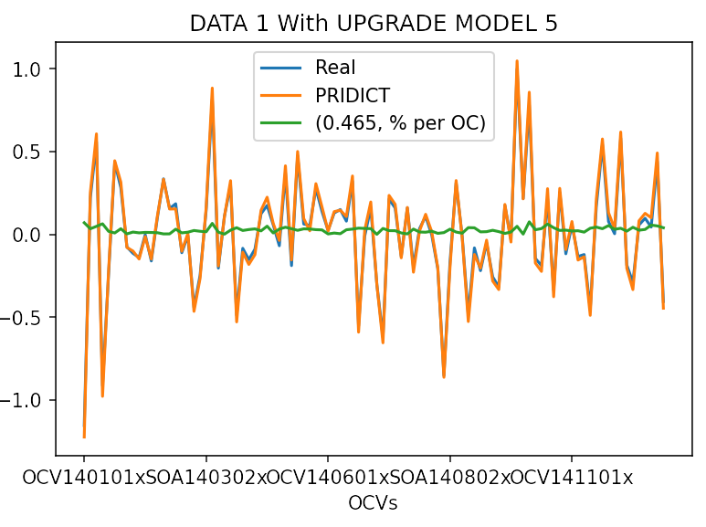
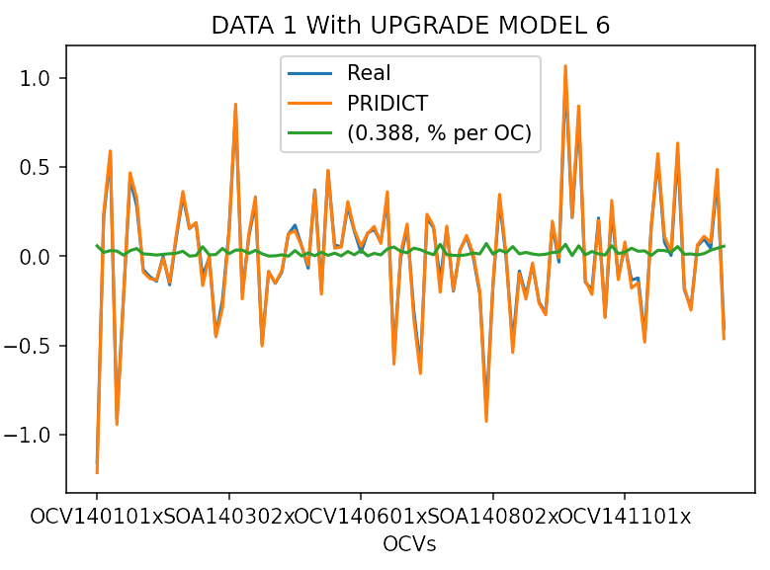
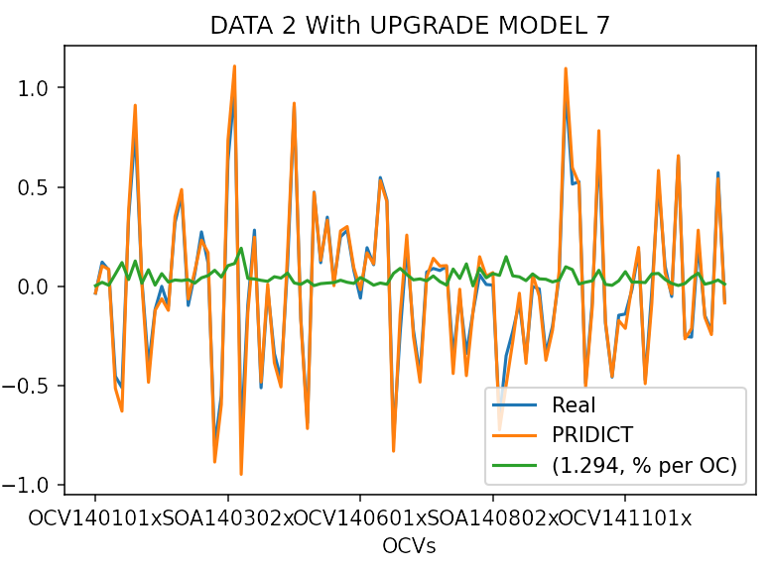
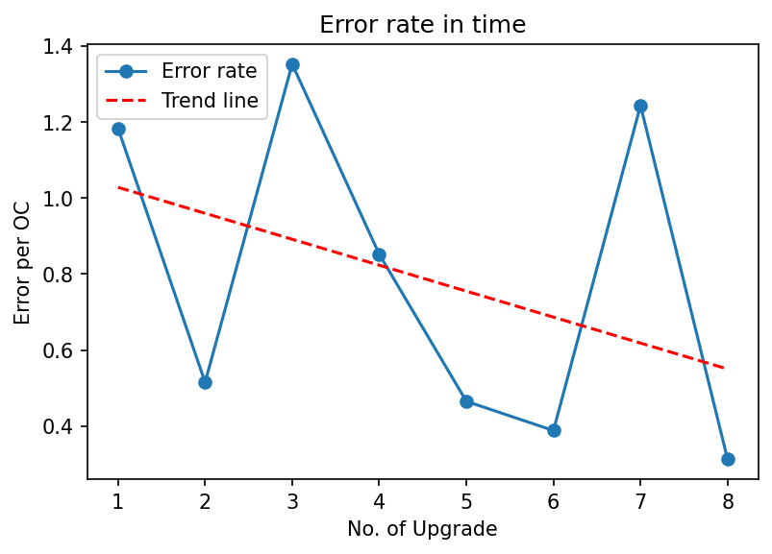
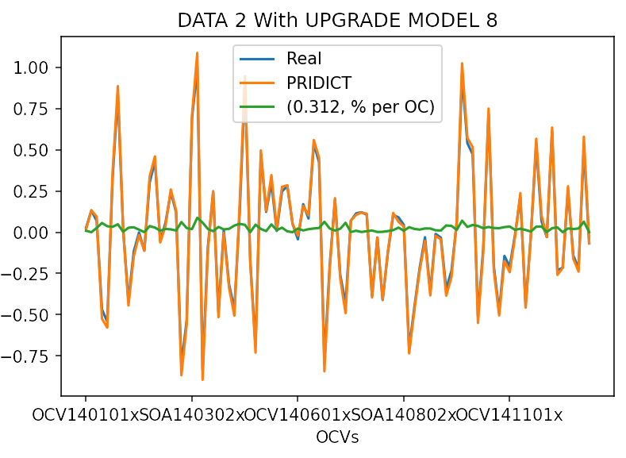
I.FAST Workshop 2025

Slide 19
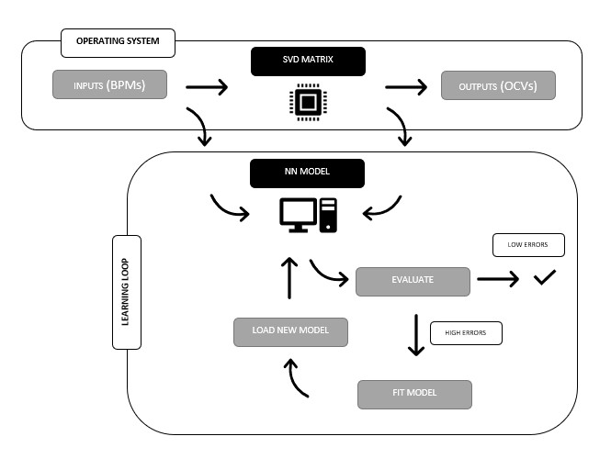
I.FAST Workshop 2025
Coding Loops Overview
Step 1: Initial Model Creation
  Goal:
  Create an initial model (Model 1) to allow the machine to run without trips.
  Built using saved (offline) data.
  Purpose: Guide machine operation.
Problem:
  Model trained on outdated data (collected months ago).
  Set points had changed multiple times.
  Result: Model guided the beam toward an outdated path.
Step 2: Correction Loop
After running Model 1, the machine checks the beam position.
Adjusts X/Y RMS by adding a bias to the correction matrix:
[Matrix Output (96 × 1)]+[Correction Bias (96 × 1)]
Goal: Reduce X/Y RMS value to zero.
Issue:
  Not tested yet.

Slide 20
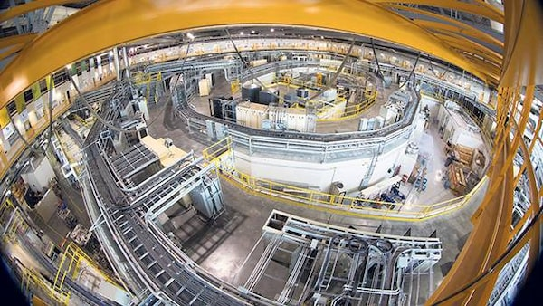
I.FAST Workshop 2025
Practical Use of the Model 1
Converting the Model:
After training the model Saves in H5 or Keras format.
  Convert to machine-compatible format for deployment
Implementing in the System:
Integrated the converted model into the machine's Fast Feedback Algorithm.
Used the model to process real-time data from BPMs and generate correction signals for OCs.
Experiment:
Ran the NN-based Fast Feedback for 5 minutes under both controlled and experimental conditions with a 9 mA current in the SR.
No beam trip observed in the storage ring during this period.

Slide 21
I.FAST Workshop 2025
Evaluation Metrics
The performance of the neural network model was evaluated using several key metrics
Beam Stability: This metric assesses the consistency of the beam current, indicating that the beam is not colliding with the vacuum chamber walls. However, consistent beam current alone does not confirm that the beam is precisely following its designated circular path, as the useful orbit for beamlines is only a few micrometers wide, while the vacuum chamber is several millimeters wide.
X-RMS and Y-RMS: These metrics represent the root mean square values for the horizontal (X) and vertical (Y) beam positions, indicating the stability and accuracy of the beam position.
Mean Squared Error (MSE): This metric measures the average squared difference between the predicted values and the actual target values in the training dataset.

Slide 22
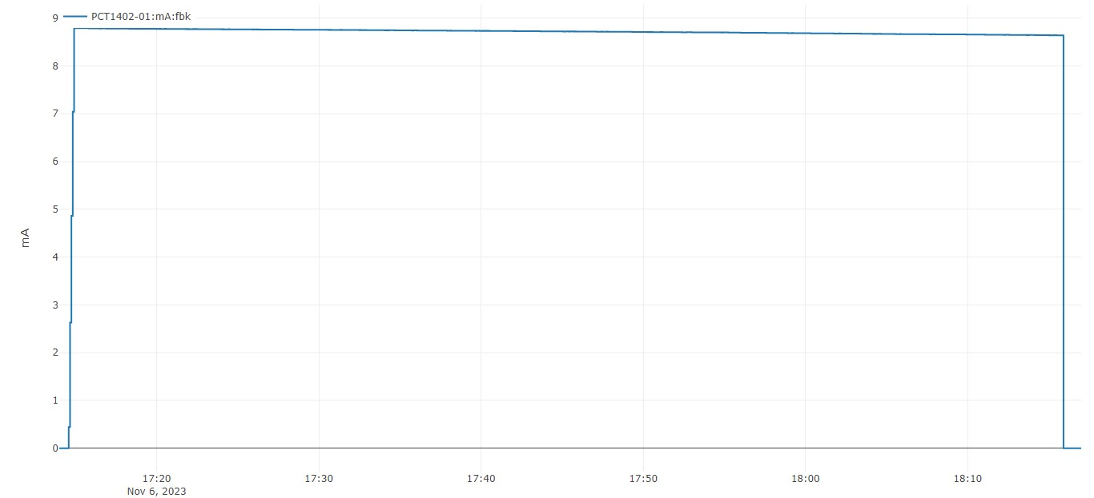
I.FAST Workshop 2025
Beam Stability
This metric assesses the consistency of the beam current, indicating that the beam is not colliding with the vacuum chamber walls.
A stable beam current alone does not confirm that the beam is precisely following its designated circular path.
The vacuum chamber is several millimeters wide, while the useful orbit for beamlines is only a few micrometers wide.
Therefore, consistent current only indicates that the beam is not hitting the walls, but it does not guarantee that the beam is accurately positioned along its intended trajectory.
As a result, the beam does not collide with the walls, and our NN model does not have a disturbing effect on the machine.

Slide 23
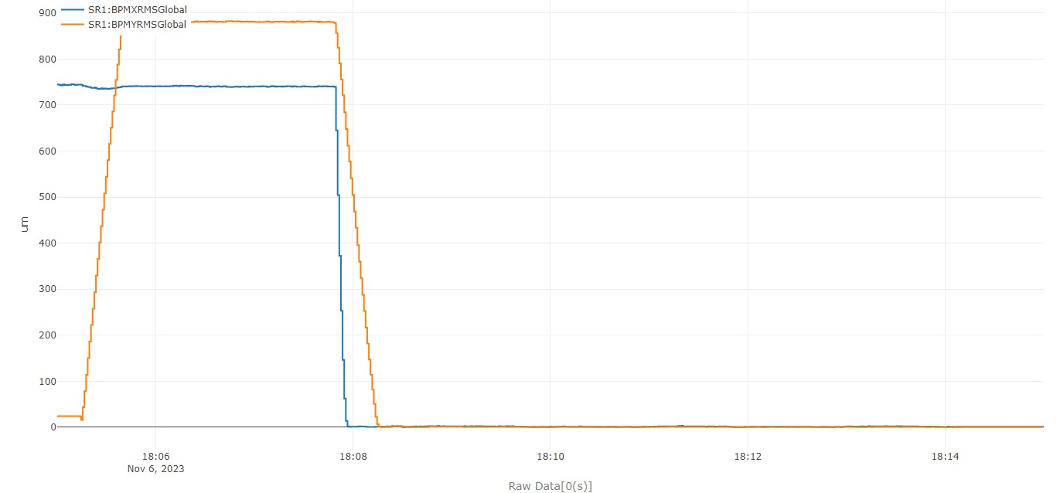
I.FAST Workshop 2025
Beam Position
The primary issue with the new model is the fluctuating reference points, leading to unusually high RMS values in both horizontal (X) and vertical (Y) beam positions.
These variations in reference points result in greater-than-expected RMS values, highlighting the need to stabilize these points to enhance model performance( By correction loop) .
Despite these challenges, A constant RMS in the NN model indicates that the beam maintains inaccurate positioning due to the outdated dataset used for training the model.
NN MODEL
RM

Slide 24
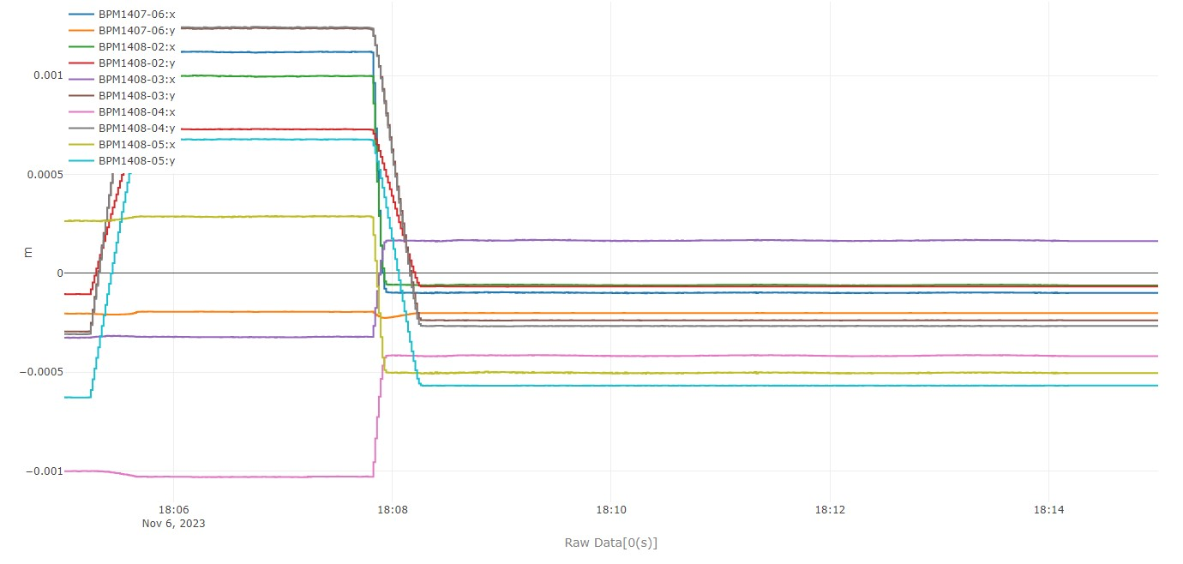
I.FAST Workshop 2025
Beam Position Analysis
The question centers on the causes of elevated RMS values. Analyzing the readings from the BPMs, it becomes clear that the new model's training involved specific reference points at (-1000, -500, 500, 1000 um), making it highly sensitive to these values and predisposed to seek data matching these points.
As a result, the BPM readings reflect a coefficient derived from these values.
For example, in BPM1401-02 , while the reference model indicates a beam position of -500 um, the new model shows -2500 um. Similarly, BPM1412-05 shows an actual position of -250 um versus the predicted +750 um .
NN MODEL
RM

Slide 25
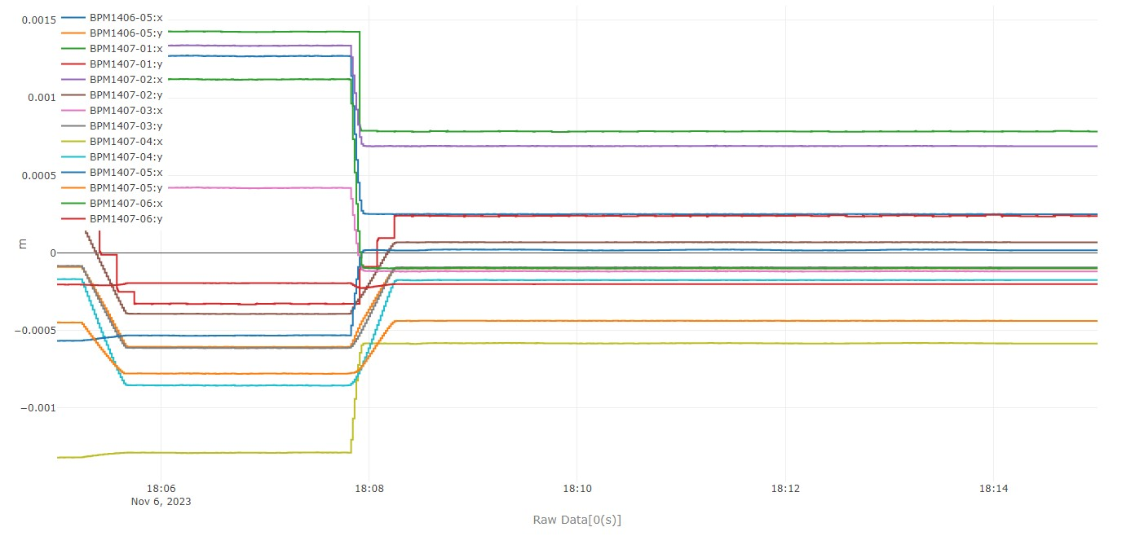
I.FAST Workshop 2025
Performance
The initial observation shows a consistent trend in the BPM positions, suggesting that the model is functioning as expected ( for first loop).
The uniformity in BPM positions reflects the model's ability to predict and maintain beam positions; however, further analysis over a broader frequency range is required to fully validate the model's performance.
While the current data suggests consistent performance, a comprehensive comparison with previous models is necessary before concluding superior performance.
NN MODEL
RM

Slide 26
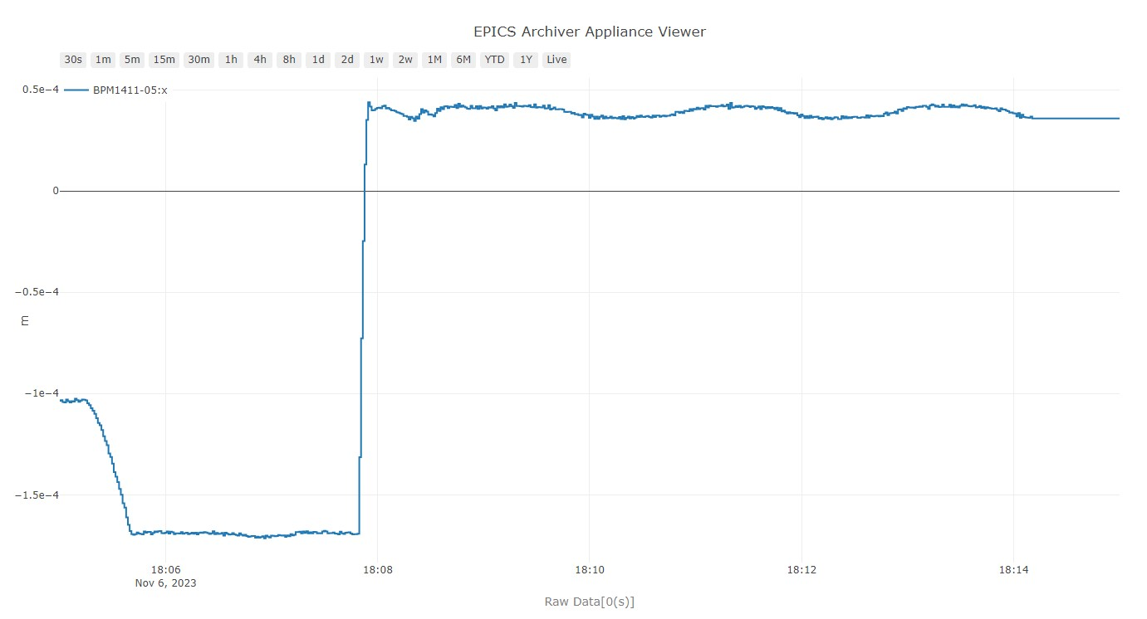
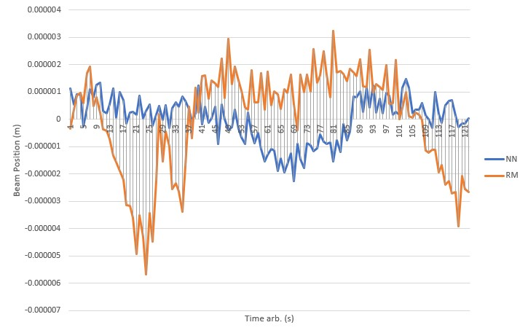
I.FAST Workshop 2025
In-Depth Exploration
Now we want to look more closely to determine how smoothly the NN model performs and how effectively it reduces fluctuations.
This will involve a comprehensive analysis to fully evaluate and understand the subtleties and complexities of their capabilities.
To begin, we'll focus on the beam position in section 11, specifically at BPM1411-05, where the difference is clearly visible to the naked eye.
This indicates that the RMS for the NN-Model is 8.14 ×10⁻⁵, while the RMS for the RM-Model is 18.69 × 10⁻⁵.
56.4% reduction in fluctuations!

Slide 27
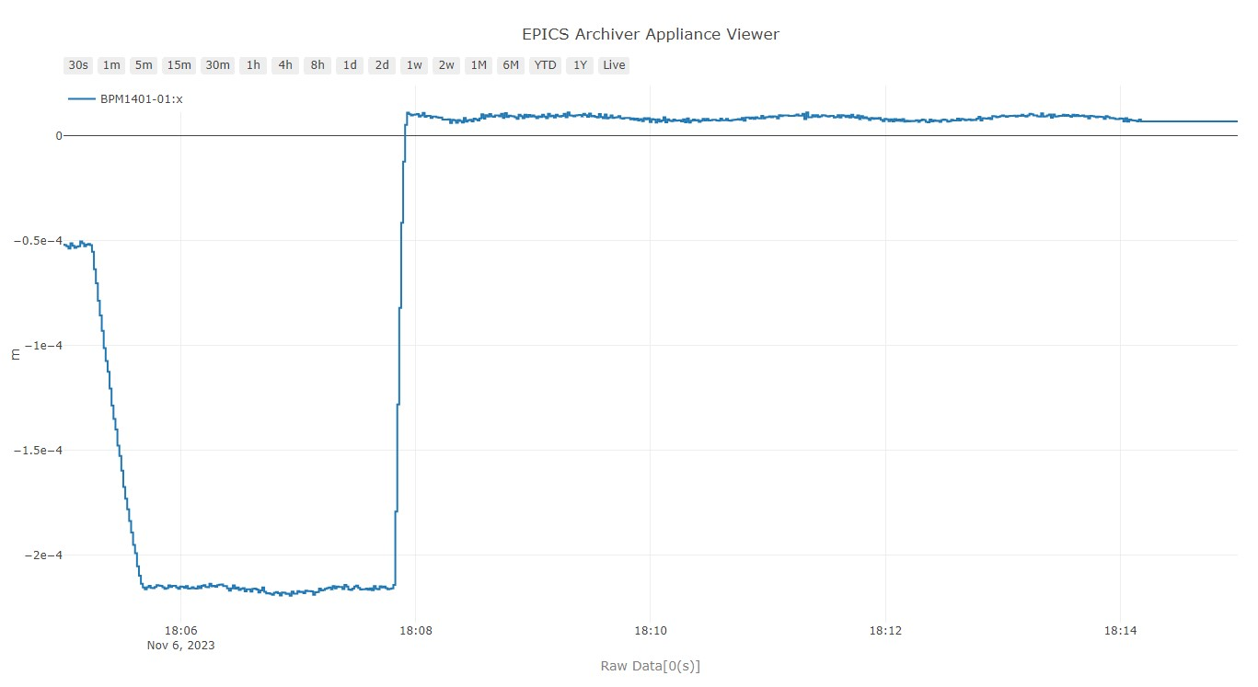
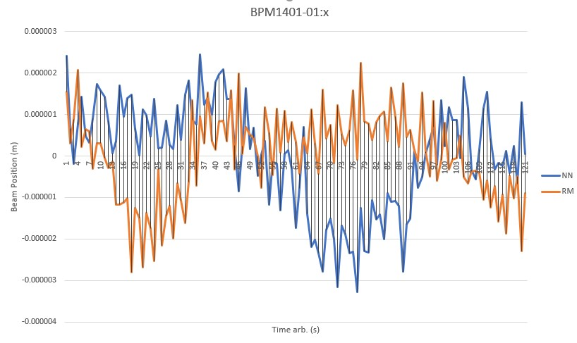
I.FAST Workshop 2025
In-Depth Exploration
Similarly, for or BPM1401-01:x in section 1, the RMS for the NN-Model is 1.02 × 10⁻⁴, while the RMS for the RM-Model is 1.28 × 10⁻⁴
20.3% reduction in fluctuations.
The consistency in results is maintained across other BPMs, although there are occasional variations where results either slightly exceed or fall short of expectations. Notably, in sections 11, 12, and 1, the NN-Model consistently outperforms others. However, it should be noted that for Y positions, the performance of both the new and old models is identical. This suggests that the NN-Model achieves improved accuracy and effectiveness in specific sections. However, more parameters need to be checked, and we have to be cautious about interpreting this result.

Slide 28
I.FAST Workshop 2025
Future Activities
Expansion of Input Parameters:
To improve the accuracy and robustness of the model, we will expand the input parameters to include additional factors such as ID movement, RF parameters, Set points and other operational variables. This will help the model account for a broader range of influencing factors beyond BPM data.
Implementation of Correction Loop:
The next step in our project involves enhancing the existing code by integrating a correction loop. This addition will focus on adjusting the Root Mean Square (RMS) values by introducing a bias parameter into the model.
Testing and Validation:
Upon implementation of the correction loop and input parameter expansion, the model will undergo a rigorous testing phase using both existing and new data sets.

Slide 29
I.FAST Workshop 2025
Future Activities
Expansion of Input Parameters:
To improve the accuracy and robustness of the model, we will expand the input parameters to include additional factors such as ID movement, RF parameters, Set points and other operational variables. This will help the model account for a broader range of influencing factors beyond BPM data.
Implementation of Correction Loop:
The next step in our project involves enhancing the existing code by integrating a correction loop. This addition will focus on adjusting the Root Mean Square (RMS) values by introducing a bias parameter into the model.
Testing and Validation:
Upon implementation of the correction loop and input parameter expansion, the model will undergo a rigorous testing phase using both existing and new data sets.

Slide 30
I.FAST Workshop 2025
Data Set Enhancement:
We will work on increasing the size of the training dataset to reduce bias and improve model generalization. This will help the model perform better under different operational conditions.
Review and Iteration:
Post-testing, we will analyze the performance data and feedback to identify any areas for further improvement. We will adjust the model as necessary to optimize its accuracy and stability.
Acknowledgment:
This experiment was conducted with the collaboration and guidance of M. Boland, T. Batten, M. Bree, W. A. Wurtz, C. Baribeau, H. Shaker and the control room operators of CLS.

