Slide 1
Orbit stability and reproducibility at SOLARIS storage ring
Adriana Wawrzyniak
adriana.wawrzyniak@uj.edu.pll
I.FAST Workshop 2025 on Stability of Storage Ring Based Light Sources
17-21.03.25 KIT, Karlsruhe, Germany

Slide 2
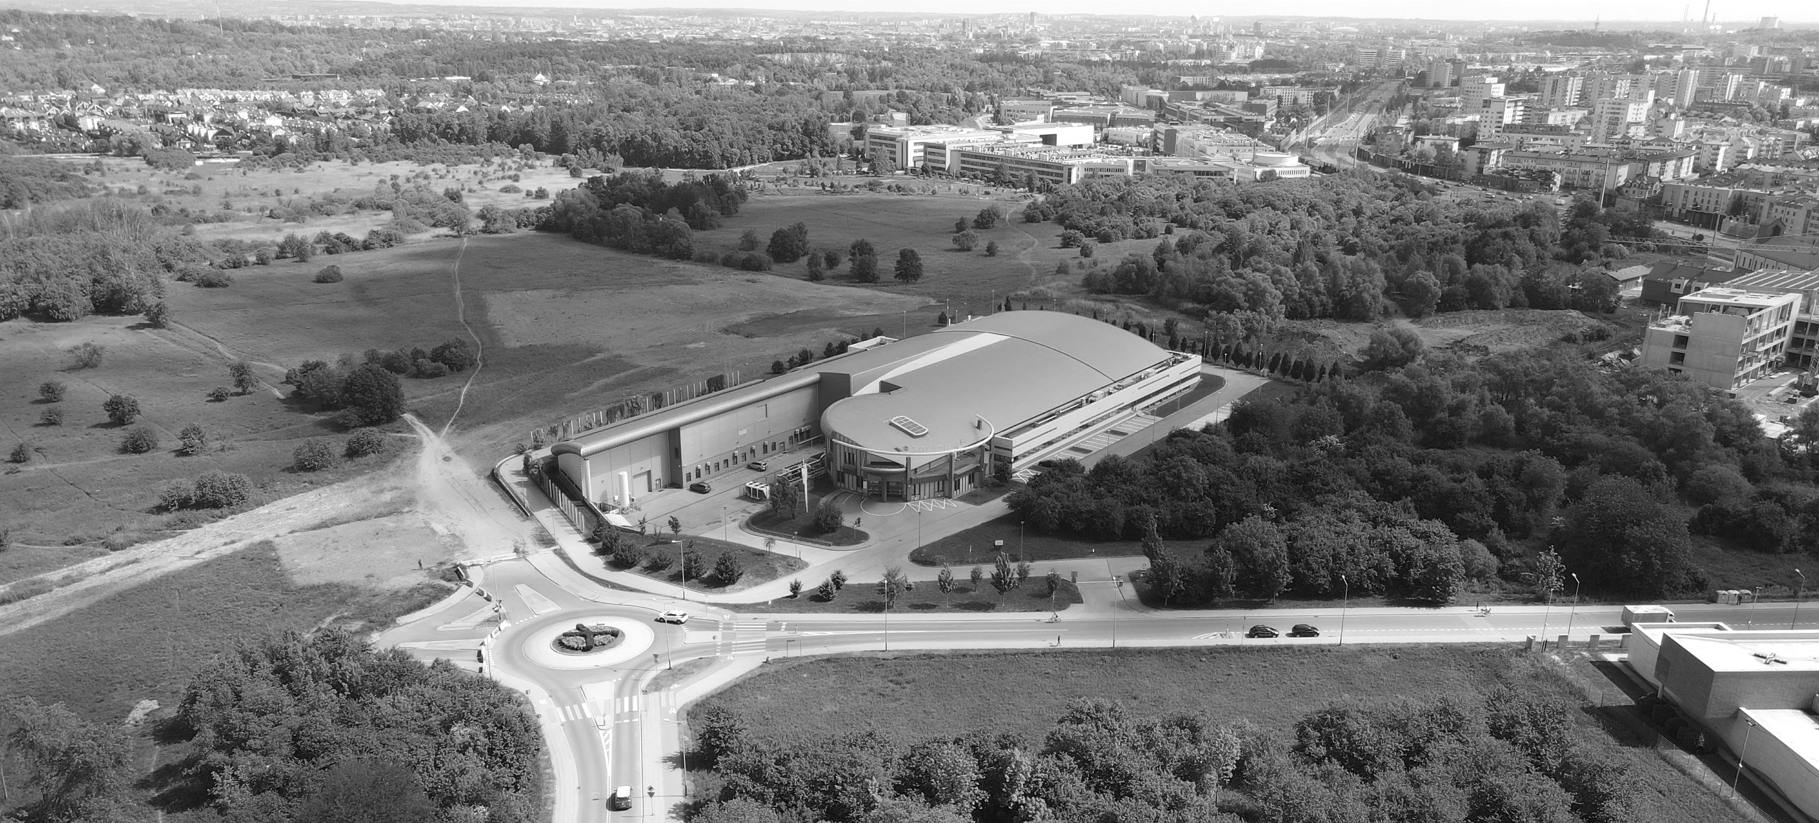
Introduction to Solaris
KRAKOW
CITY CENTRE
NEW CAMPUS
JAGIELLONIAN UNIVERSITY
SOLARIS

Slide 3
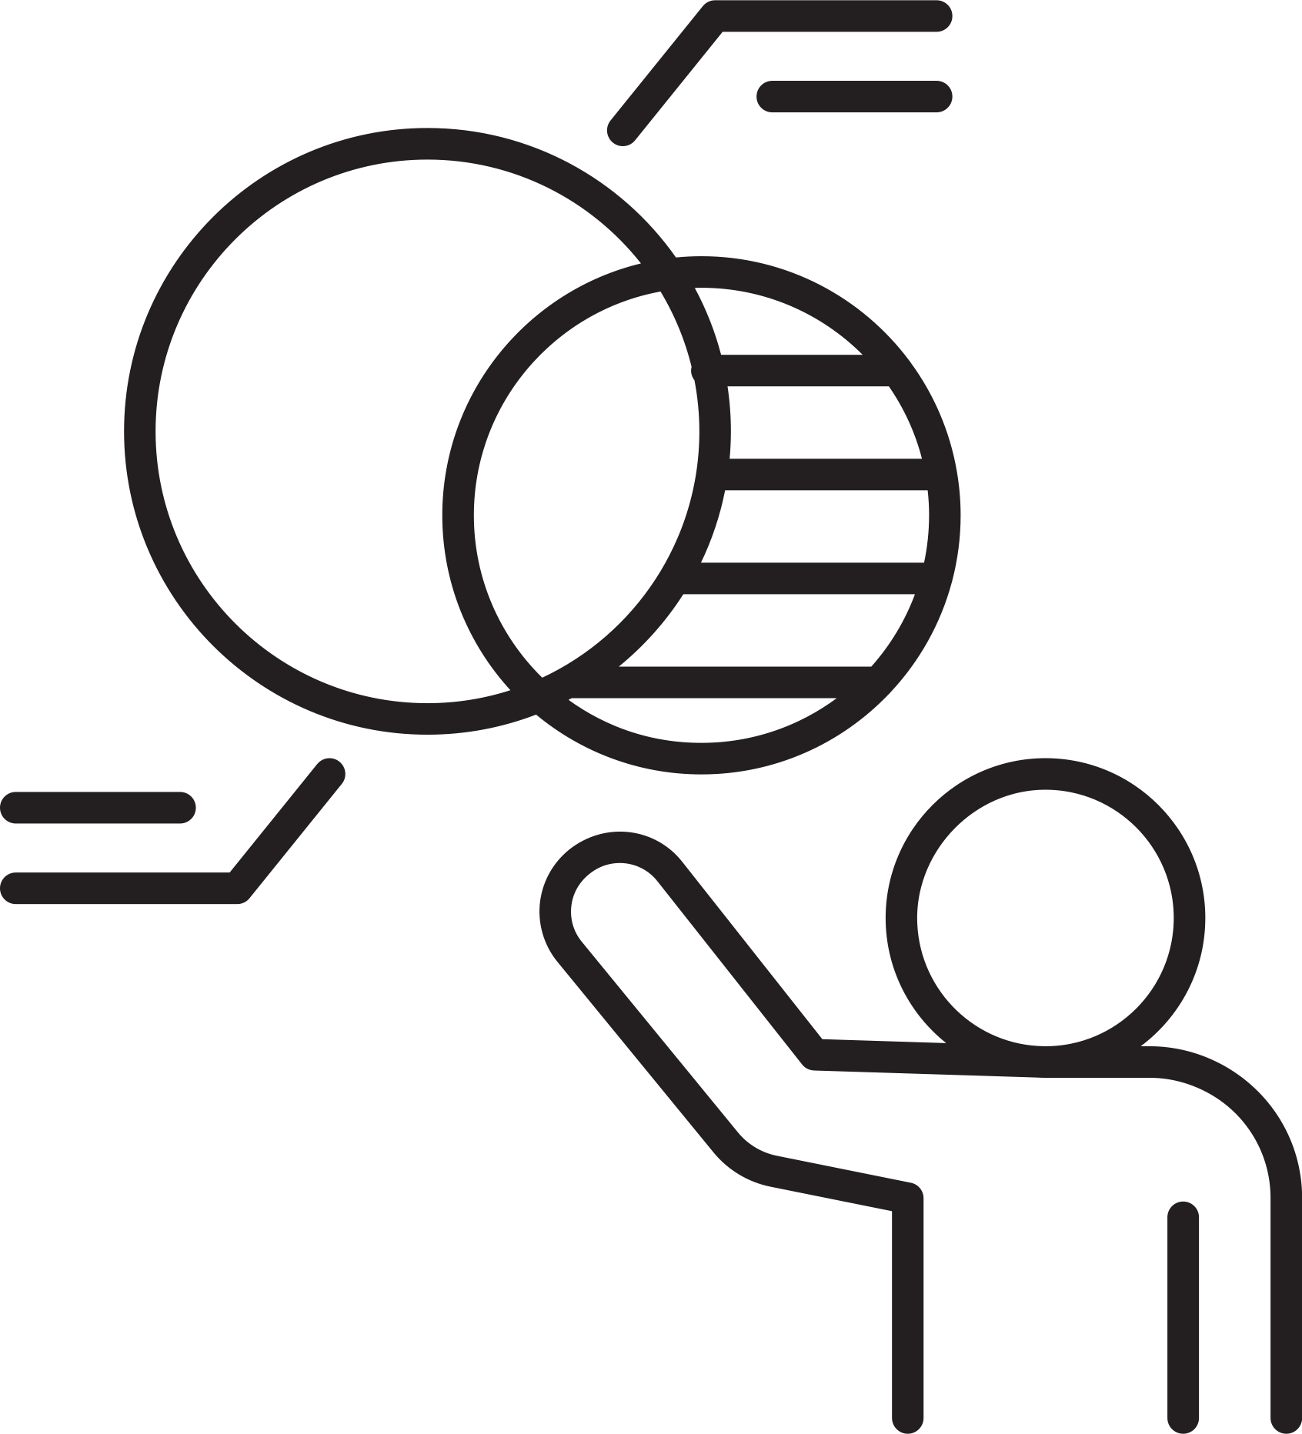
Short History of SOLARIS
02
04
2015-2018
Commissioning of the first two beamlines
2022-2023
Extension of the experimental hall
2010-2015
Construction of the facility and commissioning of accelerators
since October 2018
SOLARIS Center available for users
01
03

Slide 4
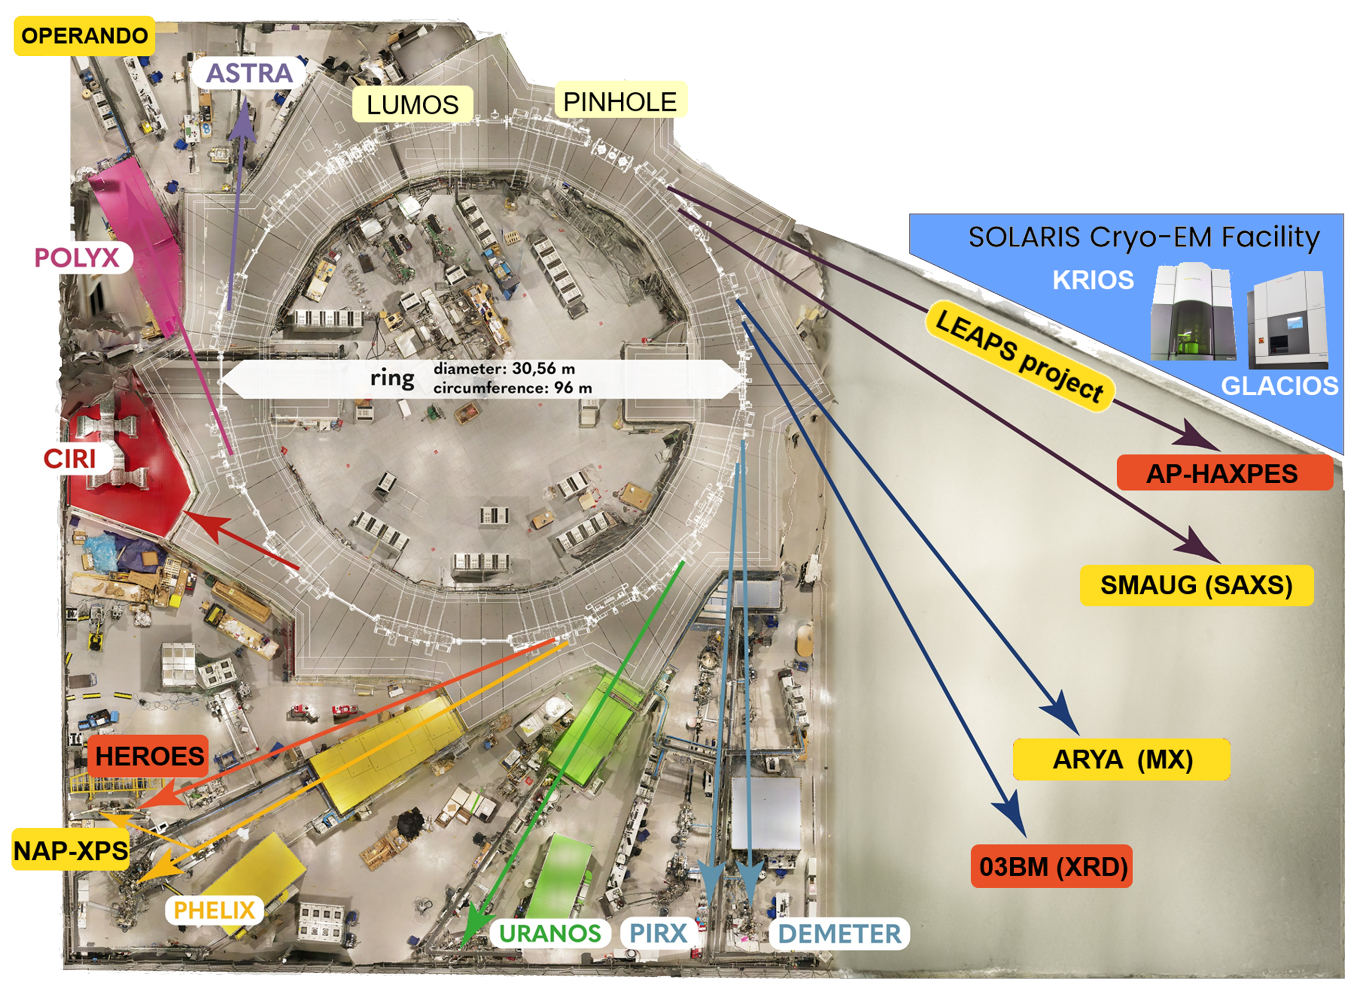
Research Facilities
Instruments
IR microspectroscopy (3)
VUV and soft X-ray spectroscopy (3)
soft X-ray microscopy (2)
hard X-ray spectroscopy (1)
hard X-ray microscopy & tomography (1)
transmission electron microscopes (2)
Operating
Beamlines
Cryo-EM Facility
Diagnostic instruments
Development plans
under construction
avaiting for funding

Slide 5
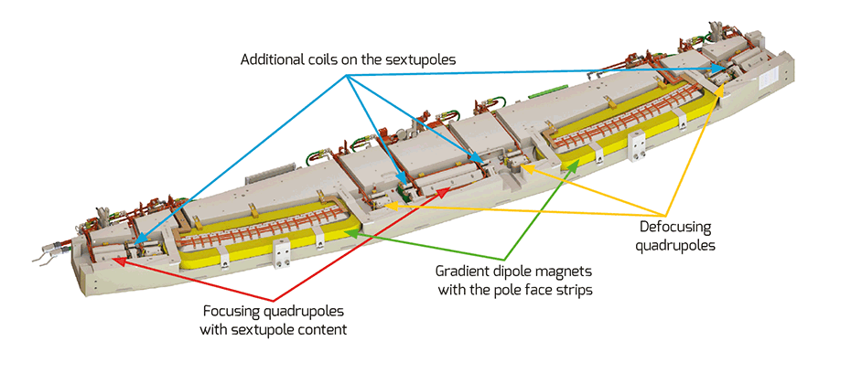
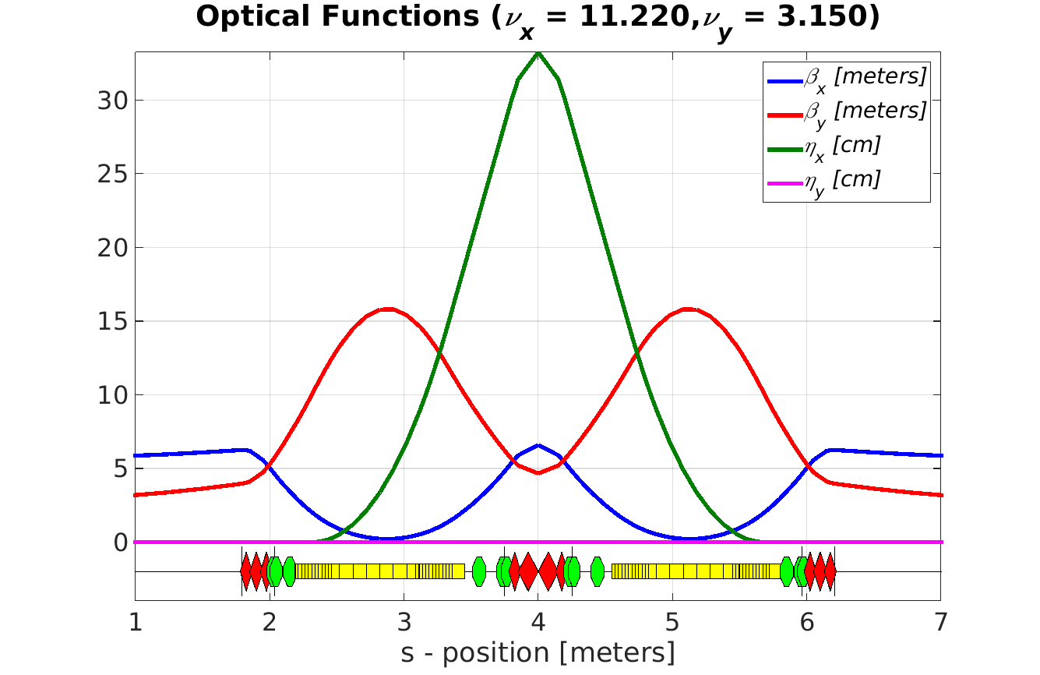
SOLARIS Storage Ring parameters
Parameter | Value
Energy | 1.5 GeV
Max. current | 500 mA
Harmonic number | 32
Natural emittance | 6 nmrad
Coupling | 1 %
Tune ν_{x}, ν_{y} | 11.22, 3.15
Corrected chromaticity ξ_{x}, ξ_{y} | +2,+2
Electron beam size s.s. center | 183 um,13um
Electron beam size dipole center | 44um,30um
Energy loss/turn | 114.1 keV
Momentum acceptance | 4%
Lifetime | 13h
ANIMACJA

Slide 6
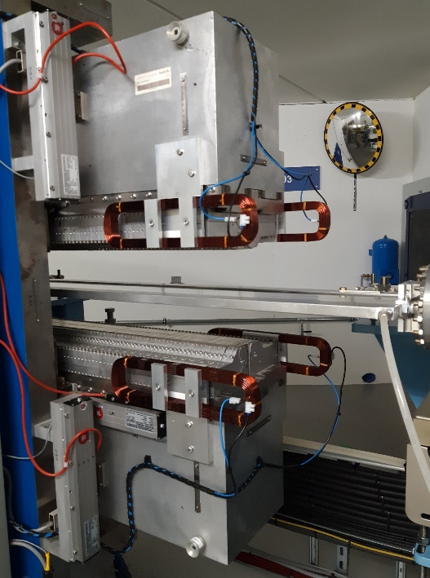
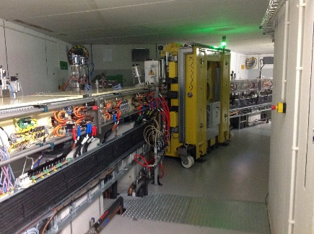
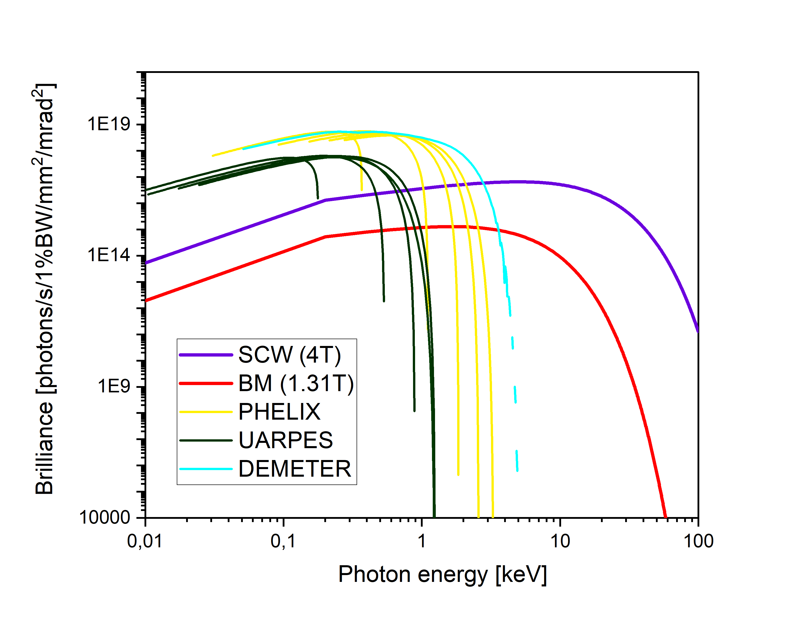
Insertion Devices
Beam Line | 04 - DEMETER | 05 - UARPES | 06 - PHELIX
ID type | EPU | EPU APPLE II type, quasiperiodic | EPU APPLE II type
Type of magnets | Permanent NdFeB NEOMAX 39SH | Permanent NdFeB | Permanent NdFeB
Magnetic period length | 46.6 mm | 120 mm | 58 mm
Number of periods | 44 | 21 | 44
Minimum gap | 14 mm | 20 mm | 14 mm
Maximum gap | > 200 mm | 140 mm | 220 mm
Length of magnet assemblies | 2116.9 mm | 2669,9 mm | 2676.6 mm
Total length of undulator | 2136.9 mm | 2699 mm | 2700 mm
Peak B field at min. gap | 0.71 T | 0.774 T | 0.879 T
Available energy Range | 100 – 2000 eV | total: 8–100 eV NIM: 8 eV–30 eV PGM: 16 eV–100 eV | 50–1500 eV for linear horizontal, linear vertical, and circular polarization 70–1500 eV for linear polarization inclined at 45°
Polarization | Circular left- and right-handed, linear horizontal and vertical | Circular, elliptical, linear horizontal and vertical, linear skewed. | Circular, elliptical, variable linear
Manufacturer | ADC | Kyma | Kyma
6

Slide 7
SOLARIS Operation
STANDARD OPERATION 24/7
2 Shifts (8:00-16:00; 14:00-22:00)
Monday – machine days, maintenance
User operation 6 days/week (Tue-Mon)
On call support to 2:00 am from Tue-Mon
2 operators/shift Injection twice/day: 8:00 am and 8 pm
One operation mode (uniform filling pattern)
Operation in the decay mode
7

Slide 8
Stability and Reproducibility
Orbit instability ( beam – environment)
Vibration (building, vibrating equipment)
Thermal (cooling water)
Magnetic field (power supply for electromagnets, insertion device)
RF field (Main cavities, Landau cavities)
Ion instability (beam – vacuum)
Coherent instabilities (beam – component)
Singe bunch
Coupled bunch
Elastic (Coulomb scattering) - residual background gas
Inelastic (Bremsstrahlung scattering) causes particles to loss energy - residual background gas
Touschek effect – intra beam scattering
Design optimisiation, optics, impedance, vacuum
Feedback (SOFB, FOFB, BbB, RF )
Magnets cycling, alignment, stability of PS
Stability & reproducibility
 | σx | σy
Straight Section Center | 183um | 13um
Dipole center | 44 um | 30um
Stability <10% of beam size | <4 um | < 1.3um

Slide 9
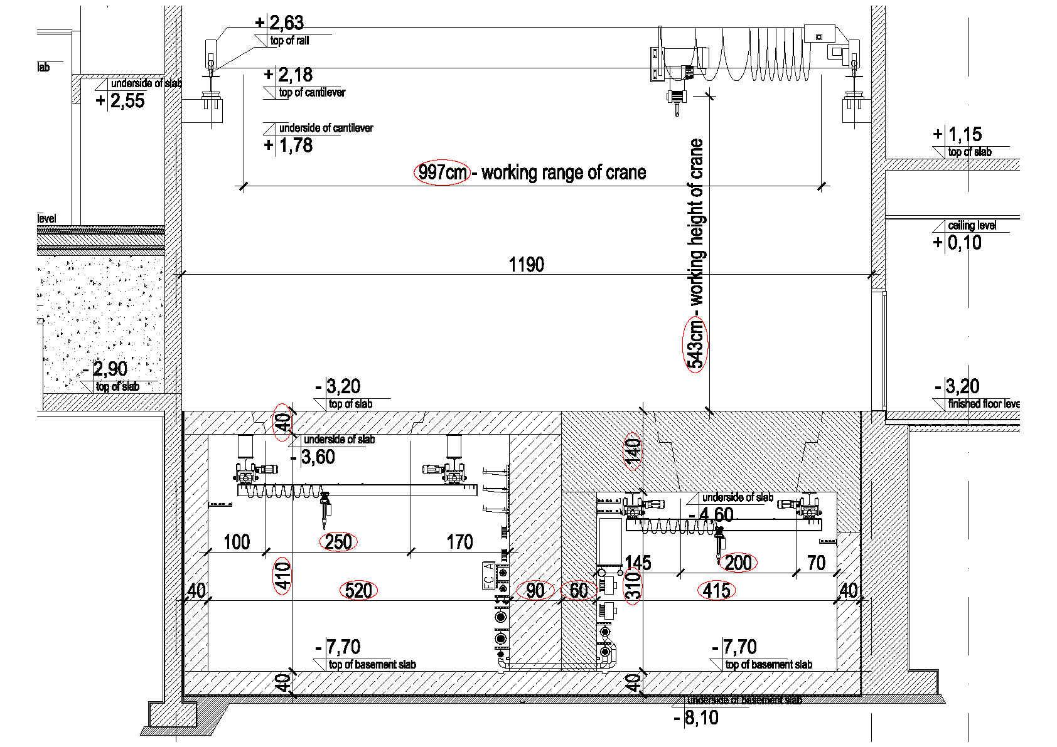
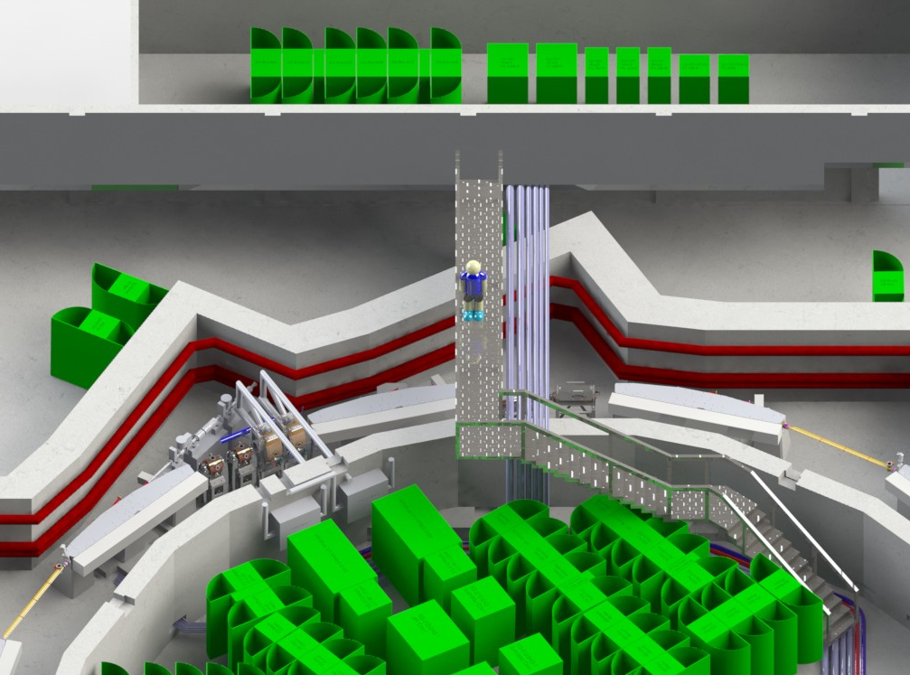
Mechanical stability
Floor: Monolithic, jointless slab, 100 cm thick, founded on vibro-isolation mats placed on underlying hydraulic concrete.
Data: M. Boruchowski

Slide 10
Mechanical stability
Section 1
Section 2
Section 3
Section 4
Section 5
Section 6
Section 7
Section 8
Section 9
Section 10
Section 11
Section 12
Section 1
Section 2
Section 3
Section 4
Section 5
Section 6
Section 7
Section 8
Section 9
Section 10
Section 11
Section 12
Data: M. Boruchowski

Slide 11
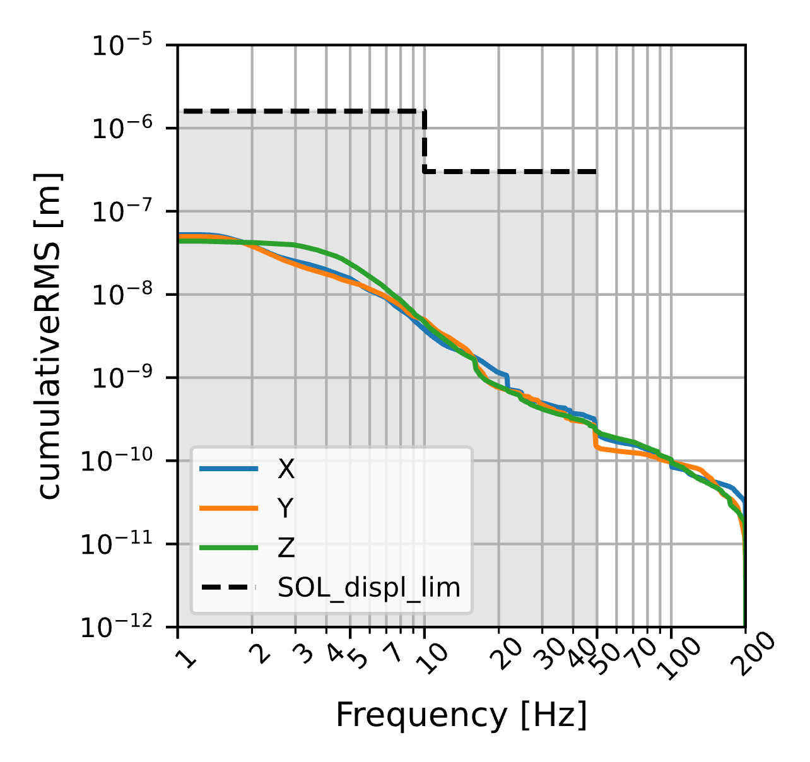
Mechanical stability
The defined vibration requirements:
Vibration displacement below 10 Hz must not exceed 1.6 µm (RMS)
Vibration displacement between 10 and 50 Hz must not exceed 0.3 µm (RMS).
Site survey before construction
Peak acceleration of ground vibrations:
170 µm/s² – both horizontal directions
70 µm/s² – vertical direction
Maximal acceleration of ground vibrations in third-octave bands:
80 µm/s² (12.5 Hz band) – both horizontal directions
30 µm/s² (10 Hz band) – vertical direction
Accelerator slab vibrations:
25-29 Hz – roughing vacuum pumps
45-50 Hz – equipment with induction electric motors powered directly from grid
100 Hz – electric power distribution equipment
Cumulative RMS displacement for normal noise background
Data: M. Piszak

Slide 12
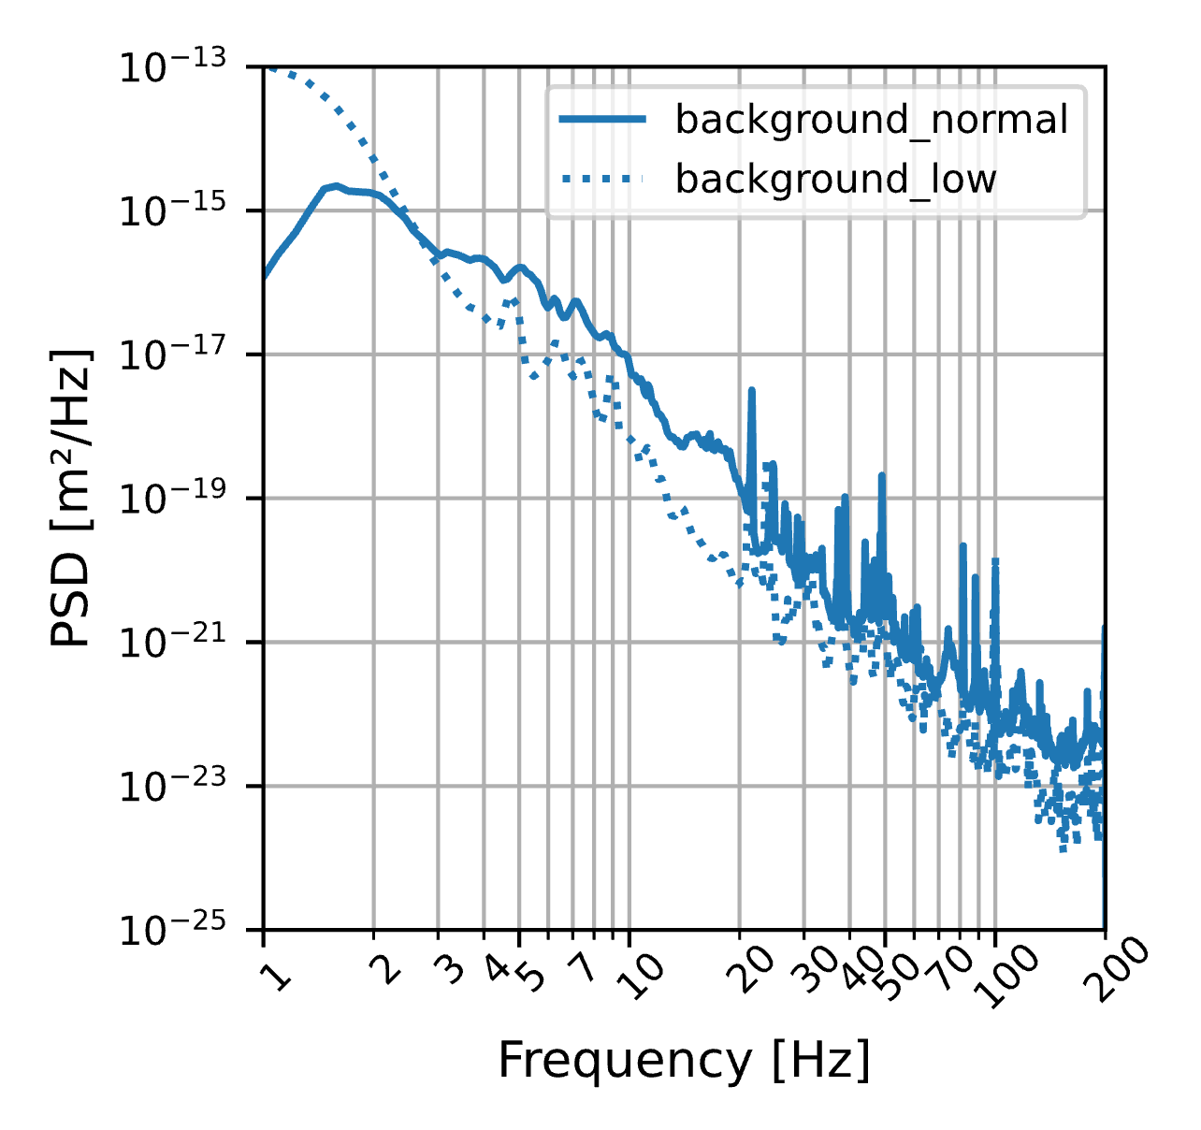
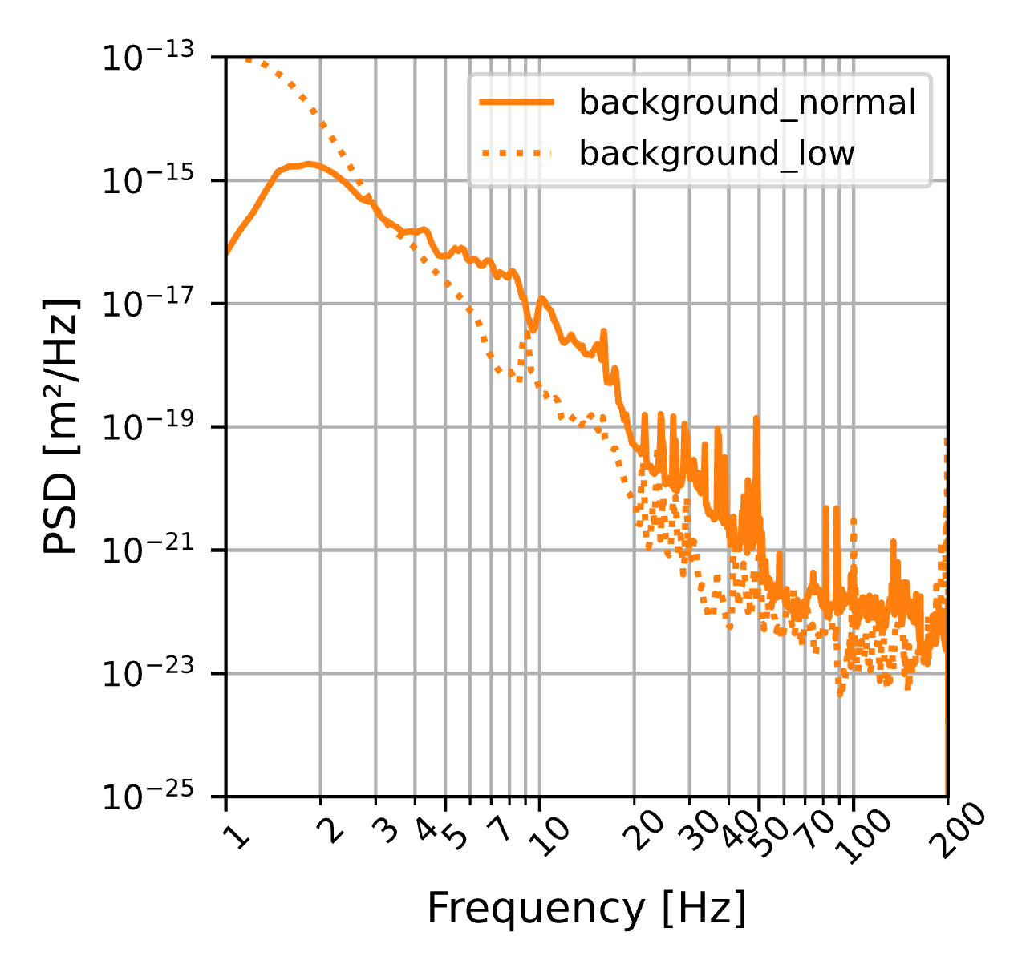
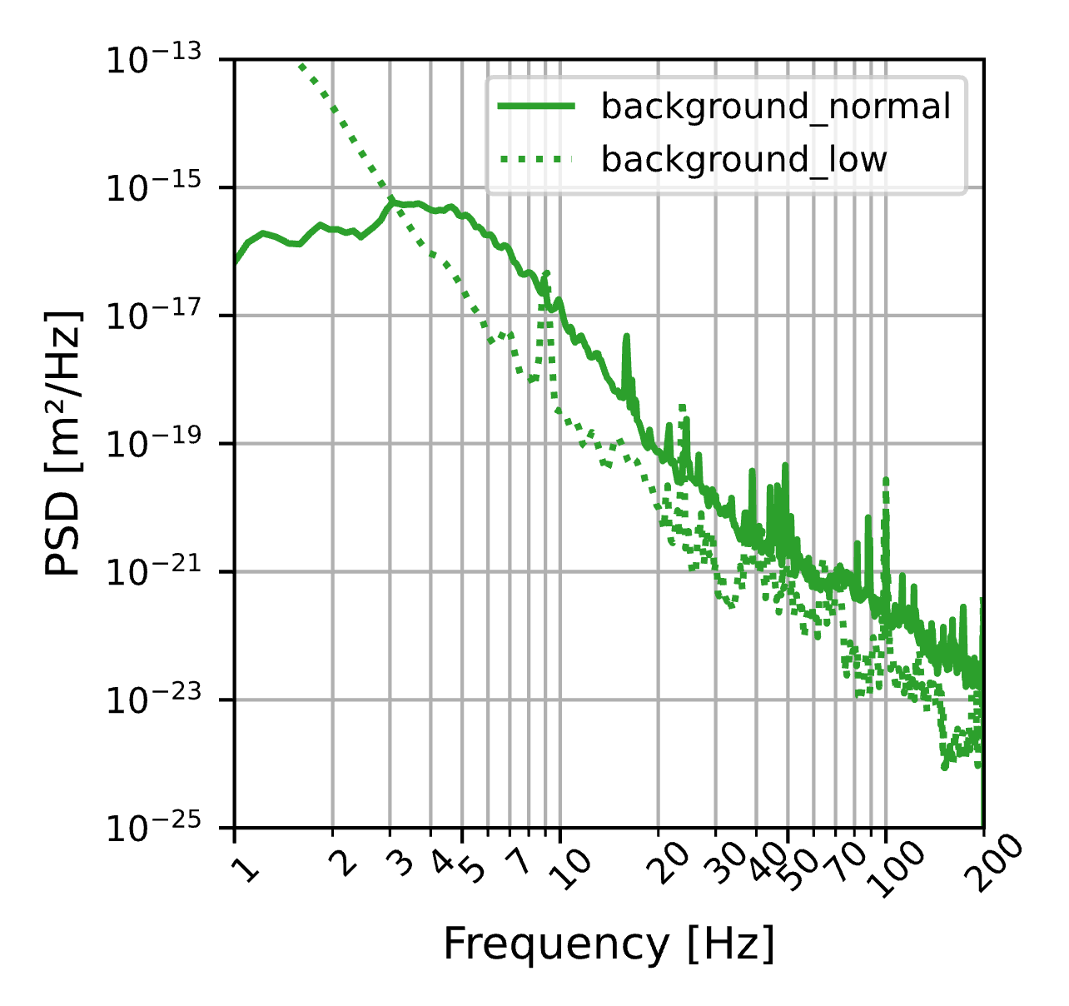
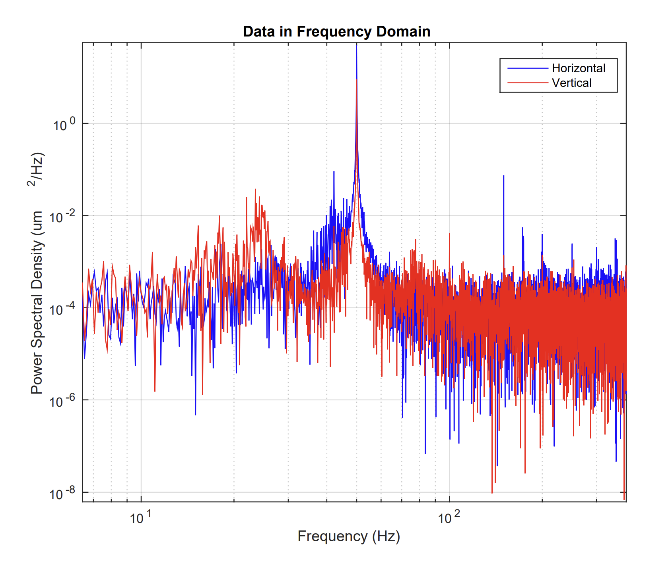
Mechanical stability
Displacement PSD comparison for X (horizontal, blue), Y(horizontal, orange) Z (vertical,green) axis
grid
roughing vacuum pumps
electric power distribution equipment
Data: M. Piszak
Many sources also generate 2nd and 3rd harmonics of their fundamental frequency, the energy transmitted by the harmonic sources is relatively small compared to that of the broadband sources.
A peak around 9 Hz ( low background data) is attributed to the accelerator slab resting on elastomeric mat to isolate the slab, along with accelerator and beamlines, from vibration sources operating at frequencies higher than 15 Hz, both from within the building (such as machine room with pumps and ventilation) and from external sources (cooling units).

Slide 13
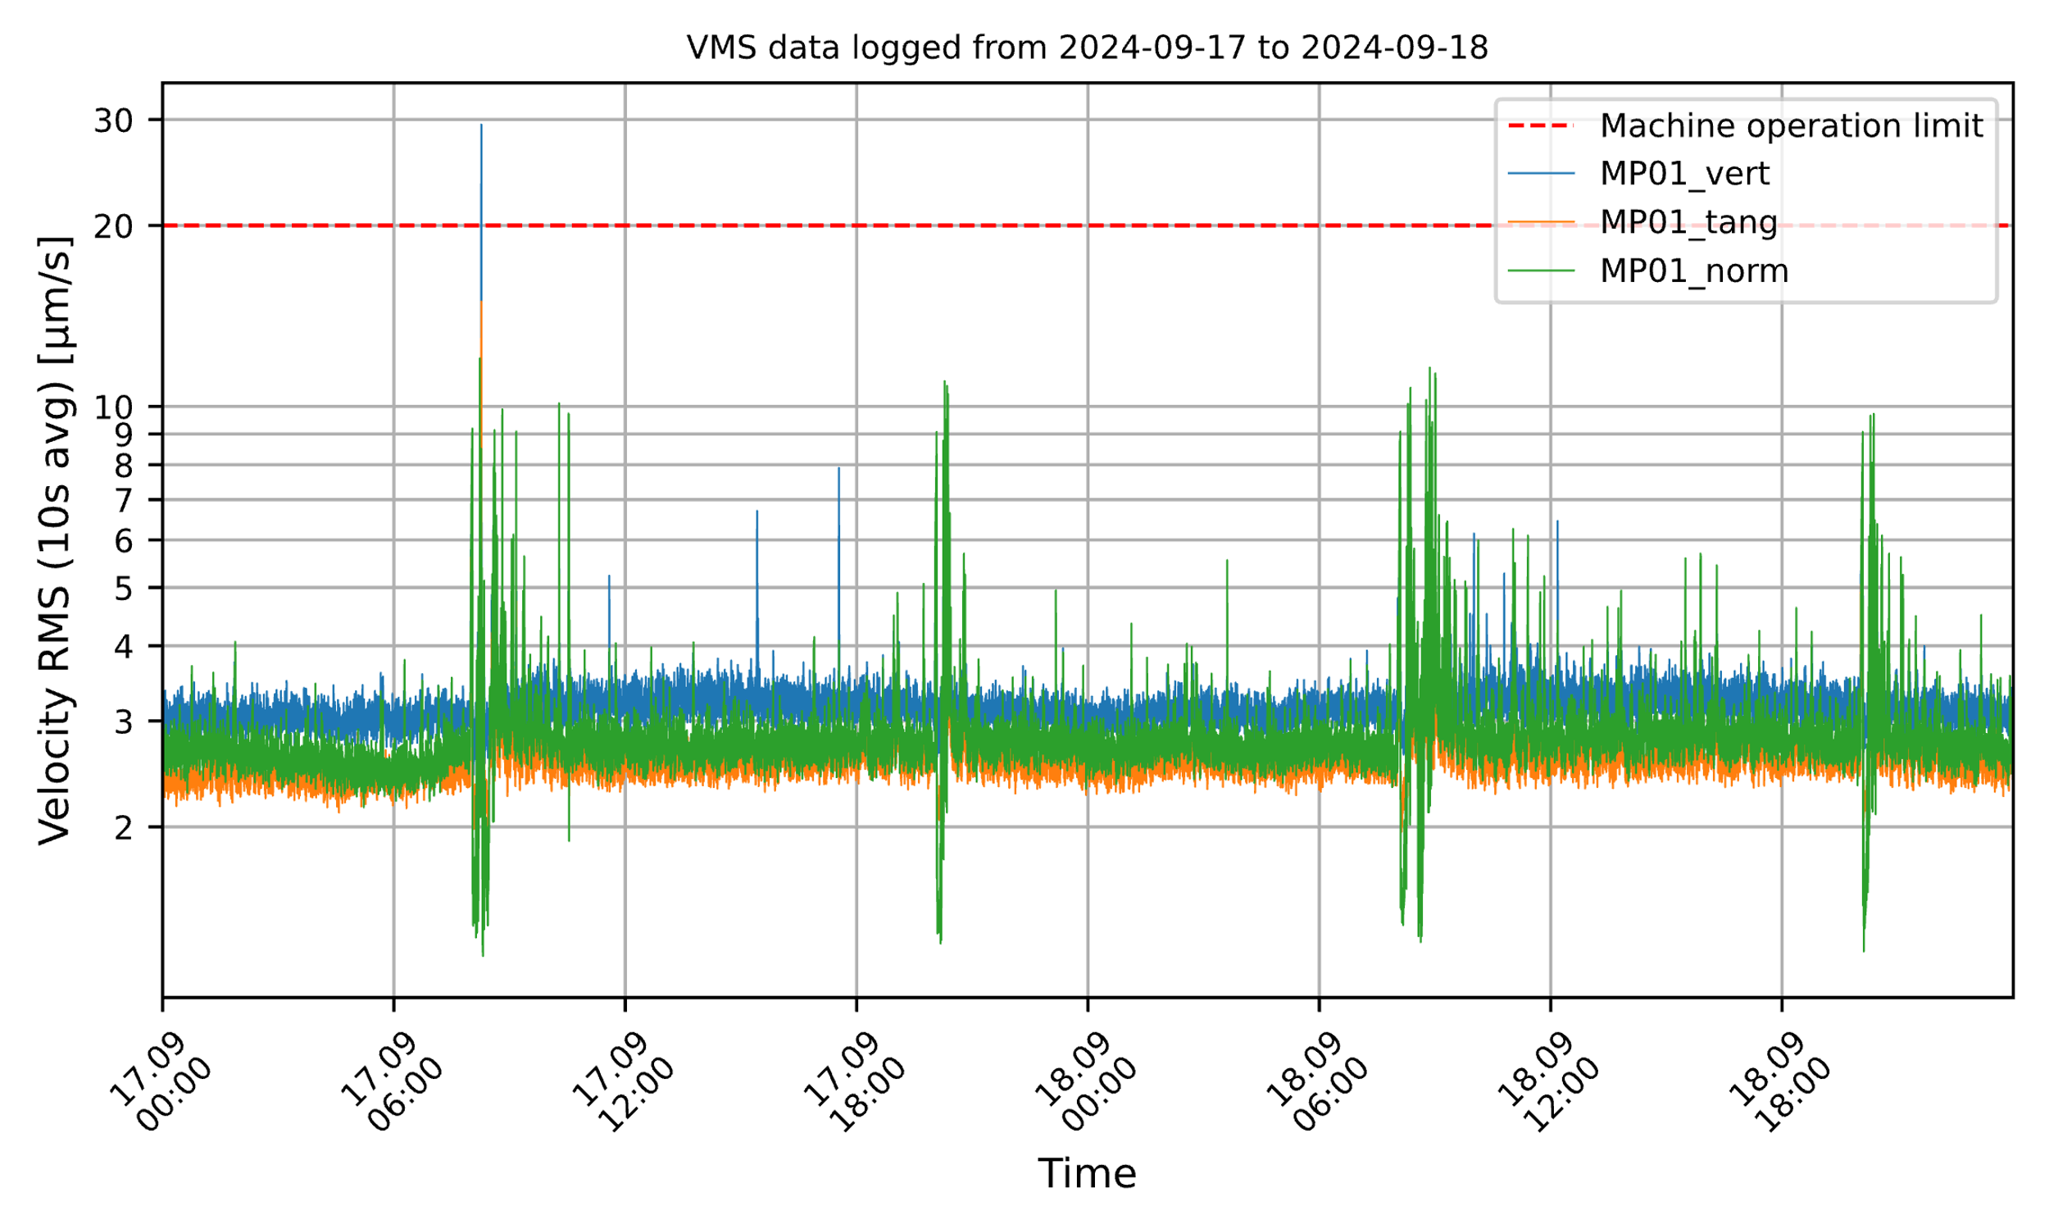
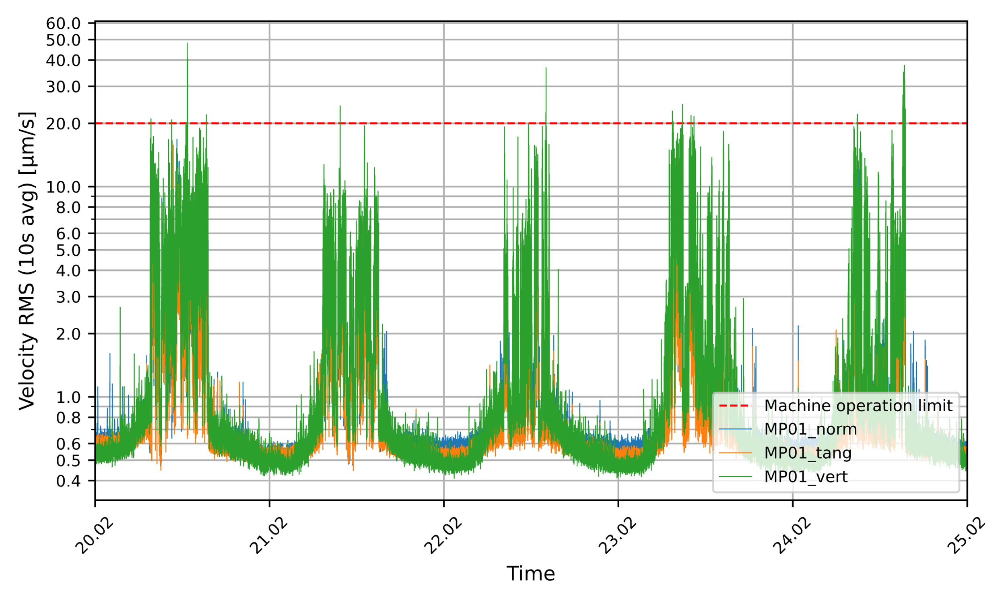
Mechanical stability
Vibration Monitoring System
The storage ring of NSRC SOLARIS is equipped with Vibration Monitoring System (VMS). The system provides real-time data directly from Double-Bend Achromat (DBA) in R1-01 section. The measurement point is equipped with accelerometers measuring vibrations in three orthogonal directions:
Vertical
Tangential (parallel to the electron beam trajectory)
Normal (perpendicular to the electron beam trajectory)
The data is being continuously logged during accelerators operation. Postprocessing includes filtering, windowing, integration and root-mean-square calculation, producing one value per 10 seconds of measured signal.
The mechanical stability requirements of the NSRC SOLARIS storage ring are met under normal operating conditions. The dynamic environment within the facility and its surroundings is characterized by low vibration levels, supported by the absence of high-traffic roads and the relatively large distance from rail-based transport.
VMS vibration level history graph during normal operation.
Sample VMS data logged during construction works (machine shutdown period). The level of vibrations during daytime was excessive
Data: M. Piszak

Slide 14
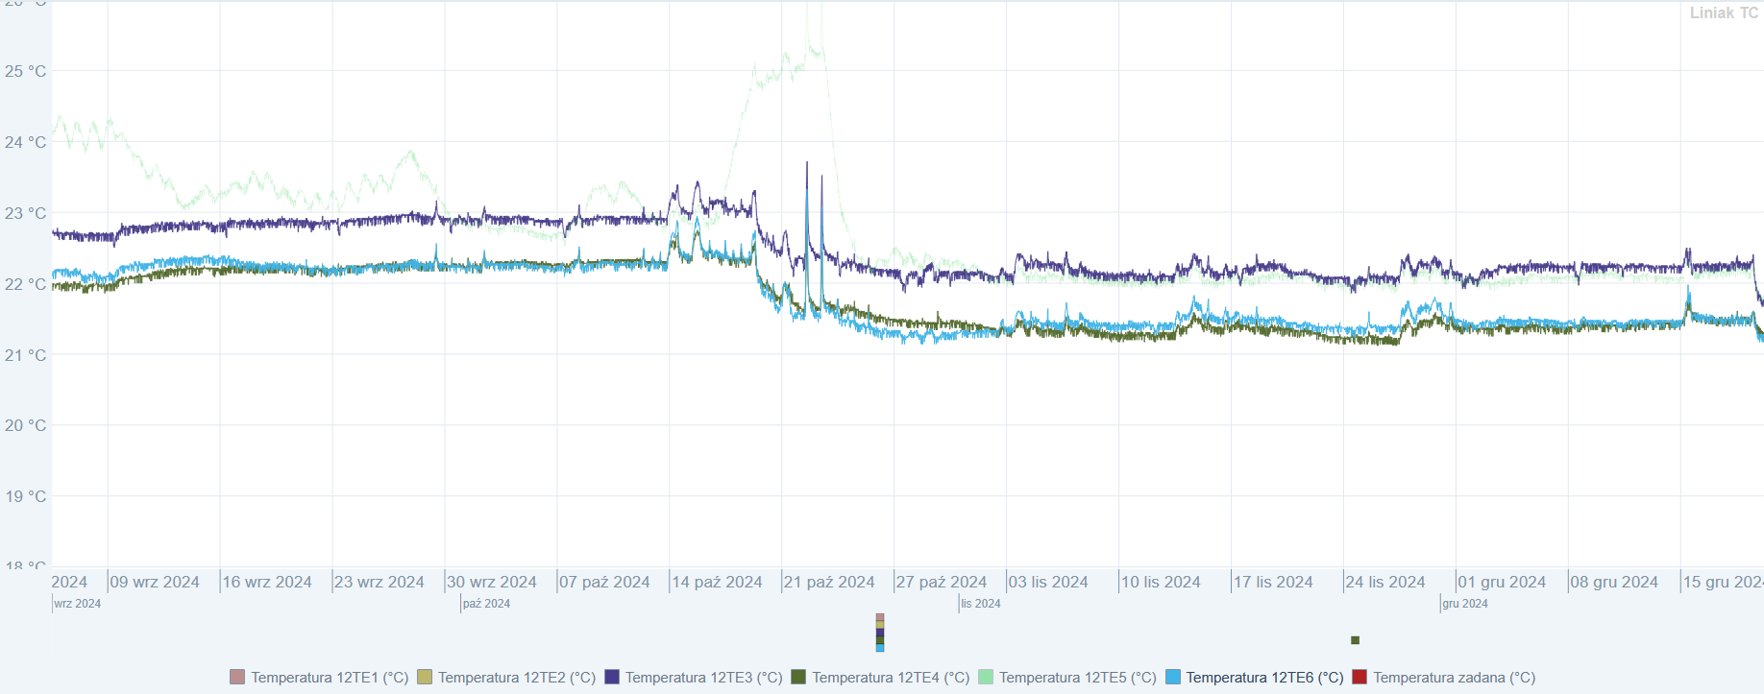
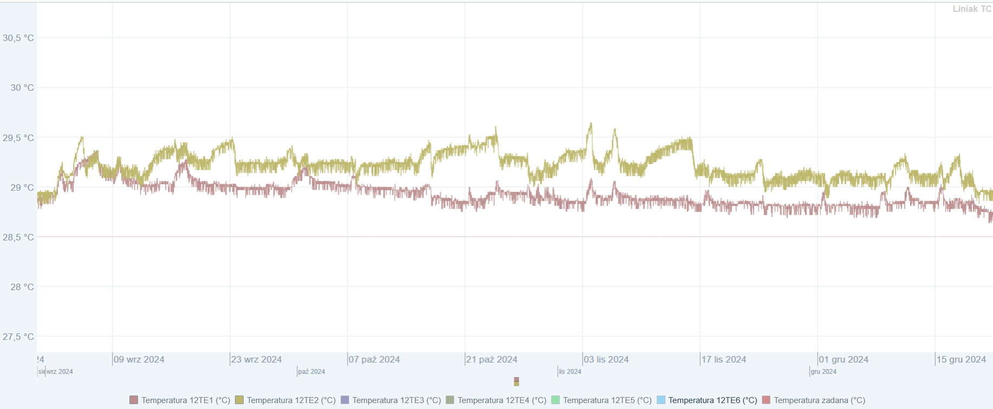
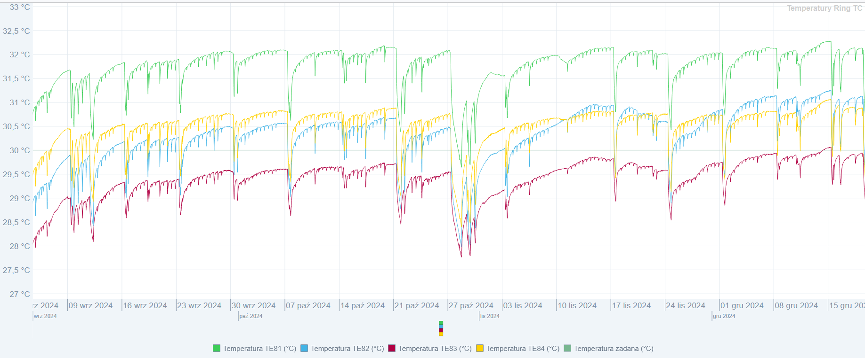
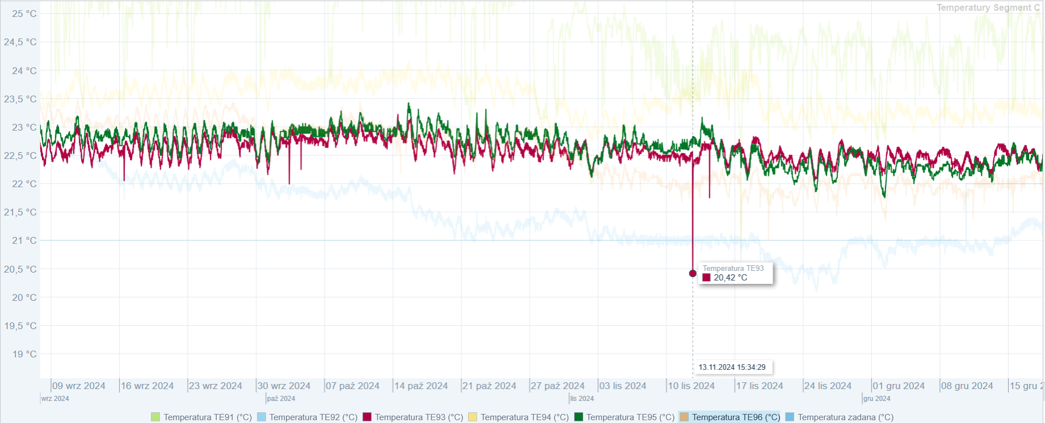
Air Temperature Over Months
Klystron gallery
Linac tunnel
Storage ring tunnel
Experimental hall
Data: P. Czernecki

Slide 15
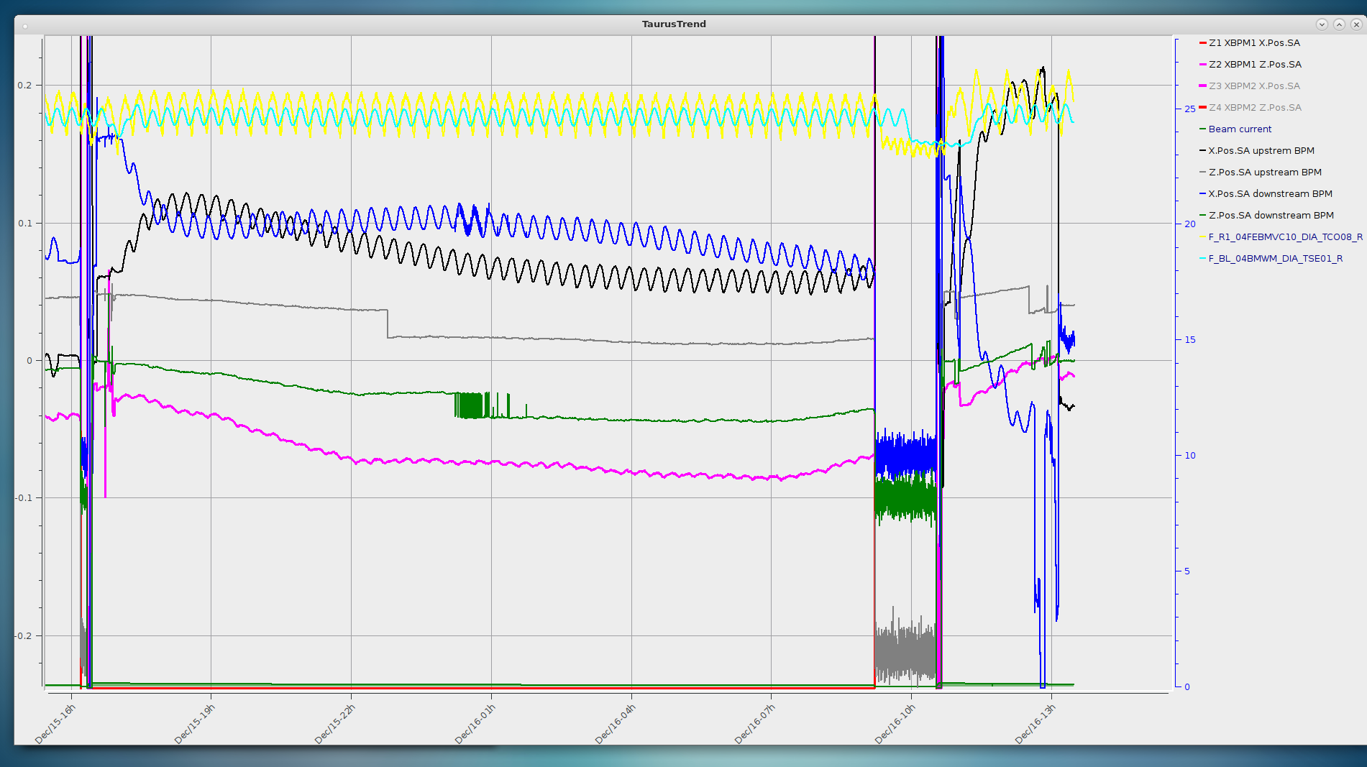
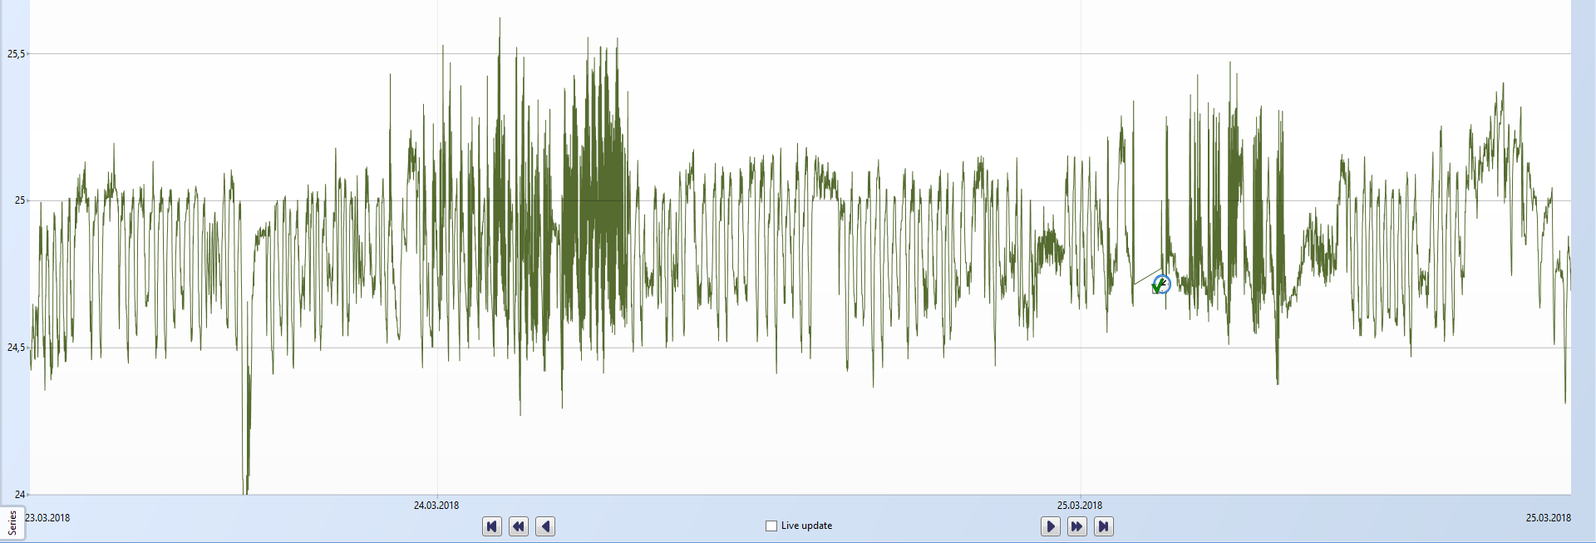
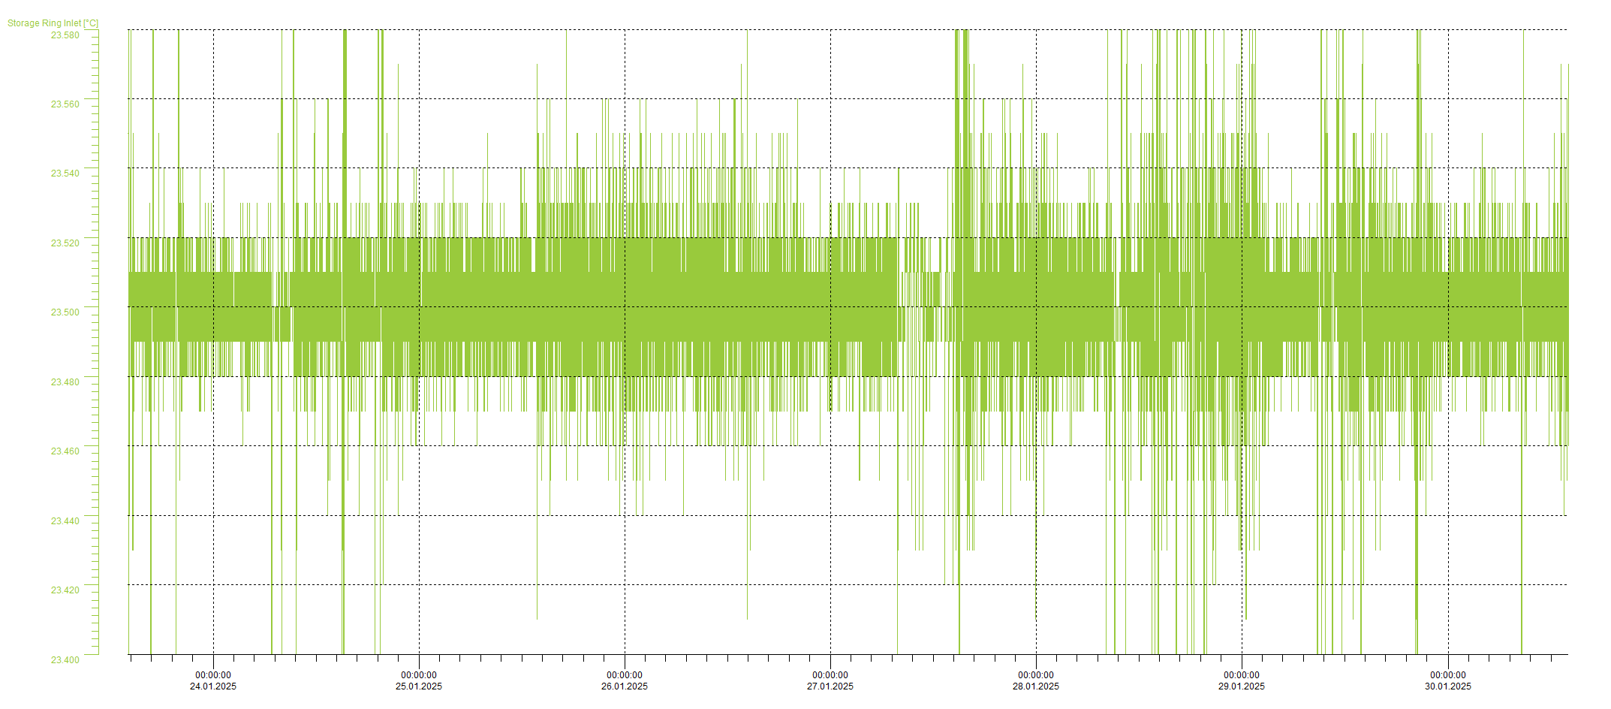
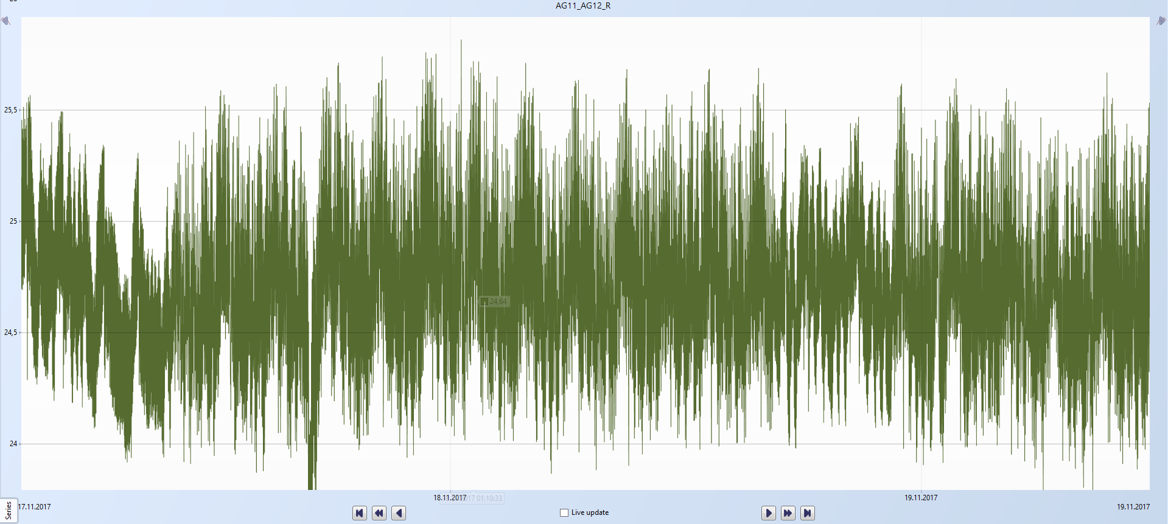
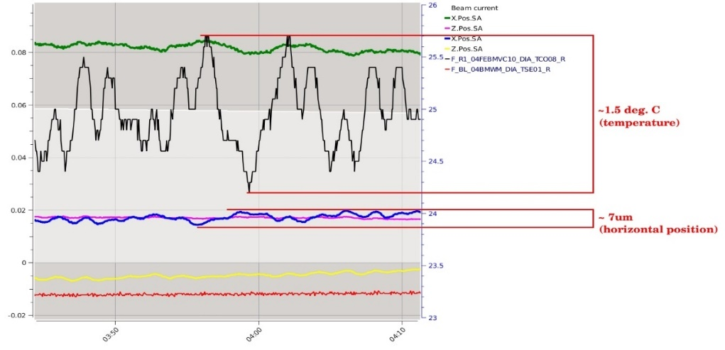
Thermal Stability
02
04
2017-2018
+/-1,5°C → 8 µm
2022-2025
+/-0,1°C → 0.5µm
2.0 deg. C
0.7 deg. C
~0,6°C
20-25 µm
20-25 µm
20 min
~1,7°C
Main goals
Improved temperature stability (±0.1°C)
Cascade temperature control - 3-way valves (I-exchangers, II-circuits)
Redundancy of aggregates
Buffer outside (possibility of adding aggregates)
Replacement of compensators
Improvement of temperature regulation (new PLC system)
2015-2017
+/-2,0°C → 25 µm
2018-2022
+/-0,6°C → 2 µm
01
03

Slide 16
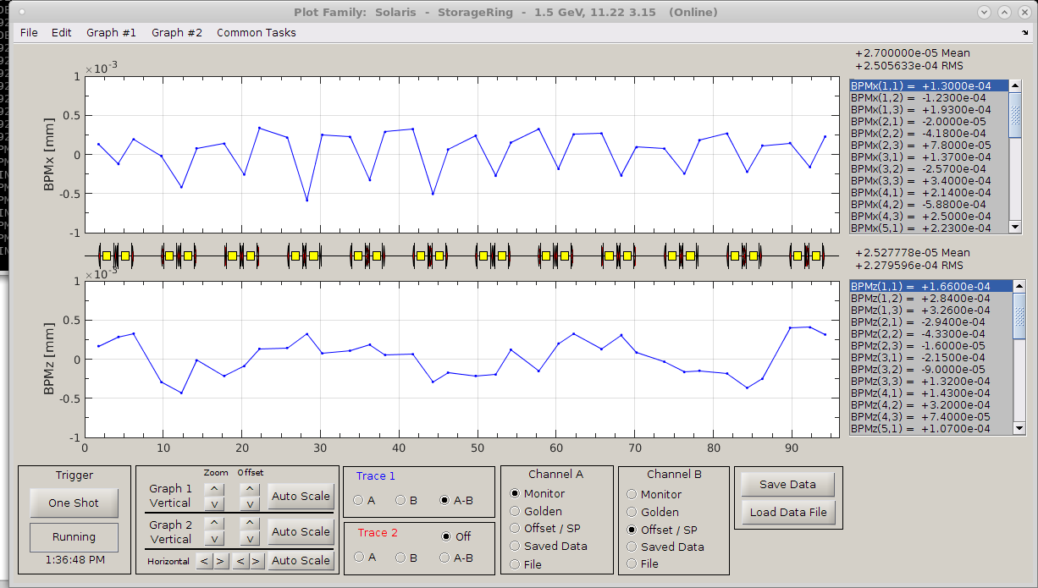
Closed Orbit And Orbit Correction with SOFB
Closed orbit correction (slow orbit feedback):
36 beam position monitors (BPMs)+Libera Brilliance+ electronics;
72 corrector magnets (36 for each plane).
Max current 11A ->kick: 25 urad
Rep.Rate 0.33 Hz
BBA procedure done – offset orbit determined
.
Closed orbit and orbit correction with SOFB
Closed Orbit | With correction &BBA After
x_{rms} | 0.25 μm
y_{rms} | 0.22 μm

Slide 17
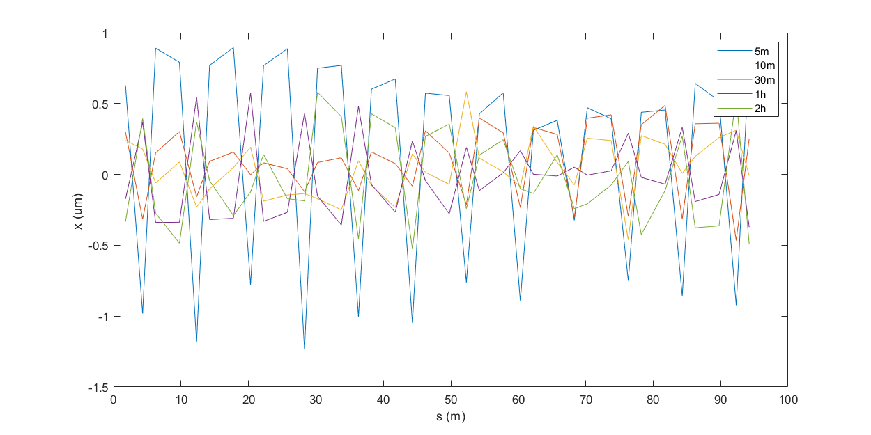
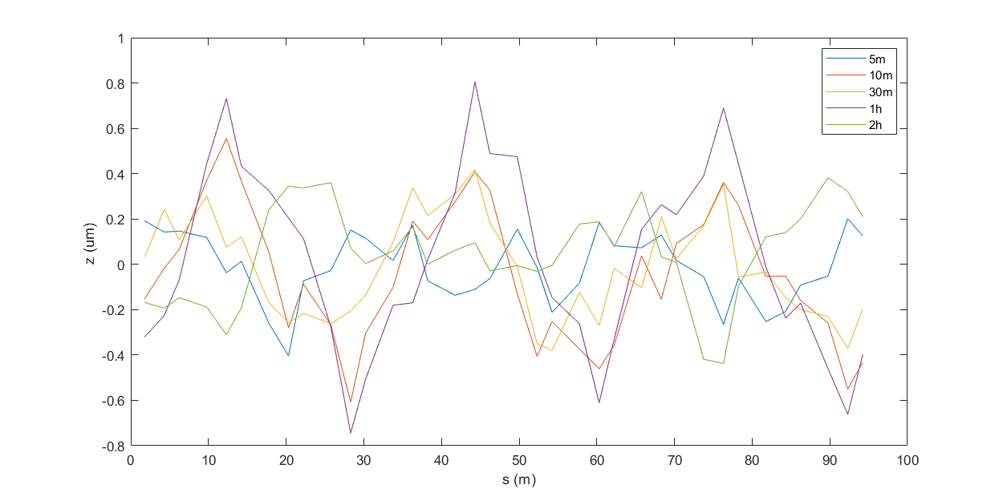
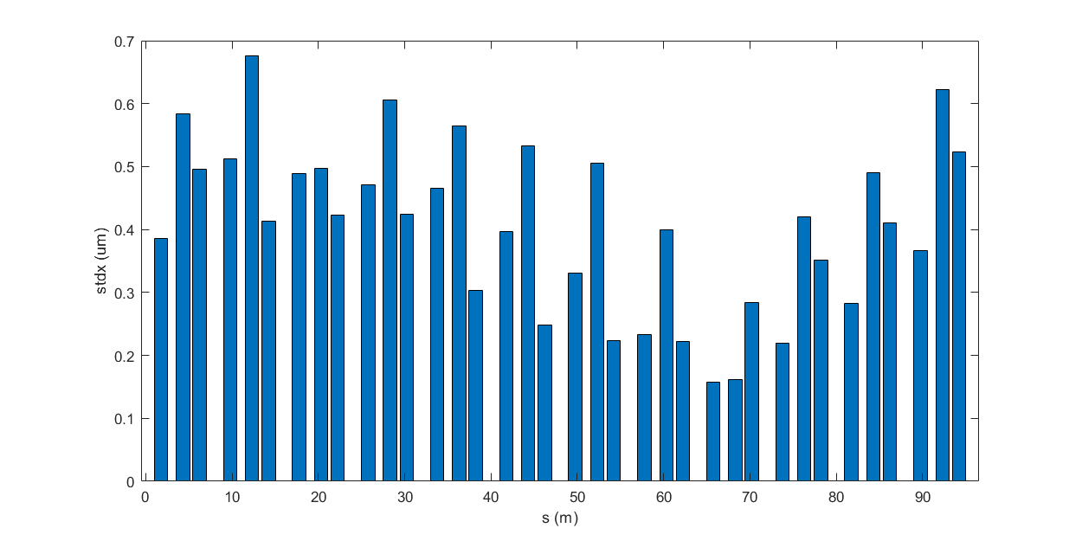
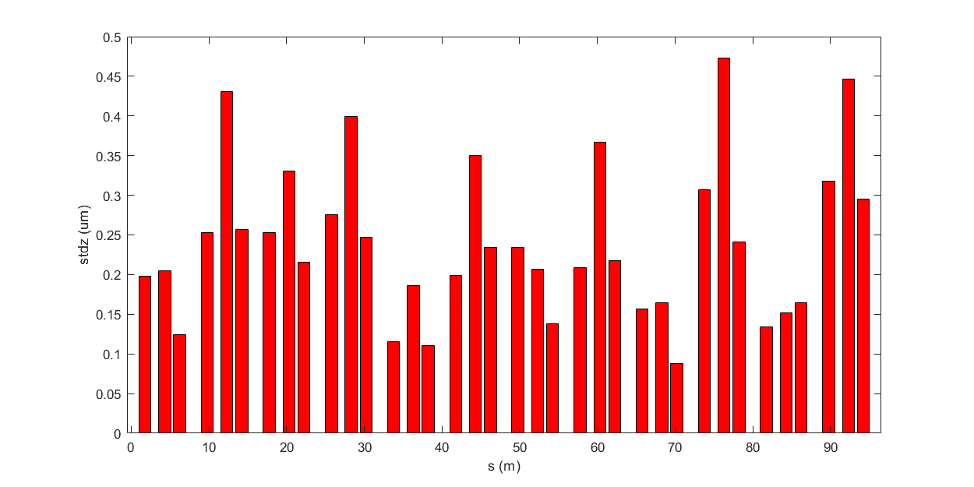
Orbit Changes with Operation Time

Slide 18
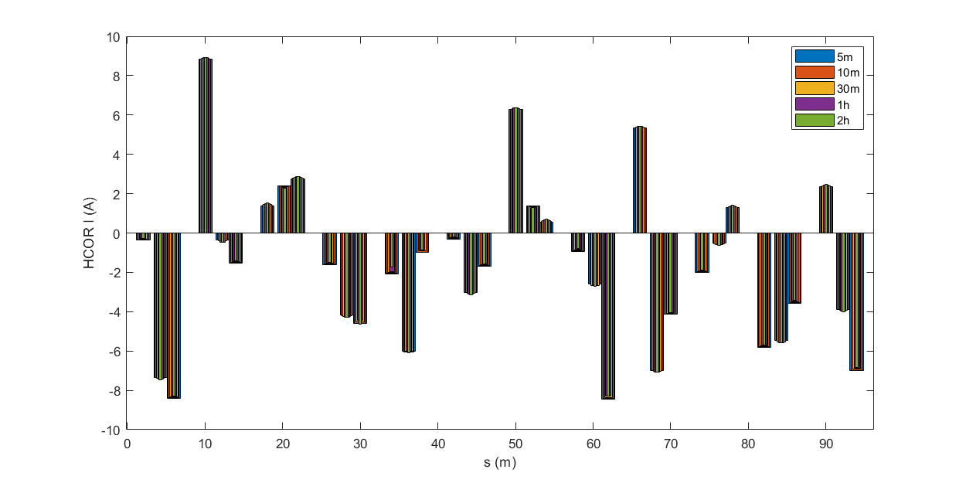
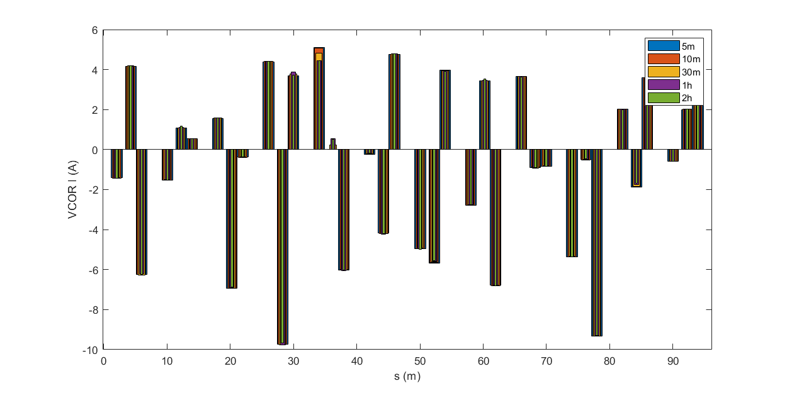
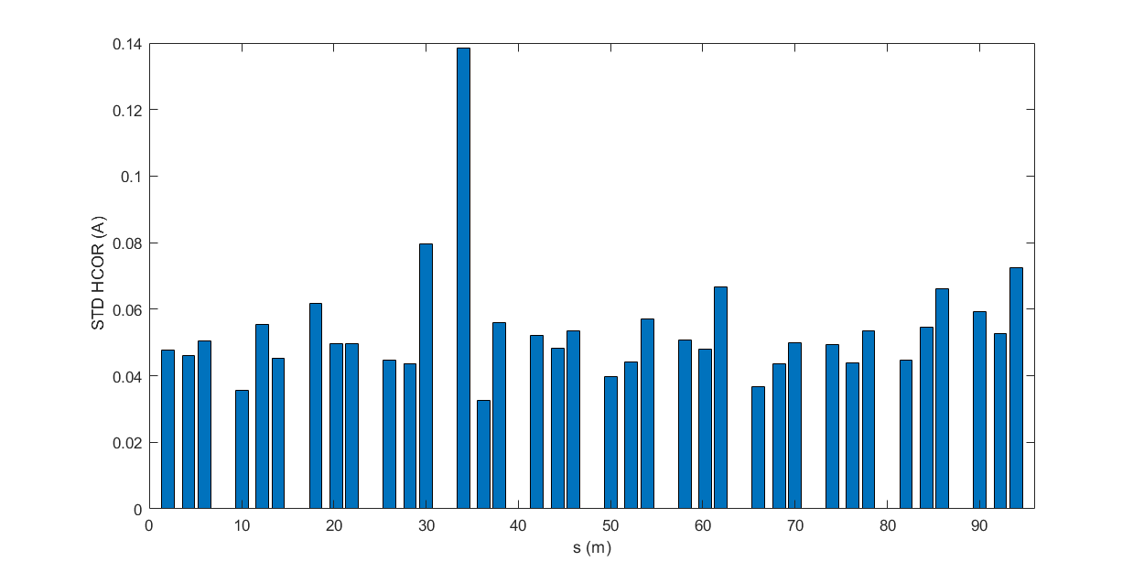
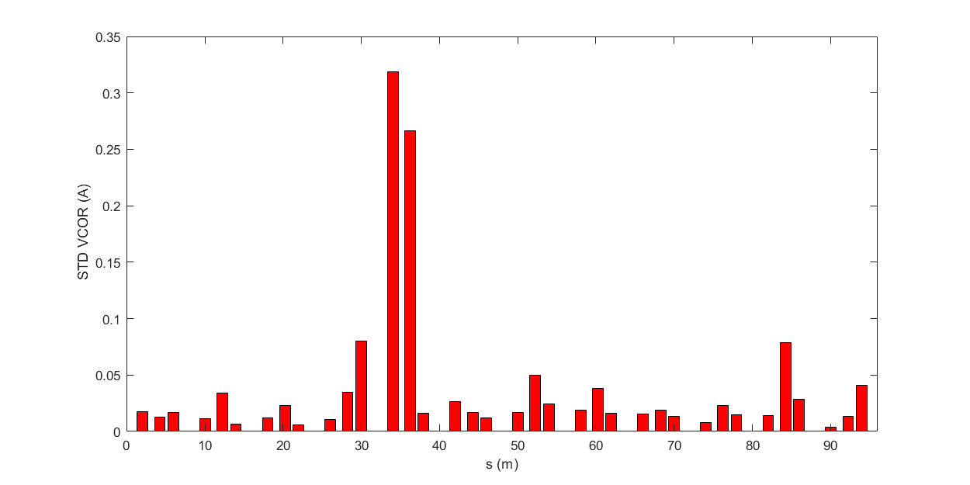
Correctors Settings

Slide 19
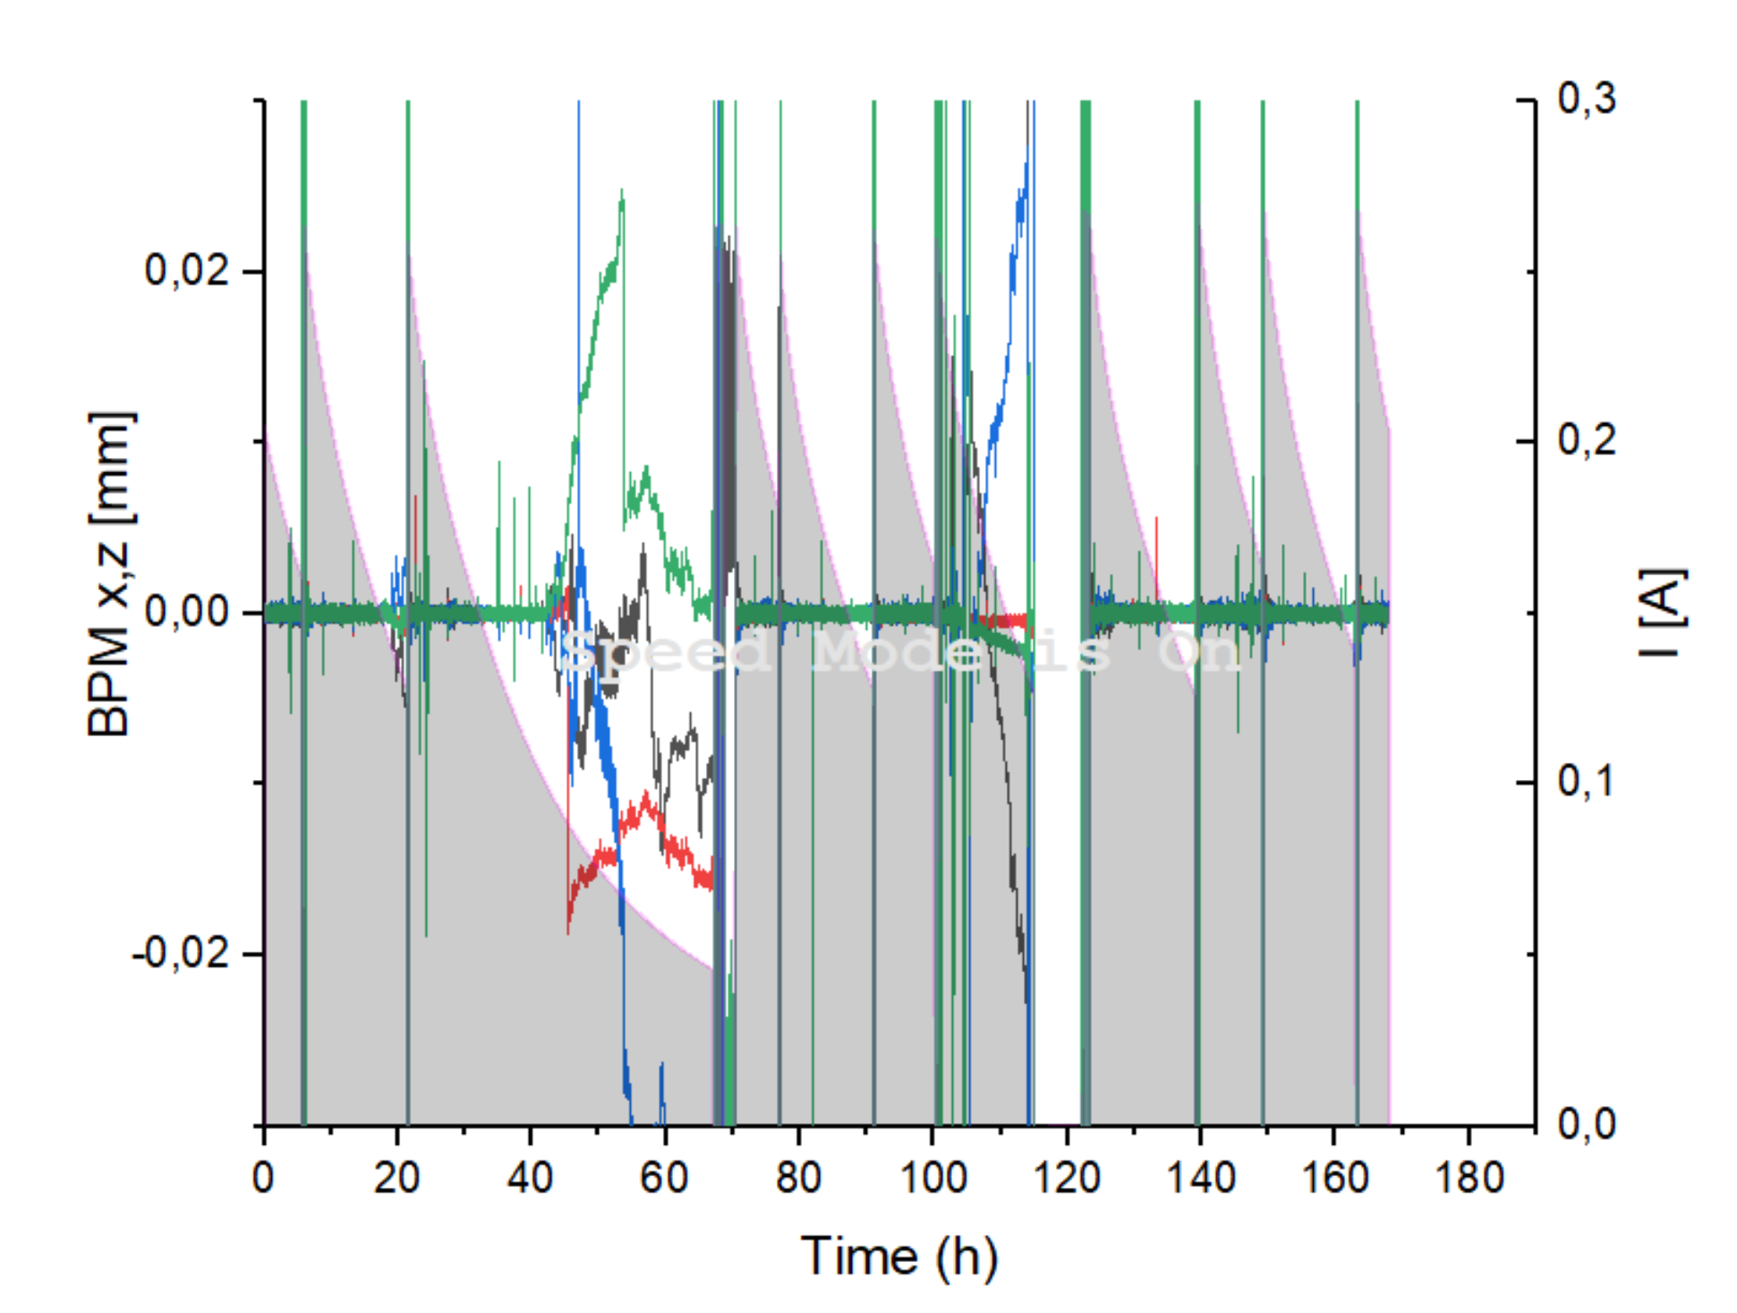
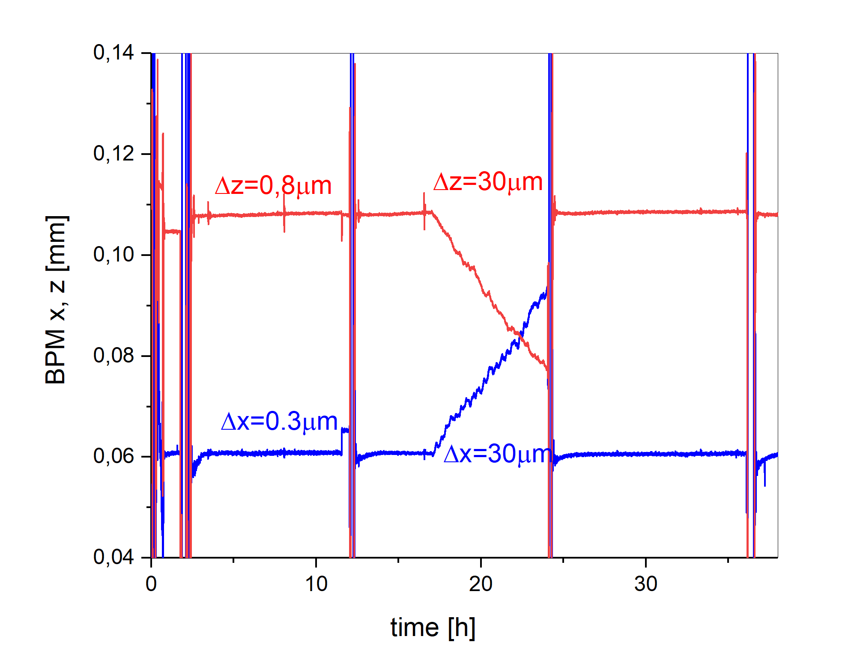
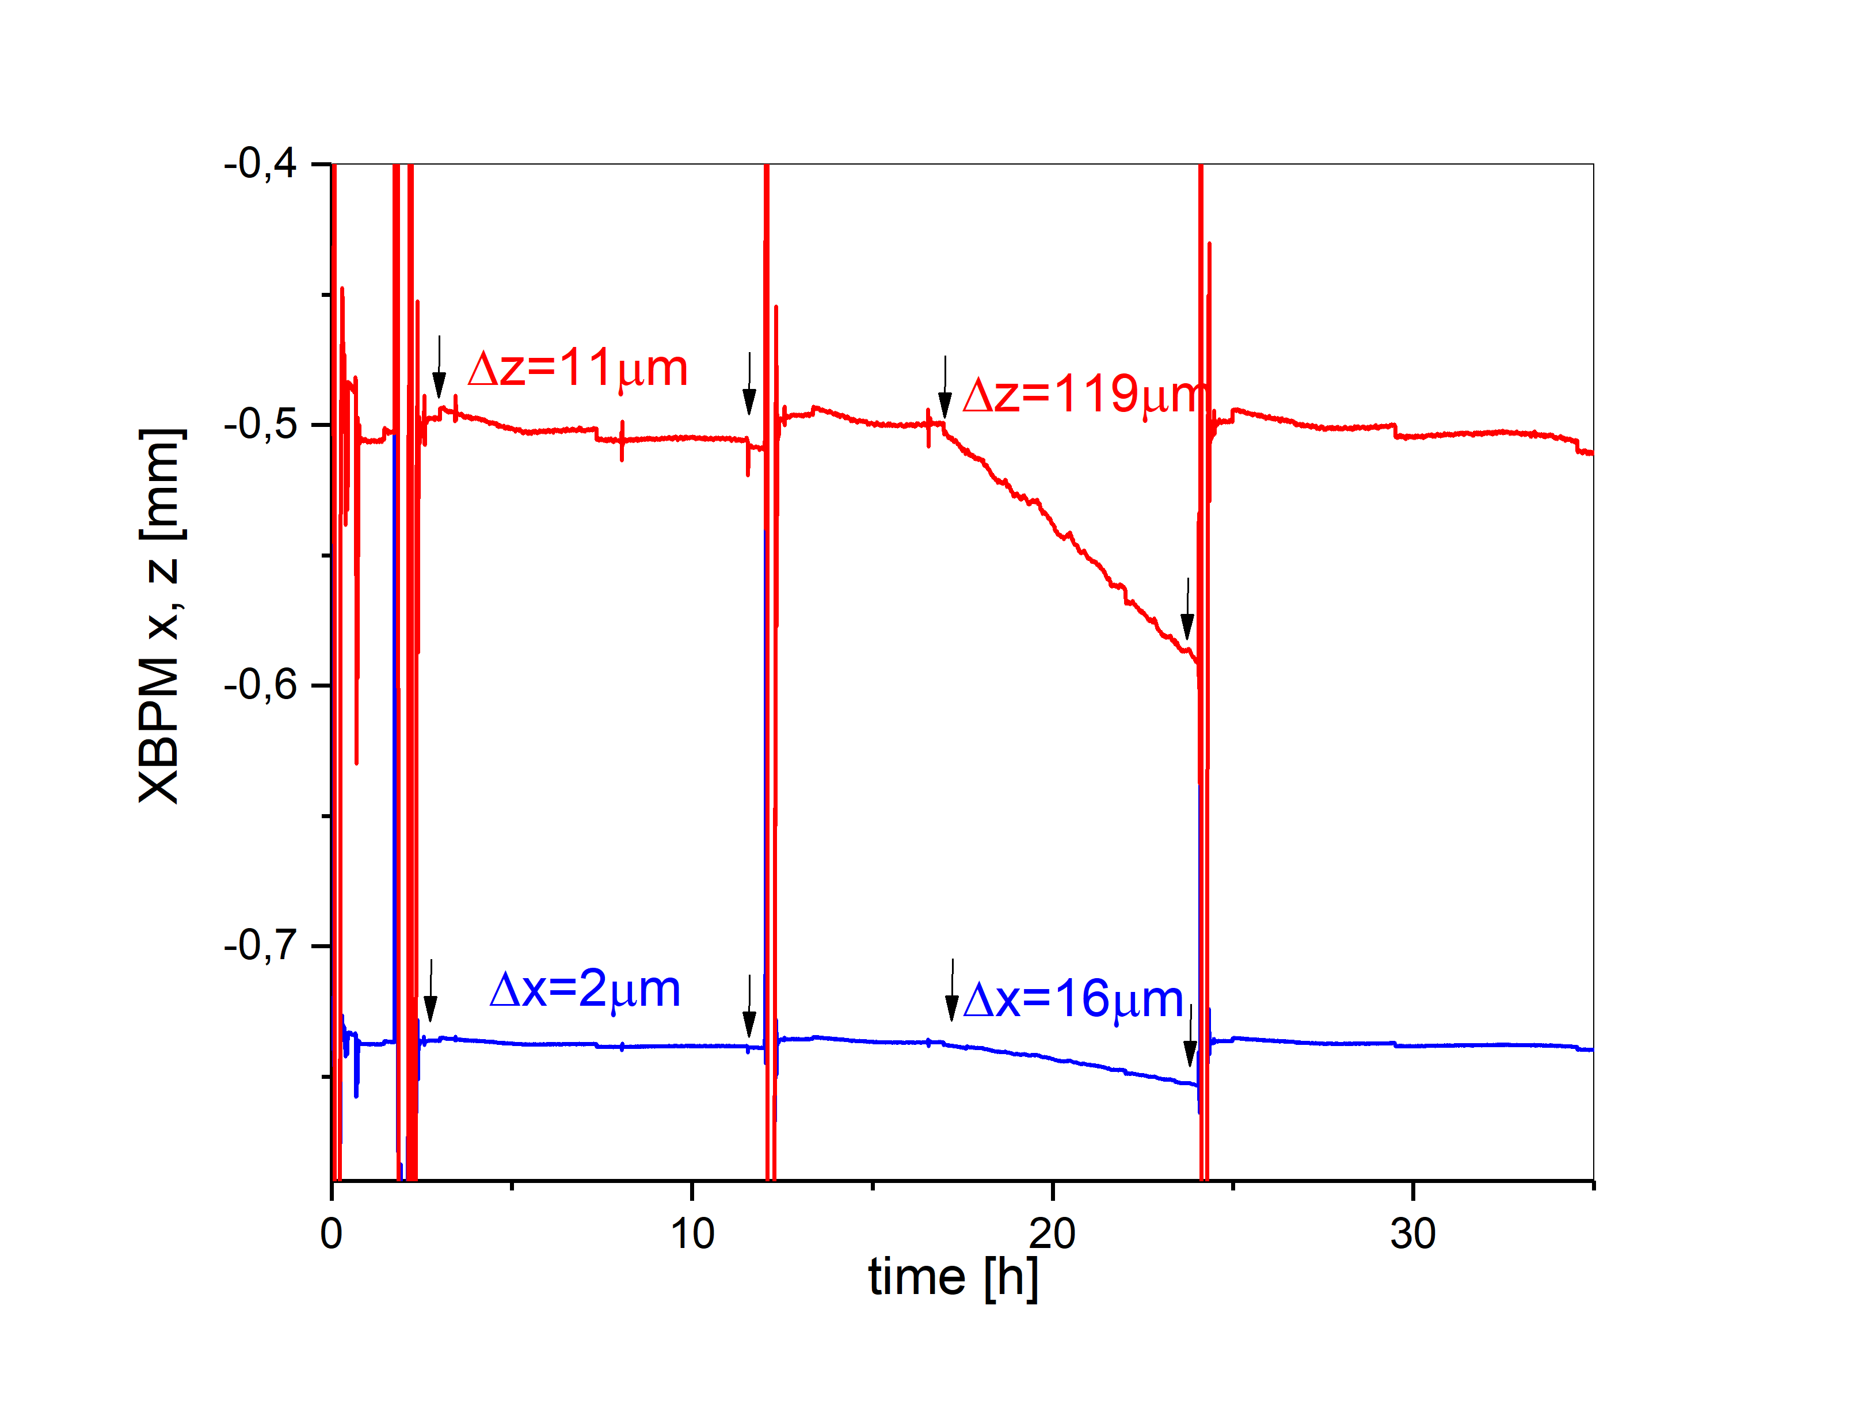
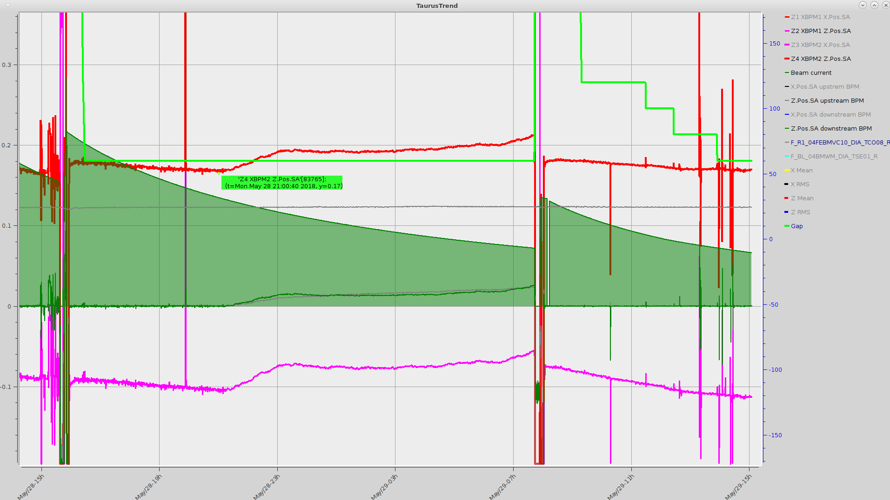
BPM and XBPM Readouts with SOFB ON & OFF
Long term stability
When orbit correction stops
40um drift when orbit correction not working

Slide 20
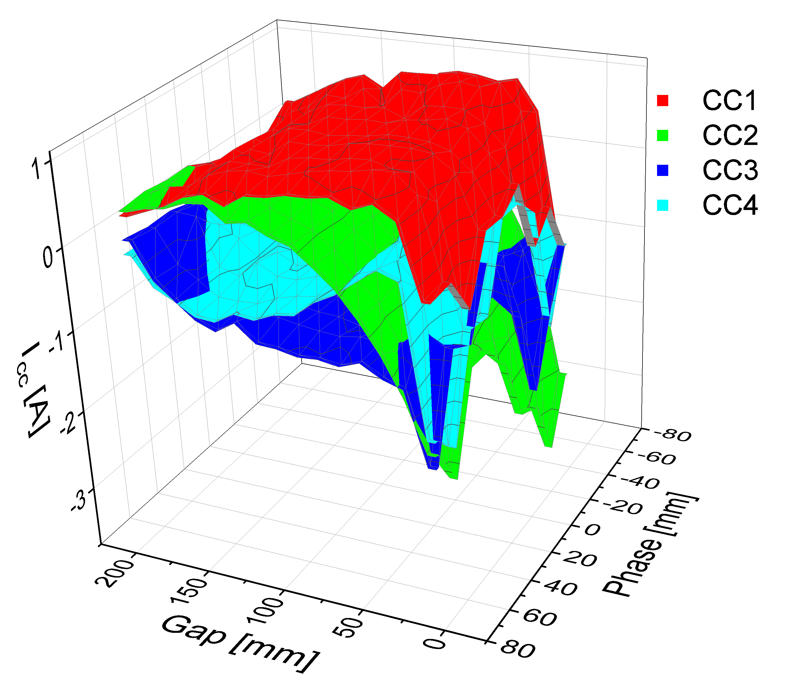
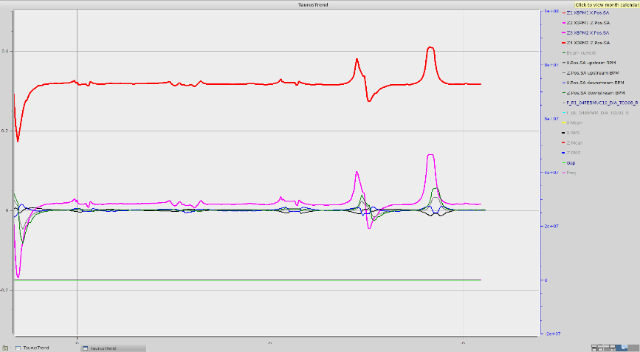
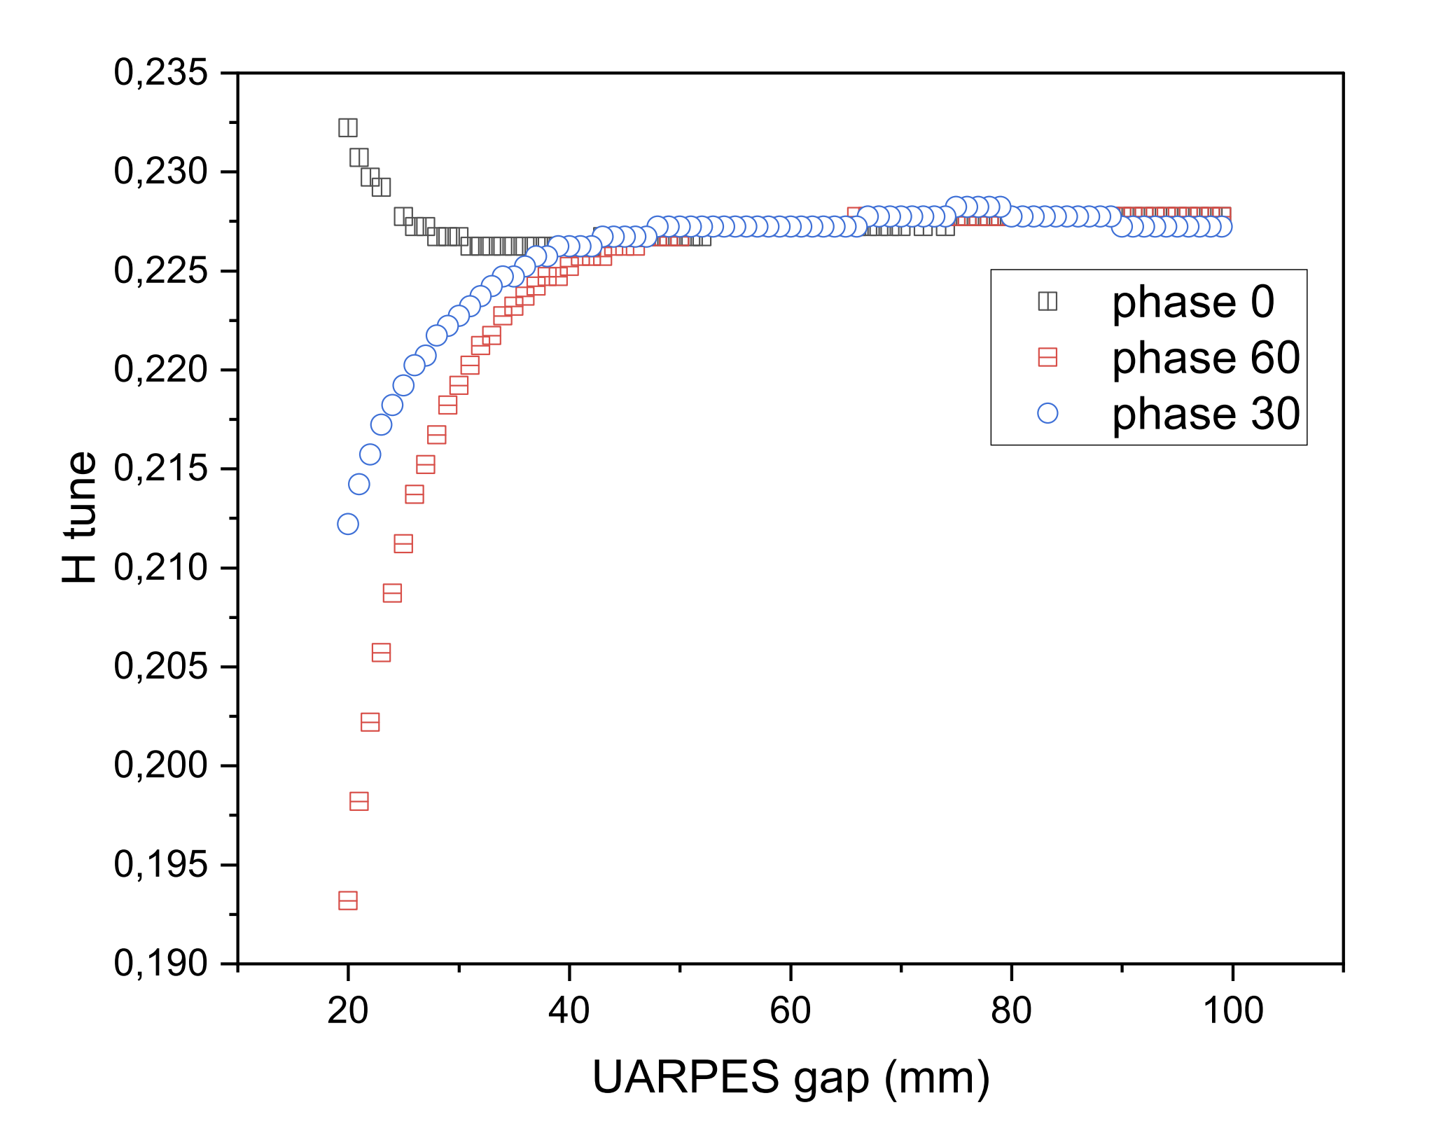
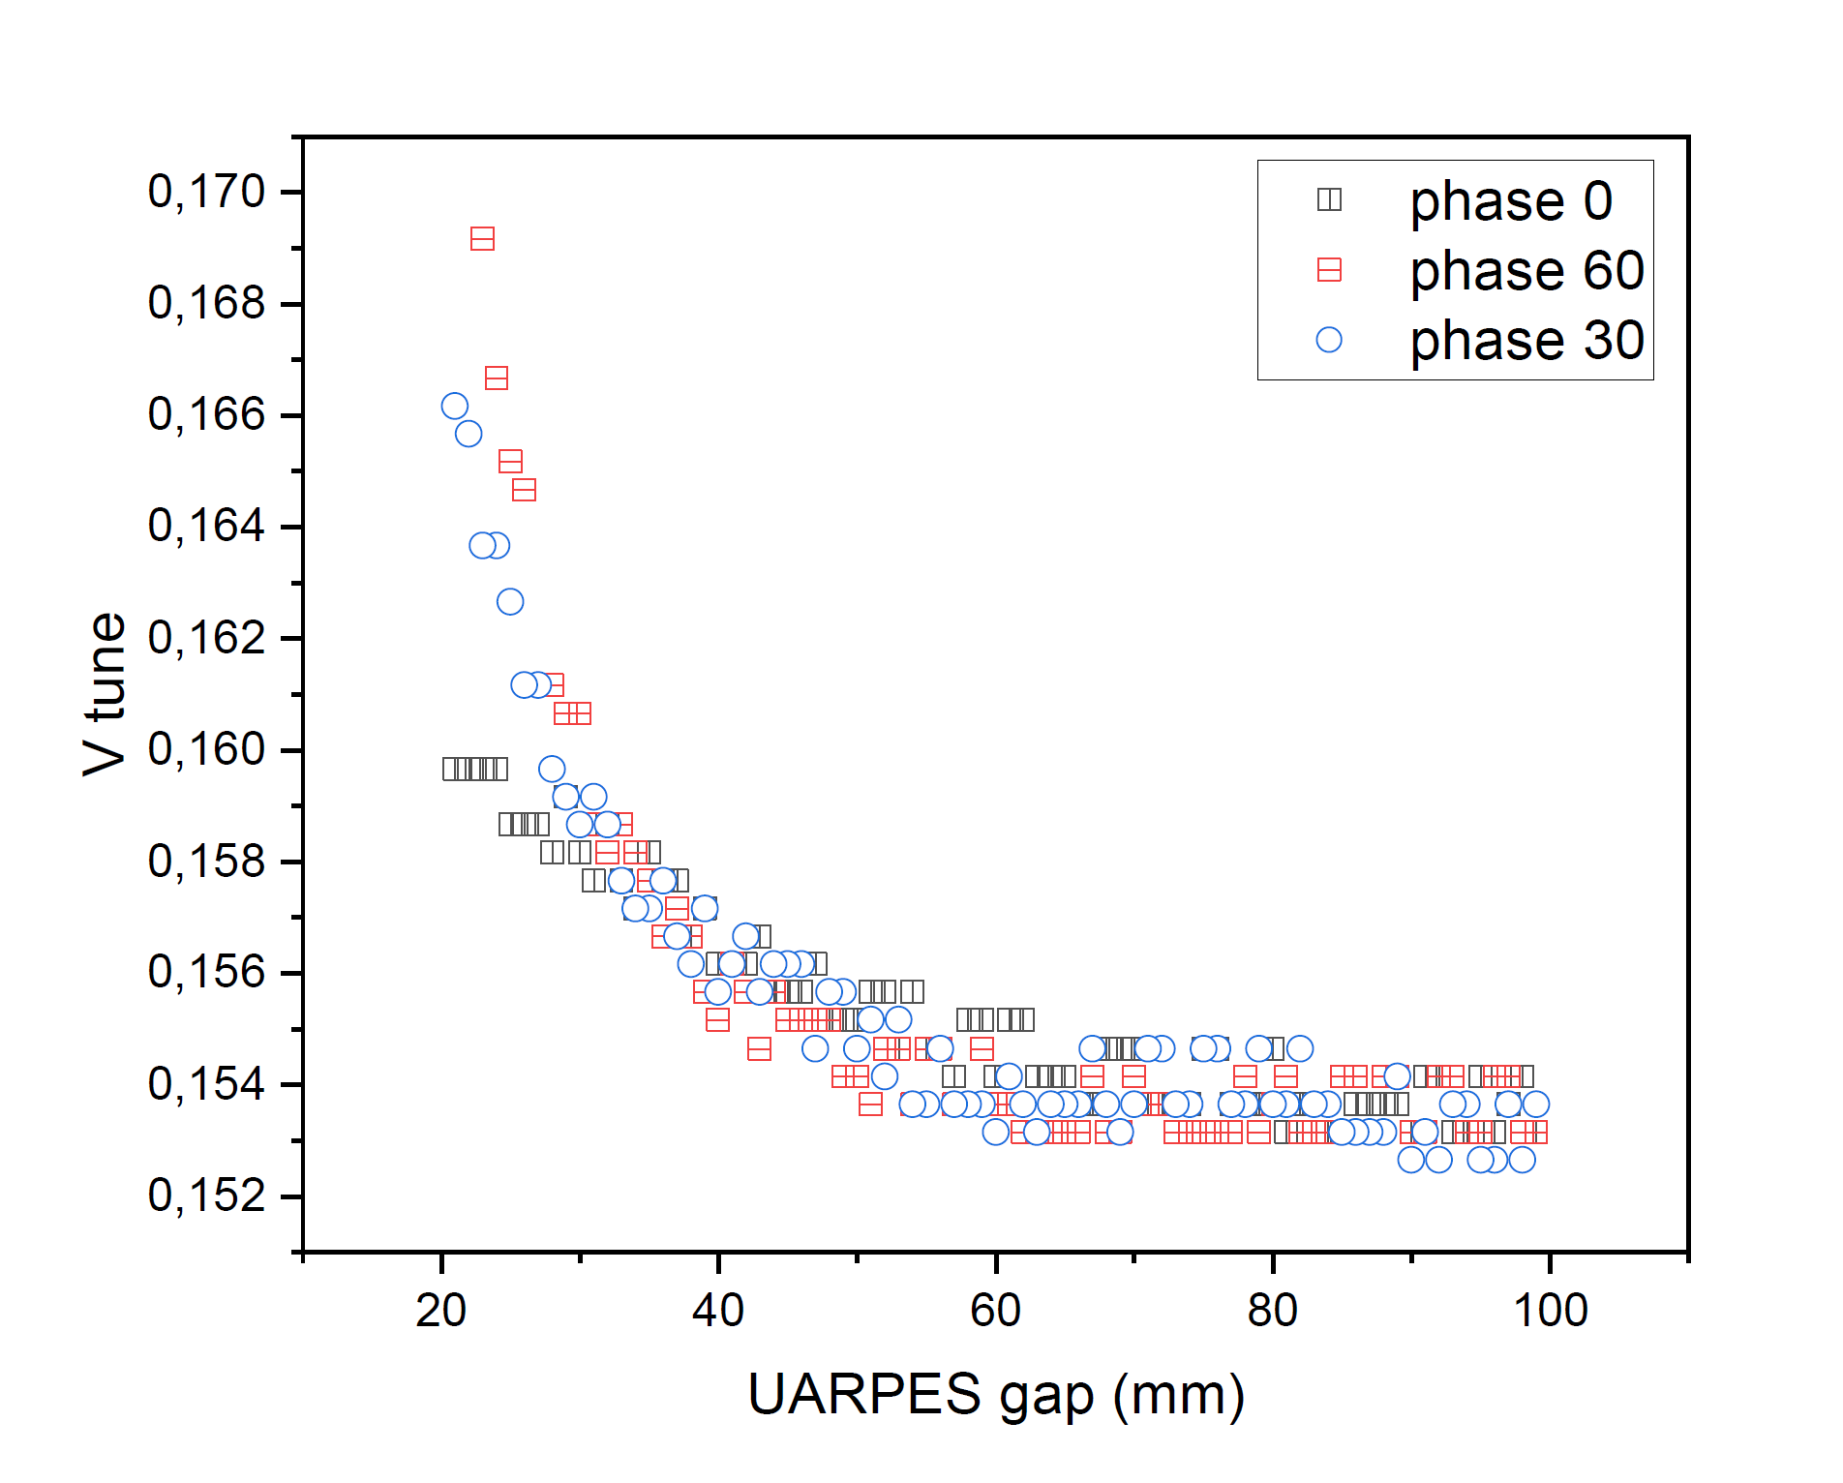
Solaris storage ring operates with three elliptically polarized undulators (EPU), as radiation sources for UARPES, PHELIX and DEMETER beamlines. The EPUs affects the stability of the photon beam during the polarization and the magnetic field changes. To minimize the impact of EPU on beam disturbances the feedforward correction tables were implemented for all three EPUs which resulted in a significant reduction of their impact on the beam position from several to 4 µm. Moreover, the EPUs affect also the tunes.
IMPACT OF INSERTION DEVICES
With orbit correction
Without any correction
With orbit&coils correctors
Photon beam distortion by EPU

Slide 21
Correction Magnets Relaxation Algorithm
Algorithm uses the correction response to the BPMs offset change.
Algorithm is based on minimalizing fitness function composed of normalized elements like: total power of corrector magnets, standard deviation of electron beam, extreme corrector magnets currents and corrector magnets response from correction algorithm. Weight of the elements can be adjusted by a, b, c, d, e, factors. Each time the BPM offset is changed fitness function is recalculated and compared to the previous value, when value decrease, the offset change remains, when the value increases, the offset value is restored back. Optimal BPM offsets which minimze fitness function thereby CM currents are result of many iterations.
Applying BPM offsets obtained from relaxation algorithm:

Slide 22
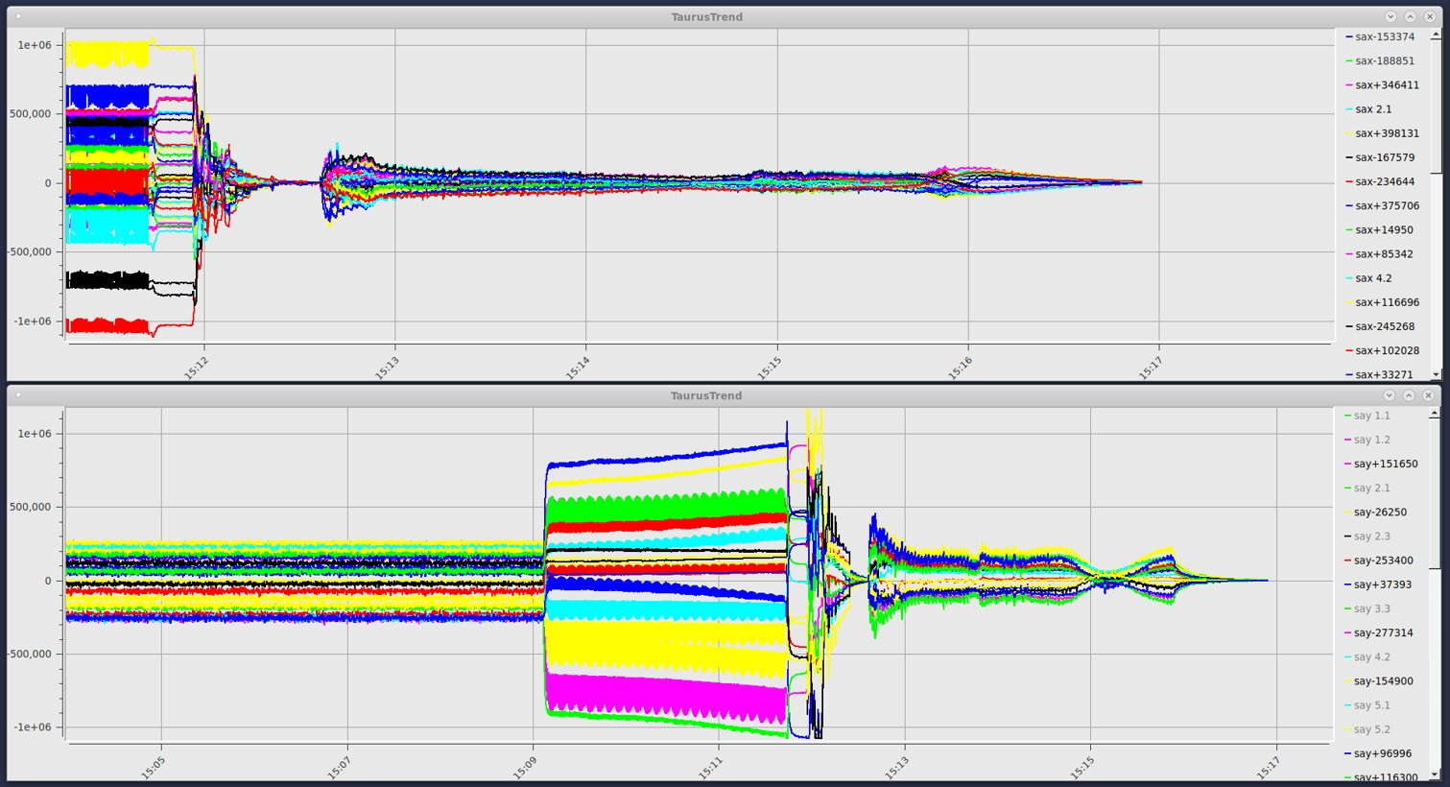
Correction During Ramping (SOFB)
Injection
SOFB Correction
Energy Ramping+SOFB Correction
SOFB Correction
Slow Orbit correction optimisation. The correction relaxation algorithm was applied, and new Golden Orbit was set in June 2019.
Main benefits:
Correctors power supplies current reduction from saturation region at 11 A below 5 A.
Electric power reduction over 80% from: 603 W to 113 W, monthly 372 kWh less energy used.
New orbit has no noticeable effect on parameters such as lifetime, chromaticity and dispersion.
It was confirmed that there is no increase in ring thermocouples temperature, with new orbit we have 25 % drop in vertical emittance
SOFB implemented in Python, rep. Rate 1 Hz
Ramping with active corretion
Injection
SOFB
Energy Ramping+SOFB Correction

Slide 23
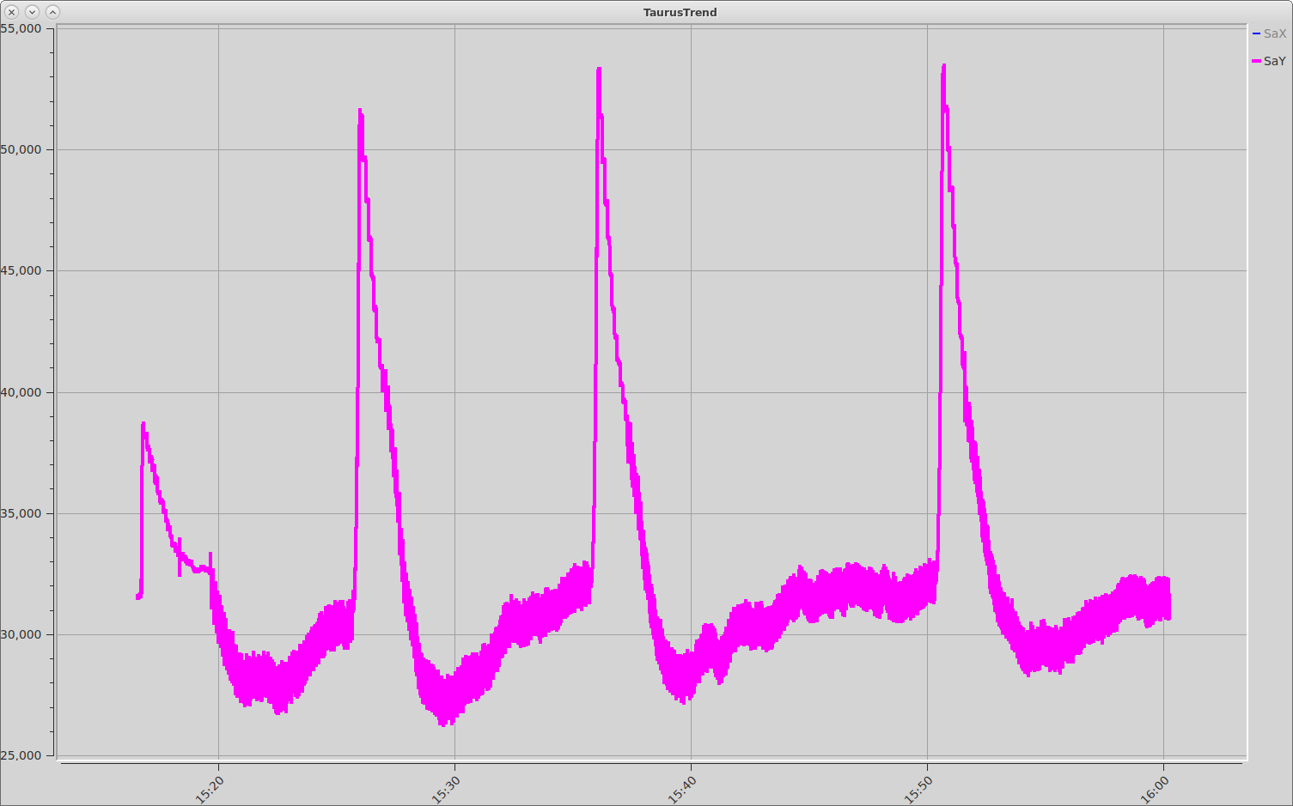
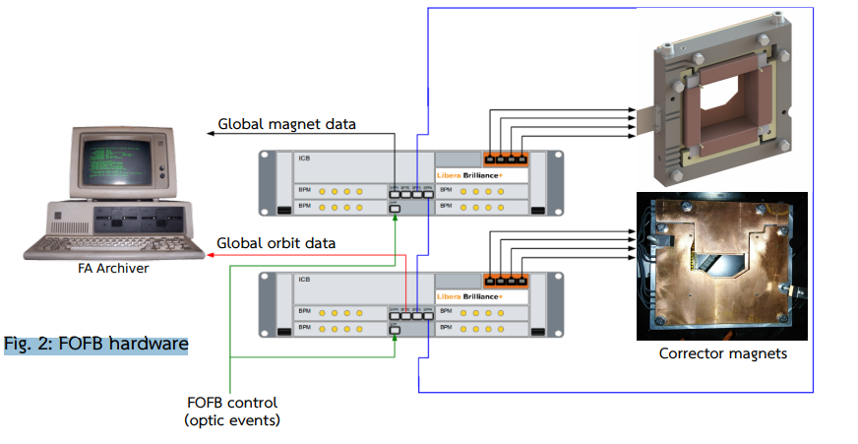
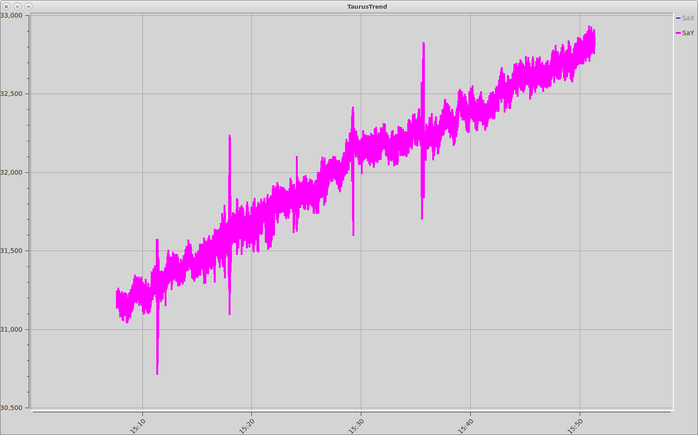
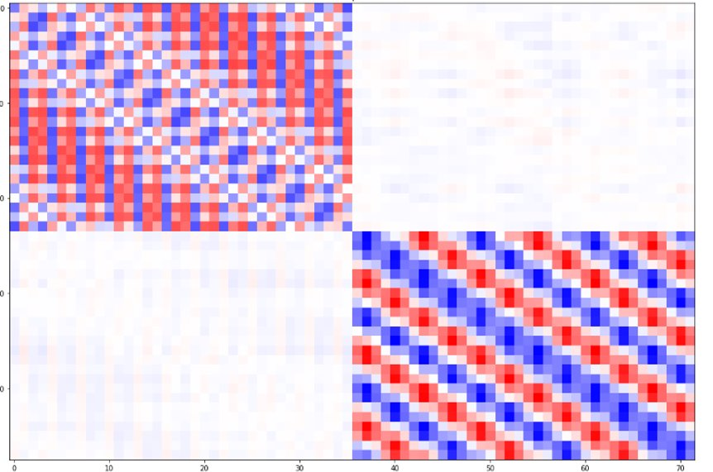
Fast Orbit Correction
10 μm
Fast orbit feedback system development
1 μm

Slide 24
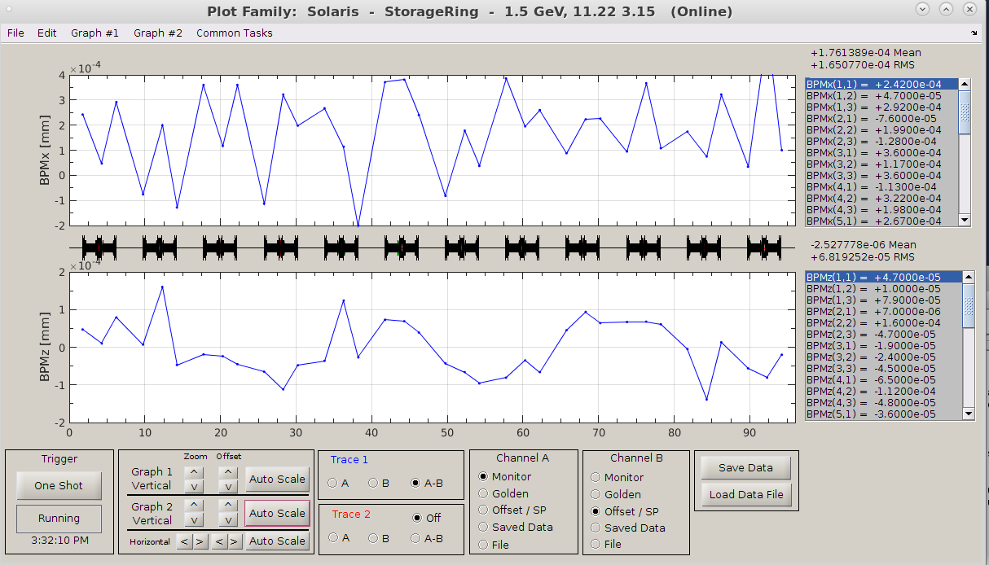
Closed Orbit And Stability With FOFB
During the simultaneous operation of both SOFB and FOFB correction systems, an offloading procedure was applied, as described by the following equation :
SOFB algorithm applies adjustments to its calculated settings for the slow correctors. This adjustment is based on the response matrix from the FOFB and the settings it would have applied to the fast correctors. In this manner, SOFB simulates the actions the FOFB would have taken at a given time step and implements those changes itself.

Slide 25
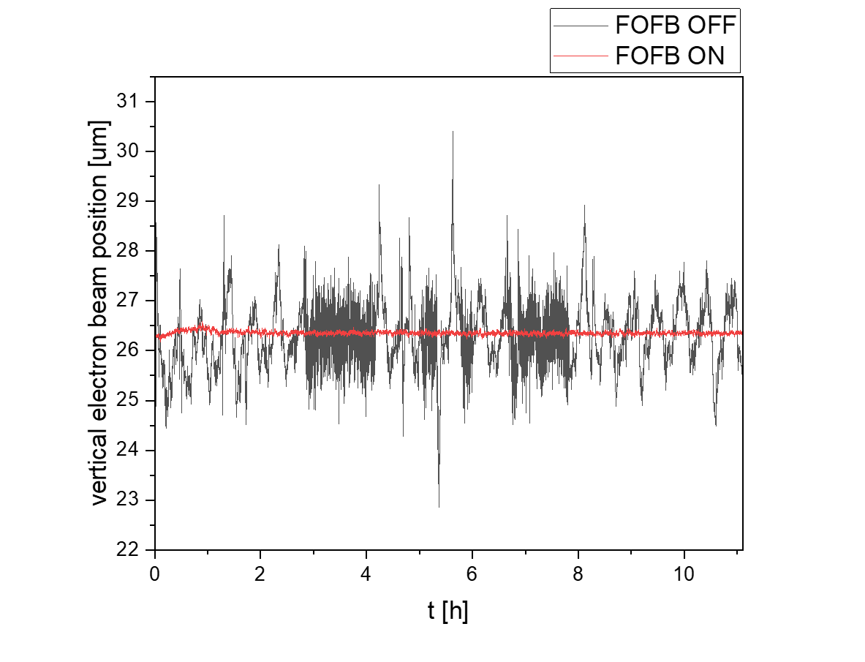
Fast Orbit Feedback Performance
Electron beam stability
The electron beam is controlled with sub-micron precision when all correction systems (SOFB, FOFB and feed-forward tables) are working. FOFB eliminates the negative impact of the insertion devices movement, which is the main cause of orbit distortion.
Over short periods of time, like milliseconds, we can see oscillations of about 2 µm. These come from the 50 Hz electrical grid frequency, which is visible on the FFT plots. It is the highest oscillation mode in both planes.

Slide 26
Fast Orbit Feedback Performance
FOFB OFF
FOFB ON
Reduction of XBPM Standard deviation.
ID’s impact compensation – more than 1 order of magnitude correction improvement.

Slide 27
Fast Orbit Feedback Performance
Power Spectral Density from BPM for horizontal and vertical plane for different conditions.
Cumultative Power Spectral Density from BPM for horizontal and vertical plane different conditions.
The main influence of te FOFB is obeserved up to 300 Hz. For higher frequencies no major changes are observed.

Slide 28
Closed Orbit Stability & Repeatability
Long-term stability of the
photon beam
Electron beam stability in the submicrometer level
Repeatability of the injection
Short-term stability of the photon beam
28

Slide 29
Reproducibility In The Past
Closed orbit changes from injection to injection with SOFB and old method of ramping with correctors
In the horizontal plane the standard deviations calculated from injection and ramping dataset are comparable reaching 200 μm and the deviation of final-corrected orbit is significantly lower (~30 μm).
In the vertical plane,for the injection orbits the deviation is up to 300 μm, after-ramping dataset - up to 100 μm and below 10 μm in corrected orbits at final energy.

Slide 30
Reproducibility Now
Closed orbit changes from injection to injection with FOFB

Slide 31
Photon Beam Position vs Cycling Magnets No
Cycling o the magnets is done after beam dump and before injection.
No cycling results in poor injection efficiency
1xcycling the injection efficiency is improving
2x cycling is optimum procedure utilized at SOLARIS
3xcycling no changes observed in injection efficiency
No major changes observed in the beam position from injection to injection with different cycling procedure

Slide 32
Photon Beam Stability
Long-term orbit stability and repeatability
Series of three intervals of operation, separated by two years shows 50 um position change. A radical improvement in photon beam position stability with the application of FOFB correction Visible 10 um drift of photon beam position readout during operation is mainly caused by thermal effects and electron beam current decay.

Slide 33
Photon Beam Position Stability And Repoducibility
The Solaris beamlines require the 2 µm over 8 h long-term stability of the photon beam measured at the front end XBPM location. However, at the moment the drift of 0.5 µm for the electron beam and ~10 µm for the photon beam is observed during 8 h of beam decay with slow orbit SOFB running. The medium-term oscillations of the photon beam measured on XBMPs are in the range of 0.5-1 µm rms. The reasons of those beam instabilities may rise from the vibration coming from the water circuit pumps. The second reason is the thermal stability, the temperature changes can affect the BPM readings due to thermal expansion of the vacuum vessels, girders and optical components.
33

Slide 34
Summary
Mechanical Stability:
vibro-elastomer mat and concrete block magnet girders were implemented to ensure the stability of the experimental area.
The overall stability of the experimental hall remains within acceptable limits.
Thermal Stability:
Improvements in the cooling water system were made multiple times to meet stability requirements.
A major enhancement in 2022 achieved ±0.1°C stability.
Orbit Feedback Systems:
The Slow Orbit Feedback (SOFB) system was redesigned and accelerated more than tenfold.
The Fast Orbit Feedback (FOFB) system was successfully developed and implemented.
An offloading procedure was introduced and fine-tuned to prevent conflicts between SOFB and FOFB.
Beam Stability and Positioning:
Submicron precision in electron beam stability was achieved.
Beam position reproducibility is at a good level, but some thermal drift remains in the XBPM readouts.

Slide 35
Acknowledgements
I would like to thank all the people contributing to this presentation:
Marcel Piszak, Mateusz Boruchowski, Roman Panaś, Mateusz Szczepaniak, Paweł Czernecki

Slide 36
INSTABILITY
Beam instability observed in the vertical plane
Closed orbit blow up of 2 orders of magnitude
Phase advance measurement reaveald the kick
in mid of DBA06
Thank you !
In the upper half of the magnet, a suspicious point was found that, as a result of thermal expansion,
could lead to a short circuit of one of the sextupol magnets coils. Bad insulation has been fixed.

Slide 37
Impact of FOFB on the beamline
Data: K. Sowa

