Slide 1

Radiation damage to permanent magnet materials
Ben Shepherd
I.FAST Workshop 2025 on Stability of Storage Ring Based Light Sources
KIT, Karlsruhe
17-21 March 2025

Slide 2
Introduction
Radiation damage is one of the main concerns when installing PM devices in accelerators
How well-understood is it?
Overview of this talk
Experiments carried out
Variables investigated
Damage mechanisms
Mitigation

Slide 3
Particle types

Slide 4
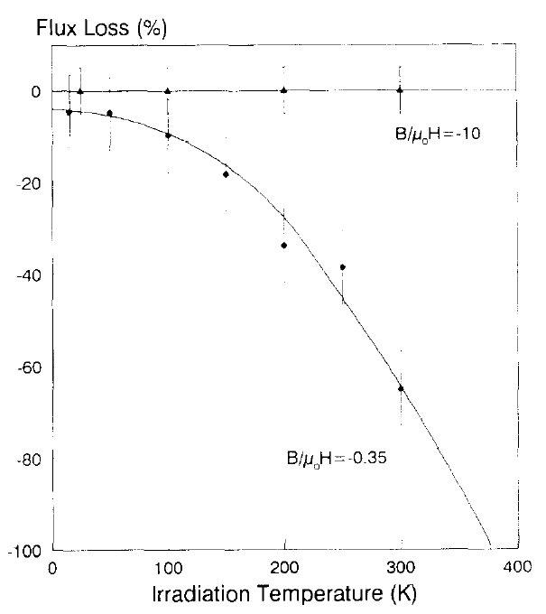
Protons
Blackmore, Nucl Sci 32 (1985) p3669
Talvitie, JMMM 102(3) (1991) p323
p⁺
TRIUMF 500 MeV 3x10¹⁷ protons
→ SmCo 13x13x25mm block at 120°C ➔ 1.6% demag
→ NdFeB block at 23°C ➔ 55% demag
Jyväskylä Uni 20 MeV protons → NdFeB blocks
  Temperature has a big effect: much less demagnetisation at 15K compared with 300K
  Also magnetisation direction: no demagnetisation observed at any temperature when the beam is perpendicular to the block magnetisation
p⁺

Slide 5
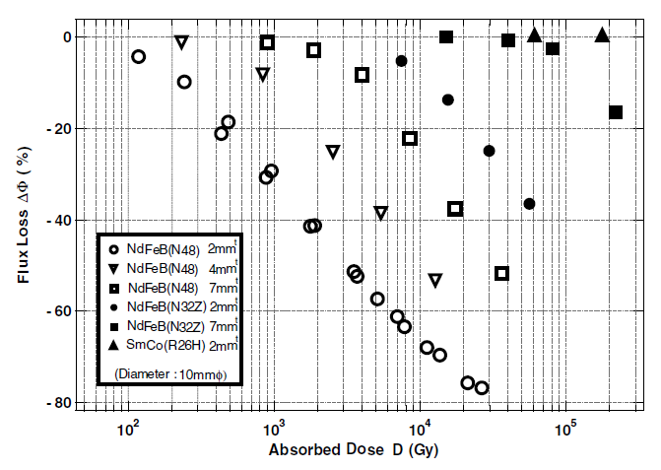
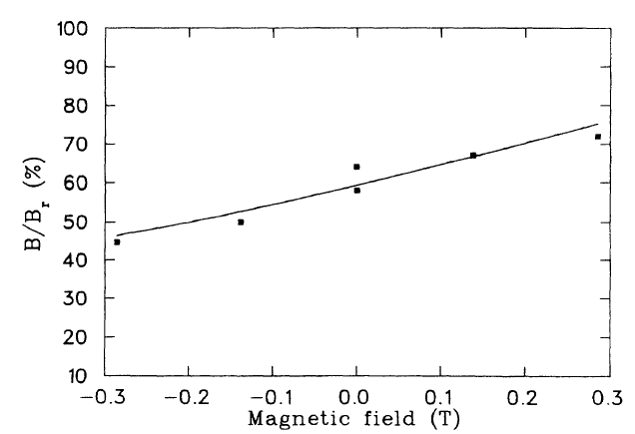
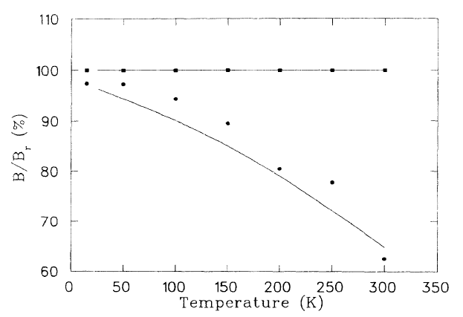
Protons
Ito, NIM B 183 (2001) p323
Kähkönen, PhysRevB 49 (1994) p6052
SmCo 2mm
N48: 2, 4, 7mm
N32: 2, 7mm
W-MAST (Japan) 200 MeV protons → NdFeB
  Permeance (operating point) has a big effect
  Less demagnetisation for a thick sample
  Coercivity has an effect too:
  higher H_{cj} (N32 > N48) ➔ less demag
University of Jyväskylä 14-20 MeV protons → NdFeB
  No discernible energy dependence
  More demag in an opposing external B-field
  Strong sample shape dependence
  (operating point again)
2mm
4mm
7mm
P_{C} = 0.5
1.0
2.0
B/µ₀H = -10
B/µ₀H = -0.35

Slide 6
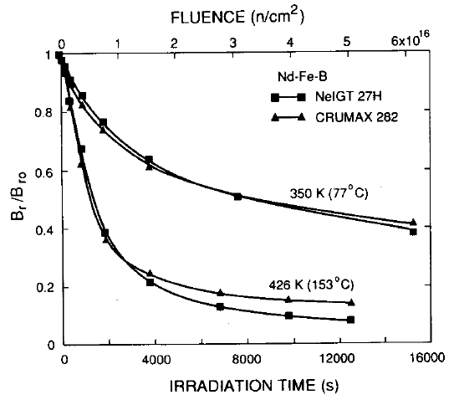
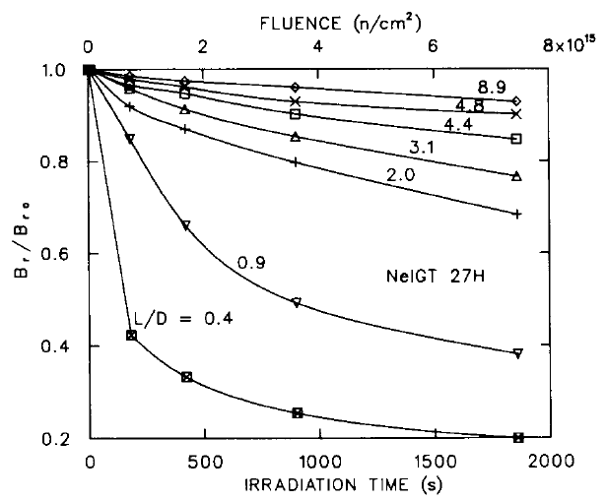
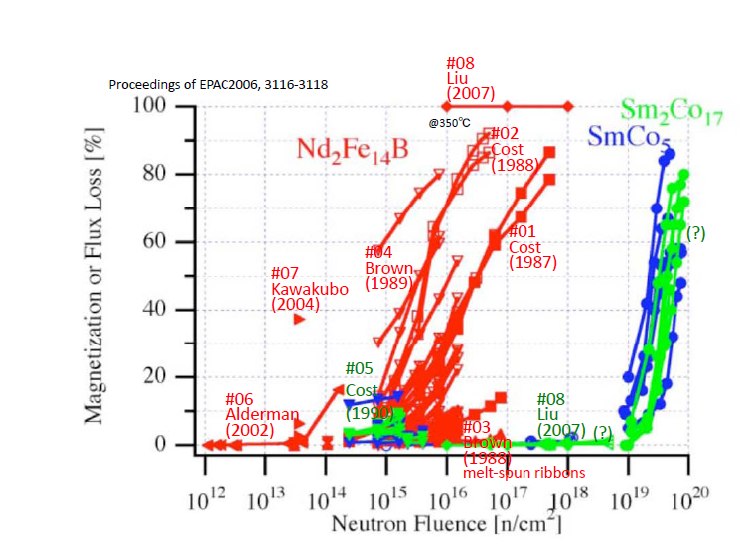
Neutrons
Maréchal, EPAC2006 THPCH135
Cost, IEEE Trans Mag 24(3) (1988) p2016
Brown, IEEE Trans Mag 25(4) (1989) p3117
Some reactor experiments carried out in 1980s
  Temperature is a clear factor:
  more demag at 426 K than at 350 K
  Magnet material: SmCo performs much better than NdFeB
  Shape: less demag for a larger L/D ratio
350 K
426 K
L/D = 8.9
L/D = 0.4

Slide 7
Other particles
Alderman, NIM A 481 (2002) p9
Negligible effect reported from
  X-rays from APS bending magnets (40-50 keV peak)
  γ-rays from ⁶⁰Co (1.2-1.3 MeV)
  thermal neutrons from ²⁵²Cf (1 MeV)
α particles (56 MeV)
  50% demag at 300 K; less at lower temperatures

Slide 8
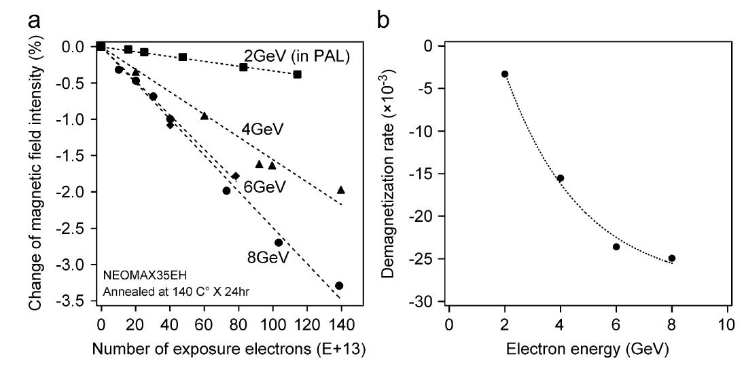
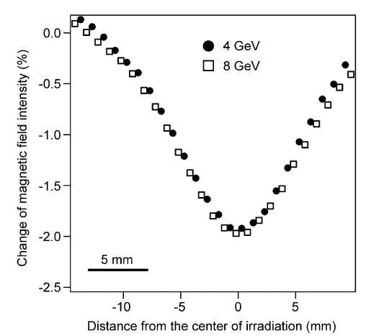
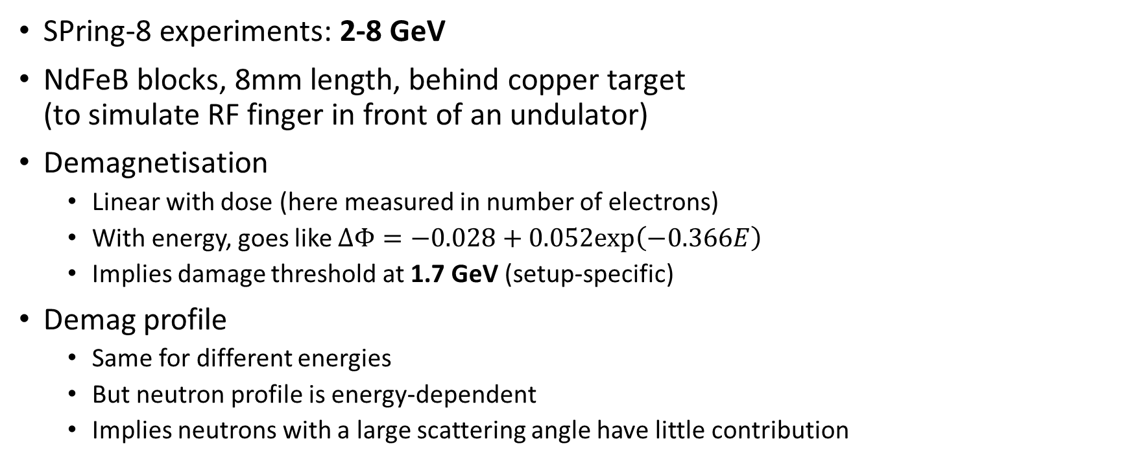
Electrons @ SPring-8
Bizen, NIM A 574 (2007)
SPring-8 experiments: 2-8 GeV
NdFeB blocks, 8mm length, behind copper target
(to simulate RF finger in front of an undulator)
Demagnetisation
  Linear with dose (here measured in number of electrons)
  With energy, goes like $ΔΦ=−0.028+0.052exp\left(−0.366E\right)$
  Implies damage threshold at 1.7 GeV (setup-specific)
Demag profile
  Same for different energies
  But neutron profile is energy-dependent
  Implies neutrons with a large scattering angle have little contribution

Slide 9
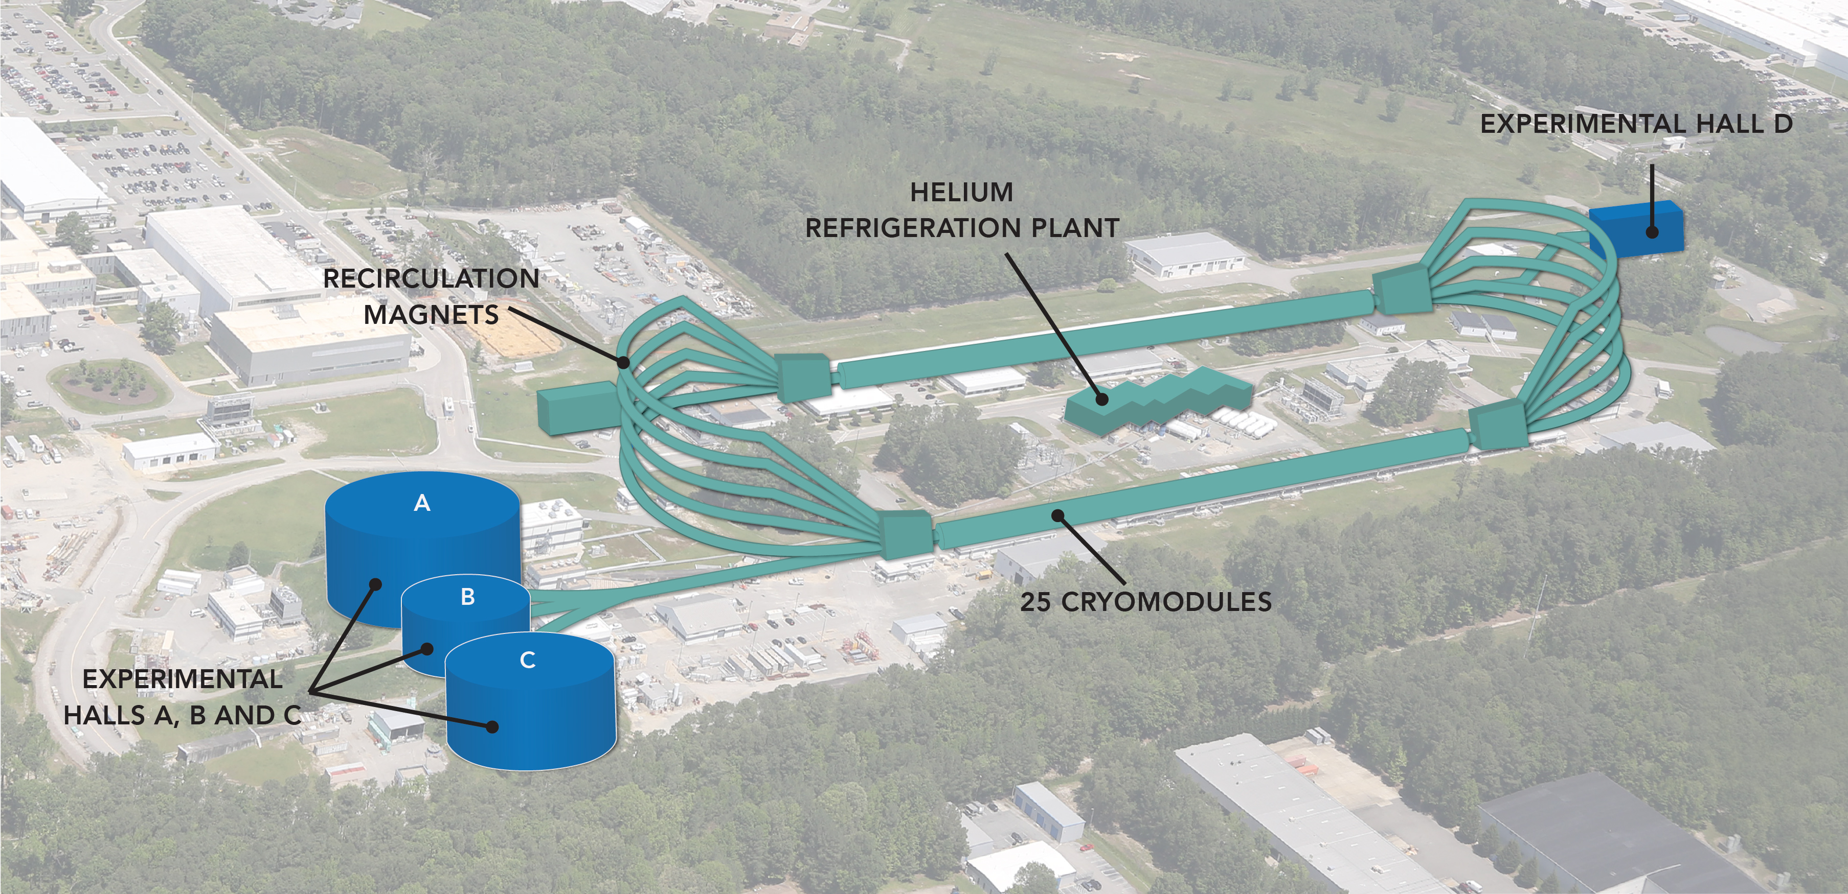
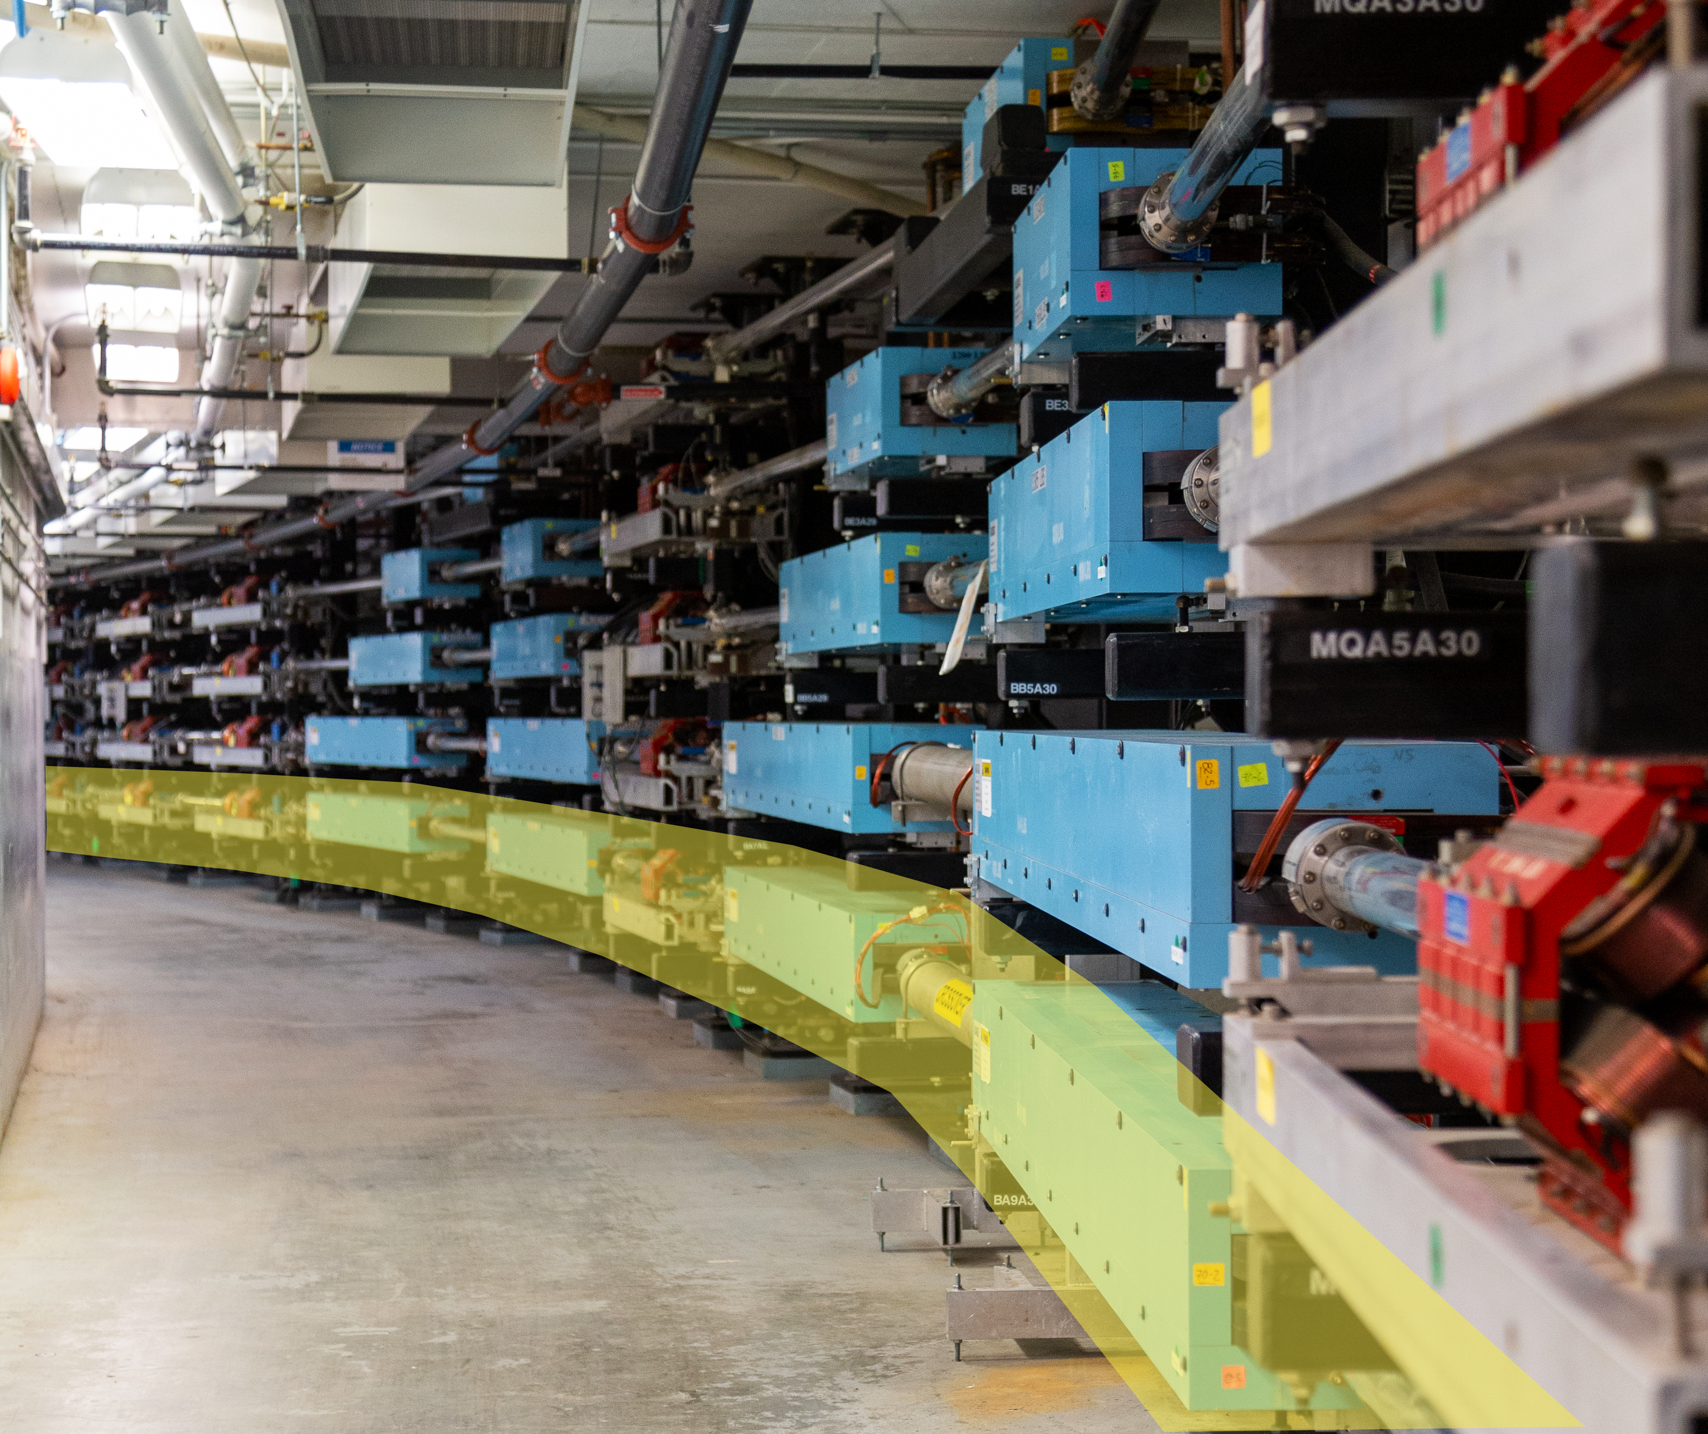
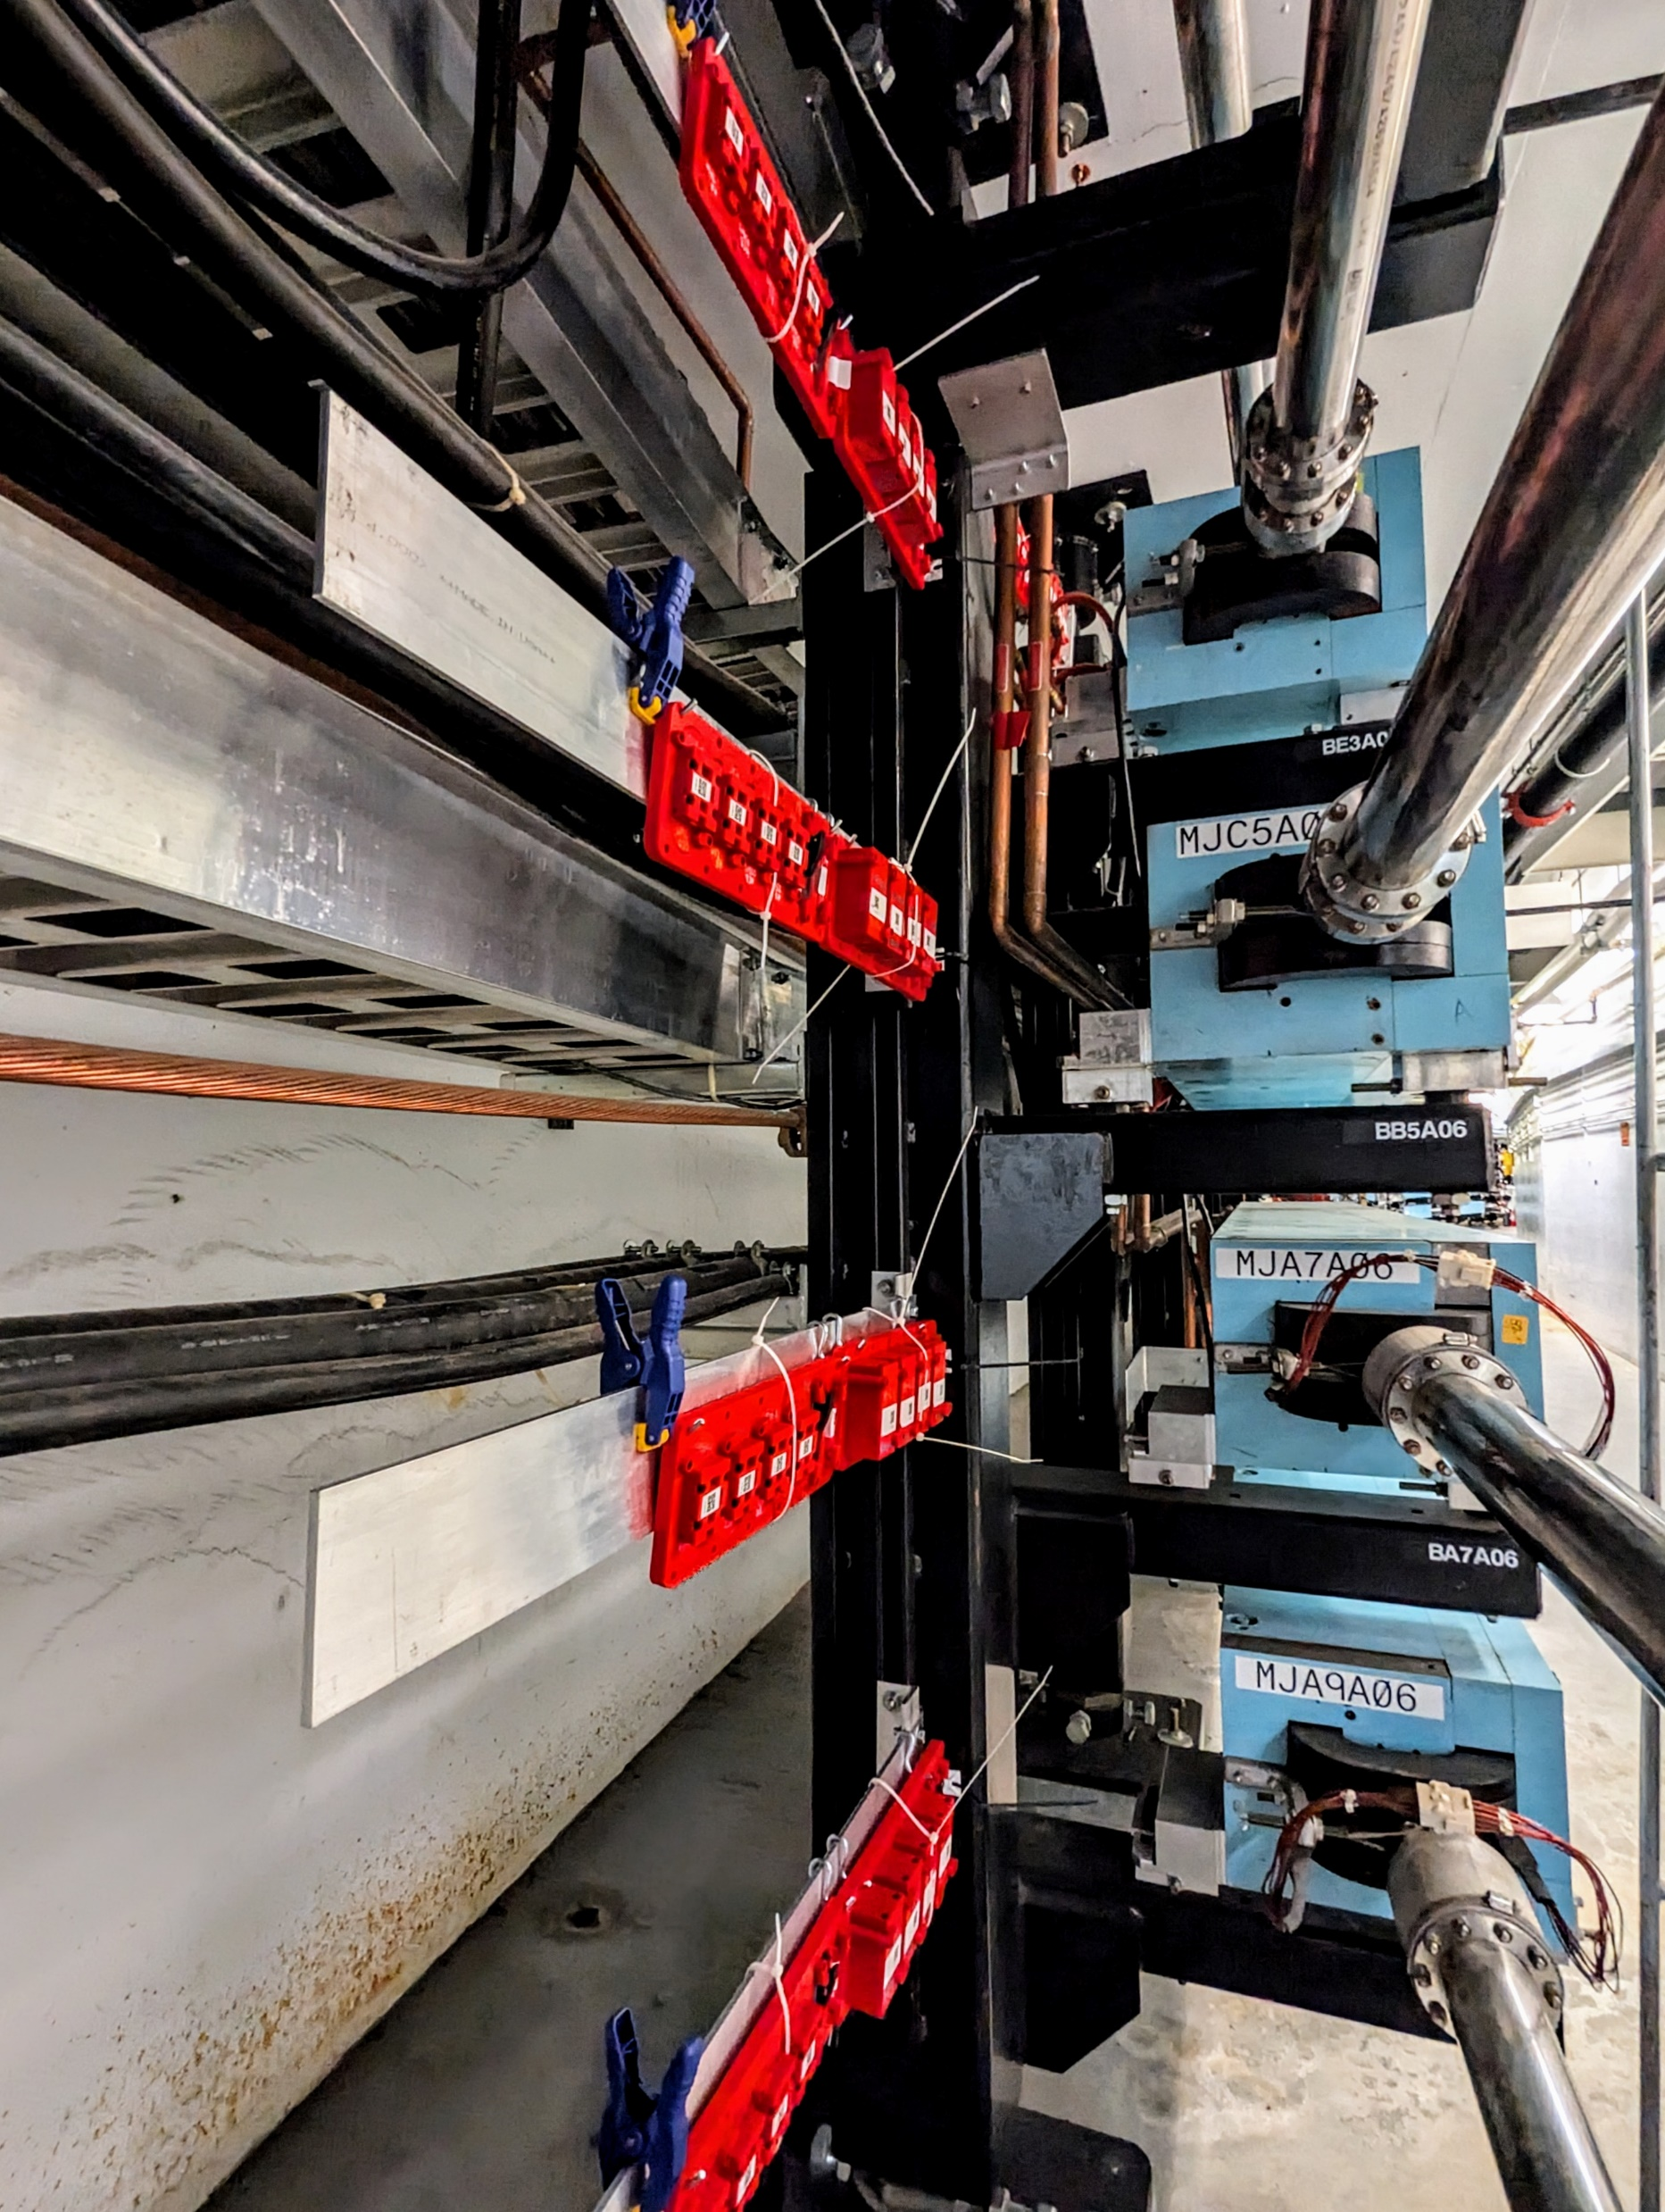
“Native radiation environment” at CEBAF
Bodenstein, ERL2024 THO11
CEBAF layout
CEBAF: 12 GeV multi-pass electron RLA
  looking to upgrade to 20+ GeV FFA
Goal: Study the degradation of permanent magnet materials in a radiation environment which resembles their intended operational environment
NdFeB (N42EH & N52SH) and SmCo (SmCo33H & SmCo35) will be placed in a wide range of radiation environments at the lab
(in the tunnel, Halls, etc…)
  Single samples and reverse-flux assemblies will be studied
Dosimetry (neutron and gamma) placed alongside all samples
High-precision Teslameter and Helmholtz coil on mobile lab carts will measure the samples as often as the CEBAF accelerator schedule allows
Using the gathered data, detailed dosage simulations, and external studies, will extrapolate to relevant energy ranges and model the magnet degradation
Arc segment
← PM sample trays

Slide 10
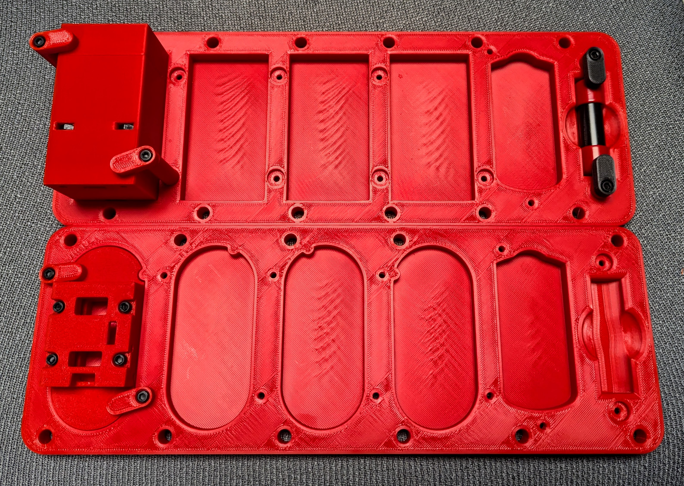
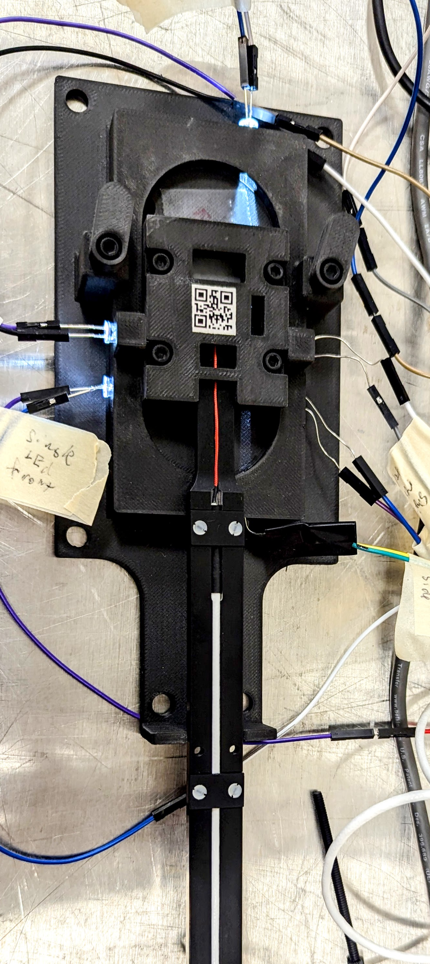
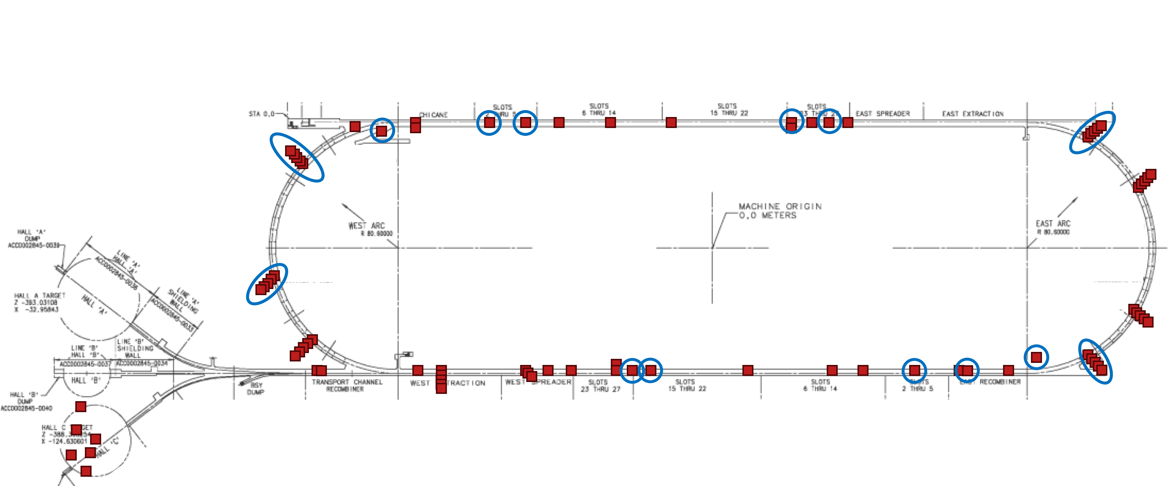
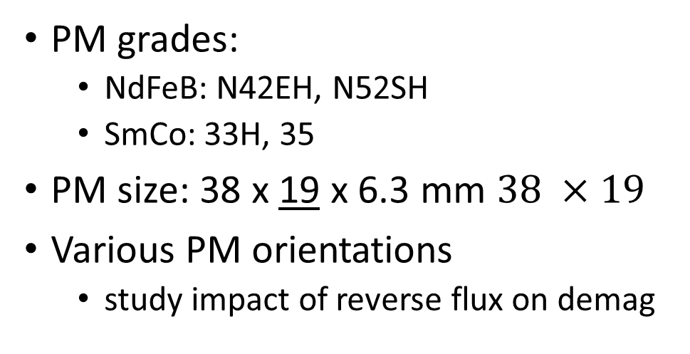
CEBAF experiment details
Bodenstein, ERL2024 THO11
3D Printed Mounting System
3-Axis Hall Probe in Rig
Pair Assembly Tray
PM grades:
  NdFeB: N42EH, N52SH
  SmCo: 33H, 35
PM size: 38 x 19 x 6.3 mm $38 ×19$
Various PM orientations
  study impact of reverse flux on demag
Single Sample Tray
Installed at each site:
2x pair assembly trays
1x single sample tray
Standardised assembly tray
Field measurements every 2 weeks
  Teslameter with 3d-printed measurement rig
  Helmholtz coil for integrated strength
Online radiation monitoring
  Area dosimeters (neutrons/gammas)
  Low- and high-dose optichromic rods (gammas)
single
parallel
perpendicular
antiparallel
Installed/analyzed Dosimetry
Location to install samples

Slide 11
Variables

Slide 12
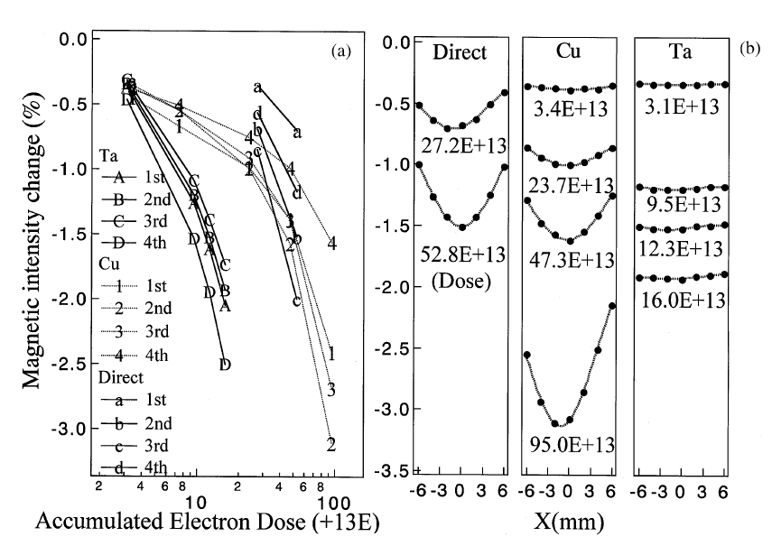
Targets
Bizen, NIM A 467 (2001) p185
2 GeV electrons
 | 1st | 2nd | 3rd | 4th
Ta
Cu
Direct
High-energy particles will produce a shower
of secondaries when they hit a target
Target materials
  (none): OK for 1st block, not for others
  copper: worst for 1st-3rd blocks
  tantalum: much worse!
Damage from secondary particles in
heavy shielding materials is important
Amount of demag for each block: less more

Slide 13
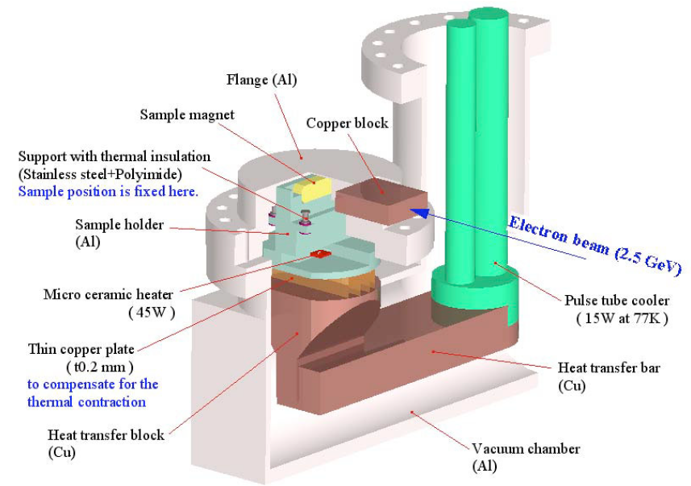
Coercivity and temperature
Bizen, EPAC2004 WEPLT103
Cost, IEEE Trans Mag 24(3) (1988) p2016
Kähkönen, EPL 12 (1990) p413
Van Vaerenbergh, RADECS 1999 p246
1 MeV neutrons: much greater demag at 426 K than 350 K
20 MeV protons: better at 15 K than 300 K
2.5 GeV electrons → NdFeB behind Cu block
  N50: 2% demag at 145 K; 25% at 300 K
  Also low demag: 27VH at 300 K, 53CR (PrFeB) at 90 K
  Strongly linked to coercivity H_{cj}
  But: SmCo with same H_{cj} ➔ less demag!
15 K
electrons
350 K
426 K
300 K
protons
neutrons

Slide 14
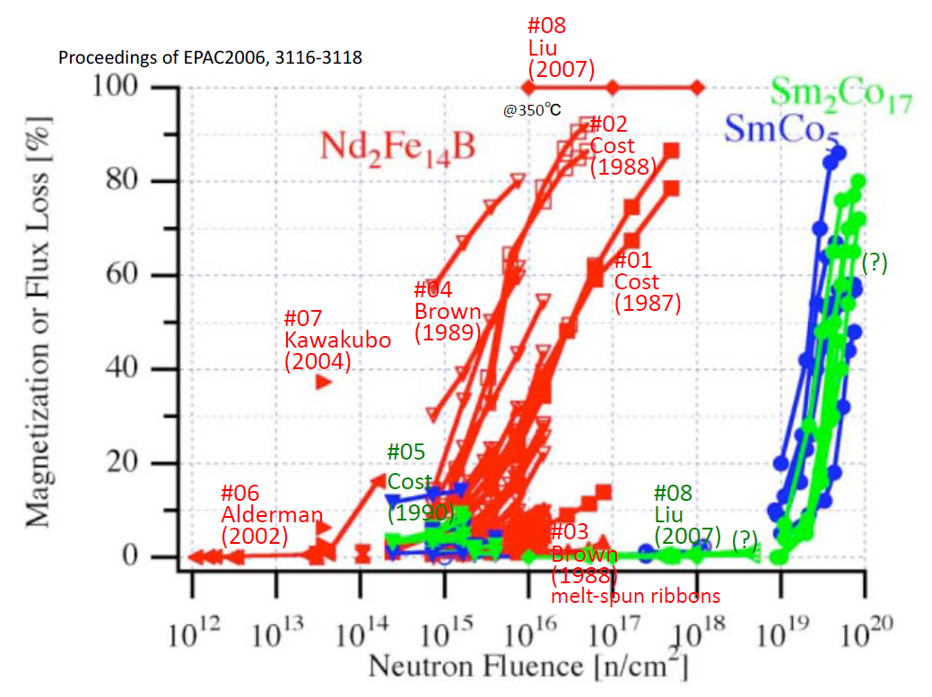
Material type
NdFeB demagnetises much more rapidly than SmCo
Summary of several different experiments using neutrons

Slide 15
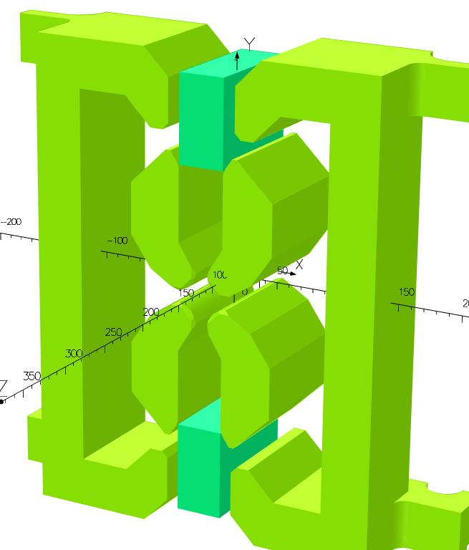
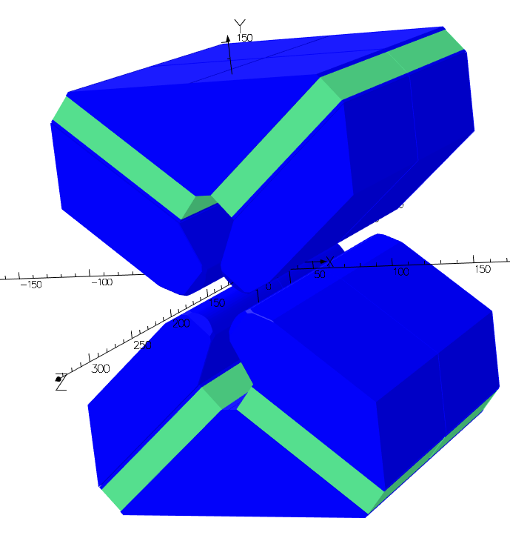

Operating point
Coercivity H_{c}
Magnetisation
M [T]
Operating point
Remanent field B_{r}
Intrinsic coercivity H_{ci}
Intrinsic curve
Stored energy (BH)_{max}
Applied field H [A/m]
PMs operate in the second quadrant of the B-H curve
Operating point depends on
  block shape
  PM environment
Described by permeance $P_{c}=\frac{B}{μ_{0}H}$
A higher demagnetising field
means more demagnetisation
in the event of irradiation
PM cylinder in free space
ZEPTO-Q2
L/D =
ZEPTO-Q1

Slide 16
Mechanisms

Slide 17
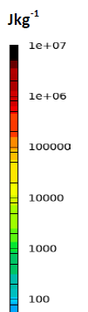
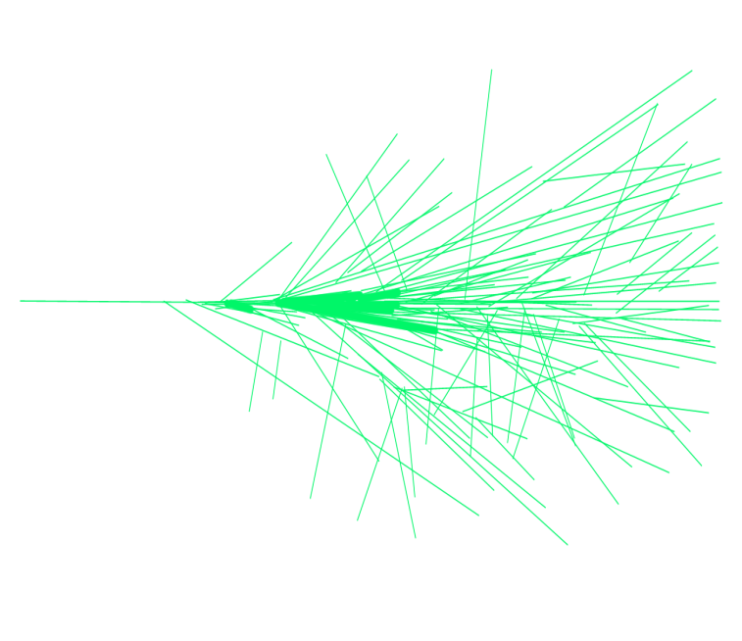
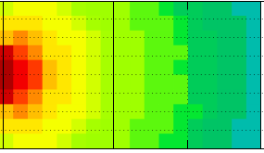
Electromagnetic cascade
Bizen, ‘Irradiation Experiments and Magnet Protection Plans at Spring-8’
A high-energy particle (here an electron) impacts on a solid
Causes a shower of lower-energy particles
Two regimes
  Electrons, gamma rays: Thermal fluctuation
  Neutrons: Thermal spike
Electromagnetic shower
e±
e±
γ
γ
γ
γ
n
e⁻
e±
γ
e±
e±
Dose (Gy)

Slide 18
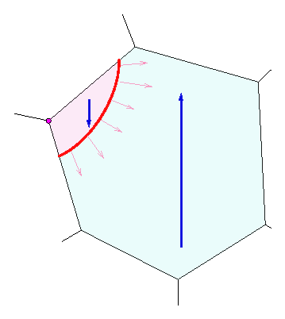
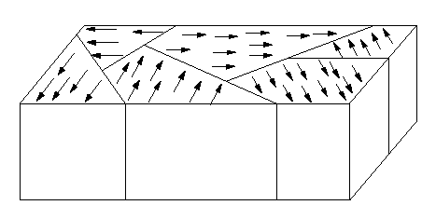
Nucleation of reverse domains
Bizen, ‘Irradiation Experiments and Magnet Protection Plans at Spring-8’
PM materials consist of magnetised domains separated by domain walls
Expansion of Reverse Domain
Applied magnetic field
Reversed Magnetization
Magnetized Direction
Domain wall
An inverse domain nucleates and expands at the defect or the grain boundary where the anisotropy barrier is lowest
Magnetic Domain

Slide 19
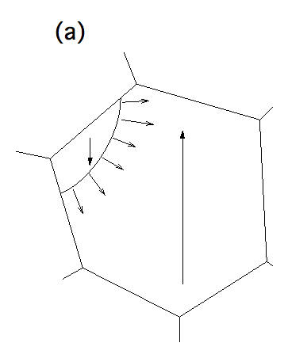
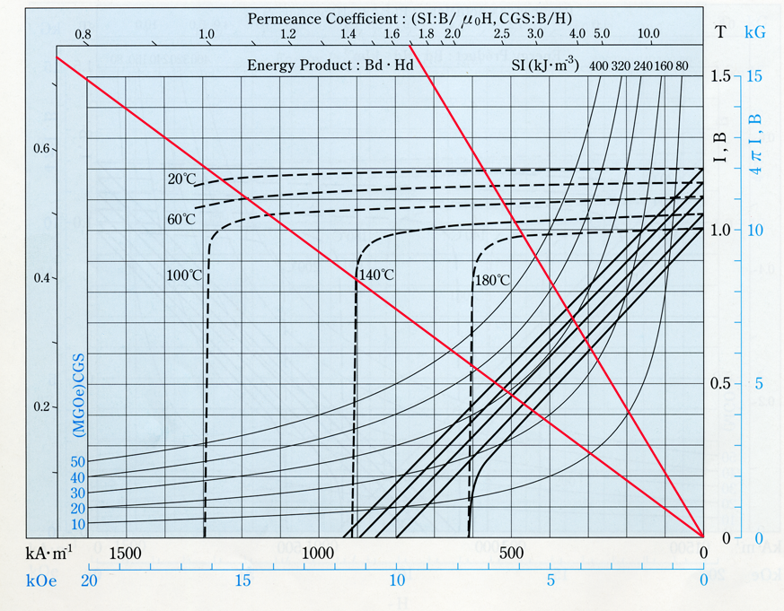
Thermal fluctuation
Bizen, ‘Irradiation Experiments and Magnet Protection Plans at Spring-8’
Coercivity in the grain decreases with temperature rise
Similar process to thermal demagnetisation
The temperature rises over a wide area
An inverse domain nucleates and expands at a crystal defect or grain boundary where the anisotropy barrier is the lowest
The coercivity decreases over a wide area
Inverse domain walls can expand easily in the low coercivity region
Can estimate an equivalent temperature based on experiment
  SPring-8: 2 GeV electrons → 440 K eqv (167°C)
Inverse domain nucleates and expands

Slide 20
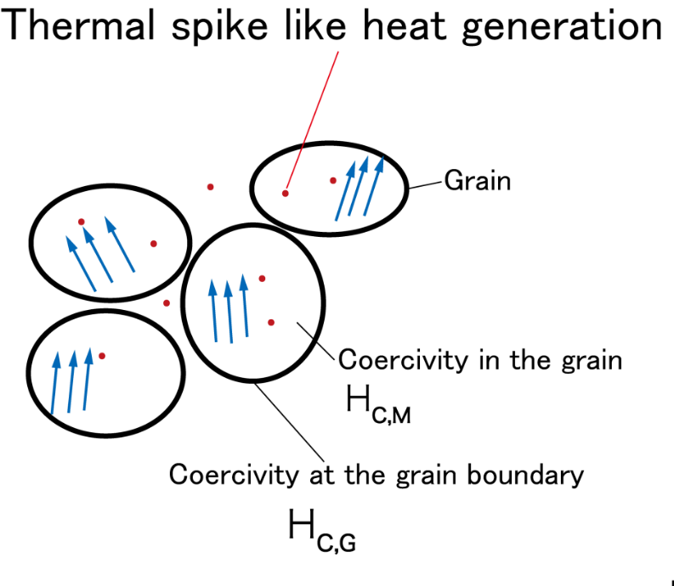

Thermal spike
Bizen, ‘Irradiation Experiments and Magnet Protection Plans at Spring-8’
A high-energy neutron imparts energy to the primary knock-on atom in the lattice
The recoil atom generates heat above the Curie temperature in a very small region and forms a core or track
The spike occurs both in the grain boundary where anisotropy is low, and in the grain where anisotropy is high
The coercivity around the track is kept high because the affected region is very small
Not all inverse domain walls expand in the grain where coercivity is kept high

Slide 21
Mitigation

Slide 22
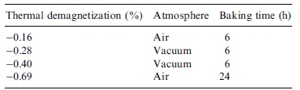
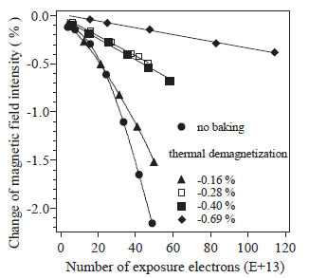
Baking
Bizen, NIM A 515 (2003) p850
NdFeB blocks
  NEOMAX 35EH
  46 x 8 x 12 mm
  Coercivity 1989 kA/m
  Baked at 142°C for 6-24 hours
  Some demag from this: up to 0.7%
Irradiated by electron beam
  PM behind copper block
  Water cooled, stable to 2°C
  2 GeV
  600 mA
  6 hours
  Up to 10¹⁵ electrons

Slide 23
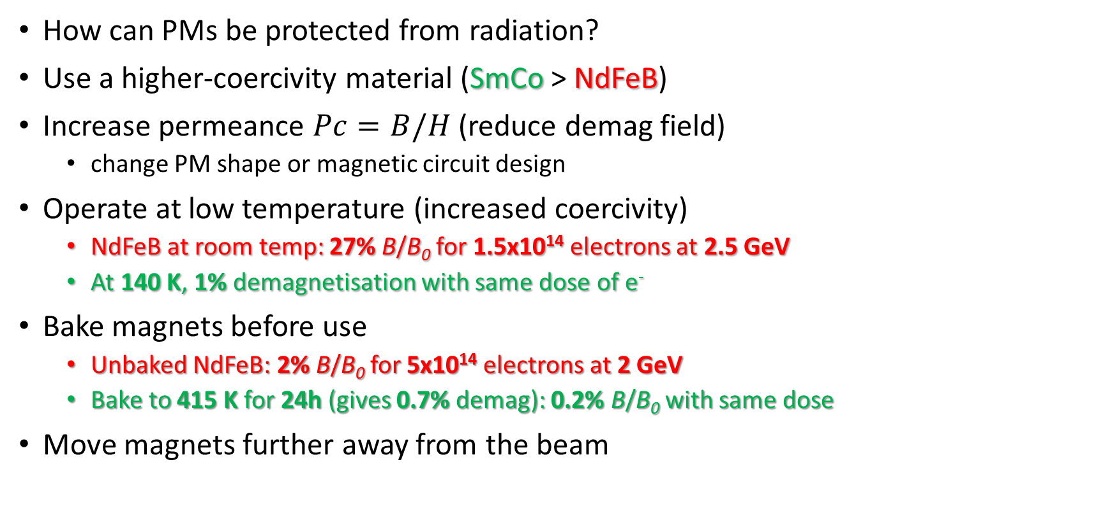
Mitigation - summary
How can PMs be protected from radiation?
Use a higher-coercivity material (SmCo > NdFeB)
Increase permeance $Pc=B/H$ (reduce demag field)
  change PM shape or magnetic circuit design
Operate at low temperature (increased coercivity)
  NdFeB at room temp: 27% B/B₀ for 1.5x10¹⁴ electrons at 2.5 GeV
  At 140 K, 1% demagnetisation with same dose of e⁻
Bake magnets before use
  Unbaked NdFeB: 2% B/B₀ for 5x10¹⁴ electrons at 2 GeV
  Bake to 415 K for 24h (gives 0.7% demag): 0.2% B/B₀ with same dose
Move magnets further away from the beam
W
W
H
H
small H/W, low Pc
large H/W, high Pc
B [T]
B_{r}
H_{ci}
H [A/m]

Slide 24
Conclusions
A large range of studies have been carried out, investigating radiation damage across a number of different variables
Dose (energy deposited) is a poor predictor: need to consider particle types and energy spectra
Radiation resistance can be improved by
  Increasing coercivity
  Increasing permeance
  Decreasing ambient temperature
  Pre-baking magnets
  Increasing distance from beam
  Adding shielding

Slide 25
References
Papers stored on Dropbox
Alderman, NIM A 481 (2002) p9, 'Measurement of radiation-induced demagnetization of Nd–Fe–B permanent magnets'
Asano, IPAC2011 THPC165, 'Estimations For Demagnetization Of ID Permanent Magnets Due To Installation Of OTR'
Asano, JSR 16, 317-324 (2009) 'Analyses of the factors for the demagnetization of permanent magnets caused by high-energy electron irradiation'
Barlow, LA-UR-97-3370 (1997), 'Radiation Hardness Measurements of New Permanent Magnet Materials for High-Intensity Linac Applications'
Bizen et al, 'High-energy electron irradiation of NdFeB permanent magnets - Dependence of radiation damage on the electron energy' (2007)
Bizen, 'Irradiation Experiments and Magnet Protection Plans at SPring-8'
Bizen, EPAC2004 WEPLT103, 'Radiation Damage in Magnets for Undulators at Low Temperature'
Bizen, ERL2011 WG5005 'Brief Review Of The Approaches To Elucidate The Mechanism Of The Radiation-Induced Demagnetization'
Bizen, ERL2011 WG5005 talk 'Brief Review Of The Approaches To Elucidate The Mechanism Of The Radiation-Induced Demagnetization'
Bizen, Nature SciRep 6, 37937 'Radiation-induced magnetization reversal causing a large flux loss in undulator permanent magnets'
Bizen, NIM A 467 (2001) 185, 'Demagnetization of undulator magnets irradiated high energy electrons'
Bizen, NIM A 515 (2003), 'Baking effect for NdFeB magnets against demagnetization induced by high energy electrons'
Bizen, NIM A 574 (2007) 'High-energy electron irradiation of NdFeB permanent magnets- Dependence of radiation damage on the electron energy'
Bizen, Particle Accelerator Society Meeting 2009, p133, 'Radiation-Induced Demagnetization Model for Undulator Magnets'
Bizen, Radiation Measurements 41 (2007), 'Radiation damage in permanent magnets for ID'
Blackmore, Nucl Sci 32 (1985) p3669, 'Radiation Effects of Protons on Samarium-Cobalt Permanent Magnets'
Bovda, 'The PM Magnetic Characteristics Change Under Effect of 10 MeV Electron Beam', IPAC2018 THPAL044
Bowman, NASA-TM-2012-217752, 'Magnetic Materials Suitable for Fission Power Conversion in Space Missions'
Bowman, NETS2013 6801, 'Design Issues for Using Magnetic Materials in Radiation Environments at Elevated Temperature'
Brown, IEEE Trans Mag 25(4) (1989), 'Radiation-Induced Changes in Magnetic Properties of Nd-Fe-B Permanent Magnets'
Brown, JAP 64 (1988) p5305, 'Neutron irradiation study of Nd-Fe-B permanent magnets made from melt-spun ribbons'
Chen, IEEE Trans Mag 41 10 (2005), 'The Effect of Neutron Irradiation on Nd–Fe–B and Sm₂Co₁₇-Based High-Temperature Magnets'
Clarke, ASML-ASTeC internal memo 'Radiation damage assessment for undulators'
Cost, IEEE Trans Mag 24(3) (1988) p2016, 'Effects of Neutron Irradiation on Nd-Fe-B Magnetic Properties'
Cost, MRS F 96 (1987) p321, 'Radiation Effects in Rare-Earth Permanent Magnets'
Cost, MT A 21(7) (1990) p1817 'Sm-Co permanent magnets effects of fast neutron irradiation‘
Danly, MSci thesis (2014), 'Radiation Damage in Permanent Magnet Lenses'
Holzer, CLIC Beam Instrumentation Workshop (2009), 'Beam Loss Monitors'
Hoorne, CERN-THESIS-2012-112, 'Cherenkov Fibers for Beam Loss Monitoring at the CLIC Two Beam Module'
Ikeda, NIM A 407 (1998) p439, 'Magnetic ßux loss of the permanent magnets used for the wigglers of FELs by the irradiation with high-energy electrons or X-rays'
Ito, NIM B 183 (2001) p323, 'Magnetic flux loss in rare-earth magnets irradiated with 200 MeV protons'
Kawakubo, EPAC2004 WEPKF041, 'Permanent Magnet Generating High and Variable Septum Magnetic Field and its Deterioration by Radiation'
Kostroun & Gulliford, 'Radiation Limits on Permanent Magnets in CBETA', IPAC2019 MOPRB075
Kähkönen, EPL 12 (1990) 413, 'Temperature Dependence of Irradiation-Induced Magnetic Flux Loss in Nd₂Fe₁₄B Permanent Magnets'
Kähkönen, JPhys Cond Matt 4 (1992), p1007 'Radiation damage in Nd-Fe-B magnets temperature and shape effects'
Kähkönen, PhysRevB 49 (1994) p6052, 'Effects of proton and α irradiations on permanent magnets'
Leitner, SLAC-PUB-14020 (2010), 'Radiation Protection Studies for LCLS Tune Up Dump'
Li, NIM B 413 (2017) 68, 'Investigation on demagnetization of Nd2Fe14B permanent magnets induced by irradiation'
Liu, Space Nuclear Conference 2007, 'Thermal_stability_and_radiation_resistance_of_SM-CO based permanent magnets'
Luna, NIM A 285 (1989) p349, 'Bremsstrahlung Radiation Effects In Rare Earth Permanent Magnets'
Makita, J. Magn. Soc. Jpn., 28, p326 (2004), 'Flux Loss of Nd-Fe-B Sintered Magnets Placed Near a Proton Synchrotron'
Martin, IEEE Trans Mag 8-3 (1972) p562, 'Temperature dependence of coercivity for Co-Sm permanent magnet alloys'
Maréchal, EPAC2006 THPCH135 figure 1 and references (cleaned up)
Maréchal, EPAC2006 THPCH135 figure 1 and references
Maréchal, EPAC2006 THPCH135, '65 MEV Neutron Irradiation of ND-FE-B Permanent Magnets'
Maréchal, NIM A 580 (2007) 1594–1596, 'On the importance of measuring all three components of the remanent field in radiation-induced demagnetization experiments'
Miyahara, NIM B 268 (2010) p57, 'Irradiation effects of a 10 MeV neutron beam on a Nd–Fe–B permanent magnet'
Okuda, NIM B 94 (1994) p227, 'Effects of electron-beam and y-ray irradiation on the magnetic flux of Nd-Fe-B and Sm-Co permanent magnets'
Petra, NIM A 507 (2003) 422, 'Radiation effects studies at the Advanced Photon Source'
Qiu, JNST sup 5 (2009) p46, 'Demagnetization of Nd-Fe-B Permanent Magnet at 2.5 GeV Electron Accelerator'
Qiu, NIM A 594 (2008) p111, 'Radiation damage of Nd2Fe14B permanent magnets at 2.5 GeV'
Samin, 'A review of radiation-induced demagnetization of permanent magnets', JNM 503 (2018) p42-55
Samin, NIM B 334 (2014) p43, 'Characterization of magnetic degradation mechanism in a high-neutron-flux environment'
Samin, NIM B 342 (2015) p200 'An analysis of radiation effects on NdFeB permanent magnets'
Sapinski, IPAC2010 WEPEB074 'Requirements of CLIC Beam Loss Monitoring System'
Schanz, RSI 88, 125103 (2017), 'High energy proton induced radiation damage of rare earth permanent magnet quadrupoles'
Shepherd (2018), 'Radiation Damage to Permanent Magnet Materials A Survey of Experimental Results’, CERN-ACC-2018-0029
Simos et al, 'Demagnetization of permanent magnets in spallation irradiation fields' (2018)
Simos, EPAC2008 WEPC053, 'An Experimental Study Of Radiation-Induced Demagnetization Of Insertion Device Permanent Magnets'
Talvitie, JMMM 102(3) (1991) p323, 'Magnetic flux loss in Nd-Fe-B magnets irradiated with 20 MeV protons'
Vagin, IPAC2014 WEPRO035 'Radiation Damage of Undulators at PETRA III'
Van Vaerenbergh, RADECS 1999 p246, 'Ageing of Permanent Magnet Devices at the ESRF'
Volk, FERMILAB-Conf-01-430 (2002), 'Summary of Radiation Damage Studies on Rare Earth Permanent Magnets'
Wolff-Fabris, 'Absorbed Radiation Doses on the European XFEL Undulator Systems During Early User Experiments', FEL19 wed02
Wolff-Fabris, 'Status of Radiation Damage on the XFEL.EU Undulator Systems', IPAC2018 WEYGBD2

