Slide 1


Beam-based girder alignment in PETRA-IV
Conceptual simulations
Sajjad H. Mirza for the PETRA IV WP2.08 team
Karlsruhe, 19.03.2025

Slide 2
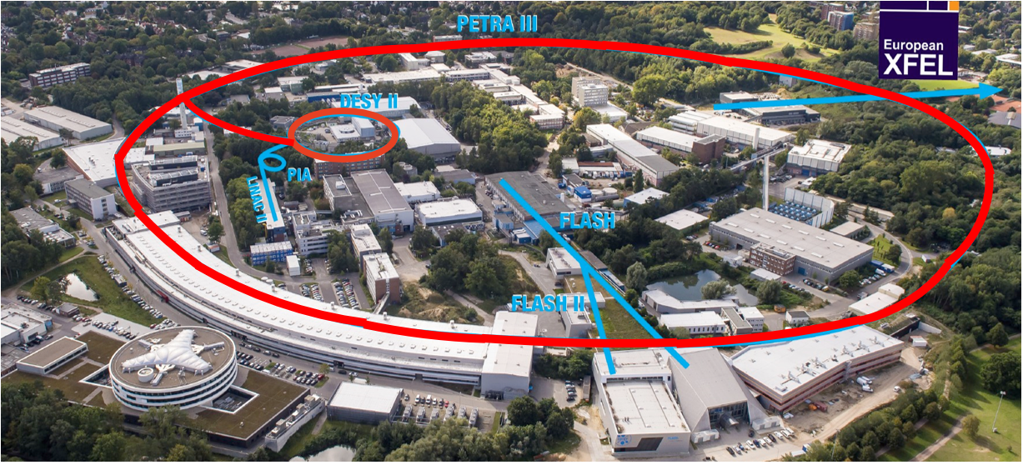
PETRA III is one of the core facilities at DESY
Each year ~5000h users operation serve more than 2000 users
Ada Yonath Hall
Extension Hall East
Parameter | PETRA III
Energy [GeV] | 6
Circumference [m] | 2304
Emittance (hor./vert.) [nm] | 1.3 / 0.013
Total current [mA] | 100
PETRA III emittance 1300 pm
PETRA IV emittance 20 pm
65 times smaller
enabling 500 times larger
X-ray beams brightness
Max von Laue Hall
Paul P. Ewald Hall
Extension Hall North
PETRA IV project:
replacing PIII with an ultra-low emittance ring (20 pm), adding a new Experimental Hall in two more octants,
replacing DESY II with a new low emittance booster

Slide 3

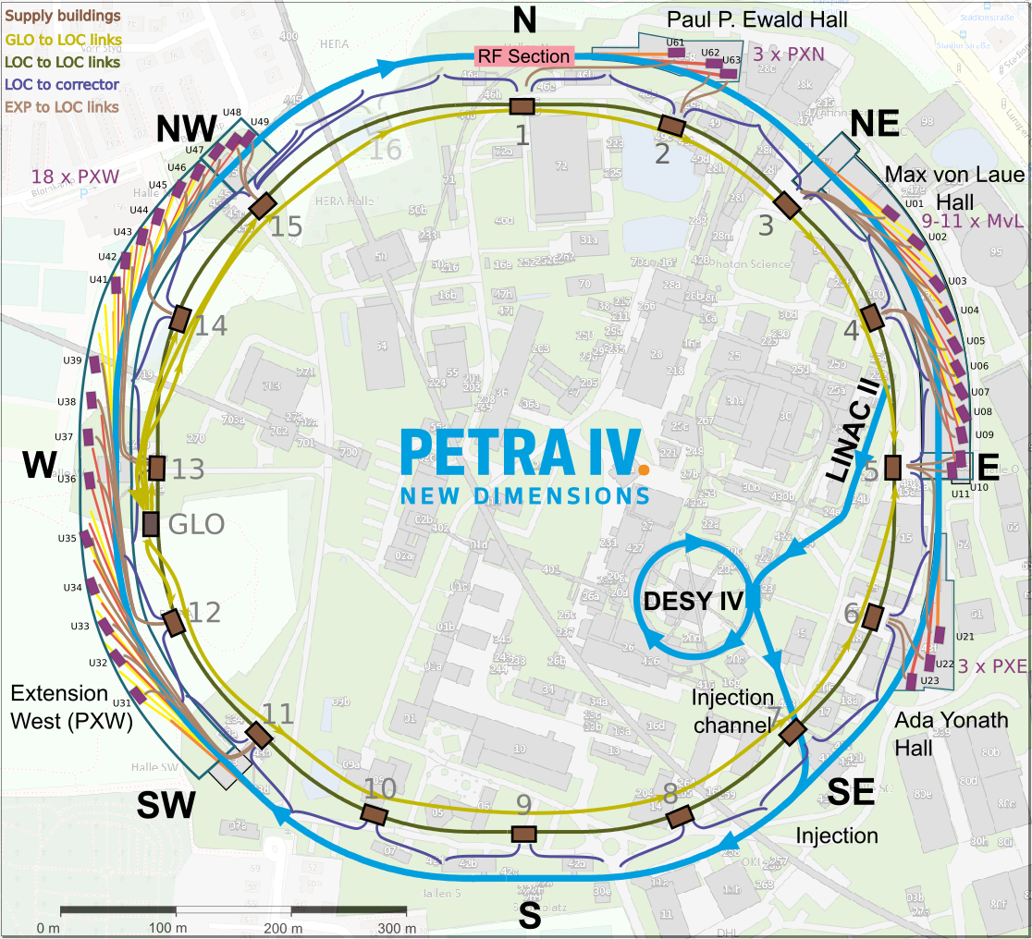
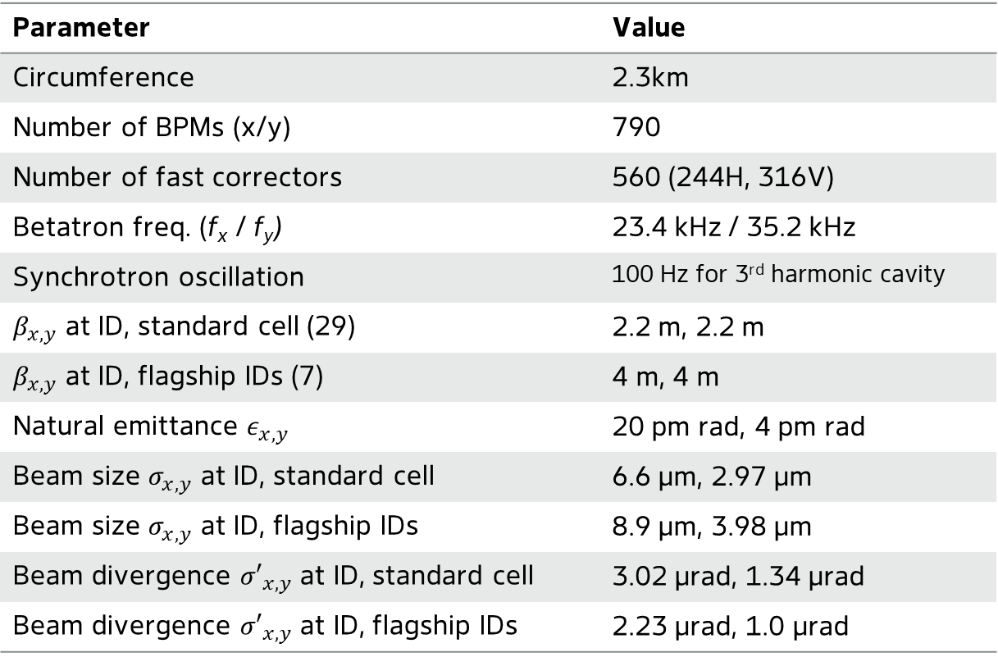


FOFB parameters
FOFB: Machine Parameters & Beam Stability Requirements
Parameter | Value
Circumference | 2.3km
Number of BPMs (x/y) | 790
Number of fast correctors | 560 (244H, 316V)
Betatron freq. (f_{x} / f_{y}) | 23.4 kHz / 35.2 kHz
Synchrotron oscillation | 100 Hz for 3rd harmonic cavity
$β_{x,y}$ at ID, standard cell (29) | 2.2 m, 2.2 m
$β_{x,y}$ at ID, flagship IDs (7) | 4 m, 4 m
Natural emittance $ε_{x,y}$ | 20 pm rad, 4 pm rad
Beam size $σ_{x,y}$ at ID, standard cell | 6.6 µm, 2.97 µm
Beam size $σ_{x,y}$ at ID, flagship IDs | 8.9 µm, 3.98 µm
Beam divergence ${σ′}_{x,y}$ at ID, standard cell | 3.02 µrad, 1.34 µrad
Beam divergence ${σ′}_{x,y}$ at ID, flagship IDs | 2.23 µrad, 1.0 µrad
Beam stability requirements:
Typically 10% of beam size and divergence at the IDs.
Remark: Some beamlines may require even 5%, 3%, … in future?
$$σ_{e}= \sqrt{βε+ σ_{E}^{2}η^{2}}$$
$$σ_{e}^{/}=\sqrt{\frac{ε}{β}}$$

Slide 4


Slow and fast correctors in lattice
Overlap of slow and fast magnets
Fast corrector magnets = 244 in X-plane
Fast corrector magnets = 316 in Y-plane
Slow corrector magnets = 618 in X-plane
Slow corrector magnets = 618 in Y-plane
Slow and fast correctors have overlapped locations in lattice
Planned strategy: Single FOFB system (Quasi-DC to high frequency)
Slow correctors for machine setup and large static correction
DC download from fast correctors to slow correctors
Expected corrector strength budget
$600 μrad$ based upon commissioning simulations
SOFB regime
$$30 μrad$$
$$3 μrad$$
FOFB regime
Higher net corrector strengths for the fast magnets due to combined slow/fast action – space constrains
Notes:
First we see the distribution of corrector magnets in the lattice. One cell is shown here alongwith beta function and phase advance.
We see less number of corrector magnets in horizontal plane → based upon machine physics simulations for optimal phase advance.
Although from our side, 30 urad maximum corrector strengths looks enough, but there are certain locations where slow/fast magnets are identical.
So a maximum of 600 urad corrector magnets are required.

Slide 5
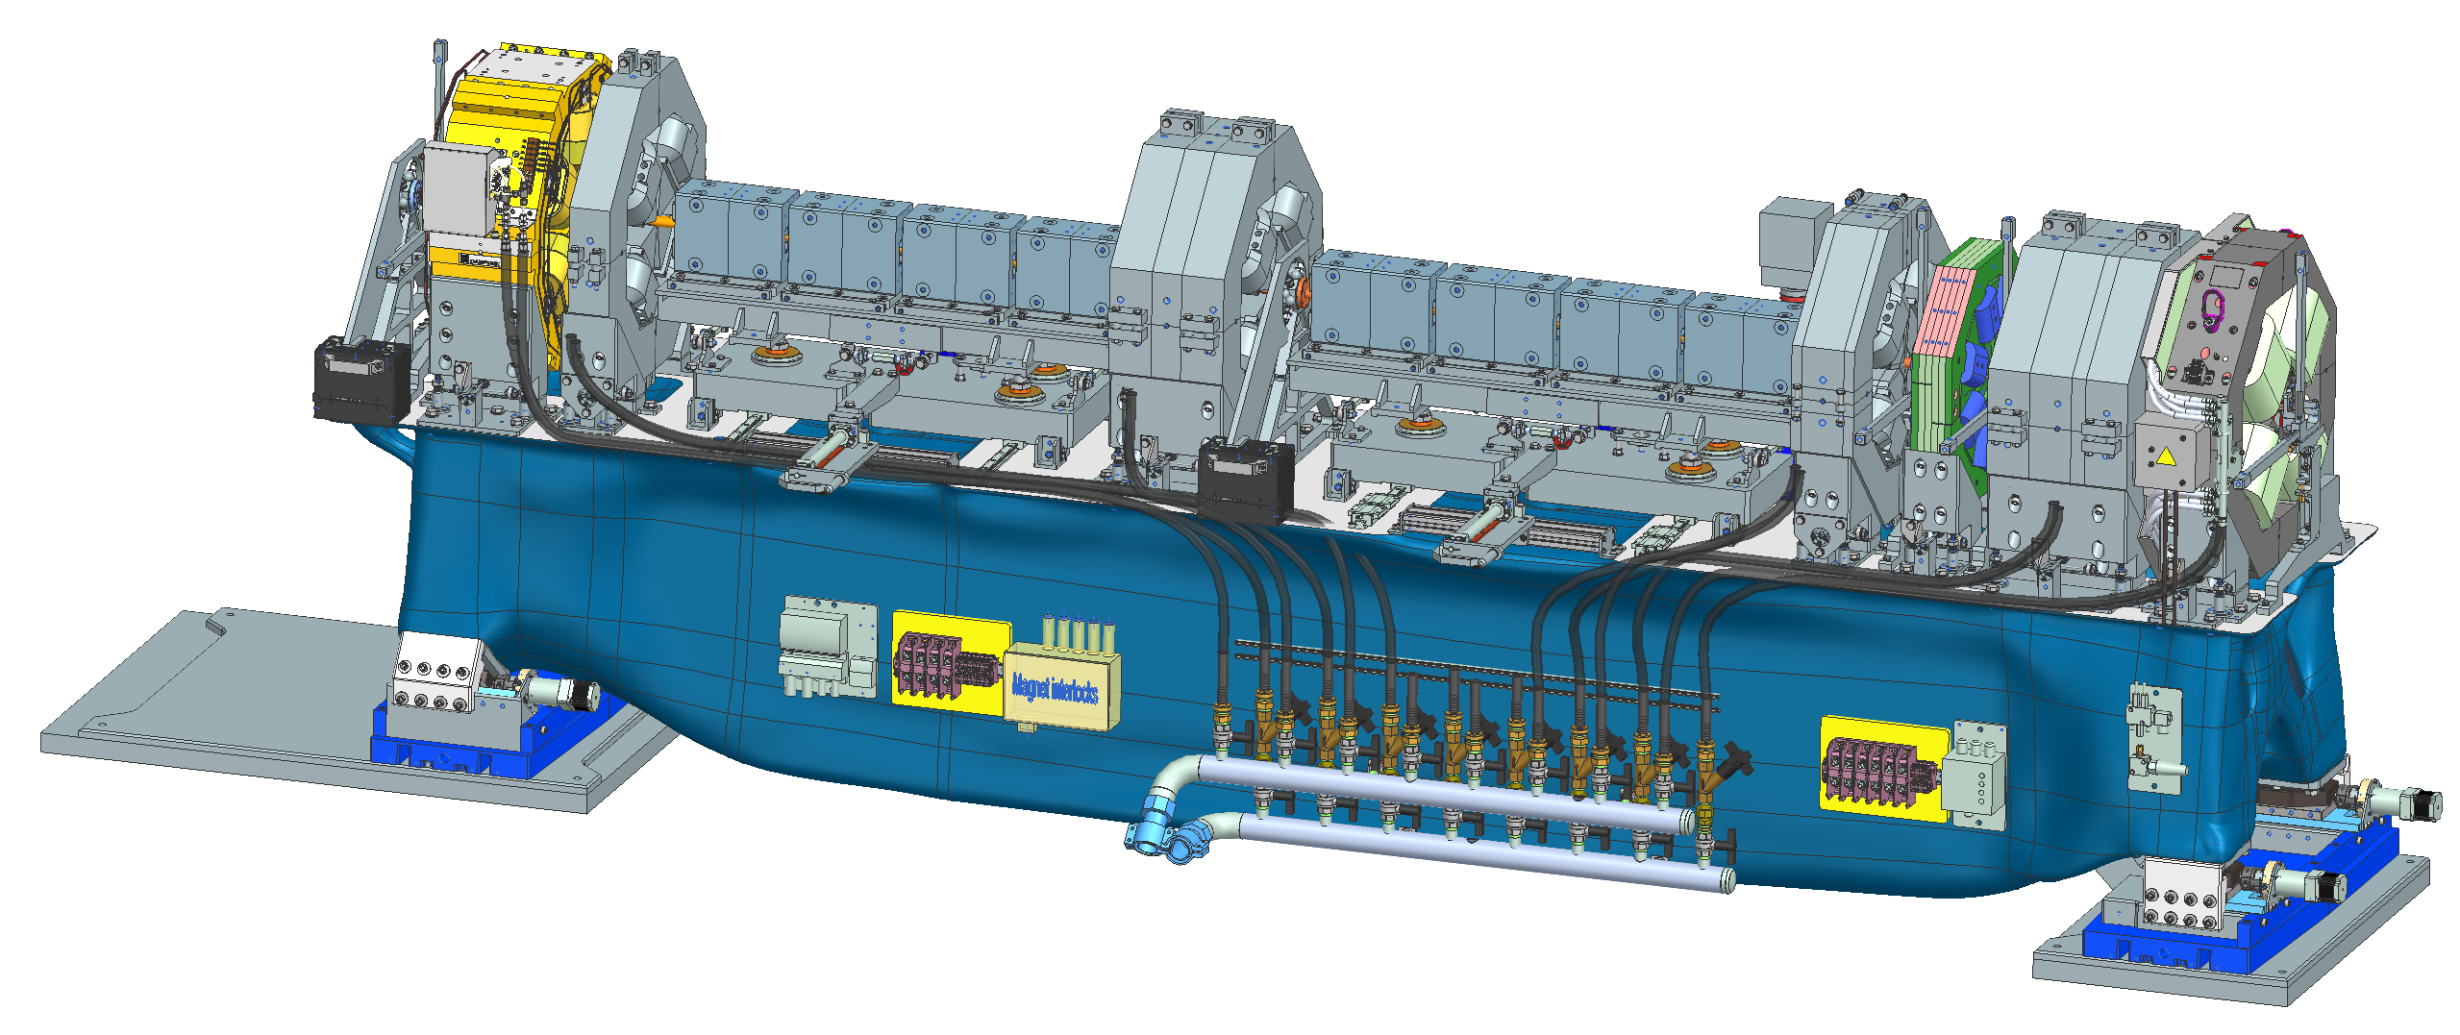
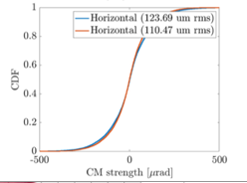
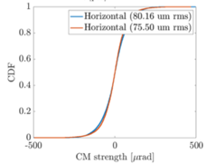


Why higher slow corrector strengths
Overlap of slow and fast magnets
Fast corrector magnets = 244 in X-plane
Fast corrector magnets = 316 in Y-plane
Slow corrector magnets = 618 in X-plane
Slow corrector magnets = 618 in Y-plane
No. of Girders = 288
→Talk: Normann Koldrack
Slow and fast correctors have overlapped locations in lattice
Below shown the corrector strengths required for girder misalignment
For $150 μm$Girder offsets
For $0 μm$Girder offsets
Courtesy to T. Hellert (MPY)
33 % reduction
One major contributor to large slow corrector strengths is
large girder misalignment → Heritage from PETRA I
Notes:
First we see the distribution of corrector magnets in the lattice. One cell is shown here alongwith beta function and phase advance.
We see less number of corrector magnets in horizontal plane → based upon machine physics simulations for optimal phase advance.
Although from our side, 30 urad maximum corrector strengths looks enough, but there are certain locations where slow/fast magnets are identical.
So a maximum of 600 urad corrector magnets are required.

Slide 6


Heritage from PETRA I
PETRA I tunnel reused for PETRA IV
Tunnel NW-N*
Nord
NL
NR
NWR
RF hall*
NOL
NW
NO
FLASH
NWL
NOR
PETRA IV Tunnel
Outside the experimental halls the old PETRA I tunnel will be reused
5 old sections, 100 – 300m long, in total ~800m.
The old sections of the tunnel are below streets and buildings.
The tunnel is covered by 3 – 10 m of soil.
Tunnel access at the halls, every 300m.
Tunnel between PXW and RF building will be rebuild (part of a construction package).
WR
Linac II
OL
West
PXW*
PIA
Ost
L-Weg
WL
DESY
OR
P-Weg
E-Weg
SOL
SWR
SW
e-
SO
SWL
Süd
SOR
SR
SL

Slide 7
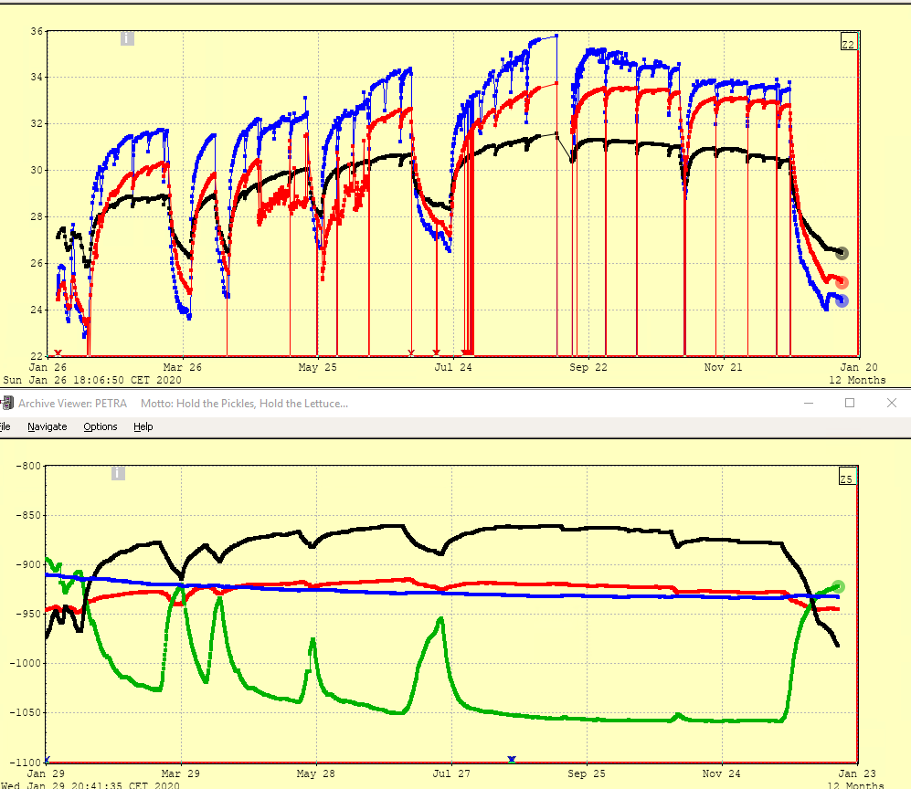
PETRA III Tunnel segment movements: Temperature effects
Relative movement of neighboring Tunnel segments (only one example of many possible scenarios)
Mechanical measurements at cracks (2020)
Typical temperature changes 23º – 36º C
Typical movements over one year (2020):
Units: Micro meter
x, horiz.: 50 - 100 µm, black, blue, red curve, temp. stabilized
x, horiz.: 150 µm, green curve, not temperature stabilized (this is above the alignment tolerances of PETRA IV!)
Long term transvers movements are dominated by the outside temperature.
Assumption: Reducing the temperature changes by a factor of 10 would reduce the short term movements by a factor of ~10 and make them tolerable.
Temperature variation in 2020
SOR85
OR59
OR59
Relative movement of horizontal
tunnel segment in 2020
50 – 100 µm,
temperature stabilized
Variation ~ 150µm,
not temperature stabilized
Notes:
Tunnel segments experience significant movement (up to 150 µm) driven by temperature changes.
Mitigation via improved temperature stabilization could reduce movements to acceptable levels.

Slide 8
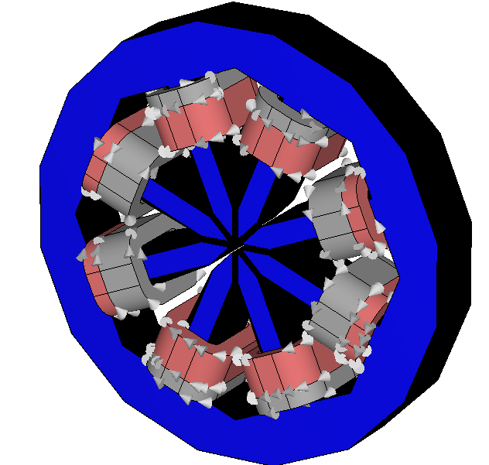
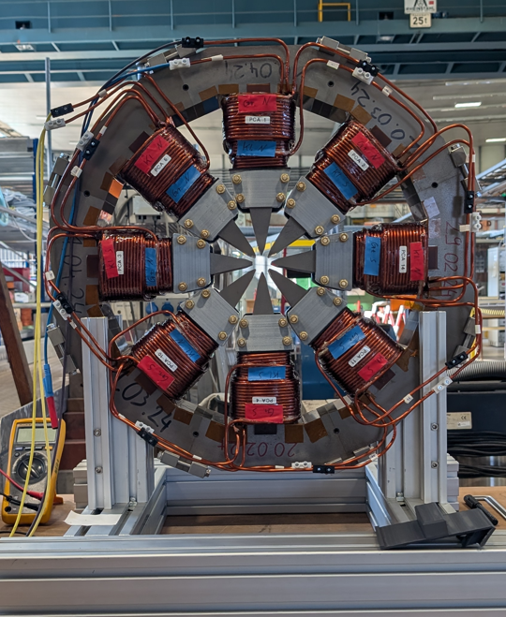
Slow/fast combined corrector parameters
Based upon APS-U design
Main coils
First prototype
Auxiliary coils
WP2.02
Baseline parameters:
  Main/aux coil is 65/27 turns (2.4074)
  Coil current 15 A
  Self-inductance 23 mH
Overlap of slow and fast correctors lead us (FOFB system) to interfere in
→Optimization of fast corrector magnet design (Sven’s talk)
→DC current downloading from slow magnets to Girder alignment (this talk)
Notes:
First we see the distribution of corrector magnets in the lattice. One cell is shown here alongwith beta function and phase advance.
We see less number of corrector magnets in horizontal plane → based upon machine physics simulations for optimal phase advance.
Although from our side, 30 urad maximum corrector strengths looks enough, but there are certain locations where slow/fast magnets are identical.
So a maximum of 600 urad corrector magnets are required.

Slide 9
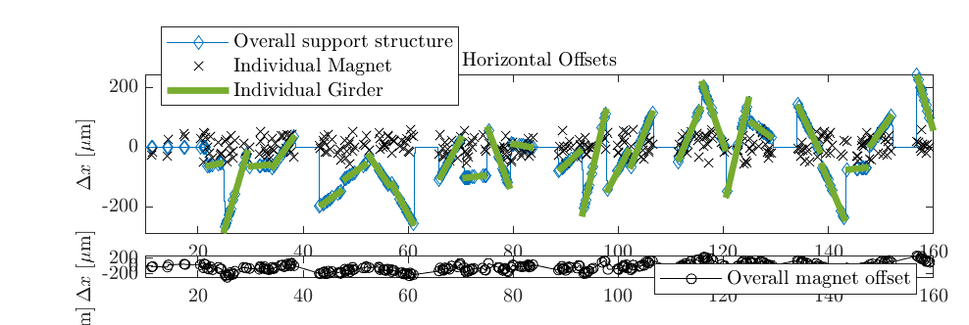
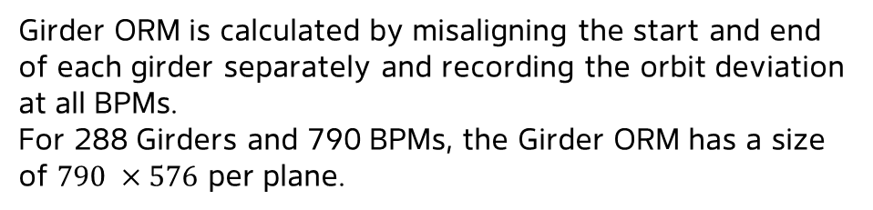
Beam-based girder alignment
What is the concept?
Fast correctors strengths →fast ORM→ BPM space
BPM space→ slow ORM → Slow corrector strengths
First download →
Slow correctors strengths →slow ORM→ BPM space
BPM space→ Girder ORM → Girder alignments
Second download →
Hard to measure, we have to rely on model!
Girder ORM is calculated by misaligning the start and end of each girder separately and recording the orbit deviation at all BPMs.
For 288 Girders and 790 BPMs, the Girder ORM has a size of $790 ×576$ per plane.

Slide 10
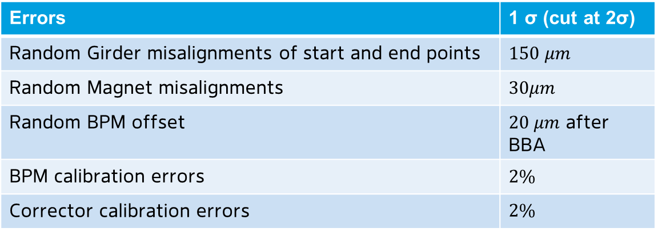
Assumed misalignments
Girder misalignments → corrector relaxation to Girder movements
Errors | 1 σ (cut at 2σ)
Random Girder misalignments of start and end points | $150 μm$
Random Magnet misalignments | $30μm$
Random BPM offset | $20 μm$ after BBA
BPM calibration errors | $2\%$
Corrector calibration errors | $$2\%$$
Such large alignment errors cannot be applied directly to PETRA IV lattice → commissioning simulations
For this study, the errors were ramped in small steps and orbit correction was performed for each step (work around)

Slide 11
Slow corrector relaxation to Girders
Required corrector strengths
Achieved orbit correction at BPMs
Girder misalignments
Predict Girder
alignmnets

Slide 12

Slow corrector relaxation to Girders
Tikhonov regularization for Girder ORM inverse
$$μ_{x}=1,μ_{y}=1$$
Reduced corrector strengths
Achieved orbit correction at BPMs
Girder correction applied

Slide 13
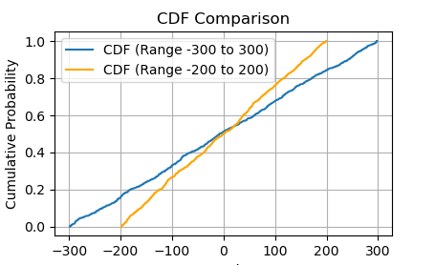
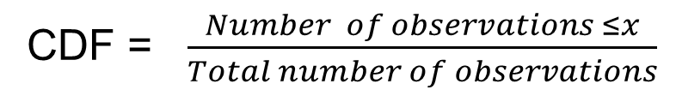
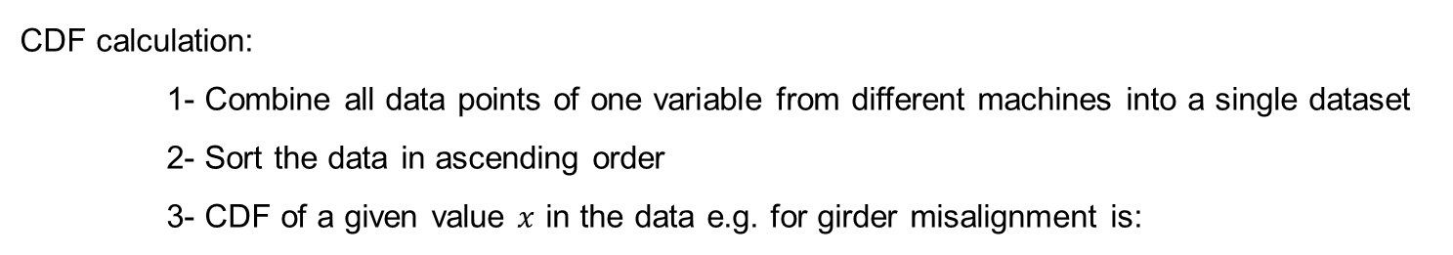
Rolling the dice many times: simulation for 72 machines
Simulations extended to 72 random misalignment patterns of girders and magnets etc.
Cumulative distribution function (CFD) is calculated for girder misalignment, slow corrector strengths and BPM values for all machines! → and compared before and after girder alignment
Don’t ask please about
this Golden Number of 72 ☺
CDF calculation:
1- Combine all data points of one variable from different machines into a single dataset
2- Sort the data in ascending order
3- CDF of a given value $x$ in the data e.g. for girder misalignment is:
CDF = $\frac{Number of observations ≤x}{Total number of observations}$
Example →

Slide 14
Slow corrector relaxation to Girders → for 68 of 72 random machines, 4 failed
Tikhonov regularization for Girder ORM inverse
$$μ_{x}=1,μ_{y}=1$$

Slide 15
Girder movement histogram
The net movement required for each Girder end is plotted here
Left: for one machine Right: for 68 machines as histogram
Tikhonov regularization for Girder ORM inverse
$$μ_{x}=1,μ_{y}=1$$
Single machine
68 machines

Slide 16
Girder alignment in feedback fashion
RMS of girder alignment, corrector strengths and BPM values are plotted below at different iteration of feedback. (no information about controller type etc. )
With aggressive correction, the girder correction diverges

Slide 17
Girder alignment in feedback fashion
Let us include only Girder misalignment as source of errors, for comparison.
After certain iterations, magnet misalignment dominates as main source of errros

Slide 18
Summary
Reuse of PETRA I tunnel for PETRA IV (with some improvements) comes with challenges of relatively large tunnel segment movements.
Space constrains require combined slow and fast corrector magnets.
Large slow corrector strengths are required to cope with accepted girder misalignments for PETRA IV.
Simulations are performed to demonstrate the possibility of beam-based girder alignment of the PETRA IV.

Slide 19
Thank you
Sajjad H. Mirza
WP 2.08 - Feedback
sajjad.hussain.mirza@desy.de
+49 40 8998 - 1991

