Slide 1


Topology-Optimized Girder Design
Achieving High Eigenfrequencies for Enhanced Stability
Koldrack, Normann
Karlsruhe, 19.03.2025

Slide 2

Agenda
01 Design Requirements for PETRA IV
Cell layout
Design space
Vibration
02 Design Process
Topology optimization using ANSYS
Comparison between a casted and welded design
Material choice
03 Girder Production
Casting
Machining
Delivery

Slide 3
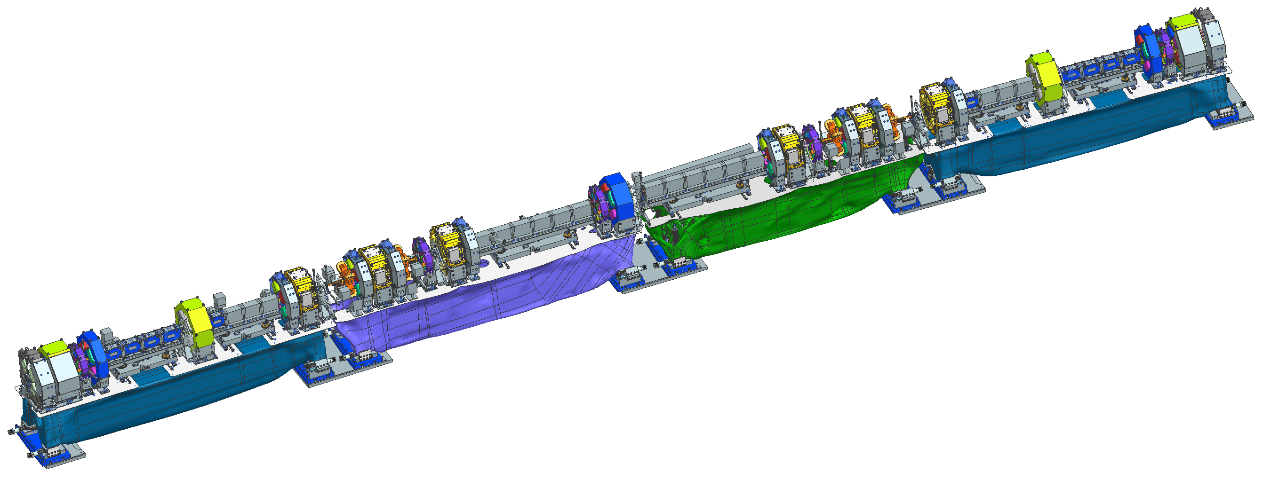


Cell layout
Girder Types
Three different girders per cell, "Alpha“-shape is rotated
72x Alpha, 72x Beta, 72x Gamma, 72x Delta = 288 girders
Girders only in arcs (8 arcs; 9 cells per arc)
Maximum assy. weight 12 tons = ~5 t for the girder
800mm high, 900mm wide between 4,7m and 4,2m long

Slide 4
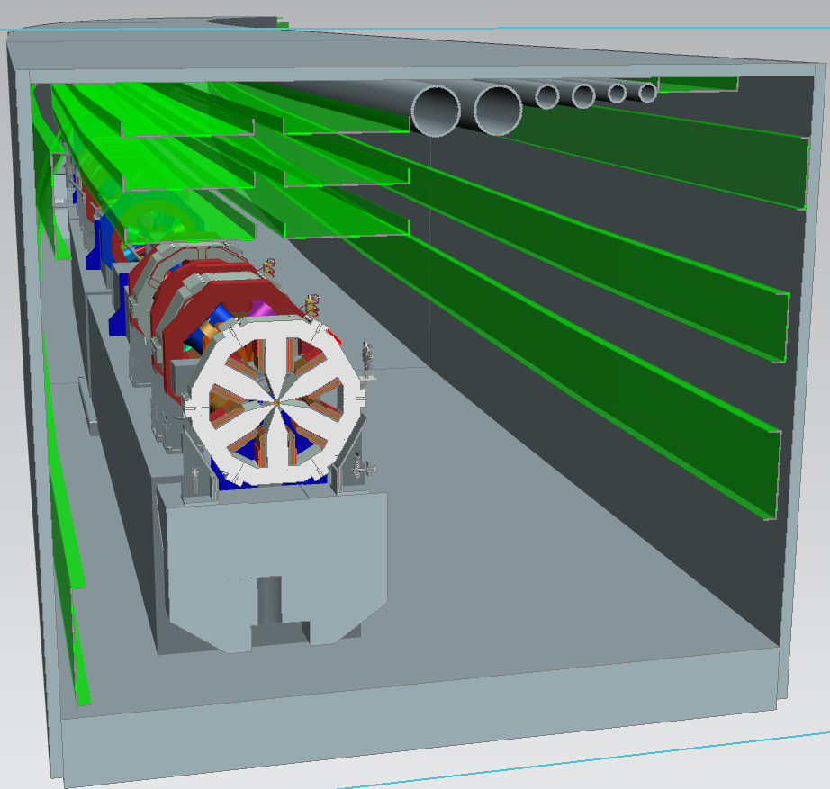
Design space

Slide 5
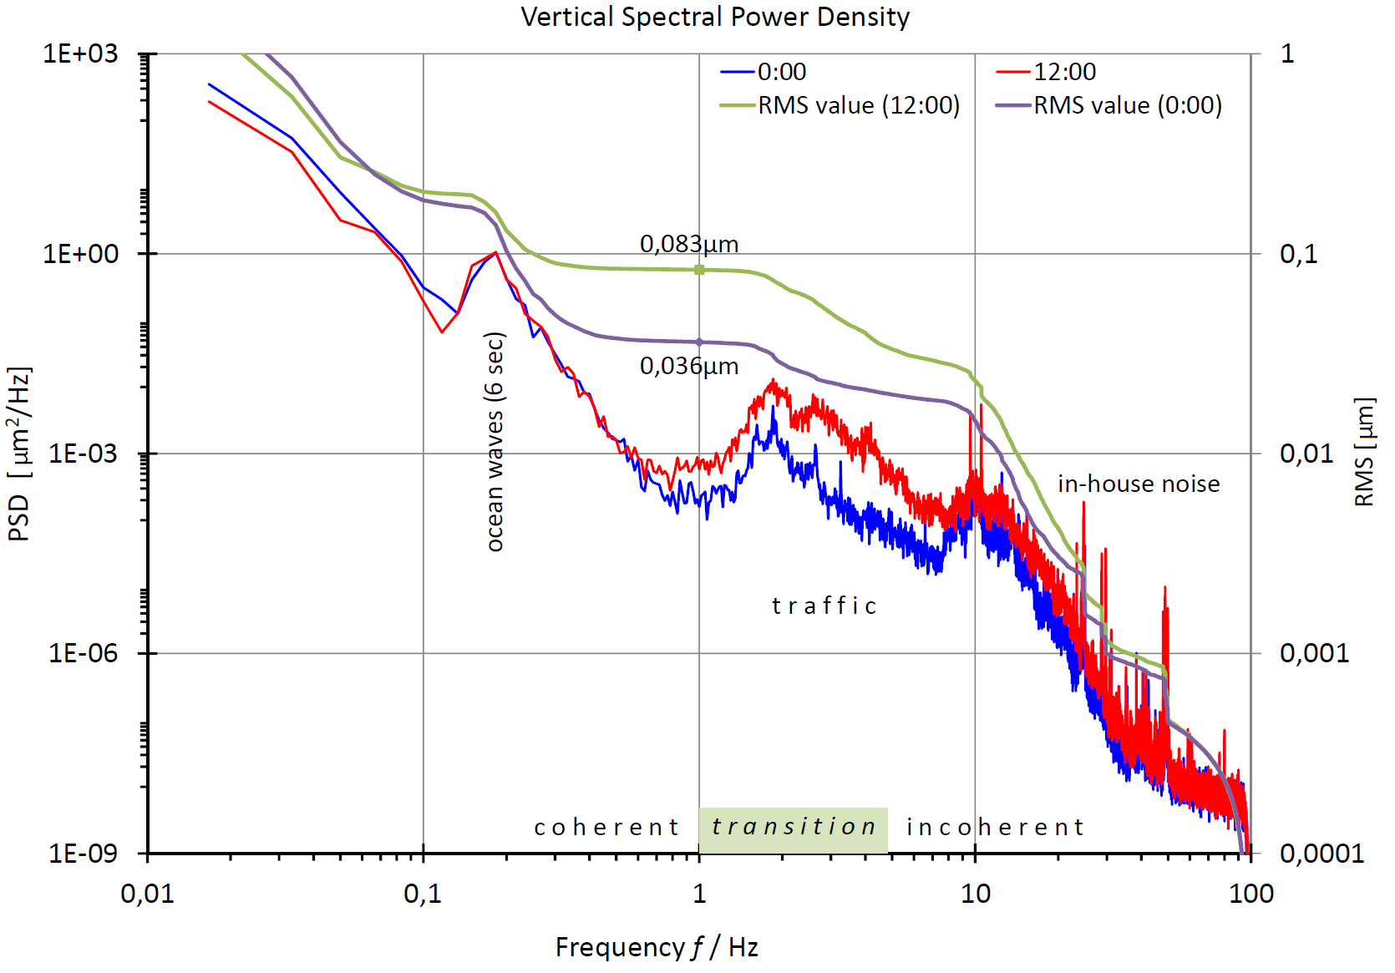
Vibration
~25 Hz asynchronous machines (fans,pumps,…)
~50 Hz AC power network
< 1Hz everything moves coherent
> 26 Hz RMS is below 1nm

Slide 6
Requirements summery
Requirement | Quantification | Comment
Weight of girders (loaded) | < 5 000 kg (< 12 000 kg) | Up to 9 magnets per girder
Design space | 4,7 x 0,9 x 0,8 m
Required amount | 288 Girder in 4 types
Natural frequencies | > 23 Hz; ≠25 Hz; ≠50 Hz
Girder mover | All axes electrically remote-controlled adjustable to an accuracy of 10 µm
Tunnel movements | Compensation of ±0,4mm in all axes remote controlled; ±5mm with manual intervention | Current tunnel movement over a year is within ±0.4mm
Girder supports must be at the ends to minimize the displacement between girders; lateral movement bad for bellows

Slide 7
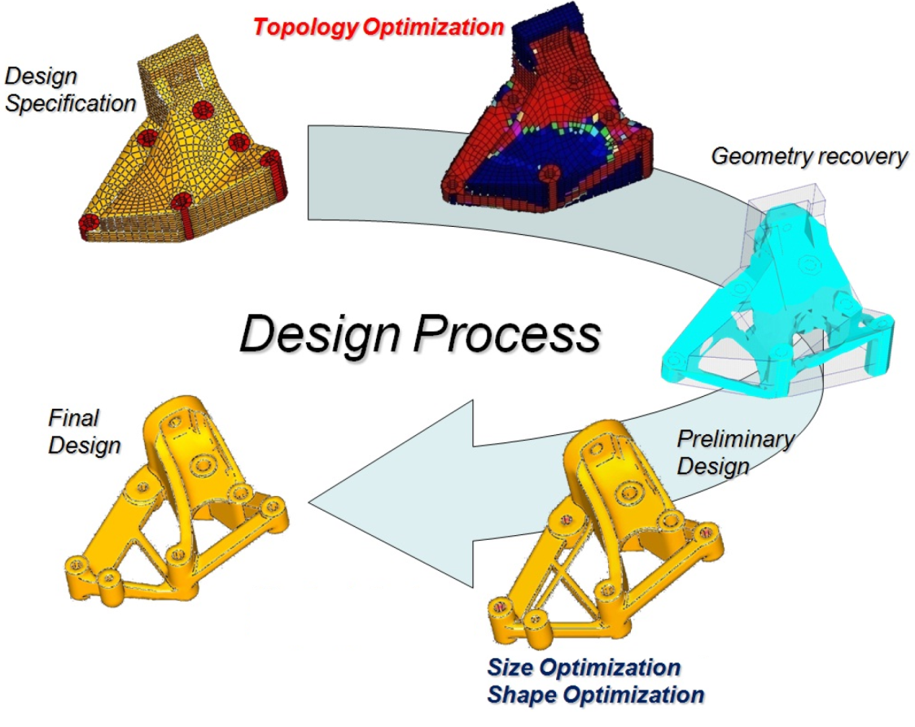
Girder Design progress
General approach
Collect all the specifications
  Design space
  Loads
  Supports
Generate designs with Topology Optimization and choose the best
Recover the geometry in a parameterized CAD model
Generate a Preliminary Design by optimize the CAD model
Finalize the design
Altair OptiStruct User Guide
Lightweight SUV Frame Design Development

Slide 8
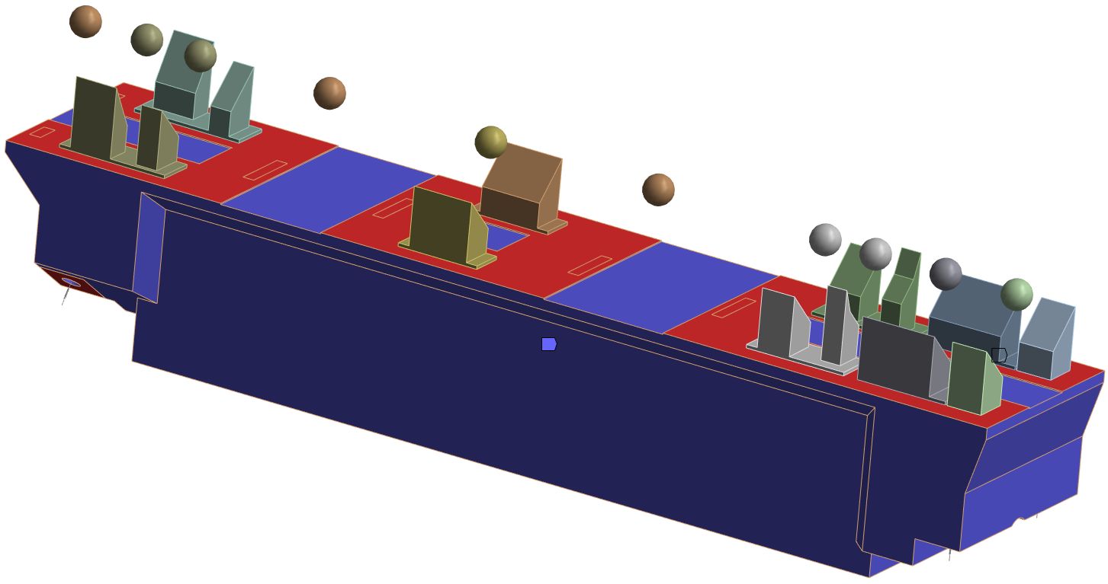

Topology optimization using ANSYS
Collect all the specifications

Slide 9
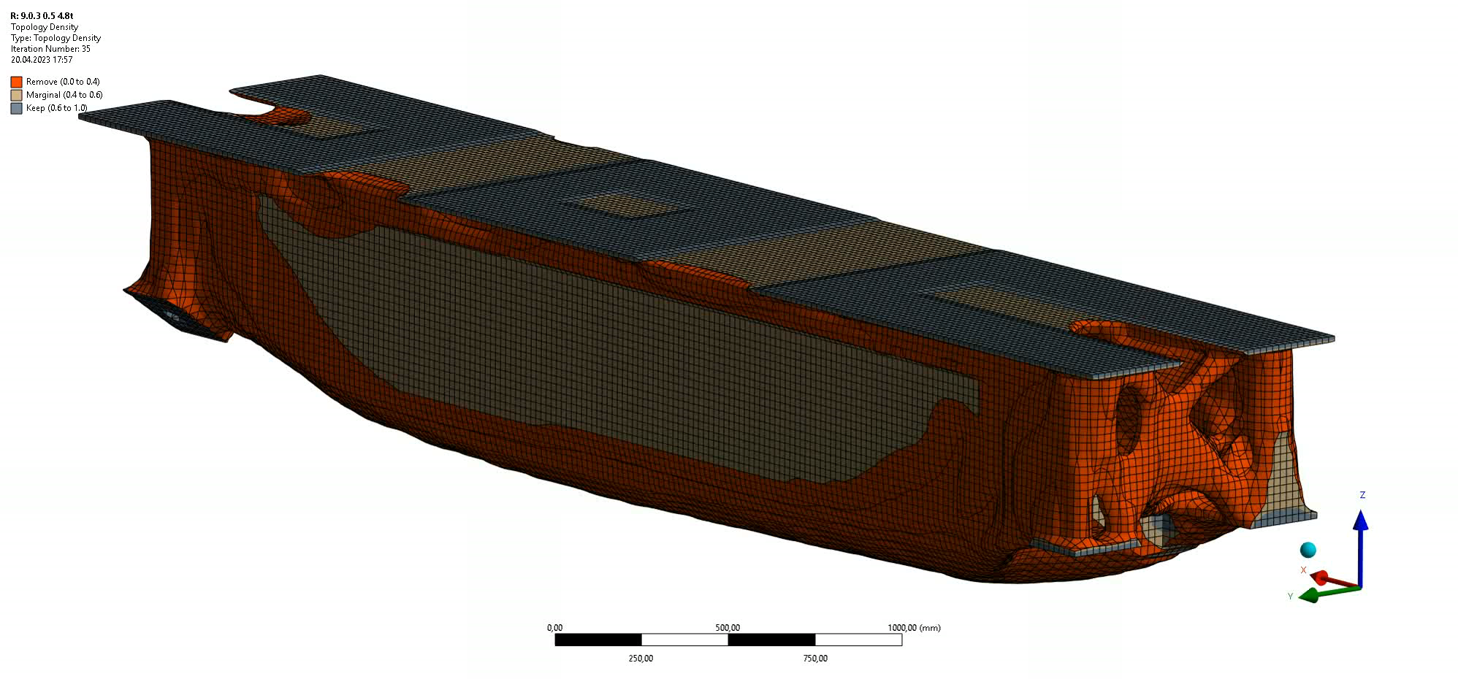
Topology optimization using ANSYS
Generating the design through topology optimization

Slide 10
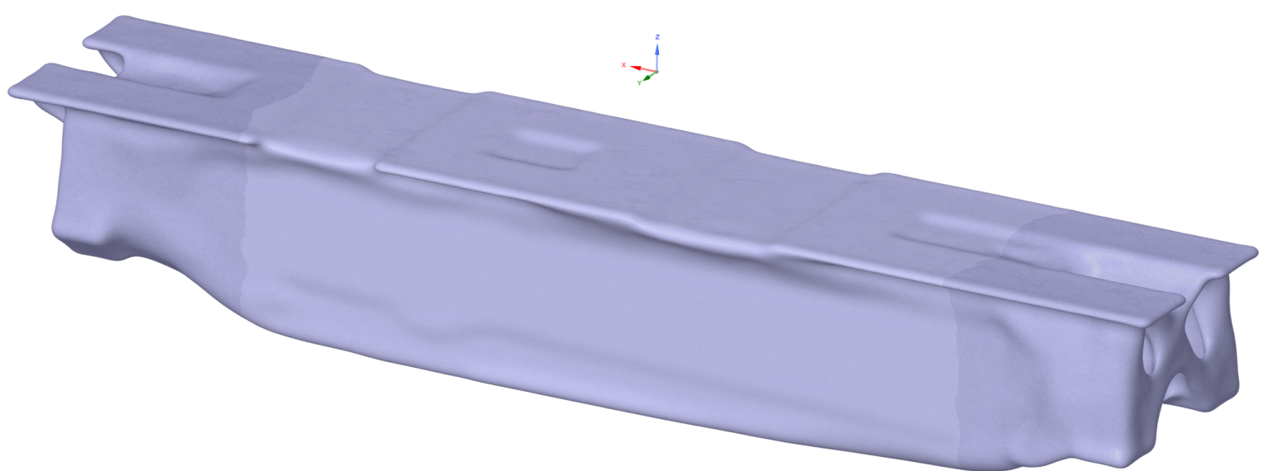
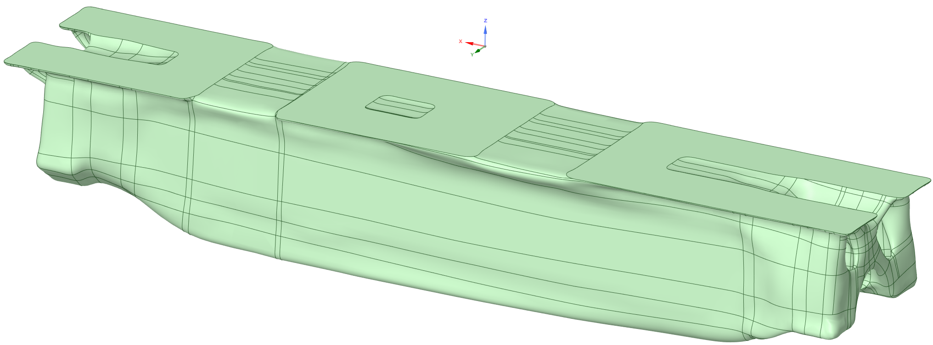
Topology optimization using ANSYS
Smoothing 2x 360°: Smooth operation performed twice in a 360-degree manner, possibly smoothing out any sharp edges or irregularities.
Smooth Volume Aware: A type of smoothing that takes into account the volume of the object being smoothed.
Smooth Add Facets: Adding facets during the smoothing process to refine the surface.
Generating Nurbs: Converting the smoothed topology into Non-Uniform Rational B-Splines (NURBS), which are commonly used in 3D modeling for representing curves and surfaces. (Auto-Skin)
Post-processing in SpaceClaim
Topo Modification: Joining with extra bodies, adding material around 10-15mm to the existing topology.
Fixing and Checking: Ensuring that the triangulated surface are correct and error-free. (Auto-Fix)
Manifold Removal: Removing any manifold edges from the topology.
Shrinkwrap with 15mm: Applying a wrapping technique with a mesh size of 15mm.

Slide 11
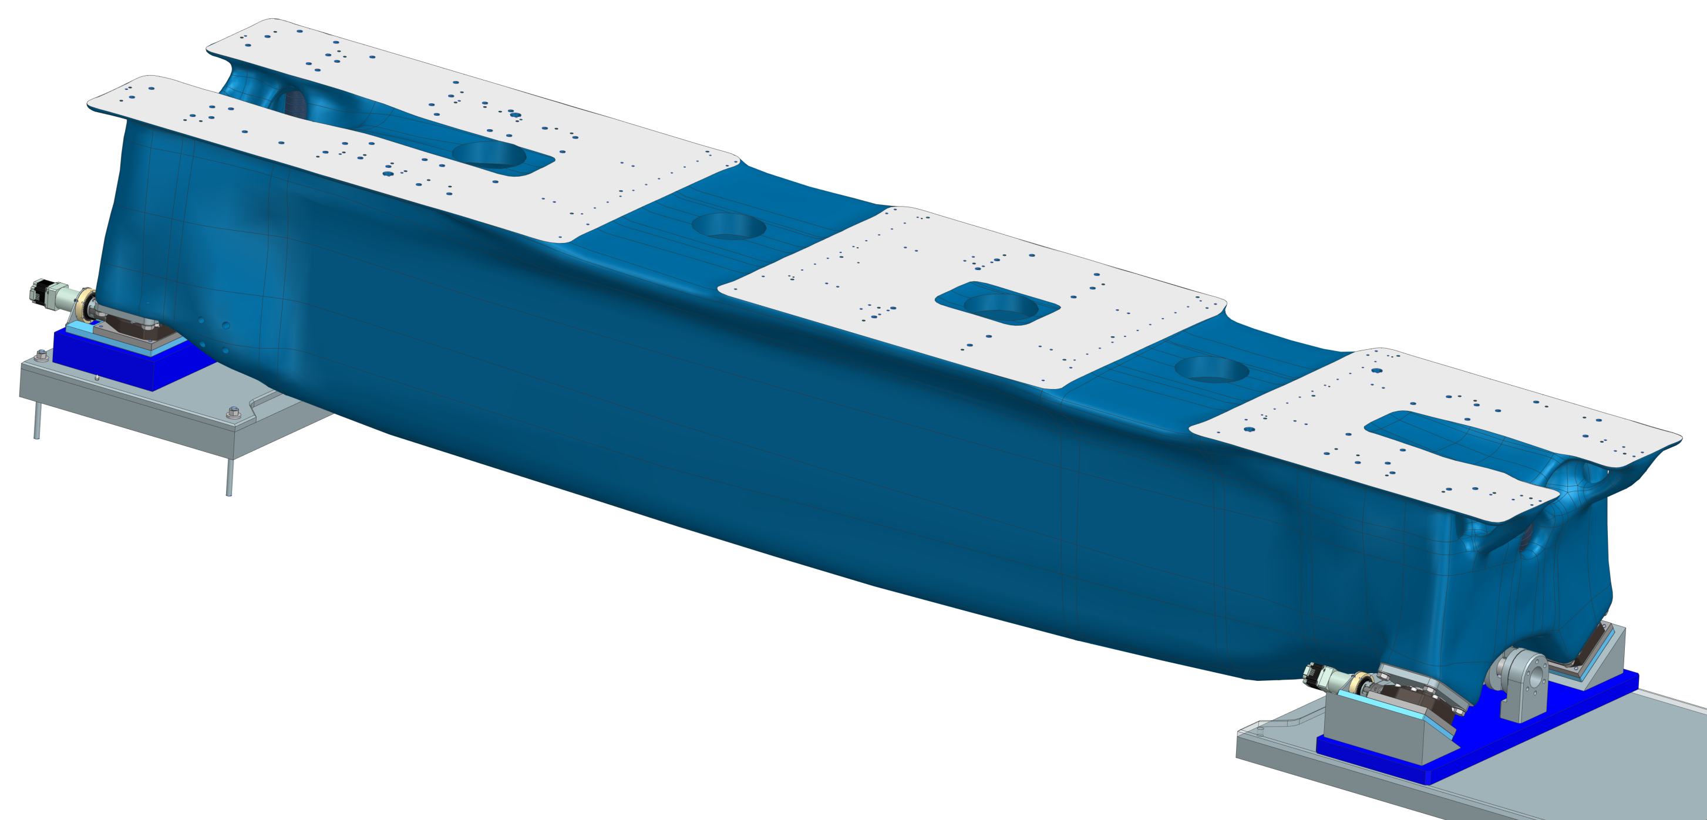
Topology optimization using ANSYS
Post-processing in Simens NX
Natural frequencies from simulation with magnets mass:
Mode 1: 45.8 Hz
Mode 2: 59.0 Hz
Mode 3: 81.3 Hz
Mode 4: 93.9 Hz
Z
Y
X

Slide 12
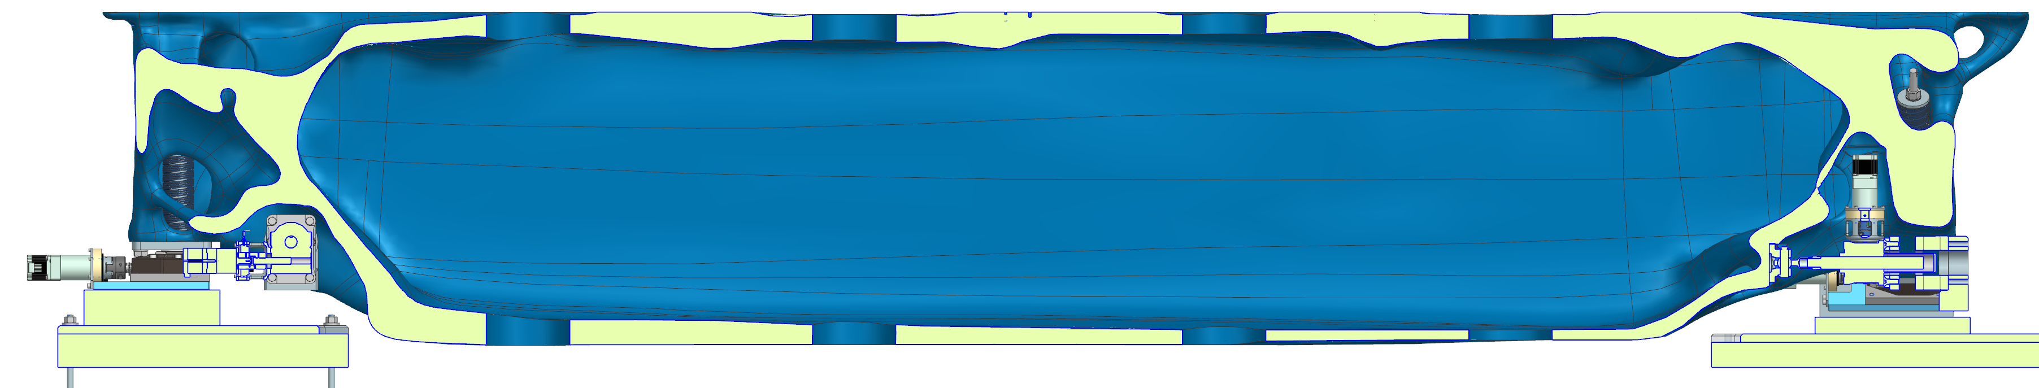
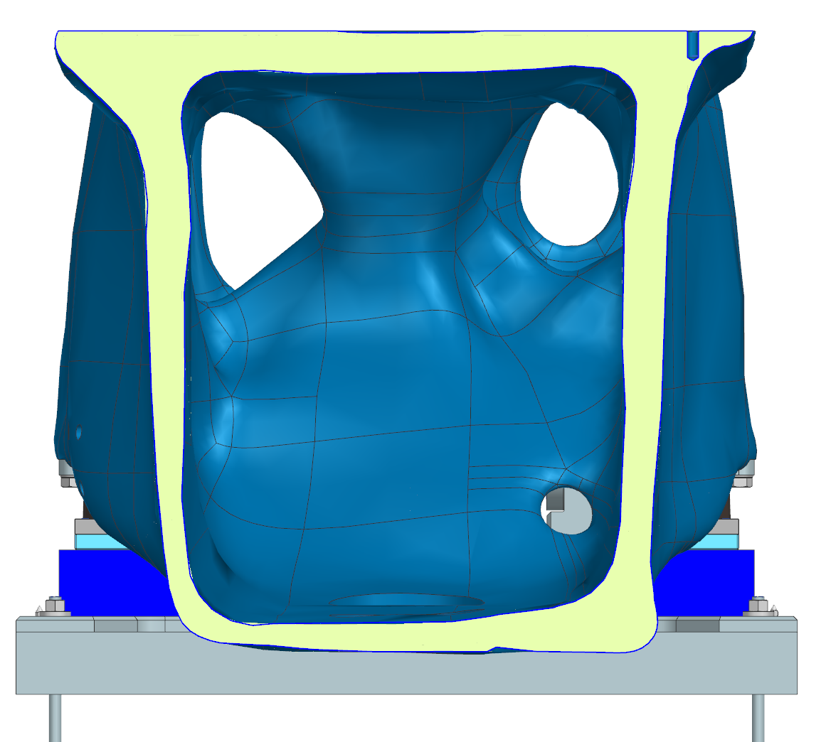
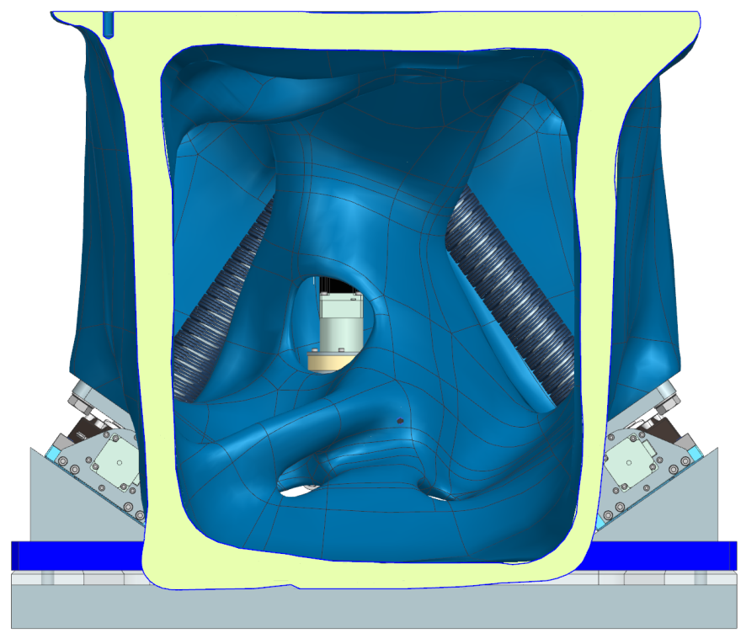
Topology optimization using ANSYS
Interior views
A
B
A
B
B
A

Slide 13
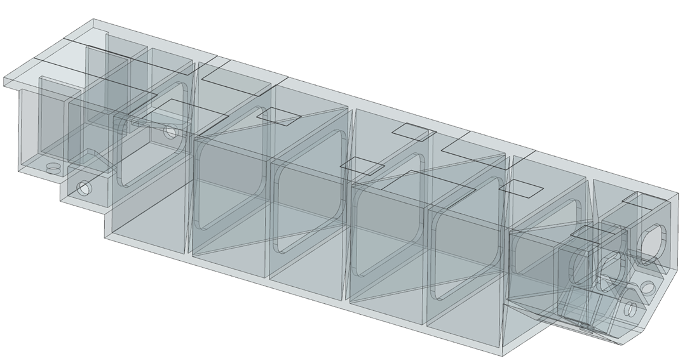
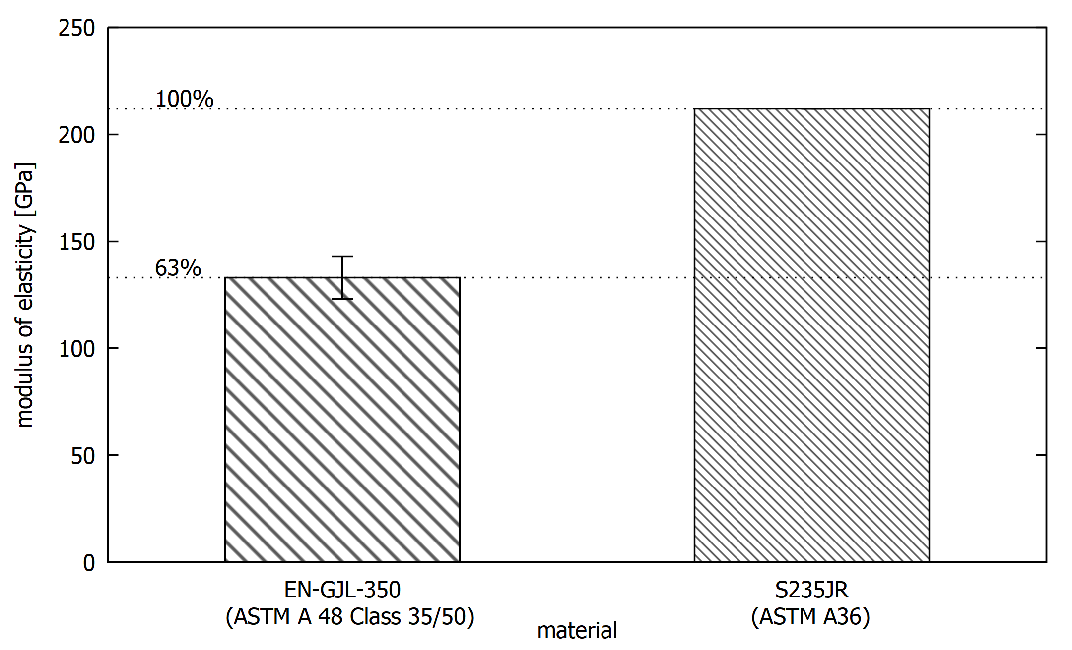
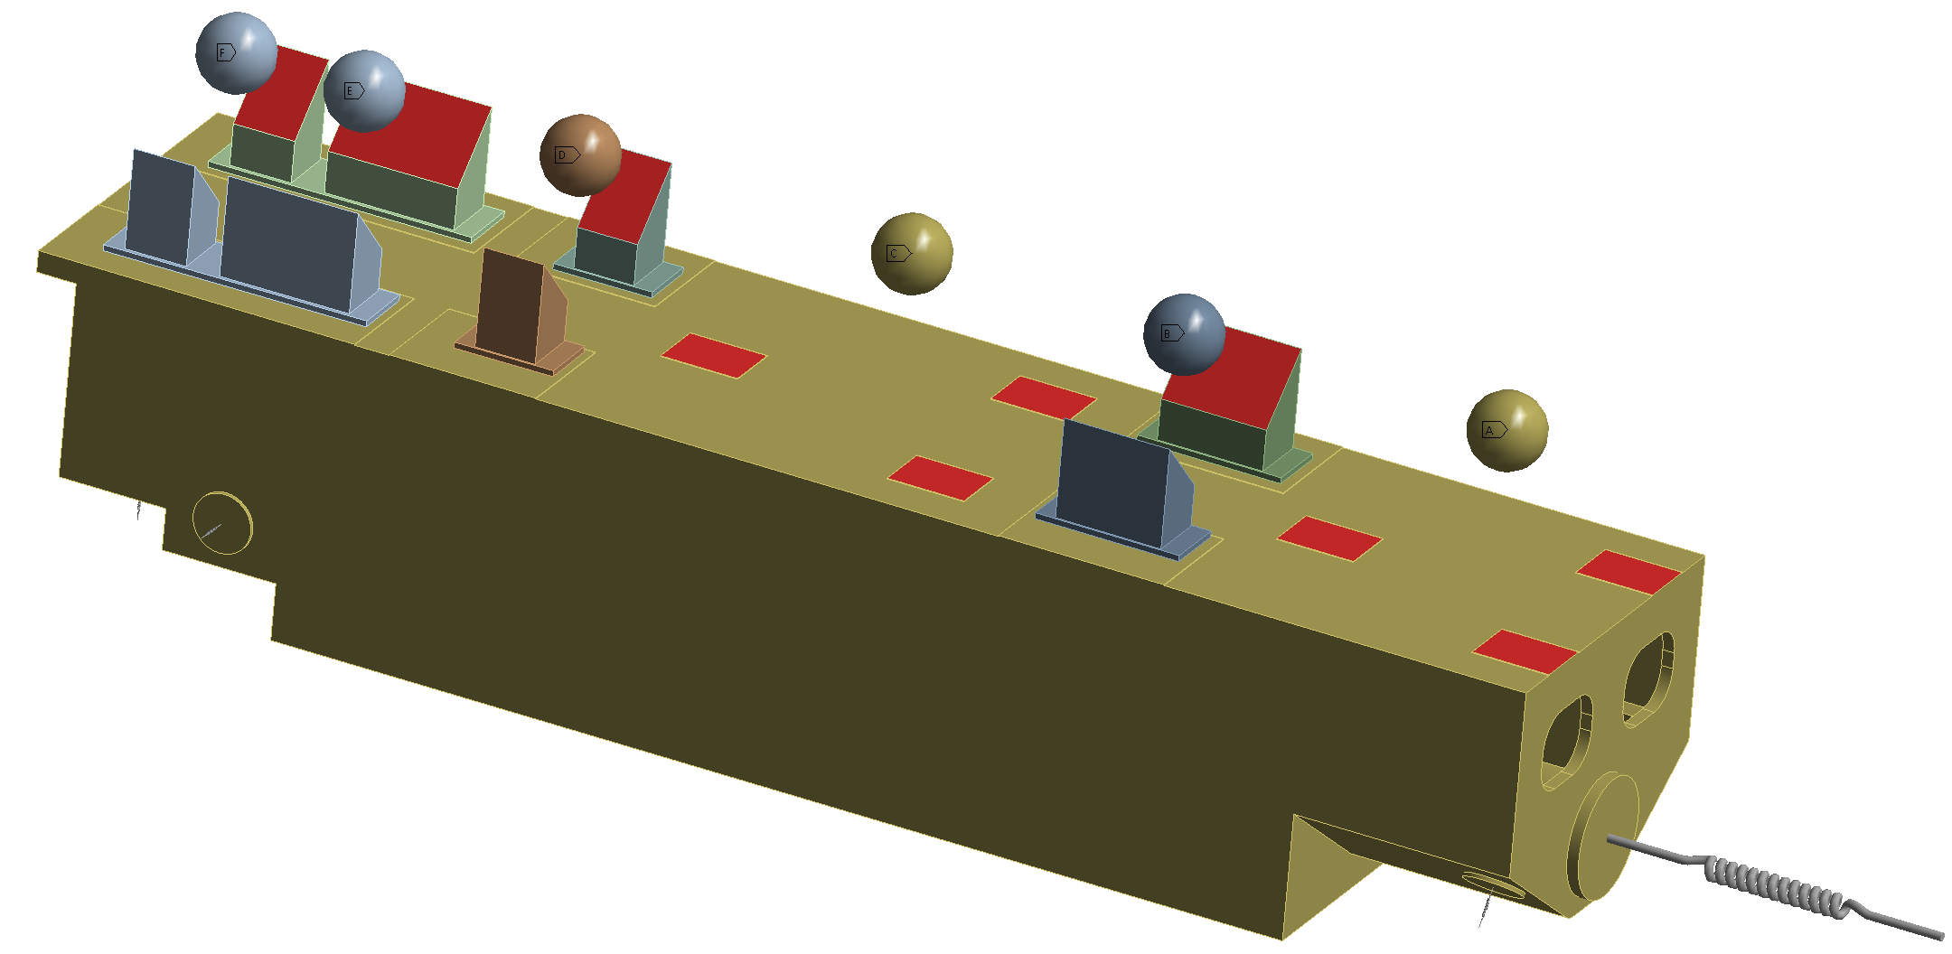
Casted VS Welded Design
Comparison to conventional designs
83%
EN-GJS-600-3U
Notes:
bulkhead

Slide 14
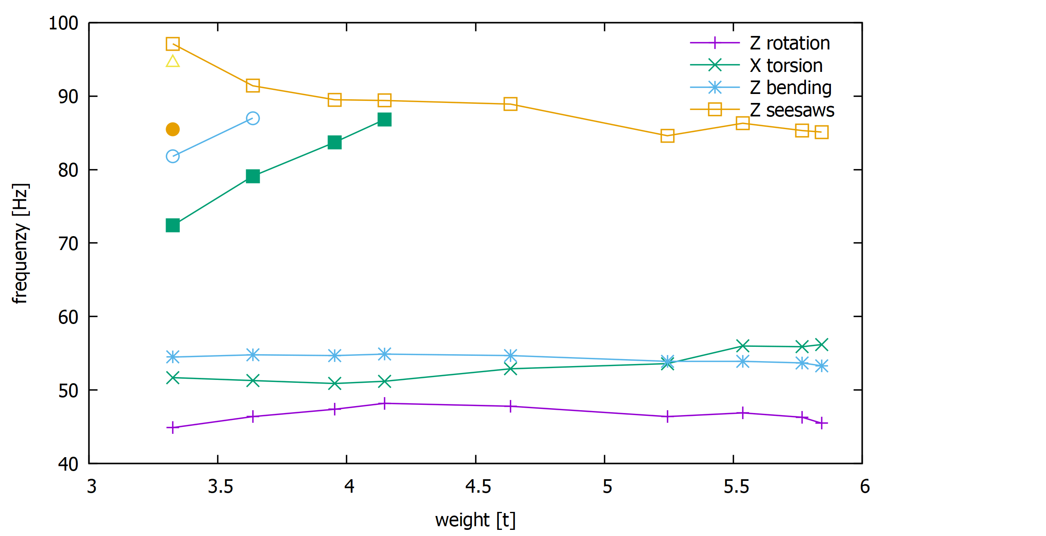
Casted VS Welded Design
Comparison to conventional design
results for different weight goals
Freq. above the “Z seesaw” ignored
Material: GJL-350
Optimisation target were the four lowest EF and the general stiffness with different priority numbers

Slide 15
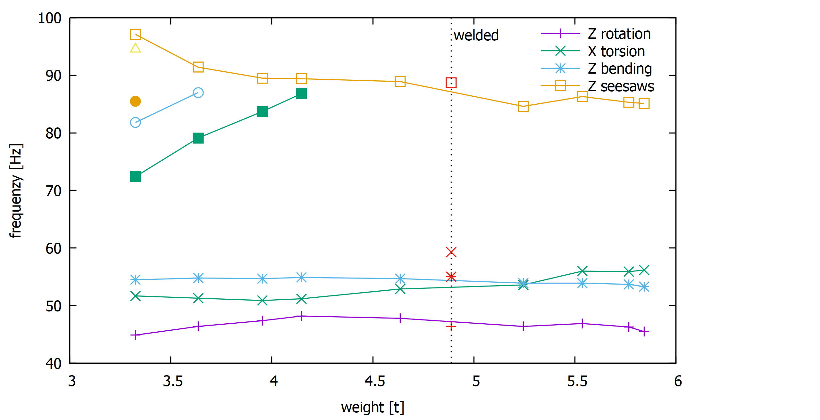
Casted VS Welded Design
Comparison to conventional design
Welded design has a weight of 4,8 t
Slightly lower Z-rotation mode
Way higher torsion mode
Welded design was made with a high torsion stiffness in mind

Slide 16
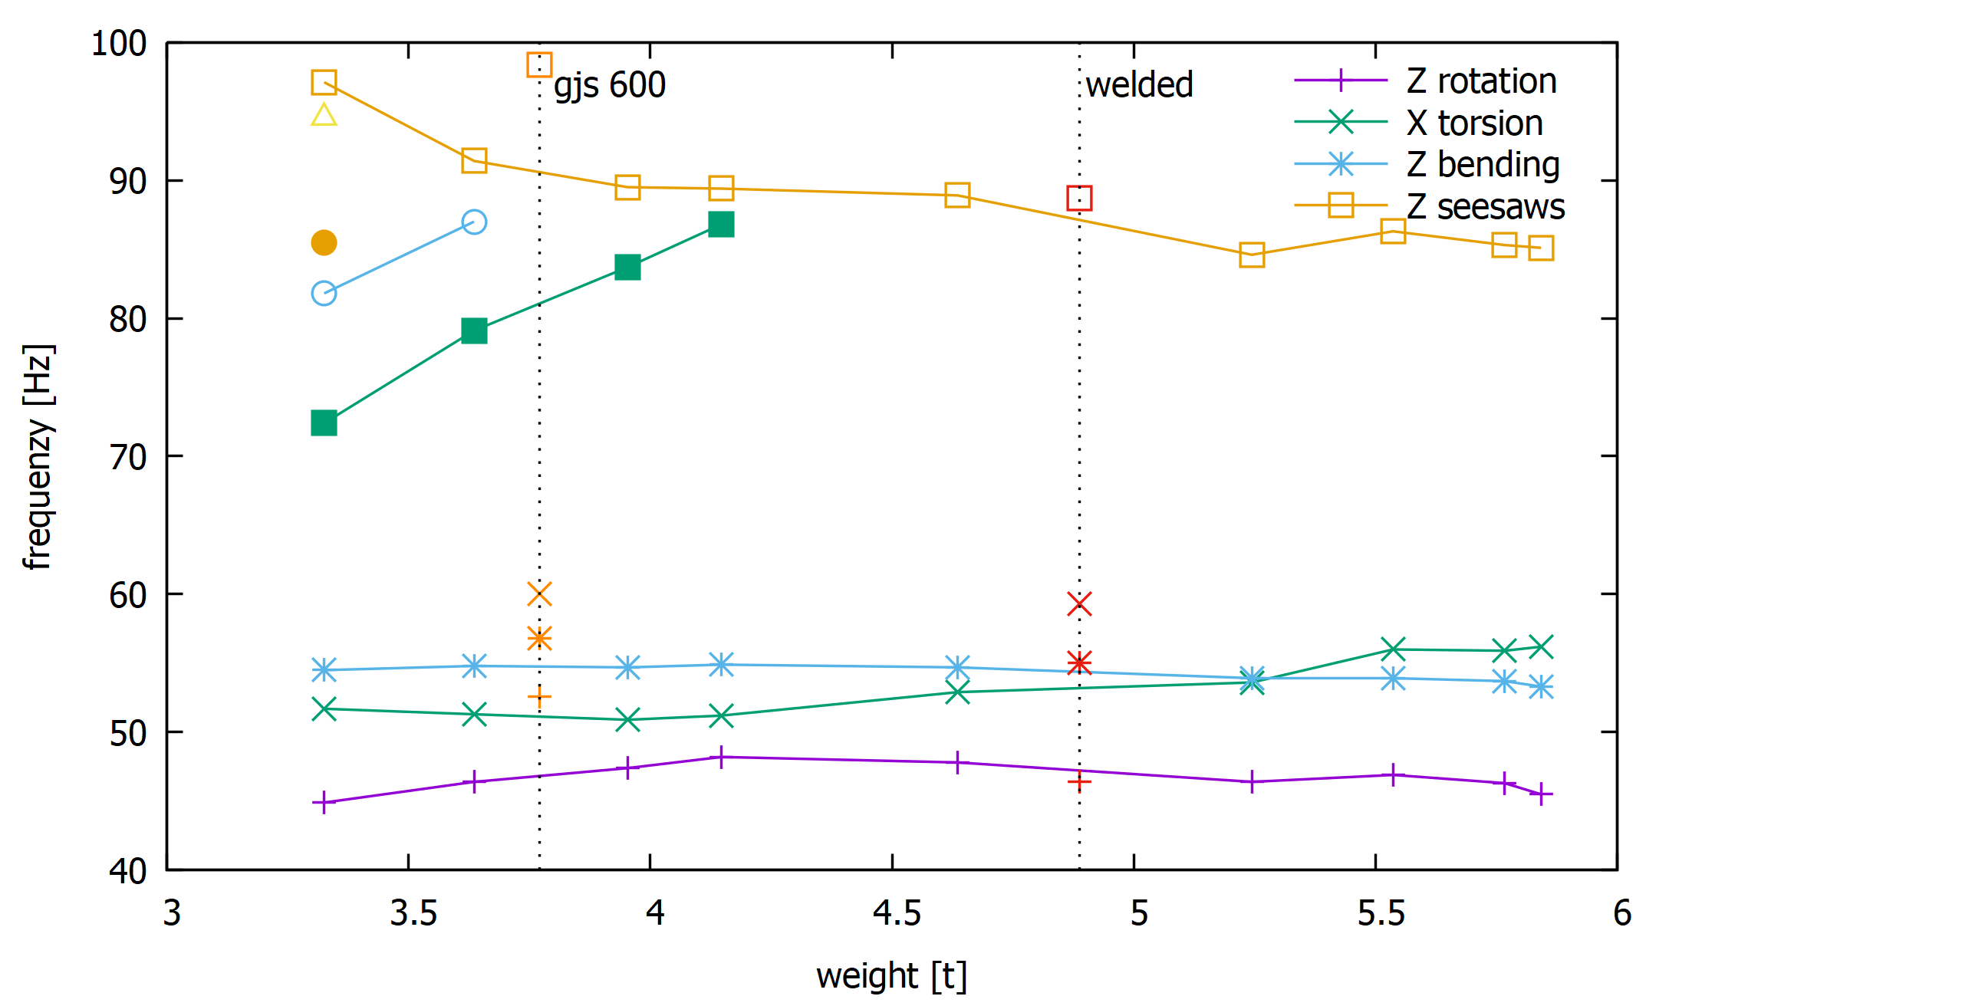
Casted VS Welded Design
Comparison to conventional design
better casting iron yielded way better results
Especially the first EF is higher with ~1 t less mass
EN-GJS-600-3U
Notes:
+5 +5 +2 +10

Slide 17
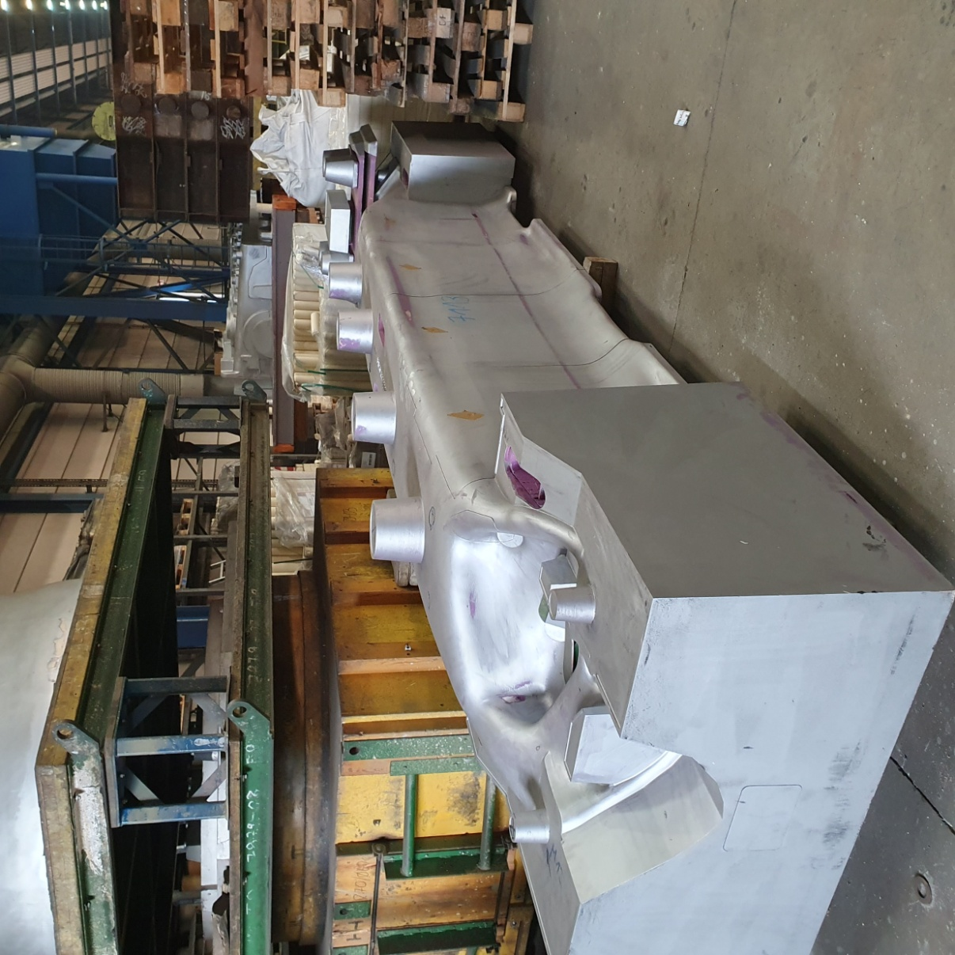
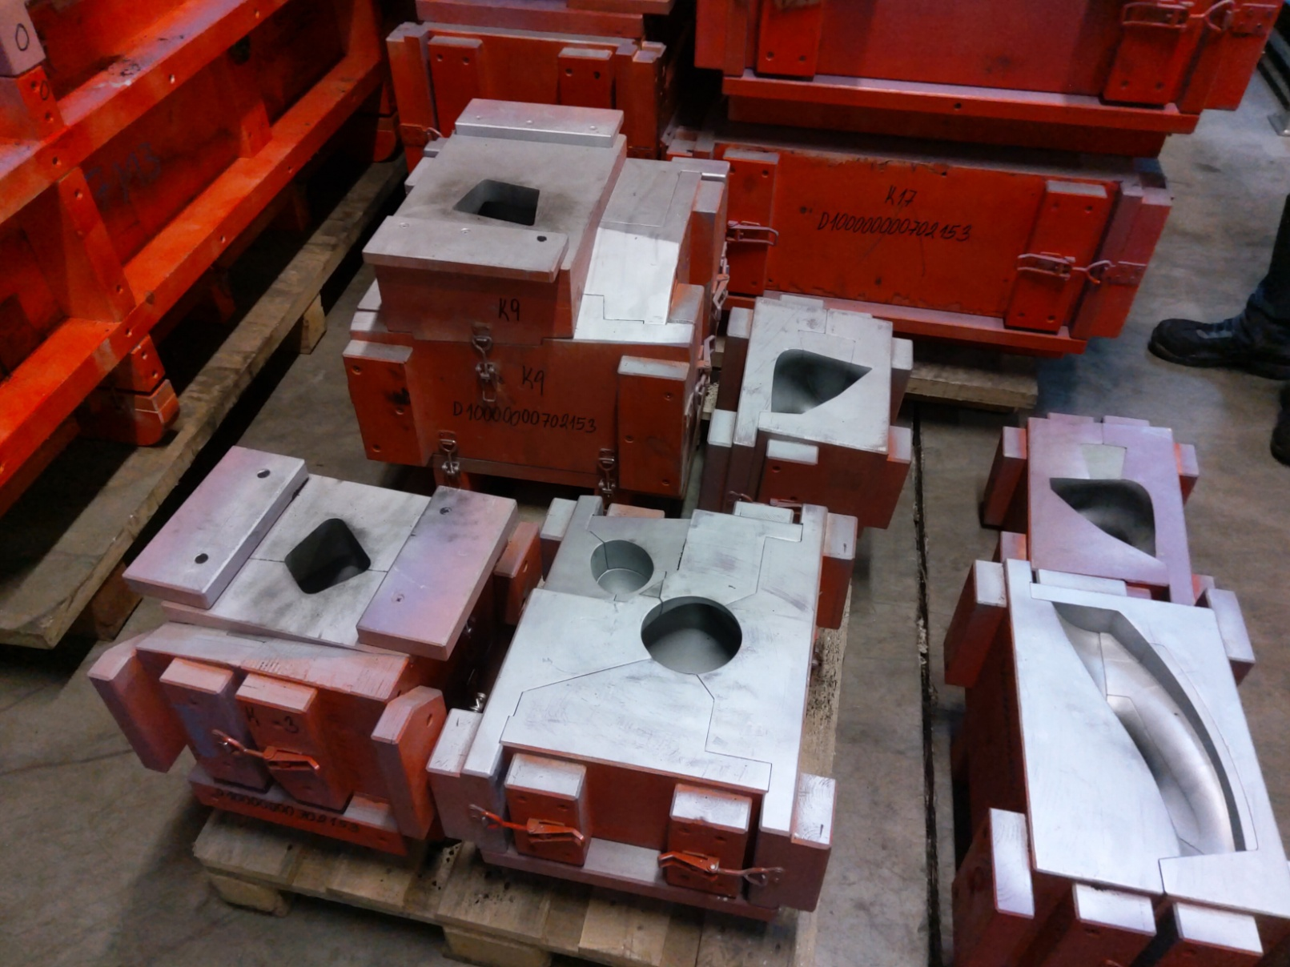
Girder Production

Slide 18
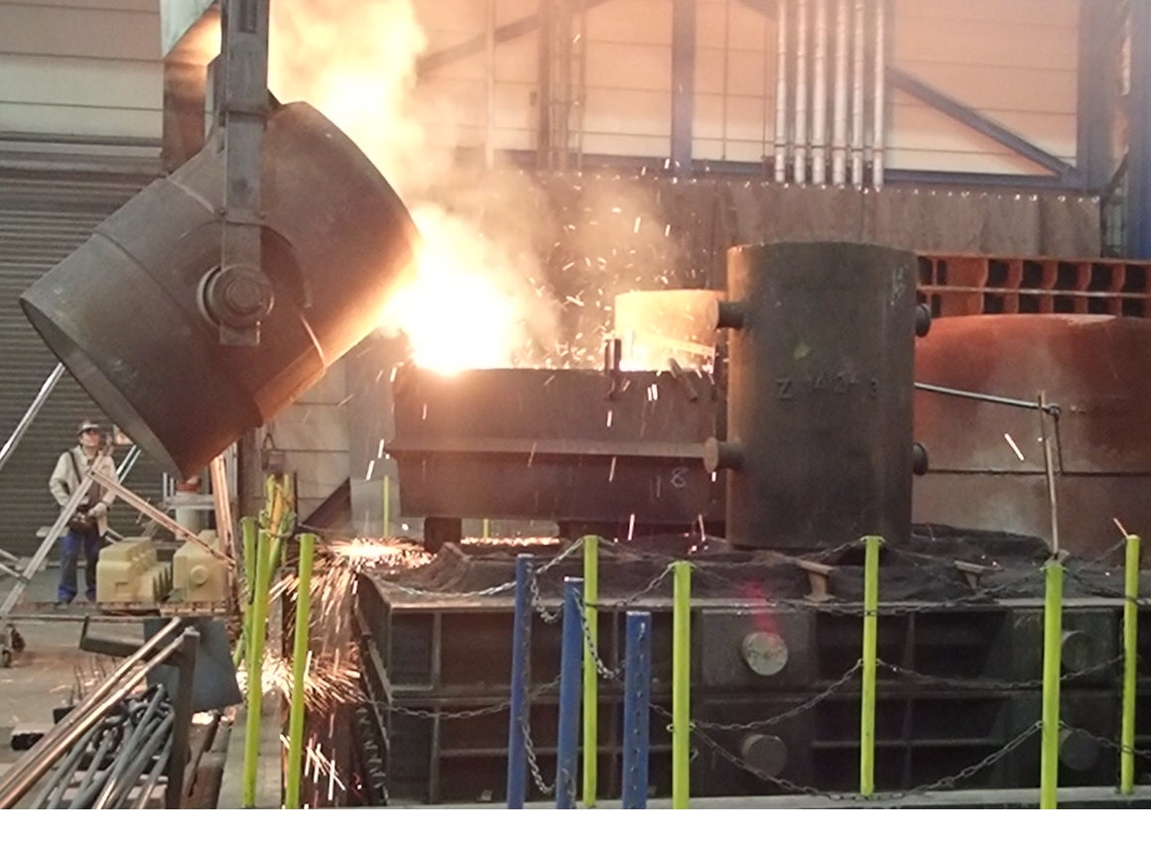
Girder Production
Casting

Slide 19
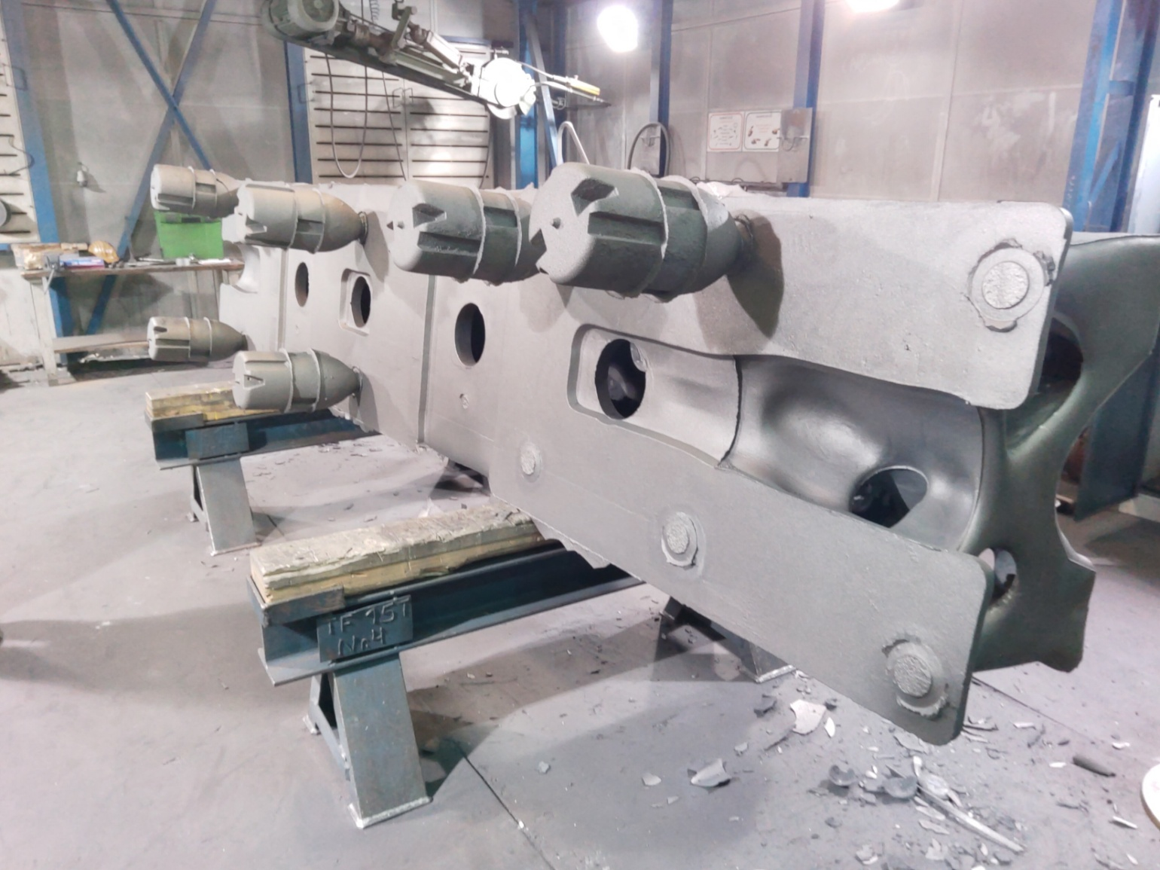
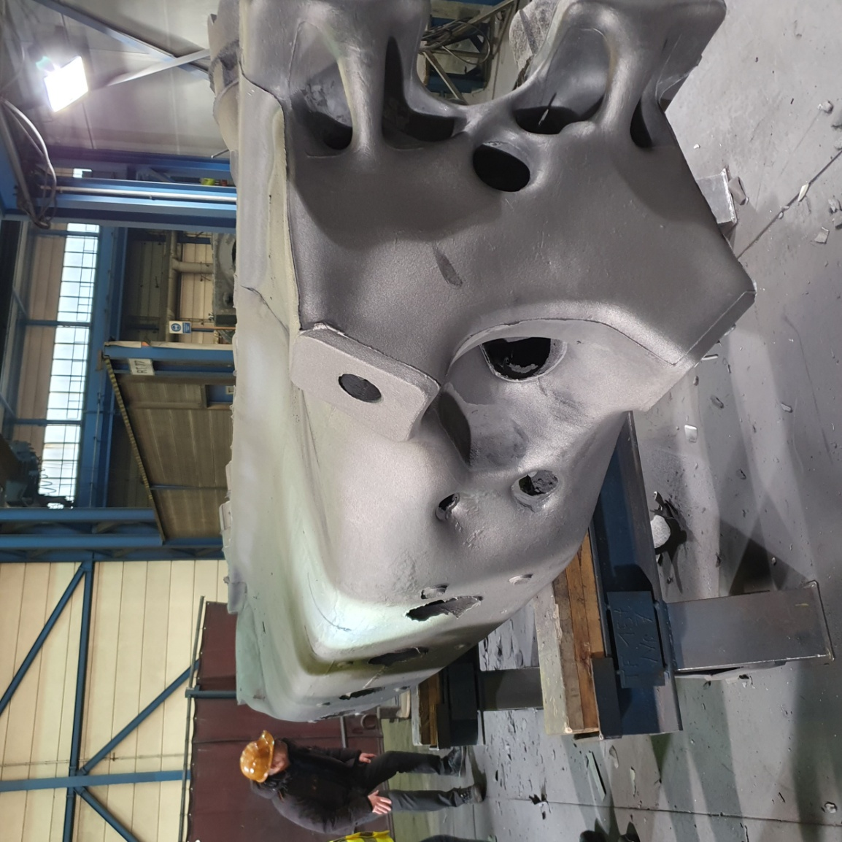
Girder Production
Casting
After demolding, during cleaning

Slide 20
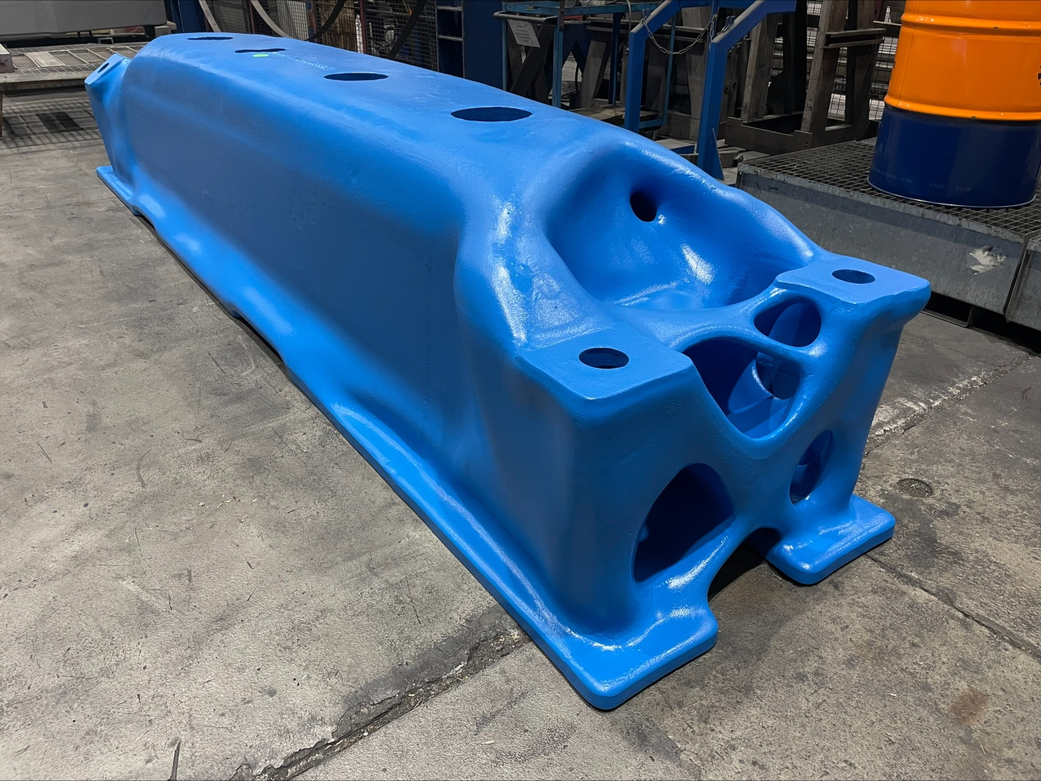
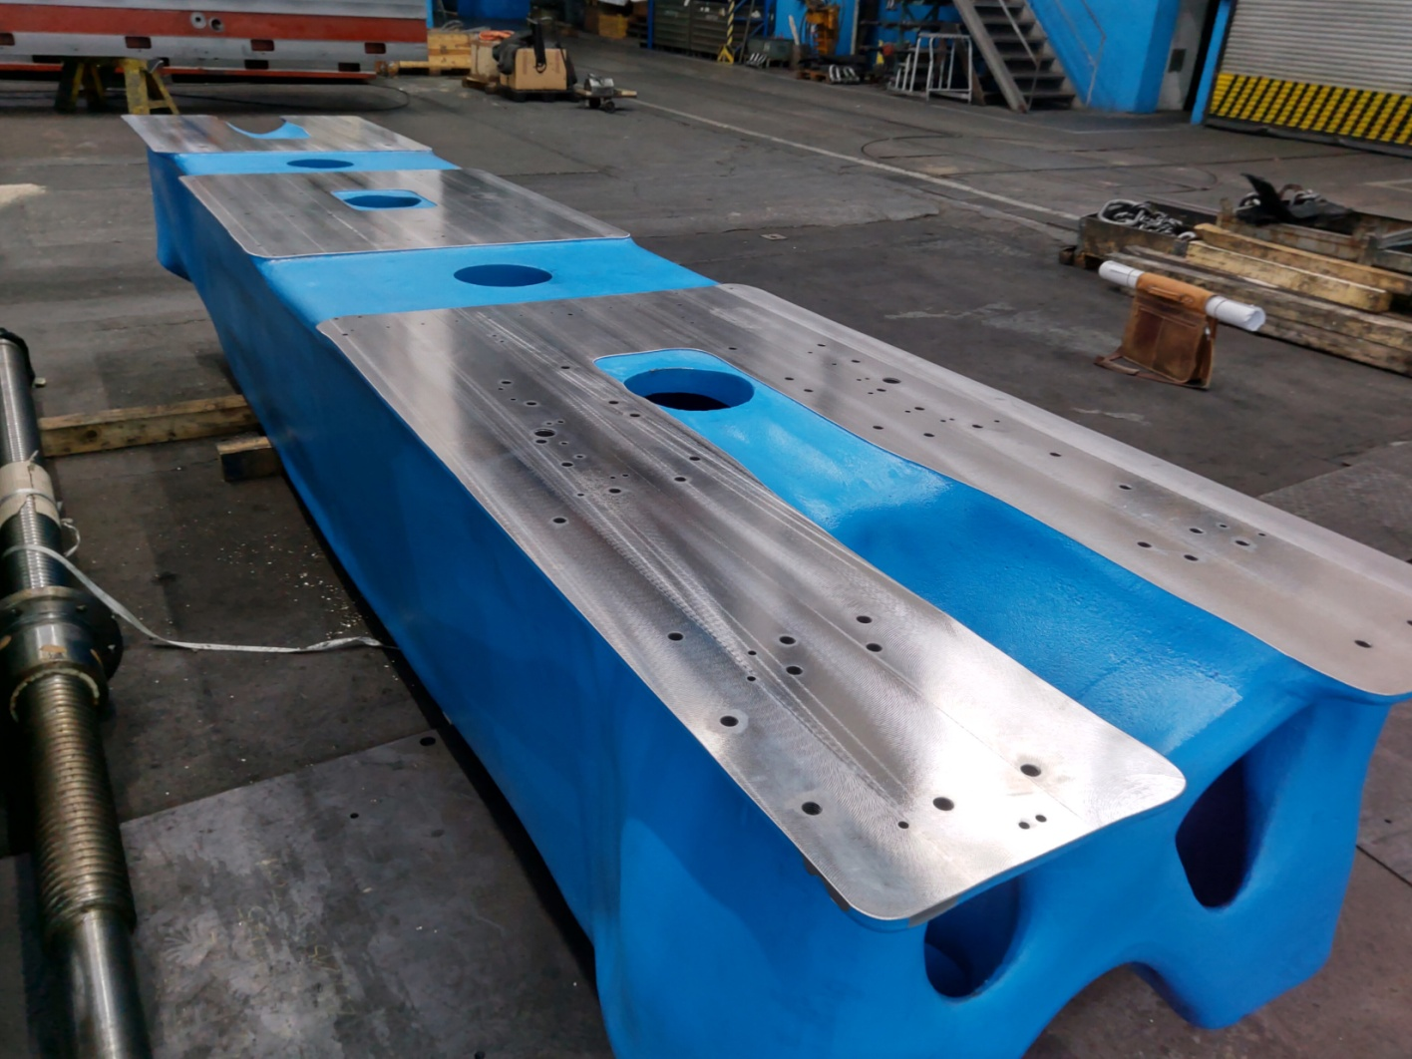
Girder Production
Machining

Slide 21
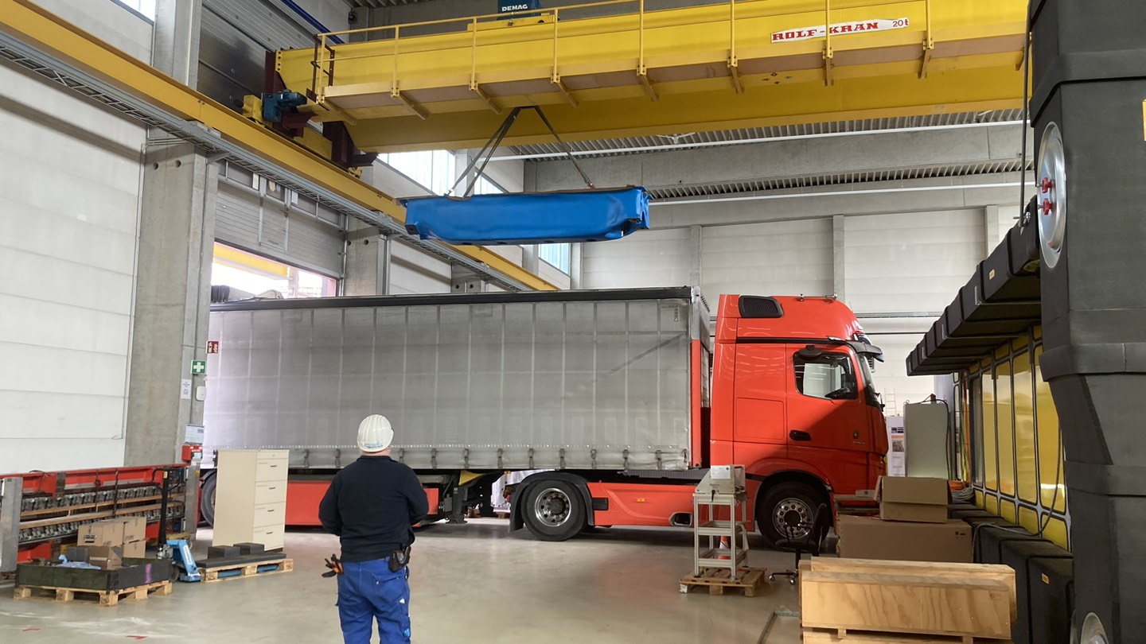
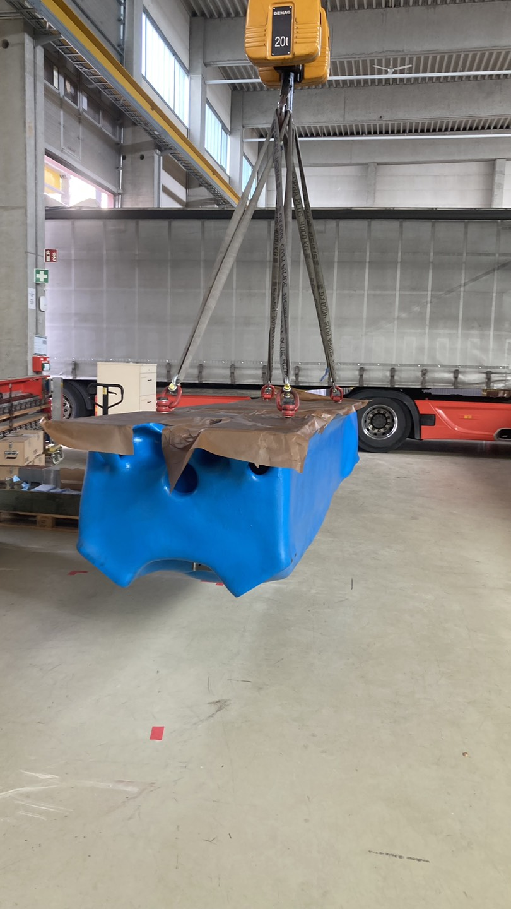
Girder Production
Delivery

Slide 22

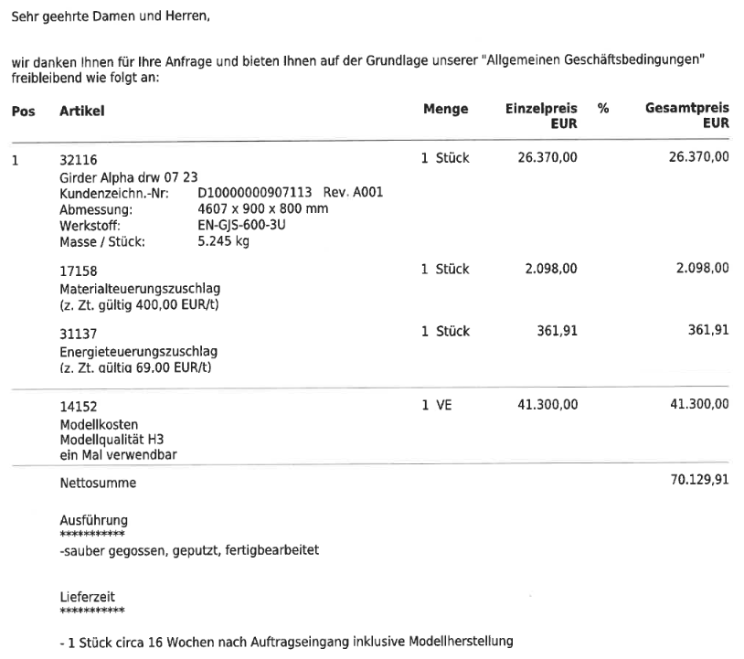
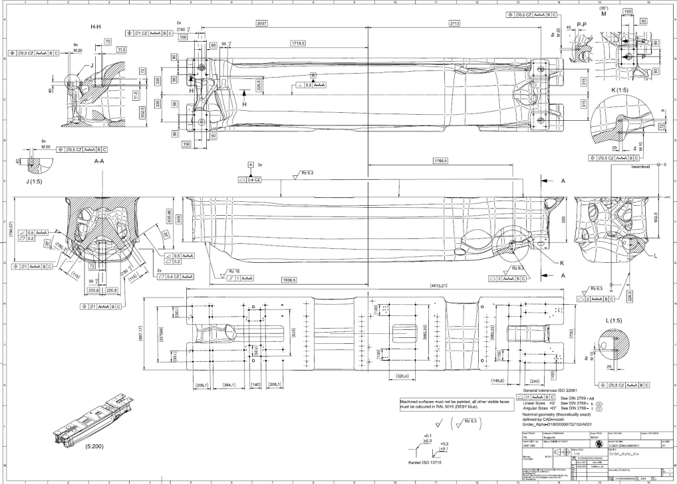
Girder Production

Slide 23
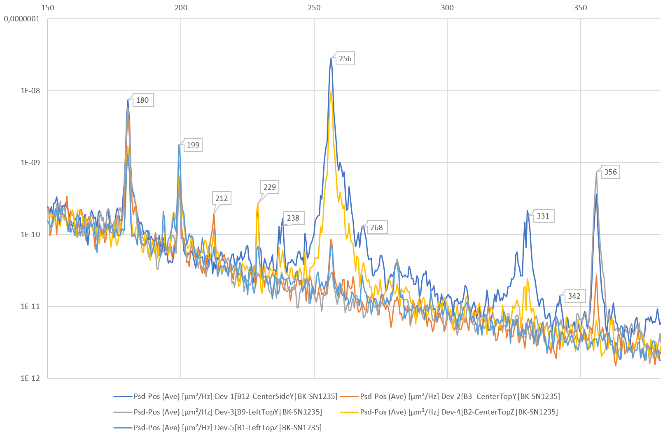
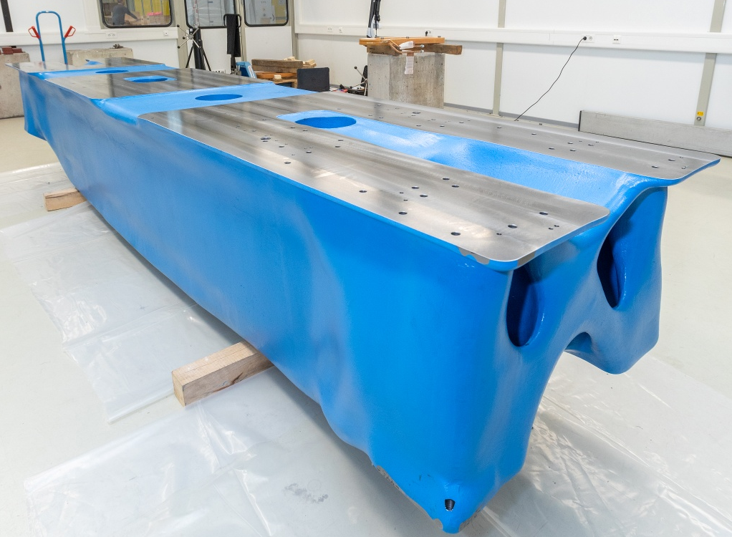
02 Demonstrator Girder Inspection Report
[Hz]
[µm²/Hz]

Slide 24
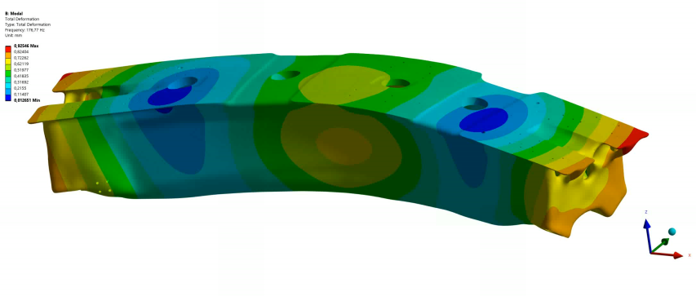
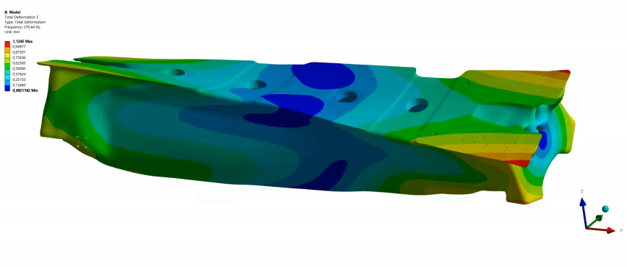
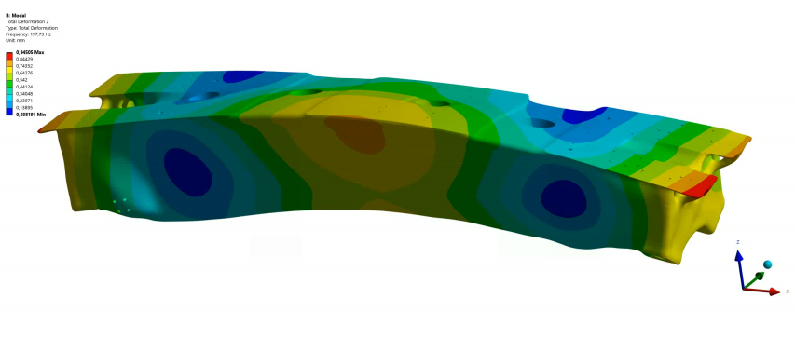
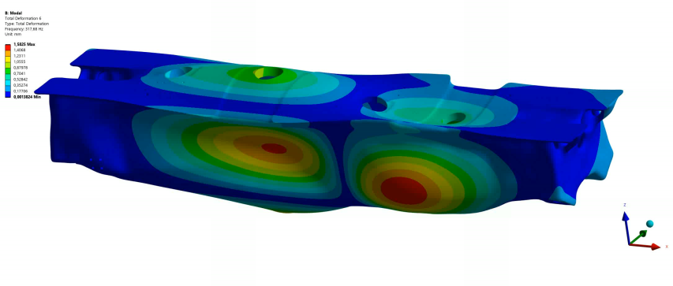
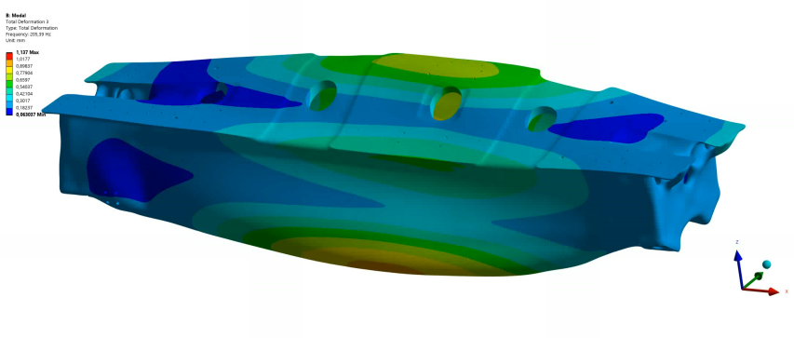
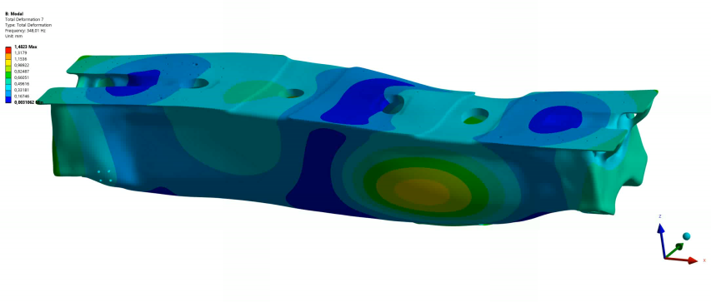
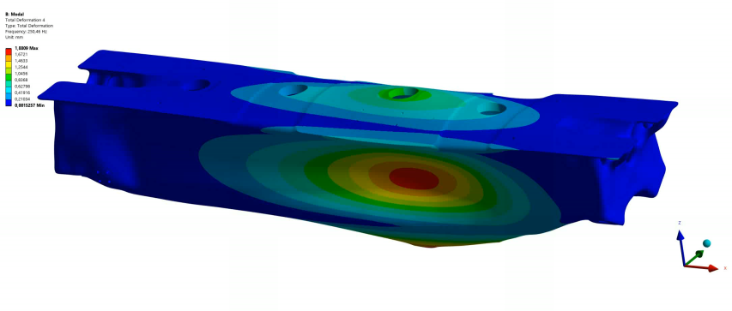
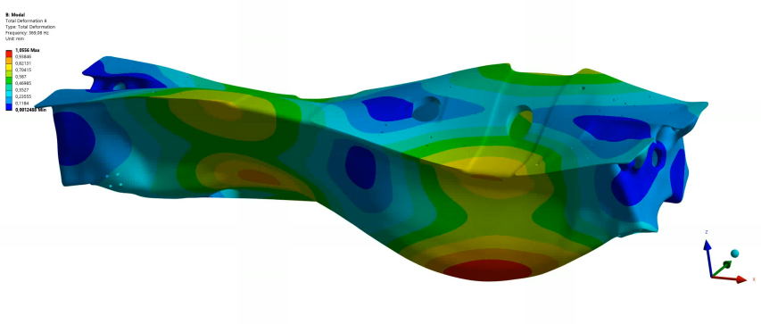
02 Vibration Modes
Mode | Measurement [Hz] | Calculated [Hz] | Difference [%]
1 | 180 | 176,77 | 1,8
2 | 199 | 197,73 | 0,6
3 | 212 | 205,39 | 3,1
? | 229
? | 238
4 | 256 | 250,46 | 2,2
5 | 268 | 270,44 | -0,9
6 | 331 | 317,68 | 4,0
7 | 342 | 348,01 | -1,8
8 | 356 | 369,08 | -3,7
Results
● Simulated vibrations response does fit quite good to the measured values
● Chosen material properties in the simulation are a good fit

Slide 25
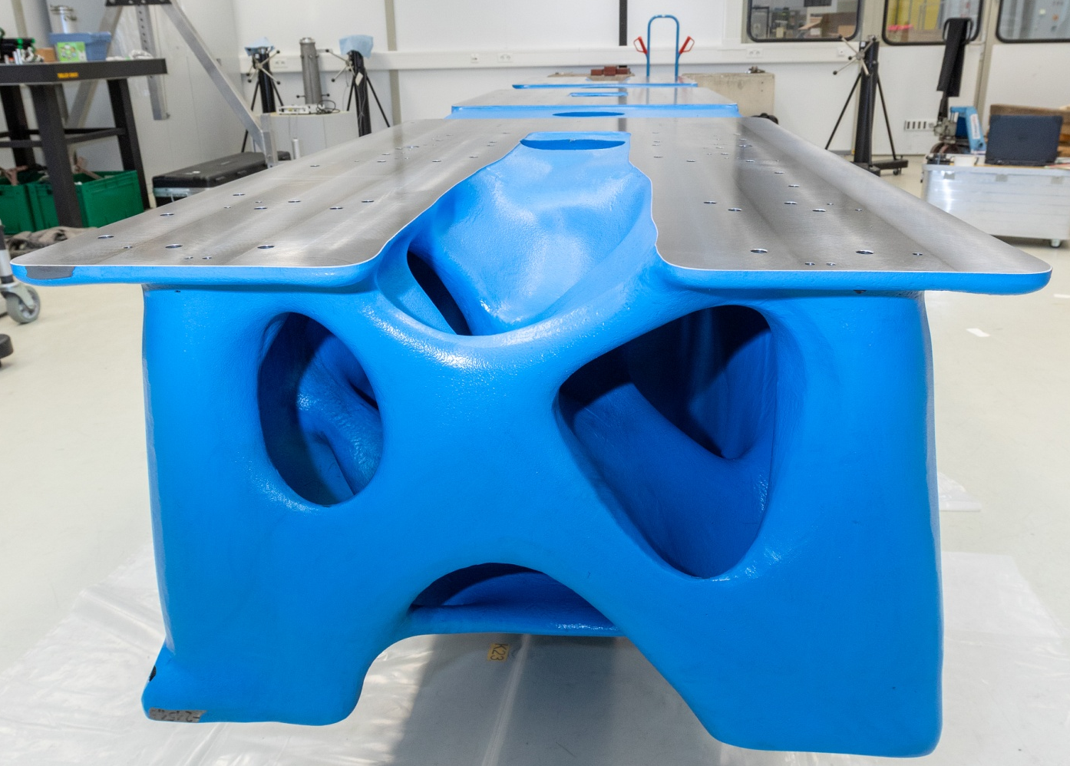
Thank you
Dr. Normann Koldrack
PETRA IV WP 2.06– Girder
Normann.Koldrack@desy.de

Slide 26
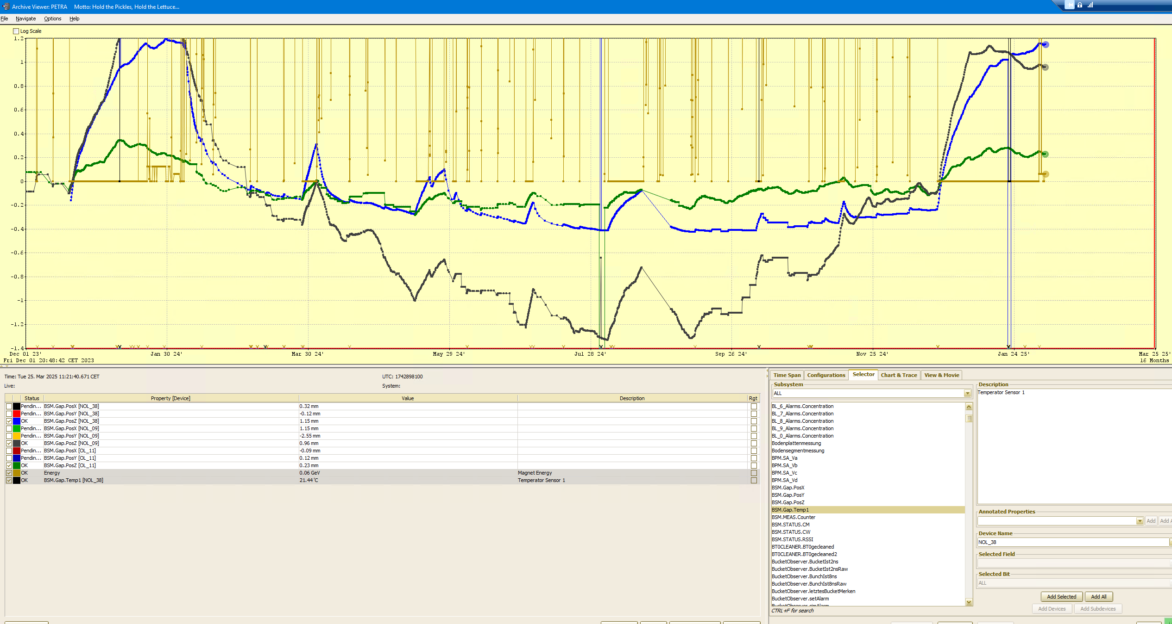

Slide 27
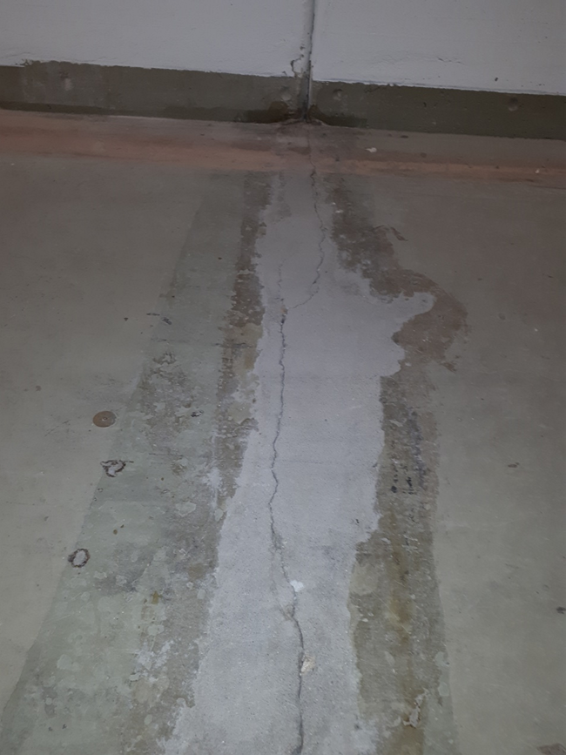
Heritage from PETRA I
Tunnel
Tunnel construction for PETRA I (1976)
The tunnel was built in a very efficient (i.e. fast and cheap) way.
The floor was prepared in long pieces, 5+25 cm thick.
The tunnel was set on the floor in ~80 segments of 24 m each (a bit shorter than a cell of PETRA IV).
The gaps between the segments are sealed with rubber.
Today the floor is cracked at the gaps, the ~80 segments are moving independently.
This tunnel was built for an e+/e- collider and never meant to be used for a light source.

Slide 28



Girders for PETRA IV
Support
Girders:
Girders will bridge cracks in the tunnel floor at arbitrary positions.
Girders are usually supported at points away from the end to reduce girder oscillations.
This causes vertical offsets at the cracks.
A challenge for the vacuum system.

Slide 29
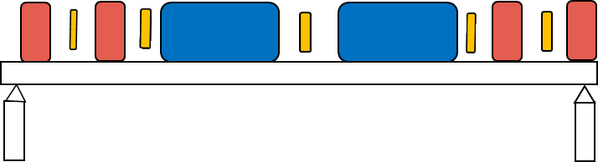
Girders for PETRA IV
Support
Girders:
Girders can be supported at their ends.
This transforms offsets of the tunnel segments into angles at the girder joints.
This is an advantage for the vacuum system, but could cause stronger oscillations of the girders.

Slide 30
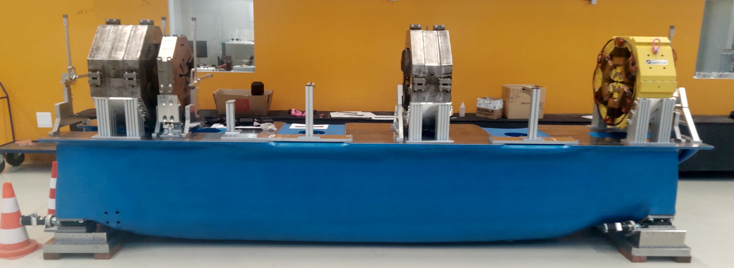
Current Girder status
Located in bldg. 36 – ready for PoF

Slide 31
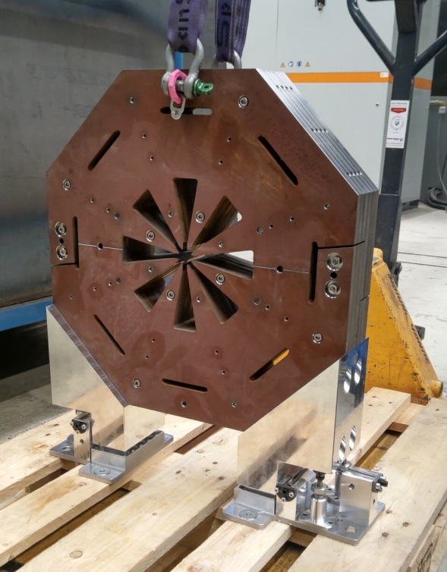
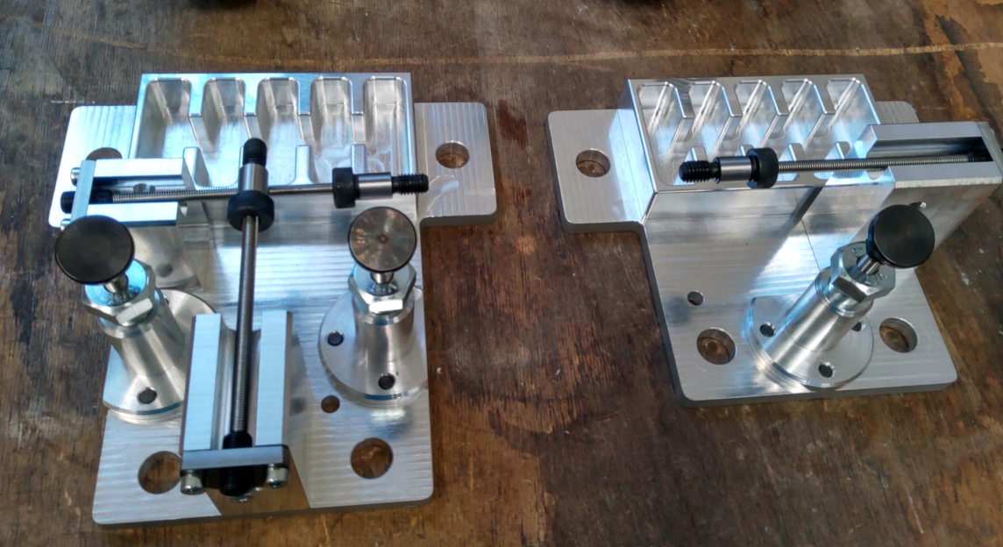
Lessons learned
Magnet support

