Slide 1
Status of the design and simulations for the FOFB of PETRA IV
An brief overview of the activities towards a stable beam orbit
Sven Pfeiffer for the PETRA III & IV team
Karlsruhe, 18.03.2025

Slide 2
Outline
Introduction PETRA (III / IV)
Stability task force
System modelling and HW design
Disturbance and noise model
SISO simulation
Conclusion

Slide 3

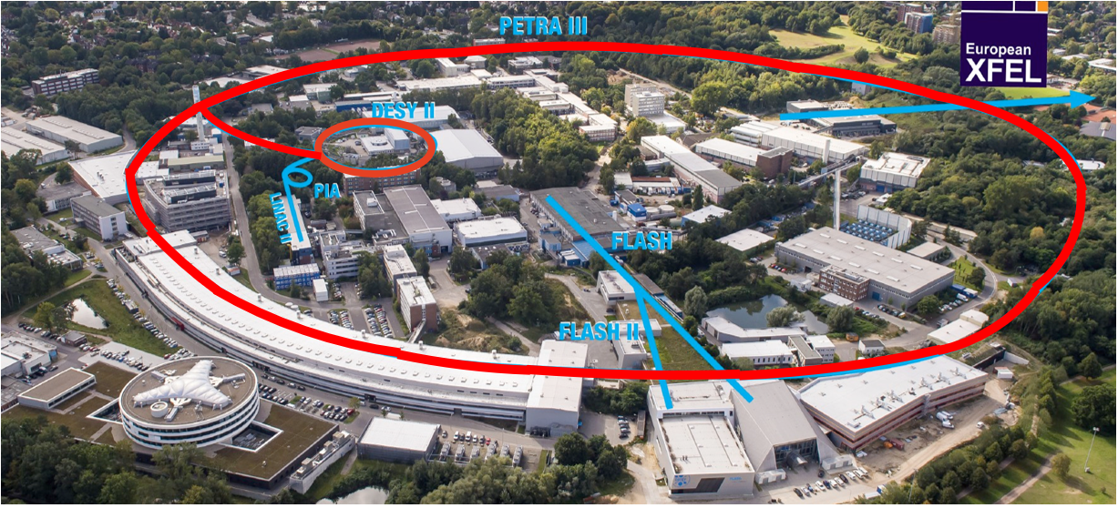
PETRA III is one of the core facilities at DESY
Courtesy: R.Bartolini
Each year ~5000h user operation serving more than 2000 users
Ada Yonath Hall
Extension Hall East
Parameter | PETRA III
Energy [GeV] | 6
Circumference [m] | 2304
Emittance (hor./vert.) [nm] | 1.3 / 0.013
Total current [mA] | 100
PETRA III emittance 1300 pm
PETRA IV emittance 20 pm
65 times smaller
enabling 500 times larger
X-ray beams brightness
Max von Laue Hall
Paul P. Ewald Hall
Extension Hall North
PETRA IV project:
replacing PETRA III with an ultra-low emittance ring (20 pm), adding a new Experimental Hall in two more octants & replacing DESY II with a new low emittance booster

Slide 4
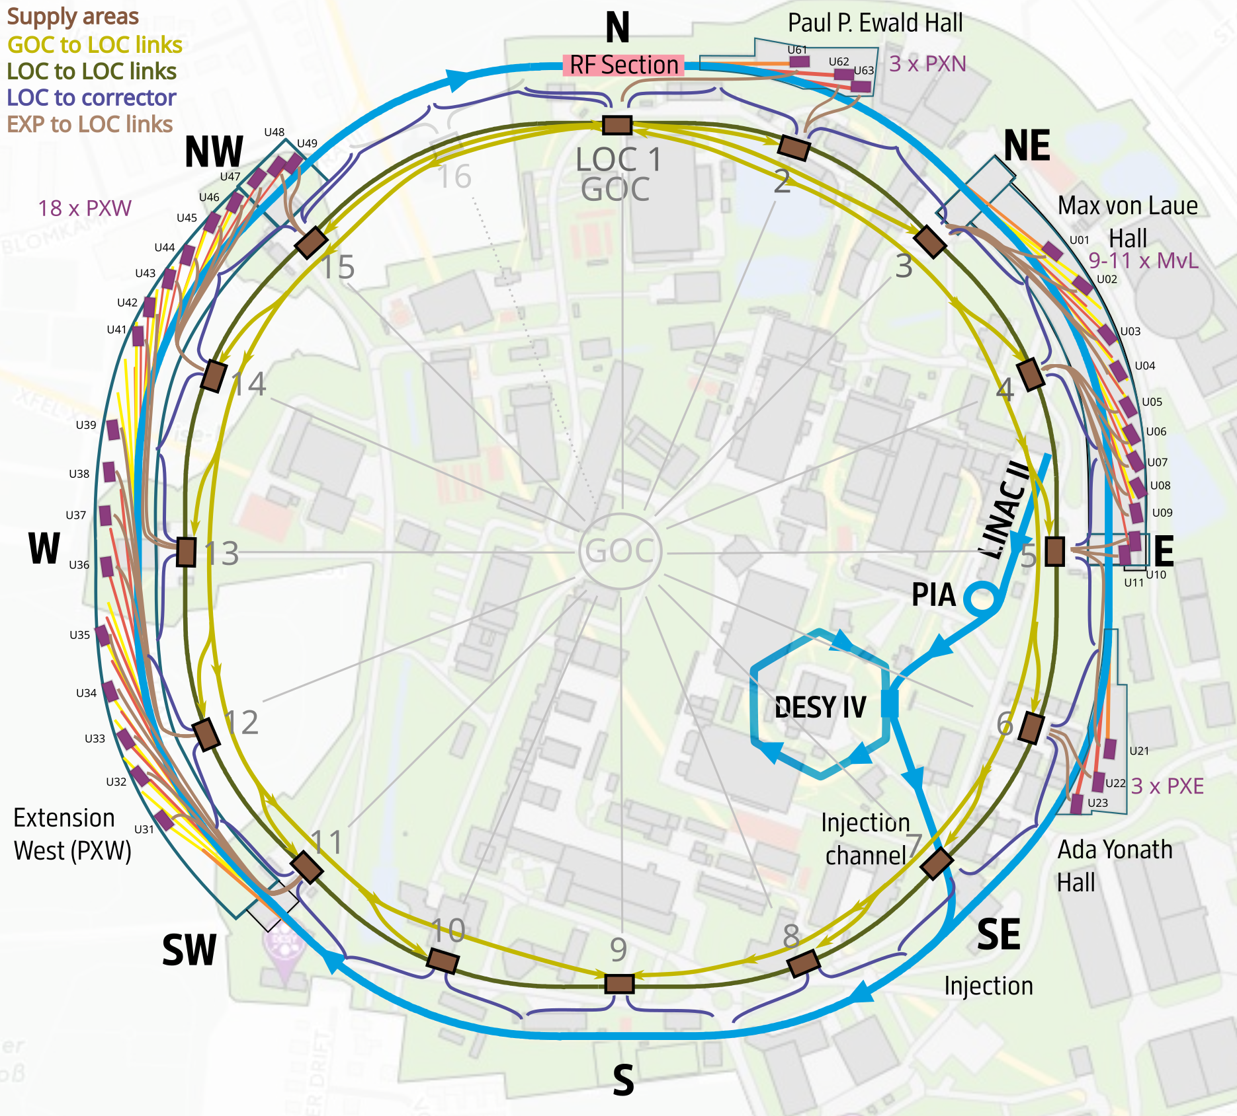
FOFB system topology
Ring: 789 BPMs, 560 fast correctors, 2.3km FOFB: 10% (5%, 3%) beam stability, DC to 1kHz
Latency optimized topology
1 global orbit control unit (GOC)
  Close to RF system / timing system
  Short path from GOC to LOC in experimental halls
16 (15) distributed local controllers (LOC)
  Collection of BPM information
  Transmission of updated magnet current to power supplies
Optical fiber communication links
  Global to all local systems → classical regulation (star topology)
  Local to local system links
    Integrating experiments based on photon diagnostics

Slide 5
Stability task force

Slide 6
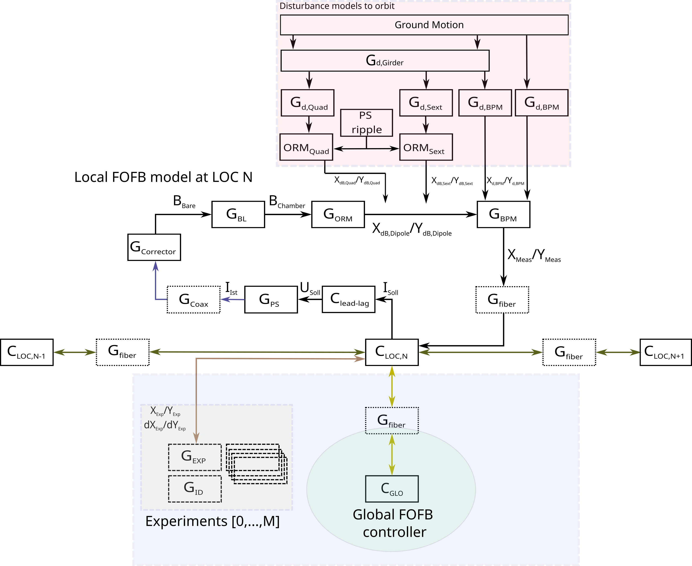
FOFB concept
Stability task force
(N. Meyners)
(I)
GOC, LOC, EXP blocks
(II)
Initial MIMO and SISO simulations
Incoherent disturbances
Focus on main system dynamics
Goal: Full implementation of the dynamic MIMO simulation
PETRA III as benchmark facility
Including coherence length
Realistic dynamic errors and disturbances
Stability task force
(I) Ground motion / disturbances
(II) Girder/support amplification/eigenfrequencies
(III) PS ripple, effect on beam
(IV) Orbit measurement noise
(V) Fast corrector power supply ripple
(III)
(IV)
(V)
→ Passive and active orbit stability aspects

Slide 7
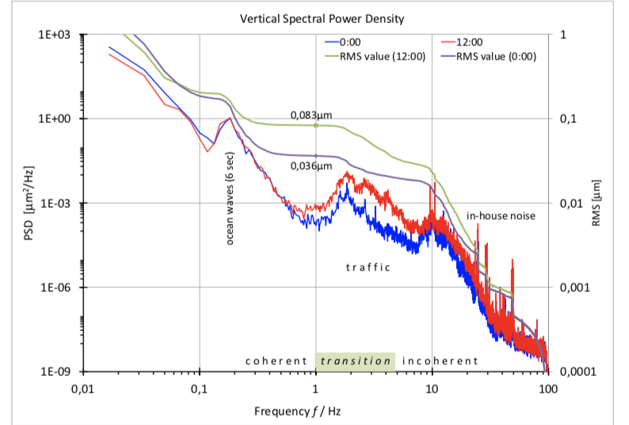
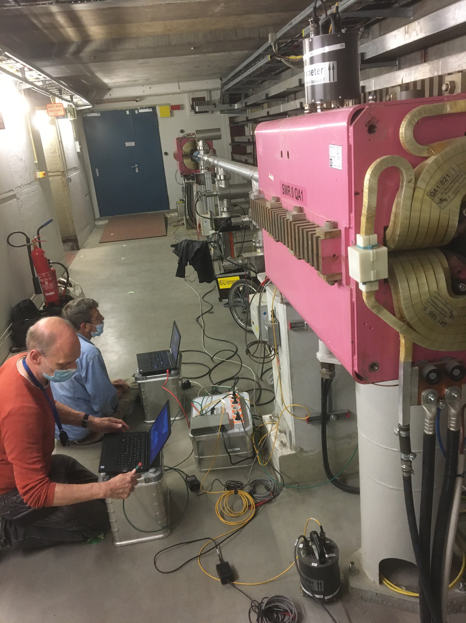
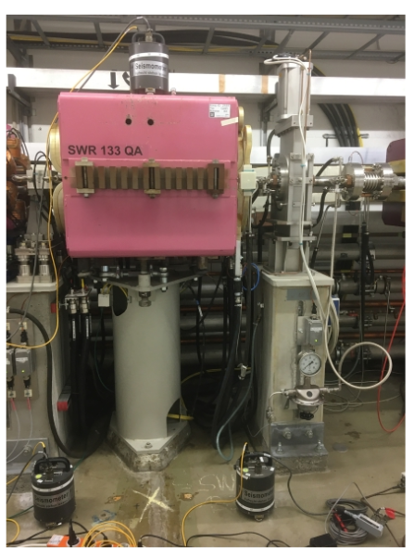
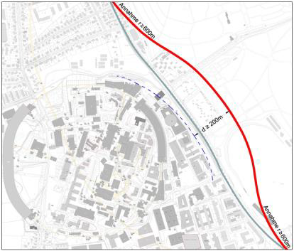
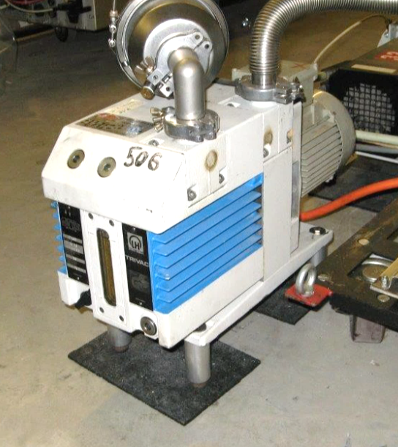
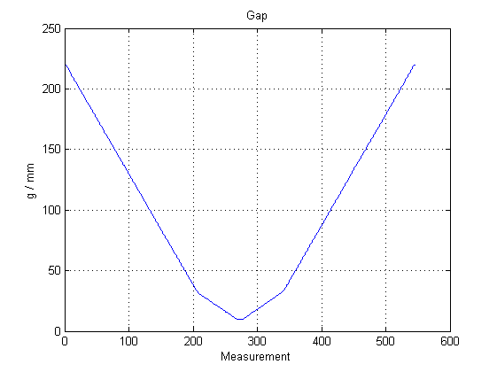
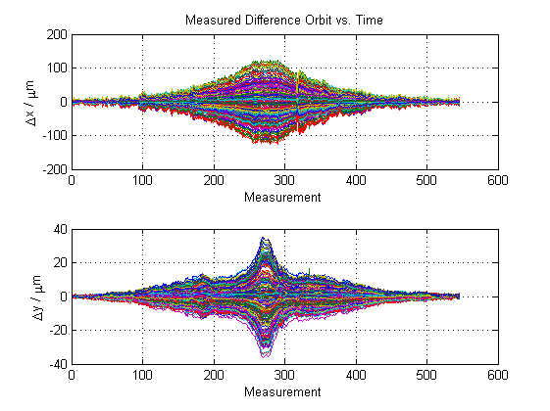
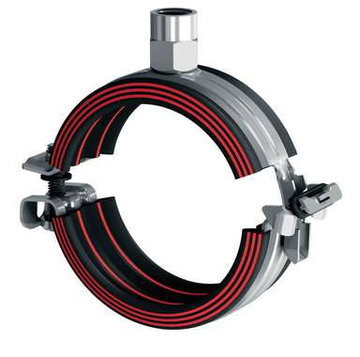
Disturbances
High horz. and long. amplification factor in range 7-10Hz
FOFB: Stability task force @ PETRA III (N.Meyners et al.)
Ground motions
PETRA I tunnel reused
Ground settlements and seasonal motions
Ocean waves (<1Hz)
Traffic (1…10Hz)
In-house noise (10…100Hz)
Girder and amplification factor (< 48 Hz)
Incl. excitation bursts
Talk: Sajjad Mirza
Additional sources / sinks
Asynchronous motors (<50Hz)
Controlled motors/pumps (25Hz)
Power supply output ripple (k · 12.5Hz)
Harmonics of DESY II (~30Hz)
ID gap movements (Hz – depending on speed)
Injection process (injection FF)
Orbit perturbation due to gap movements at PETRA III
Isolation of major sources
: Δx= ±120 µm
200m
Δy= ±35 µm
Upcoming train nearby DESY

Slide 8
System modelling and design

Slide 9
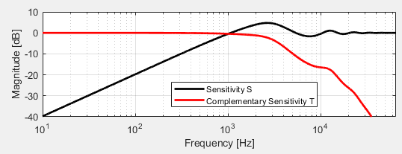

FOFB sub-systems
SISO modelling and simulation
Disturbance
(based on PIII)
Subsystems based on PETRA IV design
Disturbance spectra approximated with measurement at PIII
PI controller optimized for disturbance rejection
  Goal: 1kHz
PI controller optimized for reference tracking
  Integration of experiments (photon diagnostics)
Analog signal chain
Cable, magnet, vacuum chamber and ORM element
1Hz for 23mH
Orbit in vacuum chamber
1.5us
60kHz
7kHz
V_{D}
Magnet Power Supply
(PWM as noise)
BPM
(noise)
30kHz
Loop delay ~ 78µs
15us
65kHz
20.4us
Digital signal chain ……..
(data processing, feedback controller, communication)
7.5us
V_{SP}

Slide 10
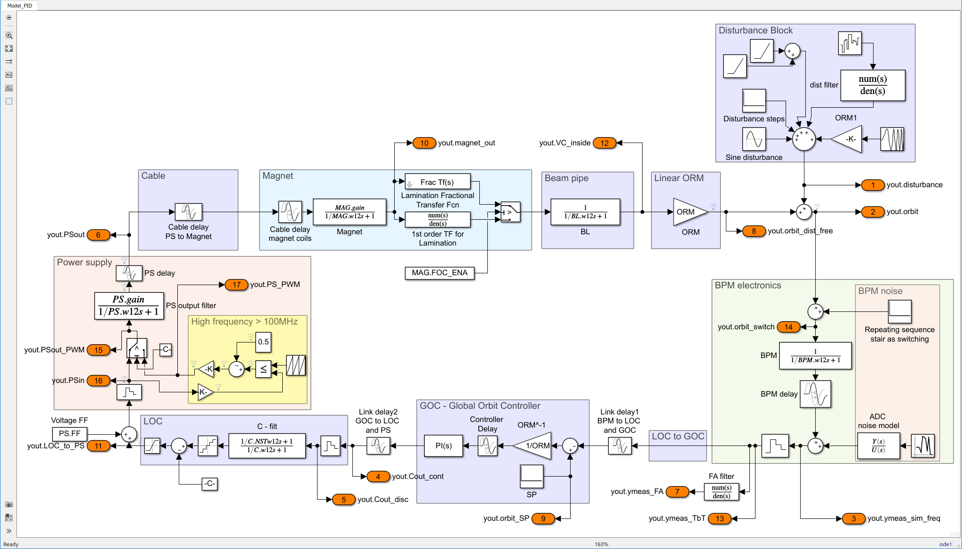
FOFB Simulations
Simulation framework will be made available via Gitlab if you are interested
Overall signal chain
SISO feedback loop
Magnet
Vacuum chamber
Disturbance block
BPM electronics
Power supply
Cable
Digital signal chain
ORM element (PIV lattice)
ORM element from PIV lattice that maps µrad into an orbit offset at a distance of 1m

Slide 11
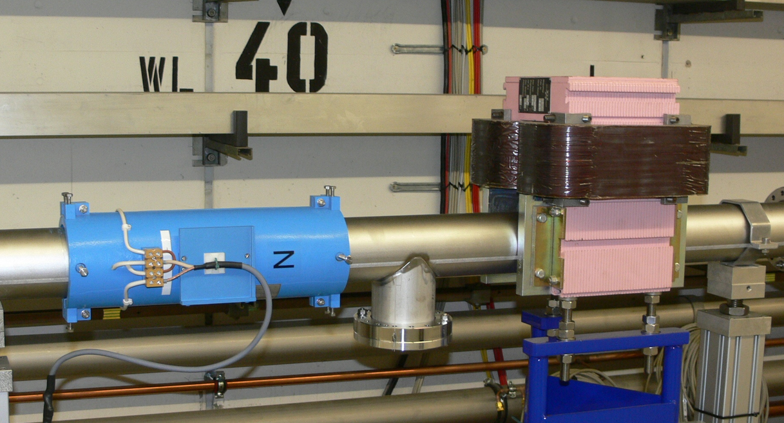
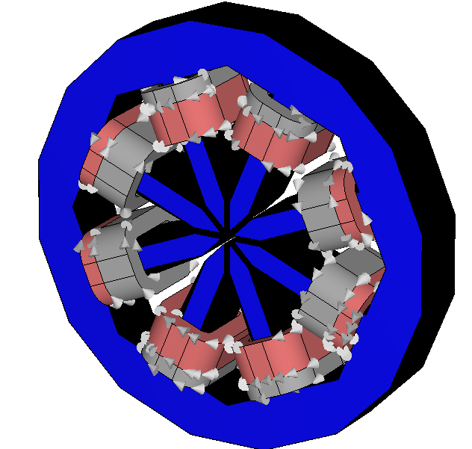
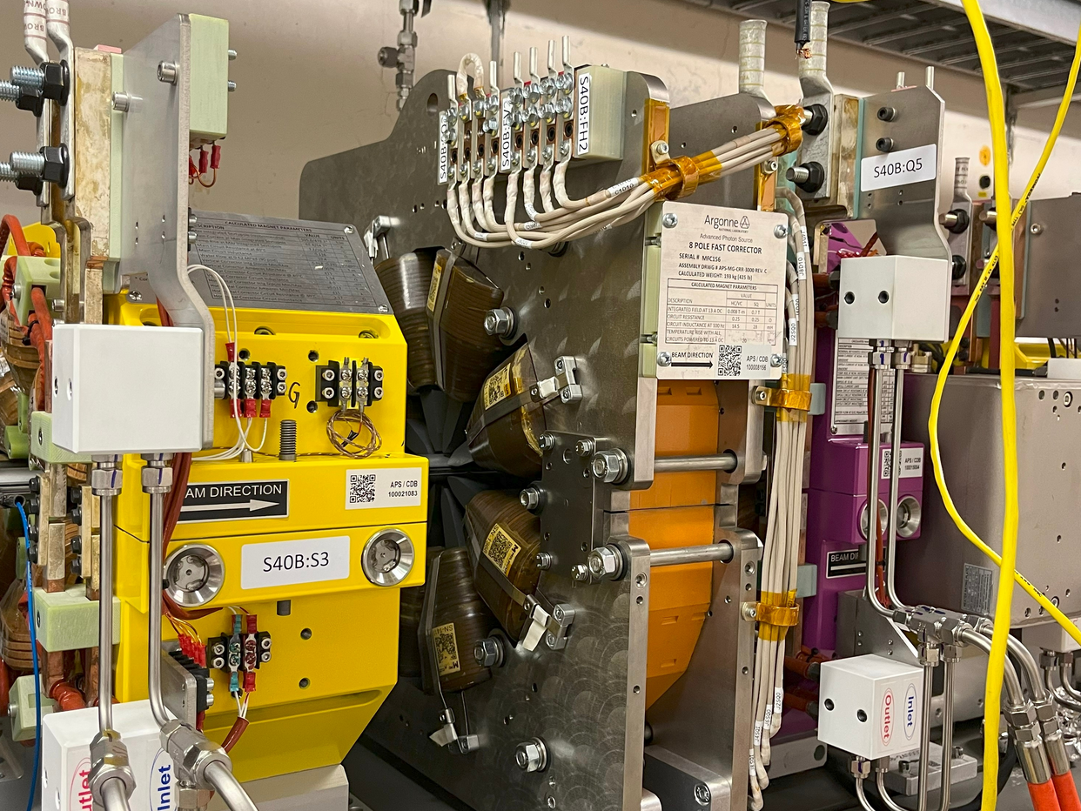
PETRA IV FOFB
PIII: H fast corrector with DC corrector
Courtesy: H.T.Duhme, J.Klute
Corrector requirements from PIII to PIV
PETRA III
Small corrector magnet (0.2mH…0.48mH) as air coil (kHz bandwidth) for fast orbit feedback; max 45µrad
Larger magnet for static (DC) corrections
Stainless steel vacuum chamber (D=94-98mm) with ~1kHz bandwidth as limiting element
PETRA IV → Complete redesign by space constraints
Combined functioning magnet (slow and fast corrections) with 23mH; max 560µrad DC, 30µrad AC
  High field quality (less dependence on orbit fluctuations)
  Hz bandwidth, pushed digitally into kHz regime → more demands on magnet power supply
  (Possibility to integrate skew quad coils)
Slow and fast corrector magnet based on APS-U design
@APS-U (courtesy: John Carwardine, Animesh Jain)

Slide 12

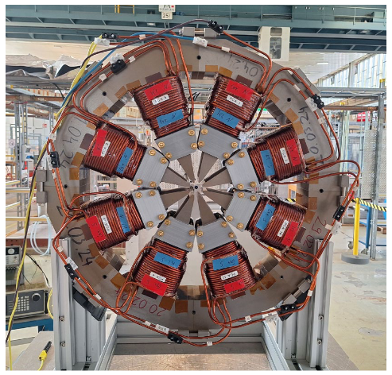
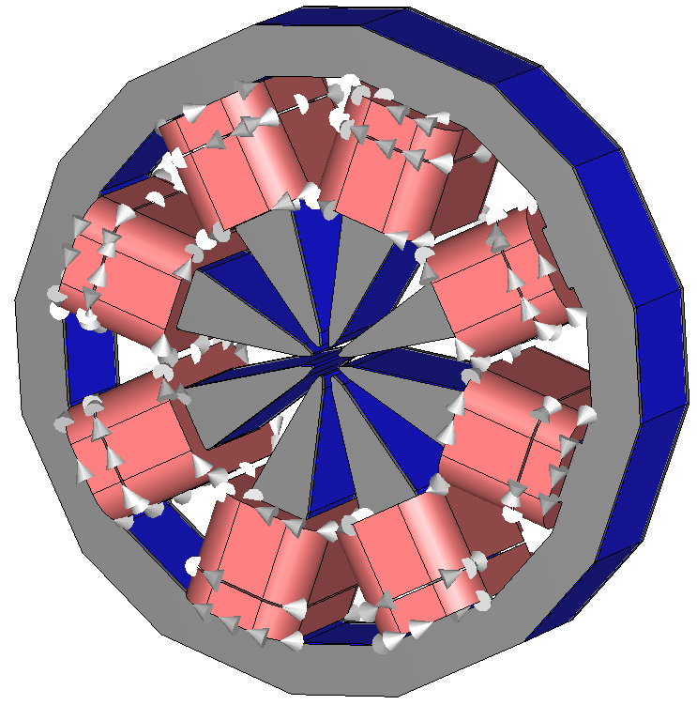
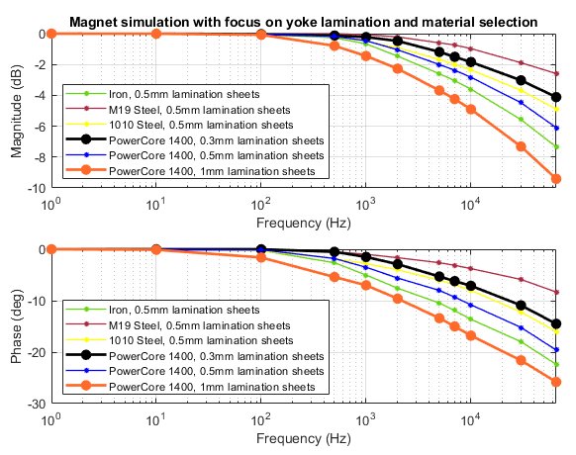
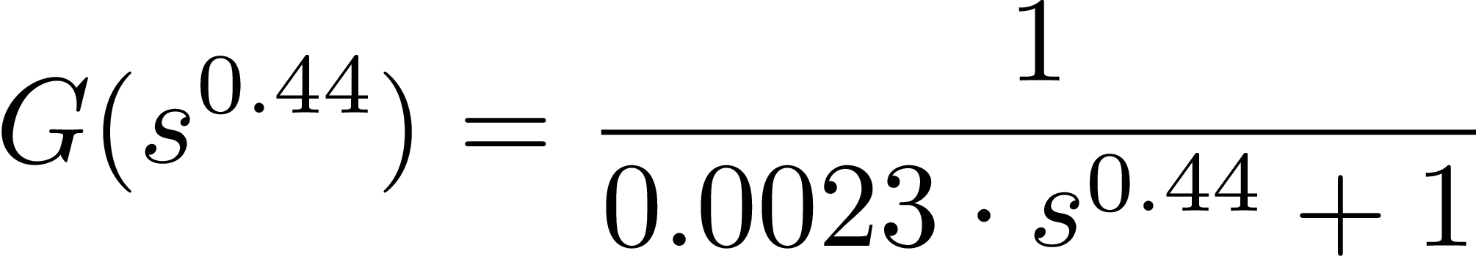


Magnet update
Courtesy: M.Thede
Simulation by TU Darmstadt (TEMF)
Yoke variations
Courtesy: J.M.Christmann
1st prototype magnet with PowerCore 1400 and 1mm lamination thickness
  3kHz with -10deg.
2nd prototype magnet with PowerCore 1400 and 0.3mm lamination thickness
  30kHz with -10deg.
→ Fractional order system
First simulations done → shifted in frequency by x10 using 0.3mm laminations → side project for master student

Slide 13
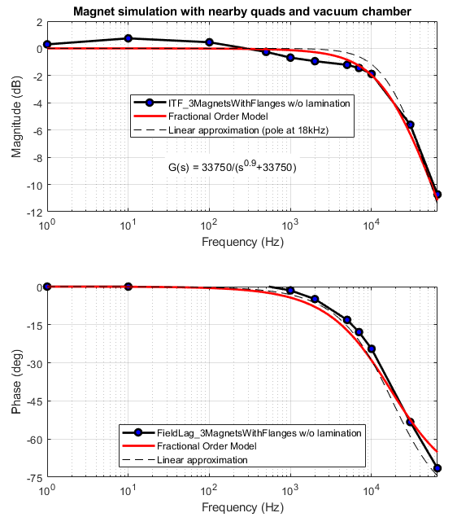
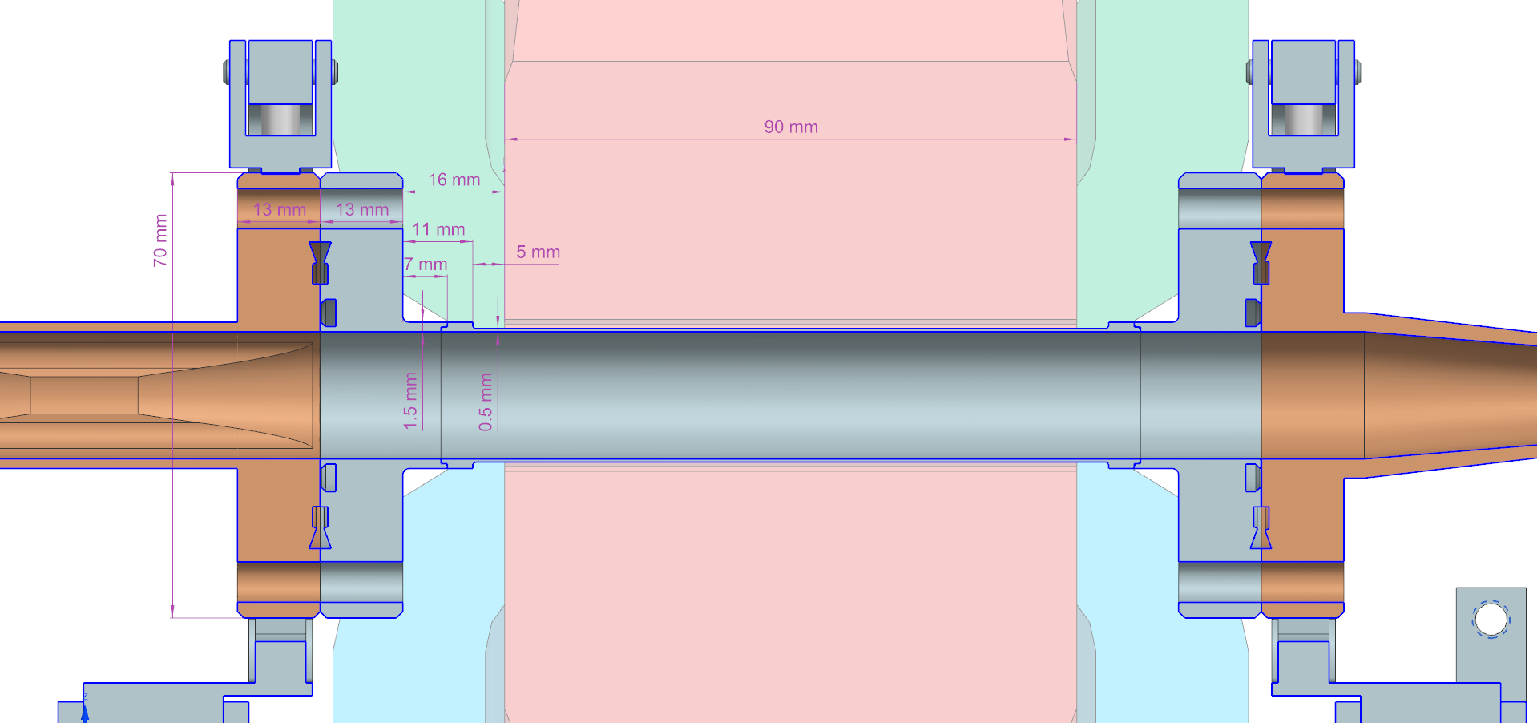
Vacuum chamber design
… for the fast correctors
SS vacuum chamber with symmetric CU transitions
Thickness 0.5mm
Yoke-CU distance 29mm
First order approximation seems sufficient
Courtesy: J.Hauser

Slide 14
Disturbance and noise models

Slide 15
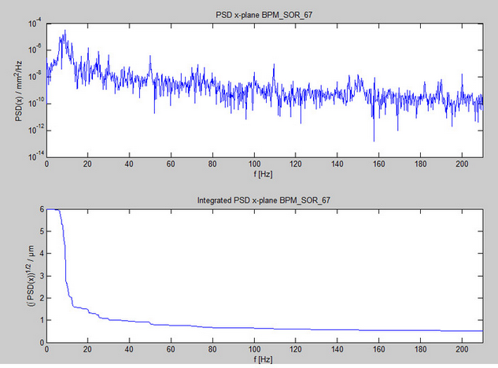
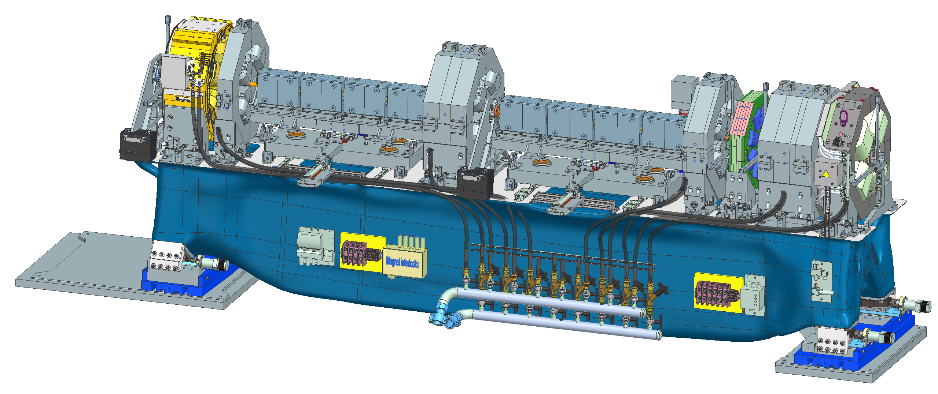
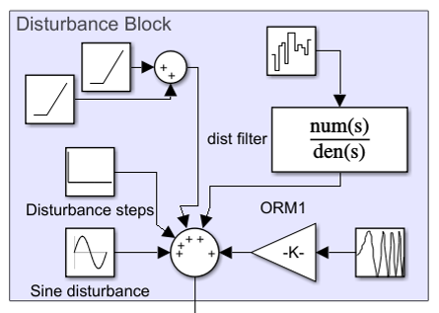
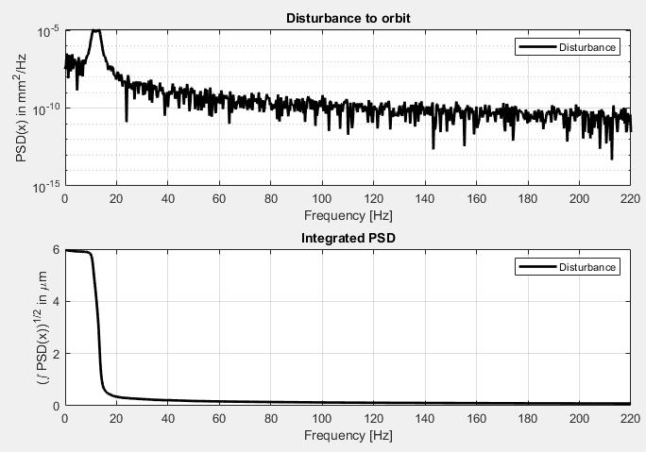
PIV - FOFB system
Start with PIII disturbance model to check PIV system simulations
→ Reduced distortions at PIV expected by optimization of girder eigenfrequencies
Disturbance integration - SISO
Disturbance
BPM measurement at PETRA III
Incoherent: DC … kHz
BPM Measurement at PIII
→Talk: Normann Koldrack
Next steps:
Spatial disturbance integration into full ring simulation including coherence length and transition
Coherent: < 1Hz (ocean waves)
Transition: 1…10Hz (traffic noise)
Approximation for simulation
Here: β = 8 (later β=4 or β= 2.2)

Slide 16
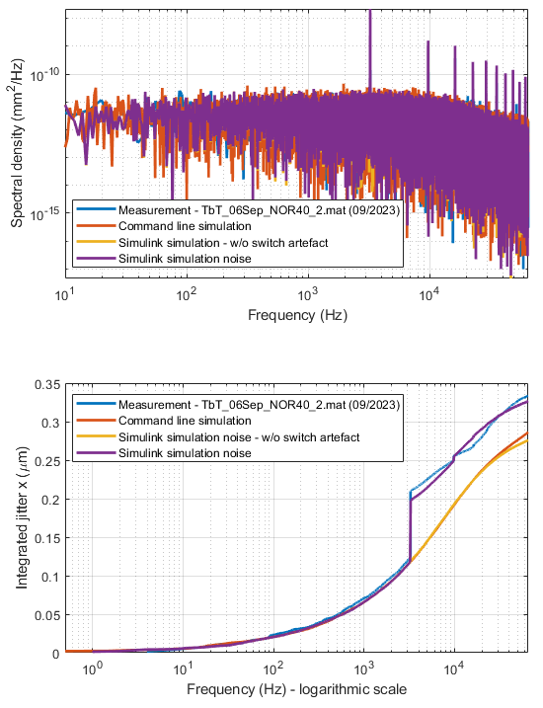
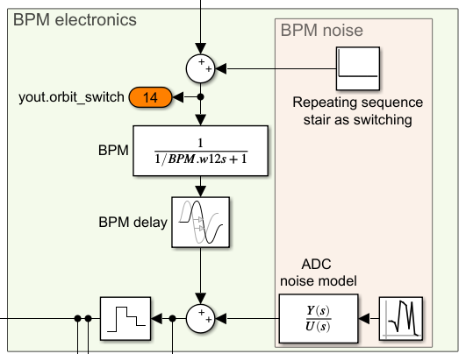
BPM update
Matching of integrated jitter
BPM electronics model
BPM electronics
  DDC bandwidth and I/O latency
  Noise including switching sequence
Noise characteristic for electronics
  Measured at PIII with PIV system (09/2023)
Simulations with or without BPM noise and the switching artefact for drift compensation
Working on an advanced noise characteristic, i.e. variation of
Number of bunches
Bunch repetition rate
Fill pattern (1920b, 80b, 7/8, hybrid mode)
Bunch charge (hybrid mode)
…
Measurement with 480b, 120mA, uniform distribution
OUT

Slide 17
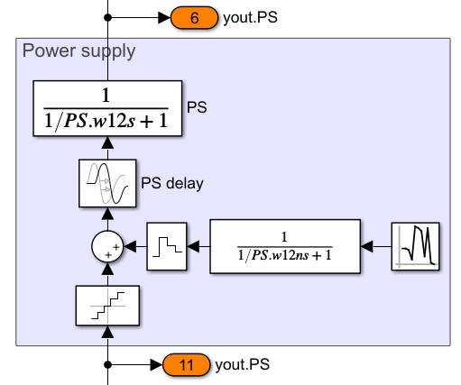
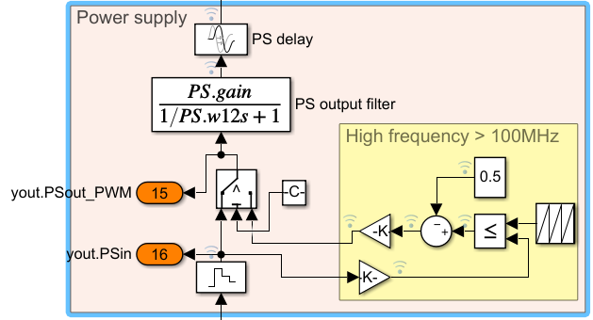

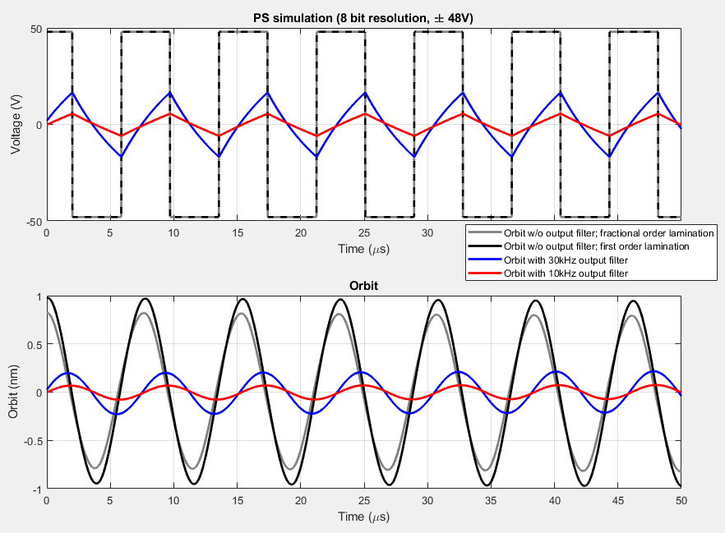
PS update for fast correctors
OUT
Power supply noise using pulse width modulation
Power supply
  I/O delay (max 15µs)
  Changeable output filter (10kHz)
Noise characteristic
  PWM as comparator (implementation on FPGA)
  Quantization effects/noise (8, 10, 11 bit)
Conclusion from simulation
PWM switching filtered by the output filter and by bandwidth limiting elements (magnet, yoke lamination and vacuum chamber) → 1nm expected maximum orbit distortion
Noise is working point dependent, but well below the BPM resolution
Goal to replace analytical model by PSD measurement for first prototype; further checks for 50Hz mains and harmonics contribution and other noise sources.
IN = 0
Notes:
50Hz and harmonics by RF noise →

Slide 18
SISO simulation

Slide 19
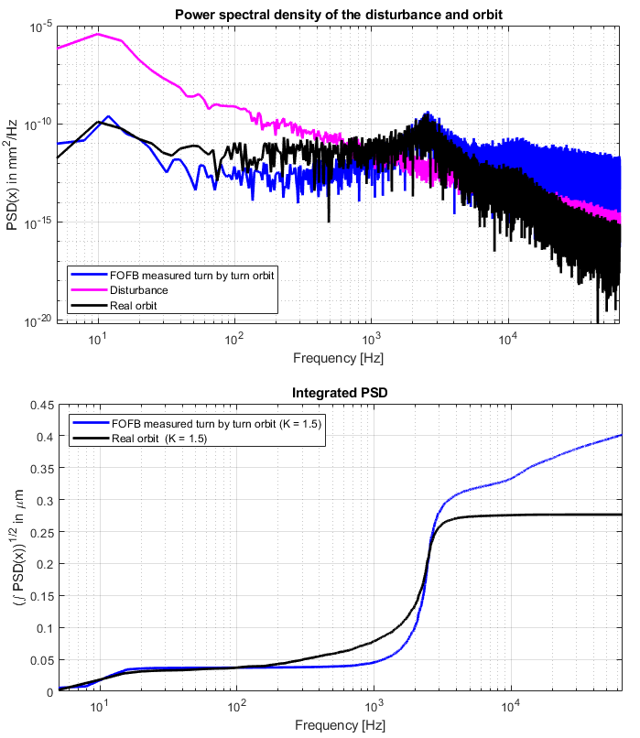
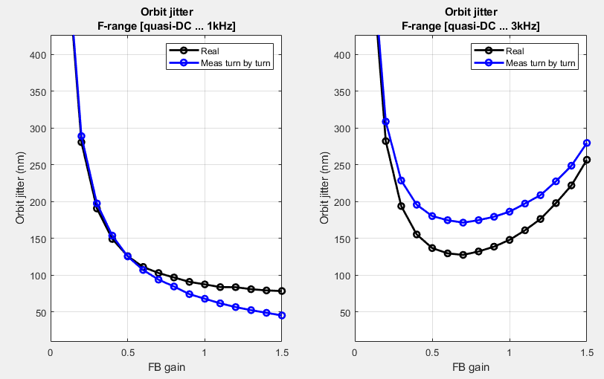
FOFB simulation
FB gain = 1.5
Expected orbit jitter as function of FB gain
Advanced noise characteristic is missing; i.e. variation of
Number of bunches
Bunch repetition rate
Fill pattern (1920b, 80b, 7/8, hybrid mode)
Bunch charge (hybrid mode)
…
SISO closed loop simulation
Feedback gain scan vs integrated orbit jitter
Measured in comparison to real orbit jitter
Difference by measurement (incl BPM noise) and expected orbit
Integration
DC…1kHz
Integration
DC…3kHz
10%
3%

Slide 20
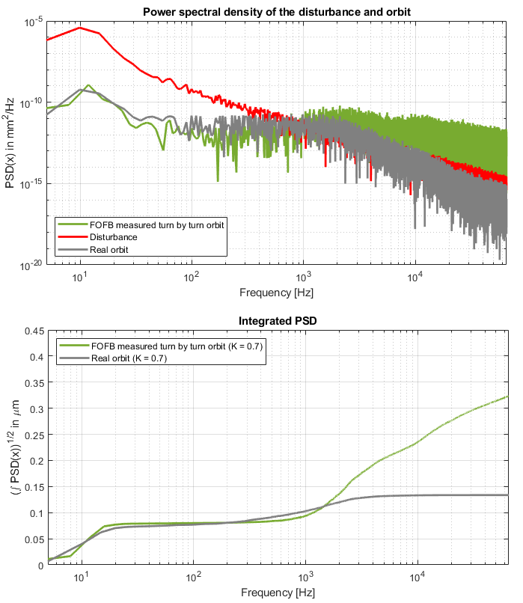
FOFB simulation
FB gain = 0.7
Expected orbit jitter as function of FB gain
SISO closed loop simulation
Feedback gain scan vs integrated orbit jitter
Measured in comparison to real orbit jitter
Advanced noise characteristic is missing; i.e. variation of
Number of bunches
Bunch repetition rate
Fill pattern (1920b, 80b, 7/8, hybrid mode)
Bunch charge (hybrid mode)
…
Difference by measurement (incl BPM noise) and expected orbit
Integration
DC…1kHz
Integration
DC…3kHz
10%
3%

Slide 21
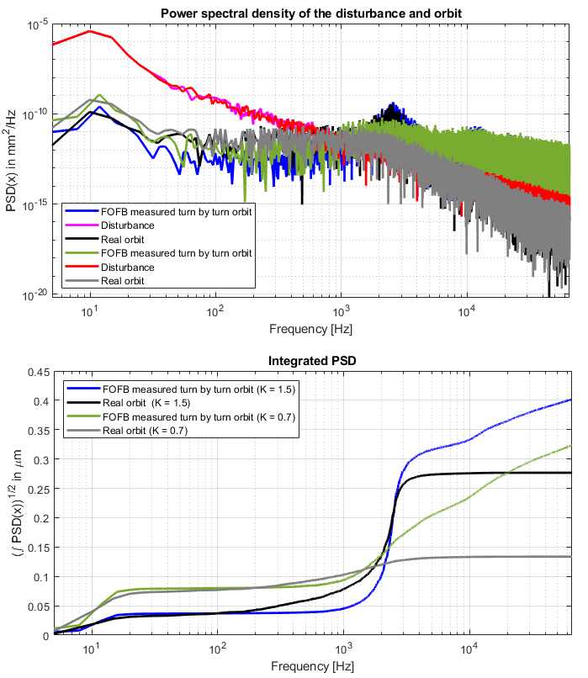
FOFB simulation
Waterbed effect at 2.5kHz
given by T_{D} and BW
(amplification of BPM noise)
Expected orbit jitter as function of FB gain
Advanced noise characteristic is missing; i.e. variation of
Number of bunches
Bunch repetition rate
Fill pattern (1920b, 80b, 7/8, hybrid mode)
Bunch charge (hybrid mode)
…
SISO closed loop simulation
Feedback gain scan vs integrated orbit jitter
Measured in comparison to real orbit jitter
Integration
DC…1kHz
Integration
DC…3kHz
10%
Reduction
3%
Relaxation
→ MIMO mode space simulation to check noise & disturbance suppression ongoing

Slide 22
Conclusion & Outlook
Conclusion
PETRA IV as the most important project at DESY
Passive and active orbit stabilization
  Orbit distortions in stability task force
  FOFB system design
  Sub-system modelling and HW specifications
  Noise and disturbance modelling
SISO simulations
Next steps
PETRA III as benchmark system for MIMO simulations
Full MIMO simulation with all noise and disturbance sources
Spatial disturbance integration including coherence length and transition
Different BPM supports (ground, girder)
Optimal (& robust) integration of photon diagnostics into (F)OFB
Thank you for your attention!

Slide 23
Thank you
Sven Pfeiffer
WP 2.08 - Feedback
sven.pfeiffer@desy.de
+49 40 8998 - 2744

Slide 24
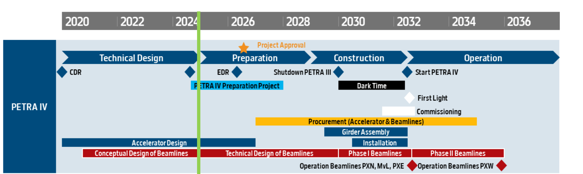
The PETRA IV project timeline hinges on project approval by mid-2026
The draft breakdown below hinges on
Project approval in mid 2026
Call for tender start in mid 2027
PIII shutdown end 2029
Procurement for the accelerator estimated to 3 years
Dark period 30 months
Three months commissioning time
First light in Jul 2032
Baltic Science and Innovation Day, DESY Photons Science Users’ meeting, 20th January 2025, R. Bartolini

