Slide 1
A Transparent Injection Scheme for Diamond-II
Ian Martin
A. Amiri, C. Bailey, T. Dobbing, J. Kallestrup (now at PSI), A. Lueangaramwong (now at BNL), A. Morgan, W. Tizzano, V. Zhiltsov
Diamond Light Source Ltd.
J. Hares, T. Dymoke-Bradshaw, P. Kellett
Kentech Instruments Ltd.
I.FAST Workshop 2025 on Stability of Storage Ring Based Light Sources
KIT, 18th/19th March 2025

Slide 2
Talk Outline
Introduction to Diamond-II:
Requirements for injection
Injection schemes and layout
Single bunch injection with fast stripline kickers:
‘Aperture-sharing’ vs. ‘Kick-and-cancel’ injection
Injection simulations (transparency, collective effects, error sensitivity)
Hardware overview:
Diamond-II injection magnet specifications
Design status / prototyping on Diamond
Conclusions
I.P.S. Martin, Diamond-II Injection, KIT 2025, 18/03/2025

Slide 3
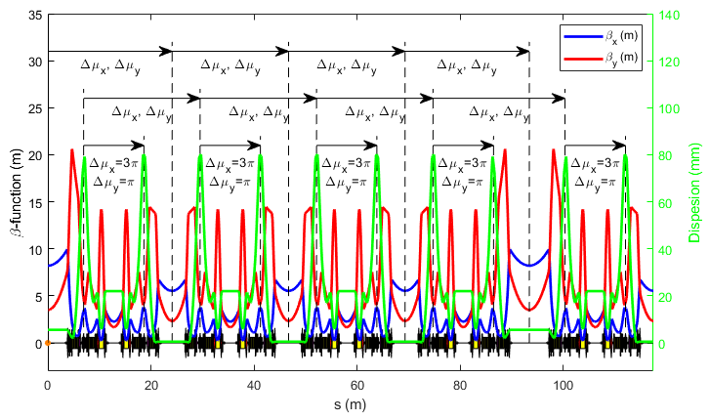
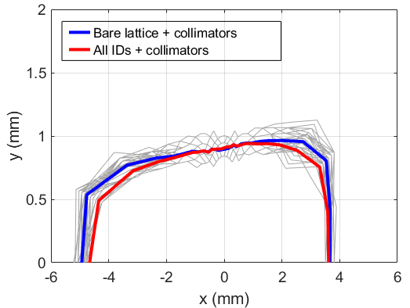
Diamond-II Lattice
Modified Hybrid 6-Bend Achromat (M-H6BA) for low emittance
Number of insertion straights increased from 24 to 48
Long straights: 7.54 m
Standard straights: 5.06 m
Mid straights: 2.92 m
Off-axis injection for beam accumulation
‘-I’ transformer plus const. cell phase for nonlinear dynamics
Passive SC harmonic cavity for lifetime / beam stability / IBS
Parameter | Units | Diamond | Diamond-II
Energy | GeV | 3.0 | 3.5
Circumference | m | 560.6 | 560.560944
Harmonic Number | - | 936 | 934
RF Frequency | MHz | 499.654 | 499.511
Positive Bending Angle | deg | 360.0 | 374.4
Reverse Bending Angle | deg | 0.0 | 14.4
Total Bending Angle | deg | 360.0 | 388.8
Betatron Tunes | - | [27.21, 12.36] | [54.14, 20.24]
Natural Chromaticity | - | [-79.0, -35.6] | [-68.2, -89.1]
Corrected Chromaticity | - | [1.7, 2.2] | [2.6, 2.6]
Mom. Compaction Factor | ×10⁻⁴ | 1.70 | 1.03
Natural Emittance | pm.rad | 2729 | 162
Energy Spread | % | 0.096 | 0.094
Energy Loss per Turn | MeV | 1.01 | 0.724
Natural Bunch Length | ps | 11.4@2.4 MV | 12.4@1.4 MV
Horizontal Damping Partition | - | 1.00 | 1.88
Horizontal Damping Time | ms | 11.1 | 9.4
Vertical Damping Time | ms | 11.2 | 18.1
Longitudinal Damping Time | ms | 5.6 | 16.1
I.P.S. Martin, Diamond-II Injection, KIT 2025, 18/03/2025

Slide 4
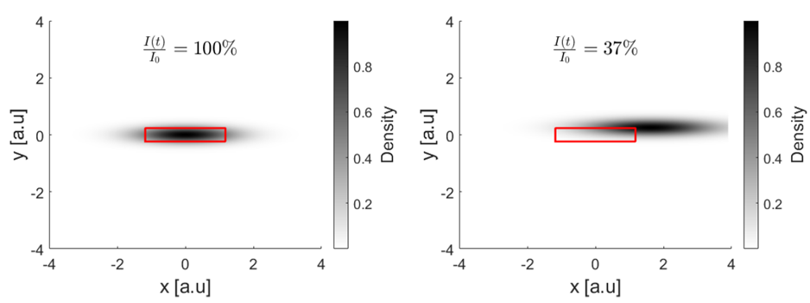
Injection Requirements
Injection requirements:
Off-axis accumulation (minimises requirements on injector; avoids beam dump?; improved reliability?)
Matched to available dynamic aperture / momentum acceptance (new booster required)
Minimise filling time after beam trip
Use proven technology where possible to minimise risk
Transparent top-up injection during user time (key requirement from users!)
Transparency figure of merit (FoM):
“Intensity integrated over 100 μs through 2D FWHM slit 45 m downstream from source point must remain above 99% of nominal at all times at all beamlines”
I.P.S. Martin, Diamond-II Injection, KIT 2025, 18/03/2025

Slide 5
Injection Schemes
Diamond-II will operate two different injection schemes:
PM thick septum + pulsed thin septum + standard four kicker bump (single or multi-bunch)
Robust, proven concept
Can be adjusted for different stages during commissioning:
  Stage 1: single shot, on-axis injection (first turns => first stored beam)
  Stage 2: off-axis accumulation with non-closed bump (improved capture efficiency)
  Stage 3: off-axis accumulation with closed orbit bump (improved transparency)
PM thick septum + pulsed thin septum + fast stripline kickers (single bunch only)
Frequent top-up injection using single-bunch injection (transparent to users: 1 bunch in 900 kicked)
180 bunches
216 to 416 bunches
I.P.S. Martin, Diamond-II Injection, KIT 2025, 18/03/2025

Slide 6
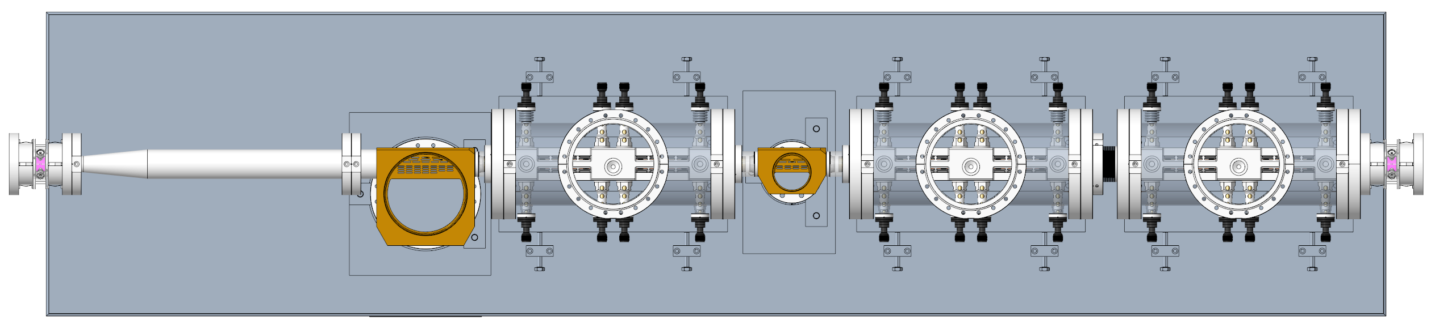
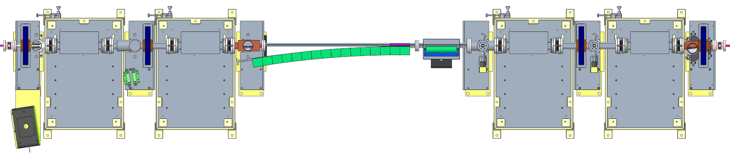
Injection Layout
DC chicane magnet
I01 Injection Straight
K01 Injection Straight
Pulsed dipole kicker magnet
400
PM thick septum
Pulsed thin septum
Vacuum pump
Photon absorber
Module containing two pairs of stripline kickers
Δµ_{x} ~90 deg
Standard straight
Mid straight
Long straight
Cell #1
Cell #2
Cell #3
Cell #4
1 Super-period
I.P.S. Martin, Diamond-II Injection, KIT 2025, 18/03/2025

Slide 7
Single-Bunch ‘Aperture-Sharing’ Injection
An aperture-sharing injection scheme was assumed during the Technical Design Report (TDR) phase:
Four-kicker bump is switched off, leaving injected bunch ~8 mm offset from on-axis stored beam
Injected bunch oscillates at large amplitude until it reaches the first mid-straight (K01)
Stripline kickers reduce oscillation amplitude for injected bunch but cause stored bunch to oscillate at similar amplitude (i.e. initial injected bunch amplitude is shared between stored and injected bunches)
Oscillation amplitude
(Injected beam only)
Stripline kickers
Injection septum
Oscillation amplitude
(Stored and injected beams)
I.P.S. Martin, Diamond-II Injection, KIT 2025, 18/03/2025

Slide 8
Single-Bunch ‘Aperture-Sharing’ Injection
Issues with aperture sharing:
Impact on overall brightness from stored bunch oscillations
  Particular problem for hybrid bunch / timing mode users
  Bunches before and after target bunch could also be kicked if pulse duration > 3 ns
Transverse wakefields generated by stored bunch affecting injected bunch
Interaction of multi-bunch feedback with off-axis bunches
Alternative: Implement a ‘kick-and-cancel’ double kick for the stored bunch
Give the stored bunch a pre-kick n turns before injection such that there is close to 180 degrees phase advance at injection
Injected bunch arrives as before:
  stripline kicker still reduces injected bunch oscillation amplitude by ~factor 2
  stored bunch is kicked back on-axis rather than being made to oscillate
I.P.S. Martin, Diamond-II Injection, KIT 2025, 18/03/2025

Slide 9
Single Bunch ‘Kick-and-Cancel’ Injection
‘Aperture-sharing’
‘Kick-and-Cancel’
Straight I01
Straight K01
Straight I01
Straight K01
Septum plate
Turn = -3
Turn = -3
Kick from striplines
Stored bunch
Injected bunch
Turn = 0
Turn = 0
I01
K01
I01
K01
magnets
septum
striplines
Δμ_{x} ~ 90 deg
I.P.S. Martin, Diamond-II Injection, KIT 2025, 18/03/2025

Slide 10
Brightness Comparison
Improved transparency:
Target >99% flux through BL aperture
Stored bunch back on axis after second kick
Only injected bunch continues to oscillate
Brightness Impact for Stored Beam (300 mA, 900 bunches)
Brightness Impact for Target Bunch (3 nC, single bunch)
I.P.S. Martin, Diamond-II Injection, KIT 2025, 18/03/2025

Slide 11
Collective Effects
Injection efficiency calculated as a function of stored bunch charge including harmonic cavity (flat potential):
Impedance elements (resistive wall, cavity HOMs and short-range geometric)
Element-by-element tracking including physical apertures, IDs and field/alignment errors
Injected bunch charge = 0.1 nC
Macroparticle charge = 0.1 pC (i.e. 3 nC stored = 30,000 macroparticles)
Track stored bunch for 12K turns to reach equilibrium, add injected bunch and fire striplines, track for a further 3K turns
With HHC / no TMBF
With HHC + TMBF
Without HHC or TMBF
K&C lowers wakefield effects:
Stored bunch is on-axis
Can accumulate to higher charges
More tolerant:
  Smaller interaction with TMBF
  Does not need harmonic cavity
I.P.S. Martin, Diamond-II Injection, KIT 2025, 18/03/2025

Slide 12
Tolerance Studies
The sensitivity of injection efficiency to injected beam trajectory errors with stripline kickers has been studied using AT2 lattices at the end of Simulated Commissioning*:
Commissioning procedure applied, including field and alignment errors, IDs, HHC and closed collimators
Injection efficiency determined as a function of injected beam offsets for 40 lattices
Only considers injected beam (no collective effects) – applies to both aperture sharing and kick and cancel
Horizontal phase space
Vertical phase space
Longitudinal phase space
1.1 mm
0.5 mm
400 ps
0.2 mrad
0.4 mrad
2.2 %
*T. Hellert, et al., PRAB 25, 110701, (2022)
I.P.S. Martin, Diamond-II Injection, KIT 2025, 18/03/2025

Slide 13
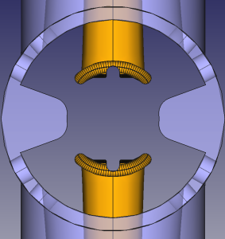
Stripline Kickers
Six sets of striplines are required, grouped in three separate modules:
Parameter | Units | Value
Length | mm | 150
Full gap | mm | 14.7
Bend angle per stripline | µrad | >156
14.7 mm
Evolution of D-II MBF stripline design + SLS 2.0 solution:
Double skin vacuum tank (Large outer chamber, internal pipe with pumping grills)
Flat central section to improve field uniformity
End tapers optimised to minimise field roll-off and reflections
Rounded edges and maximise spacing to avoid arcing
Cut-outs for synchrotron radiation
I.P.S. Martin, Diamond-II Injection, KIT 2025, 18/03/2025

Slide 14
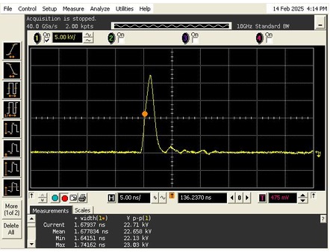
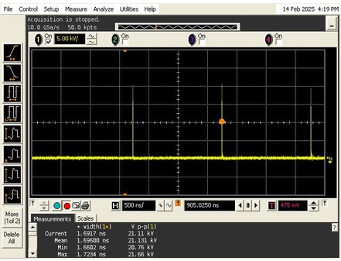

Stripline Power Supplies
To ensure only a single bunch is kicked, require:
$τ_{pulse}<\frac{2}{f_{RF}}−\frac{2L_{strip}}{c}=3 ns$
Prototype pulser developed by Kentech Ltd.
Stage 1: +2.5kV, <15 ns, 4 pulses/cycle
Stage 2: ±4 kV, <4 ns, >10 pulses/cycle
Stage 3: ±20 kV, <4 ns, >10 pulses/cycle
Specification
Amplitude adjustment: 5:1 (best effort for 10:1)
Post-pulse noise: <±5% for 15 ns, <±2% thereafter (over 2:1 tuning range)
Amplitude / timing jitter: <±5% / <±0.1 ns
2 ns
3 ns
22.7 kV
<1 ns
>1 ns
<1 ns
1.5 µs
# Striplines | Nominal bend angle | Nominal Stripline Voltage | Power Supply Peak Voltage*
All 6 operational | 124 µrad | 11.7 kV | 15.9 kV
5 out of 6 (#6 failed) | 156 µrad | 14.7 kV | 20.0 kV
*includes increase to account for 12% cable losses and +20% contingency for tuning
I.P.S. Martin, Diamond-II Injection, KIT 2025, 18/03/2025

Slide 15
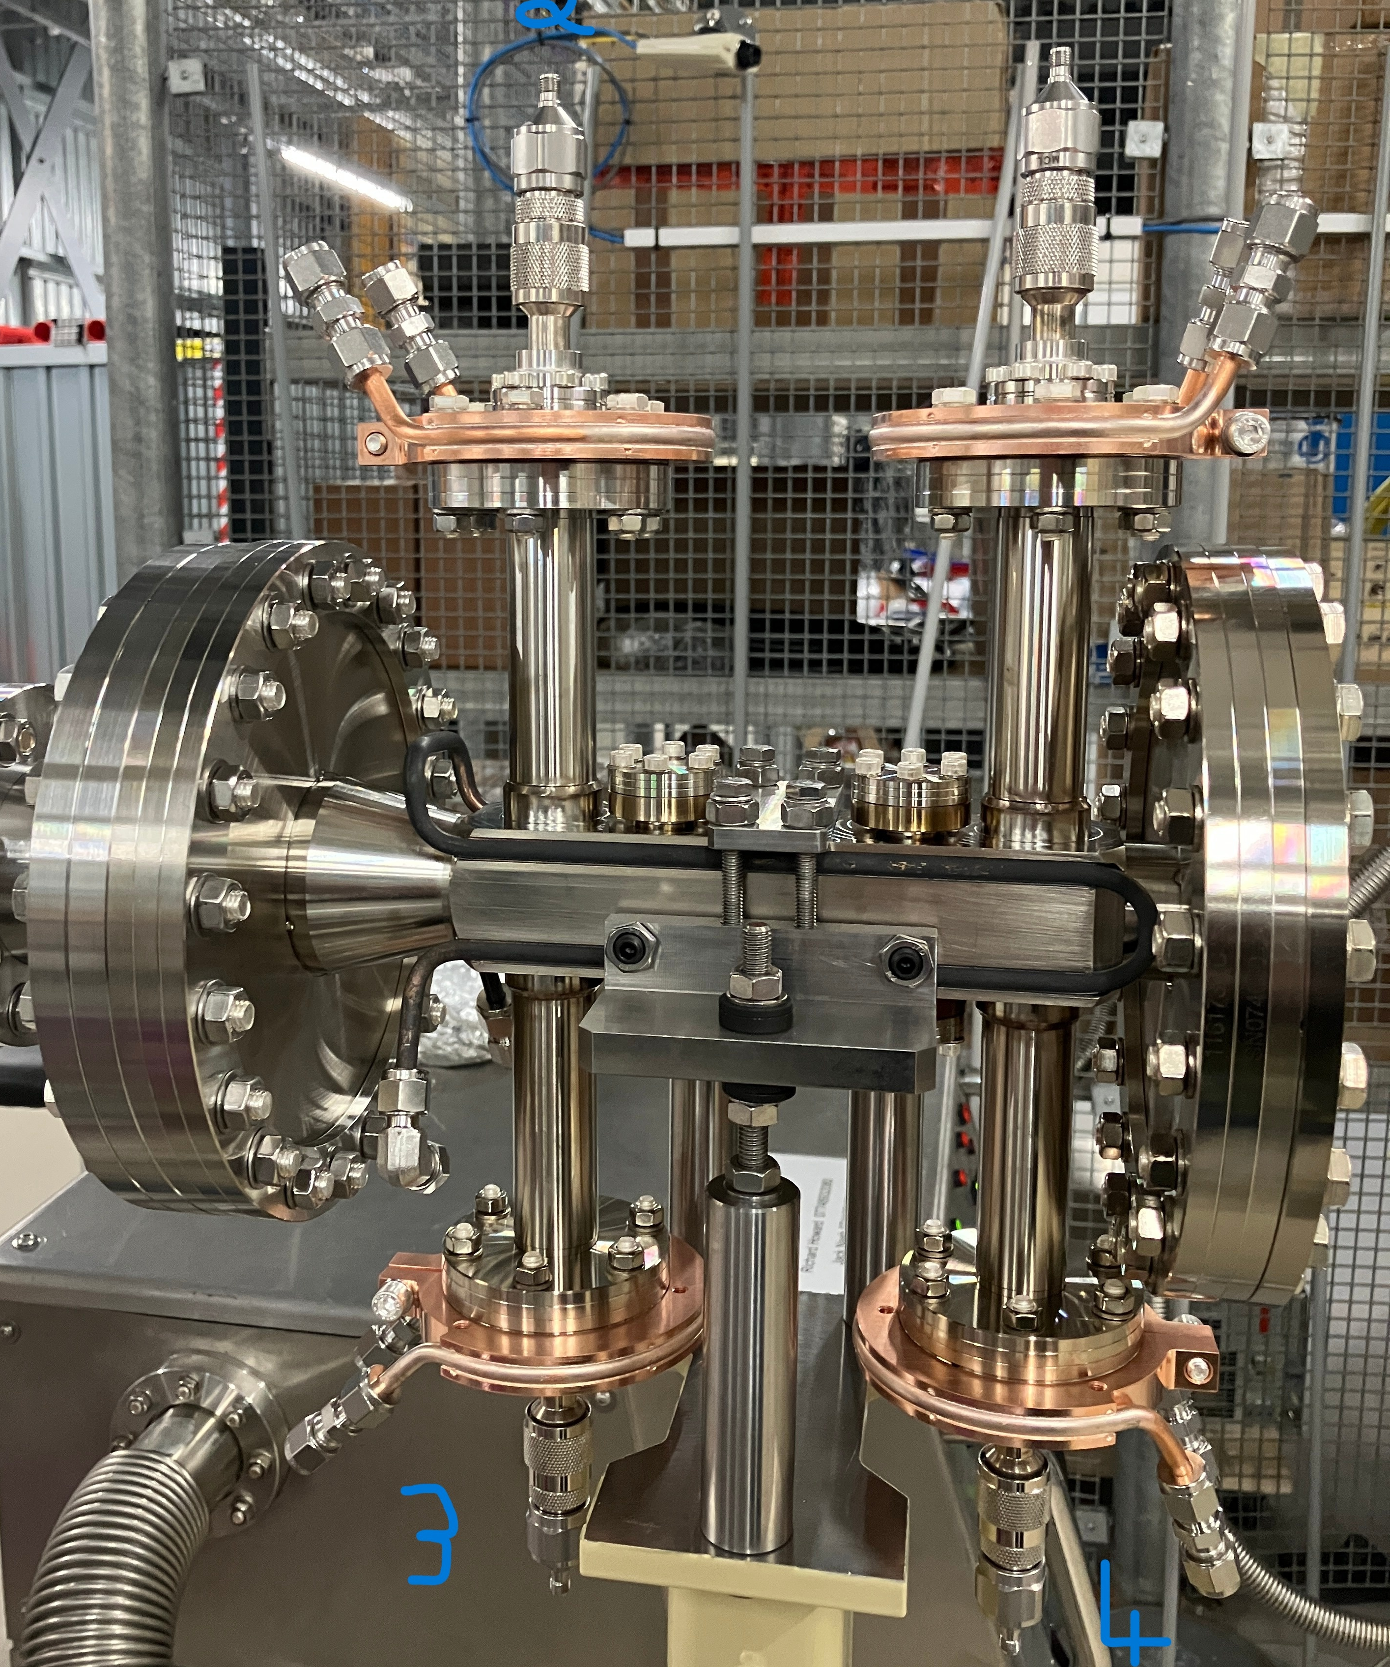
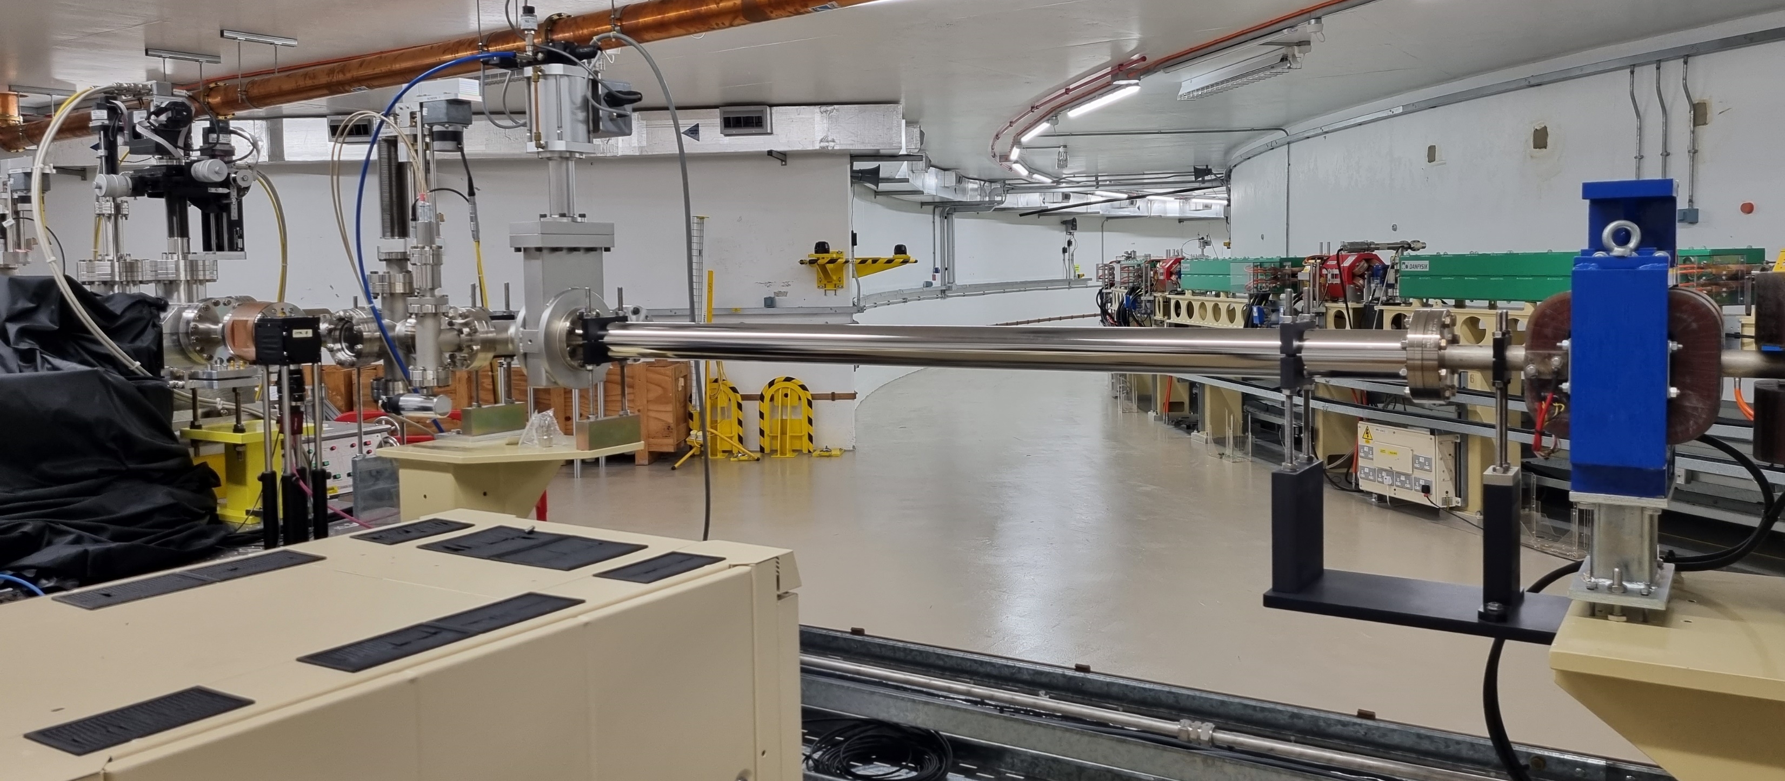
Prototype Stripline
Prototype striplines under development to validate D-II design choices and test individual components:
Rotated by 90 degrees
Larger apertures to suit Diamond injection
Single-skin vacuum chamber
Stage 1 – Lab tests (Feb 2025)
S-parameter measurements validated simulations
Pulser / cabling / feed-throughs successfully tested
Stage 2 – BTS tests (Spring 2025)
Kick amplitude and field quality
Stage 3 – Storage Ring tests (Summer 2025)
Kick and cancel operation
Impedance and beam dynamics
BTS Test Stand
I.P.S. Martin, Diamond-II Injection, KIT 2025, 18/03/2025

Slide 16
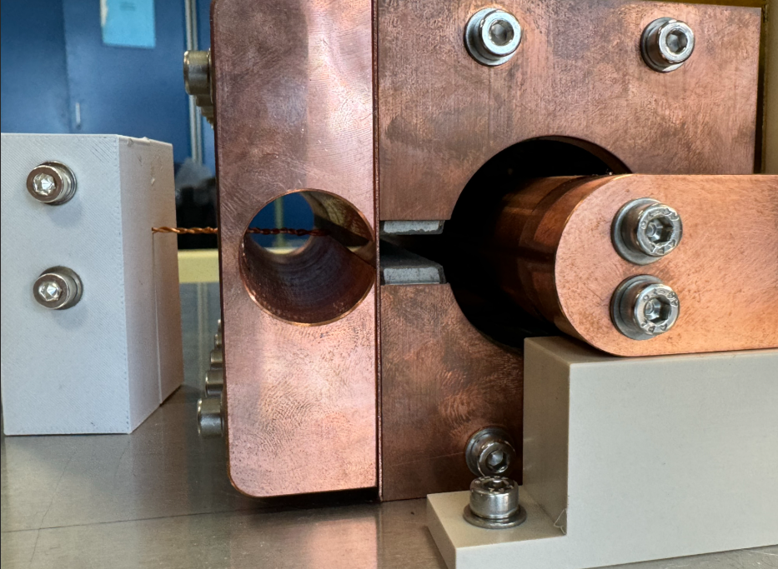
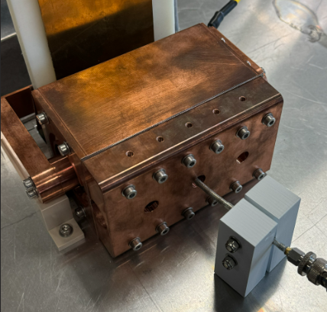
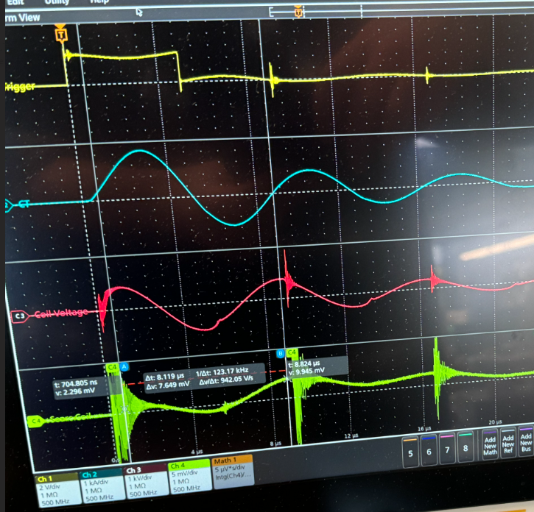
Pulsed Thin Septum Magnet
Thin electromagnetic septum (1 mm, in-vacuum)
0.6 T, 400 mm long, 10 μsec full sine, iron powder core
Targeting 10 µTm integrated leakage field for transparency
Prototype mock-up
120 mm long, full cross-section
Tested shielding configuration examples:
  0.5 mm copper
  0.5 mm copper + 0.1 mm iron layers
  0.5 mm copper + 0.05 mm mumetal layers
  0.5 mm copper + 0.05 mm nanocrystalline layers
Issues with power supply output (repurposed kicker PS)
  noise in the measurements
  clean full-sine pulse not possible
Believe end leakage might be dominating, even in the centre of the magnet (no end shielding in mock-up)
SmCo
Iron
Trigger
Magnet voltage
Search coil
I.P.S. Martin, Diamond-II Injection, KIT 2025, 18/03/2025

Slide 17
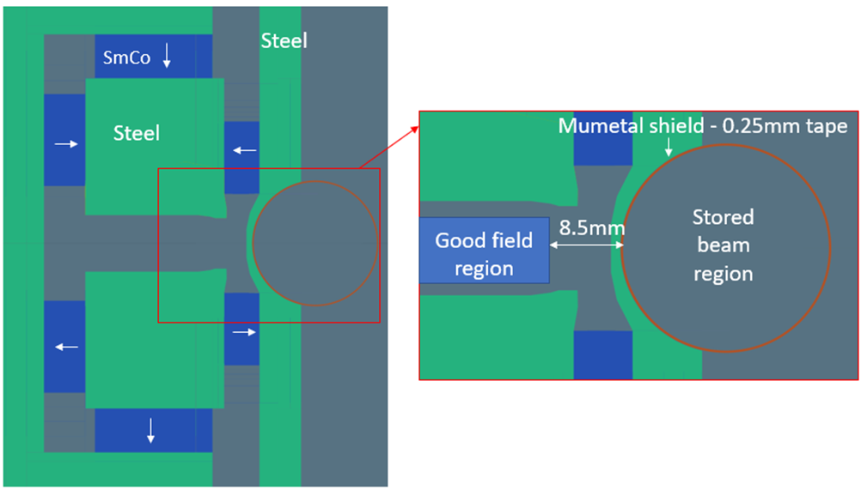
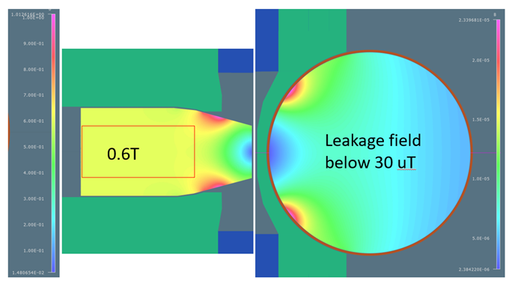
Permanent Magnet Main Septum
Thick PM septum (8.5 mm, out-of-vacuum)
PM septum reduces shot-to-shot jitter for injected beam position and angle
Static leakage field eliminates disturbance during top-up
Different strength modules to optimise shielding close to the stored beam (0.6 T end module, up to 1.5 T further away from the beam)
Integrated (DC) leakage field: aiming <100 µTm
Field tuning mechanisms under study:
  Extra corrector in transfer line
  DC EM module to replace 1T PM module
  Mechanical shunts also possible but difficult to implement
SmCo
Iron
Field uniformity and leakage in the end module (different scales)
I.P.S. Martin, Diamond-II Injection, KIT 2025, 18/03/2025

Slide 18
Conclusions
Two injection schemes developed for Diamond-II
Updated ‘classic’ four-kicker bump scheme for commissioning and beam refills:
Flexible, adjustable
Can be single or multi-bunch injection (reduces fill-time and/or number of injection shots per cycle)
Risk minimization: maintains fallback options; robust, proven technology
Transparent injection during top-up using single-bunch ‘kick-and-cancel’ injection:
Only 1 bunch in 900 is kicked
Can be installed / tested / developed separately from basic injection scheme
Upgrade path for injection into potential future ‘high-brightness’ lattices
Several key technologies under development:
In-vacuum eddy current thin septum
PM out-of-vacuum thick septum magnet
150 mm striplines
Few nanosecond pulsers from industry
Stage | Scheme | Mode
Commissioning | 4-kicker bump | Multi/single bunch
User mode - refill | 4-kicker bump | Multi/single bunch
User mode - top up | Kick-and-cancel injection | Single-bunch
Future brightness upgrade? | Kick-and-aperture-share | Single-bunch
I.P.S. Martin, Diamond-II Injection, KIT 2025, 18/03/2025

Slide 19
Extra Slides
I.P.S. Martin, Diamond-II Injection, KIT 2025, 18/03/2025

Slide 20
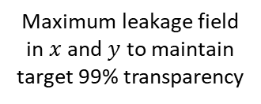
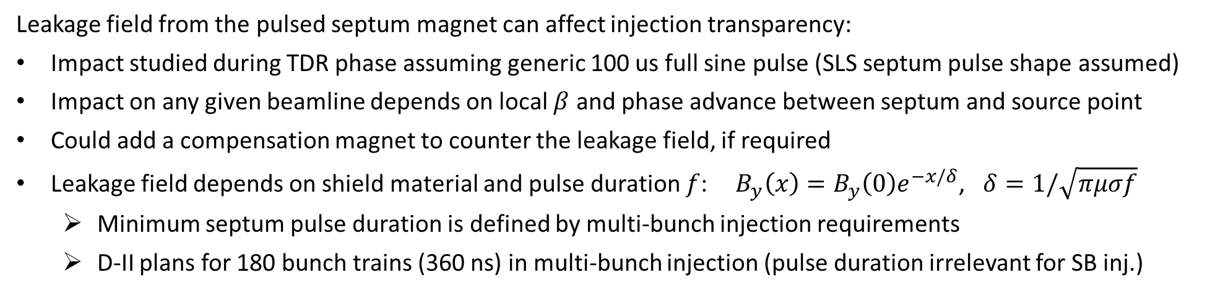
Septum Leakage Field
Leakage field from the pulsed septum magnet can affect injection transparency:
Impact studied during TDR phase assuming generic 100 us full sine pulse (SLS septum pulse shape assumed)
Impact on any given beamline depends on local $β$ and phase advance between septum and source point
Could add a compensation magnet to counter the leakage field, if required
Leakage field depends on shield material and pulse duration $f$: ${ B}_{y}\left(x\right)=B_{y}\left(0\right)e^{−x/δ}$, $δ=1/\sqrt{πμσf}$
  Minimum septum pulse duration is defined by multi-bunch injection requirements
  D-II plans for 180 bunch trains (360 ns) in multi-bunch injection (pulse duration irrelevant for SB inj.)
Leakage field causes transient orbit distortion
Beamline sees drop in photon flux – vertical steer has larger impact
Maximum leakage field in $x$ and $y$ to maintain target 99% transparency
I.P.S. Martin, Diamond-II Injection, KIT 2025, 18/03/2025

Slide 21
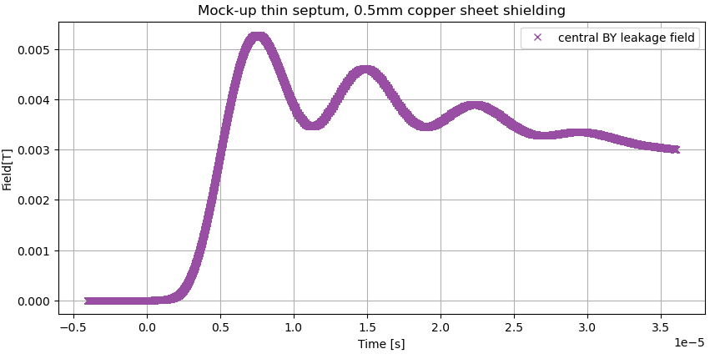
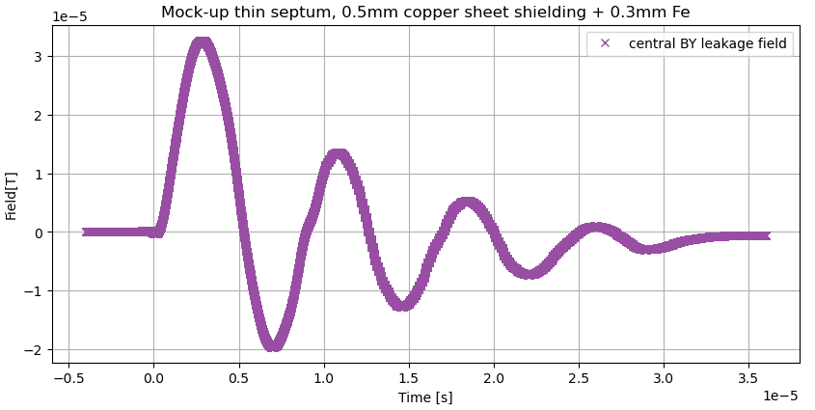
Pulsed Thin Septum Magnet
Copper shielding only
Visible phase shift of the peak leakage field (matching opera predictions)
Leakage dominated by field penetrating the copper septum blade
Copper plus Iron shielding
No phase shift of the peak field (as expected)
Leakage dominated by field penetraing openings/ends?
No improvements with different other materials/layers:
Shielding with other materials did not match simulations
All materials provided similar levels of shielding
No improvement from increasing stacking layers
SmCo
Iron
I.P.S. Martin, Diamond Update, ESLS 2024, 9/12/2024

