Slide 1
Introduction of KARA Storage Ring
Akira Mochihashi, 19.03.2025

Slide 2
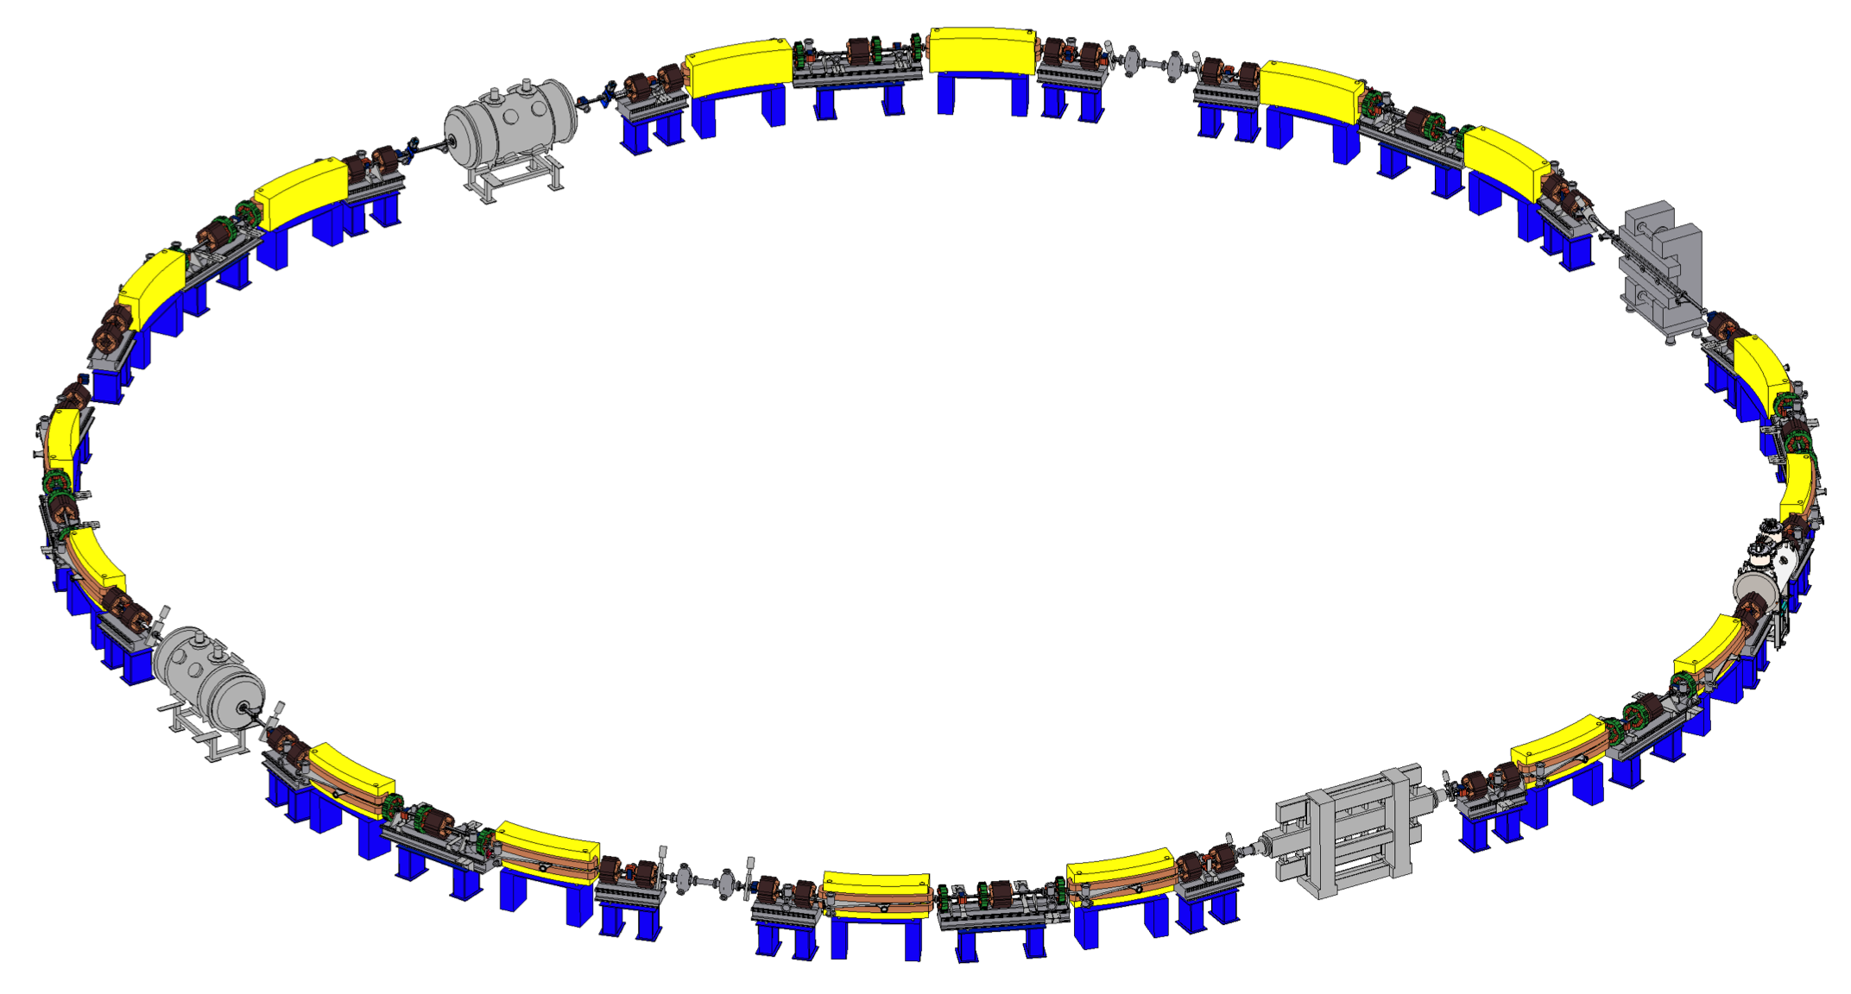
Karlsruhe Research Accelerator (KARA)
KIT synchrotron light source & accelerator test facility
Parameters | Values
Circumference | 110.4 m
Energy range | 0.5 – 2.5 GeV
RF frequency | 499.7 MHz
Revolution frequency | 2.715 MHz
Harmonic number | 184
Beam current | up to 200 mA
r.m.s. bunch length | 45 ps (2.5 GeV) a few ps (1.3 GeV, low-alpha)
Lattice structure | DBA
Injection at 500 MeV
User Operation at 2.5 GeV
Non-Top-Up Machine

Slide 3
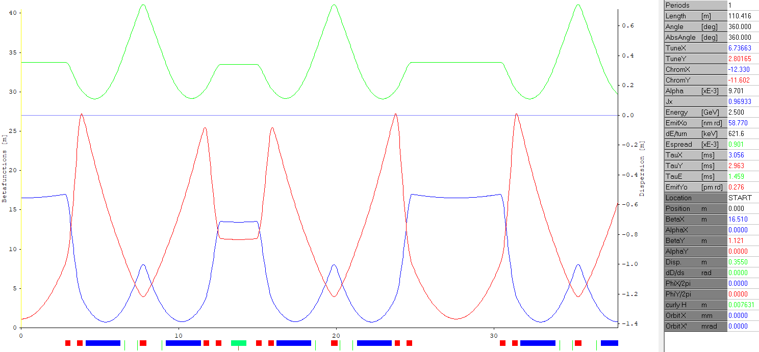
Lattice Functions at KARA
Results by OPA
One superperiod = 1 long straight + 1 short straight + 2 gaps of separated bends
KARA … four-folded structure

Slide 4
Quadupole Families at KARA
Quadrupoles: Five-Family Configuration
Family name | Main function | Location and total number
Q1 | Horizontal-quads | The first-Q at long straight: 8
Q2 | Vertical-quads | The second-Q at long straight: 8 (up- and downstream of the first bend)
Q3 | Horizontal-quads, dispersion control | In the gap of separated bends: 8
Q4 | Vertical-quads | The first-Q at short straight: 8 (up- and downstream of the second bend)
Q5 | Horizontal-quads | The second-Q at short straight. 8
Q1
Q2
Q3
Q4
Q5
Q5
Q4
Q3
Q2
Q1

Slide 5
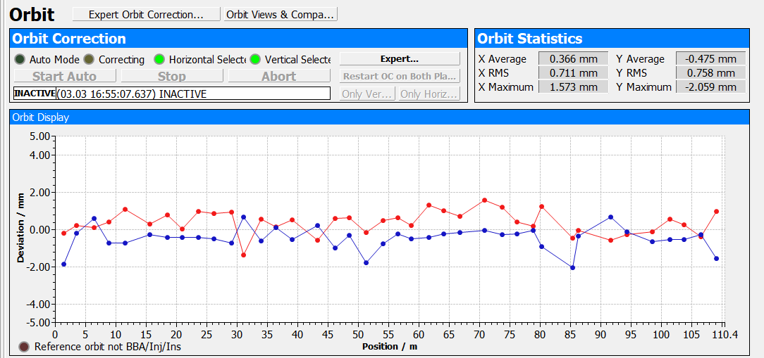
BPMs at KARA
Basic configuration … located at
up- and downstream of every separated bend
upstream of the Q1-Q2 doublet in the long straights
39 of 40 are integrated into the closed orbit measurement system now.
(1 BPM at the downstream of the second bend in sector-4 is not in operation)
BPM modules:
Libera Brilliance (i-Tech)

Slide 6
Corrector (Steering) Magnets at KARA
Location and total number: horizontal correctors
One upstream of the Q1-Q2 doublet
Two in one gap of the separated bends
One in the short straight
In total … 28 horizontal correctors
Location and total number: vertical correctors
One between the Q1-Q2 doublet
Two in the short straight
In total … 16 vertical correctors

Slide 7
Available Operation Energy at KARA
Available operation energy range: 0.5 – 2.5 GeV
Several typical operation beam energies:
0.5 GeV for injection
1.3 GeV for low-alpha & short bunch experiment (for CSR generation, etc.)
2.2 and 2.3 GeV for power-saving operation
2.5 GeV for normal user operation
Power-saving operation at 2.2 and 2.3 GeV
... One of two RF stations (klystrons) can be switched off.
*Two RF stations are needed for the 2.5 GeV operation.

Slide 8
Magnets at Energy-Saving Operation
Output current for each power supply of quadrupole families and bending magnet
Magnets | 2.2 GeV (A) | 2.3 GeV (A) | 2.5 GeV (A)
Q1 | 295 | 311 | 343
Q2 | 298 | 323 | 374
Q3 | 256 | 267 | 288
Q4 | 278 | 285 | 309
Q5 | 283 | 296 | 330
Bend | 551 | 583 | 664
A fascinating point:
Can the spatial offset of quadrupole magnets change in different operating energy modes?

Slide 9
Experiment 1: Beam-Based Alignment (BBA)
The purposes:
To measure special offsets of quadrupole magnets in different machine operation energy
Ideas (Christian will present them in detail)
BBA at 2.5 GeV operation in different beam currents (two klystrons)
BBA at 2.2 and 2.3 GeV (one klystron)
Measurement of lattice functions under the experimental conditions
BBA at 2.5 GeV by changing the temperature of cooling water (technically possible?)
Touch, disconnect and reconnect the BPM cables to see the effect on the measured beam position.
BBA by deactivation of sextupole magnets
BBA by change of the magnet-cycling procedure (ex. the number of cycling, warming-up time)

Slide 10
Experiment 2: System identification of the corrector magnets system
The purposes:
To measure the time response of the entire corrector magnet system (power supply, magnet, vacuum chamber, control system). This is relevant for FOFB (fast orbit feedback system).
Ideas (Günther will explain them in detail)
Kick the beam with a chosen corrector magnet using a step-function change
Observe the stored beam response using a fast (> 10 k Samples/sec) BPM.
Synchronization between the corrector kick and the beam orbit recording is relevant
(The synchronisation system is not yet ready for KARA, so this time we can only do some basic tests)

