Slide 1
Orbit Stability at BESSY II:
Progress of FOFB Upgrade and Current Stability
Günther Rehm, Danielle Melis Löhr, Pierre Schnizer, Ervis Suljoti,
Tobias Schneegans, Andreas Schälicke, Markus Ries
I.FAST Workshop 2025 on Stability of Storage Ring Based Light Sources, KIT
18 March 2025
Challenges
on mature
machines

Slide 2
Overview
Introduction of BESSY II and existing FOFB
Plan and Progress on Transition to new FOFB
Current Orbit Stability Challenges
Outlook

Slide 3
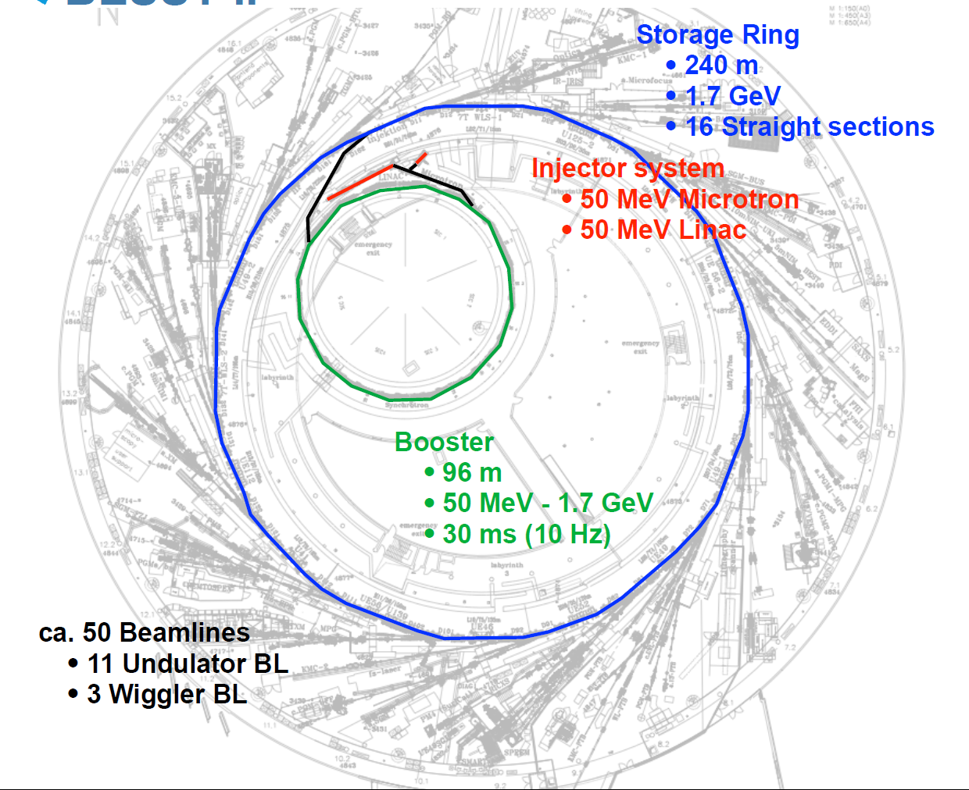
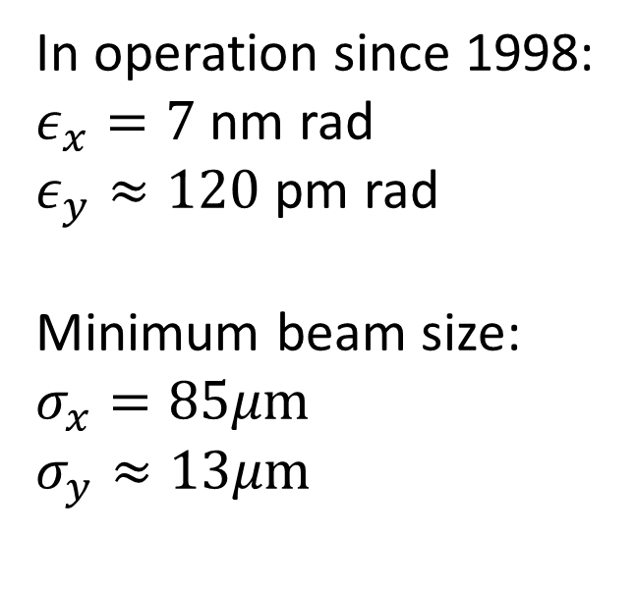
BESSY II
In operation since 1998:
$ε_{x}=7$nm rad
$ε_{y}≈120$ pm rad
Minimum beam size:
$$σ_{x}=85μm$$
$$σ_{y}≈13μm$$
2

Slide 4
ORBIT Feedback Performance
Beam
Analogue Processing
Conversion to Digital
Transfer to Central
Orbit Correction Calculation
BPM
Pickup
Digital Processing
Transfer to Correctors
Apply Kicks
Two main parameters influence all feedbacks
  Compound low pass bandwidth (filters in BPMs, corrector PSU, magnets, vessel)
  Latency (group delay in filters, transport, digital processing)
Bandwidth needs to be maximised
  Vessel and magnets cannot be changed
  PSU are fast enough
Latency needs to be minimised
  Increase in sample speed required for reduction of group delay
  Reduce transport delays by using high speed protocols
Conceptual orbit feedback loop: Forwarding changes
between E and B fields as well as electrical and digital signals

Slide 5
NEW Orbit Feedback FOR BESSY-II
Re-use corrector PSU, magnets, vessel
Conservative estimate 500 Hz LP, TBC
Existing feedback has latency of 6.6 ms
  1.6 ms in BPMs (multiplexing/averaging)
  2 ms in calculation and global transport
  3 ms in application of corrector values through CAN-bus
Potential for latency reduction
  BPMs with 0.2 ms @ 10 kHz sample rate
  Calculation and transport in 0.1 ms
  Distribution of corrector values in 0.1 ms
  Use UDP to and from calculation
Simulation using Internal Model Controller: closed loop response
of existing and future orbit feedback shows >8 times improvement
of disturbance suppression

Slide 6
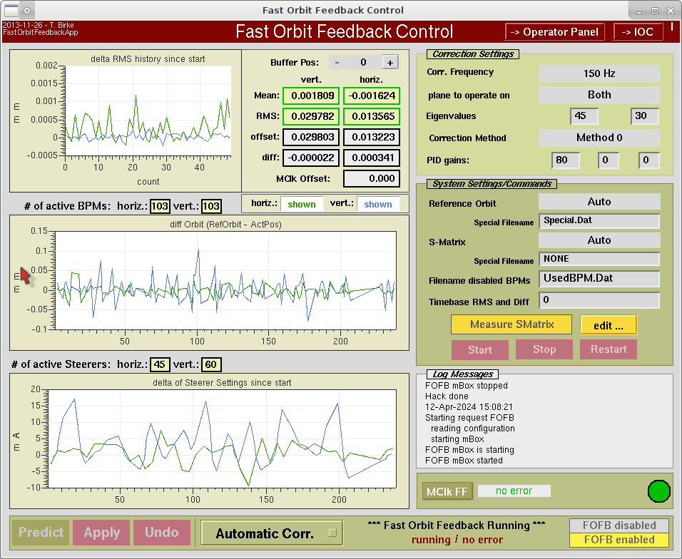
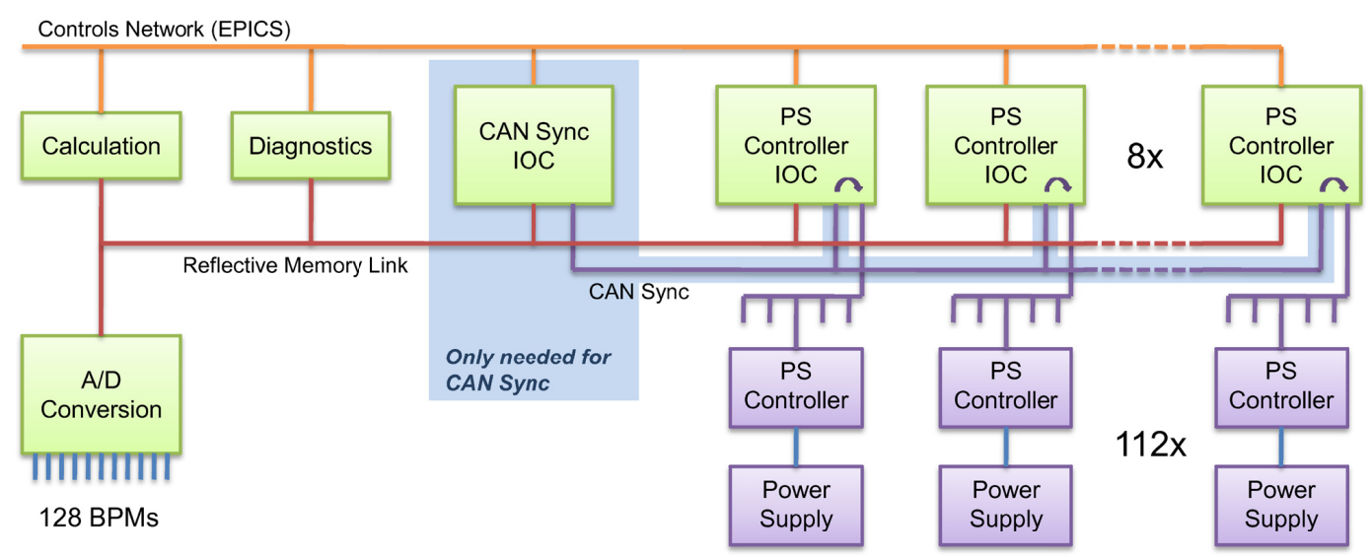
Existing FAST Orbit FEedback
In operation since 2012
Runs at 150 Hz update rate, limited by large latency
Reflective memory for BPM and corrector data
Continue use during transition
Replace after transition

Slide 7
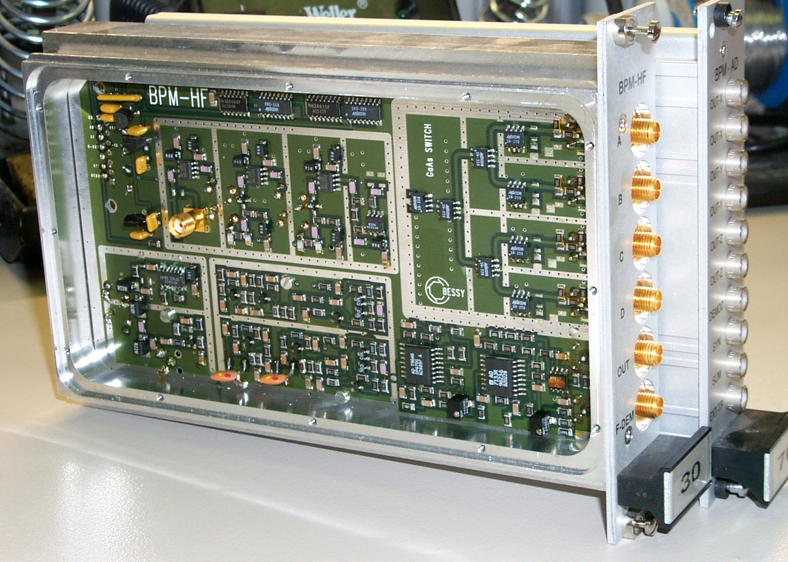
Existing BPM Electronics
Original BESSY II BPMs:
  Single channel multiplexing
  Analogue processing of X,Y and S
  1kHz analogue output bandwidth
  Double Digitisation in VME
    Local ADCs for EPICS @ 0.5Hz
    Global ADCs for FOFB @ 150Hz
Issues:
  EMI issues on FOFB signals
  Drifts between ADCs
  LO drift , causing low IF signal
  No spare parts
  TbT not usuable
  Beam current dependance >1mm on some units
  BPM-HF and BPM-AD, mid-1990s in-house design and build

Slide 8
BPM and Orbit Feedback Upgrade Plan
Install new BPMs cell by cell
  Operate SOFB (0.5Hz) and FOFB (150Hz) with hybrid BPM population
  Need to produce relevant data at original rates and in sync
Replace old SOFB with new (Python) routine
  Headless server, communicates with users solely through EPICS
  Will also be able to communicate with new FOFB
Replace old FOFB with new routine using FA data at full rate
  Transfer to compuational node through GBE and 10 GBE
  GBE Receiver for cell corrector values produces DAC values for PSU

Slide 9
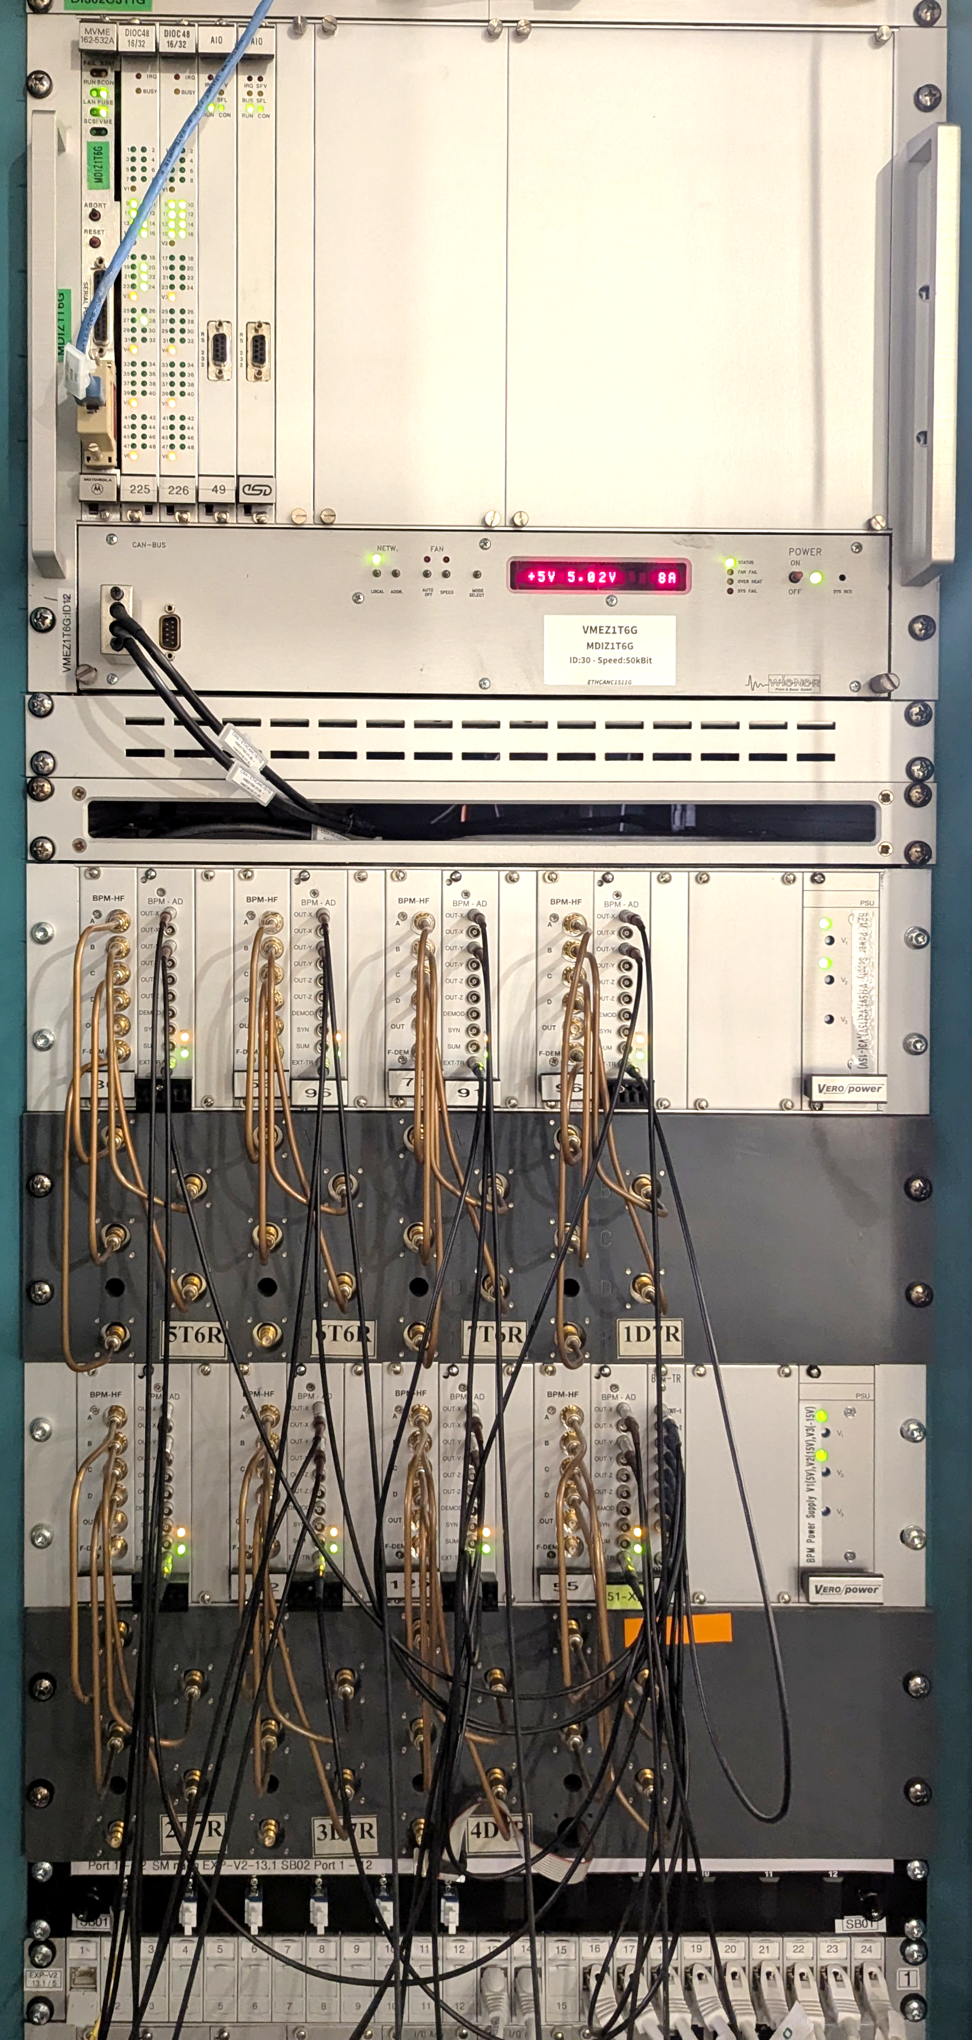
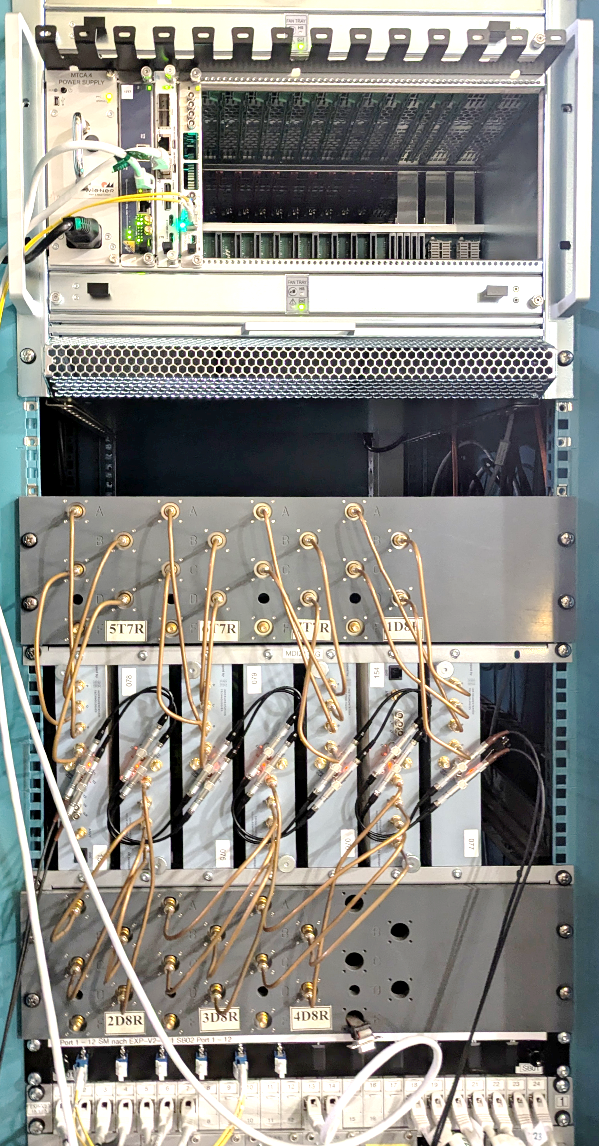
Transitioning From old to new BPM Electronics
Analogue multiplexing BPMs:
-> digital BPMs
VME with ADCs and control logic:
-> MTCA with event receiver for distributed timing
One cell can be completed in one day
3 of 16 cells completed now

Slide 10


new BPMs and Hybrid Orbit Feedback (Current State)
MicroTCA Crate (one per cell)
Fast Concentrator
PCIe
IRQ@
150Hz
EPICS
AMC CPU with Linux
Events
on fibre
Event Receiver
Sync via EPICS
Via cables
EPICS
Software
Cell Concentrator
Block Averager
trigger
revolution clock
Positions @0.5Hz
for old SOFB
SA 10Hz
Libera Spark
Slow Concentrator
Libera Spark
Sync from EVR
…
Software
Cell Concentrator
Block Averager
Positions @150Hz
for old FOFB
Libera Spark
FA 10kHz
Fast Concentrator

Slide 11
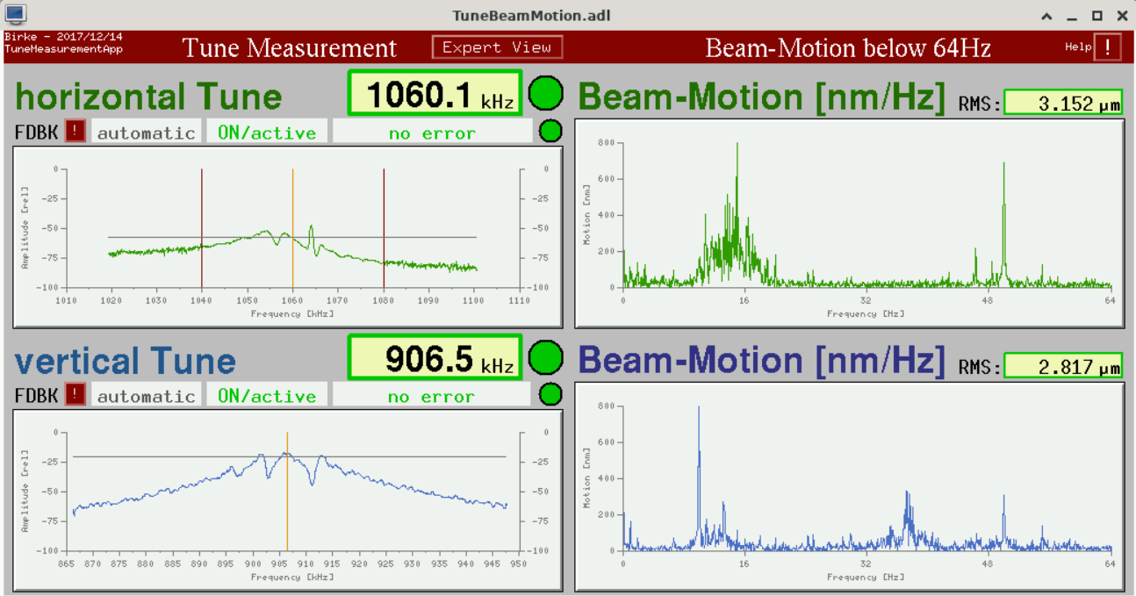
Orbit Stability MOnitoring
Always on Control Room Display
Generated from analogue BPMs
with postprocessing in LabView
Motion spectra and RMS (up to 1kHz)
integrate over 15s
Numerical values are alarmed
Spectra and values are archieved
Since 2021 recording of 10kS/s
data from one BPM using fa-archiver

Slide 12
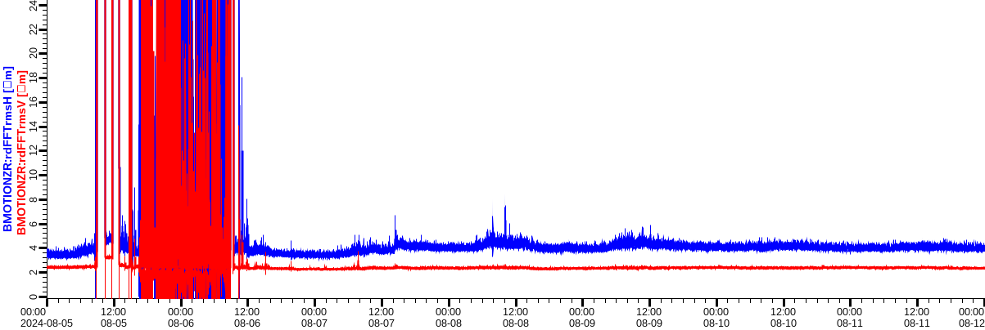
Orbit Stability Monitoring (typical week)
Monday Beam off and commisioining
Daytime Mo-Fr more noise
Weekend quiet
Just a few spikes

Slide 13
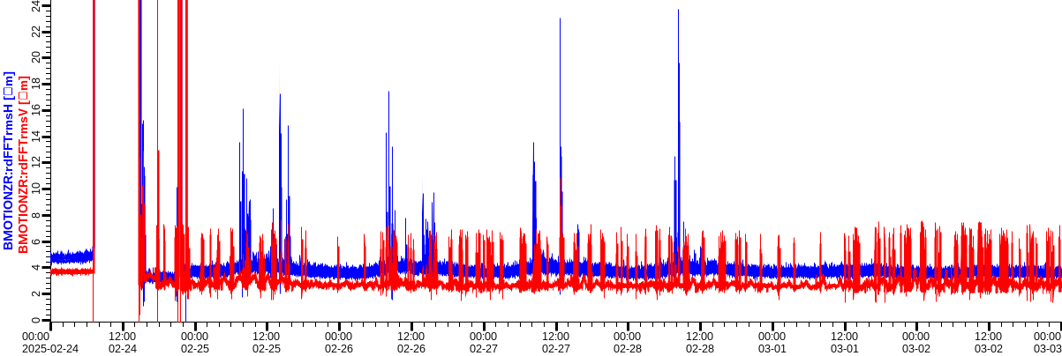
Orbit Stability Monitoring (Poor week)
Occasional huge horizontal motion
  only on weekdays/daytime
Vertical motion is on/off
  Irregular repetition
  All the time

Slide 14
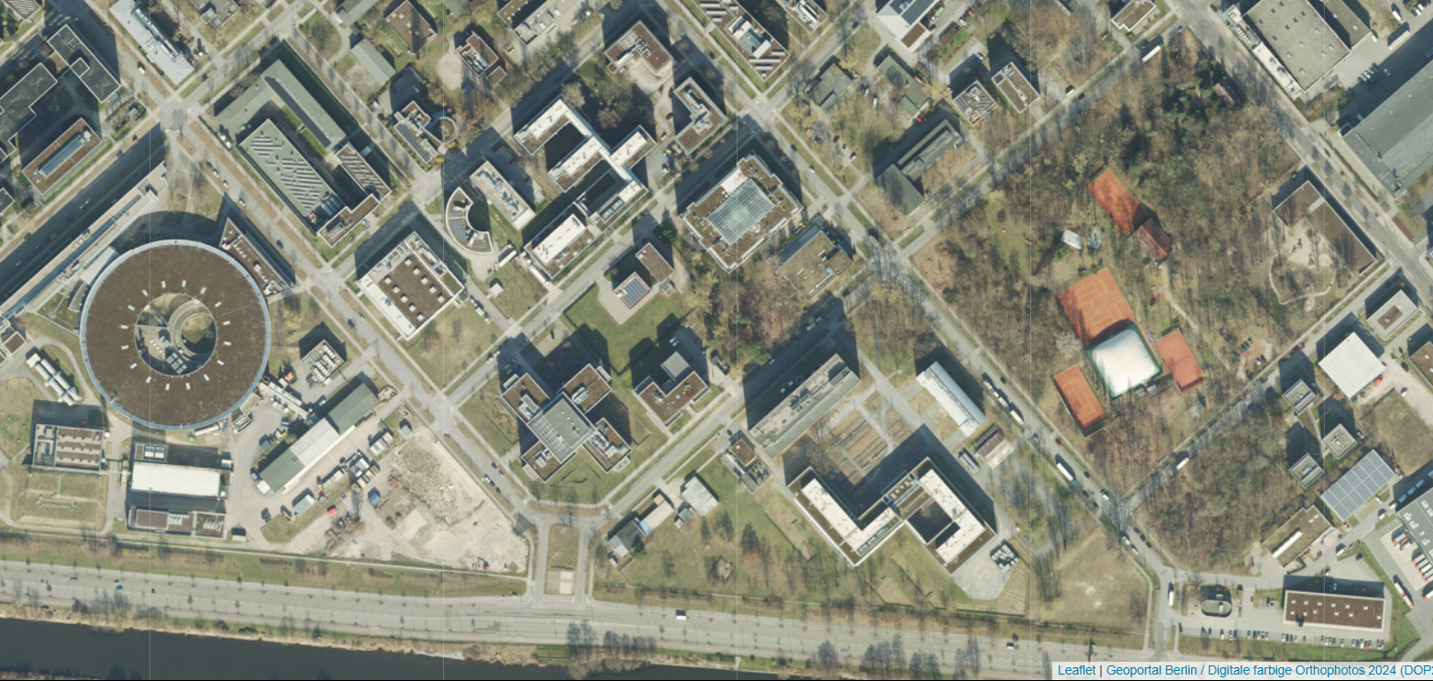
The EASY one, OLD News:
Horizontal Motion caused by Building Works
Planned
BESSY III
BESSY II
building

Slide 15
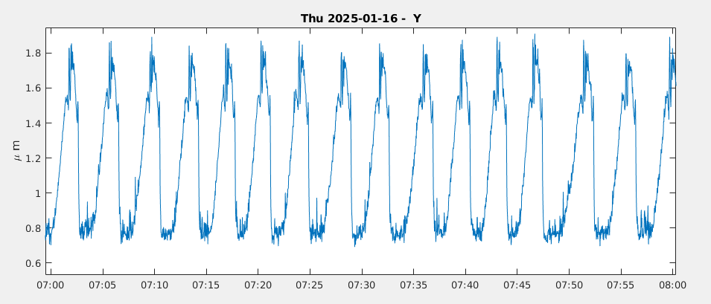
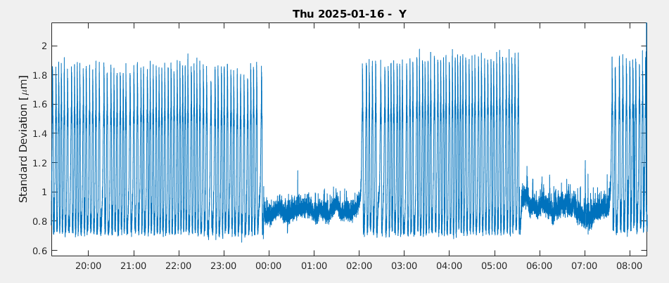
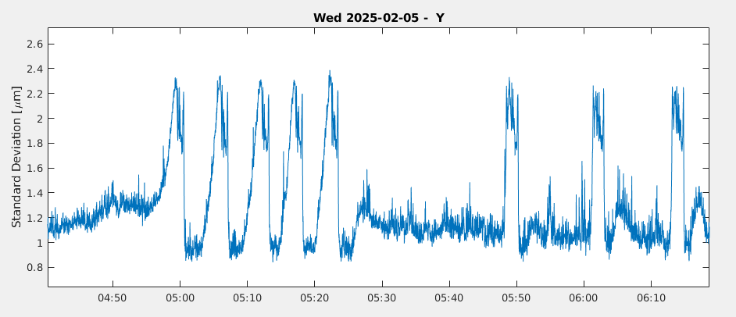
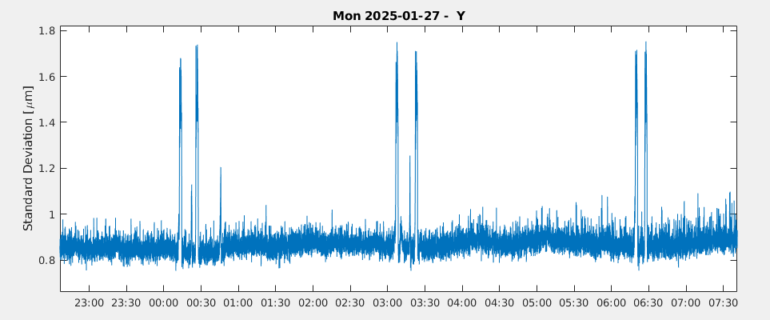
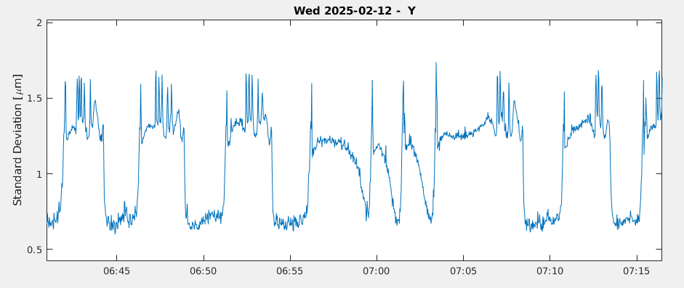
Strange and changing Dynamics of Vertical Motion on FA-Archiver
Initially every 3-4min
Ocassional gaps
Changes in shape
Nearly gone
Different behaviour
with longer bunches

Slide 16
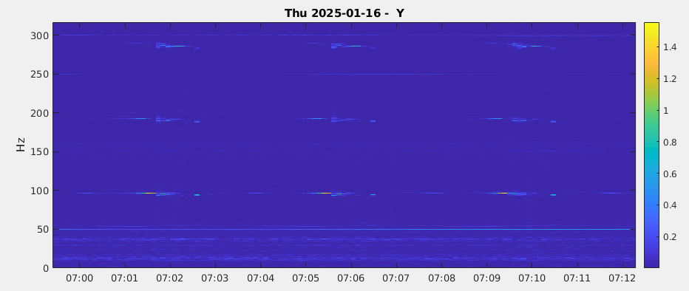
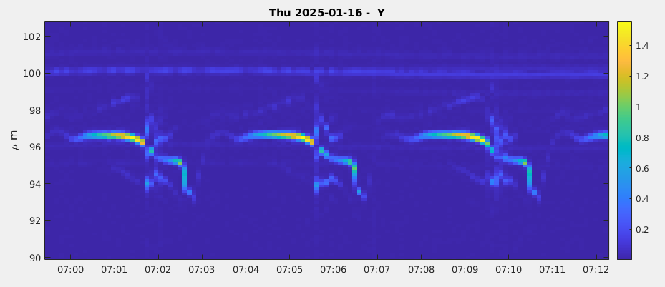
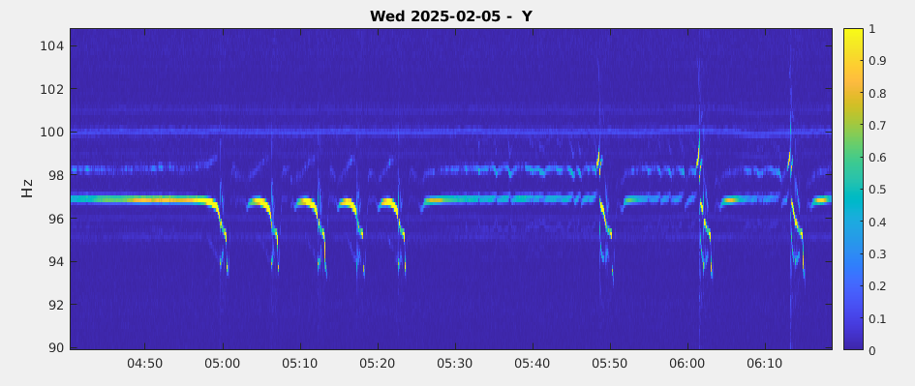
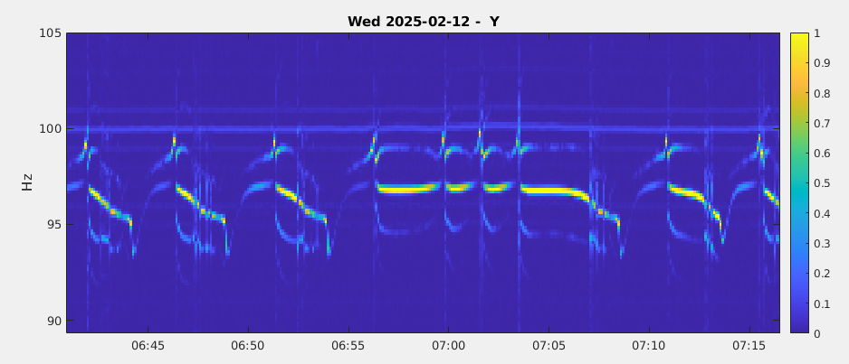
SpectroGrams Calculated from Fa-Archiver data
Power near 95Hz and
harmonics
Repeated spectral
fingerprint
Spectra correlate with
temporal behavior
Different for longer
bunches

Slide 17
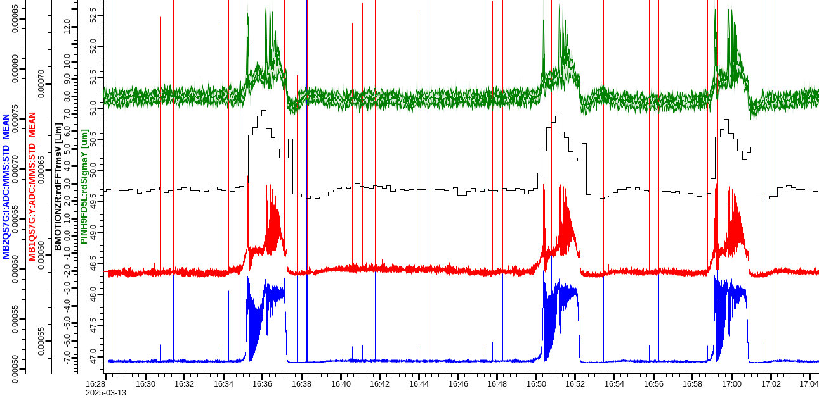
Vertical Motion on pinhole Camera, BPM, BBB vertical and Longitudinal
Pinhole:
vertical
beam size
BPM:
vertical
FFT-RMS
BbB:
vertical
bunch
motion
BbB:
long.
bunch
motion

Slide 18
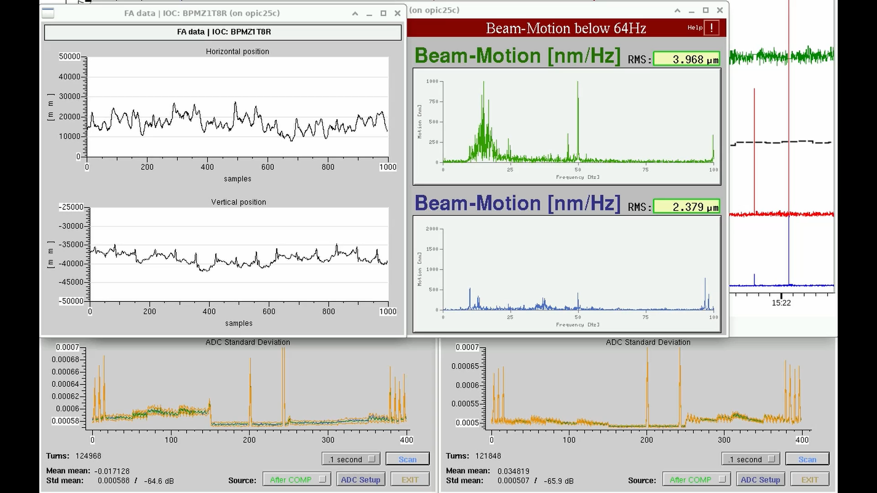
Multimedia Experience

Slide 19
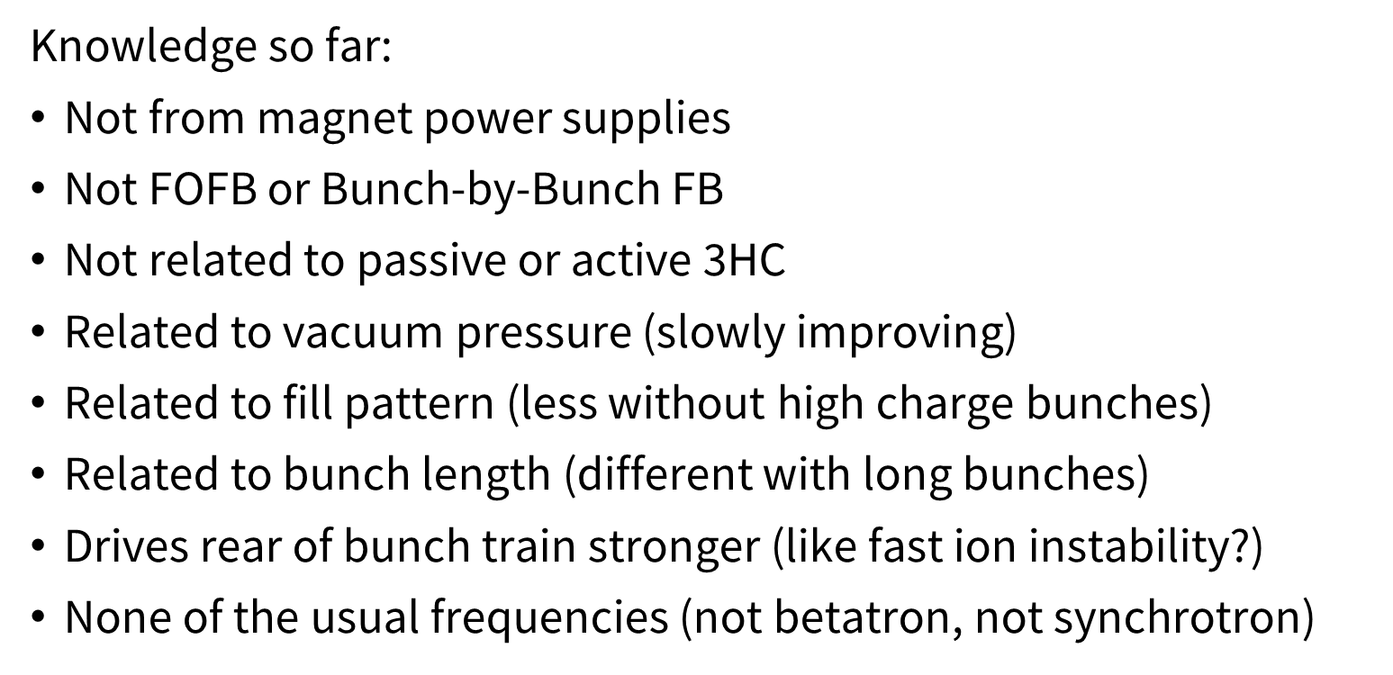
The mysterious VerTICAL Motion at 95Hz

Slide 20
Summary
FOFB upgrade making progress
Hybrid FOFB operation works well
UDP/DAC procurement and integration
Hope for improvement of vertical motion with vessel exchange

Slide 21

Thank you for your attention!
Questions! Comments! Advice!
c

Slide 22
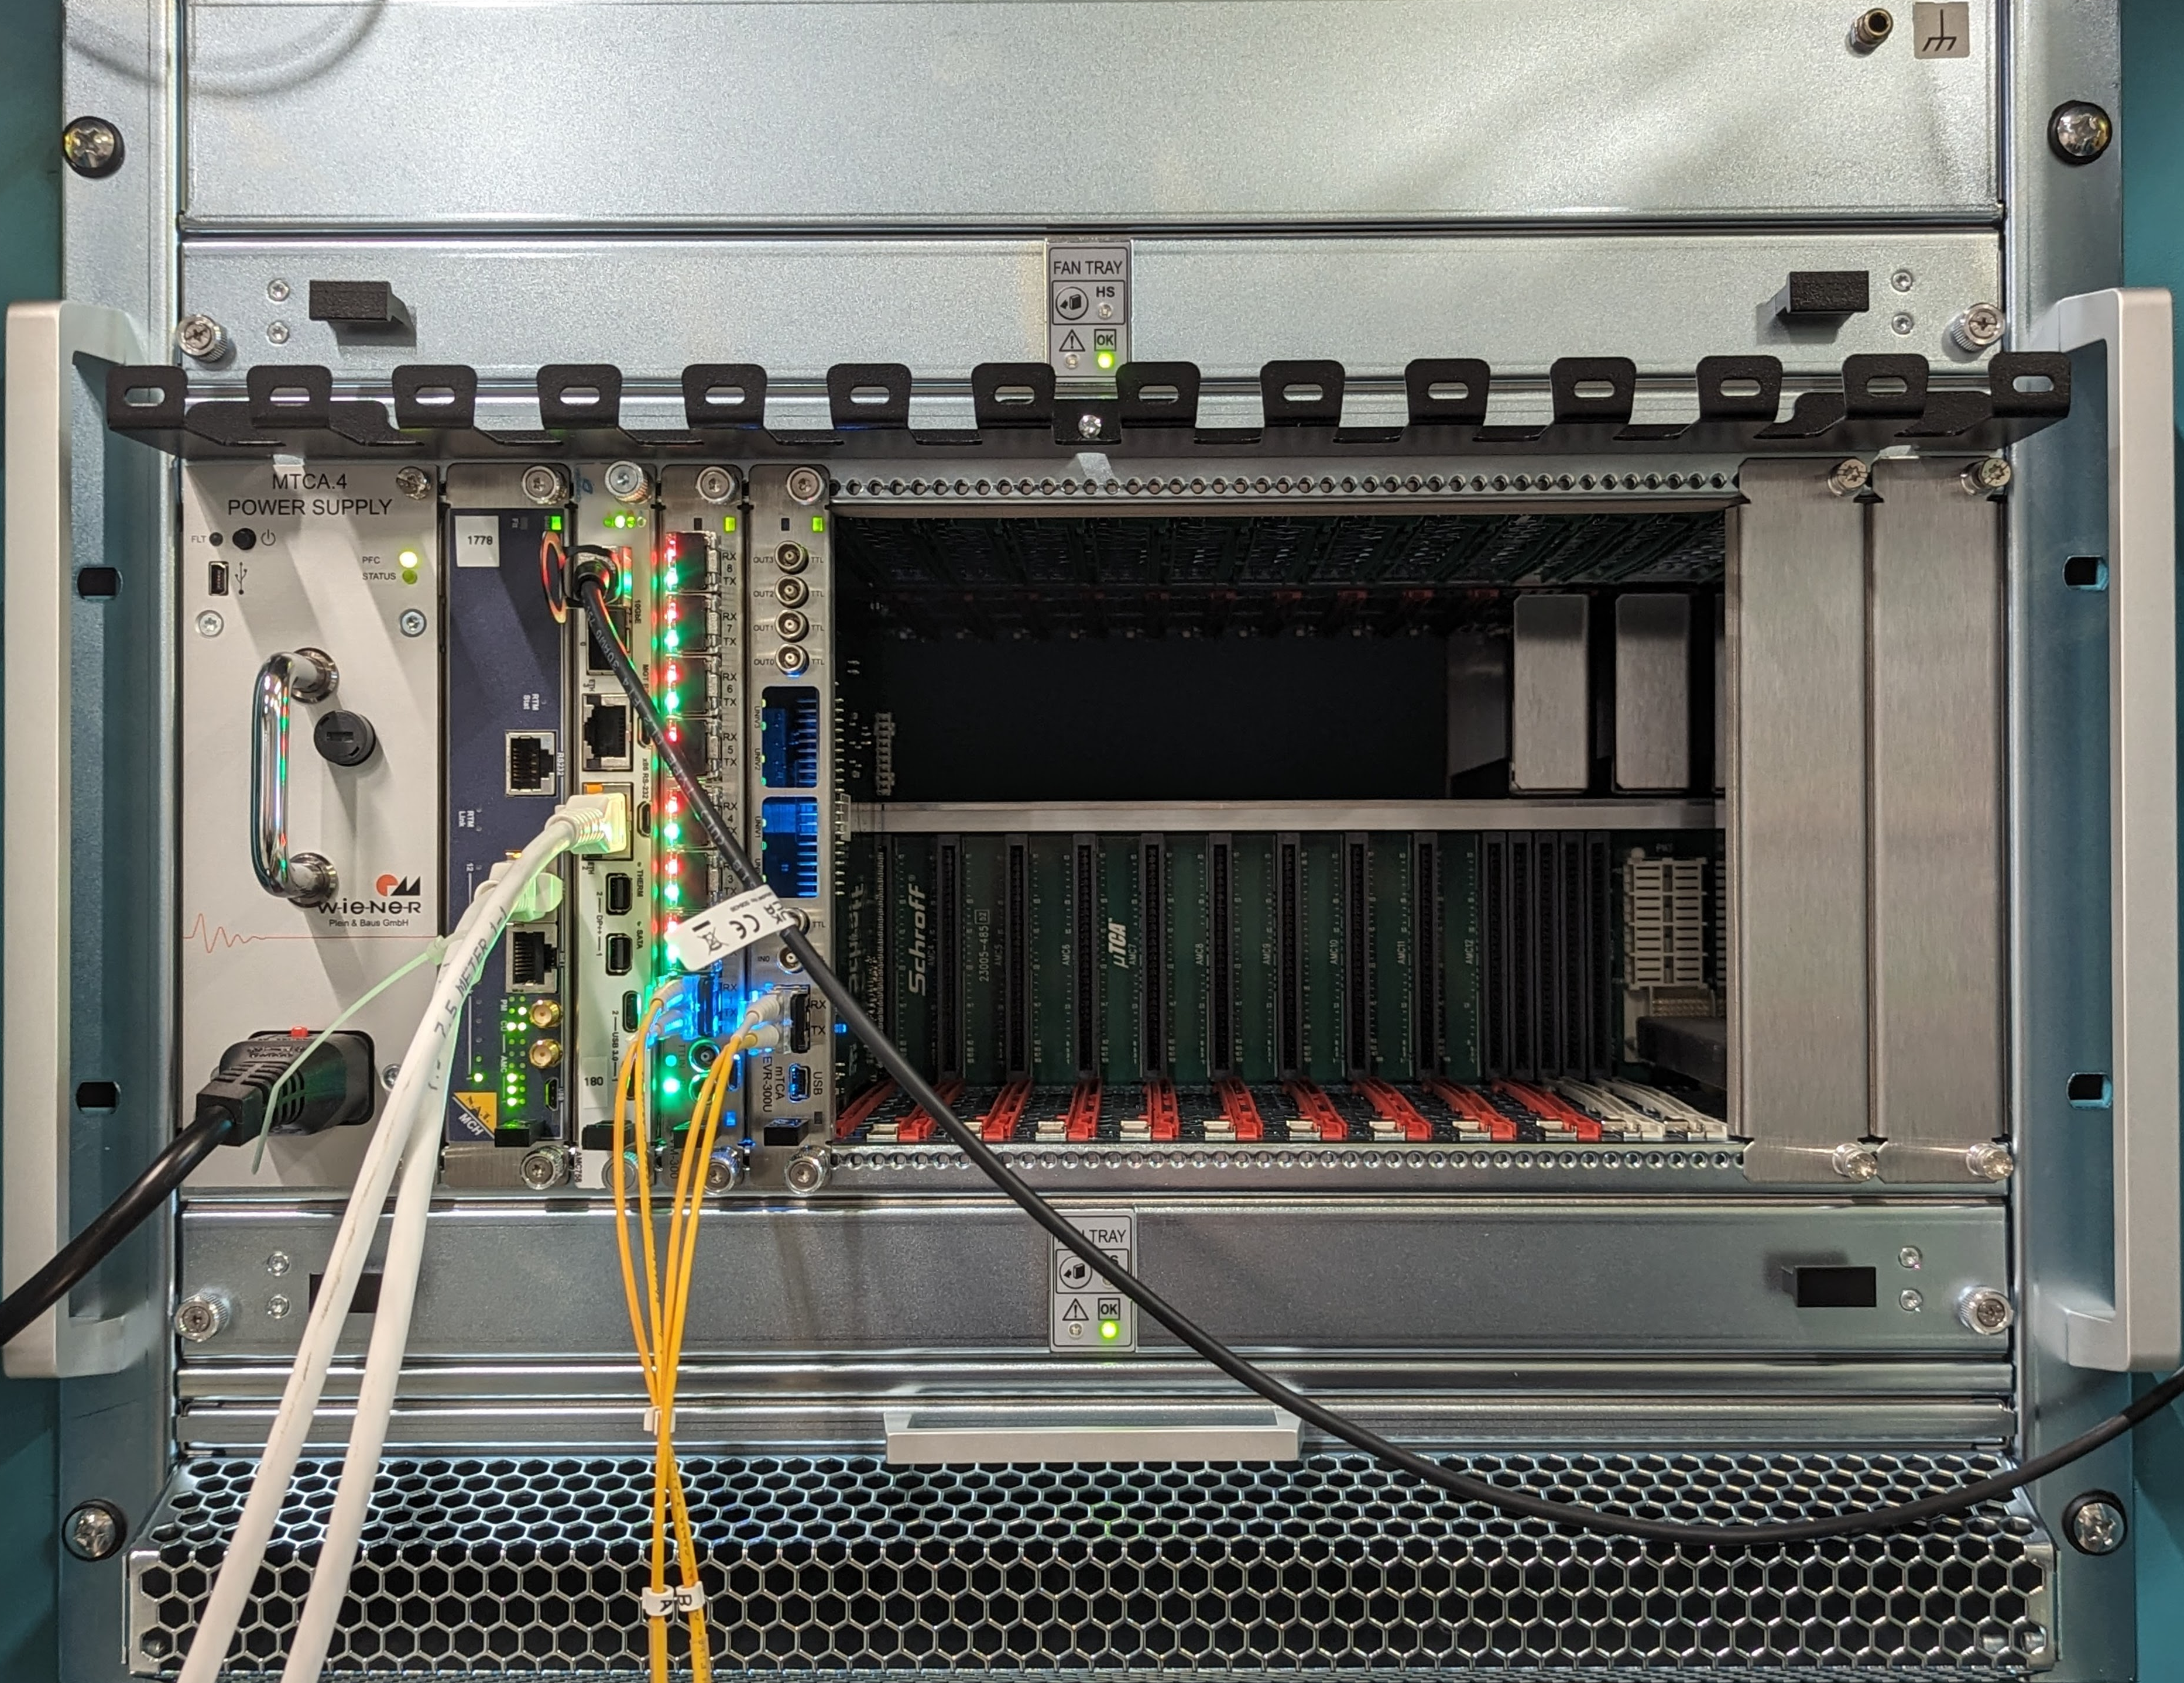
FAST CONCENTRATOR USING Low-Latency Tuned Linux
MTCA, AMC-CPU with 4 core Xeon, MRF-EVG/EVR
Three cells of UDP FA packets received in CPU
Incoming data on 10GBE from three switches
Outgoing on 1GBE, parallel with EPICS
EVR near old FOFB produces upstream event
EVG distributes 150Hz event rate
EVR here receives event, fires PCIe interrupt on CPU
On interrupt, all received FA packets are averaged
New UDP packet sent in compressed format forward to FOFB compute node
Processing 213150 FA/s into 150 orbit vectors/s
Uses 26% of one core
EVG
CPU
EVR
10GBE
1GBE

Slide 23
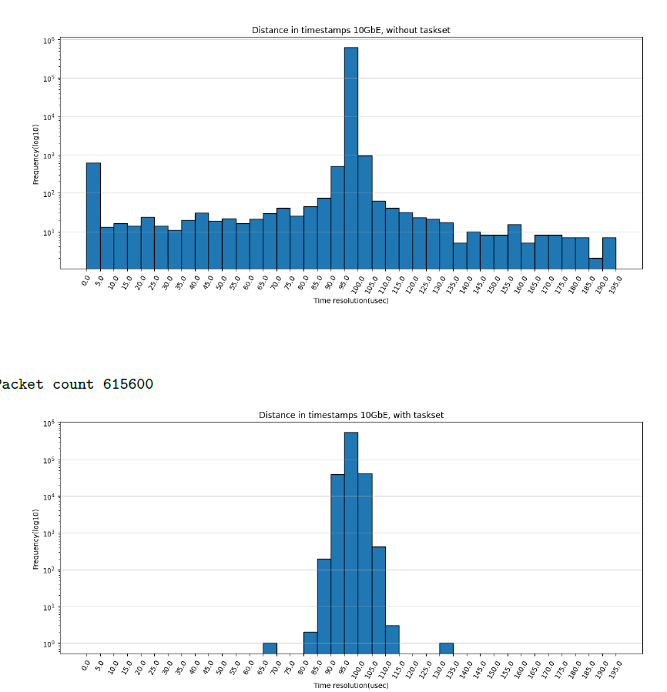
FAST CONCENTRATOR USING Low-Latency Tuned Linux
Standard Linux tuned using boot parametes and run-time configuration
Working with standard debian
Verified by timestamping using monotonic clock
No significant impact of 24port GBE Switch

Slide 24

FOFB Structure
Cell1
Cell16
Cell2
Cell15
Cell3
7-8 BPMs in each cell
BPMs produce packets synchronously at 10 kHz
Minimum ethernet packet size is 512 bits
First layer GbE switch will receive data from 8 BPMs within 0.5 µs and forward within 4 µs
Second layer switch will collect data from first layer and forward to central node on 10 GbE, time for 32 BPMs should be ~1.6 µs
Central node computes orbit correction
Corrector set points sent in one broadcast packet
Broadcast received in one DAC per cell
Differential analogue connection to existing corrector PSU
Cell14
Cell4
Cell13
Cell5
Cell12
Cell6
Cell11
Cell7
Cell10
Cell8
Cell9
Overall structure for FOFB 2.0 at BESSY II has 16 cells with 7-8 BPMs each. Data from each cell is sent to the central processing node through a second layer of switches

Slide 25
NETWORK to DAC Prototype
Supplier demonstrated ADC->network->DAC
Whole setup achieved <20 µs latency
No jitter in transmitter/receiver
Minimal jitter in switch, rarely long delays
Firmware could be modified to receive one
large broadcast packet per time slot
and apply values to DACs

Slide 26
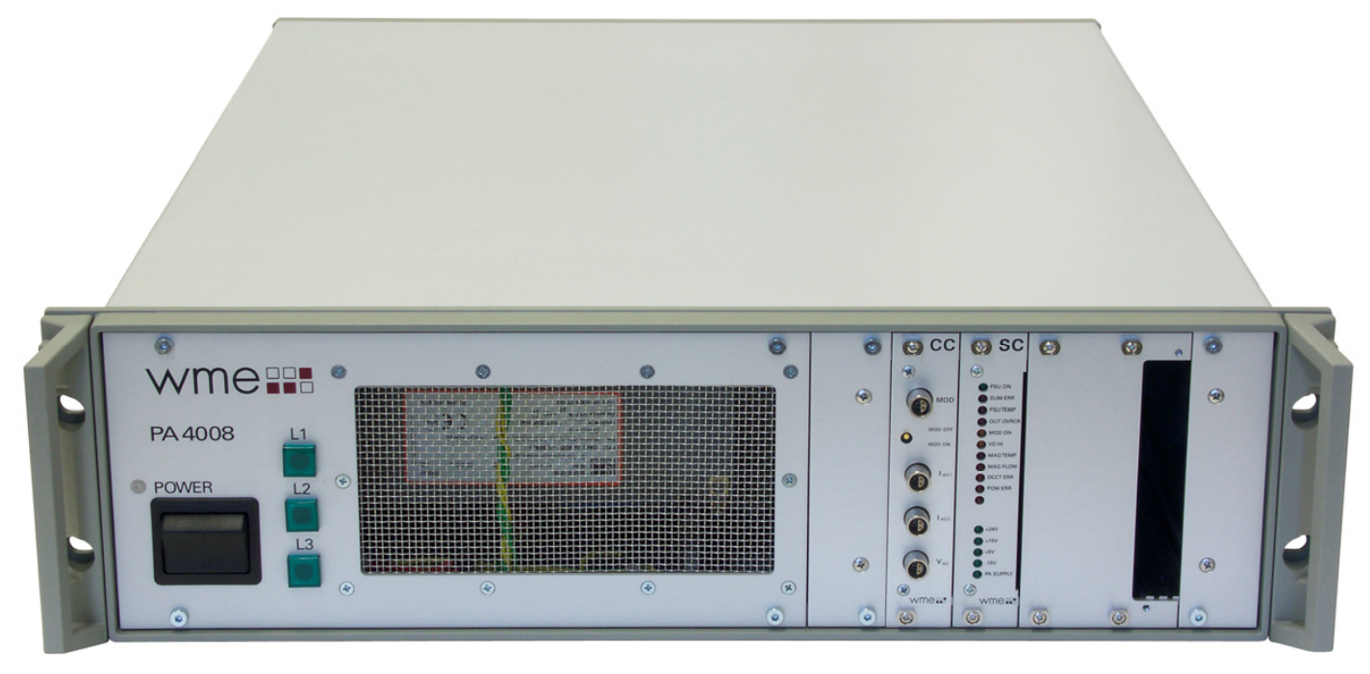
Corrector Power Supply with FAST Analogue Input
Will keep power supplies, magnets and vessel
Use analogue differential input for fast correction
CAN-bus used in the past will remain
  Use for status readback
  Use for SOFB and FOFB starting points
  Both values are internally added
Good EMI immunity in tests
  With floating differential output from DAC
Future differential
analogue input
upto 1000Hz
Old input
through
CAN-bus
max 150 Hz

Slide 27
Power supply Transfer Function:
Input Voltage to Output Current with real corrector Magnet as load

