Slide 1
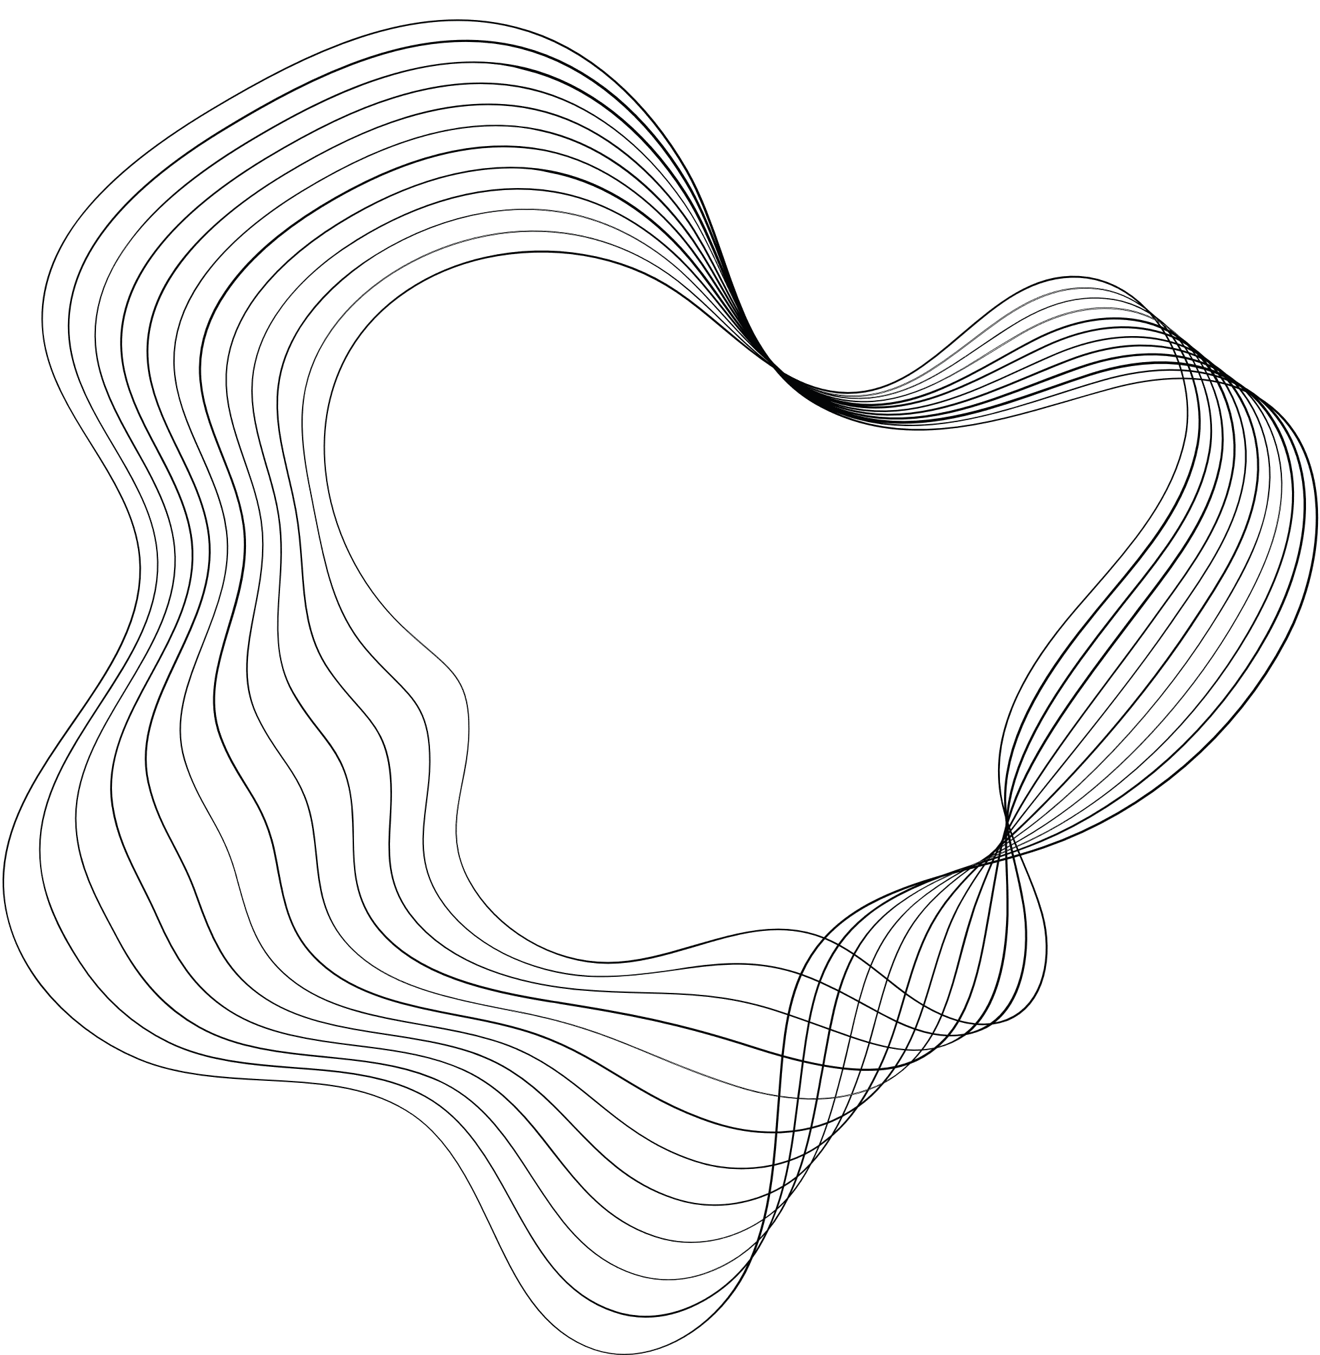




DEPARTMENT OF ELECTRICAL, ELECTRONIC, AND COMPUTER ENGINEERING
DEVELOPMENT OF A CONTROL SYSTEM FOR THE STABILIZATION OF SYNCHROTRON X-RAY BEAMS
NICCOLÒ LA ROSA
ENG. SAMUELE MOSCATO
PROF. MAIDE BUCOLO
DR. MASSIMO CAMARDA
PhD in Energy, Computer and Telecommunications Systems Engineering

Slide 2
TABLE OF CONTENTS
SYNCHROTRON CONTROL SYSTEMS OVERVIEW #1
LAB- REPLICA #2
OPEN-LOOP SYSTEM #3
  IDENTIFICATION OF THE PROCESS MODEL
CLOSED-LOOP CONTROL SYTEM WITHOUT DISTURBANCE #4
  PID TUNING
CLOSED-LOOP CONTROL SYSTEM WITH DISTURBANCE #5
  EXPERIMENTAL RESULTS
CONCLUSIONS AND OUTLOOKS #6

Slide 3
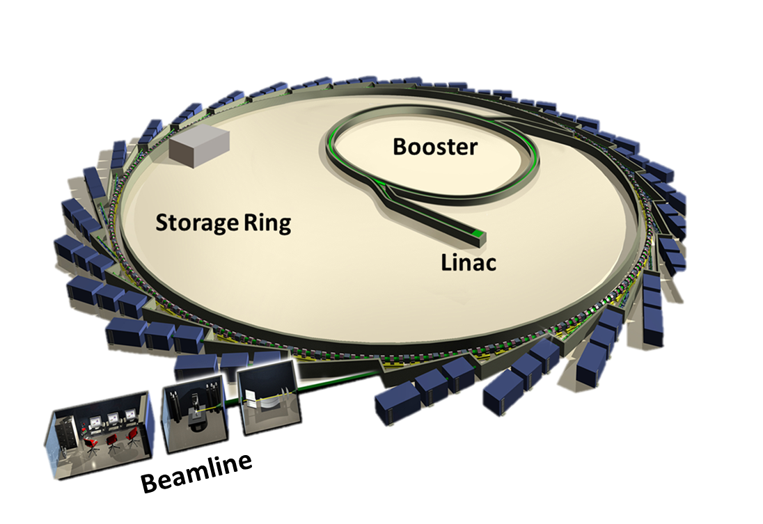
#1
CONTROL OVERVIEW

Slide 4
#1
CONTROL OVERVIEW
ORBIT FEEDBACK SYSTEM (GOFB)
SLOW ORBIT FEEDBACK SYSTEM
FAST ORBIT FEEDBACK SYSTEM
(SOFB)
(FOFB)
BEAMLINE CONTROL SYSTEM

Slide 5

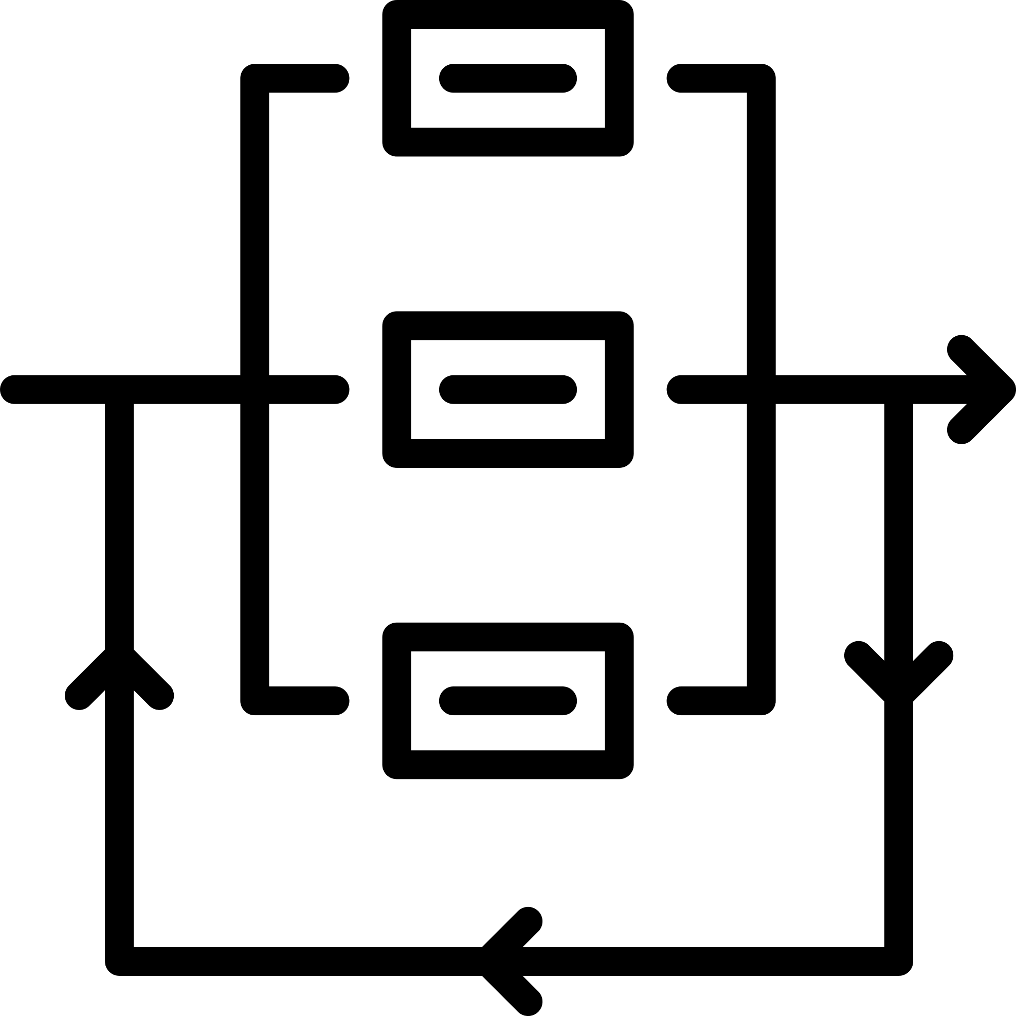
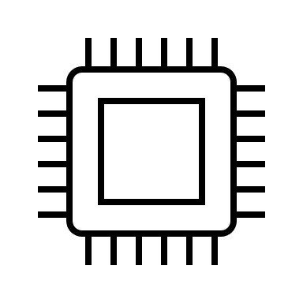

#1
CONTROL OVERVIEW
ORBIT FEEDBACK SYSTEM (GOFB)
BEAMLINE CONTROL SYSTEM
Electron beam stabilization
Radiation beam stabilization
Closed Loop Gain Bandwidth ≈ 300 Hz
Closed Loop Gain Bandwidth < 10 Hz
FPGA Based Architecture
Software Based Architecture (Tango – EPICS ecc..)
Monitoring and real time data acquisition

Slide 6
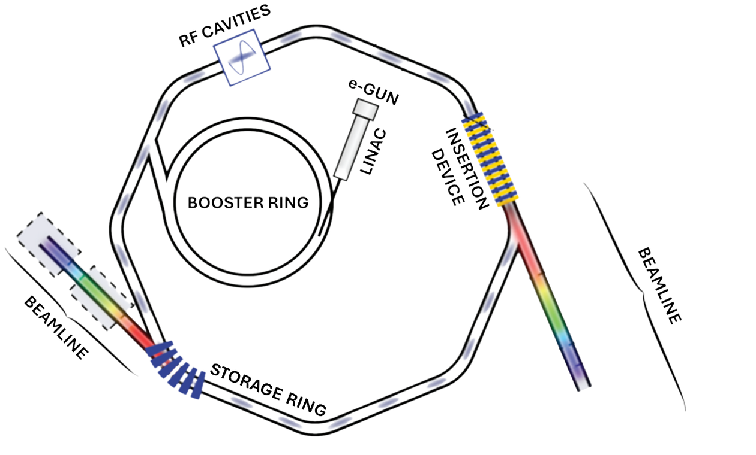
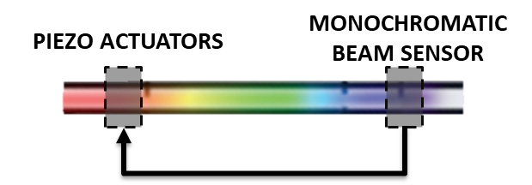
#1
CONTROL OVERVIEW
Mechanical Actuation

Slide 7
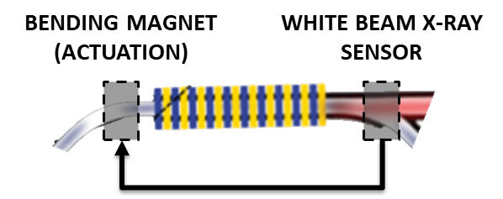
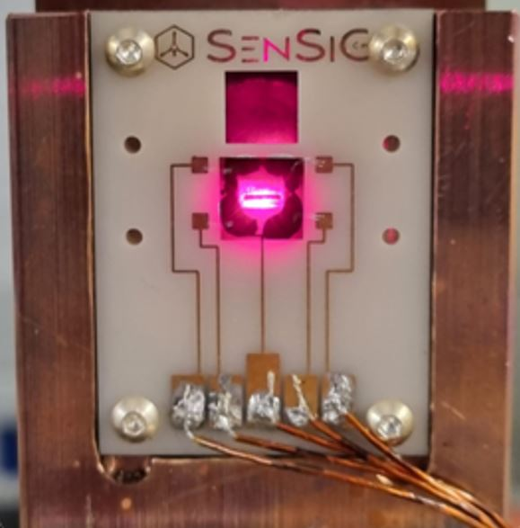
#1
CONTROL OVERVIEW
Electrical Actuation
INSERTION DEVICE

Slide 8
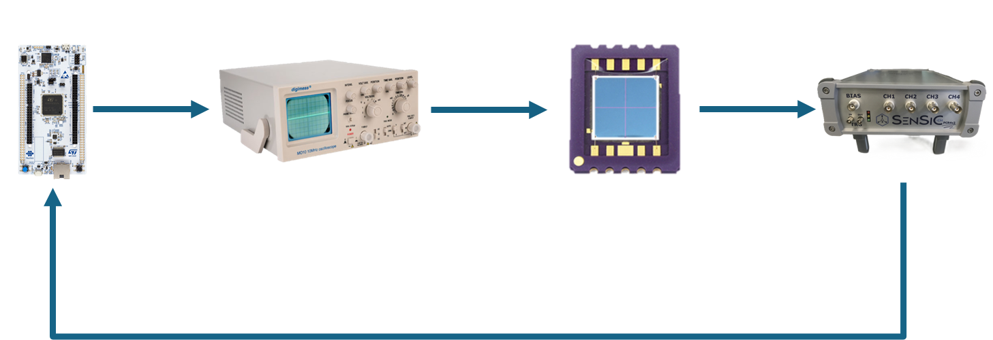
#1
CONTROL OVERVIEW
Electrical Actuation
INSERTION DEVICE
ACTUATION
+
CONTROL
BEAM SOURCE
SENSING

Slide 9
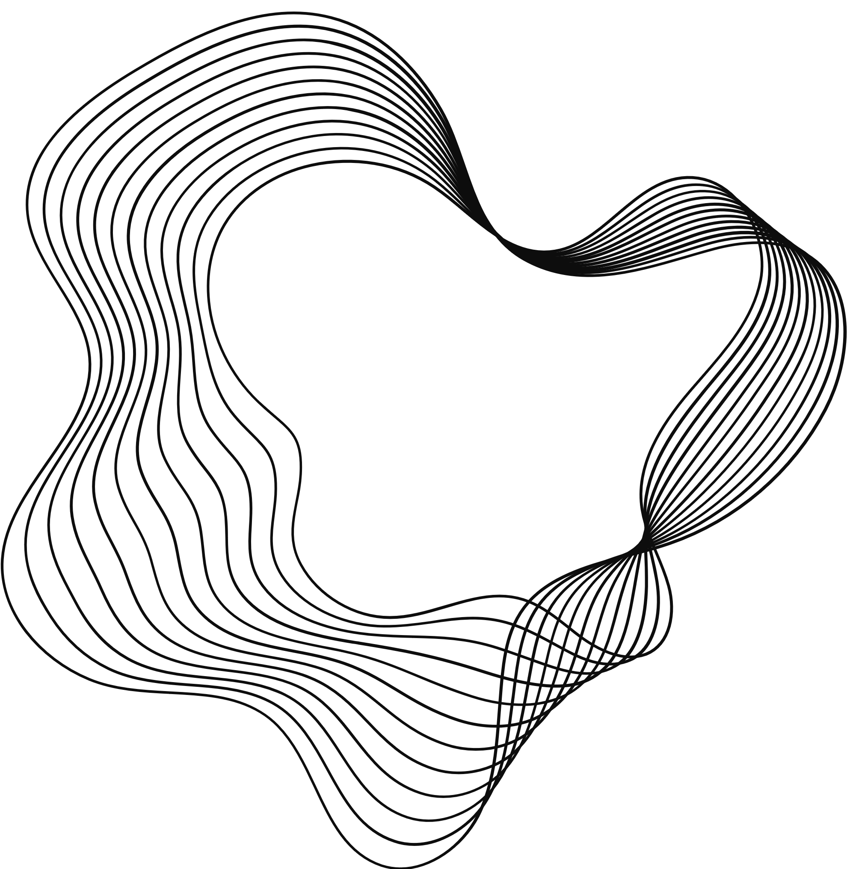
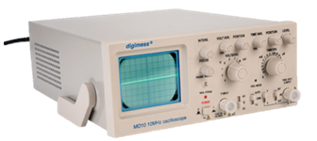
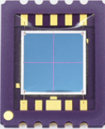
LAB-REPLICA
#2
Analog Oscilloscope
  Generates an electron beam thanks to the Cathodic Ray Tube (CRT).
  Sensitive to magnetic fields (used for disturbance).
  Sensitive to electric fields (used for actuation).
Hamamatsu S5980
  2 X 2 matrix of photodiodes.
  Visible-light sensitive.
  Structurally Equivalent to the state-of-art sensors (like SenSiC ones, but in Silicon and non-transparent..)

Slide 10
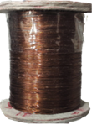
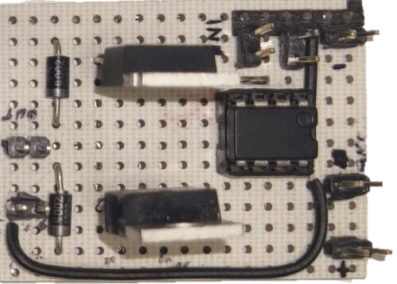
LAB-REPLICA
#2
Electromagnet
  Disturbance source.
  Generates a magnetic field which deflects the beam inside the CRT.
Buffer Amplifier
  Decoupling effect.
  Allows to supply the electromagnets, avoiding overload risks.

Slide 11
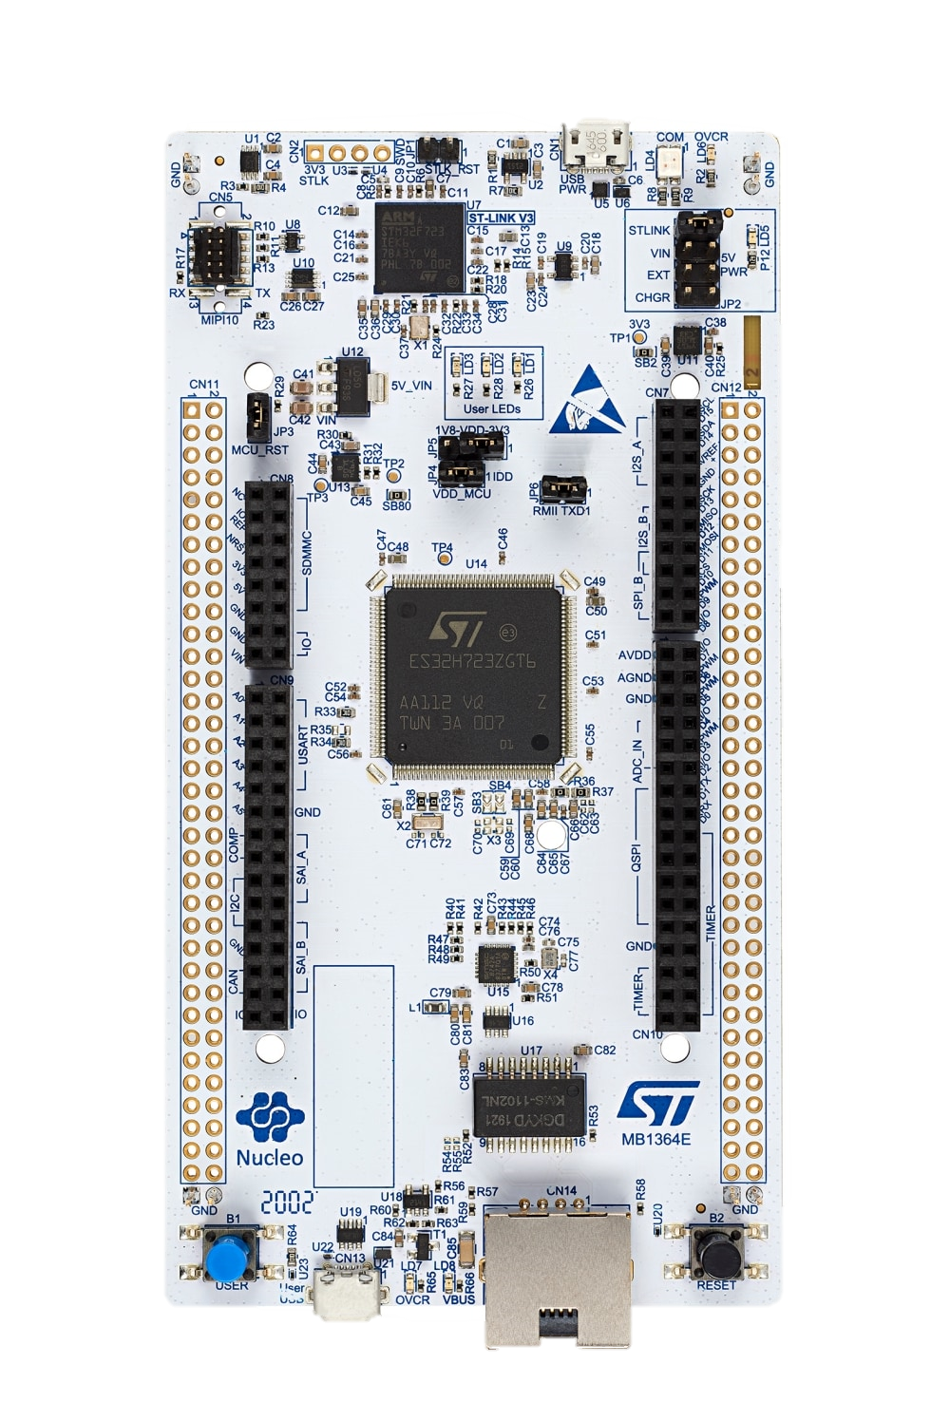
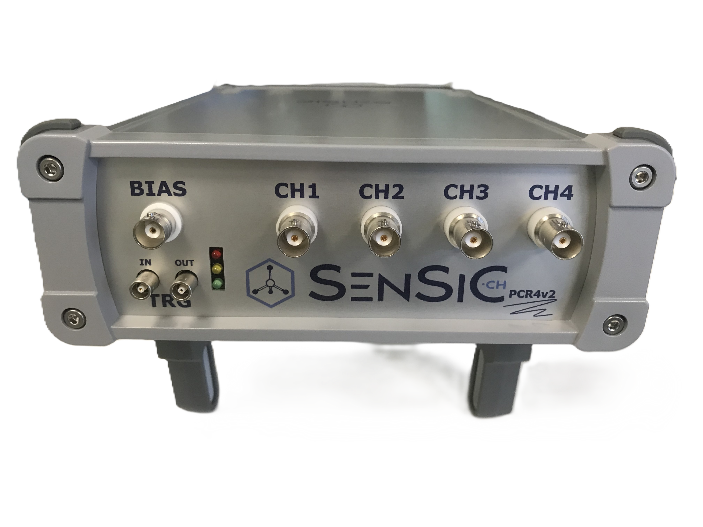
LAB-REPLICA
#2
STM32 NUCLEO-H723ZG
  Two Digital-to-analog converters (DACs).
  Ensures a higher data exchange rate through SPI protocol.
PCR4
  4-channel with 24-bit of resolution and sampling rate up to 54 kHz.
  Nominal resolution of 3fA in the range of ±25 nA.

Slide 12
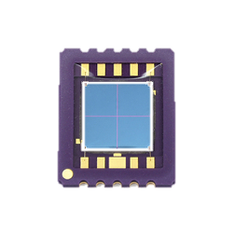

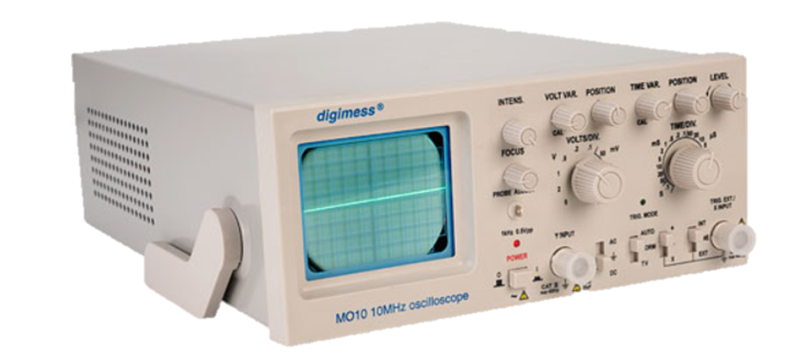





#3
OPEN-LOOP REPLICA SYSTEM
$$V\left(t,x,y\right)$$
$$s\left(t,x,y\right)$$
$$I_{ph,i}(t)$$
$$V_{ph,i}(t)$$
TRIGGER

Slide 13
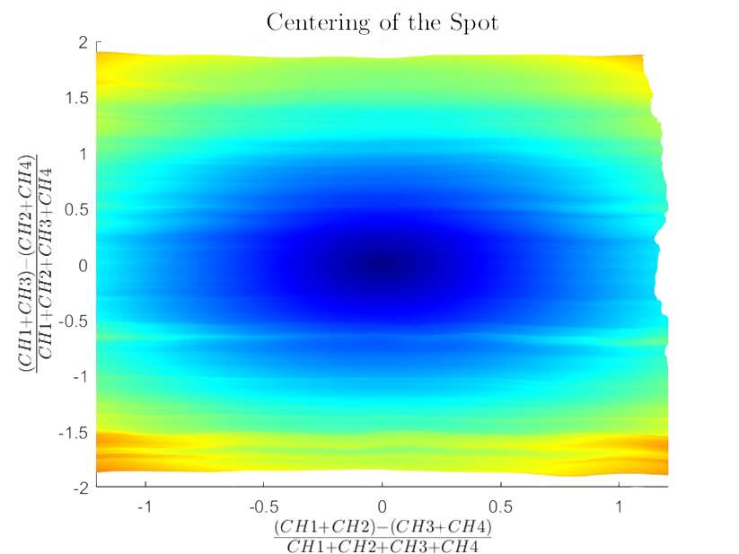
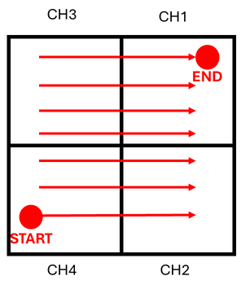
#3
EXPERIMENTAL PROCESS IDENTIFICATION
Steady-State Analysis

Slide 14
#3
EXPERIMENTAL PROCESS IDENTIFICATION
Steady-State Analysis

Slide 15

#3
EXPERIMENTAL PROCESS IDENTIFICATION
Transient Analysis
Latency
860 μs
$$P\left(s\right)= \frac{1.076}{1+4.79∙{10}^{−4}s}e^{−8.6∙{10}^{−4}s}$$

Slide 16
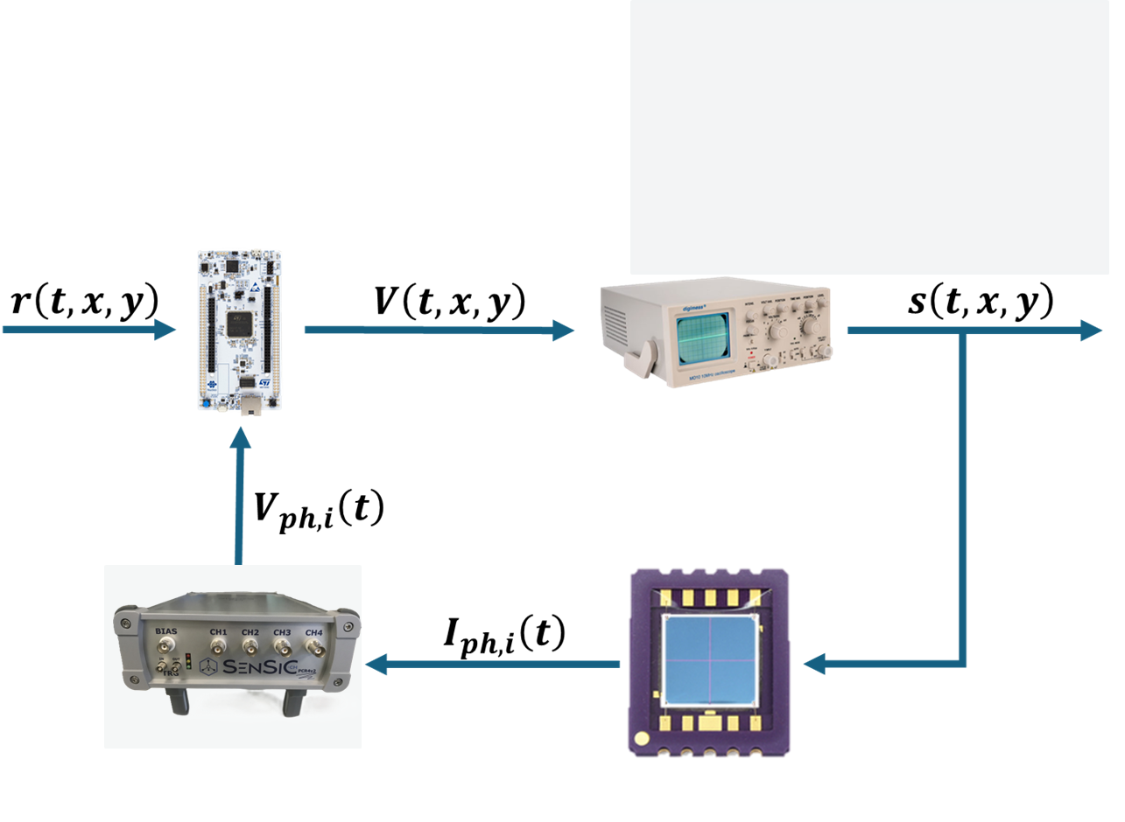
#4
CLOSED-LOOP CONTROL SYSTEM
Model
PID Controller

Slide 17
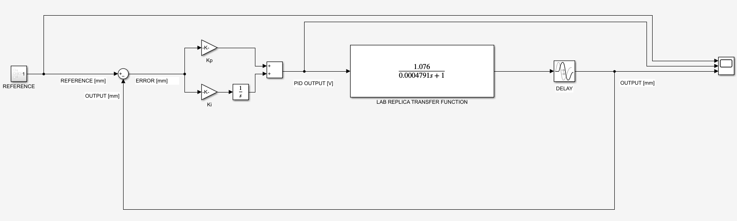
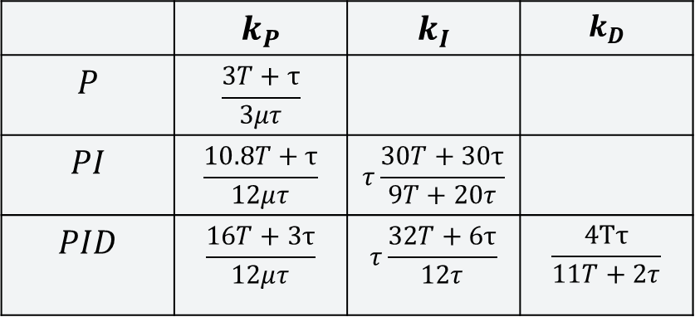
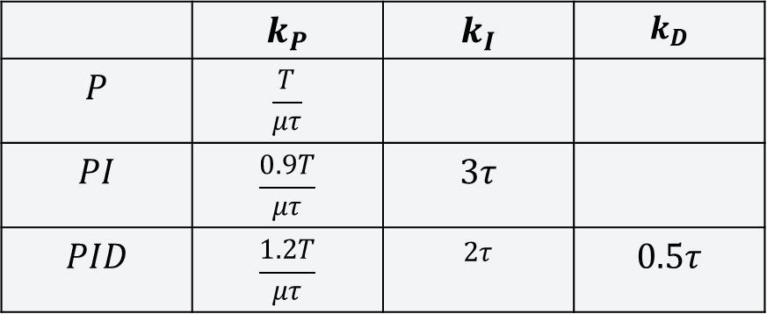
#4
CONTROL IMPLEMENTATION IN SIMULATION
Reference
PID Controller
Model
 | $$k_{P}$$ | $$k_{I}$$ | $$k_{D}$$
$$P$$ | $$\frac{T}{μτ}$$
$$PI$$ | $$\frac{0.9T}{μτ}$$ | $$3τ$$
$$PID$$ | $$\frac{1.2T}{μτ}$$ | $$2τ$$ | $$0.5τ$$
 | $$k_{P}$$ | $$k_{I}$$ | $$k_{D}$$
$$P$$ | $$\frac{3T+τ}{3μτ}$$
$$PI$$ | $$\frac{10.8T+τ}{12μτ}$$ | $$τ\frac{30T+30τ}{9T+20τ}$$
$$PID$$ | $$\frac{16T+3τ}{12μτ}$$ | $$τ\frac{32T+6τ}{12τ}$$ | $$\frac{4Tτ}{11T+2τ}$$
ZIEGLER-NICHOLS PID TUNING RULES
COHEN-COON PID TUNING RULES

Slide 18
#4
IN SIMULATION
CONTROL IMPLEMENTATION

Slide 19
#4
IN LAB-REPLICA
CONTROL IMPLEMENTATION
CONTROL: OFF
CONTROL: OFF
CONTROL: ON
CONTROL: ON

Slide 20
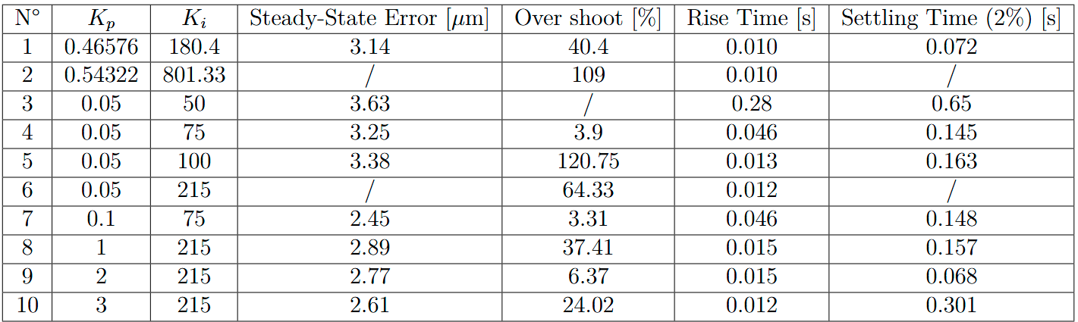
#4
PID EXPERIMENTAL TUNING

Slide 21
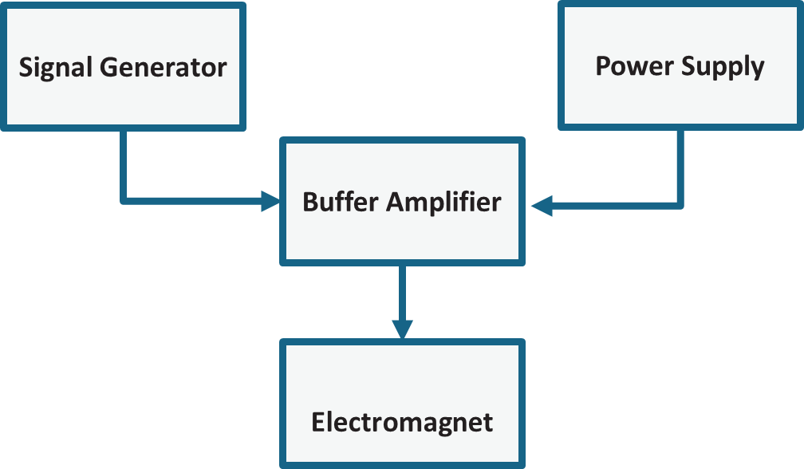
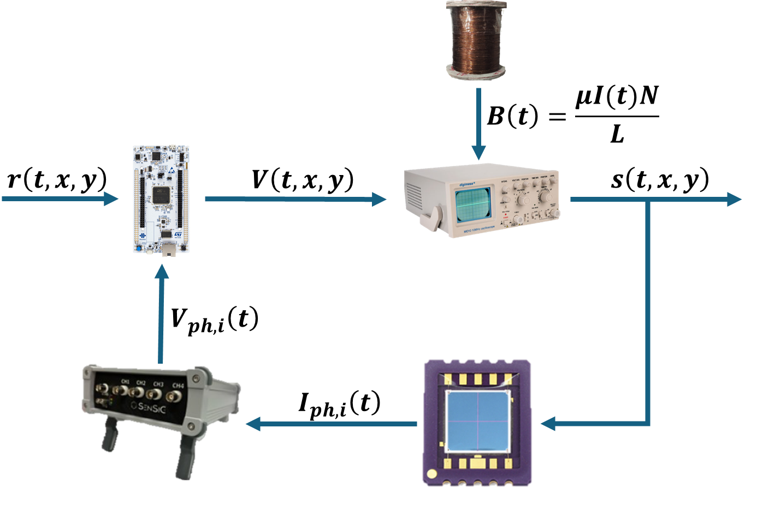
#5
CLOSED-LOOP CONTROL SYSTEM WITH DISTURBANCE
Disturbance
Control Action
[ 10,100,1000 Hz]
SPI Communication frequency: 10 kHz
Limited by low signals (nA) generated by the sensor

Slide 22



#5
CLOSED-LOOP CONTROL SYSTEM WITH DISTURBANCE
Disturbance
$$V(t)$$
$$\left\{\begin{aligned}V=const \\ I\left(t\right) \end{aligned}\right.$$
$$\left\{\begin{aligned}V\left(t\right) \\ I\left(t\right) \end{aligned}\right.$$

Slide 23
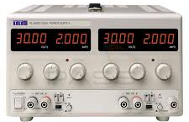
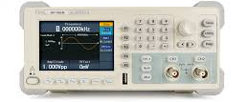
#5
CLOSED-LOOP CONTROL SYSTEM WITH DISTURBANCE
Disturbance
$$V(t)$$
$$\left\{\begin{aligned}V=const \\ I\left(t\right) \end{aligned}\right.$$
$$\left\{\begin{aligned}V\left(t\right) \\ I\left(t\right) \end{aligned}\right.$$

Slide 24

#5
CONTROL IN PRESENCE OF DISTURBANCE 100 Hz
‘IMPULSE’ > 200 mm/sec
DRIFT : 0.11 mm/sec
CONTROL: OFF
CONTROL: ON
Rise Time ≈ 0.04 sec

Slide 25
#5
CONTROL IN PRESENCE OF DISTURBANCE
10Hz
100Hz
1 kHz
DRIFT : 0.11 mm/sec
DRIFT : 0.11 mm/sec
DRIFT : 0.11 mm/sec
CONTROL: OFF
CONTROL: ON
CONTROL: OFF
CONTROL: ON
CONTROL: OFF
CONTROL: ON
Rise Time ≈ 0.15 sec
Rise Time ≈ 0.04 sec
Rise Time ≈ 0.014 sec

Slide 26
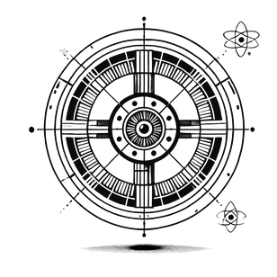
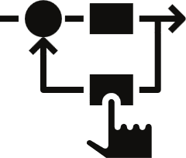


#6
CONCLUSIONS AND OUTLOOKS
Currently developing a “new replica” and its control system using a mechanical actuation.
Closed-Loop Control System successfully designed and implemented both in simulation and in real world.
17-23 June: Beamtime at SOLEIL (Galaxies) . (Mechanical Actuation)
Period at PSI for developing novel control solutions (whitebeam monitoring?)
Validation of the robustness of the systems in presence of drift disturbances.
Eurostar Project

Slide 27

THANK YOU

