Slide 1
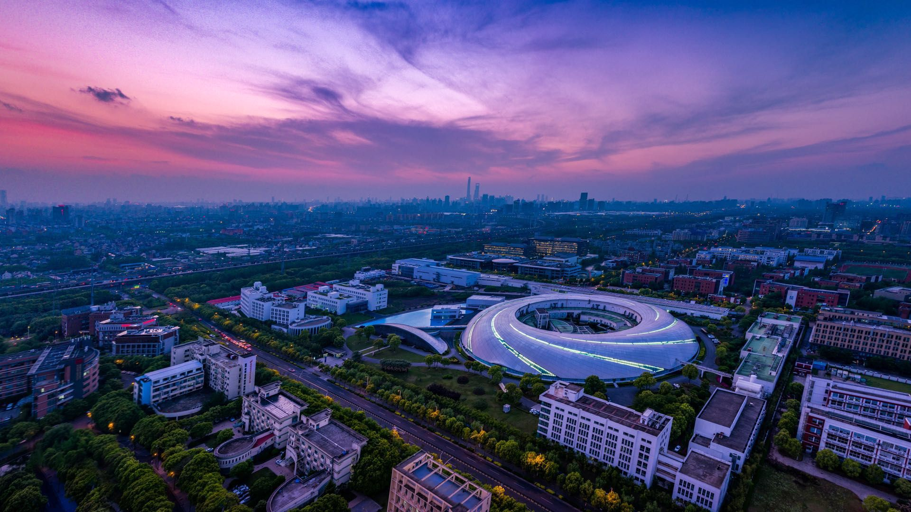
Design and commissioning of the asymmetric beam optics in the SSRF storage ring
Tian Shunqiang, SARI, CAS
March 18, 2025, KIT North Campus

Slide 2
Outline:
Overview of SSRF
Lattice design in the Beamline Project of SSRF
Commissioning of the asymmetric lattice
Summary

Slide 3
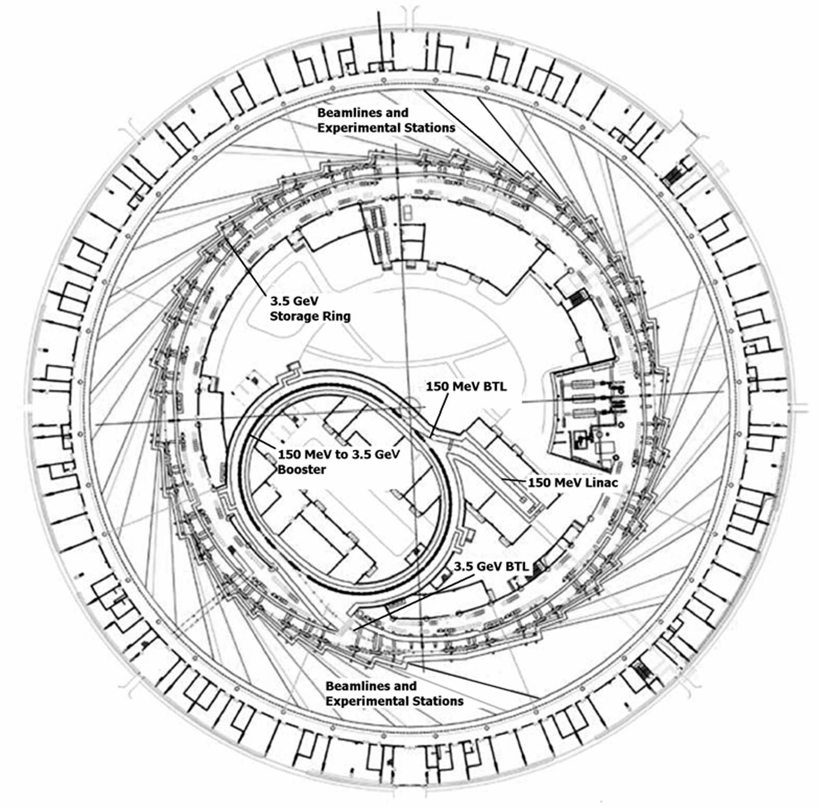
Overview of SSRF
Complex of accelerators
LINAC + Booster + Storage ring + 2×Transport lines
LINAC
Beam energy | MeV | 158
Charge (Single/Multi) | nC | 1.0/3.0
Normalized emittance | mm.rad | 50
Energy spread |  | 0.5%
Repetition rate | Hz | 2
BOOSTER
Circumference | m | 180
Beam energy | GeV | 0.158→3.5
Extracted beam emittance | nm.rad | 100
Repetition rate | Hz | 2
STORAGE RING
Circumference | m | ~432
Structure |  | 20×DBA
Beam energy | GeV | 3.5
Beam current | mA | 200~300

Slide 4
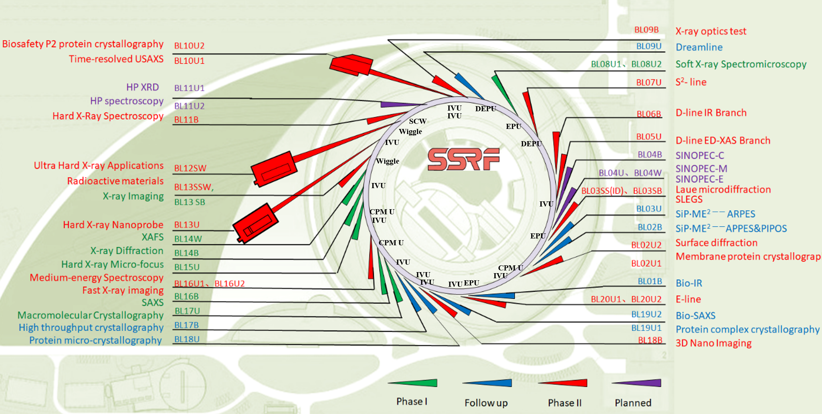
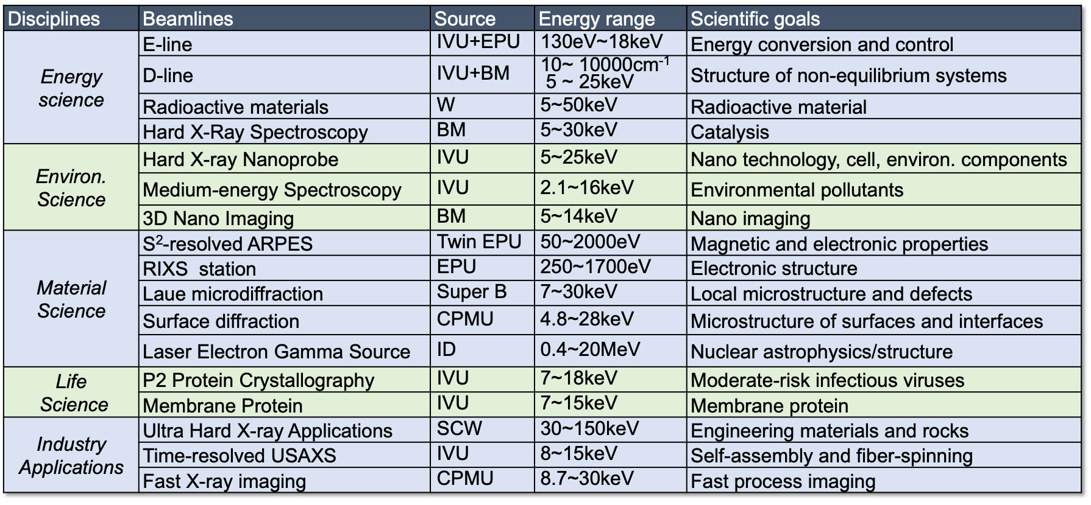
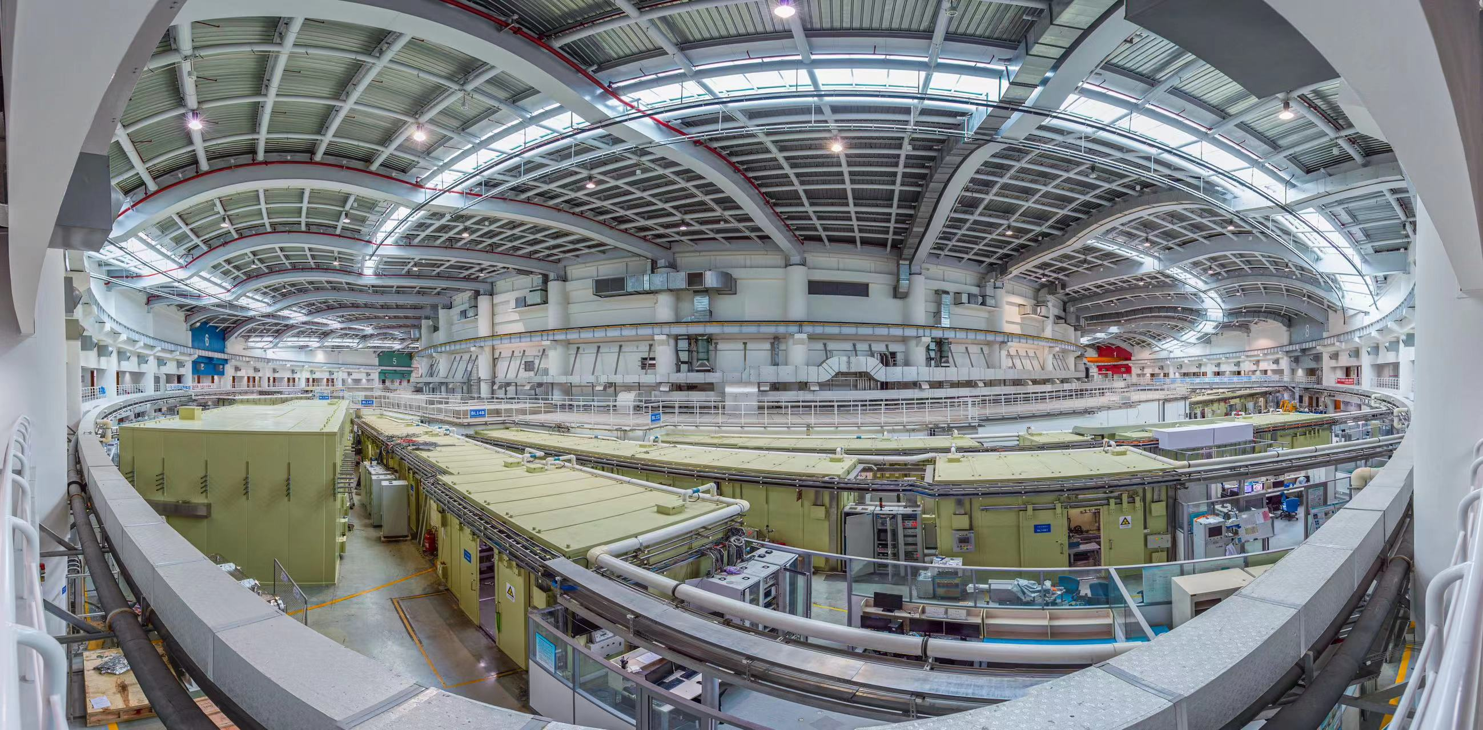
SSRF beamline project (Phase-II project)
From 11/20/2016 to 5/15 2024
19 new beamlines (13 from new IDs)
Currently, there are total of 25 IDs and 34 beamlines are in operation, and 4 beamlines are in commissioning.
Beamlines in Phase-II project
Overview of all the beamlines of SSRF

Slide 5
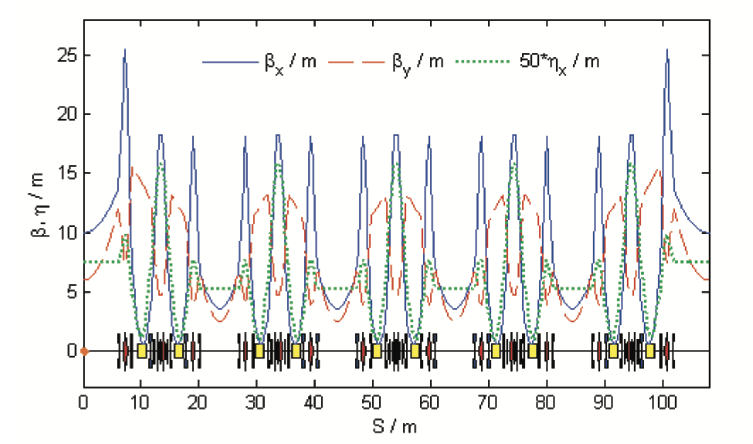
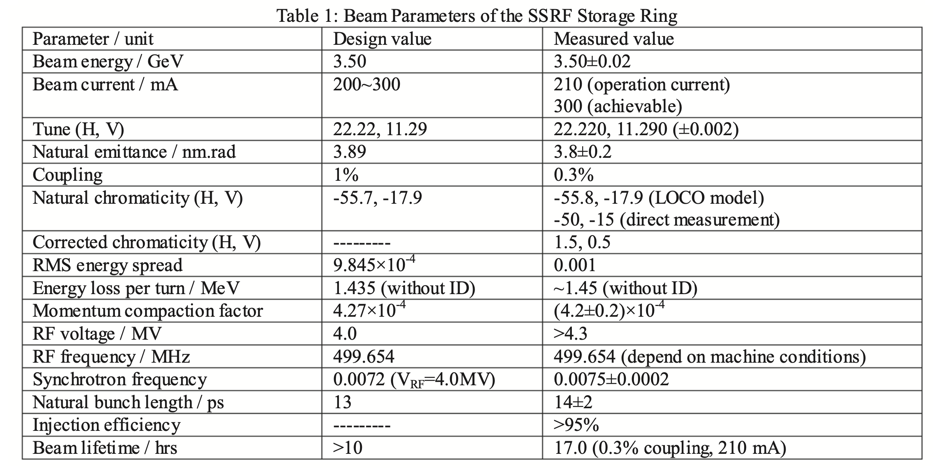
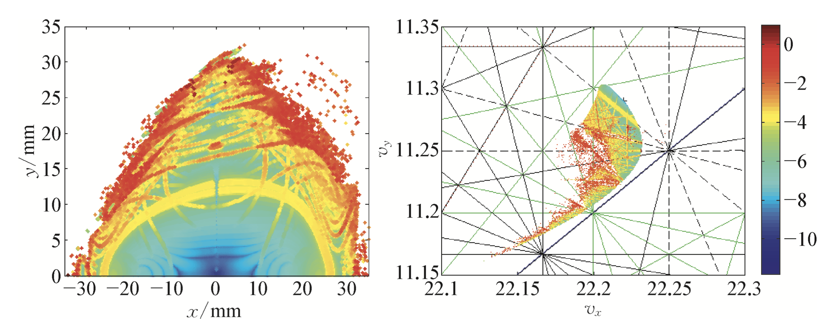
Lattice design in the Beamline Project of SSRF
Original beam optics of the storage ring
Ideal four-fold symmetry/periodicity
Had been routinely operated for ten years (2009~2018)
Most of all the beam parameters/dynamics were well agree with the designed/optimal ones
Phase-II project required necessary modification.
Beam optics in a fold of the ring
DA & FMA @ injection point

Slide 6
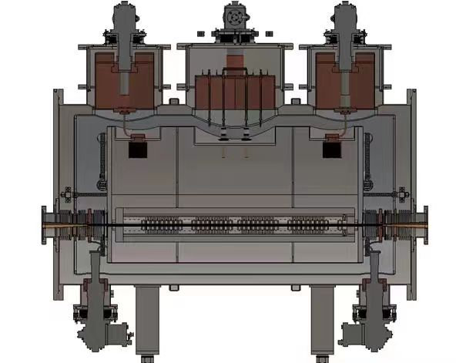
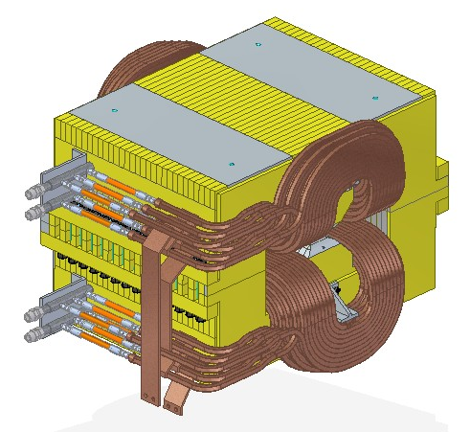
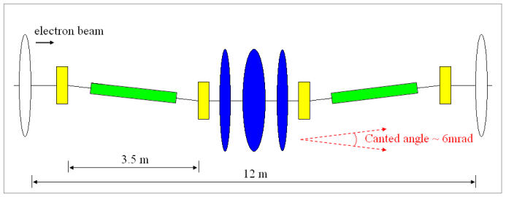
The requirements of the Beamline Project
More space for the planned IDs ← modification of arc section
Higher flux of hard X-ray from dipole ← Super-Bend
Dual-Canted ID in long SS ← double mini/waist beta-y optics
Superconducting wiggler ← eliminate dispersion in its SS
An asymmetric lattice and beam optics were required in the SSRF storage ring
Blueprints of SCW (peak field ~4.2 T) and SuperB (2.29 T)
Modification in one DBA cell
Sketch of double waist design in LSS

Slide 7
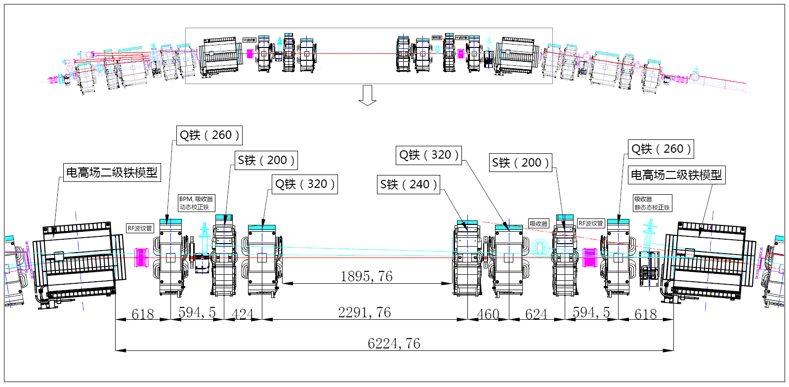
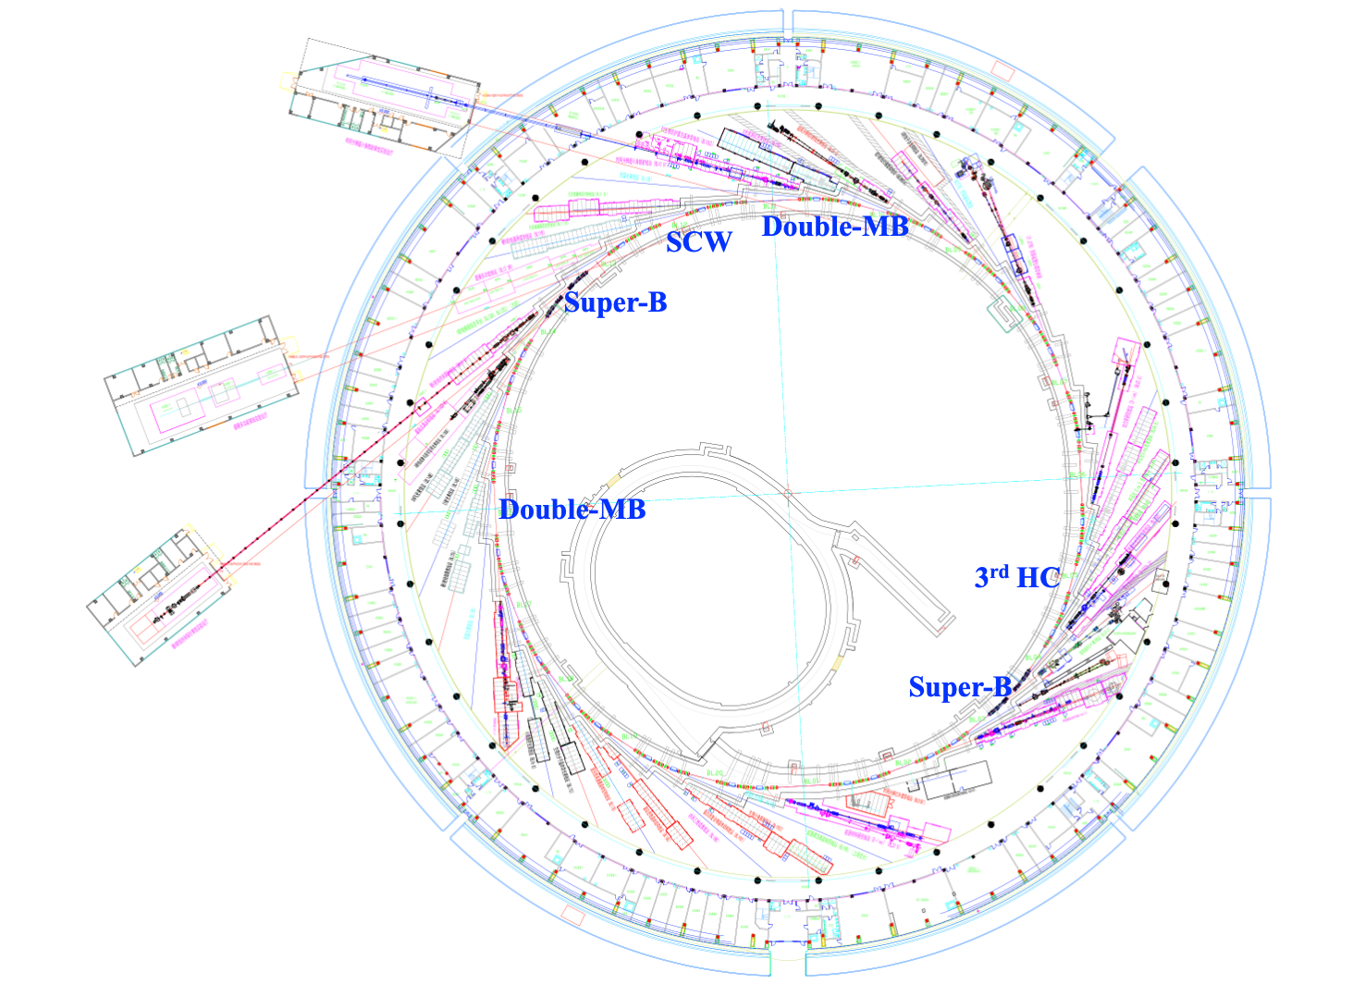
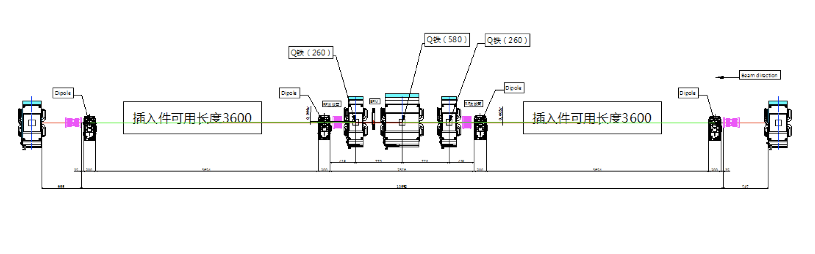
Layout of the arc section in SuperB cell
A quarter of the ring has been upgraded, and the original symmetry or periodicity has been destroyed.
Layout of the long straight section

Slide 8
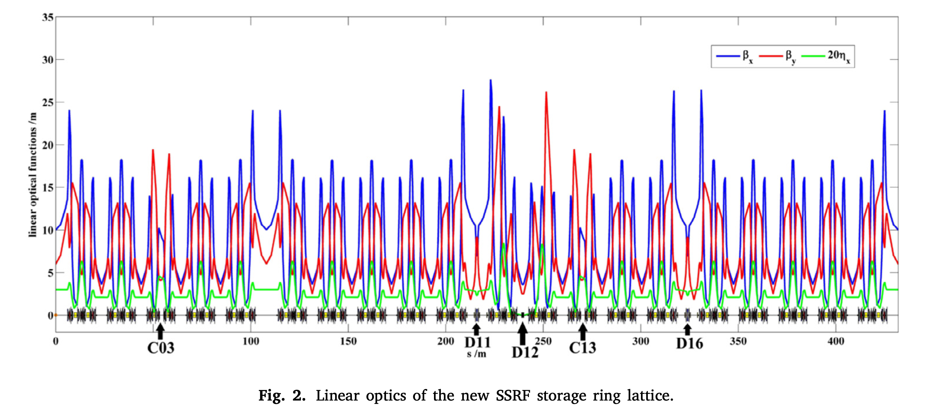
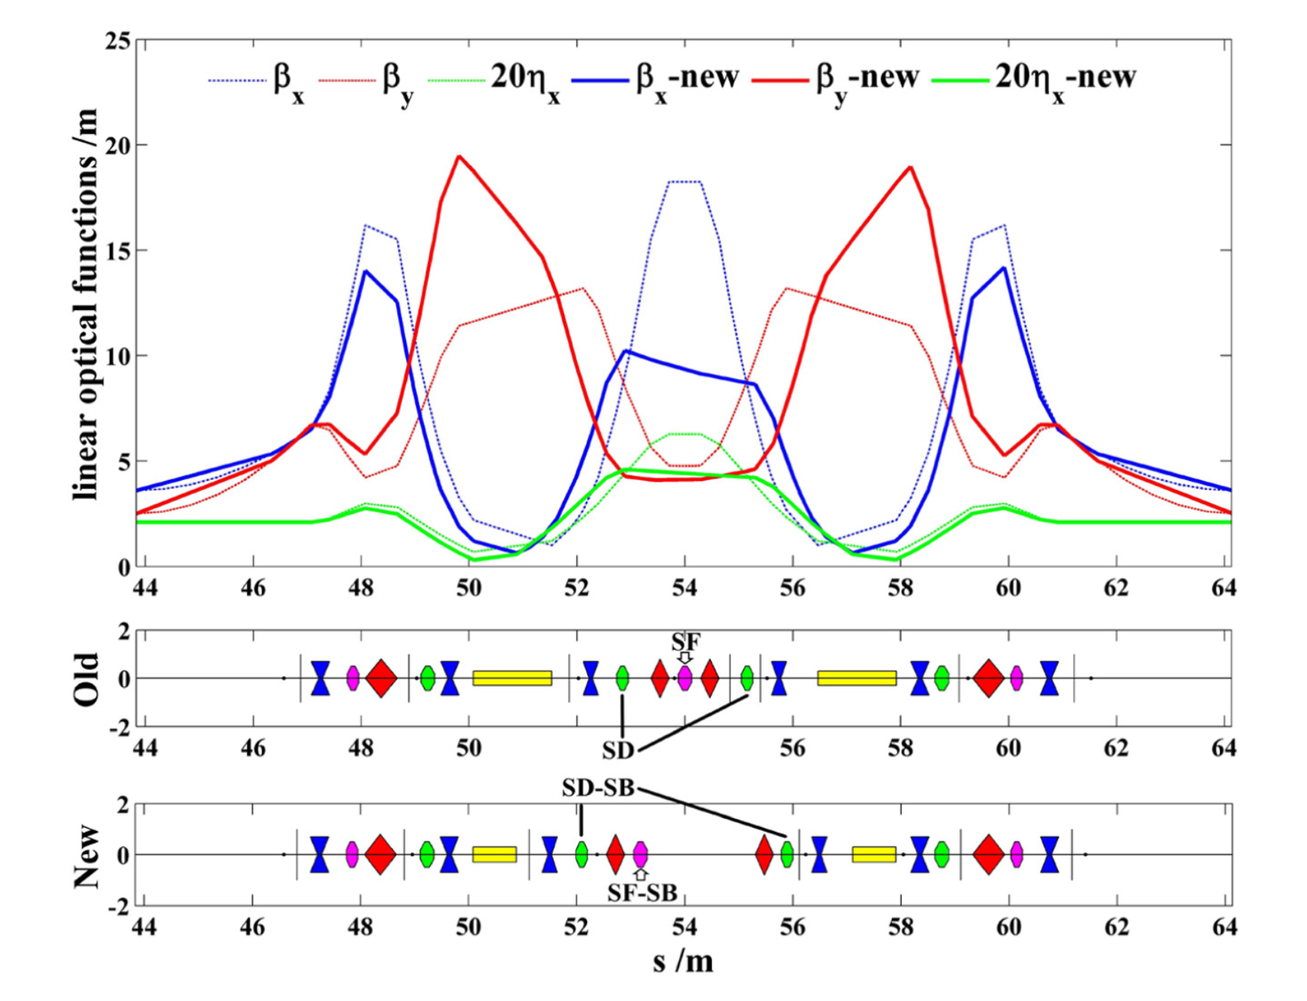
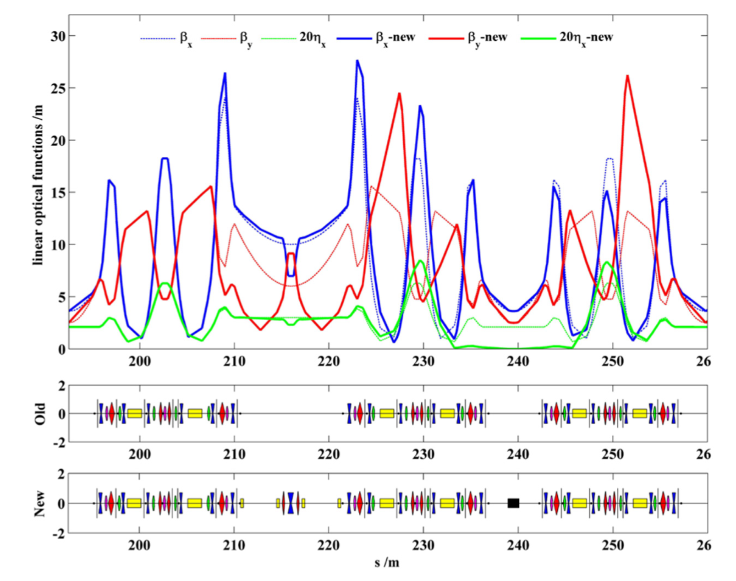
Beam dynamics design and optimization
Design strategy consisted of:
The same phase advance in SuperB cell as the nominal cell
Pi-trick in double waist section (Not exact because of sextupoles)
More sextupole families were classified according to beam optics (8→16)
Global fine-tuning with GA
Reach a suitable solution, while a little worse than the original model (such as a higher beam emittance, lower energy acceptance/dynamic aperture)

Slide 9
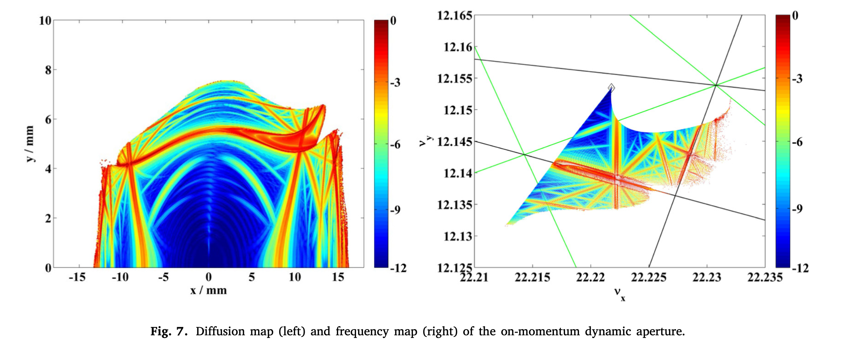
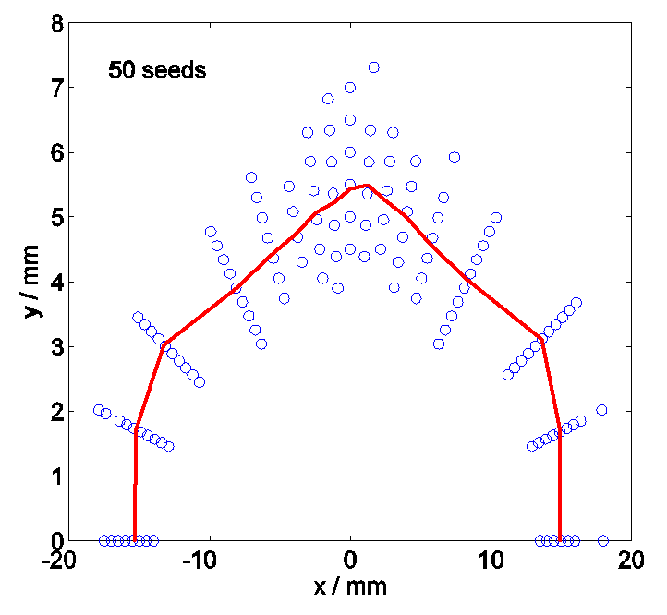
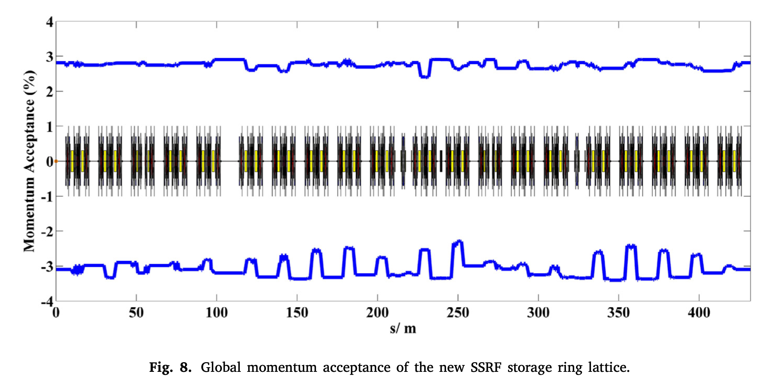
Dynamic aperture: sufficient for the pulsed closed orbit bump injection
Energy acceptance: provides a beam lifetime higher than 12 hours on the beam current of 200 mA and 0.5% beam coupling.
DA with multipole errors @ injection point

Slide 10
Beam parameters of the storage ring
Parameter | Original | Upgraded | Measured
Beam energy / GeV | 3.5 | 3.5 | 3.50±0.01
Circumference / m | 432 | 431.9893 | 431.965±0.003
Beam current / mA | 200~300 | 200~300 | 200~260
Beam lifetime / hrs | >15 (200mA) | ~12 (200mA) | 12.0±0.5 (200mA)
Working point (H, V) | 22.22, 11.29 | 22.222, 12.153 | 22.222/12.153 (±0.002)
Natural chromaticity (H, V) | -55.7, -18.0 | -55.3, -20.4 | -51/-19 (±5/±3)
Natural emittance / nm.rad | 3.89 | 4.22 | 4.5±0.3
Natural energy spread | 9.8×10⁻⁴ | 11.1×10⁻⁴ | (10±2)×10⁻⁴
Momentum compaction factor | 4.27×10⁻⁴ | 4.2×10⁻⁴ | (4.0±0.5)×10⁻⁴
Energy loss per turn / MeV | 1.44 | 1.70 | 1.8±0.2
Damping time (H, V, S) / ms | 7.05, 7.02, 3.51 | 5.98, 5.94, 2.96 | 6.0, 6.0, ---
Synchrotron tune | 0.0076 | 0.0074 | 0.0072±0.0002
Bunch length/ mm | 3.8 (zero-current) | 4~8(zero-current) | ------ ~30 (200mA)

Slide 11
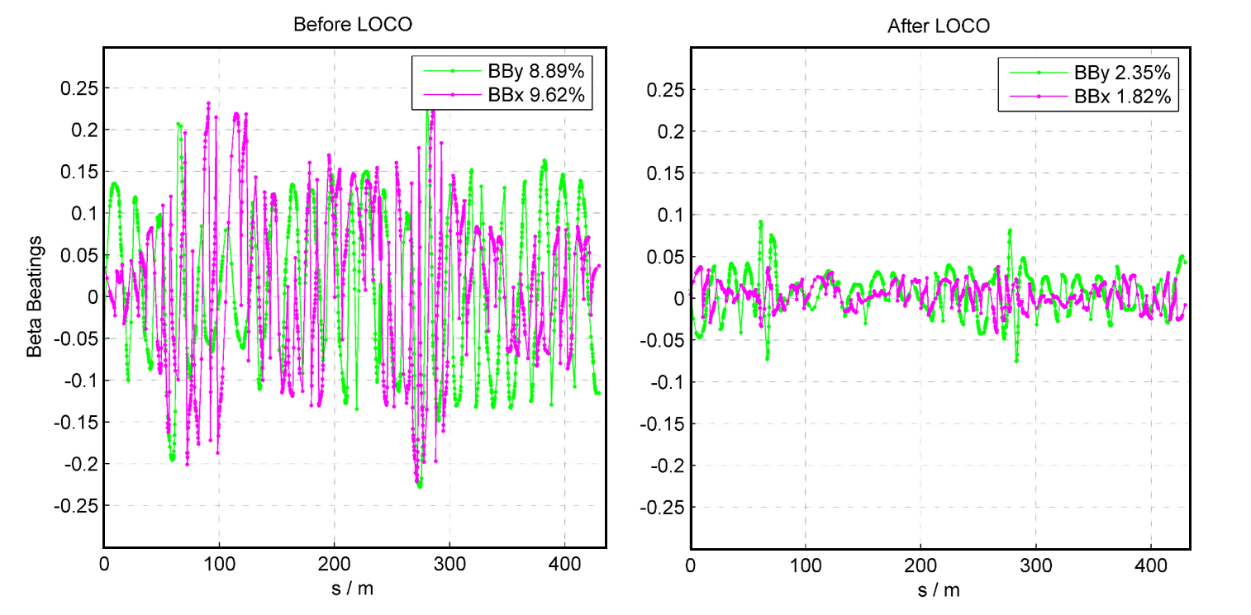
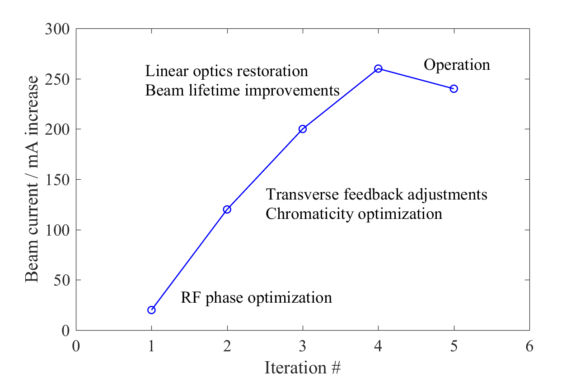
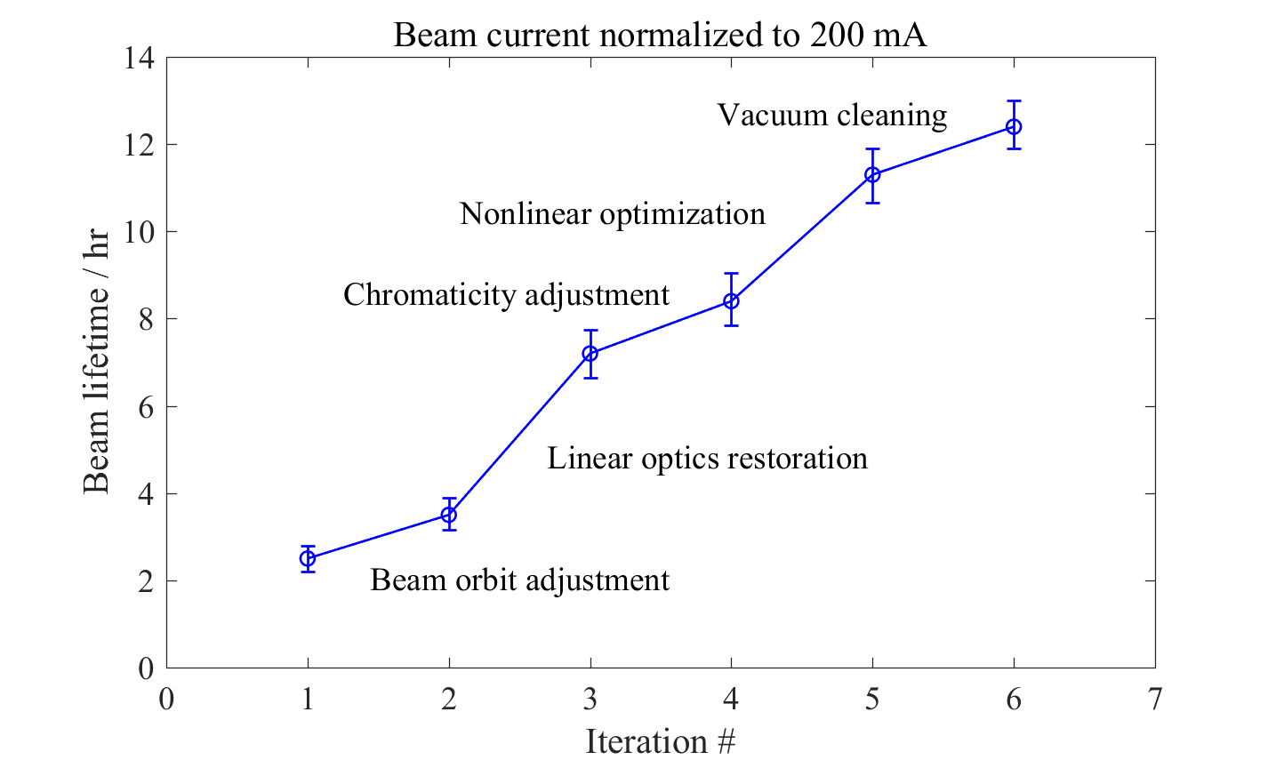
Commissioning of the asymmetric lattice
Commissioning process
First- and multi-turn: adjusting correctors/quadrupoles one by one to increase the bunch’s pass length or turn
Beam accumulation: adjusting sextupoles and related phase among the RF cavities to increase the bunch pass turn
Beam corrections in CODs, beam optics, and chromaticity (BBA, LOCO, …)
Beam current and beam lifetime increased step by step.
Eliminating the beam optics distortions with LOCO

Slide 12
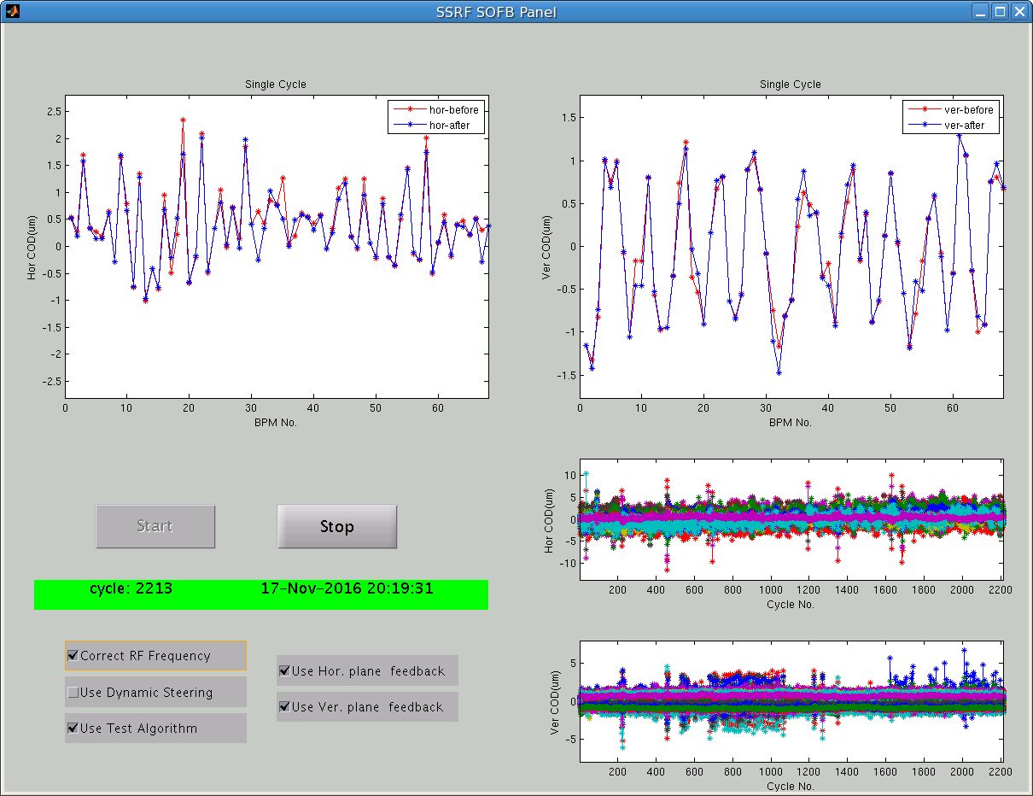
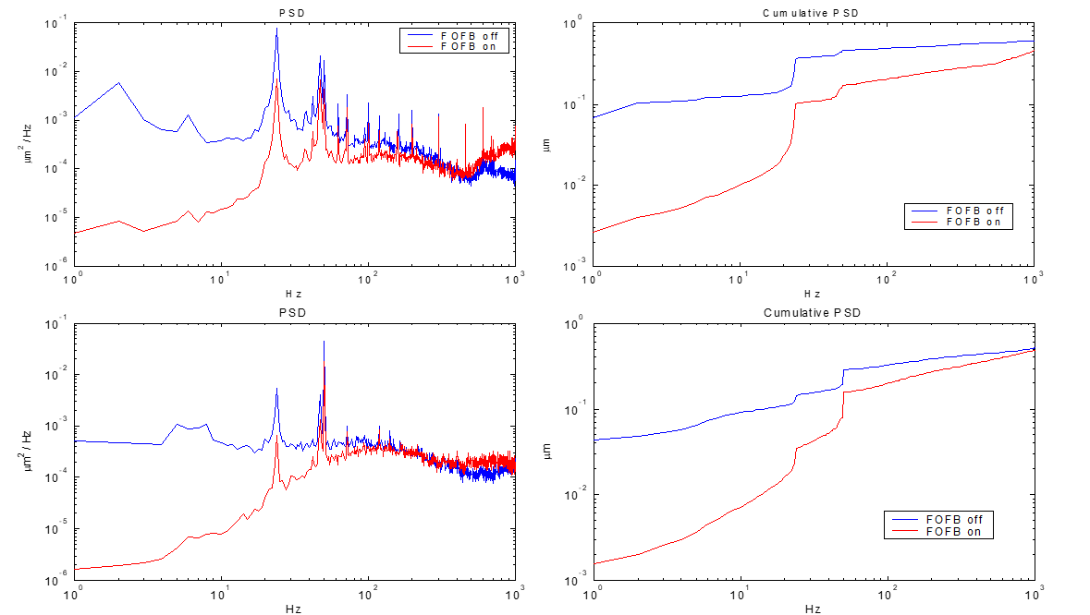
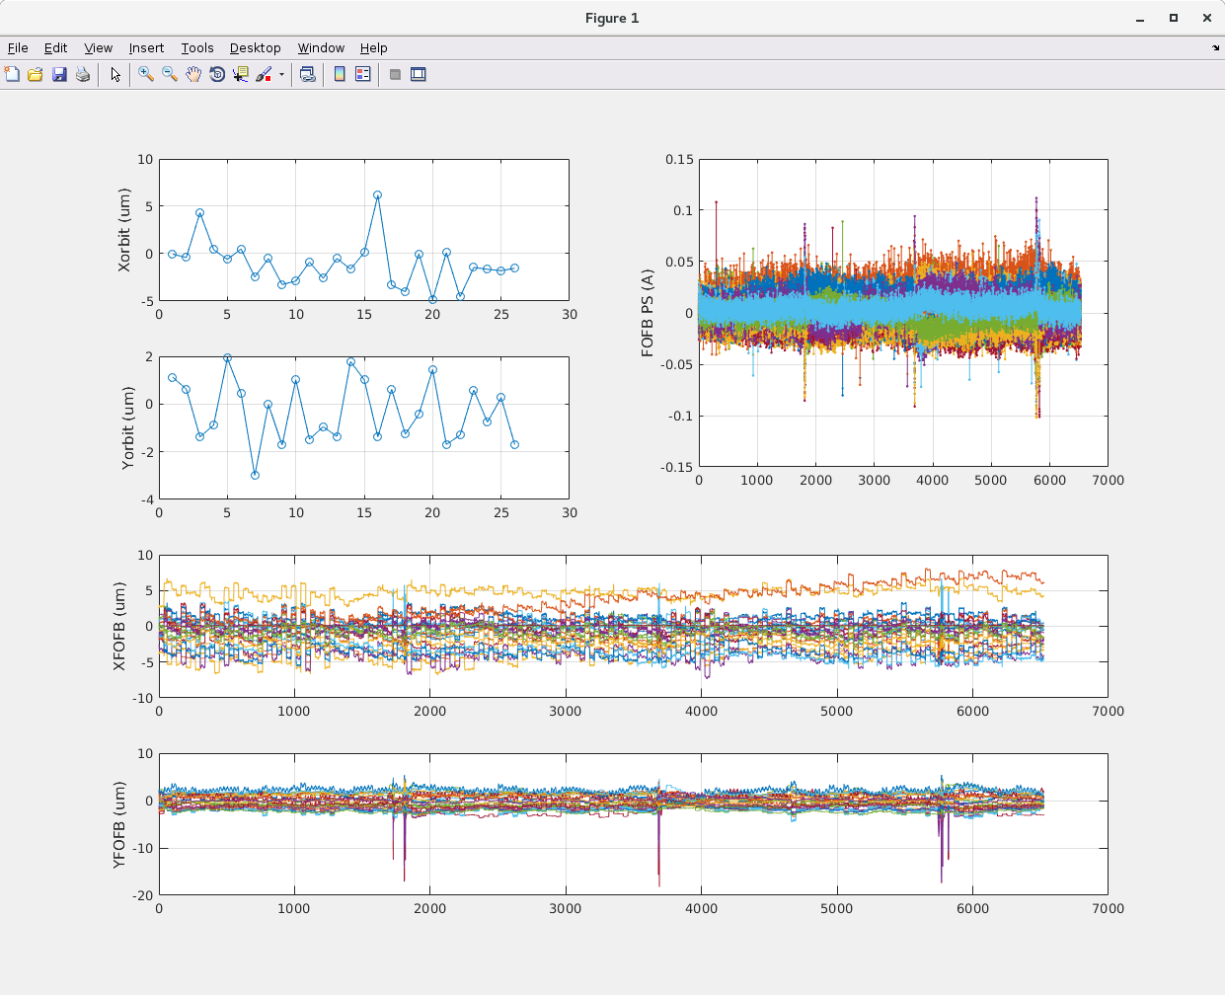
Closed orbit stability
Soft orbit feedback + Fast orbit feedback
80 slow correctors + 40 fast correctors for each plane
Successfully suppress of COD instability less than 100 Hz
Orbit stability reached the level of sub-𝜇m (RMS)

Slide 13
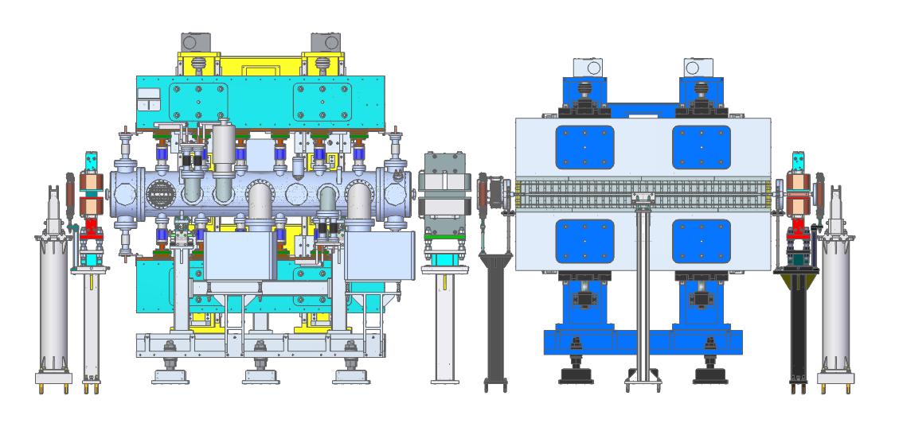
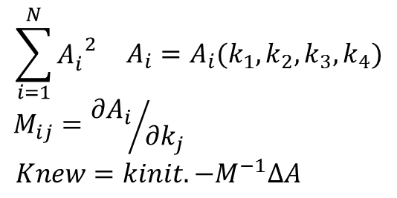
COD induced by IDs
25 IDs have been installed in the storage ring
ID type | Number
IVU | 12
CPMU | 4
Wiggler | 3
EPU | 4 (+2)
AppleKnot EPU | 1
SCW | 1
Dual-Canted | 5+2
COD induced by ID adjustment is suppressed by the method of feedforward (realized by compensation coils)
The feedforward table is measured by orbit response with the coils
One-dimension for planed undulator and wiggler
Two-dimension for EPU
The residual COD of ID is eliminated by orbit feedback

Slide 14
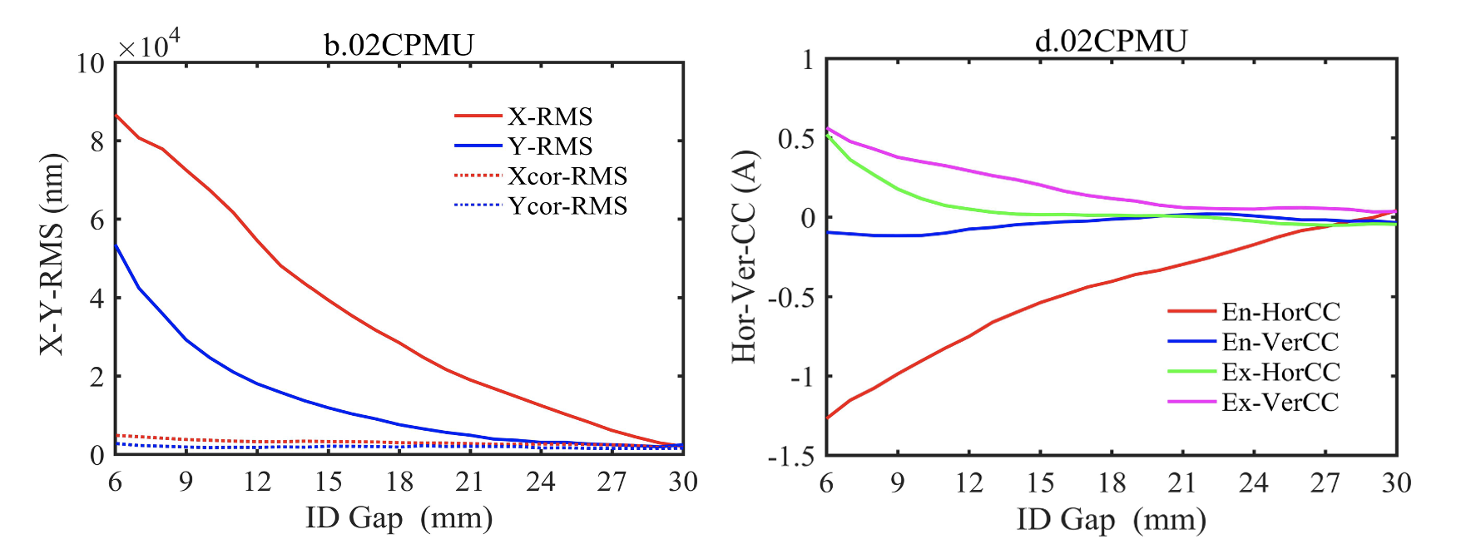
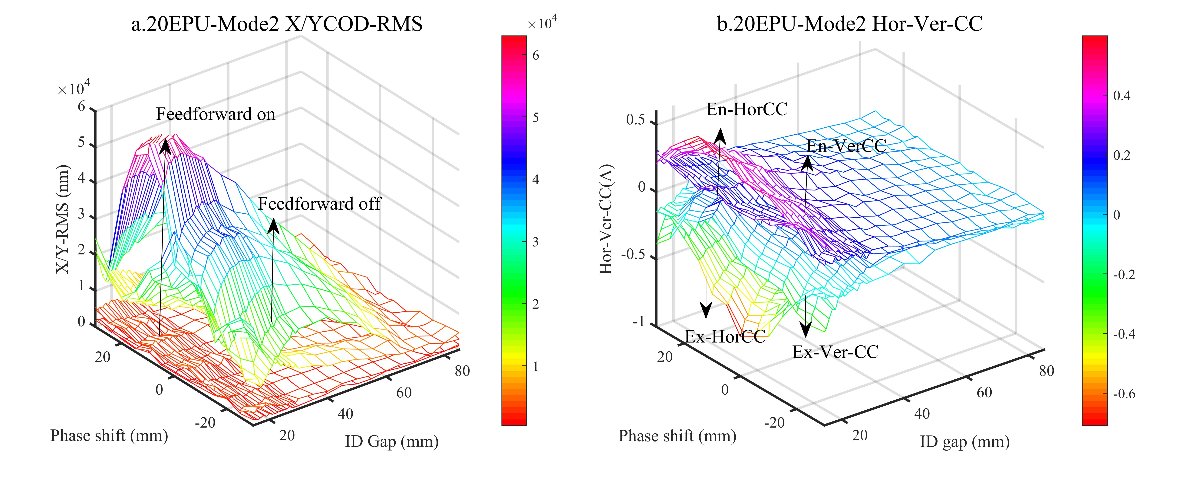
Summary of CODs induced by all the IDs
Examples of compensation tables
ID.name | Gap (mm) | Shift (mm) | COD_{x,y} (μm) | Old FF (μm) | NewFF (μm)
07EPU58 (same) | 150→16.5 | −29→29 | 75/114 | New | < 4.0/2.5
07EPU58 (opposite) | 150→16.5 | −29→29 | 75/76 | New | < 4.5/3.0
07EPU90 (same) | 150→18.8 | −45→45 | 90/52 | New | < 3.0/2.5
07EPU90 (opposite) | 150→18.8 | −45→45 | 82/31 | New | < 4.5/2.5
08EPU100 | 98→35 | −50→50 | 71/38 | 60/60 | < 4.0/3.0
09EPU58 | 160→22 | −29→29 | 86/186 | 43/47 | < 5.0/5.0
09EPU148 | 118→22 | −74→74 | 97/187 | 40/20 | < 5.0/5.0
20EPU60 Mode 0 | 85→14.5 | 0 | 49/37 | New | < 4.5/2.0
20EPU60 Mode I | 85→14.5 | −30→30 | 48/38 | New | < 5.0/3.5
20EPU60 Mode II | 85→14.5 | −30→30 | 63/40 | New | < 4.5/3.0
20EPU60 Mode III | 85→14.5 | −30→30 | 63/40 | New | < 4.5/3.0
ID name | Gap (mm) | COD_{x,y} (μm) | Old FF (μm) | New FF (μm)
02IVU | 30→6.0 | 6.7/8.3 | New | <2.0/1.5
02CPMU | 30→6.0 | 87/54 | New | <5.0/3.0
04IVU | 30→6.0 | 26/40 | New | <2.0/2.0
04Wiggler | 100→15.0 | 36/22 | New | <2.0/3.0
05IVU | 30→6.0 | 4.4/13 | New | <2.0/2.0
10IVU1 | 30→6.0 | 9.6/17 | New | <2.0/2.0
10IVU2 | 30→6.0 | 30/13 | New | <2.0/2.0
13IVU | 30→6.0 | 14/6 | New | <2.0/2.0
13SWiggler | 120→16.5 | 20/12 | New | <3.0/2.0
14Wiggler | 140→17 | 21/36 | 31/15 | <4.0/2.5
15IVU | 30→6.0 | 40/21 | 10/15 | <2.0/1.5
16IVU | 30→6.0 | 330/31 | New | <15/3.0
16CPMU | 30→6.0 | 55/35 | New | <3.5/2.5
17CPMU | 30→6.0 | 16/15 | New | <2.5/2.0
18IVU | 30→6.0 | 28/38 | 12/21 | <2.0/2.5
19IVU1 | 30→6.0 | 21/20 | 3.0/6.0 | <3.0/2.5
19IVU2 | 30→6.0 | 48/6.5 | 10/11 | <2.5/2.0
20IVU | 30→6.0 | 11/24 | New | <2.5/1.5

Slide 15
Summary
The accelerator complex was overviewed, along with the original beam optics.
To meet the requirements of Beamline Project, the lattice of the storage ring was upgraded significantly. A suitable solution in the asymmetric lattice was achieved after careful design and optimization.
The upgraded lattice was successfully commissioned, resulting in machine performance agreeing well with the simulation results.
The ID adjustments are almost transparent in user experiments thanks to the few orbit influence achieved by orbit feedforward and feedback.

Slide 16
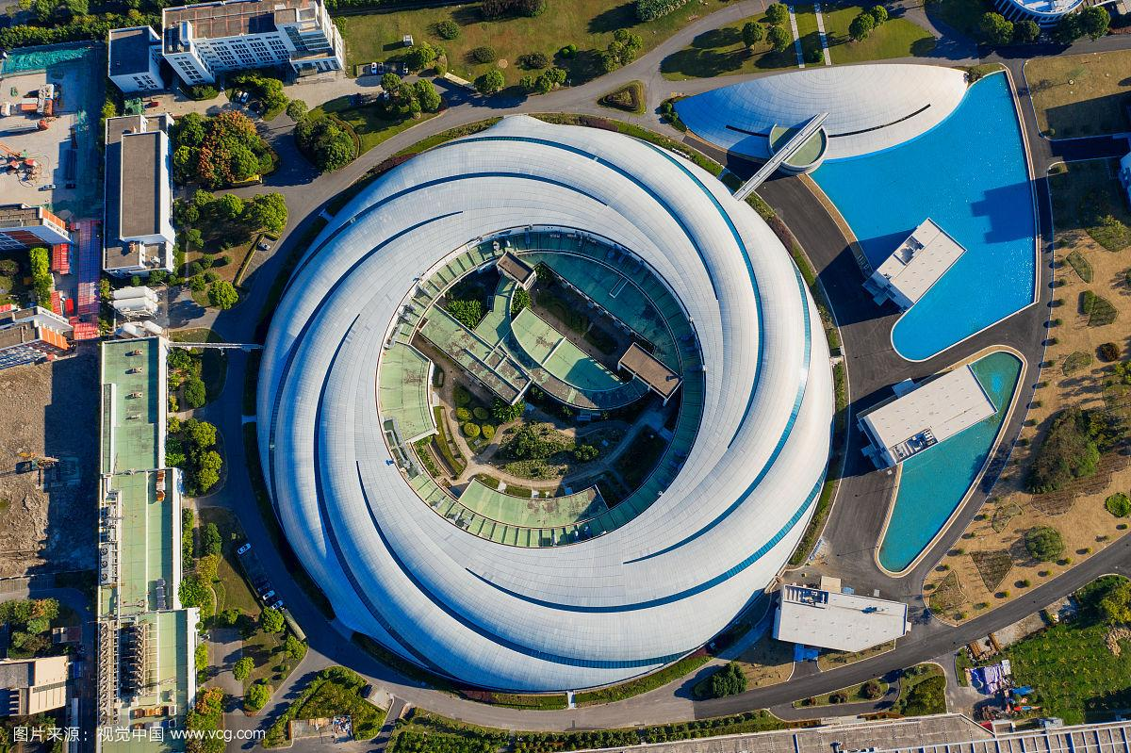
Thanks for your attention!

