Slide 1
HEPS Fast Orbit Feedback system
Wei Shujun
Wei Shujun，Gao Guodong, Zhang Hong, Zhou Daiquan, Li Yilin, Huang Xiyang, Cao Jianshe
March 19, 2025
I.FAST workshop 2025, Karlsruhe, Germany

Slide 2
CONTENT
Introduction to HEPS
FOFB Architecture of HEPS
FOFB Hardware and Software design
FOFB System laboratory test
FOFB On-site testing without Beam
FOFB Latency and Bandwidth estimation
Next plan
Summary

Slide 3
1, Introduction to HEPS

Slide 4
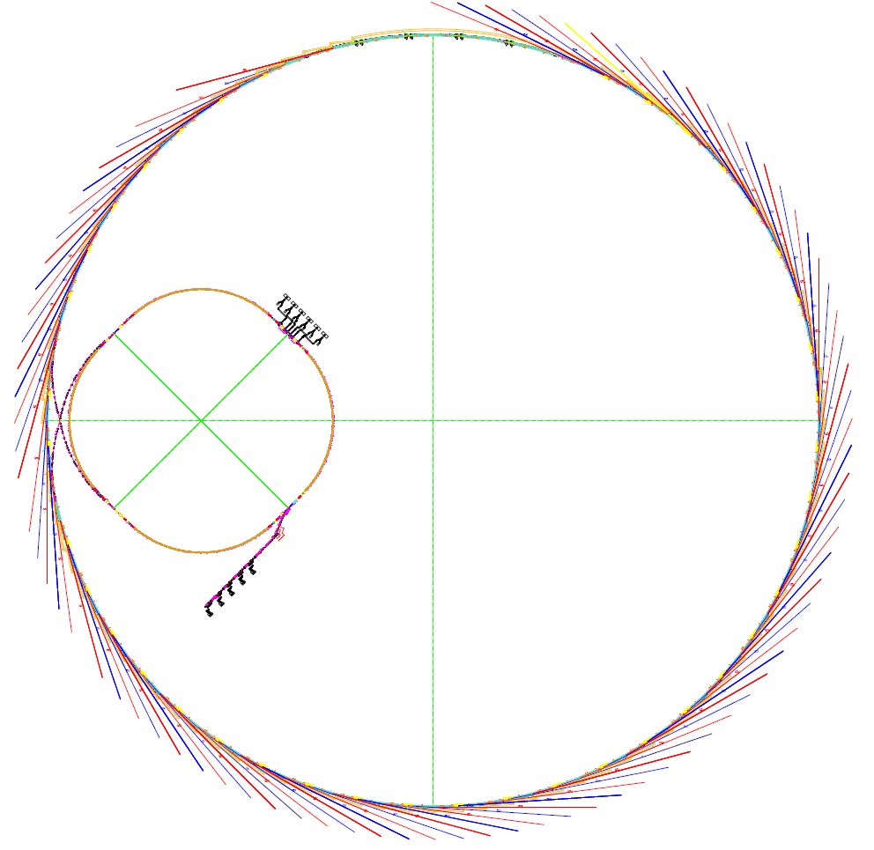

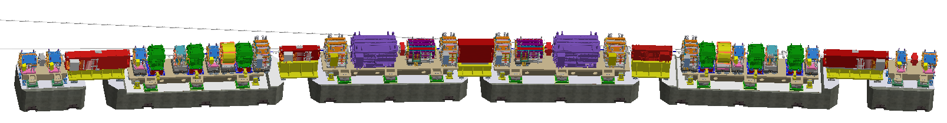
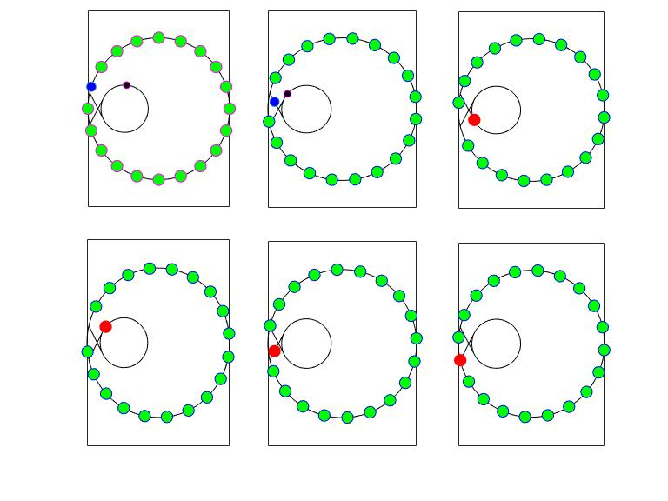
High Energy Photon Source
Hybrid 7BA with unit cell comprises dipoles of reverse bending angle and longitudinal gradient
（HEPS | High Energy Photon Source）
Parameter | Value
Energy | 6 GeV
Circumstance | 1360.4 m
Emittance | 34 pm·rad
Brightness | >1x1022 phs/s/mm²/mrad²/0.1%BW
Betatron tune | 115.15/104.29
Radiation loss | 2.64 MeV
Momentum compaction factor | 1.83e-5
Harmonic ratio | 3
Bending magnet radiation source
booster
Linac
High energy accumulation:
effectively reduced single bunch charge requirement for injector
Storage ring

Slide 5
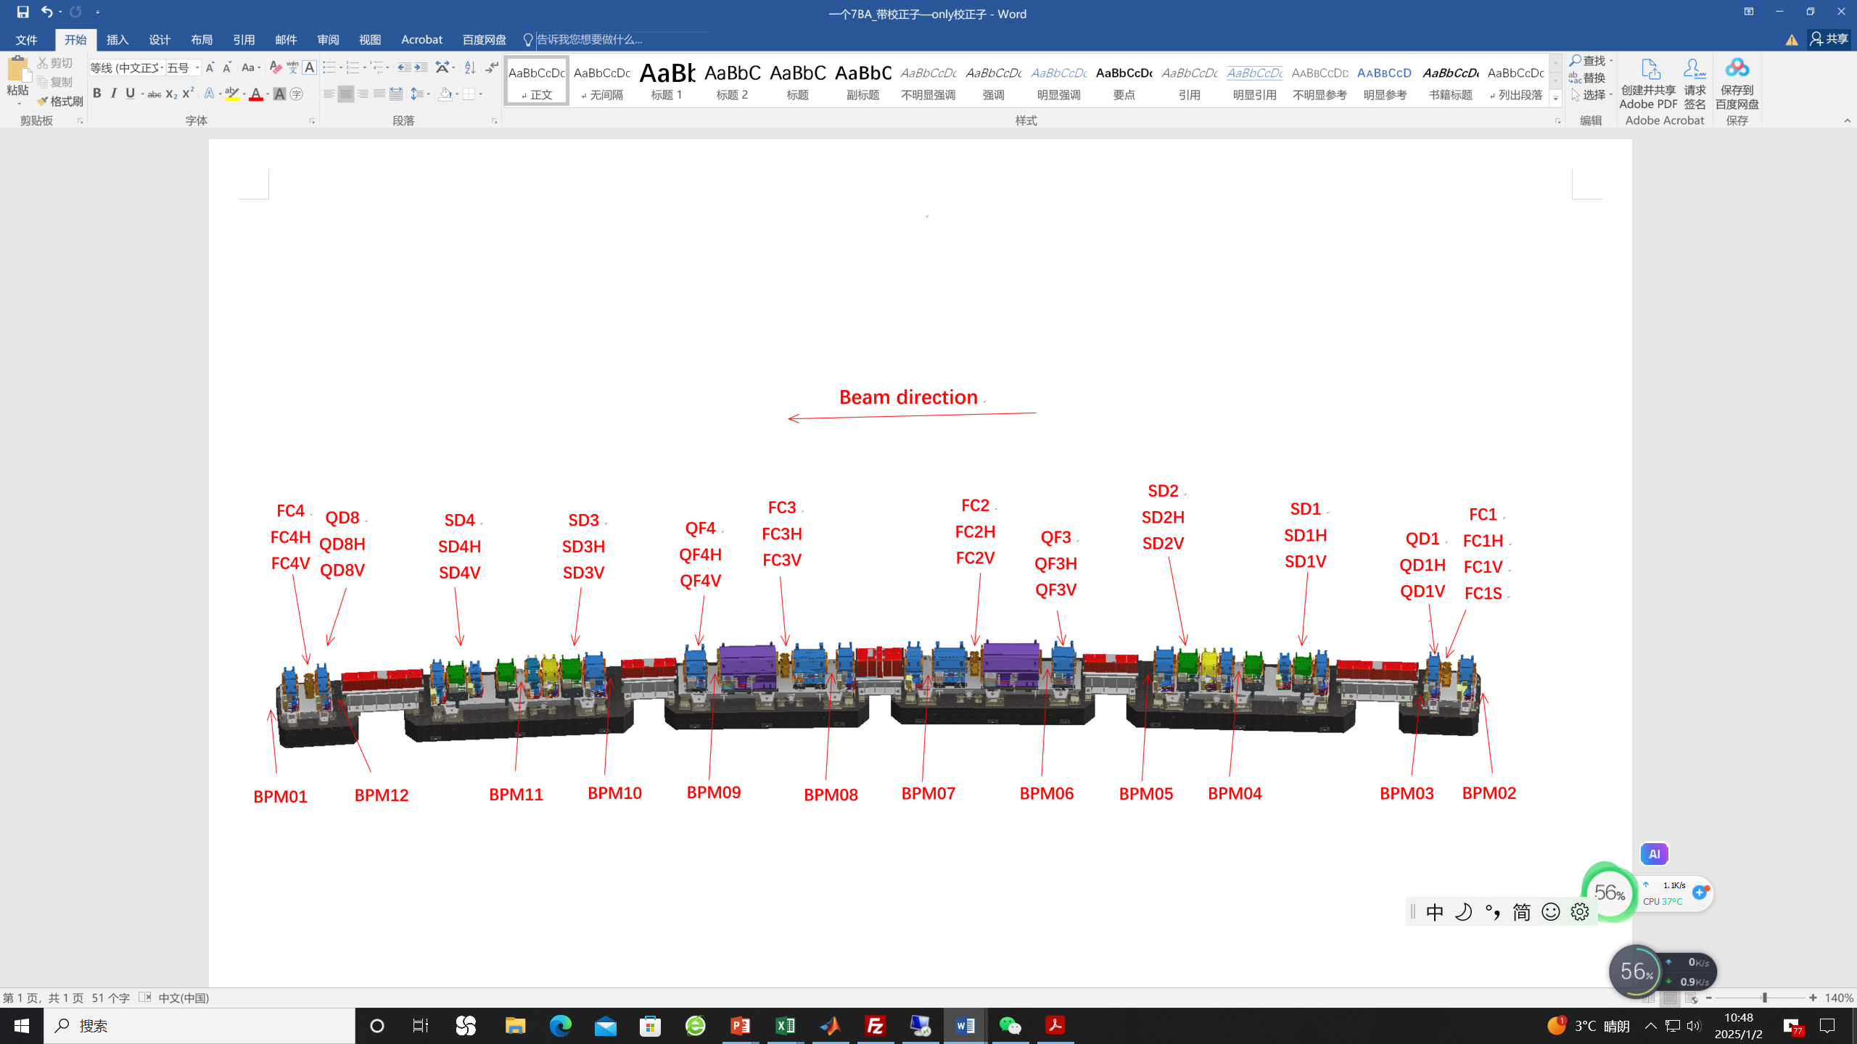
Orbit stability criteria
48 7BA cells, 576 BPMs, 192 fast correctors (FC), 288 slow correctors (SC)
HEPS stability requirement | Short time (0.01-1000 Hz)
 | orbit | angular
Horizontal | 1.0 μm | 0.2 μrad
Vertical | 0.3 μm | 0.06 μrad

Slide 6
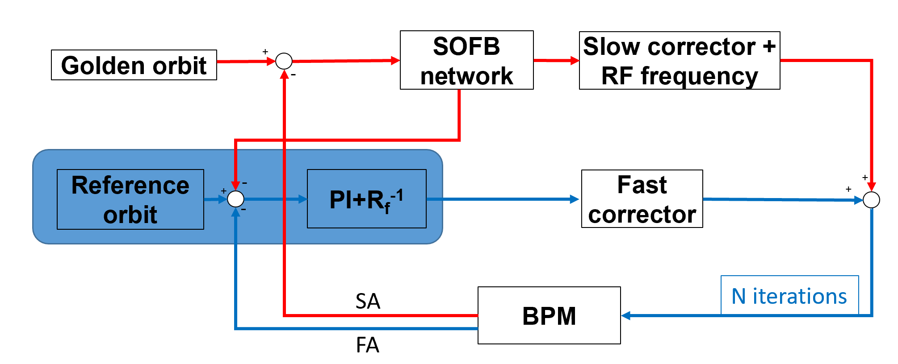
Global orbit feedback scheme
Parameter | Feedback design
Algorithm implementation | Fast + SOFB
BPM sampling rate | 22 kHz (FA)
FC sampling rate | 22 kHz
Signal processors (16 stations) | FPGA (Virtex-7)
Num. BPMs /plane | 576 (12 per cell)
FC /plane | 192 (4 per cell)
SC /plane | 288 (6 per cell)
FC PS bandwidth | 10 kHz
FC latency | < 25 μs
FOFB closed-loop bandwidth | >500 Hz
Strategy: SOFB+FOFB+RFFB
Commissioning: SOFB+RFFB
Global orbit feedback

Slide 7
2, FOFB Architecture of HEPS

Slide 8
FOFB system framework
“Ring-Star-Ring” structure
  For each BPM station, construct all 12 BPMs to a BPM ring;
  Connecting adjacent 3 BPM rings to 1 FOFB unit.
  Link all 16 FOFB units to 1 large FOFB ring.
  Connecting 1 FOFB unit to 3 FC PSC units.

Slide 9
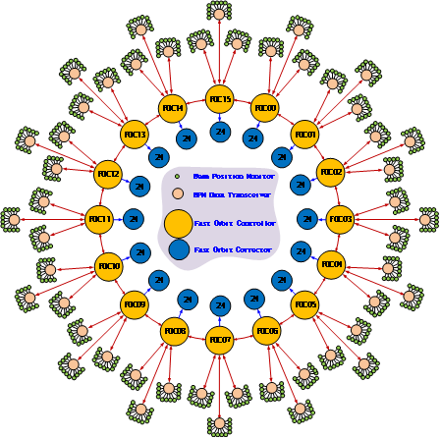
Data Transmission Network
  Our entire system has undergone two iterations of version development.
  In the previous version, the FOFB framework featured a “ring-star-ring” two-layer design. With the latest design, we have incorporated a BDT module and developed a “star-ring” framework.
    Reduce the latency;
    Expand the inputs for XBPM;
    Promote the system stability.
  Note: Changing the data transmission framework only requires changing the fiber optic connection method, without the need to modify the hardware and software of each system.

Slide 10
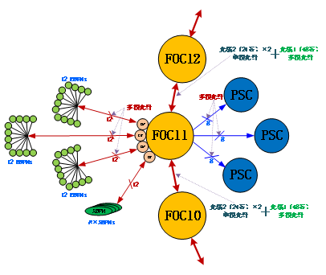
Data Transmission Network
A “star-ring” data transmission network structure.
  Added BPM data transceiver (BDT) module for point-to-point reception of all BPM data corresponding to BPM sub stations, and then sent to FOC.
  The advantages of “star-ring” framework:
    Reduce the power consumption of FOC;
    Decrease data transmission latency;
    Prevent the failure of one BPM from affecting the transmission of data to other BPMs;
    It make XBPM input possible.

Slide 11
FOFB system Hardware Unit
FOFB Unit Function block
  3*12 BPMs
  3*8 PSCs
  1 FOC
  4 Timing signals
    Trig_291Hz
    Trig_FA
    Trig_Sync
    Trig_DAQ
  1 Clock Fanout module
  FOFB Server for Control and DAQ

Slide 12
FOFB system Hardware Unit
FOFB Unit Components
  FOFB.ATCA.BackPlane
  FOFB.ATCA.FOC
  FOFB.ATCA.AUX
  FOFB.ATCA.PSC_Interface
  FOFB Server for control and DAQ Op.
  RF clock Fanout module
  BPM data Transfer module
    Used for BPMs data reassemble and
    forward function.

Slide 13
FOFB system Hardware Unit
All components and Signal
connections in 1 FOFB unit

Slide 14
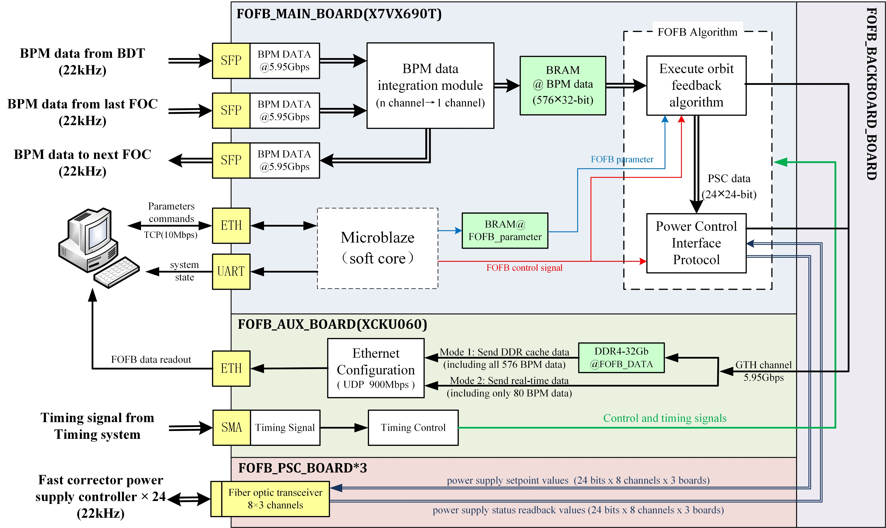
FOFB system data processing flow

Slide 15
3, FOFB Hardware development

Slide 16
FOFB Hardware development(main parts)
FOFB.ATCA.Backplane
  Provide power supply for all FOFB ATCA function modules, and provide the signal interconnection between the ATCA function modules
FOFB.ATCA.FOC
  Receiving and Processing the BPMs data, perform the FOFB algorithm and output the PSC correction data
FOFB.ATCA.AUX
  Auxiliary function module, processing the Trigger signals, temperature monitor and FOFB system protection, moreover, to perform the data acquisition operation.
FOFB.ATCA.PSC_Inf.
  Receive the PSC correction data from FOC module, and forward the information to PSC module, furthermore, read the PSC setting information back to FOFB.

Slide 17
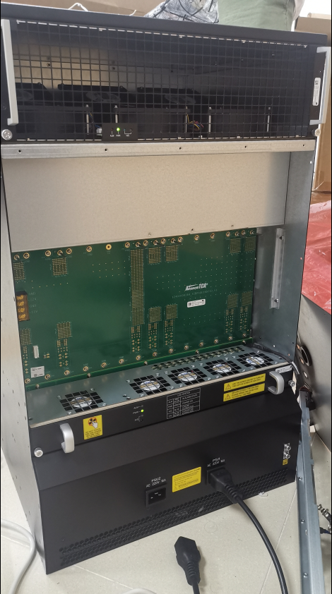
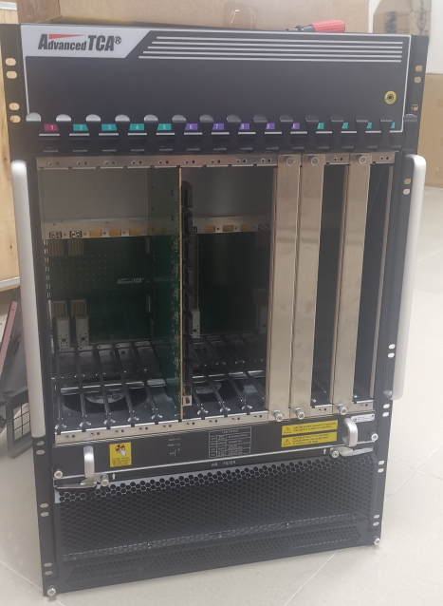
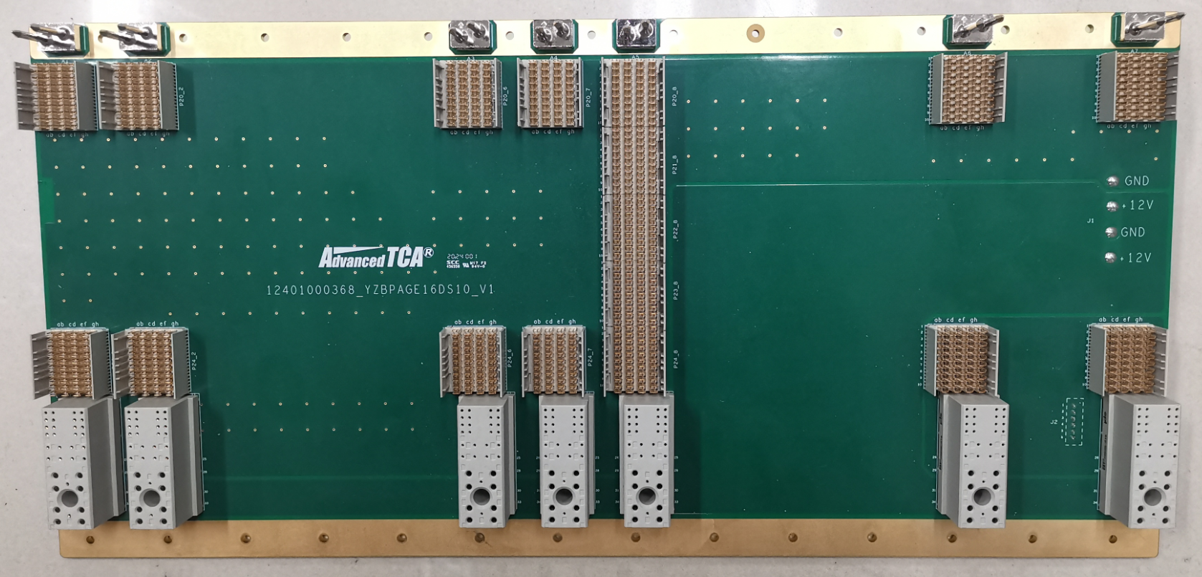
FOFB.ATCA.Backplane design
Signal interconnection scheme
Key features
  Power supply for all function module
  Clock link from FOC to other module
  Trigger link from AUX to FOC
  Data link between FOC and PSC
  I2C bus for Temp. Monitor
  GTX link between AUX and FOC
Physical picture of the backplane

Slide 18
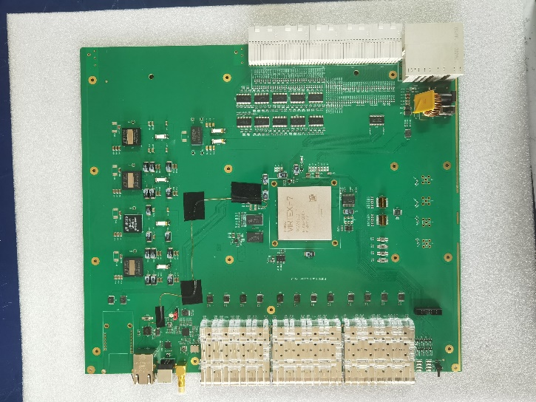
FOFB.ATCA.FOC module design
FOFB FOC function block
FOC Key Features
  Parameters setting by the FOFB Server’s program
  Receive 36 BPM.FA data from adjacent 3 DBPM cabinets
  Communicate and exchange data with adjacent FOC units
  Processing the BPMs data and obtaining the fast corrector information through the FOFB algorithm
  Send fast corrector information to the fast PSC through the PSC interface module.
  Send BPMs and other data from this station to the AUX board via the GTX high-speed data link.
  Receive the Trigger information from AUX module, which is used for FOFB data processing.
  Logic to monitor the FOC’s temperature, and send those information to AUX.
Physical picture of the FOC module

Slide 19
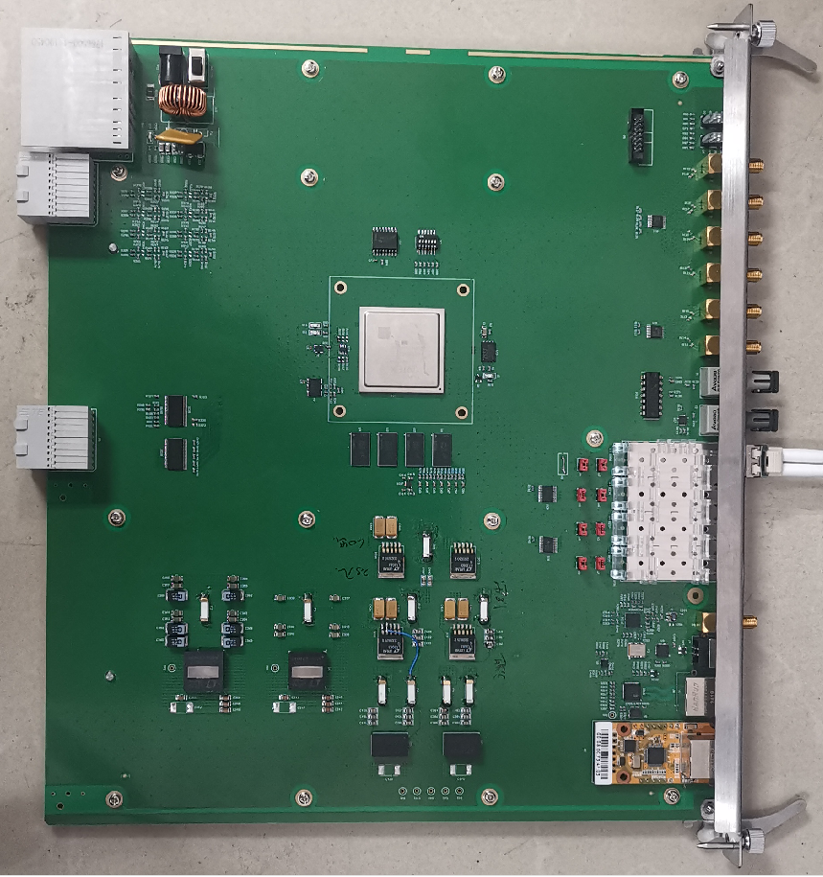
FOFB.ATCA.AUX module design
FOFB AUX function block
Key features
  Receiving Trigger signals from Timing system and forwarding those signals to FOC.
  Receiving local BPM data, PSC data, and other configuration information from the FOC , then storing all those data to the server via GbE.
  Receiving temperature information from other modules, and
  sending it to the server program to monitor the FOFB system
  temperature, to shut off the FOFB system power supply in
  emergency situations.
Physical picture of the AUX module

Slide 20
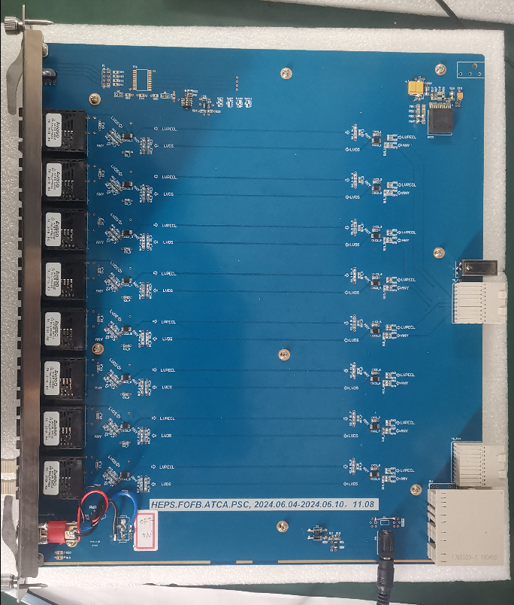
FOFB.ATCA.PSC_Interface module design
Function block
Key features
  Receive the fast corrector information from FOC module, and send it the fast PSC with multimode fiber.
  Read back the fast corrector information
  and other configuration information from
  PSC and send it to FOC
  Temperature monitor, the temperature
  information is send to AUX module for the
  FOFB system protection.
  Working Status disp.
Picture of the PSC_inf.

Slide 21
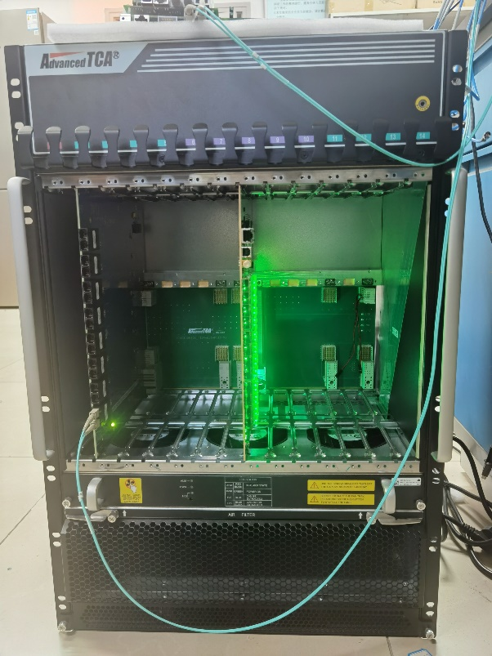
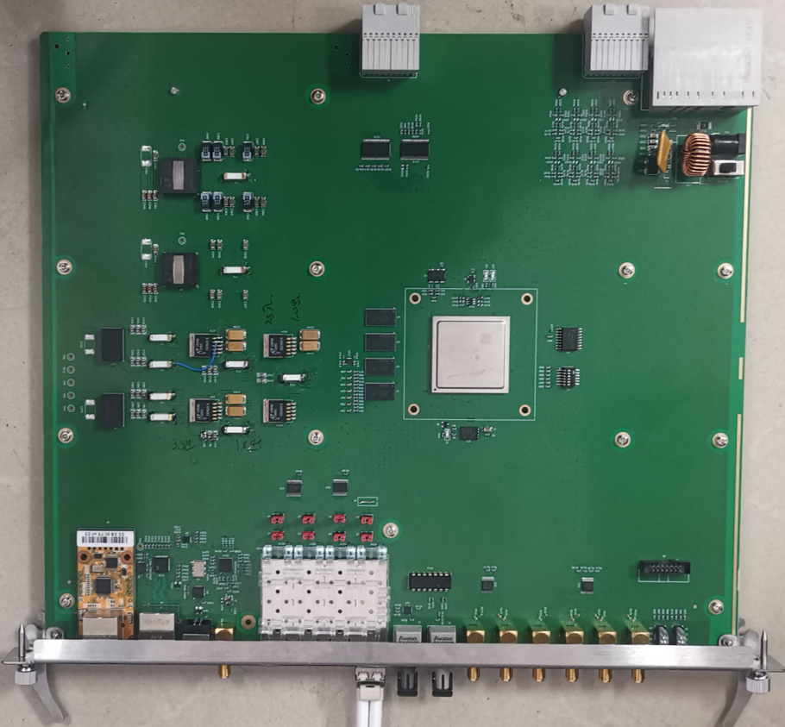
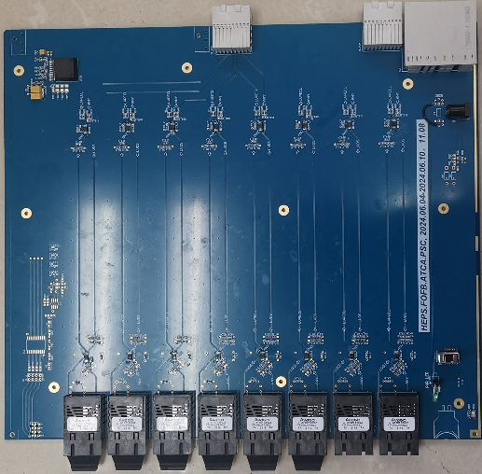
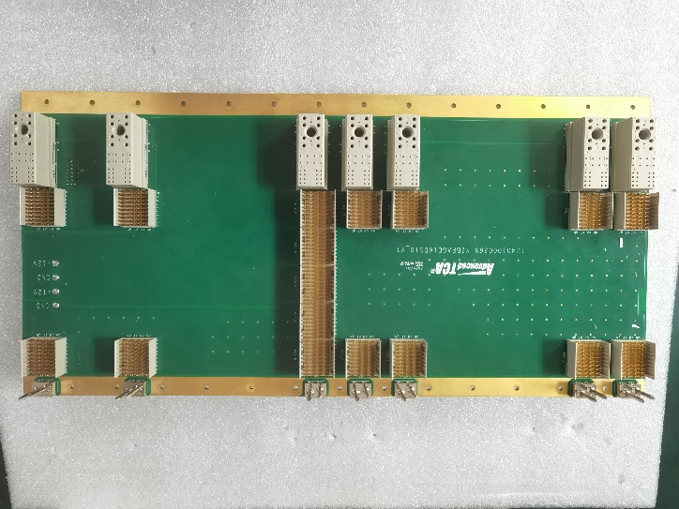
Hardware implementation
  At present, all FOFB system modules have been produced and tested.
  Based on the existing hardware, the FOFB system can be deployed on HEPS to conduct the basic functional testing.
ATCA crate
MAIN board
AUX board
PSC board
Backboard

Slide 22
4, FOFB system laboratory testing

Slide 23
Laboratory testing platform
  Four BPM, one FOC and one PSC were used to build a test
  platform in the laboratory to test the basic functions and
  evaluate the performance of the system.
  BPM data communication test: The delay of 50 meter fiber optic transmission is about 0.65𝜇s, and the total delay of data transmission is estimated to be about 0.5𝜇s.
  Power controller interface testing: calibration value sending test, read back data receiving, power on/off control, etc.
  FOFB Algorithm Simulation: Calculate PS setpoints using test data in both FOC and the upper computer's Matlab, and cross-check for verification.
  Data Readout Function Test: Real-time reading of FOFB system data at 300Mbps rate by receiving UDP data packets through Python on PC.

Slide 24
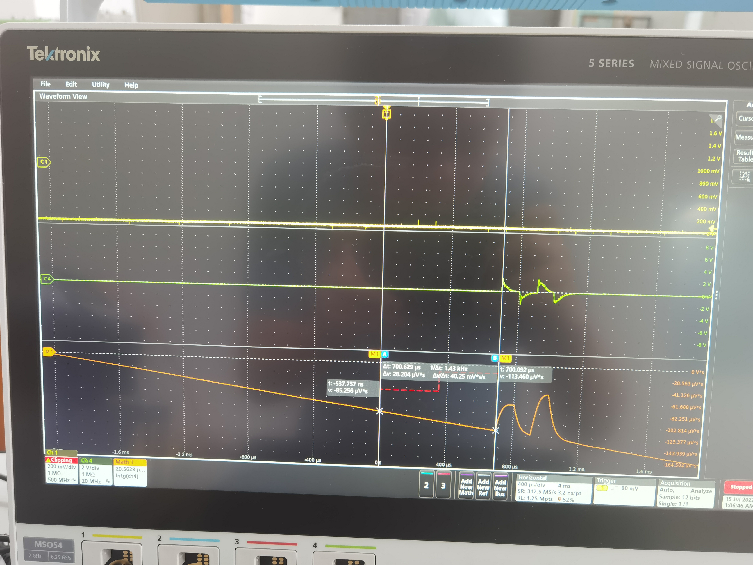
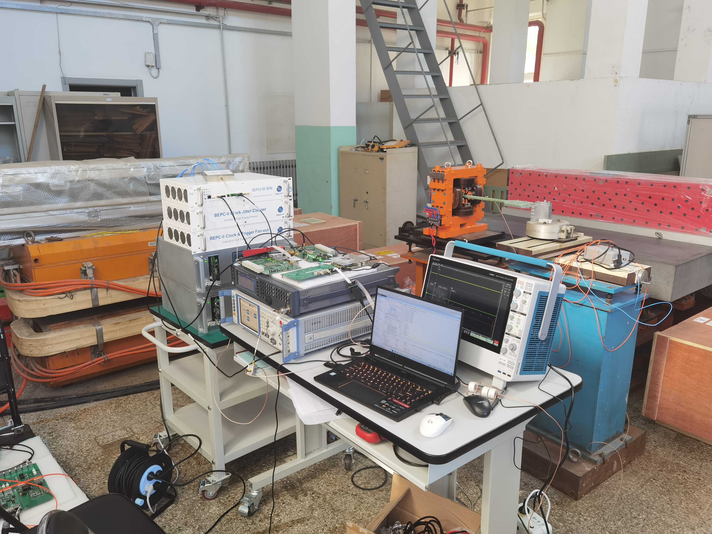
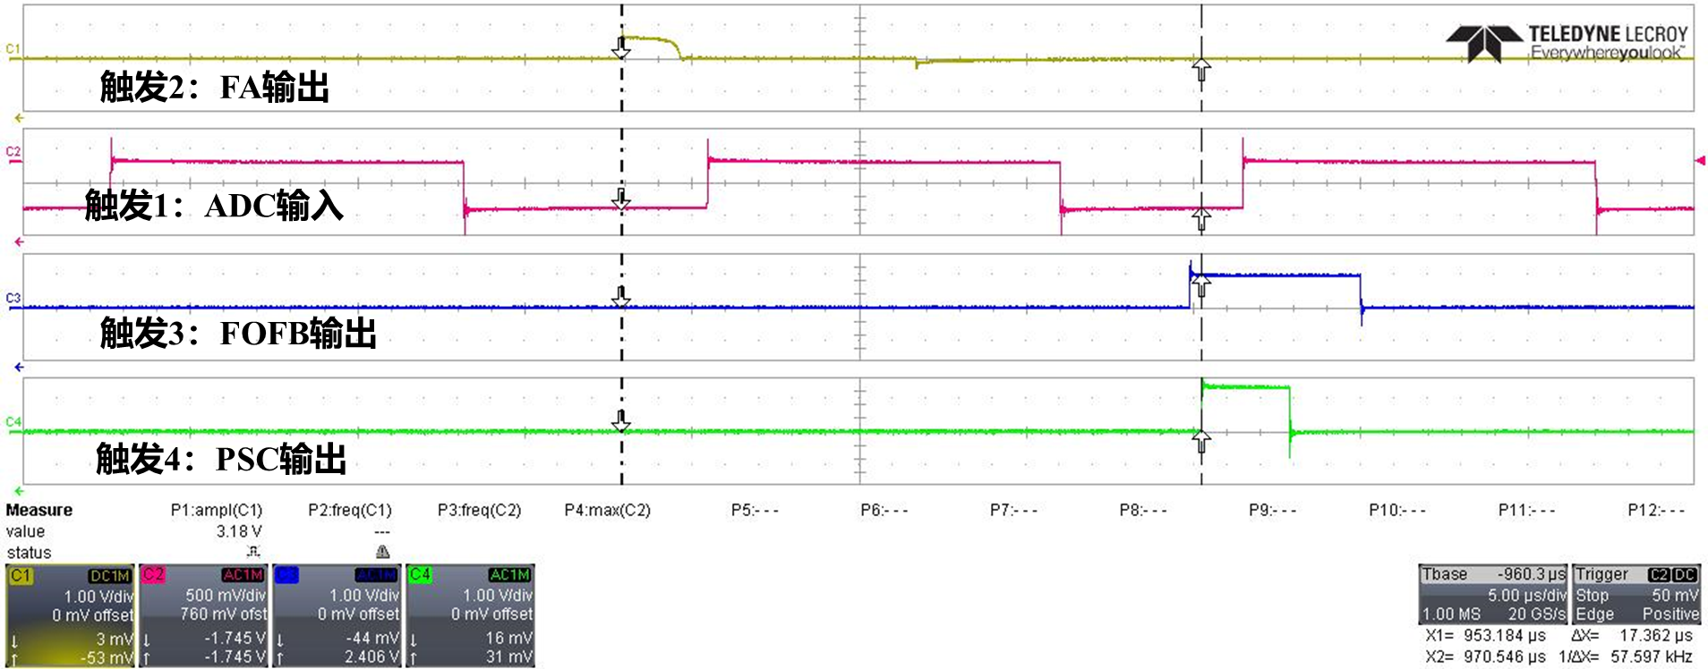
Multi-system joint test in laboratory
  Test platform include BPM, FOFB, PSC, and Magnets.
  Function test: the signal from BPM to FOFB, and to PSC, at last, to Magnets. The system have a fixed latency .

Slide 25
5, FOFB On-site testing without Beam

Slide 26
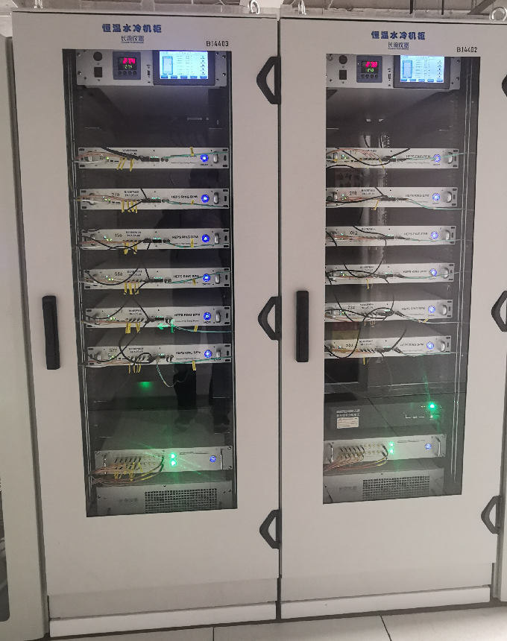
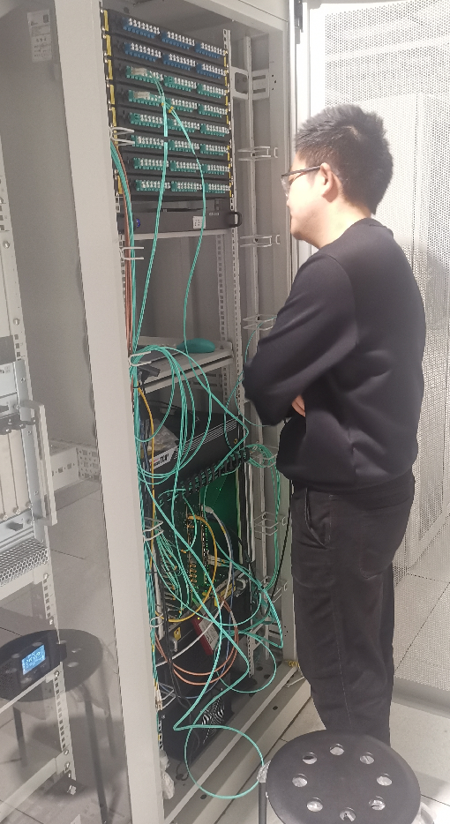
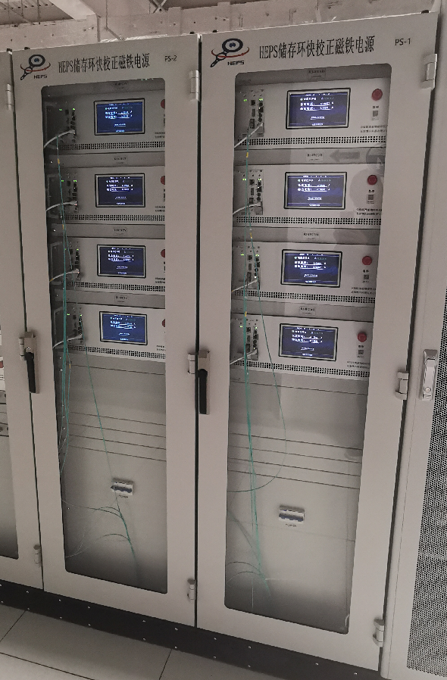
On site testing platform construction
Testing platform components
  BPMs: 36BPMs at Zone13, Zone14 and Zone15
  FOFB Unit: located at Zone 14
  PSC: 24 PSCs at Zone13, Zone14 and Zone15
DBPMs
FOFB
PSCs

Slide 27
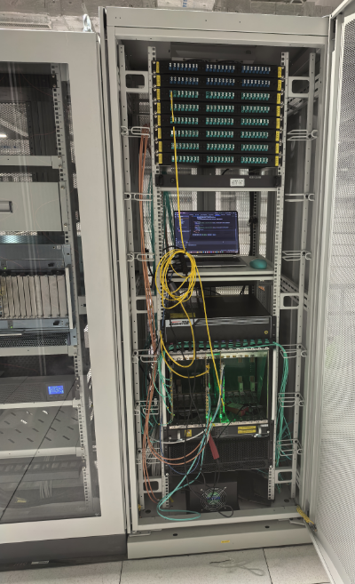
On site testing: FOC self testing
FOFB components in zone 14
  FOFB.ATCA.FOC / FOFB.ATCA.AUX / FOFB.ATCA.PSC_Inf.
  Clock Fanout logic / Trigger Input
  Intelligent PDU with Remote Control Capabilities
FOC self testing result:
  Intelligent PDU Switch ON/OFF with the control program. (OK)
  FOFB.ATCA.FOC and FOFB.ATCA.AUX program loading. (OK)
  The server program controls FOFB through the GbE.(OK)
  Testing program running in FOC is ready

Slide 28
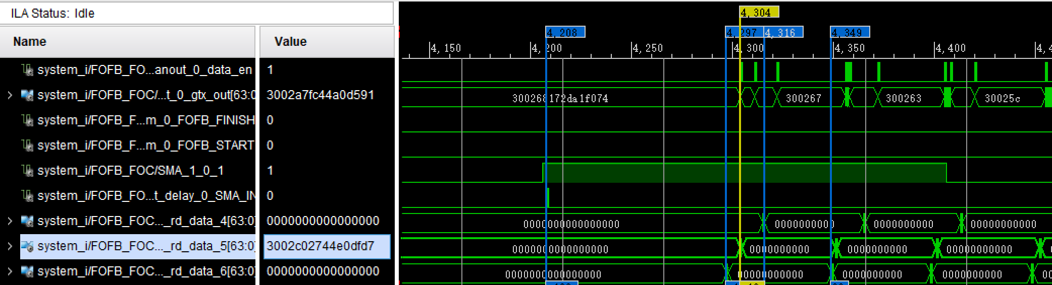
On site testing: DPBMs-FOFB
Testing the data link from Zone 13 DBPMs to Zone 14 FOC.
  The following tasks must be ready before the data link testing
    Related parameter loading is ready, which include: KX,KY / KA,KB,KC,KD/ offset / BPM physical Number / ……
    DBPM FA data should be synchronized : FA data output from the BPM ring must be synchronized with the FA timing signal(TRIG_FA)

Slide 29
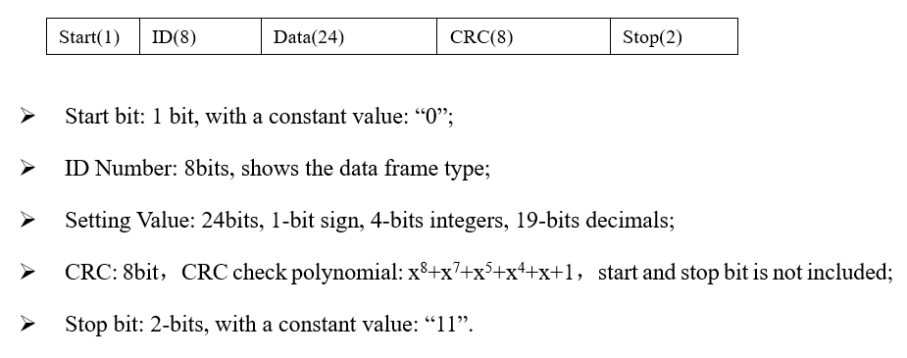
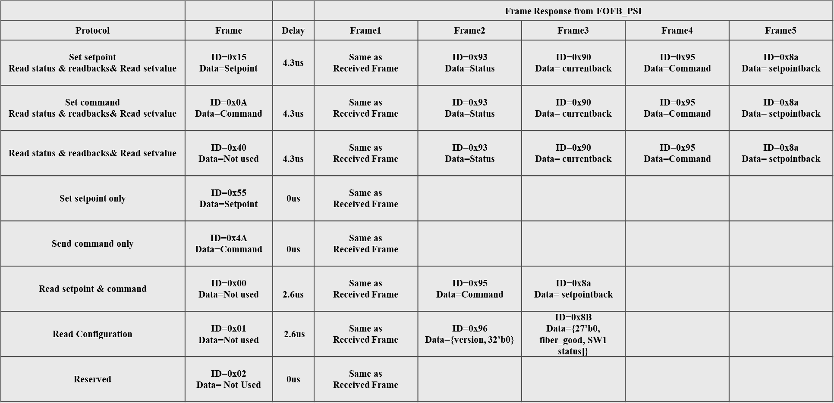
On site testing: FOFB-PSC
Testing contents include:
  Corrector value setting and Data frame checking
    24-bit data, with 1 bit for the sign, 4 bits for the integer, and 19 bits for the decimal bit, which corresponds to the current setting with a range of ±16A. The current setting resolution is 1.9075 µA.
  Related parameters readback(all readback data frame is 24bit)

Slide 30
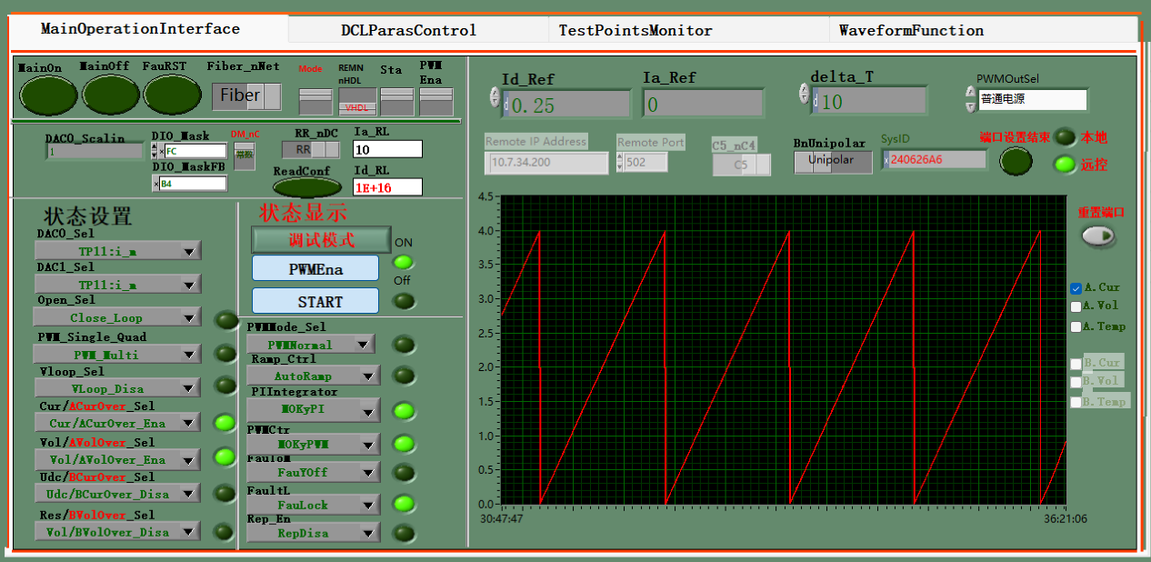
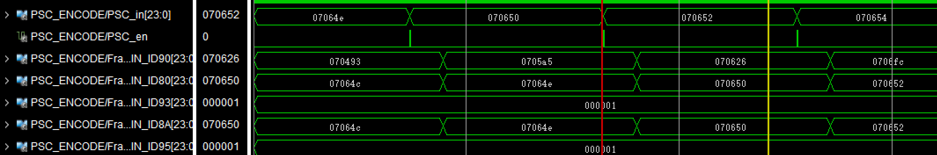
On site testing: FOFB-PSC
Testing results
  The PSC module power on/off is controlled by the network, and the function of fiber optic control for power on/off has been removed.
  The FOFB receives normal read back data, and there are no errors in data communication during short-term testing. the power supply current setpoint can correspond to the setpoint value.

Slide 31
6，FOFB Latency and Bandwidth estimation

Slide 32
Time consumption and FOFB system bandwidth
FOFB system time consumption testing, and FOFB feedback bandwidth estimation
T1, BPM detector and signal transmission time: 0.2𝜇𝑠
T2, BPM date processing time: 96𝜇𝑠
T3, BPM ring data transmission time: 0.4+12*0.2=2.8𝜇𝑠
T4, Data transmission time from BPM ring to FOFB ring: 1.41𝜇𝑠
T5, FOFB ring data transmission time: 9.75𝜇𝑠
T6, Data processing time of FOFB algorithm: 3.5𝜇𝑠
T7, Data transmission time from FOFB to PSC: 3.0𝜇𝑠
T8, Fast corrector system delay: less then 25𝜇𝑠

Slide 33


Time consumption and FOFB system bandwidth
The delay of the FOFB system is divided into 8 parts, and the total delay of the system is estimated based on our laboratory test results.
$$T_{totle}=\sum{T_{i}=141.66}μs$$
${BW}_{FOFB}=\frac{1}{{10∗T}_{totle}}=705.9Hz$
Conclusion: a feedback bandwidth of more than 500 Hz can be achieved for the HEPS FOFB system.

Slide 34
6，FOFB software and algorithm design

Slide 35
System software architecture
Three tier software architecture:
PL(Verilog)、PS(C)、PC(Python)
8 core software function modules.
PL: FOFB core signal link, FOFB algorithm, GTH transceiver, etc., directly determine FOFB system performance.
PS: Developed based on Microblaze soft core, used for data transmission between PL terminal and PC.
PC: User control interface, data processing and analysis.

Slide 36
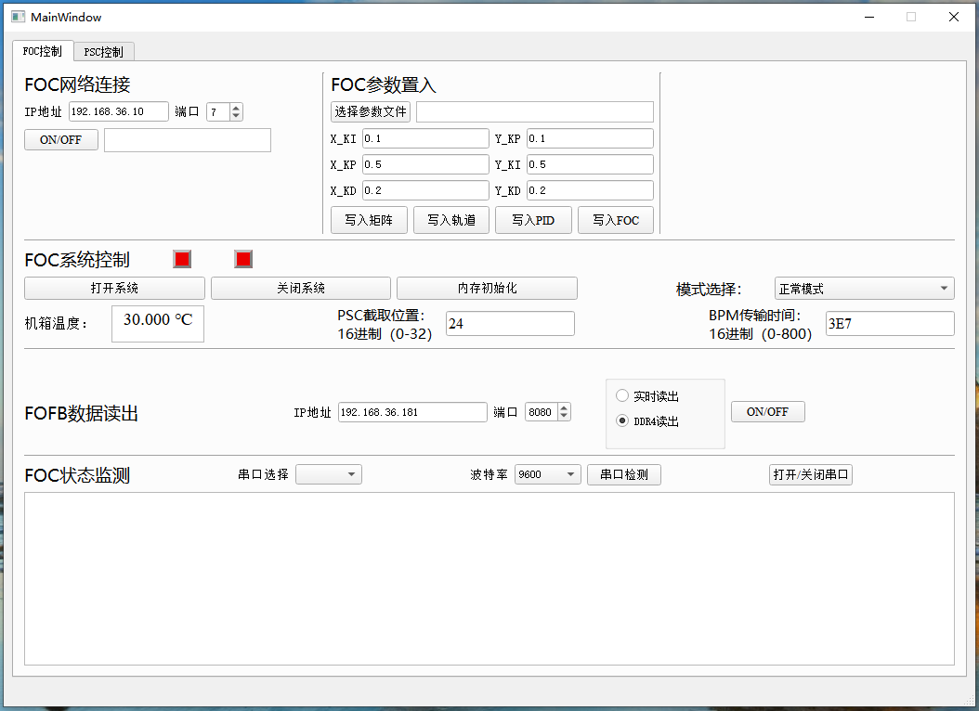
Upper-Layer Control Software
Develop the Upper-Layer Control Software for the FOFB System Using QT.
The implemented functions include: FOC state control, FOFB parameter setting, FOFB data readout and processing.
Over 15,000 32-bit FOFB system parameters should be set in the system running time.
The read data is stored in binary file format, and after format conversion, the data can be saved in large quantities on the server.

Slide 37
Implementation of FOFB algorithm
The core algorithm of FOFB controller adopts periodic pipeline deployment in FPGA.
FOC delay should be less than 35 𝜇s, it needs to be completed within 3500 clock edges（~100M clk）.
T1: BPM data transmission time is set based on the actual measurement results of HEPS.
T2+T3: Correction calculation, based on Systolic Array, currently completed using 392 clock edges.
T4: Computation setpoint transmission time to PSC, adopting a custom transmission protocol ,about 2 𝜇s.

Slide 38
7，Next plan

Slide 39
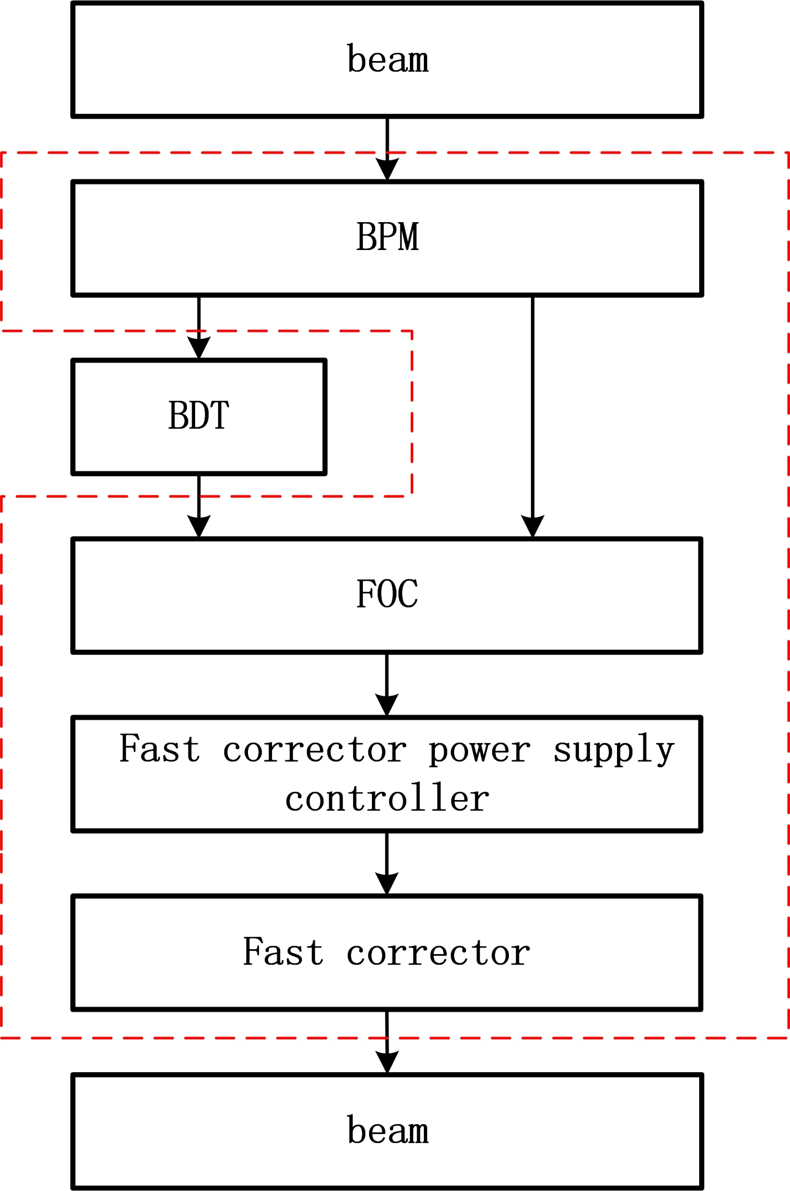
Next plan in 2025
We have already completed testing and simulation of the signal links within the red box in the laboratory.
Next, we will promptly conduct the following tests on HEPS:
Communication and latency testing of the 578 BPM data transmission network.
Interface testing with the timing system and control system.
R&D based on actual beam signal in one FOC station.
Mass production.
Start commissioning.

Slide 40
Long-term plans
Target:
Realize intelligent monitoring and diagnosis of beam current online
Realize compensation correction for the dynamic offset of the “Golden Orbit" and its impact on the accelerator FOFB system
Accurate FOFB control of beam based on AI technology
The developed control algorithm is based on FPGA and can be deployed in different FOFB systems. When the hardware resources meet the algorithm resource requirements, only software upgrades are needed
Correcting the impact of dynamic offset
strong scalability
Adaptive update of control strategy
Multisensor data fusion
Adaptive correction of nonlinear errors

Slide 41
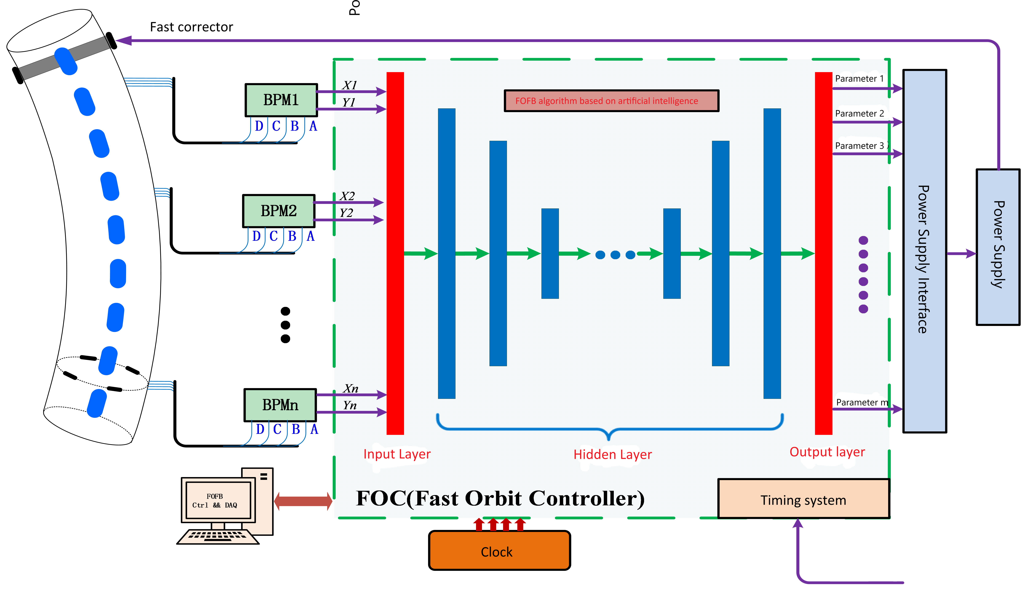
Long-term plans
Hardware implementation Strategy： ZYNQ +GPU
ZYNQ: Complete high speed data receiving and caching via DDR4 among the BPMs and the Fast Correct Power sources, and the Parallel neural network reasoning acceleration.
Xilinx AI Processor IP Core & DPUCZDX8G
Supported devices : Zynq® UltraScale+™ MPSoC and ZYNQ 7000, which have been used in the FOFB systems
Vitis AI development kit : Verilog, AXI4, HLS
GPU: Acceleration of neural network reasoning based on GPU.
Feedback control system based on neural network
Instead of PID algorithm, improves feedback accuracy and reduces data calculation delay
Notes:
基于高度并行的特性，FPGA适合采用定点数完成神经网络中的大规模运算，实现降低运算延迟，适合于对实时性要求高的FOFB系统

Slide 42
8，Summary

Slide 43
Summary
The very small beam sizes of HEPS present significant challenges in achieving orbit stability.
The FOFB system adopts star-ring data transmission network structure to reduce latency, and promote the system stability, furthermore, expand the input capability.
We have completed all the hardware design, the overall hardware of the crate adopts a custom ATCA architecture.
V7-FPGA manages BPM and FC data streams and perform correction computations.
Based on the current latency test results of various systems, the system can achieve a closed-loop bandwidth of 500 Hz or even higher.
We will soon complete the small system testing with beam and proceed to mass production. We hope to start commissioning by the end of the year.

Slide 44
Acknowledgement
Thanks to Tian Yuke(NSLS2), Yin Chongxian (SSRF), Jiang Bocheng (Chongqing University), Liu Lin (Sirius), Daniel Tavares (Sirius), Fernando de Sa (Sirius), and Holger Schlarb (DESY) for their insightful discussions.

Slide 45



Slide 46
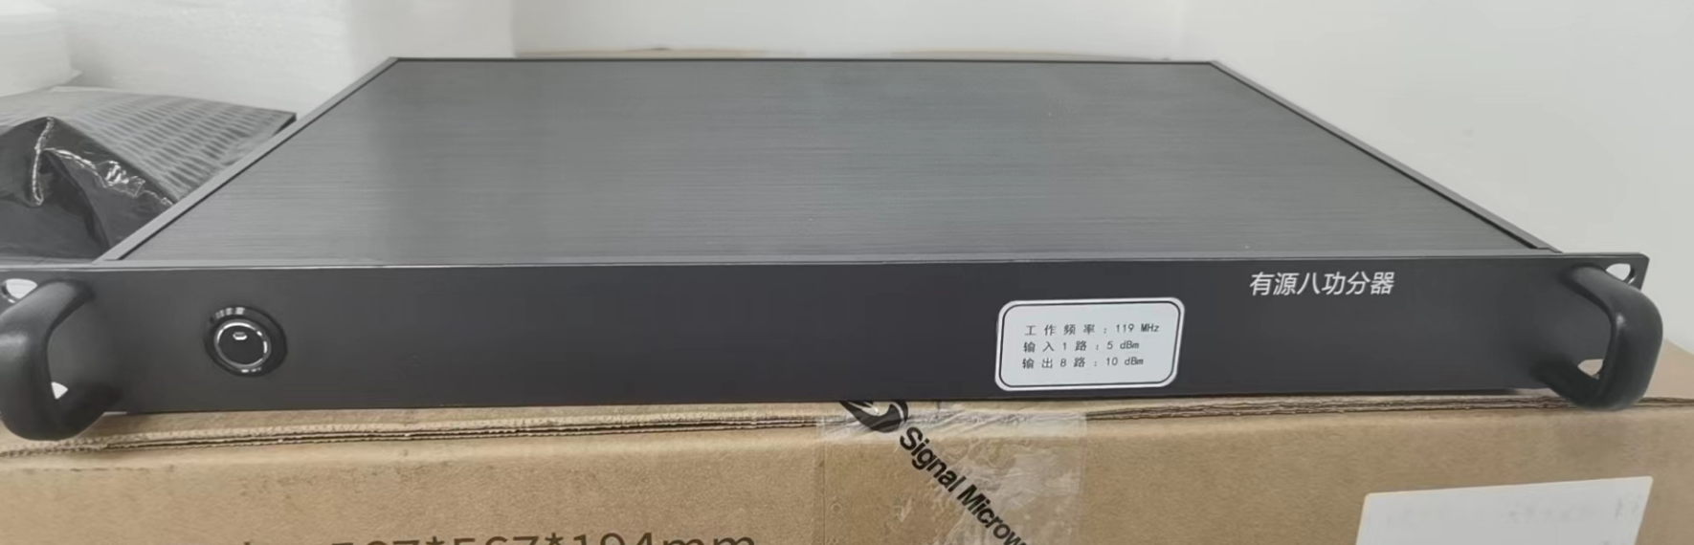
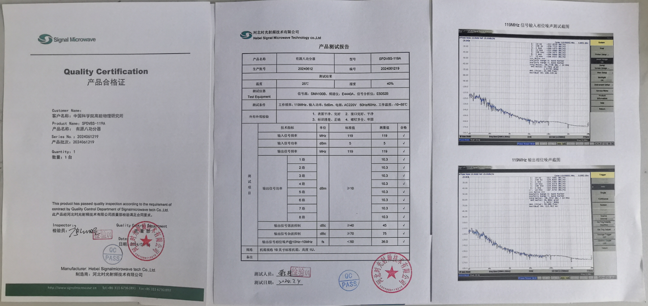
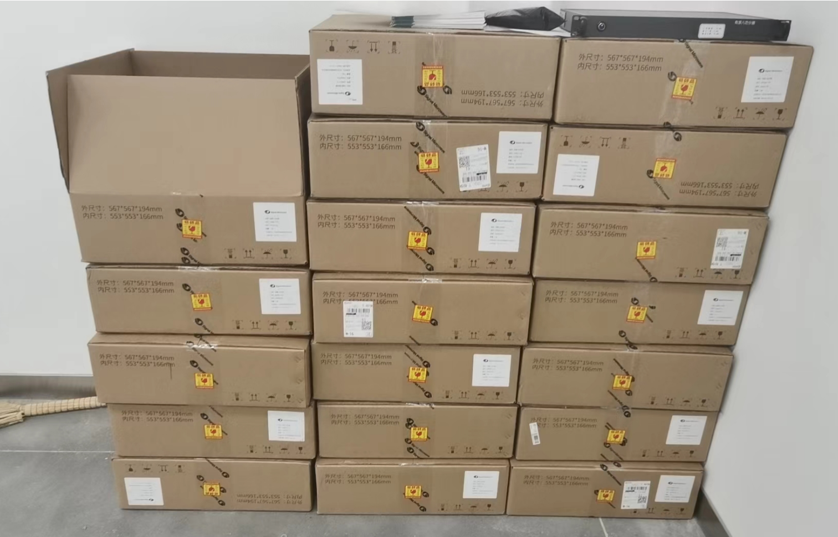
RF clock fanout mdoule
1-8 power splitter for RF clock fanout.

Slide 47
BDT module function block
FOFB BDT Function block
Key features
  Receive all 12 BPMs from one station;
  Receive all XBPMs near the FOFB station;
  Check, reassemble, and align all BPM data;
  Finally, send the data to the FOC module using one fiber.

