Slide 1
Welcome and Kickoff Meeting
- I.FAST Workshop on Stability of Storage Ring Based Light Sources
The Quadro City Hotel, Karlsruhe, 17 March 2025
Akira Mochihashi, I.FAST Task 7.2 / KIT - IBPT

Slide 2
Words of Thanks
The workshop has been organized jointly with Synchrotron SOLEIL in France and KIT.
The partners of the I.FAST Task 7.2 have strongly supported the scientific organization of the workshop.
Thank you for all your contributions, support and understanding in organizing the workshop!

Slide 3
Contents
About the workshop + joint experiment
The I.FAST Project: a brief introduction
KIT Facility Overview
Organisational information

Slide 4
Contents
About the workshop + joint experiment
The I.FAST Project: a brief introduction
KIT Facility Overview
Organisational information

Slide 5
Stability Workshop
The workshop focuses on the light source stability
  Session 1: Source Position Stability (11 Talks)
    Orbit Correction and Feedback, Top-Up Injection, Diagnostics
  Session 2: Resistive/Permanent Magnets (4 Talks)
    Field Measurement, PM-Development, Demagnetization Issue
  Session 3: Infrastructure (4 Talks)
    Vibration, Girder Design and Alignment
  Session 4: Challenging Issues (6 Talks)
    Stability Issues to be resolved

Slide 6
Joint Experiment
  Orientation Session: About beam-based alignment (1 Talk)
    Principle (direct and parallel BBA)
    Discussion about experimental plans (what/why/how measures)
    Other options for the experiments
  Joint Experiment: 1.5 days
    At KARA control room
    With the real 2.5 GeV storage ring and real electron beams

Slide 7
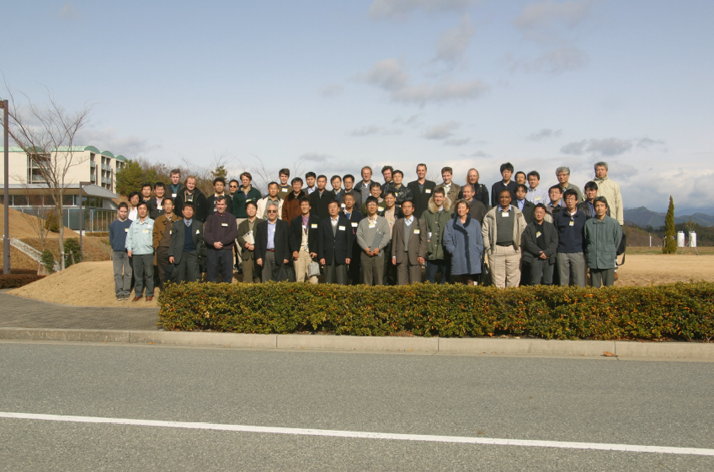
At IWBS2002 at SPring-8 …
From Brief Summary of IWBS2002, H. Tanaka
Facility Report
  … a few ~5um stability almost achieved in major labs.
Capability of Source Suppression
  … rich knowledge is being stored in each lab. … level of 1 um is reachable in the frequency range from a few Hz to a few 100 Hz.
Slow Orbit Measurement & Correction
  … each lab has own system. Methods and approaches have many varieties…

Slide 8
At IWBS2002 at SPring-8 … (cont.)
From Brief Summary of IWBS2002, H. Tanaka
Fast Orbit Measurement & Correction
  … DBPM system seems to be promising to realize a sub-micron precision.
Towards Sub-Micron Orbit Stability
  Electric circuit upgrade
  BPM mechanical shift monitoring & control
  X-ray optics stabilization
  ID shimming and its perfect transparency
  Stable building basement
  XBPM precision and stability improvement
  Road surface improvement
During the workshop, we will see:
What has been achieved, and what problems remain?
What has changed now?

Slide 9
Contents
About the workshop + joint experiment
The I.FAST Project: a brief introduction
KIT Facility Overview
Organisational information

Slide 10
The I.FAST Project
Innovation Fostering in Accelerator Science and Technology (I.FAST)
I.FAST aims to enhance innovation in the particle accelerator community, mapping out and facilitating the development of breakthrough technologies common to multiple accelerator platforms.
… Innovation is needed to identify and develop new sustainable accelerator technologies capable of reaching the performance required by particle physicists at an acceptable impact on society; and to favor the transfer of key technologies, developed over the last decades, to particle accelerators used for applied science (photon and neutron sources) and for societal applications (medicine, industry, environment).
Programme | Horizon 2020 (Research Innovation Action)
Duration | May 2021 – April 2025 → October 2025
Consortium | 48 participants from14 countries
Project coordinator | Maurizio Vretenar (CERN)
https://ifast-project.eu/index.php/
https://ifast-project.eu/index.php/about

Slide 11
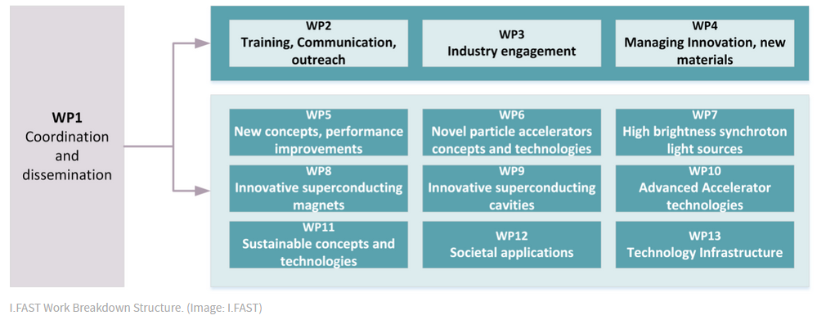
The Project Structure
Nine key thematic areas
https://ifast-project.eu/about

Slide 12
I.FAST Work Package 7
WP7: High brightness accelerators for light sources
Tasks | Name | Task leader
7.1 | Coordination and communication | R. Bartolini (DESY)
7.2 | Enabling technologies for ultra-low emittance rings | A. Mochihashi (KIT)
7.3 | Variable Dipole for the upgrade of the ELETTRA storage ring | Y. Papaphilippou (CERN)
7.4 | Very high gradient RF Guns operating in the C-band RF technology | D. Alesini (INFN)
7.5 | Compact light Prototype Accelerator Structures | G. D‘Auria (Elettra)
Task 7.2: Enabling Technologies for Ultra Low Emittance Rings
We focus on networking in the area of ultra low emittance rings dominated by the recent X-ray storage rings upgrades and exploiting synergies with existing and future e⁺/e⁻ colliders.

Slide 13
Contents
About the workshop + joint experiment
The I.FAST Project: a brief introduction
KIT Facility Overview
Organisational information

Slide 14



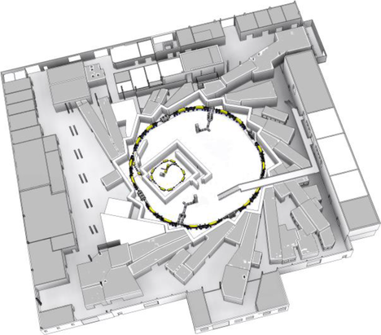
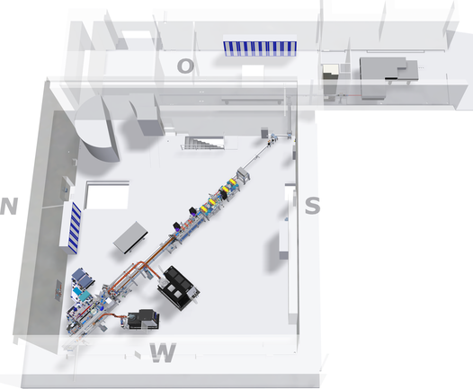
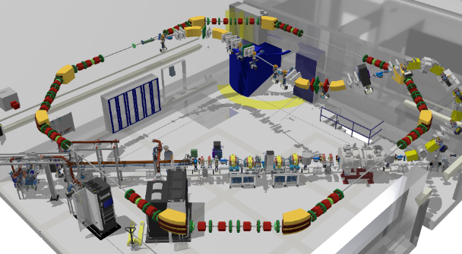
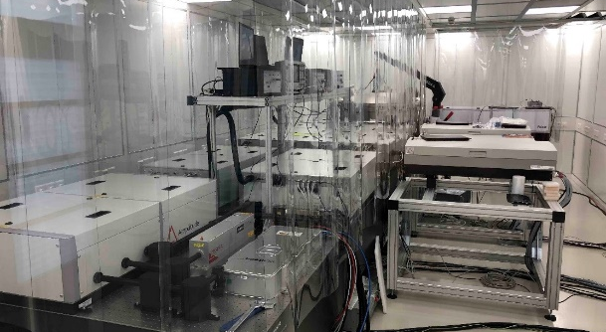
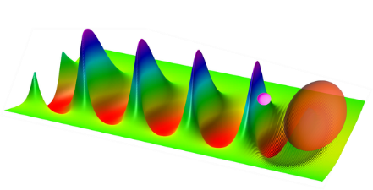
Accelerator facilities for non-equilibrium systems
Rings, linear/linac & laser plasma accelerator, non-eq. storage ring
110 m
26 m
20 m
43 m
ibpt.kit.edu/kara
FLUTE injector
ibpt.kit.edu/flute
LPA injector
ibpt.kit.edu/cstart
70 TW laser system at KIT
Laser plasma accelerator (LPA)
Courtesy: M. Schuh

Slide 15


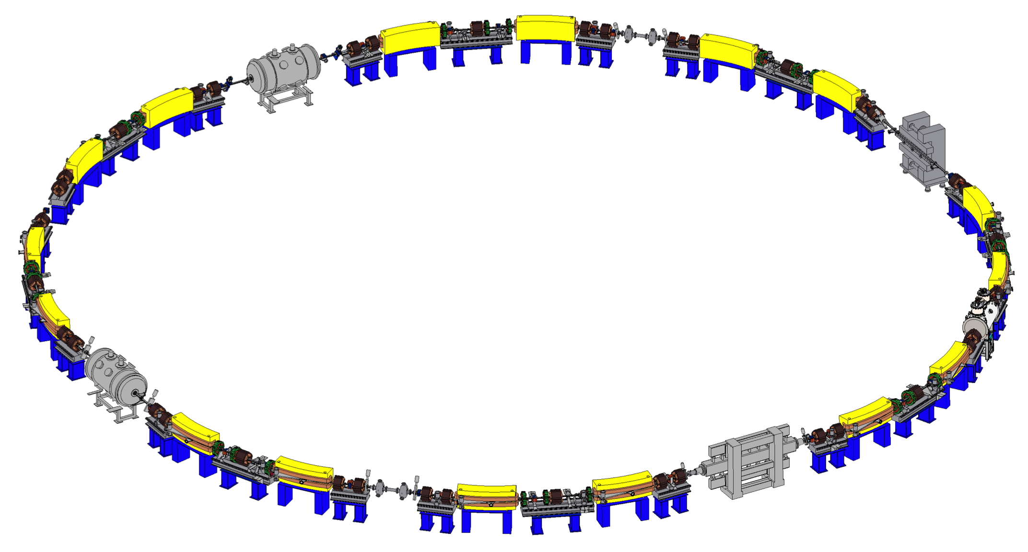



Karlsruhe Research Accelerator (KARA)
KIT synchrotron light-source & accelerator test facility
Circumference | 110.4 m
Energy range | 0.5 – 2.5 GeV
RF frequency / period | 500 MHz / 2 ns
Revolution frequency / period | 2.715 MHz / 368 ns
Beam current | up to 200 mA
RMS bunch length | 45 ps (2.5 GeV) a few ps (1.3 GeV)
Operation status in 2024:
100 days synchrotron light + 50 days machine physics
  Service on Monday morning
  Operation Monday afternoon till Saturday morning
www.ibpt.kit.edu/kara
Courtesy:
U. Herberger, M. Schuh

Slide 16
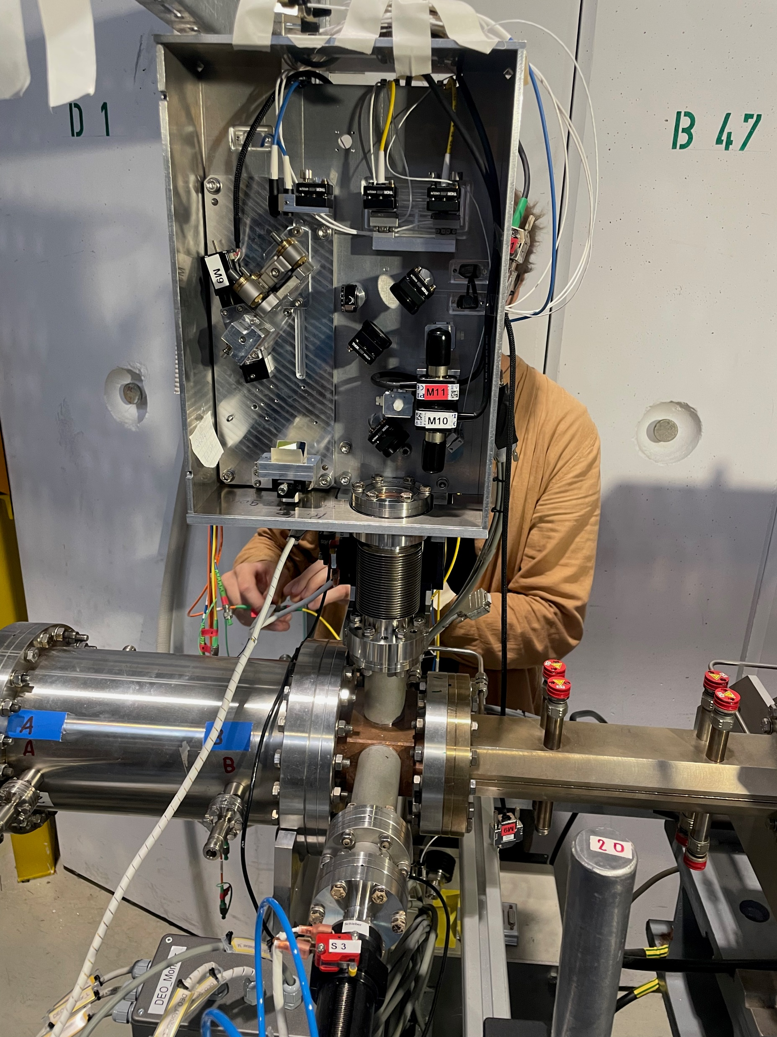
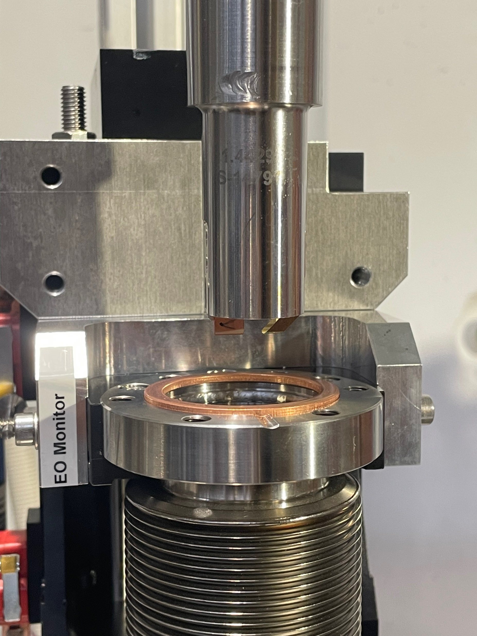

EO Crystal Change at KARA
EO monitor at KARA
First crystal change since 2017
Old crystal suspected to degrade over time
First beamtime results show an improved signal stability but similar amplitude
Further optimizations are still in progress
New EO-chamber delivered to allow crystal change without venting the complete straight section
New crystal
Courtesy:
T. Borkowski
Courtesy: S. Schott
Beam pipe
M. Reißig et al.
Courtesy: M. Schuh

Slide 17
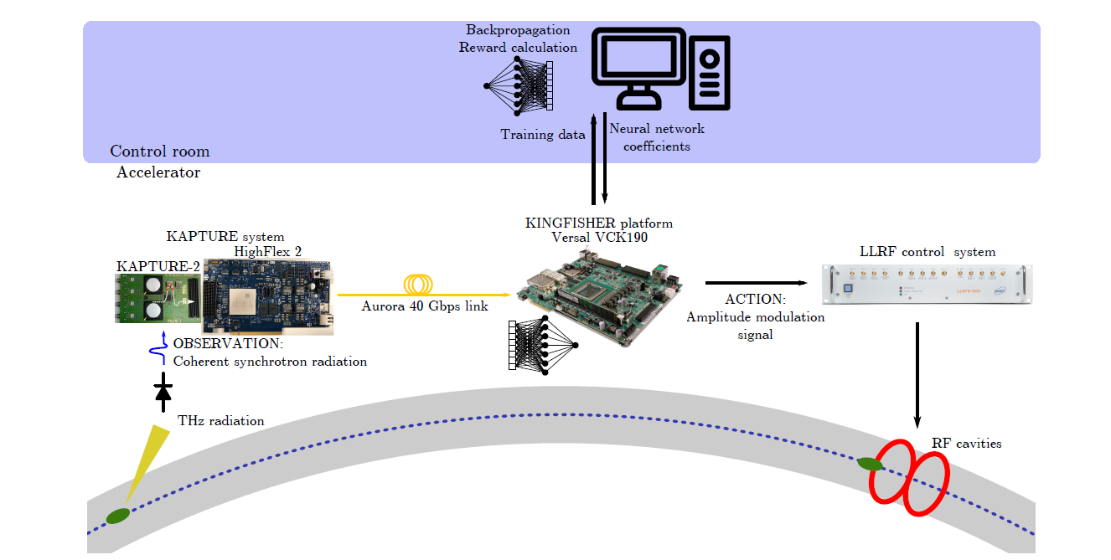
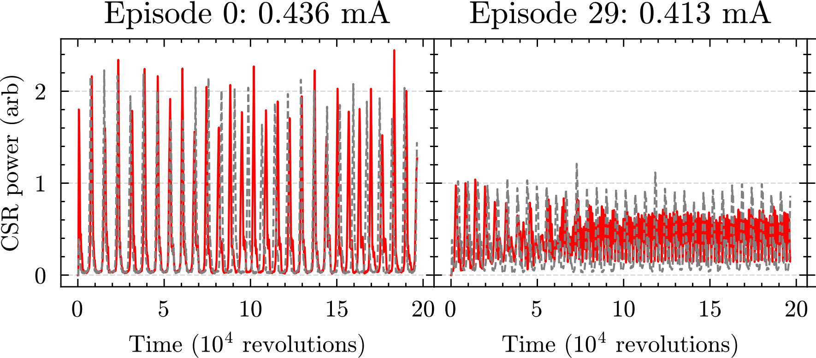
Real-time Reinforcement Learning on FPGA with Online Training for Autonomous Accelerators
World’s first AI real-time control
of the microbunching instability at KIT
Setup at Karlsruhe Research Accelerator KARA
CSR power – Feedback off
CSR power – AI controlled
Paper submitted:
AI control of coherent synchrotron radiation (CSR) with online-training – and without pre-training – on hardware.
http://arxiv.org/abs/2409.16177
10.18429/JACoW-IPAC2024-TUPS61
Scomparin et al.
Courtesy: M. Schuh
17

Slide 18

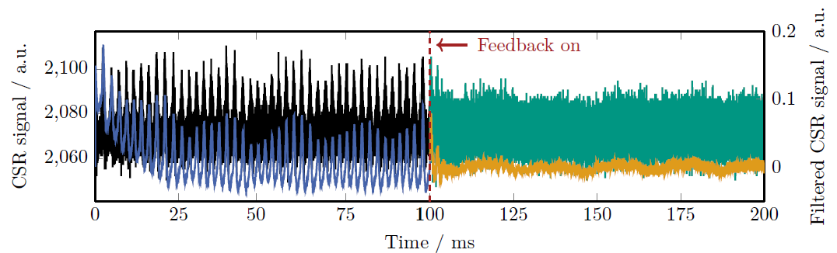
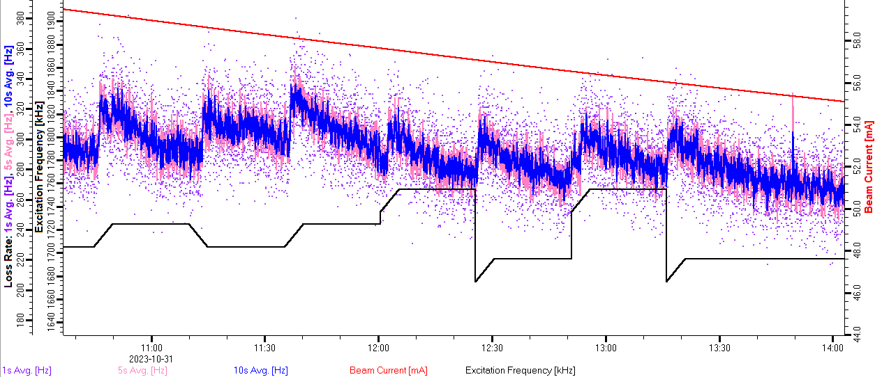
EURO-LABS and I.FAST Activities
Bestex: Photo-stimulated desorption measurements for future accelerators, FCC; Prototype No.6 measured
Advanced control of the microbunching instability
Resonant Depolarisation studies at KARA for FCC-ee
Beam stabilization- and handling experiments with KARA
bunch-by-bunch feedback system: collaboration with I.FAST, WP7.2
Beam-based alignment for FCC-ee
Microbunching control
L. Somparin
Depolarisation scan
E. Blomley
https://doi.org/10.18429/jacow-ipac2024-wepg51
https://doi.org/10.18429/jacow-ipac2024-wepr20
Courtesy: M. Schuh

Slide 19



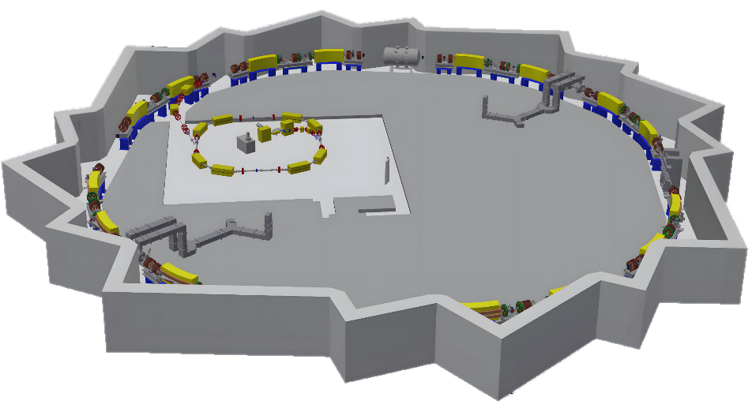
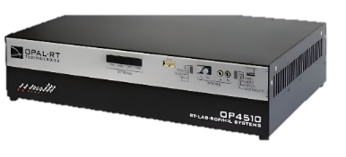
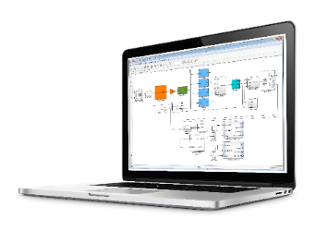
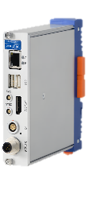
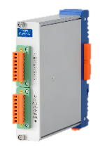


Energy Solutions – Getting Results with KITTEN
Real-time energy-informed & physics-informed digital twin
Union of 2 large-scale KIT research infrastructures: EL2.0 & KARA
Communication Infrastructure
Digital Twin
1.5 – 2 km
Measuring system
OPAL-RT Simulator
J. Gethmann, M. Mohammad Zadeh, G. De Carne
Sampling rate
10 kHz (100 µs)
Measuring system
Electrical model of KARA in Simulink
Measured electrical current & voltage signals
Europe's largest research infrastructure for renewable energy
Solar PV park 242 (+300) kWp
Thermal groundwater cooling system 1 MW
Helmholtz program “Energy System Design” (ESD) in research field Energy.
Helmholtz YIG “Hybrid Networks” (VH-NG-1613).
atp.kit.edu/sustainability.php
Courtesy: M. Schuh

Slide 20
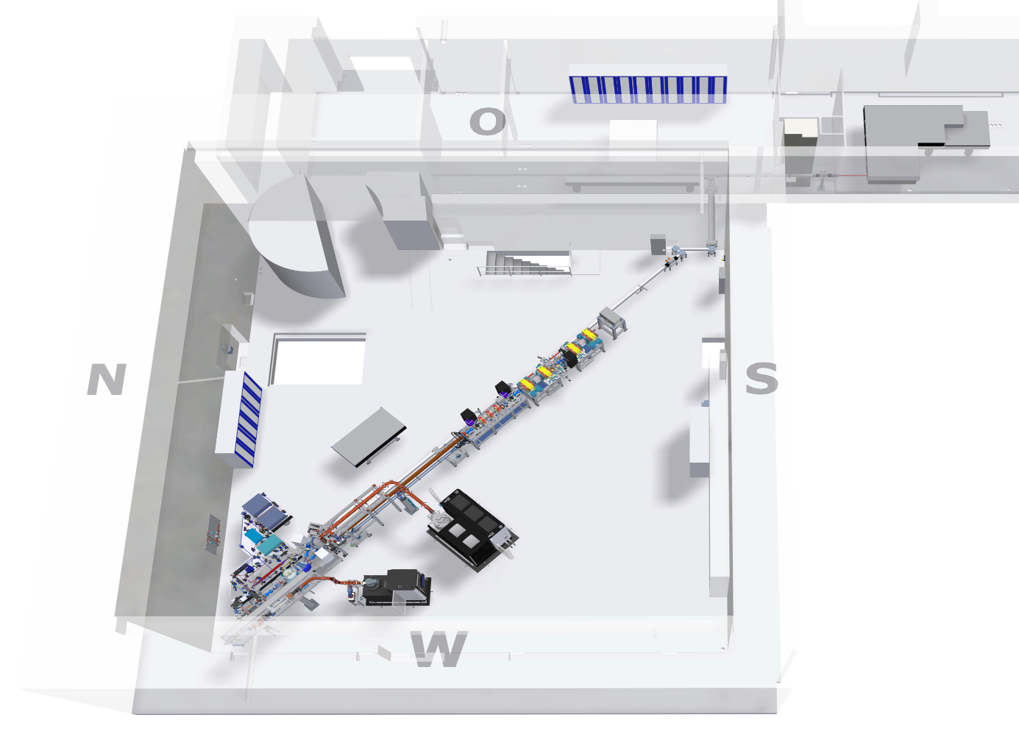

FLUTE: Accelerator Test Facility at KIT
FLUTE (Ferninfrarot Linac- Und Test-Experiment)
  Test facility for accelerator physics within ARD
  Experiments with THz radiation
Optimal electron energy | ~ 41 | MeV
Electron bunch charge | 0.001 - 1 | nC
Electron bunch length | 1 - 300 | fs
Pulse repetition rate | up to 50 | Hz
THz E-Field strength | up to 1.2 | GV/m
R&D topics
  Serve as a test bench for new beam diagnostic methods and tools
  Systematic bunch compression
  and THz generation studies
  Develop single shot fs diagnostics
  Synchronization on a femtosecond level
Courtesy: S. Schott
www.ibpt.kit.edu/flute
Courtesy: M. Schuh

Slide 21
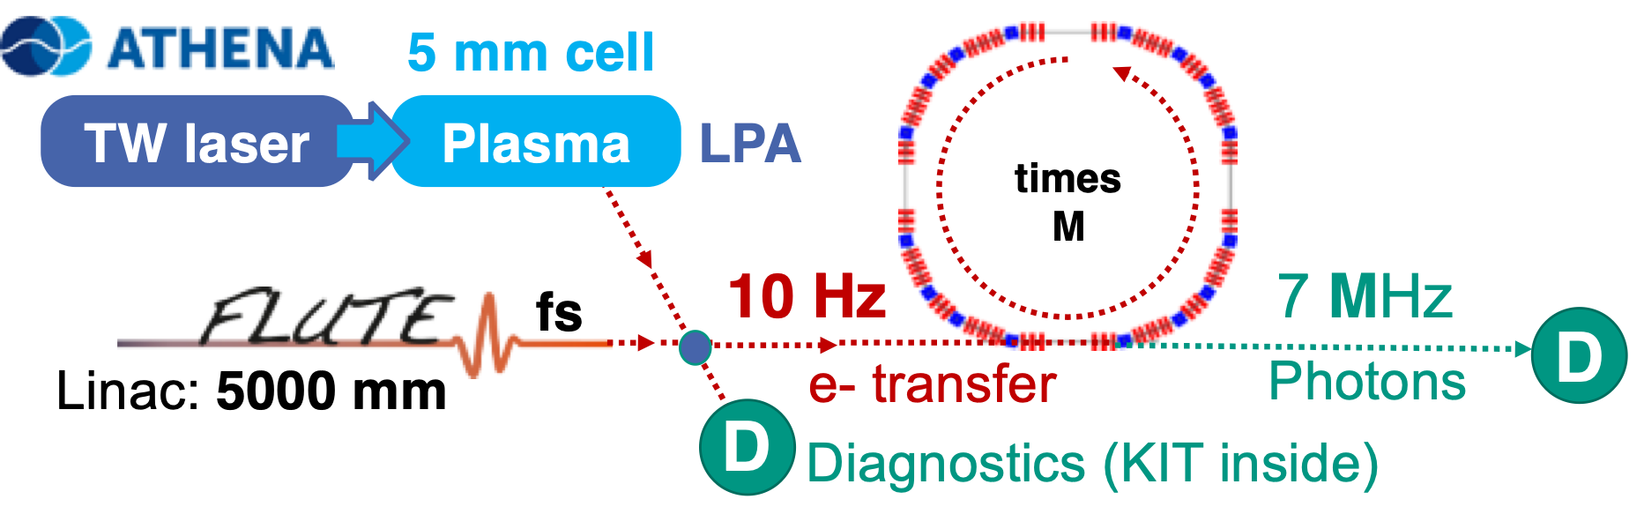


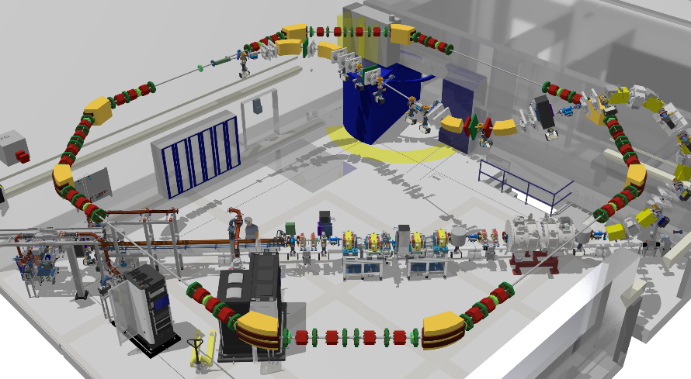

cSTART Project
Unique storage ring
  Compact (14 m diameter), energy efficient
  Large acceptance of electron energies (~4%)
  Lattice to store ultrashort electron bunches (<100 fs)
  Testbed for widely unexplored accelerator physics
  Prototype for future accelerator concepts
First injection of laser-plasma electron bunches
  future hybrid LPA - RF accelerator
  Combination of LPAs and complex electron beam optics
  Testbed for LPA experiments in storage rings
First storage ring for ultrashort bunches
  Storage of <100 femtosecond electron bunches
  (similar to LINACs, 2-3 orders of magnitude shorter than conventional rings)
Research and Applications
  Study of non-equilibrium dynamics of fs bunches
  Study and manipulation of longitudinal phase space
  Advanced turn-by-turn high-repetition rate diagnostics
  Potential for next-generation of light source with transformative impact
Courtesy: T. Borkowski
2024: TDR
Technical design report
2026: Assembly
2027: Commissioning
www.ibpt.kit.edu/cstart
Courtesy: M. Schuh

Slide 22
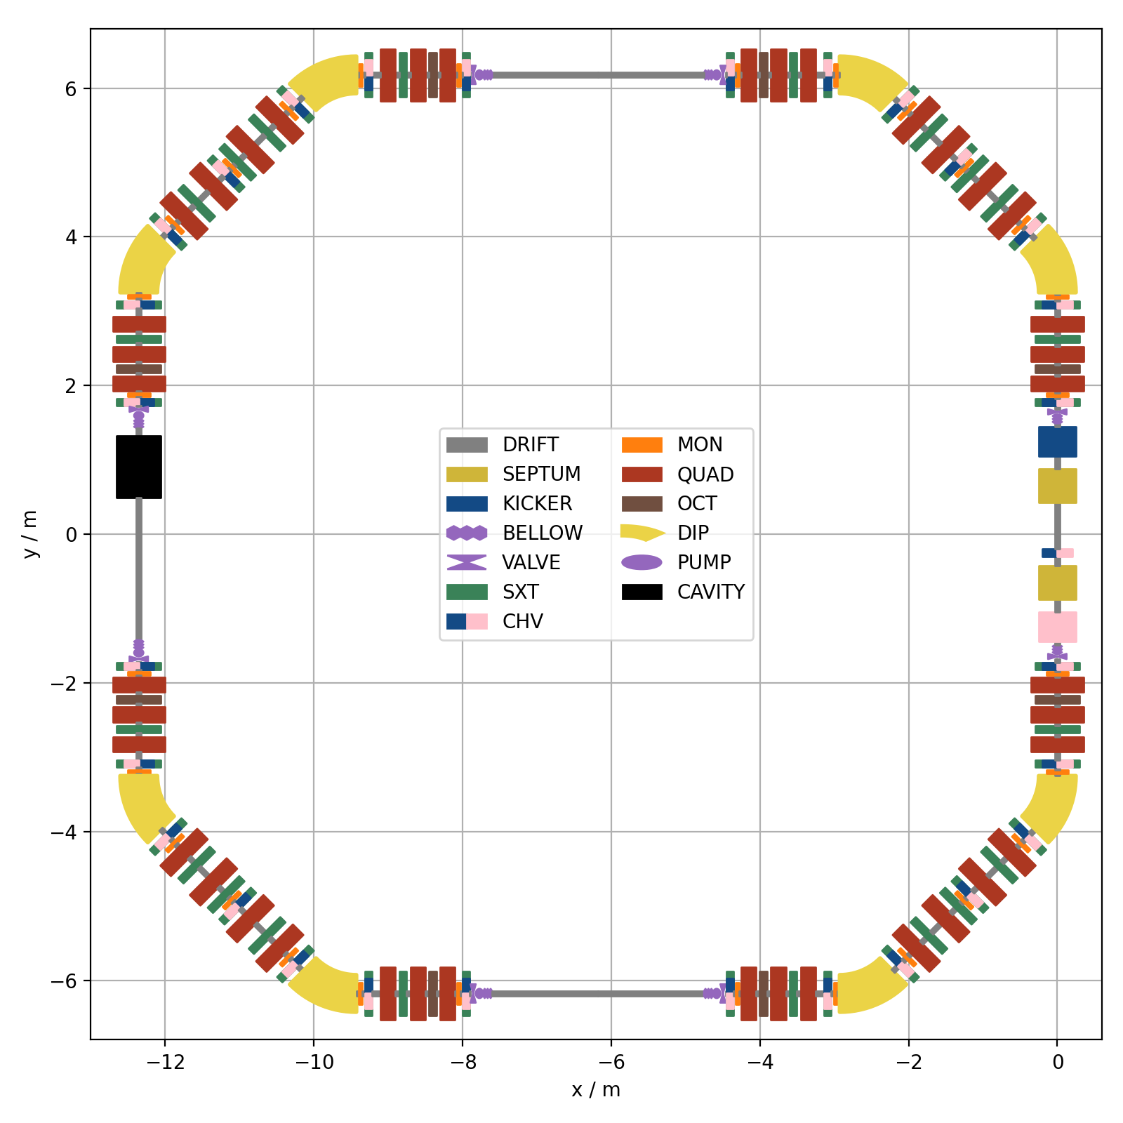
VLA-cSR
Motivation: Storage of ultra-short (fs) electron bunches with high repetition rate
Compact storage ring with very large momentum acceptance and dynamic aperture
Injectors
  FLUTE with new transfer line
  LPAs
Circumference | 43.2 m
Energy | 50 - 90 MeV
Revolution time | 144 ns; 6.9 MHz
Storage time | 100 ms
y / m
x / m
Picture: M. Schwarz
Courtesy: M. Schuh

Slide 23
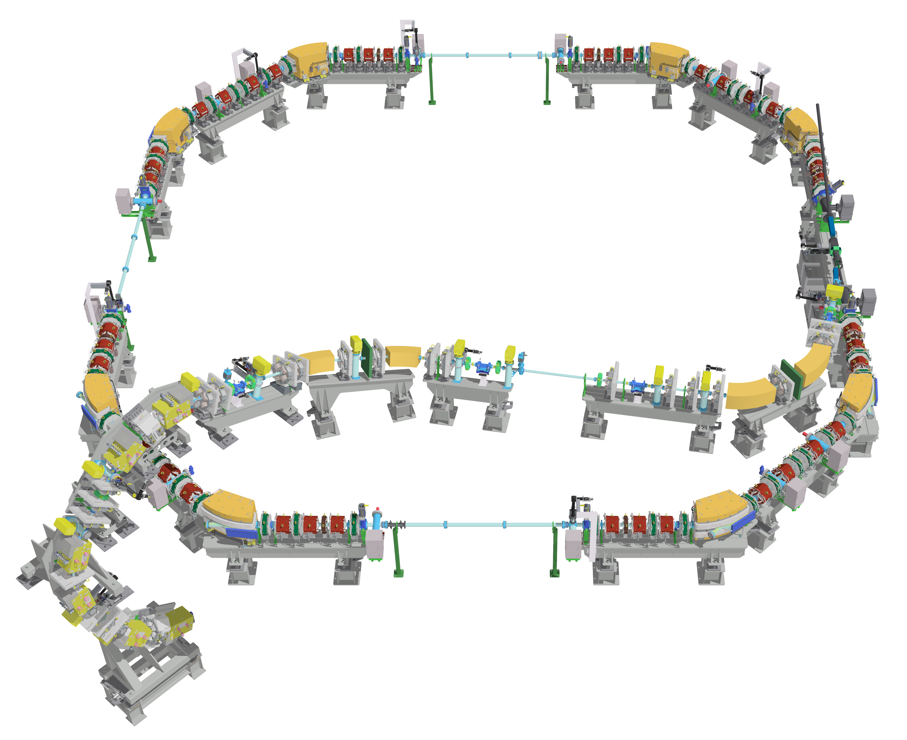

cSTART: FLUTE Injection Line Challenges
The storage ring is located on the “2nd floor”
→ Injection line needs to deflect the beam both horizontally and vertically.
Injection line need to fit into FLUTE experimental hall
→ Injection line needs to be compact
Storage ring serves as a test facility with many operation schemes
→ Injection line needs to be flexible in optics, beam energy and bunch charge
Courtesy: M. Schuh

Slide 24
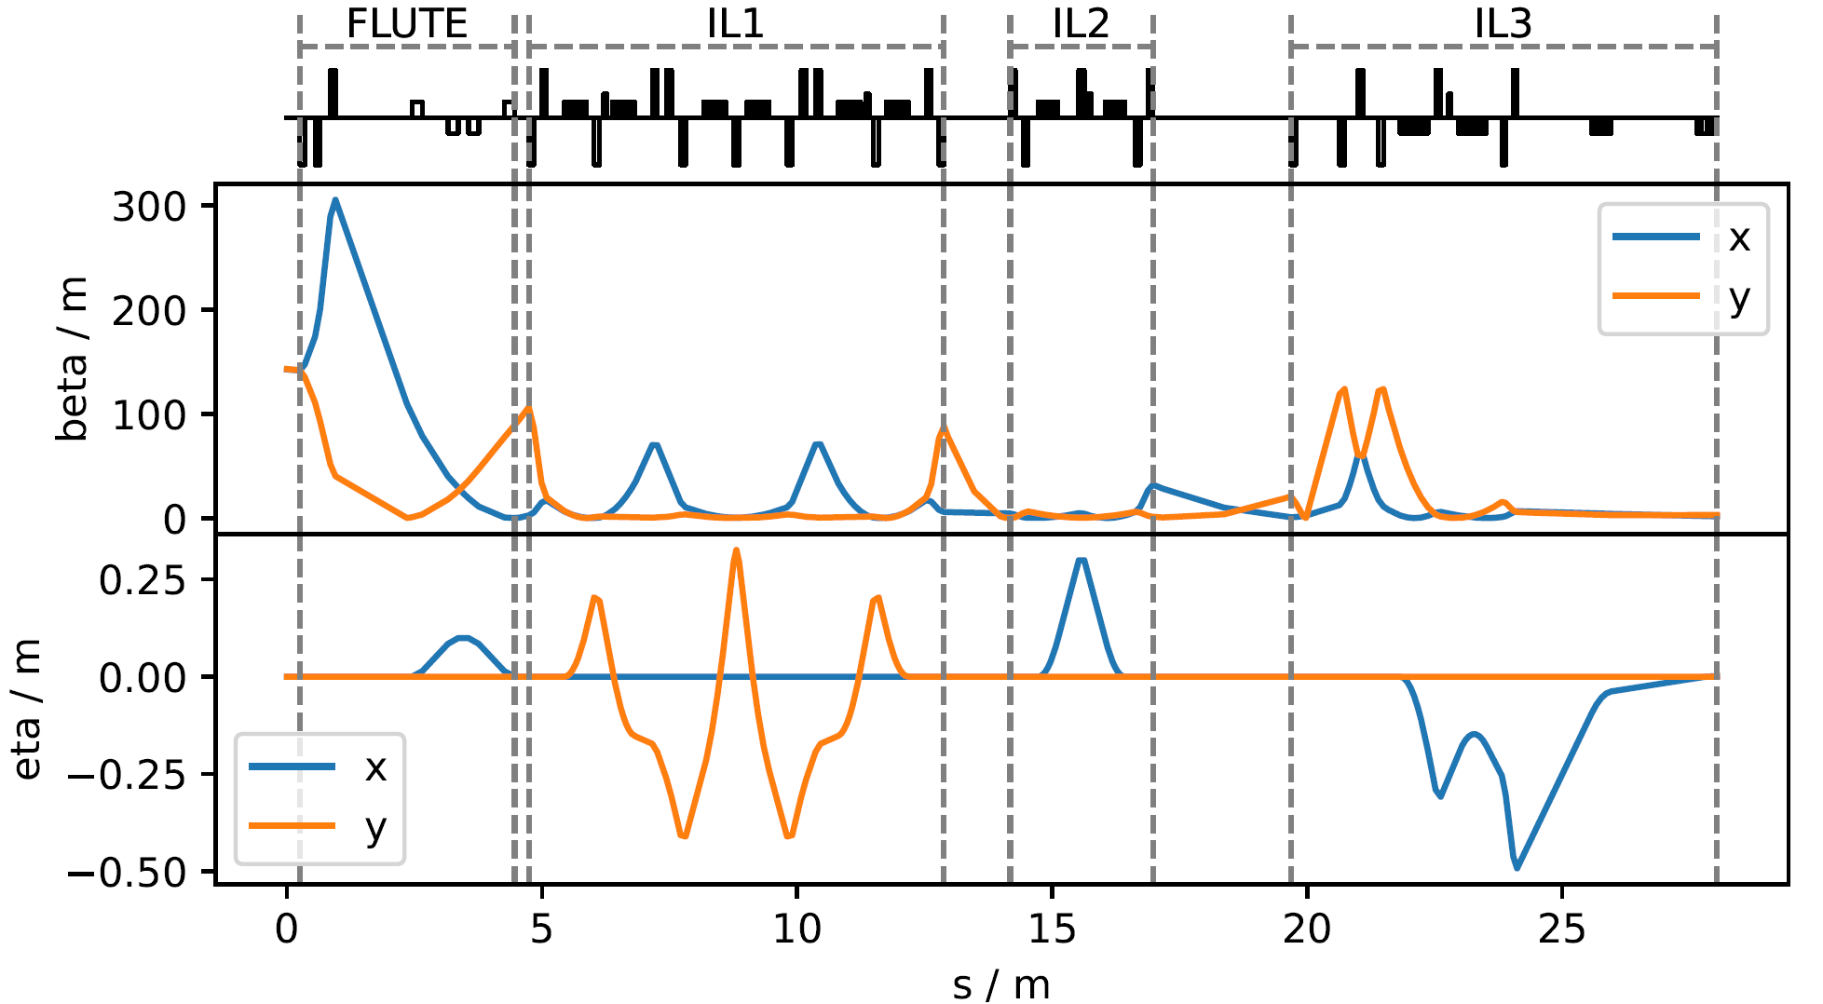
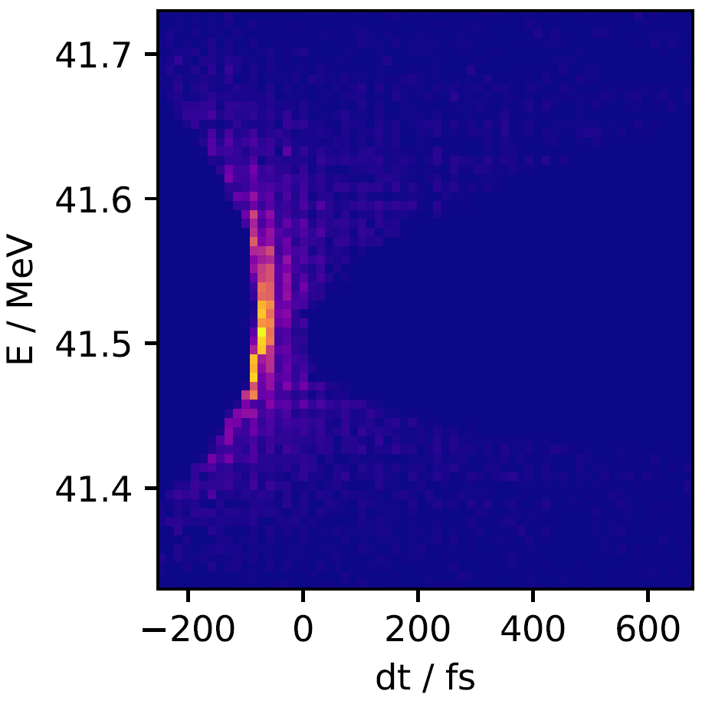
cSTART: FLUTE Injection Line Lattice
14 dipoles
28 quadrupols
4 sextupoles
14 dipoles
28 quads
4 sextupoles
J. Schäfer
Longitudinal bunch compression to 35 fs FWHM at injection point
Courtesy: M. Schuh

Slide 25
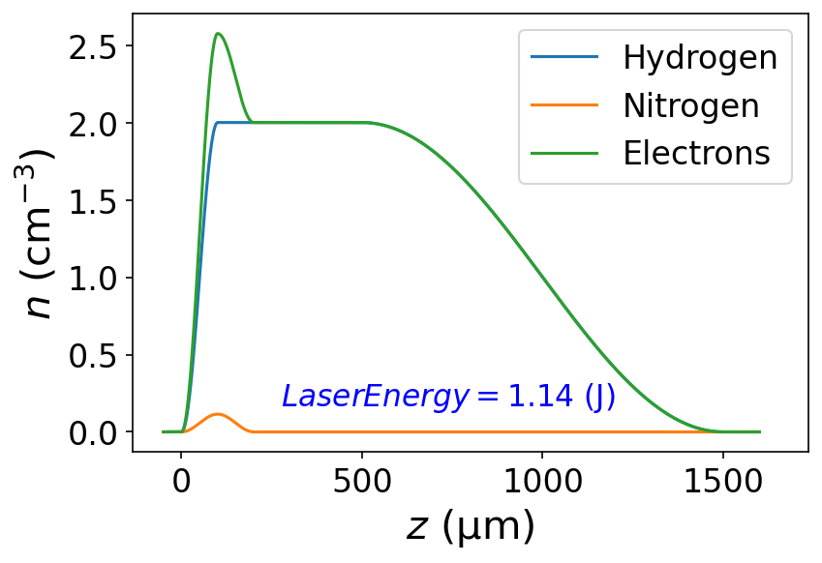
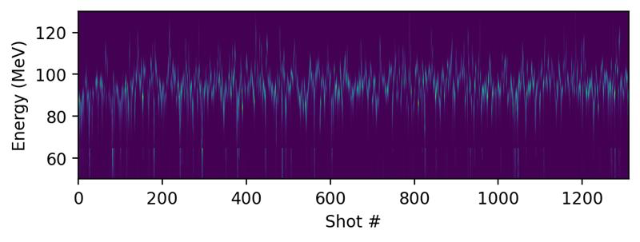
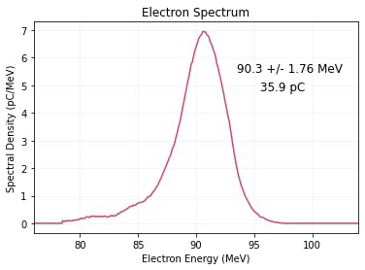
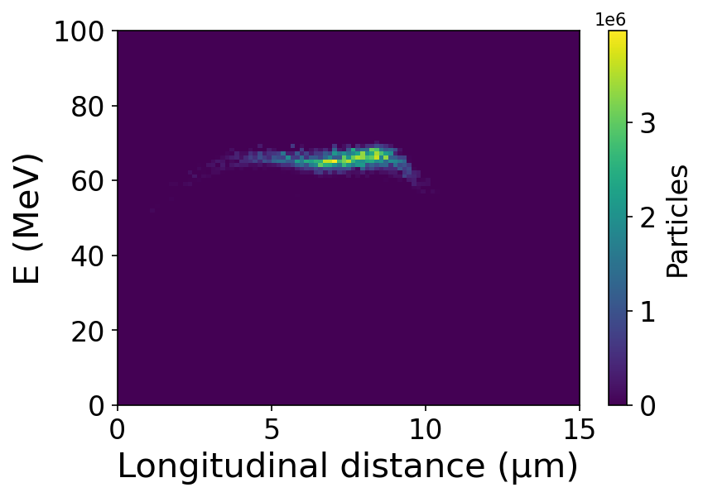
LPA Injector for cSTART
Simulations
First test experiments
1.5 mm acceleration distance
setup not optimized for 90 MeV
gas density
profile
series of shots
KIT:
N. Ray,
J. Natal,
A. Saw,
D. Squires,
M. Fuchs
DESY:
S. Jalas,
P. Winkler,
J. Hörning,
A. Maier
1.9% dE/E; 36 pC
90.3 ±1.76 MeV
selected shot
phase space distribution
65 MeV,
dE/E=1.6% (MAD),
50 pC, 17 fs
N. Ray et al.
10.18429/JACoW-IPAC2024-MOPR44
Courtesy: M. Schuh

Slide 26
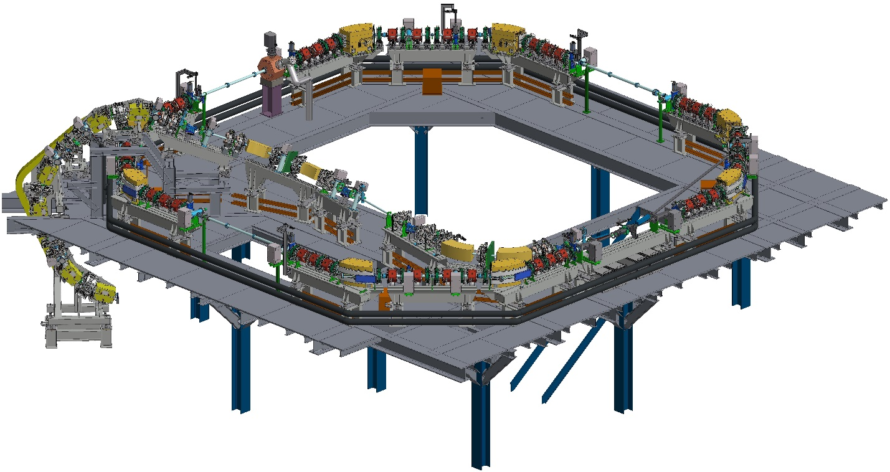

cSTART Project Plan
TDR
FDR
Components
Pre-assembly
Installation
FLUTE Operation
Commissioning
2025
2026
2027
2028
Courtesy: M. Schuh

Slide 27
Contents
About the workshop + joint experiment
The I.FAST Project: a brief introduction
KIT Facility Overview
Organisational information

Slide 28
Organizational Information (1)
Workshop Shuttle Bus
  From Quadro City Hotel to the Workshop Venue
  Departure Time: 8:30 Every Day
  We check the people on the bus to the workshop venue. This is due to a security check at the entrance gate of the KIT Campus North.
  Please come to the hotel entrance before 8:30.

Slide 29
Organizational Information (2)
Workshop Shuttle Bus (cont.)
  From the workshop venue to Quadro City Hotel
Departure Time
(will be announced before departure)
Tuesday | 18:30
Wednesday | 18:30
Thursday | 18:00
Friday | 14:00
*Those who wish to leave the workshop site before the time of the shuttle bus can find out about other transport options on the Indico workshop website.

Slide 30
Organizational Information (3)
Safety Instruction (experiment participants only)
  Those who join the experiment need to take a short safety instruction course before the experiment.
  The course will start at 9:00 am on Thursday at the workshop venue (the KARA large seminar room).

Slide 31
Organizational Information (4)
Lunch and beverages on the KIT Campus
  The lunch vouchers are with your nameplate (please check). You can take lunch at the KIT canteen with the voucher.
  On the KIT campus, cash and credit cards are not acceptable for meals and beverages.
  Please don‘t forget the voucher and the nameplate!
  At the canteen, there are three or four variations, including a vegetarian menu.

Slide 32
Organizational Information (5)
Workshop dinner
Quadro City Hotel Karlsruhe
At 19:00 on Tuesday
A welcome drink and meal will be provided by the workshop organization. Additional drinks should be paid by each person.

Slide 33
Please enjoy the workshop!
… and any questions?

