Slide 1
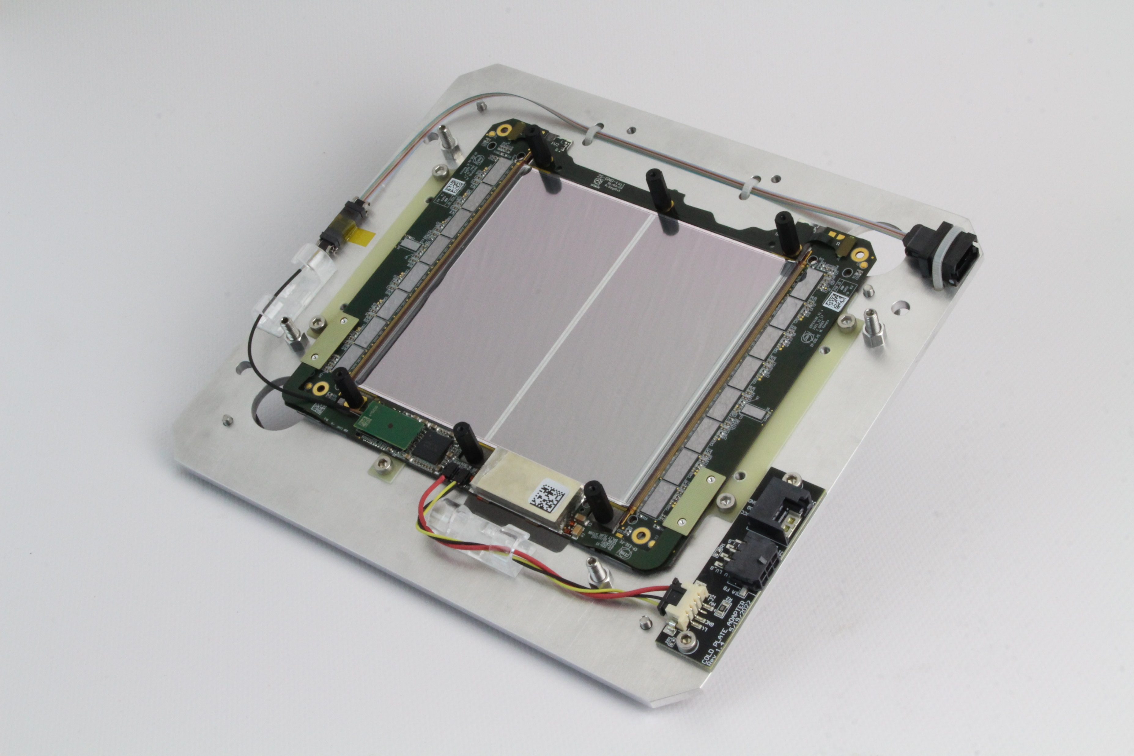

Start of 2S Module Production
ETP 2S Module Production Meeting – 03.03.2025
●Stefan Maier

Slide 2
WHY?

Slide 3

LHC

Slide 4
HL-LHC (2030)

Slide 5
HL-LHC (2030)
Accelerator will become more powerful = More data / time
Improve search for interesting physics
After the collision, more particles than currently will fly through our detector
Current detector parts are old, and will not cope with the new environment
→Upgrade large parts of the detector will be upgraded: “Phase 2 Upgrade”

Slide 6
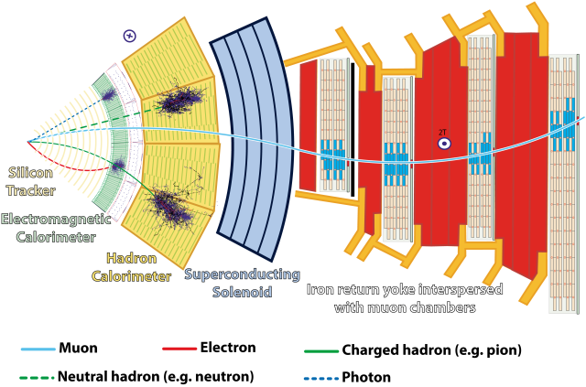
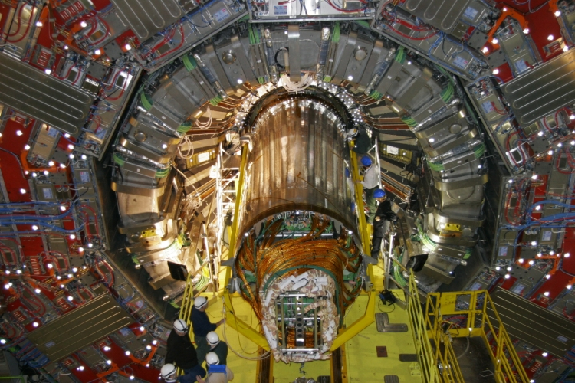
Tracker Upgrade
Tracker: Most inner part of the detector will be completely replaced
Old one out, new one in

Slide 7
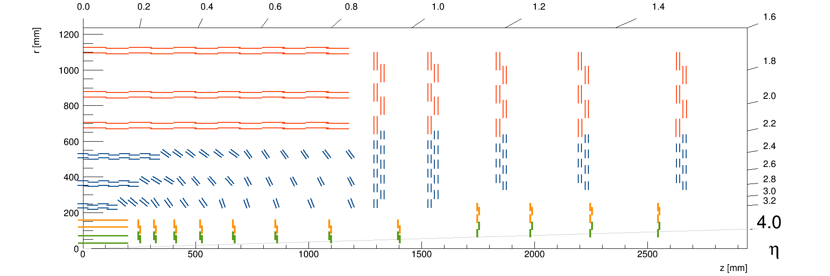
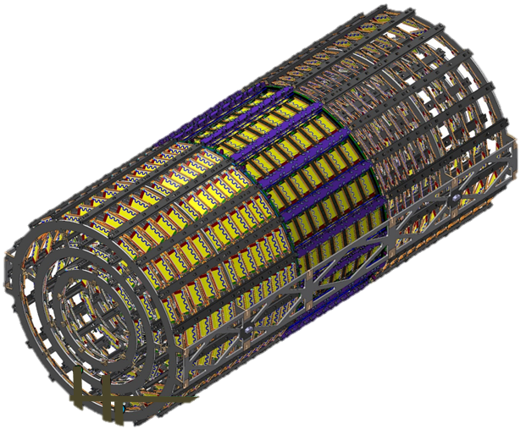
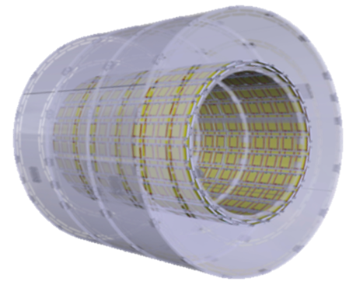
The CMS Phase-2 Outer Tracker
TBPS
TB2S
TEDD
Yellow parts: Modules

Slide 8
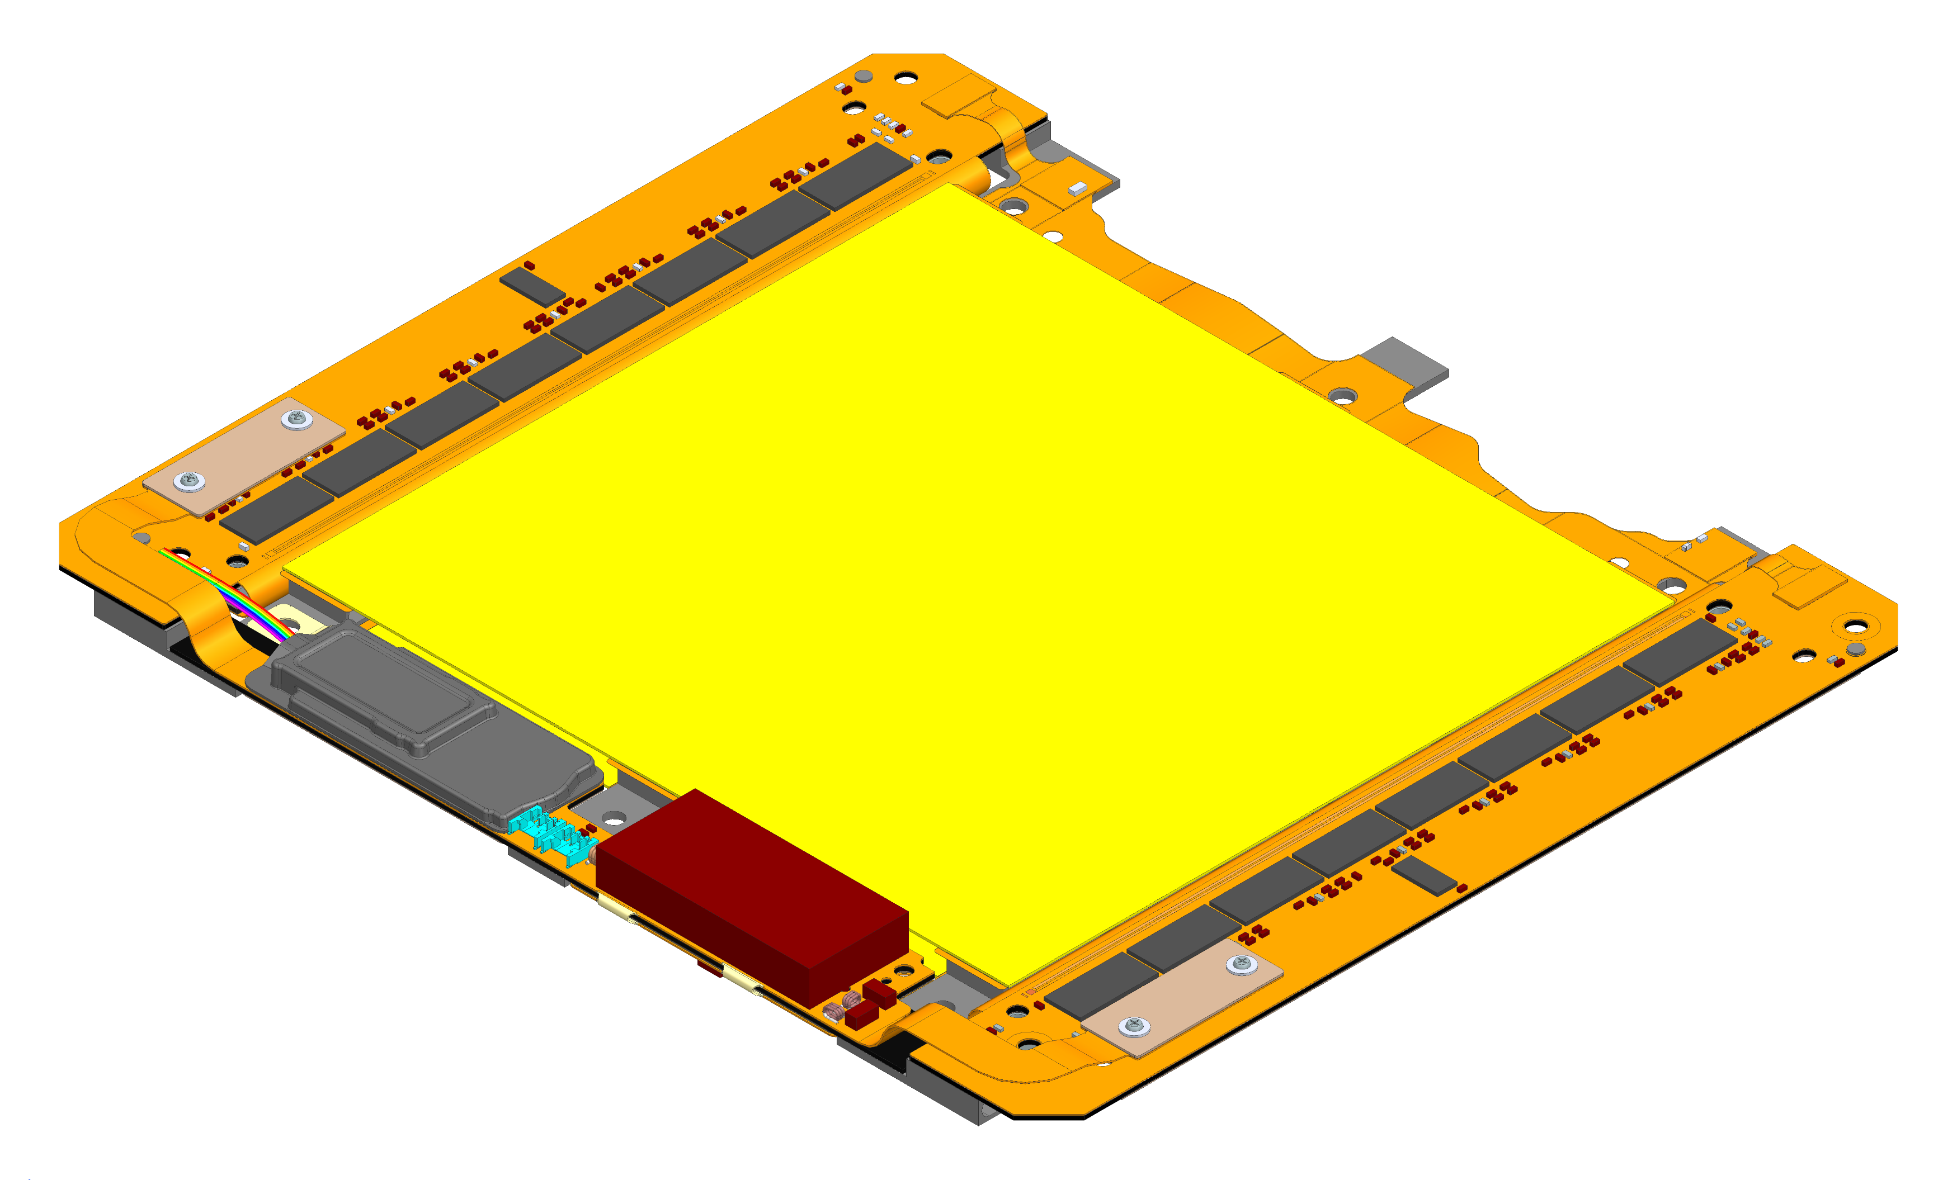
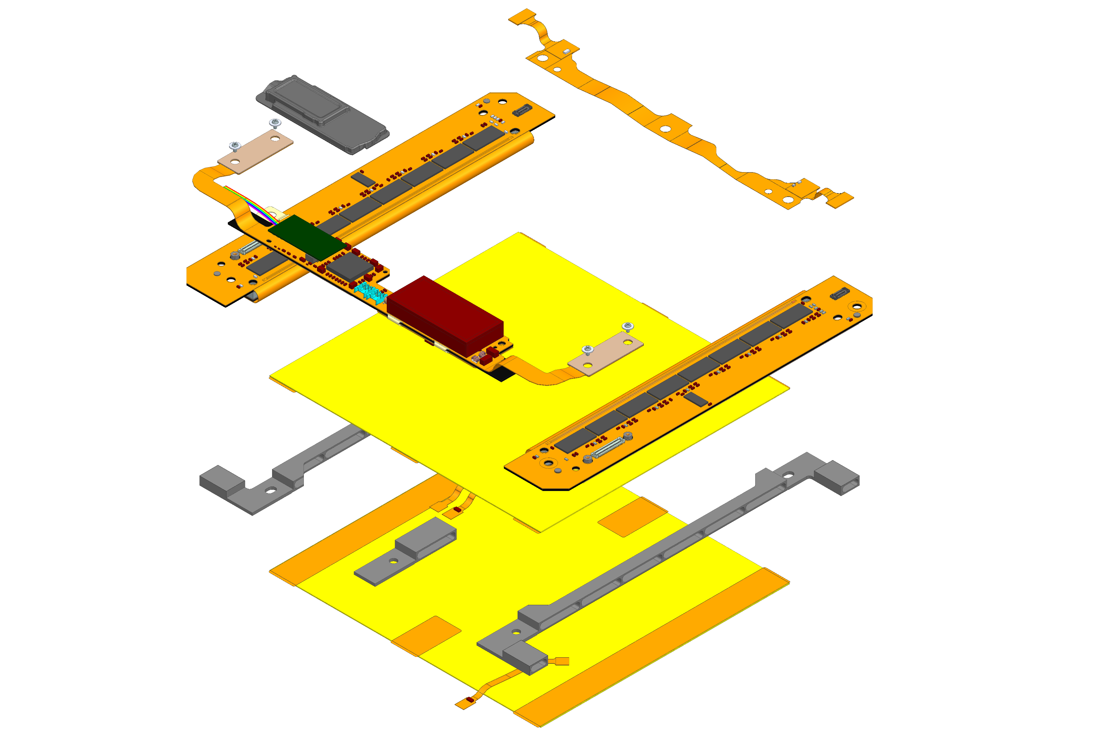
The 2S Module
Double-layered silicon strip
detector module
Electronics
  2 Front-end hybrids (FEH)
  1 Service hybrid (SEH)
  1 GND Balancer
  HV Tails
Mechanics
  3 (4) Al-CF spacers
  Kapton isolation strips
Sensors
Readout electronics
Bridges / Spacers
Kapton strips

Slide 10
~3000€
Tracking Detector!:
Precise assembly
Quality control on all parts
Very little margin for rejected parts

Slide 11
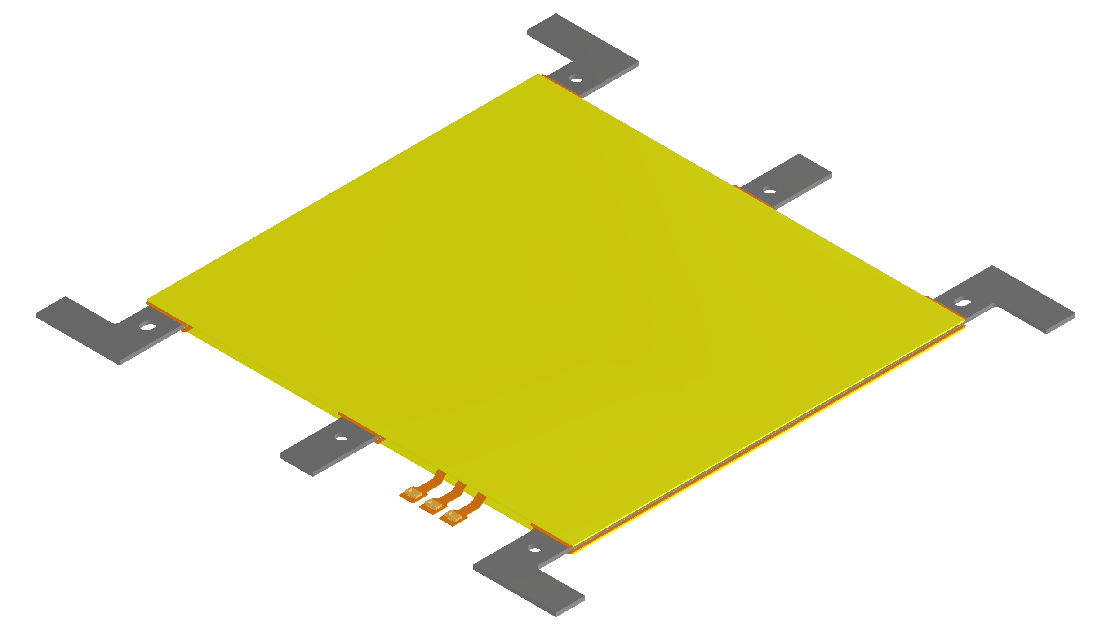



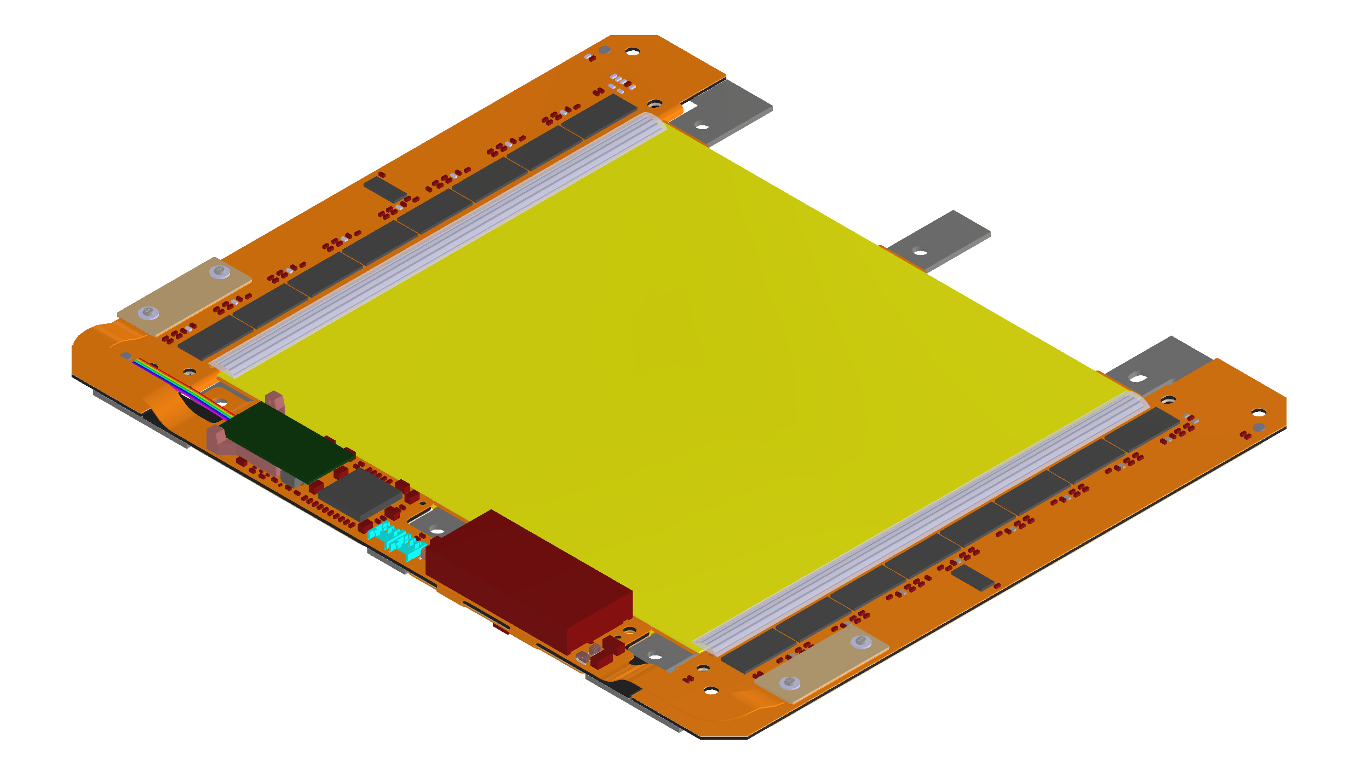
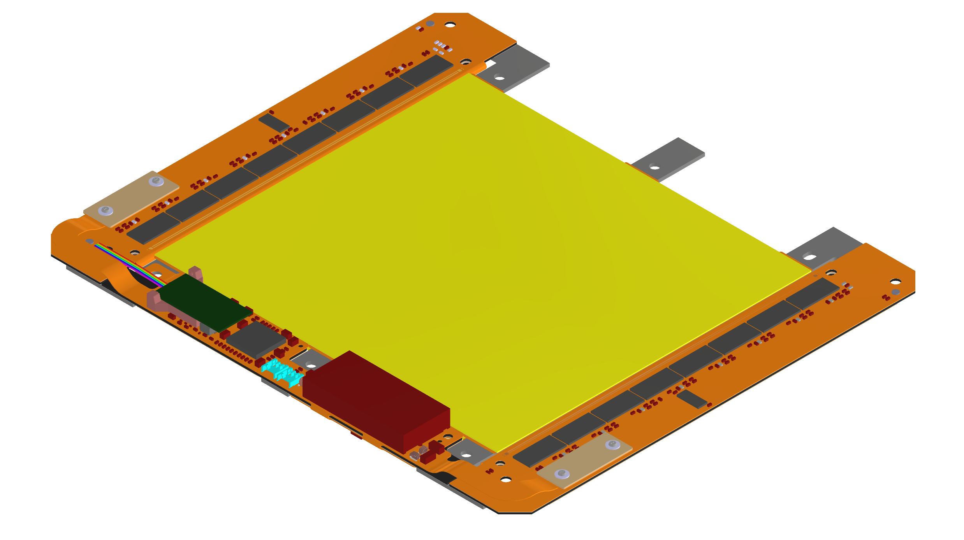
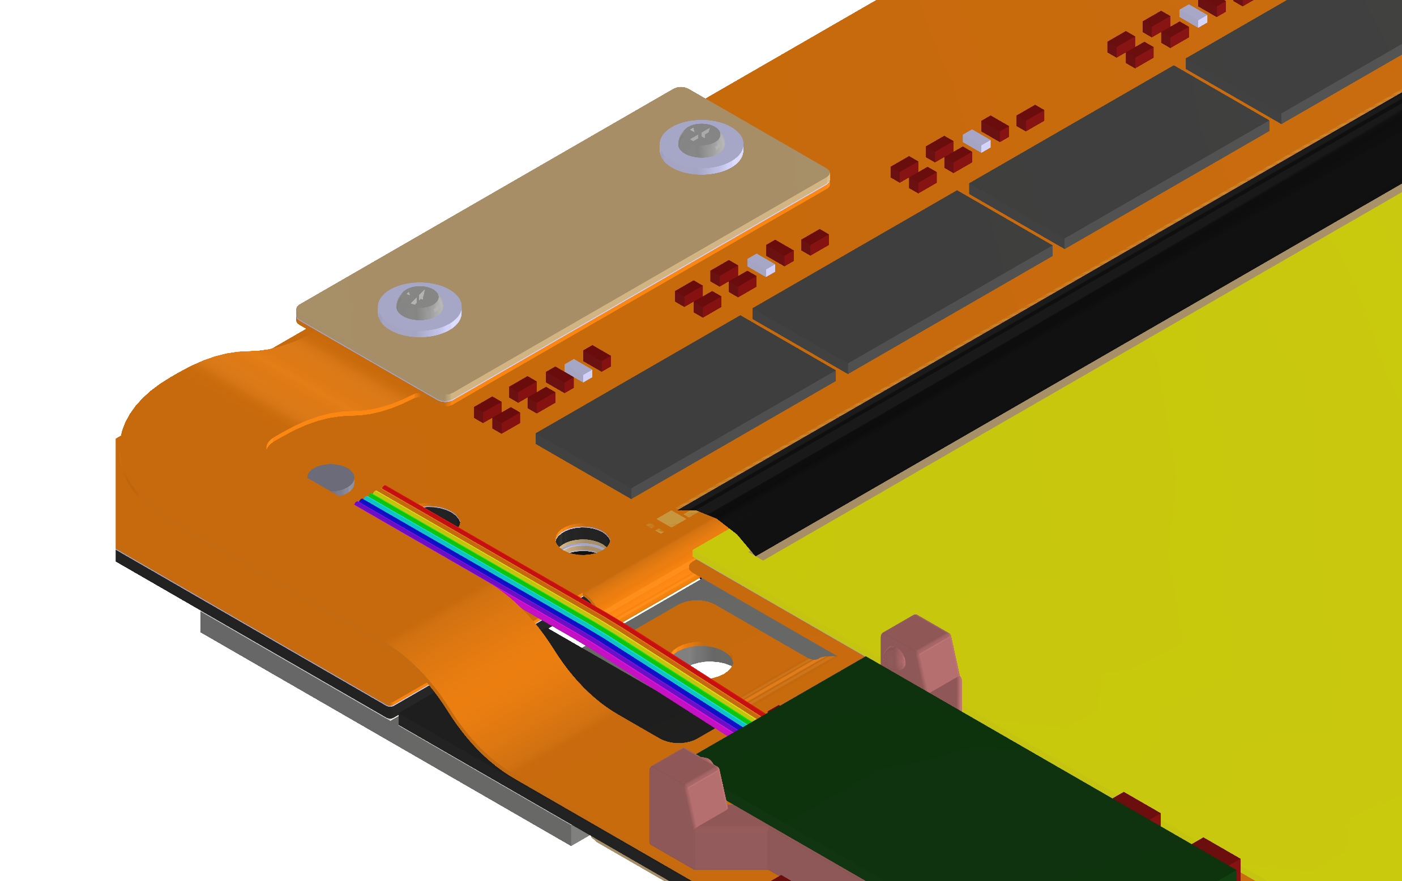

Assembly and Test Procedures of 2S Modules
1. Glue polyimide HV isolation and attach HV tails on sensor backside
2. Wire-bond and encapsulate HV tails
3. Glue sensors on Al-CF brides
Check dicing precision (metrology)
Optical inspection
HV test backside isolation
Sensor I(V)
Module metrology
6. Encapsulate wire-bonds
5. Place ~4000 wire-bonds
4. Glue readout and service hybrids on bare module
Optical inspection
(HV/LV test)
Module test
Module test

Slide 12
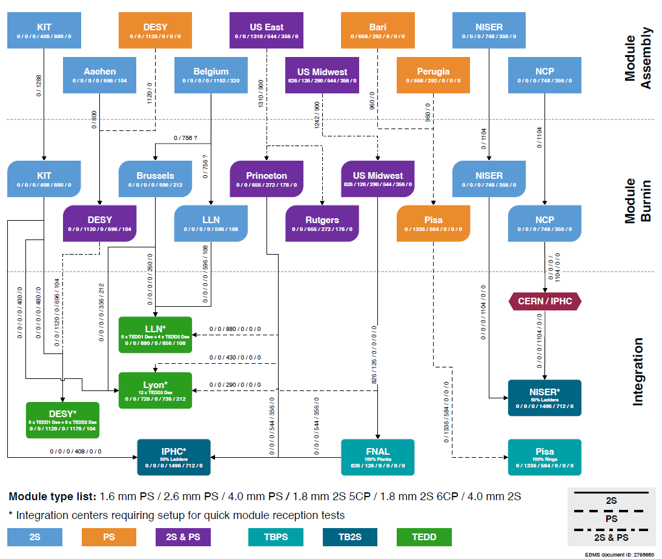
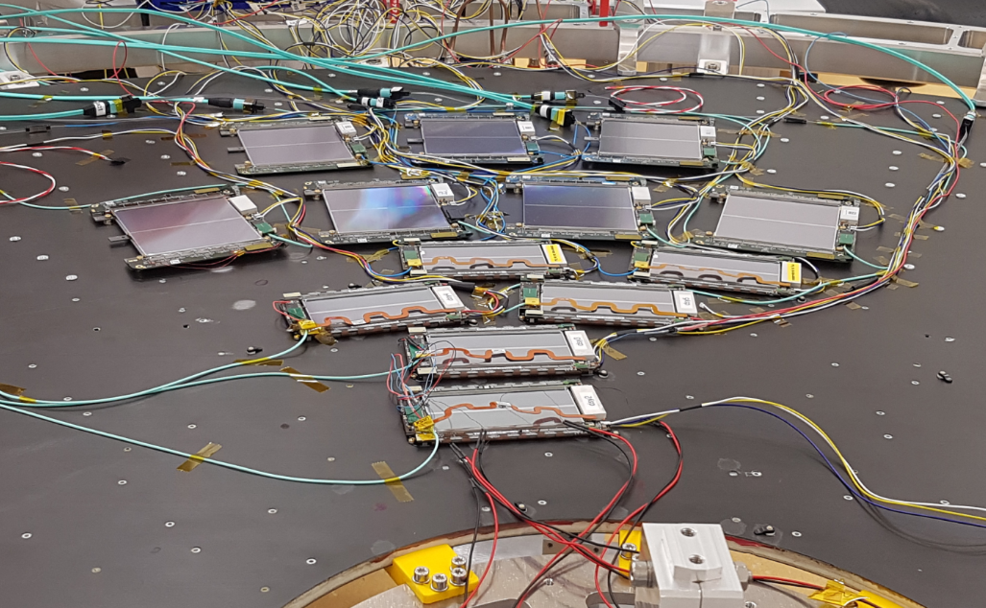
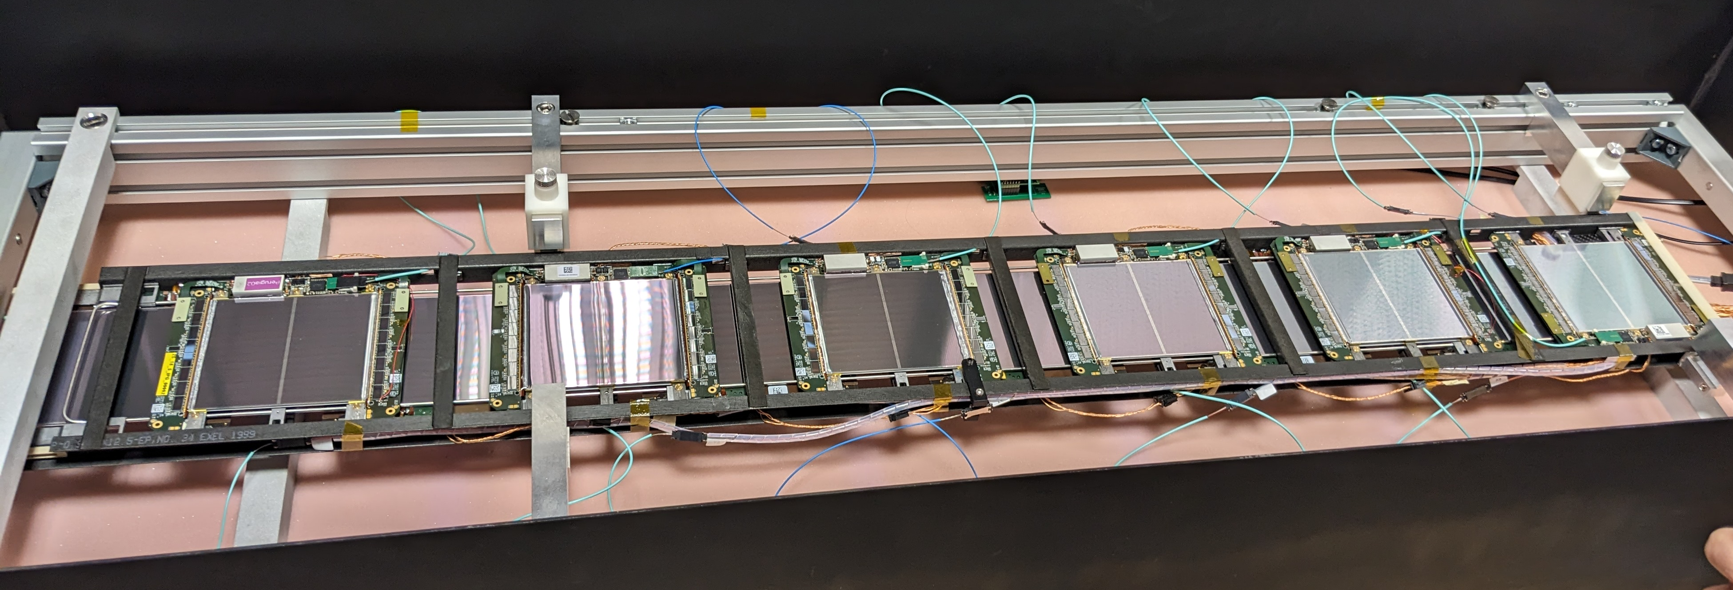
Production Flow

Slide 13
ORGANIZATION

Slide 14
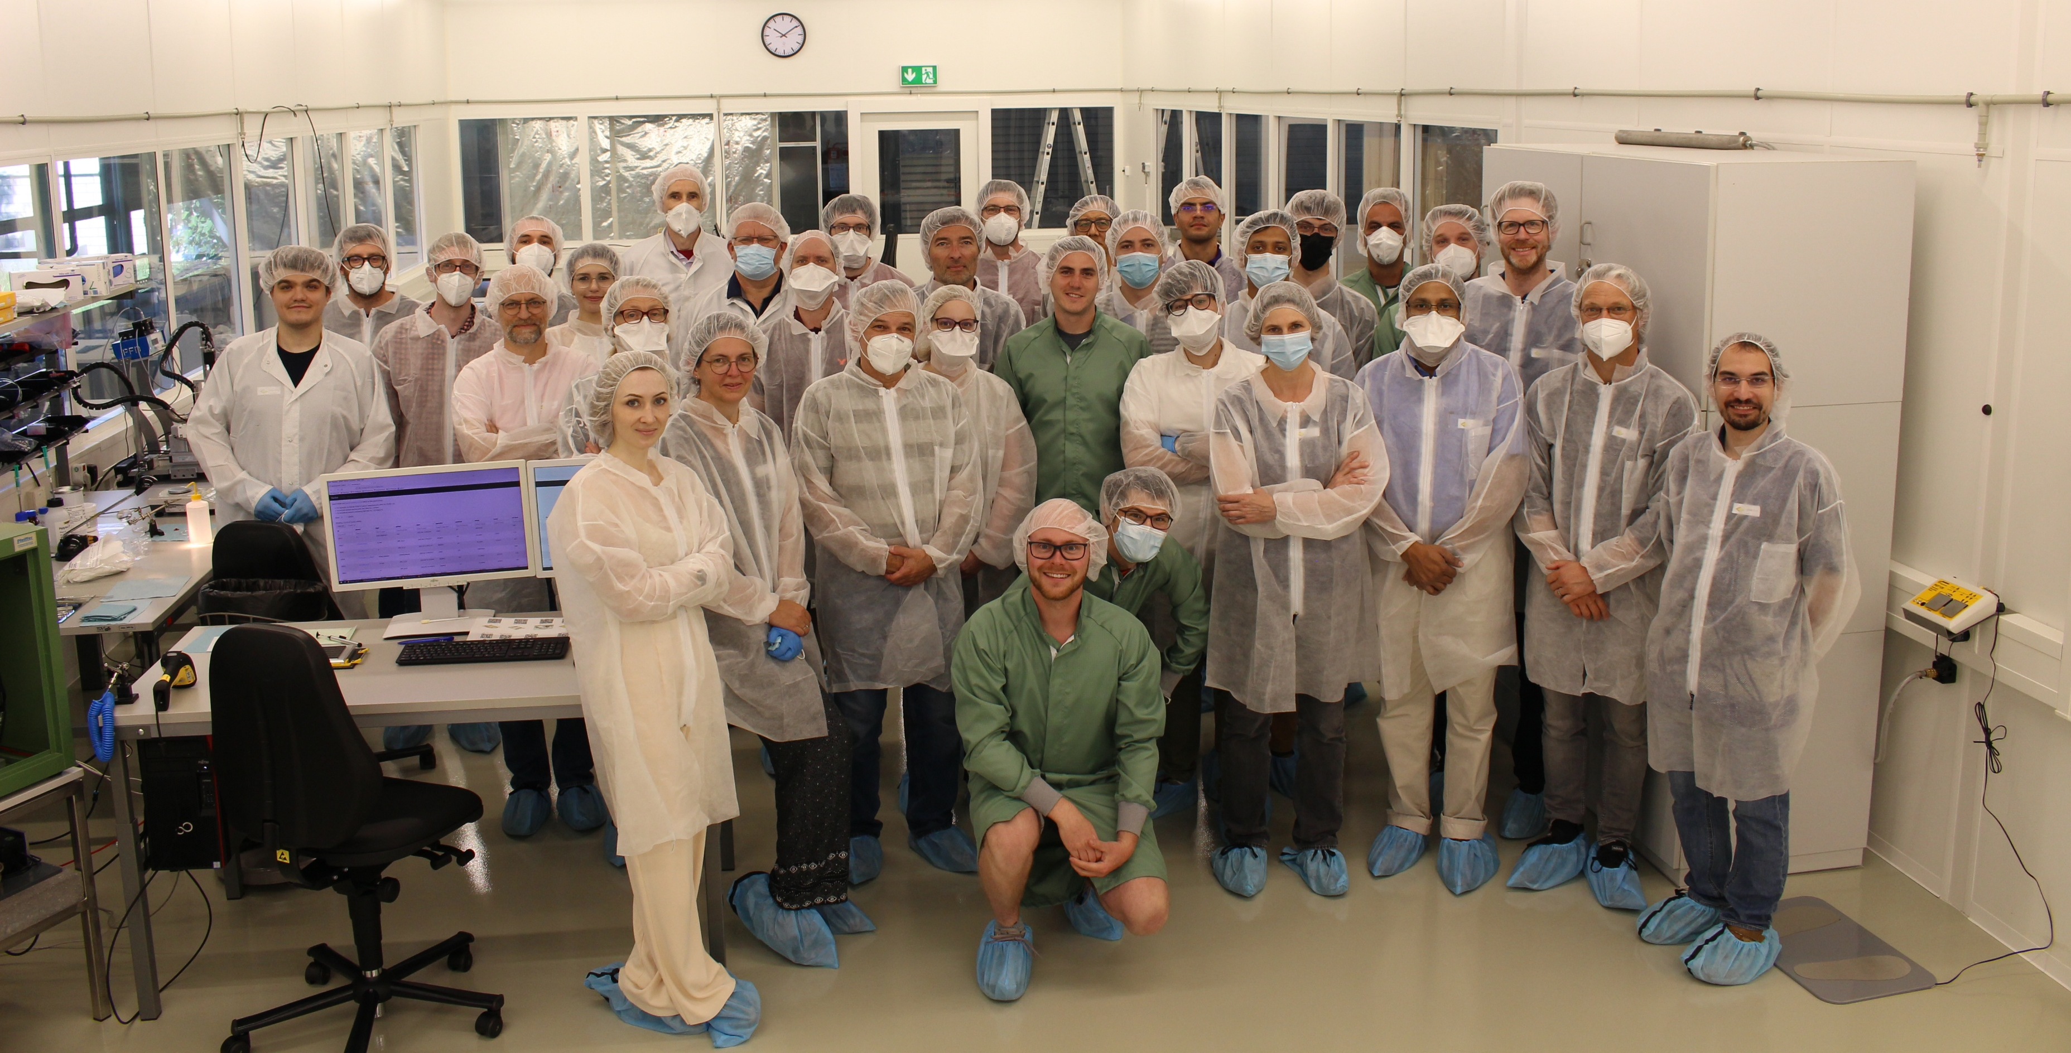
Recap
One of our main task in the ETP hardware group is the contribution to the construction of the Phase-2 Outer Tracker (OT)
We have a leading role in the silicon sensor R&D and QC
We have a leading role in the development of test and assembly procedures for 2S Modules
  In 2016 we pledged to build up to 2000 2S Modules within 2 years
  (400 working days)
  Involves the grant for two technicians,
  two PHDs and two PostDocs by BMBF
Mean production rate: 4 modules/day
with 6 modules/day at peak
  Technically, we can boost the productionline up to
  8 modules/day but we are most likely limited by staff
2S Module Workshop at ETP 2022

Slide 15
Organizational Points
Ulrich, Alexander and myself form the coordination team
  In case you need to take a sick leave, please ensure that at least one of us is informed
CernBox folder containing most of the relevant information:
https://cernbox.cern.ch/s/zsPK69Dw8yZZNTH
  Please bookmark on your institute PC
Contains:
  Shift schedules (incl. module type assembly plan)
  Instructions for assembly and front-end usage + THIS Guideline
  QC Sheets
  Cleaning log
  Glue log (When did we open which container)
  Vacation planning: Have a look at the sheet and please ask first before applying in the SAP system
E-Mail list cms-2s-module-assembly@lists.kit.edu for announcements

Slide 16
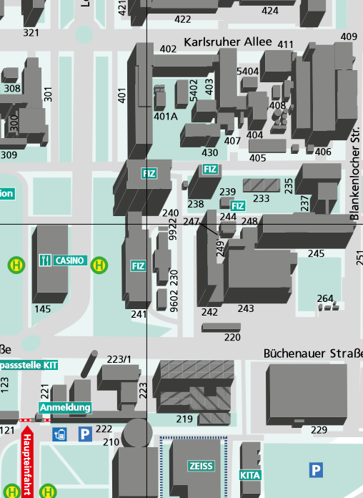
ETP at KIT
Campus North
Main building 401:
Part reception
Logistics room
Burn-In
Packaging & Shipping
Spare probe-station
Spare module test setup
Spare wire-bonder
(Climatic chamber)
Hall 245 with clean room
Full module assembly
After reception and unboxing, module components are brought and stored in clean room 245. After the module is assembled it is moved back to 401 for the burn-in test and shipping

Slide 17
Shift Schedule
We schedule the task for each person on a weekly basis
We have tasks that have to be done
  Once a week / every two weeks (Sensor dicing test, QC Al-CF bridges)
  Every second / third day (Some module tests / Hybrid VI / Skeleton test)
  Daily (Gluing and Wire-bonding)
Skipping a daily task can most likely not be recovered the following days and will result in a production day with an outcome 0 modules, reducing our mean throughput significantly
At the beginning we will try to do the gluing steps with technicians and testing steps with scientific staff (HiWi, PHDs, Post-Docs)
Once we become more confident we will start to rotate more through the steps
The shift schedule document contains a individual time line for each person

Slide 18
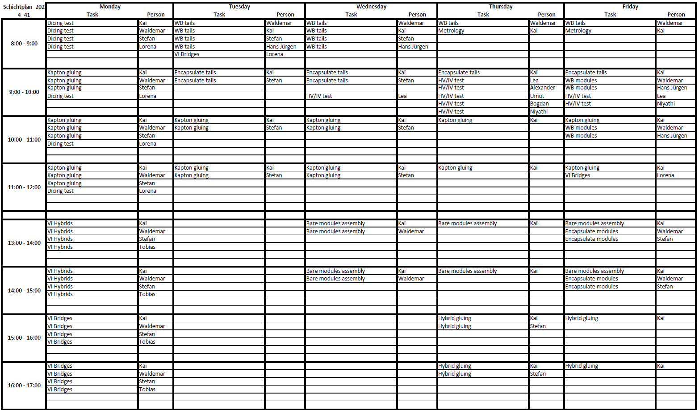

Slide 19
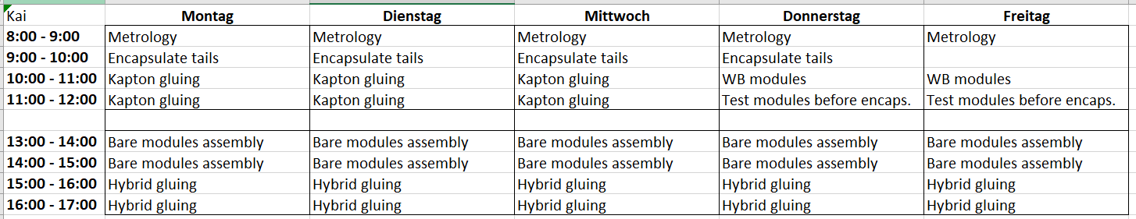
Personalized Schedules

Slide 20
Shift Schedule Granularity
Do not take the times too serious, it is not straight forward to put everything into one big table
  By design, each person would do 2.5 extra hours per week, not sustainable
  We might adapt the times as soon as we have some experience, which can only be made once we have a situation in which each task is only done by one person
Assembling the modules comes with a lot of steps
  Not all task can be depicted in the shift schedule
  Whenever you are done with your task, take a break, refresh yourself and afterwards check what you can do elsewhere or whom you can support; You can
    VI hybrids
    VI bridges
    Assemble skeletons
    Dicing tests
    Assemble carriers
    …
In a full production scenario there will be max 2 gluing/assembly tasks per day per person
  1 in the morning, 1 in the afternoon
Building 1 module / day it takes 7 days to be done. Building multiple modules / day this will change to 10-11 days to have less constraints in the testing and assembly sequence

Slide 21
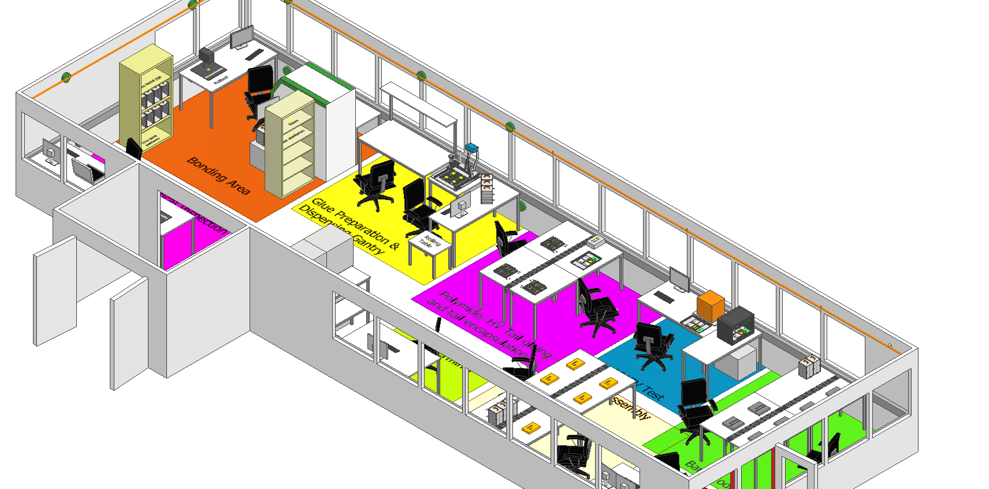
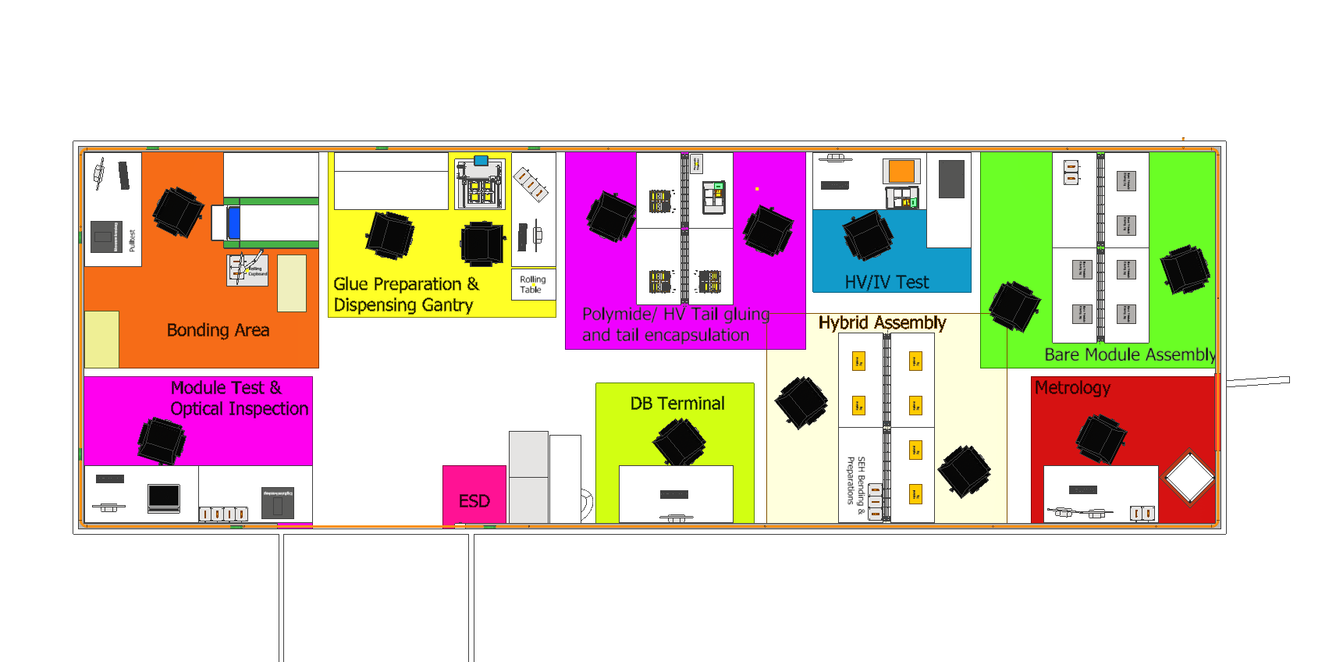
Clean Room 245
~100 m²
ISO class 7
Pressurized air ring line
Vacuum ring line
ESD-safe floor
2024: Inauguration
You need to have access to building 245 with your KIT card
  Contact Fr. Schäfer or Fr. Chen
It is a clean room: Please keep your drinks and snacks outside

Slide 22
Entering the Clean Room – Air Lock
Please leave your jackets / rain coats outside the air lock
  Put in one of the lockers or hang on TV holder
  We will install a coatrack outside soon
Put on hair net, clean room coat and get your mask
  Each long-term member should already have his own, labelled coat
  If you want you can use the same hair net and masks multiple times (not essential)
  You can keep your sweater on the same hook from which you took the coat
  We still have to come up on how to clean the coats
  (most probably one of us will take a bunch home and wash them
Shoes
  Put your street shoes on the shelves at the outer side
  Each long-term member should already have ESD-safe “clean room shoes” (Birkenstock)
    If you do not have shoes already, put on the blue over shoes and put the strap IN your sock
  Mark them with your name and always store them in the shelve labelled with your name
  Avoid taking the wrong shoes
After entering: Check ESD-connection to the floor! (No charge-up while walking around)

Slide 23
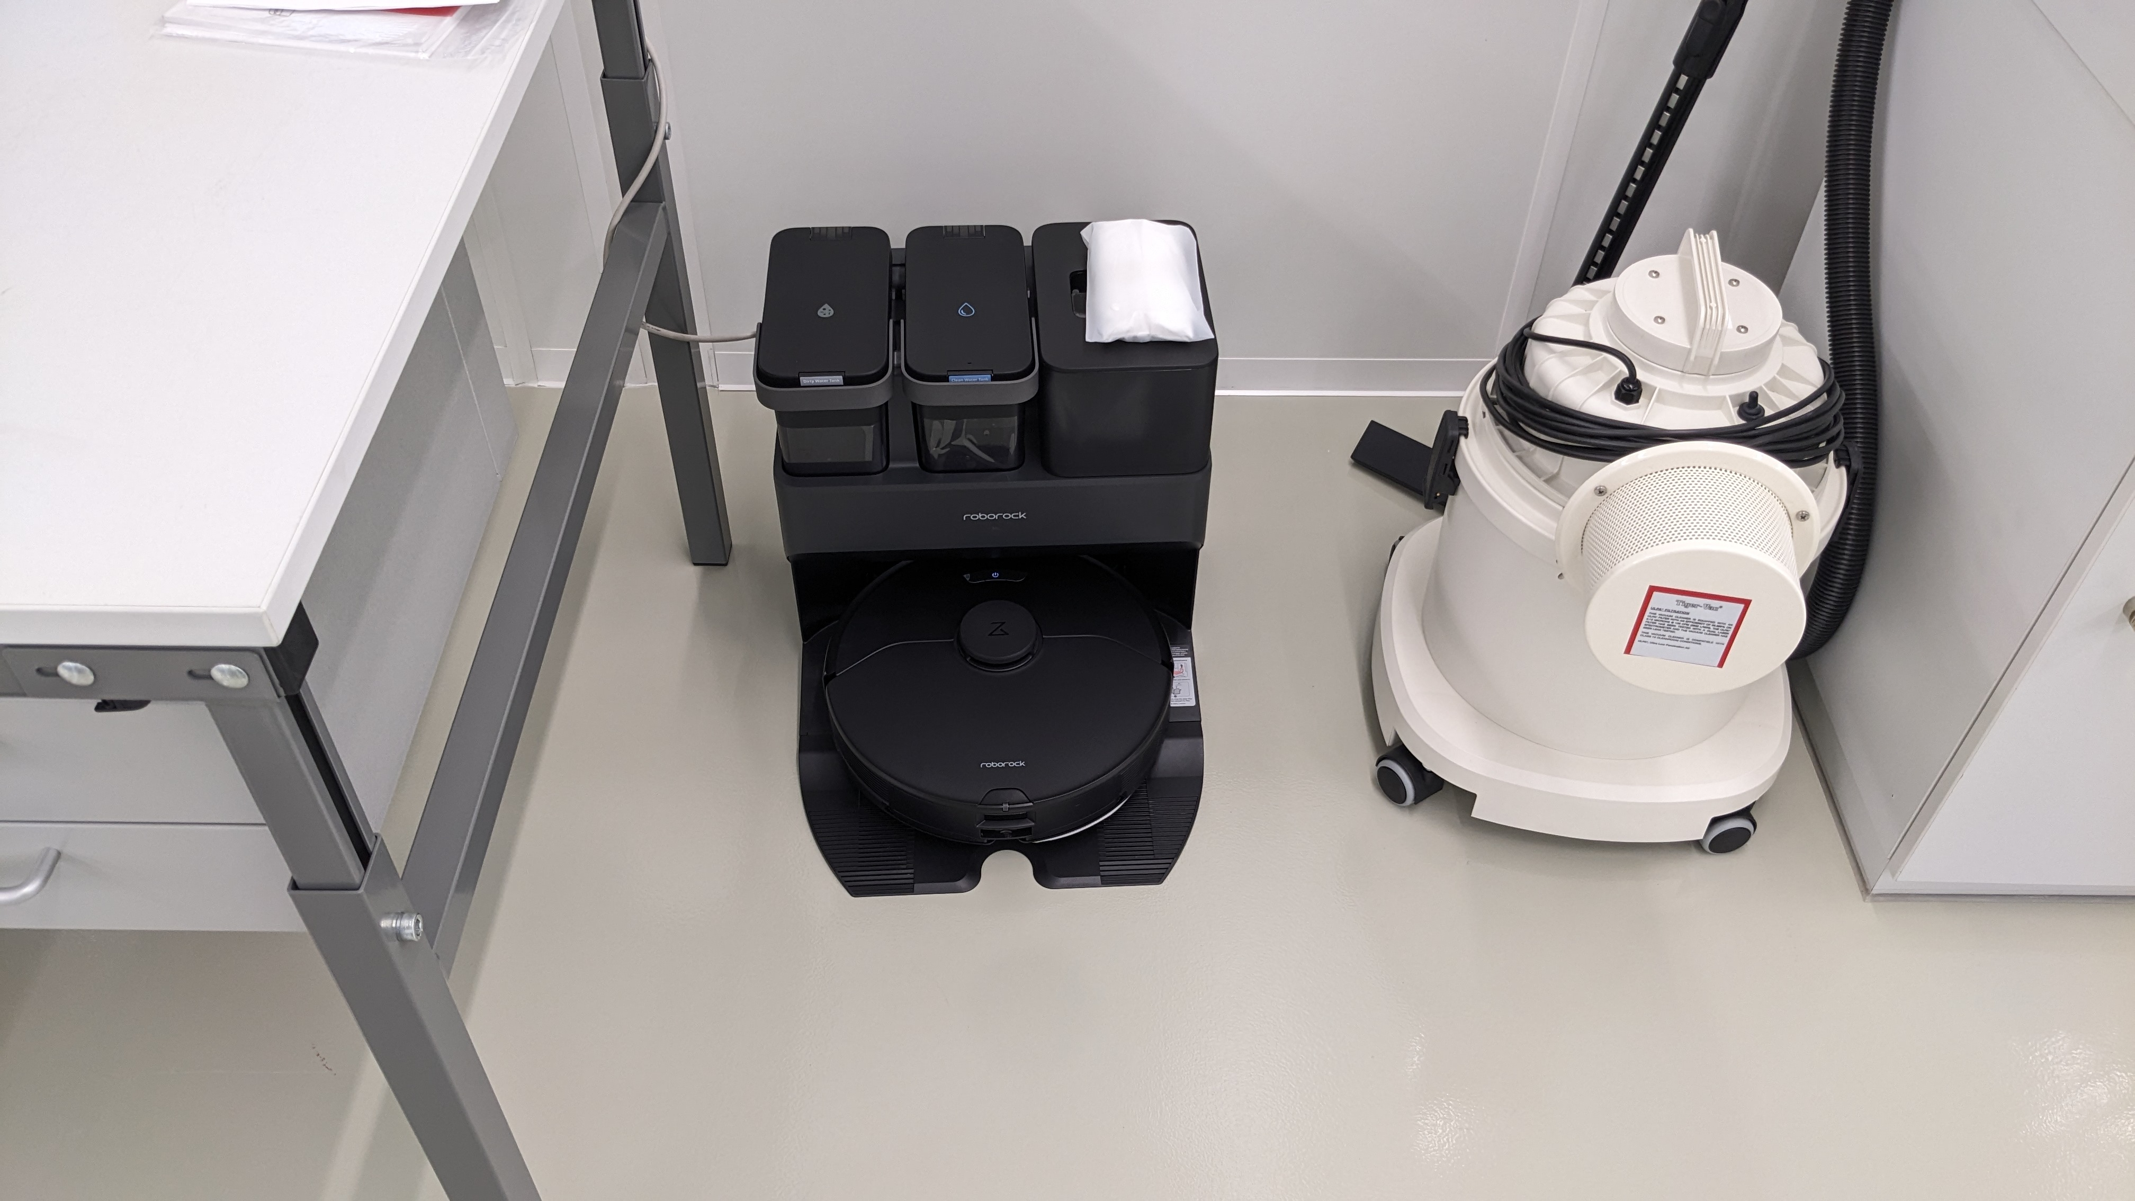
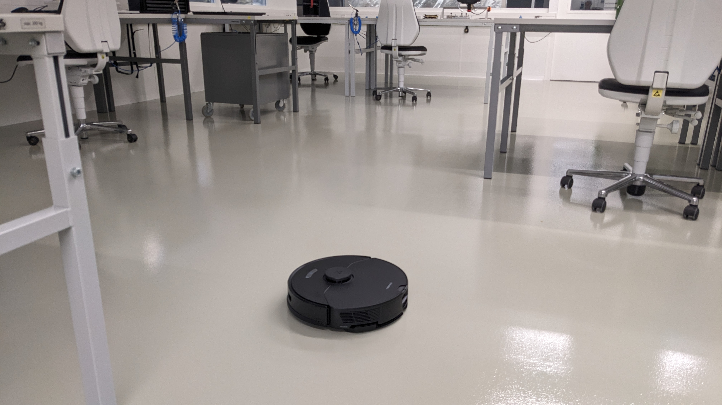
Keeping the Clean Room clean
Please do not bring cardboard boxes inside the clean room
We do have a cleaning robot (Reiner / Robby / Obi Wan Cleanobi)
  Cleans (vac. cleaning & wiping) each Thursday evening (8pm – 10pm)
  Requires water change on Friday morning
    We are using decalcified water for re-fill
  Interval might increase once we are at full pace
In times of low productivity (e.g. missing components) we will also do a manual cleaning of all surfaces
  There is a “Reiningungsplan” in the CernBox for documentation
Only things relevant to the production should stay inside the clean room
  As we are still rearranging stuff, this is not yet 100% true, but new stuff brought into the room should always be questioned
Please empty the trash bins regularly
  “Endless bag” system
Remove packaging material and put it into the trash next to building 401

Slide 24
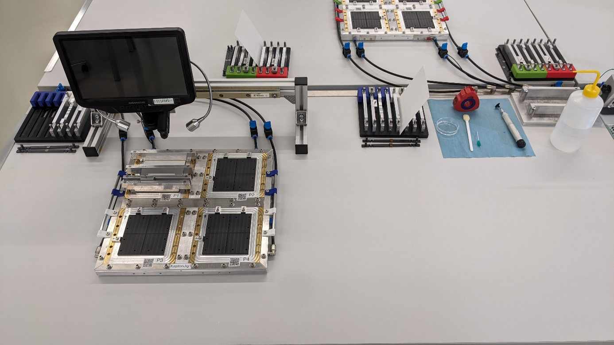
Keep the Working Space organized
You might not be the person doing the same task the following day
After the task is done, put the tools were they are supposed to be
  We will decide together what to place where and then make example images on how to leave each working space
Clean your tools (Epoxy resin)
Communicate, when we should change
things (more, other tools etc)

Slide 25
Visitors
Being the hardware flag-ship, we will have plenty of visitors during the next two years
  There are nice posters outside the clean room to introduce the topic (1 in German)
There are disposable clean room coats and over-shoes available
Please ensure that all visitors wear them (incl. hair nets)
Within the clean room:
  Only looking, everything is kept were it is
  Worst case: Jigs are moved, tools are not were they are supposed to be.
  Big No No!
  Some work requires quite some concentration. If people seem to be very busy, do not interrupt them
We will prepare some hands-on stuff to show around:
Broken sensors, bridges, hybrids

Slide 26
Breaks
There is a small office in 245 used by our IAP colleagues (‘Mo’, Heiko) that could be used for breaks
  Chairs, desks…
  On the way to the restrooms (you must bring your access card)
Not yet requested from our side
  If people want to drink a coffee we might need to setup a second coffee machine / “Kaffeekasse”

Slide 27



Slide 28
KIT 2S MODULE ASSEMBLY LINE

Slide 29
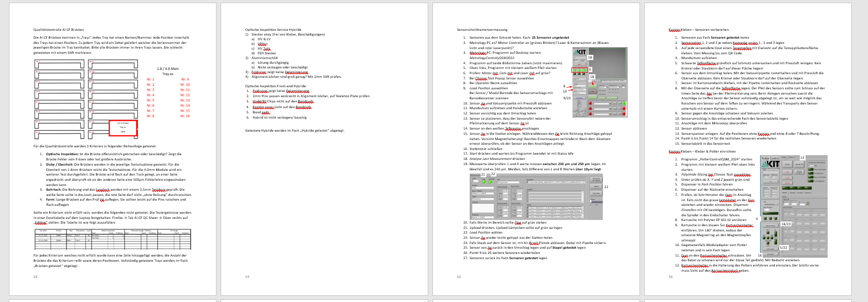
ETP Assembly Document
Also located in the CernBox folder
General overview of assembly line
Step by step instructions for all tasks
Homework 1: Read it!

Slide 30
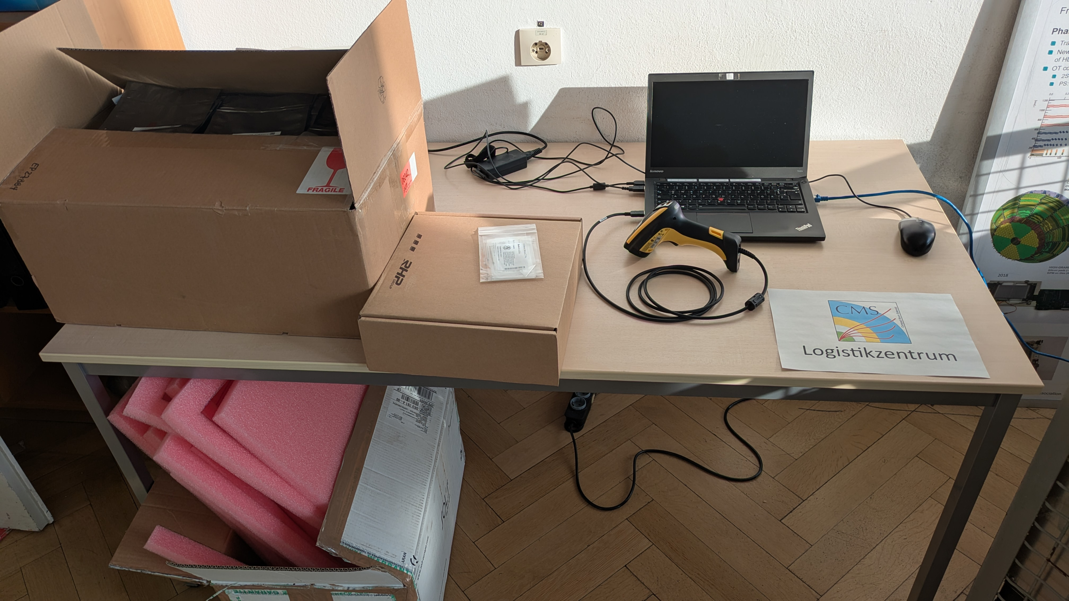
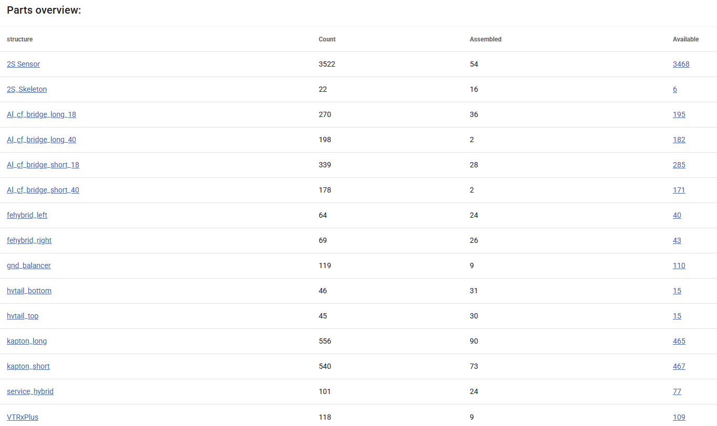
Part Reception
Parts and empty transport boxes come in
→ Modules (“of the highest quality”) go out
Dedicated logistics room planned
(401 “old probe lab”)
Coordination team: Mark the shipment in the
CMS DB to RECEIVED
We also track each component with our DB
For mass injection we have simple program that uses the input coming from the barcode
of the parts
Depending on the available storage capacity components are then moved to the clean room

Slide 31
18m
6m

Slide 32
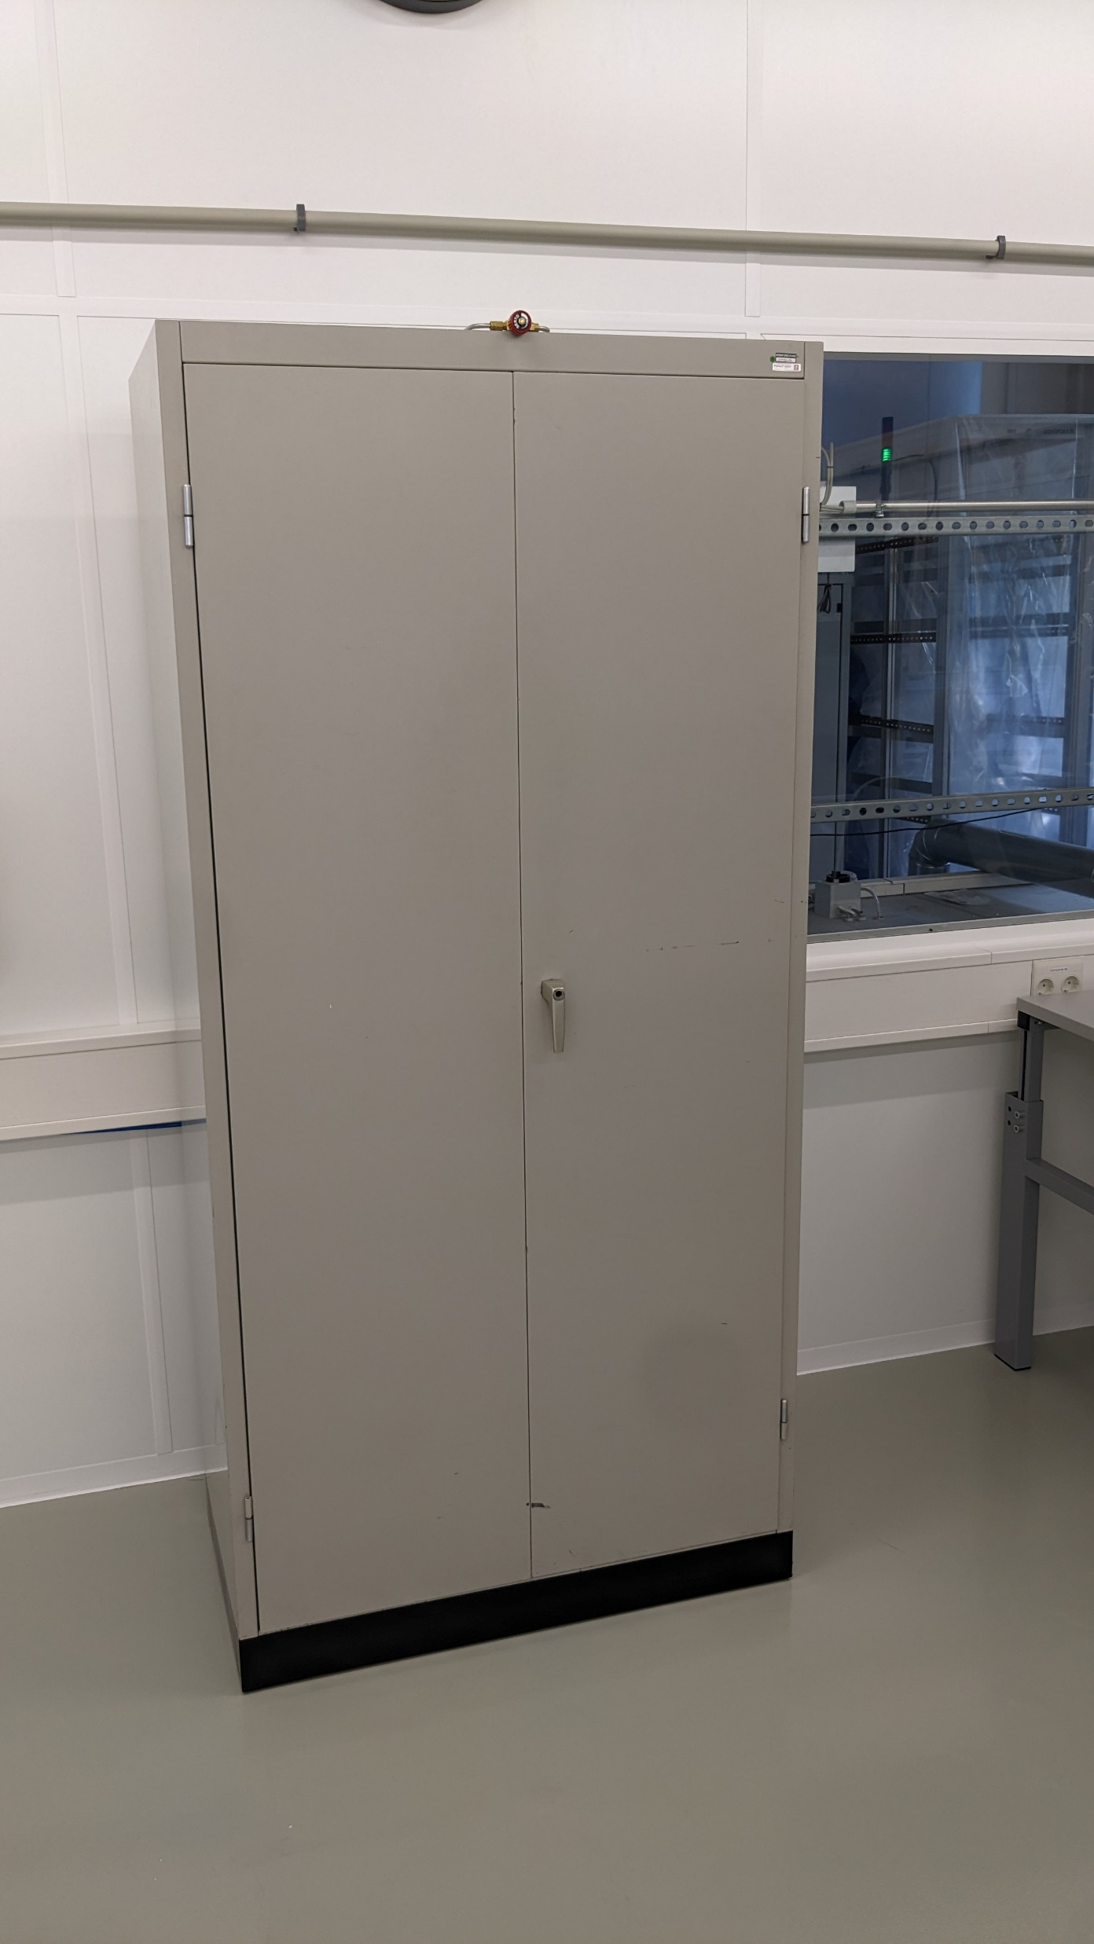
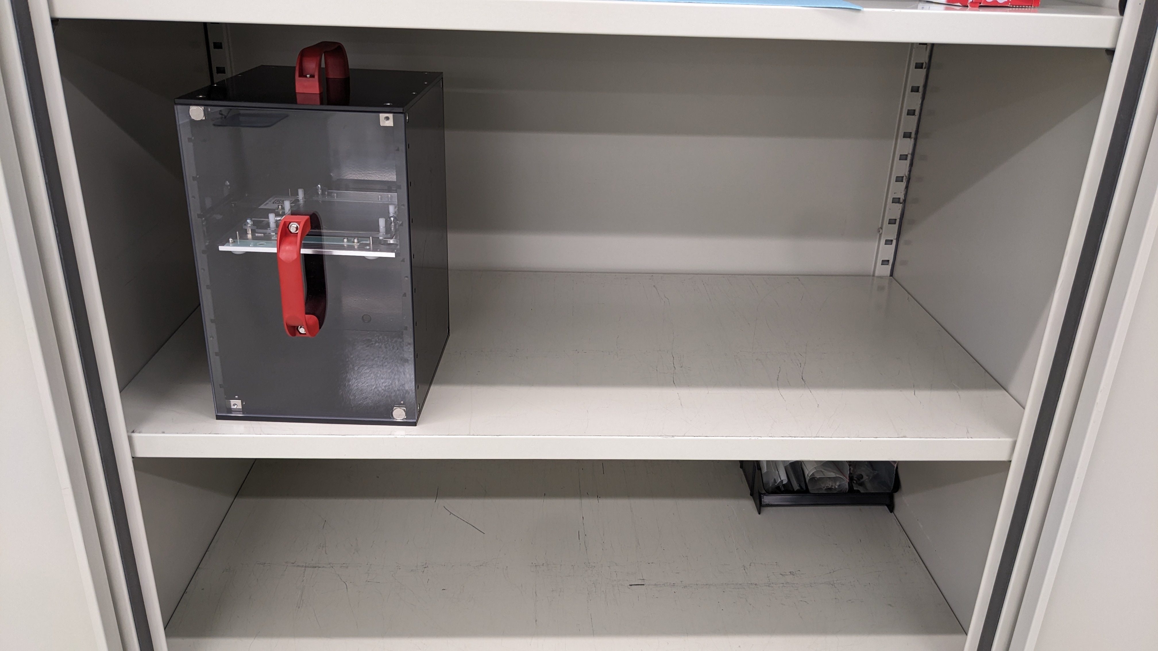
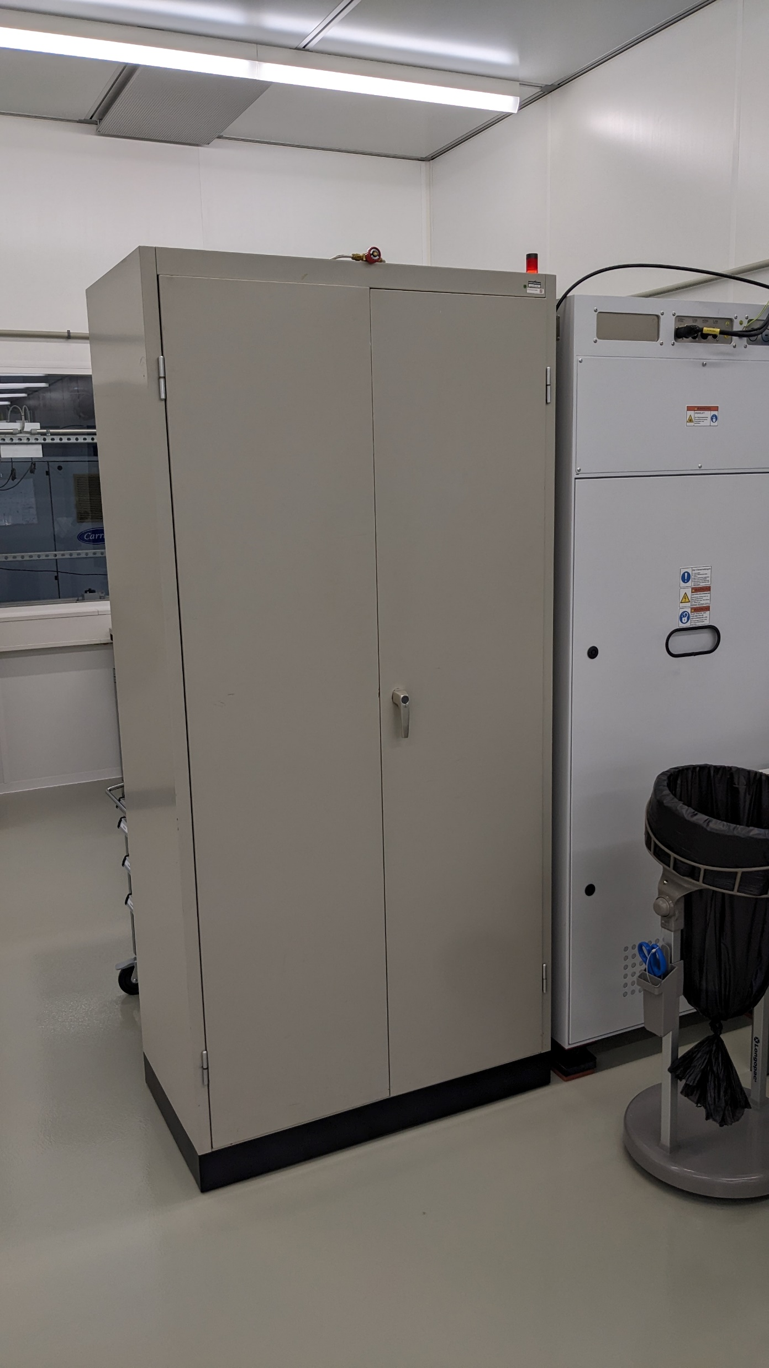
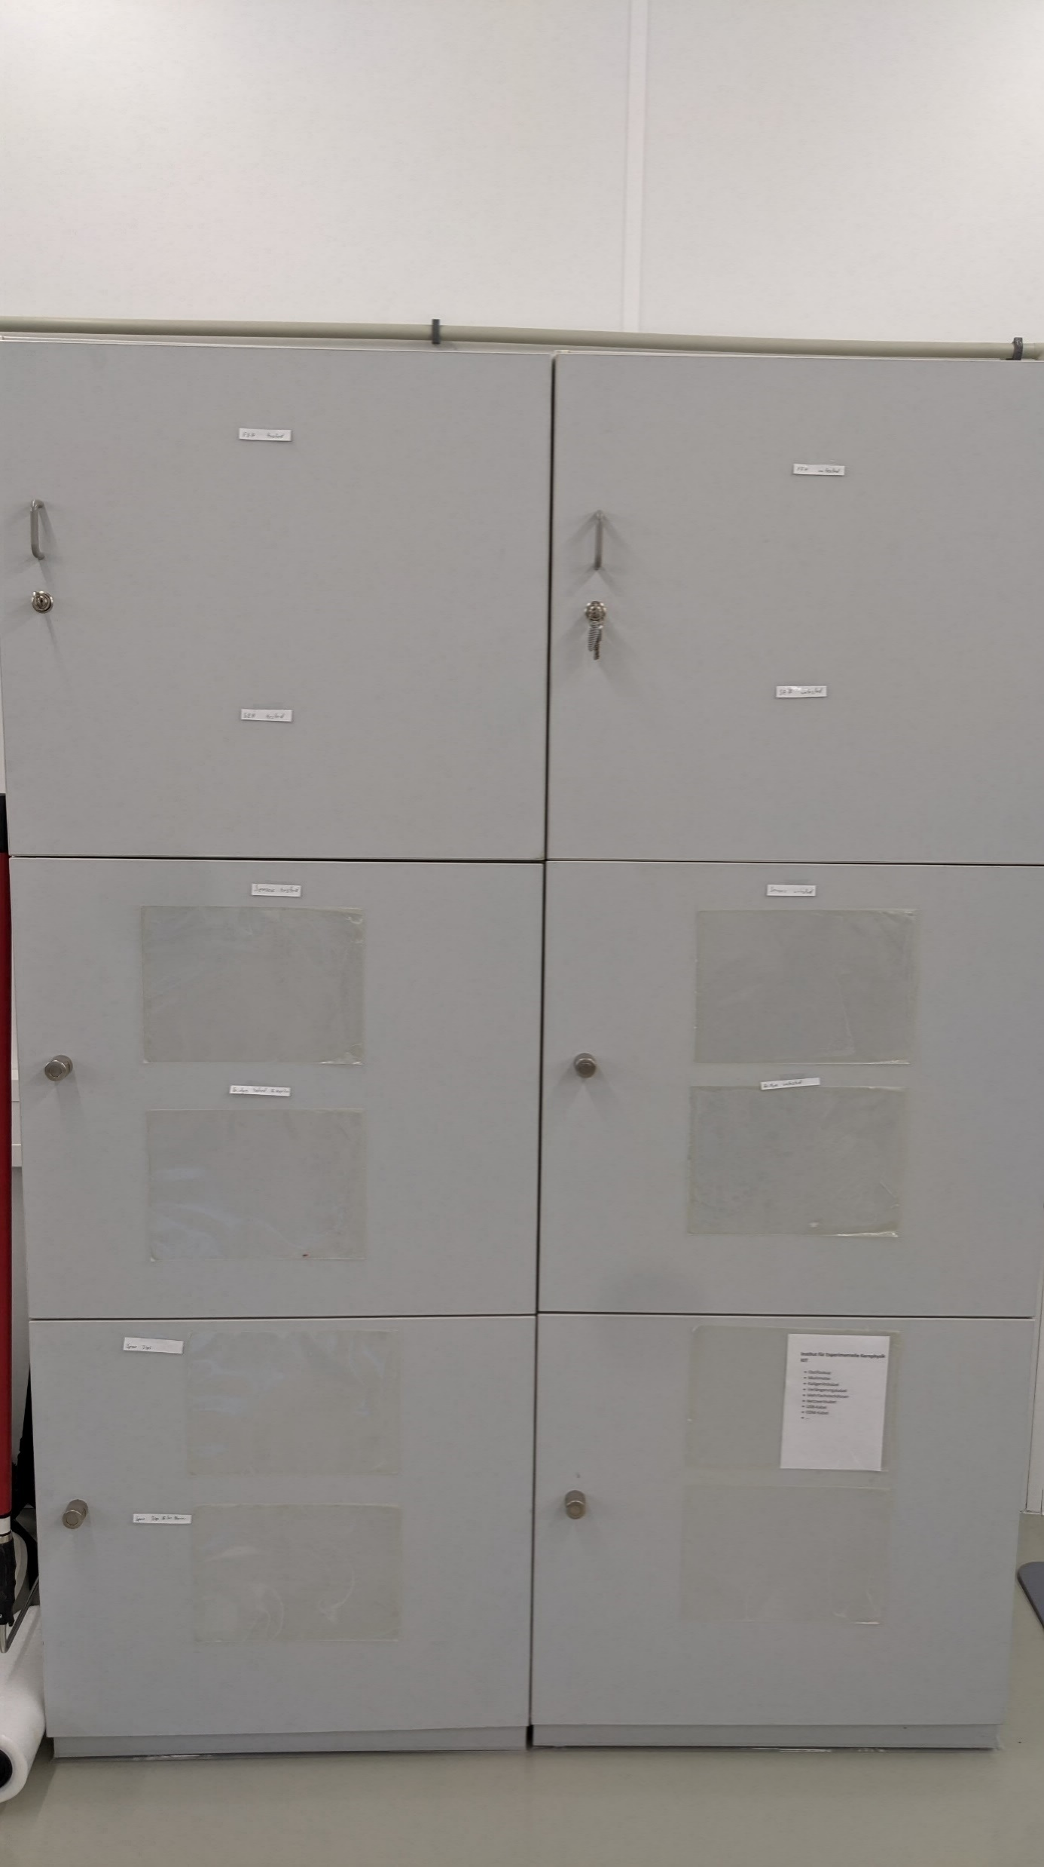
Storage
3
3 Storage cabinets: All flushed with dry air
#1 Component reception
  Store FEHs, SEHs, Bridges when they arrive
  1 Shelf for each:
    Tested components
    Untested components
  Spare jigs, clean room auxiliaries
#2 Dispensing and clean room supplies
  Gloves, masks, tissues, dispensing tips, cartridges, Petri dishes, glues ….
  Broken pieces
#3 Wire-bonding and module cupboard
  Wire-bonding jigs and auxiliaries
  Final module storage before moved to burn-in in another building
1
2
tested
untested

Slide 33
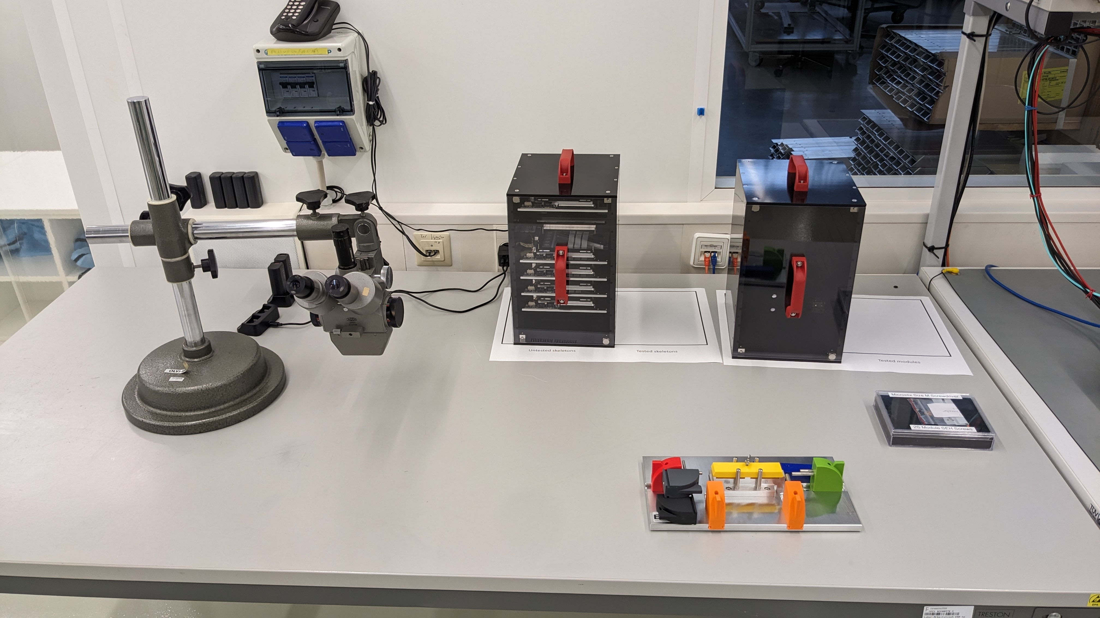
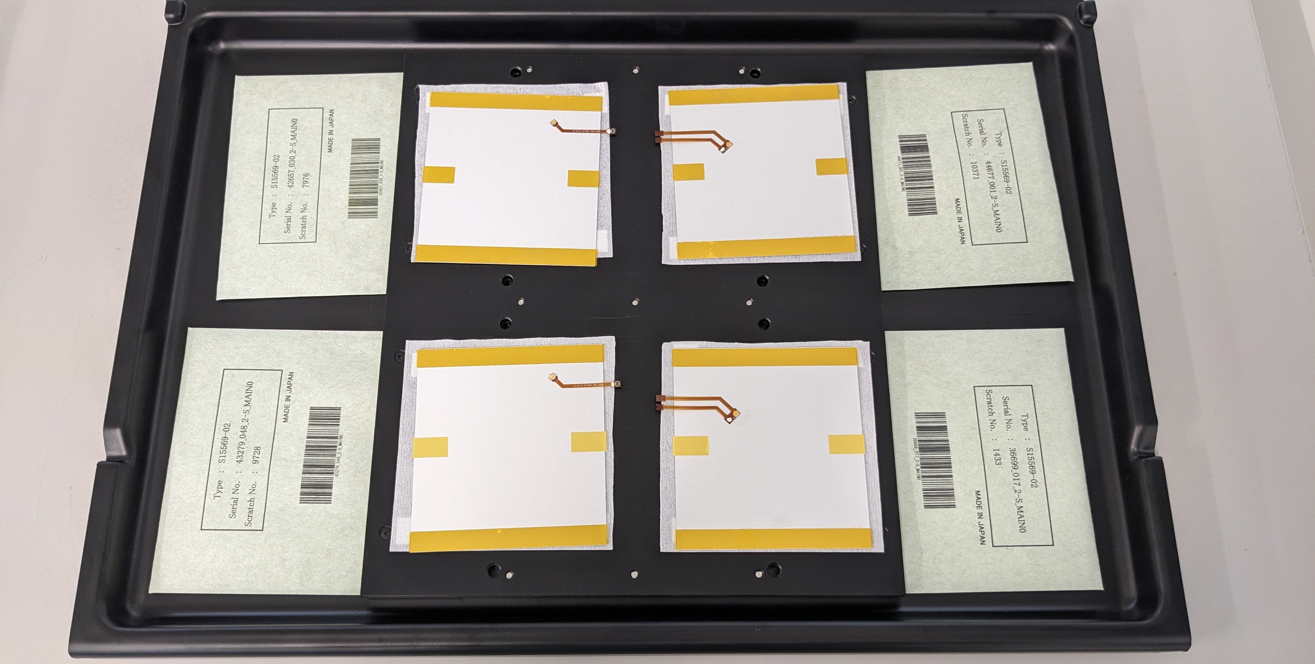
Intermediate Storage and Component Travel
Between assembly steps parts must travel from one table to another
We designed dedicated transportation and intermediate storage vessels
  Sensor tablet Module cassette
One of the first thing to do in the morning:
Rotate cassette from yesterday's to today's task

Slide 34
Sensor tablets

Slide 35
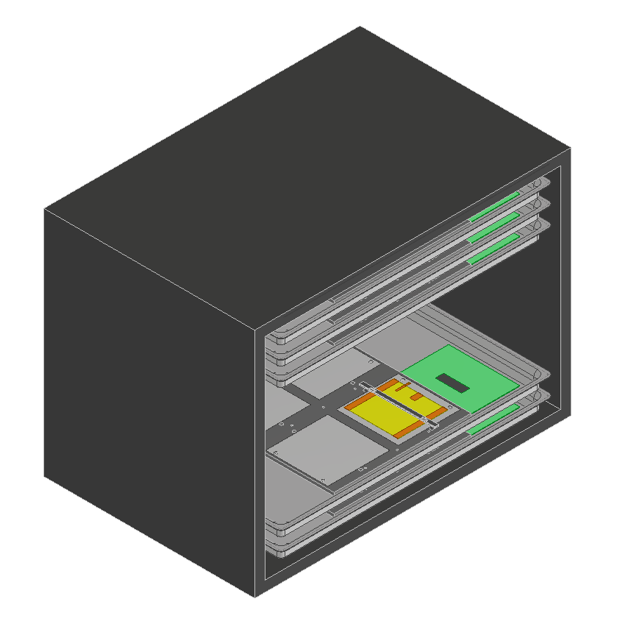
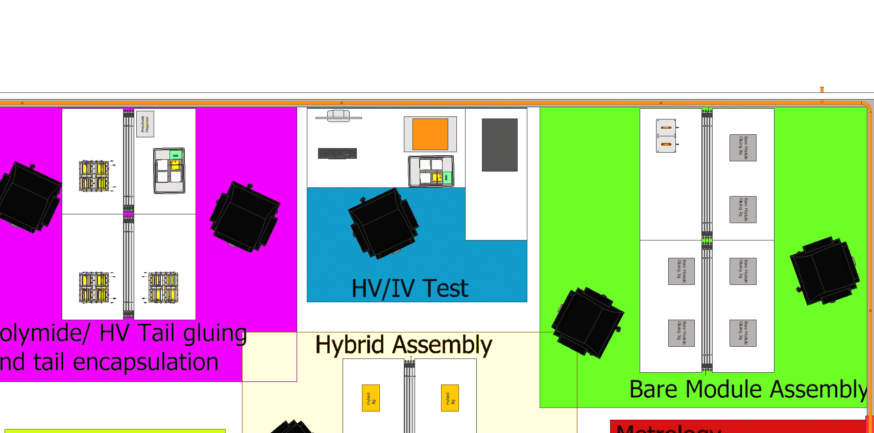
Sensor Tablets
Tablet rack
Apply encapsulation on HV bonds (1)
Store sensors in tablet rack (2)
HV/IV test (3)
Take sensors to assemble bare modules (4)
3
2
1
4

Slide 36
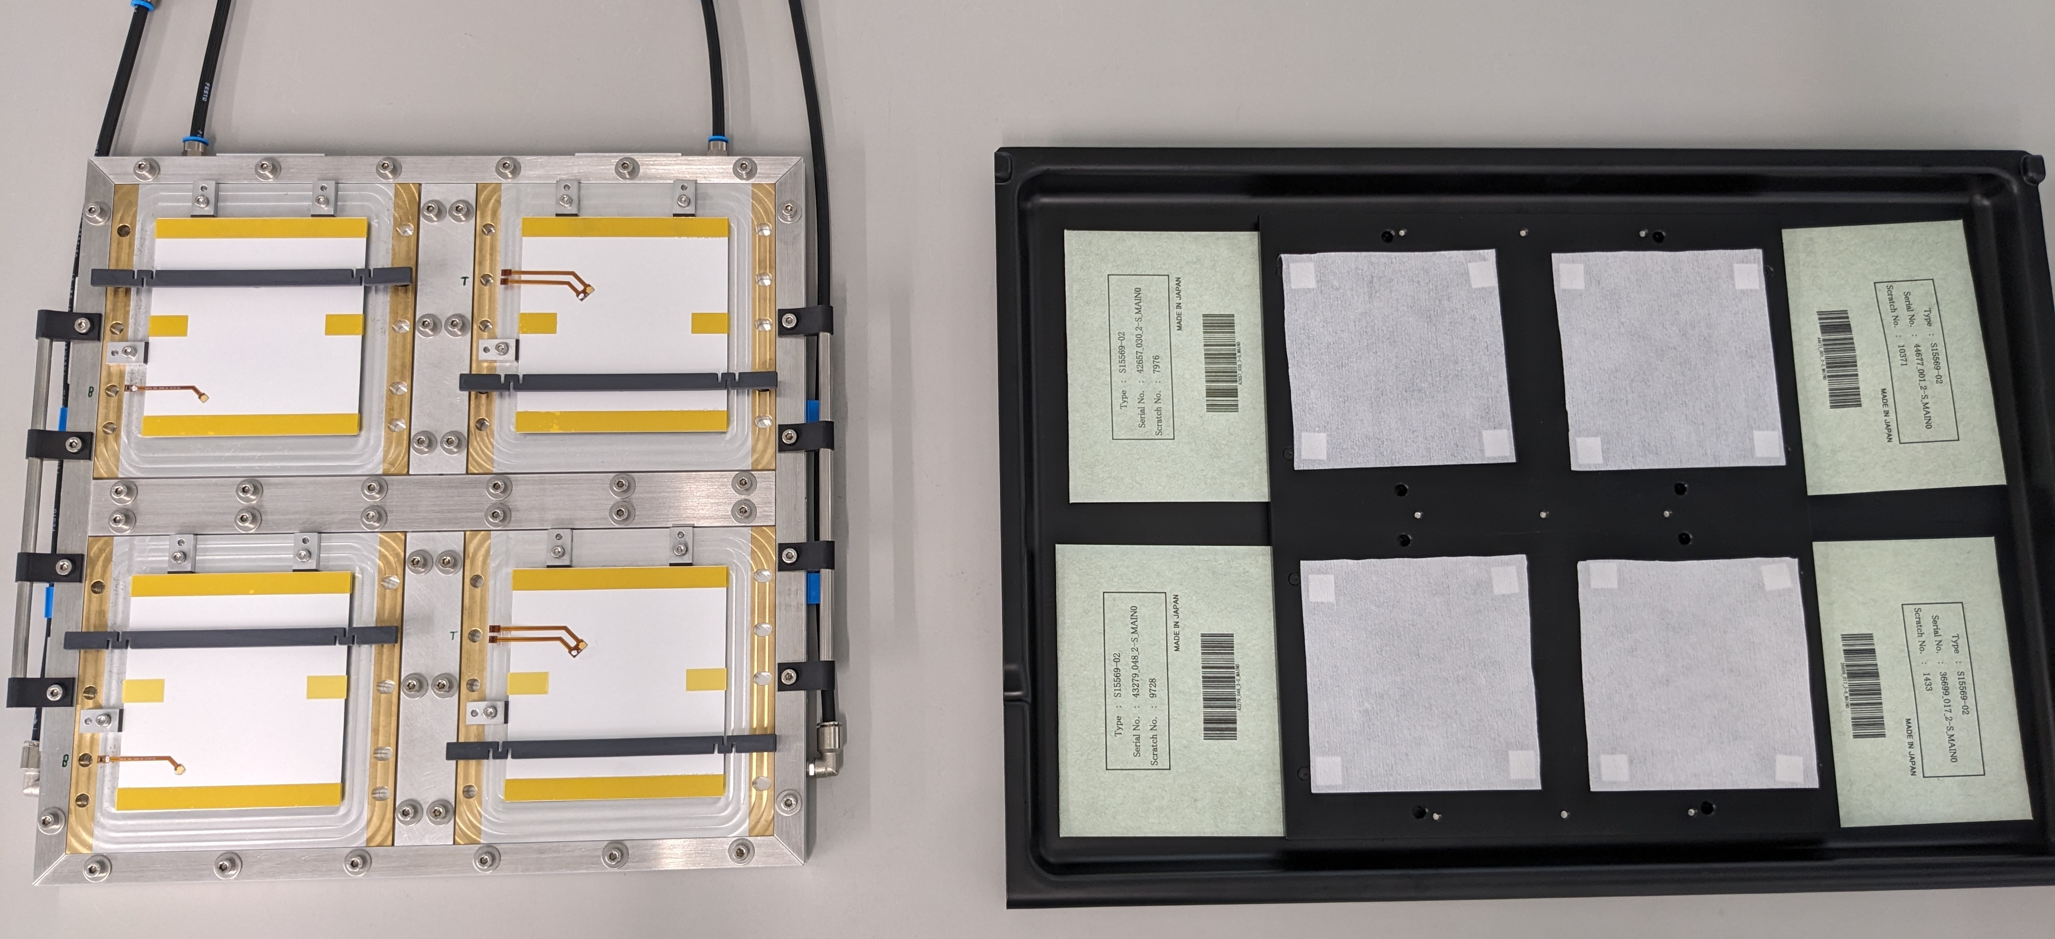
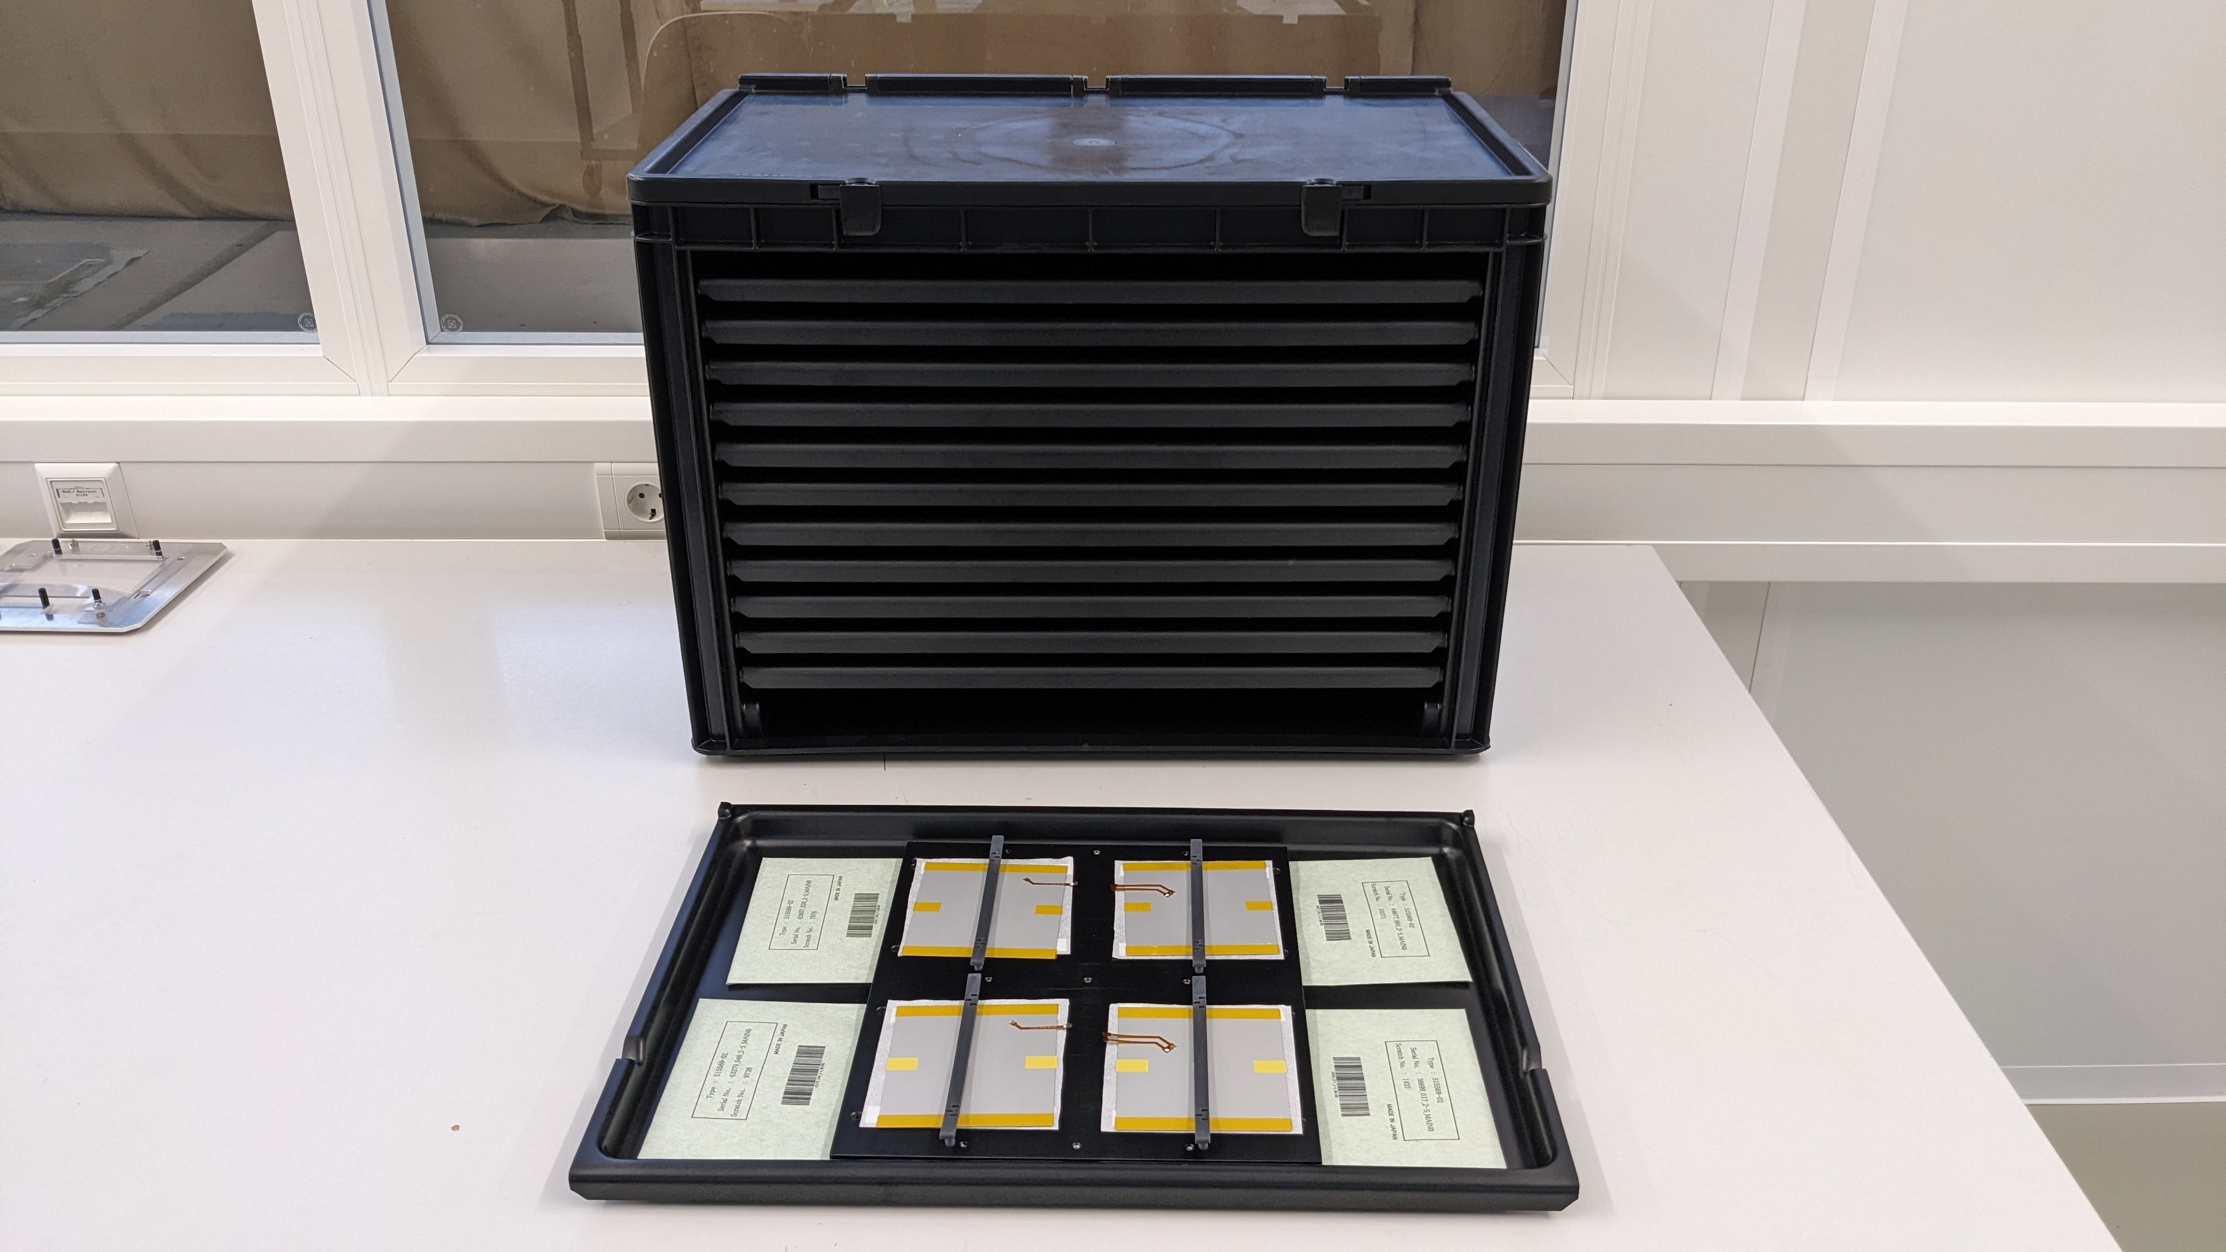
Sensor Tablets
After wire-bonding the sensors will be removed from the gluing jig and put on the sensor tablet for encapsulation (pneumatic dispenser) & HV/IV test
1 Tablet stores up to 4 sensors
  Sensor envelopes fixated with pressure pins below
  Sensors a fixated with clamps (not shown in the picture)
3 Tablets directly linked to sensors on Kapton gluing jigs
  Ensures not to lose track of sensor ID!
12 Tablets available
  Placed in a rack
  Rack could be extended with an additional shield to flush it with dried air
Content of tablet is indicated with a magnetic label
(Curing, To be tested, Done, …)
→ 48 sensors can be stored on long-term

Slide 37
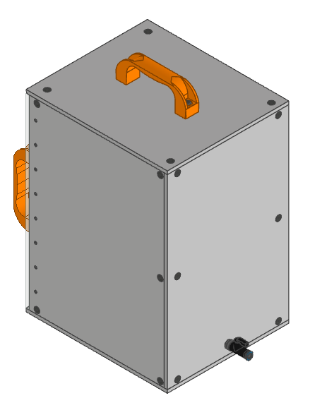
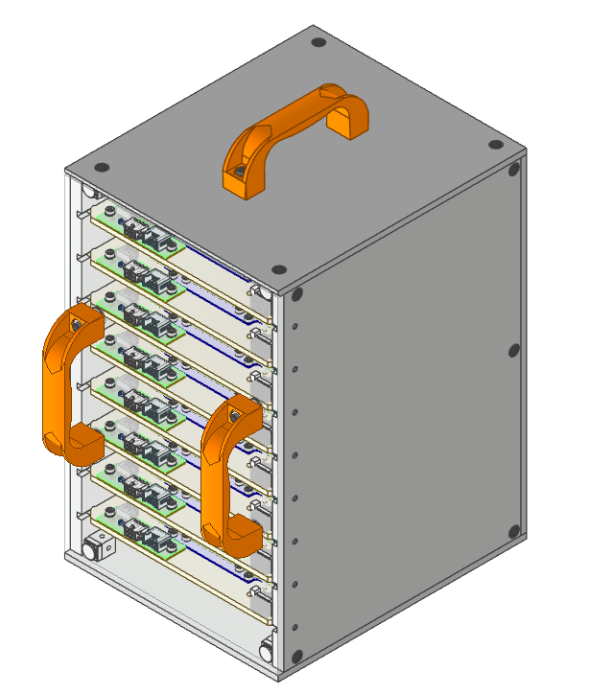
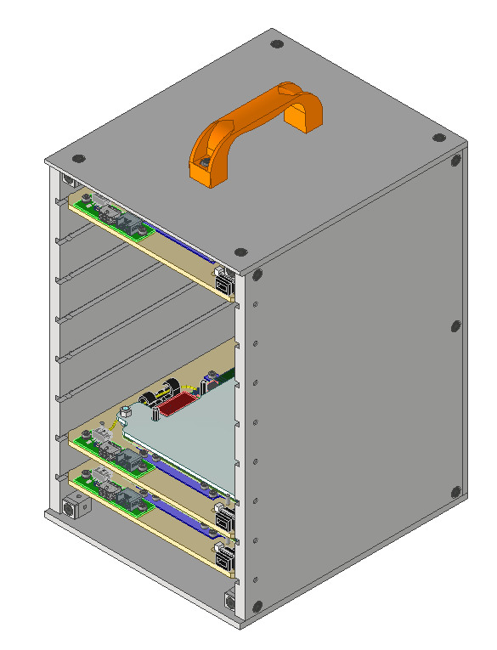
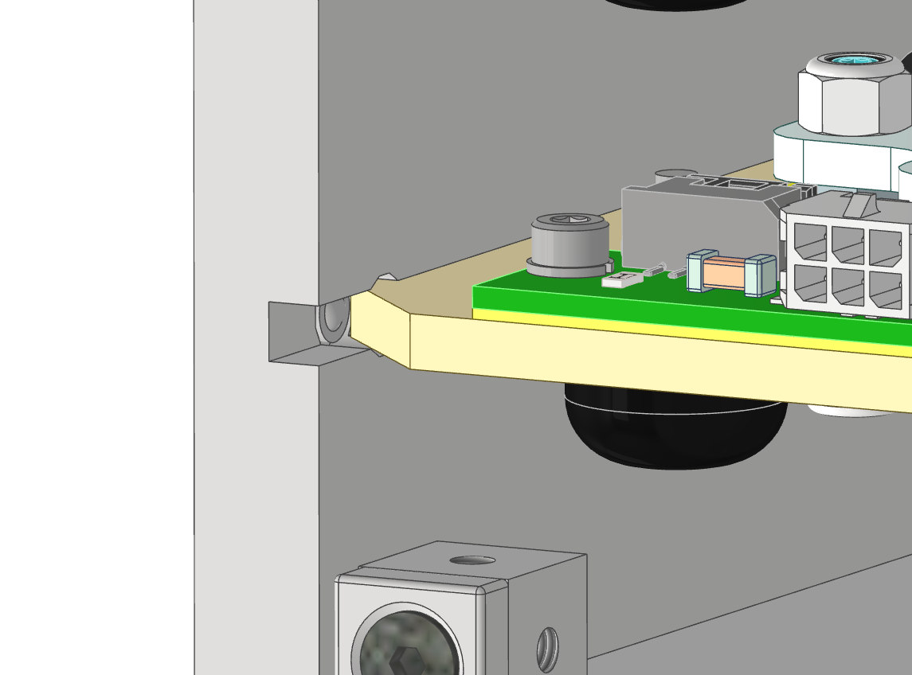
Module Cassette
ESD-safe (PE-EL)
Transport unit between assembly steps and buildings
  Contains up to 8 modules
  First time used for bare modules on carriers
  Emptied when modules are moved to transport box for shipping
Handle
Flushed with dry air (magnetic connector)
Optional Makrolon cover (exiting clean room)
Always check that the connector is properly attached!
Up to 8 modules
Pressure pins
Keep modules inside

Slide 38
Module cassettes

Slide 39
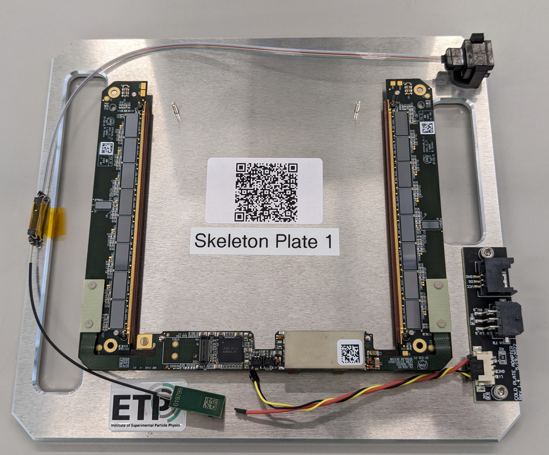
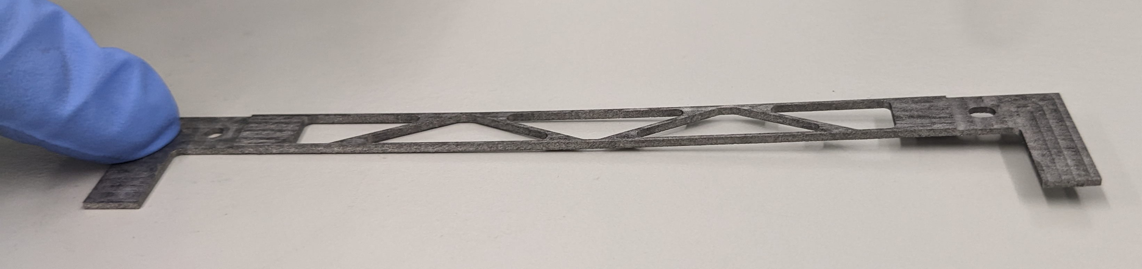
Visual Inspection / Skeleton Assembly
One dedicated desk with a stereo microscope to
visually inspect hybrids, bridges and to assemble skeletons
Hybrid VI entered into DB via Front-end (Laptop available)
Hybrids: We search for obvious damages on the hybrids:
  Delamination
  Broken connectors
  Significant dirt on the wire-bond pads
  Do not take too much time for this!
Bridges: 4 checks:
  Broken
  Thickness
  Flatness
  Hole diameter
Checked hybrids and bridges moved into the “tested” cabinet
After the assembly of skeletons they are stored
on skeleton plates in module cassettes
Hybrid & Bridge VI: Perfect task that can be done if you have some time left over

Slide 40
Gluing Stations
Gluing will happen on “gluing stations” made out of 4 desks each. 3 of those desks host jigs to glue parts for 2 modules
→ 6 Modules / day
Each stations comes with an integrated vacuum and dry air supply
→ Modular arrangement
Each gluing station has a battery-powered
portable digital microscope
Microscopes do have certain
focus setting:
Do not move them
from one station to the other!
After your shift:
Put the batteries
back in to the charger!

Slide 41
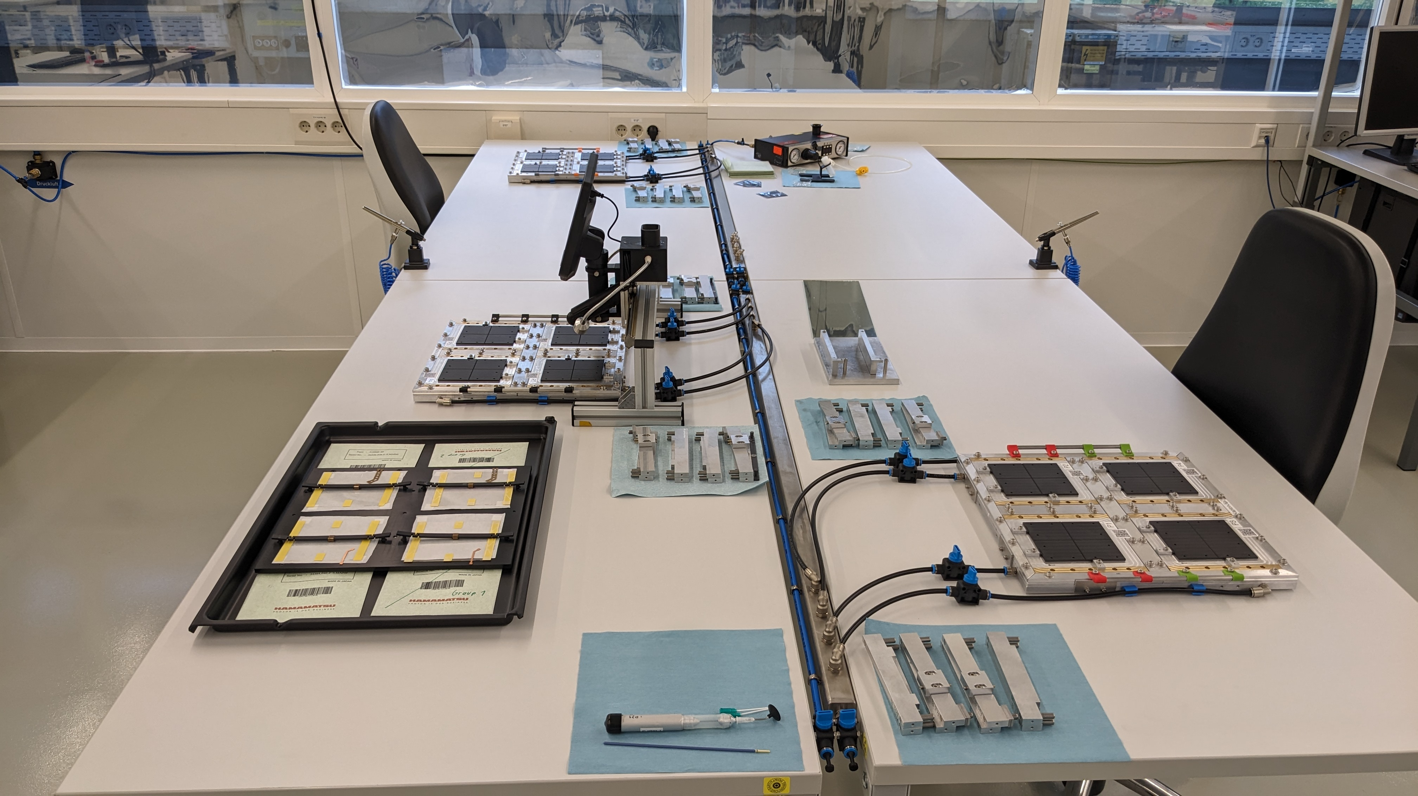
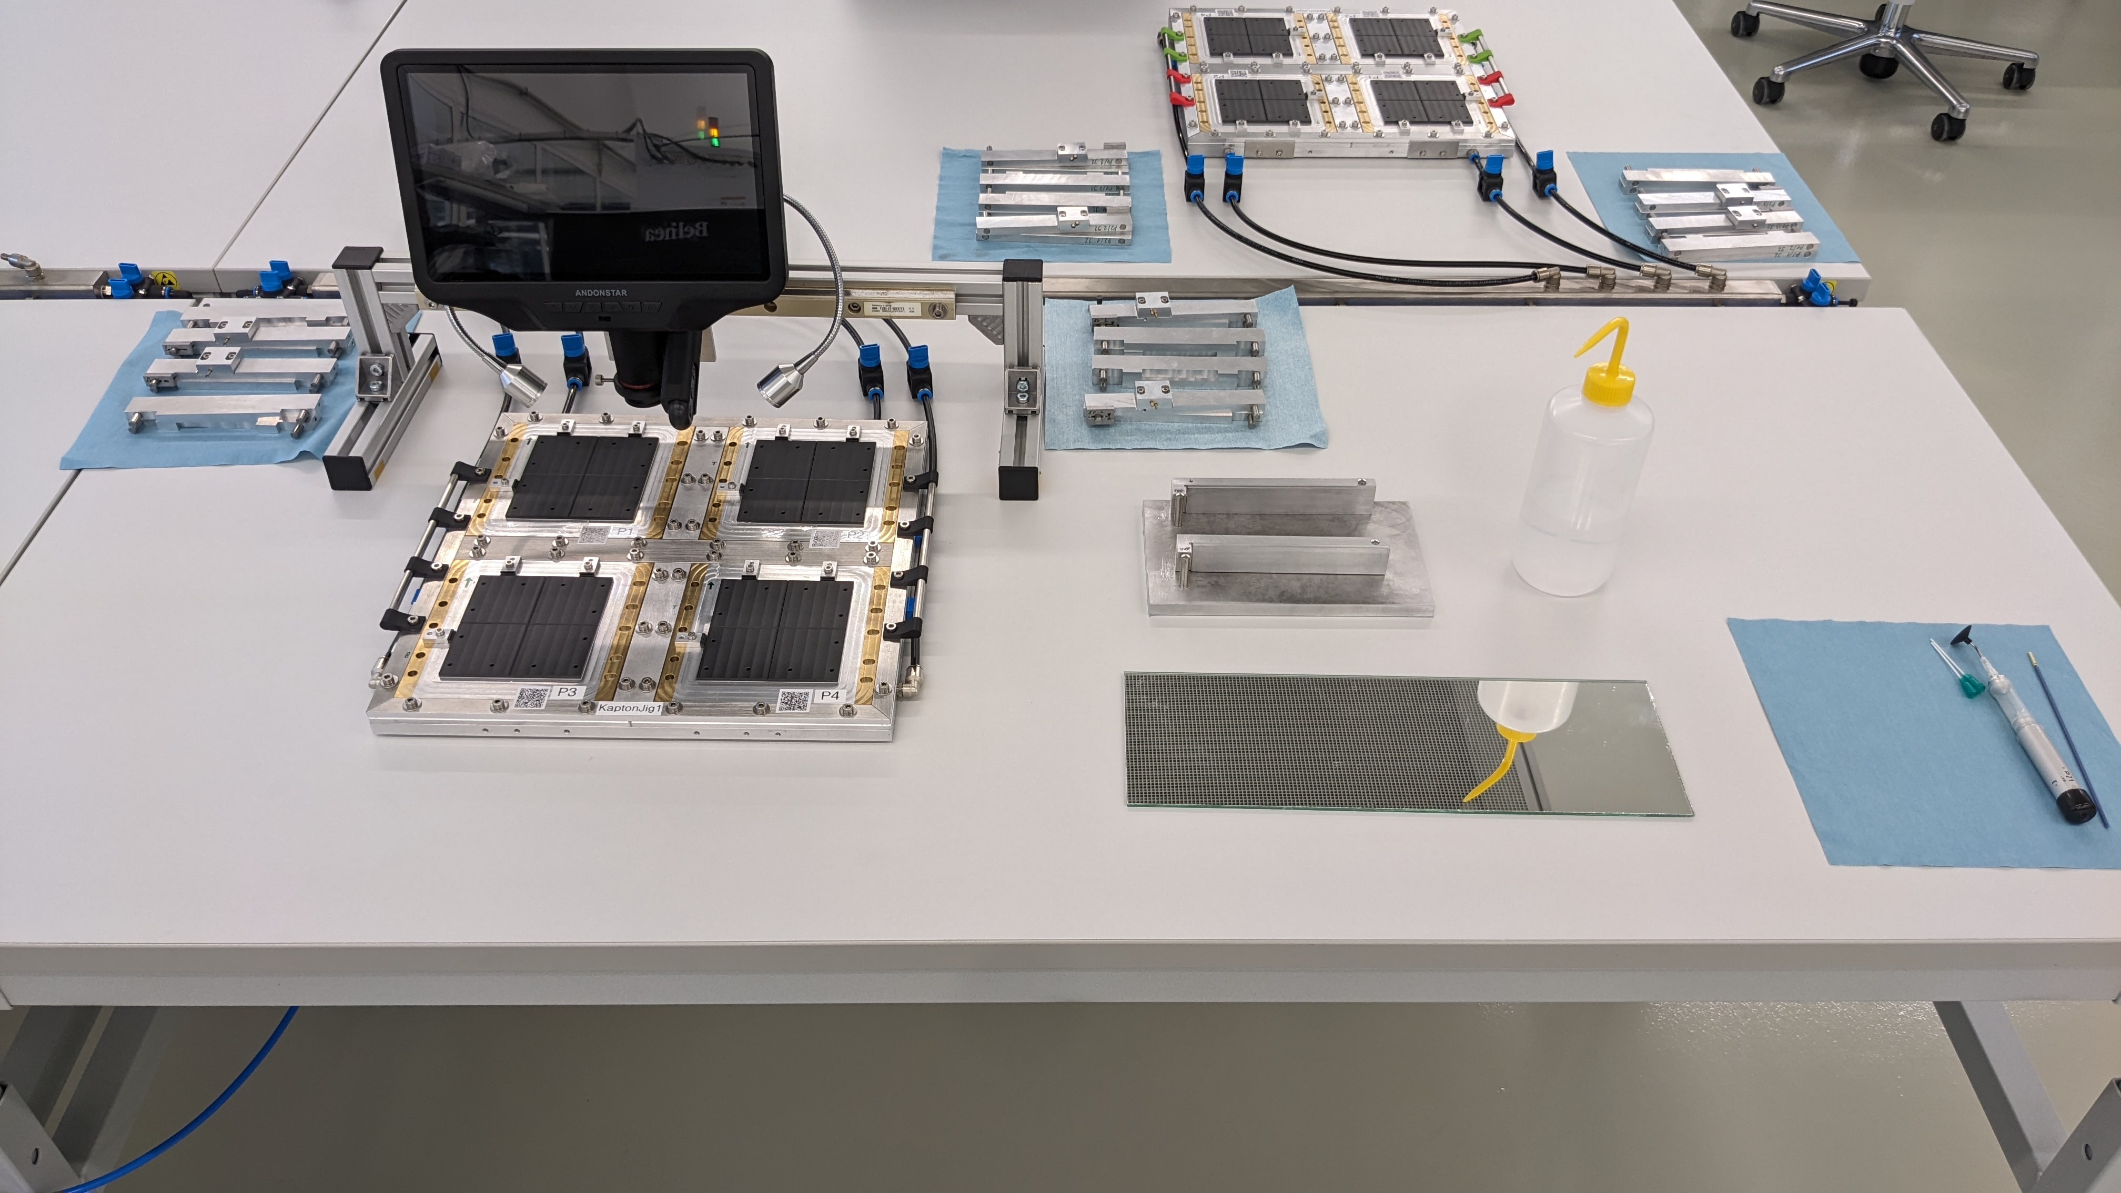
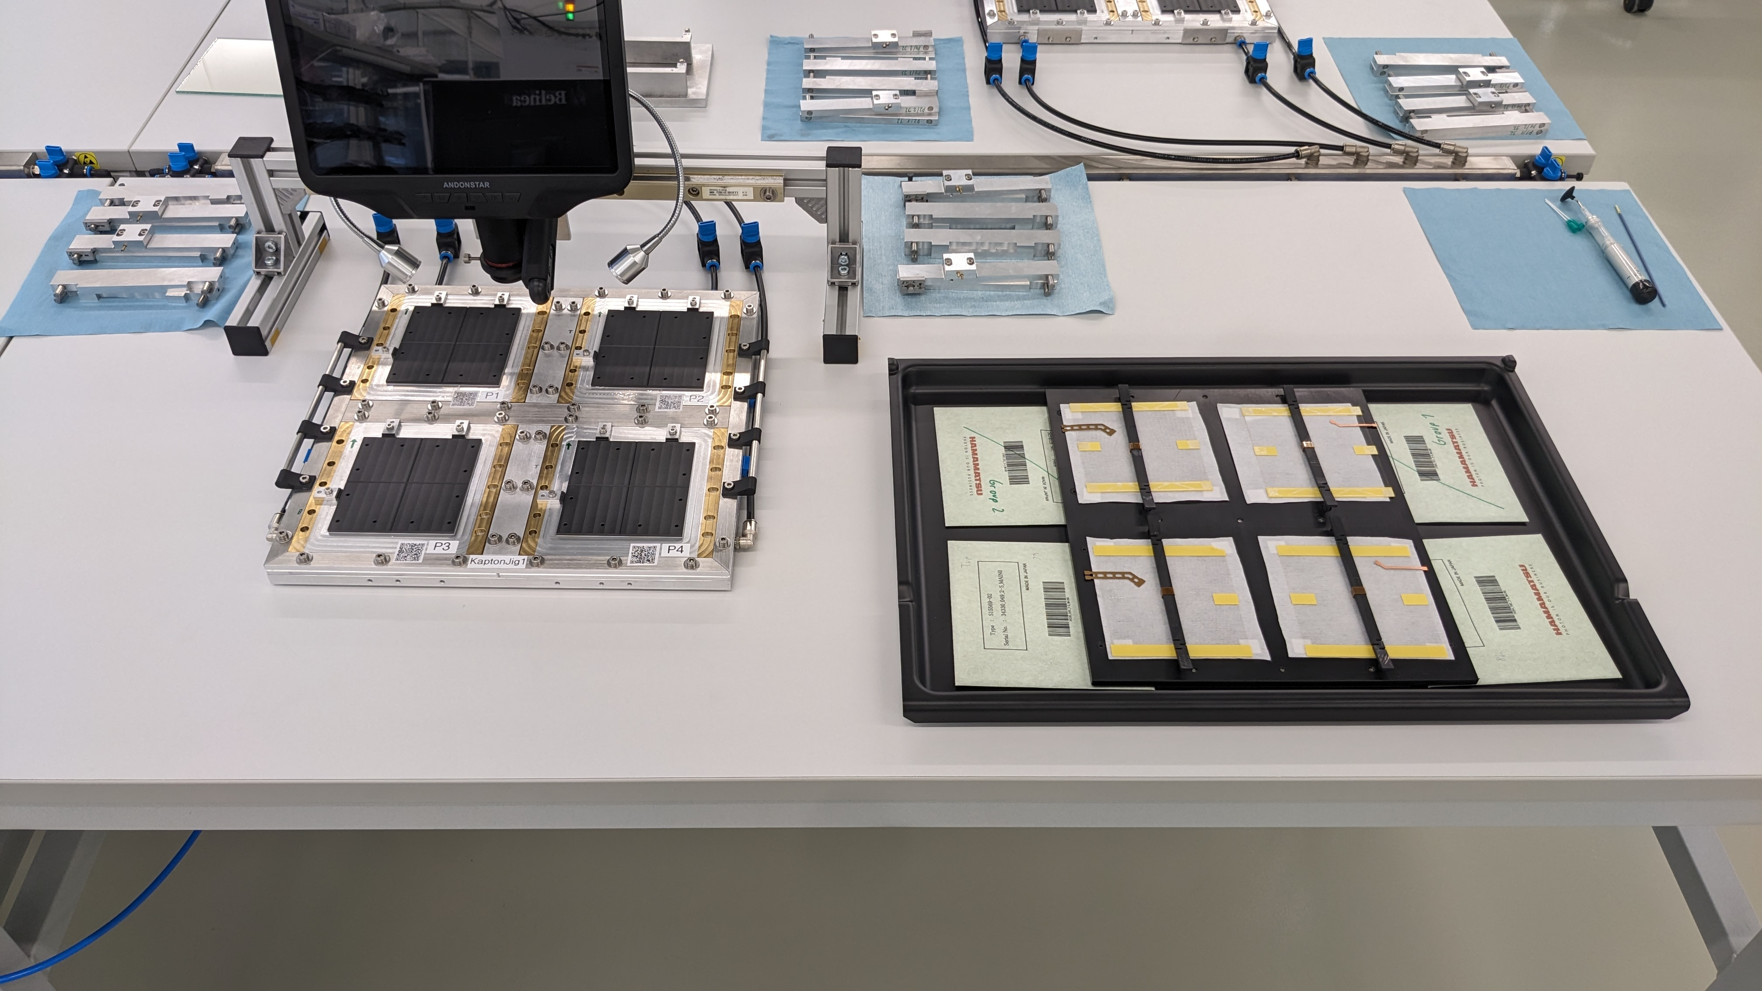
Polyimide Gluing Station
In total 3 jigs à 4 sensors
4th table to for HV tail encapsulation. Equipped with a pneumatic dispenser
After sensors are placed their envelopes are stored on a sensor tablet, which is then moved to a rack to leave space for the alignment tools

Slide 42
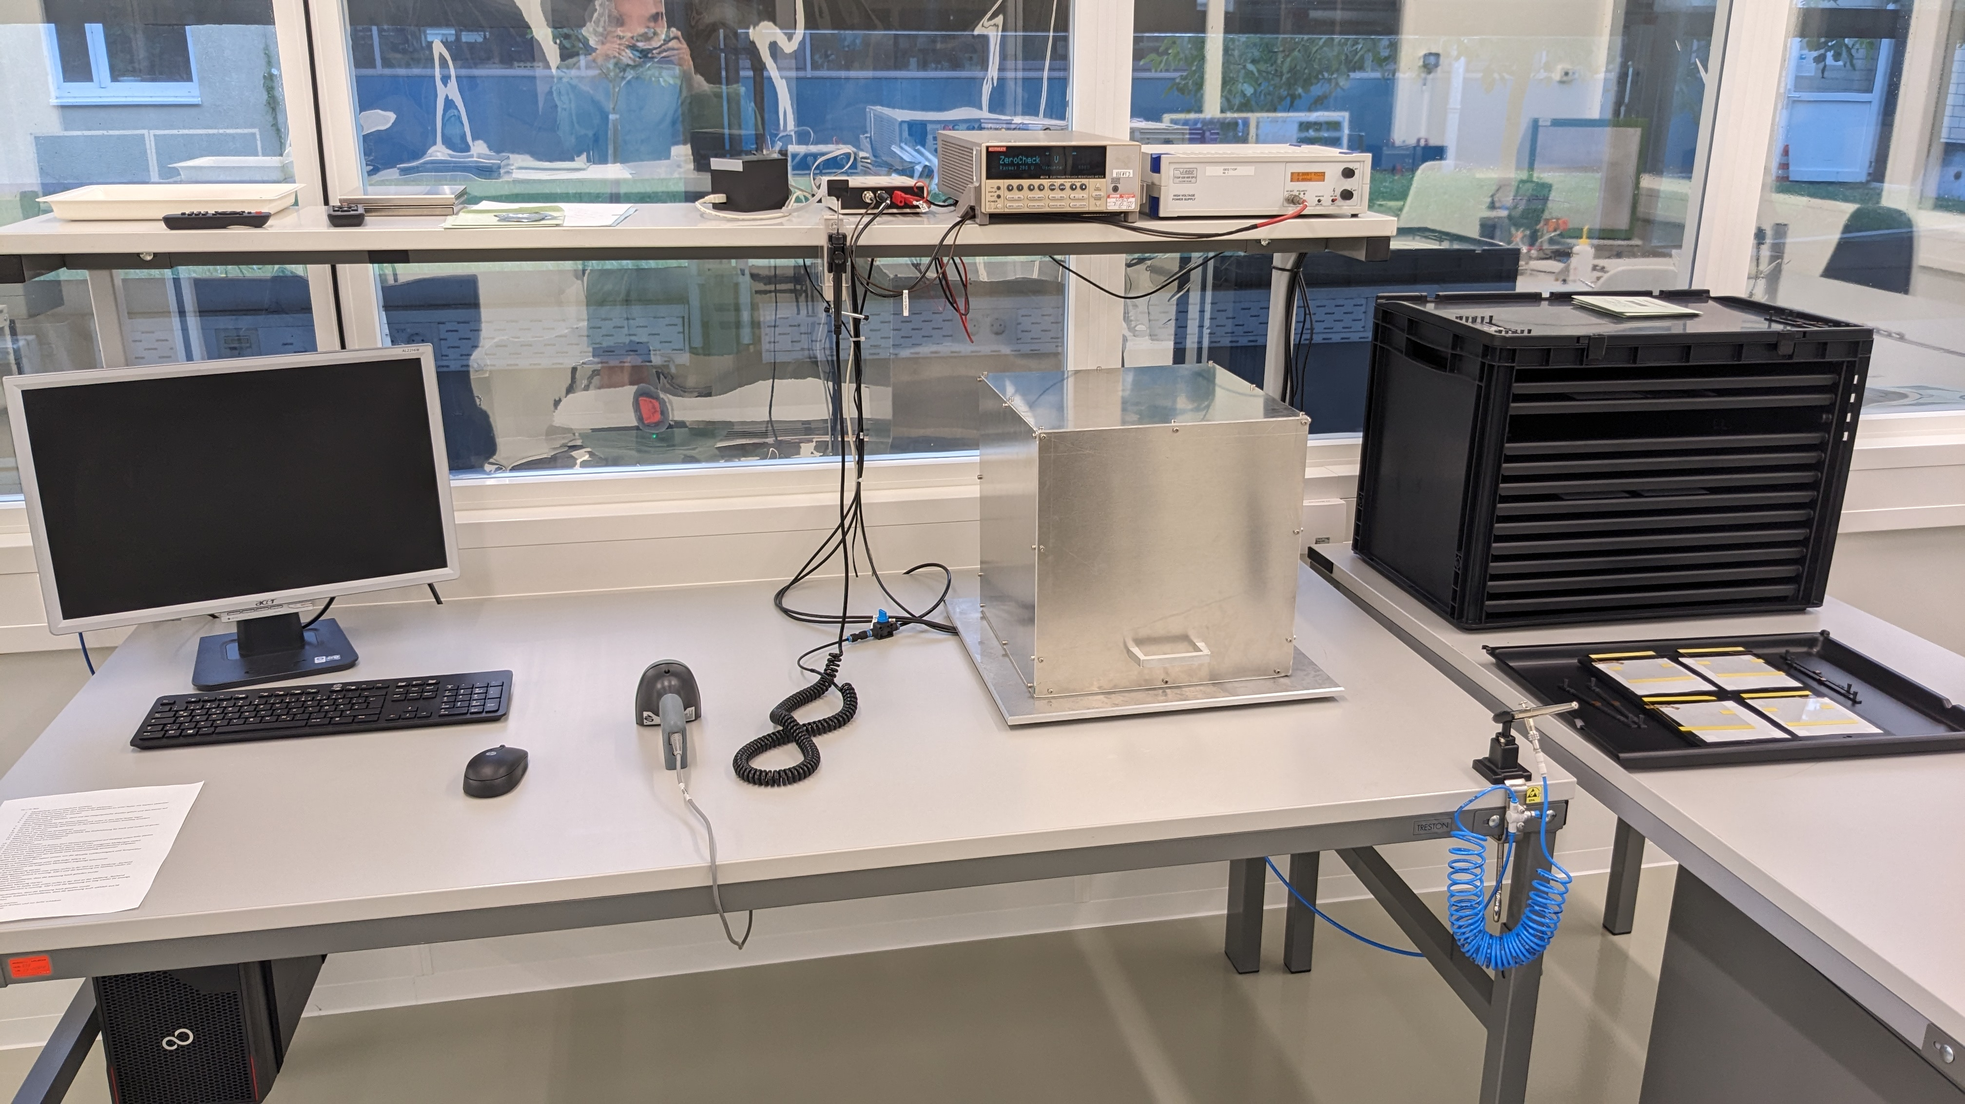
HV / IV Test
Test HV stability of Kapton strips
Measure IV curve of kaptonized sensor
IV measurement uploaded to local DB and forwarded to CMS construction DB
  Data forwarded to construction DB on daily basis

Slide 43
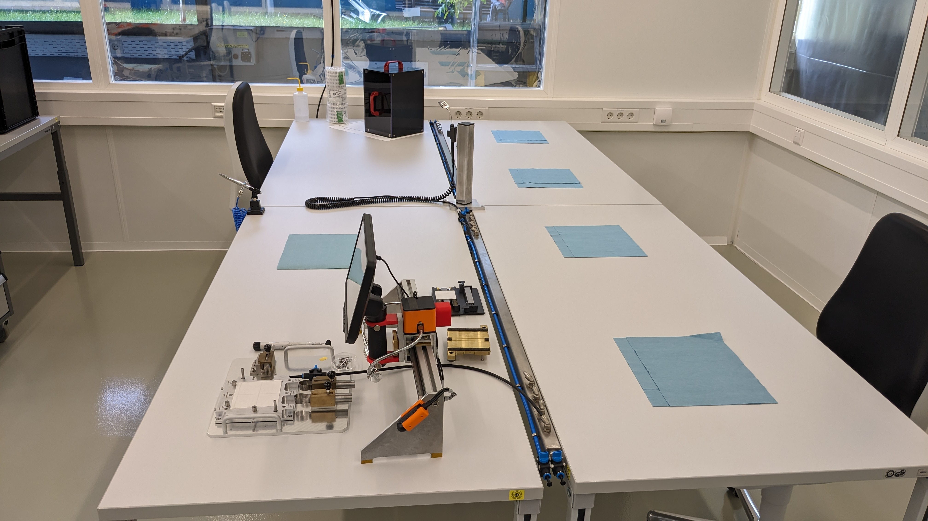
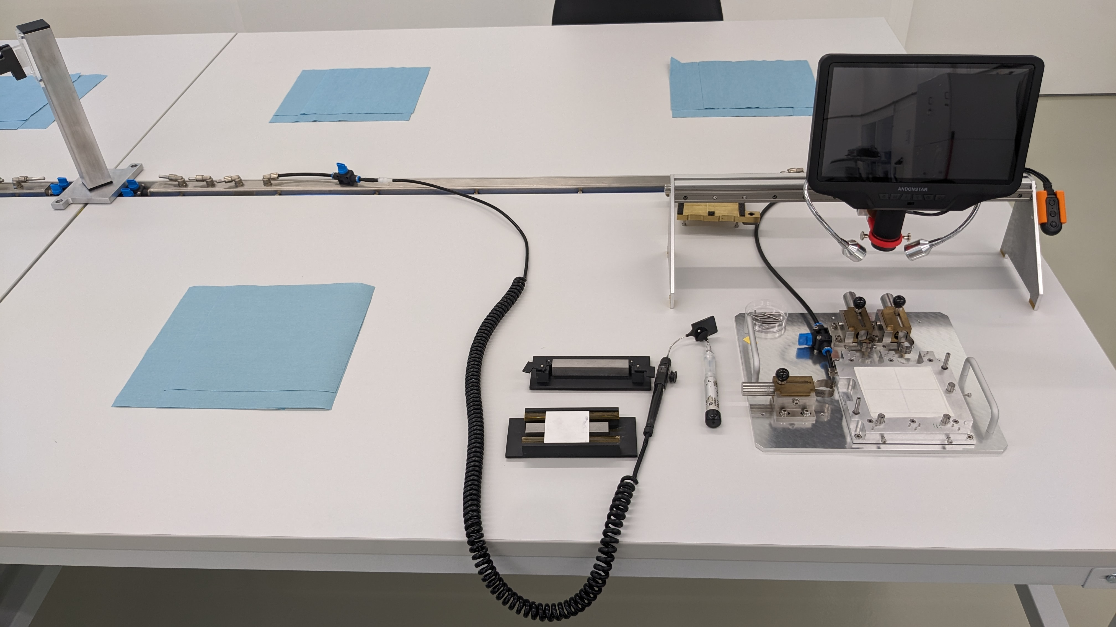
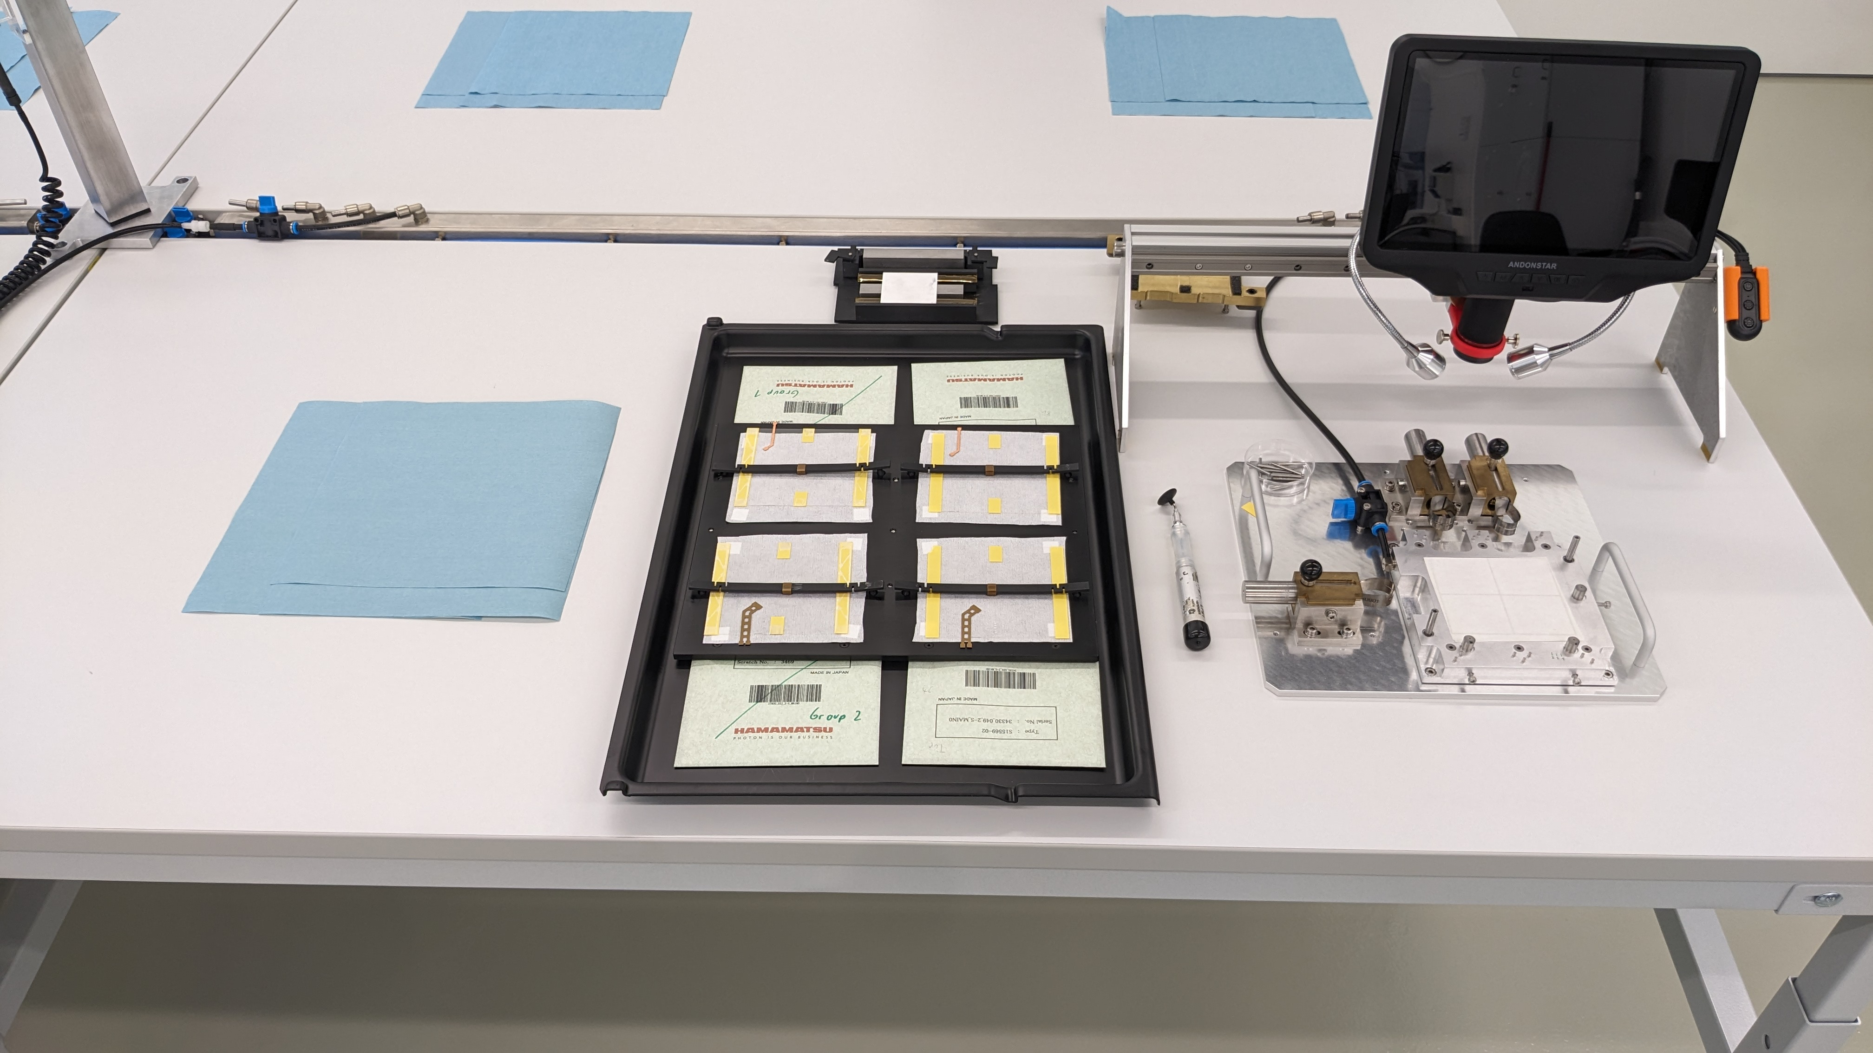
Bare Module Gluing Station
3 desks with 2 jigs each
Sensor tablet is placed between two jigs to place sensors
4th desk for preparation, carrier labelling and storage

Slide 44

Metrology
Measure sensor dicing accuracy
Edge to edge alignment
Fusing script generates top strip to bottom strip alignment
Alignment uploaded to local DB and then forwarded to construction DB
  Data forwarded to construction DB on daily basis

Slide 45



Hybrid Gluing Station
3 desks with 2 jigs each
4th desk for preparation and storage with 3 module cassettes
  Skeletons
  Bare modules
  Modules
Jigs will be slightly shifted on the table to free some space for the assembly itself

Slide 46
Hybrid Gluing Station
3 desks with 2 jigs each
4th desk for preparation and storage with 3 module cassettes
  Skeletons
  Bare modules
  Modules
Jigs will be slightly shifted on the table to free some space for the assembly itself
Do not glue the SEH in the upcoming assembly exercise!

Slide 47


Dispensing Gantry /
Glue Preparation
Custom-made gantry
Volumetric dispenser (Precifluid)
  5cc Gun (Kapton Gluing, Wire-bond encapsulation)
  30cc Gun (Wire-bond encapsulation)
Handles 4 sensors or modules at once
3 module cassettes to store modules for
  Not encapsulated
  Bottom side curing
  Top side curing
Keep it clean!

Slide 48



Wire-bonding
Hesse BJ855 (Backup BJ820 in building 401)
  Both bonders use the same vacuum table compatible with our wire-bonding jigs
2 Module cassettes to store unbonded and bonded modules
Jigs stored in cupboard nearby
One extra desk for VI

Slide 49

Module Test

Slide 50

11. Encap-sulation
2. Kapton gluing
4. Tail encapsulation
3. Tail bonding
5. HV/IV Test
6. Bare module
9. Wire-bonding
13. Storage
7. Metrology
8. Hybrid gluing
10. Module test
12. Module test

Slide 51

ETP Database Front-end
Each assembly step is tracked via an web-accessible front-end
  Assembly
  Measurements
  Visual inspection
Big Brother is watching you
  Who, when, which tool (jig, station),
  which components,…

Slide 52



ETP Database
Front-end

Slide 53


Front-end How To Made by Lorena
Stored in the CernBox folder
Homework 2: Read it

Slide 54

Upcoming Exercise
We do have parts for 15 complete modules
This time, also exercise parallel assembly of multiple modules / day
Wire-bond pull test should be done on all modules
Assembly of multiple modules / day only at the end of the exercise leaving some margin as pipeline runs dry towards the end (no part injection anymore)
Afterwards: Review and improve (April)
New parts should be there in April / May, but who knows…
Day | 1 | 2 | 3 | 4 | 5 | 6 | 7 | 8 | 9 | 10 | 11 | 12 | 13 | 14 | 15 | 16 |  | Sum
Prepare sensors | 4 | 4 | 4 | 4 | 4 | 2 | 2 | 2 | 2 | 2 |  |  |  |  |  |  |  | 30
Kaptonized sensors available |  |  | 4 | 6 | 8 | 10 | 12 | 12 | 12 | 12 | 10 | 8
Build bare module(s) |  |  | 1 | 1 | 1 | 1 | 1 | 1 | 1 | 2 | 2 | 4
Modules finished |  |  |  |  |  |  | 1 | 1 | 1 | 1 | 1 | 1 | 1 | 2 | 2 | 4 |  | 15

Slide 55
Assembly Team – Status
Stefan
Kai
Waldemar
Tobias
Andreas
Bernd
Hans Jürgen
Alexander
Niyathi
Thomas
Lea Busy writing
Bogdan Busy writing
-------------
Lorena
Leander
Aurora Contract starts in march?

Slide 56


Slide 57


Slide 58



Mistakes happen!
Don’t feel bad
Important is that we learn from them
and how to avoid them in future!
Always report and document, this helps all other people avoiding them!

Slide 59
BACKUP

Slide 60

Logistics
According to the module flow a large fraction of our modules will go to DESY
  Same for Aachen
Idea: Book a courier which
  Picks up full boxes at KIT
  Picks up full boxes at Aachen
  Delivery boxes to DESY, picks up empty boxes from previous delivery
  Drives back, stores empty boxes in his storage unit (~2 weeks)
  Picks up full boxes at KIT, brings back empty boxes from storage unit
  Picks up full boxes at Aachen, brings back empty boxes from storage unit
First offer from a courier used in Phase 1: 1755€ per round
Alternative: DHL express mail (insured)
Round robin

Slide 61


Slide 63


Slide 64


Slide 66

FTE
We put quite some effort defining on how
much time is needed for which step
  Scalable and granular down to minutes
Out of experience wire-bonding and
everything implying the usage of glue
should by done by a technician
Real numbers hard to estimate without
having real parts in large quantities
In the end the amount of work must
fit in usual and realistic working hours
I put up a schedule describing the work that needs to be done within the clean room (no burn-in, packaging, shipping, organization etc…) estimating how many people we need at minimum and what constraints we have in the assembly flow

Slide 67
Schedule (≥4 modules / day)
Person / Time | FTE 1 | FTE 2 | FTE 3 | FTE 4 | FTE 5
8:00 – 9:00
9:00 – 10:00
10:00 – 11:00
11:00 – 12:00
13:00 – 14:00
14:00 – 15:00
15:00 – 16:00
16:00 – 17:00

Slide 68
Schedule (≥4 modules / day)
DAY 1
Person / Time | FTE 1 | FTE 2 | FTE 3 | FTE 4 | FTE 5
8:00 – 9:00 | Dicing test | Optical inspection hybrids bridges
9:00 – 10:00 | Kapton gluing
10:00 – 11:00 | Kapton gluing
11:00 – 12:00 | Kapton gluing
13:00 – 14:00
14:00 – 15:00
15:00 – 16:00
16:00 – 17:00

Slide 69
Schedule (≥4 modules / day)
Constraint 1: Free Kapton gluing jigs after tail bonding
DAY 1
DAY 2
Person / Time | FTE 1 | FTE 2 | FTE 3 | FTE 4 | FTE 5
8:00 – 9:00 | Dicing test | Optical inspection hybrids bridges |  | WB tails
9:00 – 10:00 | Kapton gluing
10:00 – 11:00 | Kapton gluing
11:00 – 12:00 | Kapton gluing
13:00 – 14:00 | Encapsulate Tails
14:00 – 15:00
15:00 – 16:00
16:00 – 17:00
1

Slide 70
Schedule
Constraint 1: Free Kapton gluing jigs after tail bonding
DAY 1
DAY 2
DAY 3
Person / Time | FTE 1 | FTE 2 | FTE 3 | FTE 4 | FTE 5
8:00 – 9:00 | Dicing test | Optical inspection hybrids bridges | Assemble and test skeletons | WB tails
9:00 – 10:00 | Kapton gluing | HV/IV Test | Assemble and test skeletons
10:00 – 11:00 | Kapton gluing | HV/IV Test
11:00 – 12:00 | Kapton gluing | HV/IV Test
13:00 – 14:00 | Encapsulate Tails | Bare modules assembly
14:00 – 15:00 |  | Bare module assembly
15:00 – 16:00 |  | Bare module assembly
16:00 – 17:00
1

Slide 71
Schedule
Constraint 1: Free Kapton gluing jigs after tail bonding
Constraint 2: Metrology machine used for dicing test and bare module metrology
DAY 1
DAY 2
DAY 3
DAY 4
Person / Time | FTE 1 | FTE 2 | FTE 3 | FTE 4 | FTE 5
8:00 – 9:00 | Dicing test | Optical inspection hybrids bridges | Assemble and test skeletons | WB tails
9:00 – 10:00 | Kapton gluing | HV/IV Test | Assemble and test skeletons
10:00 – 11:00 | Kapton gluing | HV/IV Test | Metrology
11:00 – 12:00 | Kapton gluing | HV/IV Test | Metrology
13:00 – 14:00 | Encapsulate Tails | Bare modules assembly | Hybrid gluing
14:00 – 15:00 |  | Bare module assembly | Hybrid gluing
15:00 – 16:00 |  | Bare module assembly | Hybrid gluing
16:00 – 17:00
1
2

Slide 72
Schedule
Constraint 1: Free Kapton gluing jigs after tail bonding
Constraint 2: Metrology machine used for dicing test and bare module metrology
Constraint 3: One person cannot bond for 8 hours
Constraint 4: Bonder used for tail and readout bonds
DAY 1
DAY 2
DAY 3
DAY 4
DAY 5
Person / Time | FTE 1 | FTE 2 | FTE 3 | FTE 4 | FTE 5
8:00 – 9:00 | Dicing test | Optical inspection hybrids bridges | Assemble and test skeletons | WB tails
9:00 – 10:00 | Kapton gluing | HV/IV Test | Assemble and test skeletons | WB modules
10:00 – 11:00 | Kapton gluing | HV/IV Test | Metrology | WB modules
11:00 – 12:00 | Kapton gluing | HV/IV Test | Metrology | WB modules
13:00 – 14:00 | Encapsulate Tails | Bare modules assembly | Hybrid gluing |  | WB modules
14:00 – 15:00 |  | Bare module assembly | Hybrid gluing |  | WB modules
15:00 – 16:00 |  | Bare module assembly | Hybrid gluing |  | WB modules
16:00 – 17:00 |  |  |  |  | WB modules
1
4
2
3

Slide 73
Schedule
Constraint 1: Free Kapton gluing jigs after tail bonding
Constraint 2: Metrology machine used for dicing test and bare module metrology
Constraint 3: One person cannot bond for 8 hours
Constraint 4: Bonder used for tail and readout bonds
Constraint 5: Dispensing gantry used for Kapton gluing and encapsulation
DAY 1
DAY 2
DAY 3
DAY 4
DAY 5
DAY 6/7
Person / Time | FTE 1 | FTE 2 | FTE 3 | FTE 4 | FTE 5
8:00 – 9:00 | Dicing test | Optical inspection hybrids bridges | Assemble and test skeletons | WB tails | Test modules before encaps.
9:00 – 10:00 | Kapton gluing | HV/IV Test | Assemble and test skeletons | WB modules | Test modules before encaps.
10:00 – 11:00 | Kapton gluing | HV/IV Test | Metrology | WB modules
11:00 – 12:00 | Kapton gluing | HV/IV Test | Metrology | WB modules
13:00 – 14:00 | Encapsulate Tails | Bare modules assembly | Hybrid gluing |  | WB modules
14:00 – 15:00 | Encapsulate modules | Bare module assembly | Hybrid gluing |  | WB modules
15:00 – 16:00 | Encapsulate modules | Bare module assembly | Hybrid gluing |  | WB modules
16:00 – 17:00 | Encapsulate modules |  |  |  | WB modules
1
4
2
3
5

Slide 74
Schedule
Constraint 1: Free Kapton gluing jigs after tail bonding
Constraint 2: Metrology machine used for dicing test and bare module metrology
Constraint 3: One person cannot bond for 8 hours
Constraint 4: Bonder used for tail and readout bonds
Constraint 5: Dispensing gantry used for Kapton gluing and encapsulation
DAY 1
DAY 2
DAY 3
DAY 4
DAY 5
DAY 6/7
DAY 8
Person / Time | FTE 1 | FTE 2 | FTE 3 | FTE 4 | FTE 5
8:00 – 9:00 | Dicing test | Optical inspection hybrids bridges | Assemble and test skeletons | WB tails | Test modules before encaps.
9:00 – 10:00 | Kapton gluing | HV/IV Test | Assemble and test skeletons | WB modules | Test modules before encaps.
10:00 – 11:00 | Kapton gluing | HV/IV Test | Metrology | WB modules | Test modules after encaps.
11:00 – 12:00 | Kapton gluing | HV/IV Test | Metrology | WB modules | Test modules after encaps.
13:00 – 14:00 | Encapsulate Tails | Bare modules assembly | Hybrid gluing |  | WB modules
14:00 – 15:00 | Encapsulate modules | Bare module assembly | Hybrid gluing |  | WB modules
15:00 – 16:00 | Encapsulate modules | Bare module assembly | Hybrid gluing |  | WB modules
16:00 – 17:00 | Encapsulate modules |  |  |  | WB modules
1
4
2
3
5

