Slide 1
2S Module Production – Debriefing
ETP 2S Module Production Meeting – 27.03.2025 ●Stefan Maier

Slide 2
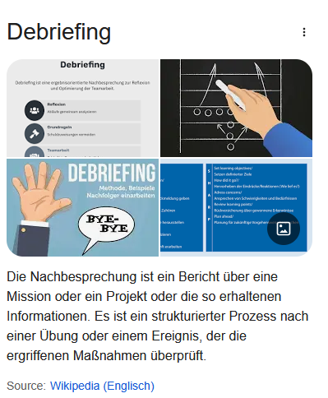

Slide 3
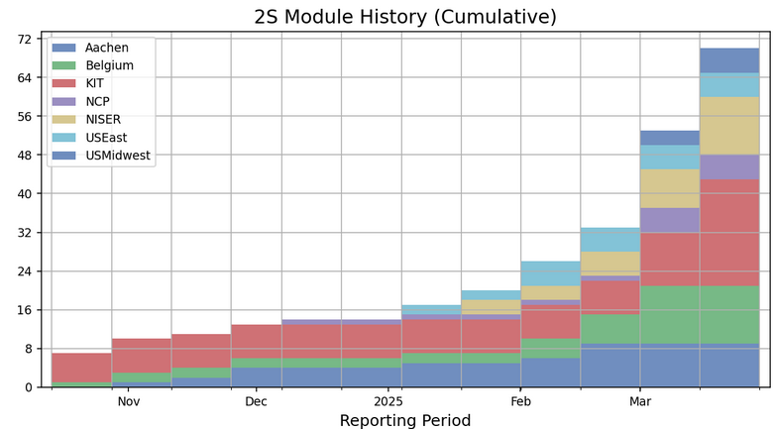
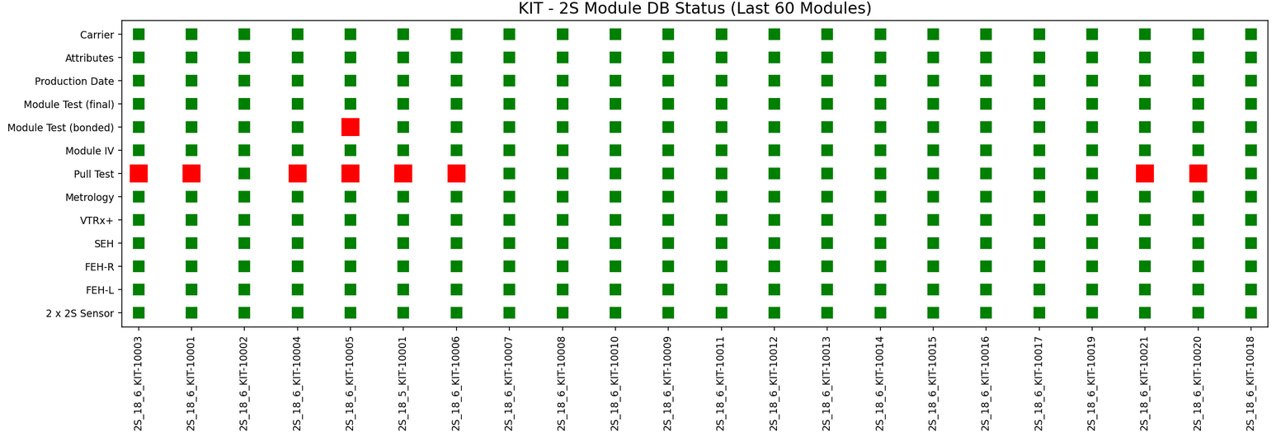
15 Modules in 16 Days
Long story short: Success!
We took the lead! ; )

Slide 4
Shift Scheduling
As already stated in the kick-off meeting the high granular scheduling of shifts and task is not feasible for a full scale production scenario
We will change from 8 time slots to 4 time slots
2 in the morning 2 in the afternoon
One “major” gluing task per 2 shifts
Try to keep HiWis busy
Dicing test
VI hybrids
Skeleton assembly and test
VI Bridges
Assemble carriers
Register parts on arrival → Logistics room ; )
We remove starting and end times as we will drop constraints in the pipeline

Slide 5
Pipeline in general
Currently: 7 days
Kapton gluing
O.I. & Wire-bonding & encapsulation
HV / IV test & Bare module assembly
O.I. & Metrology & Hybrid gluing
O.I. & Wire-bonding & quick test & encapsulation
Encapsulation
Full test
7 days
In future: 13 days
Kapton gluing
O.I. & Wire-bonding & Encapsulation
HV / IV test
Bare module assembly
O.I. Bare Modules
Metrology
Hybrid gluing
O.I. Hybrid gluing
Wire-bonding
Quick test
Encapsulation
Encapsulation
Full test

Slide 6
Pipeline in general
Currently: 7 days
Kapton gluing
O.I. & Wire-bonding & encapsulation
HV / IV test & Bare module assembly
O.I. & Metrology & Hybrid gluing
O.I. & Wire-bonding & quick test & encapsulation
Encapsulation
Full test
7 days
In future: 13 days
Kapton gluing
O.I. & Wire-bonding & Encapsulation
HV / IV test
Bare module assembly
O.I. Bare Modules
Metrology
Hybrid gluing
O.I. Hybrid gluing
Wire-bonding
Quick test
Encapsulation
Encapsulation
Full test
Time constraint in our pipeline

Slide 7
Pipeline in general
In future: 13 days
Kapton gluing
O.I. & Wire-bonding & Encapsulation
HV / IV test
Bare module assembly
O.I. Bare Modules
Metrology
Hybrid gluing
O.I. Hybrid gluing
Wire-bonding
Quick test
Encapsulation
Encapsulation
Full test
Constraint
Limited by #of jigs
Constrains us to do O.I. immediately followed by HV tail bonding
Kapton gluing in the afternoon not feasible as the glue will not harden enough
Module bonding schedule must account for this:
Start only one module in the morning
Wire-bond tails
Bond remaining modules

Slide 8
Front-End
Basic functionalities given by the software
Login problems solved
Improvements mandatory
Better overview pages
Display of part history (comments)
Edit tasks already done
Please use the comment field!
Unify way of giving comments?
Lets hope our HiWis are good with JavaScript!

Slide 9
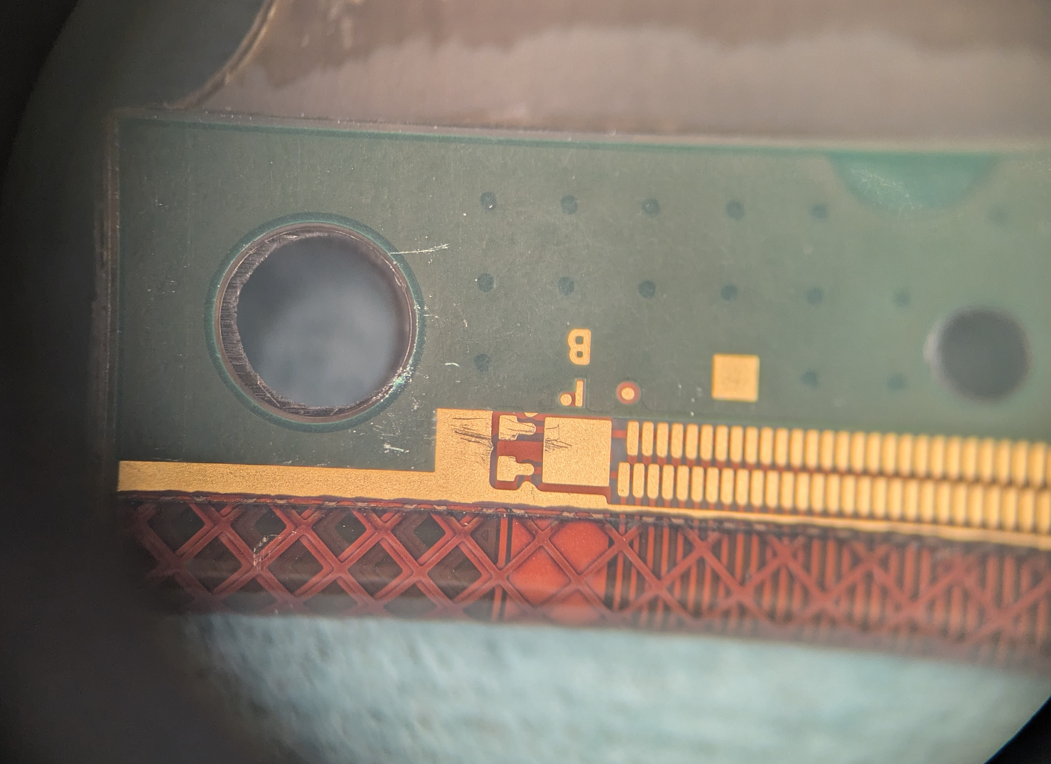
Skeleton Assembly and Test
Hybrid VI:
Leander identified 3 FEHs with scratches on the antenna and GND bond pads
We concluded that we identify such hybrids with a red sticker to make clear that wire-bonding might be problematic
Could also be done via the front-end but given the severity this is more straight forward and indicative
Skeleton assembly is a time consuming step
We will try to stick and let it be done by HiWis, but this might not fully work out
Skeleton test can be run while another one is assembled

Slide 10
Al-CF Bridges
With new no-go pins all “newer” bridges passed hole QC test
Thickness gauges machined by brown questionable
Results in 10% dropout rate, contacted conveners
We were told to measure bridges manually to crosscheck their gauges…

Slide 11
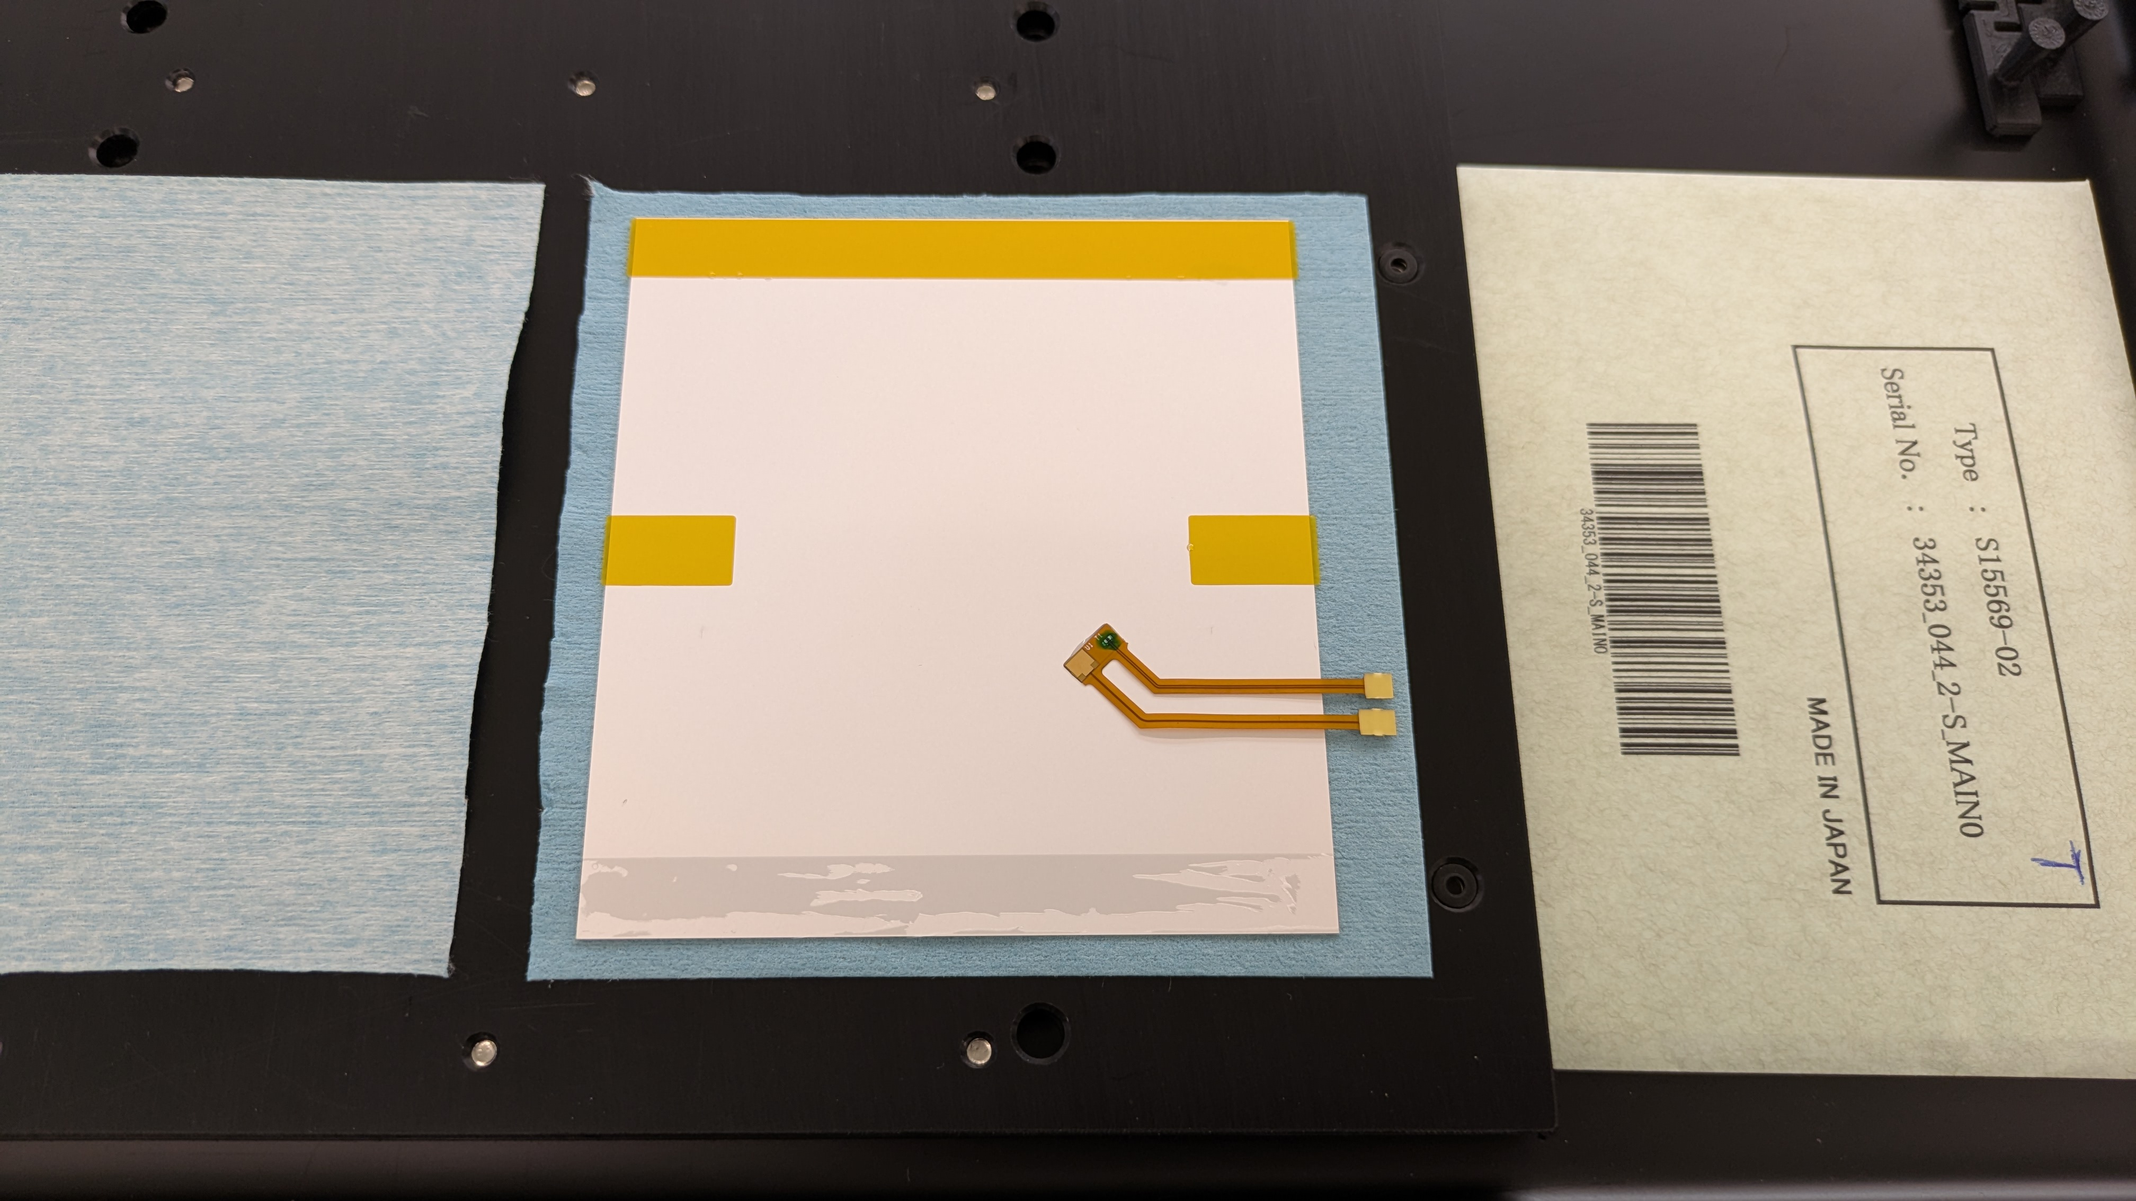
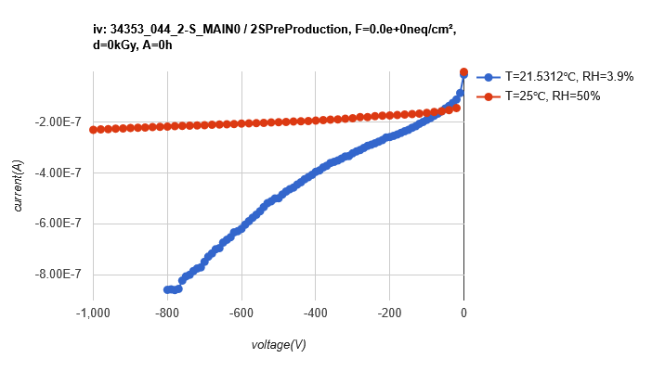
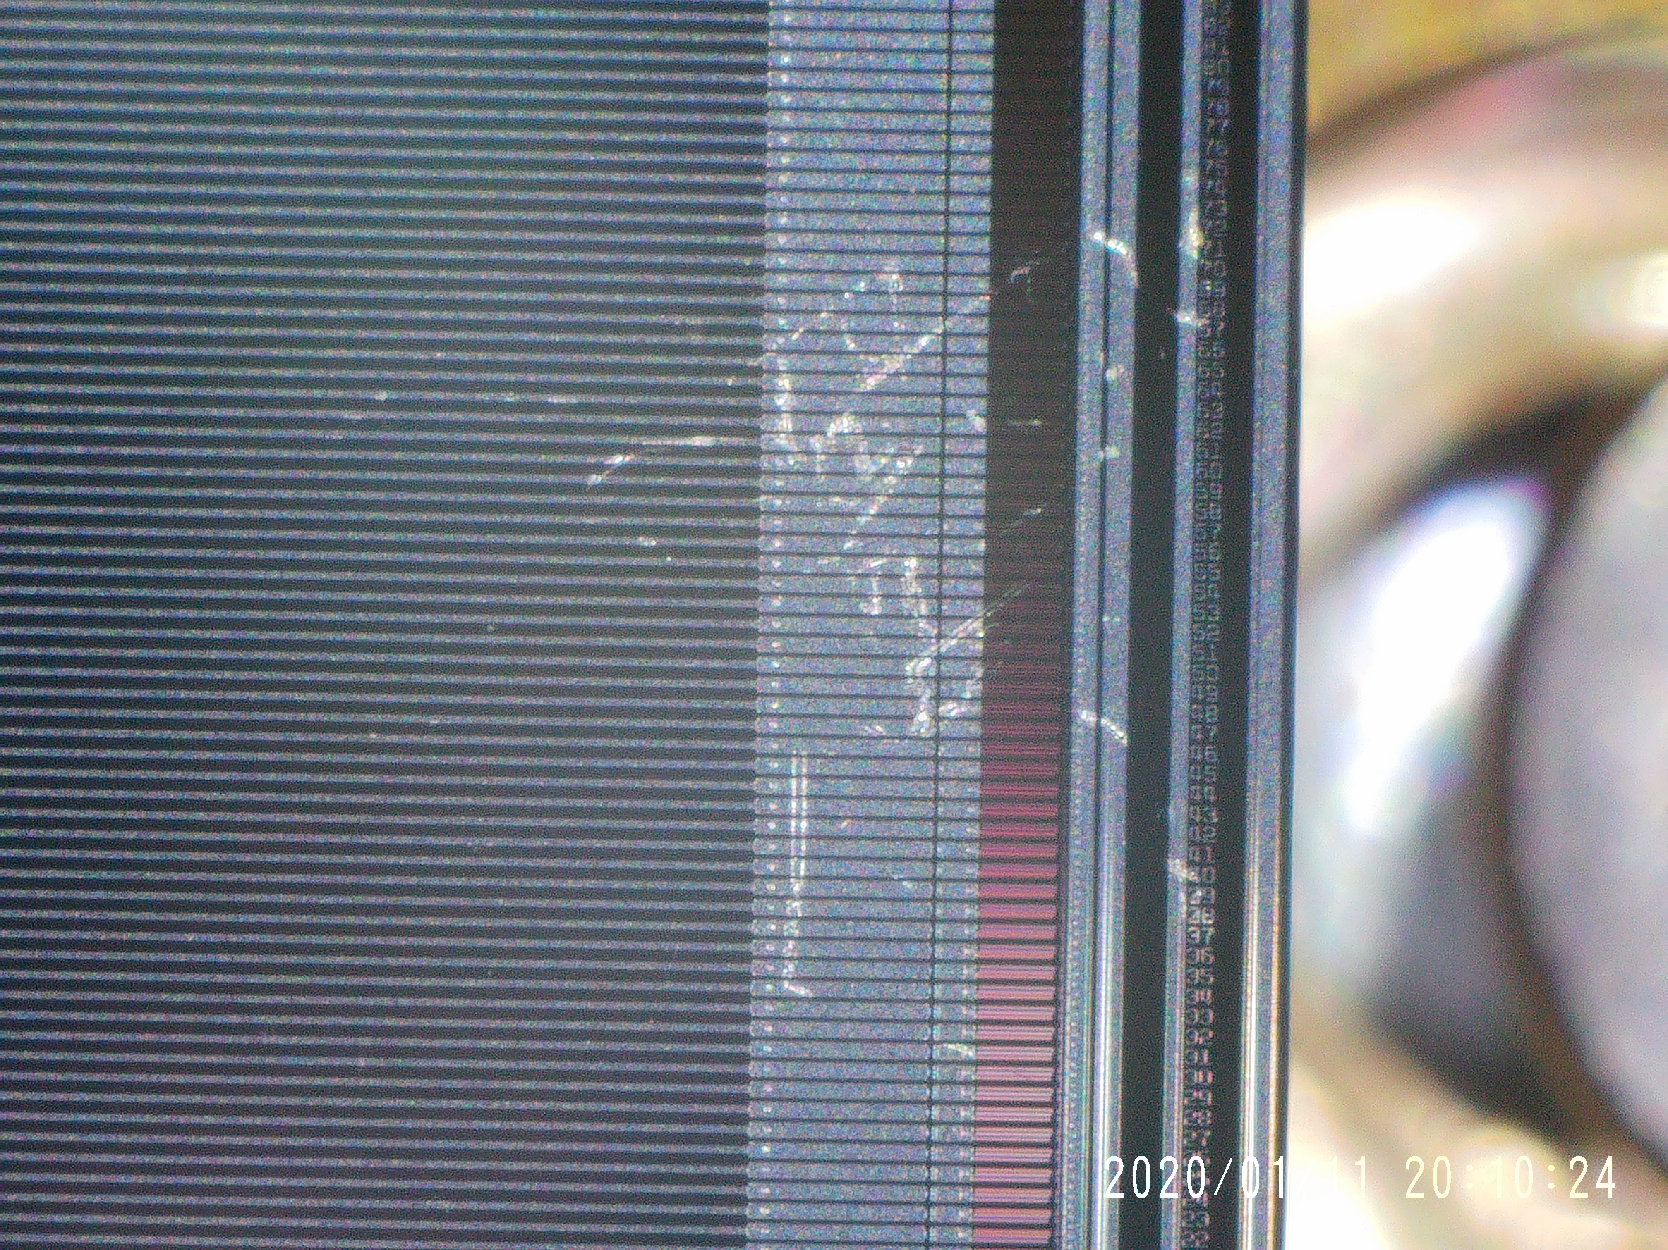
Kapton Gluing
Incident: Pickup tool stuck to sensor
Repairable
Increased IV curve. Not severe
Amount of glue in the pattern was reduced by 10%
We try and stick to do the gluing in the morning shift
Keep 24h of curing as we need to wire-bond this in the morning
Recheck of gluing in the afternoon
Sensor showed some scratches during/after bare module assembly
Assumption: They come from the repair
Buy dedicated dropper/pipette to apply isopropanol
HPK
ETP

Slide 12
Sensor handling / Sensor Dicing
Now: Sensor processes is started after dicing test

Slide 13
HV Tail Bonding and Encapsulation
Bonding went flawless
Pattern recognition even better with new tails
Ease front-end usage: We skip the location scan, implemented

Slide 14
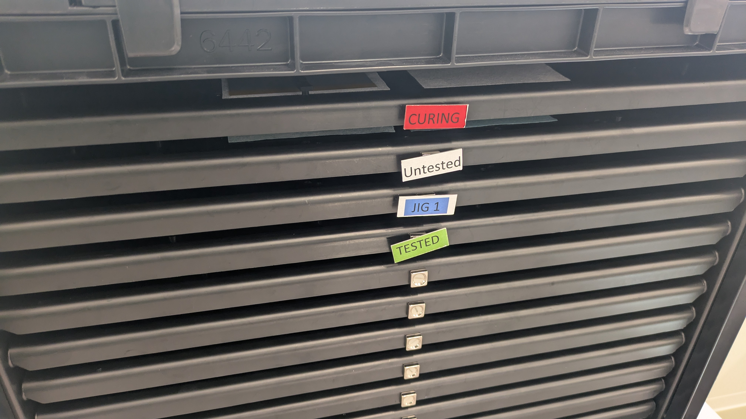
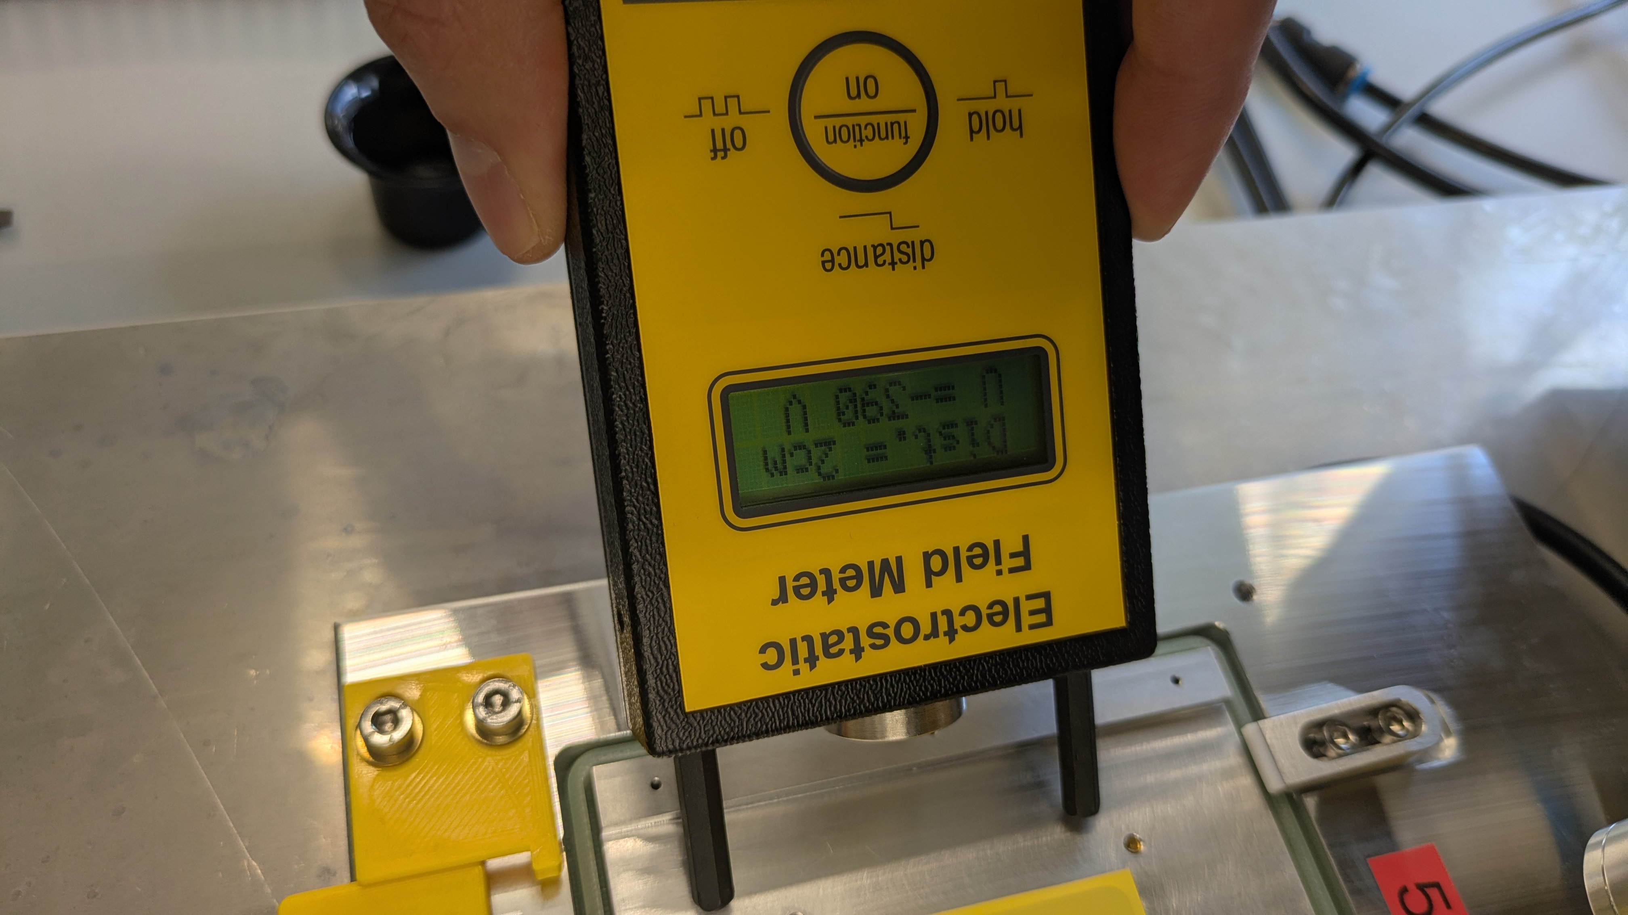
HV / IV Test
Sensor tablets are now tagged:
One caveat: First person in the morning must change tags from curing to untested. Error Prone How does one know he /she is the first one? Ideas?
Current recipe for measurement: 20 mins if everything goes well
Place sensor, attach HV tail
Place ion blower for 3-5 minutes
Place bias needle
Wait for 5% RH
Measure
Problem sensors do charge up / are charged up after the HV test
We had >500V on the jig after the measurement!
Check relay setting and investigate
Possible damage on sensors? (See later damaged channels)

Slide 15
Microscopes on Gluing Stations
Looking forward for their upgrade
Should be done before we re-start
Experience with batteries?

Slide 16
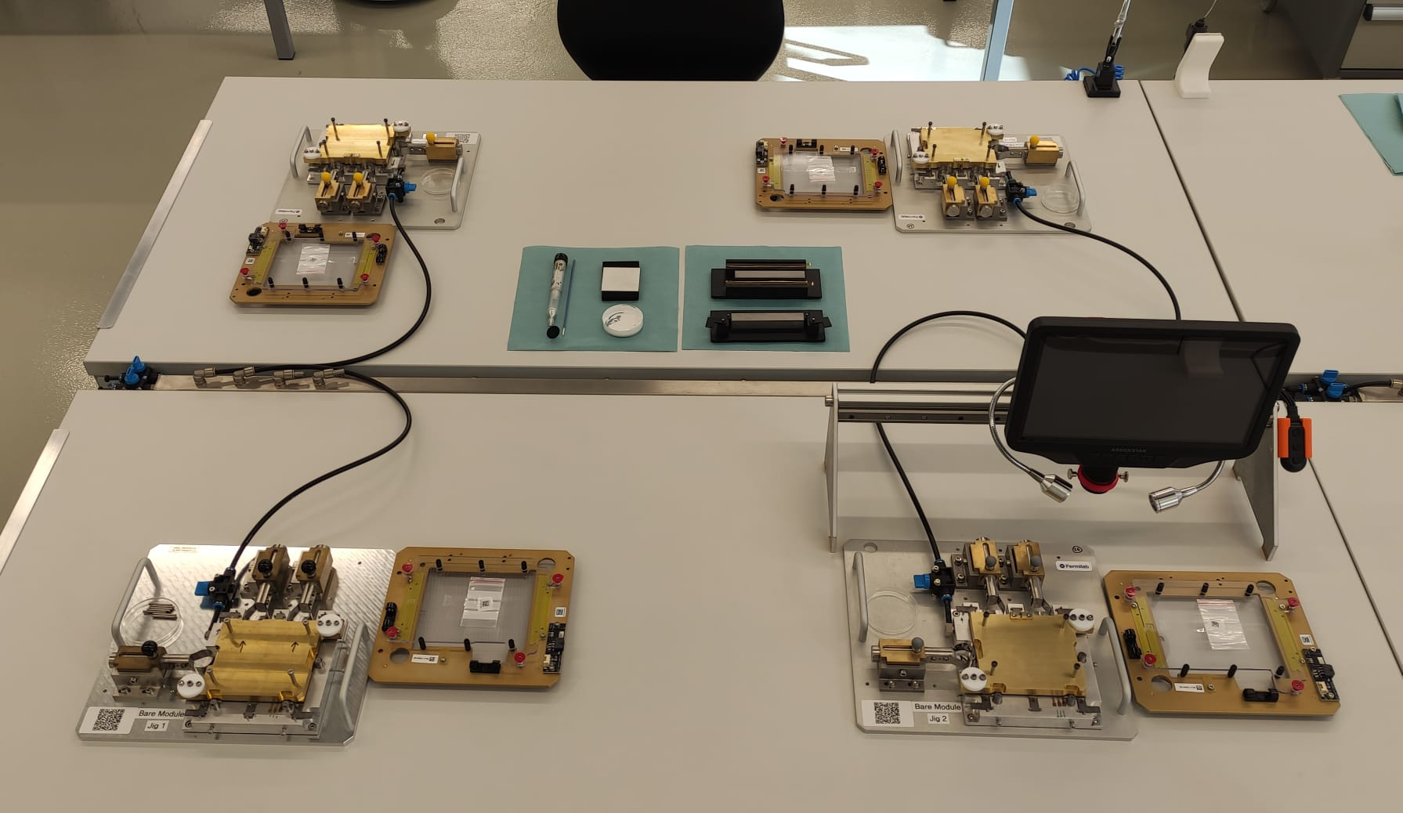
Bare Module Assembly / Metrology
Space sufficient for 2 jigs/table?
Different jigs yield slightly different alignment results
Eager to see trends
Recheck alignment pins
Jig #3 base plate uneven?

Slide 17
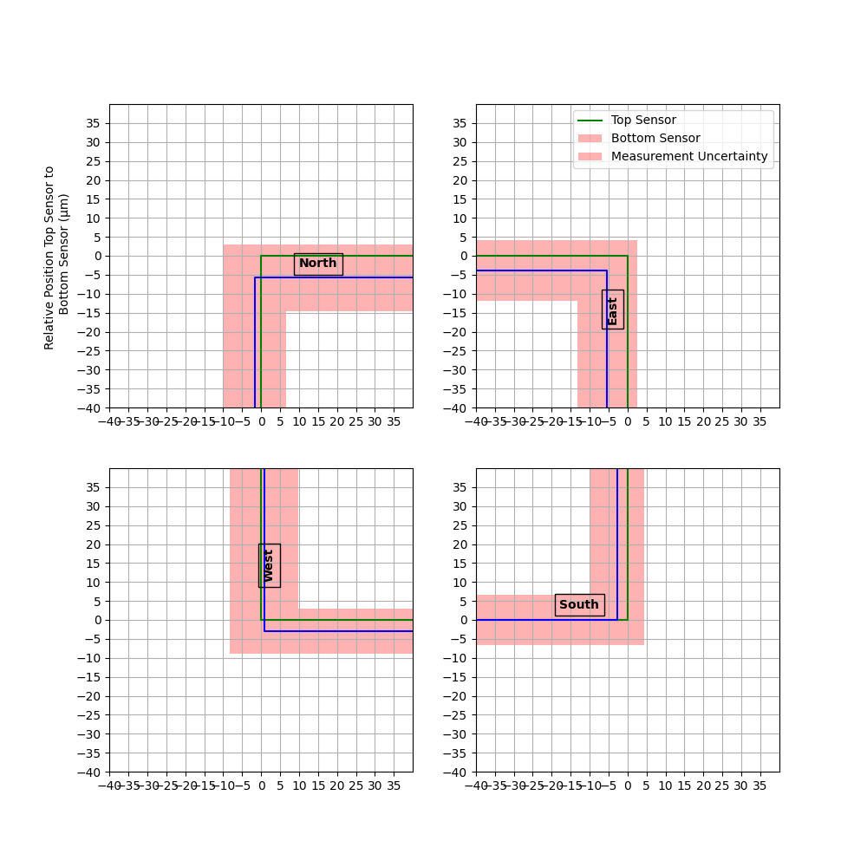
Modul 12
Jig 1

Slide 18
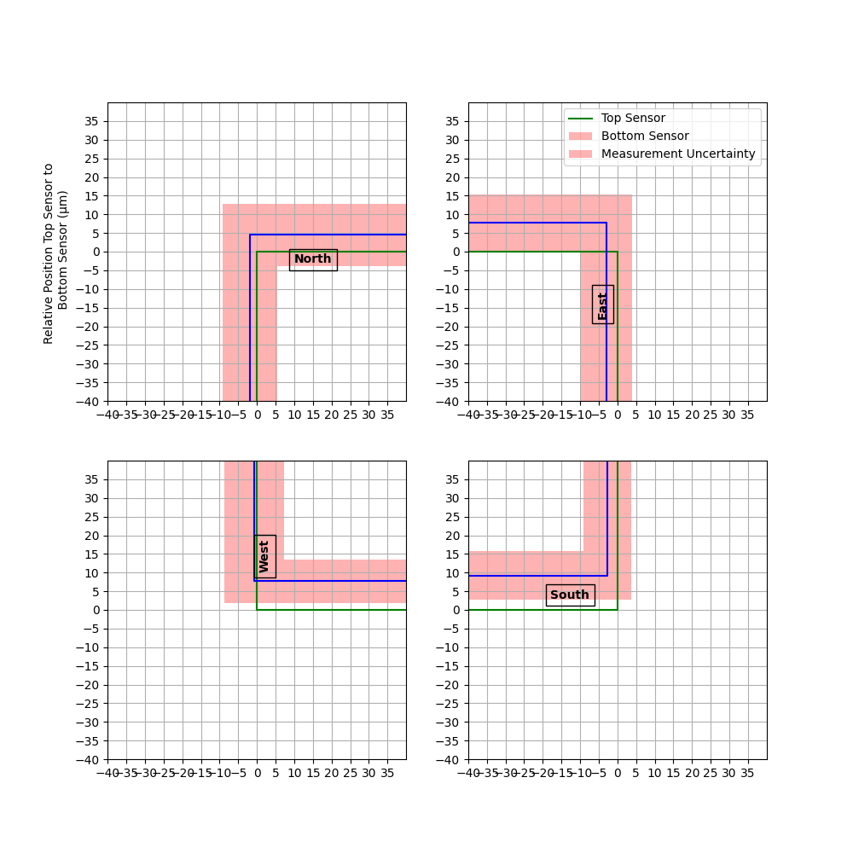
Modul 15
Jig 1

Slide 19
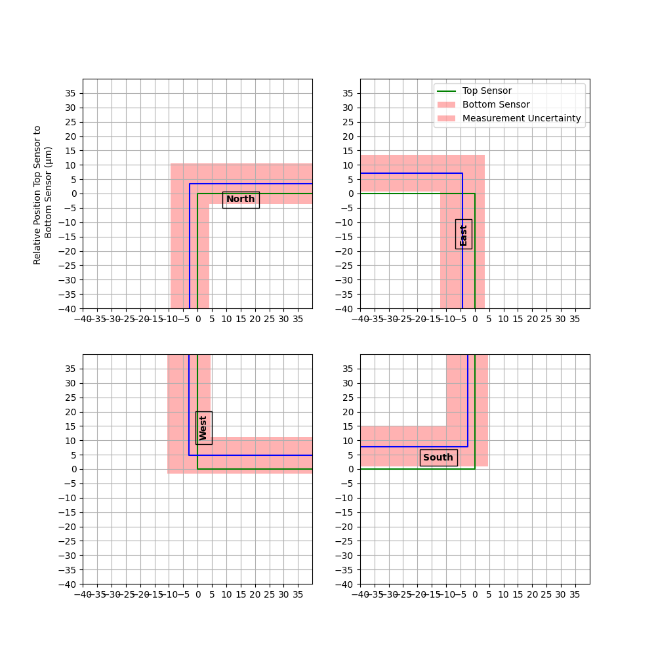
Modul 20
Jig 1

Slide 20
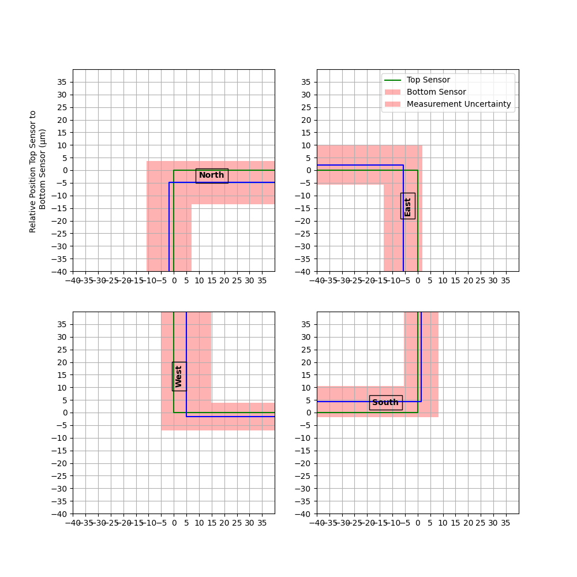
Modul 13
Jig 2

Slide 21
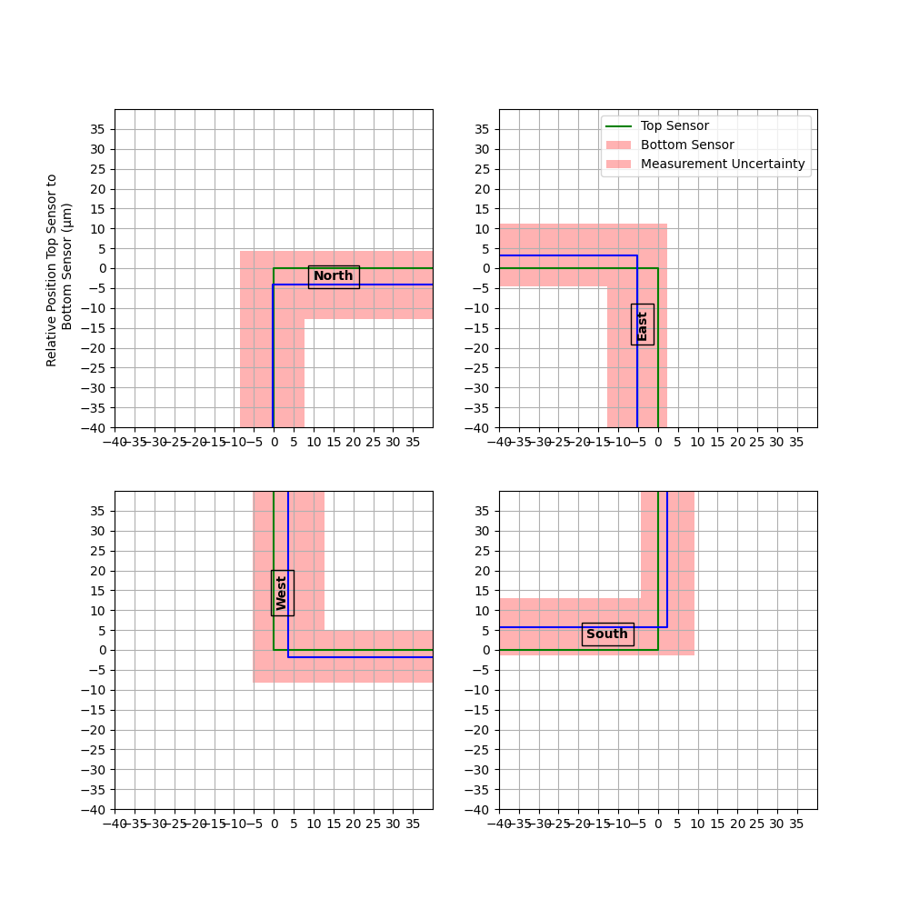
Modul 1
Jig 2

Slide 22
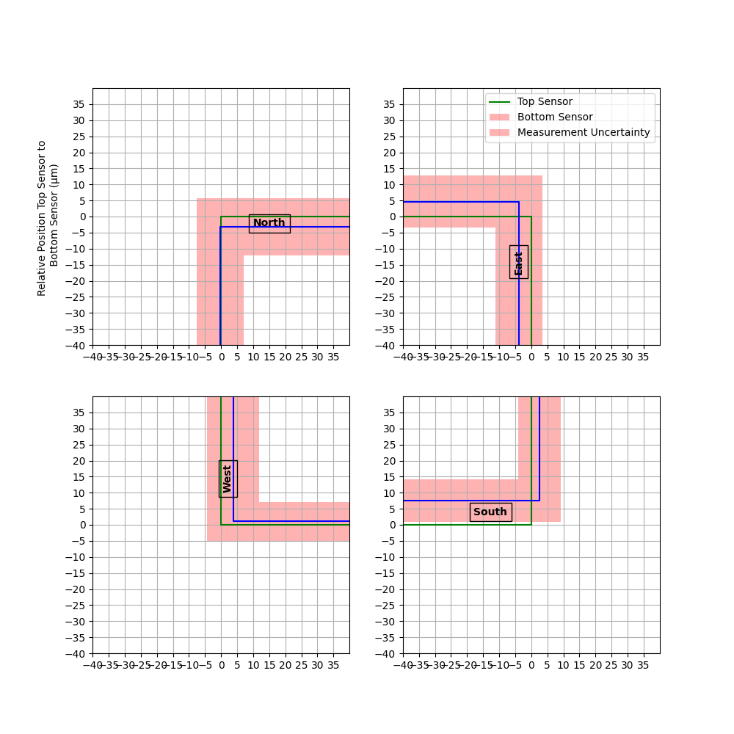
Modul 21
Jig 2

Slide 23
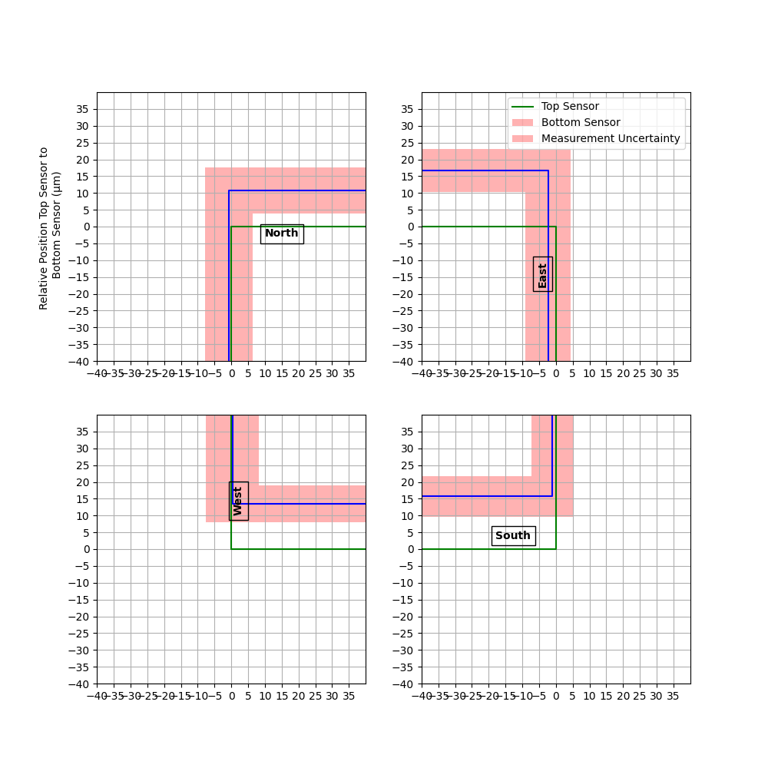
Modul 16
Jig 3

Slide 24
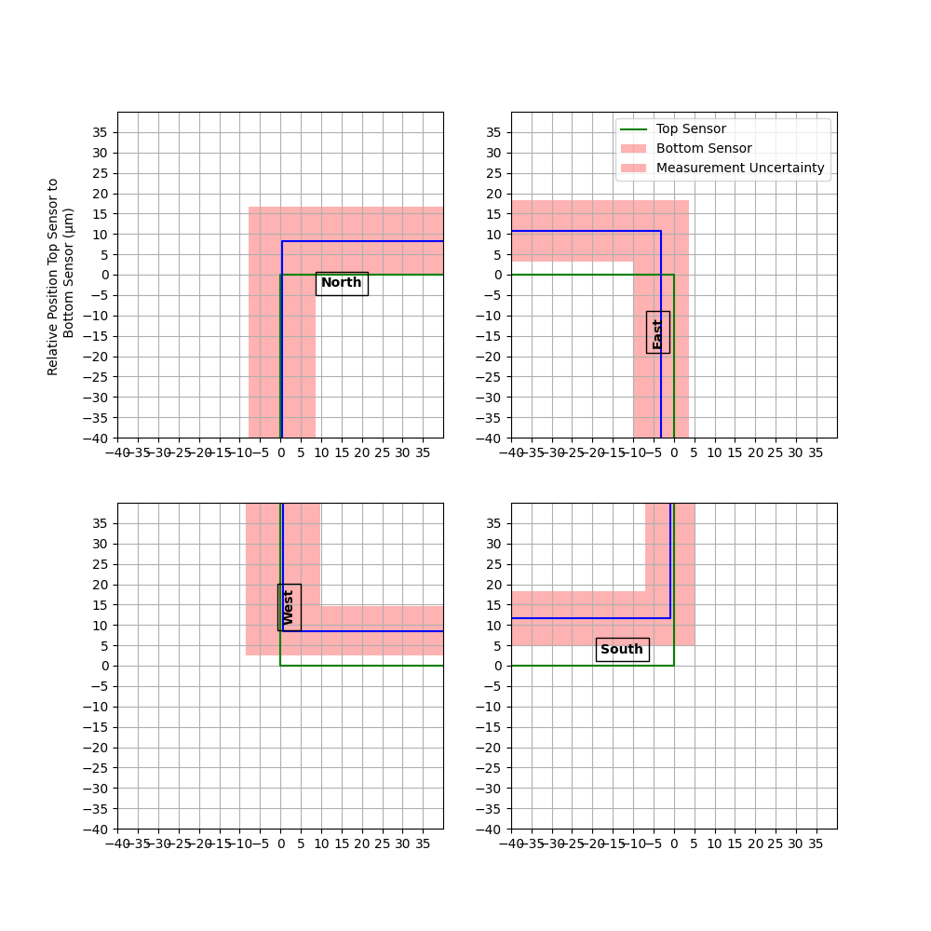
Modul 19
Jig 3

Slide 25
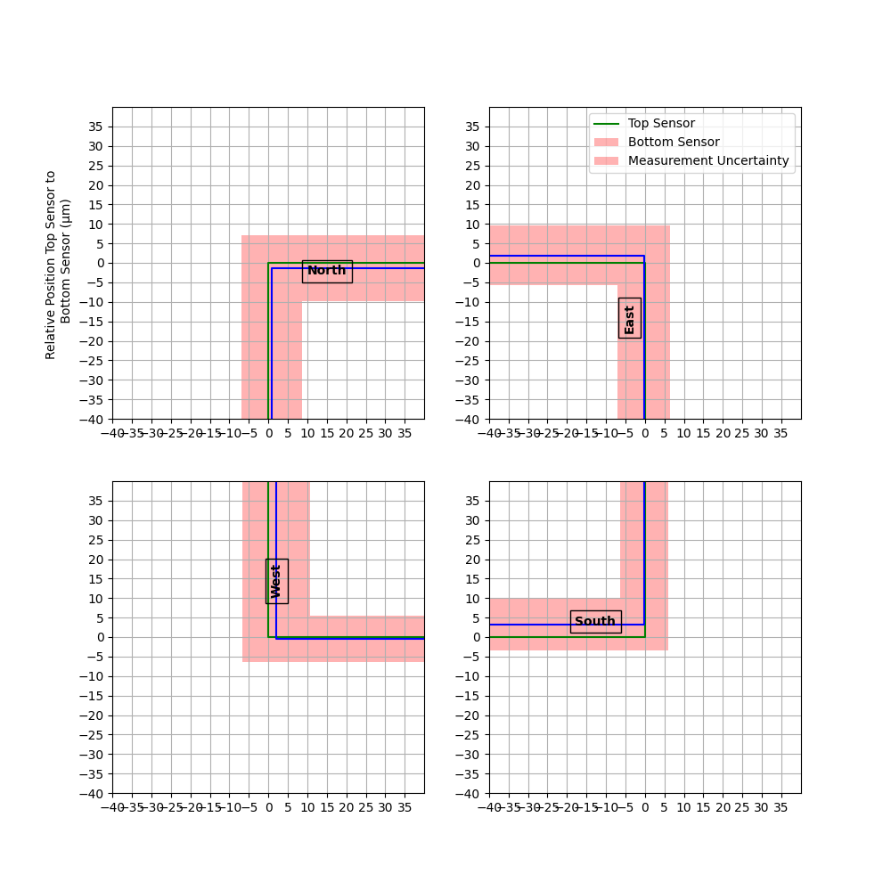
Modul 17
Jig 4

Slide 26
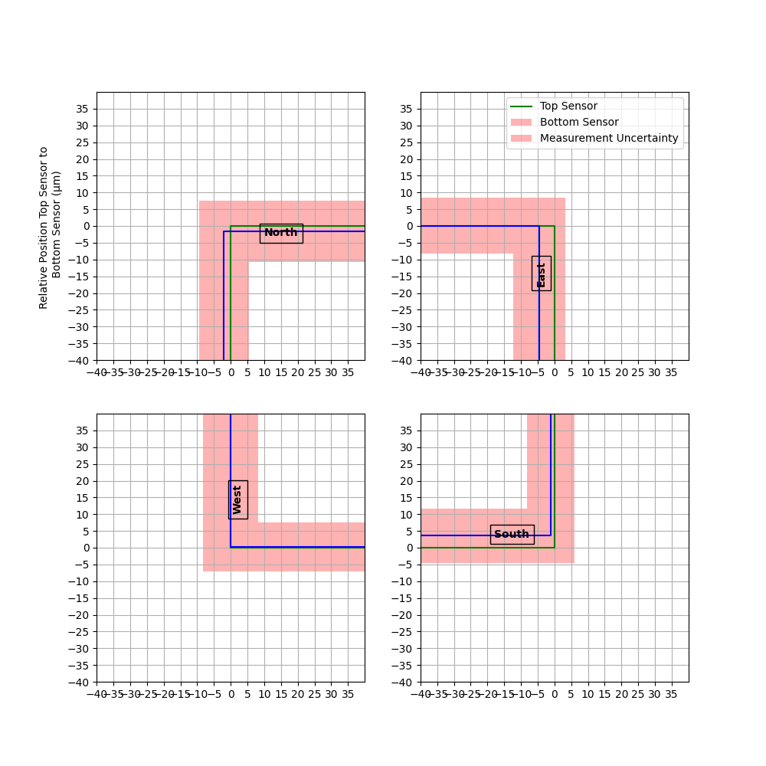
Modul 18
Jig 4

Slide 27
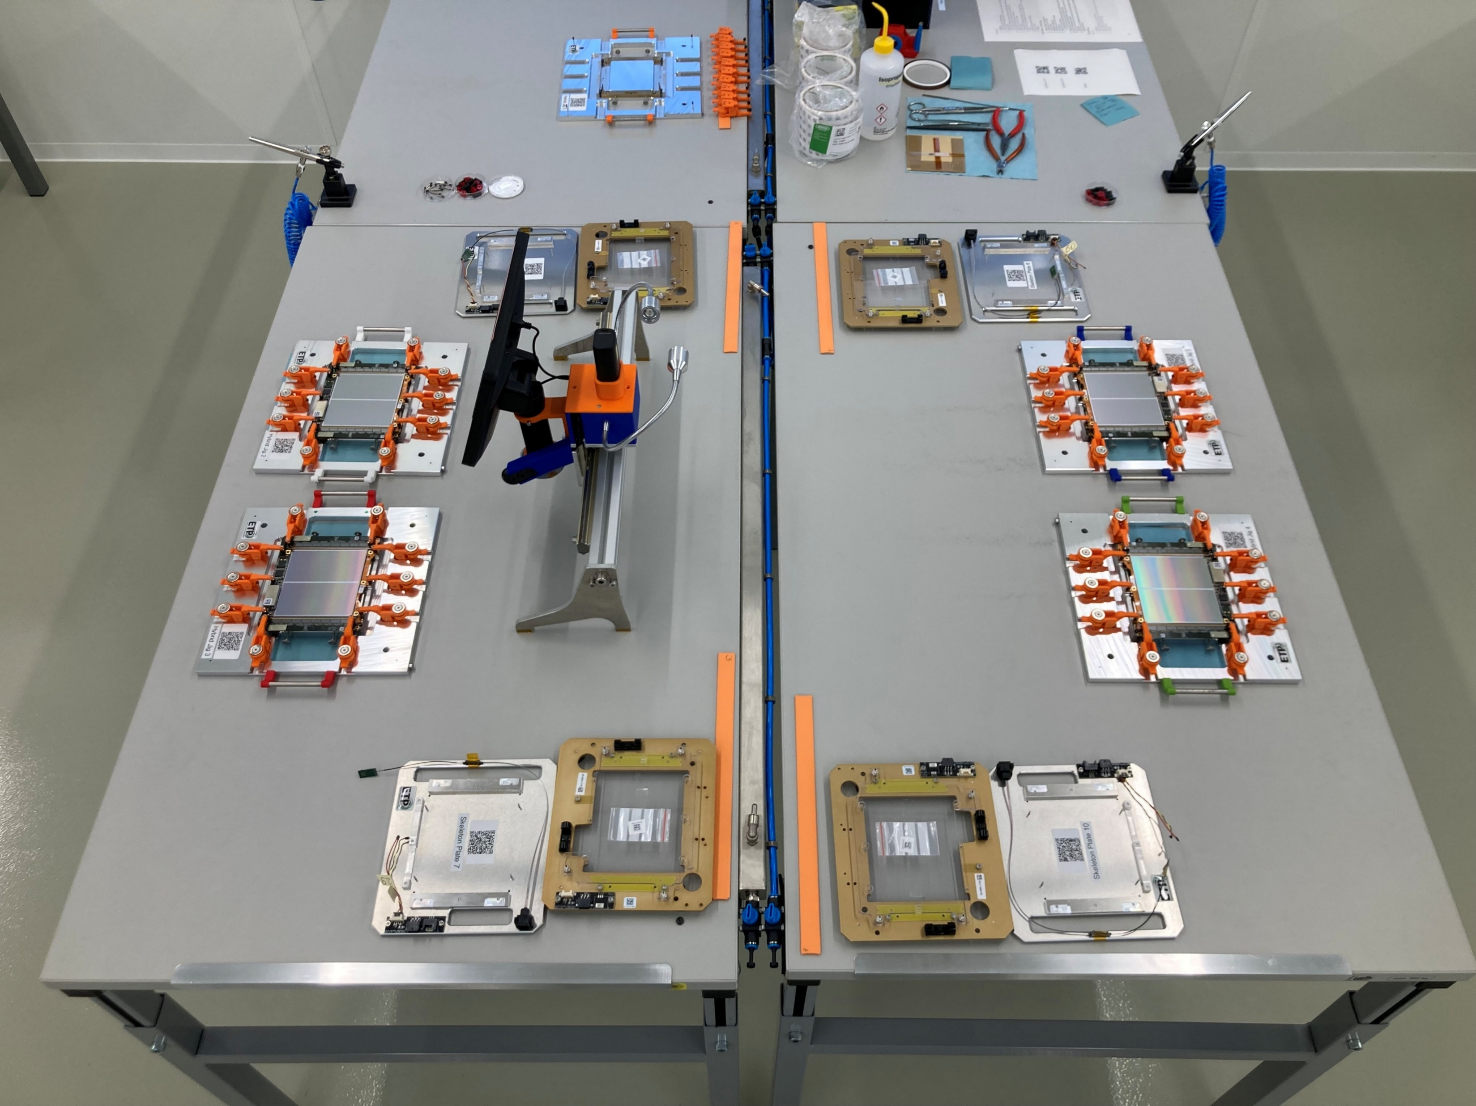
Hybrid Assembly
Sufficient space for 2 jigs/table?
Further comments?

Slide 28
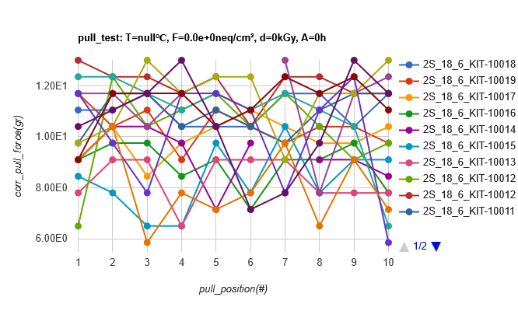
Wire-bonding
In general even smoother than in October
4 modules and 20 pull test wire-bonds: 4 hours and 30 minutes
Where is the bottleneck?
→ PARTS
All pull test values between 6 and 13 g
Add dedicated microscope to make these pull tests and to inspect modules (?)

Slide 29
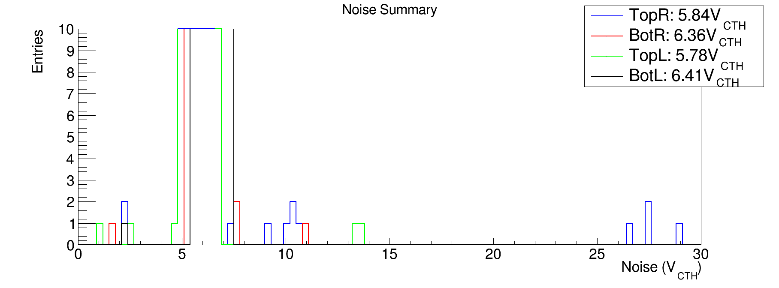
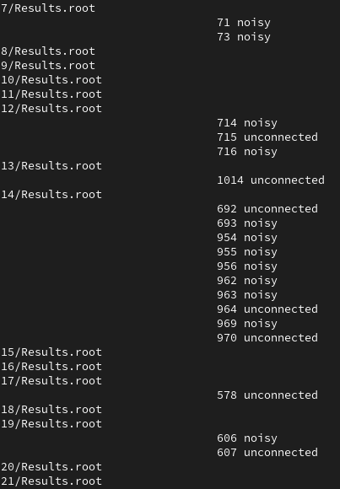
Channel outliers
?
“Leaky strip effect”
?
Scratched area
?
Most likely scratch

Slide 30
Encapsulation
Clash of MT / MPO connector (Zip tie) with module adapter
Already modified, might need to reprint plastic piece
5cc and 30cc usage exercised
Both run smooth
Might need to adapt the 30cc program slightly
Did not 100% hit the wire-bond feet on last modules, to be investigated
Change dispensing height
6 modules tested with WBE height tool. All passed (<1mm above bottom sensor)
9 more (incl 30cc modules) to do…

Slide 31
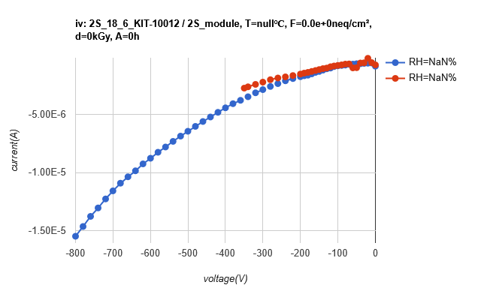
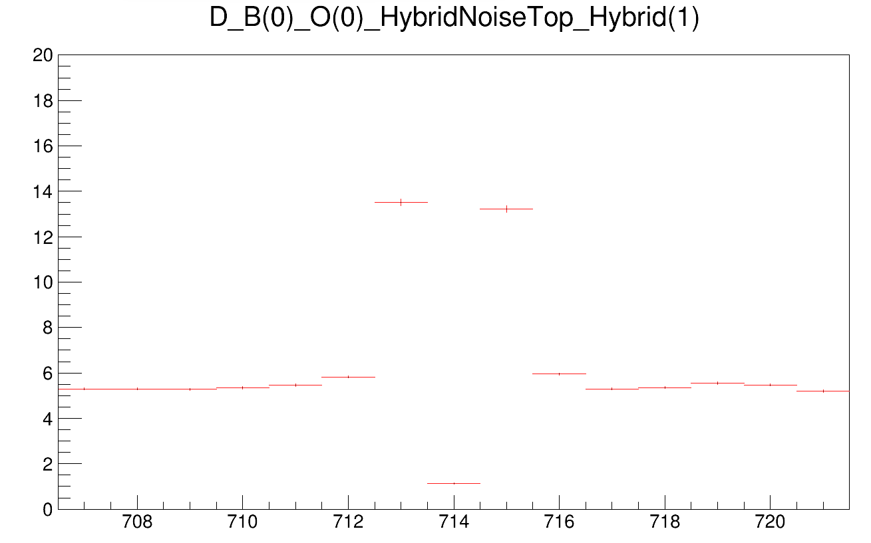
Module Test
New failure mode (1 Module in October and one this time)
Single channel increases global leakage current significantly
Until we do not understand the cause and the impact on operation we must identify these channels and pull the corresponding channel
We will start testing how this is triggered and its impact

Slide 32
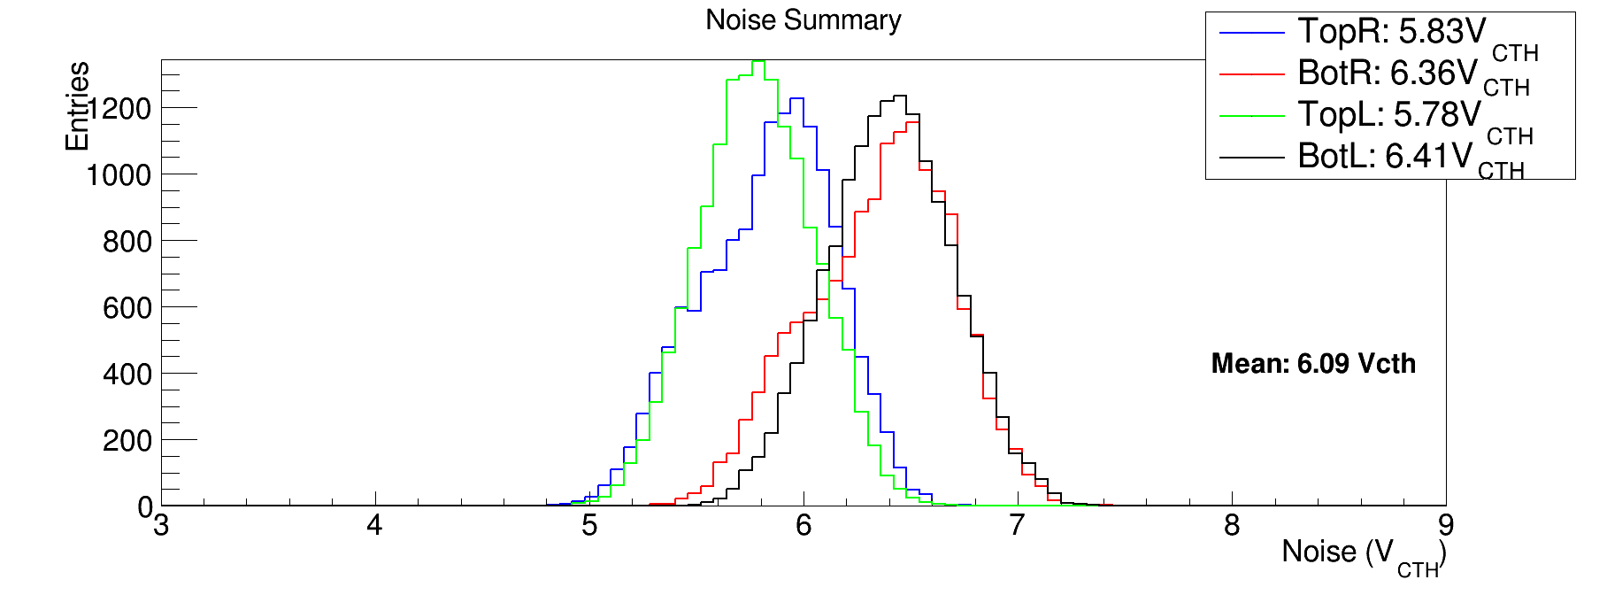
Module Test (2) - Noise

Slide 33
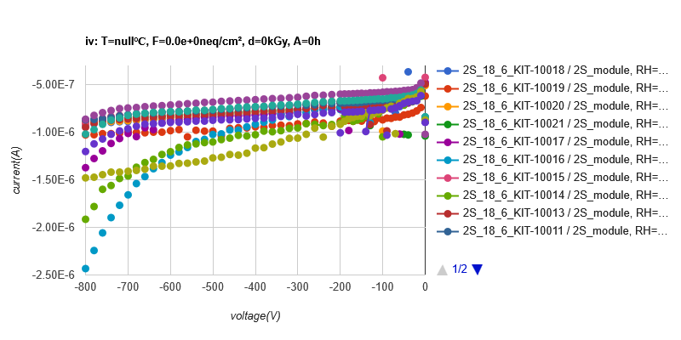
Module Test (3) - IV

Slide 34
Organization
Vacation / sickness leave etc: How to run the assembly line?
Need to come up with some knowledge transfer
At the moment a lot of things happen “in the background” using custom scripts and manual work

Slide 35
Outlook
Soon, we will get more FEHs
They will have blocked alignment holes. Assembly without pins
New HV Tails are currently prepared at CERN.
Update expected tomorrow in the electronics meeting
IF they are good we can expect them mid of April
We expect ~120 or more carriers “soon”
Assembly time should not to be underestimated
New type of SEH will be build “soon”, we do not expect that we need to build too much incomplete modules anymore
Soon: New modules must be finalized with another SEH
Hybrid gluing
Light shield attachment (encapsulant)
Single module full test
Burn in
Once we ramp again we will again start only doing one module per day, increasing towards 4 modules per day, depending on how much material we get. We will try to enter in a continuous production.

Slide 36
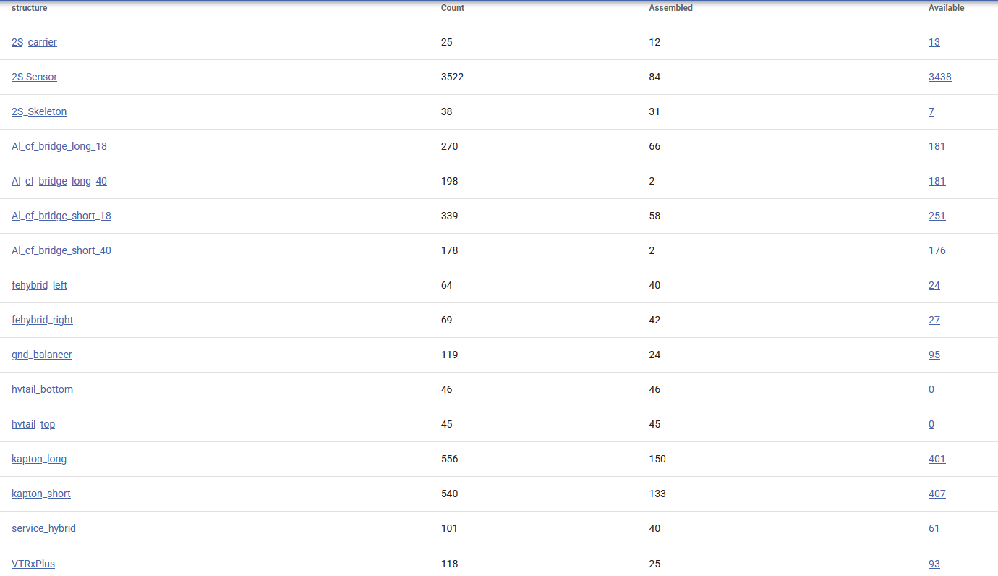

Slide 37
Vacation

