Slide 1
Bad Channel Tests
Alexander

Slide 2
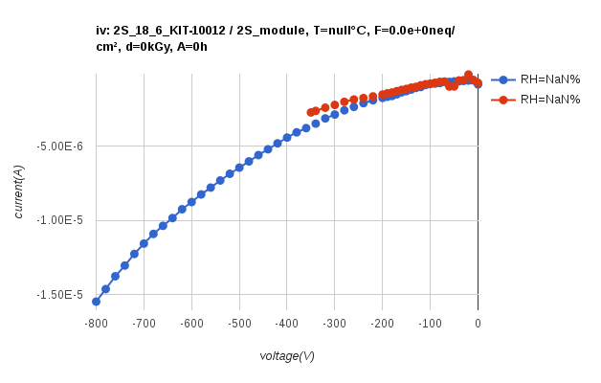
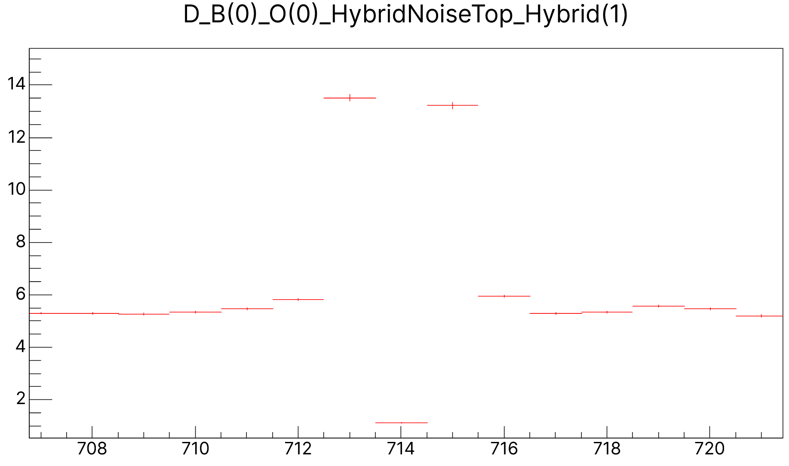
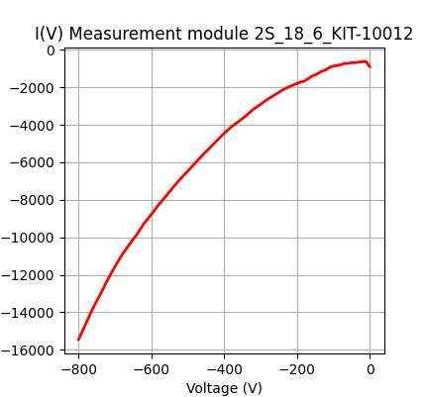
The issue
High leakage current after wire-bonding
At least one noisy channel
when increasing HV and current, channel noise drops belo average ans neighbors start to increase
Pulling this channel restores moderate current

Slide 3
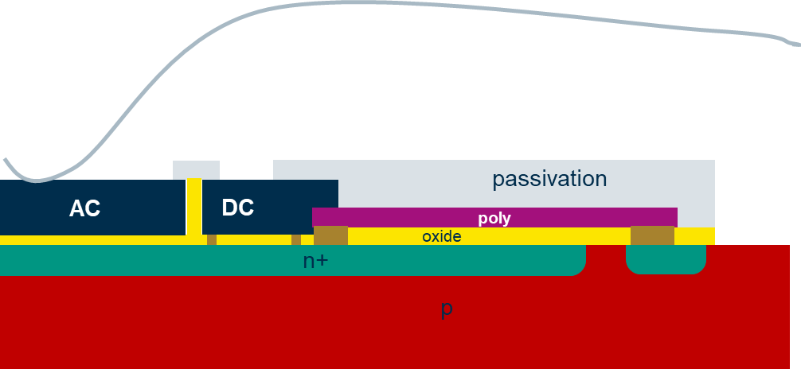
Possible Defects ?
A simple pinhole?
unclear why bonding the AC pad causes current increase
strip still connected via Rpoly to bias ring
Spark below poly?
could damage Si bulk and oxide; current flows to bias ring independent of AC pad contact
Discharge event in center of sensor on AC pad
pinhole plus defect in/near implant (pinhole possible with V>180V over coupling oxide)

Slide 4
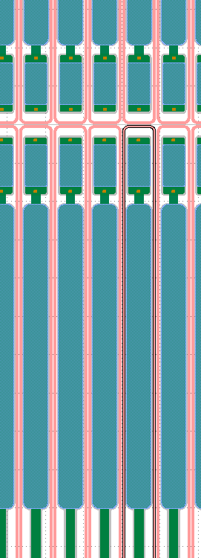
What to measure?
Revive IR camera
check bond position AND center position of affected channel
will we see through the Sylgard?
Check on center of sensor:
Rint to neighbors on DC pads
Rpoly of affected channel plus Rpoly of neighbors
Ileak on DC and AC pads
More to be discussed afterwards…

Slide 6
AC
DC
passivation
poly
oxide
n+
p

