Slide 1
B_{s}→τ⁺τ⁻Physics at
Future Z Factories
Ánuar Sifuentes Name
uxtzj@student.kit.edu
Supervisor: Xunwu Zuo
Master‘s Thesis Update – April 2025

Slide 2
Introduction
Why Study B Meson Decays to Taus at FCC-ee?
$$B_{c}^{+}→ τ^{+}ν_{τ}$$
$${\text{B}}^{+}\text{ →}{ τ}^{+}ν_{τ}$$
B_{s} $\text{→}$τ⁺τ⁻

Slide 3
Motivation
Anomalies in semileptonic decays:
R_{K} and R_{D} ratios show tensions with SM
$τ$channels interesting because due to strong coupling to New Physics (NP) like:
Leptoquarks
Two-Higgs-Doublet Models 2HDMs
Light Higgs Boson h→τ τ
FCC-ee has clean environment and high luminosity
Table 1: B-meson anomalies
Credit: arXiv:2012.00665 [hep-ph]

Slide 4
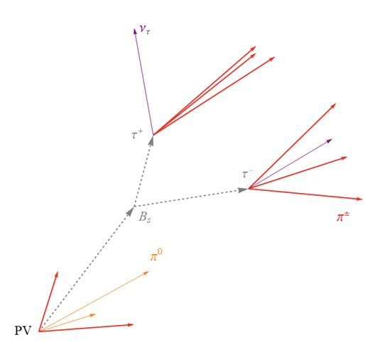
Why focus on B_{s}→τ⁺τ⁻
SM prediction: very suppressed → ideal to spot New Physics
B_{s}→τ⁺τ⁻ Analysis cannot be done in LHC at the moment
→ FCC may have the first chance to observe this decay
Main challenge: Identification of both tau particles in B_{s} decay
Potential extensions:
Lepton Flavor Violation: B_{s} → τ± μ∓ , B_{s} →τ± e∓
Exotic decays: h (light Higgs) → τ⁺ τ⁻
Figure 1: Schematic pictures of B_{s} → τ⁺ τ⁻
Credit: arXiv:2012.00665 [hep-ph]

Slide 5
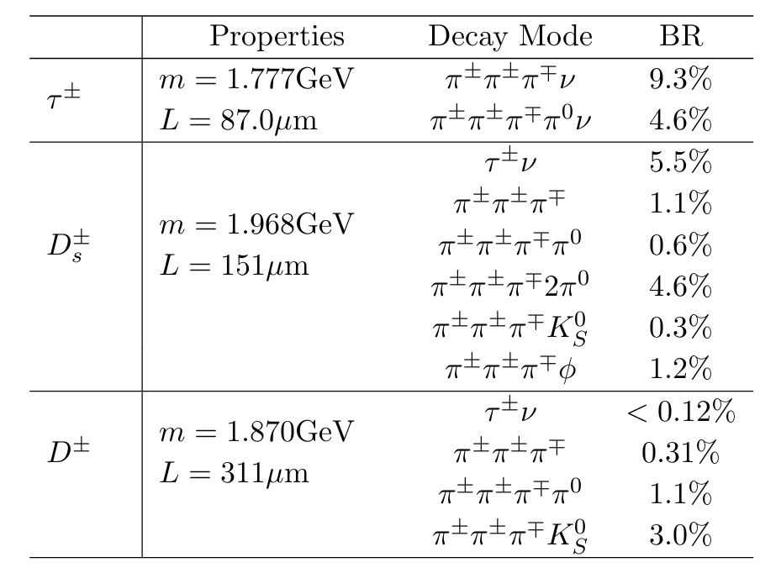
Dealing with background events
$D_{s}^{±}$ and $D^{±}$ are main backgrounds (bkg)
They can mimic τ± decays, they also decay in 3 pions
Lifetime and mean decay Length is similar
combination of preselection:
vertex displacement
geometric angle ΔΩ
Isolation variables
Resonance reconstruction (ρ⁰ and a₁)
Table 2: Invariant mass and mean decay length (L) of τ± leptons and charged D mesons
Credit: arXiv:2012.00665 [hep-ph]

Slide 6
What Has Been Done Before Bu and Bc Decays
Analysis on $B_{c}^{+}→ τ^{+}ν_{τ} and {\text{B}}^{+}\text{ →}{ τ}^{+}ν_{τ}$

Slide 7
Simulation and samples
Events simulated using :
PYTHIA8
EvtGen
DELPHES + IDEA detector card
Campaign: Major Monte Carlo (MC) production efforts for the FCC-ee project.:
Winter 2023 samples
Spring 2021 samples
Samples include
Inclusive: Z→ bb, cc, qq; incluisive decay of every particle
Exclusive: Specific B meson decay chains

Slide 8
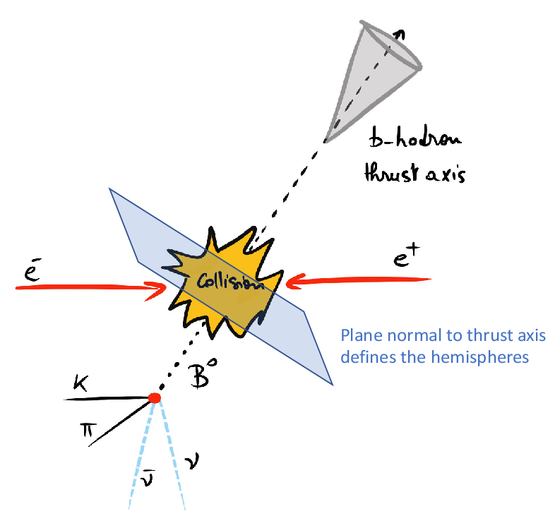
Event selection strategy
The two b-quarks can be split into two hemispheres
→ Thrust axis
Signal decays involve missing energy from neutrinos
→ Energy imbalance
Bkg have more balanced energy distributions
Preselection removes obvious background
Figure 2: Representation of thrust axis (not our decay)
Credit: Rivière et al. (2024) – Prospects for searches
of b→s ν νˉ at FCC-ee ResearchGate link

Slide 9
Tau reconstruction
Events must have a candidate tau vertex:
Candidate is chosen as the 3π vertex with the smallest vertex fit χ² in the signal hemisphere.
have an invariant mass below that of the τ lepton
have at least one m(π+π−) combination within the range 0.6–1.0 GeV
Look for 3 pion system
Reconstruct the mass and number of 3 pion candidates in the event
Reconstruct invariant mass of intermediate resonances
a₁± and ρ₀ mesons in the τ decay chain.
τ⁺ → π⁺ π⁺ π⁻ ν_{τ}

Slide 10
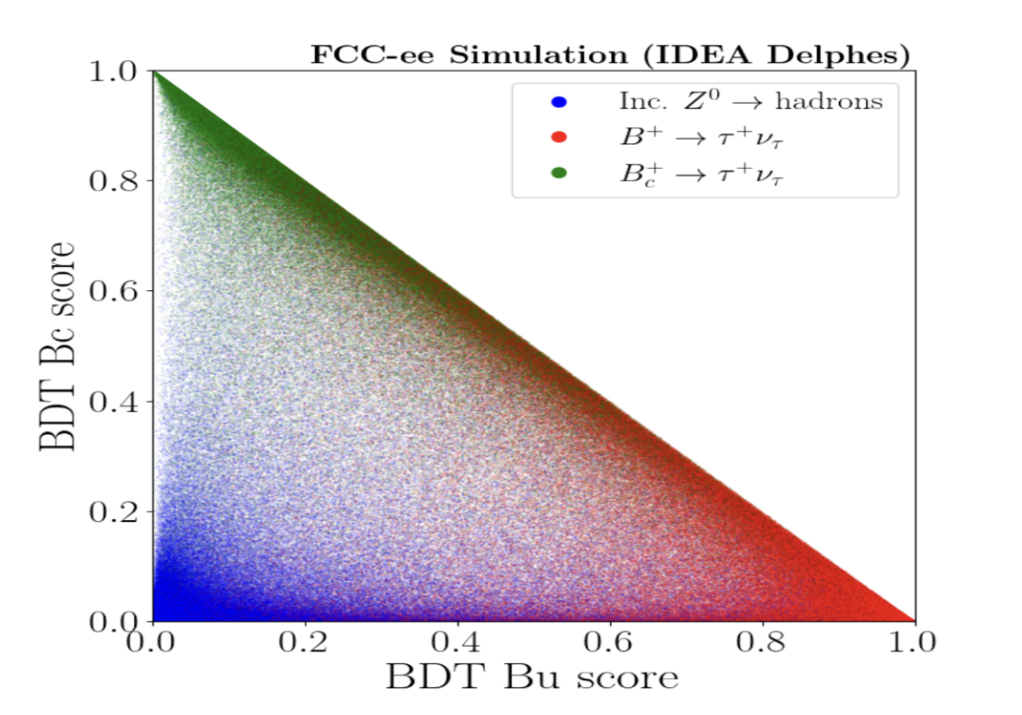
Boosted Decision Trees
XGBoost-based BDTs to separate signal from background.
BDT1: General Background Rejection, uses event-level features:
Energy balance; Number of tracks; Vertex properties
Achieved excellent separation in Bu/Bc analyses:
ROC Area = 0.983
BDT2: Signal Type classification
Distinguishes $B_{c}^{+}$, ${\text{B}}^{+}$ and background
Uses more refinded methods:
3π system: mass, thrust angle, multiplicity
Vertex info: impact parameter, PV mass
D meson tagging
Performance
AUC (Bc vs non-Bc): 0.921
AUC (Bu vs non-Bu): 0.886
Figure 3:Distribution of second stage BDT output in Bu-Bc plane
Credit: https://arxiv.org/abs/2305.02998

Slide 11
Plans for B_{s}→τ⁺τ⁻
Analysis Strategy for B_{s} decays

Slide 12
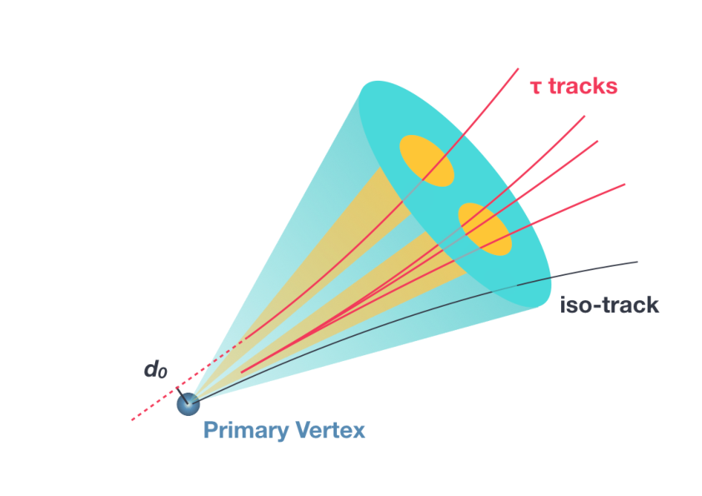
Analysis strategy
Two reconstruction methods being studied:
Single jet/cone: Does the jet structure look like 2 overlapping taus?
Vertex based-method: Similar to Bu/Bc, but for 2 displaced vertices
Will train MVAs for:
B_{s}→ τ⁺τ⁻ vs inclusive Z → bb
Using isolation, geometry, energy imbalance, and tau reconstruction
Figure 4: Schematic representation of a di-ττ object
Credit: arXiv:2007.14811CERN-EP-2020-118

Slide 13
Goal and Plan for the study
Evaluate the potential of FCC-ee to observe rare tau-related B meson decays, in this case B_{s}→τ⁺τ^{−.} (potentially also for B⁰ → τ⁺ τ⁻)
Constrain or reveal New Physics
General plan:
Understand the physics and relevant decay channels
Learn about FCC-ee event structure and background sources
Use machine learning (BDTs) to separate signal from background
Evaluate how well FCC-ee could measure or constrain these decays

Slide 14
Progress and next steps
What I’ve done so far:
✅ Studied the relevant decays: B⁺ and $B_{c}^{+}→ τ^{+}ν_{τ}$(for methodology), and B_{s}→τ⁺τ⁻
✅ Learned about background processes and their suppression strategies
✅ Understood the role of BDTs in separating signals and backgrounds
What comes next:
🔜 Set up analysis framework and load FCC-ee bkg samples
🔜 Set up the 2 reconstruction approaches and compare results
🔜 Train and evaluate BDTs for signal–background separation
🔜 Prepare plots and organize results for internal discussion

Slide 15
Thank you
Questions or feedback are welcome!

Slide 16
Efficiency and Optimization
In $B_{c}^{+} and{\text{B}}^{+}$ studies optimization is done
by maximizing: Purity = S / (S + B)
Efficiency is estimated from exclusive simulated decays.
BDT1 and BDT2 cuts are tuned separately.
Final cuts chosen to balance signal efficiency and background suppression.
A 3D efficiency function is evaluated over BDT cut values to find the optimal region

