Slide 1


Centro Nazionale di Ricerca in HPC, Big Data e Quantum Computing​
Skills for EOSC
Matteo Zanaroli, Fondazione ICSC
ICSC Italian Research Center on High-Performance Computing, Big Data and Quantum Computing
Missione 4 • Istruzione e Ricerca
Notes:
Cover

Slide 2
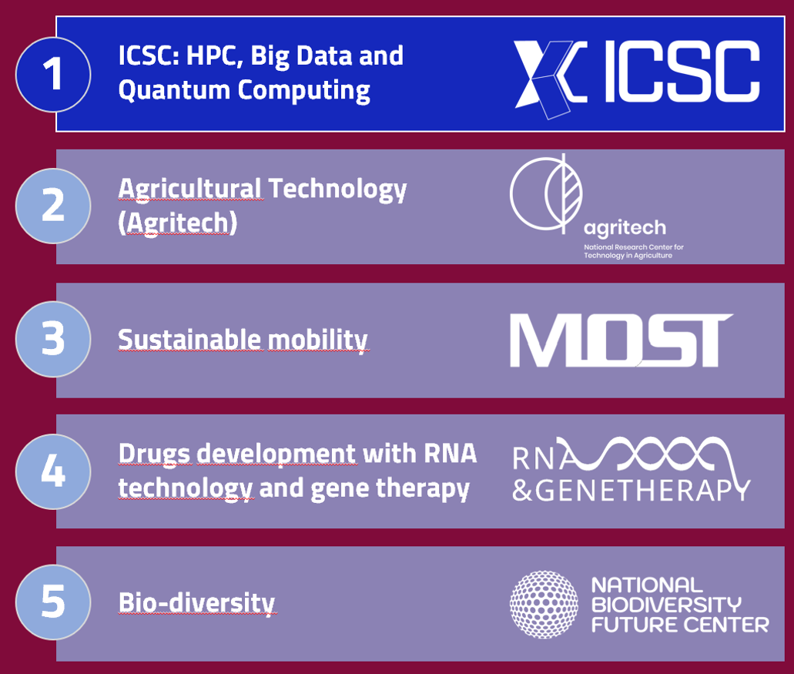
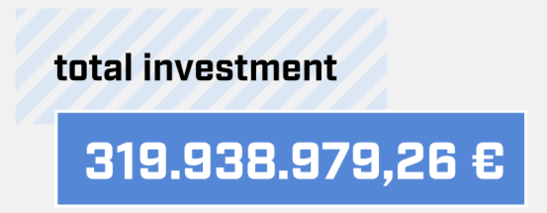
ICSC – Facts & figures
The activities of the National Supercomputing Centre focuses on maintenance and upgrade of the Italian HPC and Big Data infrastructure, as well as on the development of advanced methods and numerical applications and software tools to integrate computing, simulation, collection, and analysis of data of interest for research, manufacturing, and society, also through cloud and distributed approaches.
ICSC is a shared and open cloud/HPC infrastructure, representing a unique strategic asset for Italy, but for the international community as well.
High level of engagement with several different communities is in the mission of ICSC

Slide 3
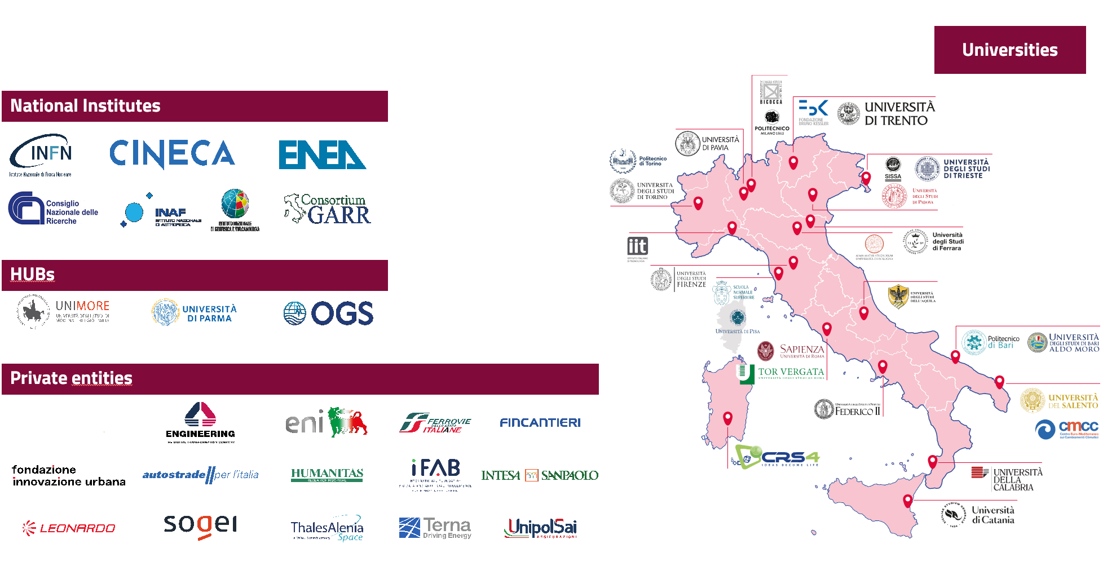
ICSC – Facts & figures

Slide 4

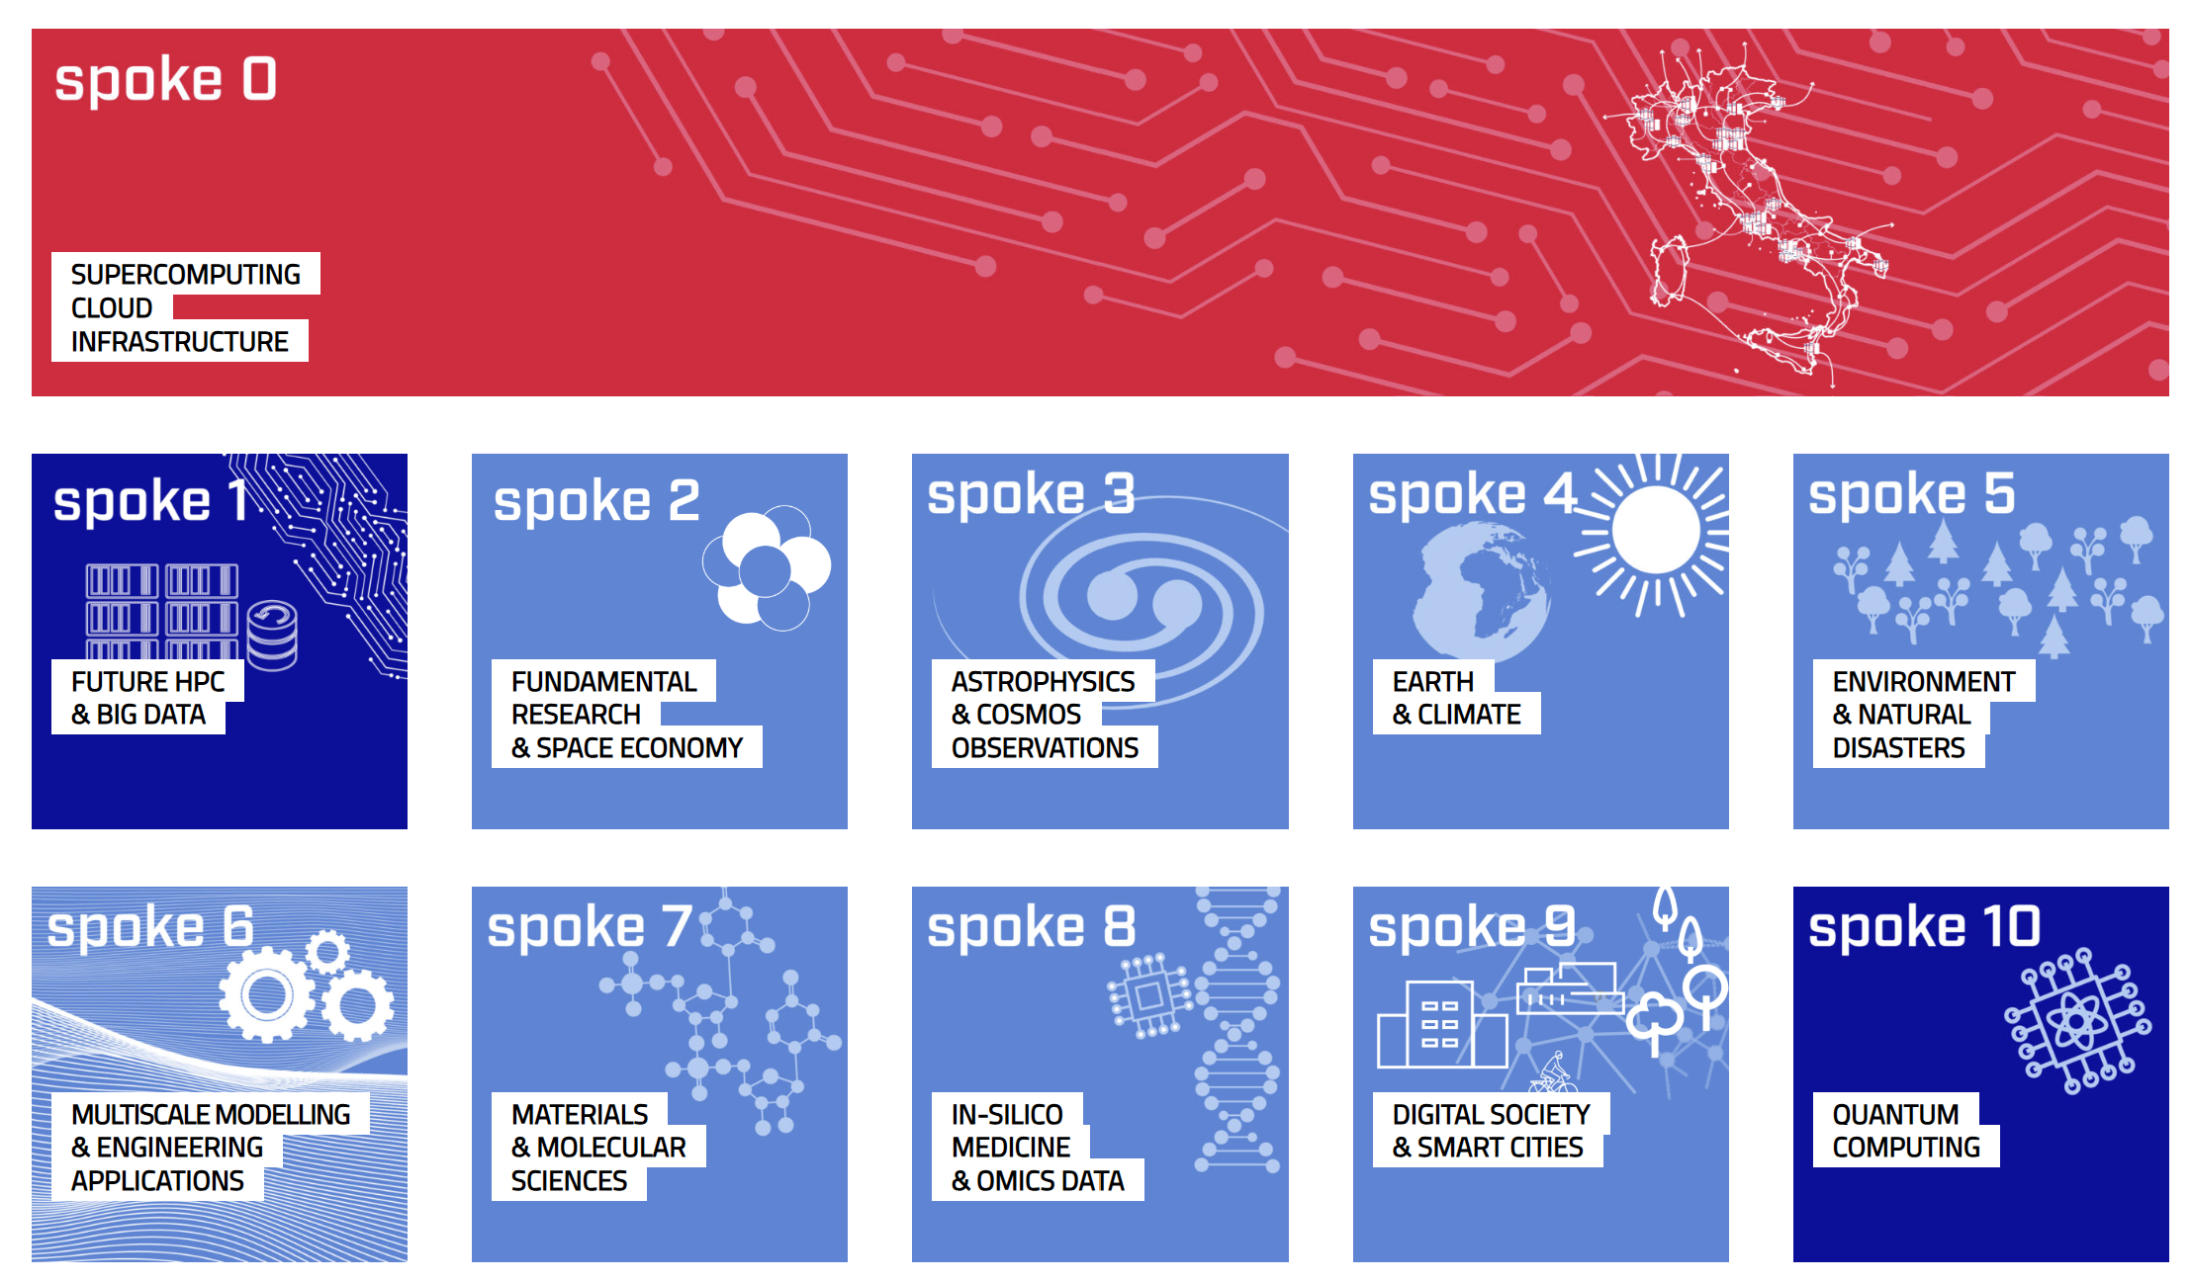
ICSC – A multidomain community
High level of engagement with several different communities is in the mission of ICSC

Slide 5

ICSC – Activities
The Innovate Consortium Chosen to Host EuroHPC’s First Industrial Supercomputer → supercomputing capabilities, specifically tailored to meet the security, confidentiality and data integrity needs of European industrial users.
EUSAiR is an EU-funded project. It aims to coordinate and support the implementation of AI regulatory sandboxes across the EU as mandated by the AI Act. The project focuses on providing standardised frameworks, enhancing technical and legal capacities, and promoting cooperation among Member States. It seeks to ensure broad access to sandboxes for AI innovators, particularly SMEs and startups, by reducing compliance costs and market barriers.

Slide 6


ICSC – Activities
IT4LIA AI Factory → The Italian AI Factory aims to become an attractive hub capable of connecting AI solution developers, companies in strategic sectors, academia, and the HPC infrastructure. This virtuous system will allow businesses to leverage new models and keep research constantly updated and evolving based on real-world challenges. ICSC will be leading two WPs: Capacity building and Data-related servicies
DARE → At the heart of the DARE SGA1 project is the development of three RISC-V-based chiplets, each serving a critical function in HPC and AI computing:
  Vector accelerator (VEC) for high-precision HPC and emerging applications in the HPC-AI convergence domain
  AI Processing Unit (AIPU) designed for AI inference acceleration in HPC applications
  General-purpose processor (GPP) optimized for HPC workloads in European supercomputers

Slide 7
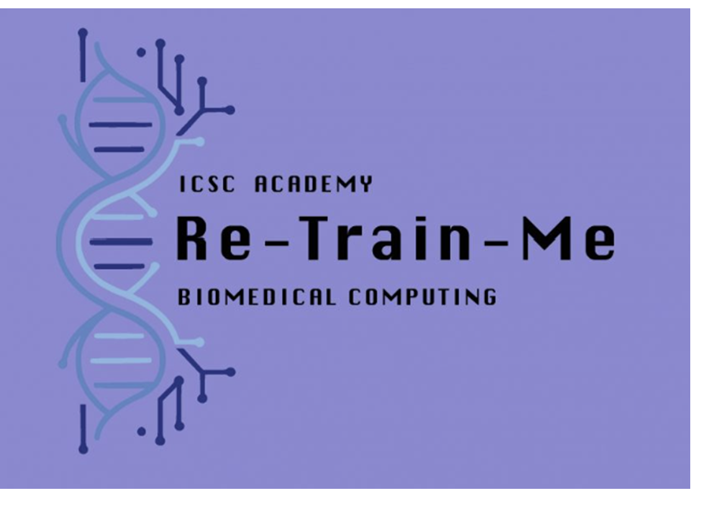
Re-Train-Me
Post-degree training in biomedical computing to people with a master's degree in math, physics, chemistry, biology, engineering, etc., but no specific training in biomedical computing
9 institutions of ICSC participating in the initiatives
36 students selected for the first phase, 17 for the second phase
Retrain existing staff or new staff they employed in connection to the programme
Link: https://www.supercomputing-icsc.it/wp-content/uploads/2024/05/Bando_Re-Train-Me.pdf

Slide 8

WE-HPC
The course is a joint initiative between the Italian Association for Wind Engineering, ANIV, and the National Research Centre in HPC, Big Data and Quantum Computing, ICSC - Italian Research Center on HPC, Big Data and Quantum Computing, with the patronage of University of Bologna.
It focuses on applying High-Performance Computing (HPC) technologies to Wind Engineering-related problems.
Link: https://agenda.supercomputing-icsc.it/event/19/

Slide 9
International School on Open Science Cloud
SOSC 2023 and 2024 - International School on Open Science Cloud (SOSC
2024). The School is multi-disciplinary and targeted at postgraduate
researchers including bachelor degree or equivalent in fields such as physics,
statistics, computer science, computer vision, biology, medicine, bioinformatics,
engineering, working at any research institute, with some experience and interest in
data analysis, in computing or in related fields
Link: https://agenda.infn.it/event/40829/timetable/?view=standard

Slide 10
Introduction to FPGA programming
The course is mainly thought for the new personnel hired by means of the ICSC project to work on projects and research activities in the framework of Spoke 2 ("Fundamental Research And Space Economy") and Spoke3 (Astrophysics & Cosmos Observations), but open to anyone interested within the fundamental physics community.
Course unit contents:
  Introduction to FPGAs
  FPGA Architecture
  FPGA programming flow
  VHDL language by examples
    Introduction to the Vivado programming framework and the Arty A7 board
    Combinational circuits on FPGA
    Sequential circuits on FPGA
    Arithmetic operations on FPGA
  Case study: UART interface
  Link: https://agenda.infn.it/event/45908/

Slide 11

HPQC - High-Performance and Quantum Computing – University of Bologna
The HPCQ Master aims to bridge the gap between training & research academia and business world
The teaching plan of the HPQC Master covers both the foundations of computational methods, parallel computing, machine learning techniques, and quantum computing concepts, as well as practical skills and applications to work in the context of state-of-the-art large-scale computing infrastructures.
Under the patronage of ICSC
Link: https://master.unibo.it/hpqc/en

Slide 12
Education – AI Factory
State-of-the-art analysis
Mapping skills and capabilities of the AI Factory stakeholders according to the needs of the various stakeholders/actors
    Continuous monitoring of needs and gaps
Platform development
    Management and improvement
Organization of vertical and horizontal courses (data management, ethics and cybersecurity)
Hackathons, internships and challenges

Slide 13



