Slide 1
On-Detector Intelligence
RISC-V and FPGA Integration
02. September 2025
Dr.-Ing. Michael Karagounis
University of Applied Sciences and Arts Dortmund

Slide 2
Outline
(Our) initial motivation to study radiation-hard on-chip intelligence
potential use cases in pixel detectors
Obtained Results
Future plans

Slide 3
Monitoring of Pixel System (MOPS)
MOPS
Hub
Up to 16 modules
CAN
Independent Module Monitoring
  Temperature & Voltage
Useful when frontends are offline

Slide 4
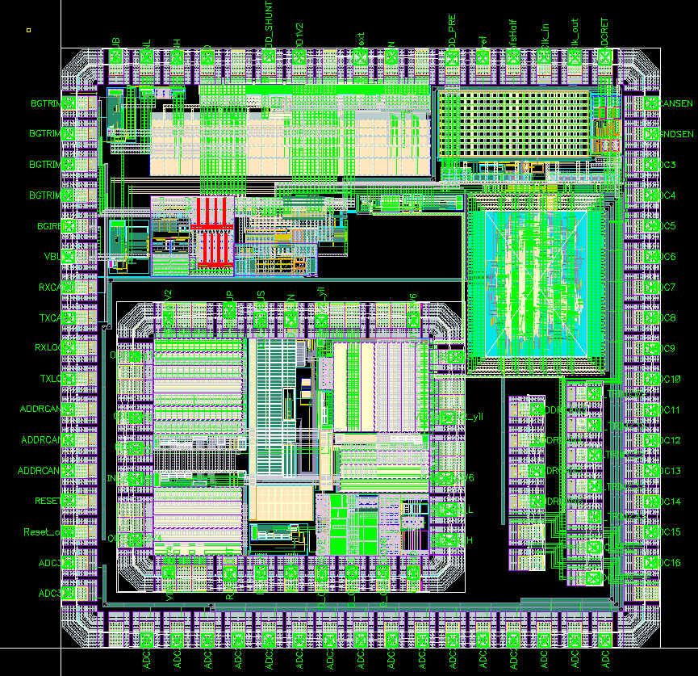
MOPS Chip
CAN Receiver
CAN Protocol
Unit
CAN Driver
CAN
Physical
Regulator
ADC
Bandgap
ADC
CAN Open
Controller
Oscillator
POR
Bandgap
Voltage
Regulator
Digital Part
Power-On
Reset
Object
Dictionary
Oscillator
5V CAN Physical
5V Regulators
Debug
Pads
Automated Trimming

Slide 5
CAN Open Communication
CANopen is a higher-layer protocol and device model on top of CAN
  Defines a standard application interface and communication scheme
data is organized in the Object Dictionary
  16-bit index + 8 bit subindex
  0x1000 Device type, 0x1001 Error register, 0x1018 Identity, 0x1400/0x1600… RPDO/TPDO comms & mapping, 0x2000–0x5FFF manufacturer-specific
communication methodology based on Objects
  Process Data Objects (PDO)
    small messages for fast event-driven process data exchange
  Service Data Objects (SDO)
    multi frame communication
CAN is implemented in hardware CANopen is usually implemented in software
  No experience with microcontroller integration ( back then)
  No microcontroller core available with proven radiation hardness for LHC inner layers
Integrated microcontroller core would have made the MOPS chip very versatile
  Usage as configurable sensor and/or power management node

Slide 6
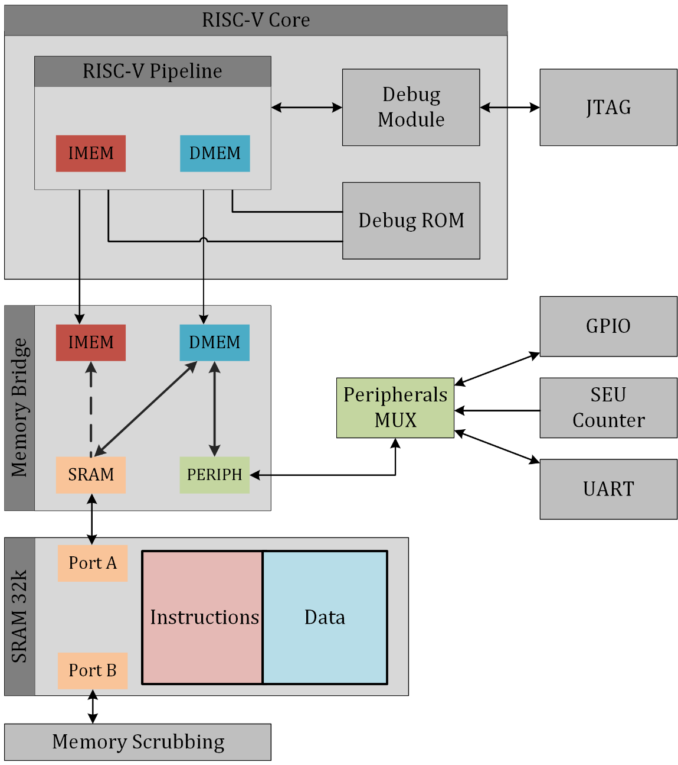
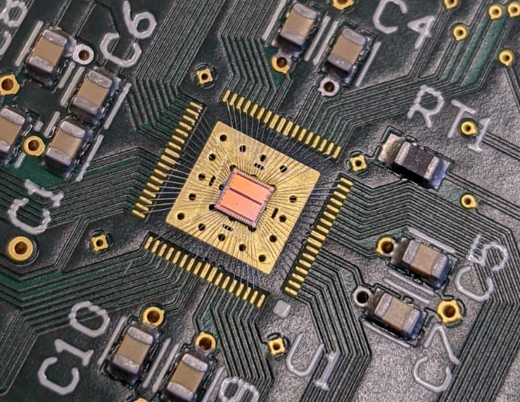
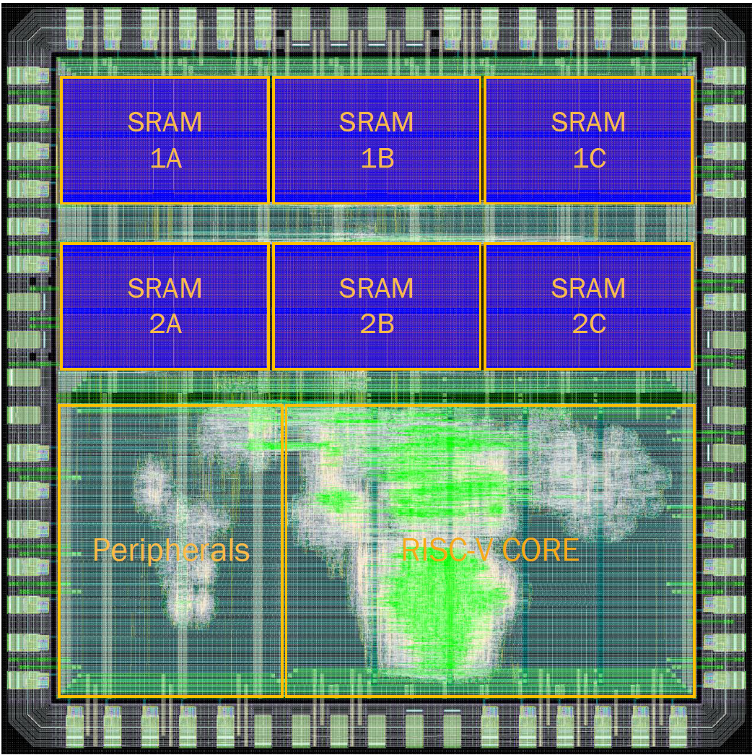
Radiation-Hard RISC-V Microcontroller
AIRES RISC-V Core Fraunhofer IMS
  RV32-IMC Core
  3 stage pipeline
  50 MHz @ 1.2V
  65nm TSMC
Peripherals
  Memory mapped registers
  Accessible via DMEM bus & MEM Bridge
  GPIOs
  SEU Counter
JTAG Interface
  JTAG TAP & debug module
  Non-volatile debug ROM with debug ISR

Slide 7
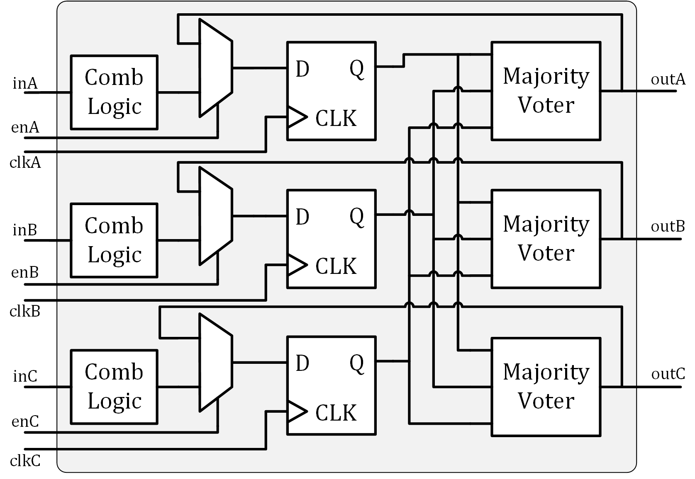
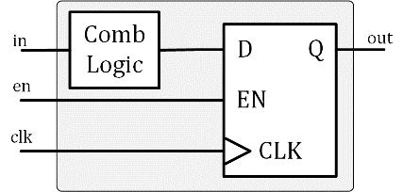
Triple Modular Redundancy & SRAM Scrubbing
Digital circuits usually consist of combinational logic and synchronous storages
Triple modular redundancy (TMR)
  Triplication of combinational logic / storage elements
Majority voter
  Three voters, preventing single point of failure
Feedback path
  Single output interface signal
Cyclical Scrubbing with ECC

Slide 8
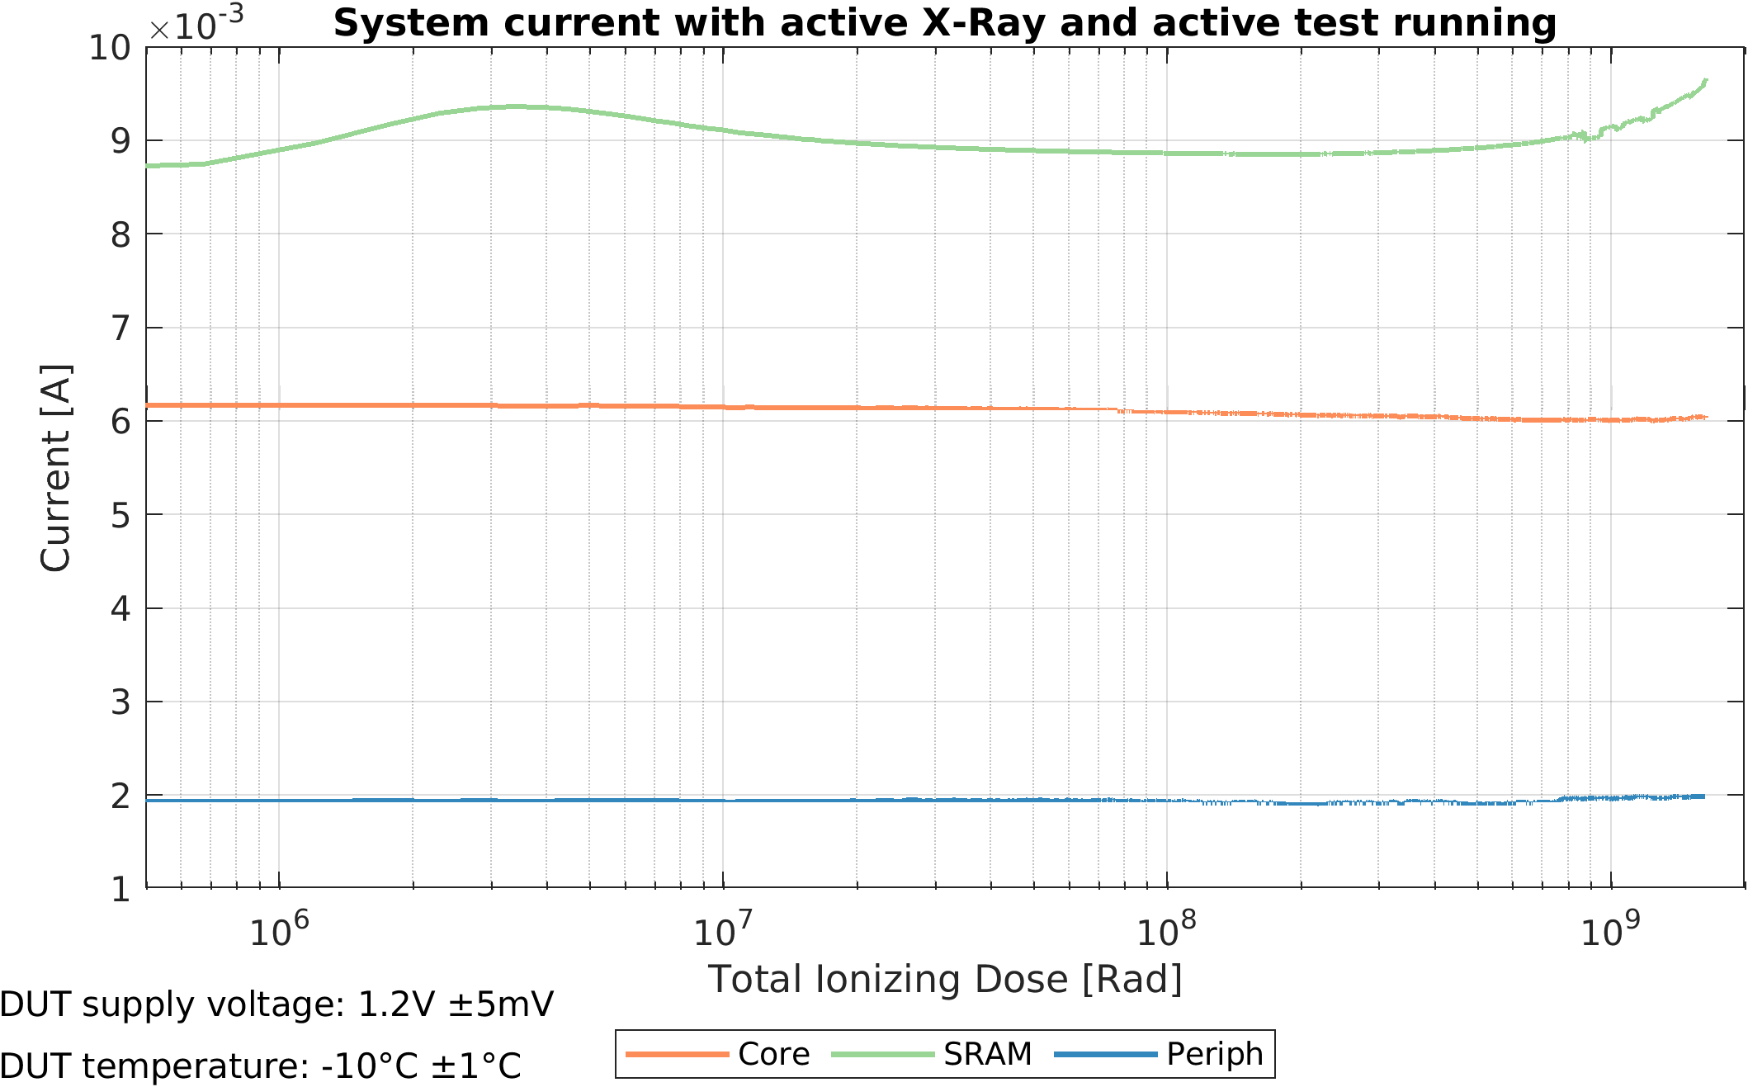
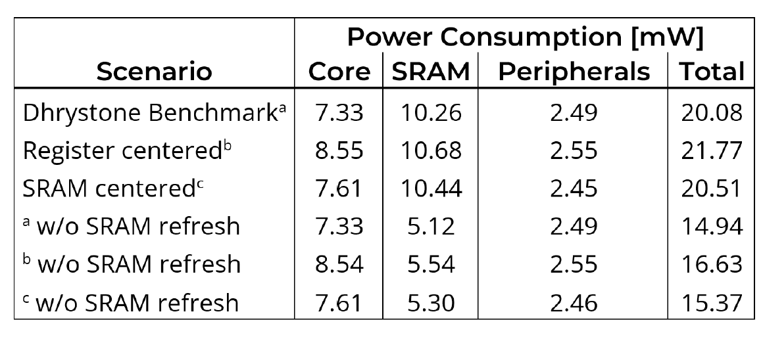
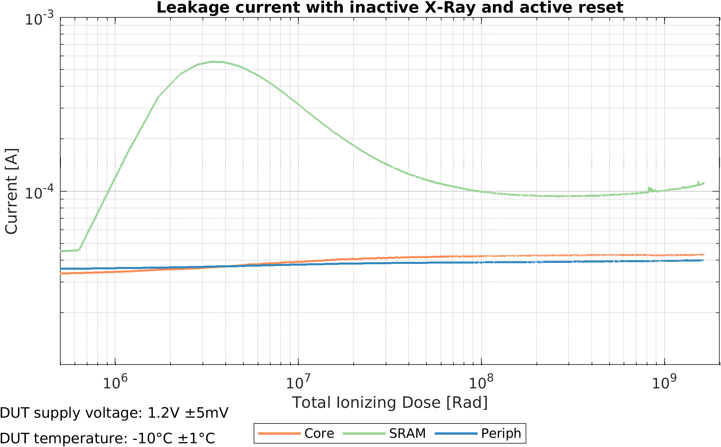
X-Ray Irradation to Study TID Influence
RISC-V processor core and peripherals show hardly any variation
  small reduction for very high TID
SRAM shows strongest variation
  Dominated by leakage current consumption
Compared to temperature radiation has stronger impact
Compared to software radiation has similar impact
Core still functional after 1Grad
  Maybe problems at higher clock frequency

Slide 9
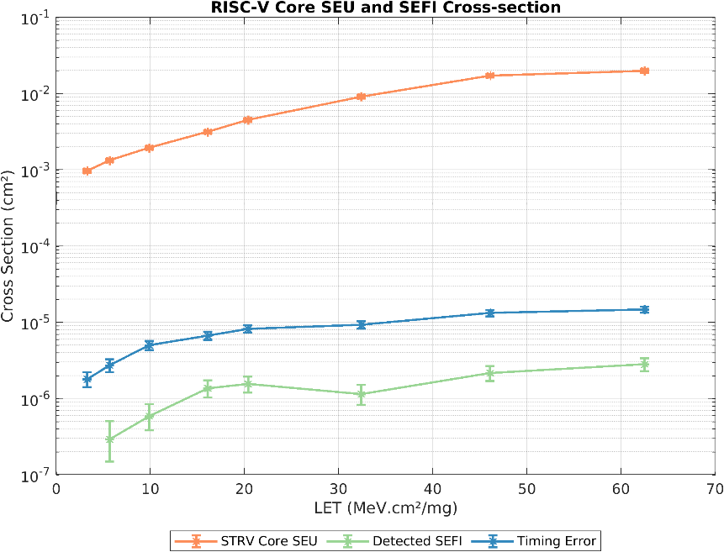
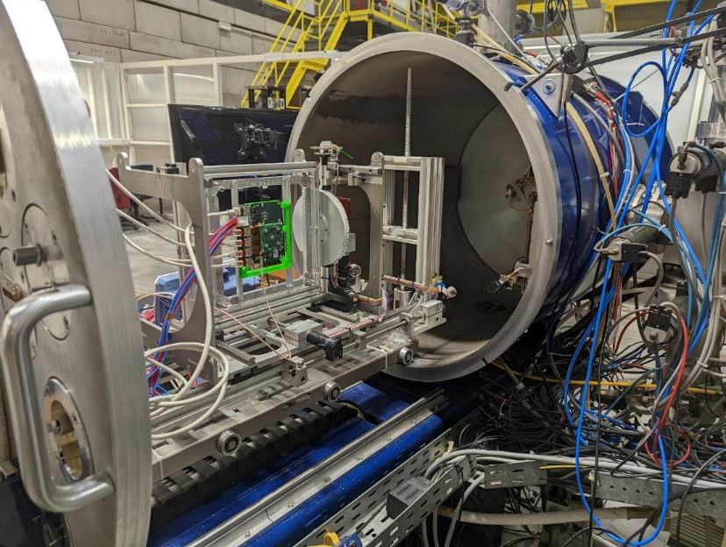
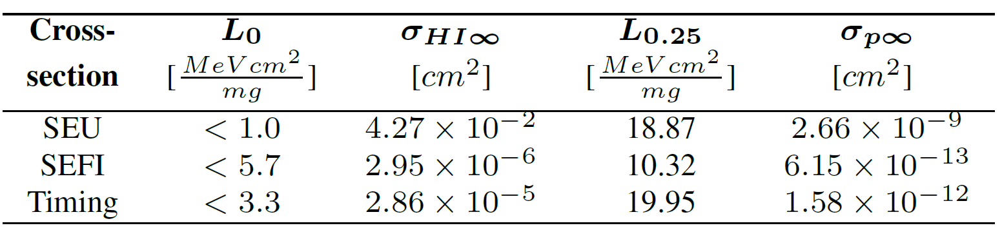
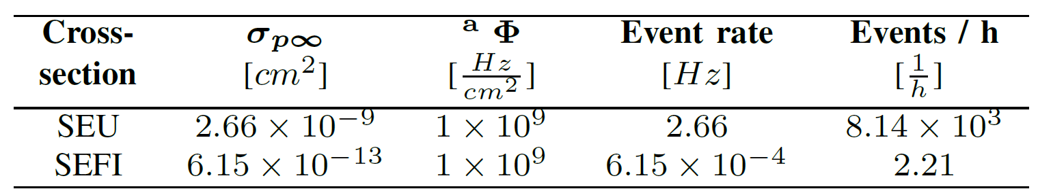
STRV-R1 | Heavy-Ion Irradiation SEFI
Despite the SEE mitigation techniques SEFIs occur
  SEFIs observed during heavy-ion Irradiation
  Average improvement over SEU cross-section
    At low LETs (<16 MeV.cm²/mg): 2800x
    At high LETs (>32 MeV.cm²/mg): 7700x
Estimated SEFI rate in HL-HLC environment
  SEE particle flux 1 × 10⁹ p/cm²/s
  2.2 Chip level SEFI per hour

Slide 10
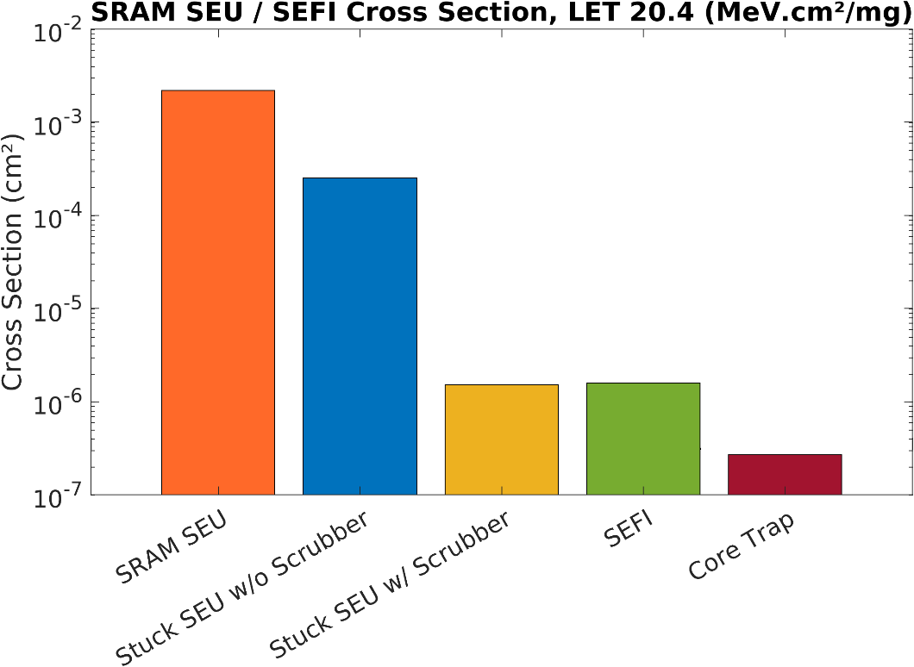
SEFI and SRAM Stuck-SEU rate comparison
SEFI and Stuck-SEU cross-section very similar
Analysis of SRAM content indicates correct data has been stored in wrong address
SRAM macro address logic sensitive to radiation
scrubbing doubles SRAM power consumption

Slide 11
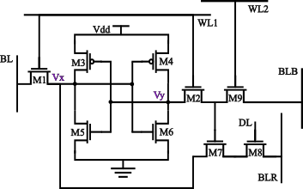
Planned research on radiation hard microcontrollers
Digital In-Memory Computing for error correction:
  Instead of scrubbing (cyclical readout and correction of SRAM data)
  data is corrected asynchronously inside the SRAM macro
Algorithm-Based Fault Tolerance
  Algebraic invariants run in parallel to the data path and flag/correct faults from SEE without triplicating logic
SEU cross section in measurements higher than expected
  Published cross section are extracted from measurements on shift register
  modeling of cross section in SET dominated designs

Slide 12
Potential Usage of Microcontroller Cores in Hybrid Pixel Detectors
Transforms the Readout ASIC into a semi-autonomous, programmable device
  flexible, adaptive, and resilient
Configuration & Control
  Flexible register & bias management
  Dynamic reconfiguration (radiation, power modes)
  Protocol handling
Data Handling
  On-chip filtering & compression
  Programmable trigger logic
  Adaptive bandwidth management
Calibration & Monitoring
  Automated calibration routines
  Radiation damage tracking
  Built-in self-test & diagnostics
System Integration & Reliability
  Autonomous fault recovery & watchdogs–
  Adaptive tuning for lifetime extension

Slide 13
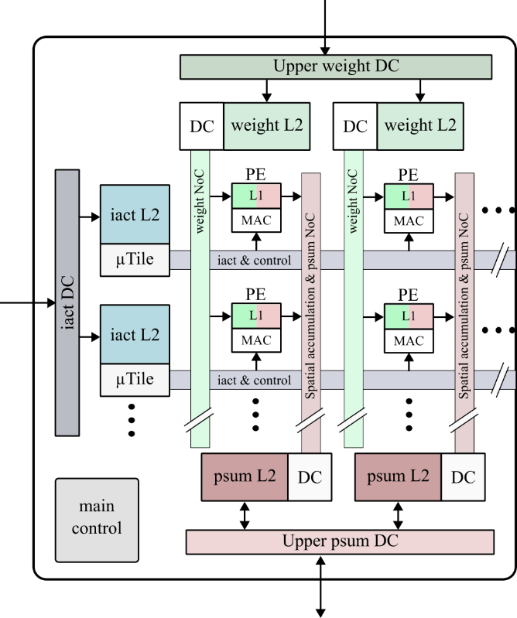
Dataflow Optimized Flexible AI/ML Accelerator
Goals:
  high data throughput at low power consumption
  Flexibility by parameterization & run-time
  configurability
Solution:
  Identification of the overall systems bottleneck
  e.g. memory or sensor bandwidth
  Adaption of the accelerator to the system
  constraints
Process element matrix scalable in X and Y direction
to define parallelism
Scalable L1 /L2 memories sizes to influence locality of
data processing and meet bandwidth requirements
Programmability of the processing sequence during
runtime e.g. spatial/temporal distribution
Data coding that restricts flexibility is avoided
e.g. bitmaps instead of RLC, CSS in the feature maps

Slide 14
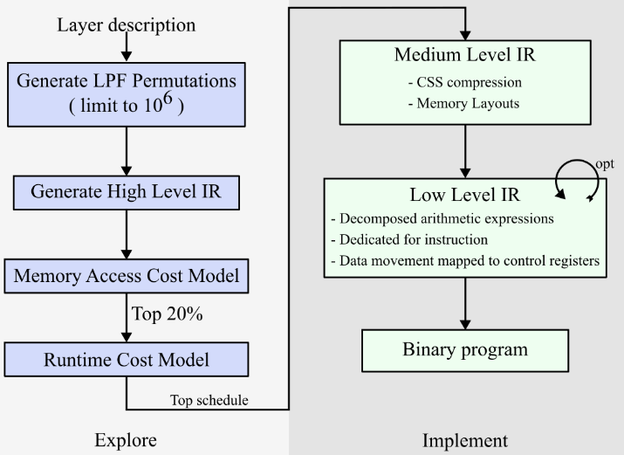
Map Space Exploration & Compilation
automatic optimized mapping of neural networks to custom hardware
high degree of flexibility leads to a high number of possible for a use case
determination of performance characteristics
at hardware level is time-consuming
optimization based on an abstract model
preferable
compiler translates configurations into
intermediate representations
  MLIR Framework
  (Multilevel Intermediate Representation)
Evaluation using cascaded cost models e.g.
for memory accesses, peak bandwidth,
runtime, pre- / post-processing,
Cascading allows fast evaluation of configurations
Optimal configuration is reduced to executable binary representation

Slide 15
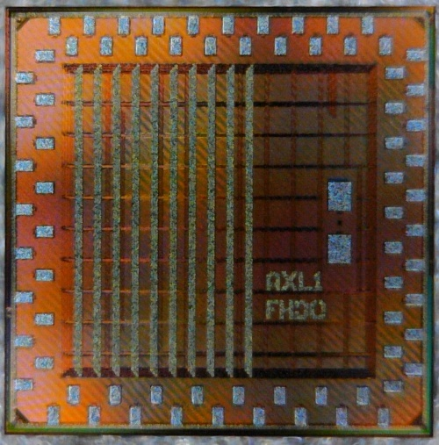
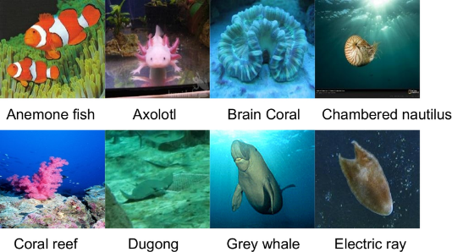
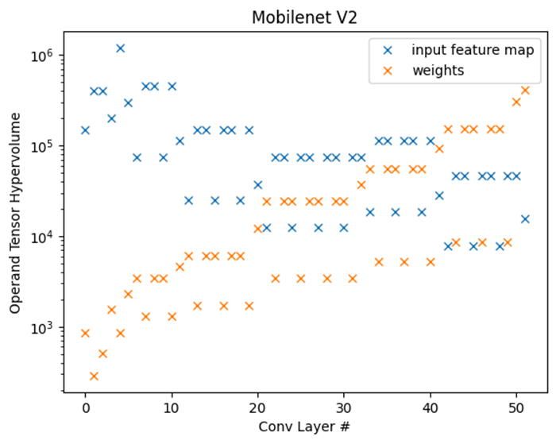
Extracted performance metrics
inference accuracy for ImageNet (classification 1000 classes)
  AlexNet: top 5 accuracy, 80.1% (float32: 79.5%)
  MobileNetV2: top 5 accuracy, 89.4% (float32: 92.7%)
  post training 8 bit quantization
hardware performance in 28 nm TSMC:
  area requirement IP core: < 0.5 mm²
  power consumption: ~ 10 mW / 4.4 TOPS/W
Throughput:
  AlexNet: ~ 10 FPS, MobileNet ~ 30 FPS
Dataset: ImageNet / ILSVRC2012 :
  1000 classes, 250x250 px
  No. of images: 1.3 million
Model: MobileNet v2
  50 layers
  weights and feature maps 1 kB - 1 MB per layer
  with 8-bit quantization

Slide 16
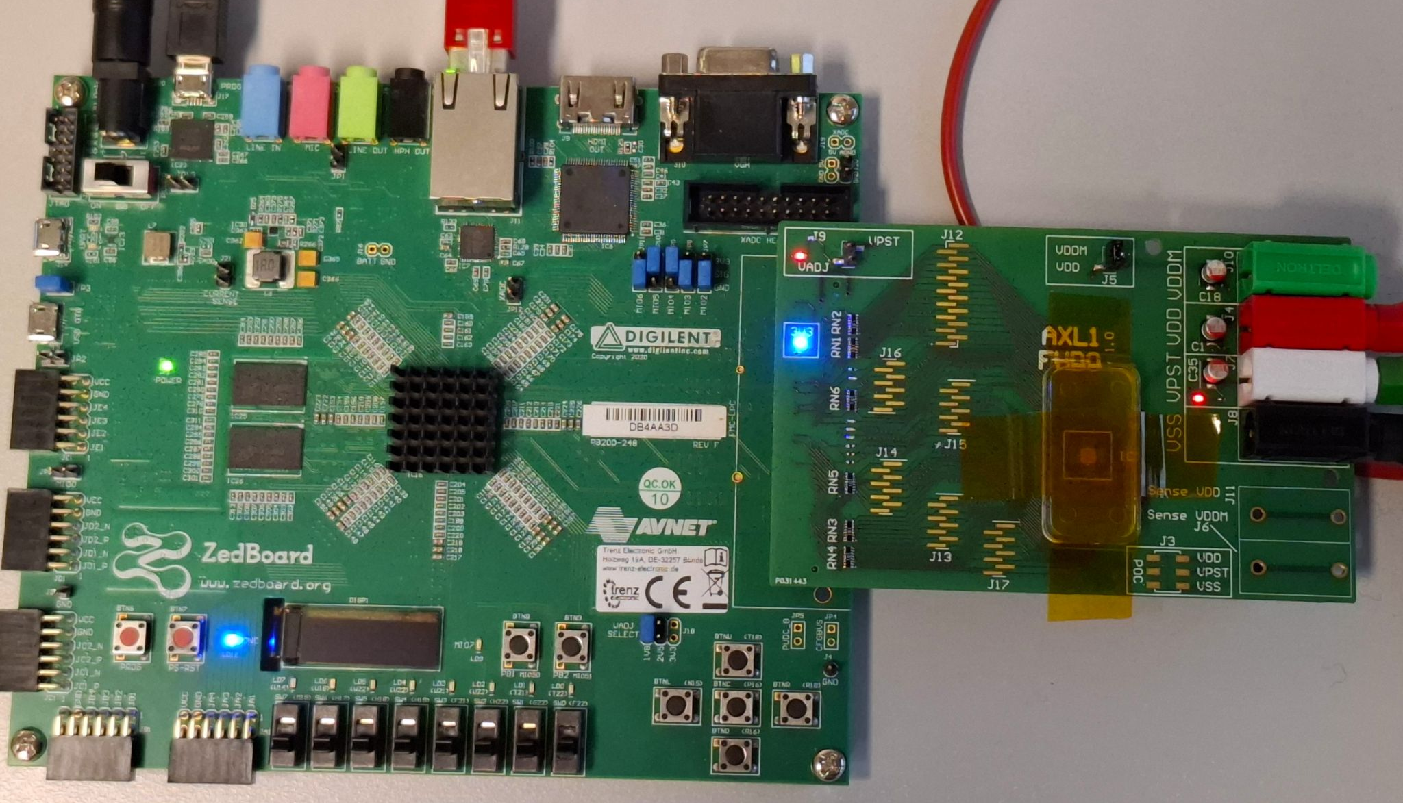
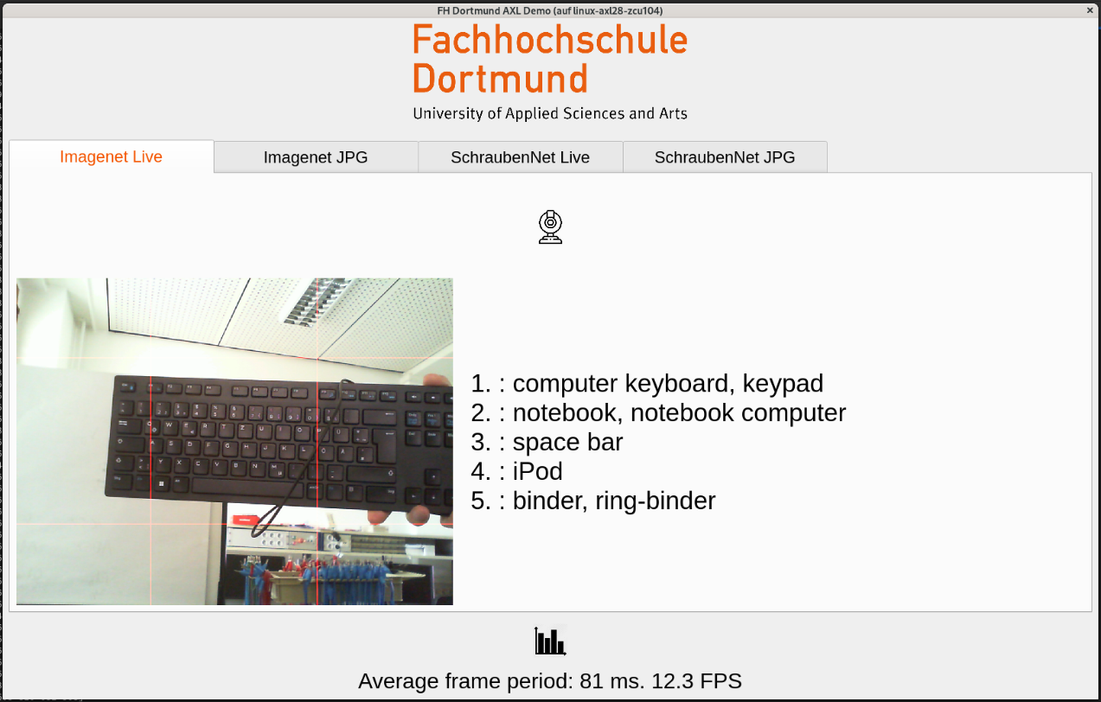
Demo – MobileNet v2
Neural Network | Mobilenet v2
Input Resolution | 224 x 224 px
Layers | 52 x convolution, 1 x linear
Parameters | 3.5 million
Operations | 300 MOP
Performance | max. 12.5 FPS, 3.8 GOP/s (int8)

Slide 17
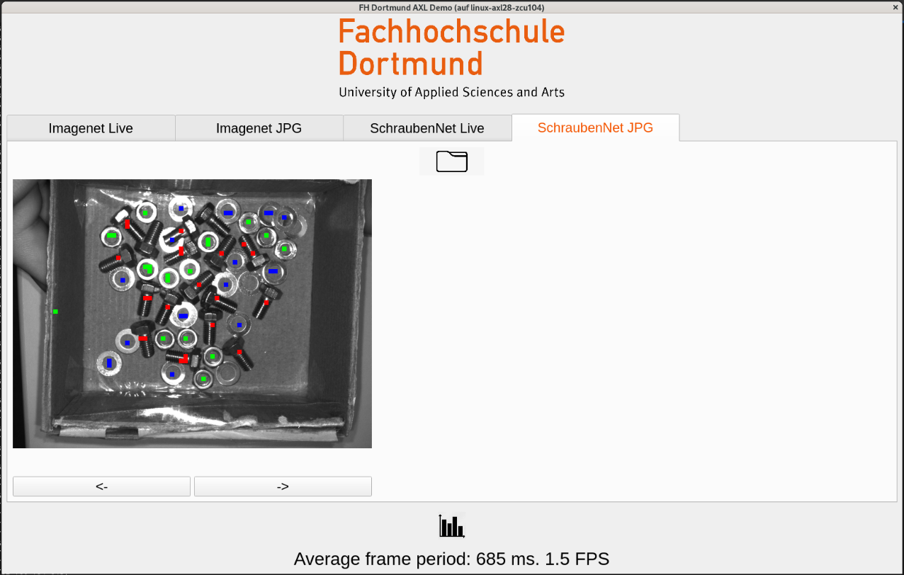
Custom Demo – „ScrewNet“
Neural Network | Custom
Input Resolution | 512 x 640 px
Layers | 36 x convolution
Parameters | 363000
Operations | 2.85 GOP
Performance | max. 1.5 FPS, 4.3 GOP/s (int8)

Slide 18
SEE Resilient AI/ML Hardware
How to design SEU resilient and resource efficient AI/ML accelerator ???
Memory access is dominating power consumption
  scrubbing increase power consumption even more
AI/ML logic already very complex
  triplication of hardware improves complexity even more
Analyze error tolerance at the algorithmic level and select a neural network that has been proven to be particularly error-resistant?
Identify sensitive part of neural network and map only this part to error-protected hardware?
Does a resource efficient alternative to TMR protection exist?
SRAMs with self-detecting/correcting error mechanism (in-memory computing?)

Slide 19
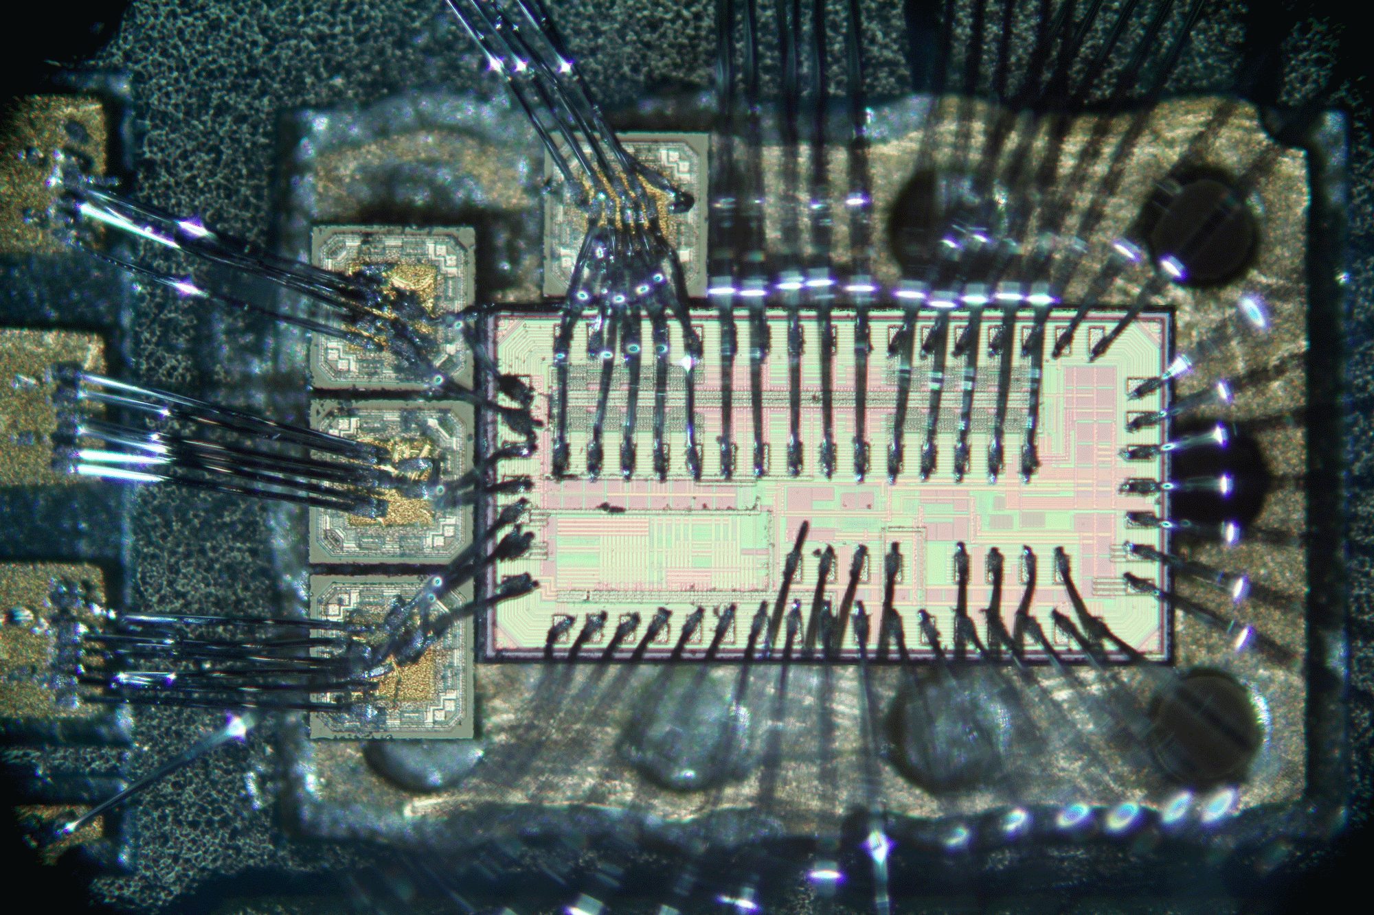
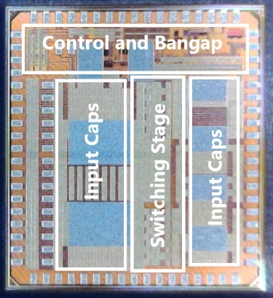
High-Frequency DCDC Buck Converter
cascoded switching stage
  high radiation tolerance
  high voltage handling
high switching frequency (100 MHz)
  requires small inductance
  low volume air coil
control circuitry optimized for high frequency
  crosstalk and kickback issues to solve
Ringing mitigation
  External bondable capacitors
  On-chip capacitors

Slide 20
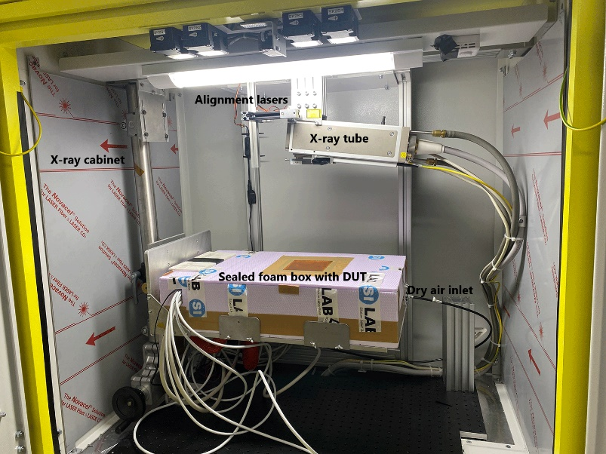
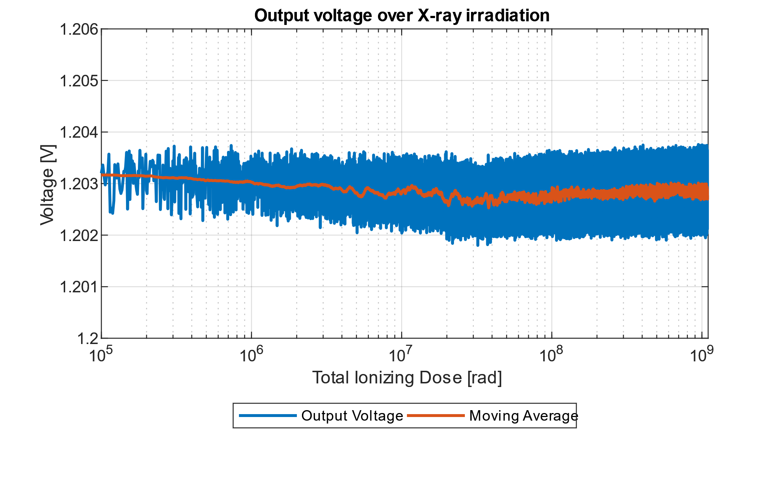
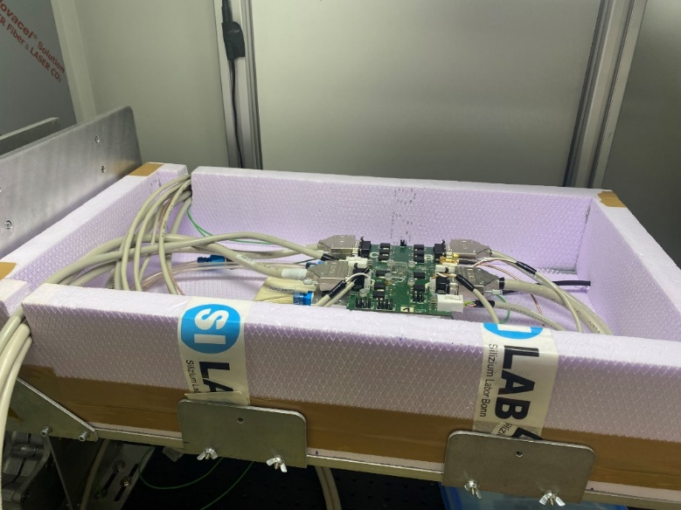
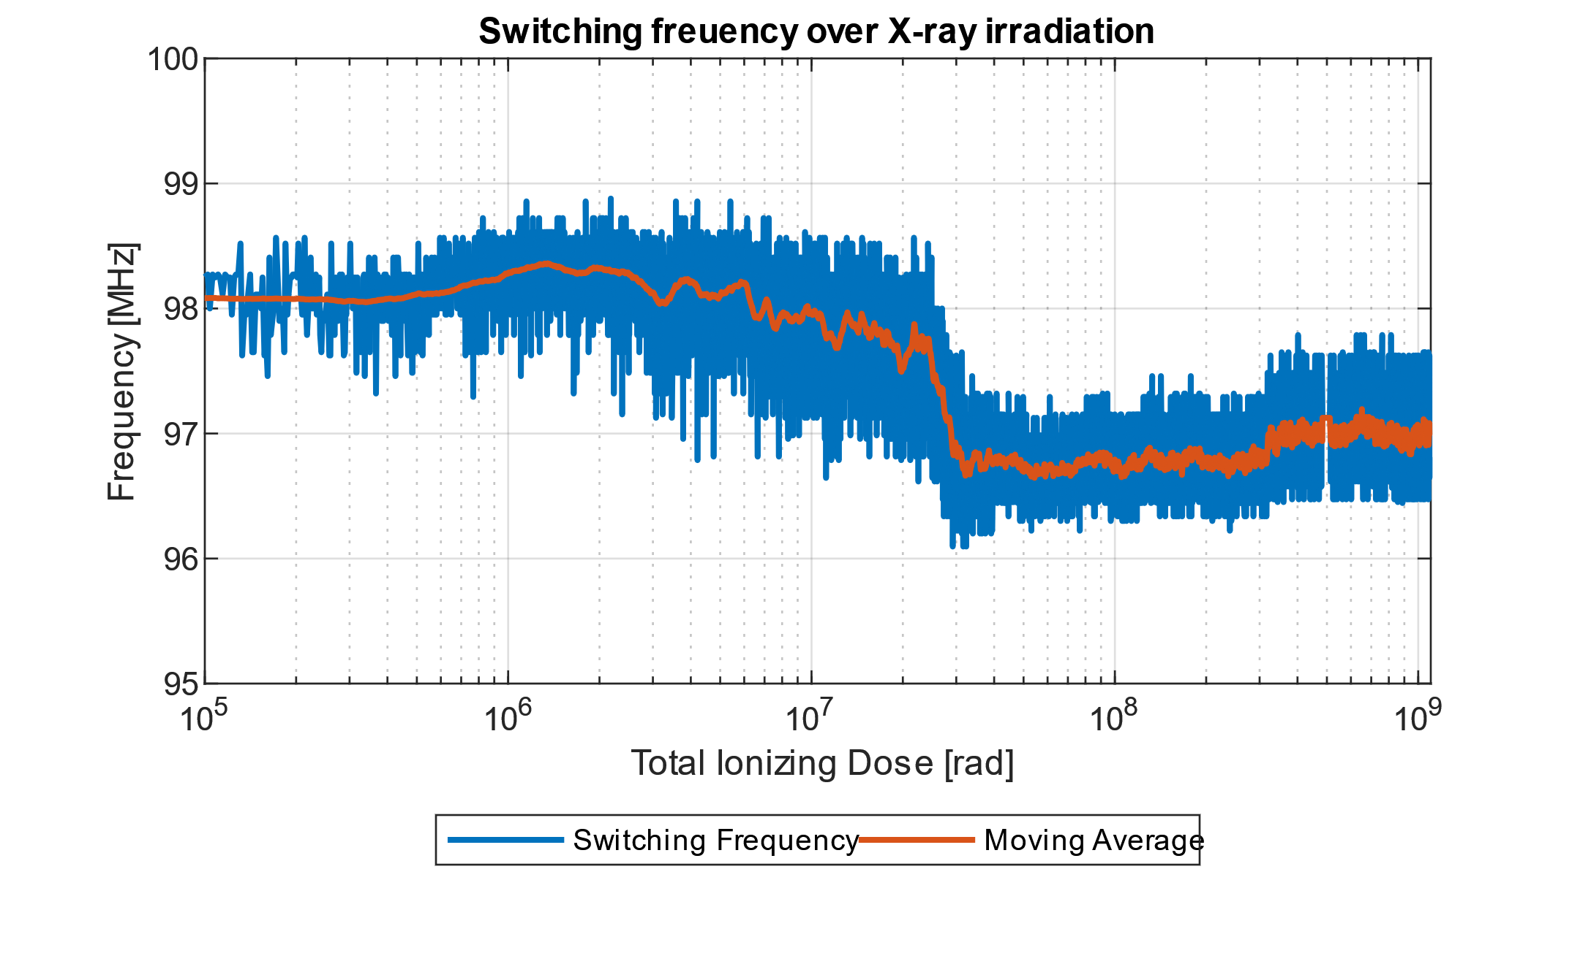
X-Ray Irradiation Campaign
Chip irradiated with X-rays at 2Mrad/h
1 Gigarad Total Ionizing Dose reached after 3 weeks
Low temperature -15°C to match experiment conditions
variation < 0,2 %
variation < 3 %

Slide 21
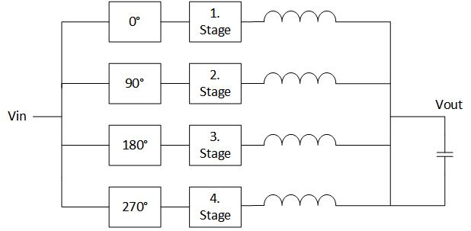
Ongoing Research and Research Ideas:
Radiation Hard Power Management Systems
DFG grant for study of radiation hard converters with advanced architectures
Switch-mode shunt regulator for serially powered systems
Study of radiation tolerance and design of GaN power stages
Multi-Level Converter
Multi-Phase Converter

Slide 22
Summary & Conclusion
IC design engineers support fundamental research with their expertise
Special challenges due to harsh environment
  TID, SEE, magnetic field
Innovative approaches and circuits designs required
  serial powering, HF DC/DC converter with cascoded power stage, radhard RISC-V
AI/ML inside the detector volume adds even more challenges
  power consumption
  circuit complexity and implementation effort

