Slide 1
First proposal of the interposer PilotProject ECFA-DRD 7.6b
Key-notes:
Stay closely aligned with the Max Planck original proposal
Provide the possibility to integrate multiple bumping technologies (e.g., SAC, Gold-Stud, anisotropic, etc.) to verify the process flow when several bumping technologies are involved.
Include transmission lines for signal integrity testing of high-speed transceivers:
Al/SiO₂ differential coplanar transmission lines
Aluminium thickness: 1 µm, oxide thickness: 200 – 500 nm
Cu/BCB differential coplanar transmission lines
Copper thickness: 5 – 6 µm, dielectric constant (K): 2.6, BCB thickness: 3 µm
Al
SiO₂
diff+
diff-
Si
Cu
gnd
diff+
diff-
gnd
BCB
GND
Al
Si
SiO₂

Slide 2
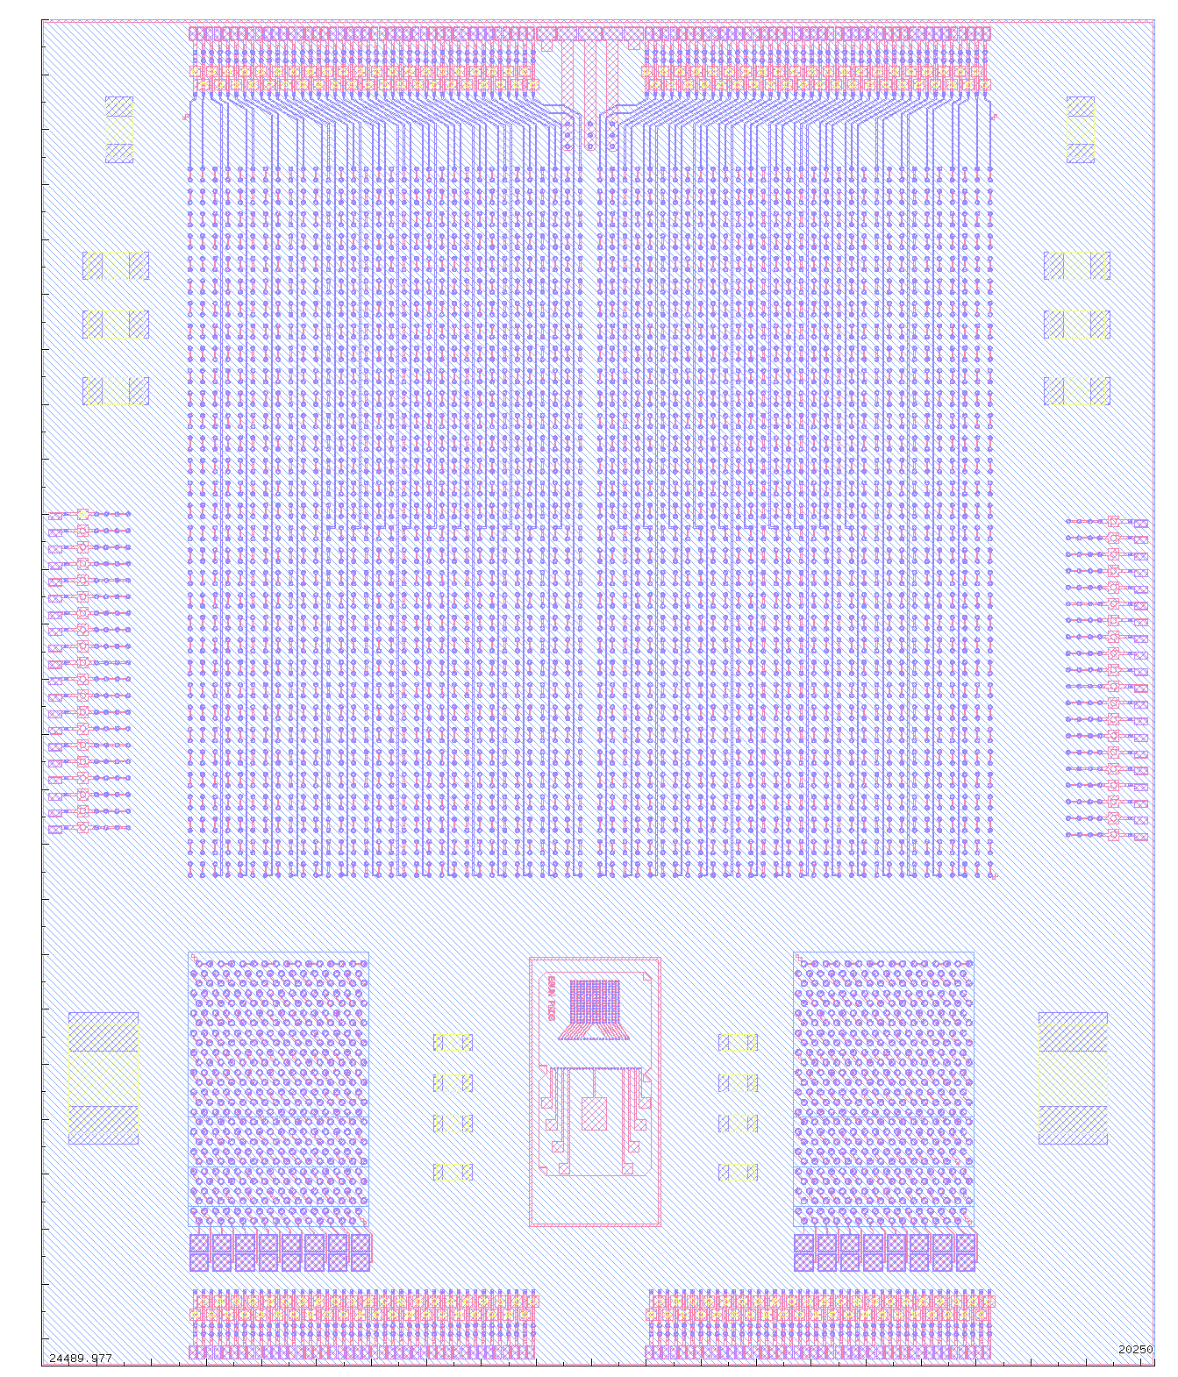
Layout of the interposer PilotProject Single unit
20,25 mm
STD passive components with package size of 0201, 0402, 0805, as requested by DRD 7.1
Modified layout where the heaters elements are placed only on the dummy chips and not on the interposer
Die size: 20,25 x 24.45 mm²
24,45 mm

Slide 3
Layout of the interposer PilotProject Single unit - completed with ASICs
20,25 mm
STD passive components with package size of 0201, 0402, 0805, as requested by DRD 7.1
Modified layout where the heaters elements are placed only on the dummy chips and not on the interposer
XFEL- dummy
dsimpl - dummy
24,45 mm
dcd-dummy
dcd-dummy
4 ASIC are bump-bonded by using of SAC bumps from Max Planck
TOP and BOTTOM pad structures as defined by Max Planck

Slide 4
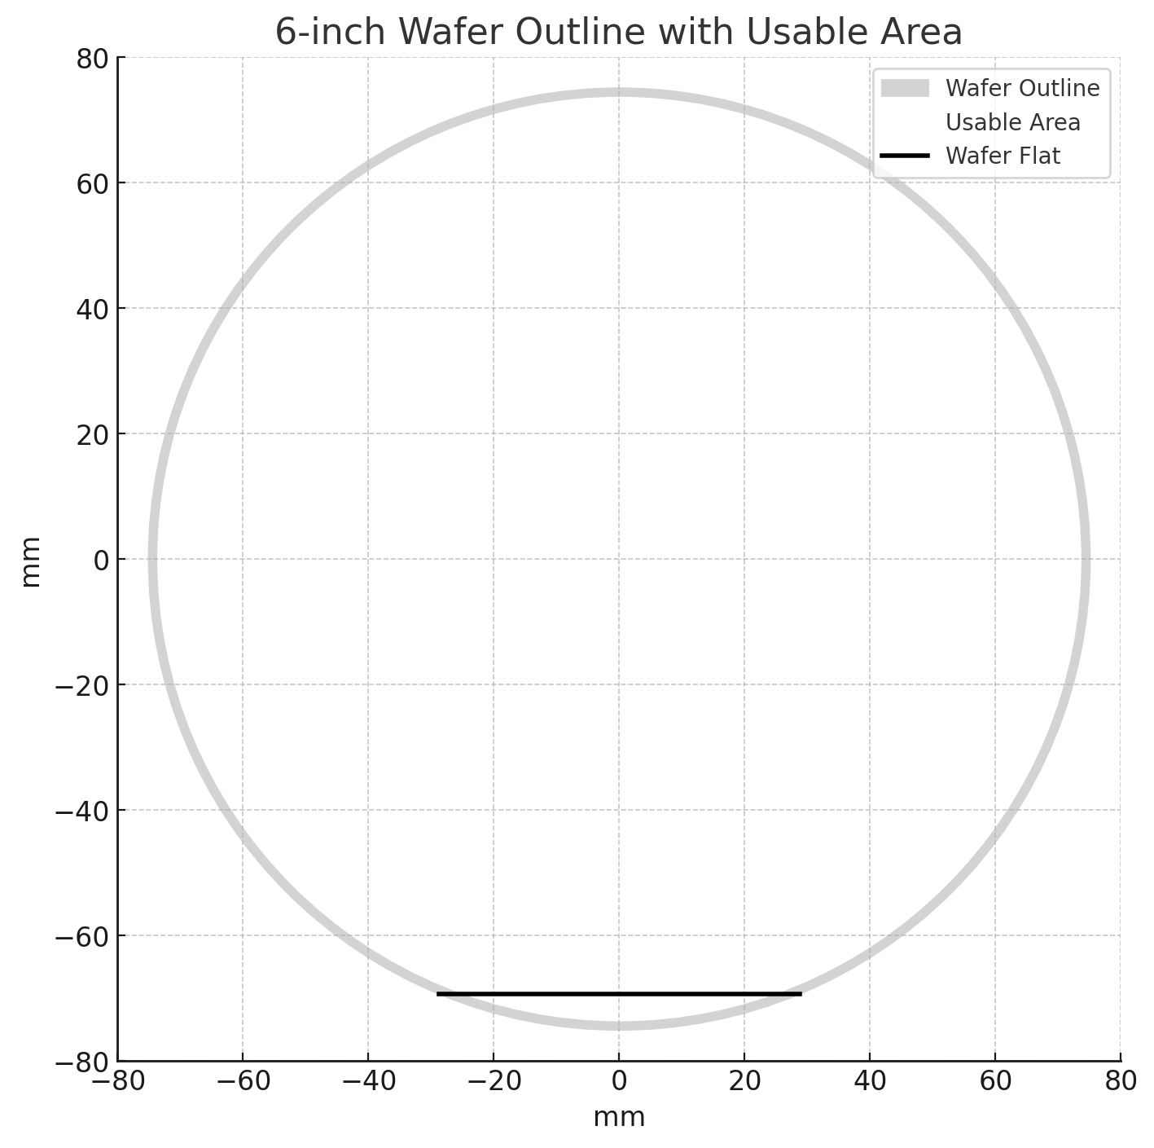
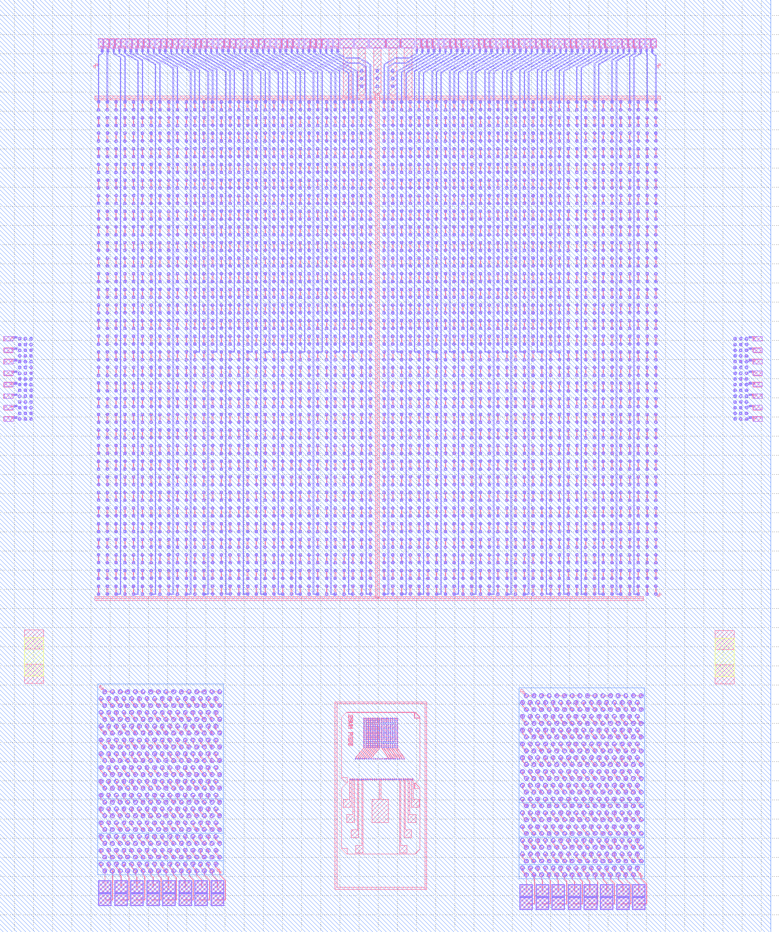
Wafer layout
Coplanar TL Cu-BCB type 2,3 and 4
Additional space for Max Planck structures
Coplanar TL Cu-BCB type 1
Interconnection chips
Additional space for Max Planck structures
Single unit interposer
Coplanar TL Al-SiO₂ type 1
Coplanar TL Si-SiO₂ type 2,3 and 4
Should be in scale

Slide 5
Layout of the interposer PilotProject Still missing
20,25 mm
The present interposer includes several completed structures
The local connections to and from the bottom pad system still need to be implemented
Optionally, the original pads can be kept, which will help speed up the design process
Do you have any questions or feedback on this topic?
24,45 mm

Slide 6
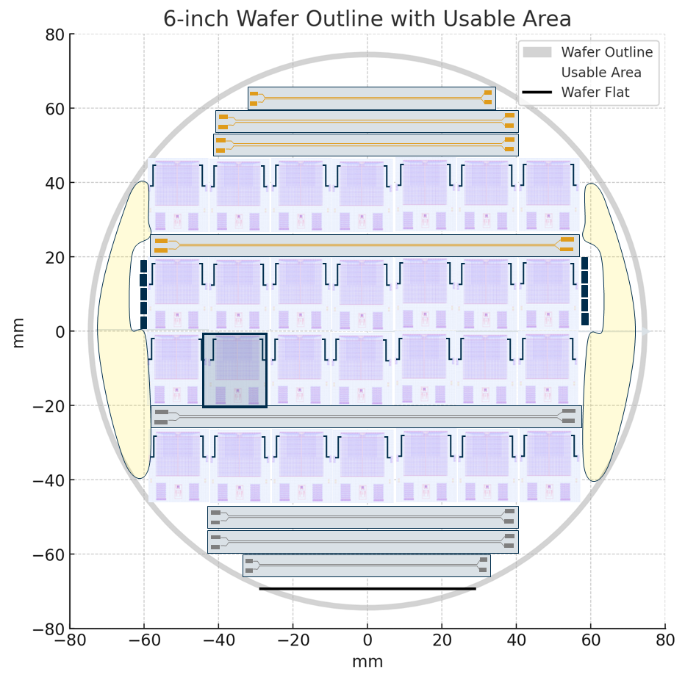
Wafer level Still missing
The transmission lines are still missing
Do you have any feedback, suggestions for new features, or ideas for improvements?

Slide 7
First proposal of the interposer PilotProject ECFA-DRD 7.6b
Key-notes:
Stay closely aligned with the Max Planck original proposal
Provide the possibility to integrate multiple bumping technologies (e.g., SAC, Gold-Stud, anisotropic, etc.) to verify the process flow when several bumping technologies are involved.
Follow a modular approach
Single interposer design could potentially be extended to support large-area 2.5D (large-area interposer)
The large-area version could serve as a scaled demonstrator, mimicking the size of future detector module

Slide 8
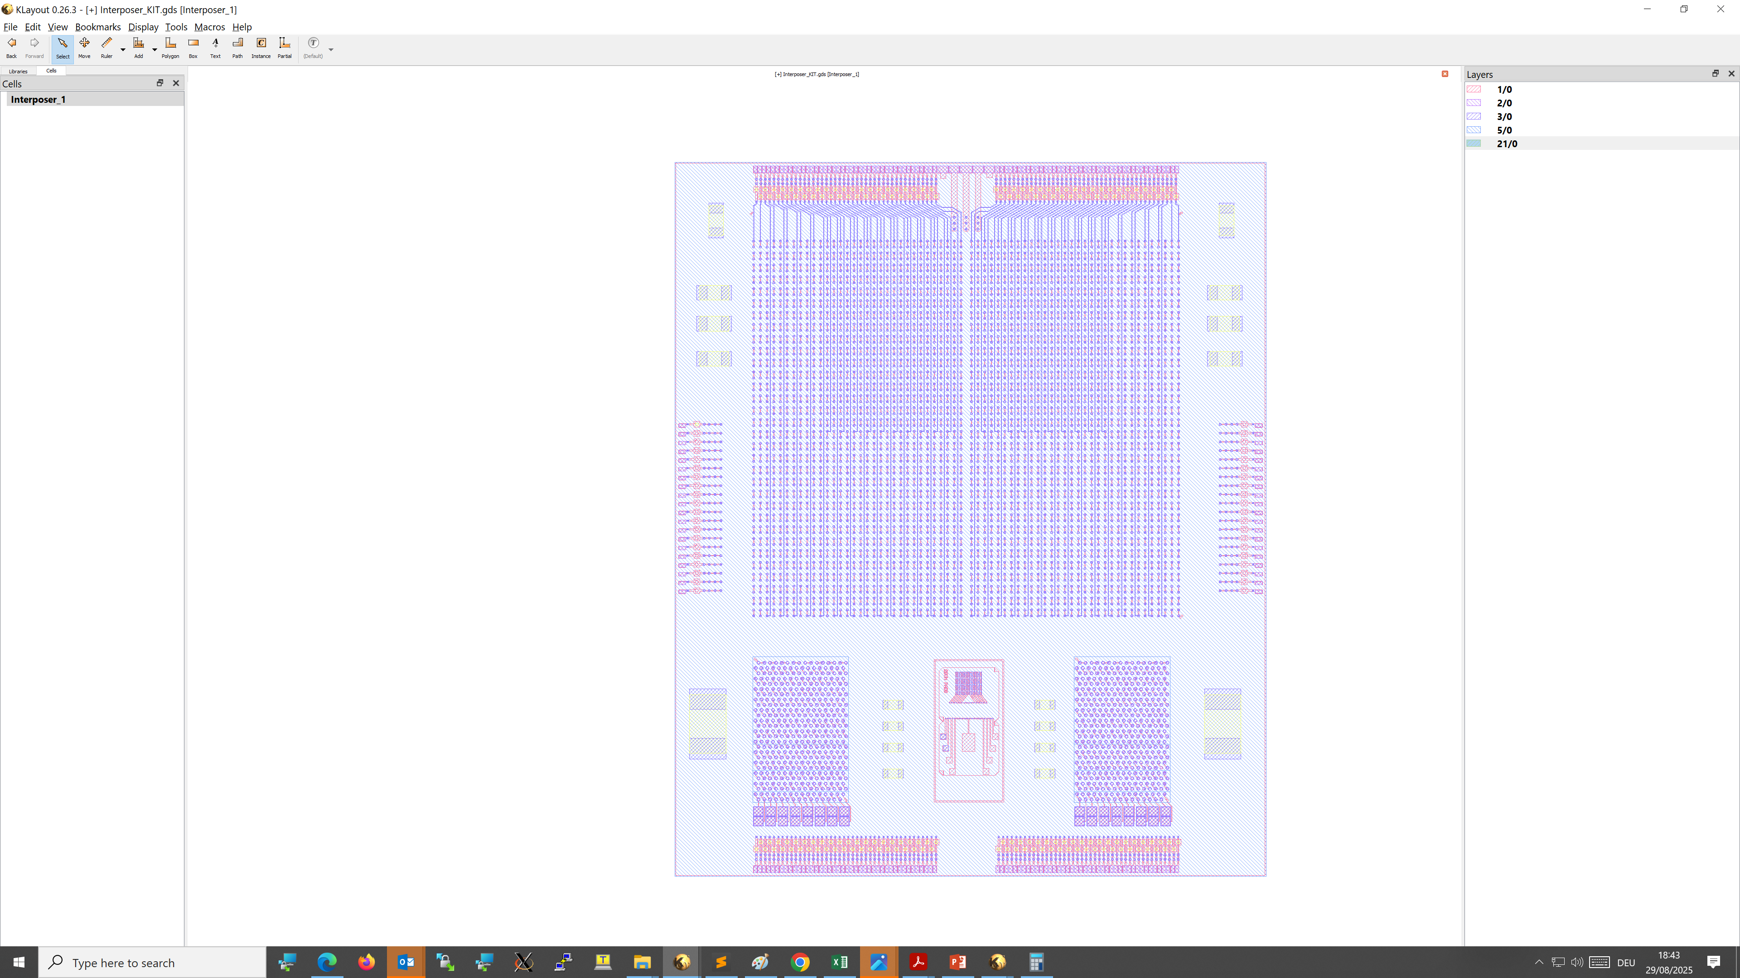
Large 2.5D detector module interposer Multi-interposer interconnected together
Additional chip for the long daisy chain by using of Au-stud
TOP and BOTTOM pad structures as defined by Max Planck
needle probing HERE
needle probing HERE
Chips are interconnected in daisy chains through local routing on the interposer
To mimic large area detector module (option)

Slide 9
Large 2.5D detector module interposer Multi interposer with 3-units building-block
Directly connected with Cu-metal paths
TOP and BOTTOM pad structures as defined by Max Planck
needle probing HERE
needle probing HERE
Chips are interconnected in daisy chains through local routing on the interposer
To mimic large area detector module (option)

Slide 10
Wafer layout
3-units building block
Coplanar TL Cu-BCB type 2,3 and 4
Additional space for Max Planck structures
Coplanar TL Cu-BCB type 1
Interconnection chips
Additional space for Max Planck structures
Single unit interposer
Coplanar TL Al-SiO₂ type 1
Coplanar TL Si-SiO₂ type 2,3 and 4
Should be in scale

Slide 11
First proposal of the interposer PilotProject ECFA-DRD 7.6b
Key-notes:
Stay closely aligned with the Max Planck original proposal
Provide the possibility to integrate multiple bumping technologies (e.g., SAC, Gold-Stud, anisotropic, etc.) to verify the process flow when several bumping technologies are involved.
Follow a modular approach
Single interposer design could potentially be extended to support large-area 2.5D (large-area interposer)
The large-area version could serve as a scaled demonstrator, mimicking the size of future detector module
Provides dummy materials for TSV development
TSVs with a maximum diameter of 100 µm and a pitch of 300 µm
Enables exploration of 3.5D integration by using a single-unit interposer as a die with ASICs on top

Slide 12
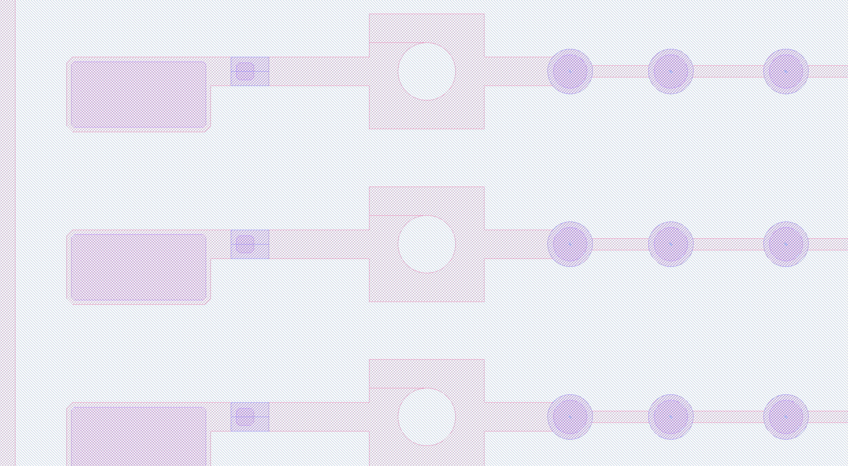
Layout of the interposer PilotProject TSVs definition and position
TSVs are defined with openings in the silicon, without metal or passivation. The main focus is on implementing very small TSVs (< 20 µm). The silicon die is used as a substrate for parameter tuning and optimization
A similar structure is also applied on the backside of the substrate
TSVs
Au-Stub
Pad
Ø = 100 µm

Slide 13
Large 3.5D detector module interposer Multi interposer with vertical interconnection
A single-unit interposer is customized into a 3-unit building block, interconnected specifically for TSV test and characterization purposes.
The interposer can be bonded on the top of the 3-units substate
Cross section

Slide 14
Fabrication Recipe for TSV-last Silicon Interposers
Front-side prep (thick wafer, 280 µm)
Top RDL build (FRONT):Sputter Al pads/traces (patterned). BCB dielectric deposition and cure and planarization (follow low-stress profile). Cu seed + Cu electroplate where thick Cu wiring/planes required. (OPEN: KIT, Max Planck, CNM, FBK ... )
Do final CMP planarization and metrology (surface roughness, bow). (OPEN: KIT ... )
Deposit protection/hard mask for DRIE (immediately before via etch): e.g., PECVD SiO₂ 0.5–1.5 µm + SiN. Pattern top mask aligned to TSV landing pads (use your front litho alignment). (OPEN: KIT ... )
DRIE from front — etch partial vias to near-through depth of 50 µm. (KIT: investigation by DRIE and laser driller )
Inspect via profiles (SEM/X-ray on coupons) (KIT)
Back-grinding + fine CMP to open through-vias. Use temperature-stable adhesive compatible with BCB and planned anneals. (outsource by company)
TSVs isolation (PECVD SiO₂) + barrier (sputtering TiN 20-50nm) + seed deposition (sputter better ALD Ti/Cu) + Cu electrofill (bottom-up plating recipe). (OPEN: KIT by cluster sputtering)
Planarize / CMP to the BOTTOM surface (KIT)
BACKSIDE lithography: Sputtered Al layer (pads / traces) .BCB dielectric deposition and cure and planarization. Cu electroplating for thick redistribution lines, planes, or bumps. . (OPEN: KIT, Max Planck, CNM, FBK ... )
Debond, final inspection (X-ray, SAM), electrical tests (TSV chains, resistance, leakage), singulation. (ALL)
Mechanical and thermal stress analysis (ALL)
Temporary wafer bonding is necessary !!

Slide 15
Fabrication Recipe for TSV-first Silicon Interposers
Front-side prep and lithography for TSVs
DRIE from front — etch full-through vias depth of 280 µm. (KIT: investigation by DRIE and laser driller )
TSVs isolation (PECVD SiO₂) + barrier (sputtering TiN 20-50nm) + seed deposition (sputter better ALD Ti/Cu) + Cu electrofill (bottom-up plating recipe). (OPEN: KIT by cluster sputtering)
Do CMP planarization (FRONT and BACK SIDE) and metrology (surface roughness, bow). (OPEN: KIT ... )
Top RDL build (FRONT): Sputter Al pads/traces (patterned). BCB dielectric deposition and cure (follow low-stress profile). Cu seed + Cu electroplate where thick Cu wiring/planes required. (OPEN: KIT, Max Planck, CNM, FBK ... )
Inspect via profiles (SEM/X-ray on coupons) (KIT)
Top RDL build (FRONT):Sputter Al pads/traces (patterned). BCB dielectric deposition and cure (follow low-stress profile). Cu seed + Cu electroplate where thick Cu wiring/planes required. (OPEN: KIT, Max Planck, CNM, FBK ... )
Ensure front-side protection layer remains intact.
BACKSIDE lithography: Sputtered Al layer (pads / traces) .BCB dielectric deposition and cure and planarization. Cu electroplating for thick redistribution lines, planes, or bumps. . (OPEN: KIT, Max Planck, CNM, FBK ... )
Final inspection (X-ray, SAM), electrical tests (TSV chains, resistance, leakage), singulation. (ALL)
Mechanical and thermal stress analysis (ALL)

