Slide 1

Assembly & Integration Technologies for Microelectronics & Microsystems Expertise & Future Prospect - Norway
Hoang-Vu Nguyen, PhD
Associate Professor at Department of Microsystems
University of South-Eastern Norway

Slide 2
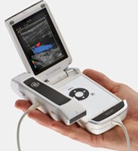
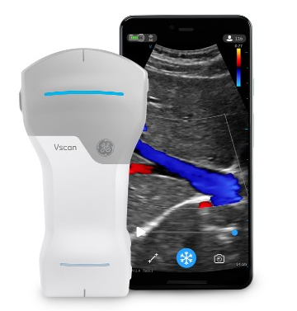
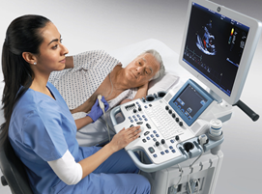
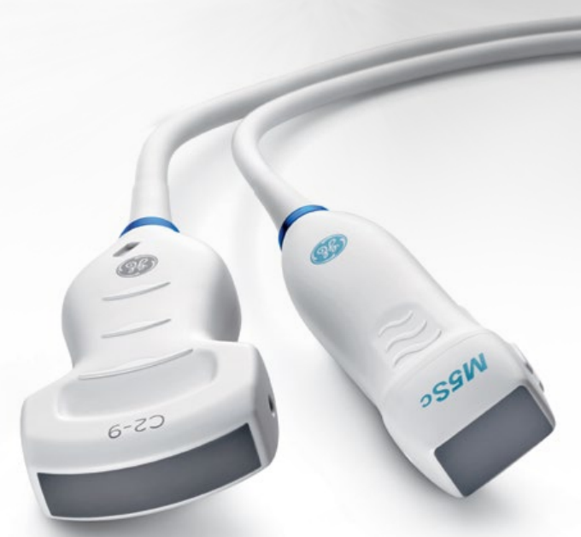

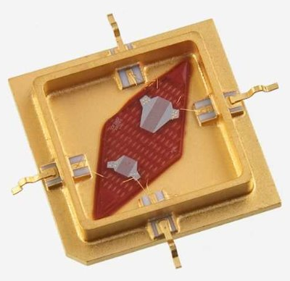
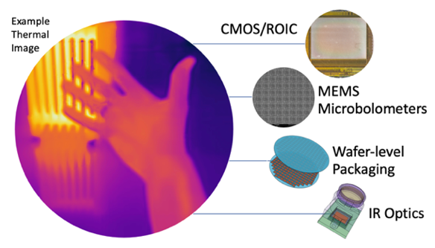
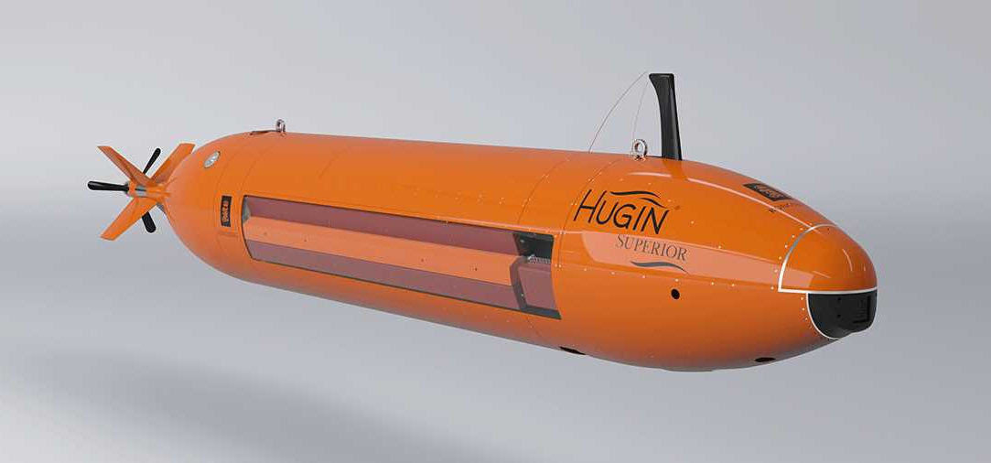
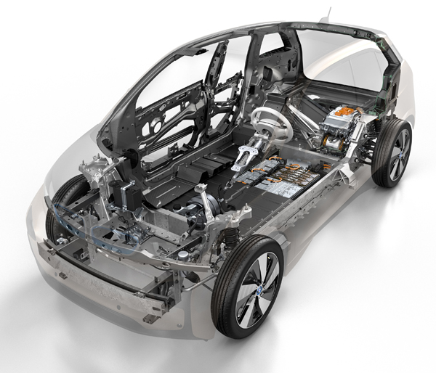
Microelectronics and Microsystems (MEMS) in Norway
Medical devices
Automotives
Aviation
Space and defense
Underwater
Surveillance
High-end sensor/detector devices
more

Slide 3
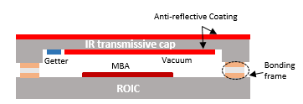
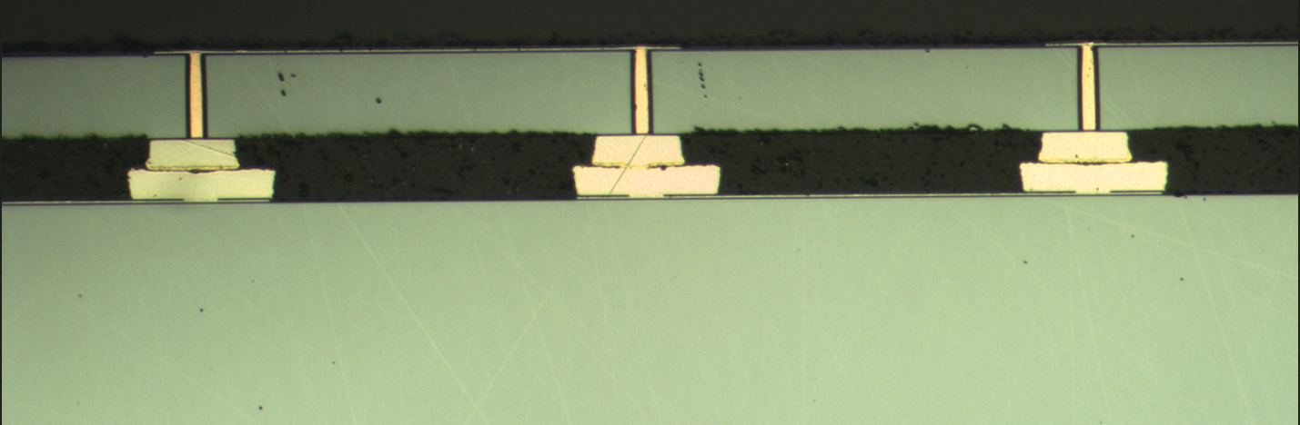
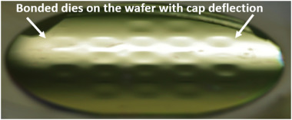
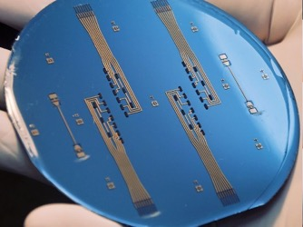
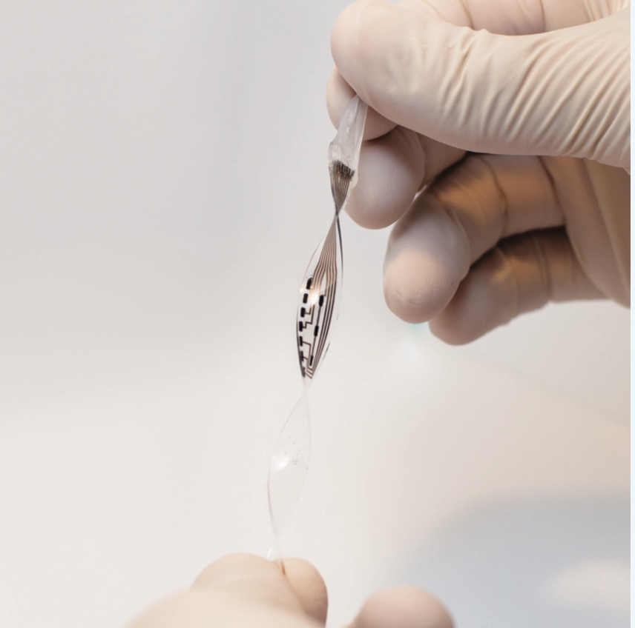
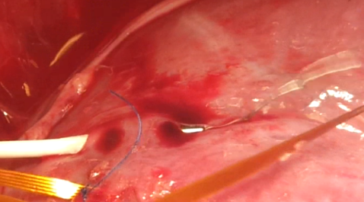
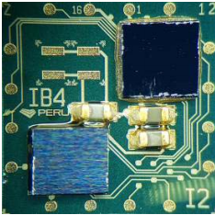
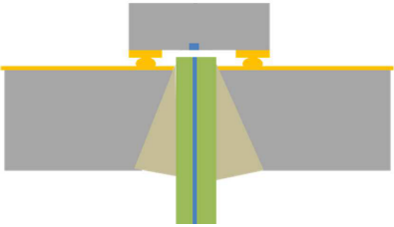
Packaging technologies
Encapsulation of MEMS sensors
Interconnection technologies for MEMS and electronics
System-integration and encapsulation for medical devices
Packaging technologies for demanding applications
Assembly photo diode (0.35 x 0.35 mm²) for cryogenic operation
Bioelectronic interfaces
Sensor implanted in the heart muscle
An integrated system
in caliber ammunition

Slide 4
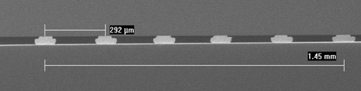
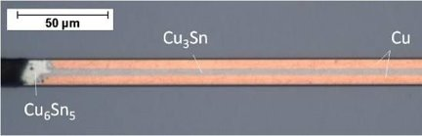
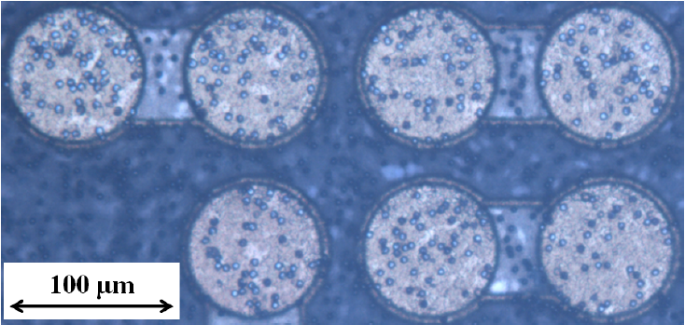
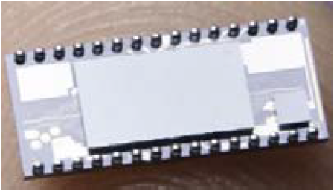
Assembly and integration
Stud bump bonding
Bonding techniques
Wire bonding: Au, Al – (12), 17, 25, 50 µm wires. Including Au stud bumping & coining, spTAB
Metal-metal thermocompression/thermosonic bonding: Au-Au, Al-Al, Cu-Cu, Cu-Sn-Cu
Soldering
Intermetallic bonding
Adhesive bonding: conductive, non-conductive adhesives
Integration levels
Die-level, wafer-level, die-to-wafer
Multiple dies on a substrate
Small dies (~0.15 mm²) to large dies (~400 mm²)
Custom-built (complex) solutions for integration of MEMS in a package
Cu-Sn SLID bonding
ACA/ACF bonding
Assembly photo diode (0.35 x 0.35 mm²) for cryogenic operation
Finger-print sensor on ASIC

Slide 5
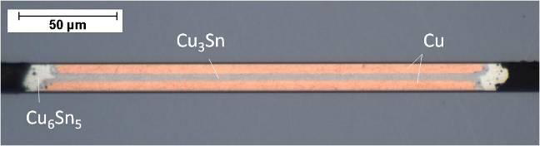
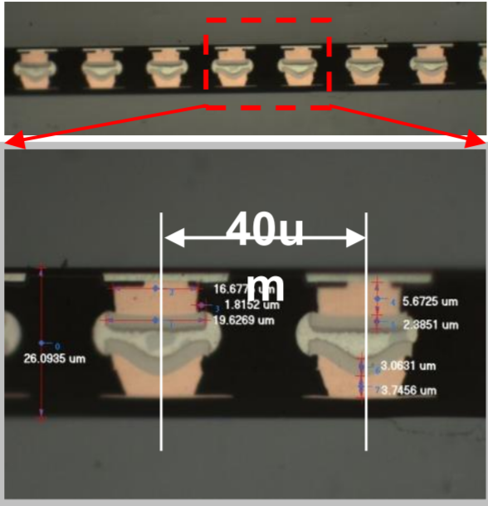
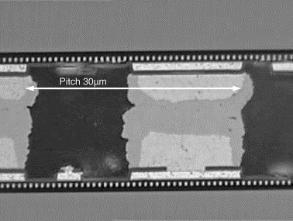
Development of advanced bonding technique Solid-Liquid InterDiffusion (SLID / TLP) - Motivation
Original motivation: High-temperature stability
High-Temperature applications
High Temperature during manufacturing
Resists repeated processing temperature
Eliminates need of solder thermal budget
Well-defined, thin metallic interconnects
Bondline thickness ~10 µm
Fine pitch possible
30 µm pitch demonstrated already in 2006
Similar to “Cu pillar” technology
H. Hübner et al,
Microelectronic Eng. 83 (2006), p. 2155
Source: ASE Group

Slide 6
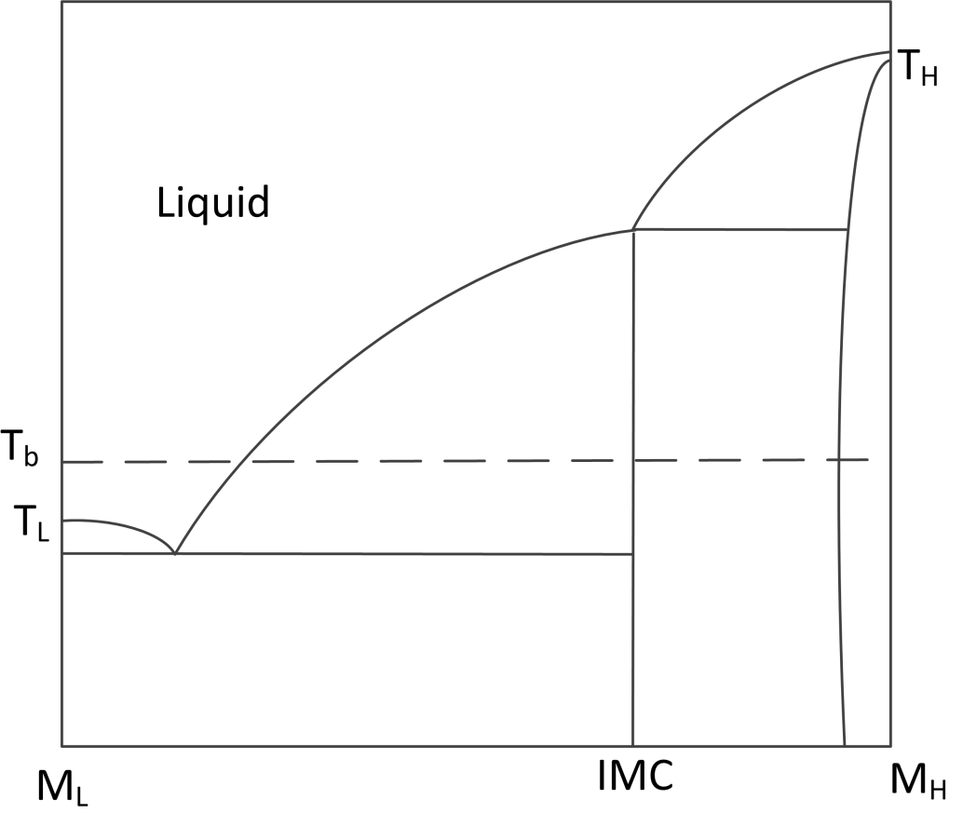
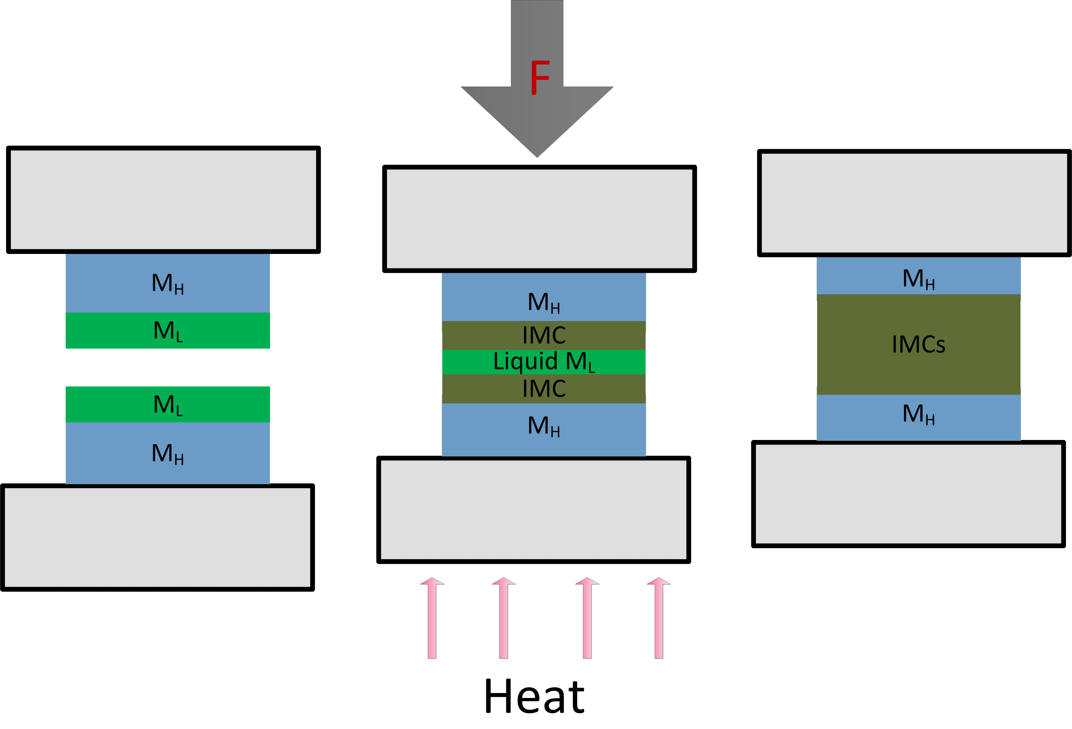
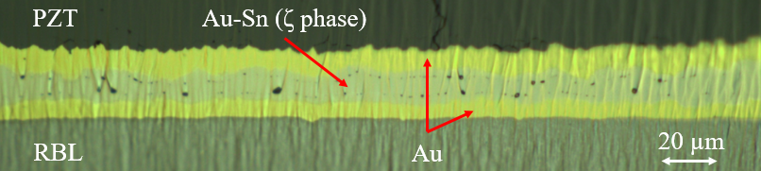
Solid-Liquid InterDiffusion (SLID / TLP)
Metal layers
High-T melting metal
Cu, Au, Ag, Ni …
Low-T melting metal
Sn, In, In-Bi …
Bonding
Moderate T_{b} (above T_{L})
Moderate pressure
Flux?? (Flux-free at USN)
Interdiffusion creates intermetallic compounds (IMC)
Higher melting point T_{r} than T_{L}
Final bond:
Layered structure, excess of high-T melting metal
Tr

Slide 7
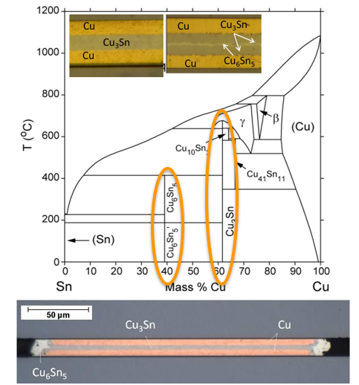
SLID bonding: Cu–Sn SLID example
Processing at ~ 250–300 ºC (Sn melts)
IMCs by interdiffusion
Cu₆Sn₅ (η) (intermediate phase)
Cu₃Sn (ε) (final, stable phase)
Final bond:
Cu / Cu₃Sn / Cu layered structure
Solid phase up to 700ºC (>> process temperature!)
Not a solder process!
Irreversible process
Final bond: Thermal equilibrium
Also known as TLP (Transient Liquid Phase) Bonding

Slide 8
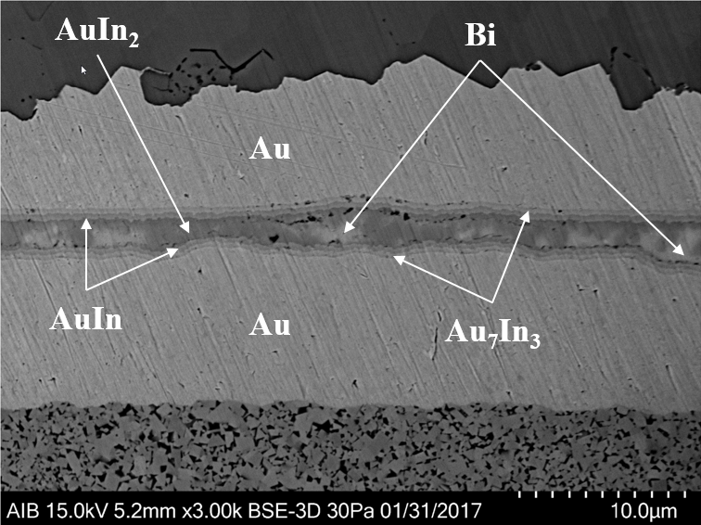
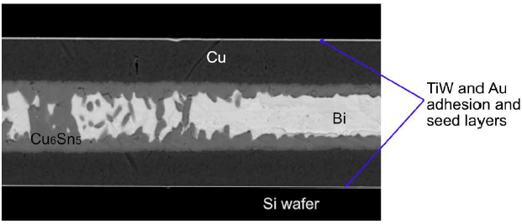
“Low-temperature” SLID bonding Our focus in coming years
PZT
Temperature-sensitive materials:
Piezoelectric materials (poled)
Not to approach T_{c} (Curie temperature)
T_{c} ~150 ºC for PZT (ultrasound transducers, actuators, etc.)
Ferromagnetic materials
Polymers
Need for low-temperature bonding
Low-temperature solders
In: T_{m} = 156 ºC
In–Bi : T_{m} = 72.7 ºC
Allows only low to moderate application temperatures (must be significantly lower than T_{m})
Low-temperature SLID bonding
Bonding is not limiting factor for application temperature
RBL
Au-(In-Bi) SLID bond for stacking ultrasound transducer
Cu-(Sn-Bi) SLID bond for Si on Si

Slide 9

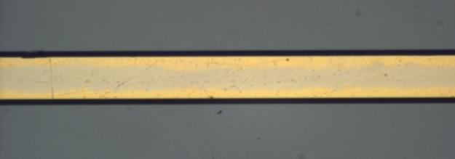
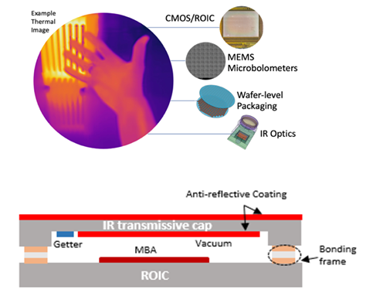
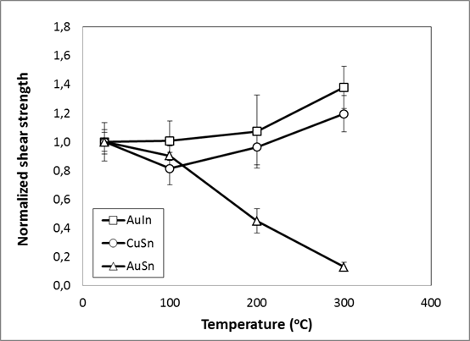
SLID bonding Achievements and future prospect
Au
SiO₂
Interconnection and die-attach for high temperatures
Processing at 250–300 °C
Bond solid to 500–700 °C
Thin-layer bonding (~10 µm)
Hermetic sealing
MEMS microbolometers
Getter activation possible
Fine-pitch possible (few µm)
2.5D–3D integration compatible
Low-temperature SLID (In–Bi alloys and similar)
Processing at 90–120 °C
Bond solid to 271 °C or higher
Where are we now:
Cu–Sn: Hermetic sealing for IR cameras
Au–Sn:
Power electronics
Down-hole (oil well) instrumentation
Compatible with thermal cycling of CTE mismatched die/ substrate
Lamination of ultrasound transducers
Ni–Sn: Potential for extreme high-temperature stability
Au–Ge: Thermoelectric generators
Au–In: Demonstrated high-temperature stability
In–Bi based:
Extreme low-temperature bonding
Compatible with ultrasound transducers lamination
Wafer-level and die-level implementation
Future prospect:
Further work on industrial implementation
Low-temperature SLID
Process optimalization and fundamental understanding
New material systems (Cu–Sn–Bi and others)
Au₅Sn

Slide 10
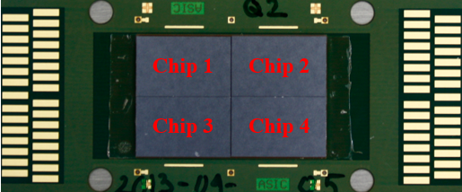
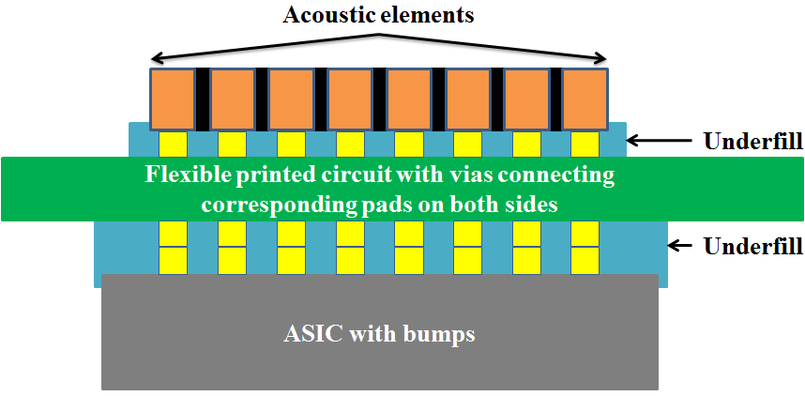
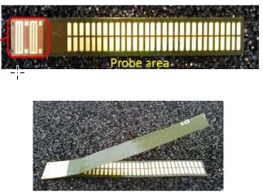
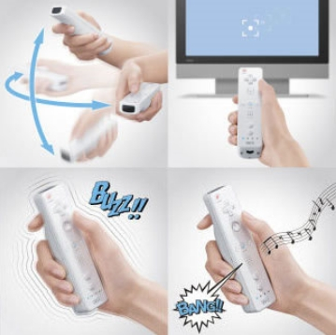

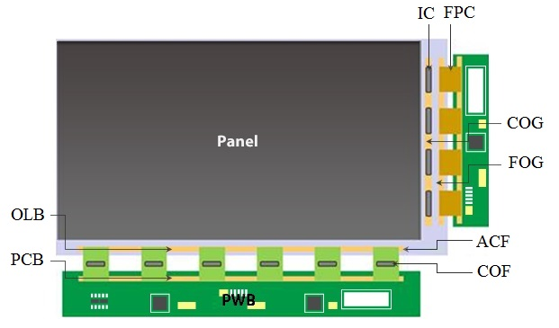
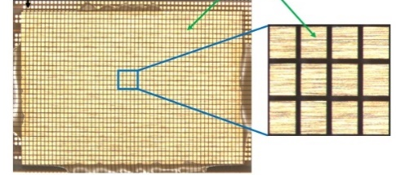
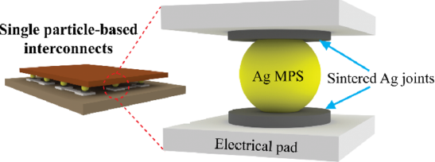
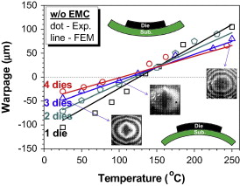
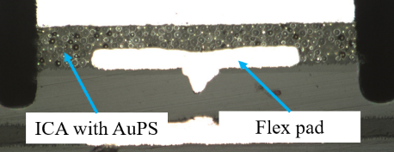
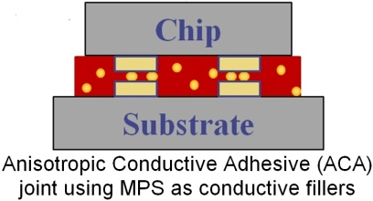
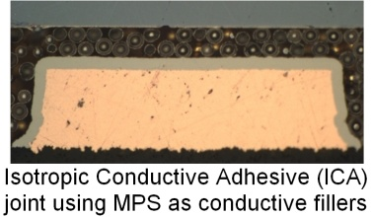
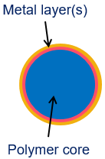
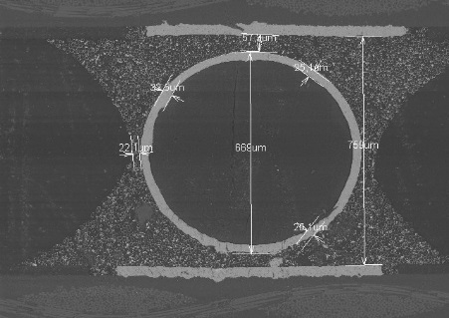
Interconnection Technologies based on Metal-coated Polymer Spheres
Motivation
Electrical interconnections for demanding applications
Improved mechanical reliability Fine-pitch capability
Bonding multiple chips with high-density interconnects to a substrate using ACA
Double-sided assembly using ACA
Flex-to-flex using ACA
Bending and dynamic mechanical loading
Mechanical vibration and mechanical shock
Assembly for thousands of ultrasonic transducer elements using ACA, ICA
Interconnect based on a single MPS
Technologies
Where are we now:
Demonstrate interconnects with improved ductility, reduced induced tress, improved impact strength, and hance mechanical reliability
Know-how: high-density interconnects; fine-pitch (<200 µm) to ultra fine-pitch capability (< 100 µm); bonding dies from a few mm² to >100 mm², from 700 µm to 50 µm thickness
Applications: medical ultrasound probes, electronics in ammunition, display
Future prospect:
Further work on industrial implementation
Demonstrate feasibility of the technologies in new applications
Solutions for low-temperature, low-pressure, ultra-fine pitch interconnections
Interconnections based on MPS
Metal-coated Polymer Sphere (MPS)
MPS to replace BGA solder balls, or even completely replace solders

Slide 11
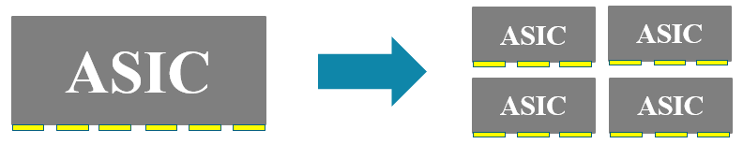
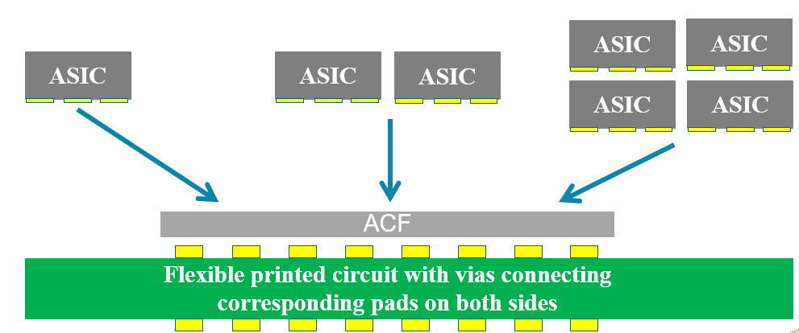
Multiple ASICs on Flex
Individual smaller ASICs is more cost-effective than one very-large ASIC
(a case in medical imaging applications)
Bonding one chip or multiple chips at a time?
????
?
??

Slide 12
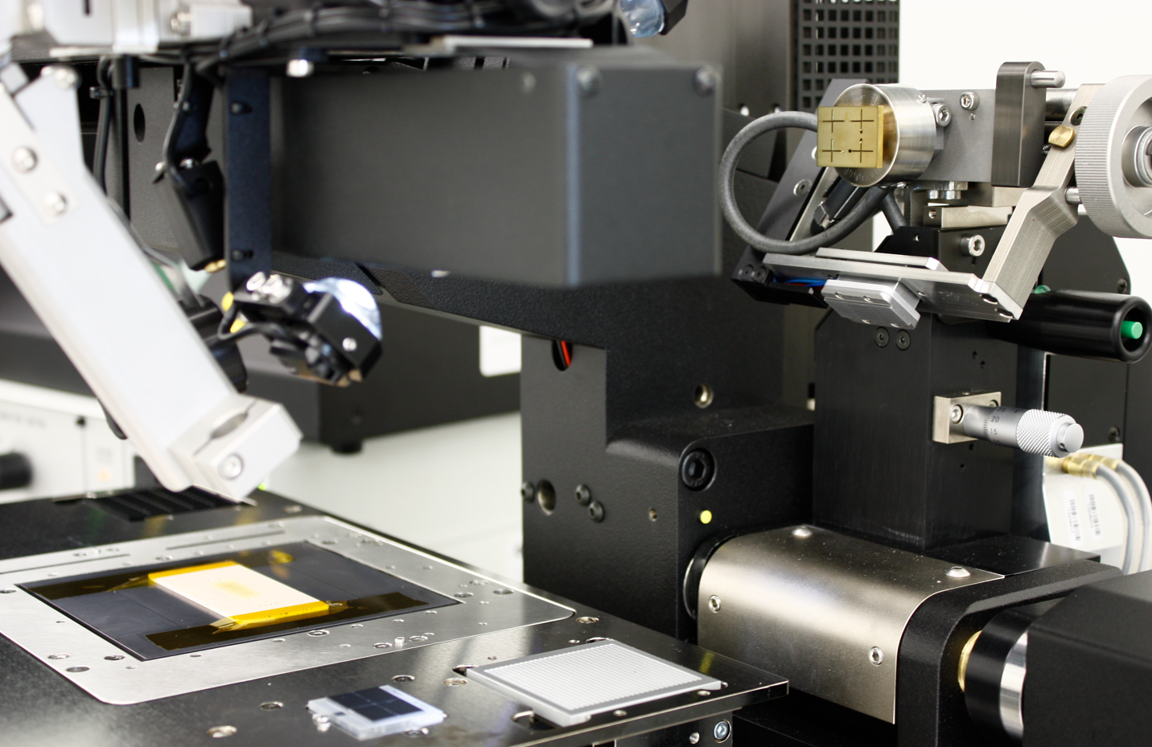
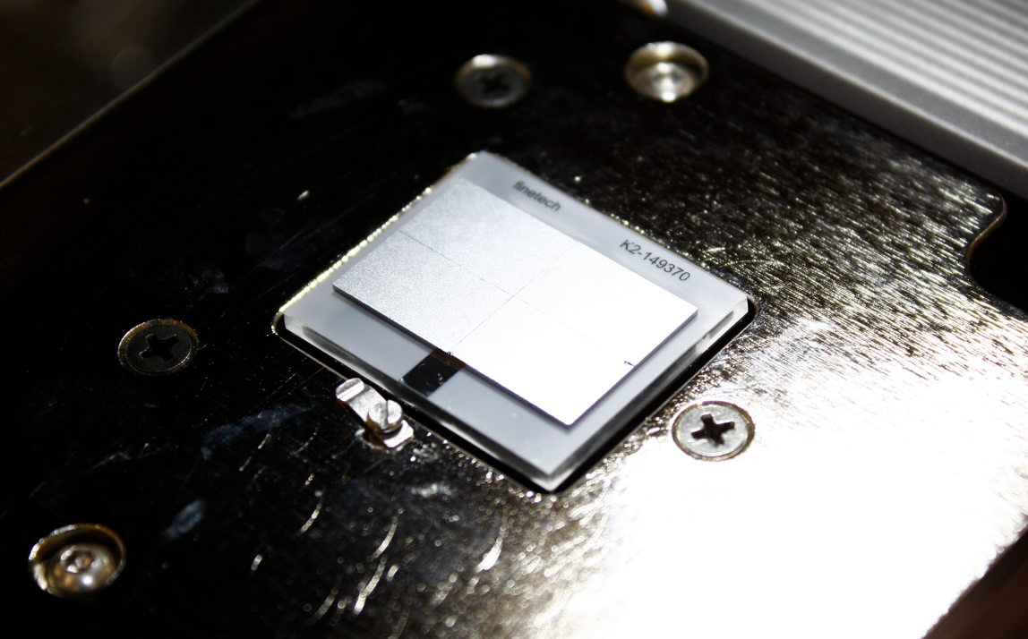
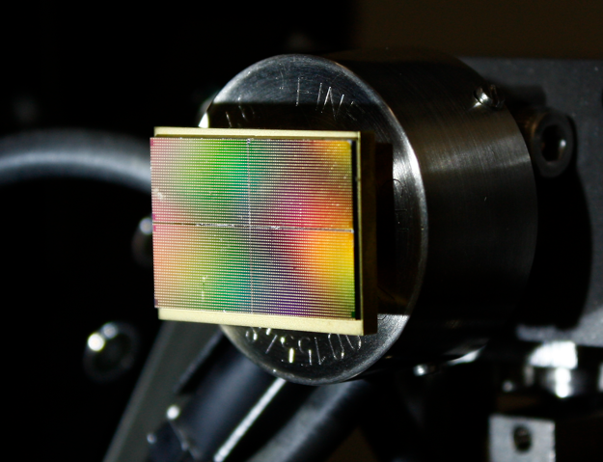

Multiple ASICs on Flex – Process

Slide 13




Multiple ASICs on Flex – Results
Bonding multiple chips with high density interconnects on a substrate is feasible!
Comparable interconnect resistance for 1-, 2-, and 4-chip samples bonded at a corresponding normalized bond force
Challenges: Uniform pressure over large area. High force demand!

Slide 14





Ultra-thin MEMS Device on ASIC
Area-array with several thousand I/Os
Device thickness: 20–50 µm
Area: >100 mm²
Feasible ACF assembly of large-area, ultra-thin Si dies with TSVs to Si substrates
CMUT-ASIC integration, IC chips to Si interposers
Suitable bonding technologies?
ACF assembly

Slide 15



Enabling ultra fine-pitch, low temperature, low pressure interconnection technology
Control the deposition of conductive particles in interconnects
Control location and number of particles in interconnects
Low temperature, low pressure (~15 mN/particle)
Ultra fine-pitch feasible (~2.5 times particle diameter)
ACA interconnects
Single-particle interconnects

Slide 16

Towards Heterogeneous Integration Processes and Materials
MEMS-on-CMOS
2.5D–3D integration
Assembly of small-sized, large-sized, ultrathin dies
Chip-scale package, chip-to-wafer, wafer-level integration
Emerging applications: quantum sensing, advanced detectors

