Slide 1


Heavy ions in therapy and space: recent progress at GSI
Marco Durante
KIT, 20.10.2025

Slide 2
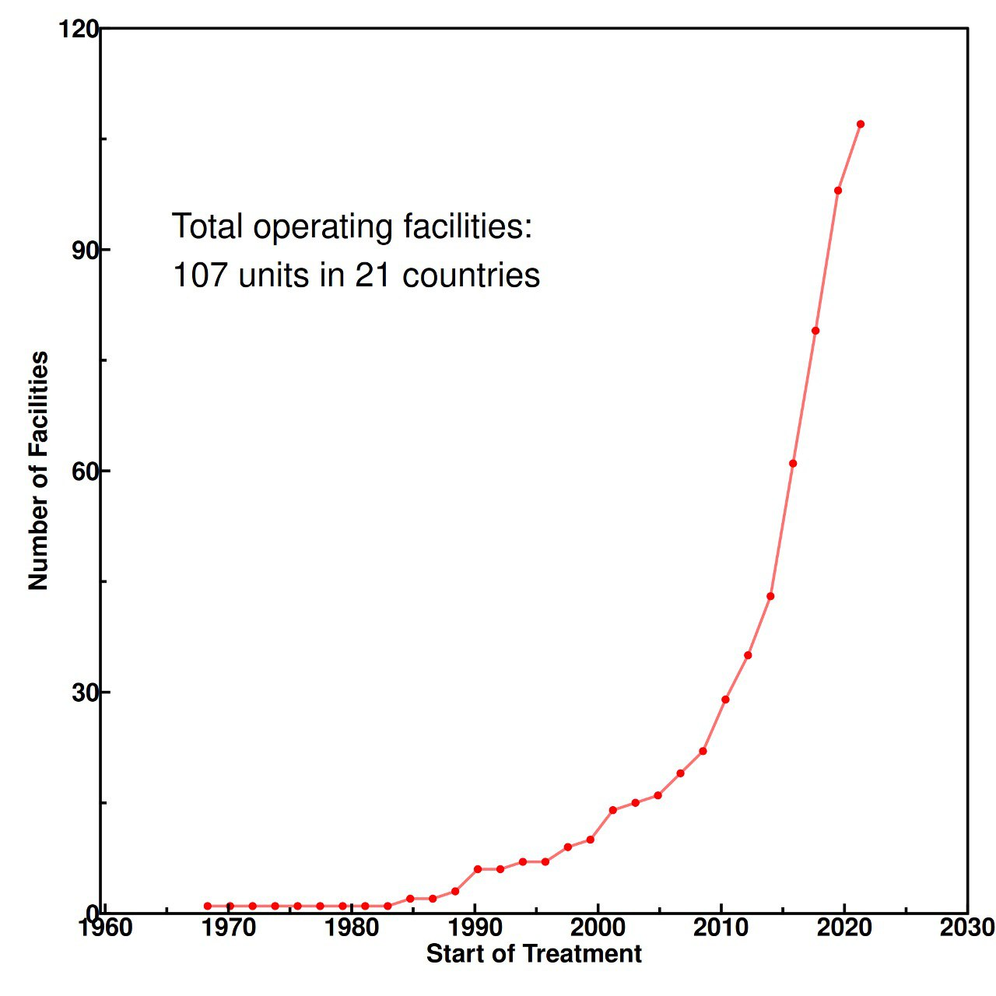
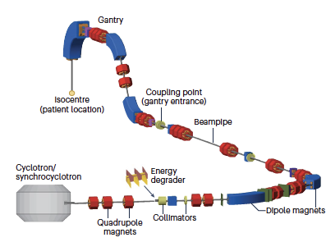
Particle therapy today
Total : 132 facilities in 23 counties
115 protons
17 C-ions
Maradia et al., Nat. Phys. 2025
Graeff et al., Prog. Part. Nucl. Phys. 2023

Slide 3
What can physics do to democratize particle therapy?
Cheaper
Faster
More conformal
Durante et al. Nat. Rev. Phys. 2021
3

Slide 4
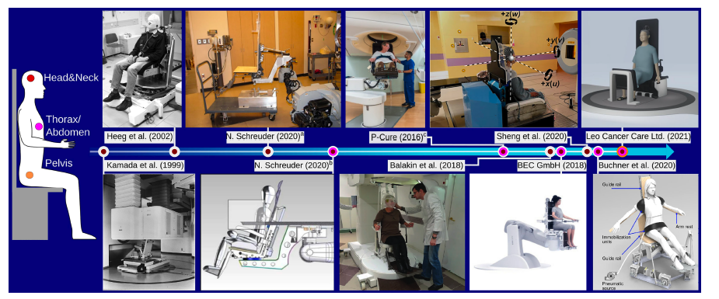
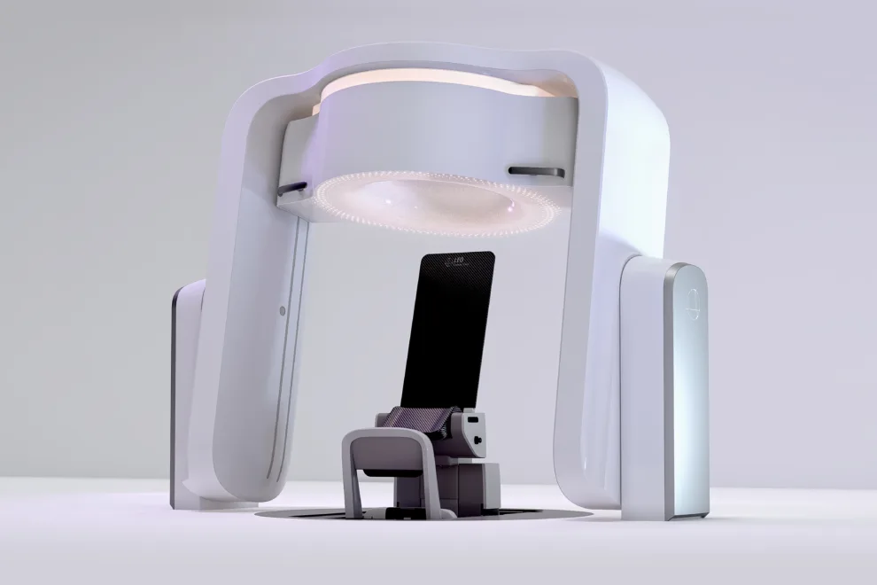

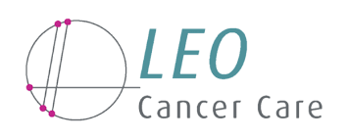
Cheaper
Gantryless particle therapy in upright position
Volz et al., Front. Oncol. 2022
Cheaper
EU MSCA Doctoral network – 15 partners

Slide 5
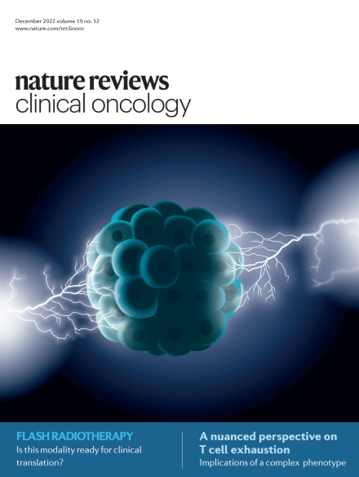
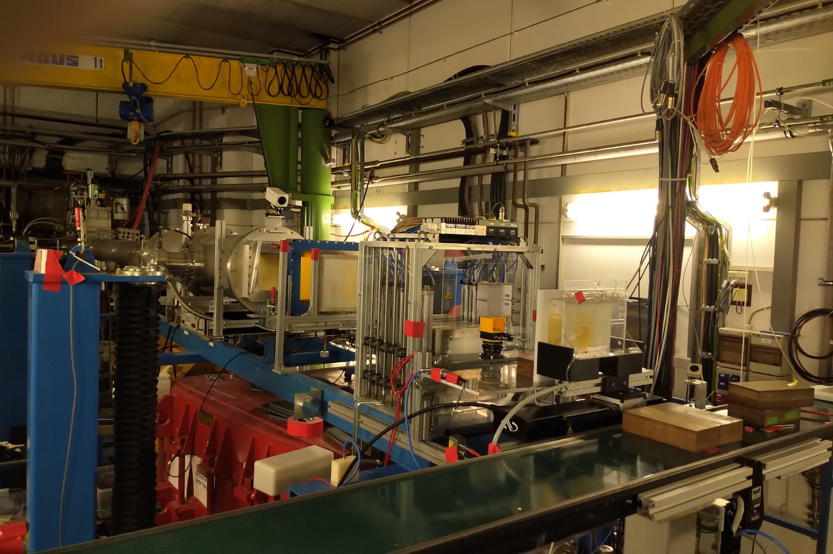
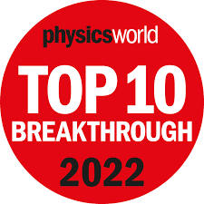
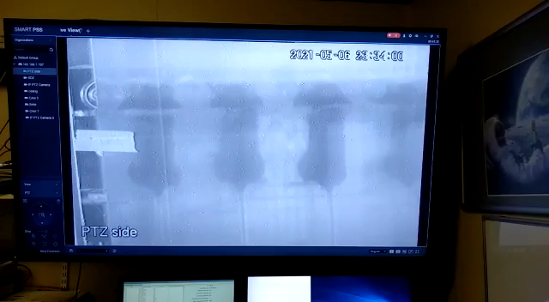
FASTER – FLASH radiotherapy
Collaboration in POFV with HZB, HZDR and DESY-PITZ
Tinganelli et al., Radiother. Oncol. 2022
Tinganelli et al., Int. J. Radiat. Biol. Oncol. Phys. 2025
Vozenin, Bourhis & Durante, Nat. Rev. Clin. Oncol. Dec. 2022

Slide 6
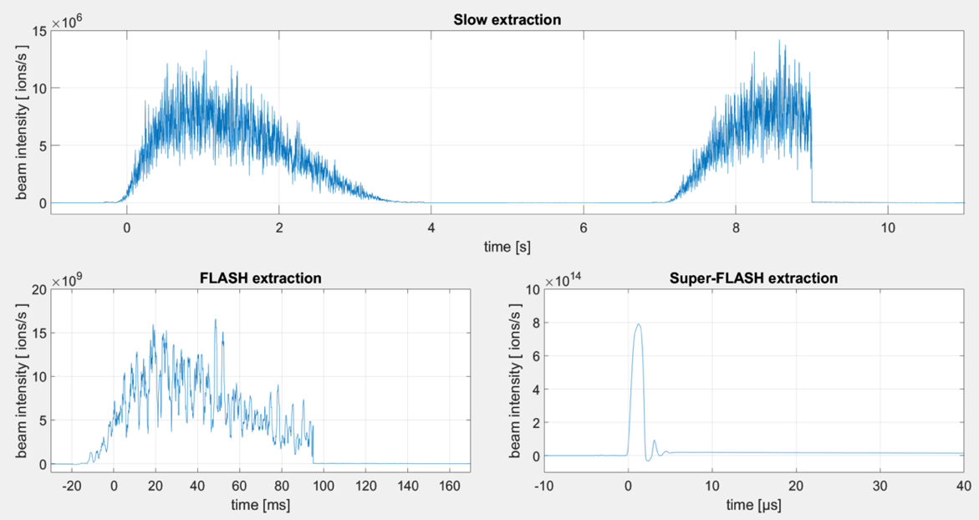
Super-FLASH
∼ 1 Gy/min
∼ 10² Gy/s
∼ 10⁷ Gy/s

Slide 7
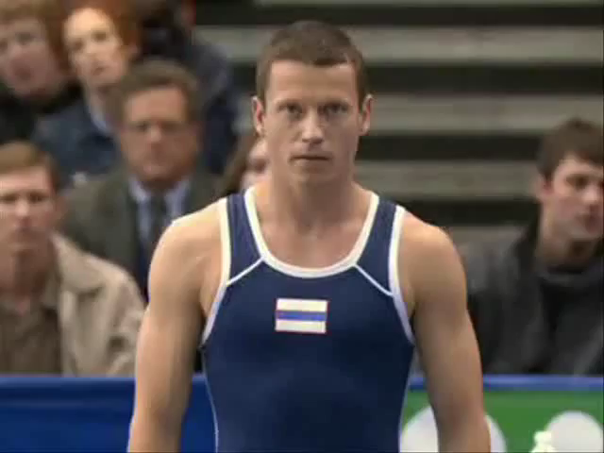
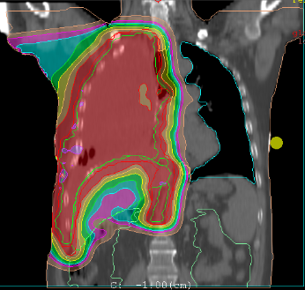
More conformal: where are my particles?
Badiyan et al., Transl. Lung Cancer Res. 2018

Slide 8
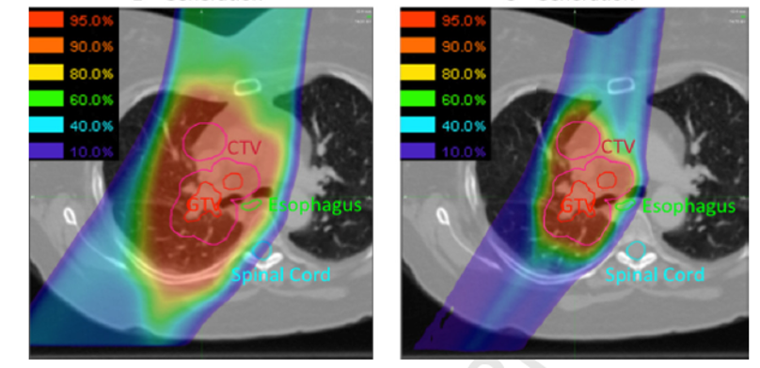
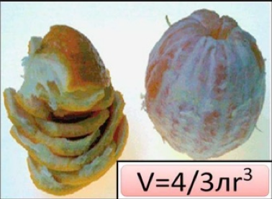
Range uncertainty jeopardizes the Bragg peak precision
Total margins ∼ 1 cm compared to a proton penumbra ∼ 2 mm
Durante & Flanz, Semin. Oncol. 2019
Verellen et al., Nat. Rev. Cancer. 2007

Slide 9
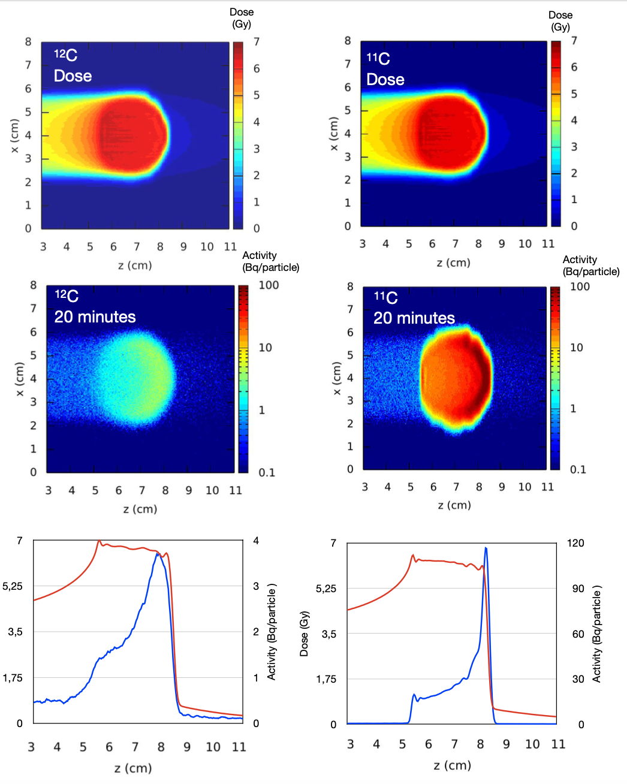

Radioactive Ion Beams (RIB) for simultaneous treatment and range verification
Compared to conventional PET imaging in heavy ion therapy, RIBs, e.g. ¹¹C, show:
Improved count rate (one order of magnitude larger than for stable ions)
Improved correlation between activity and dose
Reduced washout blur thanks to short lived isotopes
Boscolo, et al., Front. Oncol. 2021

Slide 10
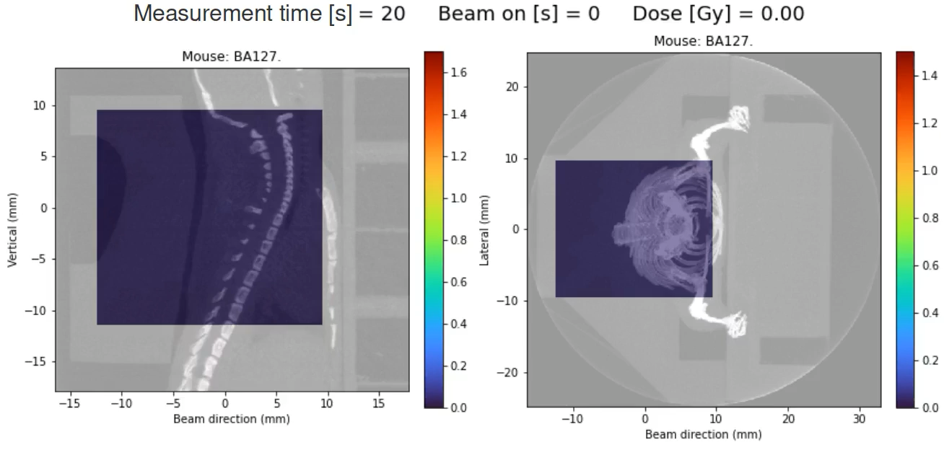
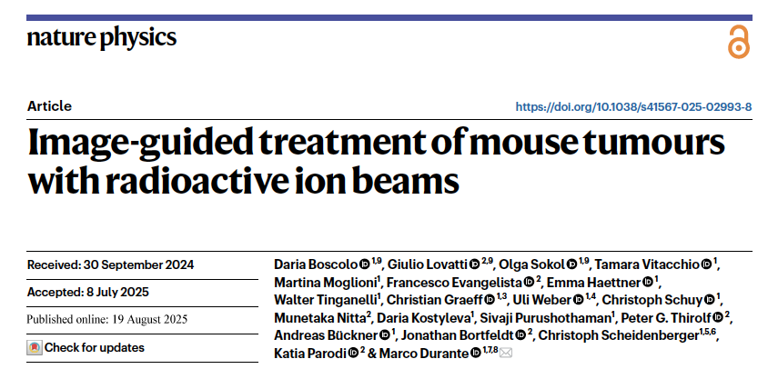

First image-guided treatment in vivo with RIB (¹¹C)
Boscolo et al., Nat. Phys. 2025 (October issue)

Slide 11
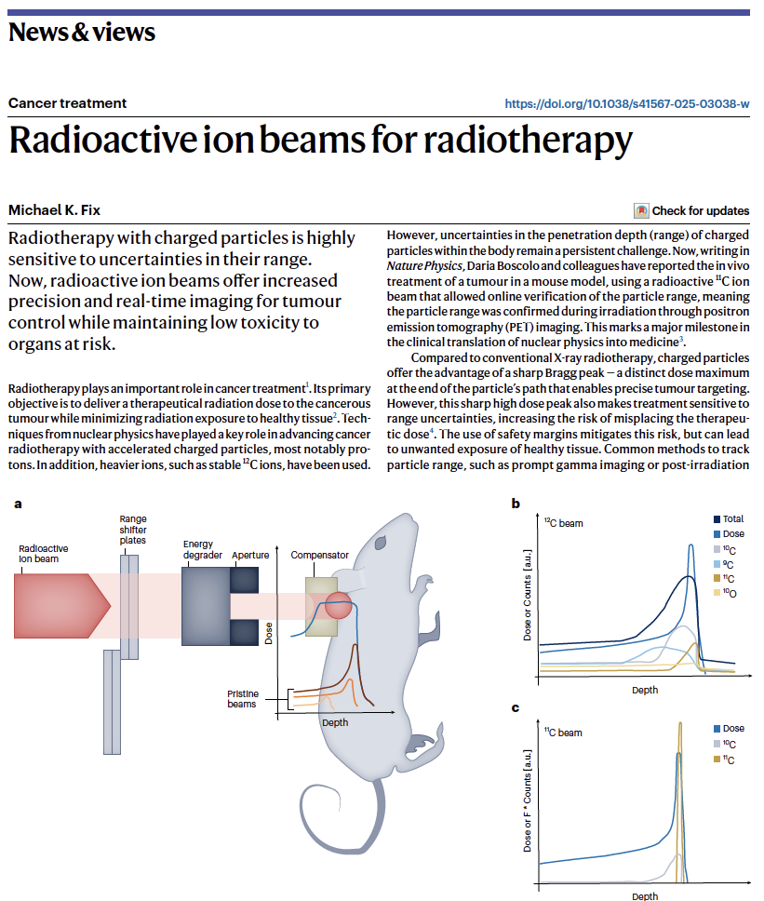
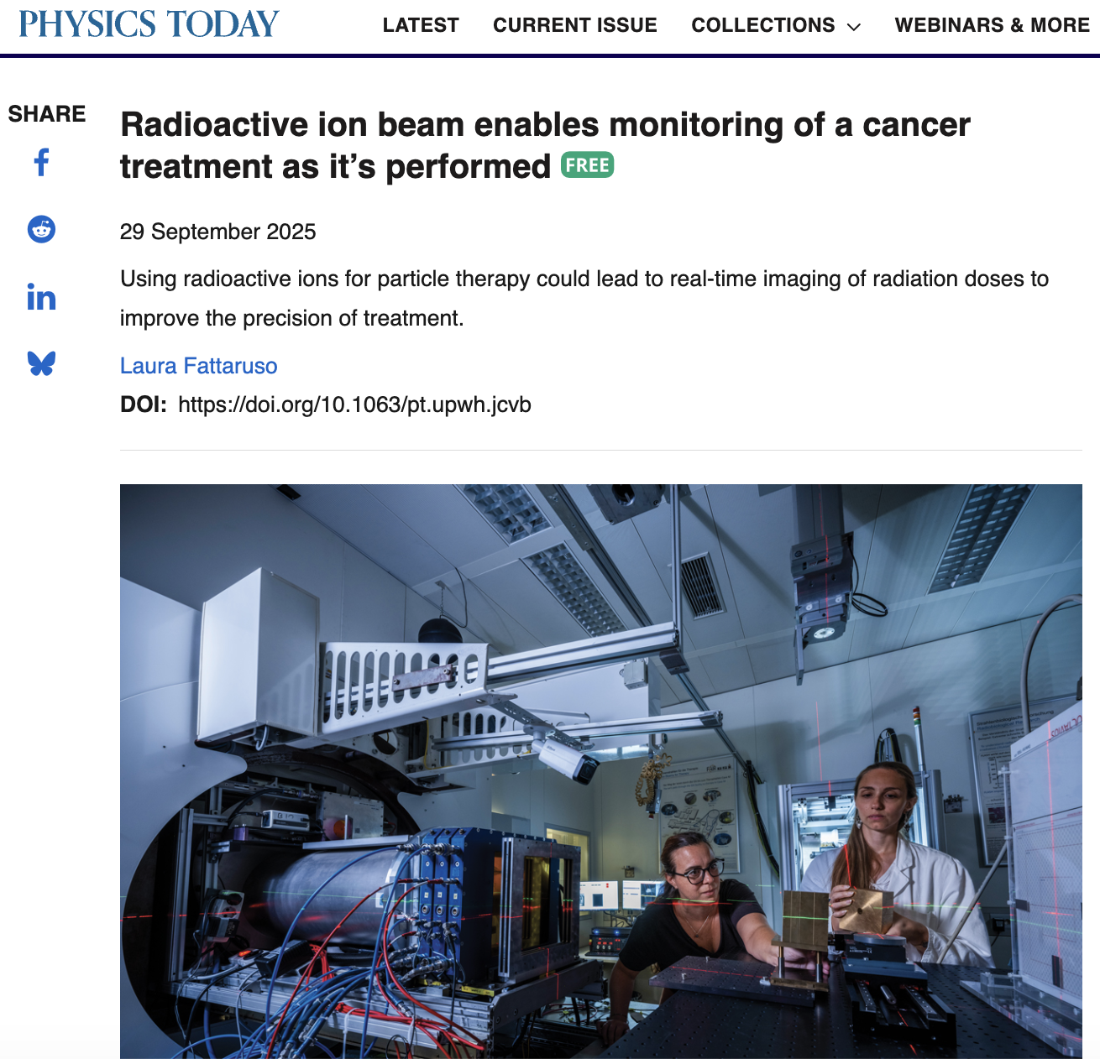
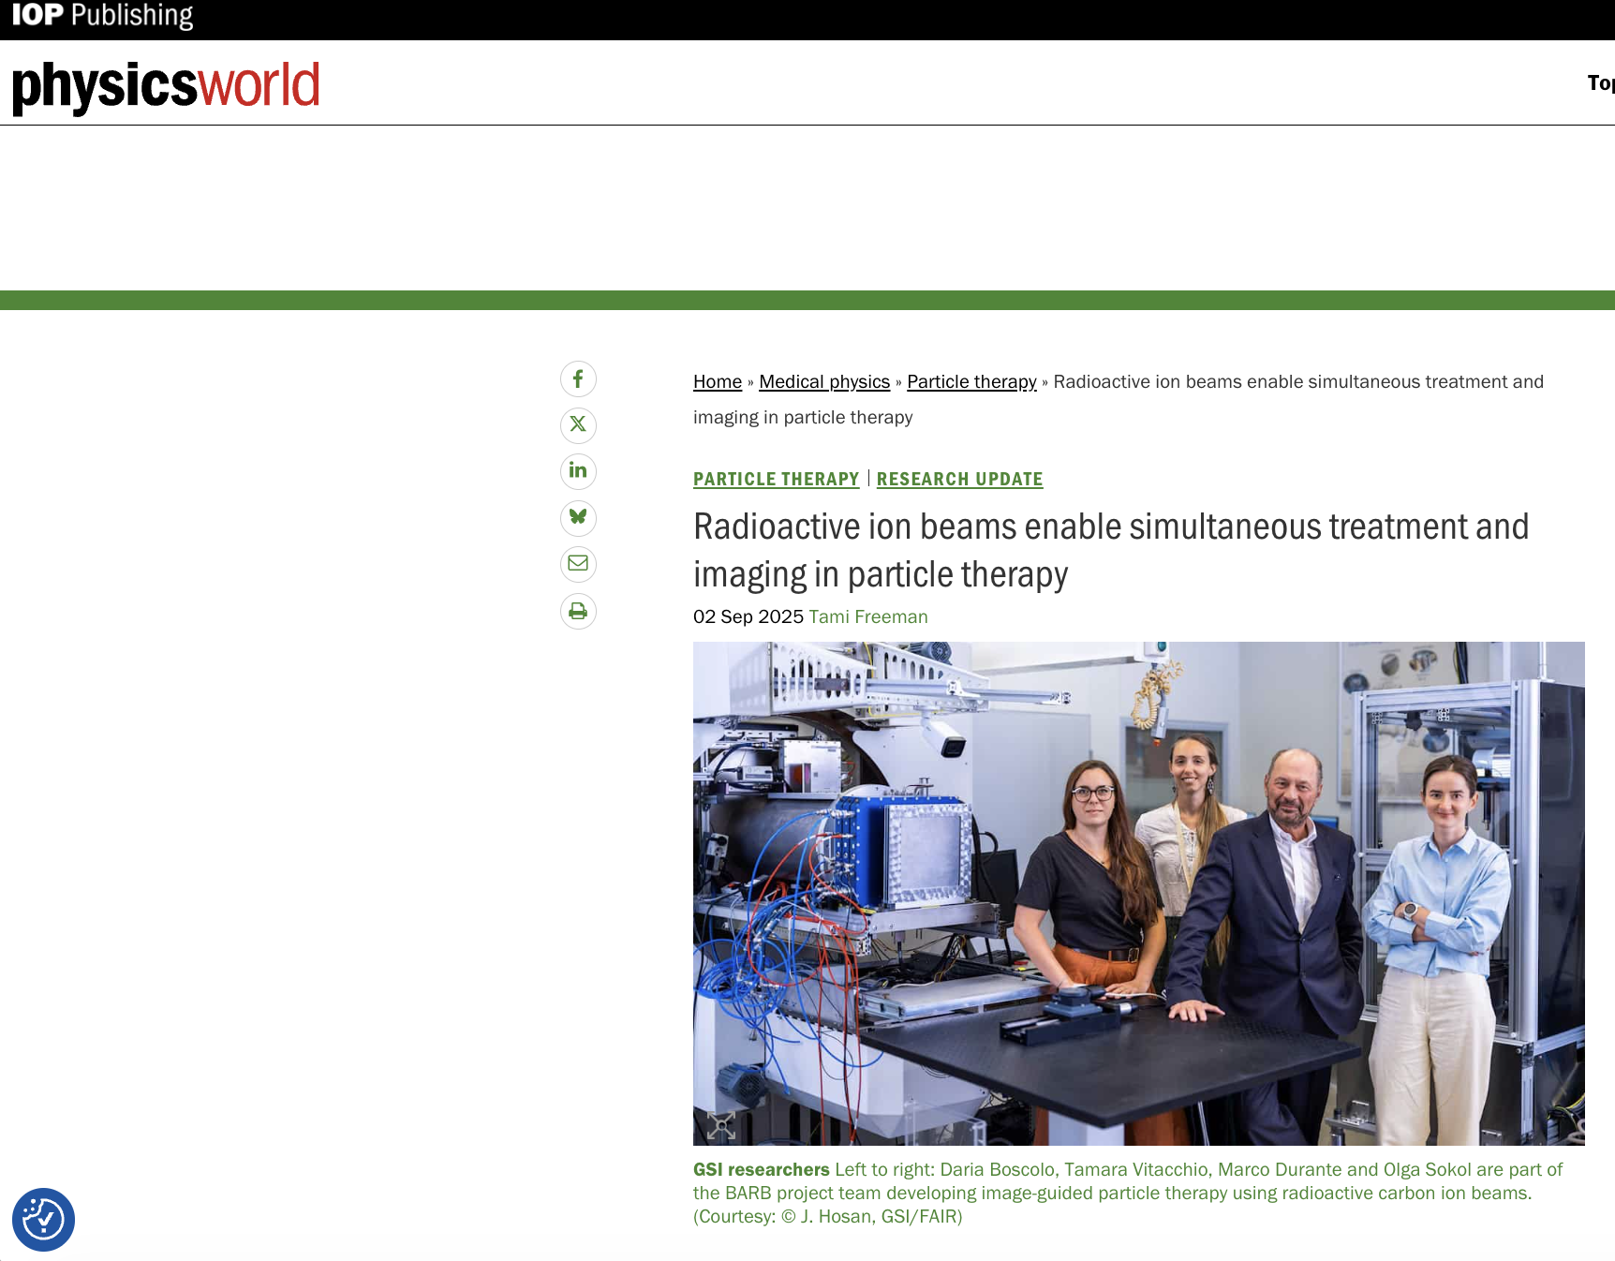
see talk by Tamara Vitacchio for the new experiments
8

Slide 12
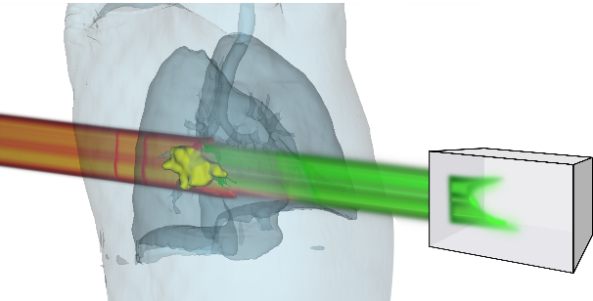
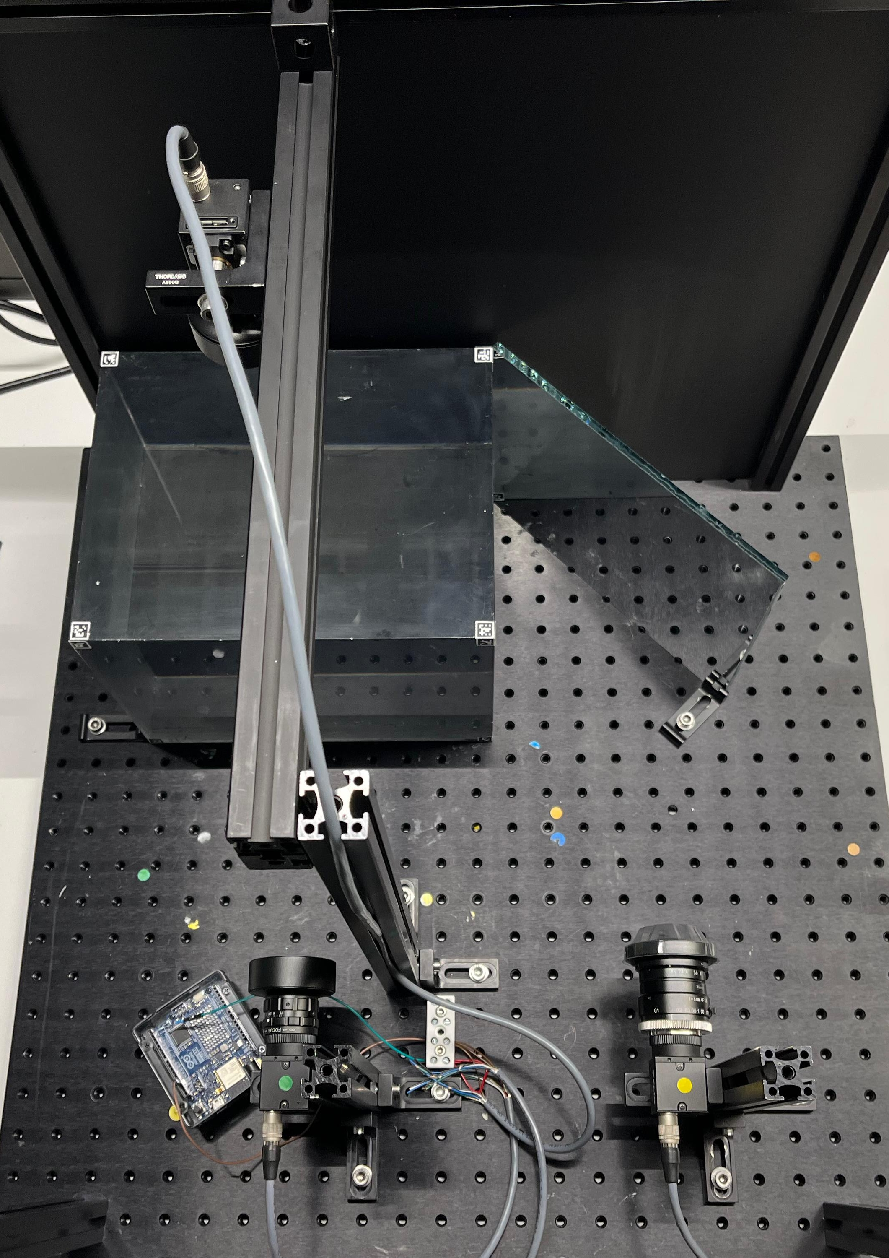
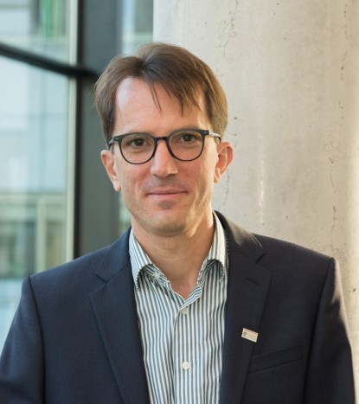
Mixed ion beams for particle imaging
First images with a scintillator-camera system (UCL)
Acquire training data for AI-based online Helium range evaluation
¹²C
⁴He
Treatment
Imaging
Scintillator
Mirrow
Cameras
Christian Graeff

Slide 13
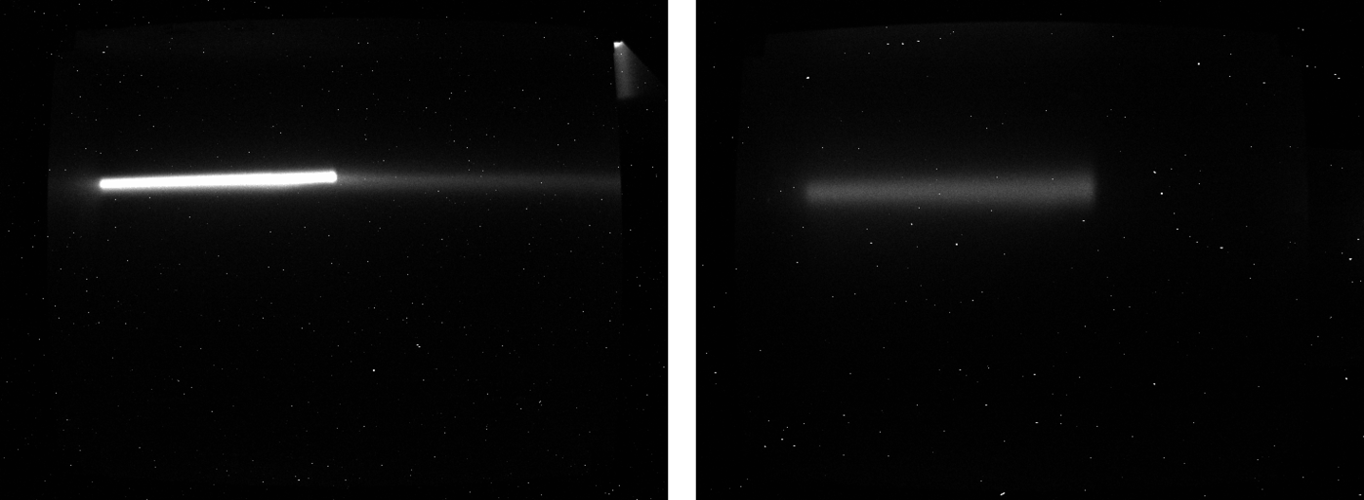
Beamtime May 2025: Imaging of C- and He-ions
C-ion beam stopped with range shifter

Slide 14
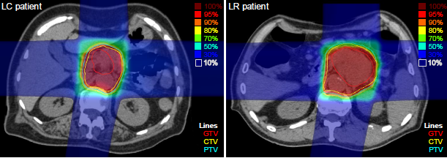
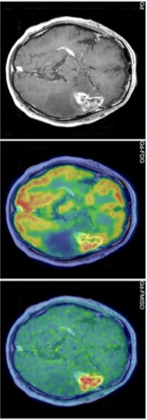
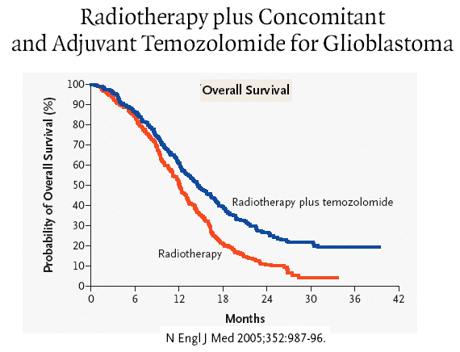
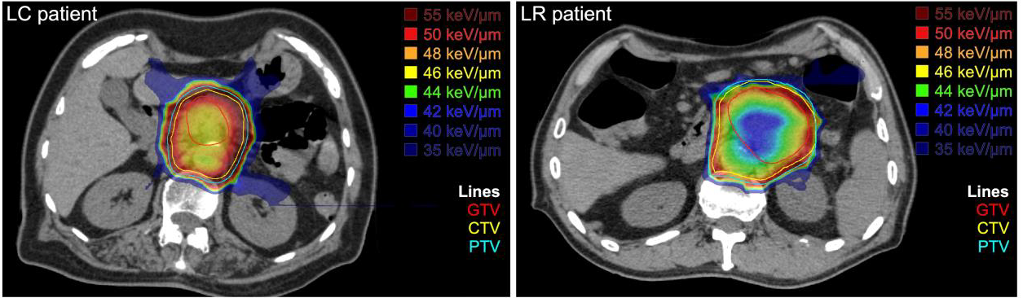
Do we need other ions in therapy?
GBM grade IV
PET-FDG
PET-FMISO
∼15.000 deaths/year in Europe and incidence is raising
Sakamoto et al., Int. J. Radiat. Oncol. Biol. Phys. 2025

Slide 15

Can we use FLASH to reduce the toxicity of very heavy ions?
www.gsi.de/HI-FLASH

Slide 16
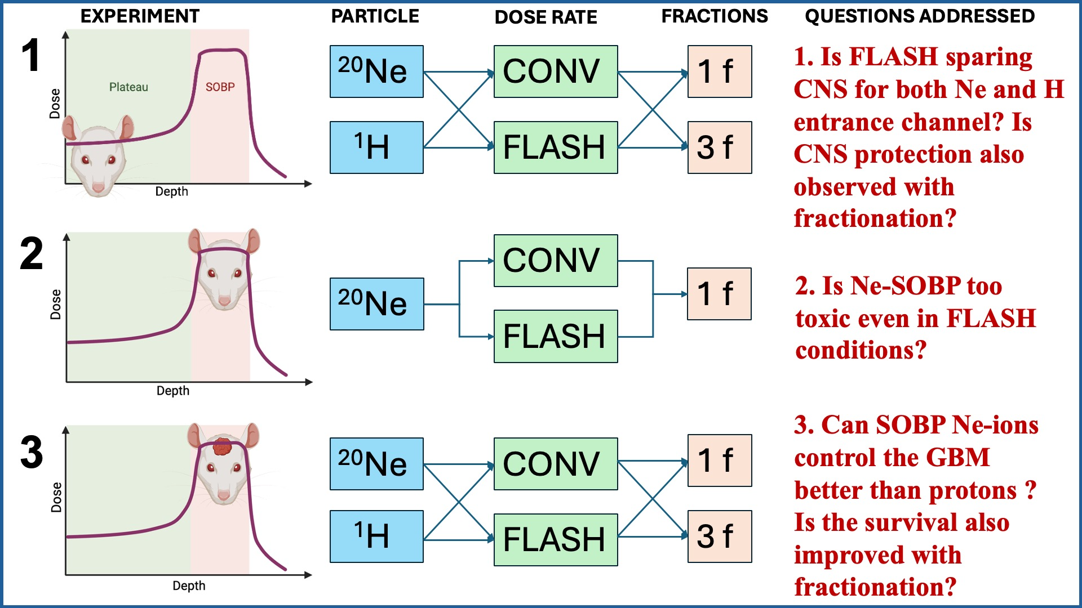
HI-FLASH experimental plan: comparing ²⁰Ne to ¹H in FLASH conditions in rat GBM
www.gsi.de/HI-FLASH

Slide 17
From therapy to space

Slide 18
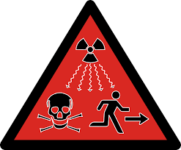
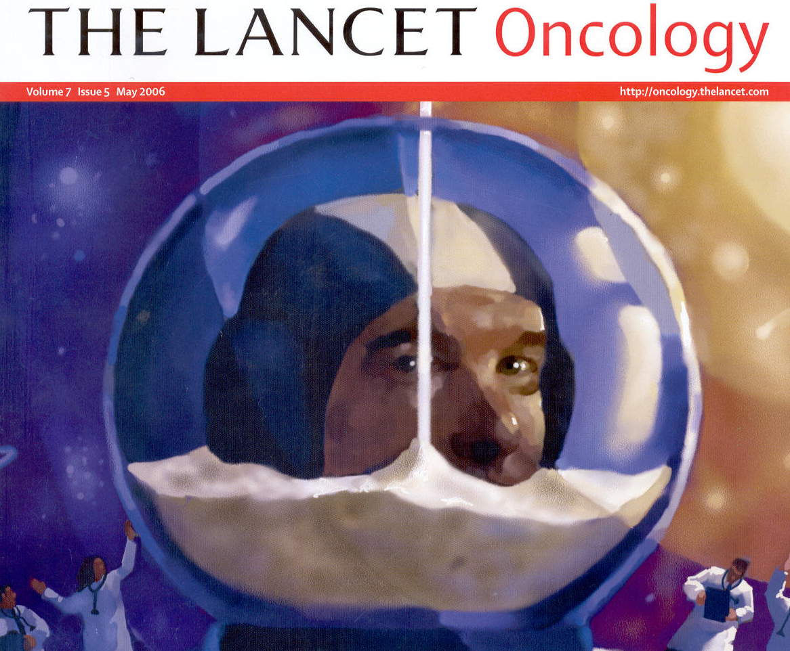
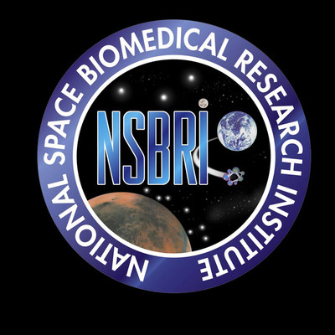
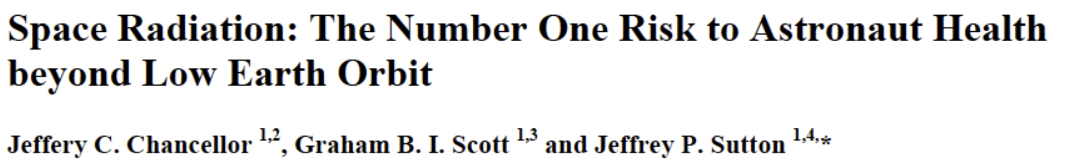
Is space radiation a danger?
Cucinotta & Durante, Lancet Oncol. 2006
1 day in deep space ≈
1 year on Earth

Slide 19
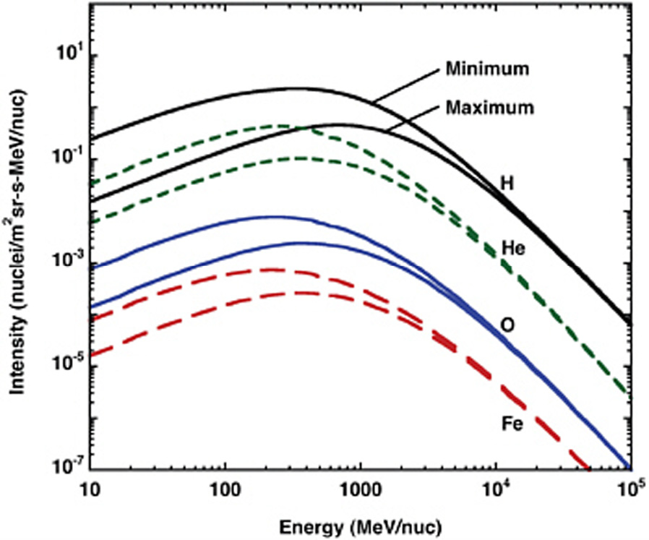
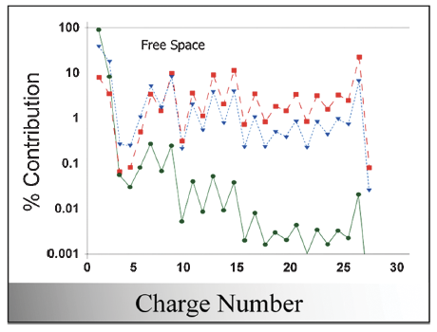
Galactic cosmic radiation: HZE particles
Durante & Cucinotta, Rev. Mod. Phys. 2011

Slide 21
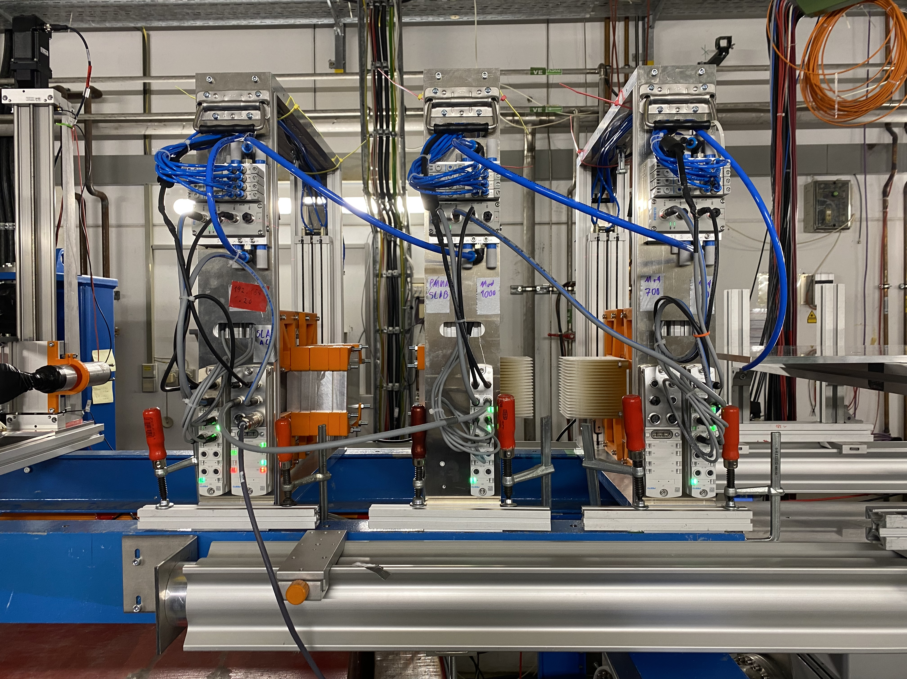
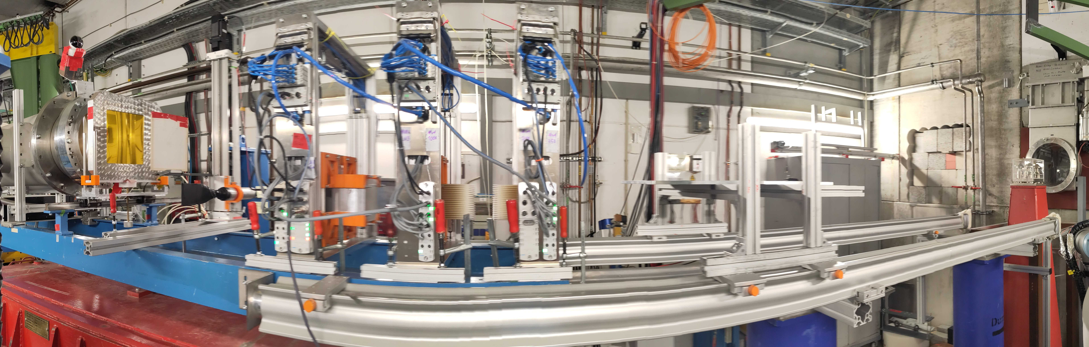
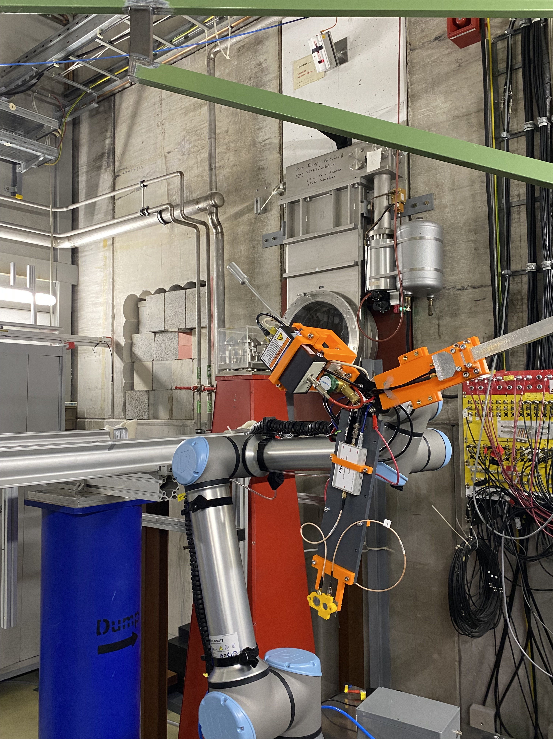
Galactic cosmic ray simulator at GSI-Darmstadt
Setups GCR Simulator (2025):
1
2
700 MeV/n ⁵⁶Fe
+
Modulator
3
4
5
6
1 GeV/n ⁵⁶Fe
+
Modulator
350 MeV/n ⁵⁶Fe
+
Modulator
1 GeV/n ⁵⁶Fe
+
“Spiky” Slab Target
1 GeV/n ⁵⁶Fe
+
“Spiky” Slab Target
350 MeV/n ⁵⁶Fe
+
Slab Target

Slide 22
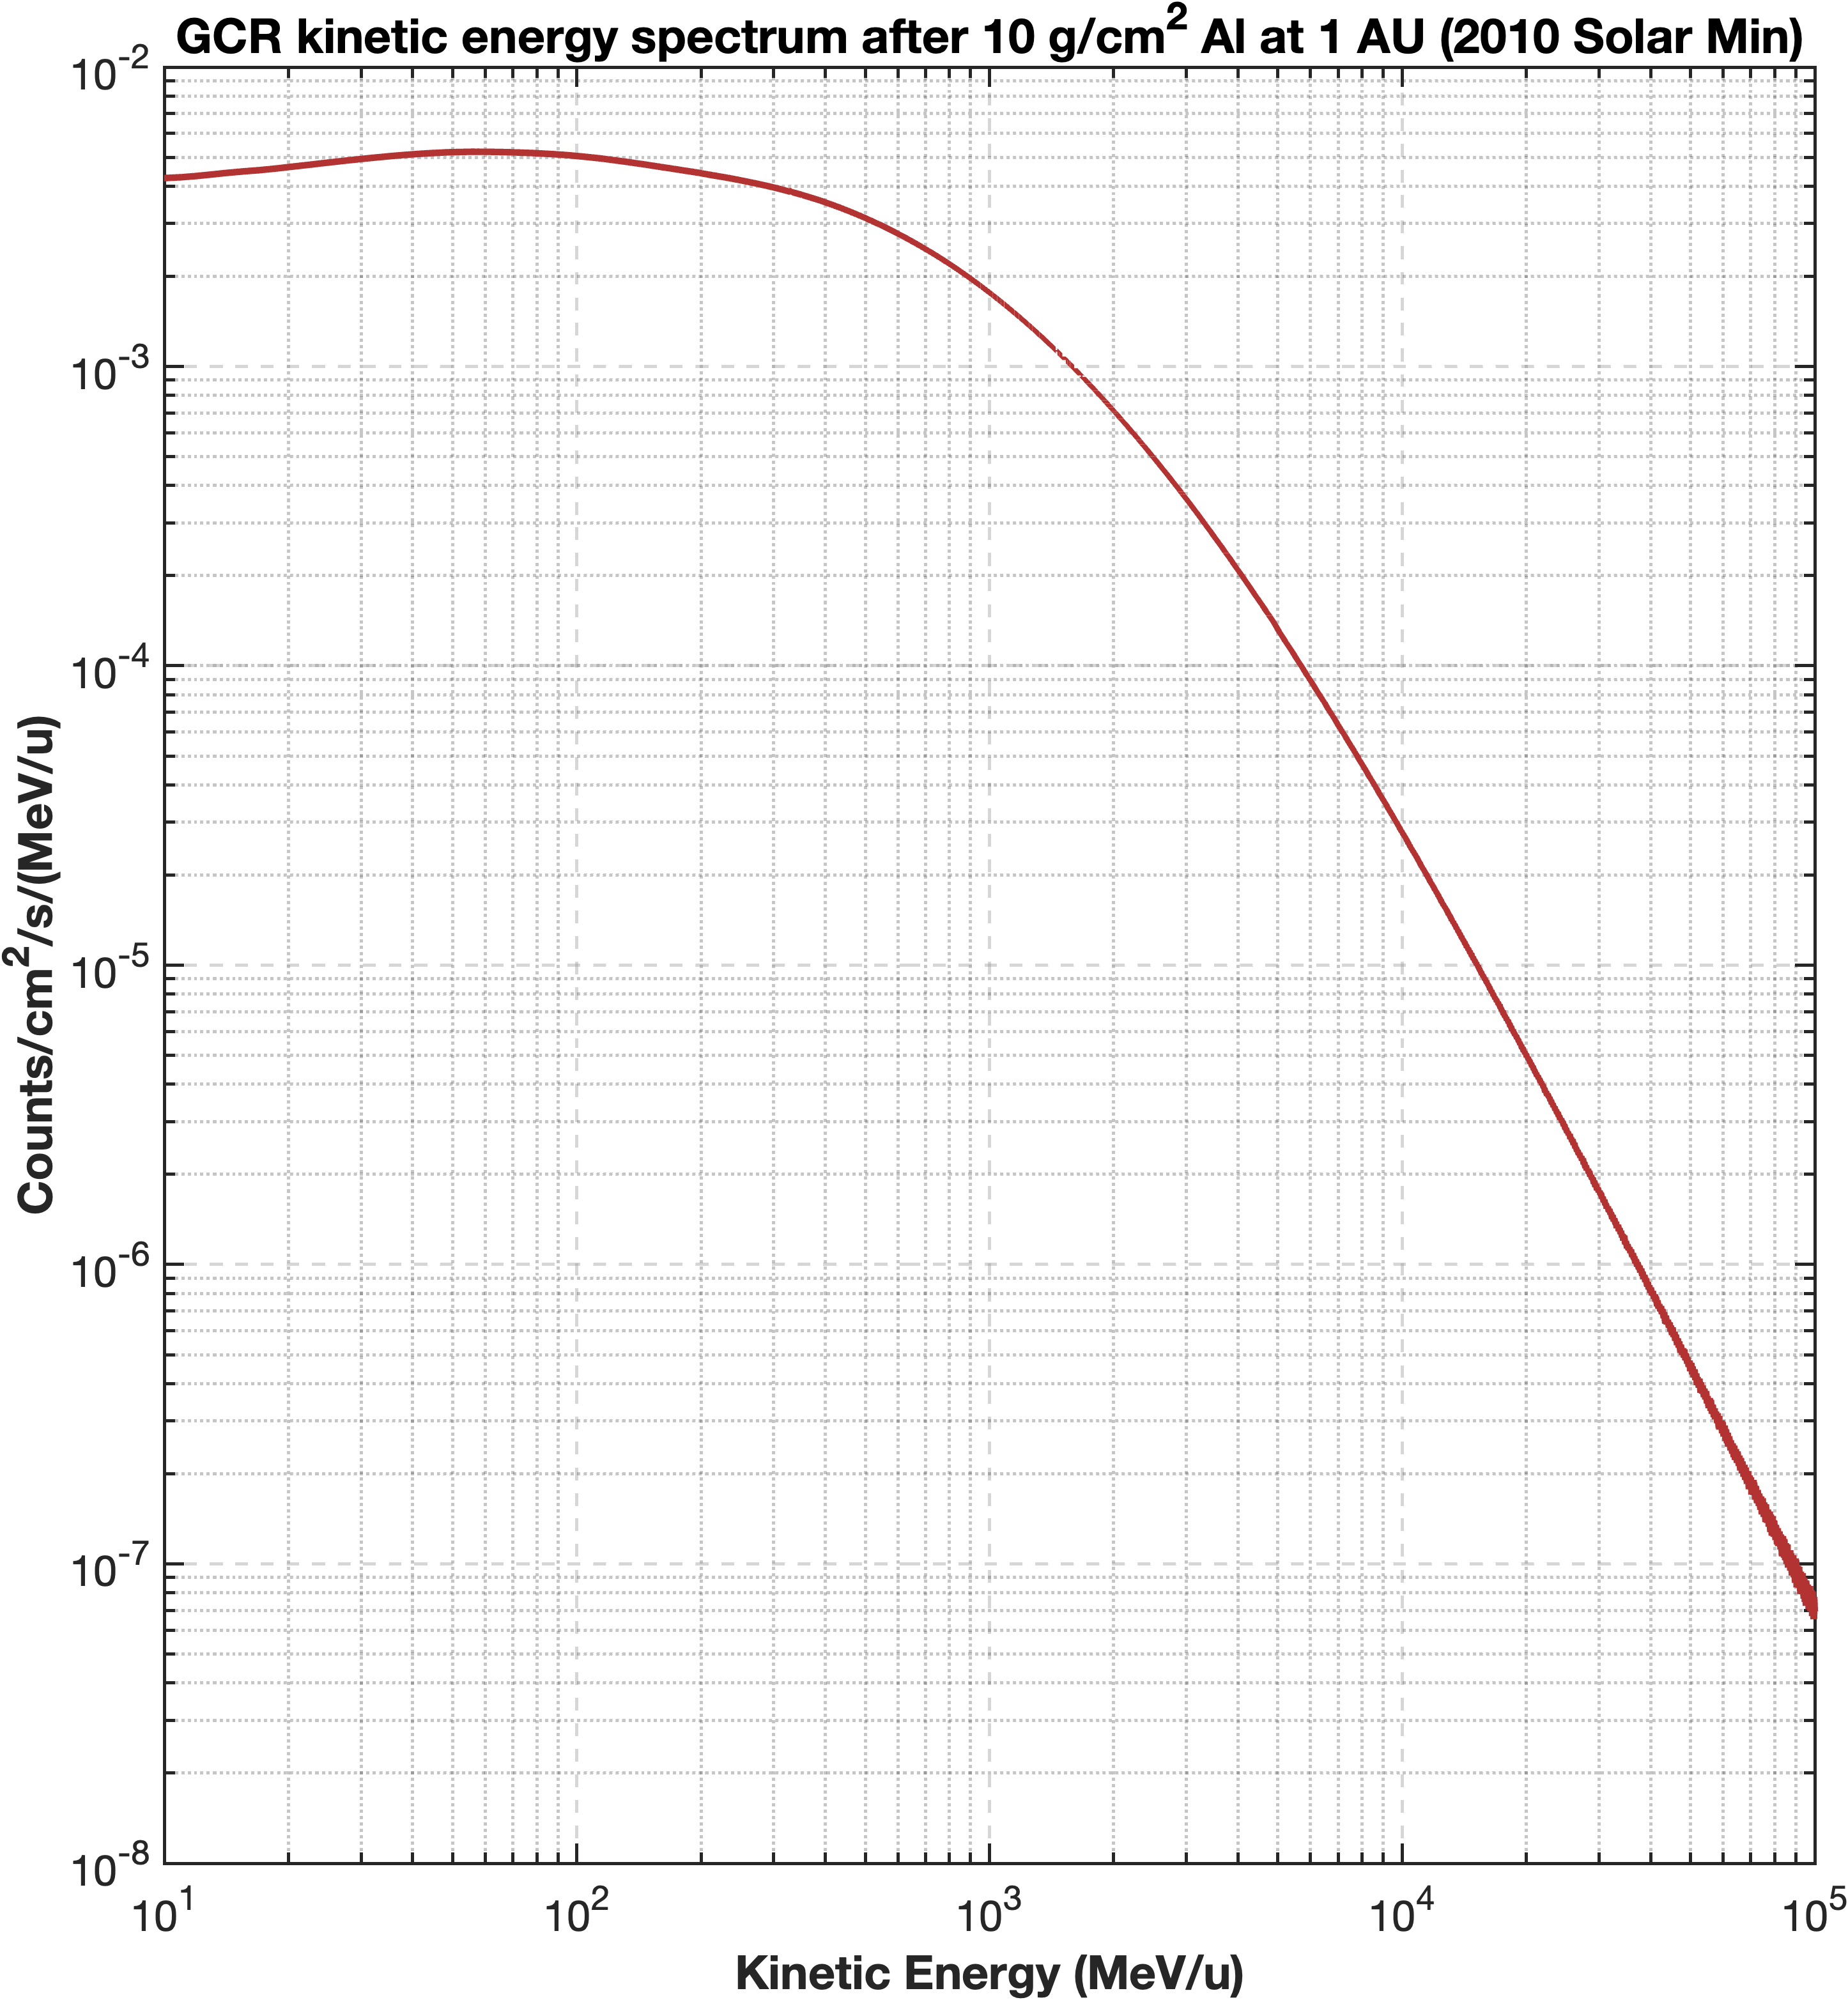
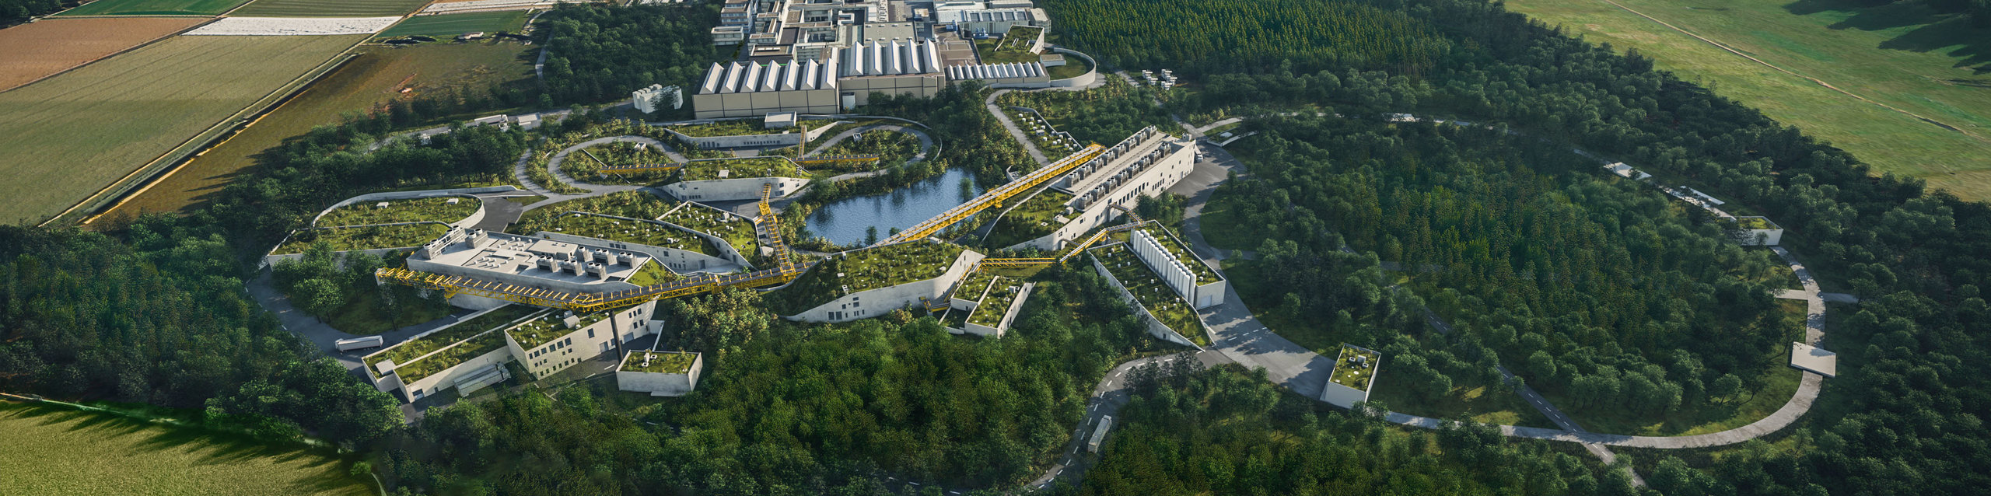

FAIR facility in Darmstadt - 2028
NEXT FUTURE
GCR simulator @FAIR: design of new modulators up to $10 GeV/n$
Monte Carlo simulations, Optimization Algorithms, CAD models
SIS-18
SIS-100
Toward full exploitation of FAIR in POFV

Slide 23
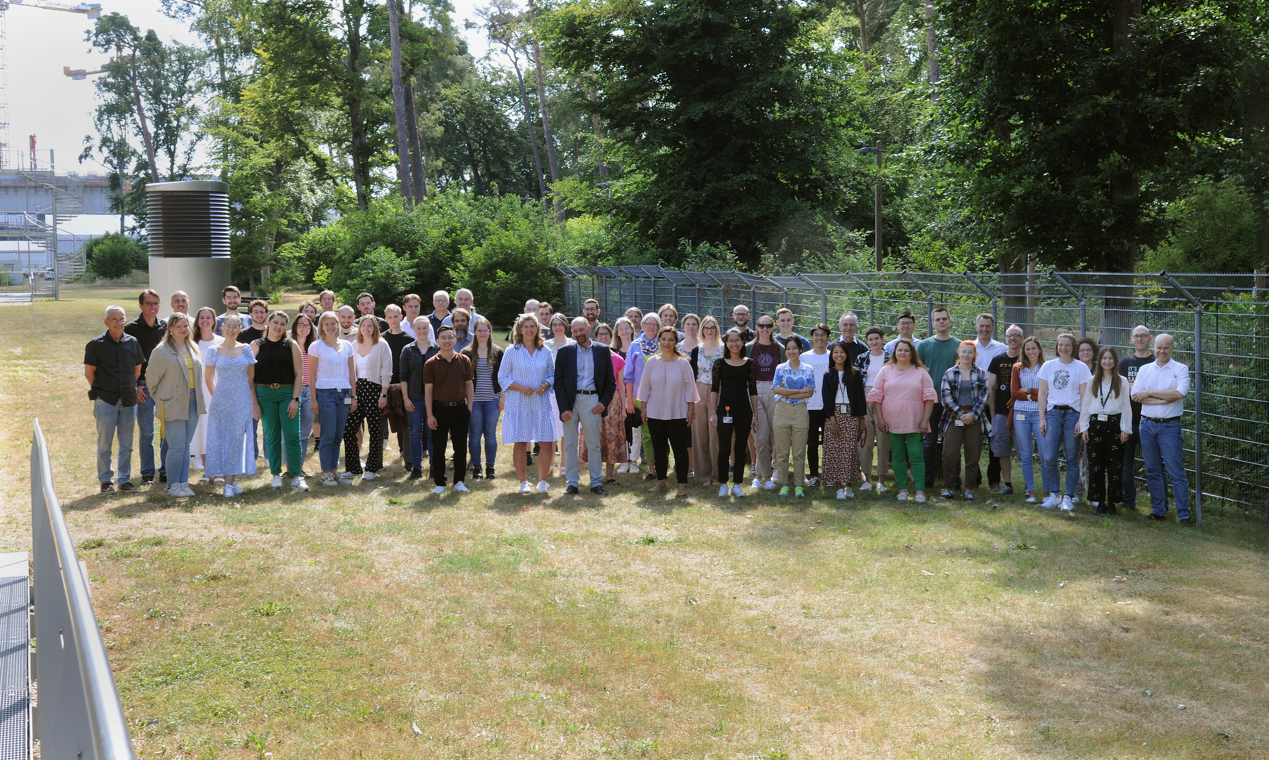
Thank you very much!
www.gsi.de/biophysik
23

Slide 24
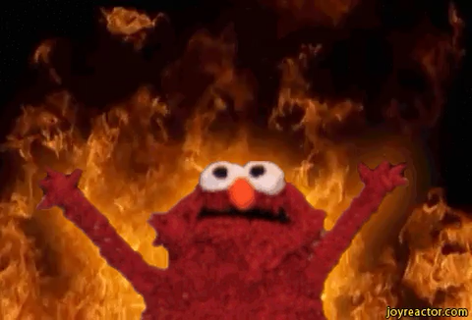






Thank you!
Funding
agencies
24

