Slide 1
KASCADE Storage
Doris Wochele, Jürgen Wochele
03. April 2019
III International Workshop "Data life cycle in physics", DLC-2019
2-7 April 2019
Irkutsk State University

Slide 2
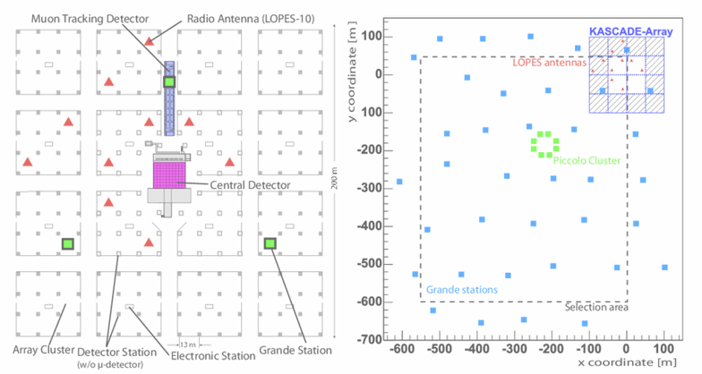
Main KASCADE detector components
LOPES Antennas
LOPES Eventbuilder
binary 16TB
Calorimeter - Central Detector
Eventbuilder
CERN ZEBRA DB
binary format
filechunks 178MB
on RUN basis
4TB raw files
GRANDE - Detector Array
Total number of data in 16 years
25.10.1996 - 15.1.2013
1.76 billion events in 54.910 files
20 TB stored on RAID6 and Tape
KASCADE - Detector Array
All subcomponents used for data refinement and quality in reconstruction
can be found in KCDC Manual Chap. 2
Notes:
KASCADE had 5 Trigger Sources and took data with 4Hz
LOPES binary format can be found at https://www.astro.ru.nl/lopes/_media/publications/thesis-horneffer-final.pdf Fig 2.6

Slide 3
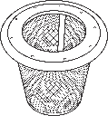
KASCADE analysis data
KASCADE
CORSIKA
+ CRES
LOPES
KRETA
CR-Tools
4+2TB, ZEBRA + HBOOK → ROOT
4000 events, ROOT
430 Mio events, ~ 200 observables
metadata / calibrated / reconstructed
LOPES has to be offline correlated with GRANDE events !
KRETA - KASCADE Reconstruction of Extensive Air showers
135k lines of FORTRAN in 860 CERN CMZ decks
analyse of all main and subcomponents in 3 levels
recently compiled on Ubuntu 18 with gcc with static cernlibs
Notes:
KRETA (KASCADE Reconstruction of Extensive Air showers)
CRES (Cosmic Ray Event Simulation)
LOPES Dez 2005 - Okt 2009

Slide 4
KASCADE data published via KCDC
1. release Wolf359 18.11.2013 / 158 Mio events KASCADE
7 meta + 8 reconstructed scalar quantities KASCADE in mysql
2. release Vulcan 12.11.2014
7 meta + 11 rec. scalar quantities (KASCADE + Calorimeter) in mysql
3. release Meridian 22.3.2016
7 meta + 11 rec. scalar quantities in mongodb
+ 3 data arrays (each 252 calibrated observables per event)
4. current release Naboo 3.2.2017 / 430 Mio events KASCADE + GRANDE
7 meta + 11 rec. scalar quantities + 3 data arrays in mongodb
+ GRANDE Component with 7 rec. scalar quant. and 2 data arrays (37 calibrated observables per event)
5. next release Oceanus June/2019
+ UUID + LOPES Component in mongodb ( → talk Frank Polgart 4.4.)
Notes:
KCDC DATA SET HISTORY : KCDC Manual Chap. 13 [ https://kcdc.ikp.kit.edu/static/pdf/kcdc_mainpage/kcdc-Manual.pdf ]
data arrays in MERIDIAN were Electron Densities, Muon Densities and Arrival times

Slide 5
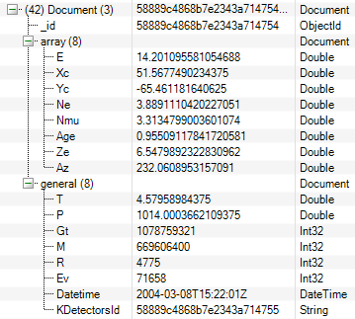
KCDC data selection
430 Mio KASCADE
4000 LOPES
quality criteria for published data
→ applied when filling mongodb
→ separately for each detector component
430 Mio KASCADE
3000 LOPES
mongodb ~2 TB on single server RAID6
2 collections for scalars and arrays
Indices on all scalars for user cuts
What physics is possible?
What cuts make sense?
What documentation is needed?
What simulations are needed?
Notes:
DB Server 48G RAM, 12 cores

Slide 6
Thank You!

