Slide 1
From QUARKS to Air Showers
A Historic Review of the Development of the
Simulation Program System ASICO:
Results, Impact, and its Evolution to CORSIKA
Peter K. F. Grieder
University of Bern, Switzerland
Invited Lecture Prepared for Presentation at the
30th Anniversary Celebration of CORSIKA & Workshop, June 17 – 20, 2019
Karlsruhe Institute of Technology (KIT), Karlsruhe, Germany

Slide 2
These days we are celebrating the 30th anniversary of CORSIKA.
However, the title of my talk suggests that CORSIKA has a past
In fact, CORSIKA is in its 50s
And here follows the story why I created its forerunner, ASICO, and why it was so successful, and likewise now CORSIKA

Slide 3
Outline
What did we know of CRs & HEIs in the early 1960s?
Quark hunt in 1960s: experimental efforts, concepts
Delayed particles in ESA, nucleons & antinucleons
ASICO: motivation, AS model, first results
The Echo Lake Experiment and its impact
Feynman Scaling, rising cross sections, large pt, etc.
CERN ISR: Results, impact on particle physics & AS
Subsequent developments, transition to CORSIKA

Slide 4
Status of Cosmic Ray and Particle Physics in the Early 1960s
Known Properties of Cosmic Rays:
CR spectrum follows a power law with an exponent of about -2.0, has a kink (knee), hints existence of an ankle, and extends to >10 EeV. (Linsley et al.)
Consists mainly of p, but existence of nuclei to Fe was known. (Peters et al.)
Known “Elementary” Particles:
- Nucleons, antinucleons, pions, kaons and hyperons were known.
Known properties of HE Interactions:
- pp-interactions have high degree of elasticity, show leading particle effect.
- pion interactions are highly inelastic, produce rarely a leading particle.
- Bulk of secondary particles are pions.
- Transverse momentum distribution of secondaries seems almost energy
independent.
- Multiplicity of secondaries follows a logarithmic or a power law energy
dependence.

Slide 5
Status of Cosmic Ray and Particle Physics in the Early 1960s
Known Properties of Cosmic Rays:
CR spectrum follows a power law with an exponent of about -2.0, has a kink (knee), hints existence of an ankle, and extends to >10 EeV. (Linsley et al.)
Consists mainly of p, but existence of nuclei to Fe was known. (Peters et al.)
Known “Elementary” Particles:
- Nucleons, antinucleons, pions, kaons and hyperons were known.
Known properties of HE Interactions:
- pp-interactions have high degree of elasticity, show leading particle effect.
- pion interactions are highly inelastic, produce rarely a leading particle.
- Bulk of secondary particles are pions.
- Transverse momentum distribution of secondaries seems almost energy
independent.
- Multiplicity of secondaries follows a logarithmic or a power law energy
dependence.
Note: CMBR, GZK, Quarks were unknown!

Slide 6
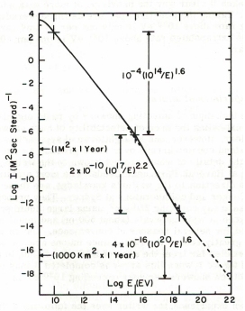
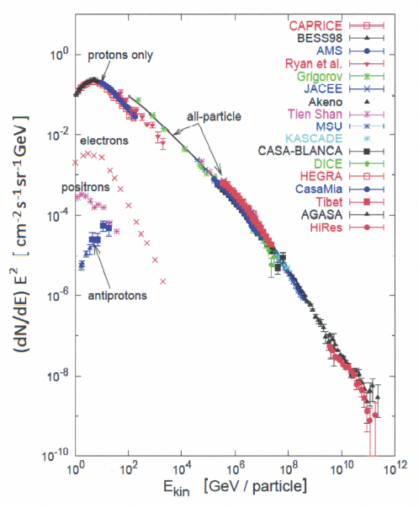
Sources of Information
For the cosmic ray spectrum: air shower arrays
How it looked in 1965
(Greisen, Proc. ICRC, 1965)
and today
(Gaisser, 2005)
No
GZK
Auger, TA

Slide 7
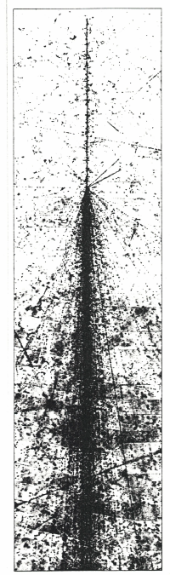
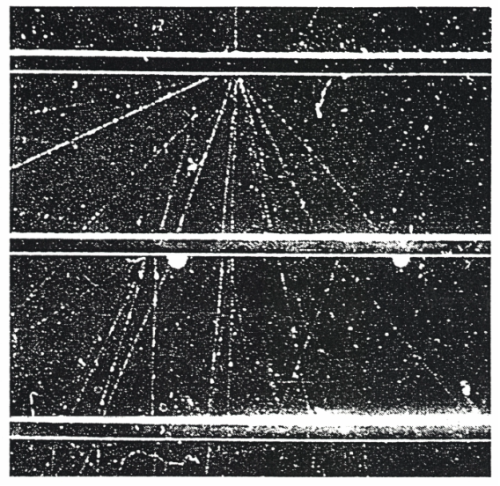
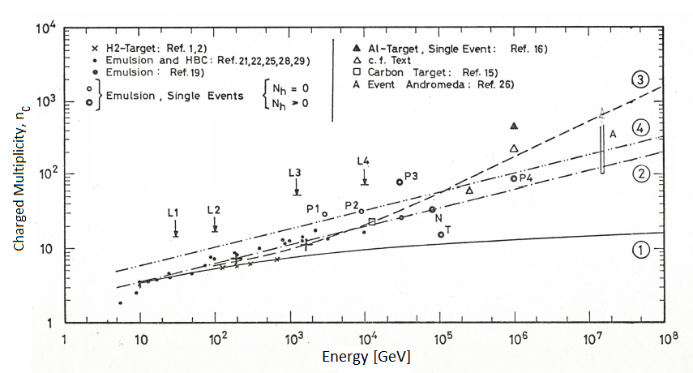




Sources of Information (cont.)
For interactions:
Emulsion
Incident 15 TeV iron nucleus producing more than 850 mesons
Cloud Chamber
Few Events
Bubble Chambers
(25 GeV)
Cascade relevant
$$↓$$
Multiplicity v/s energy
$$←$$
$$↑$$
Echo Lake data
$$↑$$

Slide 8
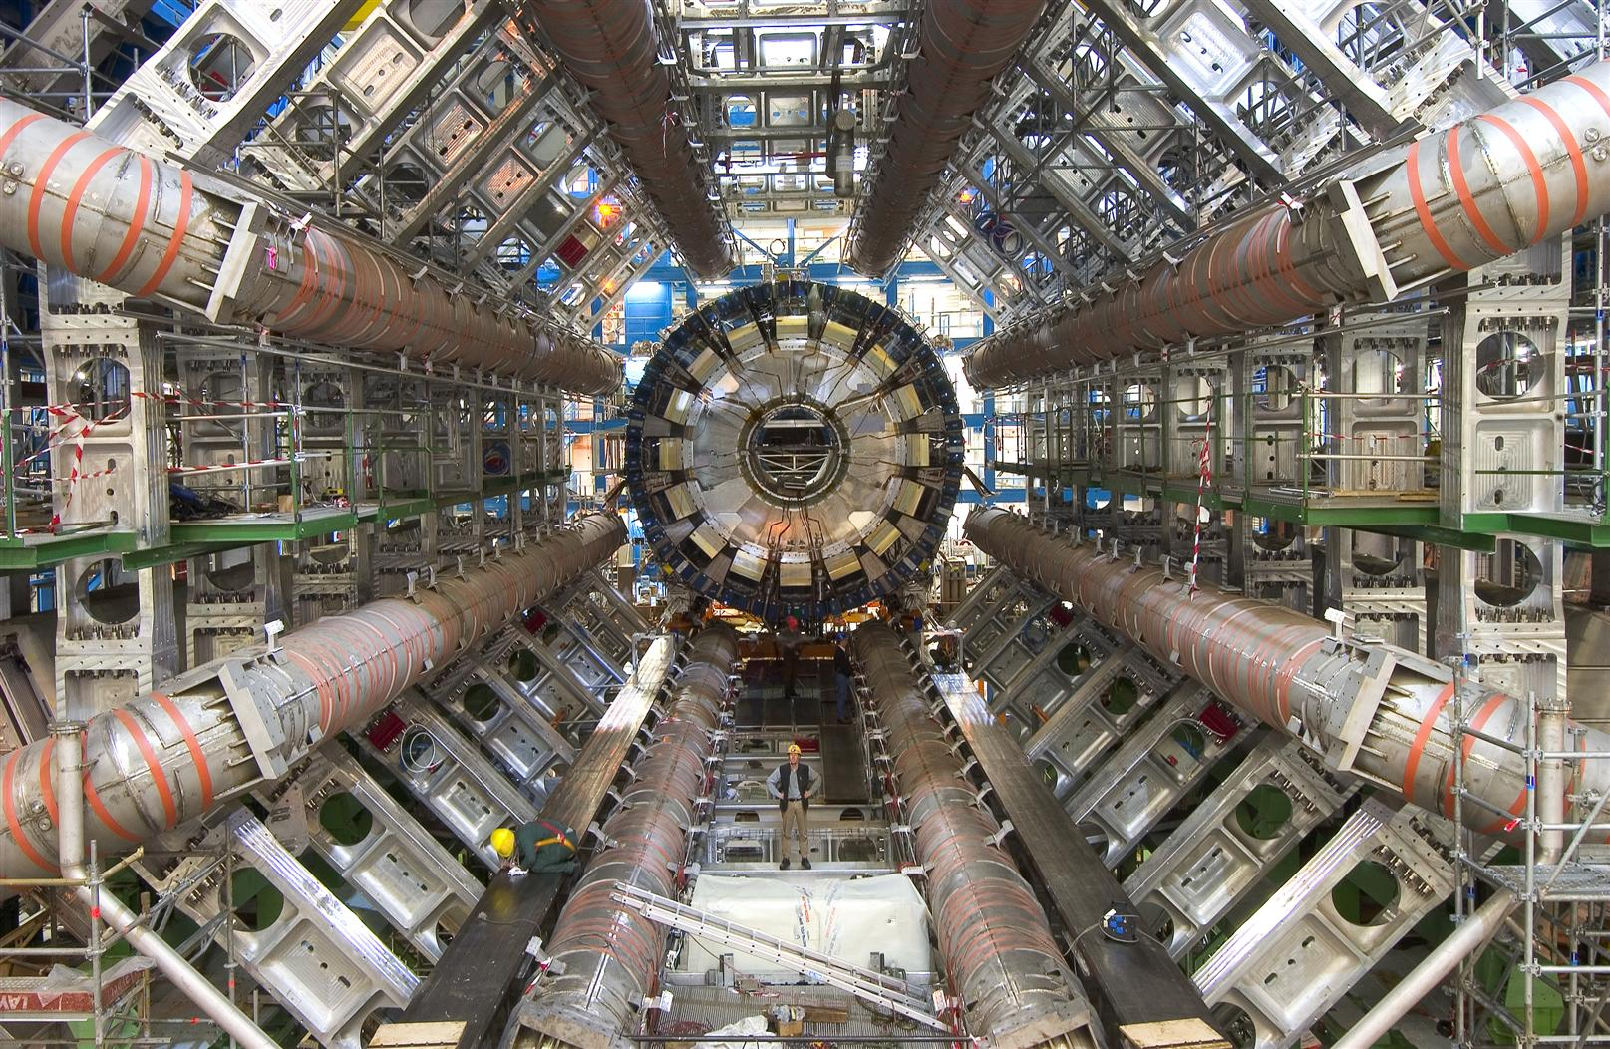

Today: CERN LHC ATLAS Experiment
Today, a wealth of data

Slide 9
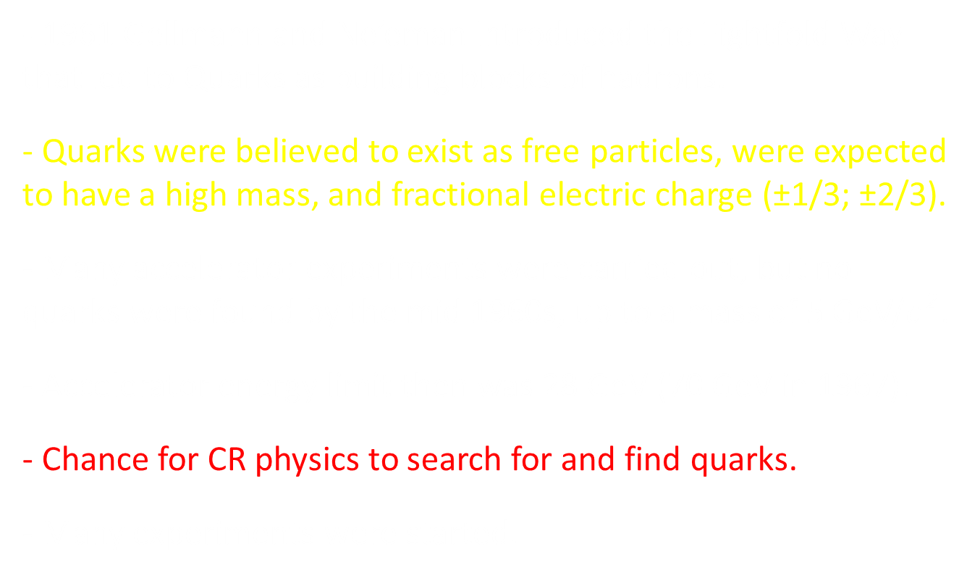
Quarks and the Quark Hunt of the 1960s
- 1961 Gellmann and Ne’eman introduced the Eightfold Way that led to Quarks as building blocks of hadrons.
- Quarks were believed to exist as free particles, were expected to have a high mass, and fractional electric charge (±1/3; ±2/3).
- Many accelerator experiments were carried out, but no quarks were found by the mid 1960s, up to a mass of 5 GeV/$c^{2}$.
- Accelerator energy limit then was 28 GeV (70 GeV in 1967).
- Chance for CR physics to search for and find quarks.
- Many experiments were started.

Slide 10
The Copenhagen Experiment
In 1964 Bernard Peters (Niels Bohr Inst.) had an idea for a quark hunt experiment and invited me to join his team to participate in this project.
Concept of experiment:
- Search for delayed particles, trailing air shower front.
- Look for typical signatures.
Why delayed particles?
Massive particles (quarks) were expected to be created most copiously near threshold, almost at rest in center of mass of HE hadronic interactions (typical for CR exp.).
They have a low Lorentz factor in the laboratory frame.
They are therefore slow and delayed w.r.t. shower front .
Signature:
- Low ionization (fractional charge), possible interactions.

Slide 11
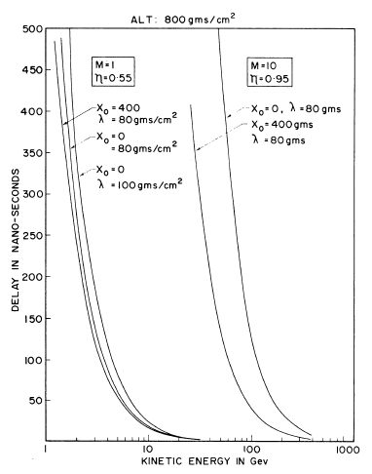
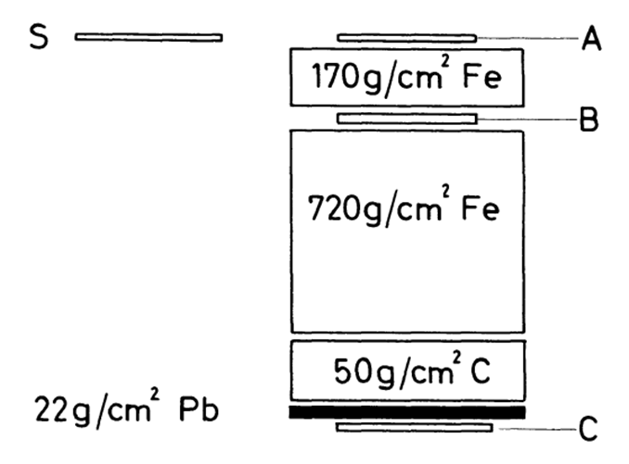
Experimental Layout
Mass Dependence of Arrival Delay of particles w.r.t. Shower Front
Delay
Energy

Slide 12
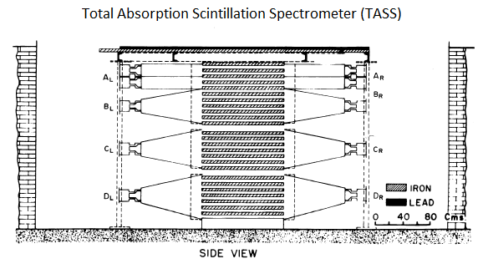
Parallel Efforts at Ootacamund (India) and elsewhere (Echo Lake, U.S.; U.S.S.R.; Italy, etc.)
The Ootacamund Experiment (2300 m a.s.l.)
(Chatterjee et al., 1967)

Slide 13
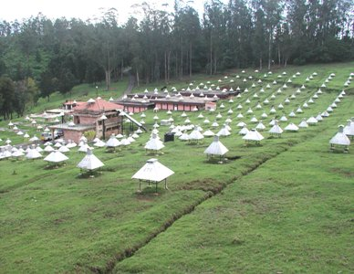
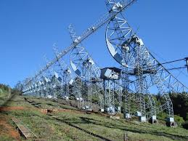
The Ootacamund (Ooty) Site (India)
Altitude 2300 m a.s.l.
A place of significant scientific activities
operated by the Tata Institute of Fundamental Research
Gamma Ray Experiment
Radio Astronomy Telescope

Slide 14
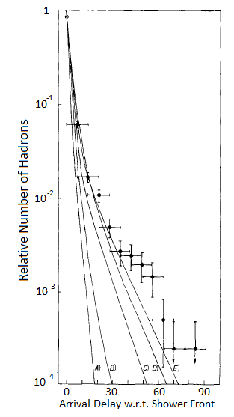

Observation of Strongly Interacting Energetic Delayed Particles trailing Shower Front in TASS at Ootacamund
Tonwar et al., 1971
10-20 GeV
hadrons in
300 TeV
showers
$$σ$$
p
What kind of particles are they?
Fe

Slide 15
Conclusions and Questions
Pions are excluded, they cannot be late, they decay unless locally produced by a late parent, but then not energetic.
Are they nucleons and antinucleons?
What is the role of nucleons + antinucleons in AS?
Contemporary knowledge:
At 70 GeV < 1% of produced particles are antiprotons.
They were generally disregarded in CR physics.
To answer these questions an “all-inclusive” 4-dimensional simulation (in space and time) was required.

Slide 16
The Beginning of ASICO
Motivation and Goal:
Study high energy interactions, particle composition of air showers, and temporal features of all air shower particles.
Requirements for AS Model:
Include all known fundamental hadronic processes.
Respect all conservation laws, include energy housekeeping.
Include all interaction products, decay products, and decays.
Handle EM component separately (subsequent processing).
Include hypothetical nucleon-antinucleon production.
Carry out simulation in 4-dimensions (space and time).
Calculate all processes correctly in respective frame.
Specify particles with 8, later 12 parameters (technical detail).
Assess past & existing simulation work

Slide 17
Assessment Results
Initial work was analytic approach, EM cascades (Rossi& Greisen, 1941; Rossi, 1952; Kamata & Nishimura, 1958), later hadron cascades (Ueda & Ogita, 1957; Fukuda et al., 1959; etc.).
MC-essays: Simulations tackled mainly simple, specific topics, e.g., study survival of nucleons of primary nuclei (Bradt et al., 1965).
Approaches were generally naive, unrealistic, grossly oversimplified, most had a limited scope, used shortcuts; + many other inadequacies.
Existing work / programs were fully inadequate for our task.
Needed fundamentally new approach.
! Limited computer capability was an issue at that time !

Slide 18
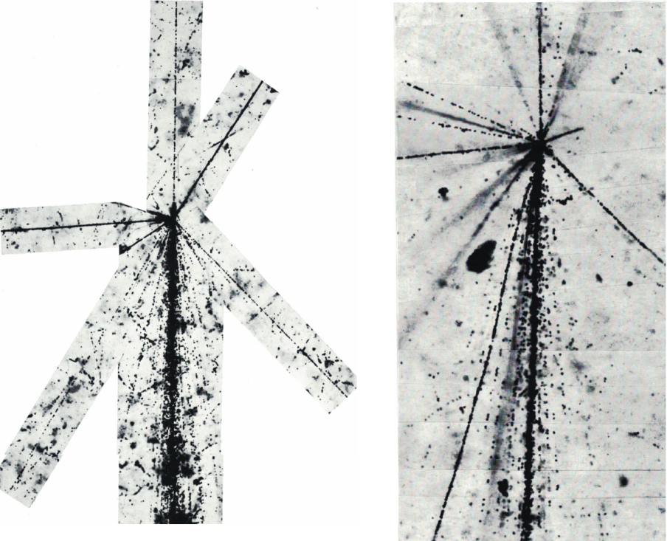
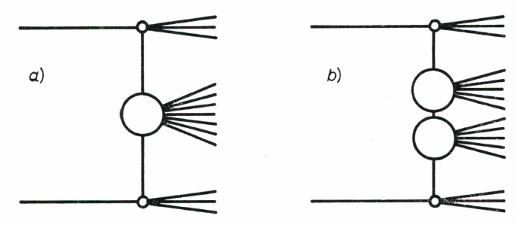
Phenomenological Mathematical Models
(Self-consistent, include / respect conservation laws)
Guidance from Experimental Observations & Theoretical Visions
These led to “cluster models”, isobars and fireballs, Aleph, Nova, jets, and multiperipheralism, etc.
Hadronic thermodynamics (p )
CKP Model
t
N* etc., from Bubble Chambers

Slide 19
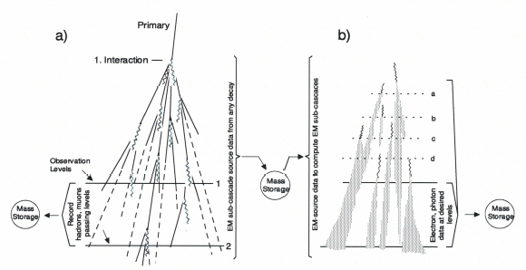
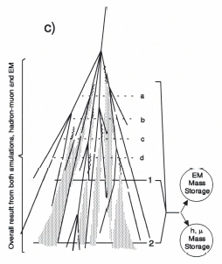
Architecture of the Program
A key issue, also the computer (CDC 6600)
Compute/Propagate hadron cascade, all interactions and decays to ground level.
Record all particles with all 8 (12) parameters when passing observation levels.
Store all EM components at creation with 8 (12) parameters.
Compute/generate EM sub-cascades from all sources, record at observation levels.
Particle parameters: angular + cartesian coordinates, time, energy, mass, charge;
later + 4 “genetic” parameters: height & generation of creation, and last scattering .
Produce distributions, spectra, target diagrams, etc., of recorded particles.
NK,G

Slide 20
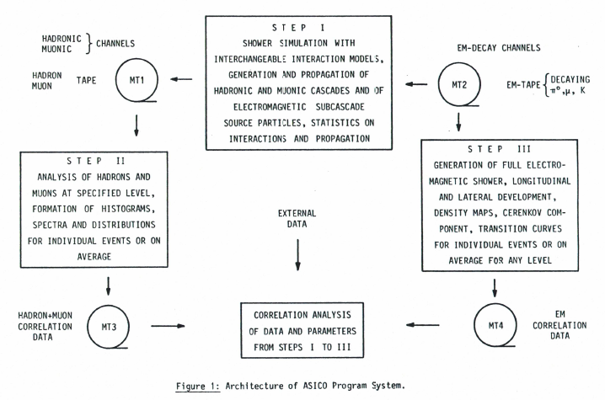
Architecture of the Program (cont.)

Slide 21
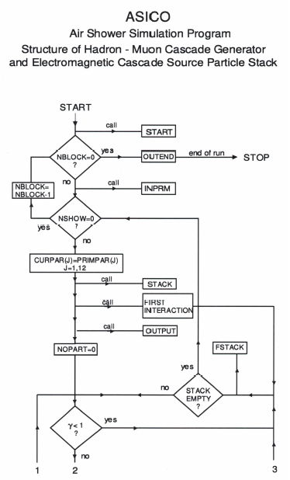
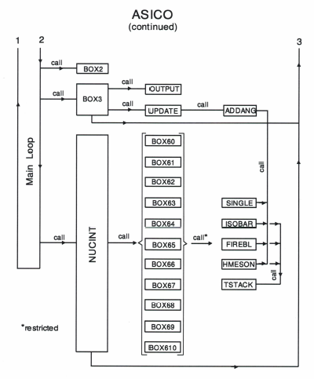
Initial Flow Chart

Slide 22
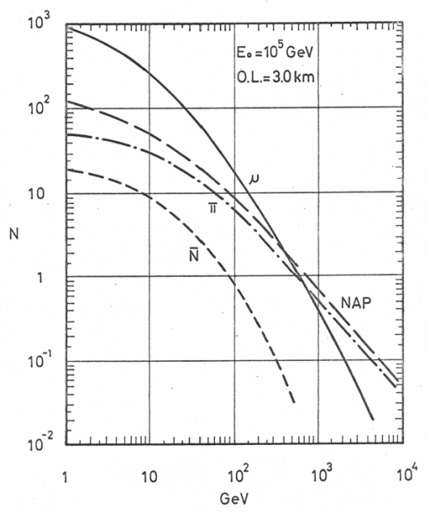
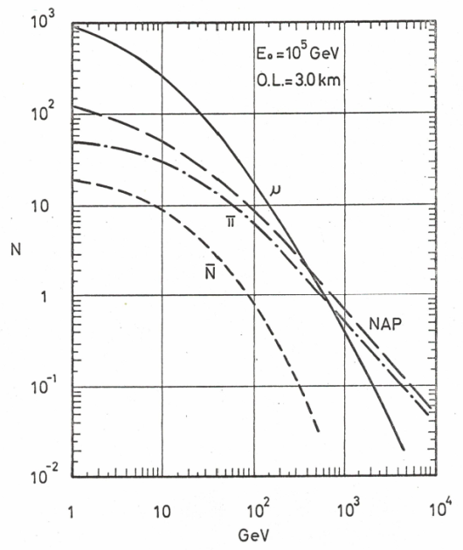
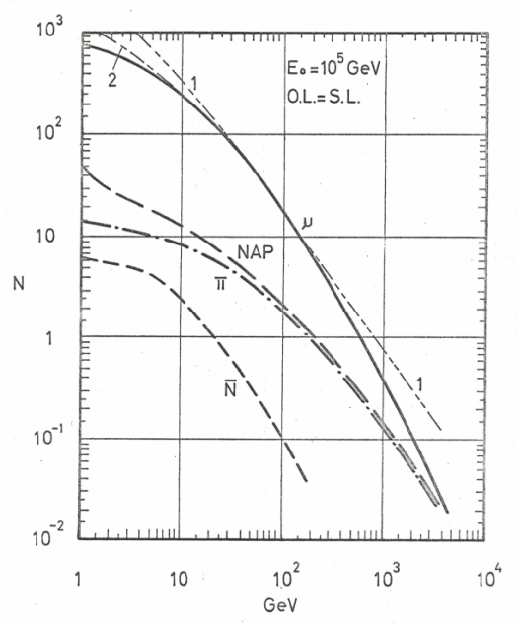
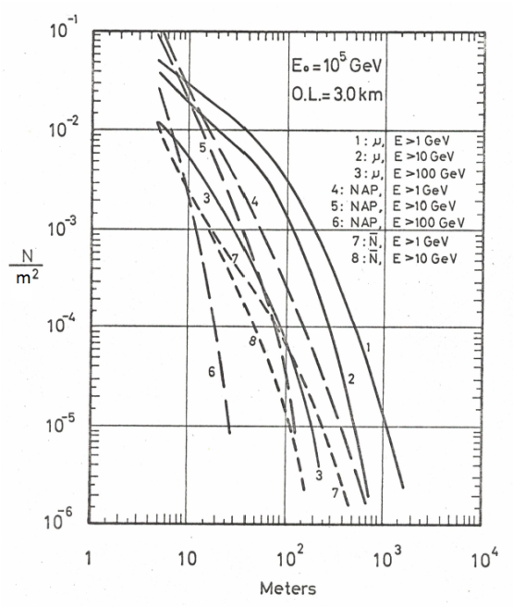
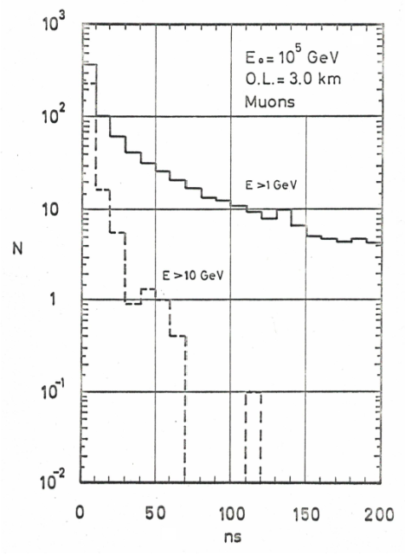
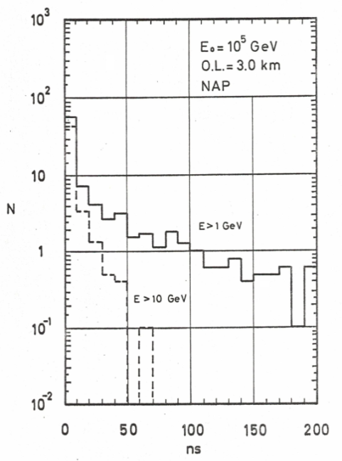

First Results & Impact on Experiments.
1967-1969
5 km
3 km
SL
Guidance for Experiments
Energy spectra at different altitudes
NAP
Left: radial density distributions.
Right: particle delay distributions w.r.t. shower front.
$$μ$$
LD

Slide 23
First Results & Impact on Experiments.
! No Realistic Air Showers without Nucleon-Antinucleon Production !
1967-1969
5 km
3 km
SL
Guidance for Experiments
Energy spectra at different altitudes
NAP
Left: radial density distributions.
Right: particle delay distributions w.r.t. shower front.
$$μ$$
LD

Slide 24
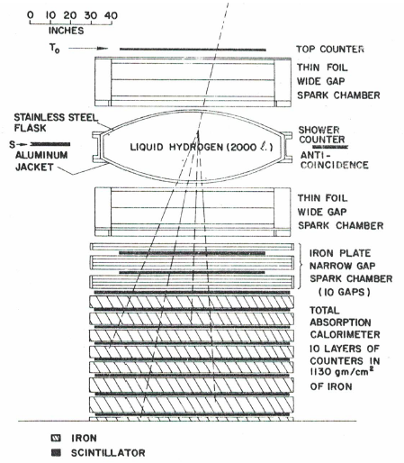
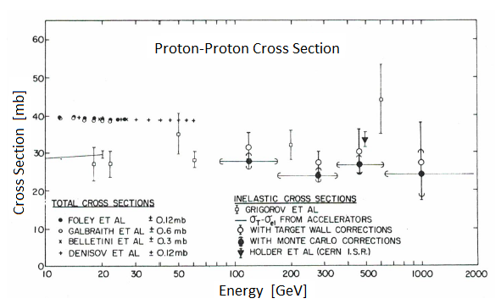
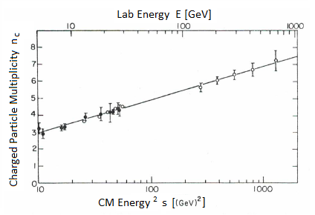
The Echo Lake Experiment: A Landmark
Jones , et al., 1970, 1972
Accelerator techniques applied to cosmic rays

Slide 25
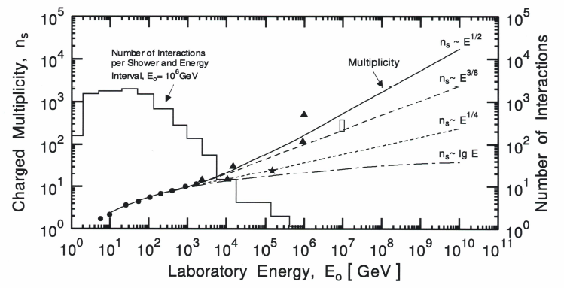

The Echo Lake Problem
The initial impact and credibility of this experiment was very high in the cosmic ray community because of the clean experimental conditions.
However, there was a serious problem, the low particle multiplicity.
Cannot produce air showers, similar to original pure Feynman scaling.
UA5 was a
CERN pbar-p
Experiment
UA5
$$↑$$
Echo Lake, corrected
Need particles to produce an air shower

Slide 26
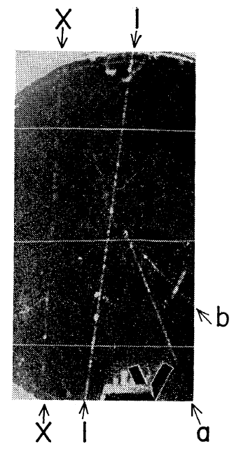

Contemporary Discoveries
Many new discoveries in the late
1960s and early 1970s
Large transverse momenta in hadronic interactions in CR.
(Japanese-Brazilian emulsion group, 1965).
Rising pp-cross sections at high energies in CR.
(Grigorov et al., 1965; Yodh et al., 1972).
Rising nucleon-antinucleon production in CR.
(Chatterjee et al., 1965; Tonwar et al., 1971).
Quark sighting!
(McCusker, 1969; Cairns et al., 1969).
Feynman Scaling
Quark track
$$→$$

Slide 27
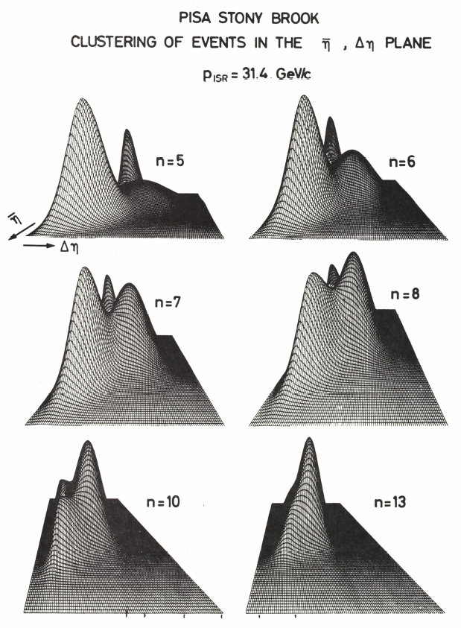
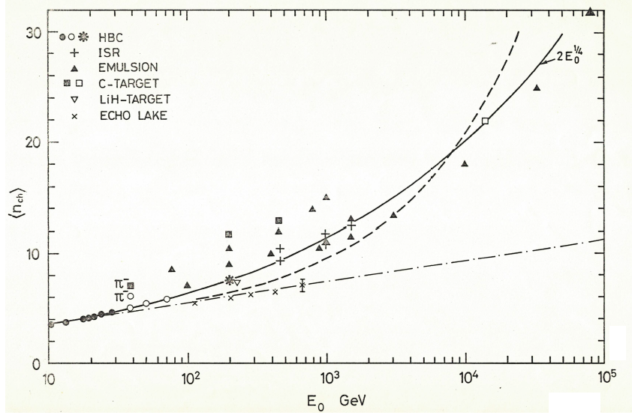
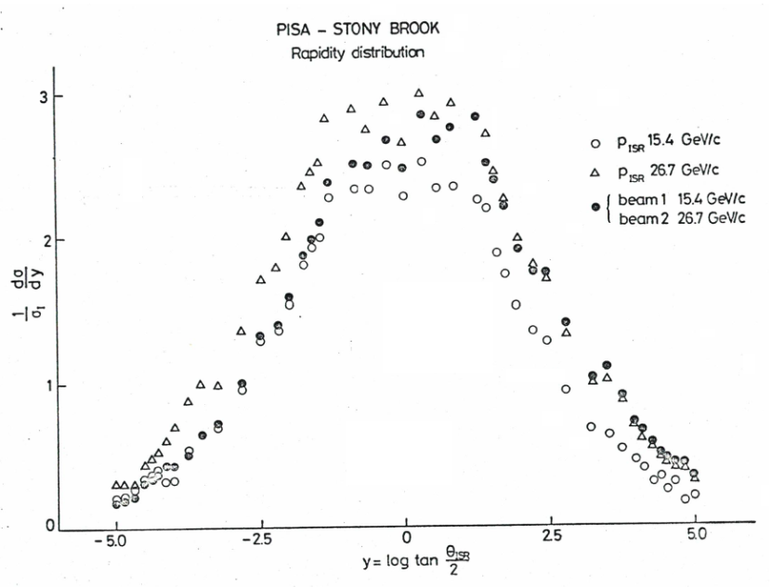


The Impact of the CERN ISR Data
Multiplicity
ISR
$$↓$$
$$↑$$
Echo Lake
Rapidity Density

Slide 28
Relevant CERN ISR Results
(~1800 GeV Anchor Points for Simulations)
Confirmation of the following cosmic ray results and predictions:
Rising pp-cross section.
Existence of large transverse momenta, up to multi GeV/c.
Prediction of significant nucleon-antinucleon production.
Cluster phenomena.

Slide 29
Subsequent Program Developments
- Continuous extensions, improvements, refinements.
- Introducing interactions with nuclear targets, projectiles.
- Generating associated EM showers for size determination.
- Adding kaons and kaon decays.
- Adding antinucleon annihilation processes.
- Addition of new phenomena, charm production, etc.
- Accounting for neutrinos, energy housekeeping, statistics.
- Introducing “genetic parameters”, target diagrams.
- Correlation studies among different observables, components.
- Exploring different interaction models, testing distributions.
- Exploring primary composition, etc.
- Vast expansion of analysis.
- Intensified comparison with experimental data worldwide.

Slide 30
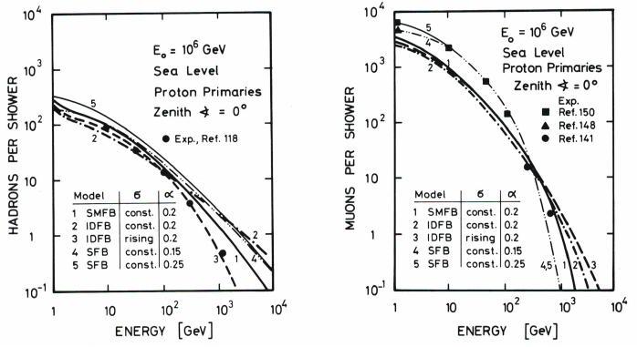
Some Selected Results
Energy Spectra of Hadrons and Muons

Slide 31
Some Selected Results
Energy Spectra of Hadrons and Muons
Conclusion: Build a large Hadron Calorimeter

Slide 32
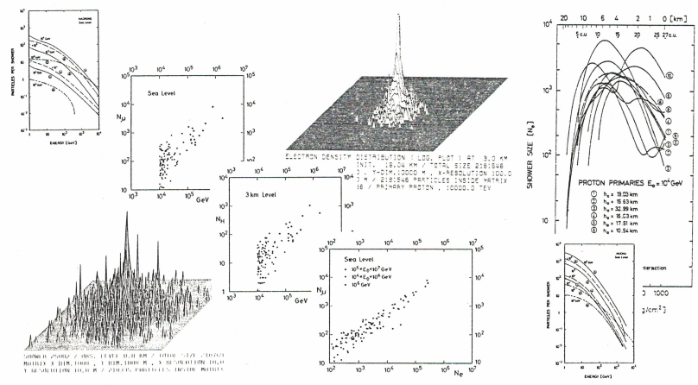
Potpourri of other Results

Slide 33
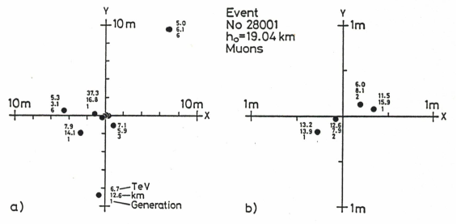
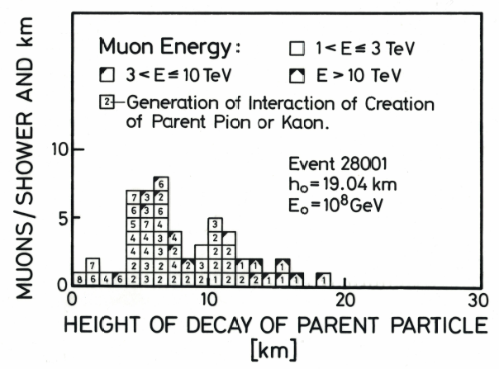
Target Diagram of TeV Muons in an Air Shower
“Genetic” Data of UH Energy Muons in a Shower

Slide 34
Competitive Efforts
Many new players began to enter the field in the late 1970s and 1980s
I apologize to all colleagues concerned for not mentioning their valuable work and
contributions to the field

Slide 35
Closing Comments
Until about the mid 1980s ASICO was to the best of my knowledge probably the most detailed and accurate air shower simulation program system.
This applies in my opinion now to CORSIKA , but that is up to you to judge.
I invested the better part of over 20 years into the development of ASICO.
In the 1980s I began to migrate from EAS to neutrino astronomy (DUMAND).
I terminated my activities in AS physics with a book (two volumes) entitled:
Extensive Air Showers
High Energy Phenomena and
Astrophysical Aspects
I think the success of ASICO and later on CORSIKA lies in the clean structure,
the ease to extend and link it with other programs (EGS, Cherenkov, Radio, etc.). It is easy to introduce new processes without affecting the rest.

Slide 36
Closing Comments (cont.)
Milestones for ASICO to become a “public utility”:
1987: at the Moscow ICRC, Prof. Schatz and I met and established the contact.
1988 : we got together and I handed ASICO over to the KIT KASCADE team.
1989: ASICO surfaced under the new name of CORSIKA, with extensions.
In my opinion, the CORSIKA team and associates have done an outstanding job to further develop, extend and maintain the entire program system.
I’m happy to have made a major contribution to this project.

Slide 37
Thank you for your attention

Slide 38
Thanks to the Organizers for the Invitation

