Slide 1
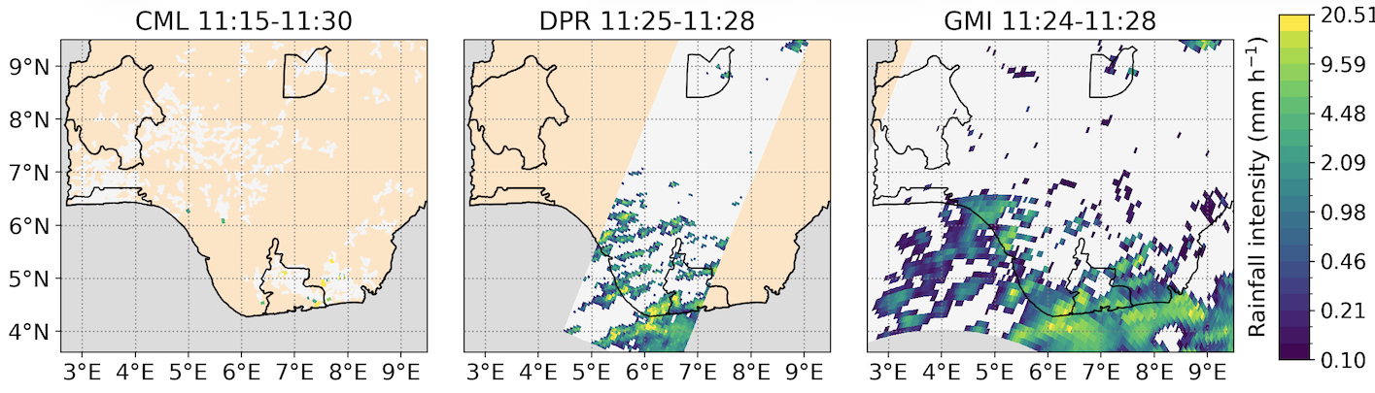



A multi-climate comparison of GPM radiometer and commercial microwave link (CML) rainfall estimates
1
2
3
Linda Bogerd^{1,3}, Bas Walraven³, Aart Overeem^{2,3}, Hidde Leijnse², Remko Uijlenhoet³

Slide 2
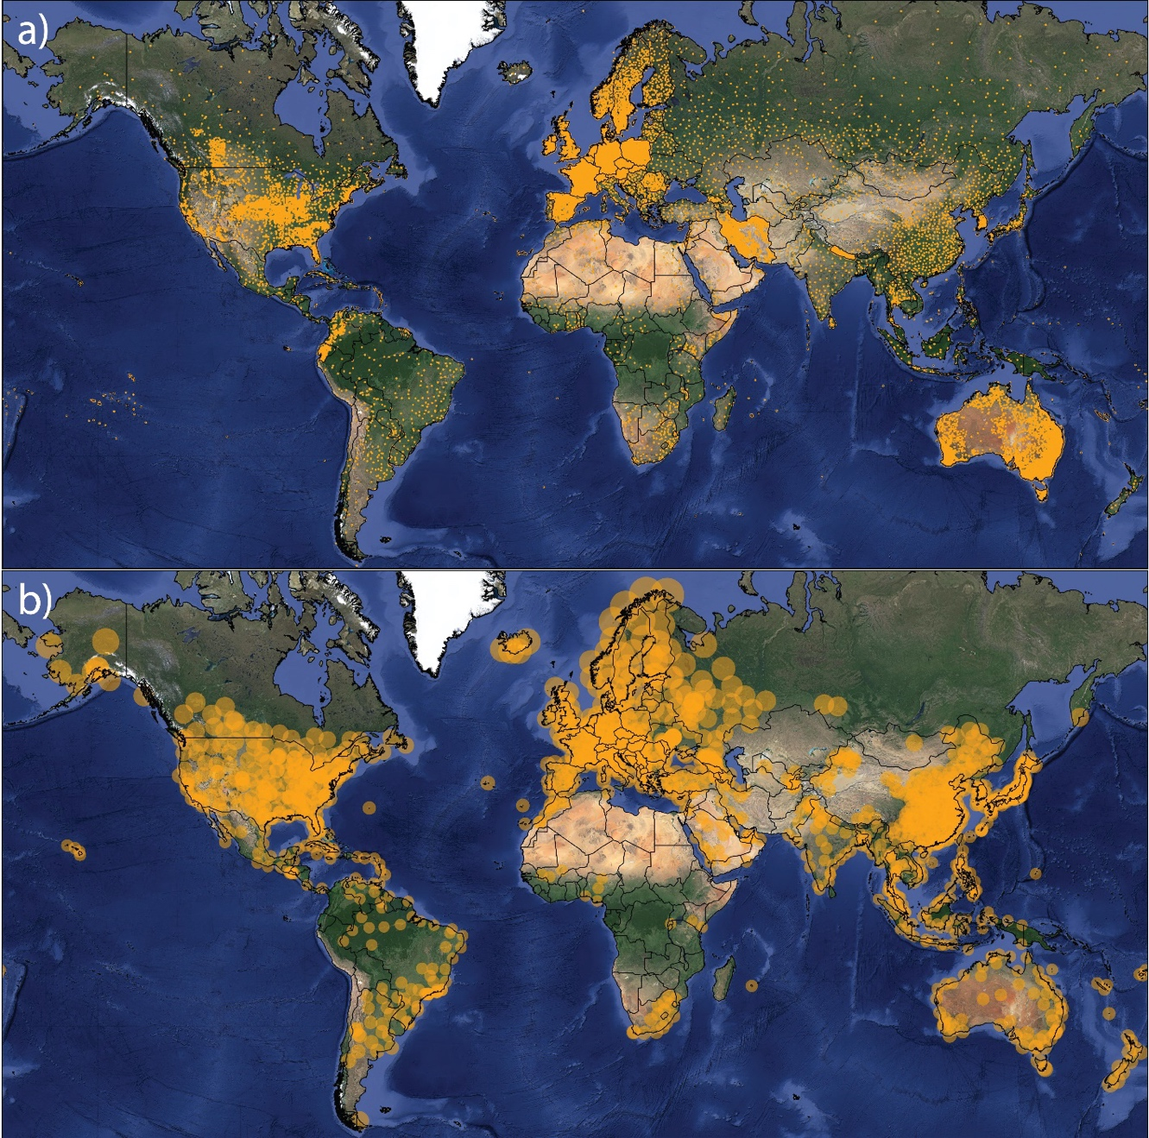
Introduction Data and Methods Results Discussion
Ground-based precipitation sensors
Picture: lyubava.21/Shutterstock
Global coverage of a) rain gauges [source: GPCC] and b) weather radars
(figure from Overeem et al, 2024)

Slide 3
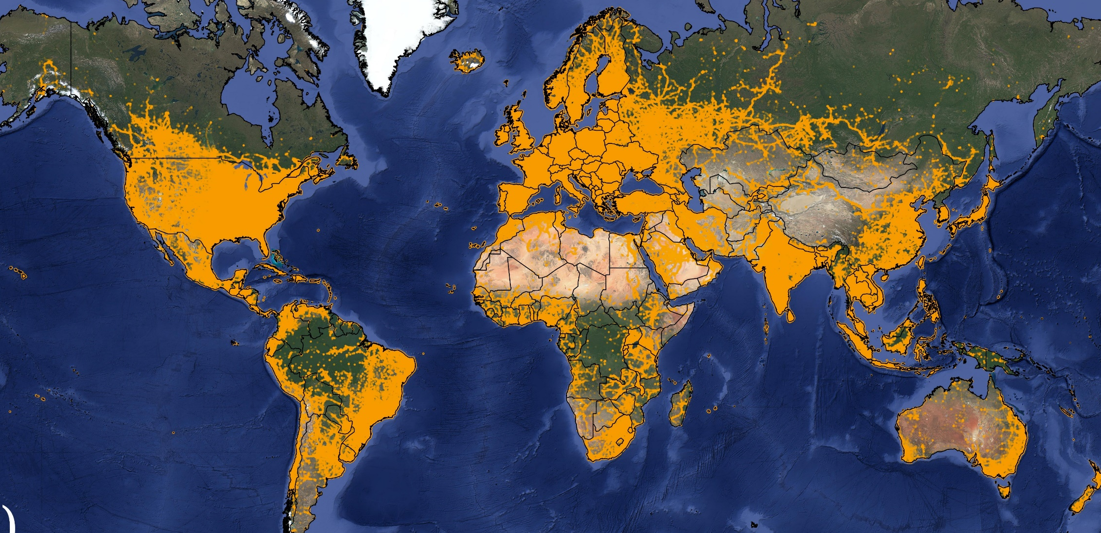
Introduction Data and Methods Results Discussion
Commercial microwave links [CMLs]
Picture: lyubava.21/Shutterstock
Global coverage of cellphone towers (Overeem et al, 2024)
Widely available, especially in populated areas where the consequences of floods are severe
Changes in signal strength can be converted into precipitation estimates using data already collected by mobile network operators
Rural regions and large water bodies remain underrepresented

Slide 4
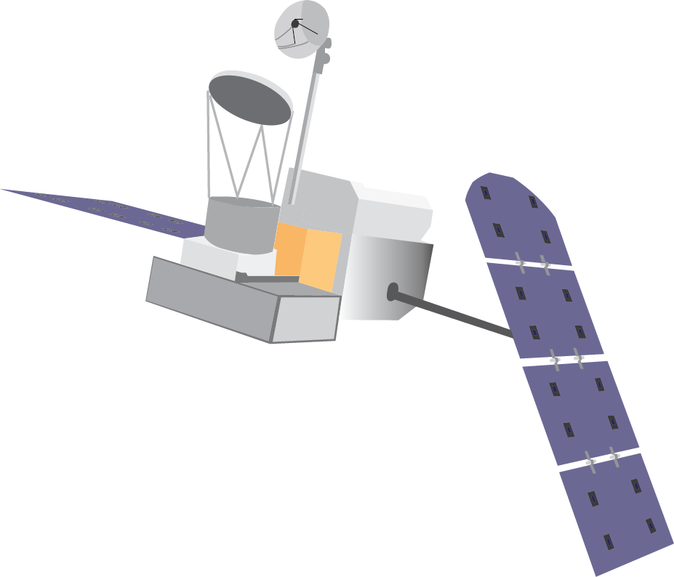

Introduction Data and Methods Results Discussion
Spaceborne precipitation estimates
Able to provide global precipitation estimates, including over remote regions and areas with sparse ground observations
This study uses GPM passive microwave radiometer (PMW) and the Dual-frequency Precipitation Radar (DPR)
NOTE: unlike opportunistic satellite microwave links [SML], GPM was specifically designed for precipitation measurement

Slide 5
Introduction Data and Methods Results Discussion
Study aim
Satellites detect incoming rainfall systems before landfall
Combined satellite–CML data improve precipitation nowcasts
CML observations help correct biases in satellite rainfall estimates
However, before analyzing how and in what circumstances precipitation estimates derived from CML and spaceborne radiometer measurements can complement each other, we need to know:
How well do CMLs and satellite products capture precipitation in different climates?

Slide 6
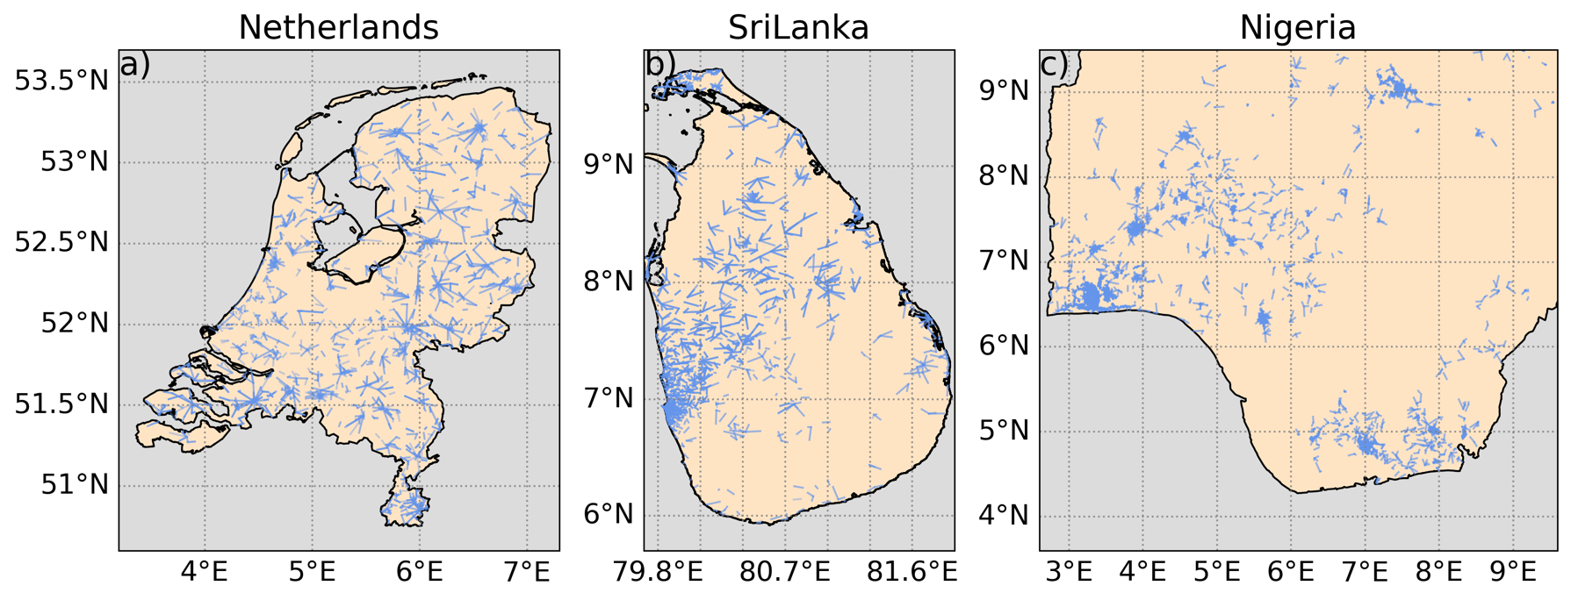
Introduction Data and Methods Results Discussion
Data
 | Netherlands | Sri Lanka | Nigeria
Link paths | 1,823 | 1,069 | 6,071
Mean frequency | 34.3 GHz | 19.0 GHz | 17.9 GHz
Mean path length | 3.95 km | 4.74 km | 2.71 km
Data availability | 96% | 82% | 89%
Study cases | 28 | 15 | 14

Slide 7
Introduction Data and Methods Results Discussion
Methods
CML precipitation estimates derived using RAINLINK, including wet–dry classification
  Same processing settings and default RAINLINK parameters applied to all three countries
GPM level 2 precipitation products used for satellite-based estimates
GPM DPR used as reference
Additional validation in the Netherlands using gauge-adjusted KNMI radar estimates
  -> a detailed evaluation of GPM products is provided by Bogerd et al. (2024)
Spatial comparisons at native resolutions
Satellite pixels matched to CML paths using path-length-weighted intersections (poligrain)

Slide 8
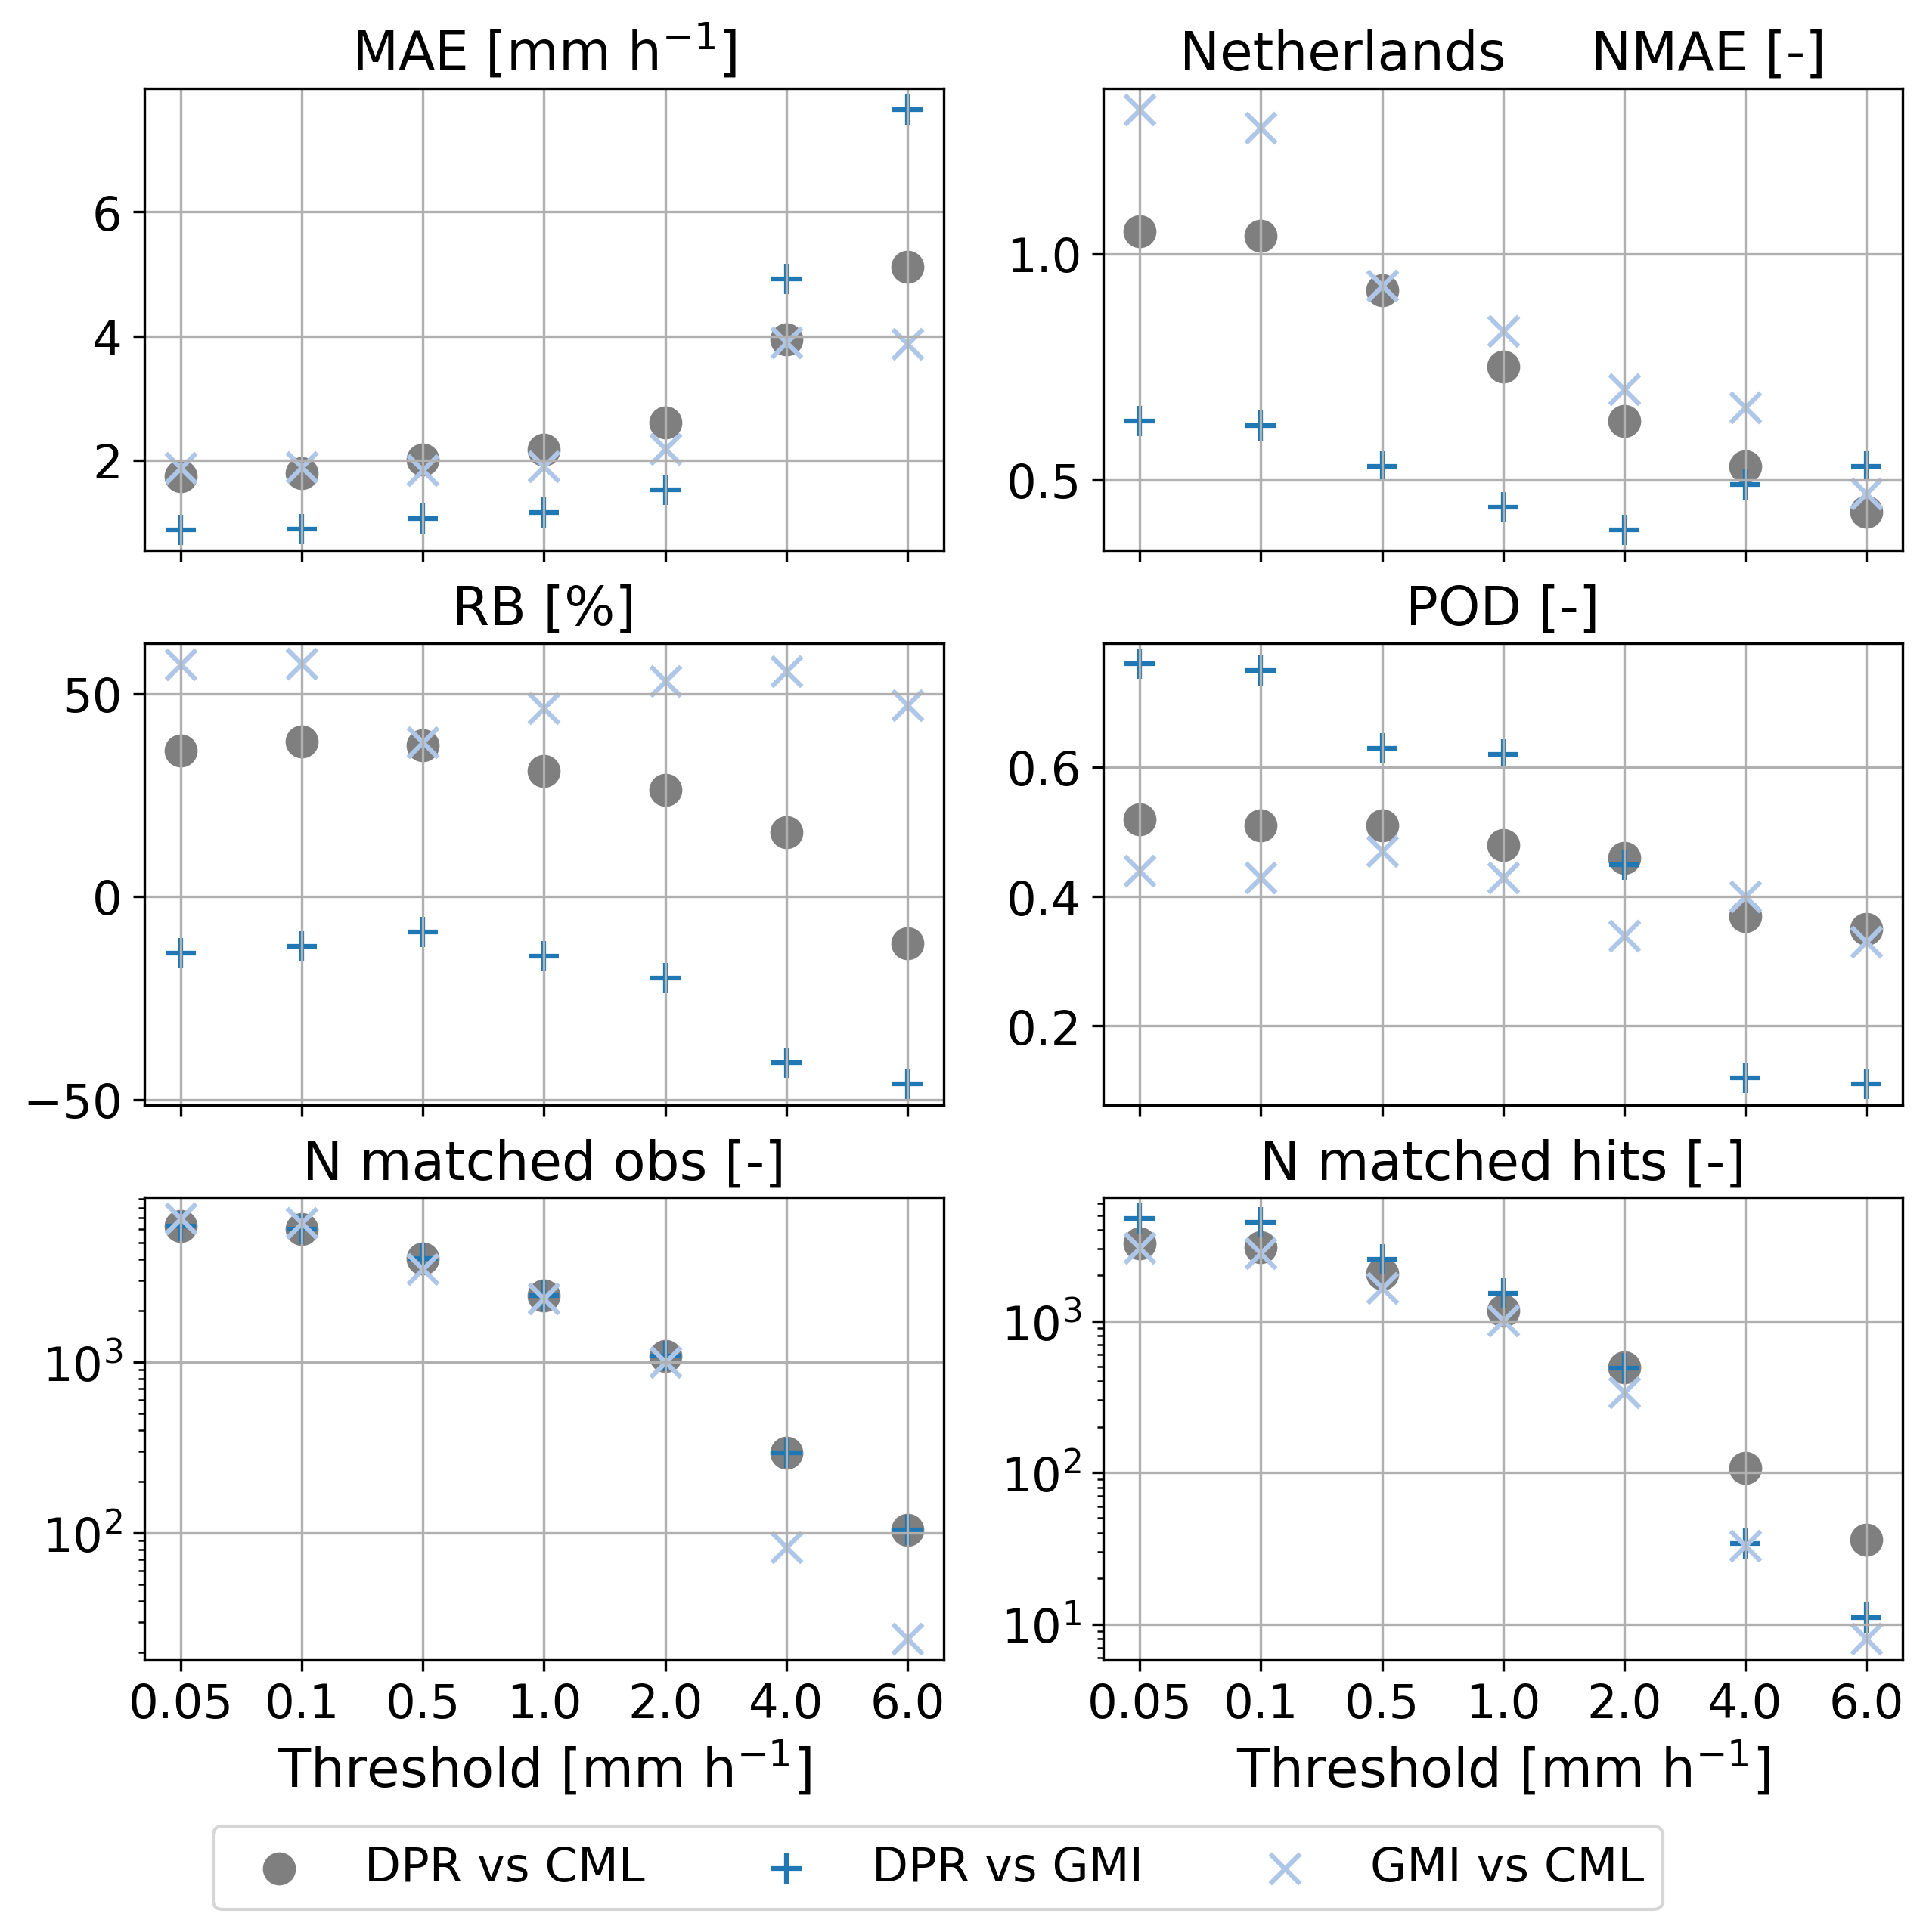
NOTE: DPR and GMI are on the same spatiotemporal resolution. This is a disadvantage for the CMLs.
Introduction Data and Methods Results Discussion
The Netherlands

Slide 9
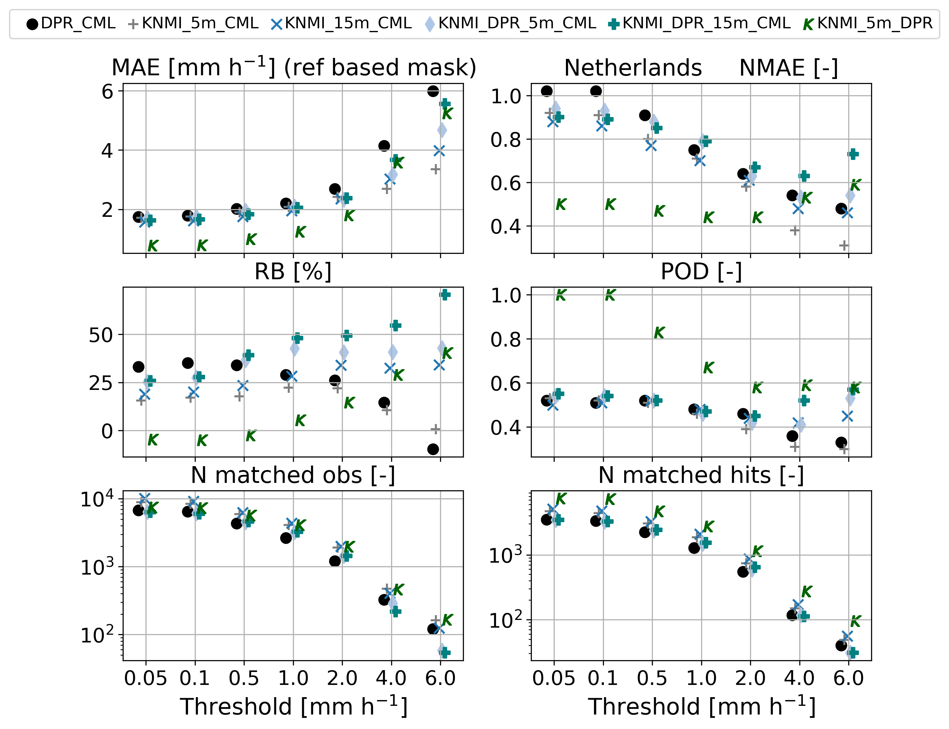
CML performance with KNMI gauge-adjusted estimates as reference using various sampling settings
Introduction Data and Methods Results Discussion
The Netherlands
Notes:
CML_DPR: CML performance with DPR as the reference (as presented in the metric figures/remainder of the study)
KNMI_5m_CML: CML performance with ground-based radar data as reference, with the reference on its native resolution before taking path-integrated CML averages, sampled at the time closest to the center of the CML interval.
KNMI_15m_CML: CML performance with ground-based radar data as reference, with the reference on its native spatial resolution before taking path-integrated CML averages, aggregated over the 15-minute CML interval.
KNMI_DPR_5m_CML: CML performance with ground-based radar data as reference, with the reference first averaged in space to the DPR grid before taking path-integrated CML averages, sampled at the time closest to the center of the CML interval.
KNMI_DPR_15m_CML: CML performance with ground-based radar data as reference, with the reference first averaged in space to the DPR grid before taking path-integrated CML averages, aggregated over the 15-minute CML interval.
KNMI_5m_DPR: DPR performance with ground-based radar data as reference, with the reference averaged in space to the DPR grid, sampled at the time closest to the DPR overpass.

Slide 10
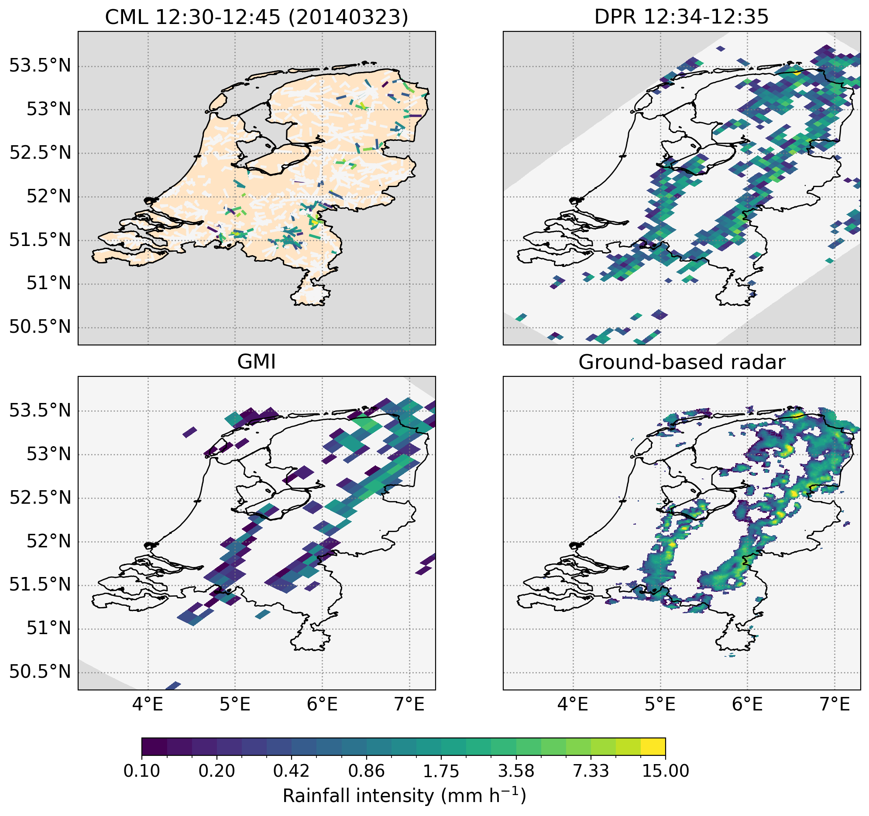
Introduction Data and Methods Results Discussion
The Netherlands

Slide 11
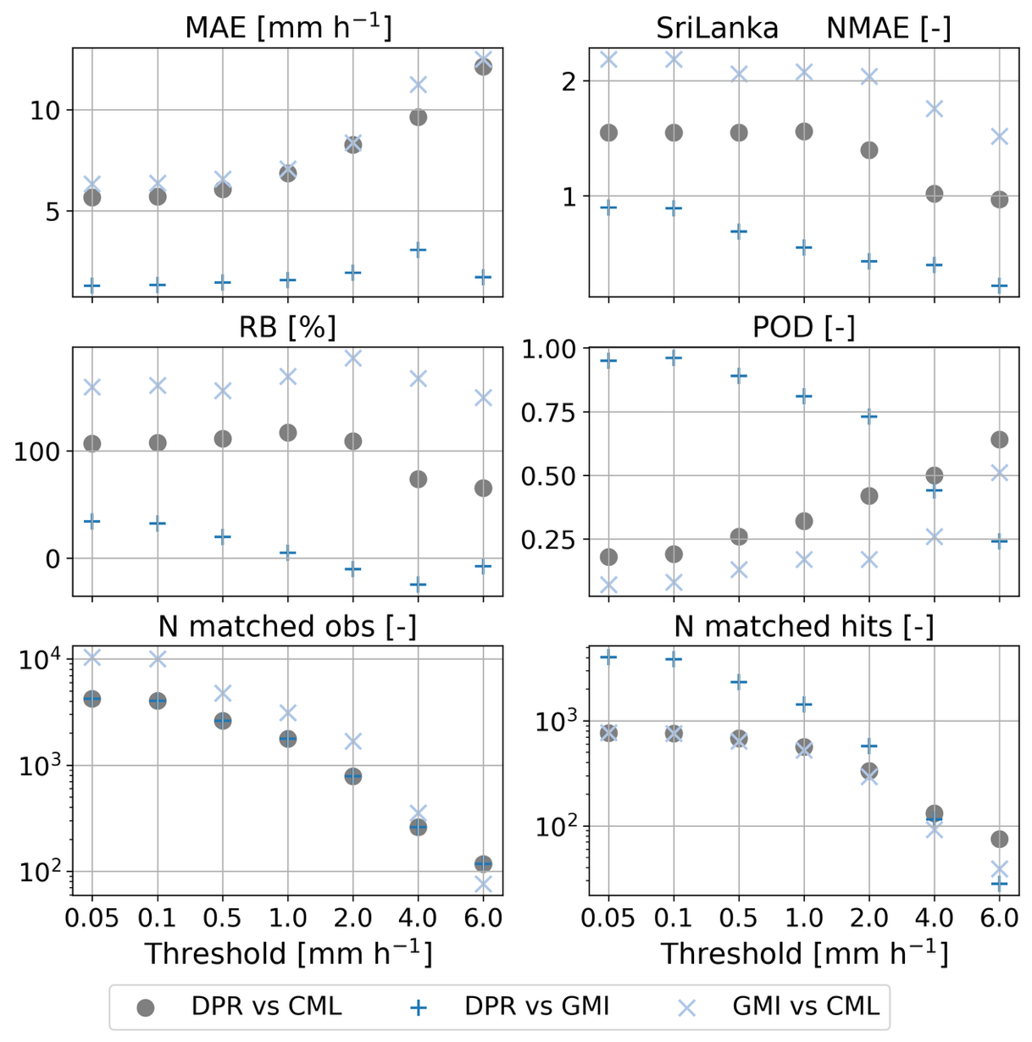
Introduction Data and Methods Results Discussion
Sri Lanka

Slide 12
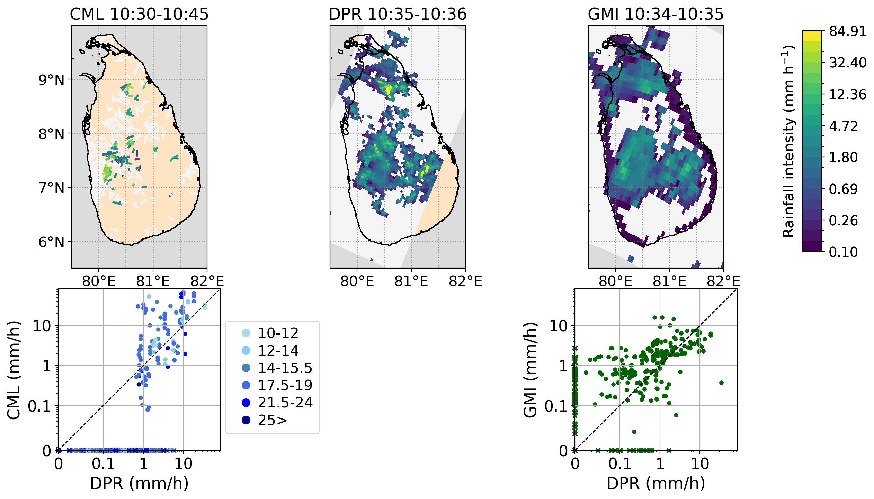
Introduction Data and Methods Results Discussion
Sri Lanka

Slide 13
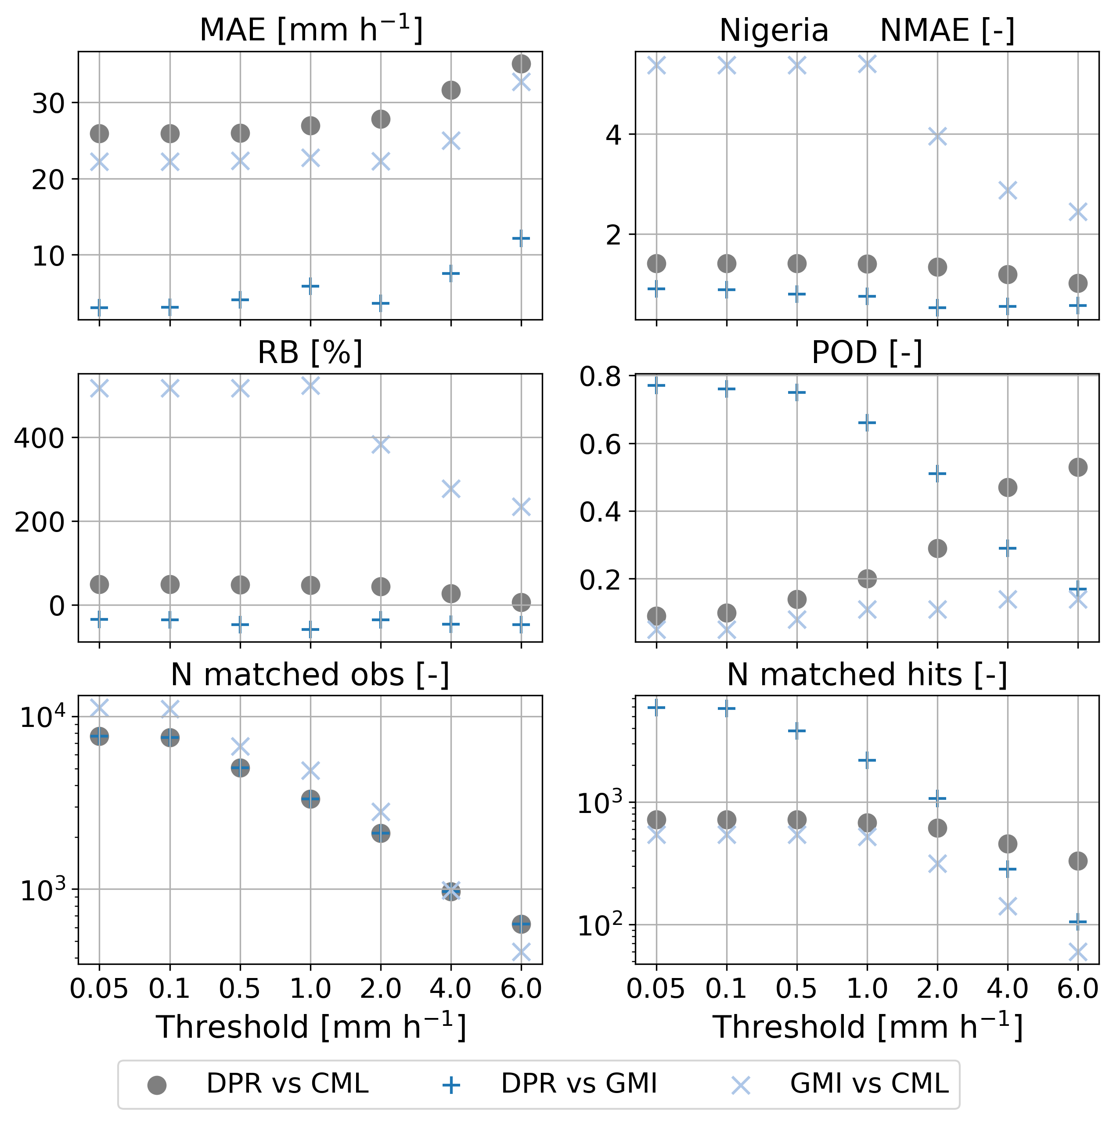
Introduction Data and Methods Results Discussion
Nigeria

Slide 14
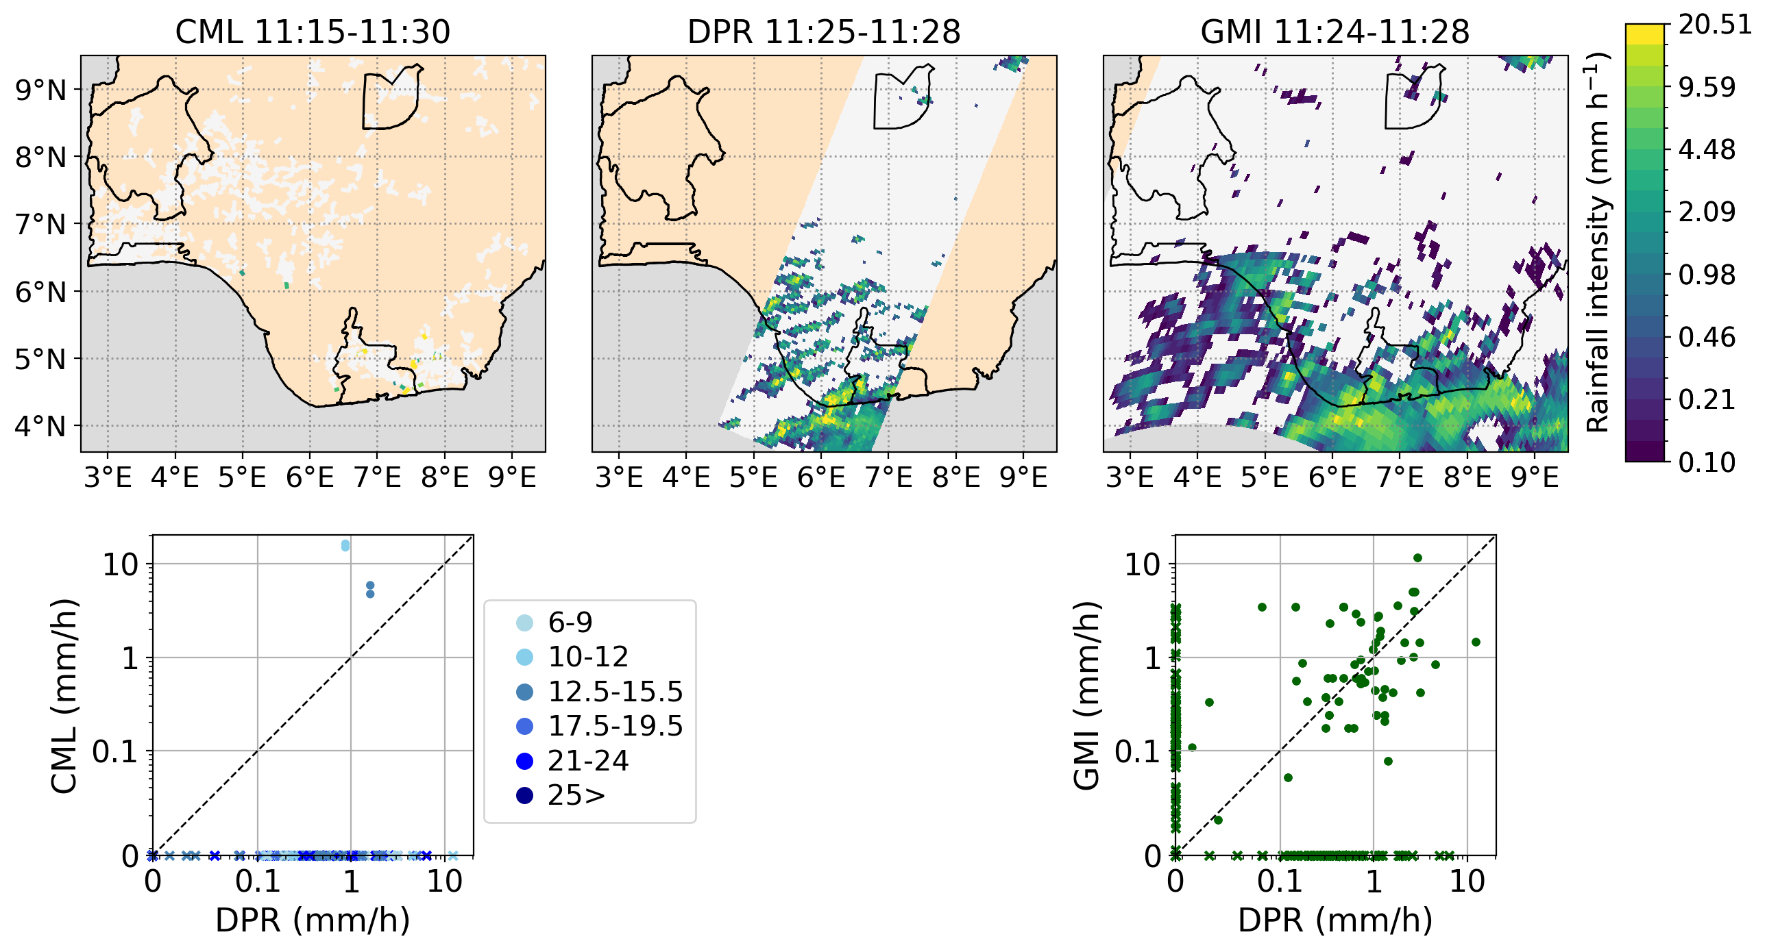
Introduction Data and Methods Results Discussion
Nigeria

Slide 15
Introduction Data and Methods Results Discussion
Discussion
15-minute evaluation of CML and GPM performance across three climates
Compared with DPR, CMLs tend to overestimate high-intensity rainfall, while radiometer products tend to underestimate it
No consistent relationship found between CML network characteristics and retrieval performance
Results are based on operational 15-minute data processed with RAINLINK
Discrepancies with published research can originate from:
1. High temporal resolution
2. DPR used as reference
3. Non-optimized RAINLINK algorithm

Slide 16
Thank you!
L.bogerd@tudelft.nl
1
2
3
Linda Bogerd1,3, Bas Walraven 3, Aart Overeem 2,3, Hidde Leijnse 2, Remko Uijlenhoet 3

