Slide 1

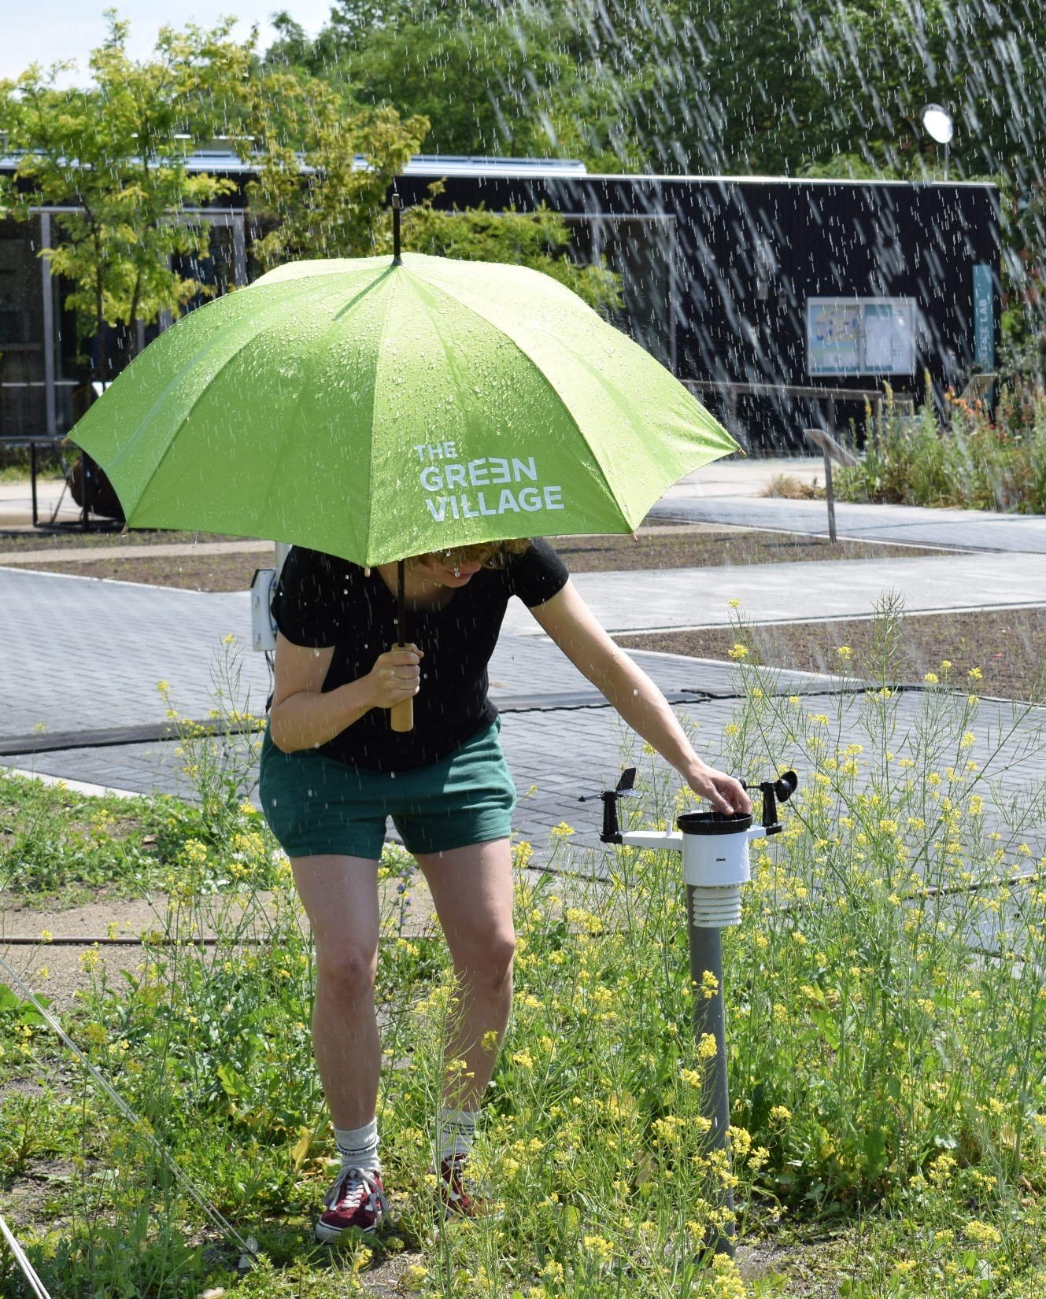
Delft Measures: Assessment of citizen science rainfall observations
Arjan Droste,
With many contributions from Marit Bogert, Sandra de Vries & Marchien Boonstra

Slide 2
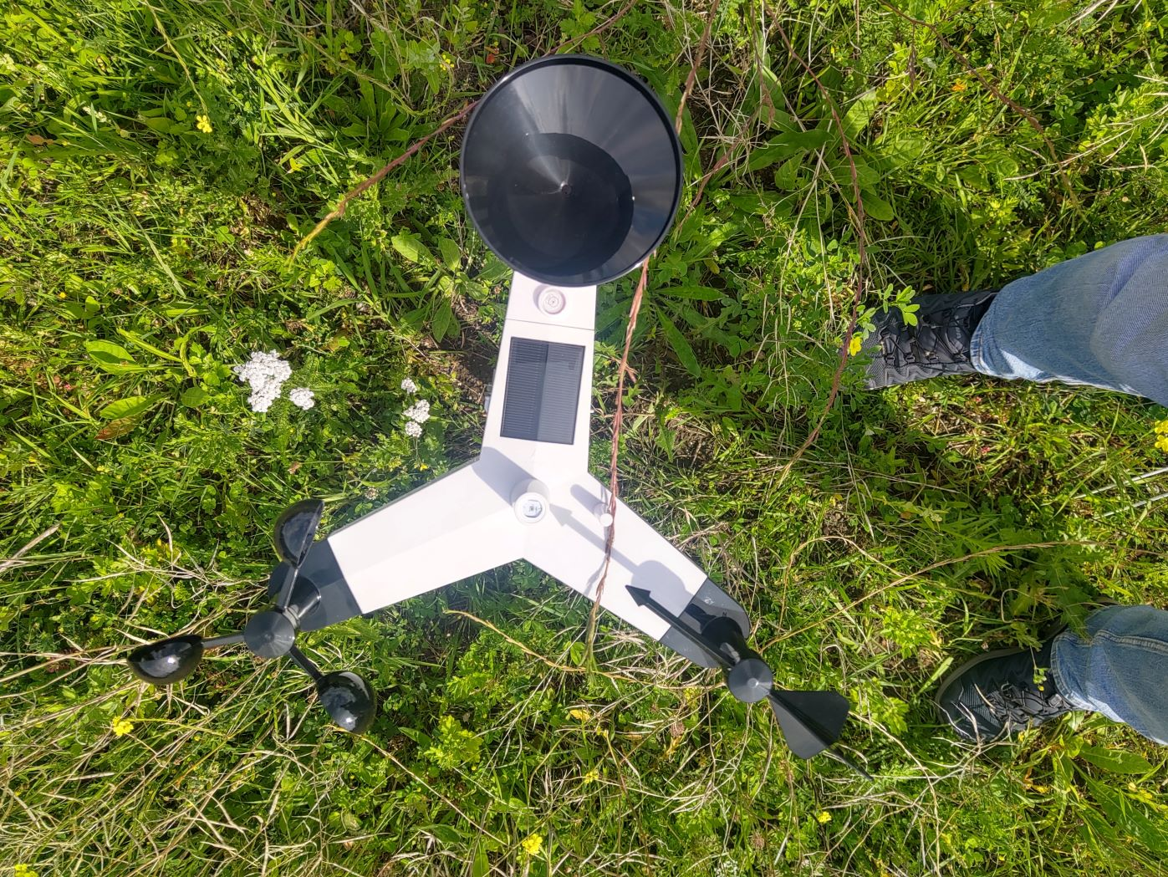
The Delft Measures Citizen Science project
Citizen science project, focusing on urban climate in Delft, the Netherlands
Over 50 Citizen Scientists
“Adopt” a weather station to measure
Alecto WS-5500
Research opportunities:
  Weather observations: rain, temperature,
  humidity, soil moisture
  Heat stress, UHI
  Benefits of citizen input for hydrometeorology
DMR data availability as of December 2023

Slide 3
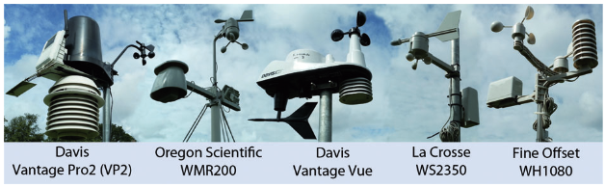
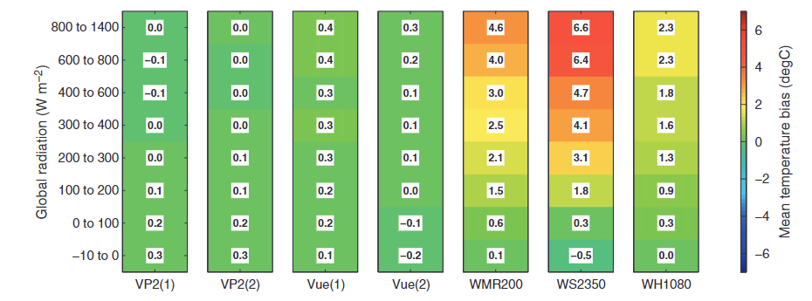
Citizen Science in (urban) meteorology
PWS: valuable for urban weather data
But: just a data-pull, without citizen interactions
Station setup unknown, which can cause massive errors

Slide 4
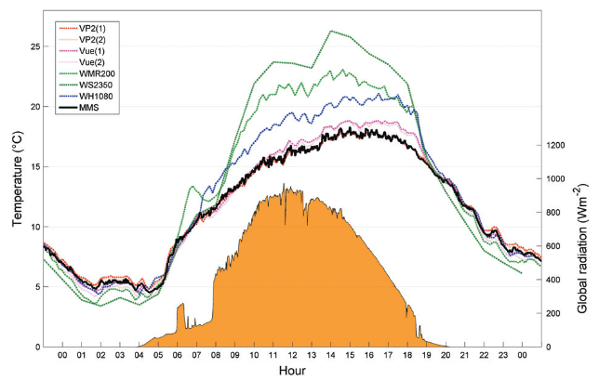

Slide 5

Can we quantify the effect of ‘bad’ setup?
We assume an “ideal” installation, but that’s often not possible
People are limited by space, personal choices, skill
What is the effect of station installation on the observed PWS rainfall?
What are the hindrances people have for PWS measurements?

Slide 6
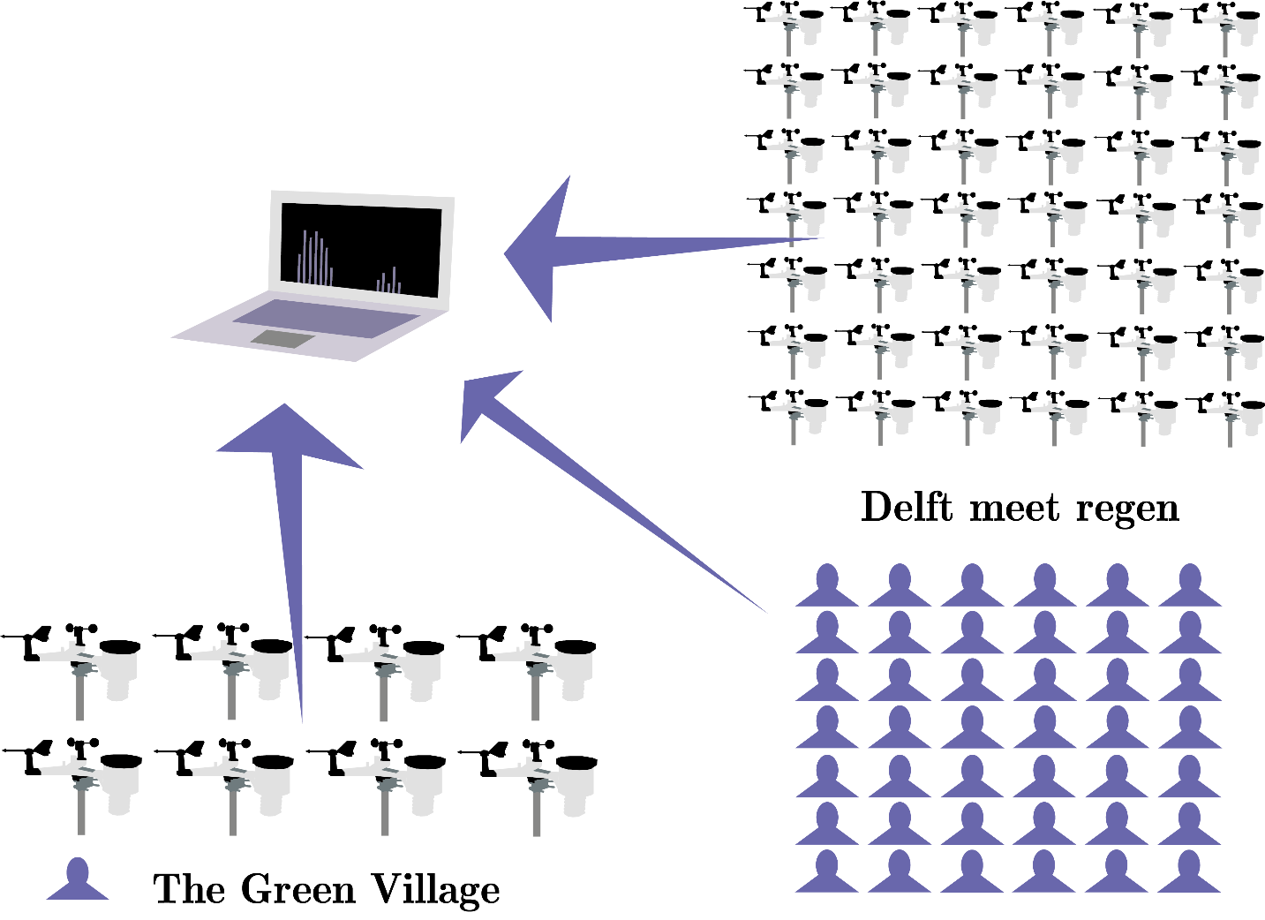
Research questions
How accurate and reliable are the precipitation observations of the Alecto WS-5500, and is it possible to quantify setup differences?
Notes:
Only 1st and 3rd question discussed today

Slide 7
Research questions
How does the monitoring and maintenance of owners of PWS influence data quality?
Notes:
Only 1st and 3rd question discussed today

Slide 8
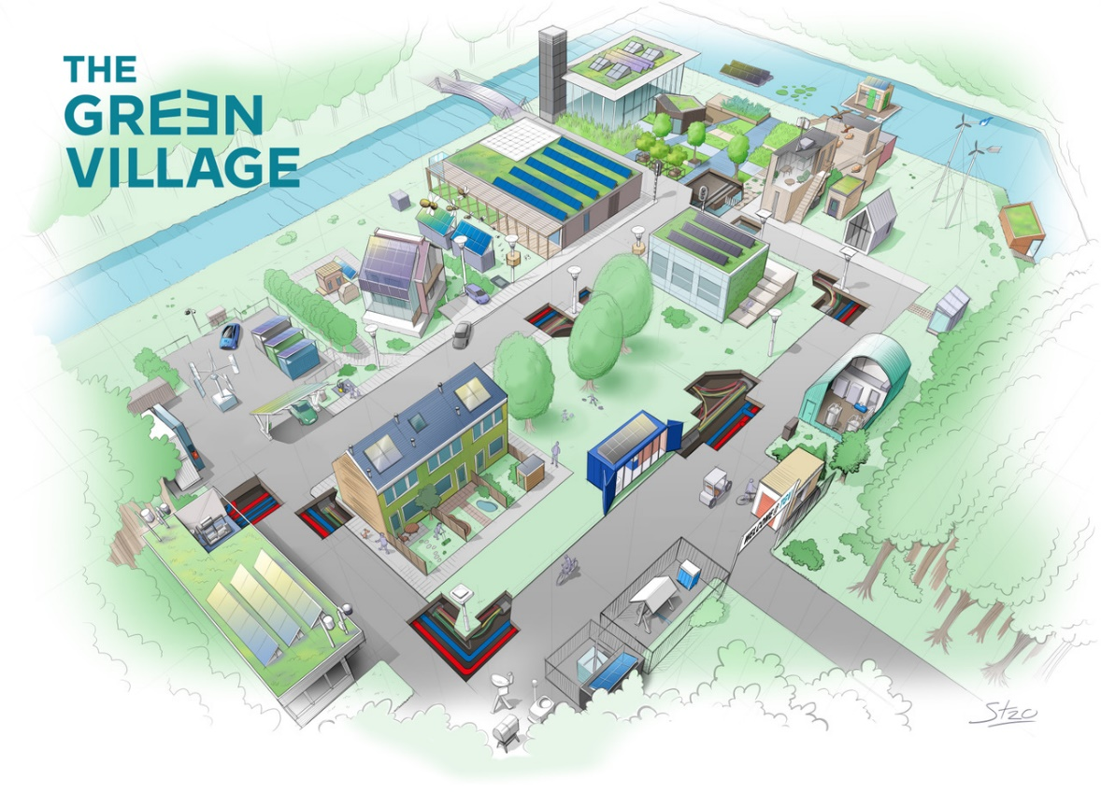




Slide 9
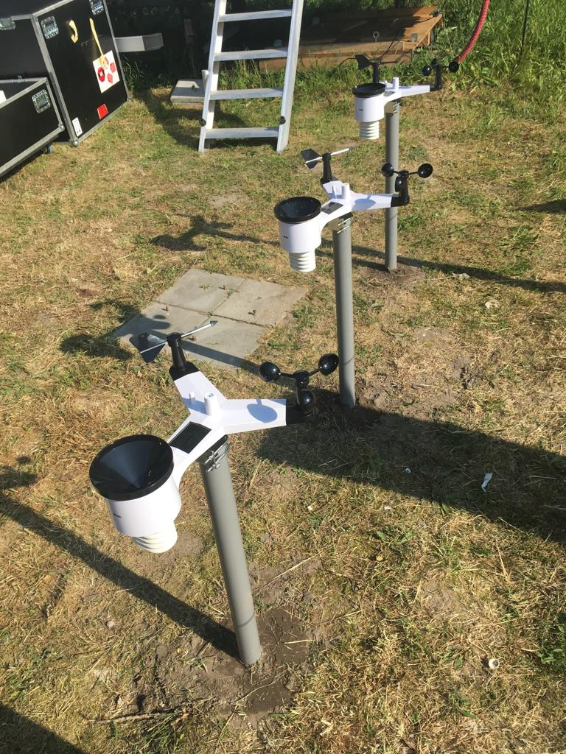
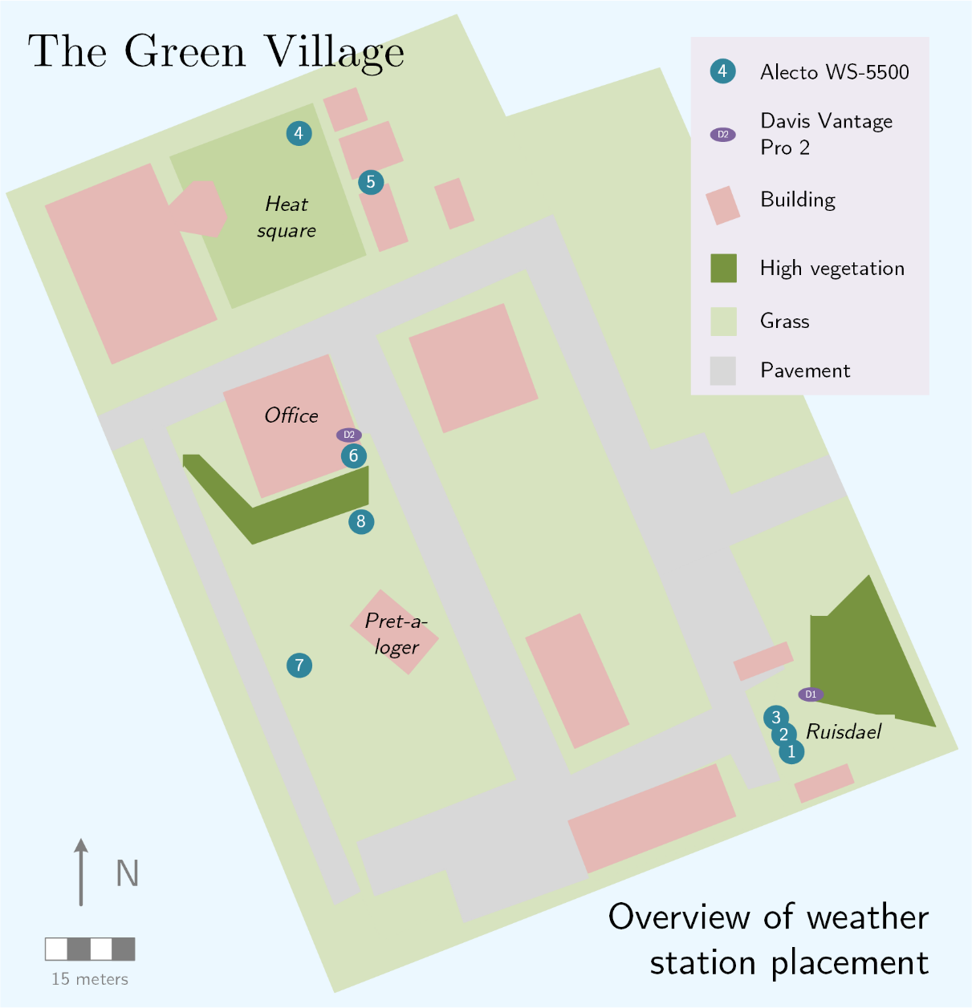
Green Village experimental setup
“Ideal” setup comparison: 1,2,3
Tilted station: 3, 4
Roof station: 6
Blocked station: 5
Environment variation: 7,8
Reference stations: radar, manual gauge, MRR, Davis VP2
Notes:
Station 1 is used as a reference for the others

Slide 10
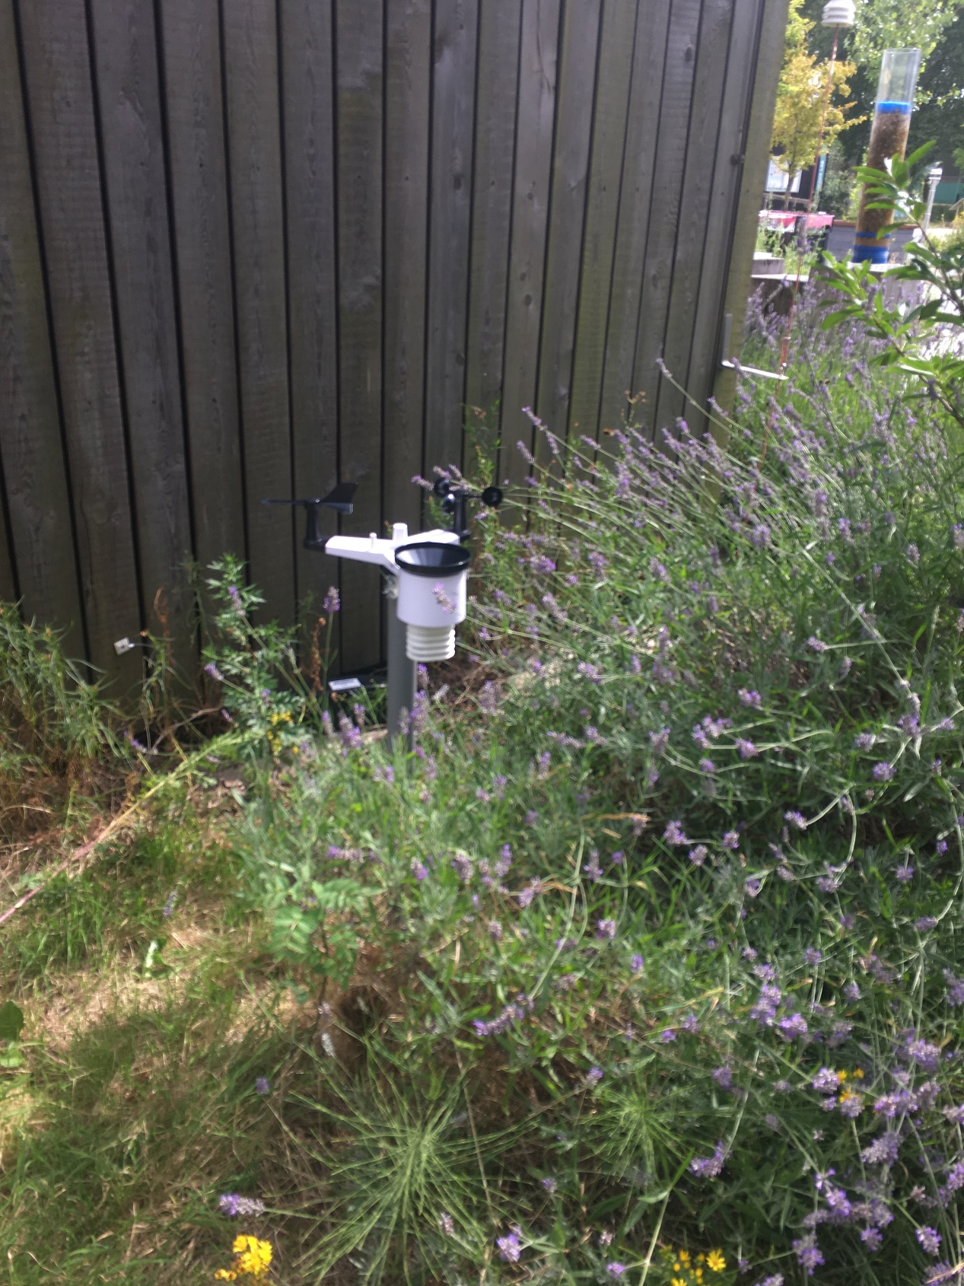
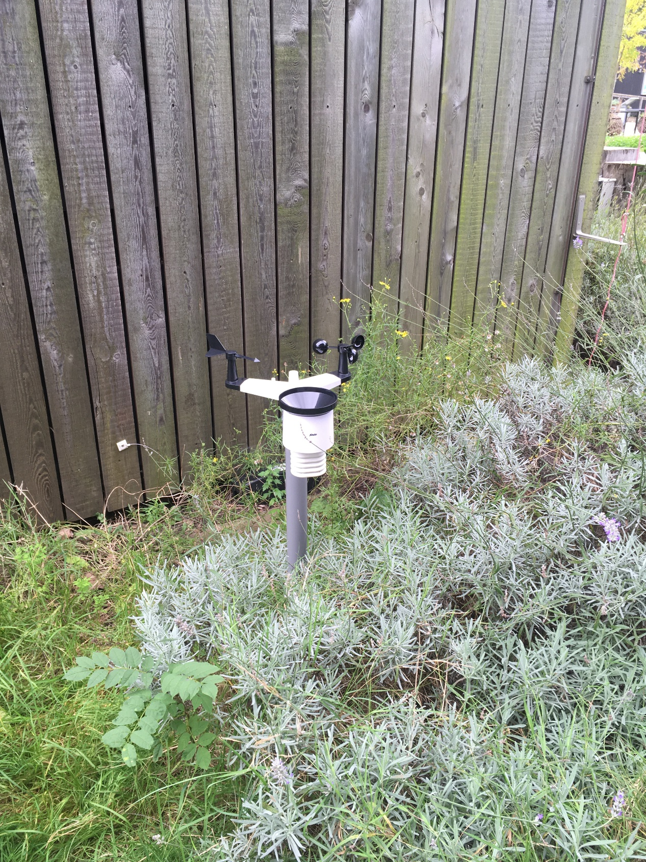
Next to wall: expected underestimation
Trend shifts

Slide 11
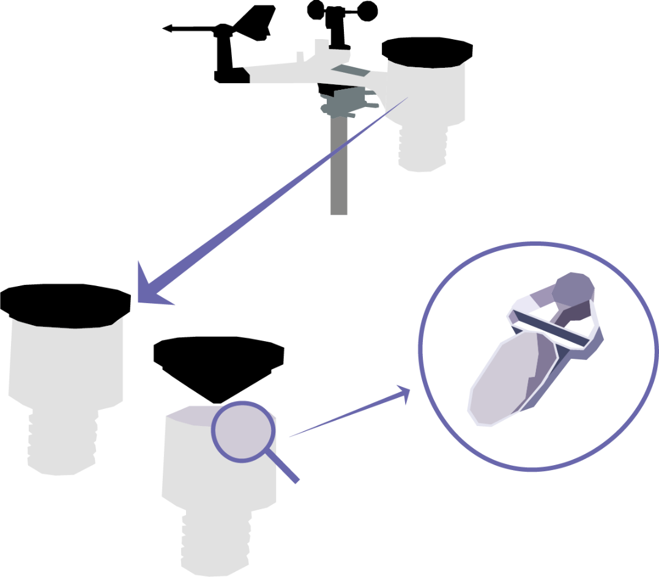
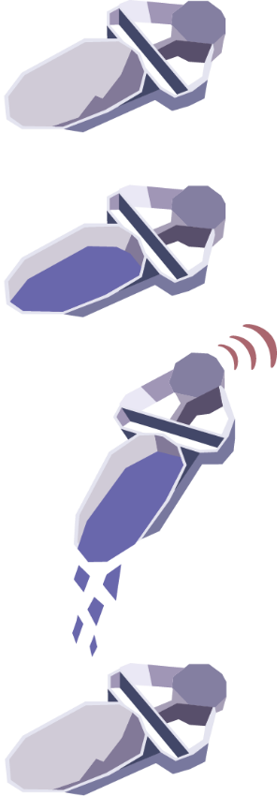

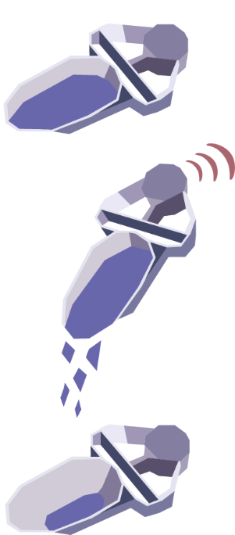
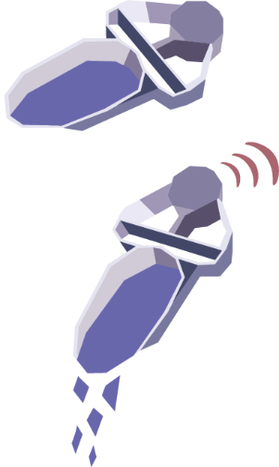
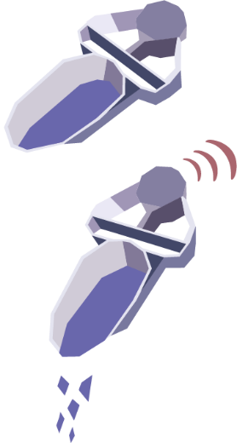
Errors in tipping volume
Lower tipping volume
Overestimation of rainfall
Incomplete emptying of tipping bucket
Tilted station

Slide 12
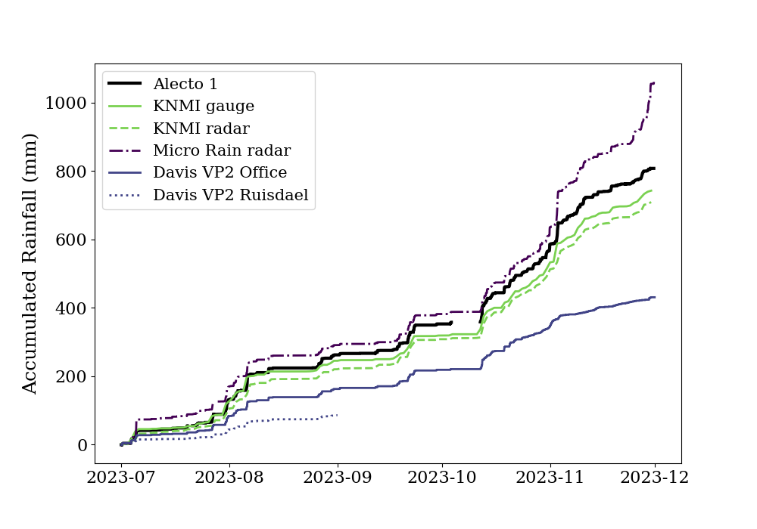

Alecto 1 vs. references
Overestimation Alecto, ~10% higher than KNMI (WMO) manual gauge
Good correlation with gauge and radar
Large differences within (established) precipitation measurement techniques!

Slide 13
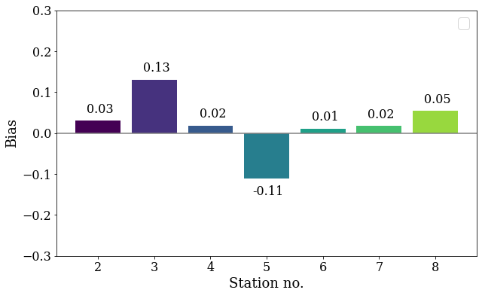
Relative bias as function of placement
(rooftop)
(tilted)
(near wall)

Slide 14
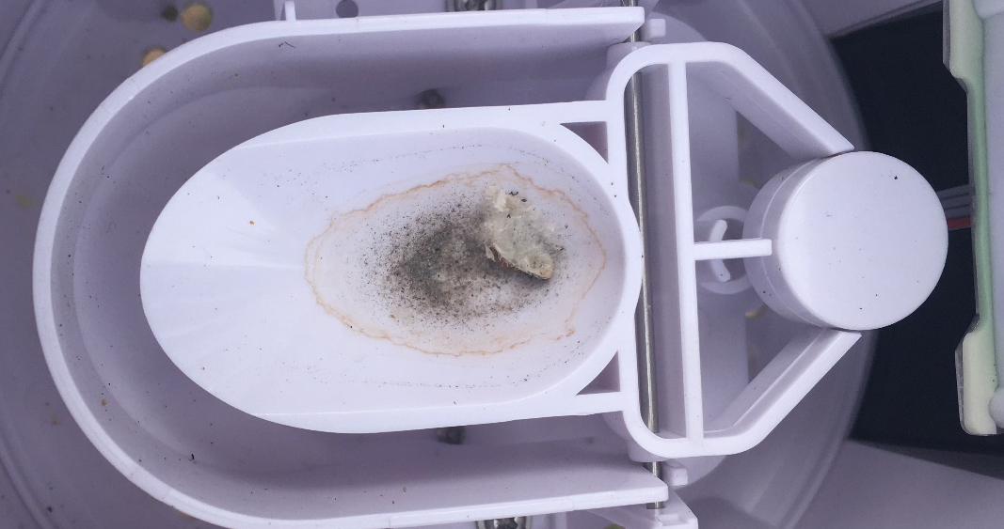
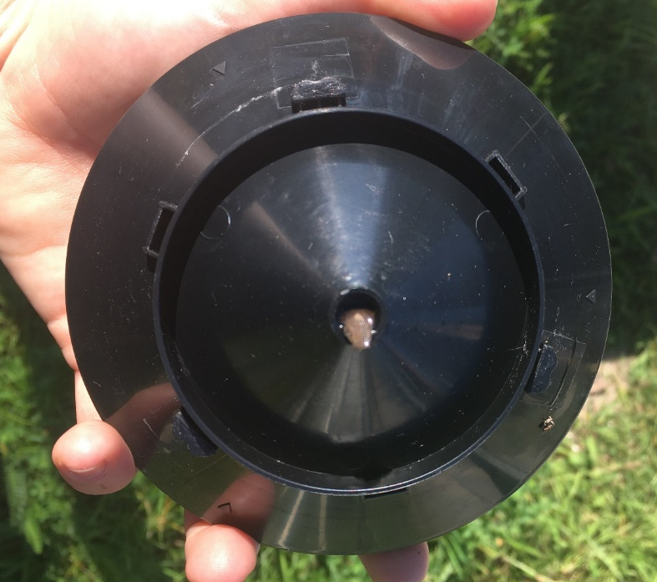
Interaction with DMR participants
Survey completed in September 2023
Questions on maintenance and monitoring frequency
Photos from participants
Home visits to assist with the installation;
Complex installation process leads to missing data
Notes:
Opportunity for metadata

Slide 15
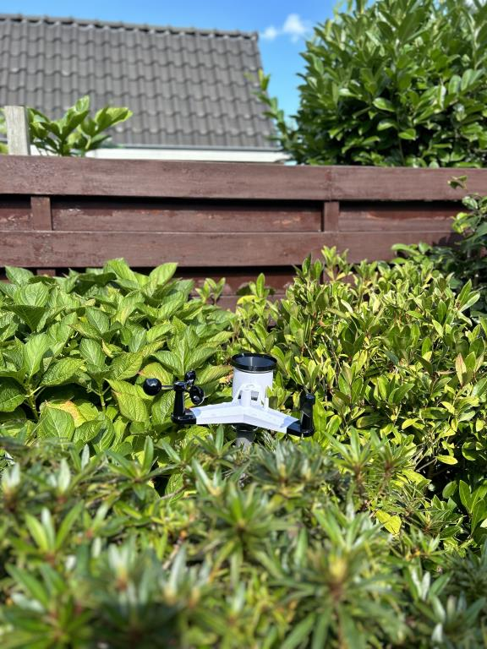
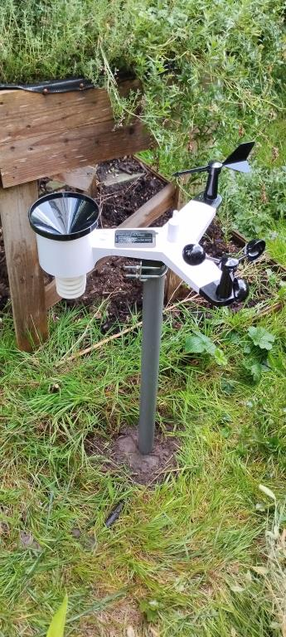
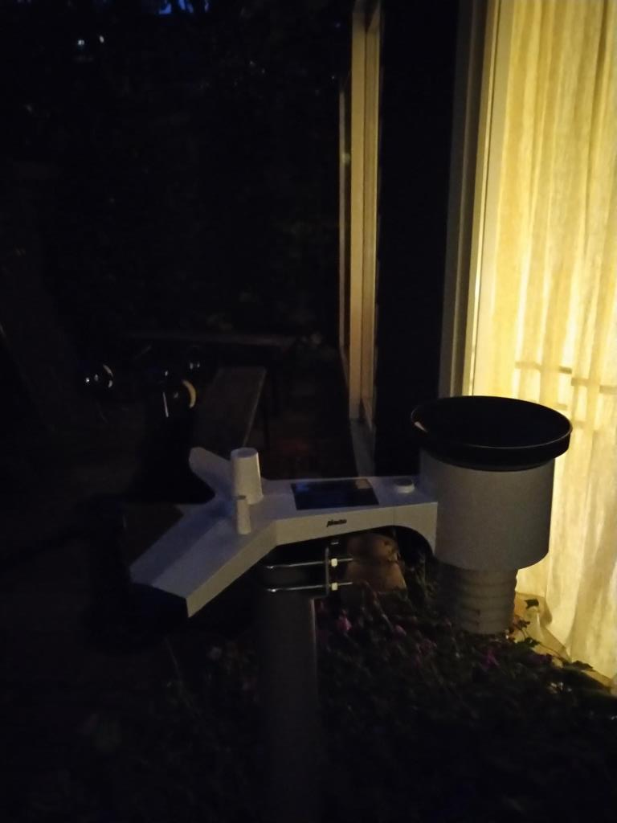
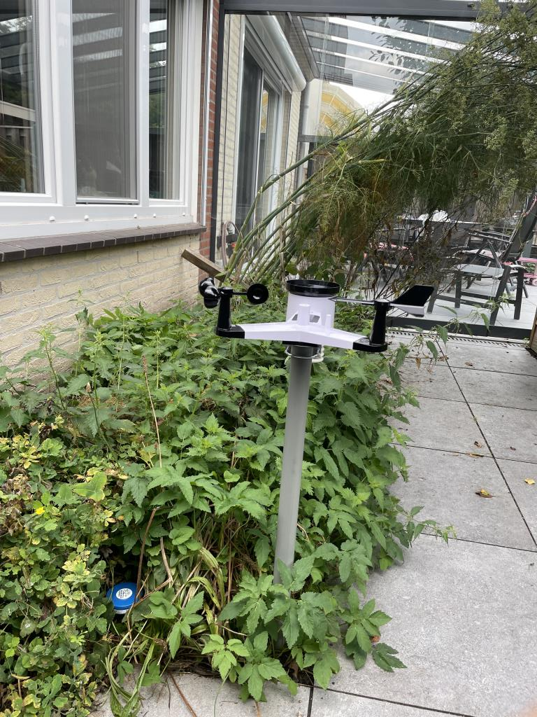
DMR Participants
Variation in setups and bias, not always explained by photographs.
Limited options for station placement: realistic conditions
How often do they check their station & data?

Slide 16
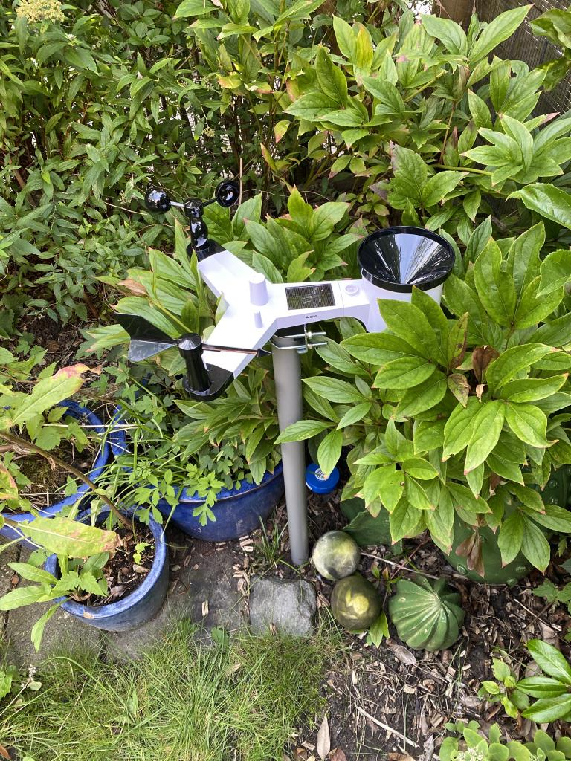
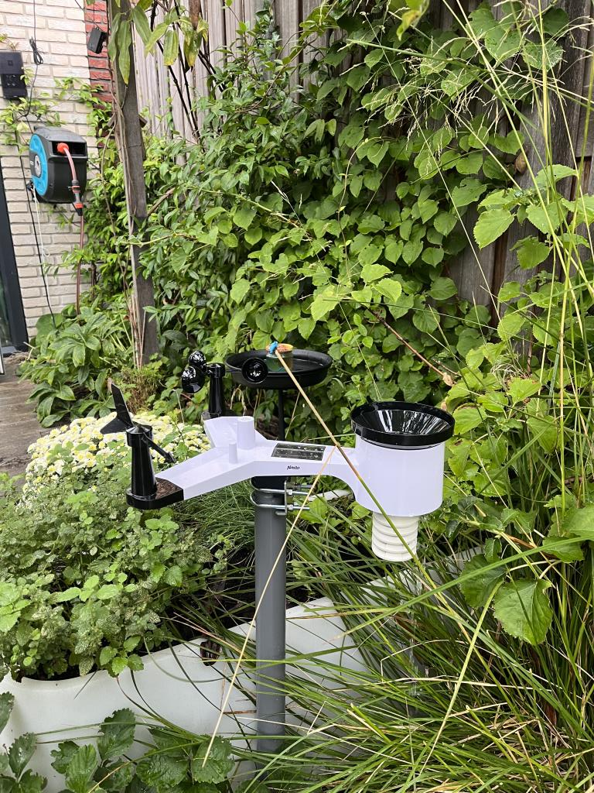
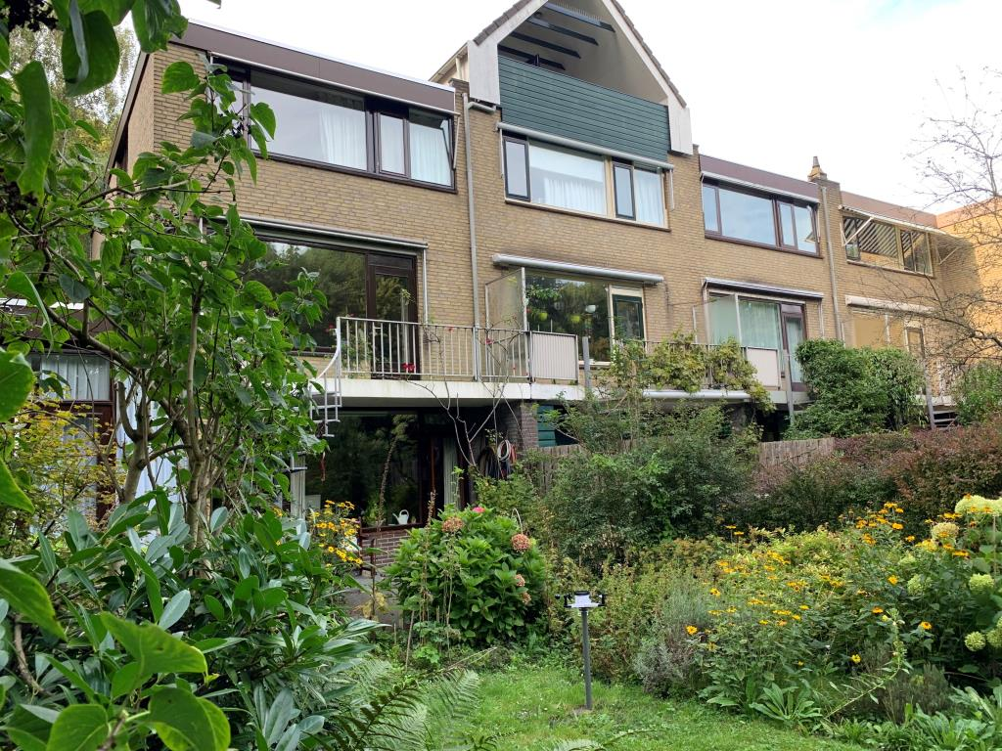
DMR Participants

Slide 17
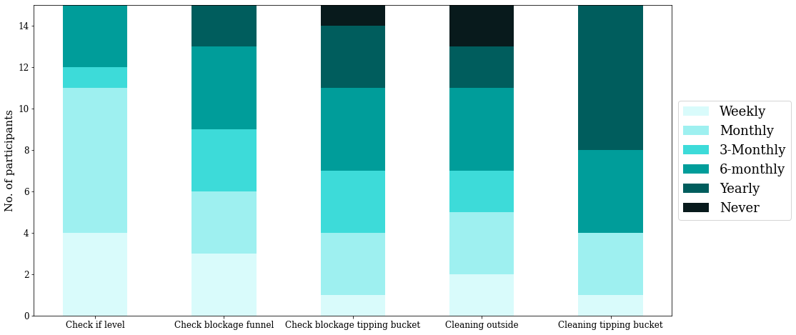
DMR Participants: maintenance
Frequency of maintenance variable amongst participants; cleaning often done less than once a month
No clear relationship between maintenance, setup information and bias

Slide 18
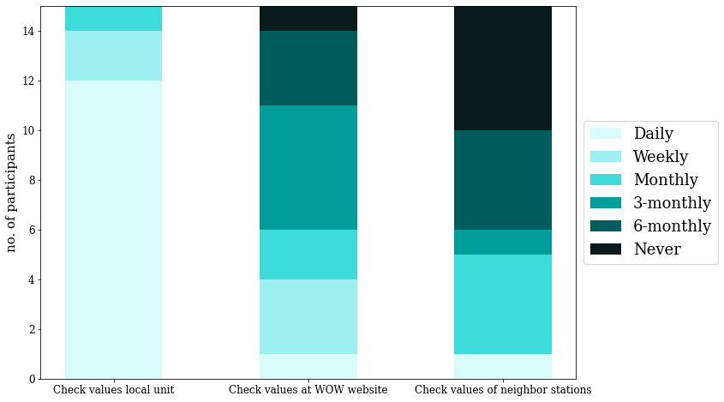
DMR Participants: data check

Slide 19

The Green Village setup
How accurate and reliable are the precipitation observations of the Alecto WS-5500, and is it possible to quantify setup differences?
Accurate rainfall accumulations compared to KNMI references, overestimation of 10%
General quality of measurements quite good!
Lower tipping volume due to incomplete emptying of tipping bucket
Substantial biases for tilted and obstructed stations
Lower correlation on 5 min resolution due to sampling errors

Slide 20
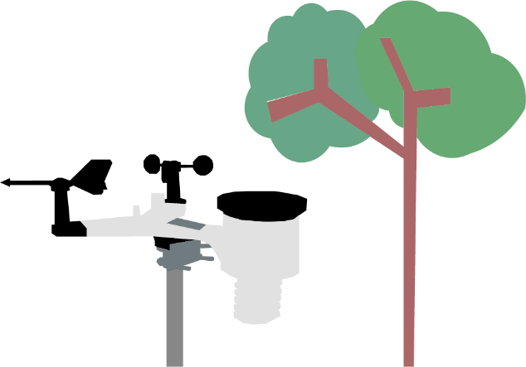
DMR Participants
How does the monitoring and maintenance of owners of PWS influence data quality?
Large variation in bias for different stations
Large variation in maintenance frequency
Large variation in station setups
No clear relationship between station bias, maintenance or location from available data

Slide 21
To conclude
Station setup is a strong component of bias and error in PWS (rainfall) data
Station quality vs setup quality
How to deal with this?
Citizen input is very valuable to correct PWS data
  And to foster interest & participation in science!
Currently: make link to local urban morphology

Slide 22
Thank you for your attention
Arjan Droste
a.m.droste@tudelft.nl

Slide 23
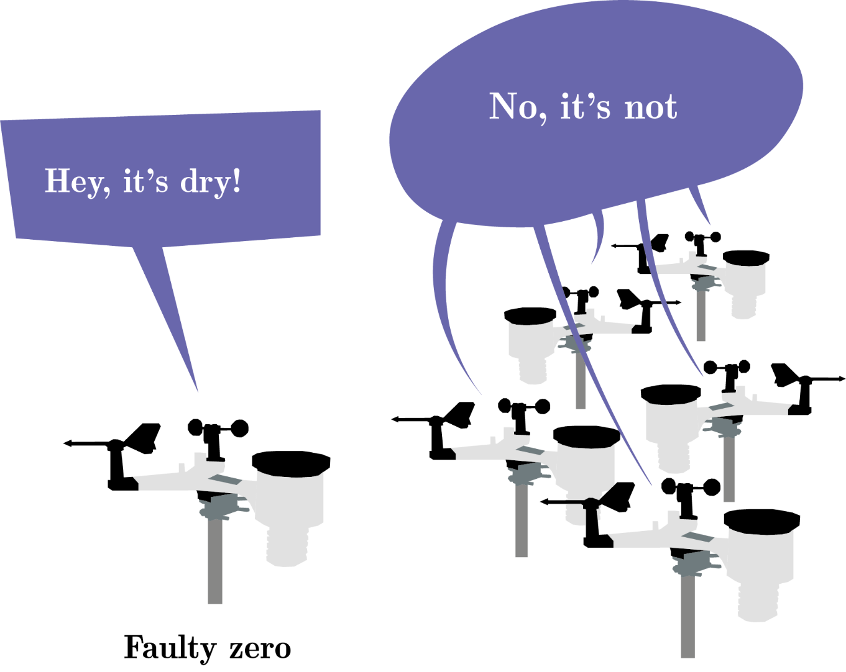
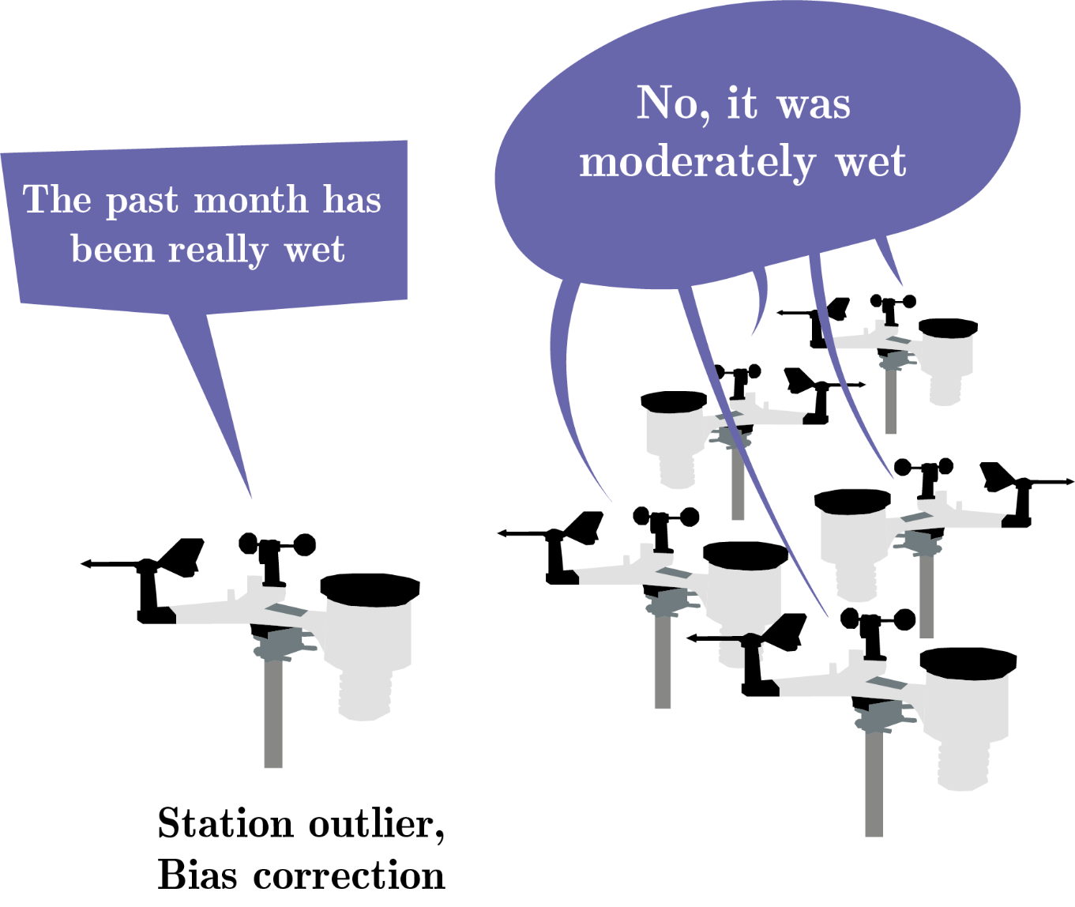
Filtering procedure
Following Netatmo QC algorithm from De Vos et al. (2019)
High Influx (HI), Faulty Zero (FZ) & Station Outlier (SO) errors + Bias Correction
Filtering based on neighbouring stations

Slide 24
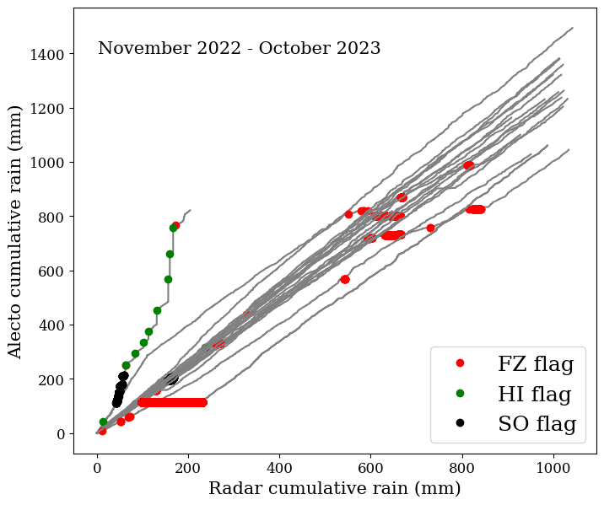
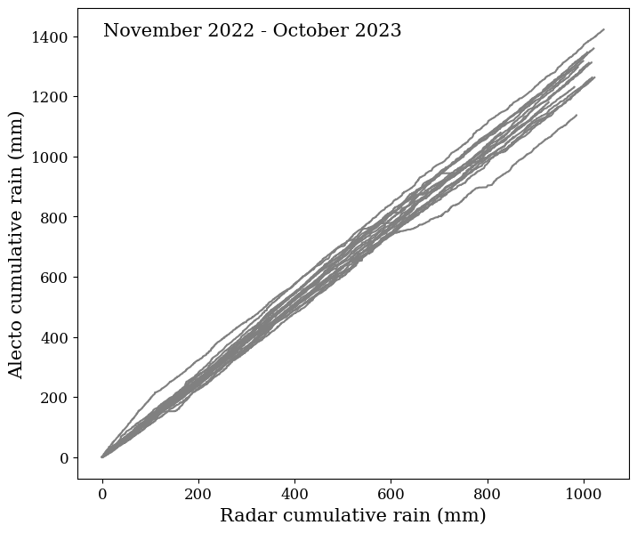
Filtering procedure
Following Netatmo QC algorithm from De Vos et al. (2019)
High Influx (HI), Faulty Zero (FZ) & Station Outlier (SO) errors + Bias Correction
Filtering based on neighbouring stations

