Slide 1
Introduction to the 2nd International Conference on Opportunistic Sensing of Precipitation
Aart Overeem (KNMI)
KNMI, De Bilt, 23 June 2026

Slide 2
Welcome by Dr. Ellen Verolme, Director KNMI

Slide 3
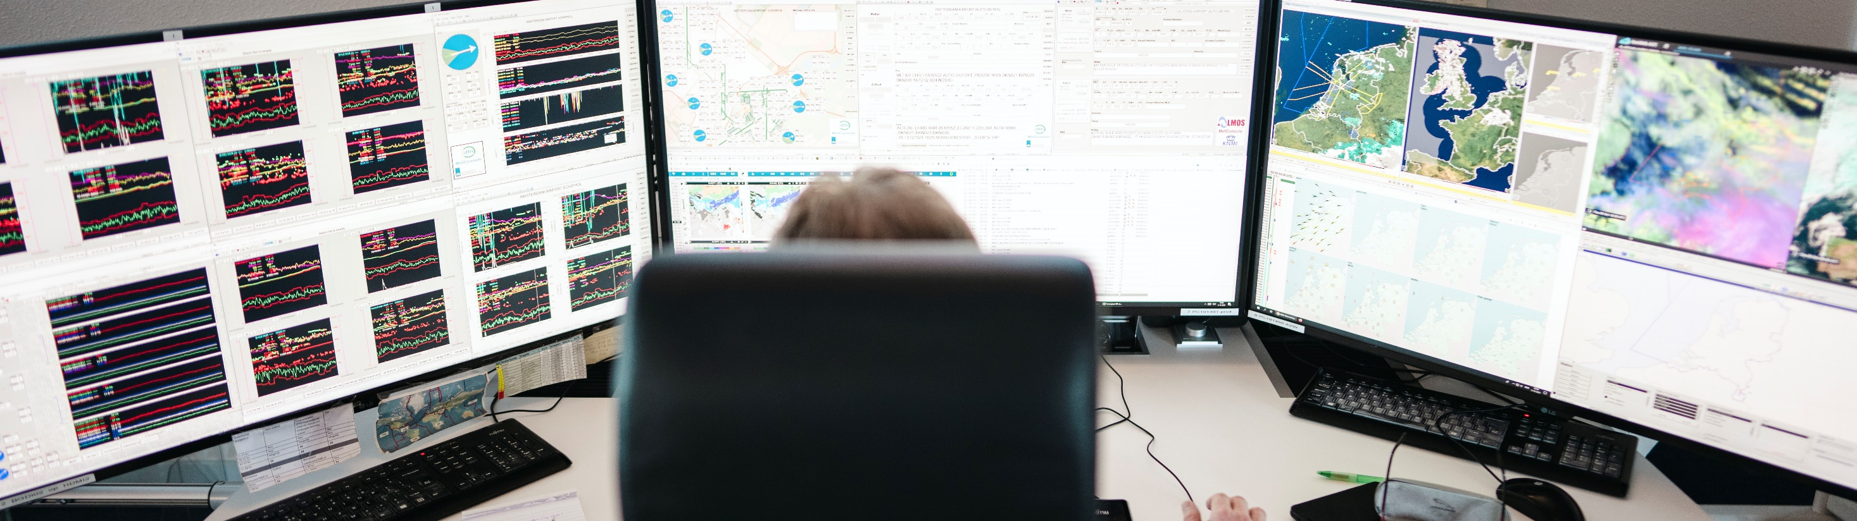
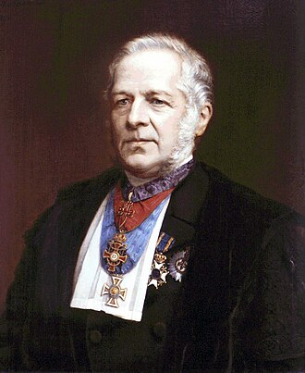
KNMI is
the national research and information centre for weather, climate and seismology;
founded in 1854, since 1897 located in De Bilt;
agency of the Ministry of Infrastructure and Water Management.

Slide 4
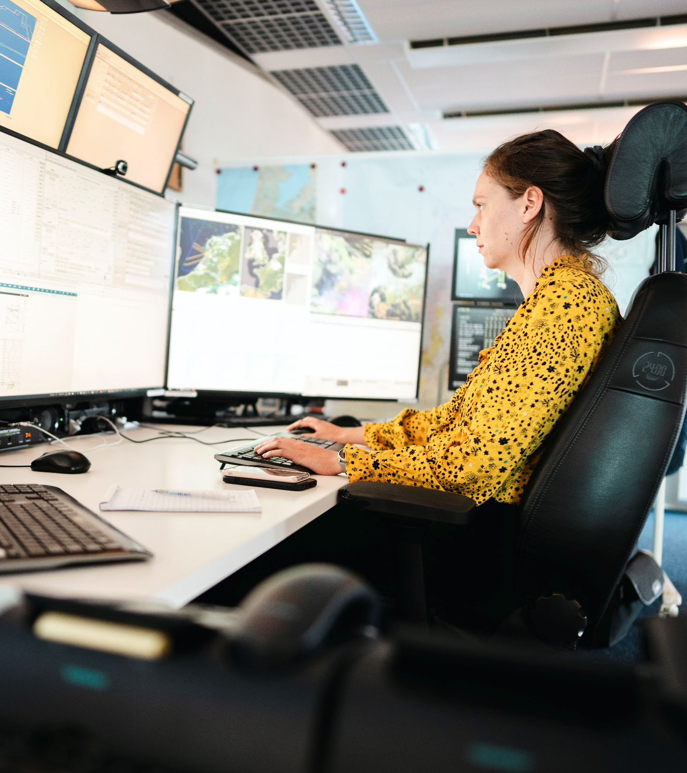
KNMI’s mission
KNMI advises on and warns society to reduce risks in the field of weather, climate and seismology in order to limit damage and injuries. With high-quality knowledge and technology plus an extensive observation network, KNMI offers products and services that contribute to the safety, accessibility, sustainability and prosperity of the Netherlands.

Slide 5
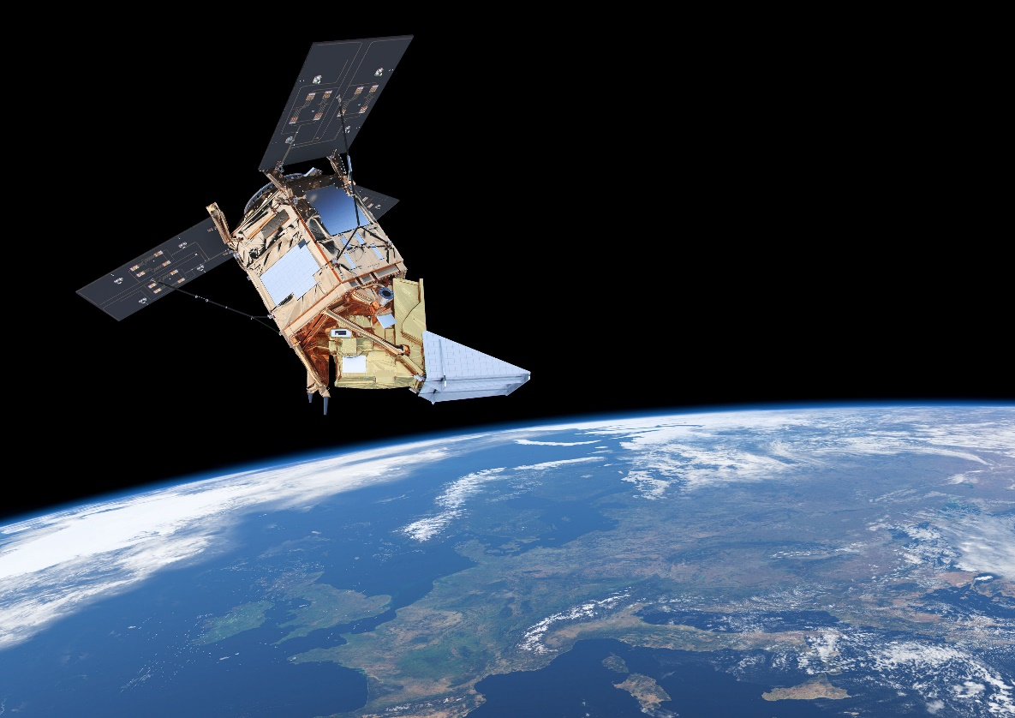
Core tasks by law
KNMI provides meteorological and seismological products and services that support various government agencies in their public tasks and responsibilities in the field of public order and safety.
The knowledge and information of KNMI is operationally available 24/7.
KNMI has an extensive observation network that forms the basis for our products, services and research.
KNMI carries out independent scientific research in the field of weather, climate, seismology and other geophysics.
Aviation and shipping services receive specific weather information from KNMI.

Slide 6
Overview of KNMI
Weather and climate are topics that concern everyone, every day. The impact on aviation, shipping, traffic and agriculture is substantial. Also earthquakes have their impact on society. The Royal Netherlands Meteorological Institute (KNMI) is involved with measurements, research, advice and warnings.
3
Users
Society
Weather services
e. g.
Weeronline
National policy
e.g. dikes, air quality
(Air)- traffic
2
Ministry of Defence
Research centers
e.g. RIVM, TNO
1
Measurements
Den Helder
KNMI data center
All data is collected at the KNMI data center, which is
part of the World Meteorological Organisation’s global network
of datacenters. KNMI receives satellite data from EUMETSAT.
Forecasts
These data are used in national and international weather forecast models that KNMI uses to provide weather and climate forecasts.
Weather balloon Upper air data
Universities
Earth observation
Measurements from space
Two precipitation radars
in Den Helder and Herwijnen to map out precipitation.
4
Research
With focus on measure- ment techniques, data processing and forecasts.
Schiphol
24/7 visual observations
Schiphol
De Bilt
KNMI compiles climate scenarios and does research on:
Meteorological tower Cabauw, 213 m.
Measures temperature, wind and radiation at various heights.
Cabauw
Upper atmosphere
Herwijnen
Lower atmosphere
(air quality,
NO2 )
Climate change (CO2)
Volcanoes
Weather model
45 automatic weather stations installed throughout
the Netherlands and the North Sea.
320 voluntary observers
with precipitation sensors complement
the KNMI data.
Seismometers and infrasound sensors provide insight into the cause of vibrations in the subsurface and the atmosphere.
KNMI alert codes
Be alert
Be prepared Take action
Earthquakes
KNMI provides services for Saba,
St. Eustatius and Bonaire
Ozone hole
This is a publication by ©KNMI 2023 | www.knmi.nl
Ice sheets and sea level

Slide 7





















KNMI positioning
Agency within the
national government
Meteorological service within the European Infrastructure
Research Institutes with strong academic ties

Slide 8
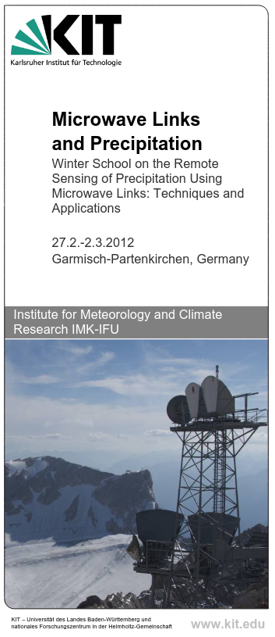
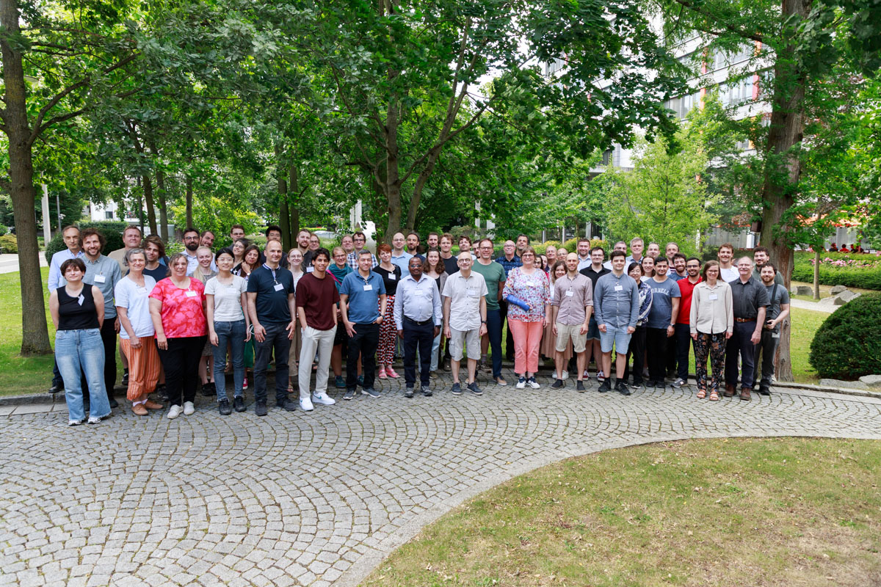
OpenSense legacy
Training schools focused on commercial microwave links (CMLs) that formed the consortium: 2012, 2019: Germany, 2015: Burkina Faso.
Proposals, e.g., CALL4RAIN (2017).
COST action OpenSense (2021 – 2025; also PWSs & SMLs)
1st OpenSense conference
SetGMDI (2025 – 2026; CML only)
(@DWD, June 2025)

Slide 9
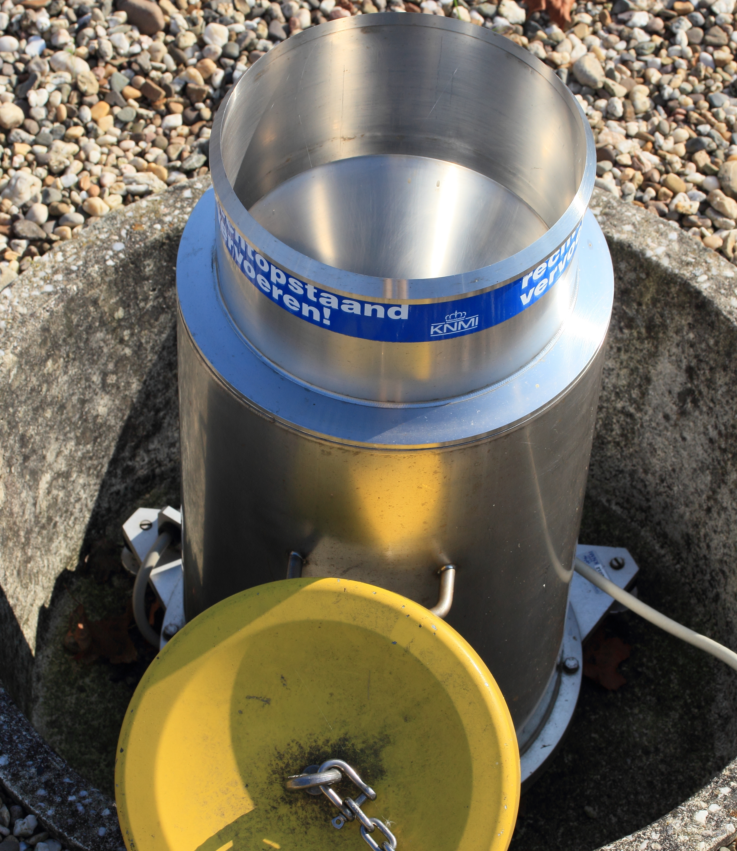
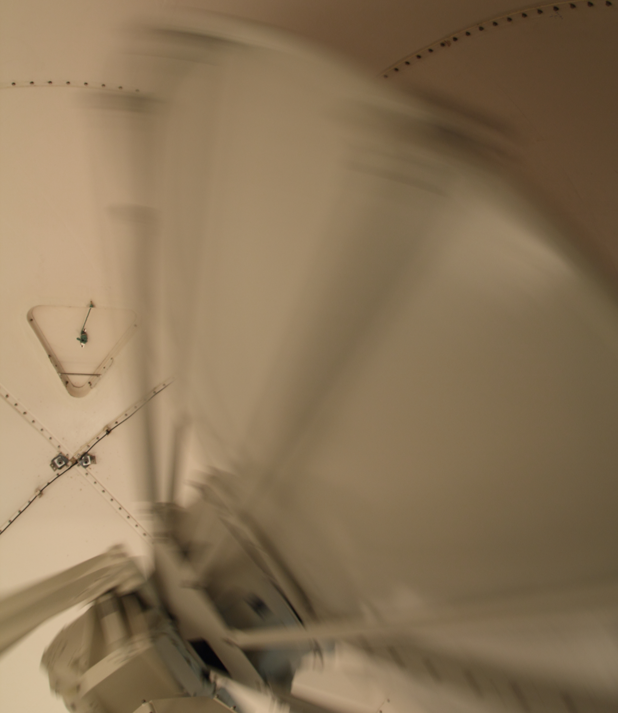
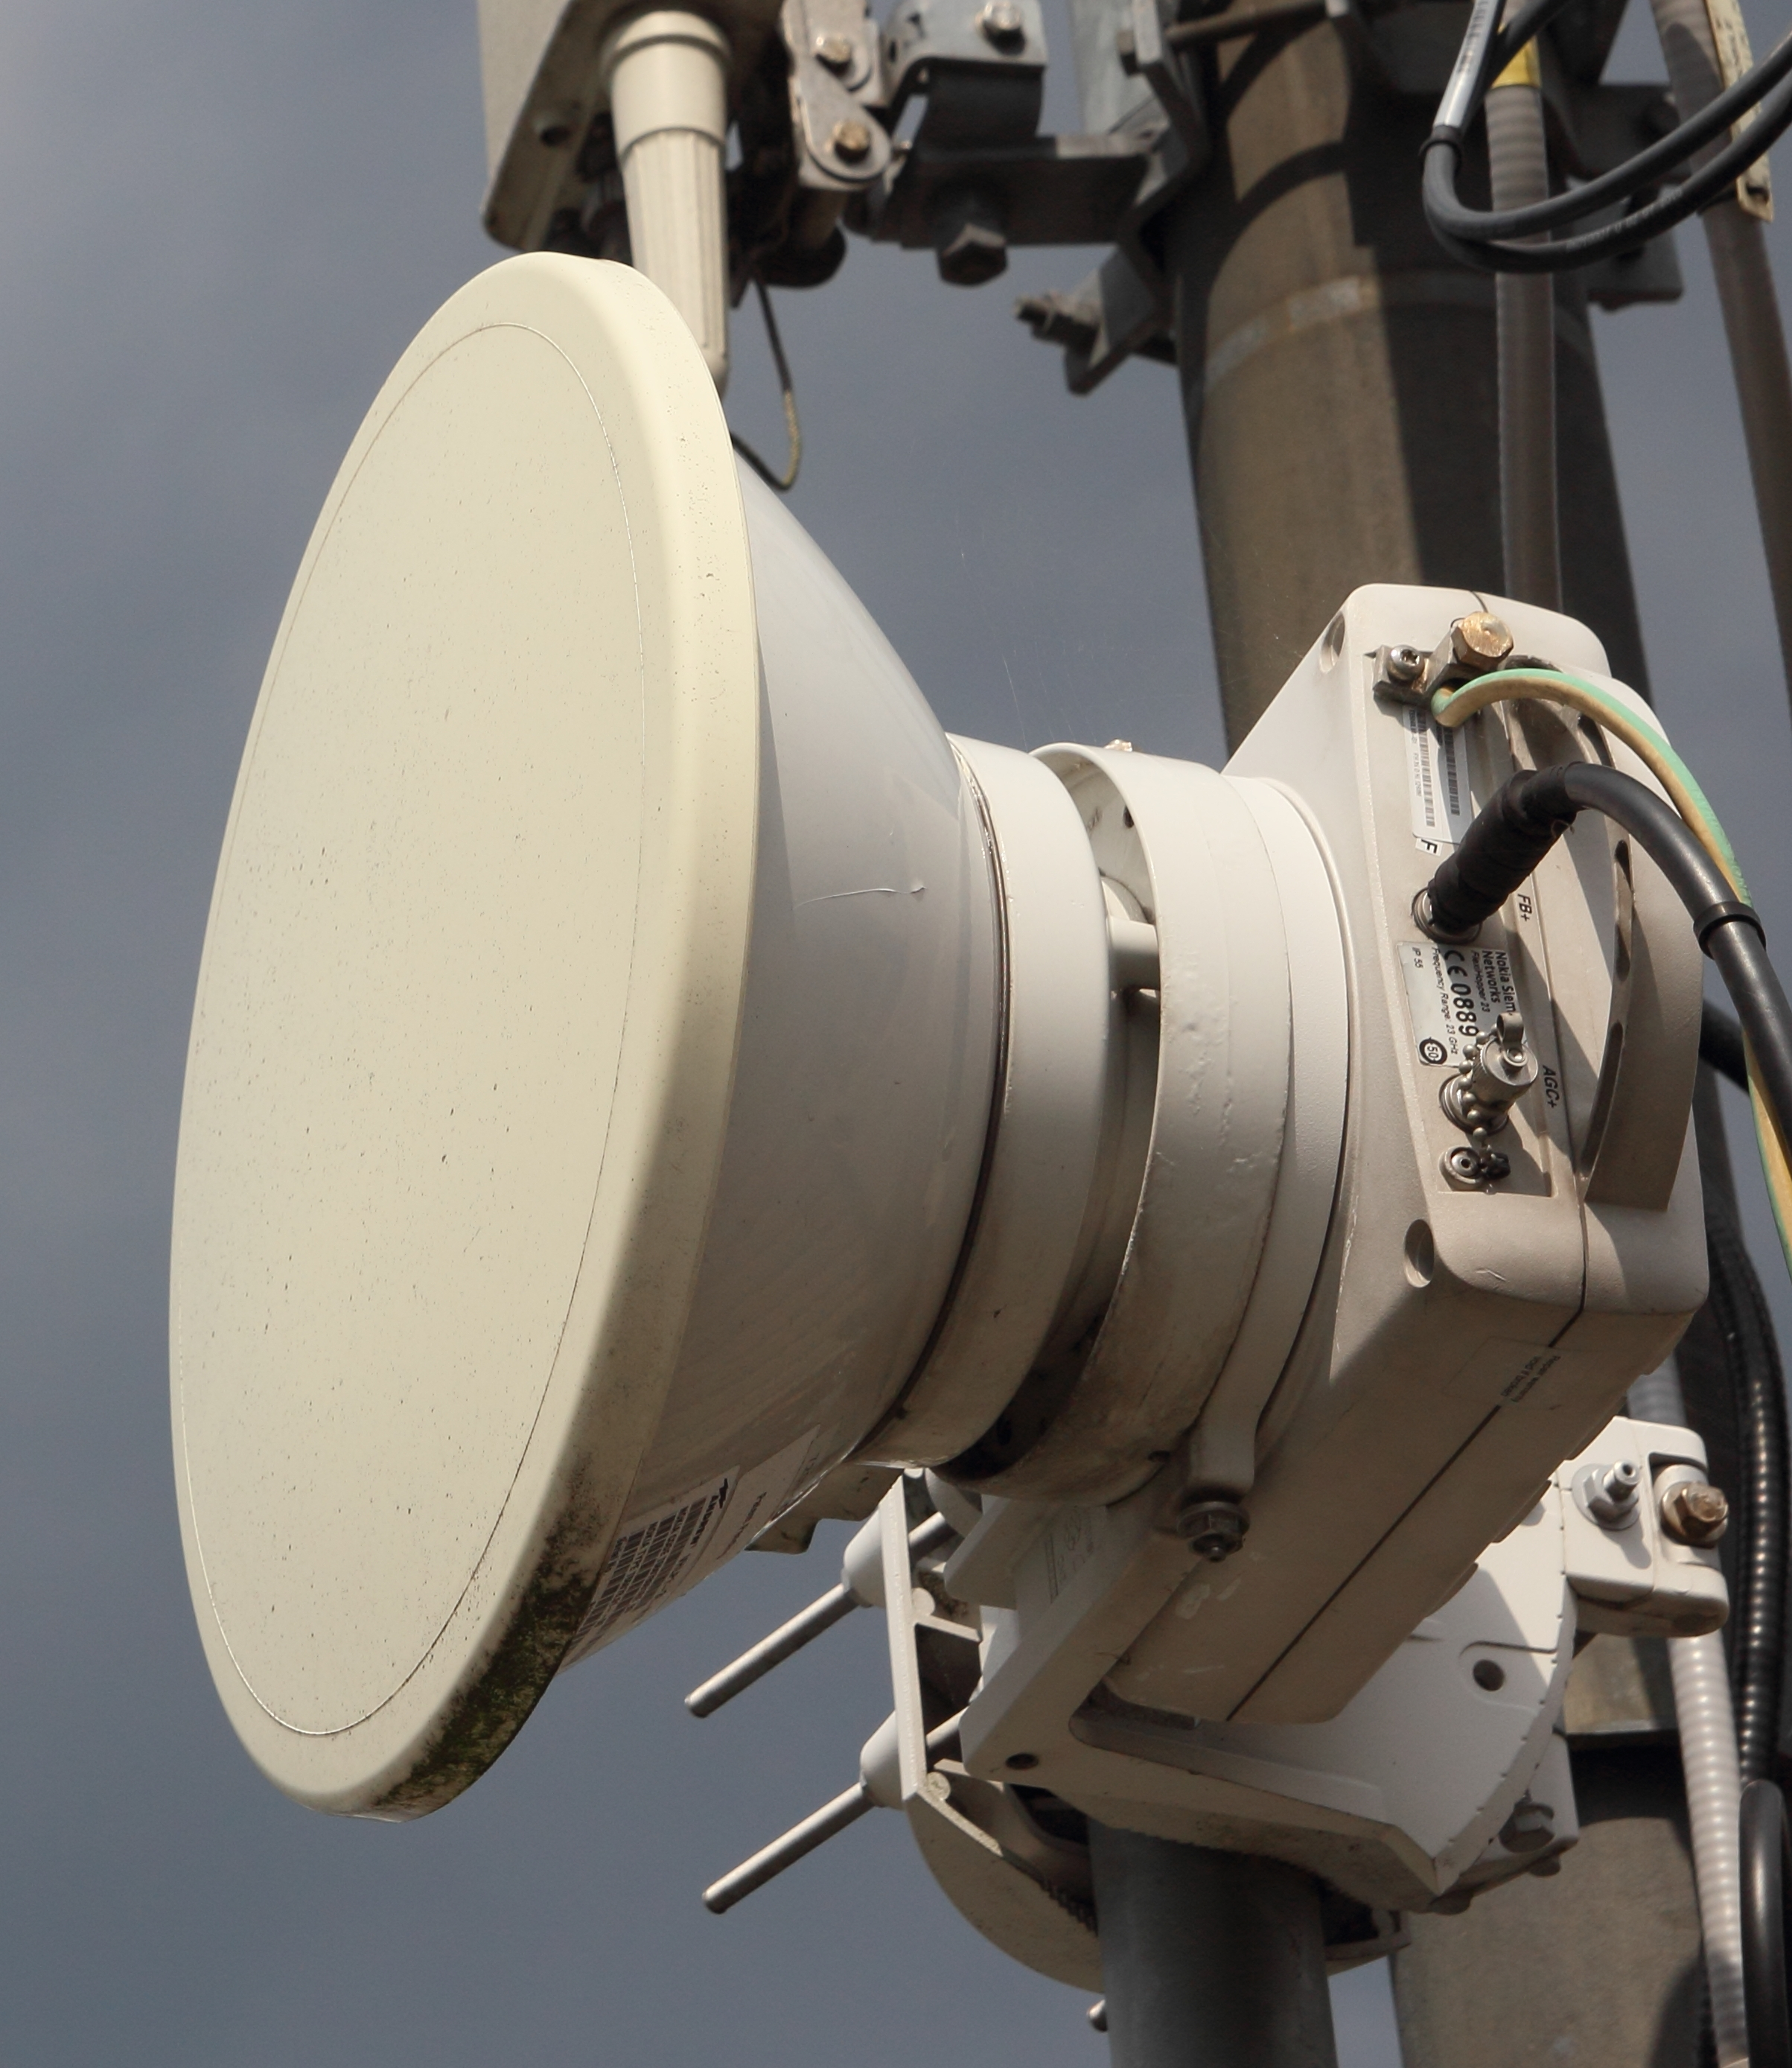
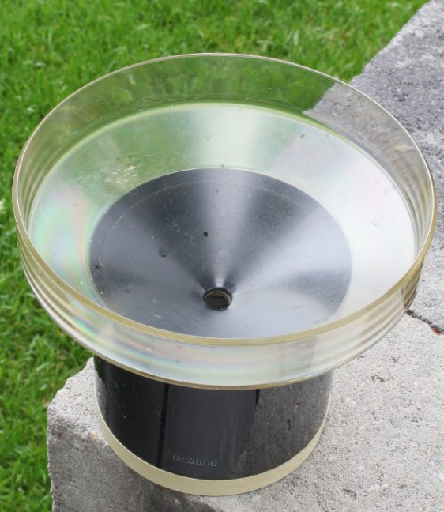
Worldwide maps with estimated coverage
GTS locations: Thanks to Peter Finger, Udo Schneider and Andreas Becker (DWD).
Olsson et al., 2025 (JHM)

Slide 10
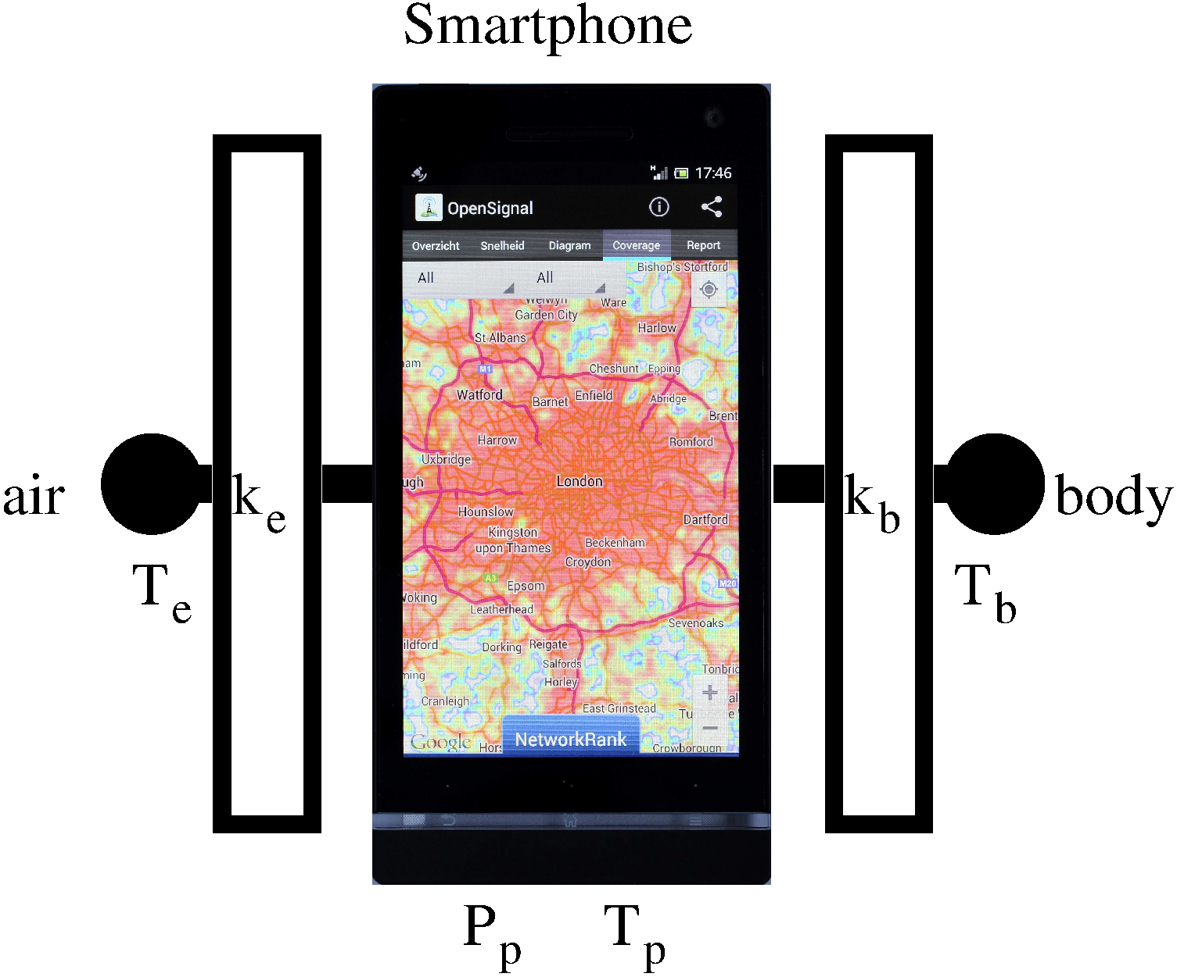
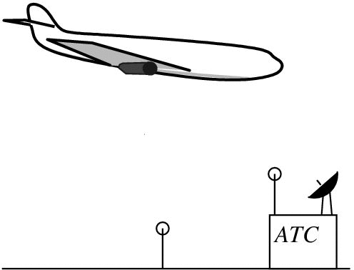
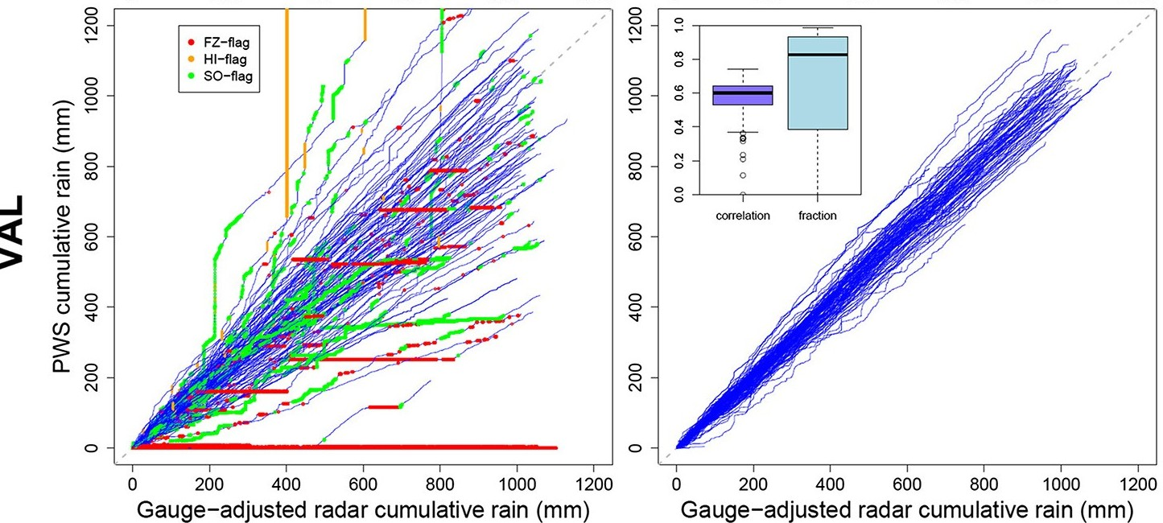
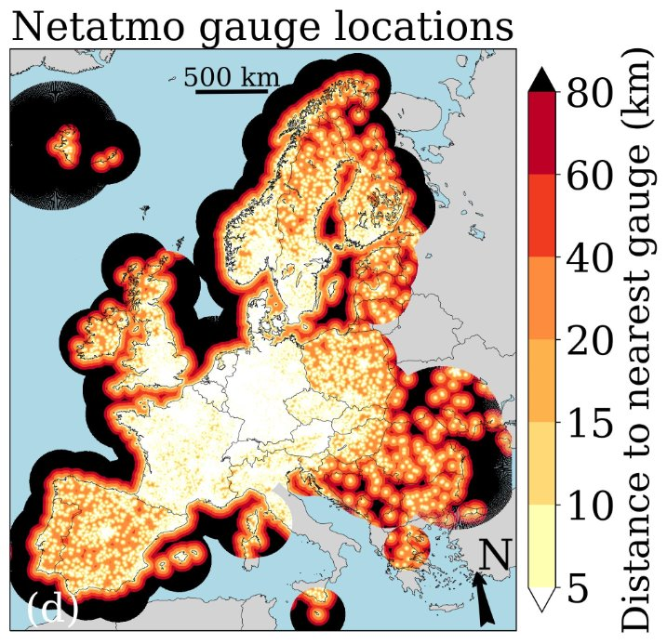
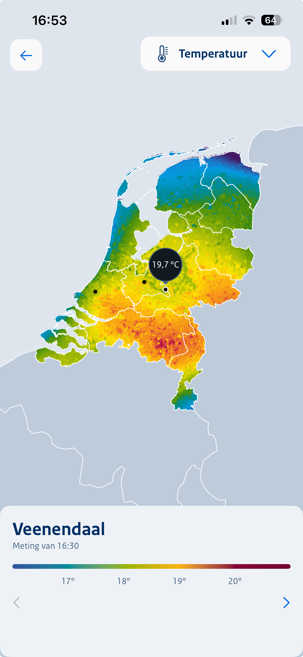
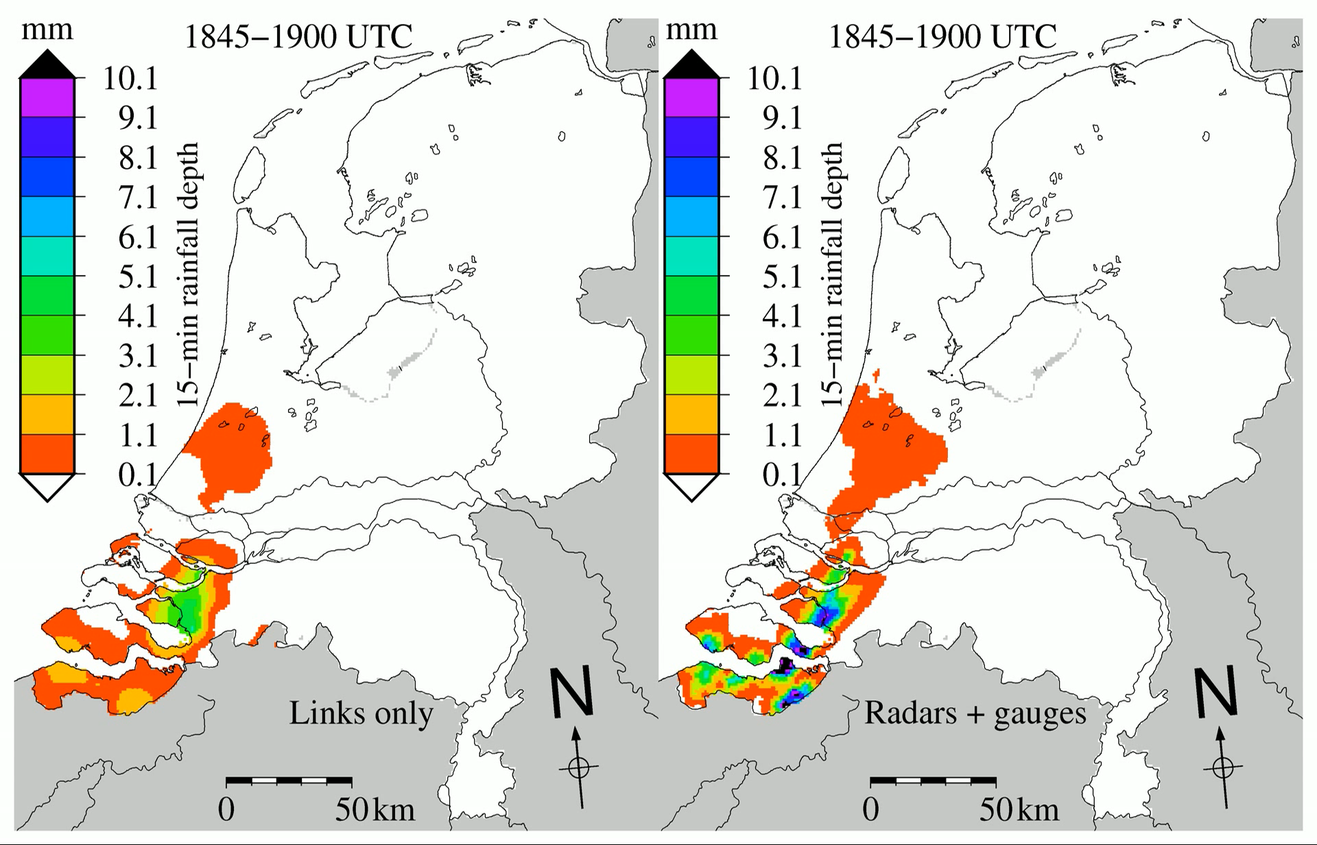
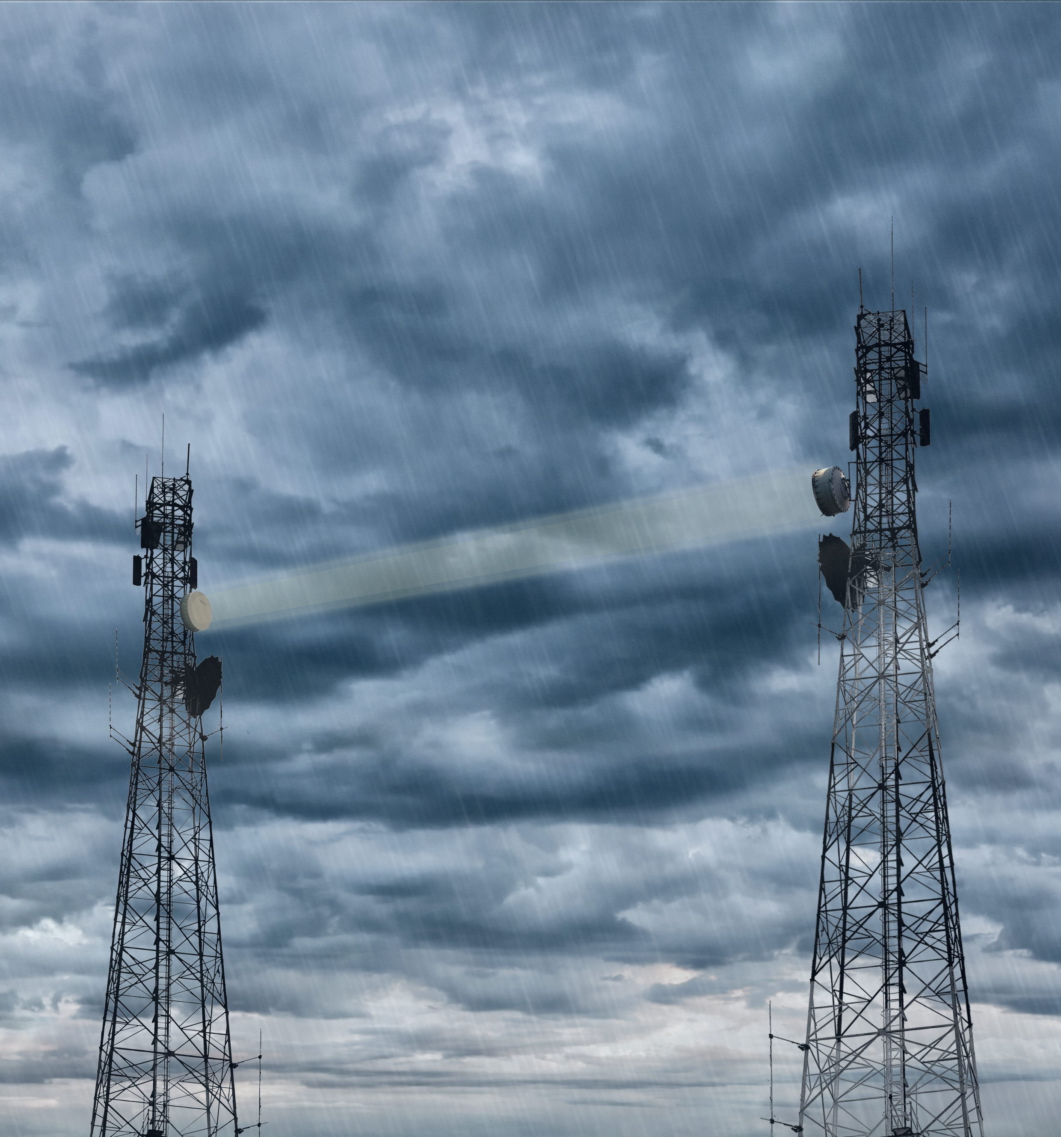
KNMI supports opportunistic sensing since ~20 years
https://doi.org/10.1002/grl.50786
https://emaddc.com/default.aspx
GPS: water vapour
MODE-S: wind & temperature (air traffic control radar)
Commercial microwave links: rainfall (> 15 years together with Wageningen University and now Delft University of Technology)
Personal weather stations (PWS): precipitation, temperature, ...
WOW-NL platform for PWS – used in our app for temperature & humidity.
…
https://doi.org/10.1029/2019GL083731
https://doi.org/10.5194/hess-28-649-2024
(identim/Shutterstock)
https://doi.org/10.1073/pnas.1217961110

Slide 11
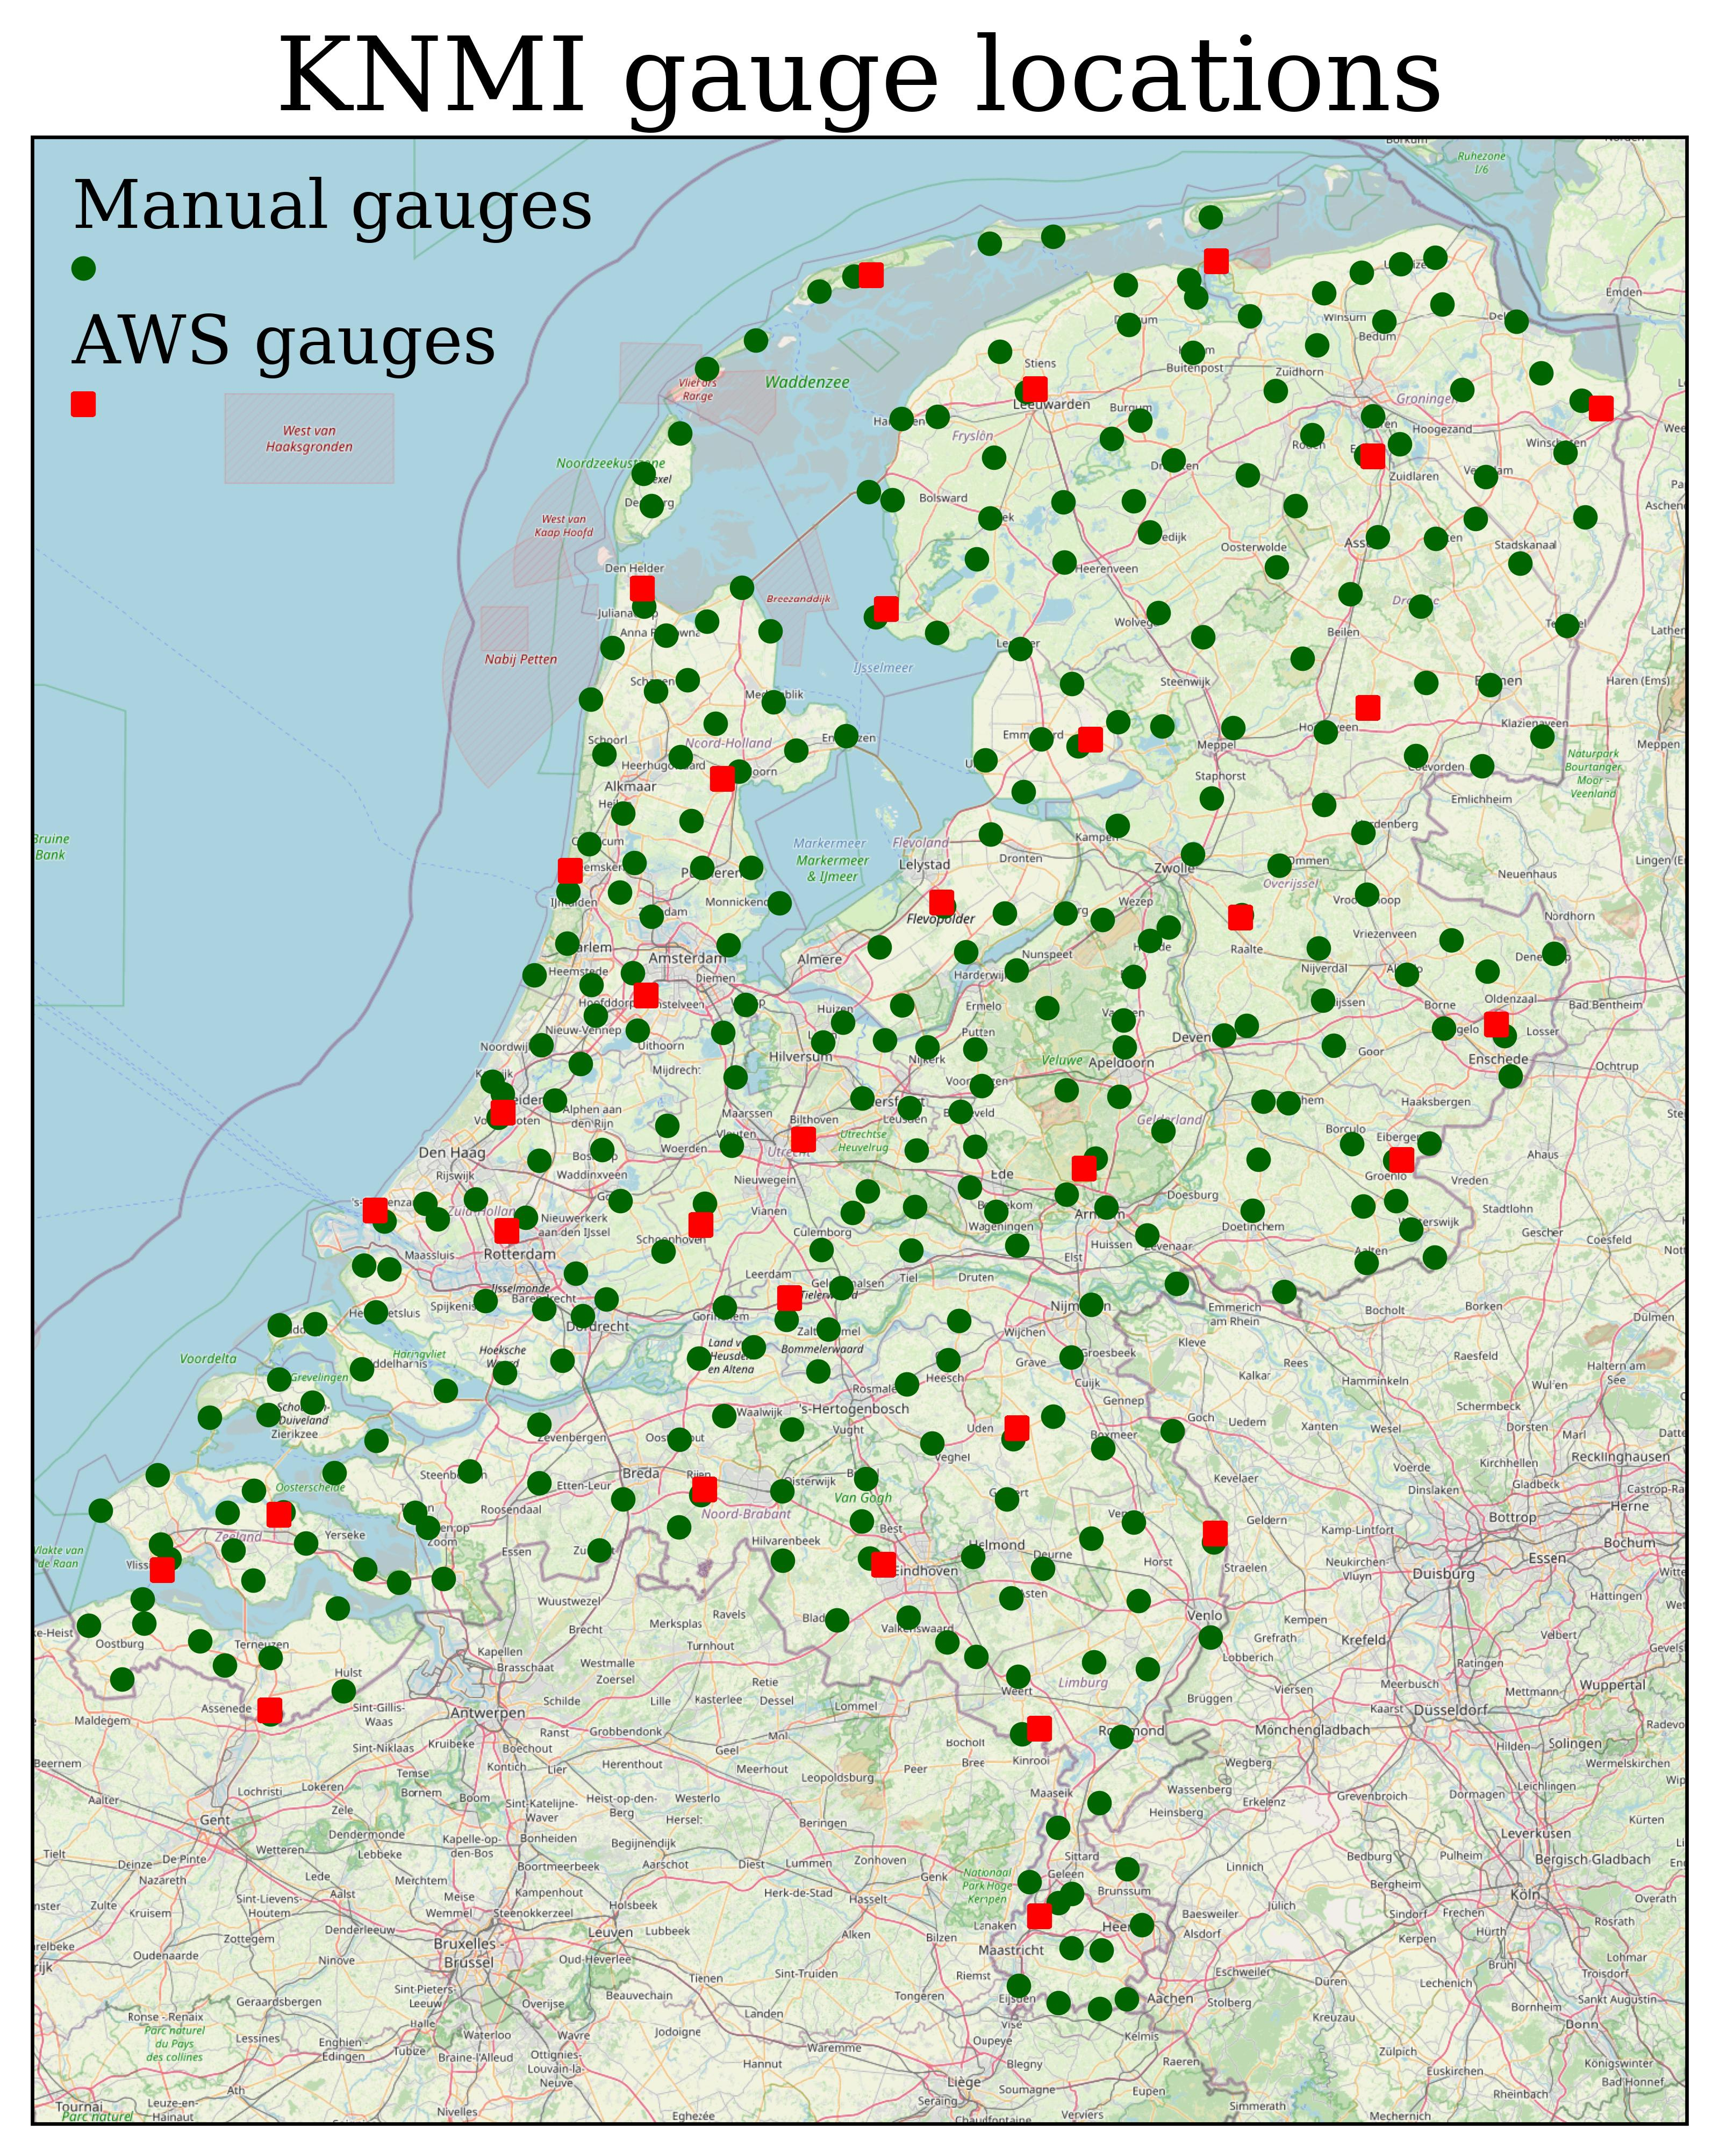
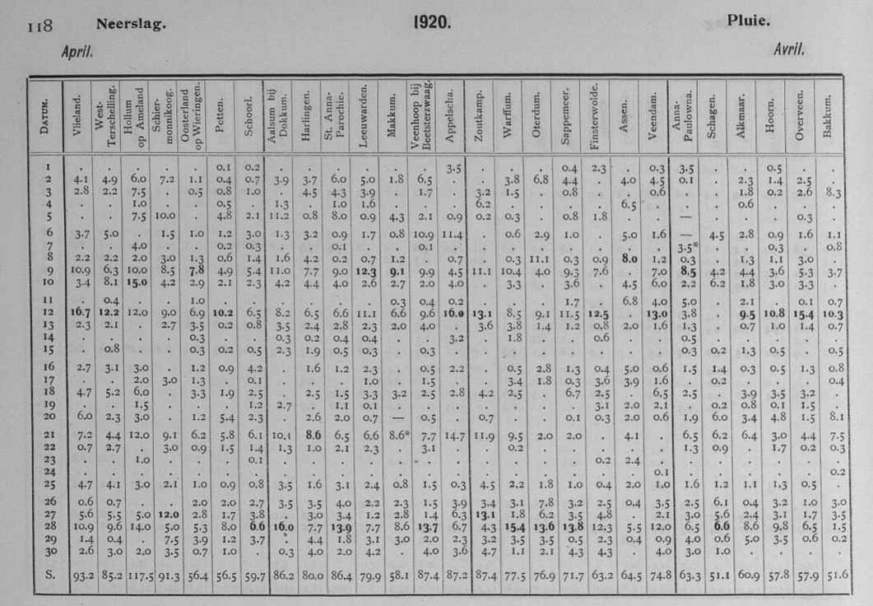
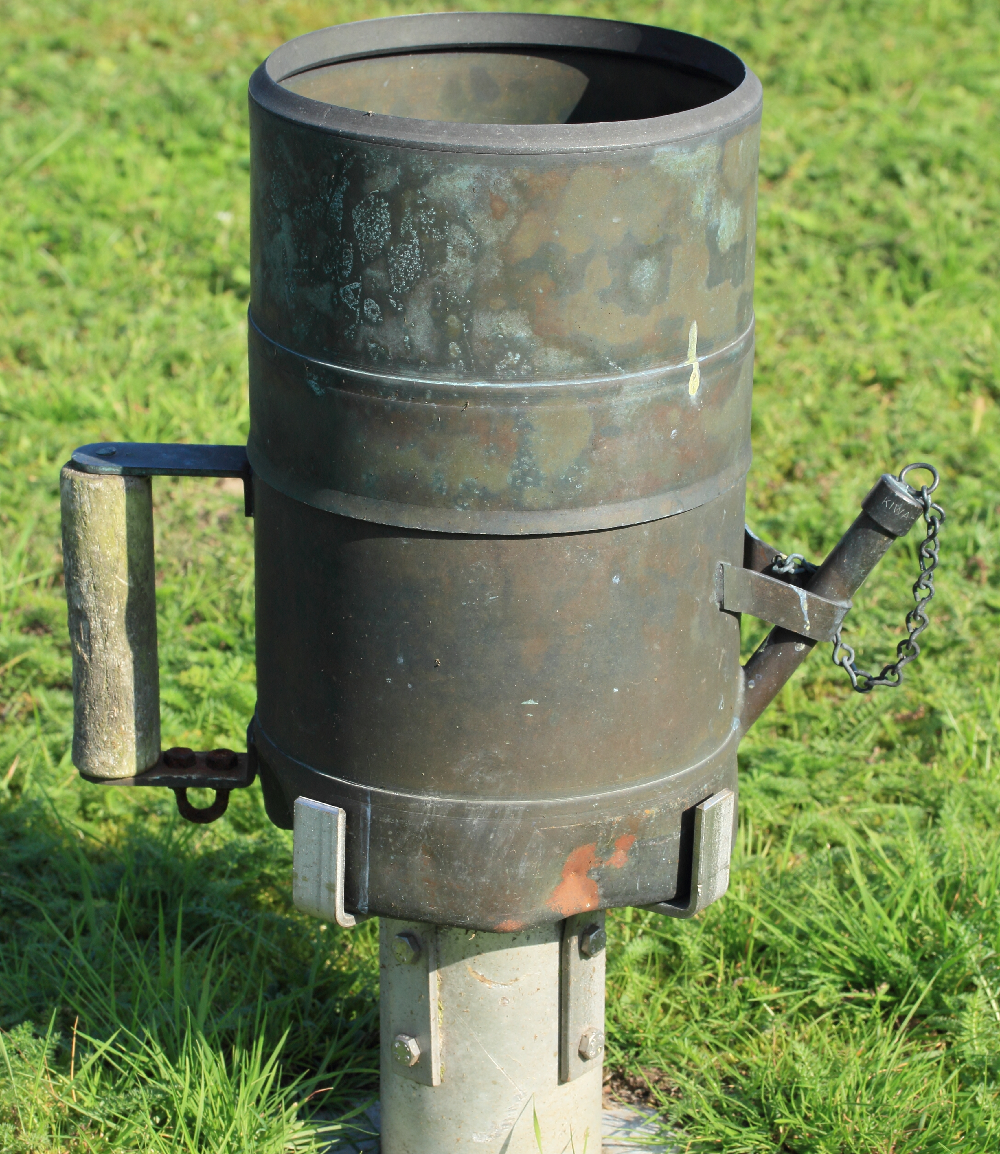
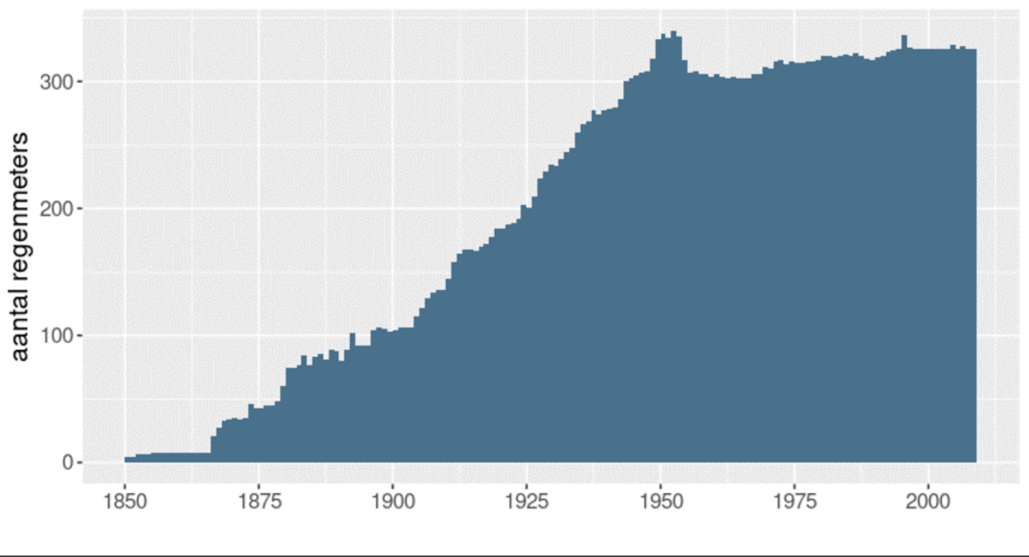


KNMI supports opportunistic sensing since ~20 ~170 years
Crowdsourcing / citizen science with manual rain gauges since 1850.
Daily precipitation accumulations read by volunteers.

Slide 12
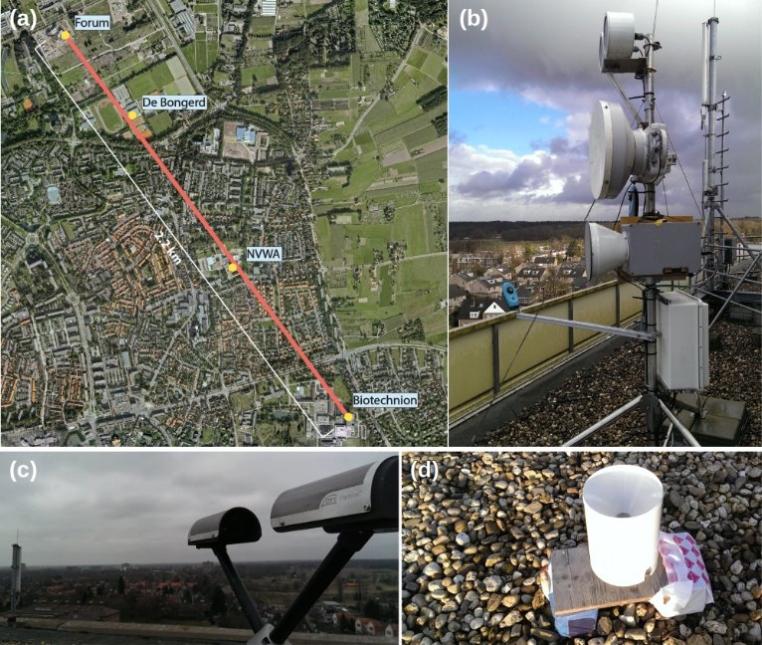
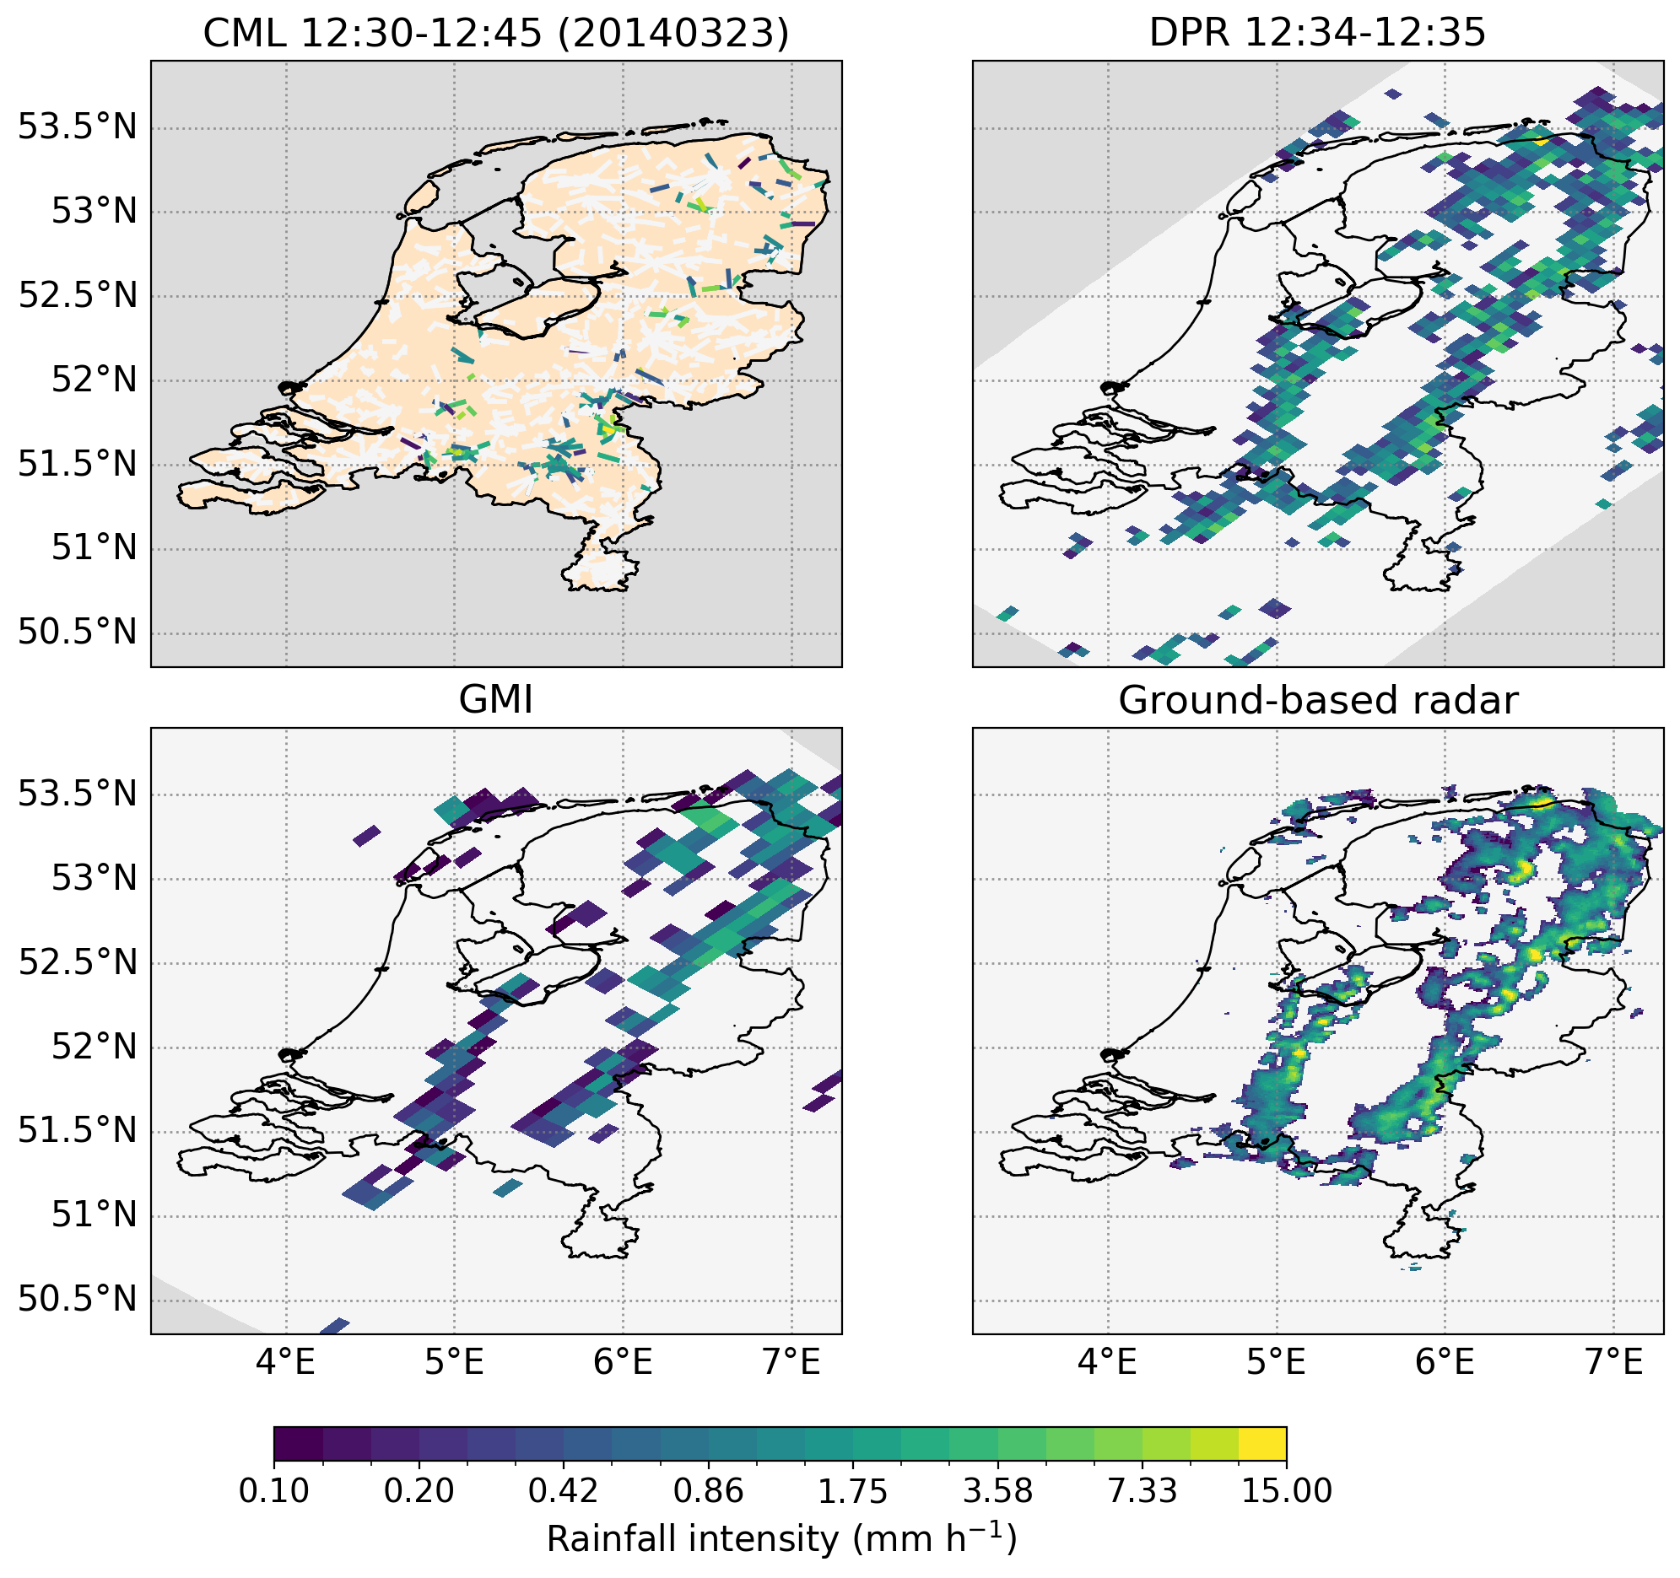
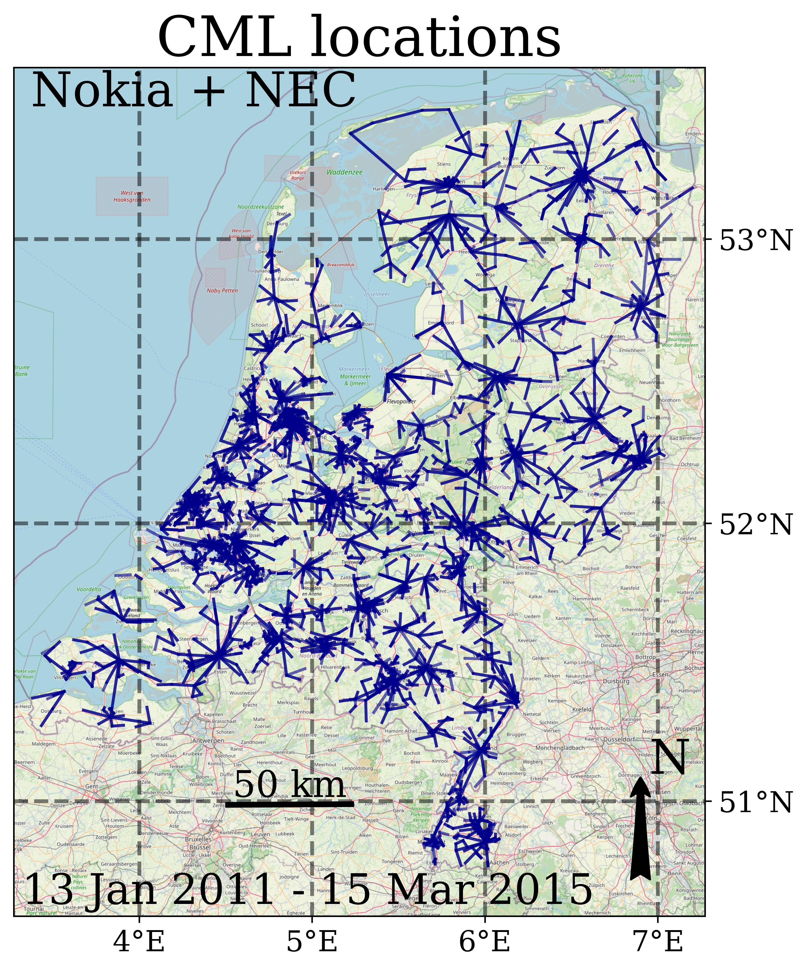
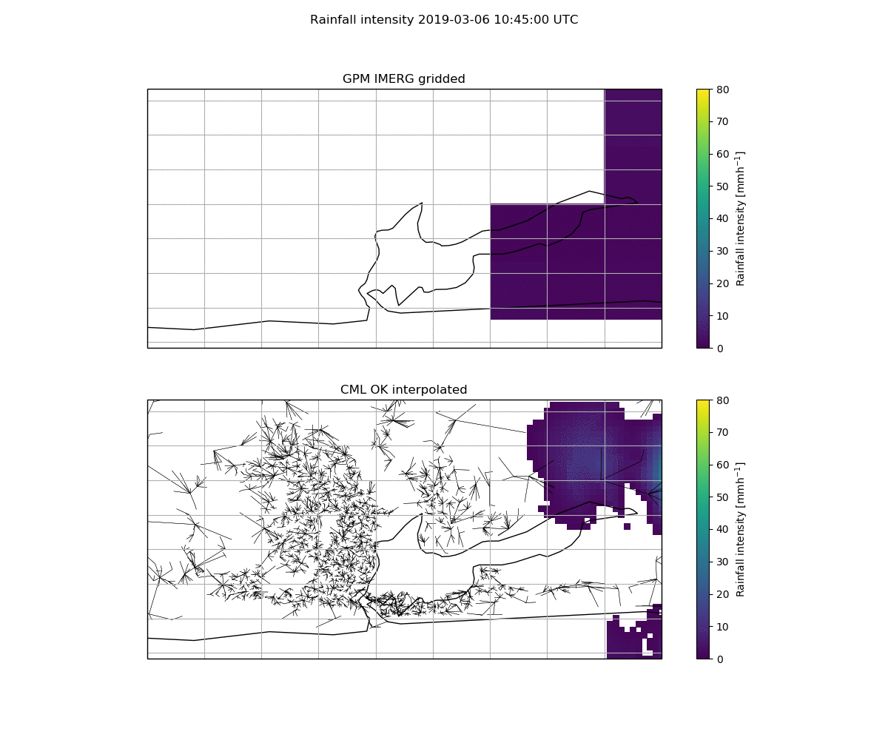
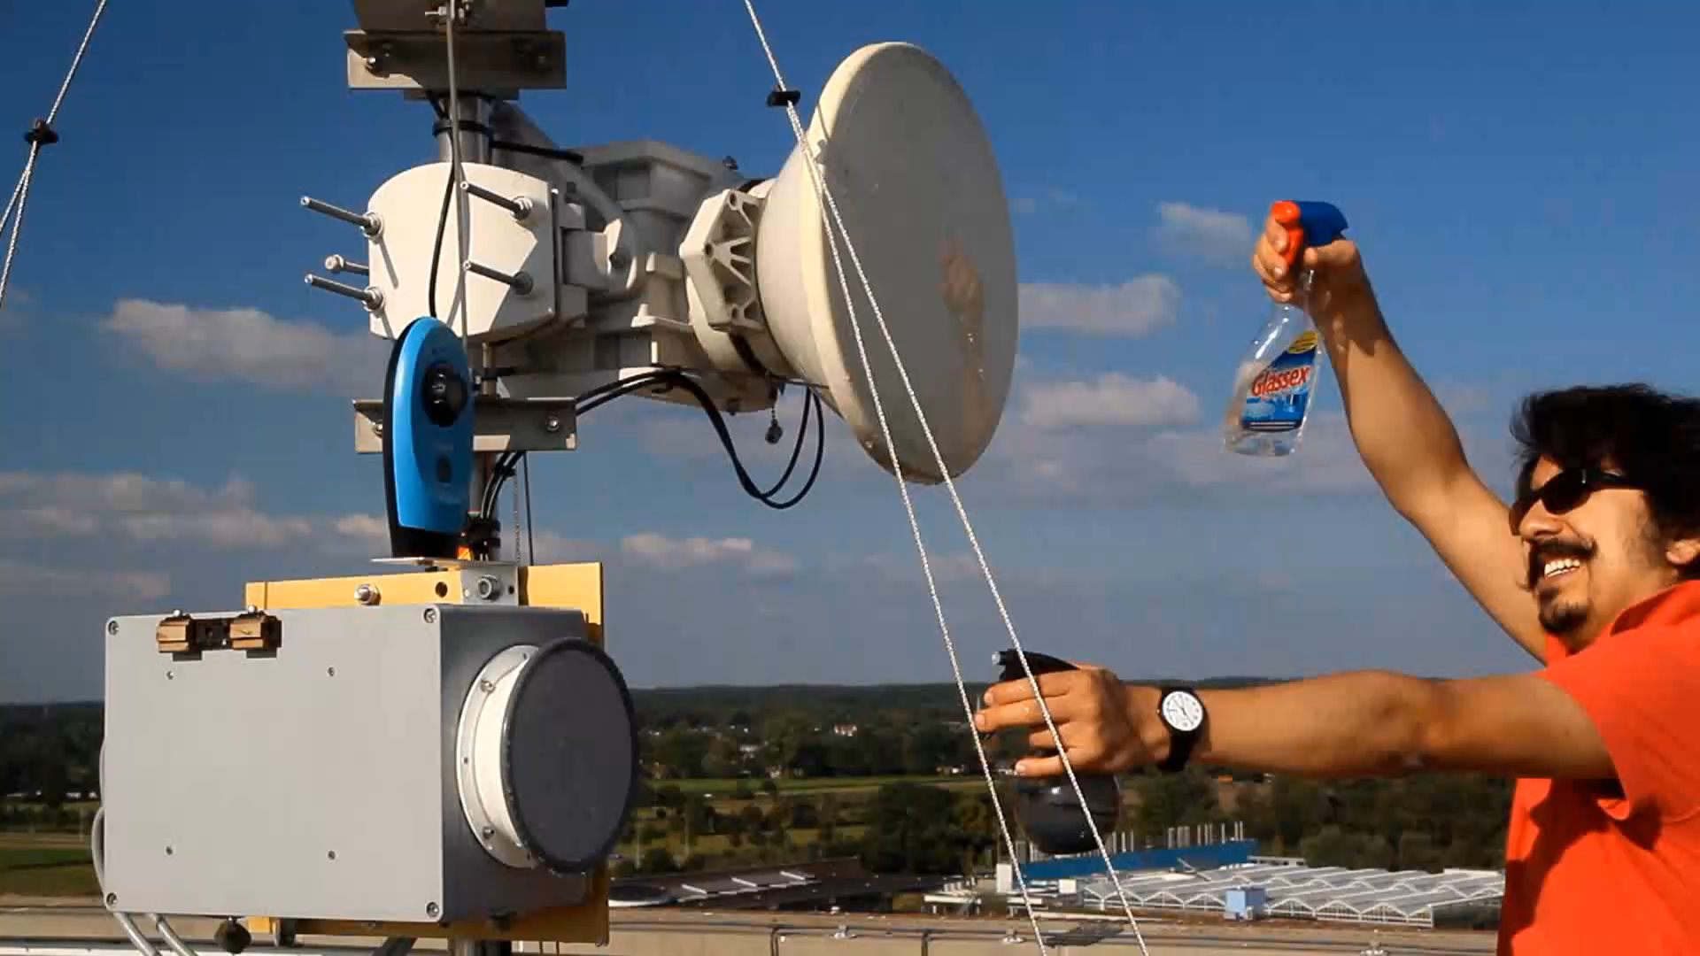
https://doi.org/10.4121/be252844-b672-471e-8d69-27269a862ec1.v1
https://doi.org/10.1080/02626667.2026.2686442
https://doi.org/10.5194/amt-11-4645-2018
Van Leth (2019)
https://doi.org/10.1175/JHM-D-24-0023.1

Slide 13
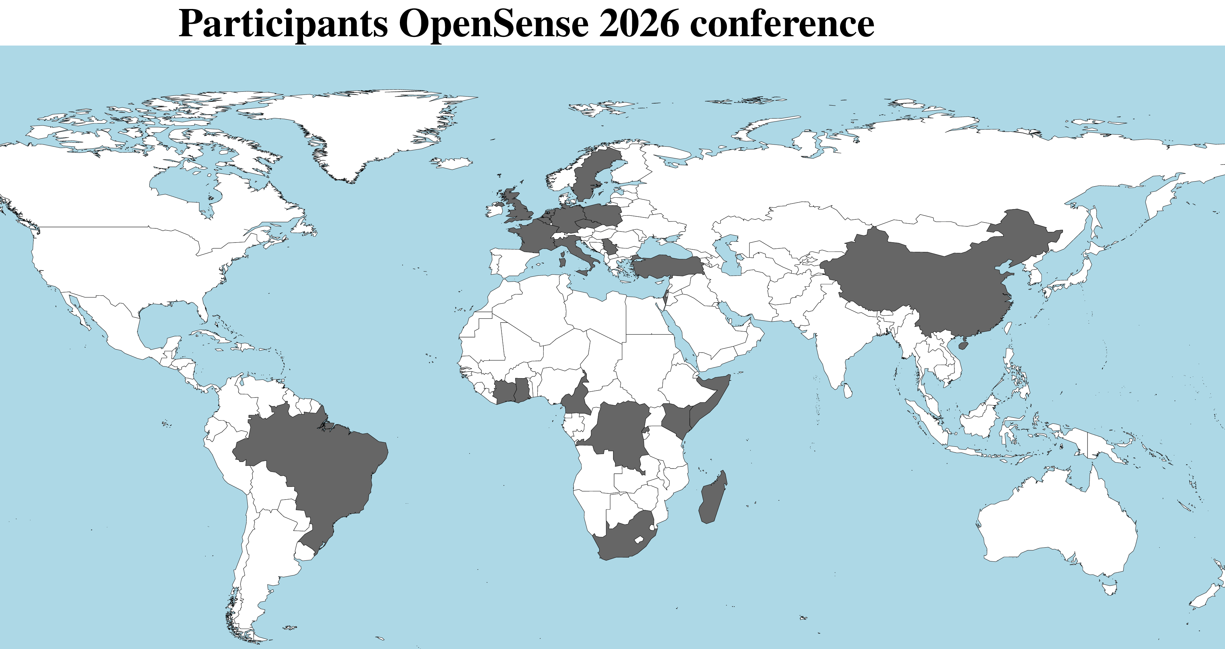
Contributions
62 face-2-face
22 online
15 posters
28 orals
3 keynotes
1 panel discussion
Belgium: 5 F2F (1 Rwanda) Brazil: 1 F2F Cameroon: 1 online Congo (DRC): 1 F2F China: 1 online
Côte d'Ivoire: 1 F2F, 2 online Czech Republic: 10 F2F France: 2 F2F, 1 online Germany: 8 F2F, 4 online
Ghana: 3 F2F Israel: 5 F2F, 2 online Italy: 4 F2F Kenya: 2 online
Madagascar: 1 F2F Netherlands: 17 F2F, 3 online Poland: 1 F2F Serbia: 2 online Somalia: 1 F2F South Africa: 2 online
Sweden: 1 F2F Turkey: 2 online United Kingdom: 1 F2F

Slide 14
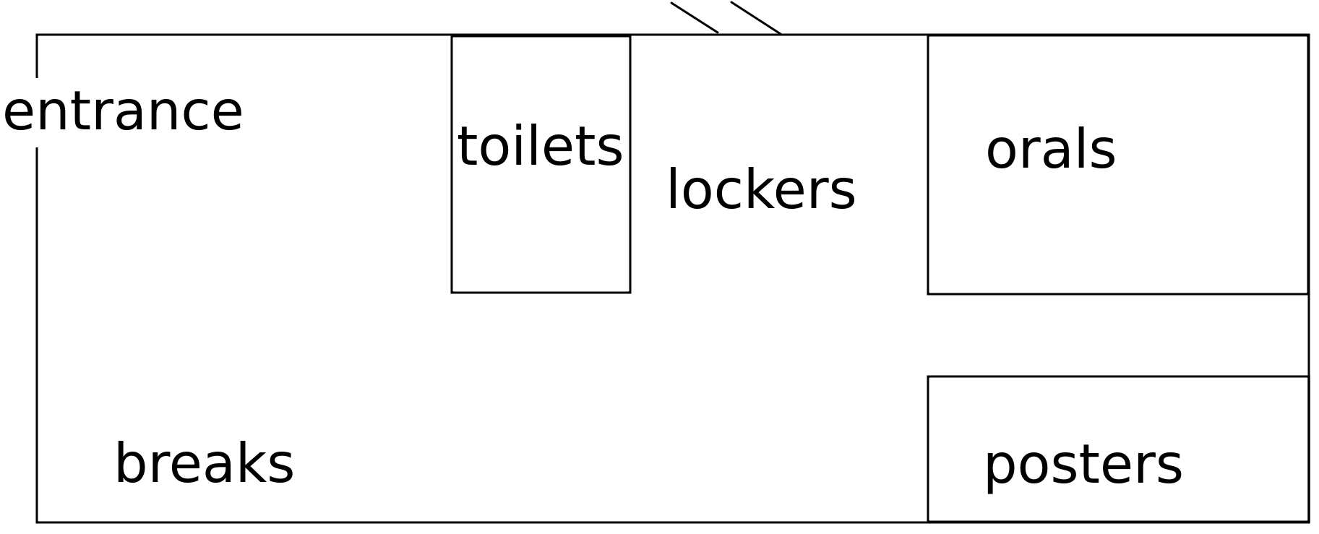
KNMI building
Contact us when you need to store luggage.
Can also be used in case you have another meeting.

Slide 15
Today's programme
09:15 - 09:45 Opening and welcome session @ Buys Ballotzaal
09:45 - 10:15 Keynote @ Buys Ballotzaal: "Maintaining performance in high-speed microwave links" by Bart Somers (Dutch Authority for Digital Infrastructure)
10:15 - 10:45 Coffee break @ central hall
10:45 - 12:15 Oral session #1 @ Buys Ballotzaal: Rainfall monitoring in the Global South
12:15 - 13:30 Lunch break @ central hall: (starting with a group picture)
For those who want: ~30 min walk @12:55
13:30 - 14:00 Keynote @ Buys Ballotzaal: "From backyard rain gauges to flood forecasts: using PWS in operational hydrology" by Eoin Burke (water authority Rijn & IJssel)
14:00 - 15:00 Oral session #2 @ Buys Ballotzaal: Application of OS data + announcement 3rd OpenSense conference
15:00 - 16:15 Coffee poster session #1 @ Combizalen: Rainfall monitoring in the Global South, Application of OS data, OS data merging, and OS data acquisition, management & standardization Includes coffee break @ central hall
16:15 - 17:00 Panel discussion @ Buys Ballotzaal: "Operational aspects of CML rainfall estimation in the Global South" - moderator: Remko Uijlenhoet (Delft University of Technology). 17:00 - 18:00 Drinks @ central hall

Slide 16
Wed 24 June
08:30 - 09:00 Registration @ central hall (reception)
09:00 - 09:30 Keynote @ Buys Ballotzaal: "Advancing a European social digital infrastructure through crowdsourced weather observations" by Irene Garcia-Martí (Royal Netherlands Meteorological Institute)
09:30 - 10:15 Oral session #3 @ Buys Ballotzaal: OS data acquisition, management & standardization
10:15 - 10:45 Coffee break @ central hall
10:45 - 12:30 Oral session #4 @ Buys Ballotzaal: Processing methods
12:30 - 13:45 Lunch break @ central hall
For those who want: ~30 min visit test field @13:10
13:45 - 14:15 Oral session #5 @ Buys Ballotzaal: OS data merging
14:15 - 15:30 Coffee poster session #2 @ Combizalen: Comparative performance analysis and uncertainty assessment, and Processing methods Includes coffee break @ central hall
15:30 - 17:00 Oral session #6 @ Buys Ballotzaal: Comparative performance analysis and uncertainty assessment
17:00 - 17:15 Closure @ Buys Ballotzaal

