Slide 1






Many thanks to the sponsors for a generous support
Silver sponsors
Bronze sponsors
Please meet them at the booth during the coffee break, the poster session, lunch
and during the social activities

Slide 2
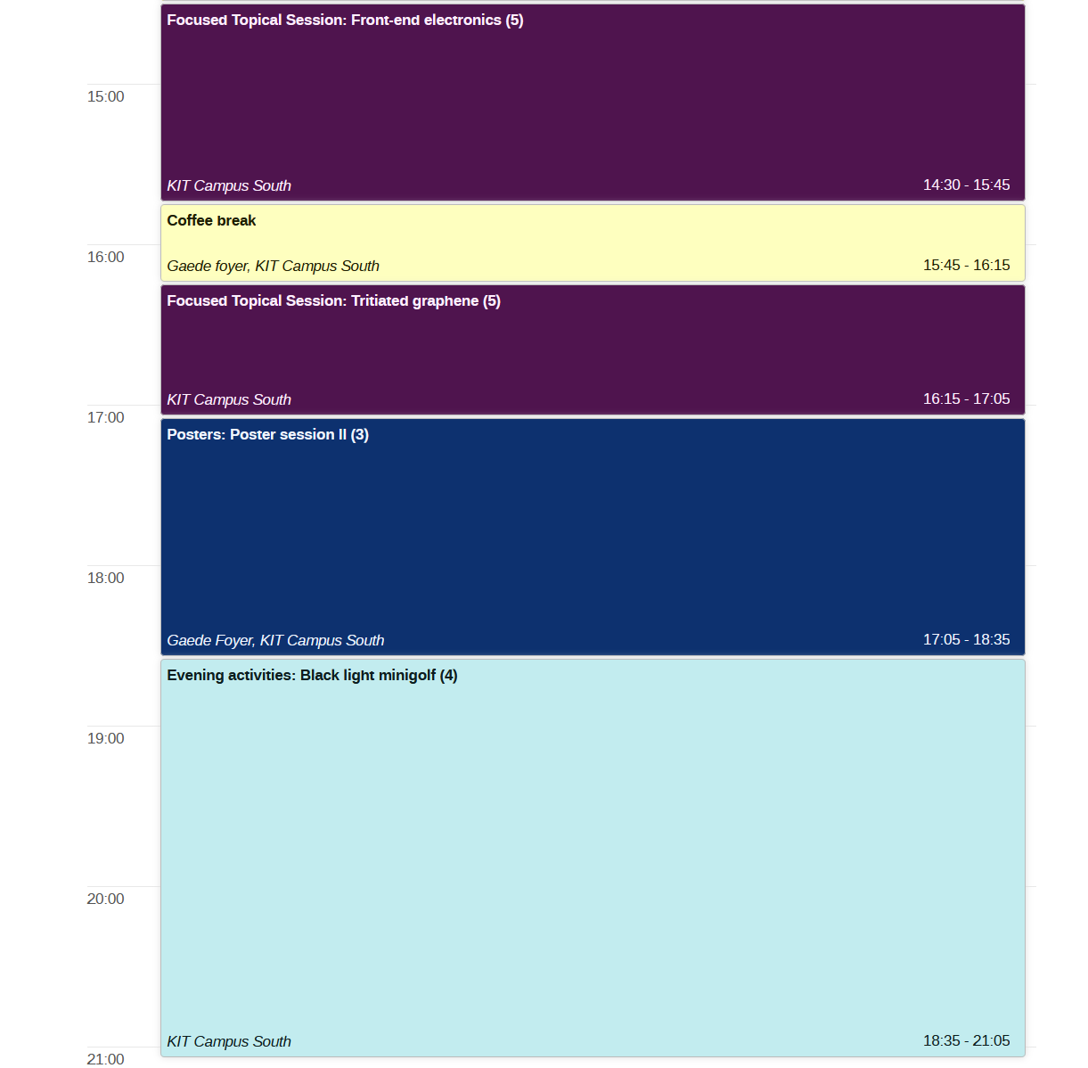
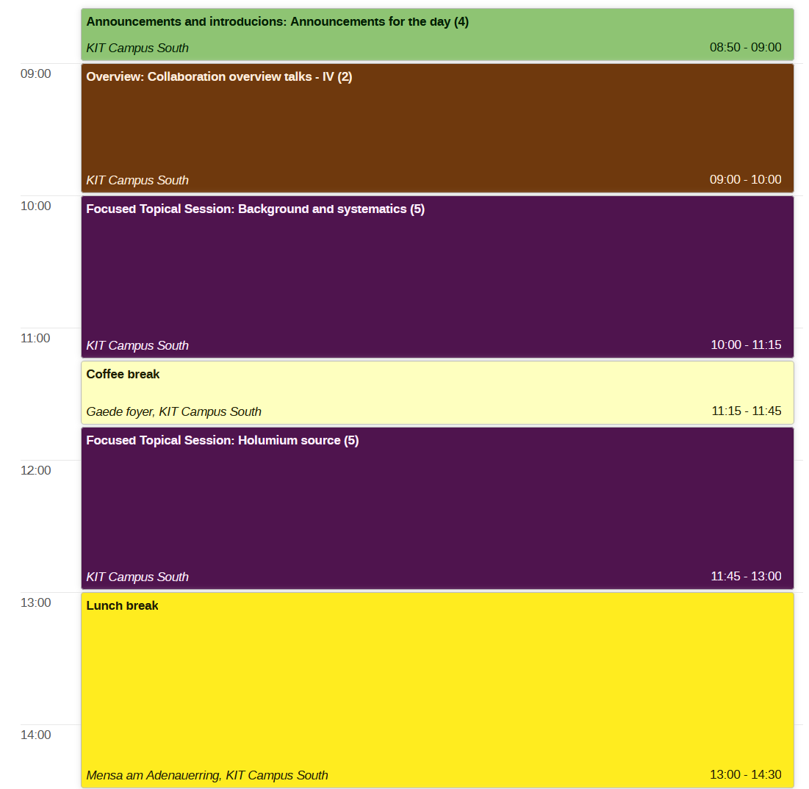
Agenda Tuesday
With pizza

Slide 3

Data upload
Please upload your presentation to INDICO
and/or drop it into this dump
https://bwsyncandshare.kit.edu/s/3CDCJk4ANE3bqrD
Please do this before until 8:00 in the morning of the session

Slide 4

Poster session and voting
Modus operandi
Set up the poster for the entire duration of the workshop. (Mo-Th)
Present your poster (at least) during the suggested session (see indico or brochure)
Poster prize
All early career scientists are eligbible for the poster prize
All participants can cast three votes (but only once!!!) using this poll
https://forms.gle/D9H9fFh8bAPgavjA9

Slide 5
Pizza
1x Glutenfree
1x w/o cheese
More wishes?
Vegetarian?

Slide 6


Good news: Real Karlsruhe experience

Slide 7
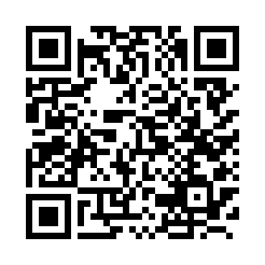
Good news: Real Karlsruhe experience
Bad news: changes in public transportation routes, closures and construction sites…
KVV route planner

Slide 8
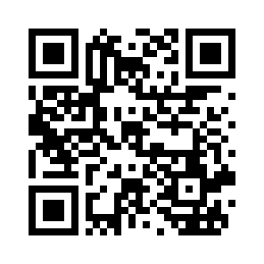
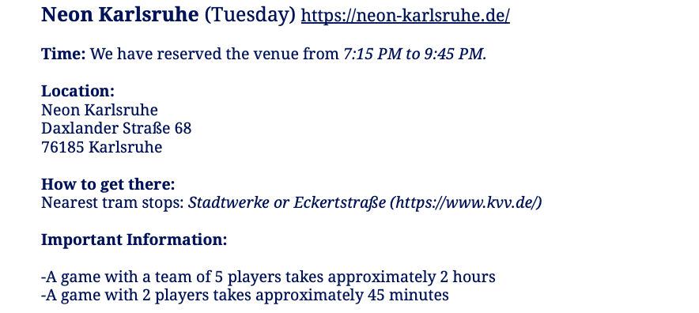

Tuesday
Eckenerstraße
Eckenerstraße
Neon

Slide 9
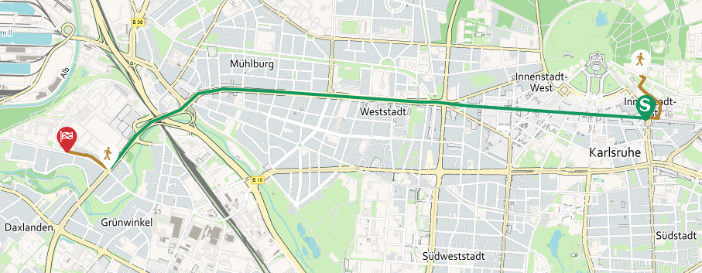
Tuesday
S2 (Rheinstrandsiedlung) | Karlsruhe Kronenplatz | Eckenerstraße
 | 06:48 pm | 07:00 pm
 | 06:58 pm | 07:10 pm
 | … | …
 | 07:48 pm | 08:00 pm
 | 08:00 pm | 08:12 pm
 | 08:20 pm | 08:32 pm
Eckenerstraße
Eckenerstraße
6 min by foot

Slide 10
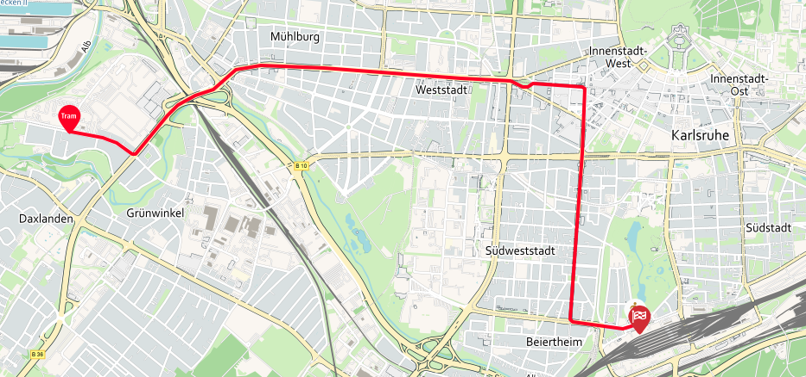
Tuesday
3 (Rintheim über Hbf) | Karlsruhe Stadtwerke | Karlsruhe Hauptbahnhof
 | 08:40 pm | 09:02 pm
 | 09:00 pm | 09:22 pm
 | 09:20 pm | 09:42 pm
 | … | …
 | 00:40 am | 01:02 am
 | 04:10 am | 04:32 am
Eckenerstraße
Eckenerstraße

Slide 11
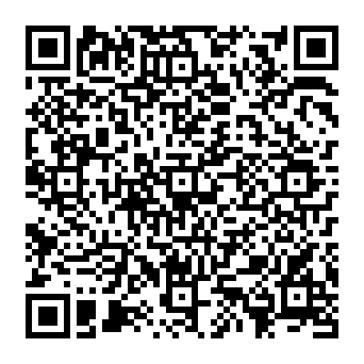
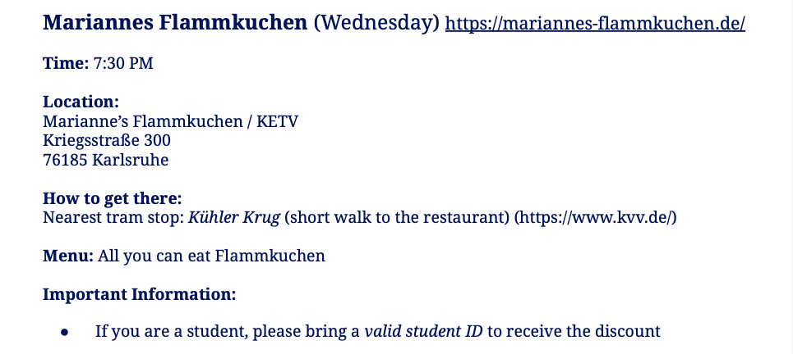

Wednesday
Food till 10:30 pm
MENU

Slide 12
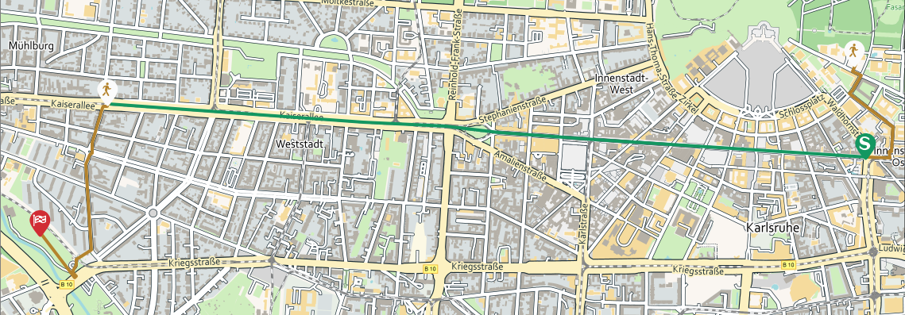
Wednesday
 | Karlsruhe Kronenplatz | Händelstraße
S51 (Germersheim, Bahnhof) | 07:05 pm | 07:13 pm
S2 (Rheinstrandsiedlung) | 07:08 pm | 07:16 pm
S2 (Rheinstetten) | 07:18 pm | 07:26 pm
12 min by foot

