Slide 1






Many thanks to the sponsors for a generous support
Silver sponsors
Bronze sponsors
Please meet them at the booth during the coffee break, the poster session, lunch
and during the social activities

Slide 2
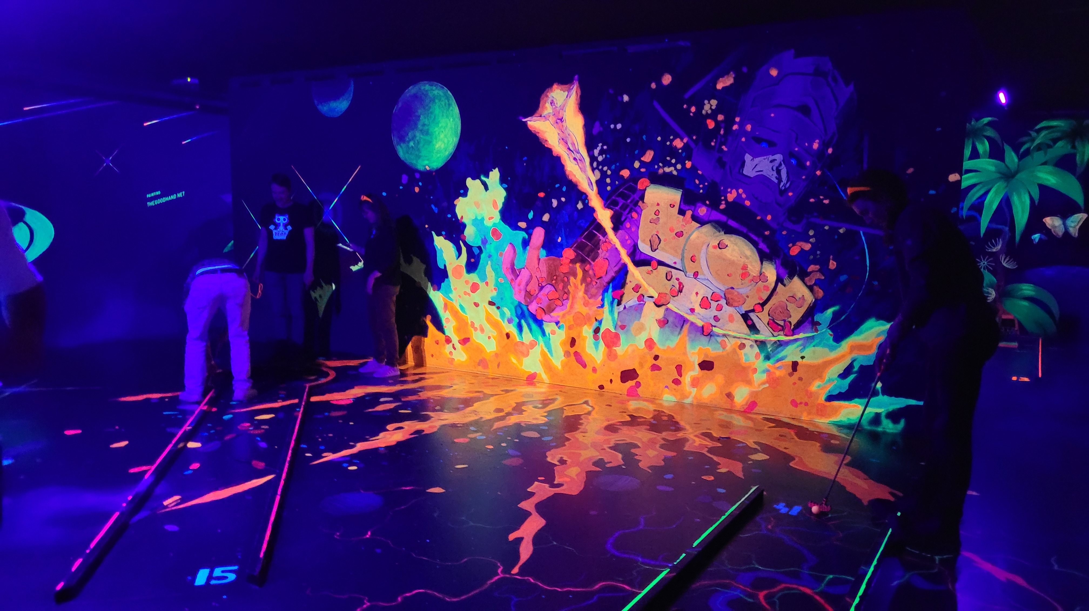
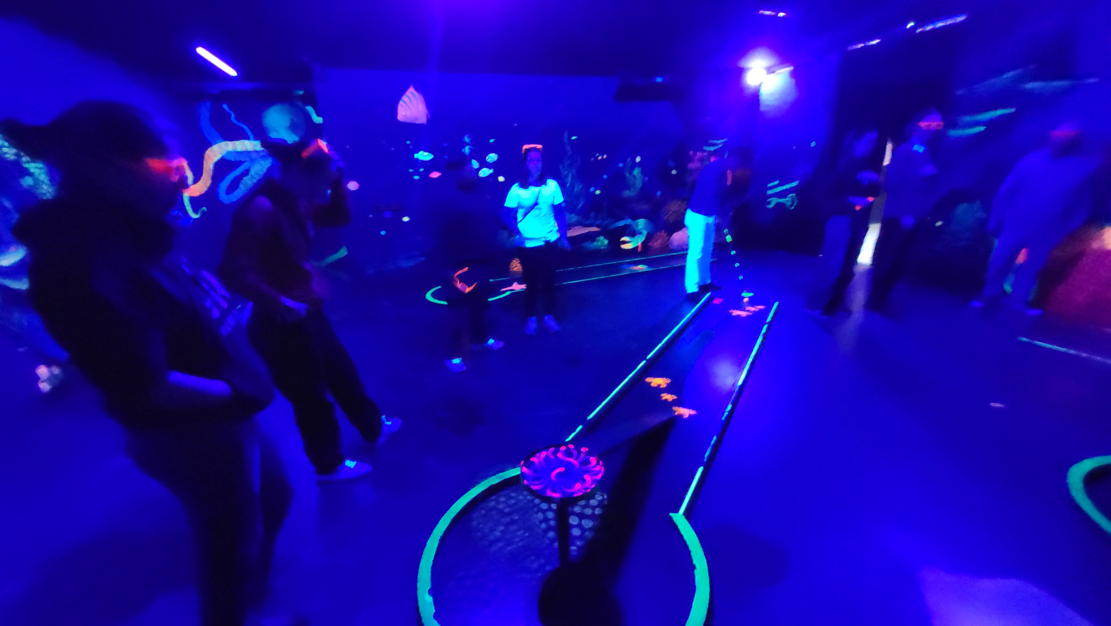
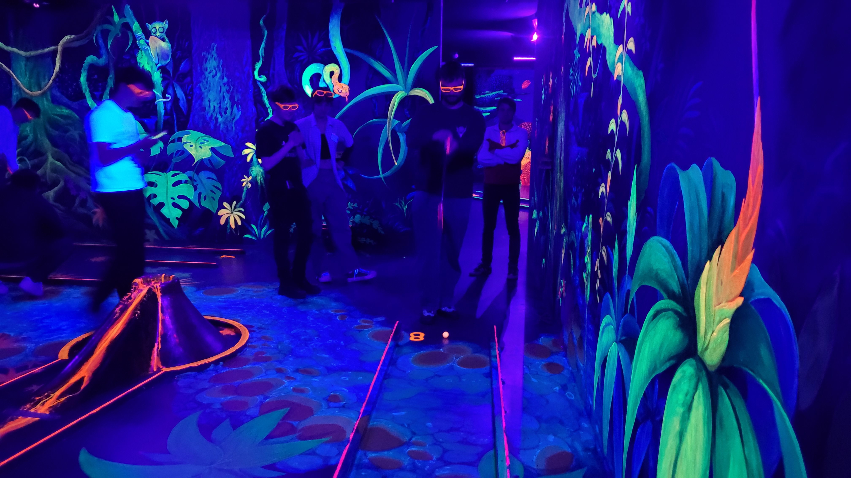
Impression

Slide 3
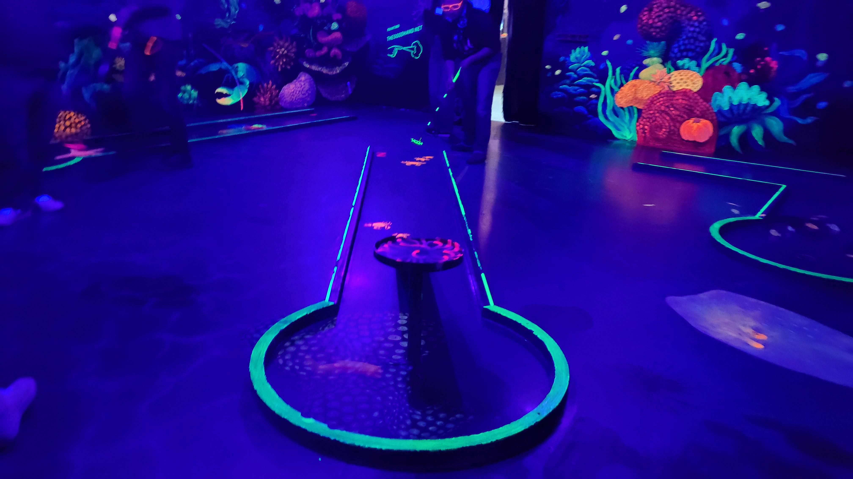
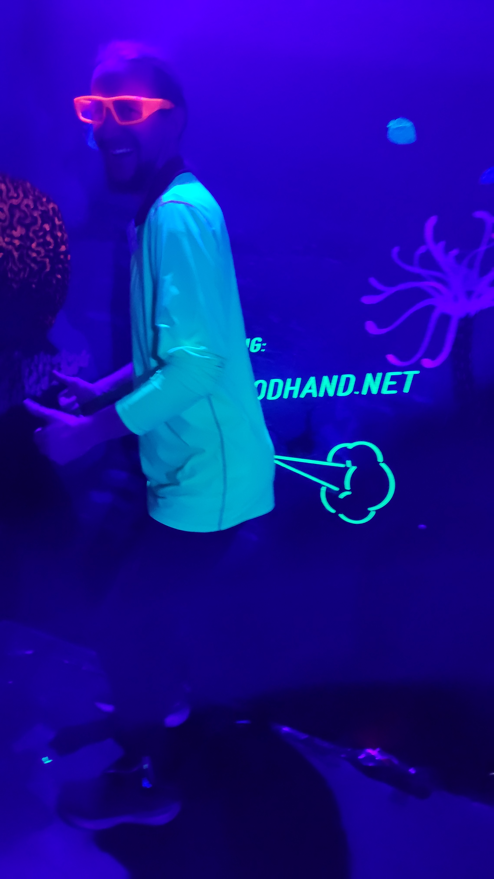

Slide 4
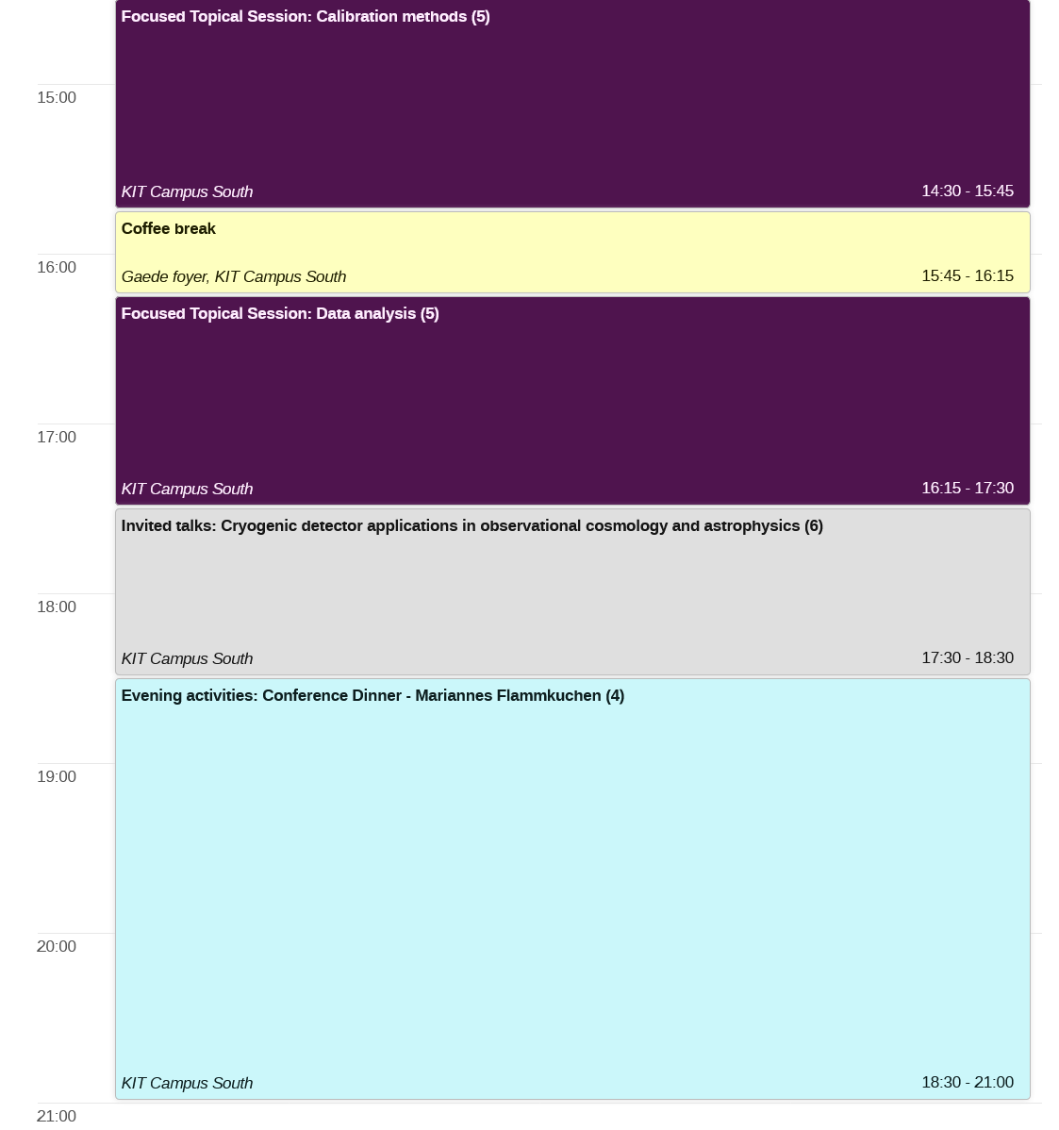
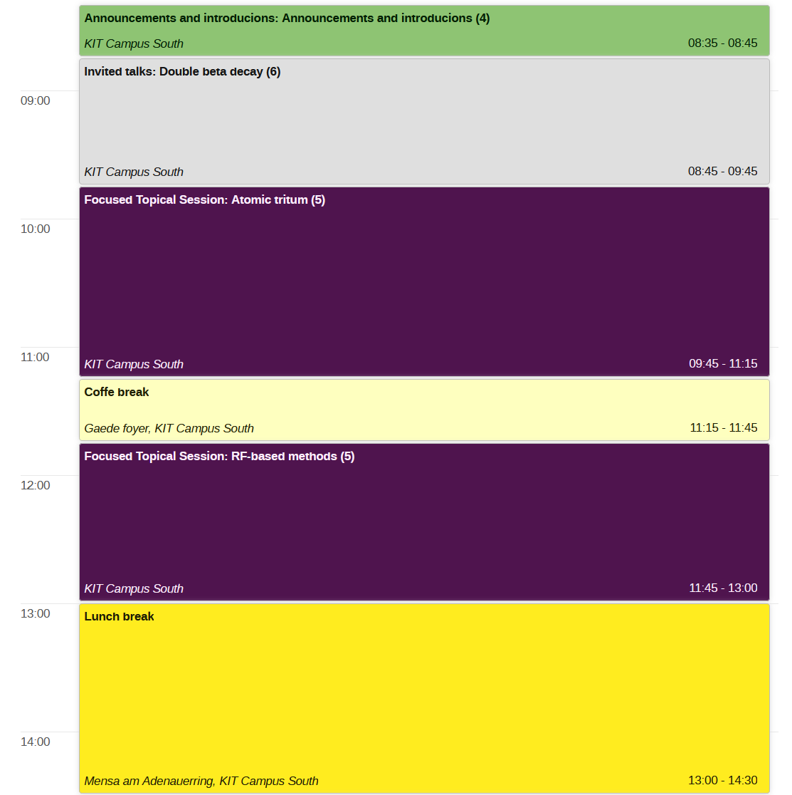
Agenda Wednesday
Dinner (free of charge)
Conference picture

Slide 5
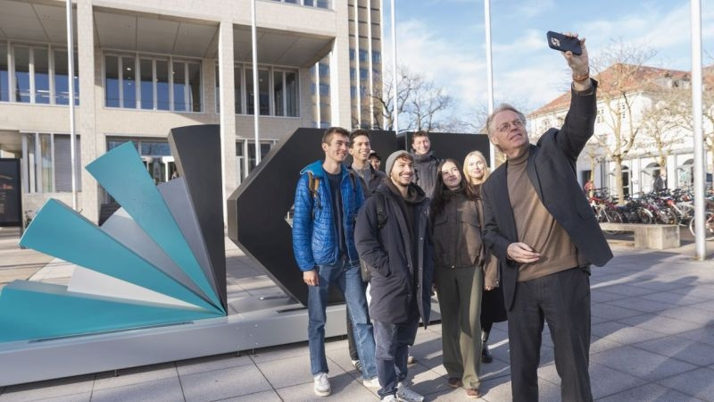
Conference Picture
The picture will be made on today
close to the cantinee (before lunch)
Leave without much delay AFTER
the session on „RF-methods“ and follow the
stream.
Arrive at the KIT sign
Smile!

Slide 6
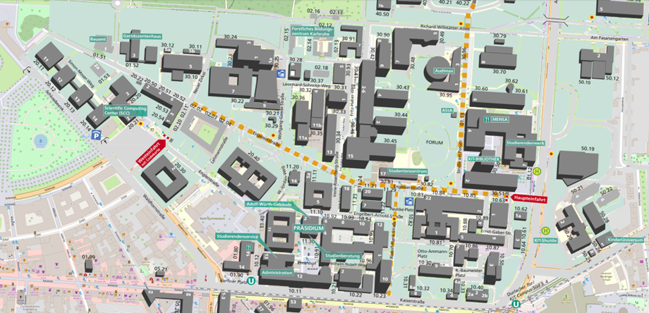
Campus Overview
talks
Lunch*
Conference photo
Follow the main road to the east
tram station
Kronenplatz
tram station
Durlacher Tor
*bring your vouchers!
Layout by Chloé Goupy

Slide 7
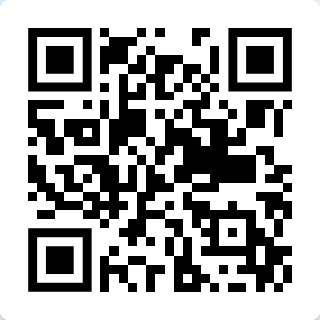
Data upload
Please upload your presentation to INDICO
and/or drop it into this dump
https://bwsyncandshare.kit.edu/s/3CDCJk4ANE3bqrD
Please do this before until 8:00 in the morning of the session

Slide 8
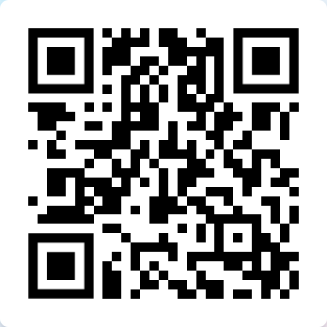
Poster session and voting
Finalize voting until TODAY 2:30 PM
Modus operandi
Set up the poster for the entire duration of the workshop. (Mo-Th)
Present your poster (at least) during the suggested session (see indico or brochure)
Poster prize
All early career scientists are eligbible for the poster prize
All participants can cast three votes (but only once!!!) using this poll
https://forms.gle/D9H9fFh8bAPgavjA9

Slide 9

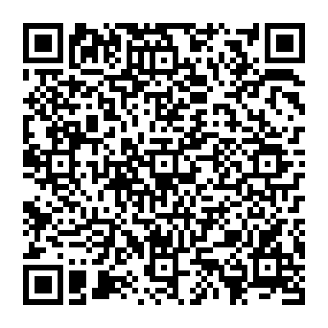
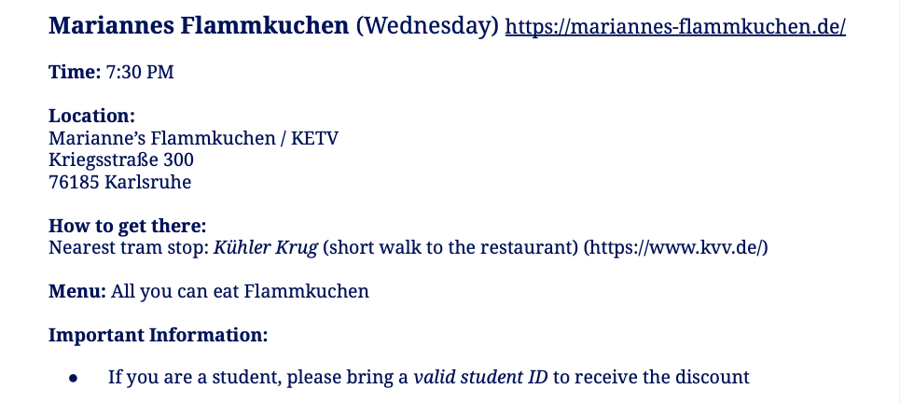


Wednesday
Food till 10:30 pm
MENU

Slide 10
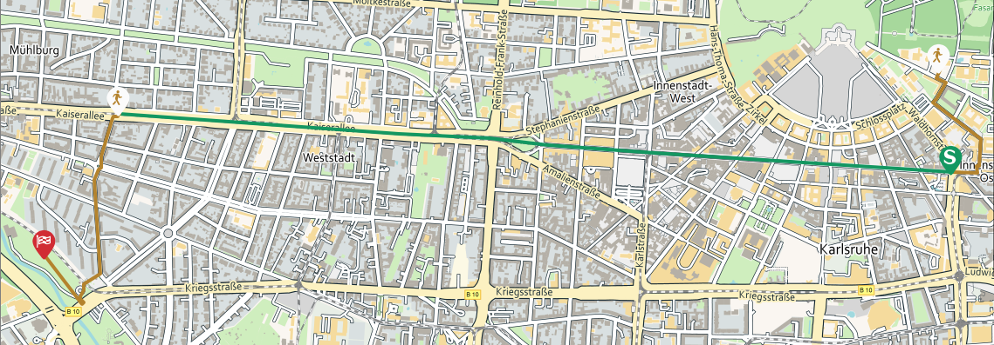
Wednesday
 | Karlsruhe Kronenplatz | Händelstraße
S51 (Germersheim, Bahnhof) | 07:05 pm | 07:13 pm
S2 (Rheinstrandsiedlung) | 07:08 pm | 07:16 pm
S2 (Rheinstetten) | 07:18 pm | 07:26 pm
12 min by foot

Slide 11
Friday – 1000 days of KATRIN
Any question which we should relay to the organizers?

Slide 12
Return the batches before you leave!!

