Slide 1






Many thanks to the sponsors for a generous support
Silver sponsors
Bronze sponsors
Please meet them at the booth during the coffee break, the poster session, lunch and during the social activities

Slide 2
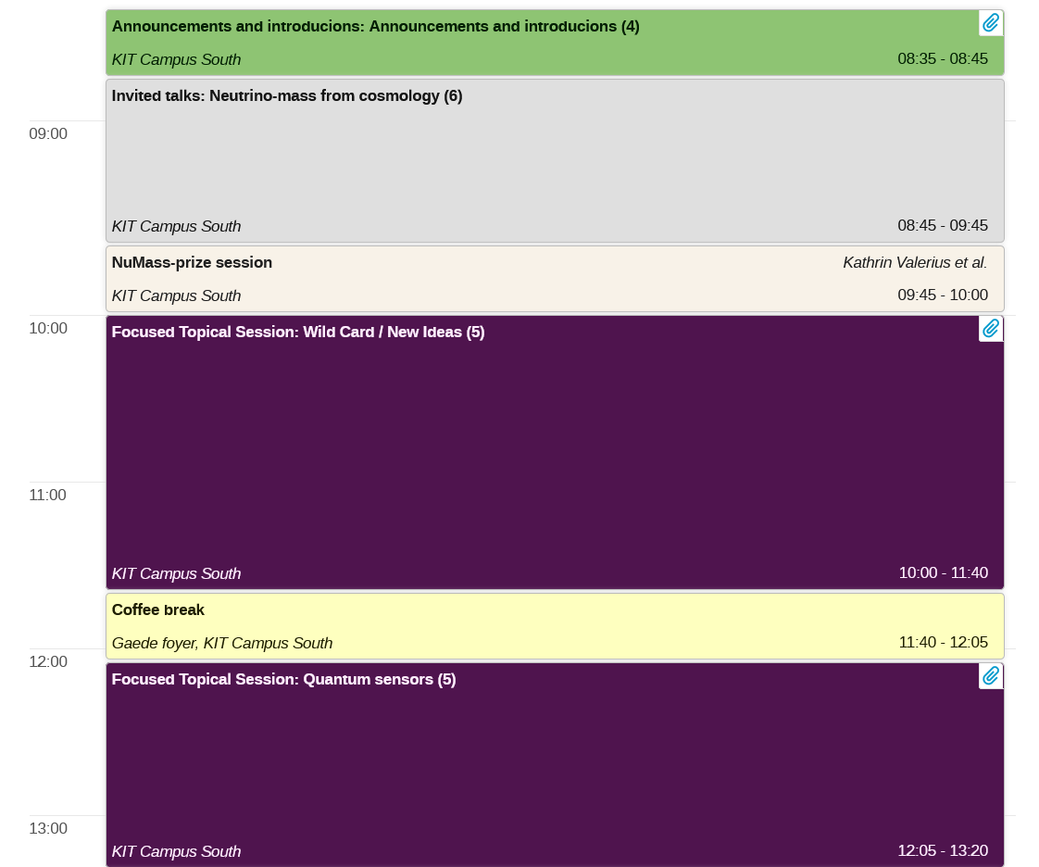
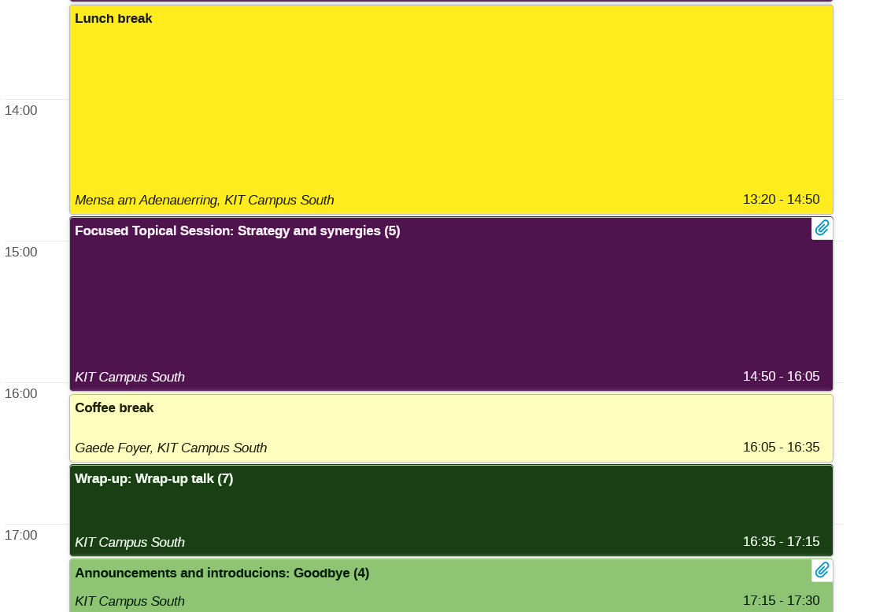
Agenda Thursday

Slide 3

Data upload
Please upload your presentation to INDICO
and/or drop it into this dump
https://bwsyncandshare.kit.edu/s/3CDCJk4ANE3bqrD
Please do this before until 8:00 in the morning of the session

Slide 4
Friday – 1000 days of KATRIN
Any question which we should relay to the organizers?
Bus transfer is still?

Slide 5
Return the batches before you leave!!

Slide 6


